Slide 1

Project Title: Netflix Show Classifier App
Name: Arnav Phukan
Enrollment No: EBEON0921447752
Batch No: 2021-6127

Slide 2


Contents
1
Project Overview/Description
2
Objectives
3
Methodology
5
Tools and technologies
6
Conclusion
4
Data Visualization
7
Future Work

Slide 3


Netflix is a very popular entertainment service used by people all over the world.
EDA on Netflix Dataset to explore the hidden insights through visualizations and graphs using python libraries, matplotlib and seaborn.
We used TV Shows and Movies listed on the Netflix dataset from Kaggle. The dataset consists of TV Shows and Movies available on Netflix as of 2021.
The dataset is directly collected from Kaggle official website.
Project Description
Project
Description

Slide 4

Recommendations
Popularity
Marketing content
Production Planning
Business Decision making
Objectives

Slide 5
Business understanding
Analytical approach
Feedback
Data requirements
Deployment
Methodology
Data collection
Evaluation
Data understanding
Modelling
Data preparation

Slide 6








Data Visualization

Slide 7
NETFLIX TYPE
As can be seen, the number of movies available on Netflix is double that of TV shows i.e. 2:1 ratio.
Netflix do not produce their own content and relies on competitors who are developing their own streaming platforms

Slide 8
TOP FIVE COUNTRY
We can identify the countries with the highest content creation using the value_counts method.
The United States account for the majority of the content created on Netflix, numbering nearly about 4042 titles. India is the second largest at 1008.

Slide 9
Rating Comparison
Movie
TV Show

Slide 10
Top Five Country Comparison on Type
Movie
TV Show

Slide 11
Top 10 Genres

Slide 12
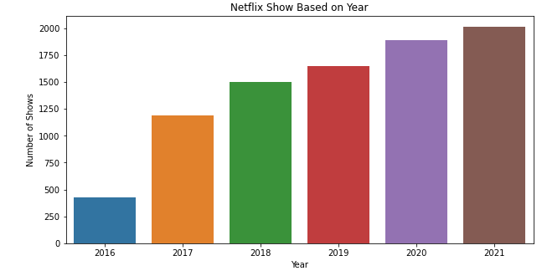
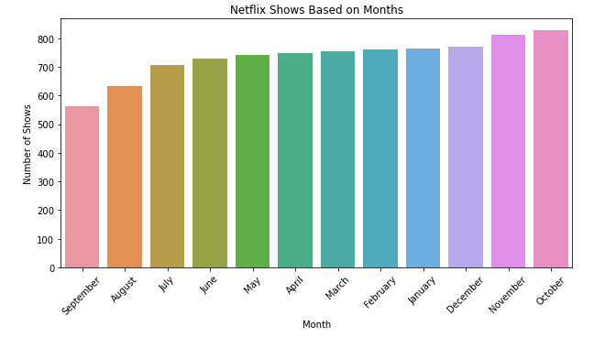
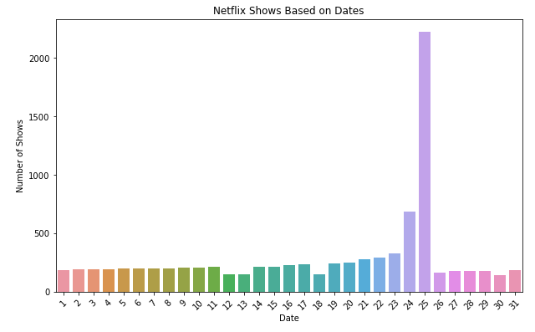
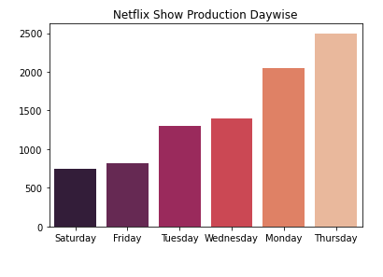
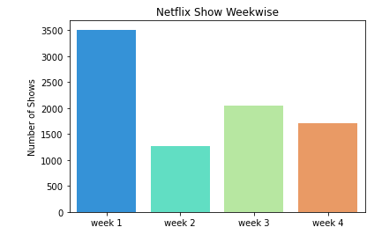

Slide 13






Tools and Technologies

Slide 14
Conclusions:
We have drawn many interesting inferences from the dataset Netflix titles; here’s a summary of the few of them:
The most content type on Netflix is movies.
The popular streaming platform started gaining traction after 2014. Since then, the amount of content added has been increasing significantly.
The country by the amount of the produces content is the United States.
The most popular year of producing most Netflix content is 2021.
Drama is a genre that is mostly in Netflix.
The largest count of Netflix content is made with a “TV-14” rating.
Full GitHub code and dataset access are here

Slide 15
Future Work
Future analysis of this data can include :
Analyzing the content available in different countries.
Identifying insight based on Directors, Actors and Actresses using network analysis.
Popularity of TV shows and Movies insight analysis.

Slide 16


Slide 17


