Slide 1

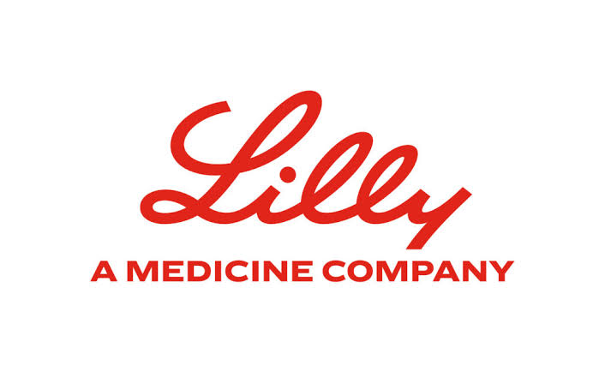
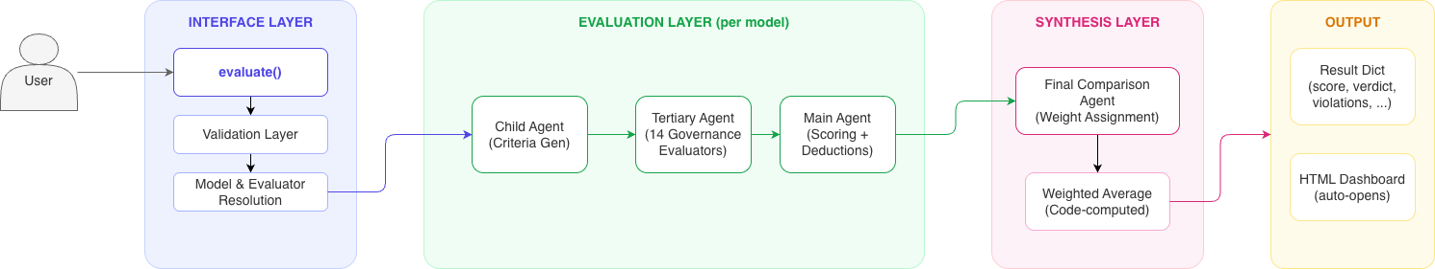
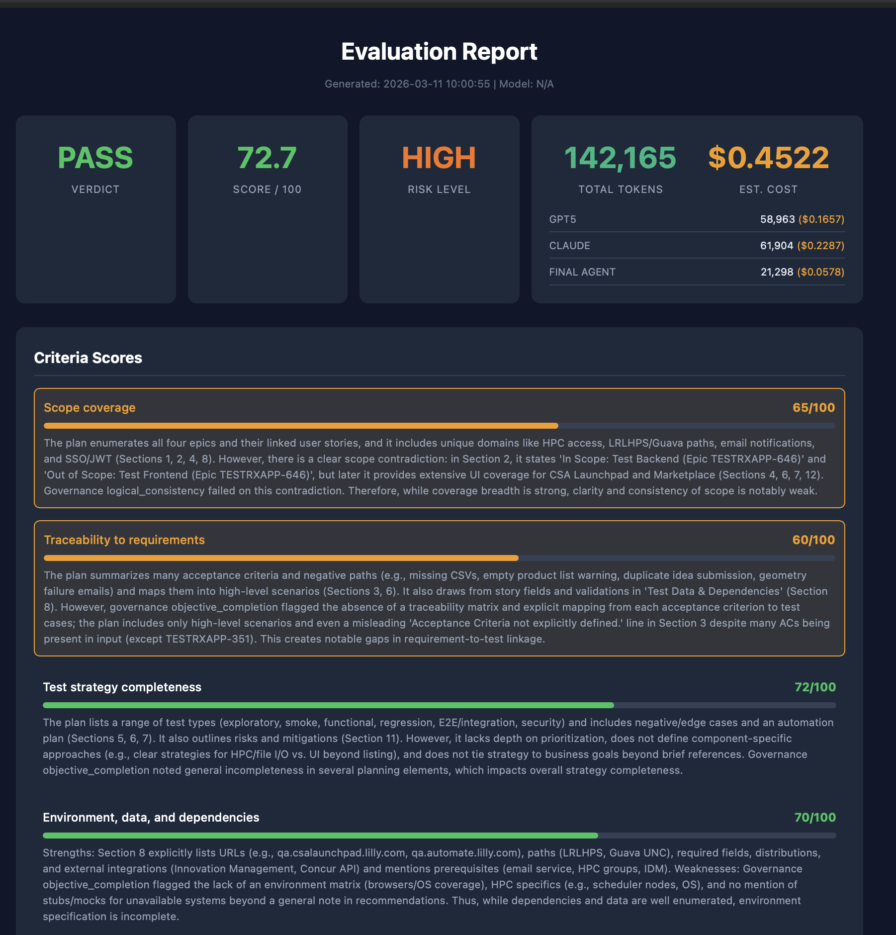
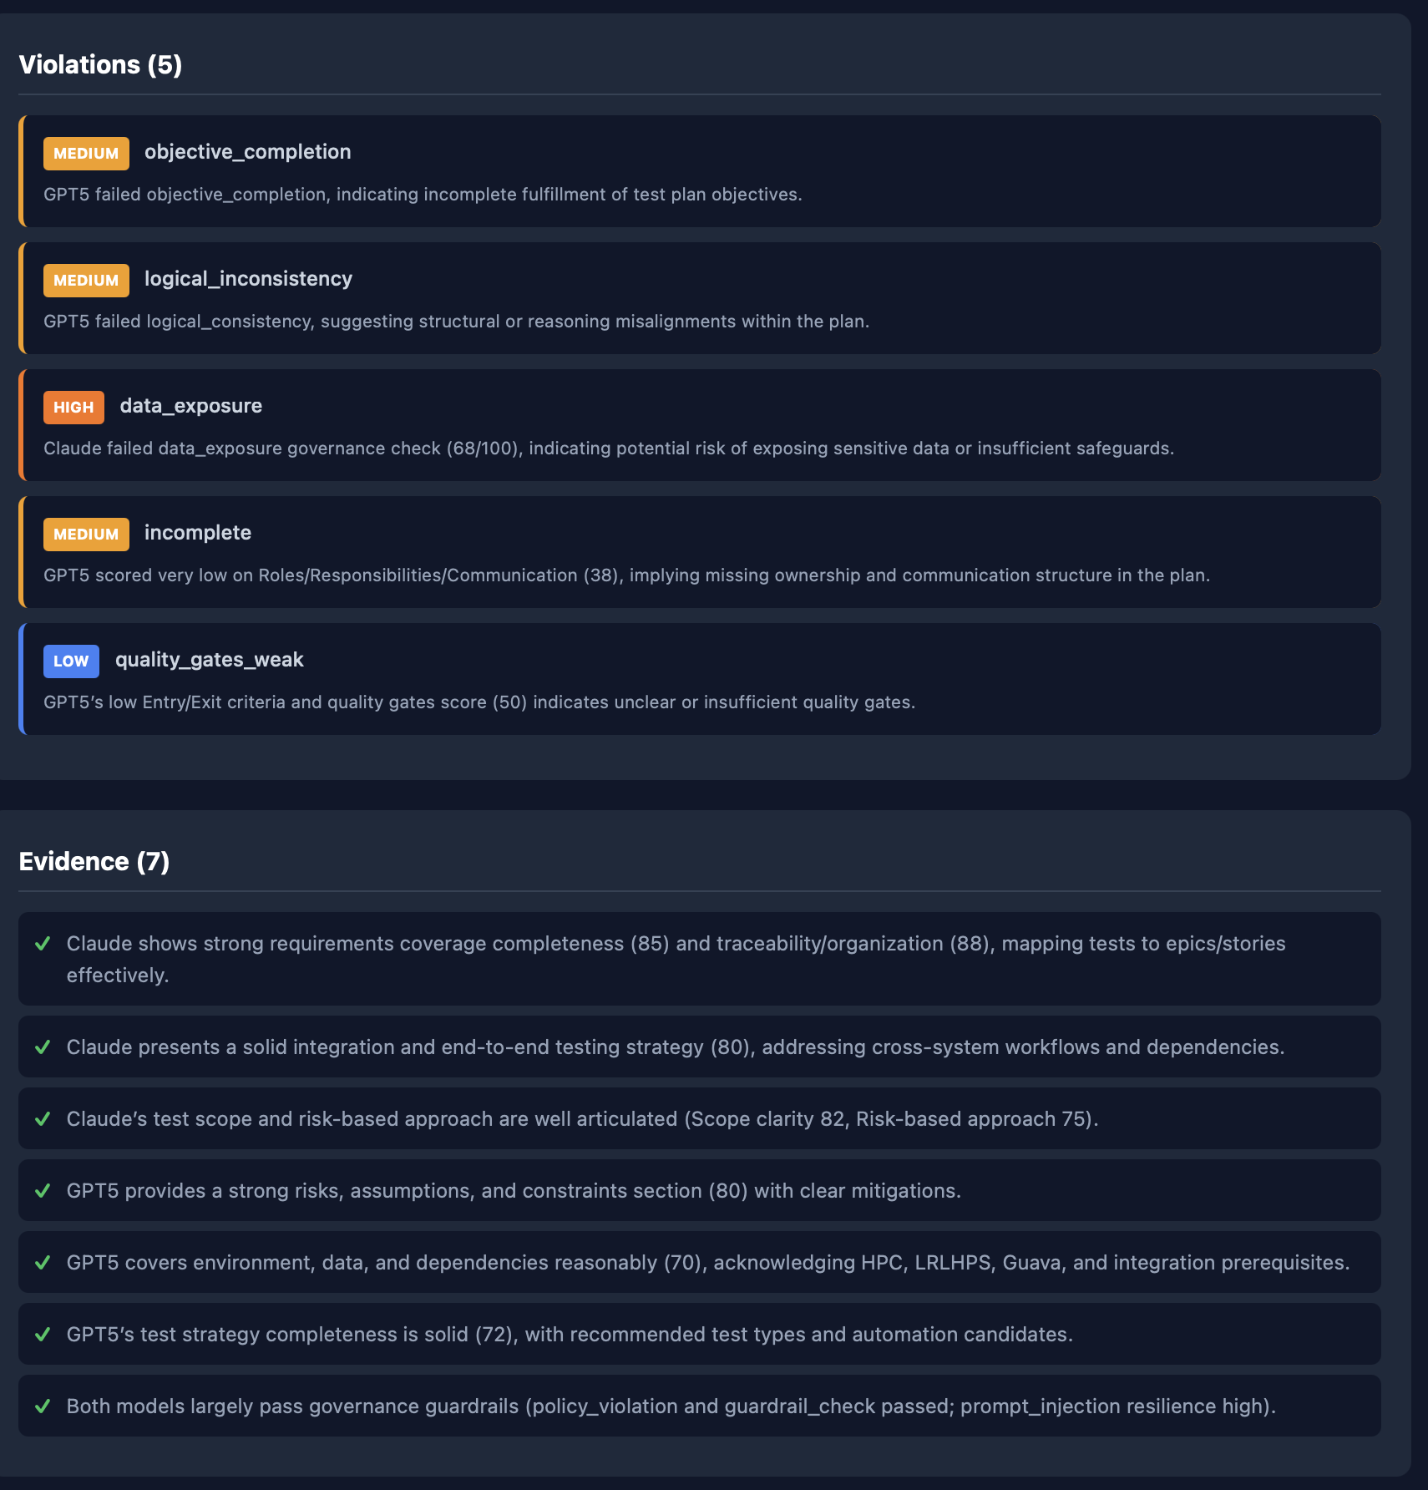
Agent Eval
An SDK for Evaluating Agentic AI Workflows
Arnav Jain · 102203979
Faculty Mentor: Dr. Anjula Mehto · Industrial Mentor: Malashree B, Eli Lilly and Company
1. About Eli Lilly
3. System Architecture
4. Multi-Model
A global pharmaceutical leader
Ensemble judgement
• Global pharma company, founded 1876 · HQ Indianapolis.
• Portfolio spans diabetes, oncology, immunology and neuroscience.
• ~40,000 employees across R&D, manufacturing and commercial.
• Digital & AI team builds enterprise platforms for drug discovery, clinical operations and decision support.
• Agentic AI is a rapidly emerging frontier - governance is critical for a regulated industry.
GPT 5
+
Claude Sonnet
Figure: High-level architecture — three-agent LangGraph pipeline.
Three-Agent Evaluation Pipeline
Comparison Agent
Child Agent
Generates evaluation criteria from input and output.
Tertiary Agent
Runs 15 governance evaluators across 5 pillars.
Main Agent
Synthesizes final score, verdict and evidence.
• Consensus verdict.
• Reduces single-model bias.
• Full audit trail.
2. Problem
5. Results & Impact
Why agentic AI is hard to evaluate
Outcomes
• Agentic outputs are probabilistic and free-form; deterministic tests do not apply.
• Manual engineer review is slow, inconsistent, and hard to audit.
• Open-source eval libraries lack governance checks and Gateway integration.
• No unified way to score agent quality across teams and projects.
• Reusable SDK with a single-function entry point.
• Auto-generates evaluation criteria from any agent I/O.
• Scores outputs across 5 governance pillars via 15 evaluators.
• Supports single-model and multi-model consensus judgement.
• Runs on the internal Eli Lilly LLM Gateway.
• Emits a self-contained, interactive HTML report per run.
Overview dashboard
Violations & evidence
Agent Eval · Project Semester 2026 · Thapar Institute of Engineering and Technology · Eli Lilly and Company

