Slide 1

Presented by:
[Team Member Names]
Knowledge Transfer System
Expert-Learning Organizational Reasoning Engine
BSc CS ([Academic Year])
Under the guidance of
[Supervisor Name]

Slide 2
Problem Statement
Background
  In engineering organisations, answers to everyday operational questions — why a release slipped, what caused an incident, who owns a service — are scattered across Slack, issue tickets, wiki pages and code commits.
Gap in existing systems
  AI and search tools retrieve documents but miss the causal reasoning an expert applies, and they do not improve when corrected, so their answers disagree with experts.
Importance
  Teams over-rely on a few senior engineers, which slows decisions, lengthens onboarding, and traps critical knowledge in individuals.

Slide 3
Objectives & Scope
Objectives
  Multi-source retrieval across Slack, tickets, wiki and commits — sparse (BM25) + dense (embeddings), fused via Reciprocal Rank Fusion.
  Knowledge-graph reasoning: entities and relationships with multi-hop retrieval for causally-linked evidence.
  Explainable, grounded answers with a cited reasoning trace and confidence (no fabricated citations); cross-encoder reranking.
  Expert-feedback learning loop: gap analysis, a generalisable and leakage-free lesson, and a measurably improved second answer.
  Rigorous evaluation: similarity, root-cause, evidence coverage, V1->V2 improvement, and generalisation to unseen questions.
Scope
  In: synthetic data, human-in-the-loop teaching, dashboard. Out: production deployment, auth/roles, live integrations, model fine-tuning.

Slide 4
Existing System / Literature Review
Existing approaches
  Plain RAG (retrieve + generate): grounds answers in documents, but is static — it never learns from corrections.
  Keyword / enterprise search (Slack search, wikis): finds documents, not the root cause or the expert's reasoning.
  Fine-tuning a model: expensive, opaque, and needs retraining — impractical for continuously changing org knowledge.
Limitations
  None capture expert reasoning or improve over feedback cycles, so answers drift from what an expert would conclude.

Slide 5
Proposed System Architecture
System overview
  Ingest sources -> three stores: a vector store (RAG), a knowledge graph, and a learning memory.
  Retrieve = hybrid BM25 + dense, fused with RRF, plus KG multi-hop and relevant lessons, then cross-encoder rerank.
  Investigate -> answer + reasoning trace + citations + confidence. Expert correction -> learn (distil + persist) -> improved re-run -> dashboard.
Modules
  Ingestion/chunking | Retrieval (sparse + dense + KG + rerank) | Investigation (LLM) | Gap analysis (judge) | Learning memory (no fine-tuning) | Dashboard.

Slide 6
Tools & Technologies
Programming language
  Python
Frameworks & libraries
  Streamlit (dashboard); sentence-transformers (bge-small embeddings + bge-reranker cross-encoder); rank-bm25; networkx (knowledge graph); numpy.
LLM
  Groq (Llama 3.x) over HTTP, with a deterministic offline stub fallback.
Data / stores & tools
  File-based JSON + numpy vector store; learning memory (lessons, KG overrides, answer memory). Git, pytest.

Slide 7
Implementation / Demo
Human-in-the-loop learning loop
  Ask -> V1 answer (cited, with confidence) -> expert corrects -> gap analysis -> learning event -> improved V2.
Generalisable & leakage-free learning
  The system stores a reusable investigative strategy, never the expert's answer verbatim.
Generalisation
  A lesson learned on one incident is applied to a different, previously unseen incident.
Live demo flow (screenshots follow)
  V1 answer -> expert correction + learn + V2 -> lesson stored -> lesson applied to a new question.

Slide 8
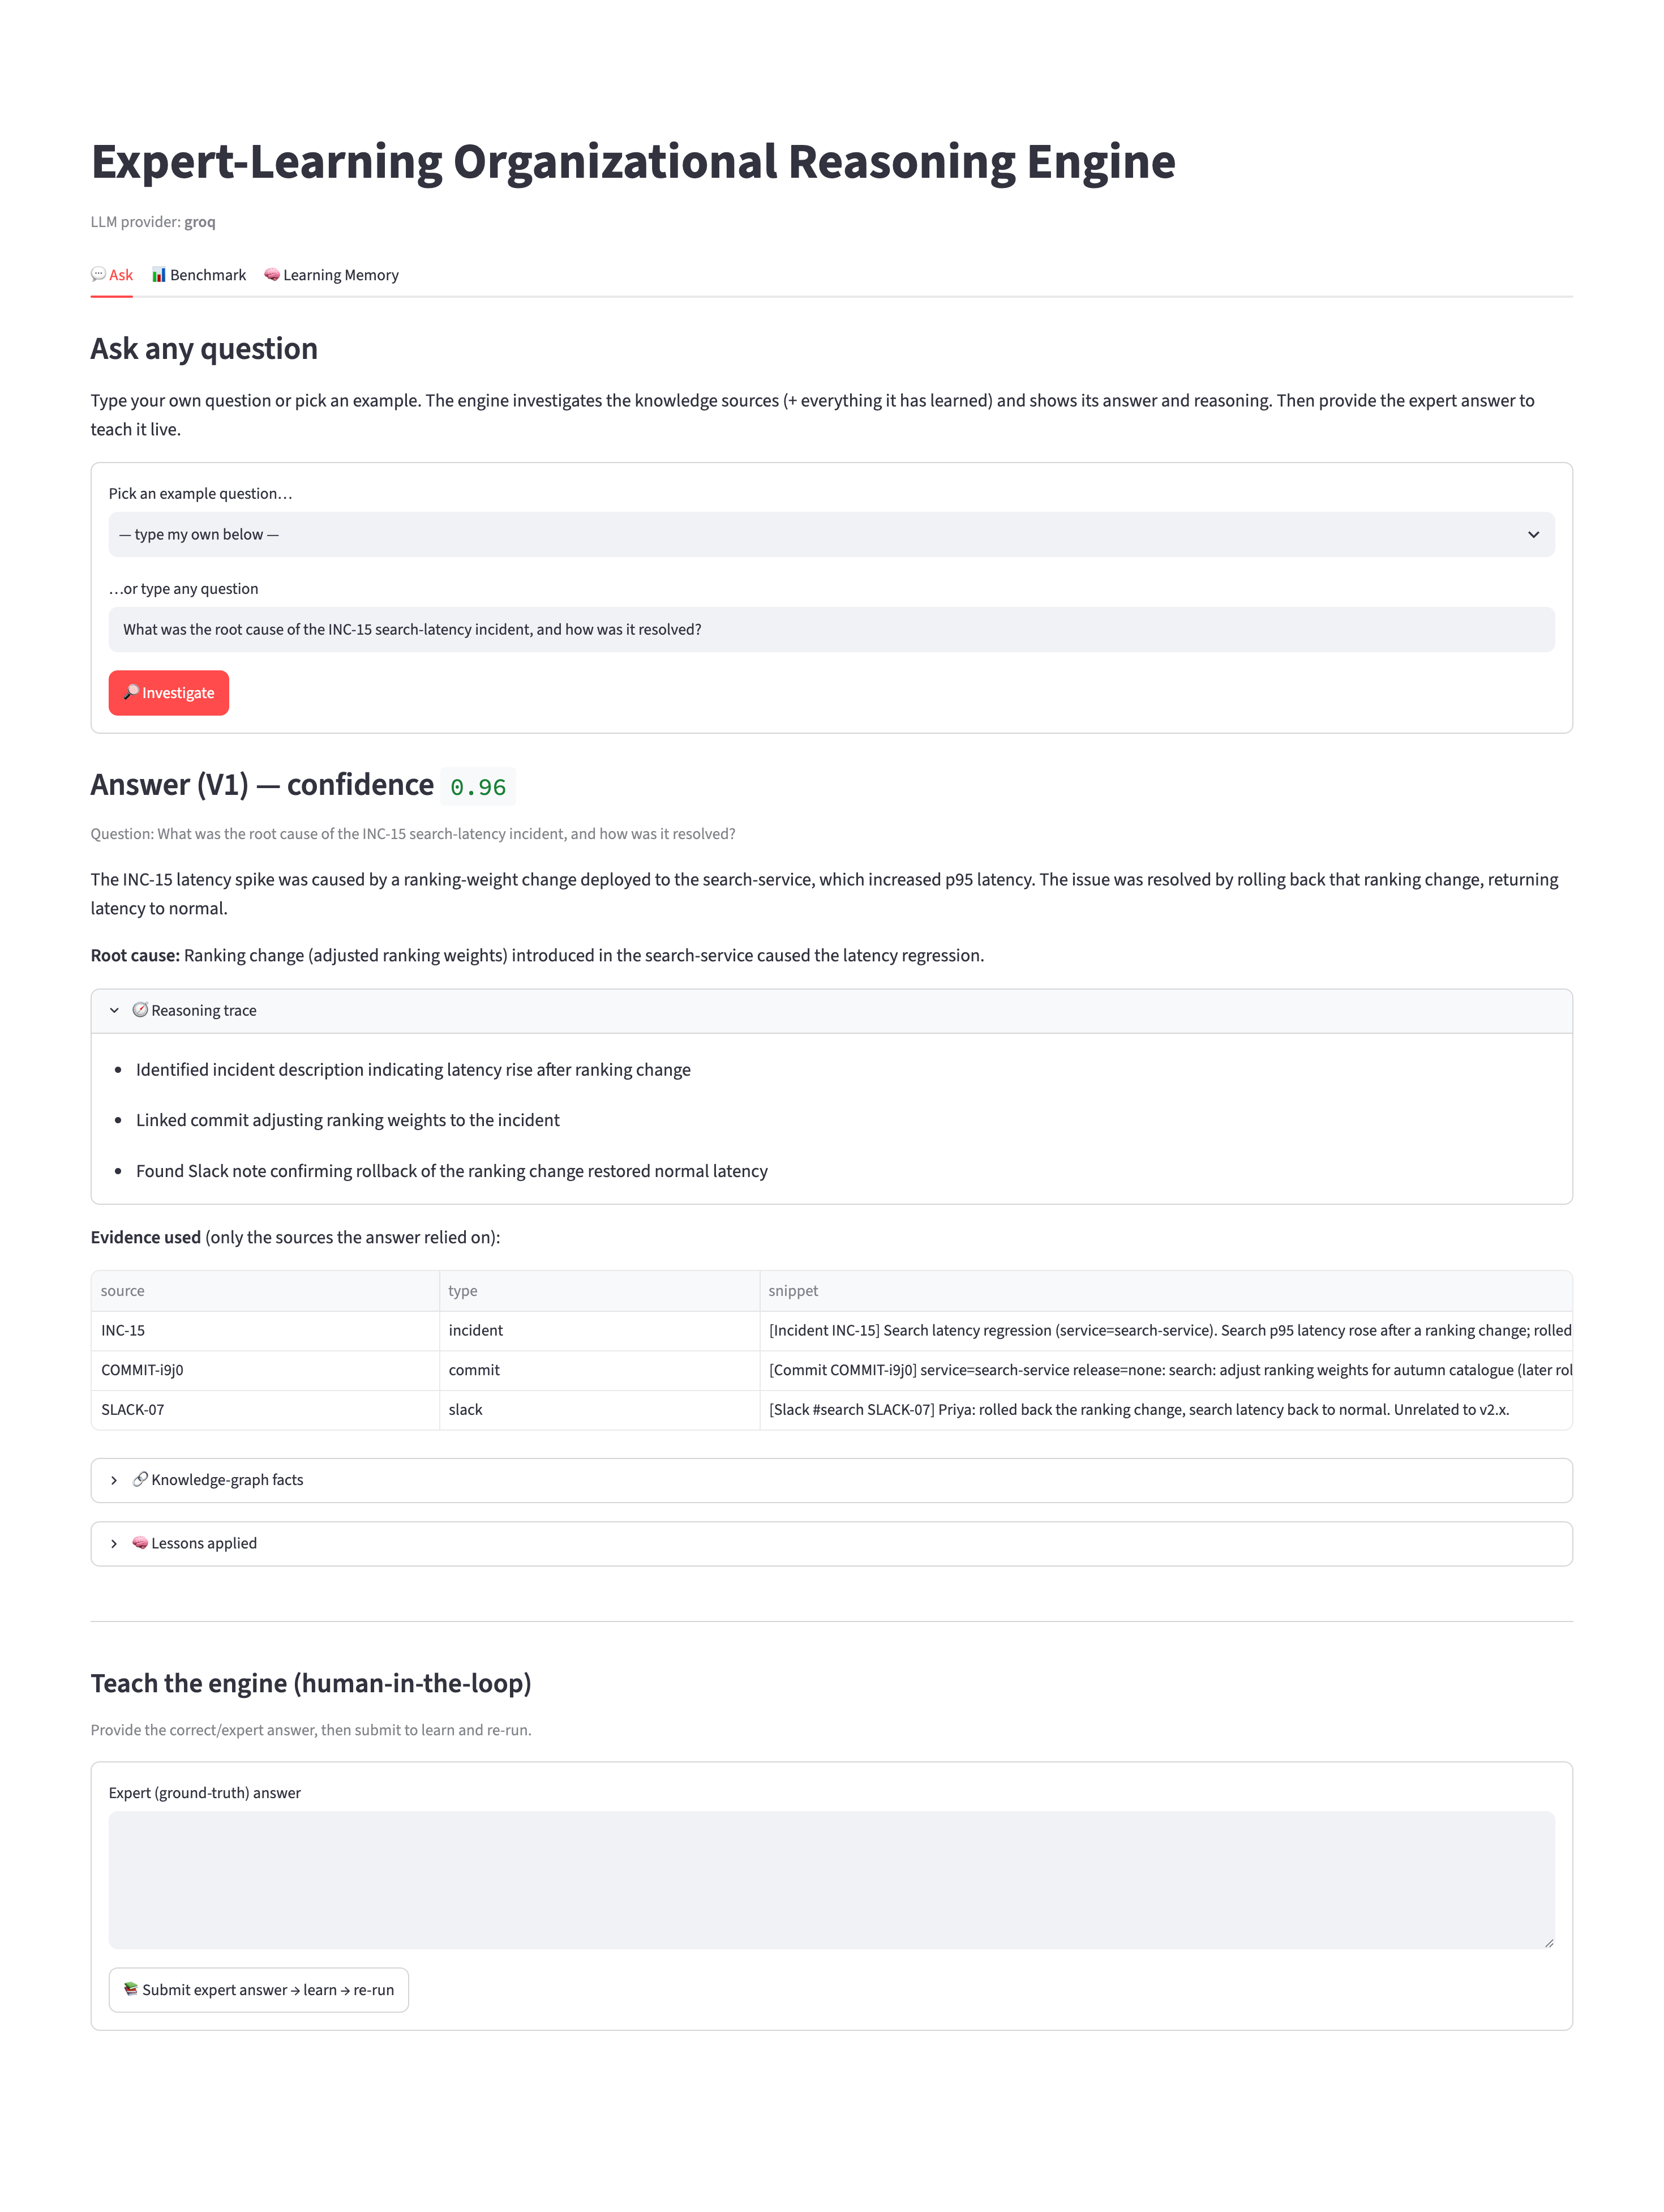
Demo 1 — Ask a new question (V1 answer)
The engine answers 'What caused the INC-15 search-latency incident?' with a cited reasoning trace, evidence, and a confidence score.

Slide 9
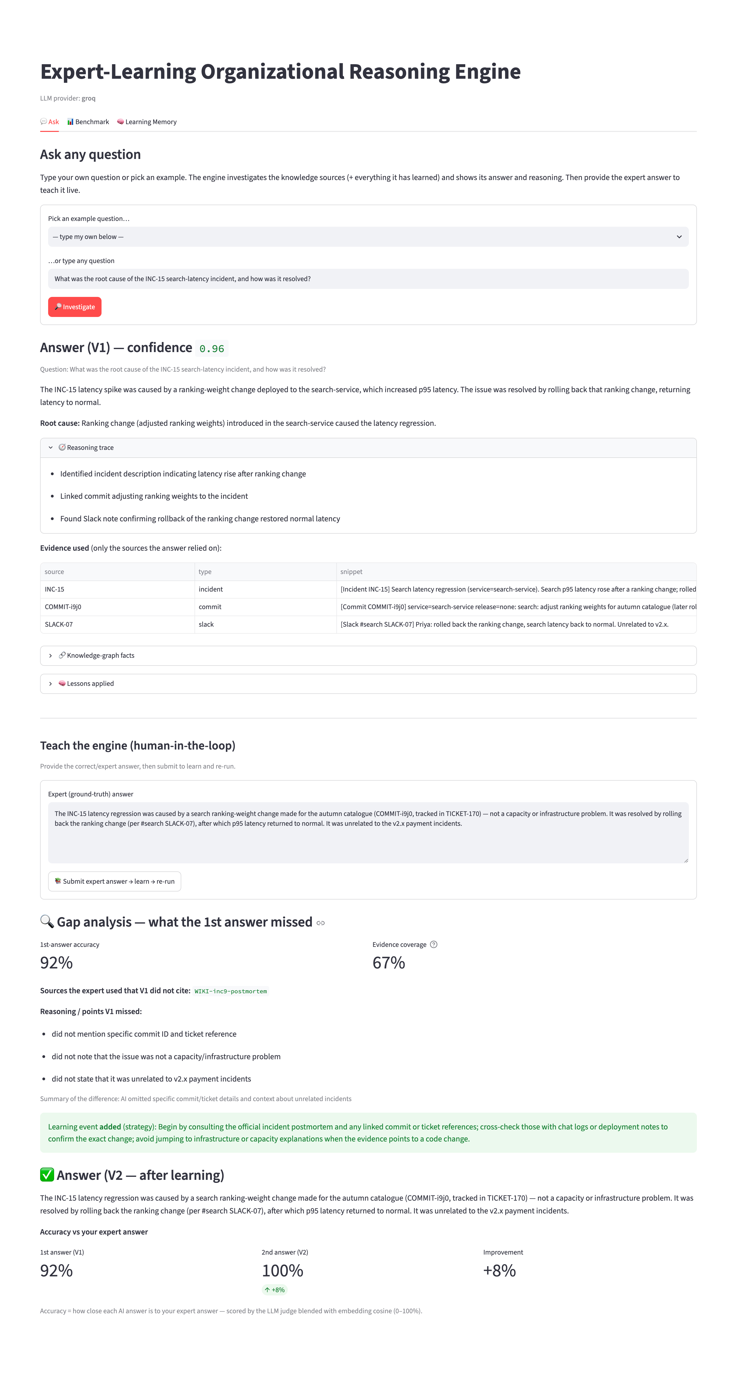
Demo 2 — Expert corrects -> gap analysis -> learn -> V2
The expert answer is submitted. The system shows the gap (missed evidence), distils a learning event, and produces an improved V2 (accuracy 92% -> 100%).

Slide 10
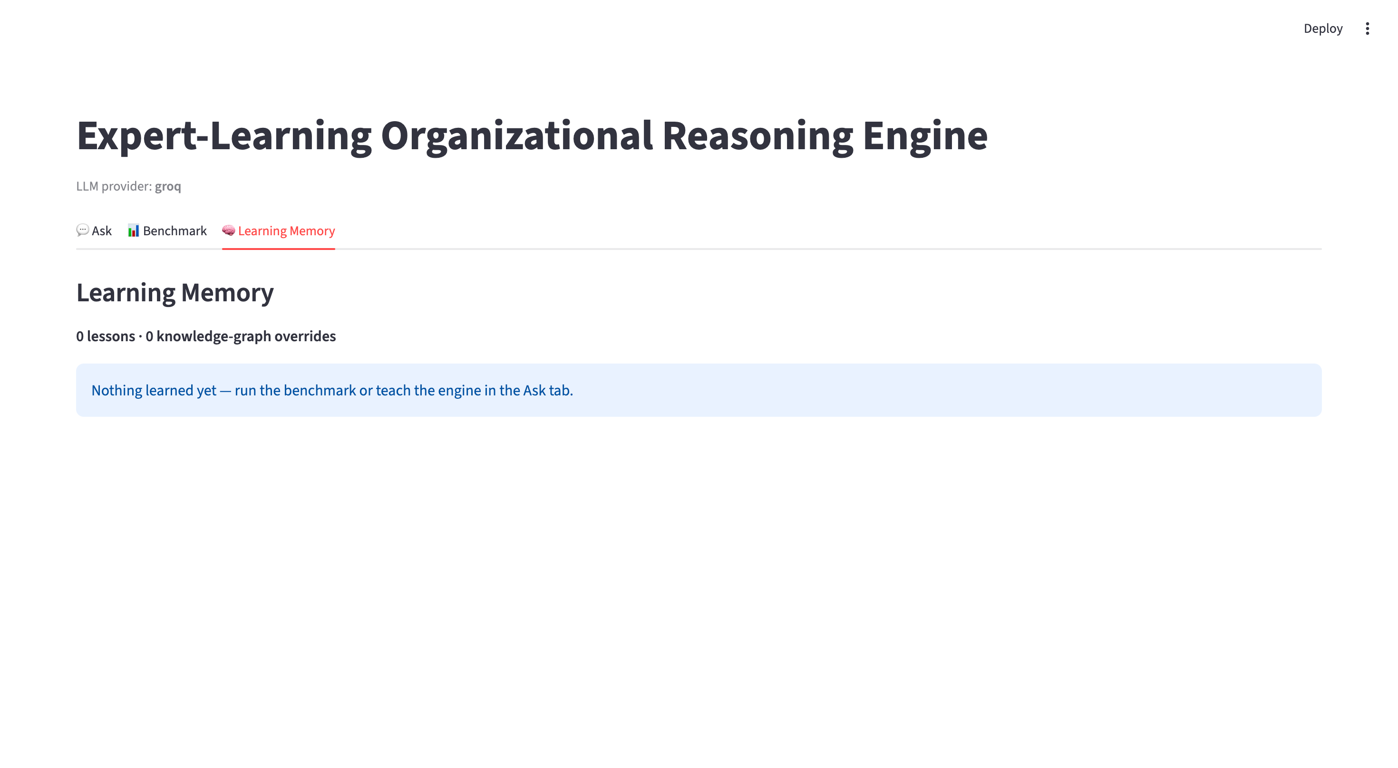
Demo 3 — Learning Memory before teaching
Learning Memory starts empty — nothing has been learned yet.

Slide 11
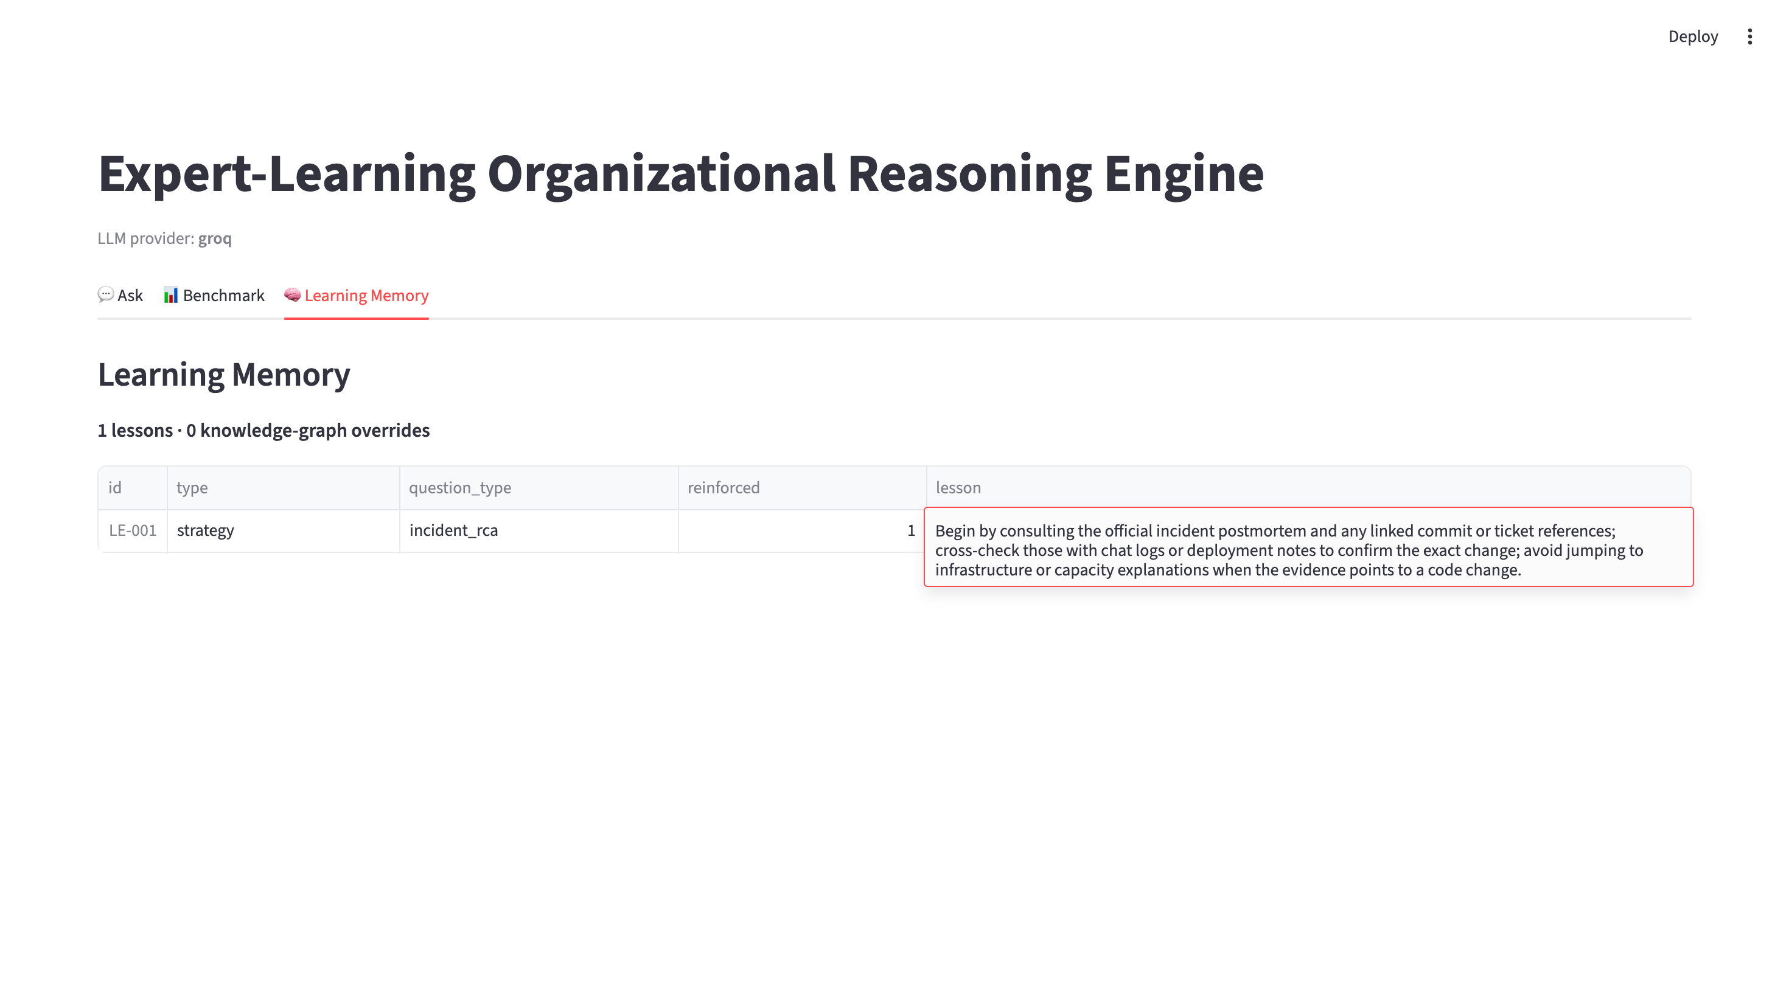
Demo 4 — The distilled, generalisable lesson
A reusable strategy (LE-001) is stored — 'consult the postmortem, verify the exact commit/ticket, don't default to infrastructure' — not the expert's answer.

Slide 12
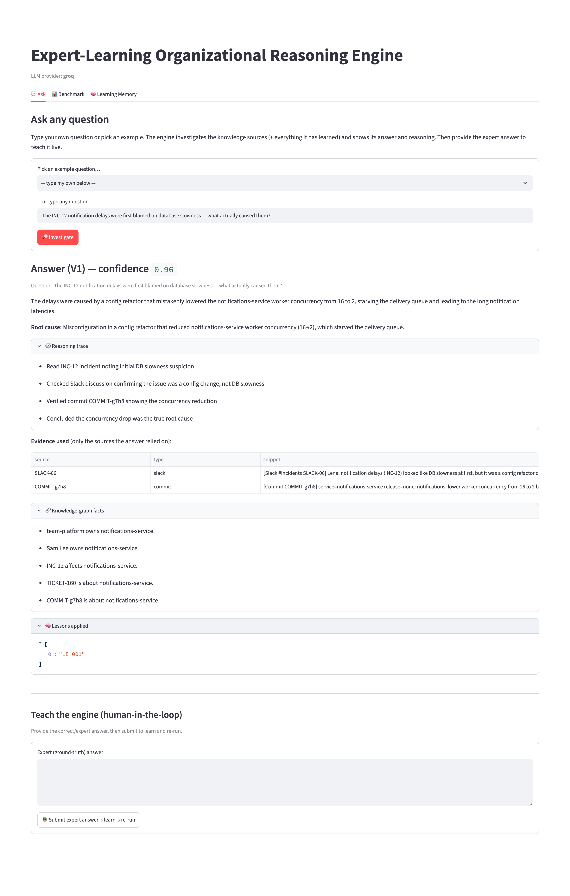
Demo 5 — Lesson applied to a NEW question
Asking a different incident (INC-12), the 'Lessons applied' panel shows LE-001 — the lesson learned from INC-15 is reused. Learning generalises.

Slide 13
Results & Analysis
Measurable improvement after feedback
  Example (INC-15): answer accuracy 92% -> 100% and evidence coverage 67% -> 100% after one expert correction.
Learning generalises (not memorisation)
  The lesson learned from INC-15 (LE-001) is retrieved and applied to a different incident, INC-12 — reasoning transfer across questions.
Explainable & grounded
  Every answer cites its sources and shows a reasoning trace; citations not in the retrieved set are dropped.
Honest note
  Results are on a small synthetic dataset with a single model; LLM outputs vary run-to-run, so scores are indicative.

Slide 14
Challenges & Limitations
Technical challenges & limitations
  LLM non-determinism: V1->V2 scores vary run-to-run even at temperature 0.
  Strong retrieval leaves little headroom on easy questions, so a lesson may add no visible change to an already-correct answer.
  Synthetic dataset (no real or sensitive data) limits external validity.
  LLM-as-judge similarity is subjective — mitigated with a fixed rubric and deterministic metrics.
  No abstention on out-of-distribution questions; a graceful 'insufficient evidence' path only partly covers this.

Slide 15
Conclusion & Future Work
Conclusion
  A working human-in-the-loop reasoning engine that learns generalisable, leakage-free reasoning from expert feedback and measurably improves — with hybrid retrieval, a knowledge graph, reranking, and an explainable, grounded UI.
Future work
  Larger / real-world datasets and statistical evaluation across more question types.
  Retry-backoff for API limits; confidence calibration and an abstention path.
  Richer knowledge graph and automated lesson-quality control; multi-user deployment.

