Slide 1

Heart Risk Project; Data Analysis
By: Mahsa Nafei, Jesús Hernández, Fernando Lopez, and Alexandru Arnautu

Slide 2

Heart Risk Data Analysis
Overview
This repository combines two data sources and API Coordinates to predict heart attack risk using machine learning and visualization analysis. It features a Flask-based web application for risk prediction, a data processing script using Postgres SQL in Amazon RDS, and employs Spark for data cleaning and preparation. For data visualization and analysis, it uses Plotly, Pandas and Folium.
Objective
This project focuses on using a dataset to create a predictive model for assessing an individual's risk of having a heart attack. It aims to understand how lifestyle factors, like smoking, obesity, and physical activity, compare to clinical parameters, such as cholesterol levels and blood pressure, in predicting this risk. Additionally, the project seeks to examine how data analysis can influence insurance premium adjustments and underwriting processes improvement. A critical aspect of the project is ensuring fairness and reducing bias in predictions across different demographic groups. The ultimate objectives are to improve risk assessment accuracy, support informed decision-making in insurance, and promote fairness and transparency in heart attack risk evaluation.

Slide 3
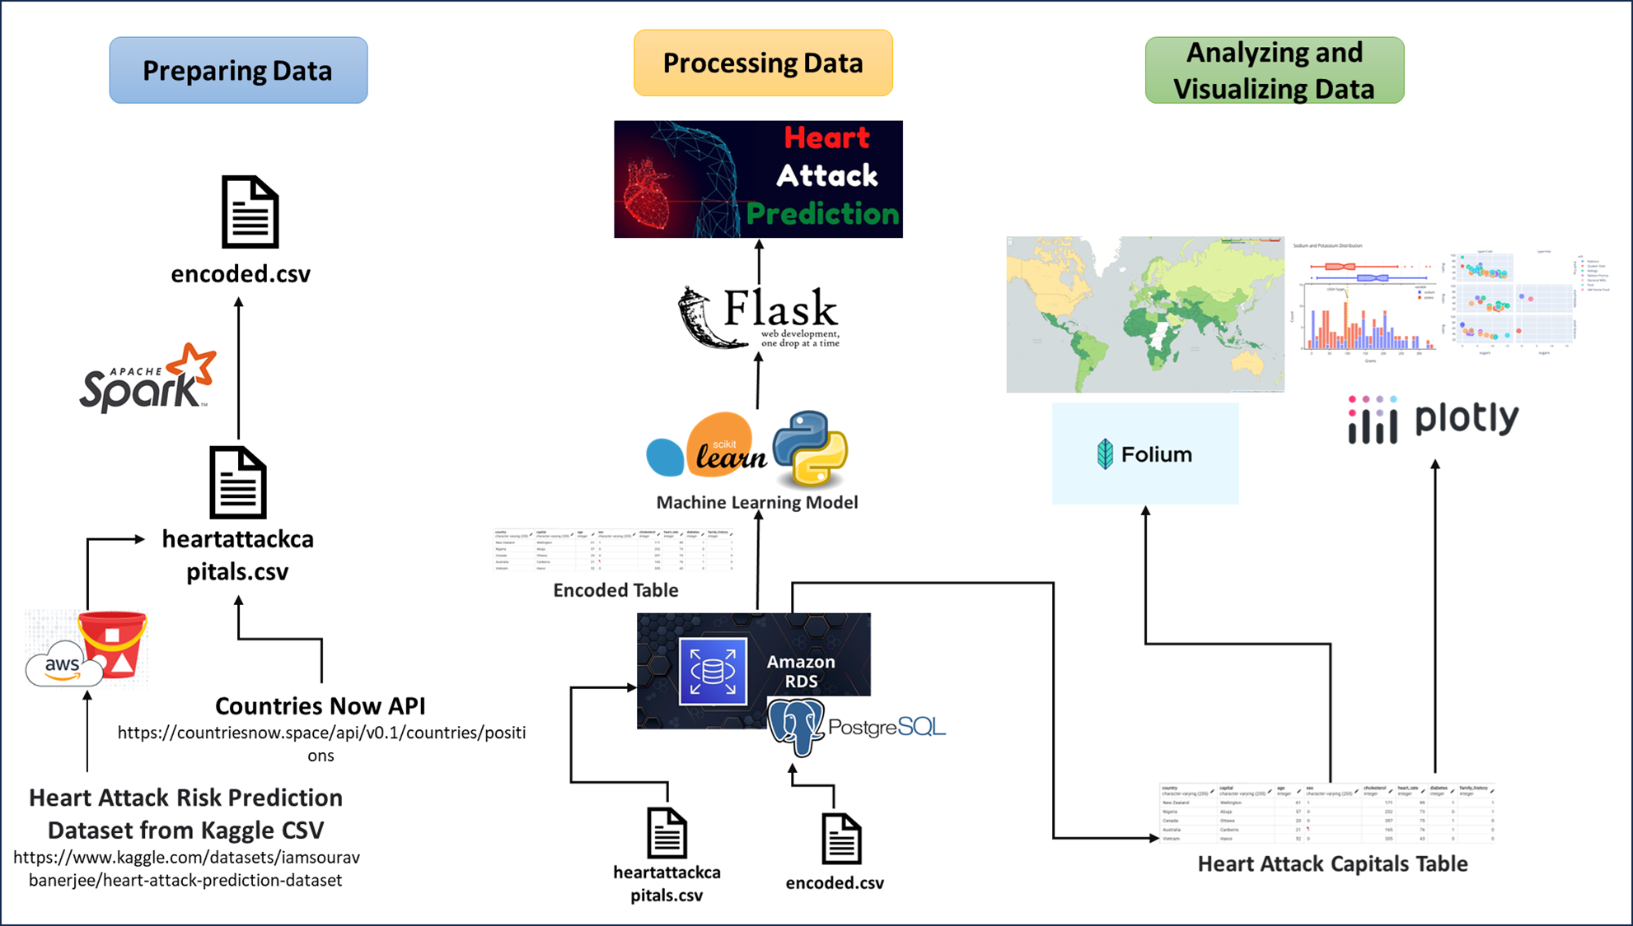
Data Collection and Preprocessing
Preparing the Data
Processing the Data
Analyzing and Visualizing the Data
The dataset for Heart Attack Risk Prediction was meticulously sourced in CSV format from the renowned data science platform, Kaggle. Additionally, we procured geographical coordinates for each country via the Now API. Subsequently, the datasets were proficiently encoded utilizing the robust capabilities of Amazon Relational Database Service (RDS) and processed with the high-performance analytics engine, Apache Spark.
Utilizing the refined datasets, specifically the Heart Attack Capitals and Encoded CSV, we employed the advanced capabilities of PostgreSQL in conjunction with Amazon Relational Database Service to meticulously identify the most efficacious machine learning model. This model is poised to be the cornerstone of our sophisticated Heart Attack Prediction application developed in Flask.
We articulate our analytical conclusions in response to the posed research inquiries, articulated through intricate visualizations crafted using the Folium library, along with Pandas and Plotly. These visual representations provide a comprehensive understanding and interpretation, facilitating an effective resolution to the research questions at hand.

Slide 4
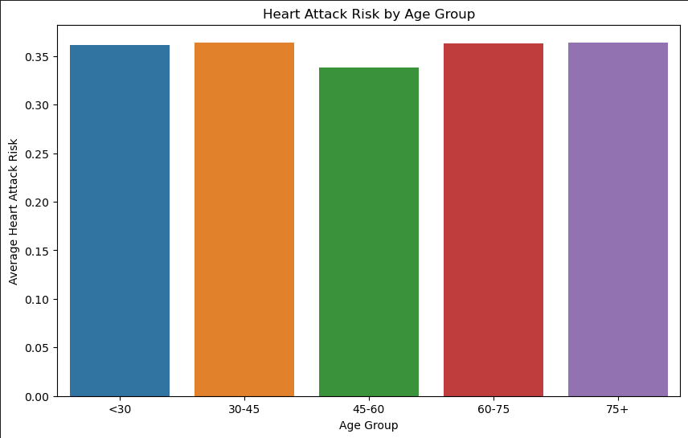
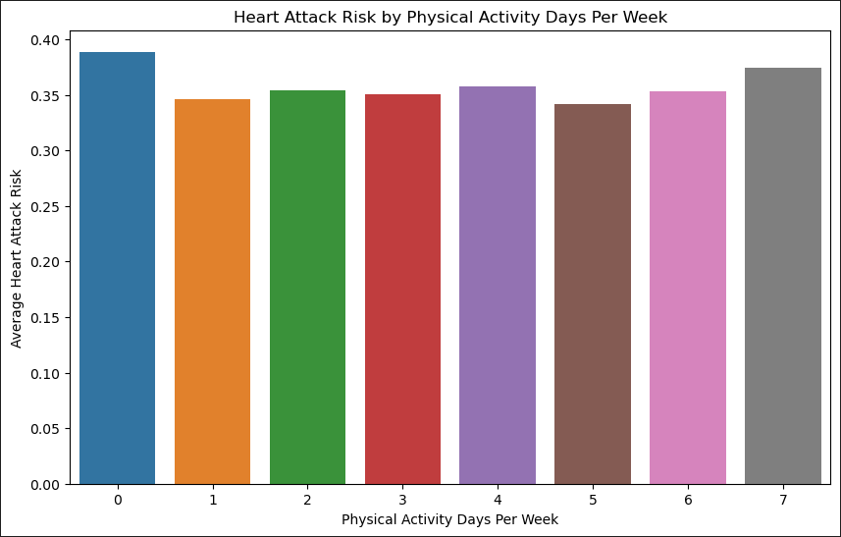
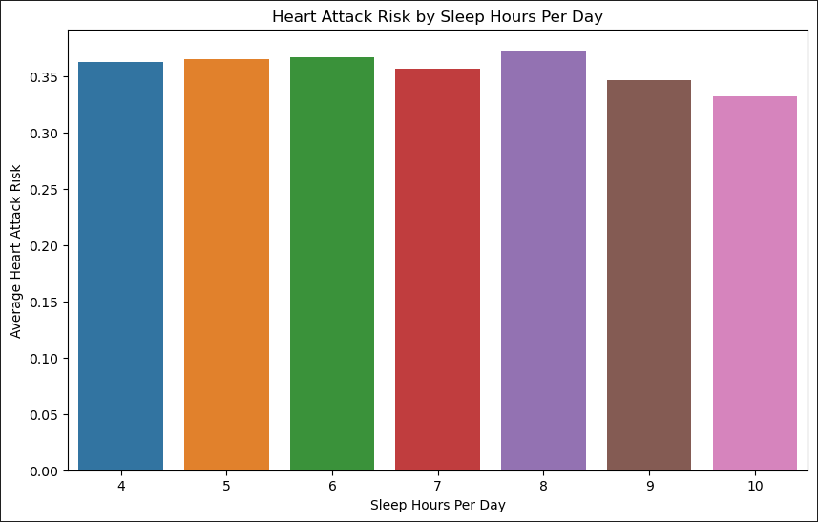
Data Analysis and Visualizations
Heart Attack Risk by Age Group
Heart Attack Risk by Physical Activity Days Per Week
Heart Attack Risk by Hours of Sleep per day
The bar graph provided illustrates a comparative analysis of heart attack risk across different age groups. It highlights that individuals aged 75 and above are at an elevated risk of experiencing a heart attack. Conversely, the graph also indicates that people between the ages of 45 to 60 exhibit the lowest risk of such cardiac events.
The bar chart indicates that individuals inactive throughout the week face the highest heart attack risk, while those active daily are also at a notable risk. People with five active days per week show the least risk for heart attacks.
The bar graph suggests that a daily rest of 10 hours minimizes the risk of heart attacks. It also notes that an 8-hour sleep duration appears to have the highest associated risk, potentially attributable to it being the most common sleep duration.

Slide 5
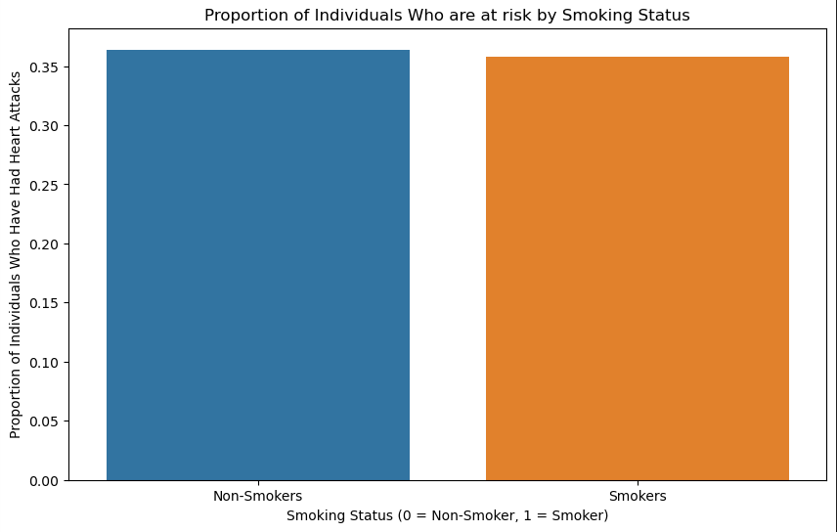
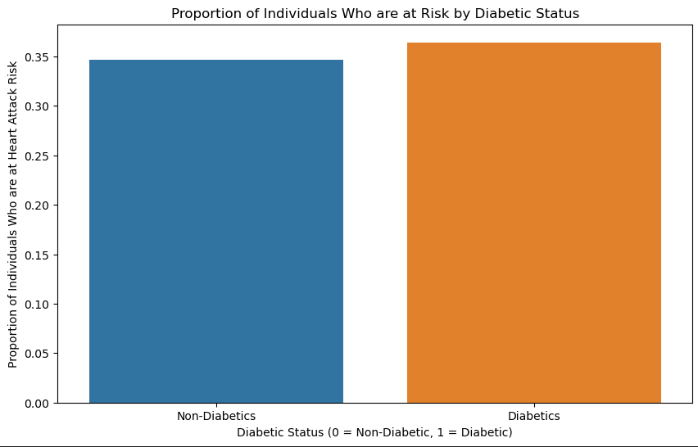
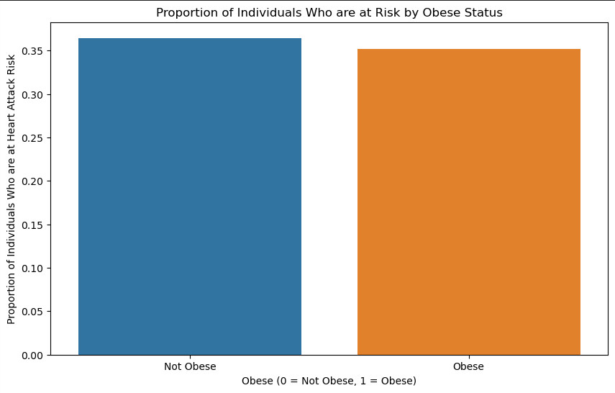
Data Analysis and Visualizations
Proportion of Individuals who are at risk by Smoking Status
Proportion of Individuals who are at risk by Diabetic Status
Proportion of Individuals who are at risk by Obesity Status
The graph displays a surprising trend: smokers seemingly have a reduced heart attack risk. This could be an instance of the "smoker's paradox," where smokers may exhibit a misleading resilience to heart attacks due to variables not captured in the data.
The graph demonstrates that individuals with diabetes have an elevated risk of experiencing heart attacks.
The graph indicates that obese individuals appear to have a lower risk of heart attacks, possibly due to protective factors or more intensive medical treatments often given to overweight patients.

Slide 6
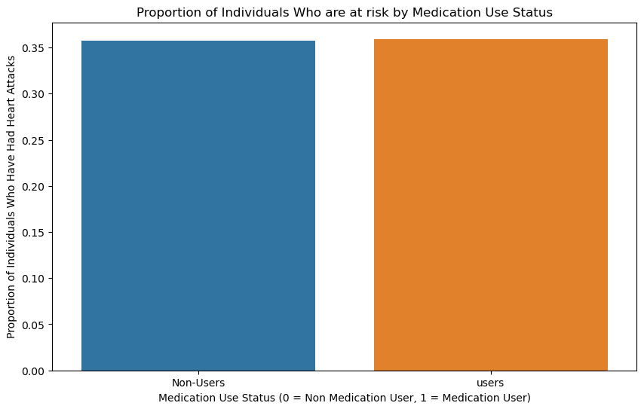
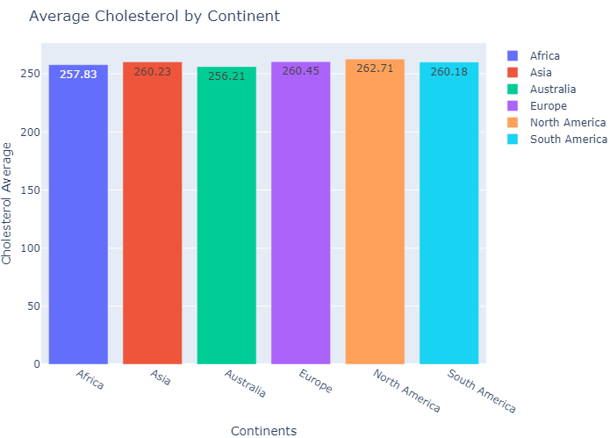
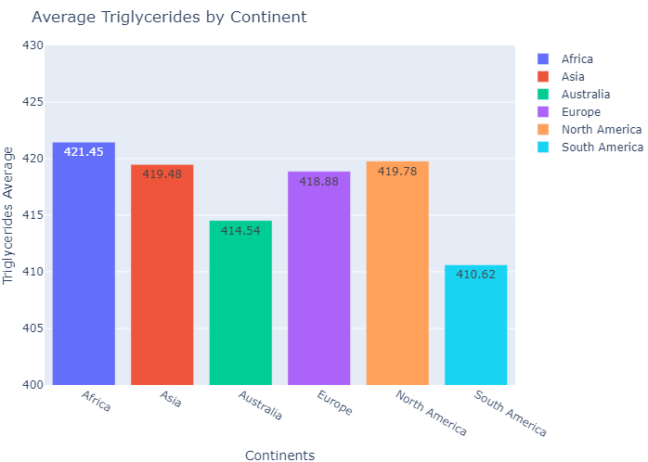
Data Analysis and Visualizations
Average Cholesterol Levels per Continent
Average Triglyceride Levels per Continent
The bar graph vividly conveys that individuals who adhere to a medication regimen exhibit a diminished risk of heart attacks.
The bar graph elegantly displays the comparative average cholesterol levels across continents, revealing North America as the region with the highest readings, while Australia boasts the lowest cholesterol figures.
The bar graph elegantly delineates the triglyceride levels by continent, pinpointing South America as the region with the minimal levels, while Africa emerges with the maximum.

Slide 7
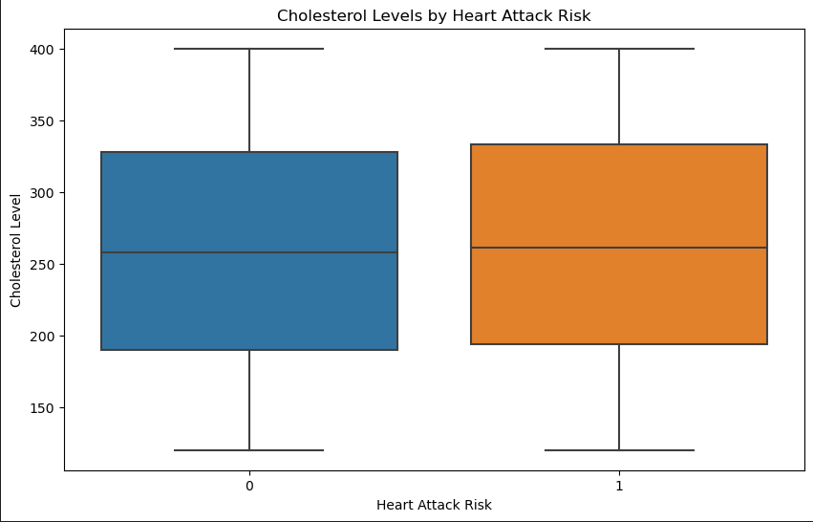
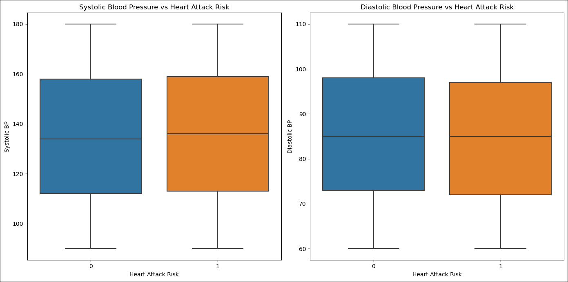
Data Analysis and Visualizations
Cholesterol Levels by Heart Attack Risk
Systolic and Diastolic Blood Pressure vs Heart Attack Risk
The box plot graph elegantly illustrates that elevated cholesterol levels are associated with an increased risk of cardiac events.
These box plots reveal a nuanced cardiovascular insight: individuals with elevated systolic blood pressure face an increased susceptibility to heart attacks, whereas those with higher diastolic blood pressure exhibit a surprisingly reduced risk.

Slide 8
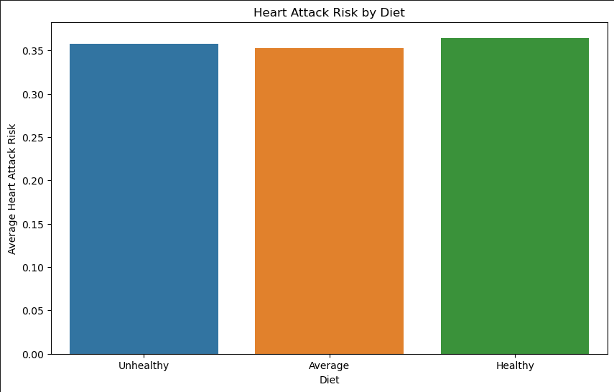
Insights and Findings
Key Insights
While the majority of the data collected aligns with expectations and demonstrates predictable patterns, certain unanticipated results have emerged due to key influence. Given that the data compilation spanned globally and accounted for numerous variable, it is conceivable that the sample size of 8,763 patients may not have been sufficiently large to encapsulate a definitive accuracy in the data’s representation.
Trends and Patterns
The analysis reveals that adequate sleep and medication compliance are linked to a lower incidence of heart attacks. Moreover, it’s observed that people adhering to exceptionally healthy diets often register a higher risk of heart attacks. This counterintuitive result could be related to a phenomenon knows as the “health-conscious worker effect,” where individuals who are proactive about their health are more likely to get regular check-ups. Such vigilance may lead to a higher reported incidence of heart issues simply because their conditions are more likely to be diagnosed then those less health-conscious

Slide 9
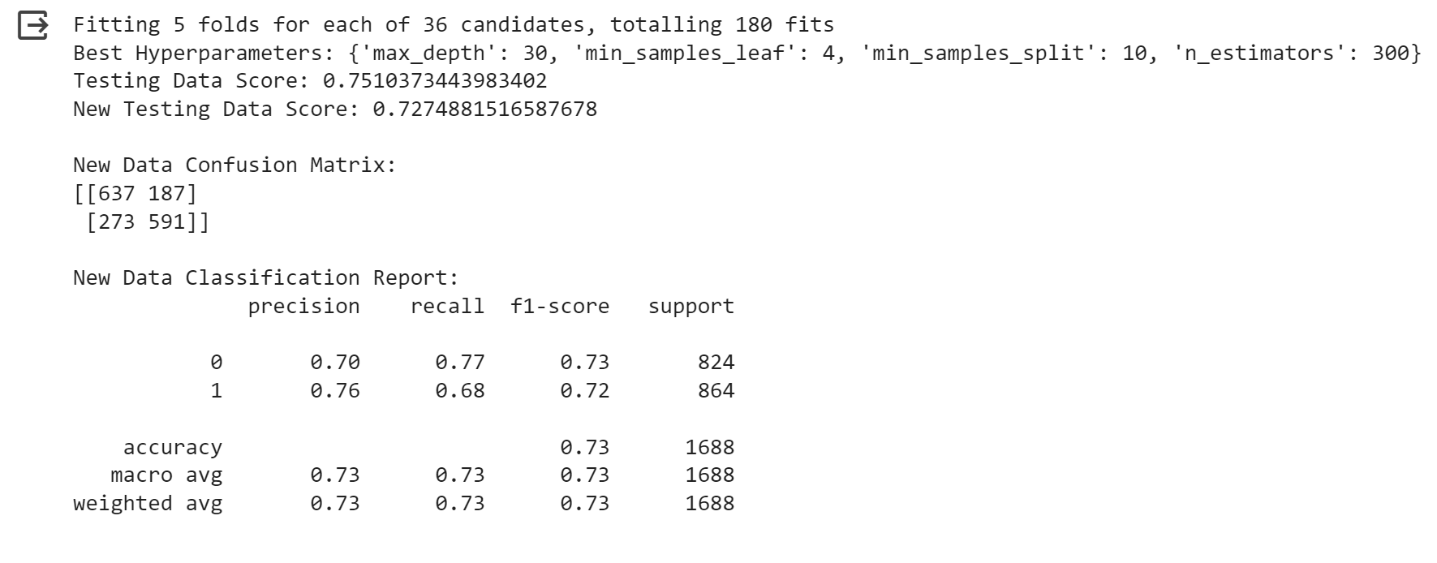
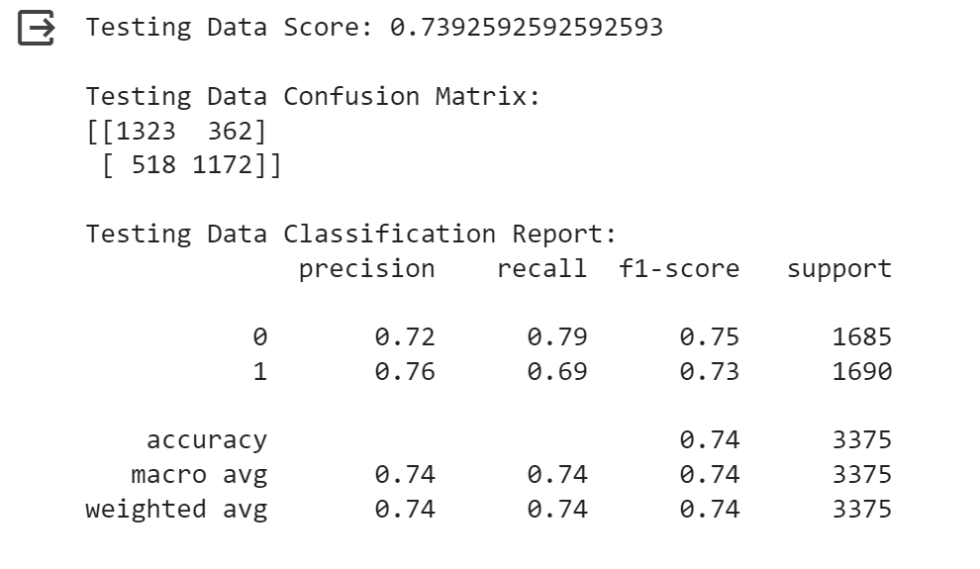
Best Prediction Model Data Resampling with RandomOverSampler Grid serach and RandomForestClassifier

Slide 10

Recommendations
Actionable Steps
Potential Interventions
To minimize your heart attack risk, ensure ample sleep, adhere to a nutritious diet, maintain a five-day exercise regimen per week, comply with medication schedules, and keep cholesterol levels in check.
To achieve a representative dataset with global scope, and expanded sample size is necessitated.
Future Research Opportunities
Further examination could be conducted into the median age of individuals adhering to a nutritious diet and an in-depth analysis of familial heart disease history among both smokers and non-smokers, to glean additional insights in the occurrence of the “smoker paradox” phenomenon.

Slide 11

Conclusion
Summary of Findings
Implications and Applications
Recapitulating the significant findings and insights from the data analysis.
Exploring the real-world implications and potential applications of the findings.
Future Actions
Proposing possible next steps and actions based on the analysis outcomes.

