Slide 1

Startup Name Short description STARTUP as DIMPOLMA
TEAM
ROLE: <NAME> / EDUCATION STAGE / SCPECIALISATION / UNIVERCITY | COMPANY
EXAMPLE:
CEO: Leonid Yakubovich / MA / BUSINESS INFORMATION SYSTEMS/ ITMO
CTO: Victor Pipchenko / MA / DIGITAL CONTROL / ITMO
CBDO: Anna Petrova / POLYTECH Univercity
CMO: Lena Popova / Yandex

Slide 2
CONTENTS
GRAPHICS
GLOSSARY
RESUME
PROBLEM
TECHNOLOGY AND/OR PRODUCT
MARKET
COMPETITION
BUSINESS-PROCESS
PROJECT STATUS
REGULATION
PRODUCTION
IP
TEAM
FINANCE MODEL
EXIT STRATEGY
ROADMAP
RISKS
SUMMARY (SWOT or other frameworks)

Slide 3
GRAPHICS
Текст

Slide 4
GLOSSARY
Текст

Slide 5
1. PROJECT RESUME
SHORT DESCRIPTION (Например: Сервис по определению стадии рака на снимках МРТ методами машинного обучения для клиник США)
STAGE {идея, бизнес-план, концепт, MVP/прототип, пилот, бизнес с выручкой}
REGULATION (есть, нет, особенности)
PRODUCTION (насколько сложно производство или масштабирование, себестоимость производства, production партнерства)
IP (на какой стадии IP-процессы)
MARKET (ЦА, Конкуренты, TAM, SAM, SOM, CAGR)
TEAM (какие С-позиции закрыты)
FINANCE (бизнес модель или unit-economy, сколько требуется на данном этапе)
EXIT STRATEGY (продажа стратегу, IPO, операционная прибыль и т.д.)

Slide 6
2. PROBLEM
The better that jury understand and agree with the significance of the problem or pain, the more meaning the solution will have for them
Describe the significance of the problem
What is the Pain or Need in the market?
What do customers have to go through to solve this problem?

Slide 7
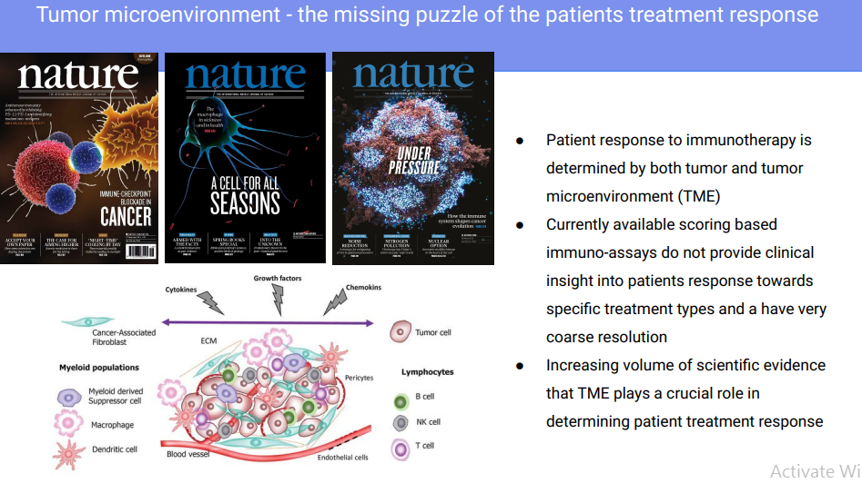
2. PROBLEM EXAMPLE

Slide 8
3. TECHNOLOGY AND/OR PRODUCT
How does your technology/product application specifically solve the problem or alleviate the “pain” for this market?
Show Data! - nothing substitutes for plenty of evidence (data) that your proposed product can work
Show experimental results, prototype testing results, external or independent testing results
Make sure your assumptions are correct and your tests are relevant, predictive or indicative of your future product’s likely performance
Describe (non-confidential) mechanism- of-action; in other words, how does the technology work?
You don’t need to reveal trade secrets or confidential information, but you need to demonstrate that the technology works

Slide 9
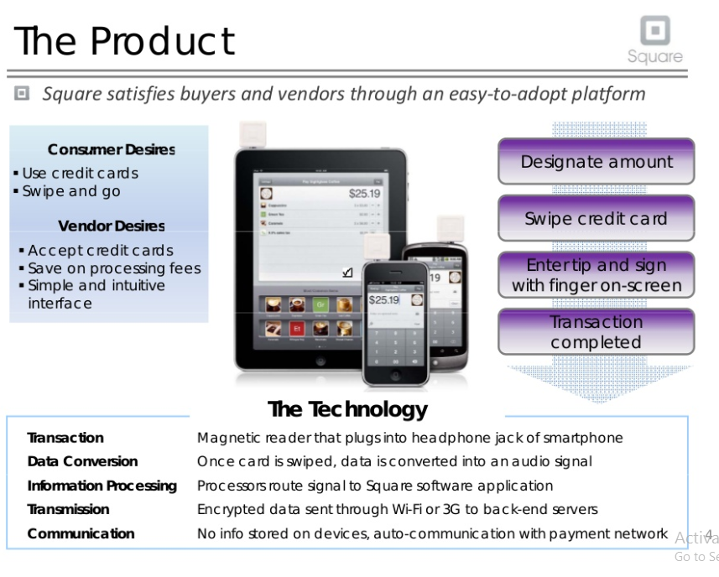
3. TECHNOLOGY AND/OR PRODUCT EXAMPLE

Slide 10
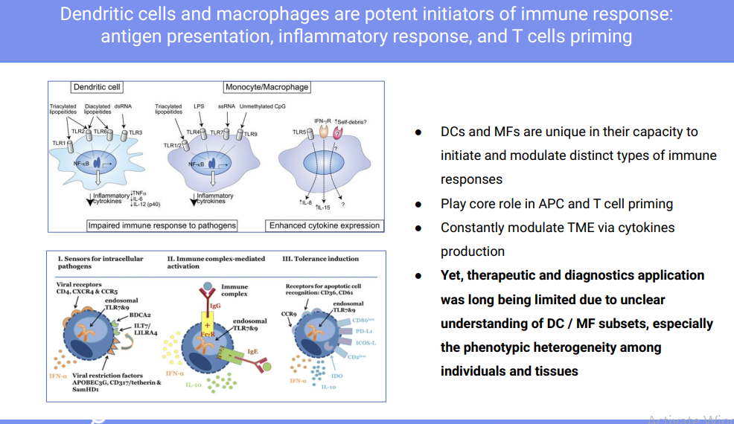
3. TECHNOLOGY AND/OR PRODUCT EXAMPLE

Slide 11
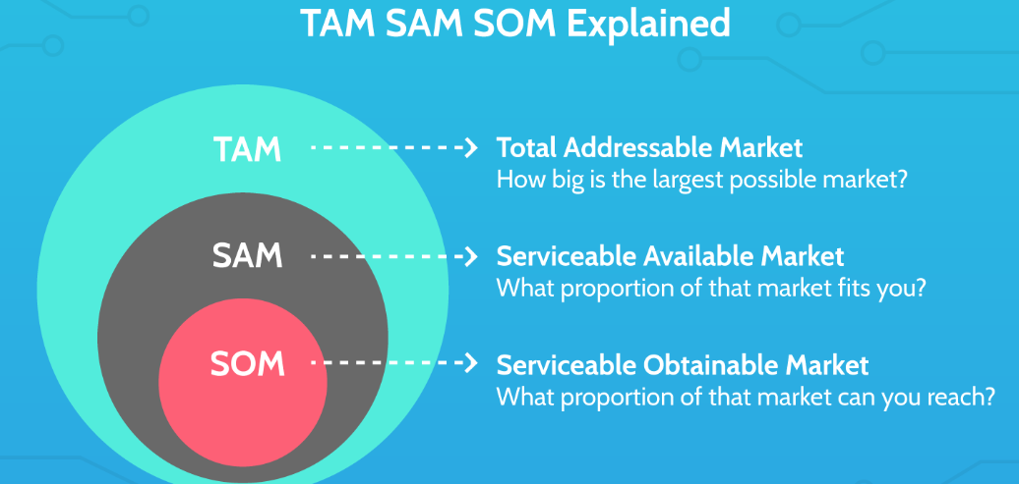
4. MARKET
• Show how big the market is in dollars
- If you determined this, show how was it calculated
- Give sources for any market data you show
Is it a niche or orphan market? Describe your target market
- Drill down to the customer segment that will purchase your product
• Describe how will you reach your customers
Will you need market channel partners?
If so, who and why would they want to work with you? TAM (+ CAGR) SAM SOM

Slide 12

5. COMPETITION
Describe the current and future competition for your proposed product
Discuss the inferior substitutes currently being used to solve the problem and alleviate the pain • Frequently there is no direct product competition for novel products, but there are substitute products being used to try to solve this problem
Describe the product features and benefits
- Be sure these are relevant to the problem and important to the customer
Develop a competitive product matrix if applicable
What are your product’s points-of- differentiation compared to the competition or substitutes for your product

Slide 13
6. BUSINESS PROCESS
Describe how will you make
money
Are you going to sell the end product or are you an intermediary?
Show how you will reach your customers
Will you need distributors
Explain the important components of your business
Is there a competitive advantage you have by the use of your business model? Unit economy can be provided if needed

Slide 14
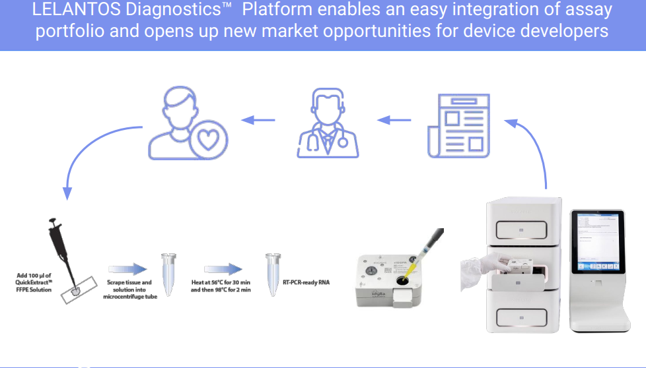
6. BUSINESS PROCESS EXAMPLE

Slide 15
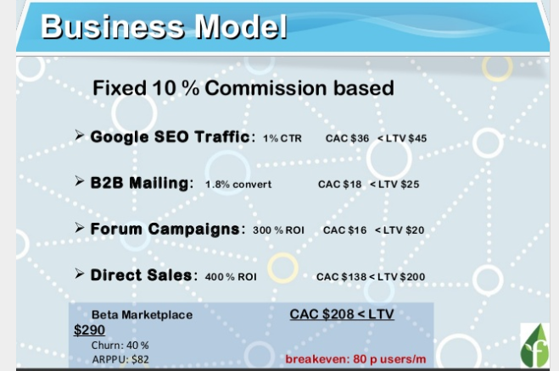
6. BUSINESS PROCESS EXAMPLE
Notes:
https://www.slideshare.net/marketingseo1/brandvertisor-startup-pitch-advertising-marketplace-to-match-advertiser-with-specific-publisher-through-detailed-and-complete-profiles-saas-bigdata-ads-adnetwork-58100069?qid=609518b9-77c4-41cb-b59a-803af15dbd97&v=&b=&from_search=11

Slide 16
7. PROJECT STATUS
DEVEOPMENT
MARKETING
OPERATION
FINANCING
TEAM LEGAL
IP

Slide 17
8. REGULATION
• Briefly discuss the regulatory pathway for approval

Slide 18
9. PRODUCTION
• Describe your current product development stage and what has been accomplished to date
• Describe the product development milestones and the timeframe you expect to reach these
• Understand what milestones have significant value inflection points for the company
• Can you scale the manufacturing? What are the obstacles? Do you need partners for that?

Slide 19
10. IP
If none, what stage are your patent applications?
Do you have exclusive license from the patent holder?
If IP is licensed, describe the terms
Who is your IP attorney?
Discuss any other types of protective measures that will help you be competitive

Slide 20
11. TEAM
Describe the current senior management team and their relevant background information
Show who are your advisors
- Be sure to have experts that can advise you in every critical area of the company and product development process
Describe your scientific advisory board members
Who else is on your team that will help ensure success?
Describe the positions that are missing from the leadership team, and what skills you are seeking and when do you anticipate to hire

Slide 21
12. FINANCE MODEL
Ideally, present a 5-year Pro Forma projection of revenue.
Show much money have you raised to date
Tell how much capital you anticipate needing and how many rounds to reach commercialization or an exit for investors
In broad general categories, describe the Use of Proceeds for the round you are raising

Slide 22
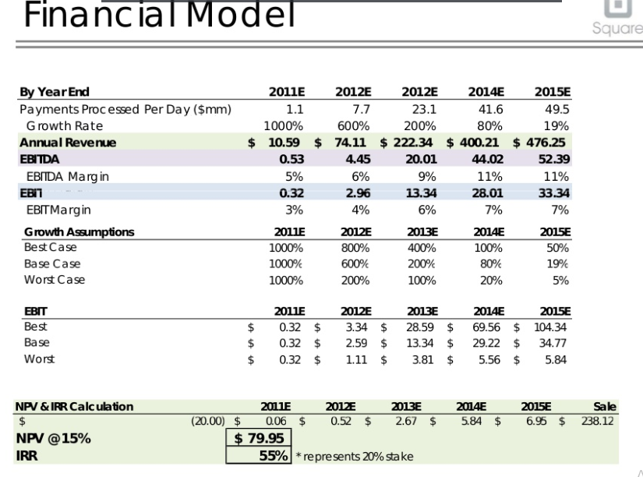
12. FINANCE MODEL EXAMPLE

Slide 23
13. EXIT STRATEGY
If acquisition, list your top 3 potential acquirers
Share how long you anticipate it may be before an investor exit
Provide data on exit valuation or revenue multiples for your sector
Share any contacts or preliminary interest from any potential partners or acquirers Is IPO is your exit strategy?

Slide 24
14. ROADMAP
• Describe your current product development stage and what has been accomplished to date
• Describe the product development milestones and the timeframe you expect to reach these
• Understand what milestones have significant value inflection points for the company
• Briefly discuss the regulatory pathway for approval
• Describe the milestone of finding product-market-fit, business development strategy

Slide 25
15. RISKS
You need to know and discuss risk issues and describe how you will mitigate these risks:
Any critical technology development risks
All regulatory issues and risks for your particular product
Any reimbursement issues
Major market issues for acceptance of your product
Anticipated intellectual property issues for protection
Competition risks and how these impact you company
Hiring certain key members and your ability to recruit the right team

Slide 26
16. SUMMARY
Summarize the points to you want the audience to remember when they walk away
The novelty of your technology and the unique opportunity of your product
A seasoned management team that has previous experience in successful start-ups
The shortened timeframe or reduced costs of your product development pathway
Your leveraged partnerships with significant experience in your
sector
Be sure to “connect-the-dots” for them
Thank You + Q&A

Slide 27
REFERENCES
Текст

Slide 28

Thank you for your attention.
www.ifmo.ru

