Slide 1
Splorrt – Final Presentation
Game design – Winter 2016 – Group 5

Slide 2
Player Rules
Traverse through the environment by moving on foot and via web
Manage your web resource
Avoid or fight enemies
Avoid traps
Finish levels

Slide 3
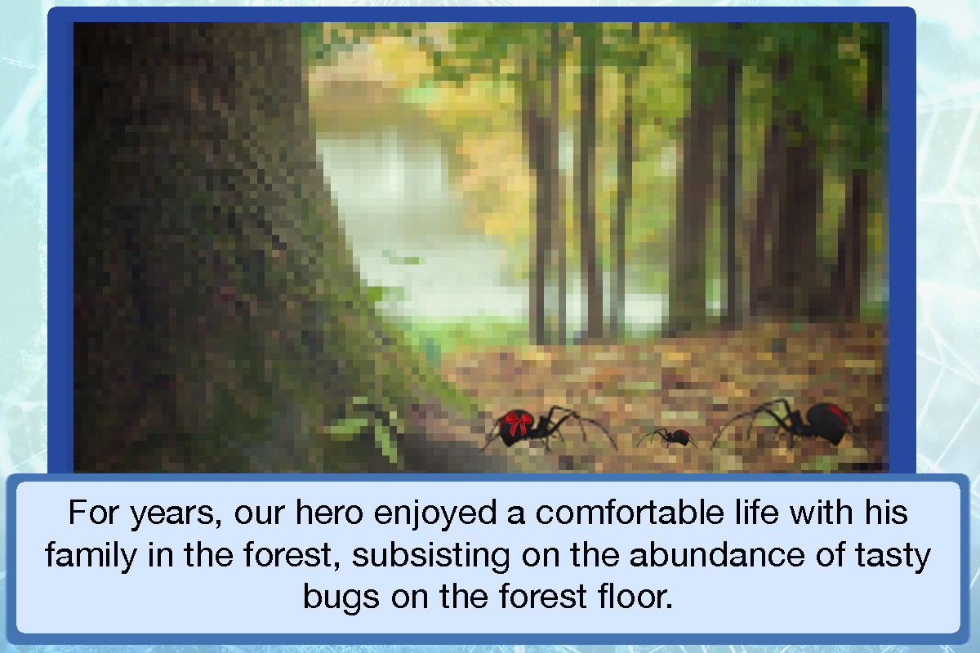
Story

Slide 4
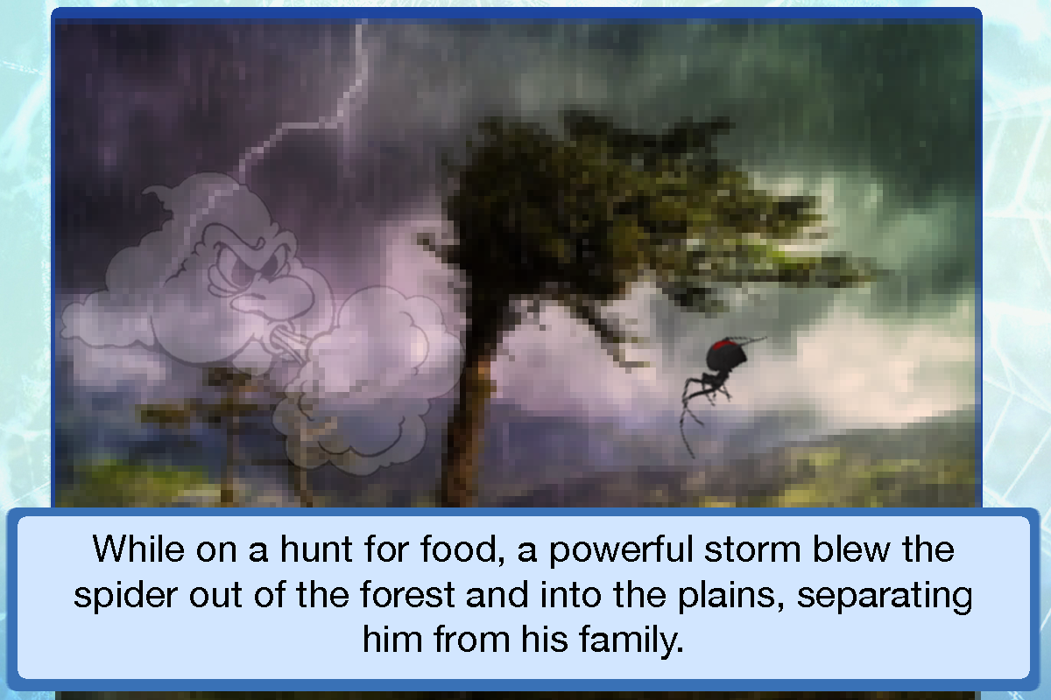
Story

Slide 5
Meaningful Play
Kill an enemy
You get rewarded with web resource!
Finish a level
The score will show you how well you did!
Explore hard to reach / hidden areas
You will find collectables to improve your score!
Choose your playstyle
You can speedrun it or go for a full 5 star run!

Slide 6
Core Mechanics
Health
Move/Jump
Shoot web
Score
Gravity
Levels
Collect web/coins
Shoot/stun enemies
Knockback

Slide 7
Feedback loops
If you die, progress saves! It will load the same level with the defeated enemies!
If you manage your web efficiently, you have more resources to be better prepared for future encounters!

Slide 8
Prototype Demonstration

