Slide 1


Slide 2
Hello Human, my name is Mbpchen. I am a smart robot. Nice to meet you!
It is great that you have jointed me to learn IoT which can help us to save the environment! I hope at the end of this journey you have learned a little more about the IoT world and you continue using it. ☺
IoT devices can be also called smart devices as well and you will see they are in everywhere. It will be an amazing journey!

Slide 3
I would like you to remember that this system is just a prototype for testing gamification concepts for learning in IoT, the Internet of Things.
A prototype is an early sample, model, or release of a product built to test a concept or process. I know, I am a robot and everything should be automatic already, but even me have started as a prototype. Do you want to see how I was born?

Slide 4
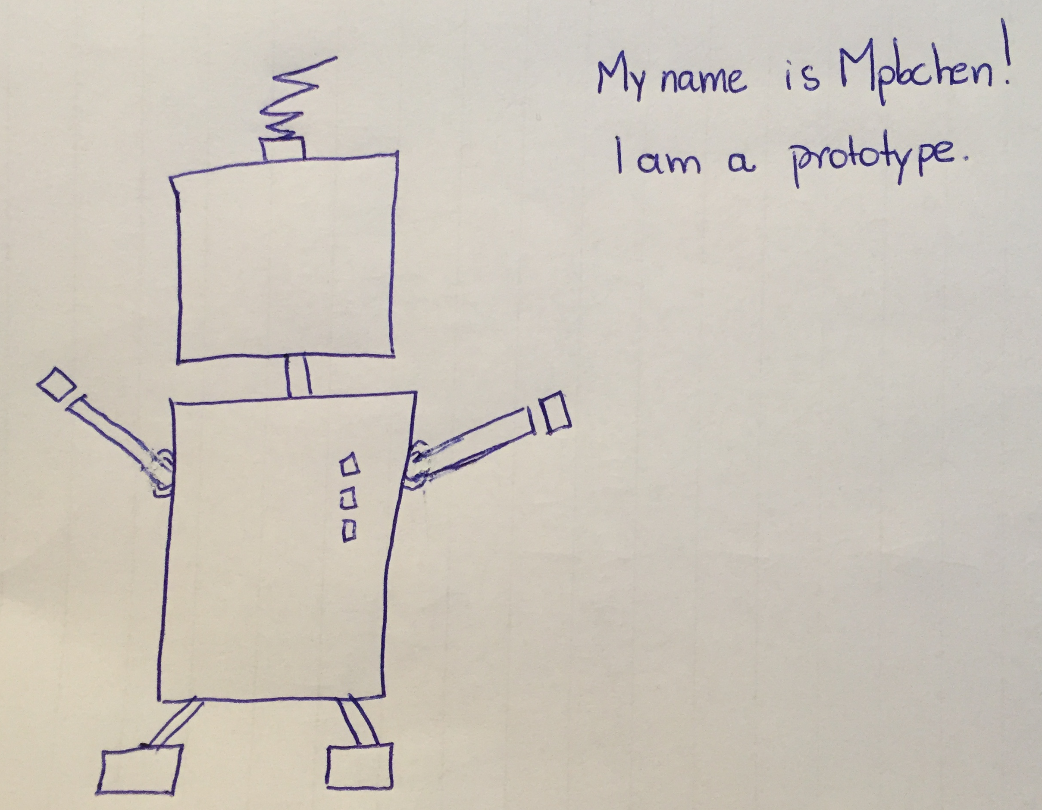
I was a bit out of touch with current trends and my body without curves, right? Look now how I am amazing! All systems start as a prototype, in paper (as me) or simple as this system without many feature and no automatized actions.
After you test it, you can tell me if I should invest time to implement a real system to help the environment and save my dear Humans!

Slide 5
So stop the talk and let's start!
In this journey you will learn basic IoT concepts and install an IoT device that will control your home heater, whenever your room temperature is above 20 degrees, the heater will be automatically turned off. This will reduce energy use, consequently help the environment and protect the humanity!
Throughout this journey, you will collect (bars of gold) which you will be able to acquire actions or objects that will really help the world. I recommend that you take a peek at the store and see what are the prizes. Here's the tip: if you do ALL the challenges, your maximum number of points will be 4300.

Slide 6
Our journey will have 3 level:
1
You will learn about general IoT concepts
2
You will learn technical concepts of how to implement an IoT device
3
You will create the rule to control of your heater automatically and save energy!

Slide 7
We are testing the bellow elements from our system, not all are implemented already:
Points
Accumulated points. Every task and quiz increase your points!
Store
You will be able to acquire good in the end of the game! Accumulate as many points as possible!
Progress
Level you have reached so far
Quest
Here you will find your tasks and quizzes! Follow this list and every time you finish it, click in done!

Slide 8
So we have a deal! Let’s save the environment to help my dear Humans!
See you in Task 1.2!
Bye Bye!
You will collect 100 points to finish Task 1.1
Notes:
100

