Slide 1


Slide 2
Woww you are in the last task to become a Intermediate IoT Expert. I am so proud of you, Human. You are learning so fast!
Now we will connect our sensor to our operator and device!

Slide 3


To register a new sensor in MBP, you will need to connect an extraction operator to a device, then you will be able to collect data from your Sensor.
Device
Sensor
Actuator
Extraction
Operator
Device collect the data from the sensor frequently
Device collect the data from the sensor frequently
Light sensor detects there is NO luminosity, which means it is night
Light sensor detects there is NO luminosity, which means it is night
Device sends the data to MBP
Device sends the data to MBP
MBP

Slide 4
Step by Step
In the Main Navigation, select Sensor
Press add new Sensor
Fill the required data:
Sensor Name: Include the sensor name in your environment, XXX.
Sensor Type: The sensor type is used to measuring one of the physical properties like Temperature, Resistance, Capacitance, Conduction, Heat Transfer etc. Choose the device type XXXX
Select extraction operator: Choose the operator you want to connect. XXXXX.
Select a device: Choose the device you want to connect to the operator. XXXX

Slide 5
Now you need to check if the sensor registration is working.
The State from sensor XXX needs to be „Ready“ which means the Sensor is ready for installation, device is available and correctly configured.
If you want to know more about States, or more technical details, you can always check our Wiki!

Slide 6
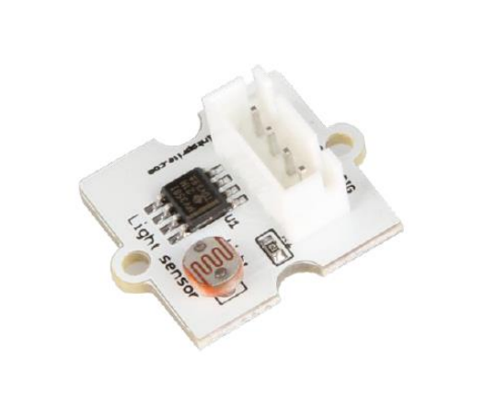
Sensor Light
xxxxx

Slide 7
Great, now you are a Intermediate IoT Expert!
Let’s try the Level 2 Quiz? I am sure you will do it well!
You will collect 200 points to finish Task 2.4
Notes:
100

