Slide 1


Slide 2
Hello Human, my name is Mbpchen. I am a smart robot. Nice to meet you!
It is great that you have joined me to learn IoT, which can help us to save the environment! I hope at the end of this journey you will have learned a little more about the IoT world and will continue using it. ☺
IoT devices can also be called smart devices and, as you will see, they are everywhere. It will be an amazing journey!

Slide 3
I would like you to remember that this is only a prototype to test gamification concepts for learning IoT, the Internet of Things.
A prototype is an early sample, model, or release of a product built to test a concept or process. I know, I am a robot and everything should already be automatic, but even I have started as a prototype. Do you want to see how I was born?

Slide 4
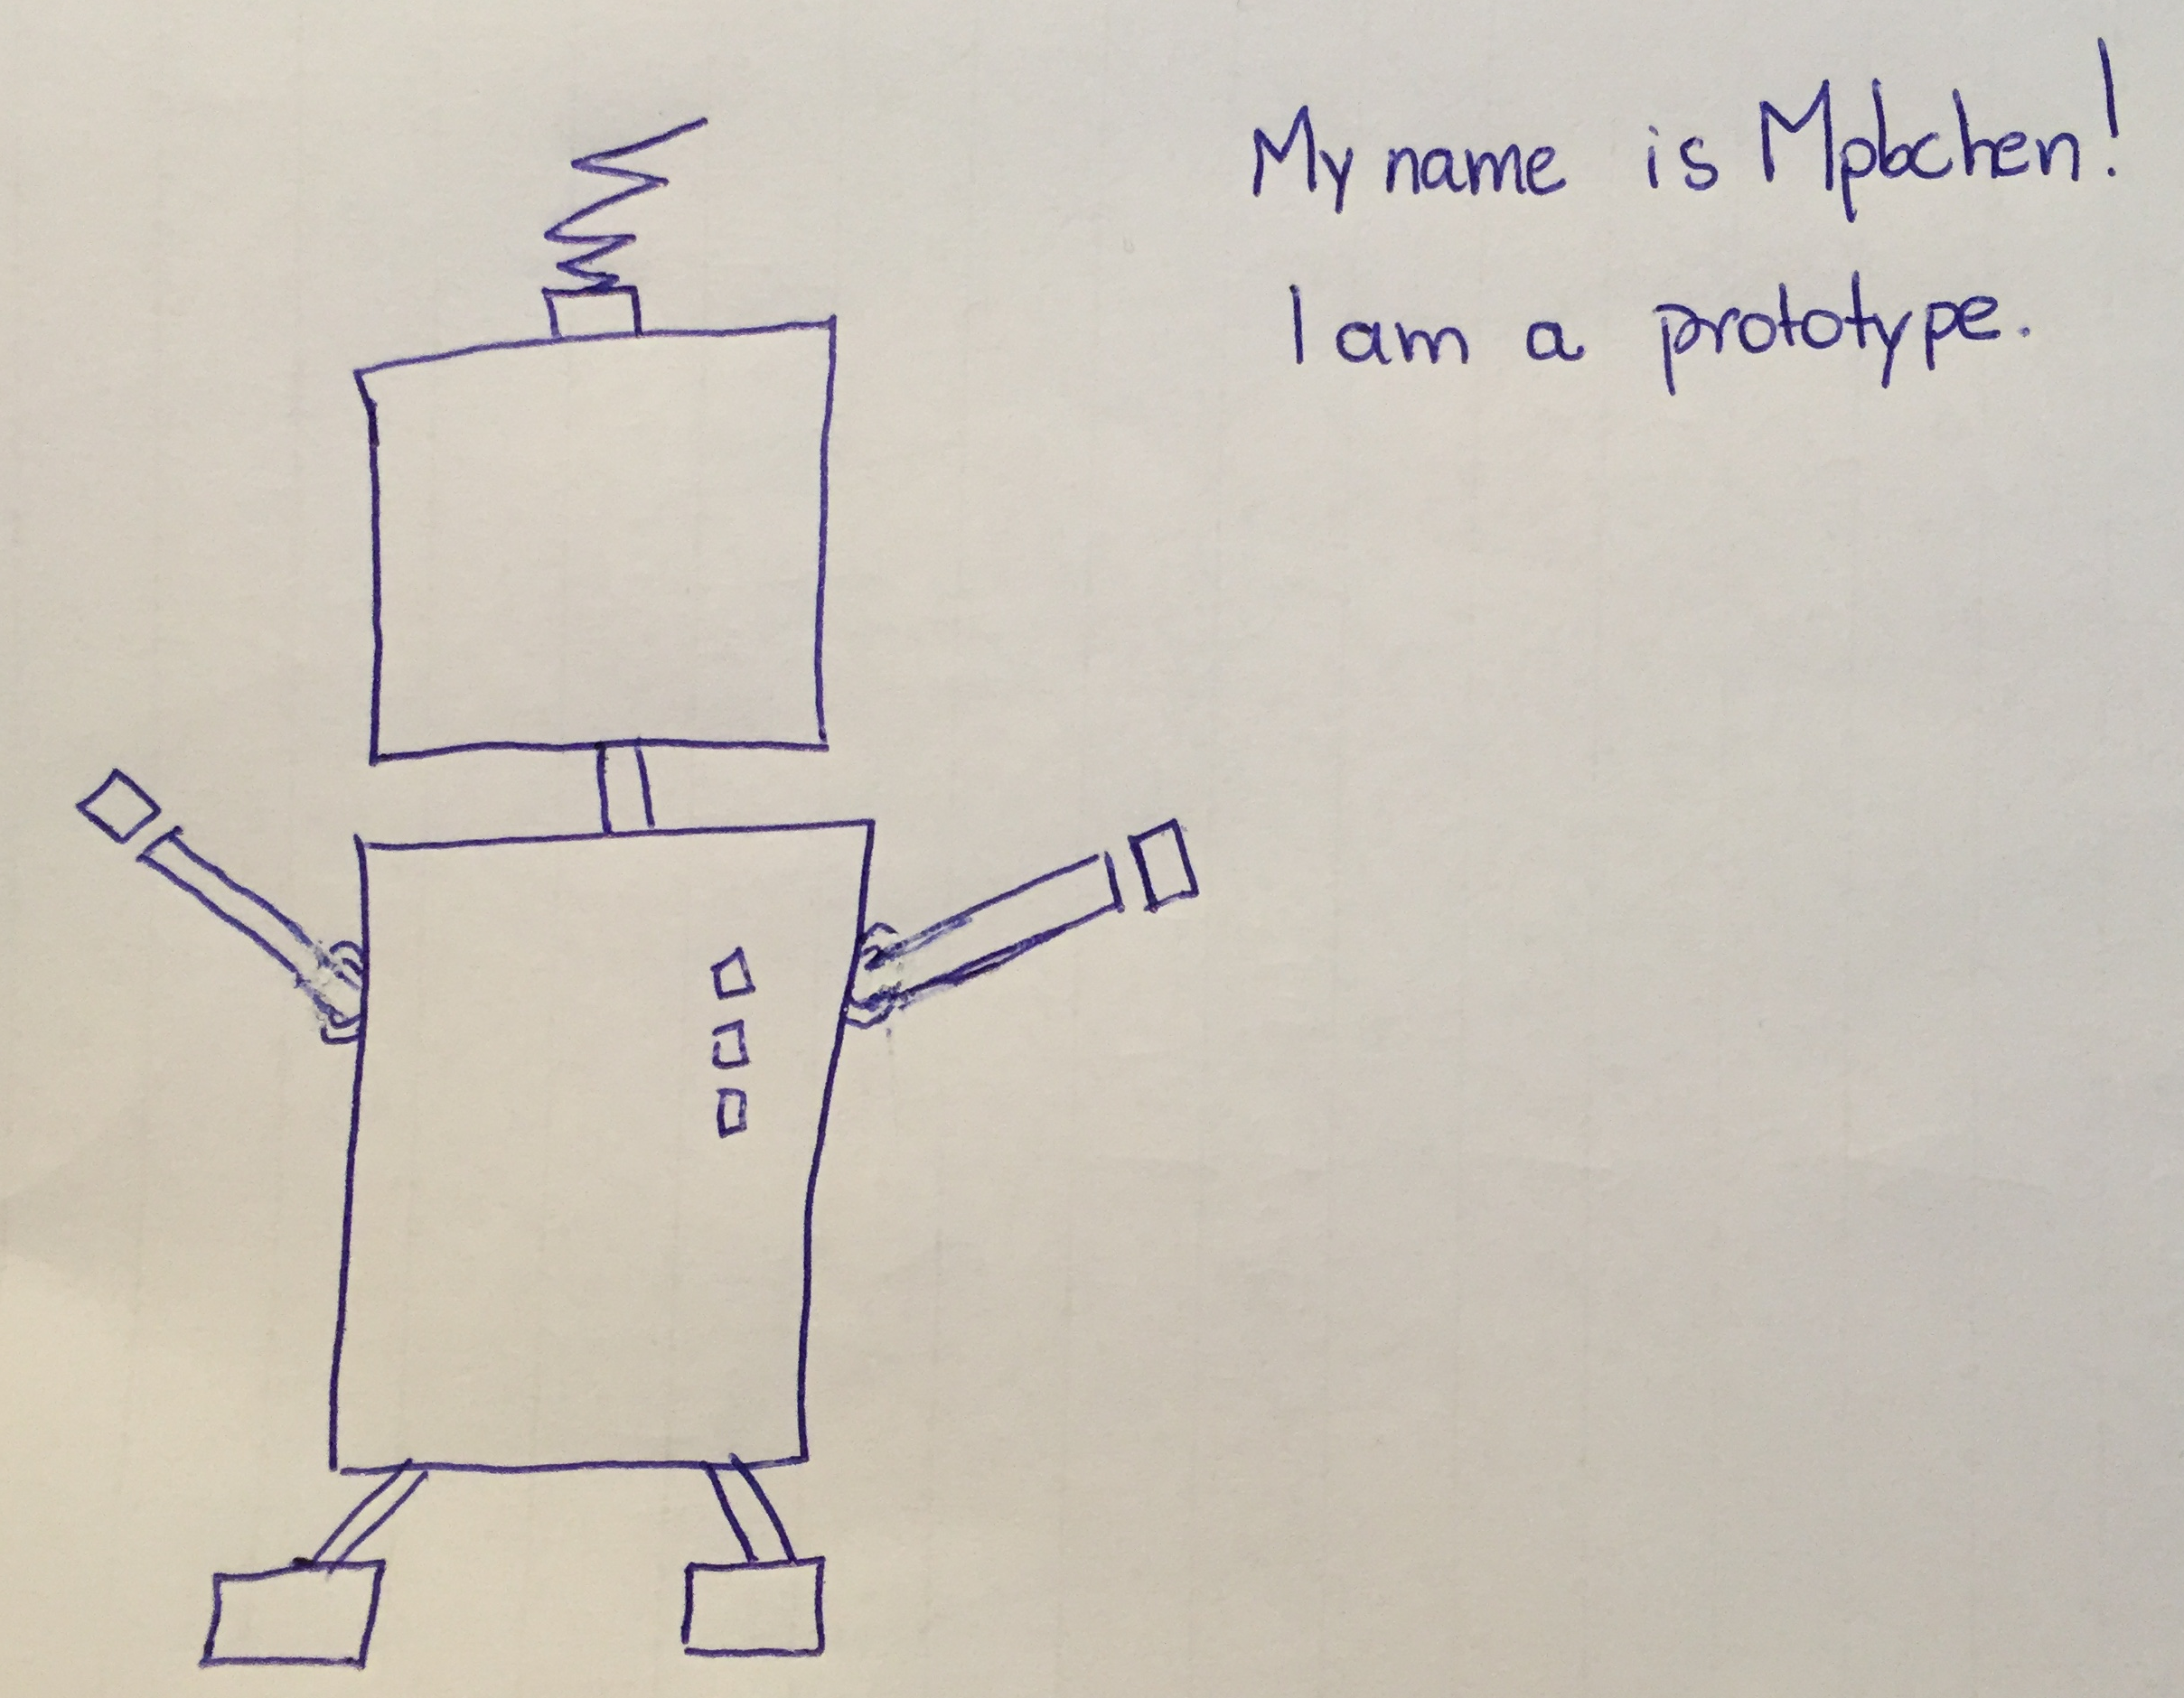
I was a bit out of touch with current trends and my body had no curves, right? Look now how I look amazing! All systems start as a prototype, in paper (as myself), or as simple as this system, without many features and no automated actions.
After you test it, you can tell me if I should invest time to implement a real system to help the environment and save my dear Humans!

Slide 5
So let’s stop talking and get things going!
In this journey, you will learn basic IoT concepts and install an IoT device that will control your home’s heater. Whenever your room temperature is above 20 degrees, the heater will be automatically turned off. This will reduce energy use, consequently helping the environment and protecting humanity!
Throughout this journey, you will collect (gold bars) which you let you acquire actions or objects that will really help the world. I recommend that you take a peek at the store and see what are the prizes. Here's a tip: if you do ALL the challenges, your maximum number of points will be 4300.

Slide 6
Our journey will have 3 levels:
1
You will learn about general IoT concepts
2
You will learn technical concepts of how to implement an IoT device
3
You will create the rule to control your heater automatically and save energy!

Slide 7
Since not all elements in our system are already implemented, we are testing only the following:
Gold bars
Accumulated gold bars. Every completed task or quiz increases your bars!
Store
You will be able to buy items at the end of the game! Accumulate as many gold bars as possible!
Progress
Level you have reached so far
Quest
Here you will find your tasks and quizzes! Follow this list and every time you finish one task or quiz, click on done!

Slide 8
So we have a deal! Let’s save the environment to help my dear Humans!
See you in Task 1.2!
Bye Bye!
You receive 100 bars for finishing Task 1.1
Notes:
100

