Slide 1


Slide 2
Wow! You are in the last task to become an Intermediate IoT Expert. I am so proud of you, Human. You are learning so fast!
Now we will connect our sensor to our operator and device!

Slide 3


To register a new sensor in MBP, you will need to connect an extraction operator to a device. Then you will be able to collect data from your sensor.
Device
Sensor
Actuator
Extraction
Operator
Device collects the data from the sensor frequently
Light sensor detects there is NO luminosity, which means it is night
Light sensor detects there is NO luminosity, which means it is night
Device sends the data to MBP
Device sends the data to MBP
MBP

Slide 4
Step by Step
In the Main Navigation, select Sensor
Press add new Sensor
Fill the required data:
Sensor Name: Include the sensor name in your environment, XXX.
Sensor Type: The sensor type defines which physical property is measured, such as Temperature, Resistance, Capacitance, Conduction, Heat Transfer etc. Choose the device type XXXX
Select extraction operator: Choose the operator you want to connect. XXXXX.
Select a device: Choose the device you want to connect to the operator. XXXX

Slide 5
Now you need to check if the sensor registration is working.
The State of sensor XXX needs to be “Ready“, which means the Sensor is ready for installation, and the device is available and correctly configured.
If you want to know more about States, or more technical details, you can always check our Wiki!

Slide 6
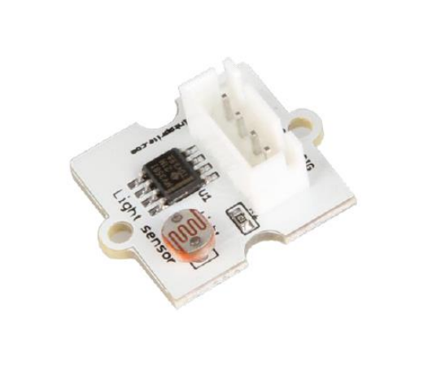
Sensor Light
xxxxx

Slide 7
Great, now you are an Intermediate IoT Expert!
Let’s try the Level 2 Quiz? I am sure you will do it well!
You receive 200 bars for finishing Task 2.4
Notes:
100

Slide 8
Quiz 2
Congratulations! You have finished the second level. Now you can say you are an Intermediate IoT Expert.
Let’s test what you have learned? You will have the chance to get more gold bars and buy more things in the store.
Play and win
+ 200 points
Play and lose
- 200 points
Do not play
No points
To win, you need to accomplish 50% of the test. I am sure you will do it easily! Let’s go? ☺

