Slide 1





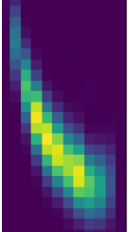









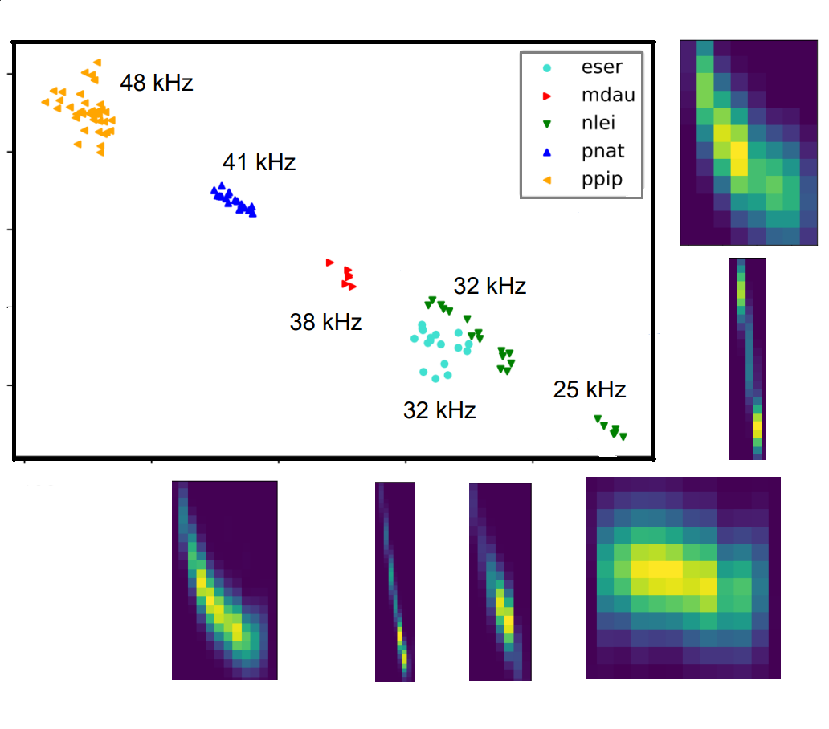

Bats Unmasked
Acoustic monitoring of bats with self-organizing maps
Arne Deloose
Intro
Echolocation
Bat monitoring challenges:
Not enough data. 20 % of species are ‘Data Deficient’ (IUCN)
Flying + nocturnal=> not many techniques
Acoustic possible, but experts needed to label=> expensive
Labeled data available only for common bats
Our research:
Extrapolate: common→ rare species
Focus on differences
Bats emit sounds, listen to echoes=>map environment
Different bat= different sound => monitoring
Ultrasound=> high freq. microphone (bat detector)
Sounds:
Played back (at slower speed)
Save on PC, convert to spectrogram and analyze
Bat detector
Frequency
Time
Why do bats matter?
Mapping bat sounds
Biodiversity
Predator of insects
Insects=> crop damage
Without bats, pesticides needed=> expensive and harmful to environment
American study (Boyles et al, 2011): 53 billion dollars per year in extra pesticides (in US)
Normal problem: new sound→ check reference library
Problem: library is lacking
Solution: model differences instead.
Find features and give them appropriate weight
Expectation: differences can be extrapolated
Unknown species=> far away from known species=> easy to find
Technique: semi supervised
Supervised distance modelling
Unsupervised clustering with distance
Important features
Real data from five bats
Model: distance between groups small, within group large
‘Emergence’: natural pattern forming
Primary pattern: average frequency across diagonal
Secondary pattern: shape (eser and nlei)
Social calls of nlei classified as separate group (25 kHz)
Location of new sound can be predicted
Conclusion
No formal classification
Clear patterns emerged
Dominant feature: average frequency
Secondary feature: shape
Differences can be generalized to new species.
New bat
45 kHz
Notes:
1

