Slide 1

Probabilistic Data Structures for In-Memory Databases
Master’s Thesis Defense (15.06.2018)
Arne Mayer Matthias Uflacker, Martin Boissier, Jan Kossmann
Notes:
Motivation liegt in Beobachtungen, die in zwei Artikeln aus 2015 und 2017

Slide 2
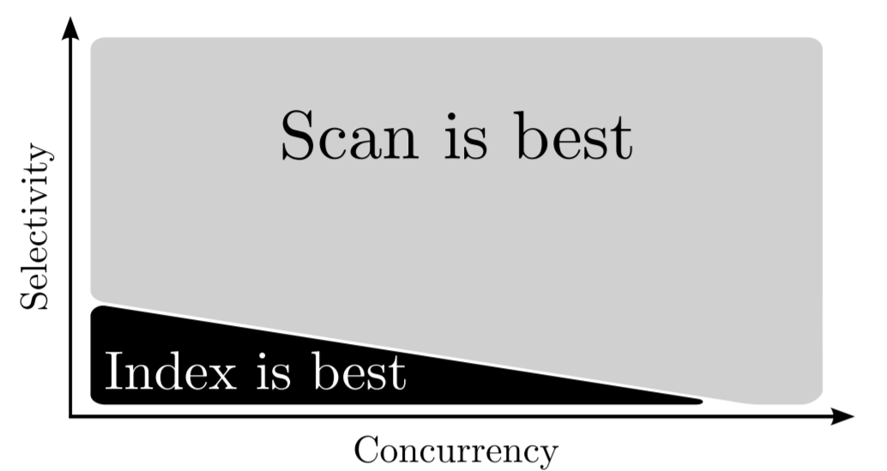
Indices Are Not Obsolete
Linear scans have become more efficient in columnar in-memory systems
Index probes still faster for low selectivity queries [1]
Desired: an alternative with a lower memory consumption
Figure taken from [1]
[1] Kester, M. S., Athanassoulis, M., and Idreos, S. Access path selection in main-memory optimized data systems: Should I scan or should I probe? SIGMOD 2017, pp. 715–730.
* „By the selectivity of a predicate p, we mean, as usual, the fraction of rows in the table that satisfy p.” Markl, V., Megiddo, N., Kutsch, M., Tran, T. M., Haas, P. J., and Srivastava, U. Consistently estimating the selectivity of conjuncts of predicates. In VLDB 31 (2005).
Notes:
Prägnant
In-Memory -> Faster Scans
Disk Latenzzeiten spielen keine Rolle mehr
Indices are less beneficial than before
But: Index Probe still faster in some cases
Indices provide a high probe performance
There is still room for improvement
In-Memory Scan kann optimiert werden
However, memory consumption is high
Gesucht ist eine Alternative mit weniger Speicherverbrauch

Slide 3
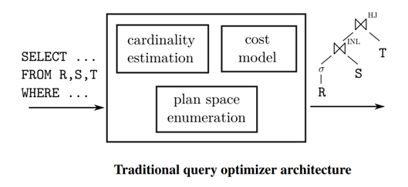
Cardinality Estimations Are Inaccurate
Cardinality estimations have a large impact on query performance
Cardinality estimators of commercial database systems produce large errors [2]
Figure taken from [2]
[2] Leis, V., Gubichev, A., Mirchev, A., Boncz, P. A., Kemper, A., and Neumann, T. How good are query optimizers, really? PVLDB 9, 3 (2015), 204–215.
Notes:
Leis und andere haben 2015 Cardinality Estimators in kommerziellen Datenbanken untersucht
Und festgestellt, dass CEs regelmäßig große Fehler produzieren
Problem denn:
CEs werden zusammen mit Kostenmodell bei der Query Optimierung genutzt um den schnellstmöglichen Plan zu finden
Falsche CEs führen zu suboptimalen Query Plänen
Leis: CEs haben großen Einfluss auf Systemperformanz
Hyrise nur uniform estimation -> könnte von besseren CEs profitieren
Hyrise: Uniform Assumption

Slide 4
Two Opportunities for Improvement
Scan performance could be improved
Cardinality estimations could be improved
Proposal: use counting filters
Notes:
-Zwei Möglichkeiten für Verbesserungen die zu Performancesteigerung führen können
-Scan Laufzeiten verbessern
-Kardinalitätsschätzungene
-Eine Datenstruktur, mit der beides bewerkstelligt werden kann
-Fählende Filter
Compact approximate representation of column data
Answers membership queries in O(1)

Slide 5
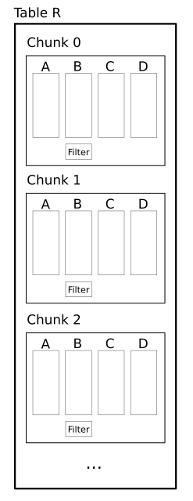
Concept
Create a counting filter for every chunk of a column
Approximate membership query
Eliminate chunks from query plan before execution
Filter probes in O(1)
Query optimization
Improve selectivity estimations with approximate counts
Notes:
Filter in Hyrise
In Operator
In Query Optimizer
Schnittstelle in Hyrise
Interval Maps?
TODO
Chunk layout
Immutable chunks
Was heißt approximate?
Beispiel?
Interval Tree?
Visualisierung
By the selectivity of a predicate p, we mean, as usual, the fraction of rows in the table that satisfy p.

Slide 6
Table R
Chunk 0
A
B
C
D
Filter
Chunk 1
A
B
C
D
Filter
Chunk 2
A
B
C
D
Filter

Slide 7
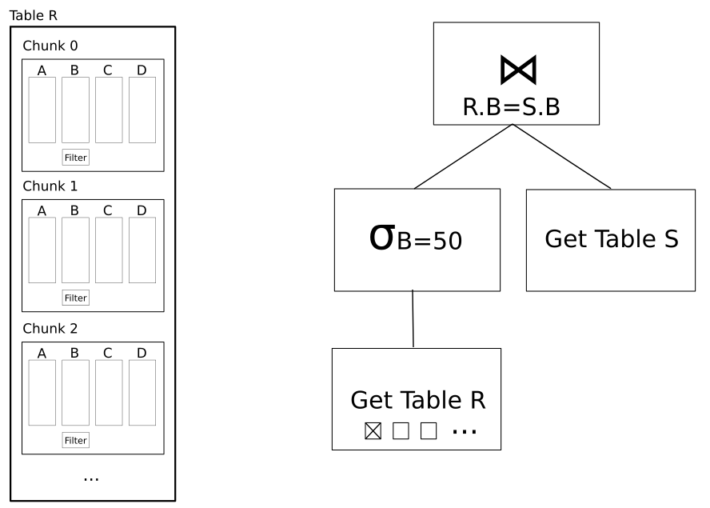
Concept
Notes:
TODO: Mit Animation
Get Table streichen
In Powerpoint

Slide 8
Research Questions
How much performance can we gain with pruning filters and what are favorable and unfavorable scenarios for chunk pruning?
How do counting filters perform against traditional cardinality estimation techniques in commercial database systems?
How do filters perform on real-world ERP data with skewed data distributions?
Notes:
Query Performance and Selectivity Estimation
-Drei Punkte
- Are these requirements realistic for enterprise data?

Slide 9
Related Work
1970
2000
2012
2014
2017
Bloom Filter [3]
Counting Bloom Filter [4]
Quotient Filter [5]
Cuckoo Filter [6]
Counting Quotient Filter [7]
CQF offers counting, good read performance, accuracy, and flexibility
This data structure was employed for my studies
[3] Bloom, B. H. Space/time trade-offs in hash coding with allowable errors. Commun. ACM 13, 7 (1970), 422–426.
[4] Fan, L., Cao, P., Almeida, J. M., and Broder, A. Z. Summary cache: a scalable wide-area web cache sharing protocol. IEEE/ACM Trans. Netw. 8, 3 (2000), 281–293.
[5] Bender, et al. Don’t thrash: How to cache your hash on flash. PVLDB 5, 11 (2012), 1627–1637.
[6] Fan, B., Andersen, D. G., Kaminsky, M., and Mitzenmacher, M. Cuckoo filter: Practically better than bloom. CoNEXT 2014, Sydney, Australia, December 2-5, 2014, pp. 75–88.
[7] Pandey, P., Bender, M. A., Johnson, R., and Patro, R. A general-purpose counting filter: Making every bit count. SIGMOD 2017, pp. 775–787.

Slide 10
Counting Quotient Filter (CQF)
Membership Query
False positives possible
Counting
Overcounts possible
No undercounts
Configuration
Filter size depends on number of slots and slot size
Notes:
Erklären?

Slide 11
Column Encodings in Hyrise
Dictionary-compressed columns
Chunk pruning already possible via dictionary lookup
Filter probe not that much faster than dictionary lookup
Run-length / frame-of-reference encoded columns
Value columns
No dictionaries for chunk pruning present
Scan runtime can be improved

Slide 12
Evaluation
Synthetic data
Configurable maximum pruning rate, data type, and data distribution
Benchmark data sets
TPC-C
TPC-H
JCCH [8]
Real-world ERP data
ACDOCA (accounting data from an SAP system) [9]
[8] Boncz, P., Anatiotis, A., and Kläbe, S. JCC-H: adding join crossing correlations with skew to TPC-H. In Performance Evaluation and Benchmarking for the Analytics Era - TPCTC 2017, Munich, Germany (2017).
[9] SAP SE. Universal Journal Entry. https://help.sap.com/doc/3c51d7531a4d424de10000000a174cb4/2.6/en-US/182f4f55ed6d6154e10000000a423f68.html, (2017). Accessed: June 14, 2018.
Notes:
Paper cites
Synthetic Data
Pruning rate, data type and byte width, data distribution
Benchmarks
TPC-C
TPC-H
JCCH¹⁰
Real world enterprise data
ACDOCA (Accounting Data from an SAP system)

Slide 13
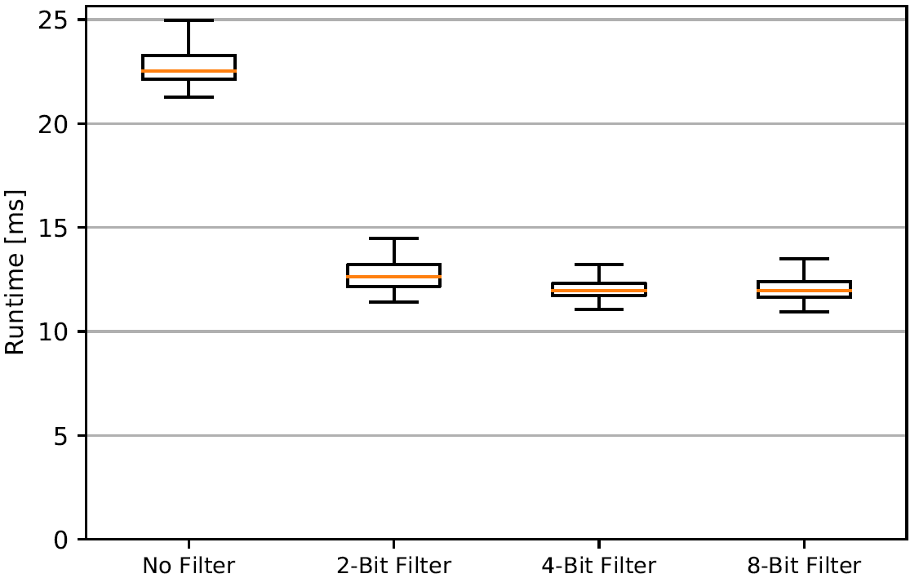
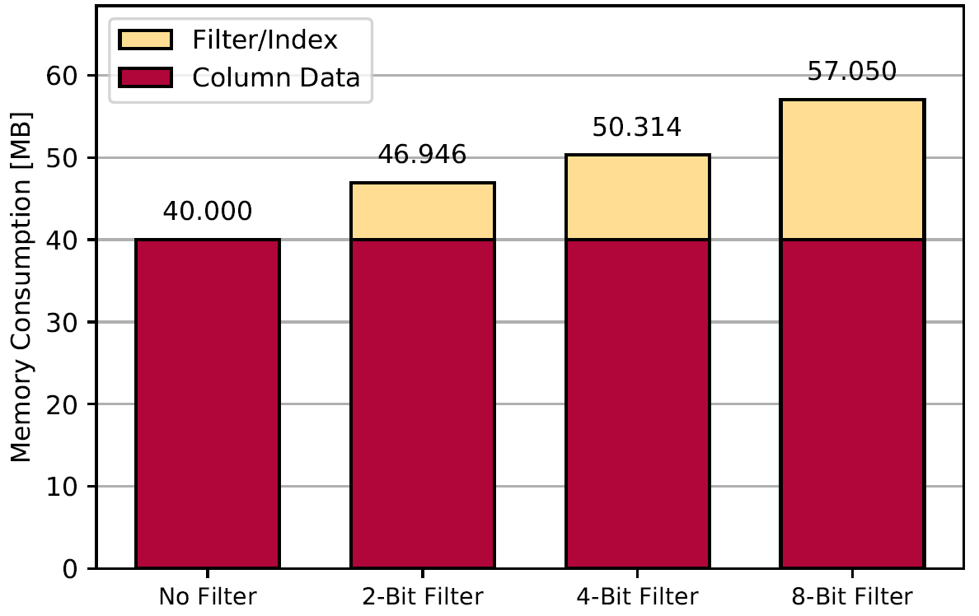
Chunk Pruning on Synthetic Data
Scan performance with different filter configurations
10M integers, 100K chunk size, 50% maximum pruning rate
Scan Runtime
Memory Consumption
Notes:
TODO
What is pruning rate?
Filter vorher erklären
Configurability erklären
String länge?

Slide 14
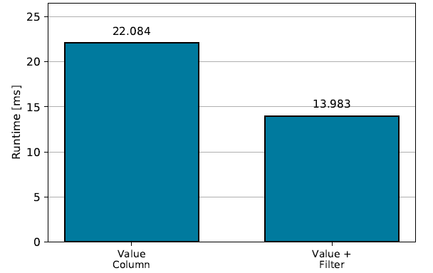
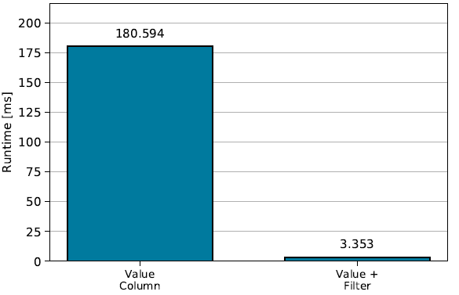
Results on Benchmark Data
On some columns we can prune well, on others we can not
Tests with a chunk size of 100K
TPC-C Order-line item-ID Scan Runtime
(40% Pruning Rate)
TPC-H Line-Item Ship Date Scan Runtime
(98% Pruning Rate)

Slide 15
ACDOCA
SAP accounting data
Chunk size 100K, 10M rows
CO_BELNR and BELNR are some of the most queried columns and show a high pruning rate
Some columns show no pruning opportunities
Column | Pruning Rate
BELNR | 98,8%
AWREF | 98,7%
DOCNR | 98,6%
CO_BELNR | 75,2%
HSL | 57,2%
TSL | 47,7%
Notes:
BELNR – Belegnummer
AWREF – Reference Document Number
DOCNR – Document Number
CO_BELNR – Controlling Document Numbere
HSL – Value in local currency
TSL – Value in transaction currency
BELNR:
Beginnt neu für:
-Company Code
-Geschäftsjahr

Slide 16
When Do We Achieve High Pruning Rates?
Two types of scenarios
Low selectivity predicate scans
Scans on implicitly clustered or sorted data
Time clustered data leads to a high pruning rate
Tuples are inserted around the time of creation
Dates mostly revolve around tuple creation date
Table is implicitly sorted by time
Notes:
Implicitly clustered -> morkoette
TODO
Besser erklären

Slide 17
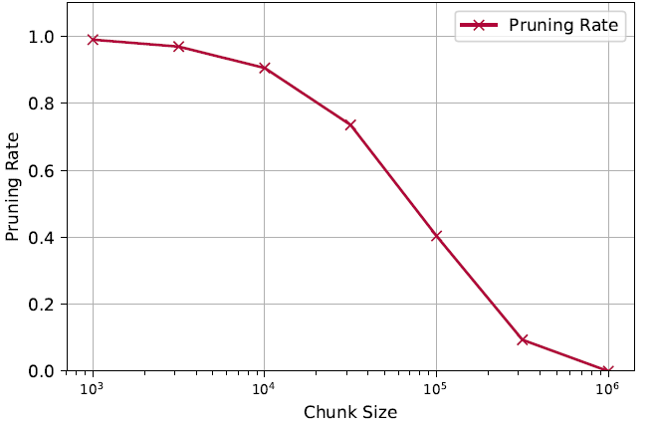
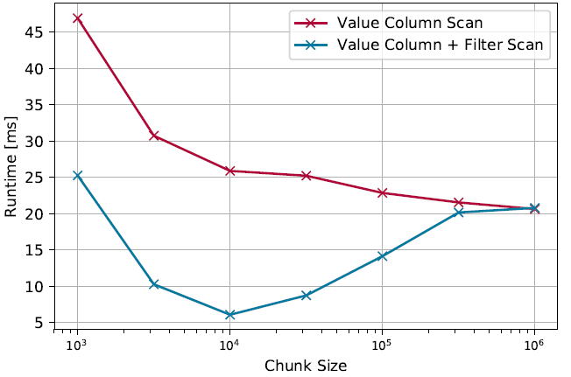
Chunk Size and Pruning Rate – Low Selectivity
Scans on the TPC-C Item-ID column show a low selectivity
The chunk size is an important factor for scan performance
Pruning Rates
Scan Runtime
Notes:
Row Count
-Nur für diese Datenverteilung und Tabellengröße
-Selektivität: 1 zu 100000
Hyrise: 100k bis 1M
HyPer: 64K
Vora: wenige dutzend MB

Slide 18
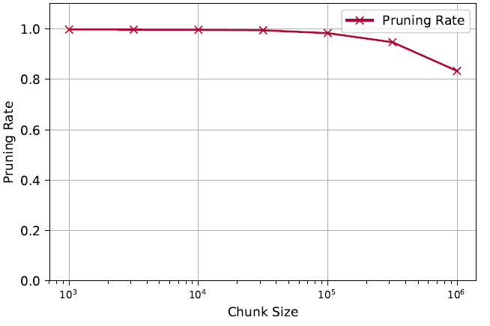
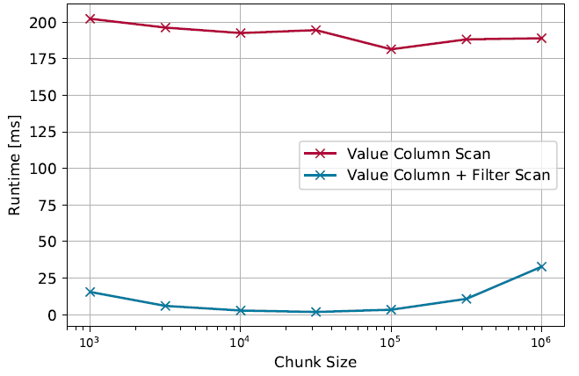
Chunk Size and Pruning Rate – Clustered Data
JCCH Shipdate column scan
Clustered data shows a higher range of beneficial chunk sizes
Pruning Rates
Scan Runtime
Notes:
Warum nicht Min/Max:
-Lücken
-Min/Max funktioniert

Slide 19
CQFs for Chunk Pruning - Discussion
Advantages
Smaller memory consumption than an index
Flexible and scalable data structure
Disadvantages
Performance gain depending on data distribution
Alternative filters’ memory footprint can be reduced further (with decreasing accuracy)
Filter construction overhead has to be considered
Notes:
-Ausreißer tun nicht weh
-Nicht angewiesen auf glatten Werteverlauf
2/4 Million inserts pro Sekunde
One time investment Vs. Reocurring runtime savings

Slide 20
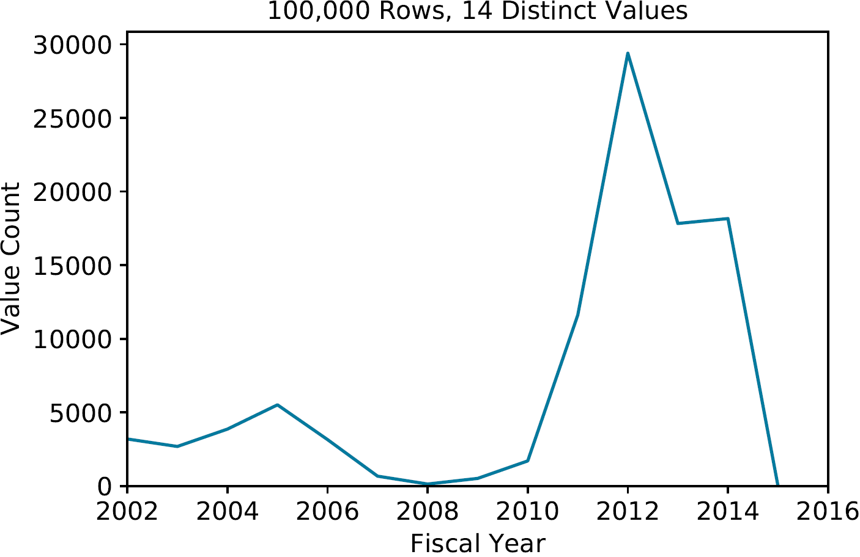
Cardinality Estimation – Two Birds With One Stone
Cardinality Estimators are not as accurate as we would like
CQFs not only store membership information but approximate value counts as well
These counts can be used to improve cardinality estimations
Value Distribution of ACDOCA Fiscal Year Column
Notes:
TODO
Beispiel?
Wie abholen?

Slide 21
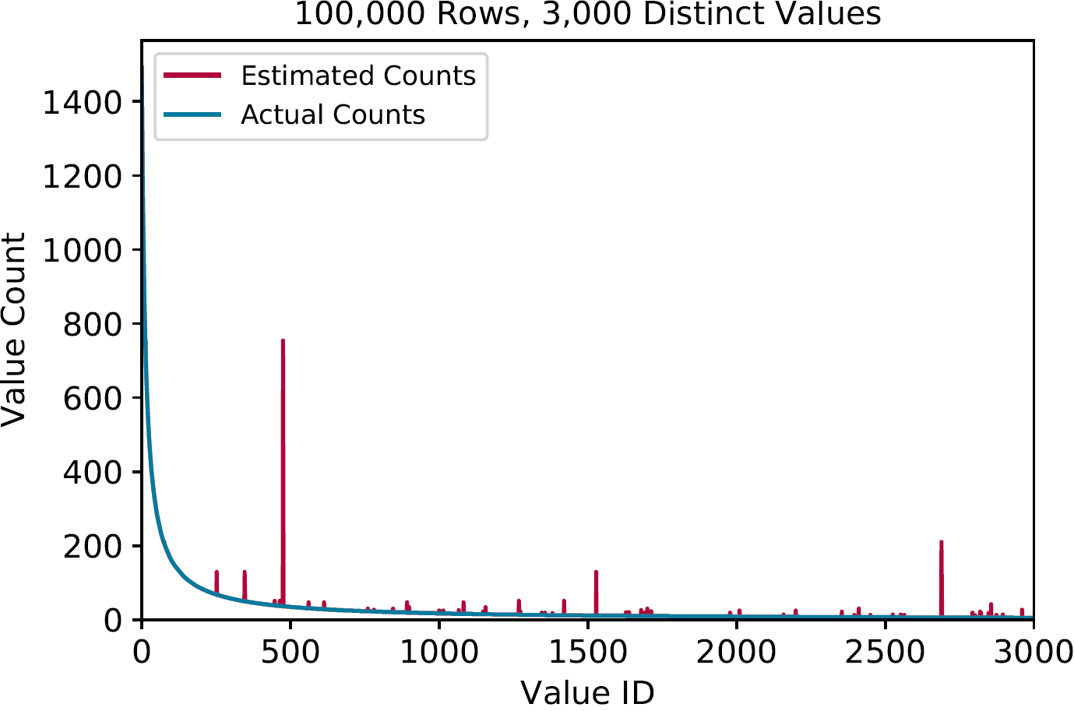
Using Filters for Cardinality Estimation
CQFs return the accurate value count most of the time (>95%)
Hash collisions cause overcounts
Undercounts are not possible
Overcounts are rare but can be large
Filter Estimation Errors on Zipfian Distributed Data

Slide 22
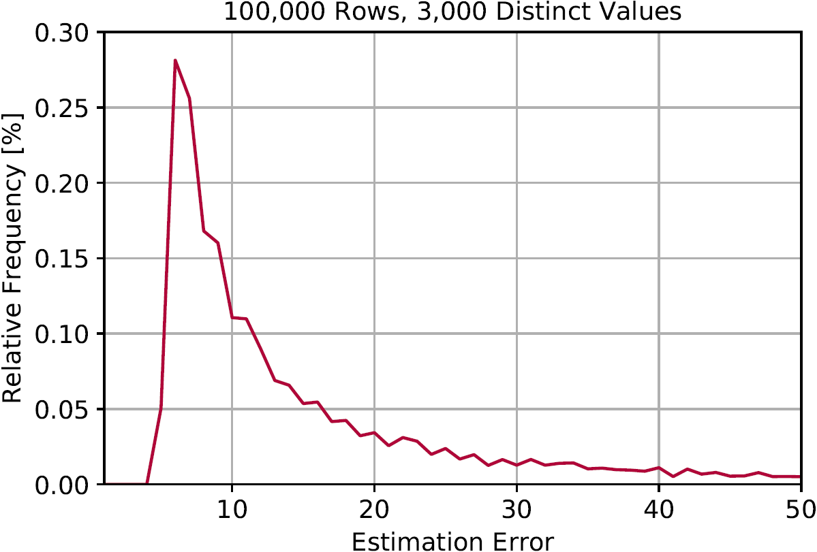
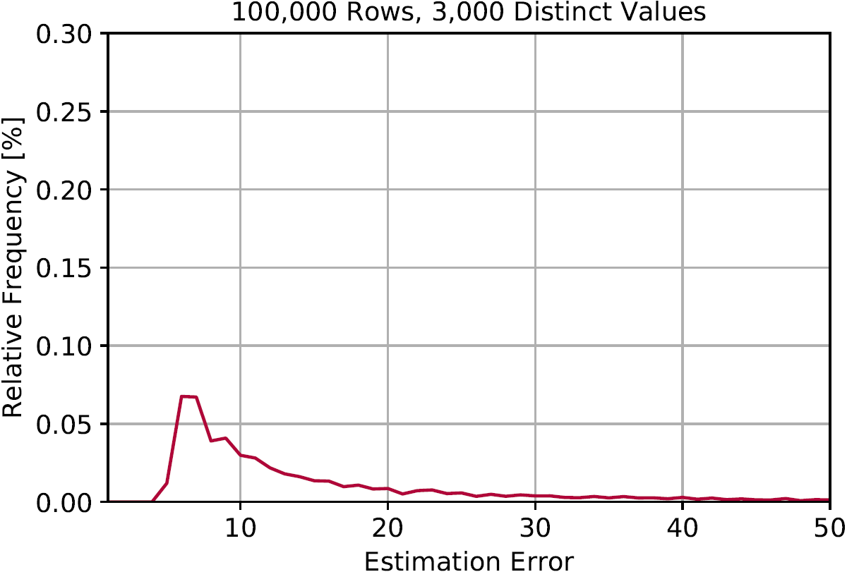
More Memory – Less Errors
Estimation Errors – 2 Bit Slots
Estimation errors and their relative frequency
Error frequency decreases with higher memory expenditure
Error distribution has the same shape but errors are less likely
Estimation Errors – 4 Bit Slots
Notes:
-Filtergrößen bereit halten
-Hier sehen wir die Schätzfehlergrößen und deren relative Häufigkeit
-Einmal mit einem Filter mit 2 Bit Slots und mit 4 Bit slots
-Auch für genaue Filter können größere Schätzfehler auftreten
-Diese Fehler sind nur weniger wahrscheinlich
-Cardinalitätsschätzungen meistens korrekt
-kleinster Filter bereits 95-98% korrektheit
-Große Überschätzungen können auftreten

Slide 23
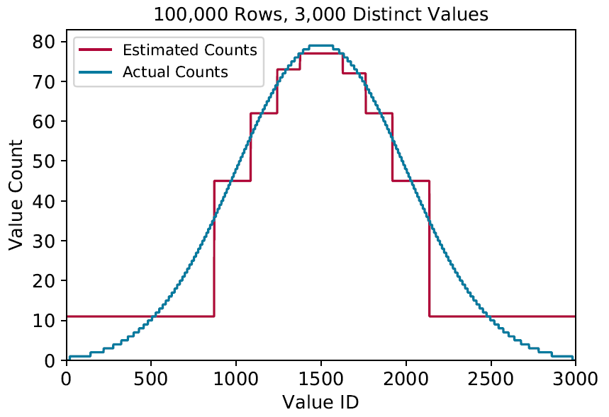
What About Conventional Techniques?
Selectivity estimation in PostgreSQL [12]
Uniform estimation
Histograms
Most common values
Low memory footprint techniques
[10] The PostgreSQL Global Development Group. Row Estimation Examples. https://www.postgresql.org/docs/9.1/static/row-estimation-examples.html, 2016. Accessed: June 14, 2018.

Slide 24
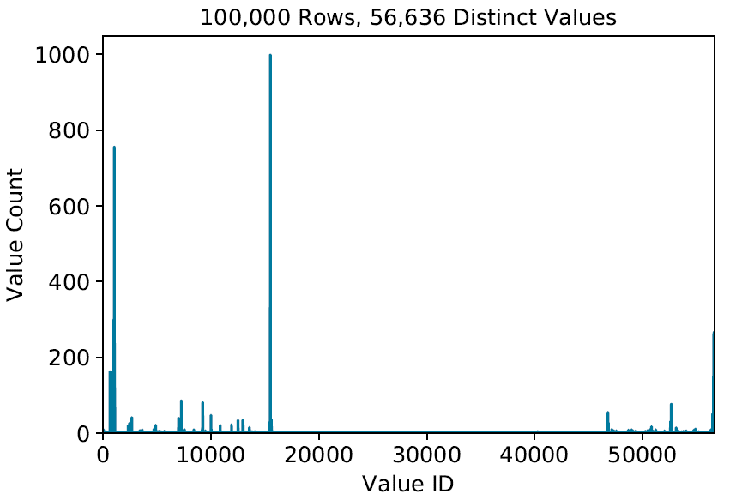
Histograms – On Real-World Data?
Histograms profit from steady value developments
Sporadic changes lead to inaccuracies
Filters handle sporadic changes well
Filters work well on any kind of data distribution
Value Distribution of
ACDOCA Document Number
Notes:
Zahlen für beide Fälle
Genauigkeit singt
ZAHLEN

Slide 25
Comparison of Estimation Techniques
ACDOCA Document Number Column
100.000 values
Technique | Memory | Mean Error | Mean Squared Error
Uniform Estimation | 4 bytes | 0.76 | 243.01
Filter (17/4) | 65000 bytes | 0.048 | 7.33
Histogram (100 Buckets) | 400 bytes | 0.54 | 80.49
Most Common Values (100 Values) | 800 bytes | 0.29 | 2.15
Notes:
Werte für Einen Chunk der ganze Tabelle?

Slide 26
CQFs for Cardinality Estimation - Discussion
Advantages
Flexible in regard to data distribution
Handles skewed data well
High accuracy, low mean error
Disadvantages
Higher memory consumption than histograms
Errors are rare but potentially large
Notes:
Wann gut / Wann nicht
Für Chunk Pruning
Für Selectivity Estimation
- Sowohl Daten als auch Workload
- Konkret!

Slide 27
Conclusion
Chunk Pruning
CQFs can be used to capitalize on the chunked memory layout and accurately eliminate non-contributing chunks during query optimization
We can achieve high pruning rates for predicates with a low selectivity and especially for implicitly clustered or time clustered data
Cardinality Estimation
CQFs show a high accuracy for any kind of data distribution and can represent skewed data distributions especially well
Future Work
On which columns should we use additional data structures and how much memory should we spend?
Notes:
Wie groß realistisch
Wie groß Index realistisch?
Interval Map?
Backup Charts / Slides

Slide 29
Future Work
Applicability in NUMA systems
Can we permanently keep filters the local NUMA node of the query optimizer?
Range queries with quotient filters
Many queries contain range queries
Filter sizing and data structure selection
On which columns should we use additionally data structures?
How much memory should we spend for a filter?
Notes:
- Decision Tree?
- Smaller Data Structure / Interval Map – Clustered Data

Slide 30
References (1)
Pandey, Bender (2017). A General-Purpose Counting Filter: Making Every Bit Count
Bloom (1970). Space/Time Trade-offs in Hash Coding with Allowable Errors
Kester et al. (2017). Should I Scan or Should I Probe?
Leis et al. (2015). How Good Are Query Optimizers, Really?
PostgreSQL Documentation 9.1.24 (2016). Row Estimation Examples. https://www.postgresql.org/docs/9.1/static/row-estimation-examples.html
L. Fan et al. (2000). A scalable wide-area web cache sharing protocol
Pandey et al. (2012). Don’t thrash: How to cache your hash on flash.
Boncz et al. (2017). JCC-H: Adding Join Crossing Correlations with Skew to TPC-H

Slide 31
References (2)
Fan et al. (2014). Cuckoo Filter: Practically Better Than Bloom

Slide 32
Related Work
Bloom Filter (1970) [3]
One of the first probabilistic filters
No counting, only membership
Counting Bloom Filter (2000) [4]
Improved by various authors over the years
Does not handle skewed distributions well
High memory consumption
[3] Bloom, B. H. Space/time trade-offs in hash coding with allowable errors. Commun. ACM 13, 7 (1970), 422–426.
[4] Fan, L., Cao, P., Almeida, J. M., and Broder, A. Z. Summary cache: a scalable wide-area web cache sharing protocol. IEEE/ACM Trans. Netw. 8, 3 (2000), 281–293.
Notes:
-> Zeitstrahl <-
Weniger Text
TODO
Wieviel Zeit investieren?
Backup Slide?
-Hohe Genauigkeit

Slide 33
Related Work – Modern Filters
Quotient Filter (2012) [5]
Smaller than Bloom Filter
Handles skewed distributions well
Cuckoo Filter (2014) [6]
Deletion, counting, bounded false positives
Using Cuckoo hashing
Counting Quotient Filter (CQF) (2017) [7]
Enhancement of the Quotient Filter
[5] Bender, et al. Don’t thrash: How to cache your hash on flash. PVLDB 5, 11 (2012), 1627–1637.
[6] Fan, B., Andersen, D. G., Kaminsky, M., and Mitzenmacher, M. Cuckoo filter: Practically better than bloom. CoNEXT 2014, Sydney, Australia, December 2-5, 2014, pp. 75–88.
[7] Pandey, P., Bender, M. A., Johnson, R., and Patro, R. A general-purpose counting filter: Making every bit count. SIGMOD 2017, pp. 775–787.
Notes:
Warum CQF prägnant:
-Zählender
-Aktuelle Hardware Features
-Hohe Read Performance

Slide 34
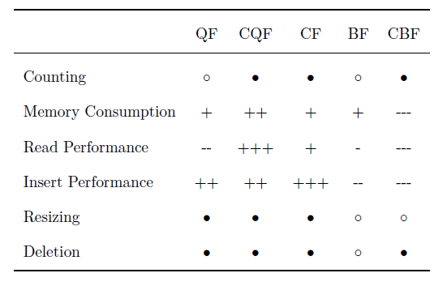
Filter Implementations in Comparison
Focus on
Counting Feature
Memory Consumption
Read Performance
Measurements gathered from [7]
Notes:
What is important for us?
CQF Insert Performance
Position entlang der Skala
TODO
cite

Slide 35
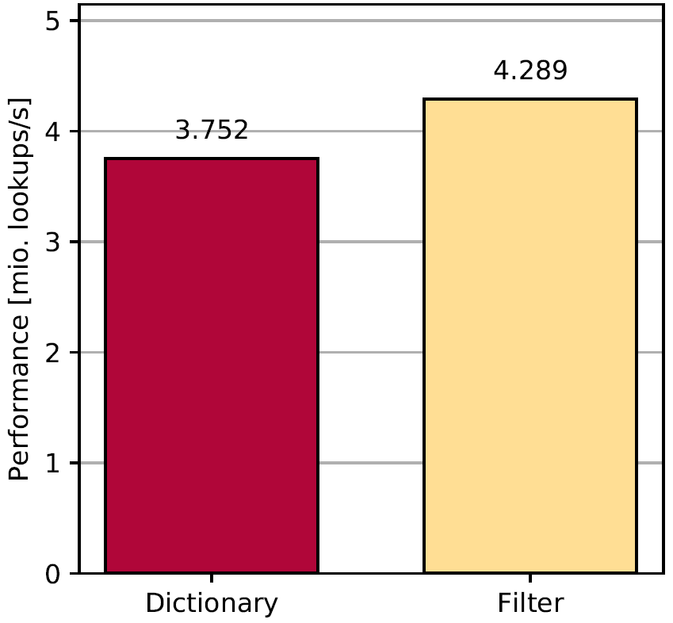
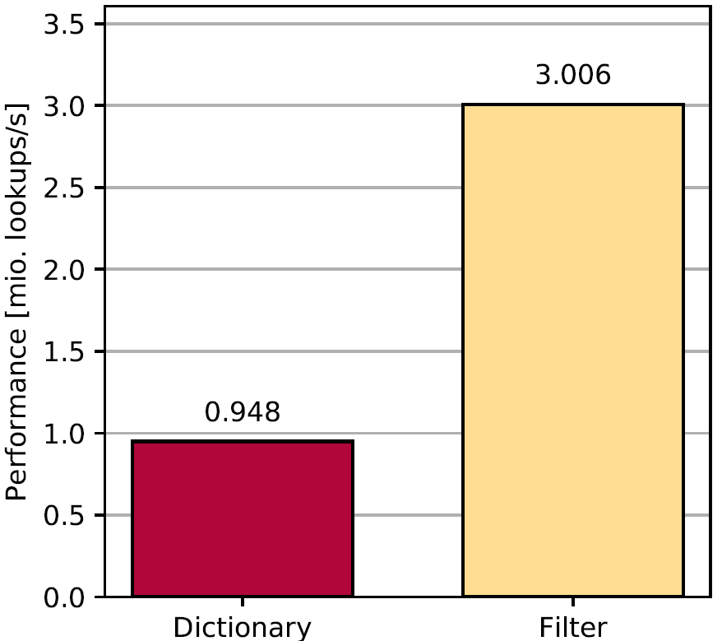
Filters Probes Vs. Dictionary Lookups
Integer Probe Performance
String Probe Performance
Notes:
Gains are higher for character data
For uncached data, filters perform better

Slide 36
Avoiding Dictionary Lookups?
Dictionary lookups only make up a small portion of scan runtime
Filter probes are only minimally faster than dictionary lookups
Filter pruning successful?
Benefit: No dictionary lookup
Filter pruning failed?
Dictionary lookup still required to perform scan
Filter probe is additional overhead
Overhead both in memory and performance

Slide 37
Filters on Dictionary Columns
No noticeable benefit at usual chunk sizes
Overhead in memory and performance
Filters not recommended
Notes:
Wann haben wir keine Dictionaries?

Slide 38
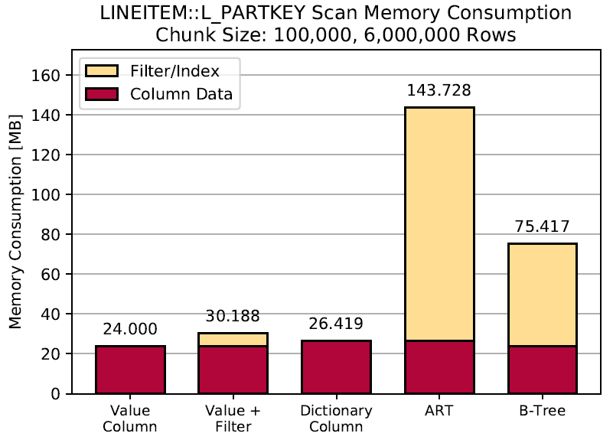
Data Structure Memory Consumption

Slide 39
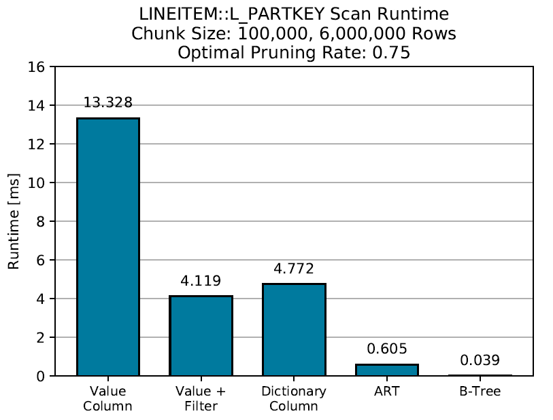
Notes:
Vc, filter, btree
Schematische Darstellung
Zu viel

Slide 40
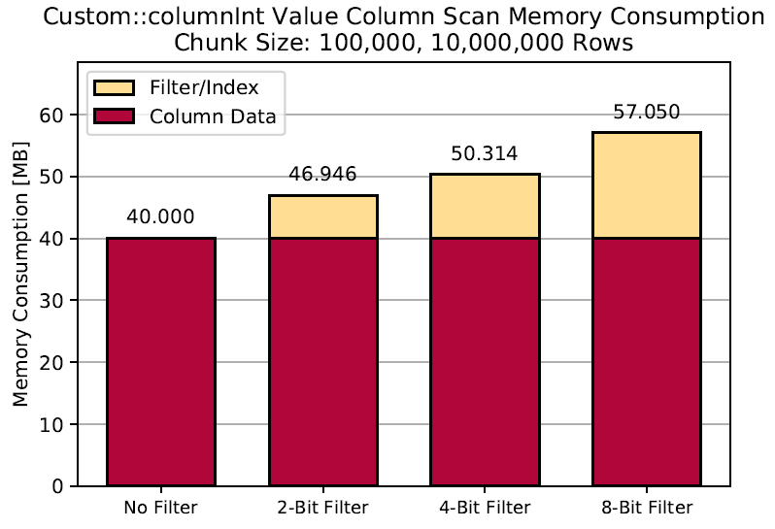
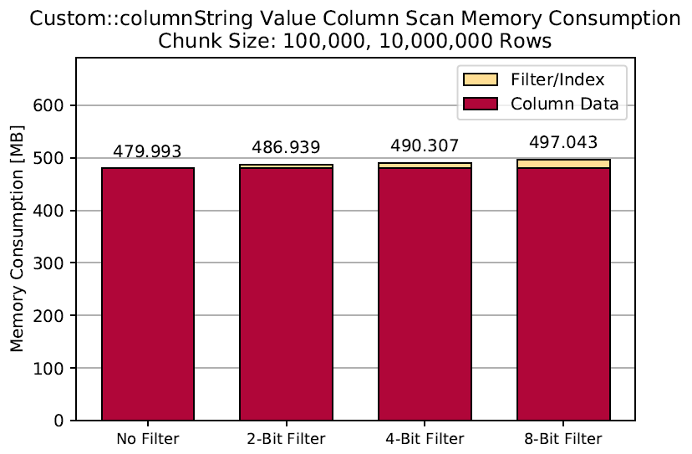
Memory Consumption – Data Types

Slide 41
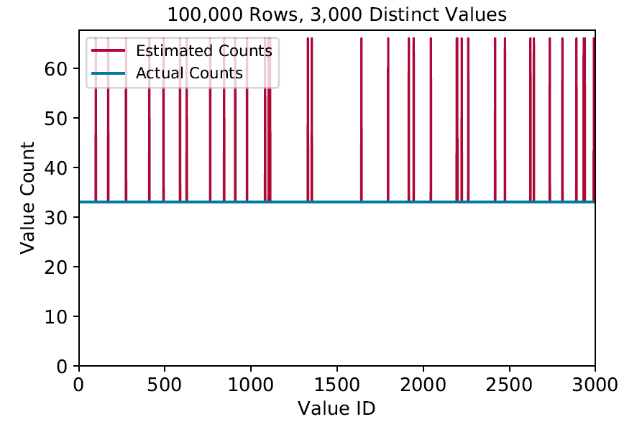
Value Counts and Error Distribution
Errors follow value count distribution
Errors happen as two values are counted in the same slot
Becomes especially apparent in a uniform distribution

Slide 42
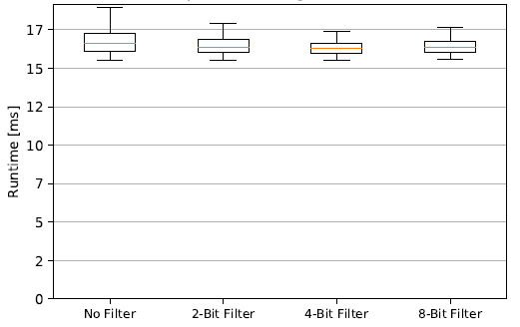
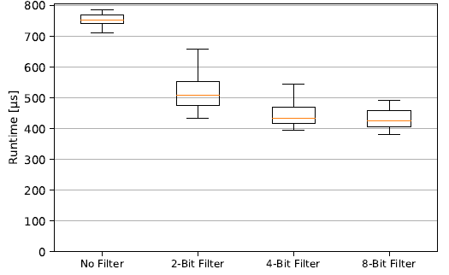
Pruning Makes up Small Portion of Scan
10,000,000 rows, 100 chunks, 50% pruning rate, dictionary columns
Table Scan Runtime
Time Spent Pruning
Notes:
weniger

Slide 43
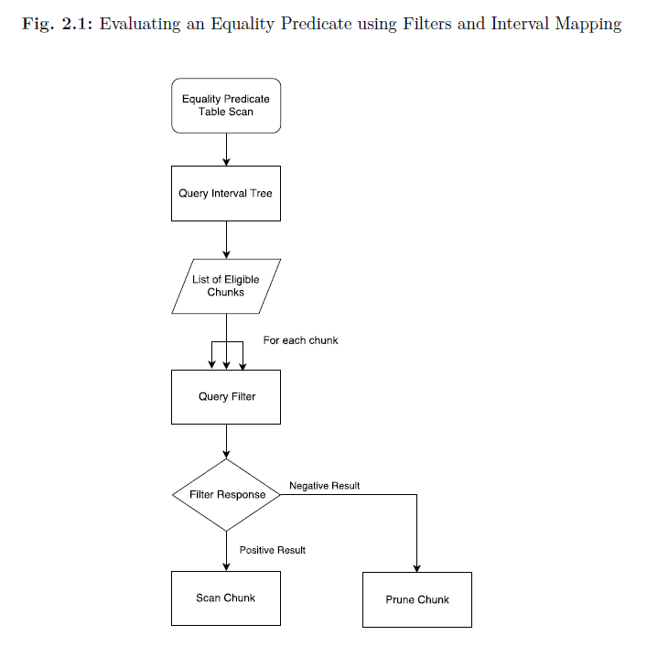

Slide 44
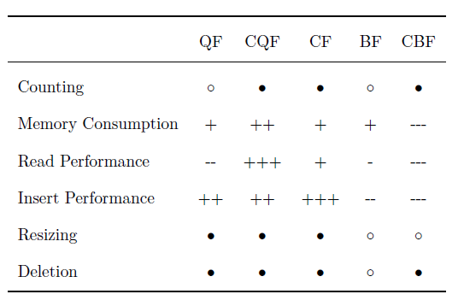

Slide 45
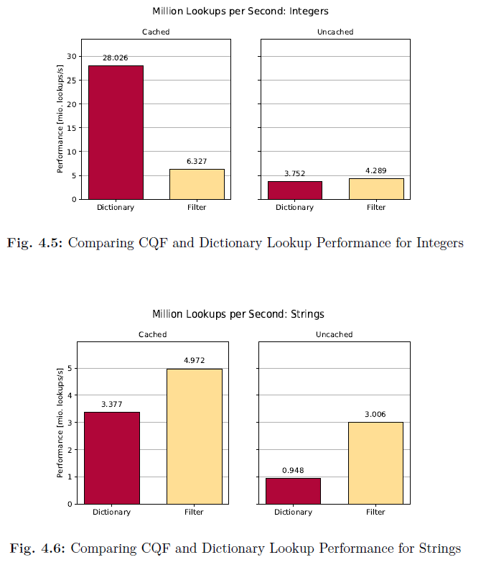

Slide 46
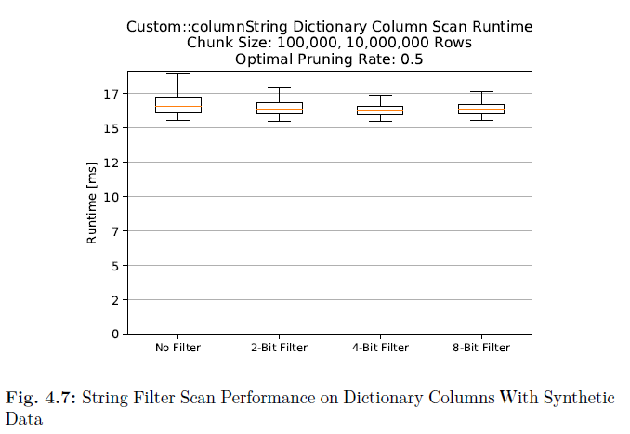

Slide 47
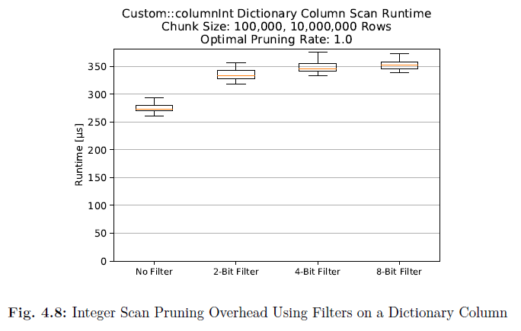

Slide 48
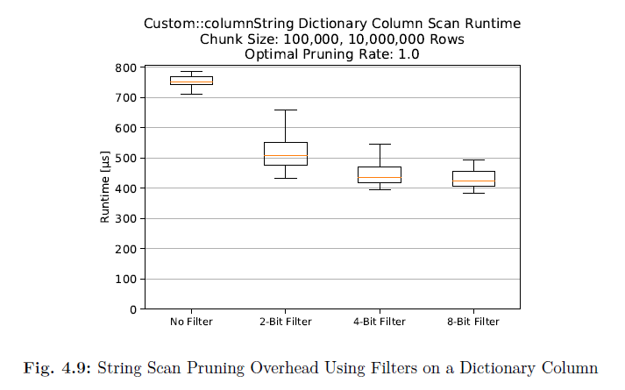

Slide 49
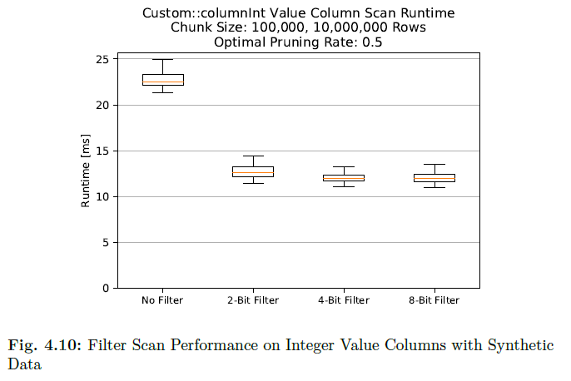

Slide 50
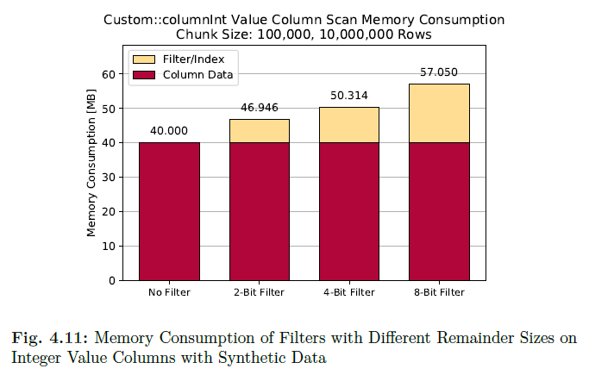

Slide 51
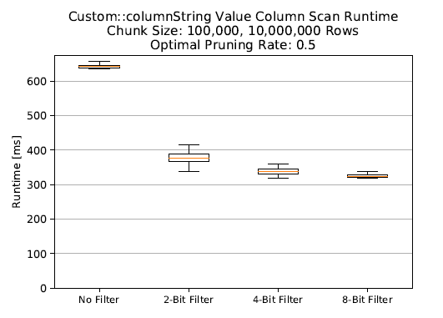

Slide 52
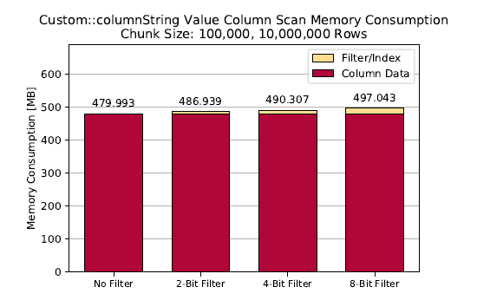

Slide 53
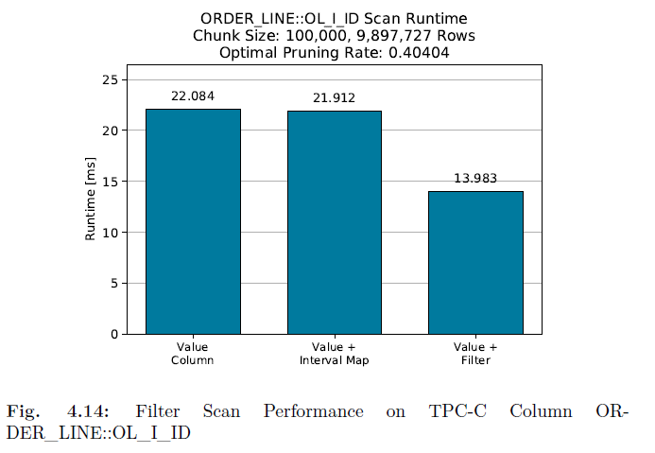

Slide 54
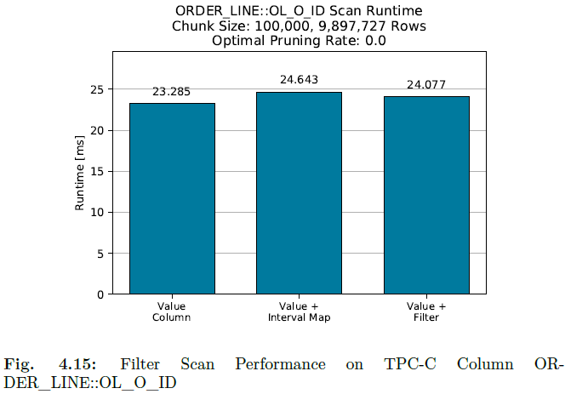

Slide 55
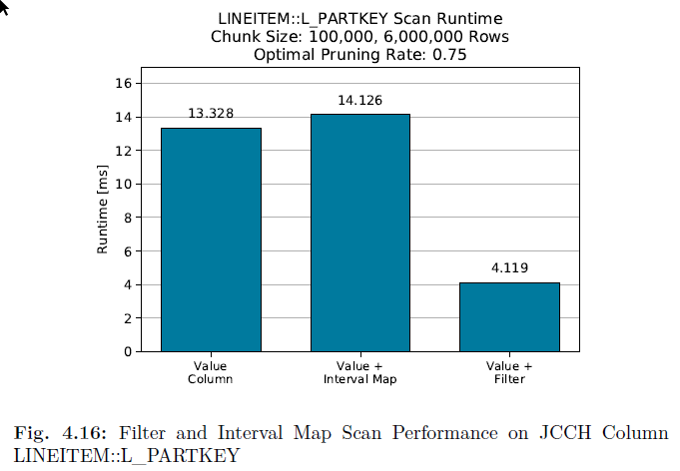

Slide 56
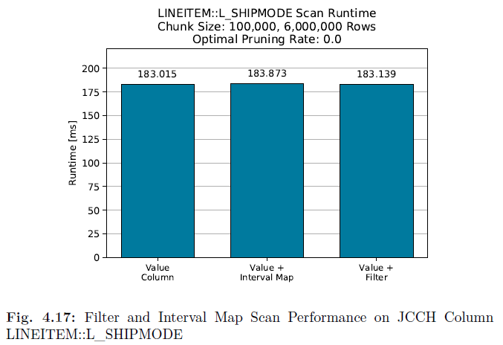

Slide 57
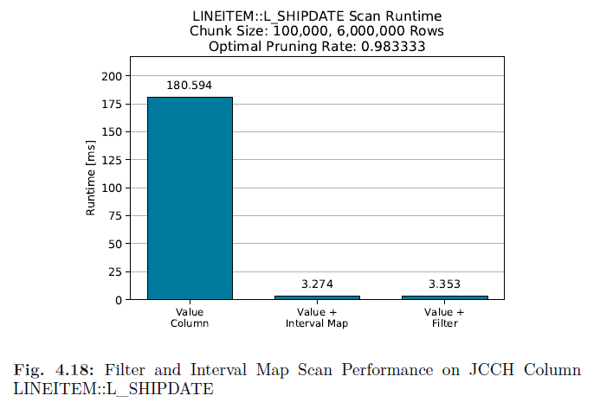

Slide 58
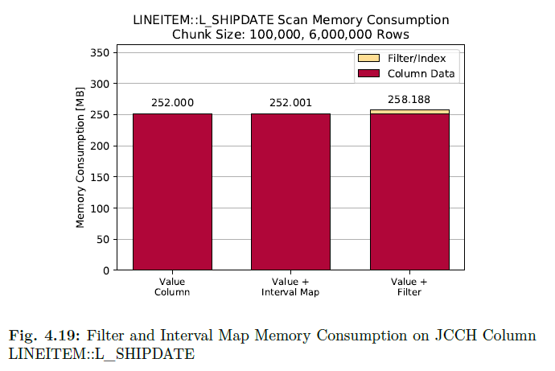

Slide 59
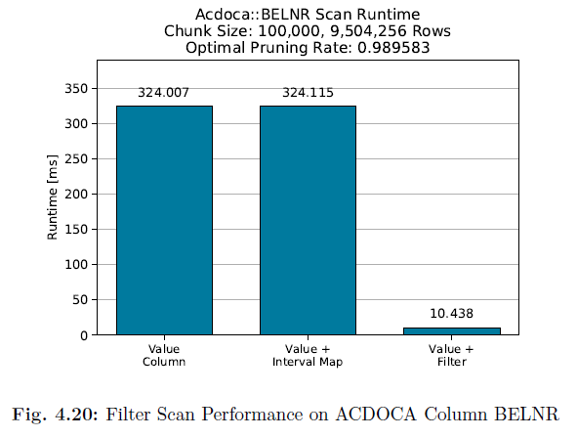

Slide 60
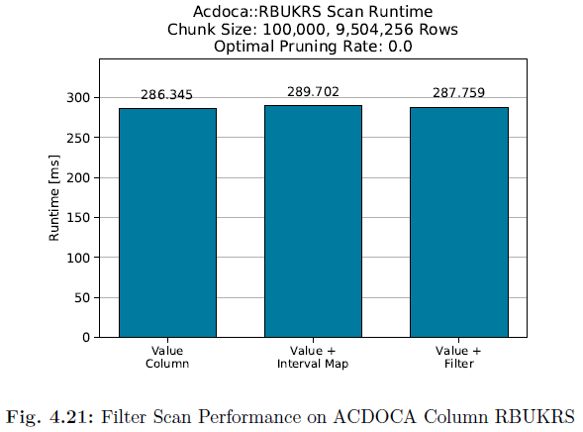

Slide 61
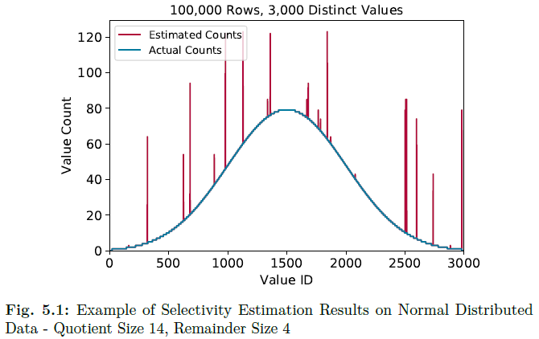

Slide 62
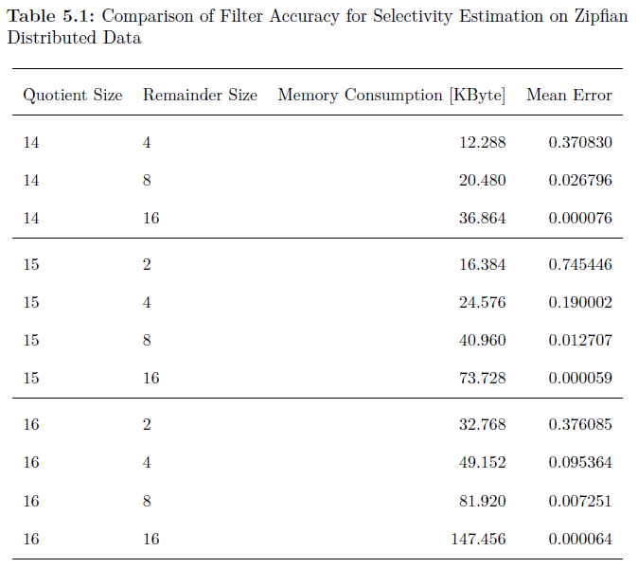

Slide 63
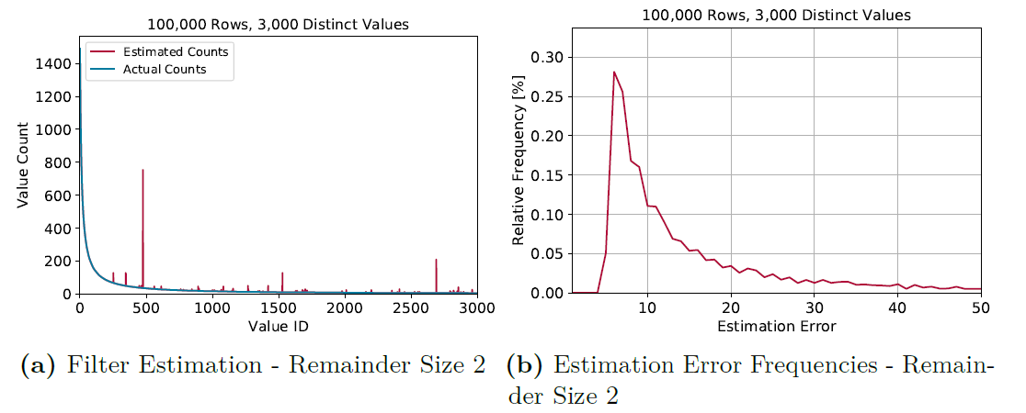

Slide 64
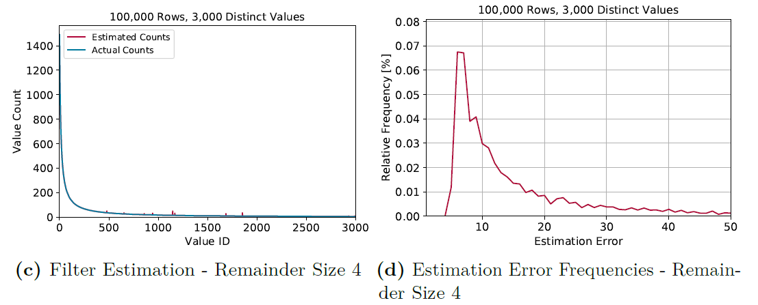

Slide 65


Slide 66


Slide 67


Slide 68


Slide 69


Slide 70


Slide 71


Slide 72


Slide 73


