Slide 1
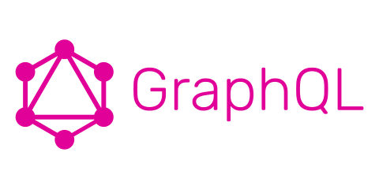

Slide 2
Procedure
What is GraphQL?
How does GraphQL work?
How can one use GraphQL?
Working with GraphQL and NodeJS

Slide 3
What is GraphQL?

Slide 4
What is GraphQL? – Brief Overview
Possibility to describe your api‘s data and to provide actions on them over HTTP
Alternative to REST (Representational State Transfer)
Query Language and Server-Side-Runtime
Not tied to any specific database or storage engine
Developed internally by Facebook

Slide 5
How does GraphQL work?

Slide 6
How does GraphQL work?
Clients send GraphQL-Queries as HTTP-Requests to a GraphQL-Service to perform actions
These GraphQL-Queries are formed in the GraphQL-Syntax
The server then validates, parses and executes them and returns the result
The Queries which can be executed by the GraphQL-Service are defined on the Server

Slide 7
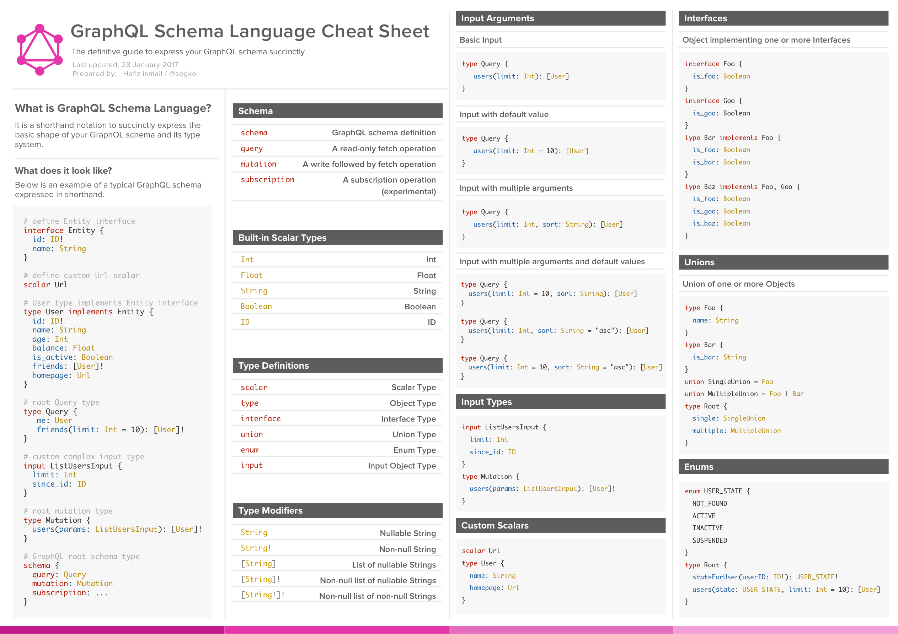
The GraphQL-Syntax
https://cdn-images-1.medium.com/max/2000/1*HaEeoGrja2IGUxzvmj5Vnw.png

Slide 9
Defining a GraphQL-Service
The main parts of every GraphQL-Service are:
the schema
the resolvers

Slide 10
The Schema
Defines which queries are allowed, what types of data can be fetched and what the relationships between these types are
Is defined with the GraphQL-Syntax
Therefore independent from the GraphQL-Implementation or programming language

Slide 11
The Schema – Example
type Author {
id: ID!
name: String!
email: String
}
type Post {
id: ID!
title: String!
text: String!
description: String
authors: [Author!]
}
type Query {
getAuthor(name: String!): [Author!]
getPost(title: String!): [Post!]
}
schema {
query: Query
}

Slide 12
The Resolvers
Specify how the various types and fields of the schema are connected to various backends
Can talk to any kind of backend to execute the queries
Are GraphQL-Implementation and programming language specific

Slide 13
The Resolvers – Example
async function (parent, { id }, context){
return context.sql.raw('SELECT * FROM authors WHERE id = %s’, id);
}
async function (parent, { author }, context){
return context.request(`https://api.blog.io/by_author/${author.id}`);
}

Slide 14
The Query
A query is formed based on the schema and the GraphQL-Syntax
The Client can specify various queries in one HTTP-Request
In the query you can specify the data which should be returned
How the query is passed in a HTTP-Request is implemented on the Server
It is possible to separate the inputs (variables) of a query from the actual query

Slide 15
The Query – Example Query
{
getAuthor(name: “Donald Trump”) {
id
name
email
}
}
{
getAuthor(name: “Donald Trump”) {
id
}
}

Slide 16
The Query – Example Response
{
“getAuthor”: {
“id”: “IAmTheOne”,
“name”: “Donald Trump”,
“email”: “Donald@whitehouse.gov”
}
}

Slide 17
The Query – Example Variables
query getAuthor($name: String) {
getAuthor(name: $name) {
id
name
email
}
}
{
"name": "Donald Trump"
}

Slide 18
The Query – Example Requests
GET /path/to/your/api?query={{ your query }}&variables={{ your variables }}
POST /path/to/your/api
{
"query": "{{ your query as string }}",
"variables": {{ your variables as JSON-Object }}
}

Slide 19
The Execution
The Query-Execution happens in three steps:
Parse
Validate
Execute
For every query an abstract syntax tree is built (Parse)
The executor then calls every node‘s resolve function from the top to the bottom until all types are resolved into scalar types

Slide 20
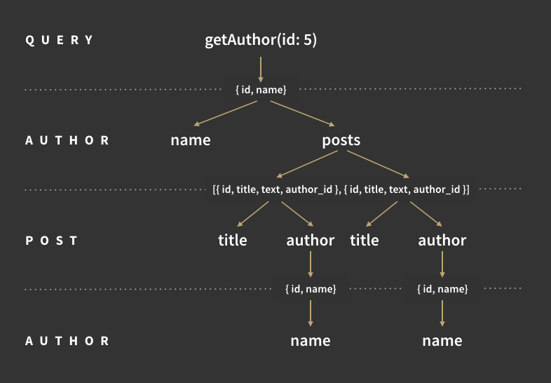
The Execution – Example
https://cdn-images-1.medium.com/max/800/1*tSO8TeQ9mYNWRzA2FqYlsQ.png

Slide 21
How can one use GraphQL?

Slide 22
GraphQL Server Libraries
Java
JavaScript
PHP
Go
Scala
C# / .NET
Python
Groovy
…
You can find a list of implementations at: http://graphql.org/code/

Slide 23
GraphQL Client Libraries
Java / Android
JavaScript
Swift / Objective-C iOS
Go
C# / .NET
Python
…
You can find a list of implementations at: http://graphql.org/code/

Slide 24
Working with GraphQL and NodeJS

Slide 25
Please follow the description on your handout
Please visit: Apollo-Launchpad (https://launchpad.graphql.com/new)
Copy the code from tutorial-script.js to your launchpad
You‘re ready to go!

Slide 26
Thank you for your attention!

Slide 27
References
http://graphql.org/learn/
https://dev-blog.apollodata.com/graphql-explained-5844742f195e

