Slide 1
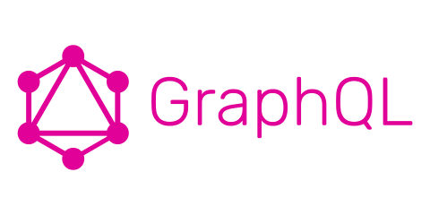

Slide 2
Procedure
What is GraphQL? How does GraphQL work?
How can one use GraphQL?
Working with GraphQL and NodeJS

Slide 3
What is GraphQL? How does GraphQL work?

Slide 4
What is GraphQL? – Brief Overview
Possibility to describe your api‘s data and to provide actions on them over HTTP
Query Language and Server-Side-Runtime
Not tied to any specific database or storage engine
Developed internally by Facebook
Alternative to REST (Representational State Transfer)

Slide 5
How does GraphQL work?
Like in REST: The client sends an HTTP-Request to the server to fetch data
The query information is passed as parameters (GET) or as body in POST-Requests
These queries have to be formed in the GraphQL-Syntax
Which queries are allowed and which are not is defined on the Server
These Queries are then executed by the server

Slide 6
Defining a GraphQL-Service
The main parts of every GraphQL-Service are the schema and the resolvers
The schema is a model of the data which can be fetched through the server
The Resolvers define how the queried data can be resolved

Slide 7
The Schema
Defines which queries are allowed, what types of data can be fetched and what the relationsships between these types are
Is defined with the GraphQL-Syntax
Therefore independent from the GraphQL-Implementation or programming language

Slide 8
The Schema – Example
type Author {
id: ID!
name: String!
email: String
}
type Post {
id: ID!
title: String!
text: String!
description: String
authors: [Author!]
}
type Query {
getAuthor(name: String!): [Author!]
getPost(title: String!): [Post!]
}
schema {
query: Query
}

Slide 9
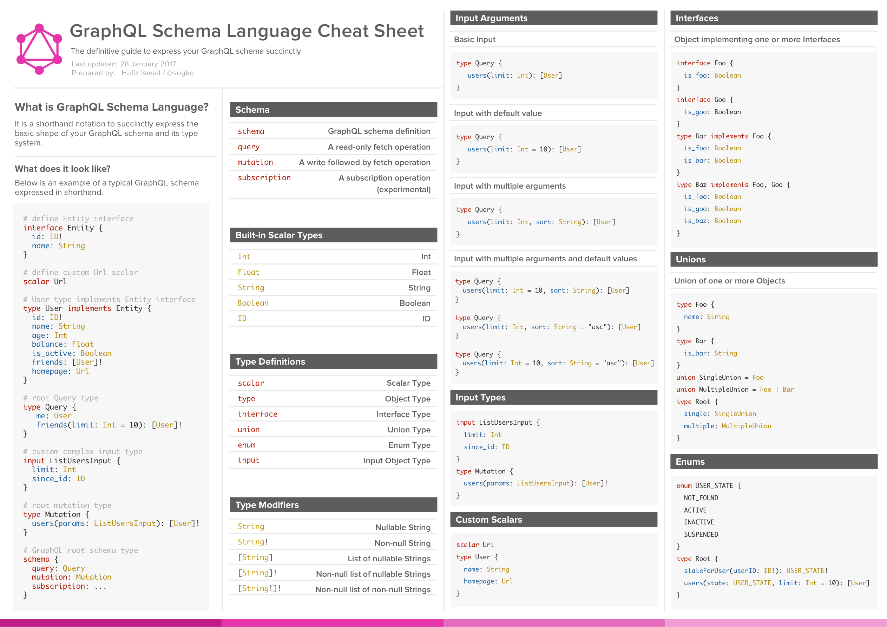
The Schema – Syntax-Cheat-Sheet
https://cdn-images-1.medium.com/max/2000/1*HaEeoGrja2IGUxzvmj5Vnw.png

Slide 10
The Resolvers
Specify how the various types and fields of the schema are connected to various backends
Can talk to any kind of backend to execute the queries
Are GraphQL-Implementation and programming language specific

Slide 11
The Resolvers – Example
getAuthor(_, args){
return sql.raw('SELECT * FROM authors WHERE id = %s', args.id);
}
posts(author){
return request(`https://api.blog.io/by_author/${author.id}`);
}

Slide 12
The Query
A query is formed based on the schema and the GraphQL-Syntax
The Client can specify various queries in one call and which data they should return

Slide 13
The Query – Example Query
{
getAuthor(id: 5){
name
posts {
title
author {
name # Just the name is queried }
}
}
}

Slide 14
The Query – Example Response
{
“getAuthor”: {
“name”: “Johann Wolfgang von Goethe”,
“posts”: [
{
“title”: “Faust. Eine Tragödie.”,
“author”: {
“name”: “Johann Wolfgang von Goethe”
}
},
{
“title”: “Faust. Der Tragödie zweiter Teil“,
“author”: {
“name”: “Johann Wolfgang von Goethe”
}
}
]
}
}

Slide 15
The Execution
The Query-Execution happens in three steps:
Parse
Validate
Execute
For every query an abstract syntax tree is built (Parse)
The executor then calls every node‘s resolve function from the top to the bottom until all types are resolved into scalar types

Slide 16
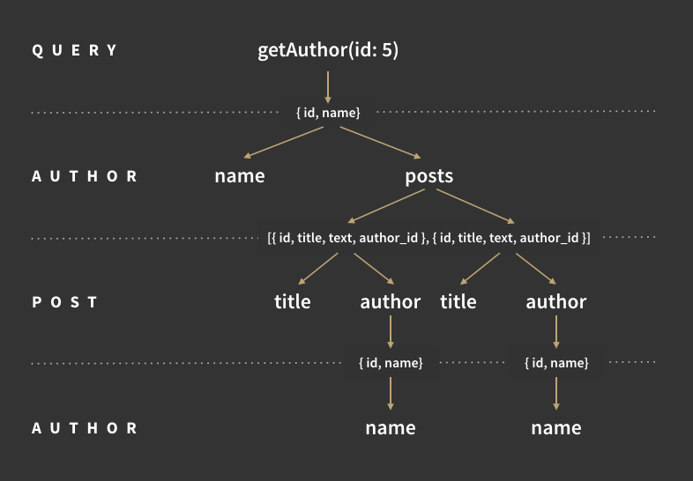
The Execution – Example
https://cdn-images-1.medium.com/max/800/1*tSO8TeQ9mYNWRzA2FqYlsQ.png

Slide 17
How can one use GraphQL?

Slide 18
GraphQL Server Libraries
Java
JavaScript
PHP
Go
Scala
C# / .NET
Python
Groovy
…
You can find a list of implementations at: http://graphql.org/code/

Slide 19
GraphQL Client Libraries
Java / Android
JavaScript
Swift / Objective-C iOS
Go
C# / .NET
Python
…
You can find a list of implementations at: http://graphql.org/code/

Slide 20
Working with GraphQL and NodeJS

Slide 21
Please visit:
https://launchpad.graphql.com/new You can find the link in my information email or the forum calendar entry.

Slide 22
Thank you for your attention!

Slide 23
References
http://graphql.org/learn/
https://dev-blog.apollodata.com/graphql-explained-5844742f195e

