Slide 1
Rental Property web-app
A rental vacation house website is an online platform designed to showcase and facilitate the booking of vacation rental properties. These websites cater to both property owners looking to rent out their homes and travelers searching for a temporary place to stay during their vacation.

Slide 2
Features
1. HOME PAGE
2. Properties
3. Booking and Payment
Welcome message
Search bar
Featured listings
User testimonials
Detailed Description
High quality images
Availability Calendar
Online booking System
Secure payment gateway
Pricing details

Slide 3

Live Demo Using Canva, Figma or any graphics software

Slide 4
Index Contents
Navbar
Hero
Featured Listings (card info of units)
Testimonials
Footer

Slide 5
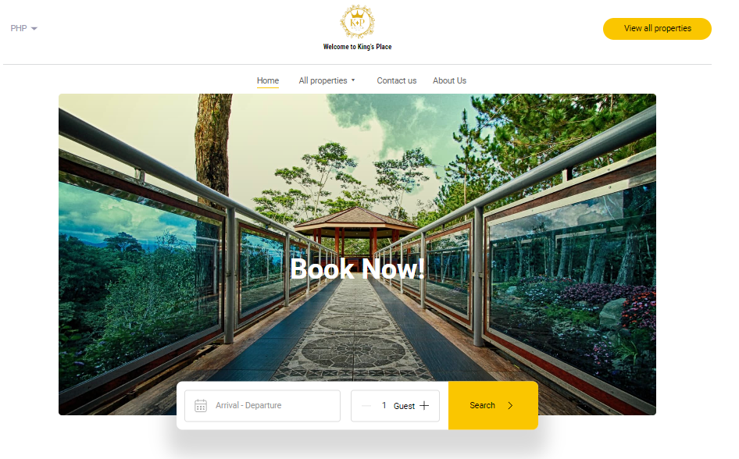
Logo Home About Us Services Contact Pages

Slide 6
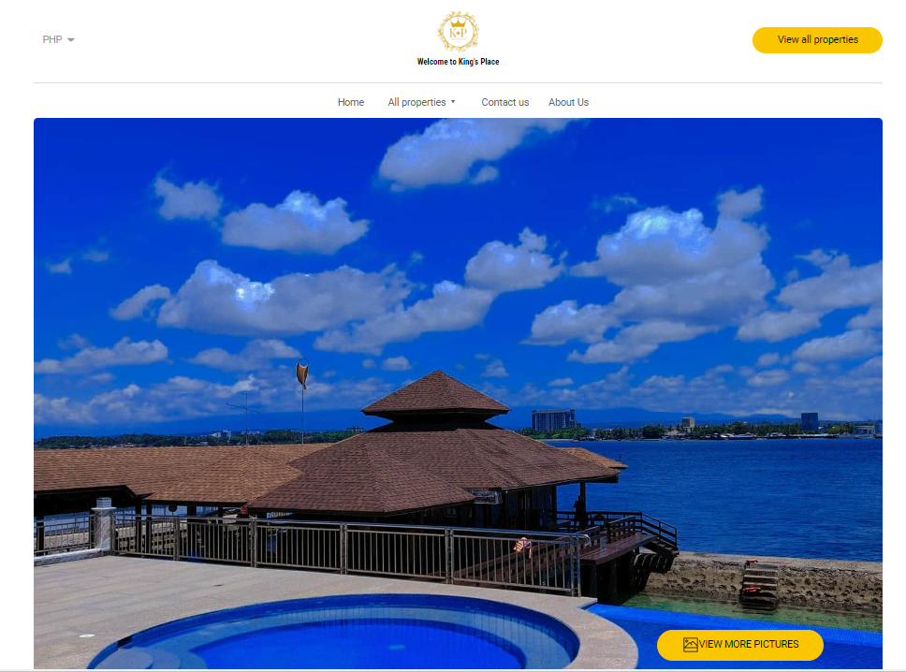

Slide 7
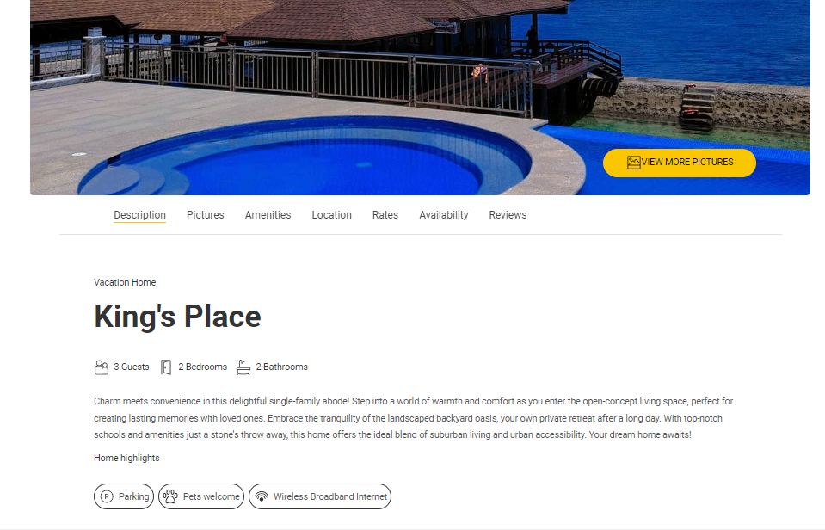

Slide 8
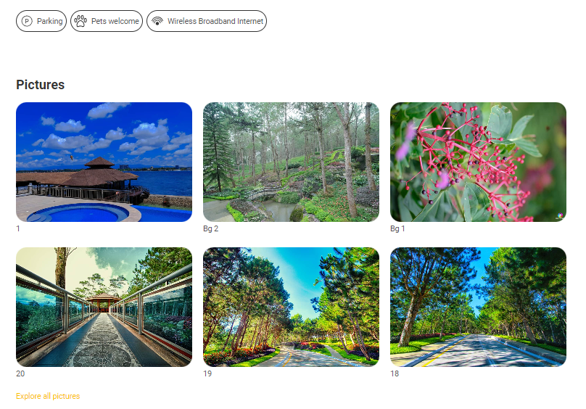

Slide 9
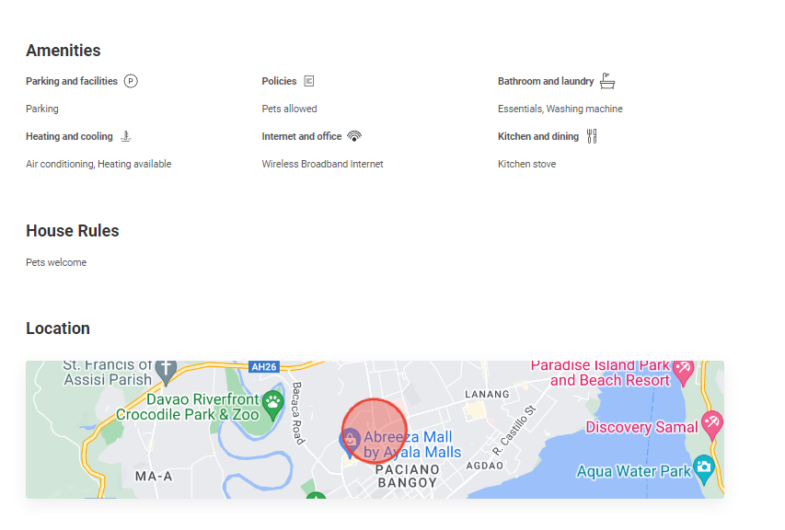

Slide 10
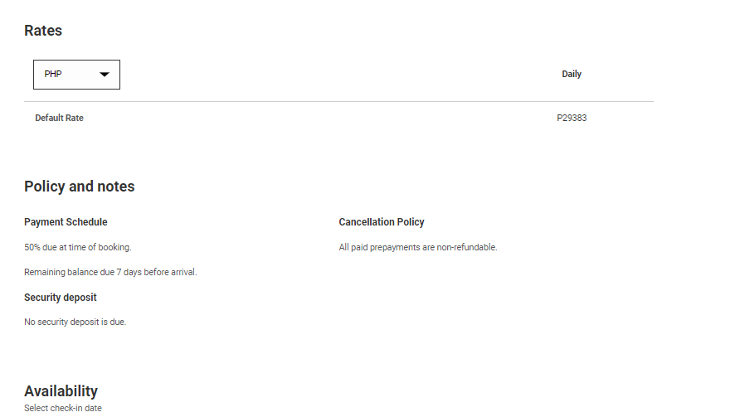

Slide 11
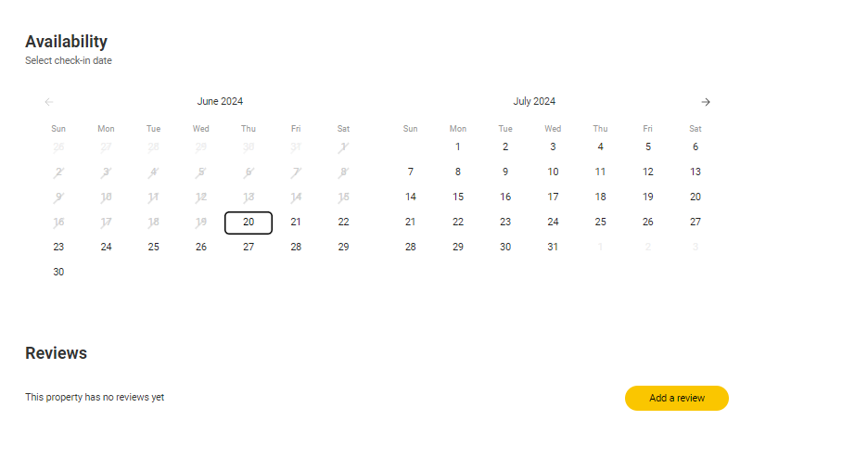

Slide 12
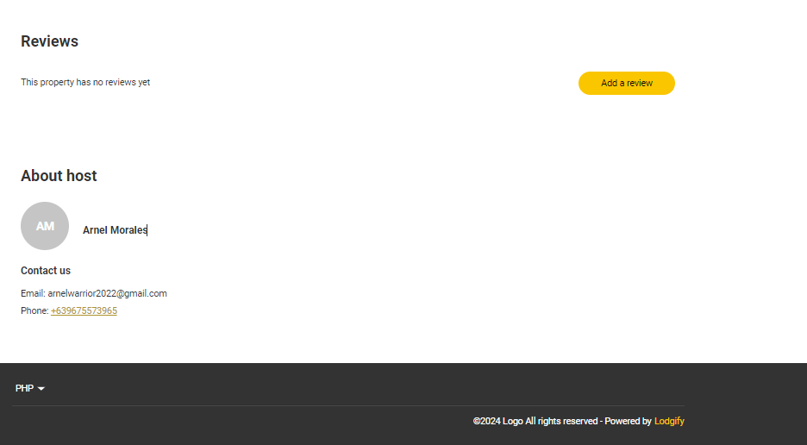

Slide 13
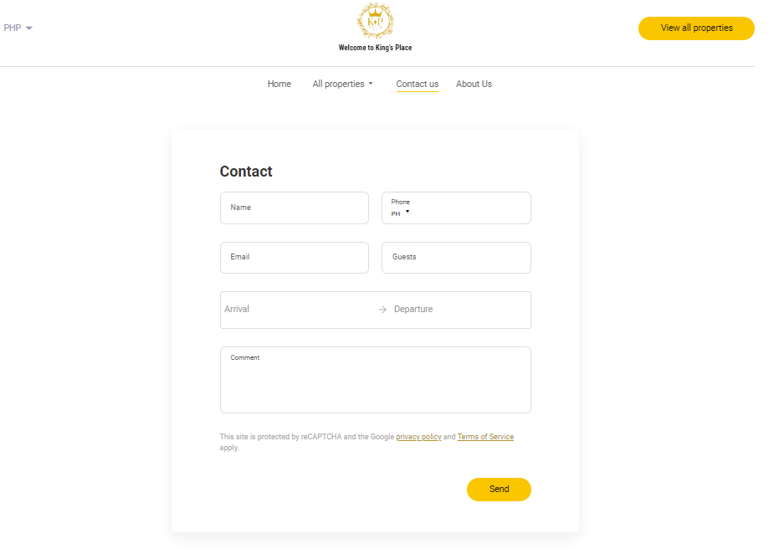

Slide 14
