Slide 1
Prediction Modeling for Autism and Application in Diagnosis
CHEN Tianyi, HE Naicheng

Slide 2
Contents
Introduction
Data preprocessing
Feature screening
Analysis and results
Summary
Future outlook

Slide 3



Introduction
Symptoms
Speech Inability
Impaired Social Communication
Repetitive Behaviors
cr. verywellhealth.com
Notes:
Inability to use spoken language
Sensitivity for crowds
Rocking, door slamming, button pressing

Slide 4

Introduction
Environmental Factors
Parturition in elder age
Fever & infection during pregnancy
Premature birth

Slide 5


Introduction
Diagnosis
+
Doctor’s Inquiry
Rating Scales
Notes:
Observation as subjective info
Rating scales as objective and uniform tool

Slide 6
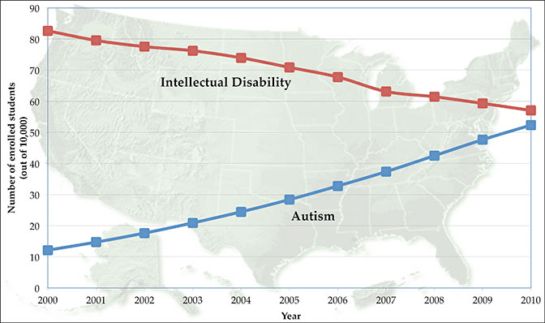
Introduction
Current Issues
Complexity | Consumption of Resources | Inaccuracy
Confusion about intellectual disability and autism
Notes:
Inaccuracy也因为表过时了
Issues lead to need for efficient and accurate prediction. Aid in quick diagnosis & self test

Slide 7
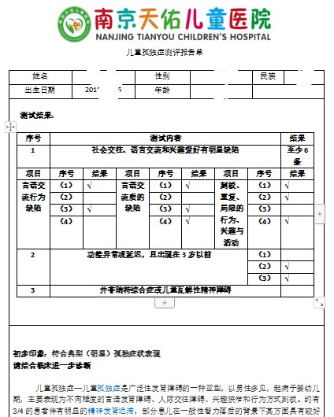
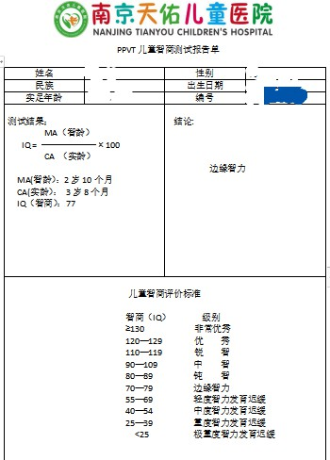
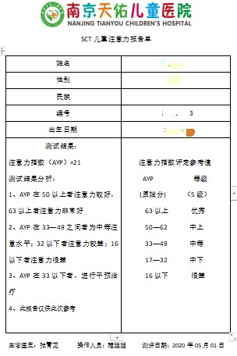
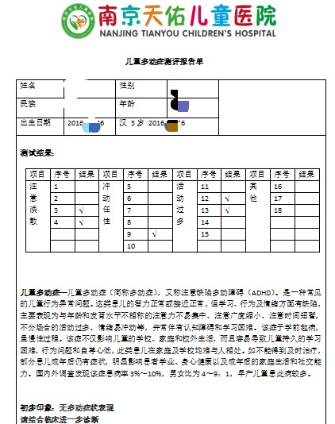
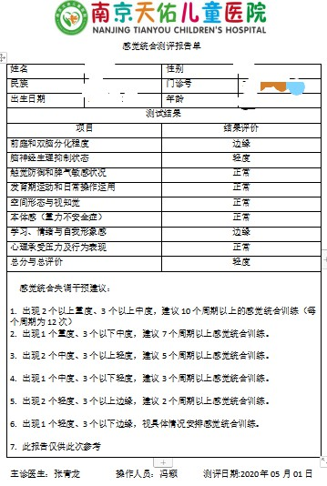
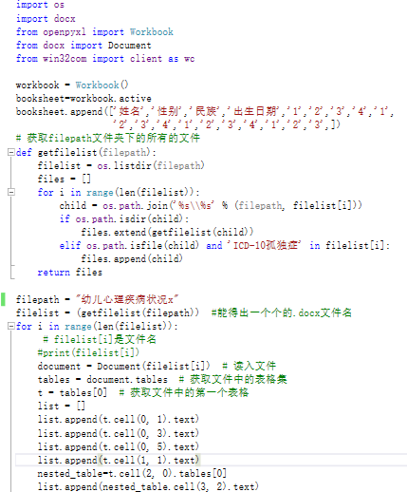
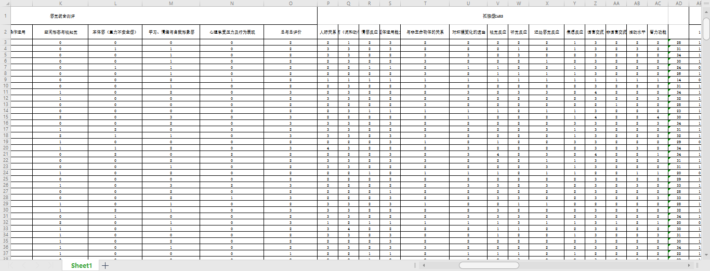
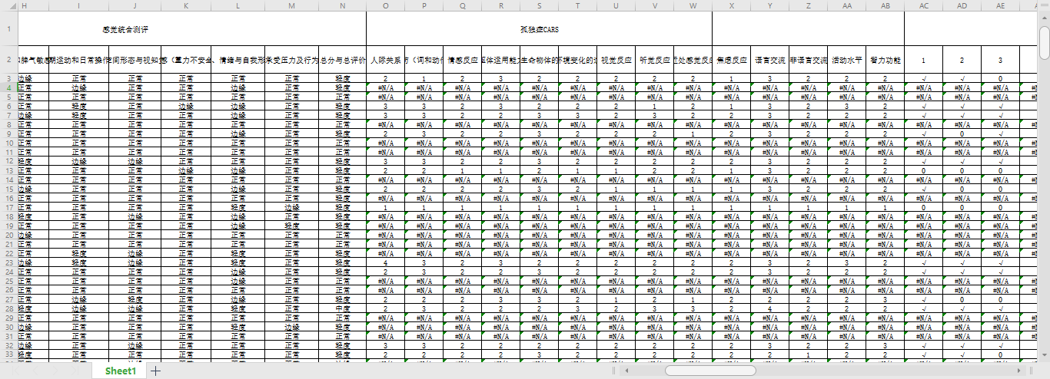
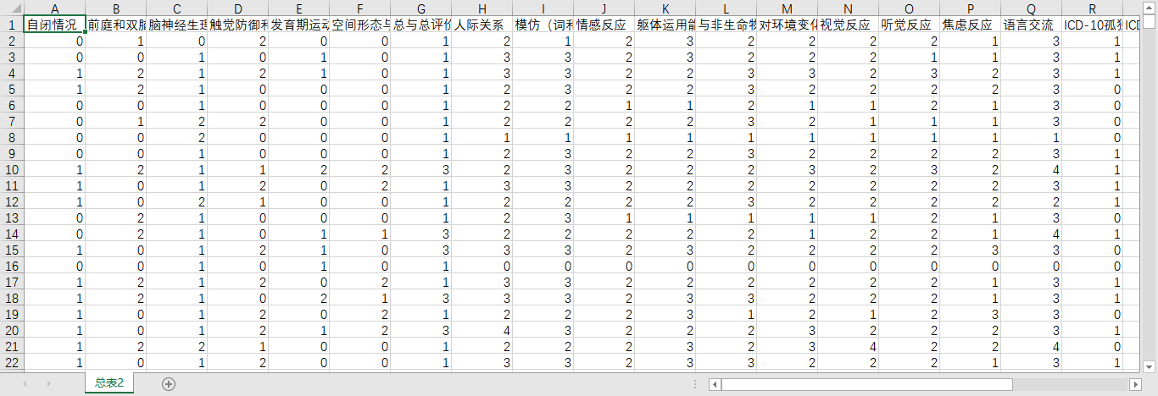
Data preprocessing
Notes:
加两张截屏

Slide 8
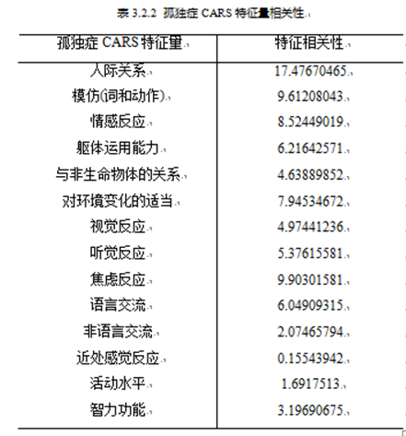
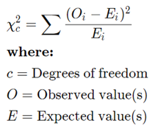
Feature screening – Chi-square test
Data normalization
Data is normalized to ensure that each x is in the range of (0,1), so as to achieve feature scaling.
Notes:
卡方检验的定义

Slide 9
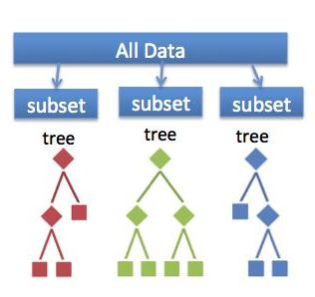
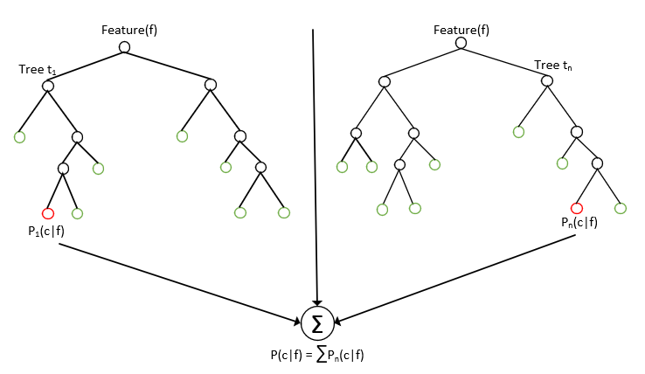
Feature screening – Random Forest
Notes:
介绍随机森林算法，引出随机森林用于参数筛选

Slide 10
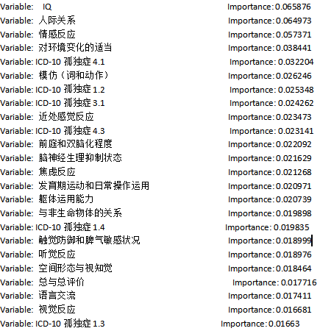
Feature screening – Random Forest
Importance of features
Notes:
为了避免出现参数过多而出现过拟合，并为了提高拟合速度，我们用随机森林按照从高到低对各个参数进行了重要性排序。

Slide 11
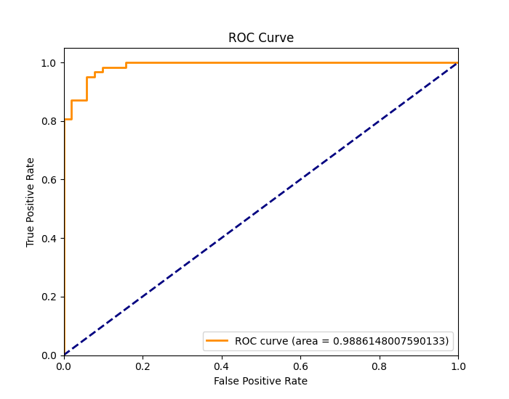
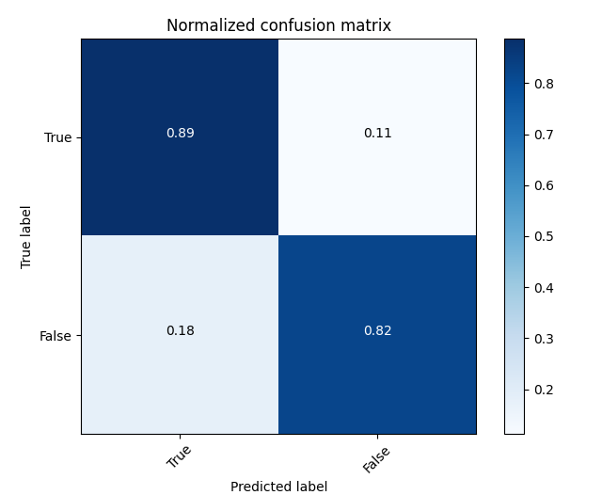
Analysis and results – Random Forest
Prediction accuracy: 81.5%
(when the random seed is 4 and the number of subtrees is 1500)
Notes:
23个feature， 1500棵树组成的森林

Slide 12
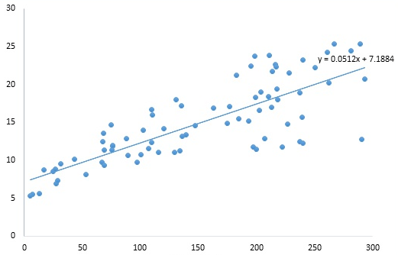
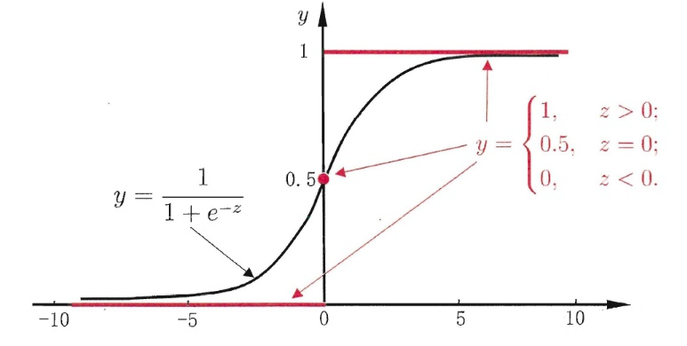
Analysis and results– Logistic Regression
Linear regression
Sigmoid Function
Notes:
逻辑回归在线性回归的基础上加了一个Sigmoid函数，逻辑回归的思路是，先拟合决策边界(不局限于线性，还可以是多项式)，再建立这个边界与分类的概率联系，从而得到了二分类情况下的概率。

Slide 13
Analysis and results– Logistic Regression
Linear kernel
Logistic regression | Accuracy
NCG | 0.779
BFGS | 0.779
L-BFGS-B | 0.779
Polynomial kernel
Logistic regression | Accuracy
BFGS | 0.806
NCG | 0.801
L-BFGS-B | 0.795
Notes:
牛顿法的基本思路是，在现有极小点估计值的附近对 f(x) 做二阶泰勒展开，进而找到极小点的下一个估计值
Quintic polynomial kernel

Slide 14
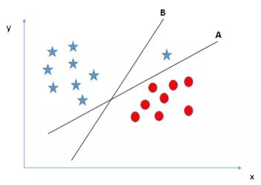
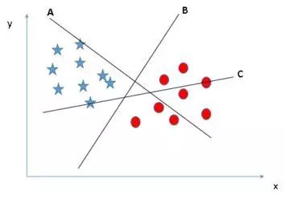
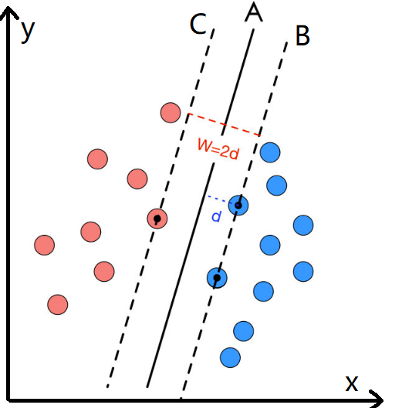
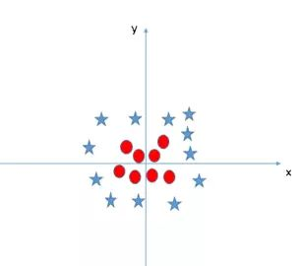
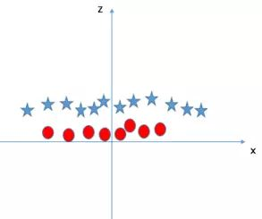
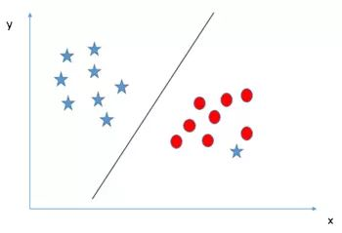
Analysis and results–Support Vector Machine
Fig 1
Fig 2
Fig 3
Fig 4
Fig 5
Fig 6
Notes:
SVM要拟合的不是一个超平面，而是两个超平面，且这两个超平面之间的距离要尽可能大。主要关注距离分类边界近的边缘数据点（支撑向量support vector）,通过凸优化方法使得正例和反例之间的间隔最大,从而使边界超平面附近的数尽可能少,避免边界附近样本点的误判,提高正确率。
What SVM wants to fit is not one hyperplane, but two hyperplanes, and the distance between the two hyperplanes should be as large as possible. The main focus is on tshe edge data points (support vector) that are close to the classification boundary. The convex optimization method is used to maximize the interval between the positive and negative examples, so as to minimize the number near the boundary hyperplane and avoid the sample points near the boundary. False judgments, improve the accuracy rate.
The objective function is
Dichotomy problem

Slide 15
Analysis and results–Support Vector Machine

Slide 16
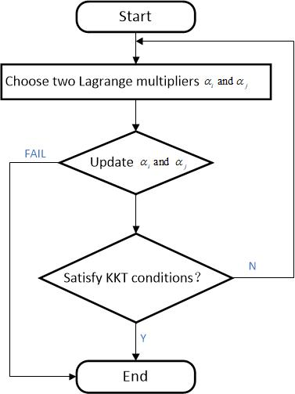
Analysis and results–Support Vector Machine
Sequential minimal optimization (SMO)
SMO is an algorithm for solving the quadratic programming (QP) problem that arises during the training of support-vector machines (SVM).
Better performance for linear SVM and sparse data.
Notes:
SMO算法由Microsoft Research的John C. Platt在1998年提出，并成为最快的二次规划优化算法，特别针对线性SVM和数据稀疏时性能更优。
What SVM wants to fit is not one hyperplane, but two hyperplanes, and the distance between the two hyperplanes should be as large as possible. The main focus is on the edge data points (support vector) that are close to the classification boundary. The convex optimization method is used to maximize the interval between the positive and negative examples, so as to minimize the number near the boundary hyperplane and avoid the sample points near the boundary. False judgments, improve the accuracy rate.
The objective function is

Slide 17
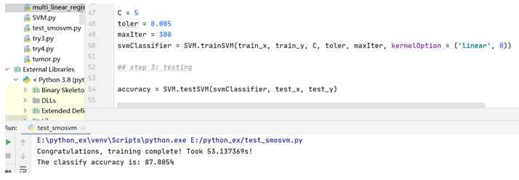
Analysis and results–Support Vector Machine
SVM+SMO model : 87.8%
Notes:
SMO算法由Microsoft Research的John C. Platt在1998年提出，并成为最快的二次规划优化算法，特别针对线性SVM和数据稀疏时性能更优。

Slide 18
Analysis and results–Support Vector Machine
Method | Accuracy
Logistic Regression | 80.6%
Random Forest | 81.5%
SMO+SVM | 87.8%
Notes:
SMO算法由Microsoft Research的John C. Platt在1998年提出，并成为最快的二次规划优化算法，特别针对线性SVM和数据稀疏时性能更优。

Slide 19
Summary
Updatable and efficient prediction models
Statistically significant accuracy
Consistency with existing neurological research results
Notes:
1 adapt to change of group’s overall characteristics
2 normal threshold is only 80%
3 IQ, social relation -> research values

Slide 20


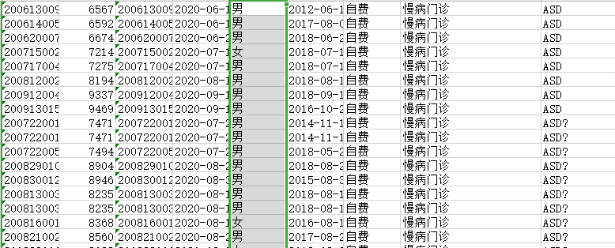
Future outlook
Trial run
AI aided diagnosis
Notes:
Save time & money. Reliable reference for doctors
Convenient. Instrumental to the dissemination

Slide 21
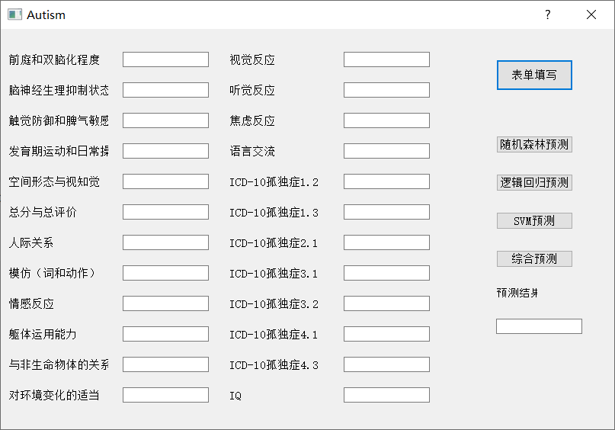


Future outlook
A more efficient screening tool
Continuous tracking & personalized healthcare plan

Slide 22
Acknowledgments
The authors gratefully acknowledge the support of the Nanjing Tianyou children hospital and the kindly guidance from Mr. Tao Bai.

Slide 23
Thank You!

Slide 24

Supplement 1

Slide 25
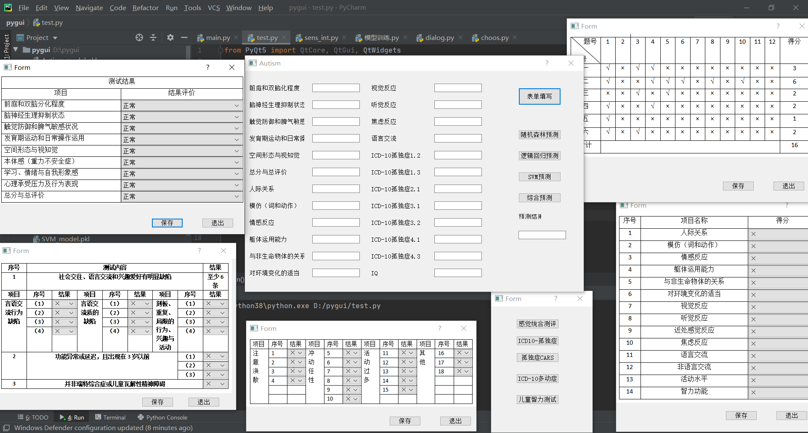
Supplement 2

