Slide 1
A Differential Protection Scheme for Tapped Transmission Line Containing UPFC & Wind Farm
DEPARTMENT OF ELECTRICAL ENGINEERING
ODISHA UNIVERSITY OF TECHNOLOGY AND RESEARCH, BHUBANESWAR
Presented By: Arnit Panda(1901106271) Durgadutta Das(1901106296) Kota Chandu Naidu(1901106103) | Guided By: Dr. Lokanath Tripathy Professor, EE Dr.

Slide 2
PROBLEM STATEMENT
Due to growth of power system multi terminal and tapped transmission lines are quite common now a days. However different teed configurations pose special difficulties and bring new challenges to the transmission line protection. Hence, when we combine all these complexities and make one system consisting of UPFC, wind-farm connected by means of a teed line then the issue of protecting that particular transmission system becomes much more challenging. Thus, there is a strong motivation in developing a different relaying strategy for this type of transmission system.

Slide 3
OBJECTIVES
To introduce a new differential relaying scheme based on the transient energy extracted using the DWT (along with DFT phasor extraction) in the current signals of each line and at every substation.
This work suggests a novel protection scheme for a tapped transmission line connected to wind-farm in presence of UPFC. The powerful analyzing and decomposing features of Wavelet Transform (WT) along with the accurate phasor extraction feature of Discrete Fourier Transform (DFT) has been combined to develop this useful and effective protection scheme.
The whole idea of the proposed scheme is to extract third level decomposed current signals at each substation using Wavelet Transform. Then third level approximate coefficients (CA3) are reconstructed for each line current at every substation to derive operating and restraining quantities after extracting the respective fundamental phasors by using DFT.

Slide 4
LITERATURE REVIEW
Sl. No. | Name of the Paper | Authors | Publication | Content Derived
1 | A Differential Protection scheme for Tapped Transmission Line containing UPFC and Wind Farm | L. N. Tripathy, M. K. Jena, S. R. Samataray and Satyabadi Mishra | International Journal of Electrical Power & Energy Systems, Nov. 2014 | Introducing a new differential relaying scheme based on transient energy using DWT in current signals
2 | Understanding FACTS Concepts and Technology of Flexible AC Transmission Systems | N. G. Hingorani and L. Gyugyi | New York: IEEE Press, 2000 | FACTS concepts and different components of UPFC and their working principle
3 | An Approach Using Wavelet Transform for Fault Type Identification in Digital Relaying | P.M. Silveira, R. Seara, and H.H. Zurn | IEEE-PES Summer Meeting, Vol. 2, pp. 937 – 942, 1999 | Use of wavelet transform in power transmission lines for identifying fault types through wavelet filters

Slide 5
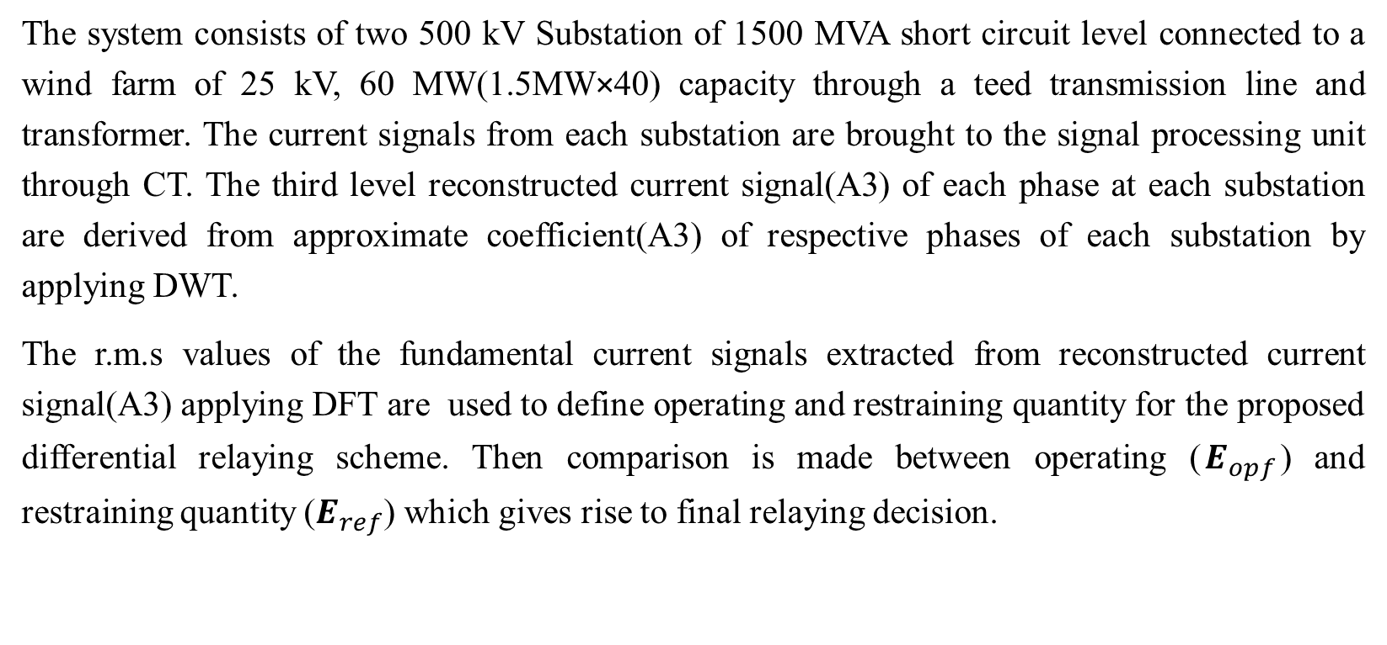
PROPOSED METHOD
The system consists of two 500 kV Substation of 1500 MVA short circuit level connected to a wind farm of 25 kV, 60 MW(1.5MW×40) capacity through a teed transmission line and transformer. The current signals from each substation are brought to the signal processing unit through CT. The third level reconstructed current signal(A3) of each phase at each substation are derived from approximate coefficient(A3) of respective phases of each substation by applying DWT.
The r.m.s values of the fundamental current signals extracted from reconstructed current signal(A3) applying DFT are used to define operating and restraining quantity for the proposed differential relaying scheme. Then comparison is made between operating ($E_{opf}$) and restraining quantity ($E_{ref}$) which gives rise to final relaying decision.

Slide 6
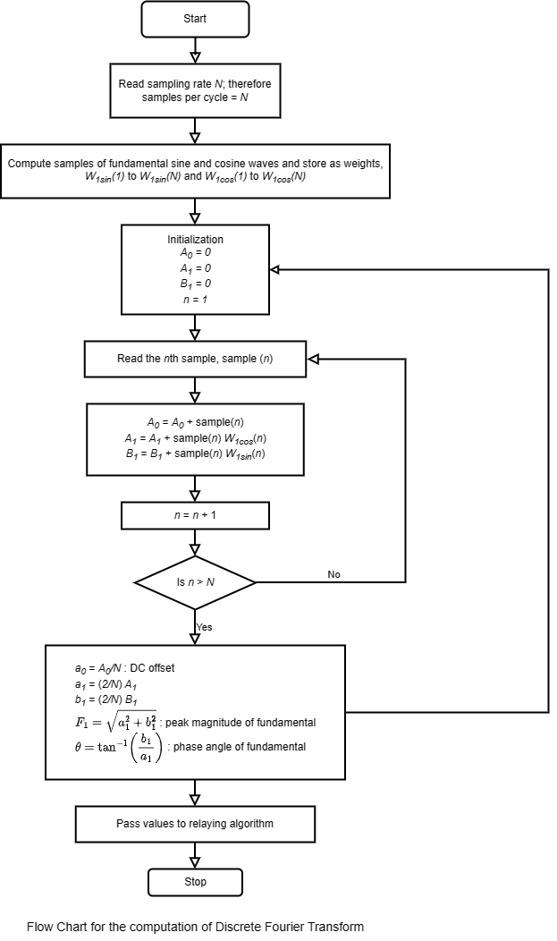
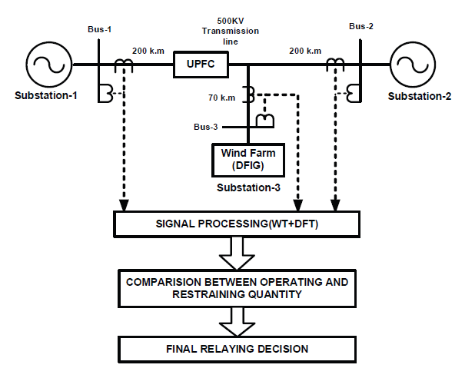
FLOW CHART
Proposed Relaying Scheme

Slide 7
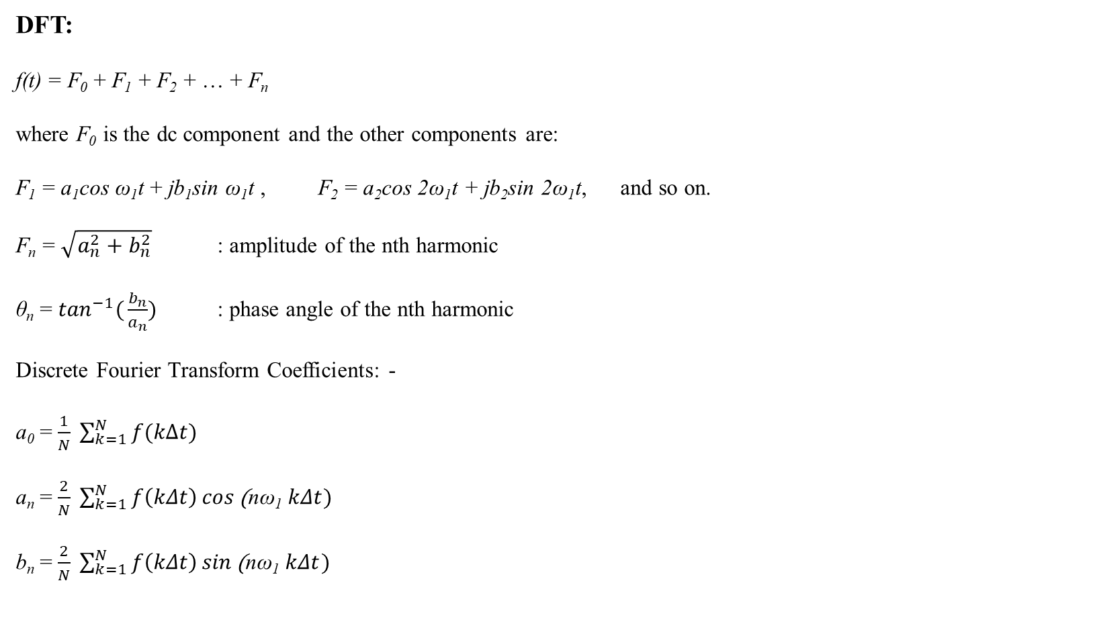
Mathematical background
DFT:
f(t) = F₀ + F₁ + F₂ + … + F_{n}
where F₀ is the dc component and the other components are:
F₁ = a₁cos ω₁t + jb₁sin ω₁t , F₂ = a₂cos 2ω₁t + jb₂sin 2ω₁t, and so on.
F_{n} = $\sqrt{a_{n}^{2}+b_{n}^{2}}$ : amplitude of the nth harmonic
θ_{n} = $\tan^{−1}({\frac{b_{n}}{a_{n}})}$ : phase angle of the nth harmonic
Discrete Fourier Transform Coefficients: -
a₀ = $\frac{1}{N} \sum_{k=1}^{N}{f(kΔt) }$
a_{n} = $\frac{2}{N} \sum_{k=1}^{N}{f\left(kΔt\right)\cos{\text{(}\text{n}\text{ω}\text{1} kΔt})}$
b_{n} = $\frac{2}{N} \sum_{k=1}^{N}{f\left(kΔt\right)\sin{\text{(}\text{n}\text{ω}\text{1} kΔt})}$

Slide 8
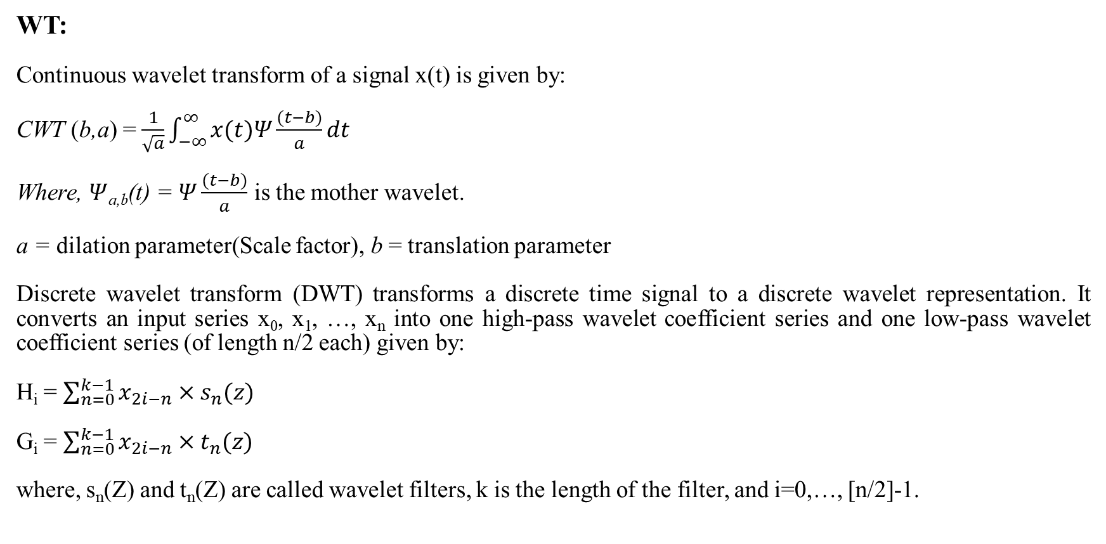
Cont.
WT:
Continuous wavelet transform of a signal x(t) is given by:
CWT (b,a) = $\frac{1}{\sqrt{a}}\int_{−∞}^{∞}{x(t)Ψ}\frac{(t−b)}{a}dt$
Where, $Ψ$_{a,b}(t) = $Ψ\frac{(t−b)}{a}$ is the mother wavelet.
a = dilation parameter(Scale factor), b = translation parameter
Discrete wavelet transform (DWT) transforms a discrete time signal to a discrete wavelet representation. It converts an input series x₀, x₁, …, x_{n} into one high-pass wavelet coefficient series and one low-pass wavelet coefficient series (of length n/2 each) given by:
H_{i} = $\sum_{n=0}^{k−1}{x_{2i−n}×s_{n}(z)}$
G_{i} = $\sum_{n=0}^{k−1}{x_{2i−n}×t_{n}(z)}$
where, s_{n}(Z) and t_{n}(Z) are called wavelet filters, k is the length of the filter, and i=0,…, [n/2]-1.

Slide 9

Cont.
Pre-processing of Current Signal:
In the signal processing part, r.m.s values of the fundamental current signals will be extracted from reconstructed current signal(A3) for each phase at each substation as the reconstructed signals are contaminated with various harmonics.
Then the fundamental operating and restraining currents for the differential relay will be derived as follows:
$$I_{op}=(I_{a_{1}}− I_{a_{2}}− I_{a_{3}})$$
$$I_{res}={(I_{a_{1}}+ I_{a_{2}}+ I_{a_{3}}) }/3$$
where, $I_{a_{1}}, I_{a_{2}}, I_{a_{3}}$ are the fundamental values of reconstructed current signals of a-phase of substation-1,2 and 3 respectively.

Slide 10
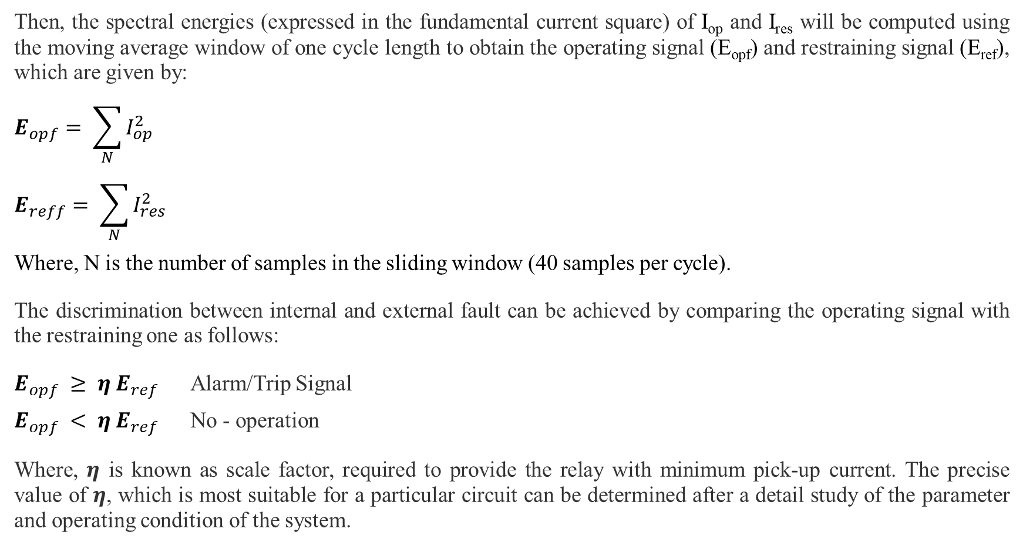
Cont.
Then, the spectral energies (expressed in the fundamental current square) of I_{op} and I_{res} will be computed using the moving average window of one cycle length to obtain the operating signal (E_{opf}) and restraining signal (E_{ref}), which are given by:
$$E_{opf}= \sum_{N}{I_{op}^{2}}$$
$$E_{reff}= \sum_{N}{I_{res}^{2}}$$
Where, N is the number of samples in the sliding window (40 samples per cycle).
The discrimination between internal and external fault can be achieved by comparing the operating signal with the restraining one as follows:
$E_{opf} ≥ η E_{ref}$ Alarm/Trip Signal
$E_{opf} < η E_{ref}$ No - operation
Where, $η$ is known as scale factor, required to provide the relay with minimum pick-up current. The precise value of $η$, which is most suitable for a particular circuit can be determined after a detail study of the parameter and operating condition of the system.

Slide 11
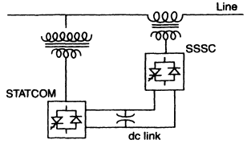
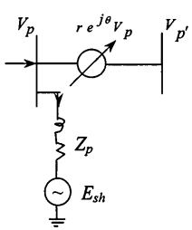
UPFC
The UPFC consists of two switching converters that are operated from a common dc link provided by dc storage capacitor.
Converter 2 provides the main function of UPFC by injecting an ac voltage of controllable magnitude and phase angle in series with the transmission line via a series transformer 1.
The basic function of Converter l is to supply or absorb the real power demand by Converter 2 at the common dc link. The active current component of Converter 1 is obtained from power balance between the series and the shunt converters and the reactive component can be independently controlled to provide necessary voltage support at the bus.
Equivalent Voltage Representation of UPFC

Slide 12
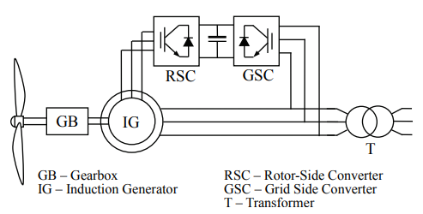
DFIG WIND TURBINE
The Doubly-Fed Induction Generator (DFIG) is currently the system of choice for multi-MW wind turbines. The aerodynamic system must be capable of operating over a wide wind speed range in order to achieve optimum aerodynamic efficiency by tracking the optimum tip-speed ratio. Therefore, the generator’s rotor must be able to operate at a variable rotational speed.
The back-to-back arrangement of the converters provides a mechanism of converting the variable voltage, variable frequency output of the generator (as its speed changes) into a fixed frequency, fixed voltage output compliant with the grid. The DC link capacitance is an energy storage element that provides the energy buffer required between the generator and the grid.

Slide 13
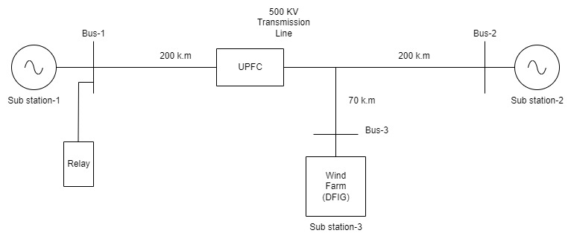
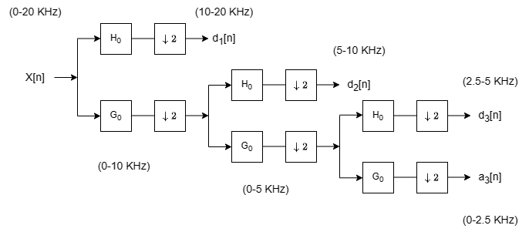
SINGLE-LINE DIAGRAM and wavelet decomposition tree
Single-Line Diagram of Teed Transmission System
Three Level Wavelet Decomposition Tree

Slide 14
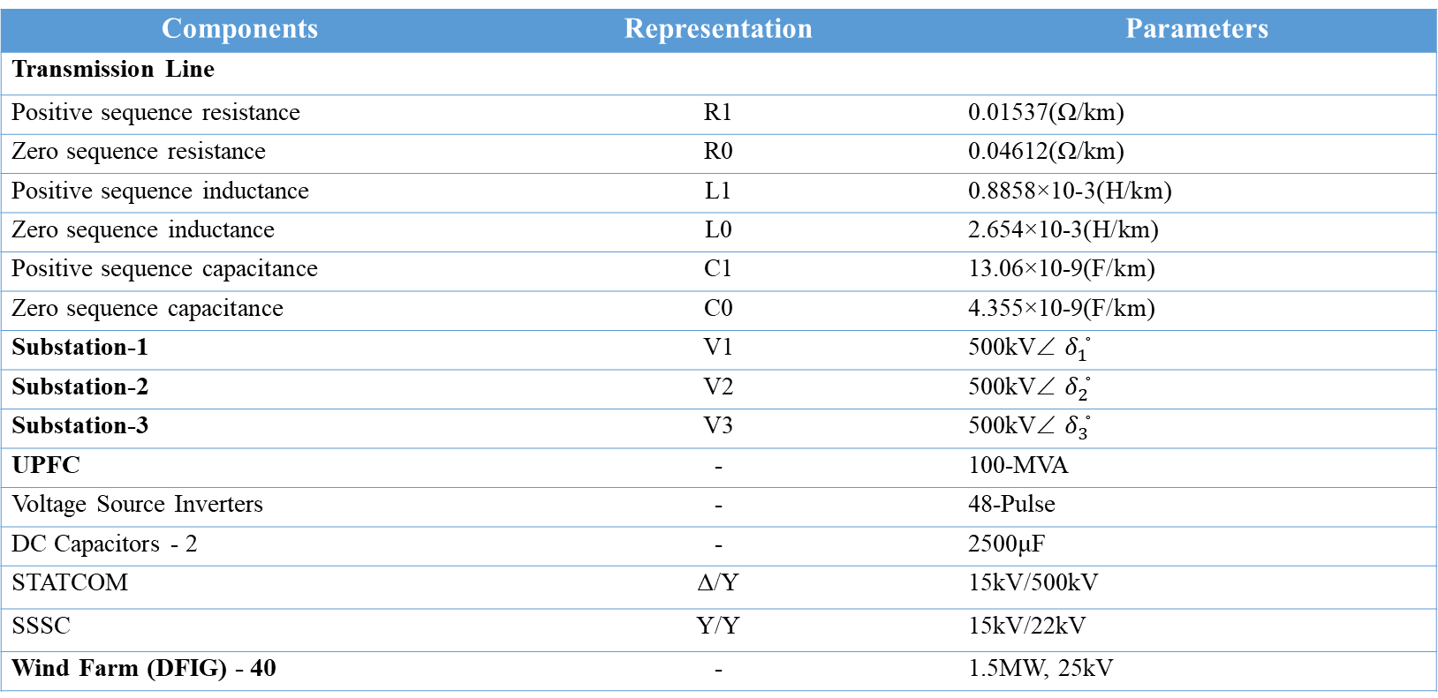
Parameters
Power System: 500Kv, 50Hz
Components | Representation | Parameters
Transmission Line
Positive sequence resistance | R1 | 0.01537(Ω/km)
Zero sequence resistance | R0 | 0.04612(Ω/km)
Positive sequence inductance | L1 | 0.8858×10-3(H/km)
Zero sequence inductance | L0 | 2.654×10-3(H/km)
Positive sequence capacitance | C1 | 13.06×10-9(F/km)
Zero sequence capacitance | C0 | 4.355×10-9(F/km)
Substation-1 | V1 | 500kV∠ $δ_{1}^{◦}$
Substation-2 | V2 | 500kV∠ $δ_{2}^{◦}$
Substation-3 | V3 | 500kV∠ $δ_{3}^{◦}$
UPFC | - | 100-MVA
Voltage Source Inverters | - | 48-Pulse
DC Capacitors - 2 | - | 2500μF
STATCOM | Δ/Υ | 15kV/500kV
SSSC | Υ/Υ | 15kV/22kV
Wind Farm (DFIG) - 40 | - | 1.5MW, 25kV

Slide 15
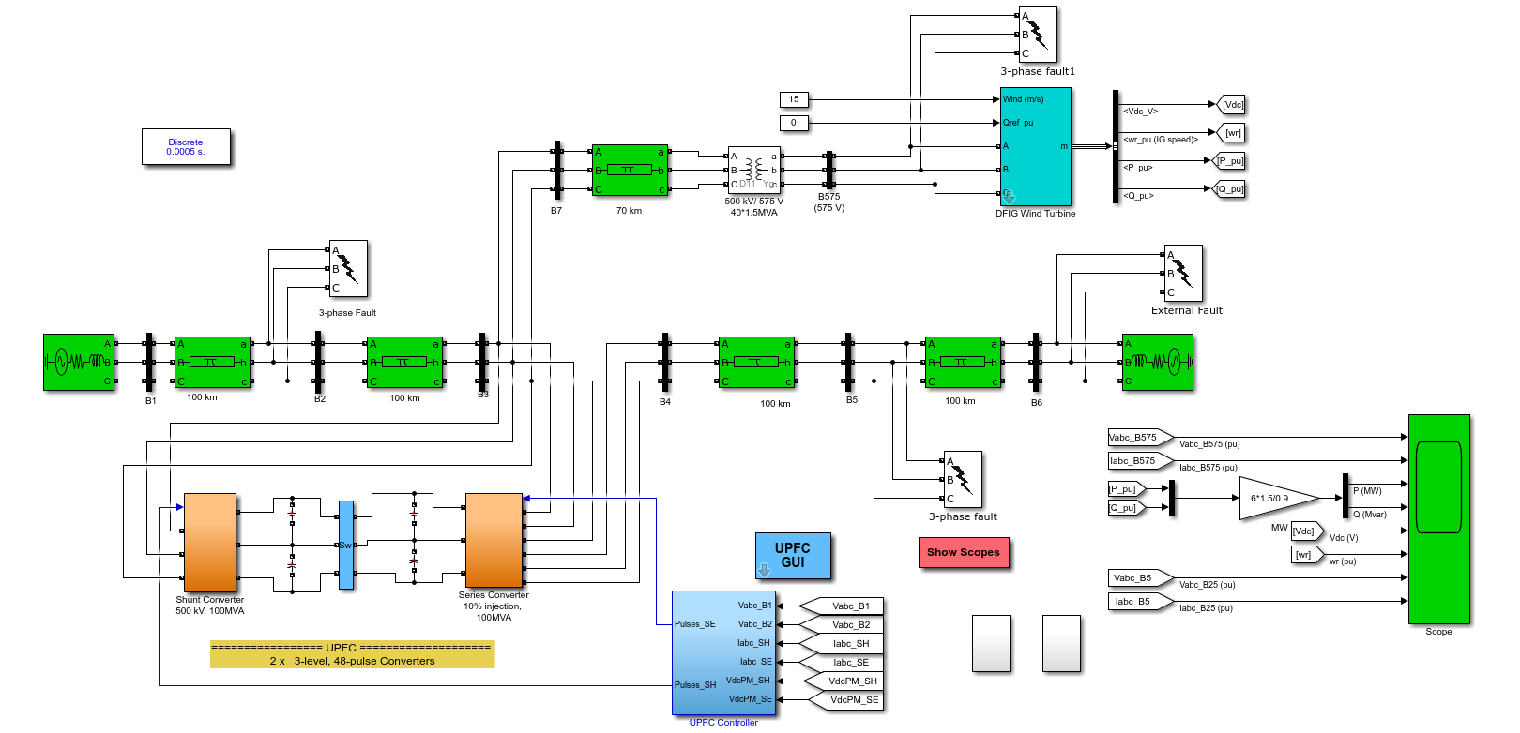
Simulation diagram

Slide 16
SENDING END RECONSTRUCTED CURRENT SIGNAL (A3) OF EACH PHASE AT A-G FAULT

Slide 17
receiving END RECONSTRUCTED CURRENT SIGNAL (A3) OF EACH PHASE AT A-G FAULT

Slide 18
Wind farm END RECONSTRUCTED CURRENT SIGNAL (A3) OF EACH PHASE AT A-G FAULT

Slide 19
MAGNITUDE OF CURRENT IN DIFFERENT PHASES VS SAMPLES
Magnitude of different phase currents for A-G fault at a distance 100k.m from substation-1

Slide 20
MAGNITUDE CHANGE AND PHASE CHANGE OF PHASE-A
Magnitude and Phase Angle of A-phase current for A-G fault at a distance 100k.m from substation-1

Slide 21
Operating and restraining current and energy at a-g fault
E­_{opf} and E_{res} for A-G fault at a distance 100k.m from substation-1

Slide 22
DIFFERENT CASES INVESTIGATED
The following circumstances of fault and network variations investigated later under:
Variation in fault resistance (R_{f}) from 0 to 30Ω
Variation in fault location: 30%, 50%,70% and 90% of the line
Variation in fault inception angle (FIA): 0° ,20° ,40° ,60° ,80° ,100°, 120°, 140°, 160°, 180°
Different types of faults: a-g, b-g, c-g, a-b, b-c, c-a, ab-g, bc-g, ca-g, a-b-c
UPFC series injected voltage (V_{se}) varied for 0-15% of the normal voltage.
Variation in wind speed: 5m/s, 10m/s, 15m/s, 20m/s, 25m/s
Reverse power flow.

Slide 23
PLOT OF E_{OP} AND E_{RES} FOR EXTERNAL A-G FAULT
Effect of External A-G fault at far-end of substation-3 on E_{op} and E_{res}

Slide 24
EFFECT OF FAULT INCEPTION ANGLE
Effect of fault inception angle for internal A-G fault at a distance 100k.m from substation-1

Slide 25
EFFECT OF INTERNAL FAULT RESISITANCE
Effect of fault resistance on E_{op} and E_{res} for internal A-G fault at a distance 100k.m from substation-1

Slide 26
EFFECT OF WIND SPEED
Effect of different wind speed on E_{op} and E_{res} for internal A-G fault at a distance 100k.m from substation-1

Slide 27
OPERATION AGAINST REVERSE POWER FLOW
Effect of Reverse Power Flow with internal A-G fault at far-end of substation-2 on E_{op} and E_{res}

Slide 28
CONCLUSION
Here we have discussed about a differential relaying scheme based on spectral energy.
It provides discrimination between external and internal faults at all operating conditions.
The differential scheme is more reliable in detecting faults due to the data being evaluated comes from all ends of transmission system.
The proposed scheme is independent of many problems associated with the teed transmission lines such as out feed currents, high resistance internal fault and wind speed variation of the wind farm

Slide 29
FUTURE SCOPE
In the future, we can study about the performance assessment of the proposed differential relaying scheme for transmission line protection in presence of UPFC and windfarm based on three statistical metrics: Dependability, Security and Yield. And compare between the proposed scheme and the conventional relaying scheme that which one gives better dependability for all types of faults at different fault location.
The real time implementation of the scheme is feasible due to availability of RTDS and DSP chips with execution time of the order of nano second. As the proposed technique works on the energy content of the signals at different substation, only communication link is required to perform the relaying task at a particular substation and thus reducing the cost of time-synchronization of the signals (error introduced due to phase angle difference are minimized) at all substations.

Slide 30
REFERENCES
L. N. Tripathy, M. K. Jena, S. R. Samantaray and Satyabadi Mishra, A Differential Protection scheme for Tapped Transmission Line containing UPFC and Wind Farm, International Journal of Electrical Power & Energy Systems, Nov. 2014
N. G. Hingorani and L. Gyugyi, “Understanding FACTS Concepts and Technology of Flexible AC Transmission Systems.”, New York: IEEE Press, 2000, pp. 16 – 24
P. K. Dash, A. K. Pradhan, G. Panda, and A. C. Liew, “Adaptive relay Setting for flexible AC transmission systems (FACTS),” IEEE Trans. Power Del., vol. 15, no. 1, Jan. 2000, pp. 38 – 43.
Xiaoyao Zhou, Haifeng Wang, R. K. Aggarwal, and Phil Beaumont, “Performance Evaluation of a Distance Relay as Applied to a Transmission System With UPFC”, IEEE Trans. Power Del., vol. 21, no. 3, Jan. 2006, pp. 1137 – 1147.
Amir Ghorbani, Babak Mozafari, Ali Mohammad Ranjbar, “Digital distance protection of transmission lines in the presence of SSSC”, International Journal of Electrical Power & Energy Systems, Volume 43, Issue 1, December 2012, pp 712 - 719.
A. K. Pradhan and Geza Joos, “Adaptive Distance Relay Setting for Lines Connecting Wind Farms”, IEEE Trans, Energy conversion, vol. 22, no. 1, March 2007.
S. I. Jang, J. H. Choi, J.W. Kim, and D. M. Choi, “An adaptive relaying for the protection of a wind farm interconnected with distribution networks”, in Proc. IEEE PES Transmiss. Distrib. Conf. Expo. vol. 1, Sep. 7– 12, 2003, pp. 296 – 302.
John Flectcher and Jin Yang, “Introduction to Doubly-Fed Induction Generator for Wind Power Applications”, Paths to Sustainable Energy, Dr Artie Ng (Ed.), ISBN: 978- 953-307-401-6, (2010), pp. 262 – 263.
Badri Ram and D N Vishwakarma, “Power System Protection and Switchgear 2e”, Tata McGraw Hill Education Private Limited, ISBN (13): 978-0-07-107774-3, ISBN (10): 0-07-107774-X, (2011), pp. 327 – 347.
Bhalja, B.; Maheshwari, R.P., "Wavelet Transform Based Differential Protection Scheme for Tapped Transmission Line", Industrial Technology, 2006. ICIT 2006. IEEE International Conference.
P.M. Silveira, R. Seara, and H.H. Zurn, “An Approach Using Wavelet Transform for Fault Type Identification in Digital Relaying”, IEEE-PES Summer Meeting, Vol. 2, 1999, pp. 937 –942.

Slide 31
Thank You

