Slide 1

Retail Analytics Python Project
Spring 2025, University of West Georgia
By
Enita Omuvwie

Slide 2
Table of contents
01
02
03
04
05
Objective
Background
Methodology
Code & Output
Conclusion

Slide 3
Objective
Develop a Python DataFrame for further analysis
Read in the SQL Marketing Data csv file into Python
Create basic statistical summaries for variables
Generate essential statistics and create What-if-Scenarios for analytical insights

Slide 4
Background
Overview
Dataset integrates Customer, Product and Transaction data for marketing analysis
Understand customer behavior, product performance and sales trends
Key Tables in Dataset
Customer Data: Cust_ID, Cust_Gender, Cust_Age
Will be used for customer segmentation and targeting
Product Data: Prdct_ID, Prdct_Category, Prdct_Amt
Will help identify top selling products and revenue drivers
Transaction Data: Trnsct_ID, Trnsct_Date, Prch_Quantity
Will help discover sales trends
Purpose
Develop Python-based marketing analysis for decision making

Slide 5

Methodology
02
03
04
01
Data Ingestion
Data Exploration
Statistical Analysis
Scenario Analysis
Load the SQL marketing data csv into Python using pandas library
Create column names and assign that when reading in the dataset
Created new metrics for customer segmentation and trends
Created visuals for new metrics
Checked for missing, duplicates
Get summary statistics
Compute statistics
Create new variables
Analyze purchase behavior, revenue, and product performance

Slide 6
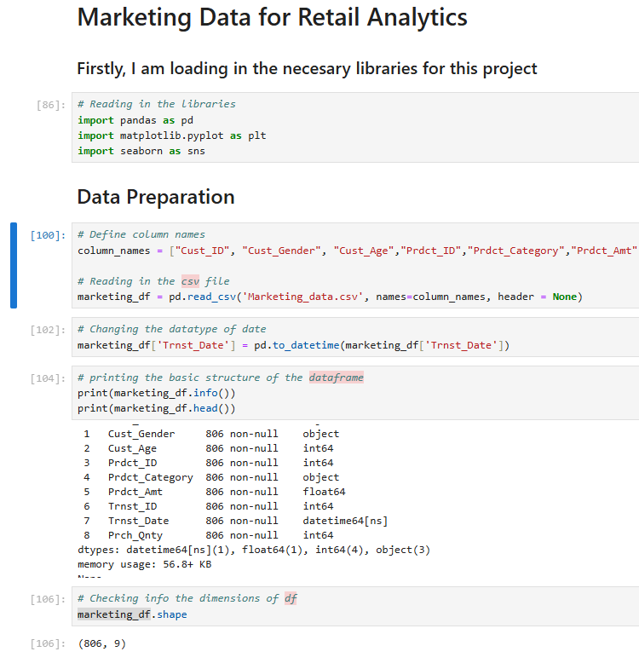
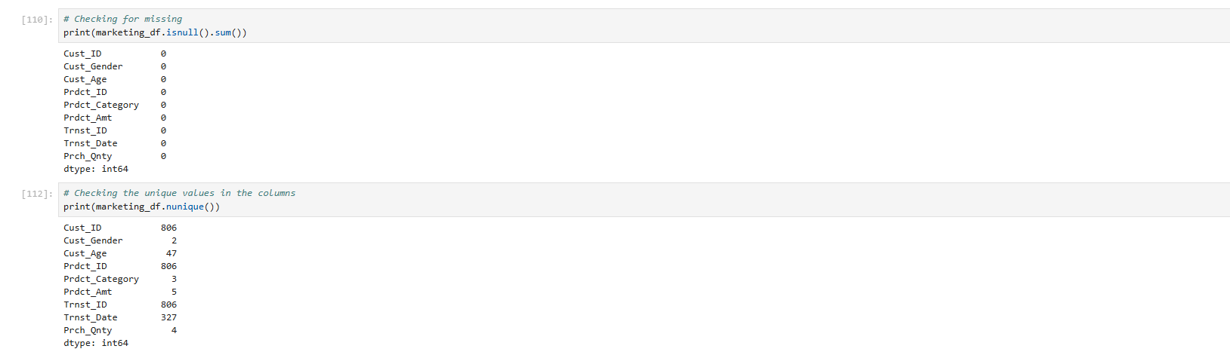
Code Output: Data Ingestion
Libraries for analysis
Defined column names for csv file
Read in the csv file with indication of column names
Changed Data datatype
Checked the structure of each column name
Checked dimension of dataframe
Checked for missing and nulls

Slide 7
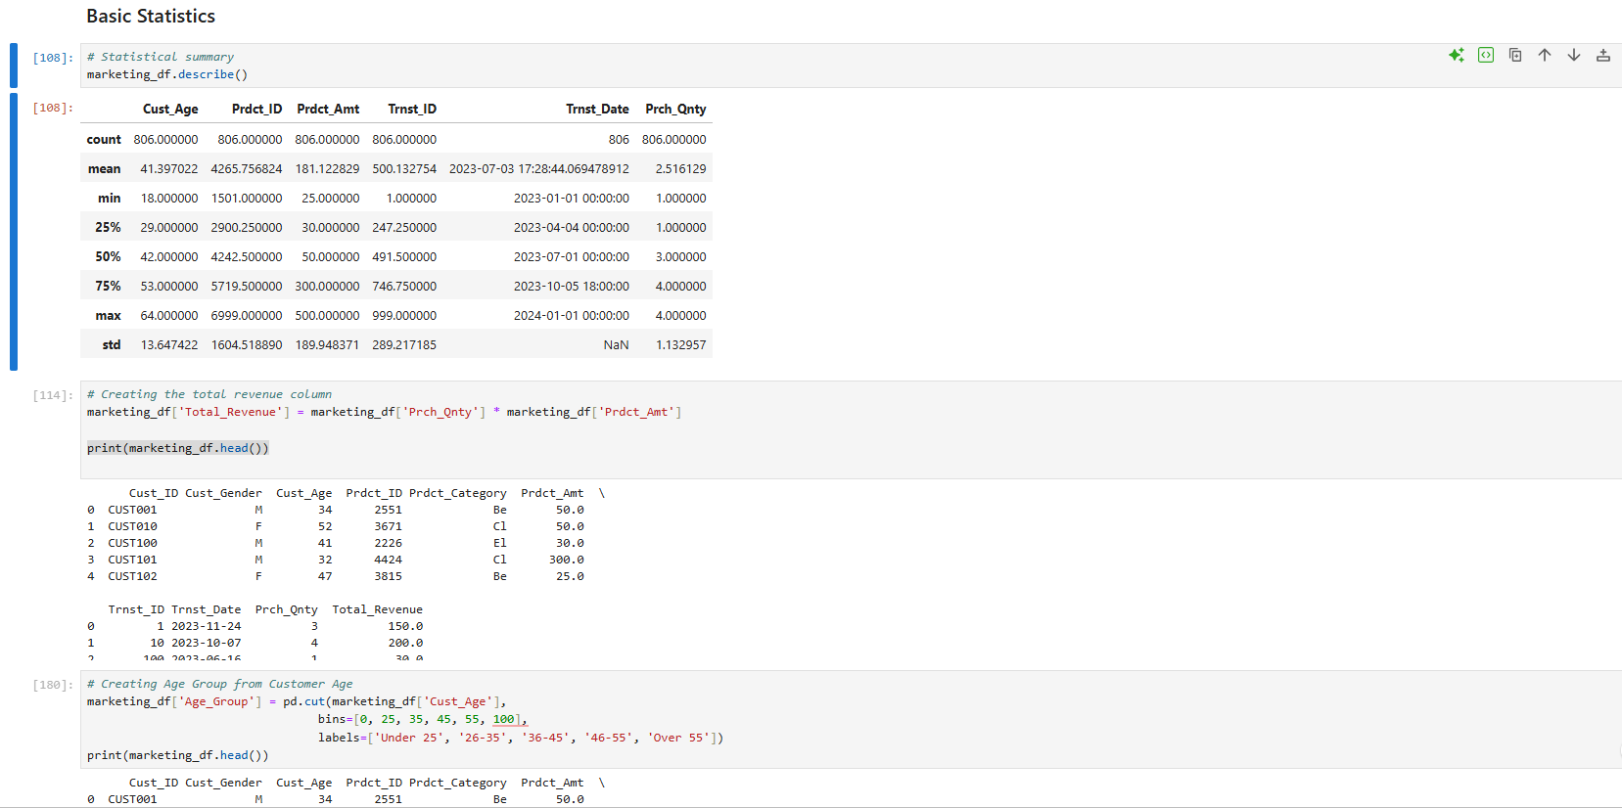
Code Output: Data Exploration
Checked the Statistics: Min, Max, Avg, Std, Count
Created new variables: Total_Revenue and Age_Group

Slide 8
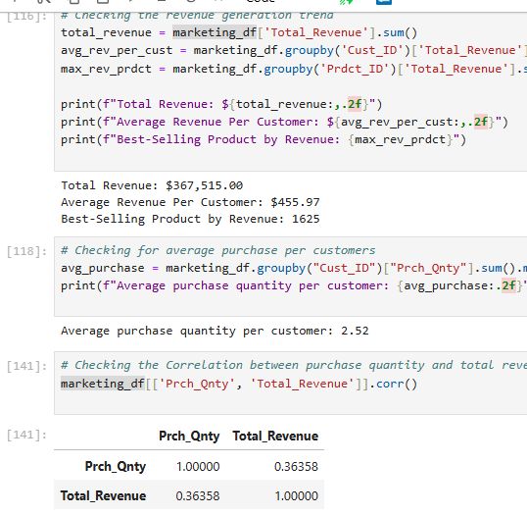
Code Output: Data Scenarios
Checking Revenue : Total, Average and Best-selling product by Revenue
Average Purchased products
Correlation between Quantity and Total Revenue

Slide 9
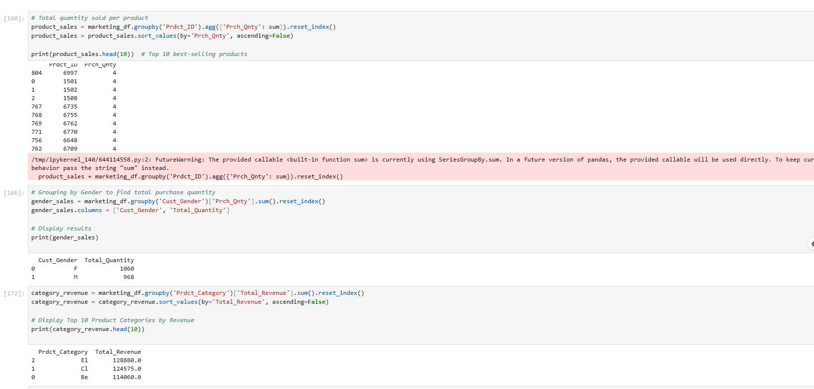
Code Output: Data Scenarios
Products by the Quantity sold
Purchase Quantity of products by Gender
Product Categories by Total Revenue

Slide 10
Code Output: Data Scenarios
Products by the Quantity sold
Purchase Quantity of products by Gender
Product Categories by Total Revenue

Slide 11
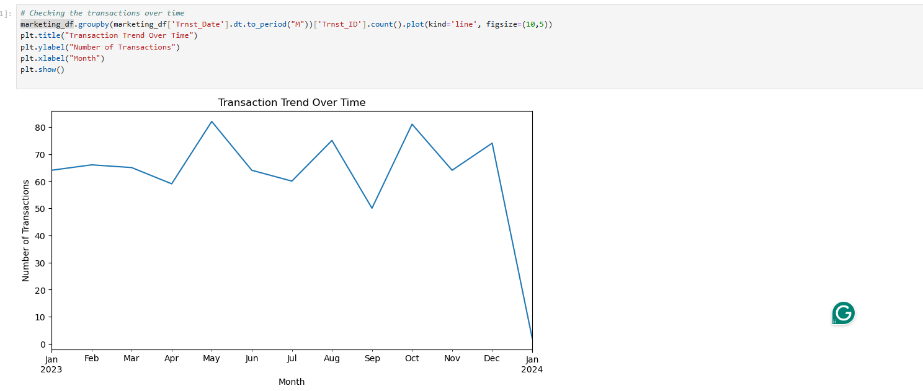
Code Output: Data Scenarios
Monthly Total Transactions Plot trend: We see the variation in how customers purchase monthly

Slide 12
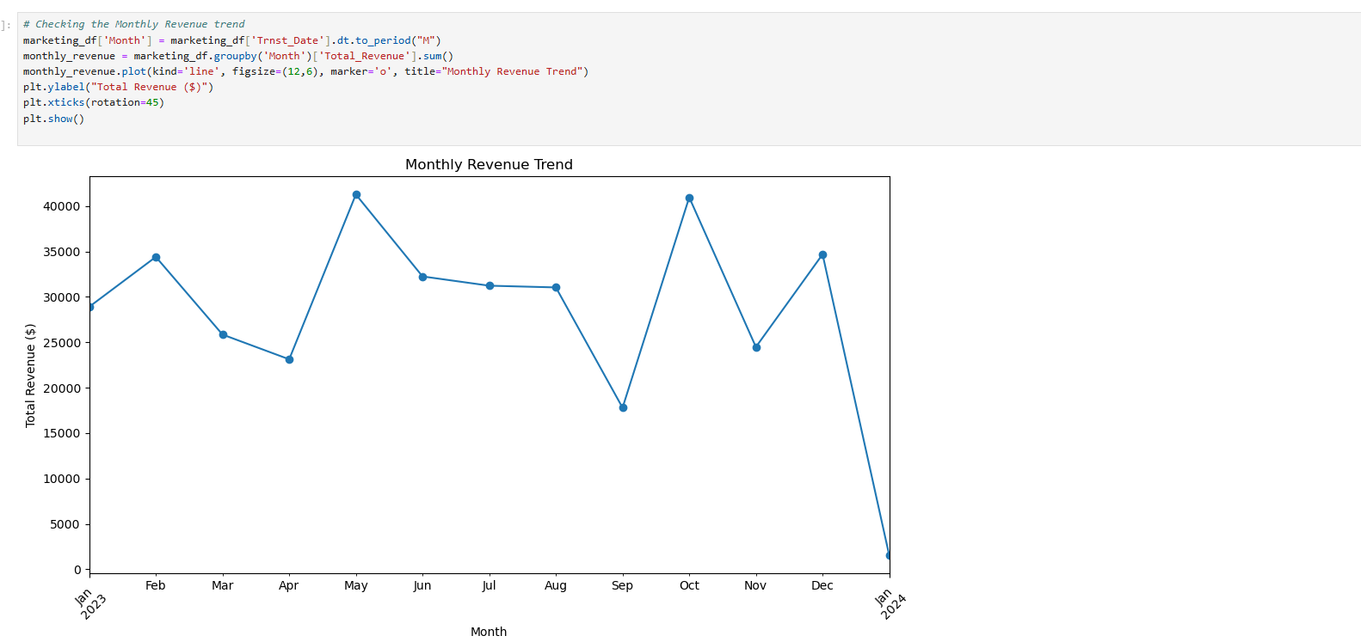
Code Output: Data Scenarios
Monthly Total Revenue Plot trend: We see that October and May of 2023 have the highest revenue

Slide 13
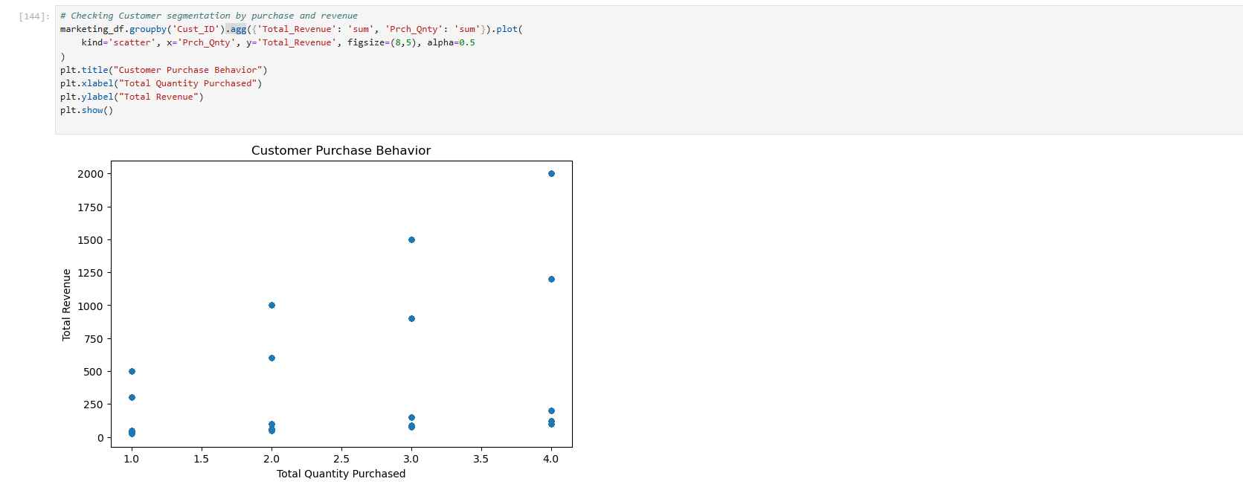
Code Output: Data Scenarios
Customer Segmentation Behavior: We see that as Quantity purchased increases so does revenue

Slide 14
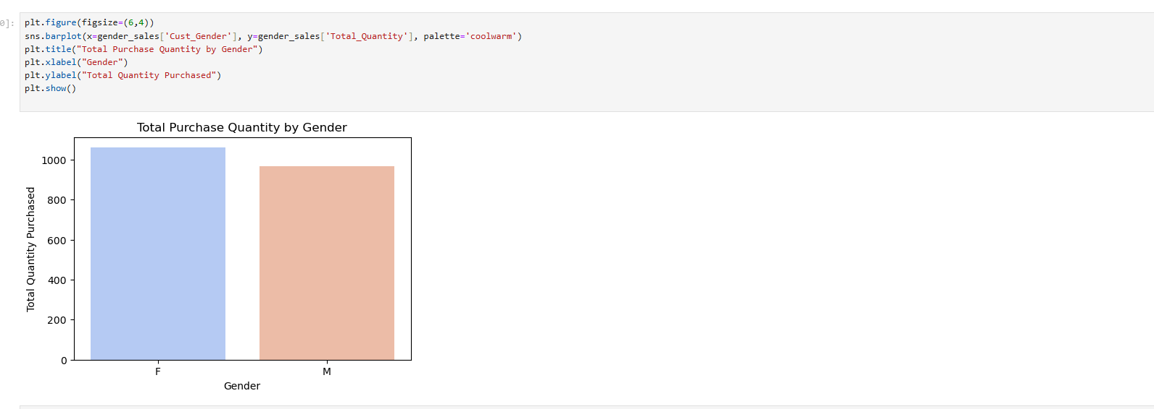
Code Output: Data Scenarios
Distribution Gender by Quantity purchased showing more of the products are purchased by Females

Slide 15
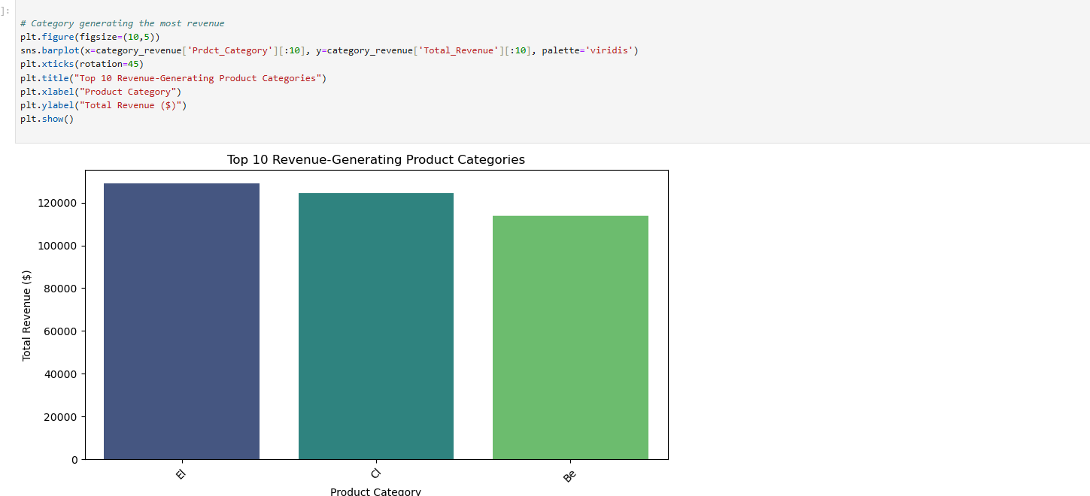
Code Output: Data Scenarios
Revenue Generating Product Categories: We see that product category with highest revenue meaning more customers purchased products from that category

Slide 16
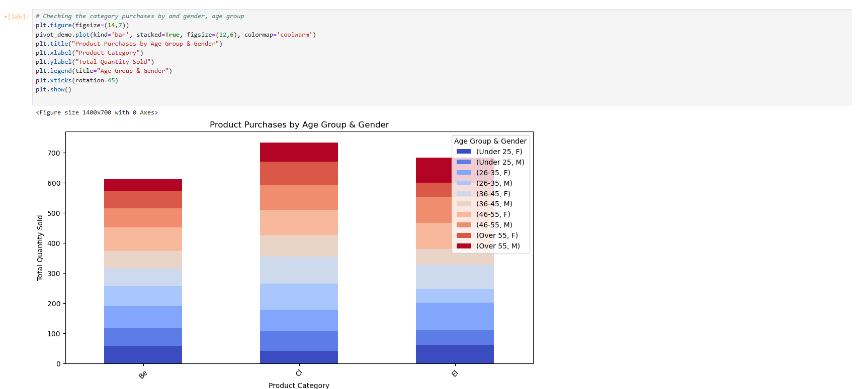
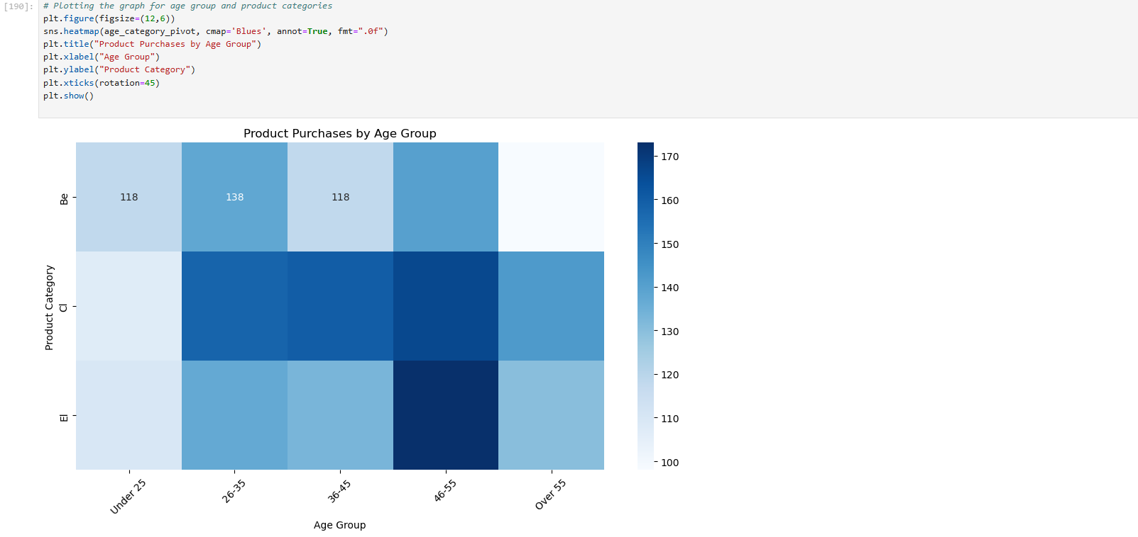
Code Output: Data Scenarios
Product Purchases by Age Group: Checking which Age Group purchased the most items from which product category
Category of Product purchased by Age Groups and Gender: Checking which category was purchased from most by which gender

Slide 17
Conclusion
Imported Marketing data csv into Python for analysis
Performed exploratory data analysis for valuable insights
Developed new statistical metrics and scenarios for decision making
Further analysis and business applications can be done like developing a model

Slide 18
Thanks!
Do you have any questions?
eomuvwi1@my.westga.edu

