Slide 1

Retail Analytics Term 1 Project
Spring 2025, University of West Georgia
By
Enita Omuvwie

Slide 2
01
02
03
04
05
Table of contents
Objective
Background
Methodology
Code & Output
Conclusion

Slide 3
Objective
SQL
Python
Develop a structured marketing dB from different tables to store both transactions and customer information
Generate essential queries to extract key data sets
Cleaning of data, handling missing values and data format
Visualize distribution of key variables
Identify transaction trends over time
Create a new variable DEPVAR and flags per product
Computing summary statistics of time dependent variable related to the new variable DEPVAR

Slide 4
Background
Overview
Dataset integrated three datasets: Customer, Product and Transaction data to create Marketing_data.csv
Understand customer behavior, product performance and sales trends
Key Tables in Marketing Dataset
Cust_ID, Cust_Gender, Cust_Age
Will be used for customer spending behavior
Prdct_ID, Prdct_Category, Prdct_Amt
Will help creating flag per products and discover purchasing patterns
Trnsct_ID, Trnsct_Date, Prch_Quantity
Will help in conducting time-dependency analysis
Purpose
Develop further marketing analysis for decision making

Slide 5
Methodology
Data Ingestion
Extract data from SQL databases(Customer, Product and Transaction)
Removing missing values and standardize data formats
Data Exploration
Generate summary statistics
Time Dependency Analysis
Convert Trnst_Date variable to date using pd.datetime()
Analyze seasonality trends and transaction peak periods
Feature Engineering
Calculate the Total Amount per Transaction (DEPVAR)
Define Dependent Variable
Statistical Analysis
Create product category flags
Compute statistics for DEPVAR
Load data into Python for further analysis
Visualizing variable distributions
Identifying data inconsistencies or outliers
Discover transaction patterns over time
Create new variables for RFM analysis and other behavioral features
Visualize DEPVAR distribution

Slide 6
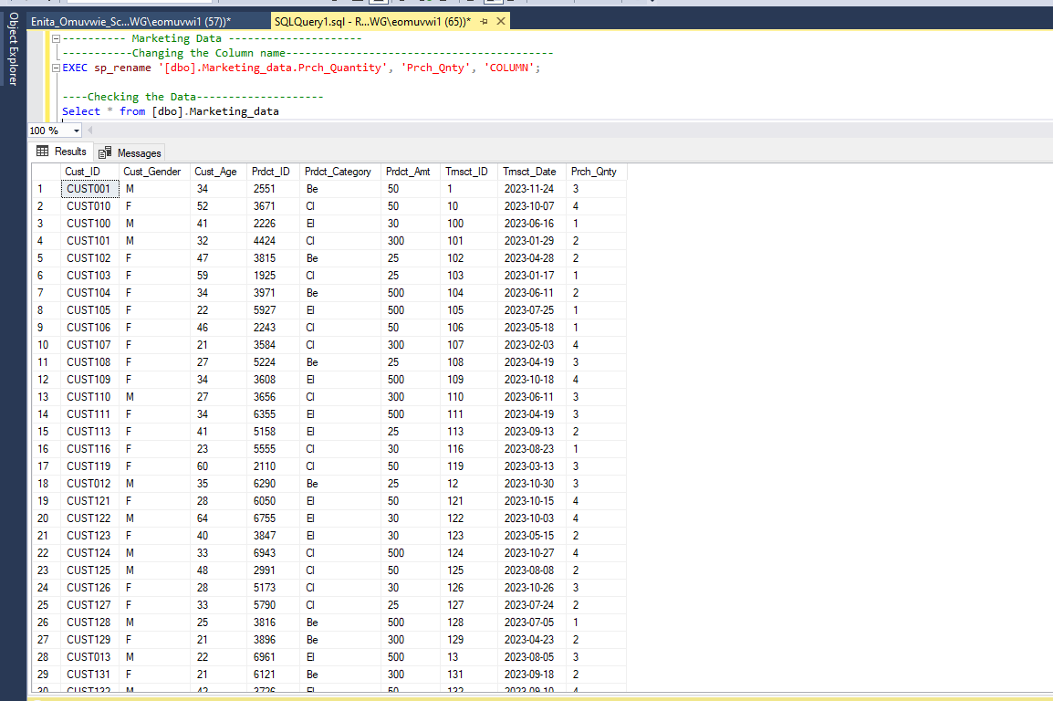
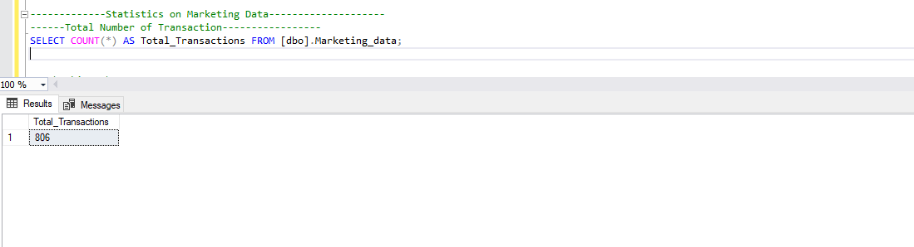
Code and Output : SQL
Total Number of Transactions
Marketing Table Output

Slide 7
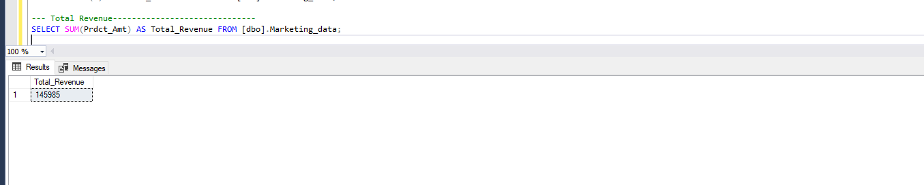
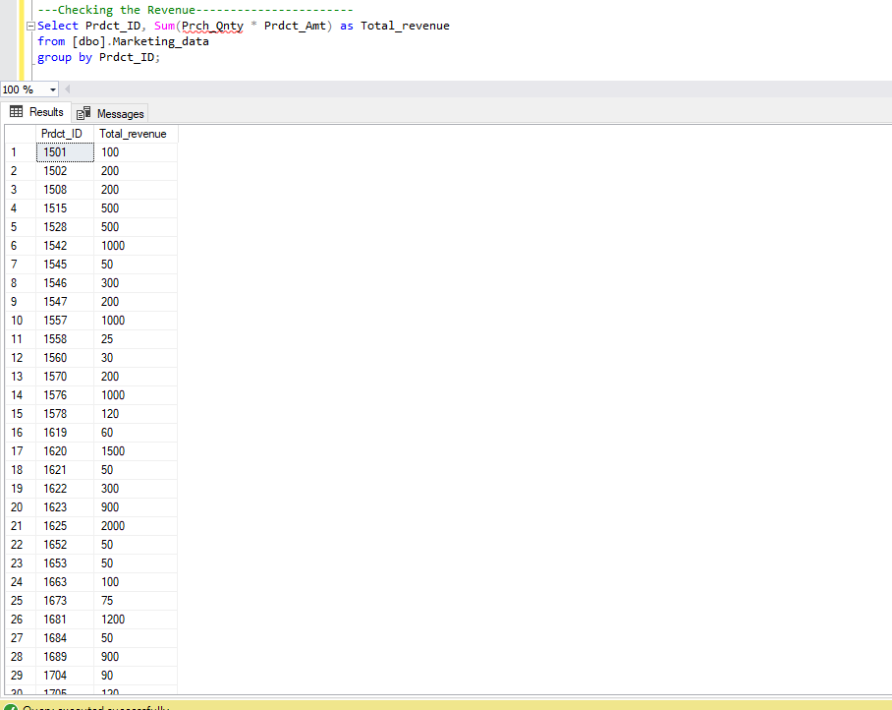
Code and Output : SQL
Total Spent by Customers
Total Spent by Products

Slide 8
Code and Output : SQL
Total Spent by Customers
Total Spent by Products

Slide 9
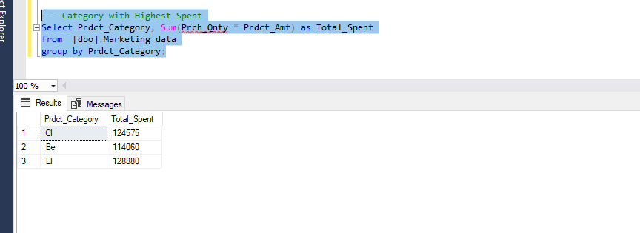
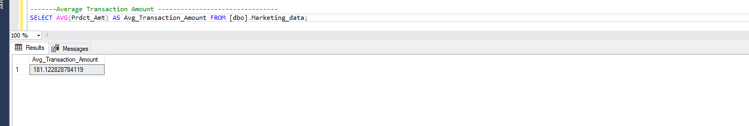
Code and Output : SQL
Total Spent by Categories
Average Transaction Amount

Slide 10
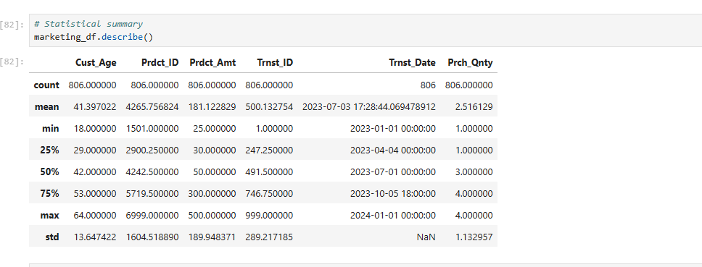
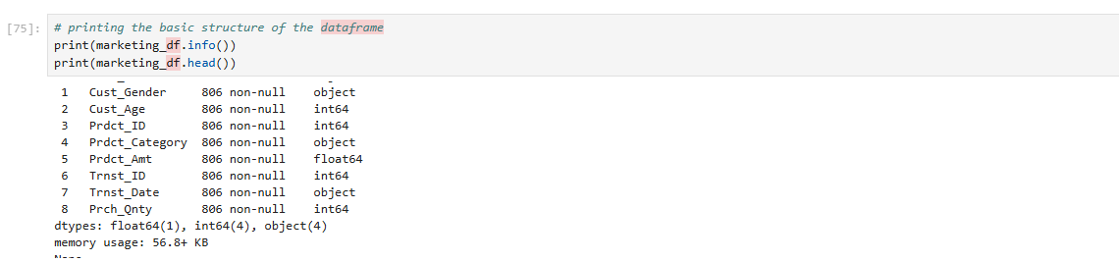
Code and Output : Python
Marketing Data Statistics
Data Types before Date Conversion

Slide 11
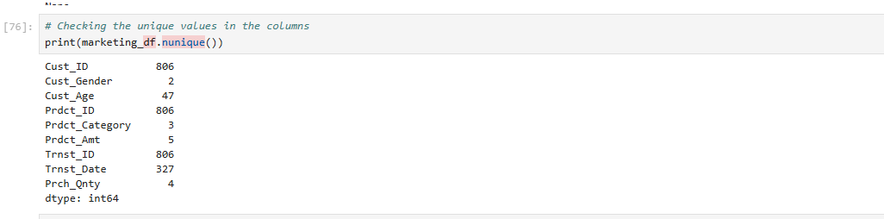
Code and Output : Python
Marketing Data Details

Slide 12
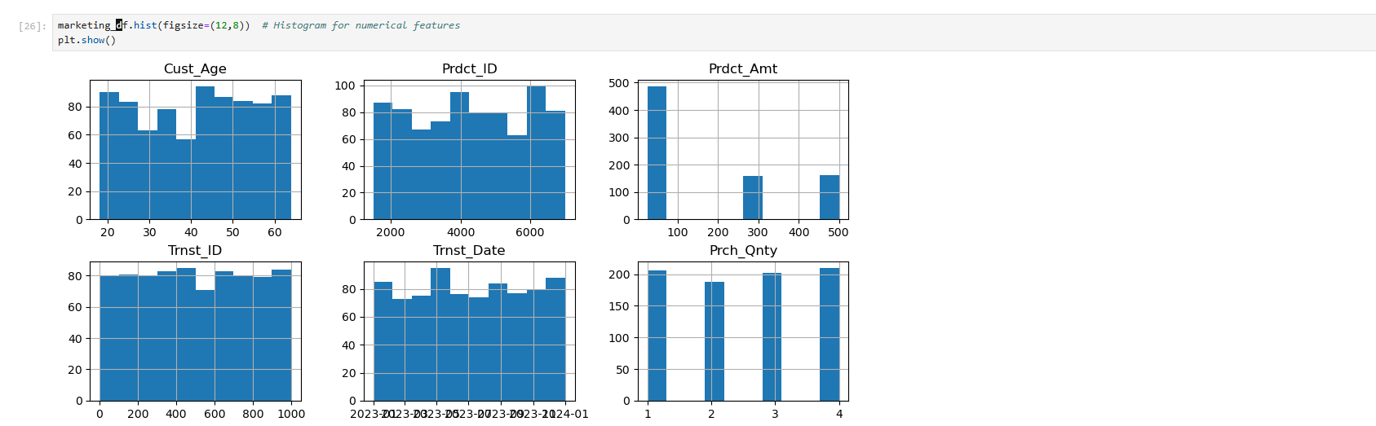
Code and Output : Python
Marketing Data Graph Distribution

Slide 13
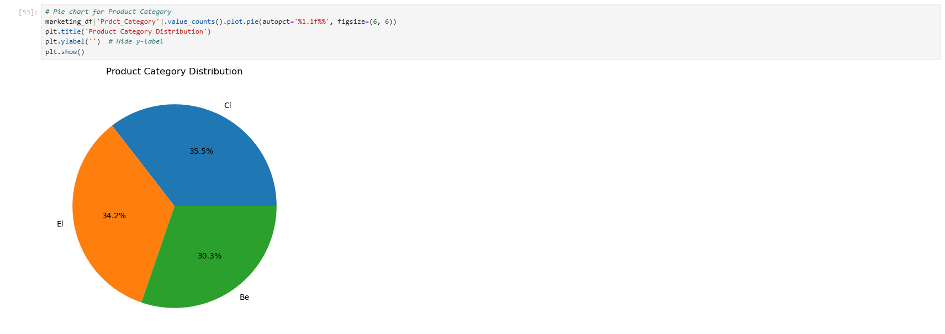
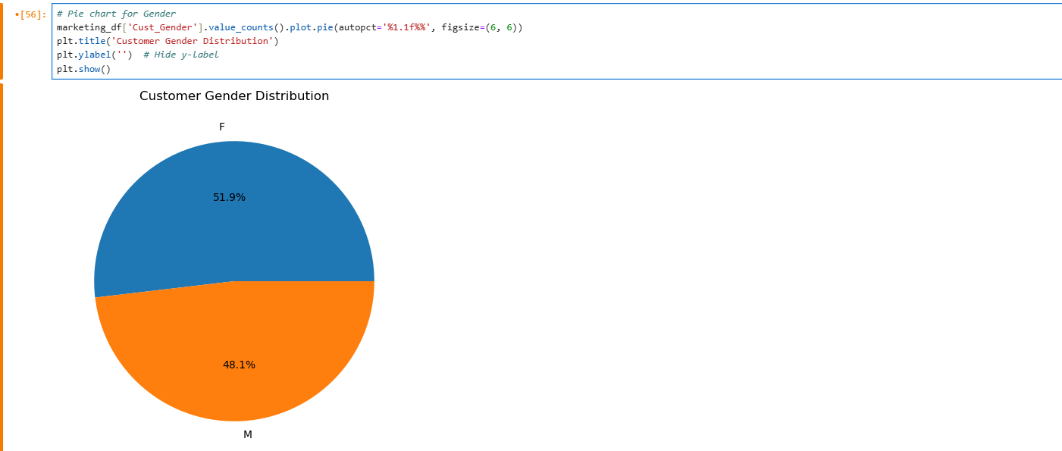
Code and Output : Python
Product Category Distribution
Customer Gender Distribution

Slide 14
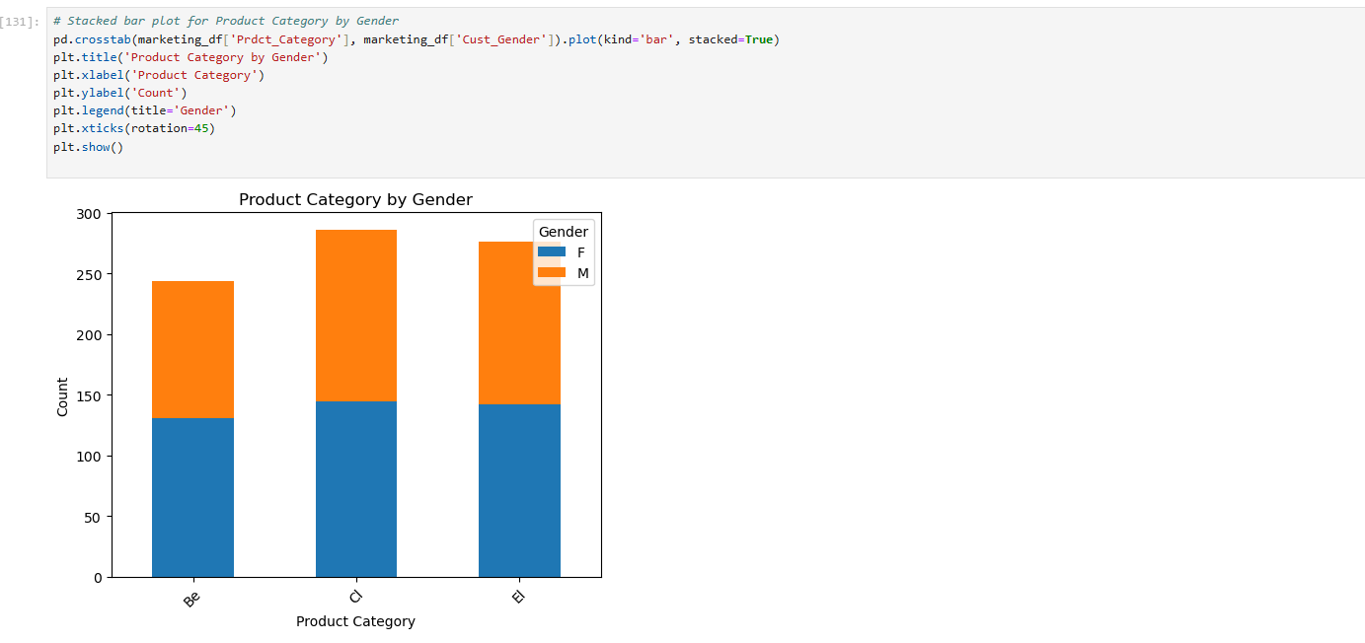
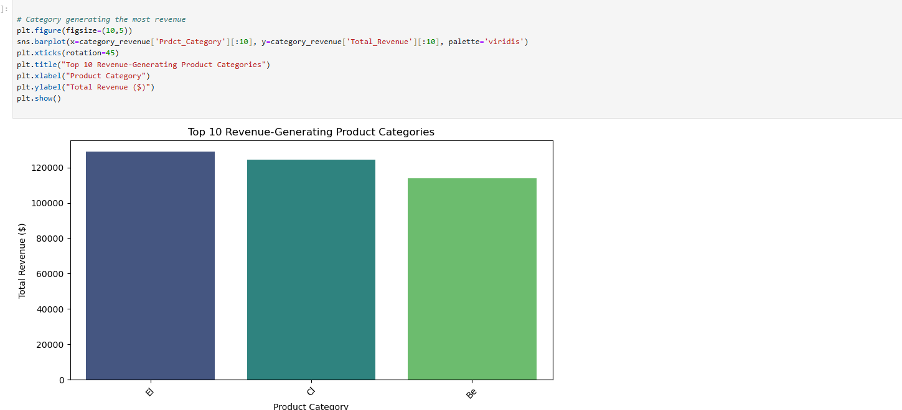
Code and Output : Python
Product Category Distribution by Gender
Customer Gender Distribution

Slide 15
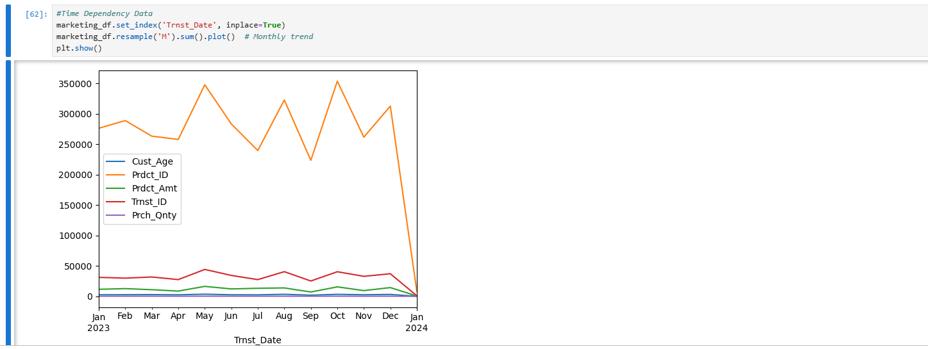
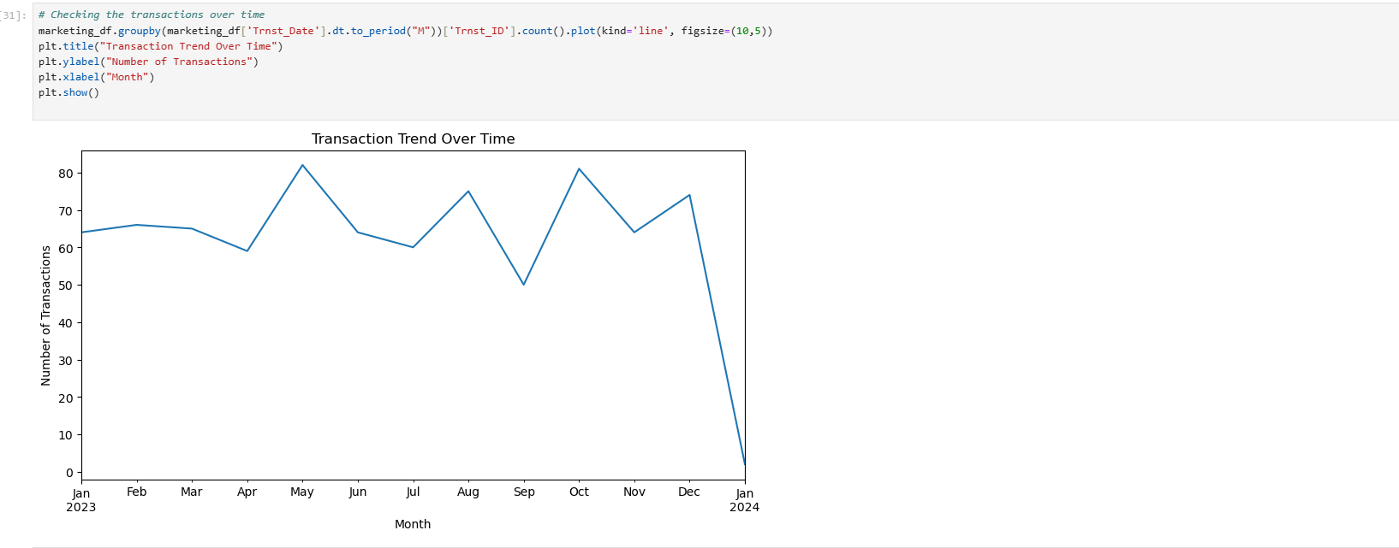
Code and Output : Python-Time Dependency
This shows the trend of transactions over some features
Transaction Trend over Time

Slide 16
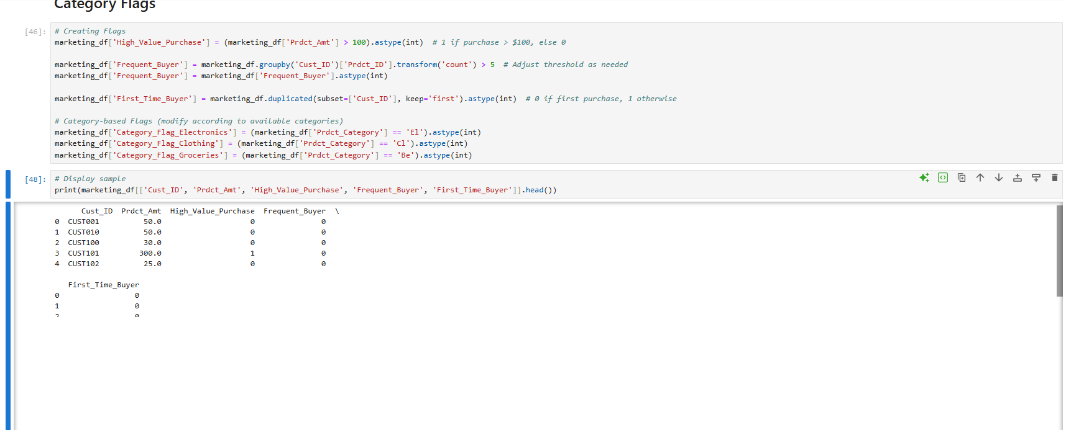
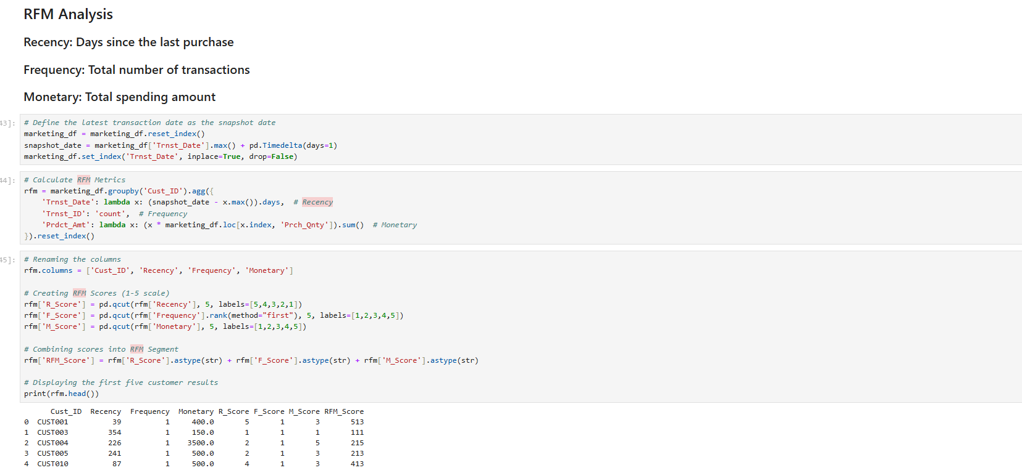
Code and Output : Python- Category Flags
Customer Segmentation using RFM Analysis(Recency, Frequency, Monetary)
Category Flags

Slide 17
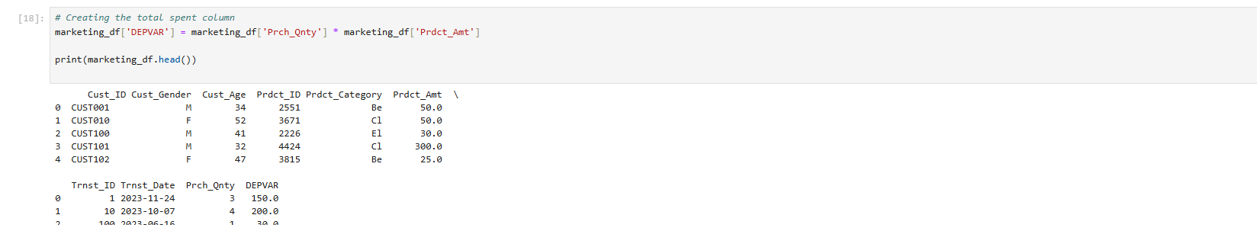
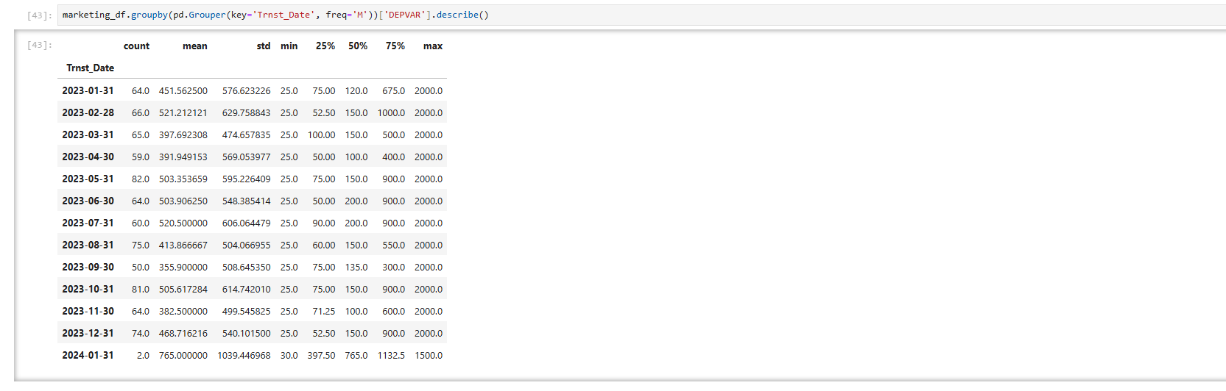
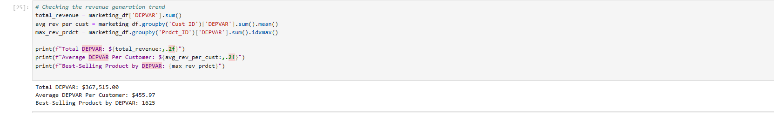
Code and Output : Python – Feature Engineering
DEPVAR Statistics
Creating Feature DEPVAR

Slide 18
Thanks!
Do you have any questions?
eomuvwi1@my.westga.edu

