Slide 1
A Comprehensive Framework for Classifying Biotic and Abiotic Stress in Plants
Presenter: Hong Chen

Slide 2
Contents
Introduction & Background
Theoretical Analysis
Data Engineering & Rigorous Partitioning
Results and Performance Analysis
Discussion & Conclusion

Slide 3
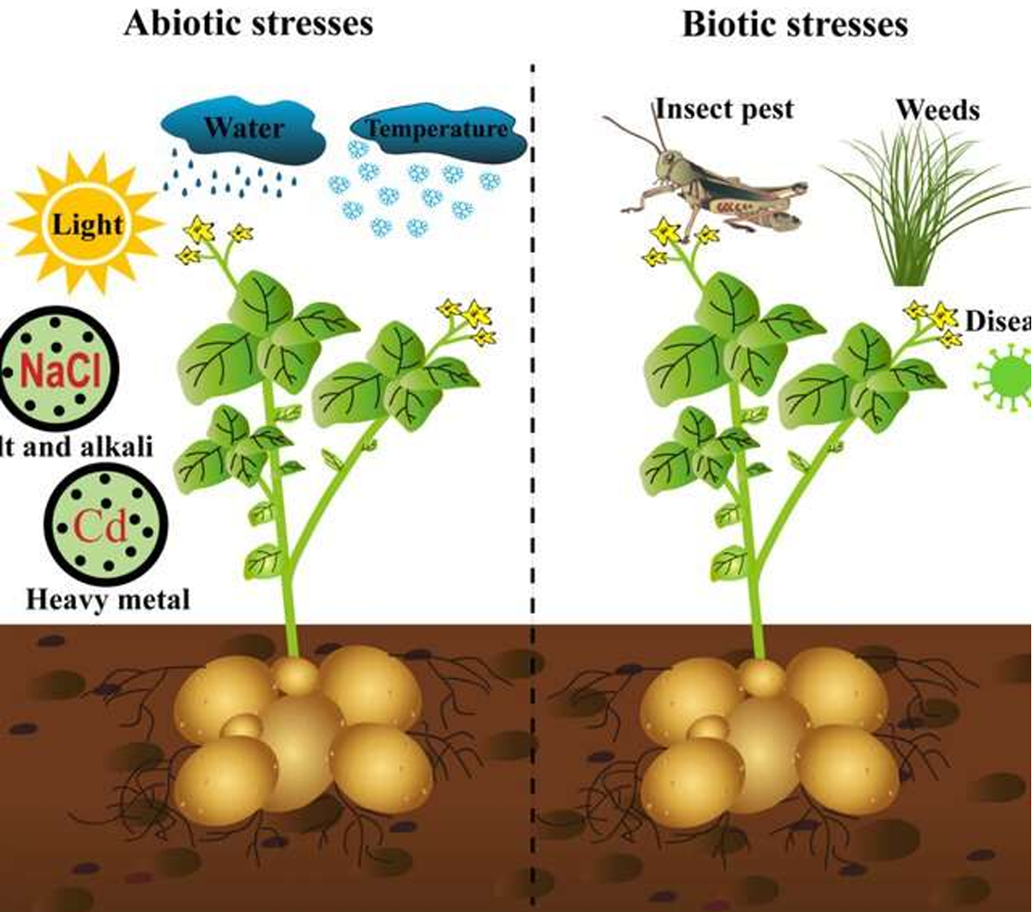
1. Introduction & Background
The Global Stakes:
Agricultural Productivity: Plant stress is a primary threat to food security, causing 20-40% annual yield reduction [1].
The Taxonomic Challenge
Biotic: Pathogens and pests (Requires chemical intervention).
Abiotic: Light, water, temperature, nutrient deficiency (Requires environmental management).
Shift in Methodology
Moving from visual scoring to non-invasive optical imaging and AI [2].
Notes:
英文汇报稿 (Oral Presentation Script)
"First, let’s look at the background of our project. As shown in the image on the right, plant growth is heavily impacted by both biotic and abiotic stressors.
On the biotic side, we have factors like pests, weeds, and various viral or bacterial infections. On the other hand, abiotic factors include nutrient deficiencies—such as a lack of nitrogen, iron, or potassium—as well as issues with water and sunlight. On average, we lose 20% to 40% of our crop yields every single year just because of these stressors.
To provide the right treatment, we must accurately identify which stressor the crop is facing. Traditionally, this relies on manual inspection, which is neither efficient nor accurate for large-scale farming. That’s why we’ve developed an AI-driven approach to replace manual observation, using crop images to automatically identify specific stressors."

Slide 4
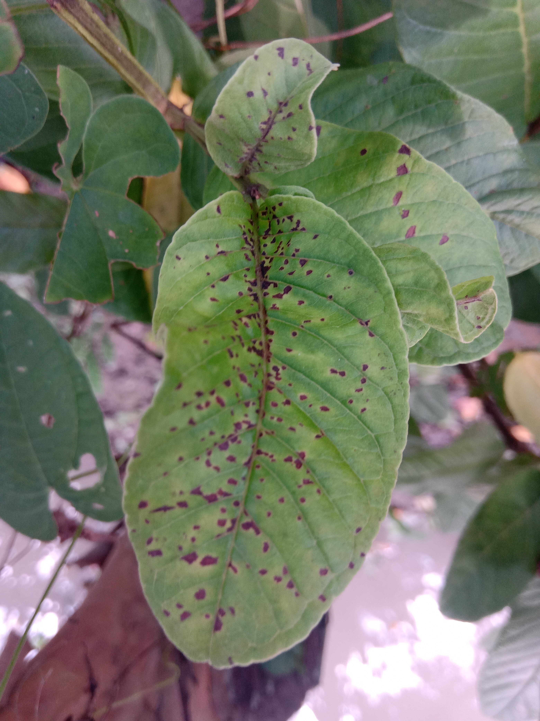
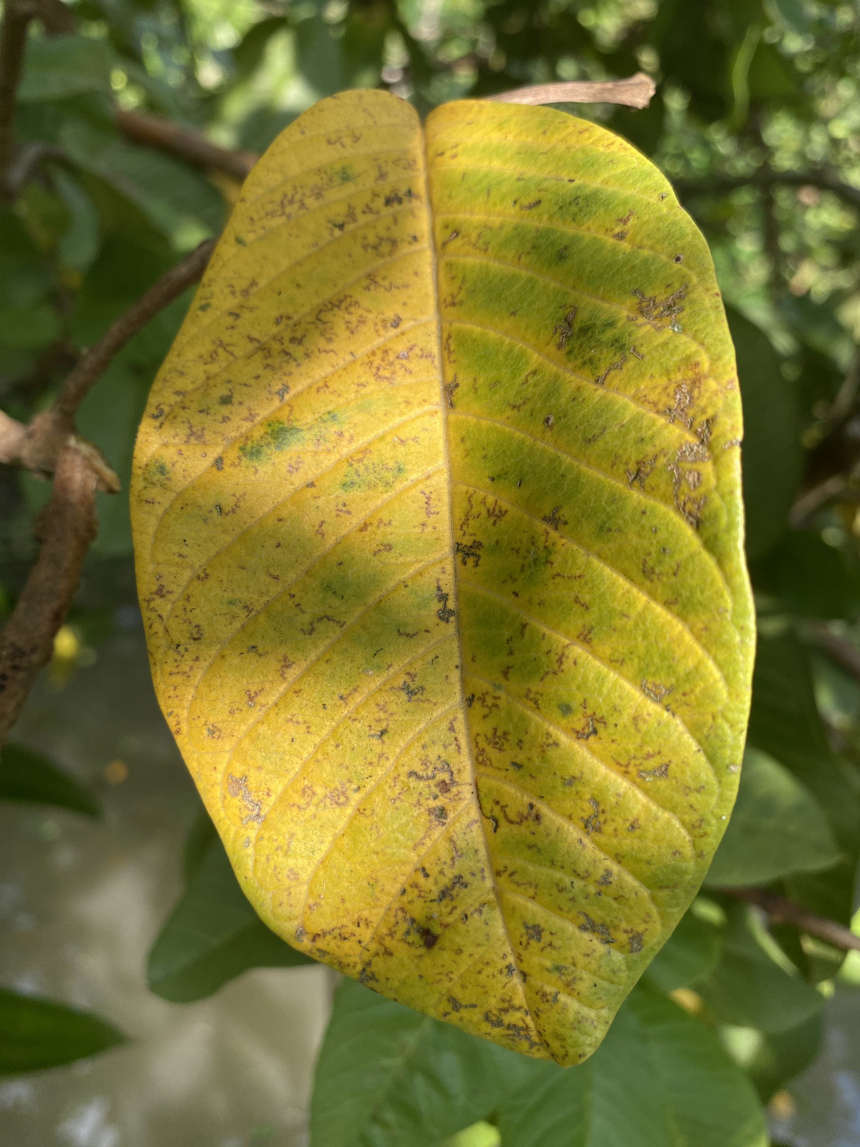
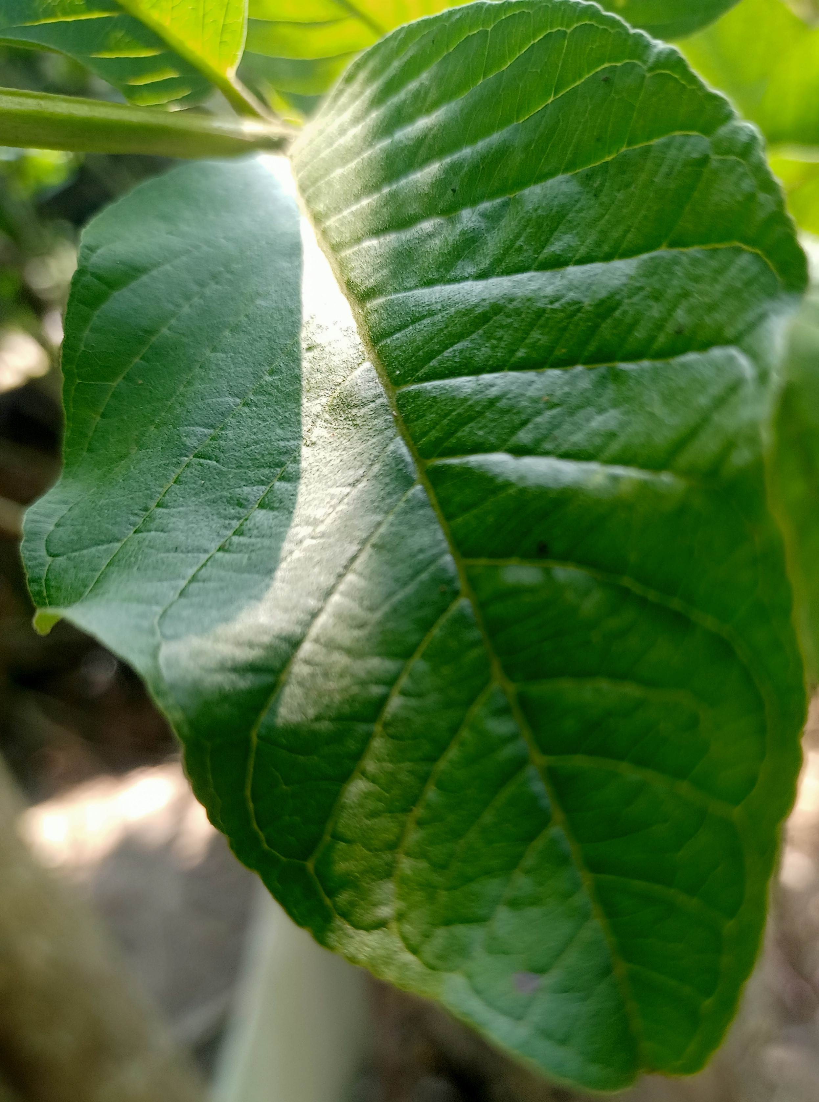
1. Introduction & Background
Core Task - Binary Stress Classification
Objective: To classify plant health status into two distinct diagnostic categories.
Abiotic Path (e.g., Nutritional Deficiency)
Biotic Path (e.g., Fungal/Viral Infection)
Abiotic stress
Healthy
Biotic stress
Notes:
Our project simplifies this complex reality into a Binary Classification task: Is it Biotic or Abiotic? This clear distinction is the first and most important step for any targeted intervention.

Slide 5


2. Theoretical Analysis - Core Architecture
Model Backbone: MobileNetV3
Efficiency: Inverted Residual blocks designed for mobile/edge deployment
Optimization: Perfect for real-time agricultural diagnostics.
Learning Strategy: Transfer Learning
Source: Pre-trained weights from ImageNet
Benefit: Accelerates convergence and overcomes the scarcity of specialized plant stress data.
Development Stack
Core: Python 3.10 | PyTorch & Torchvision
Processing: OpenCV (Vision) & Matplotlib (Analytics)
Notes:
We chose MobileNetV3 because it’s incredibly efficient. In a real-world farm, we don't have giant servers; we need a model that can run on a smartphone or a drone. By using Transfer Learning, we adapted this powerful model to recognize specific plant stress patterns with much less data.
We didn't train from scratch. Instead, we utilized Transfer Learning by leveraging pre-trained ImageNet weights. This allows our model to start with a sophisticated understanding of visual shapes and textures, which is essential when dealing with specific plant stress datasets.
The entire system is implemented in Python using the PyTorch framework, ensuring a flexible and scalable pipeline for our image processing and voting logic.

Slide 6
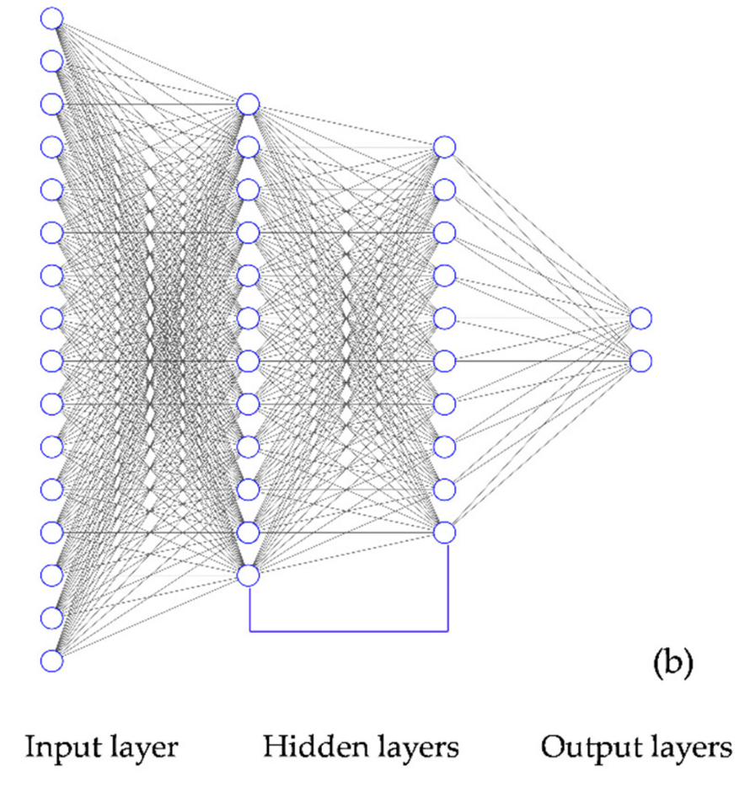
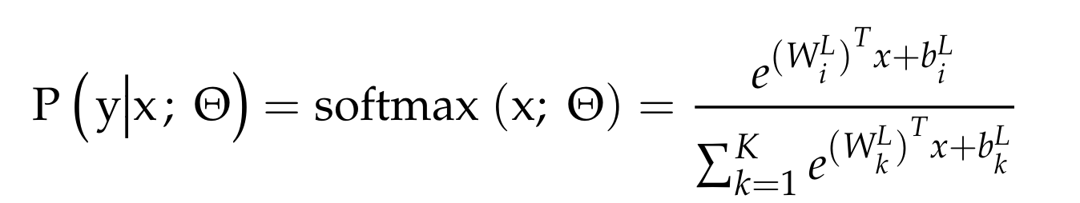
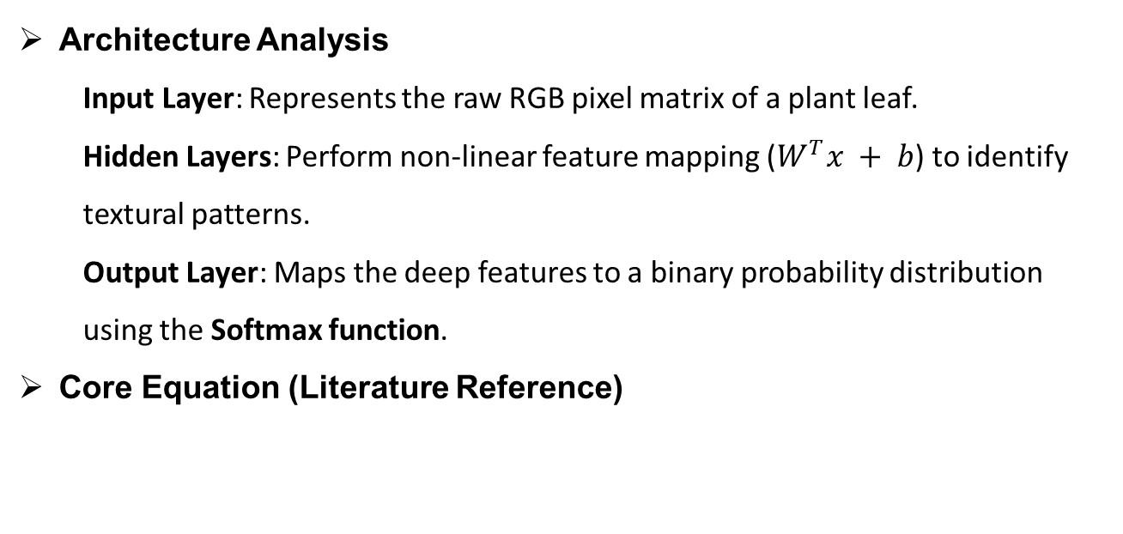
2. Theoretical Foundation: DCNN & Probability Mapping
Architecture Analysis
Input Layer: Represents the raw RGB pixel matrix of a plant leaf.
Hidden Layers: Perform non-linear feature mapping ($W^{T}x + b$) to identify textural patterns.
Output Layer: Maps the deep features to a binary probability distribution using the Softmax function.
Core Equation (Literature Reference)
Notes:
To understand how we classify stress, we look at the DCNN architecture. We use MobileNetV2 as a mathematical function $f(x)$ that transforms pixels into abstract features. It looks for patterns like the rough texture of a fungus or the yellowing of a nutrient deficiency.
As shown in the Softmax equation from our literature, the network doesn't just say 'Yes' or 'No'. It calculates a probability, $P(y|x)$, for each class. (指向公式) This value represents the model's 'confidence’.
This is the core of our Soft Voting logic. Instead of taking one final guess, our framework collects these probability scores from all tiles. By averaging these mathematical confidences, we get a much more stable and accurate diagnosis than any single-image model.

Slide 7
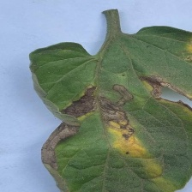
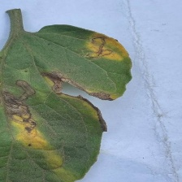
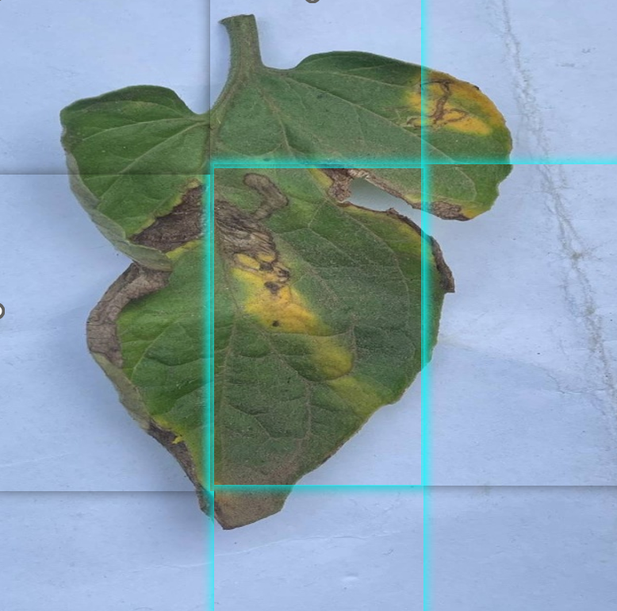
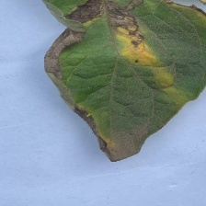
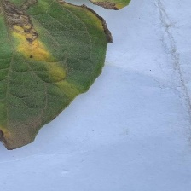
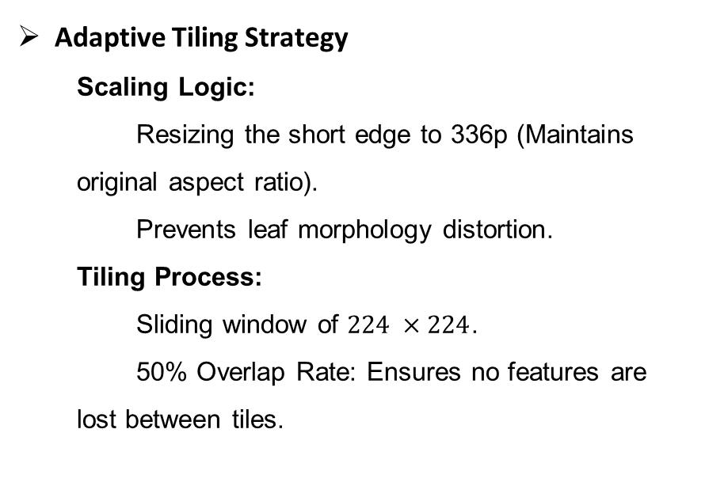
2.1 Problem Analysis - The "Resolution Bottleneck"
Adaptive Tiling Strategy
Scaling Logic:
Resizing the short edge to 336p (Maintains original aspect ratio).
Prevents leaf morphology distortion.
Tiling Process:
Sliding window of $224 ×224$.
50% Overlap Rate: Ensures no features are lost between tiles.
224 pixels
336 pixels
224 pixels
Notes:
The most critical part of our preprocessing is the Adaptive Tiling. First, we resize the short edge to 336 pixels while letting the long edge scale proportionally. This keeps the leaf's natural shape intact.
Then, we use a 224 x 224 sliding window with a 50% overlap to crop the image. By doing this, we ensure that even the smallest fungal spots are preserved at their original detail, which is the key to our high classification accuracy.

Slide 8
2.2 MobileNetV2 Pipeline
Block 1 (Conv)
Block 2 (InvRes)
Block 3 (InvRes)
Block 4 (InvRes)
Block 5 (InvRes)
Avg Pool
FC Layer
Input Tile
Classifier
Decision
224² x 3
112² x 32
56² x 64
28² x 128
14² x 256
7² x 512
1² x 512
512 x 1
2 x 1
Biotic / Abiotic
Notes:
This is the heart of our system. Each 224 x 224 tile we cropped earlier enters this pipeline here.
The data passes through these Inverted Residual blocks. Notice how the spatial size shrinks while the depth increases to 512. This is where the model 'sees' the microscopic patterns of disease.
Finally, after the Average Pooling and Fully Connected layers, the model reaches the Classifier. (指向 Classifier) It outputs two numbers: the probability of being Biotic or Abiotic. This 2 x1 vector is exactly what we use for our final Soft Voting.

Slide 9

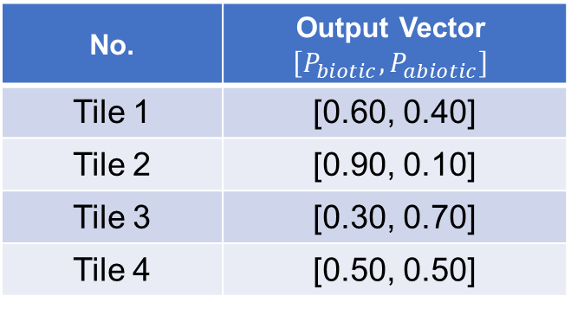
2.3 Example - Soft Voting
224 pixels
No. | Output Vector $$\left[P_{biotic},P_{abiotic}\right]$$
Tile 1 | [0.60, 0.40]
Tile 2 | [0.90, 0.10]
Tile 3 | [0.30, 0.70]
Tile 4 | [0.50, 0.50]
224 pixels
$$\text{Mean}=\frac{\sum{P_{tiles}}}{4}=\left[0.575,0.425\right]$$
Final Result: Biotic
Notes:
For example, if one tile is blurry and only gives a 60% confidence score, but another tile clearly sees a fungal spot and gives a 90% score, our Soft Voting combines them. Instead of just picking a 'Yes' or 'No' from one tile, we average these 2 x 1 vectors to reach a final, high-confidence diagnosis for the entire leaf.

Slide 10
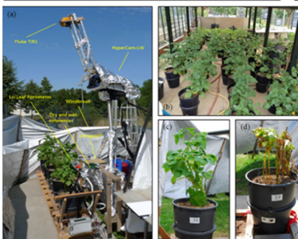
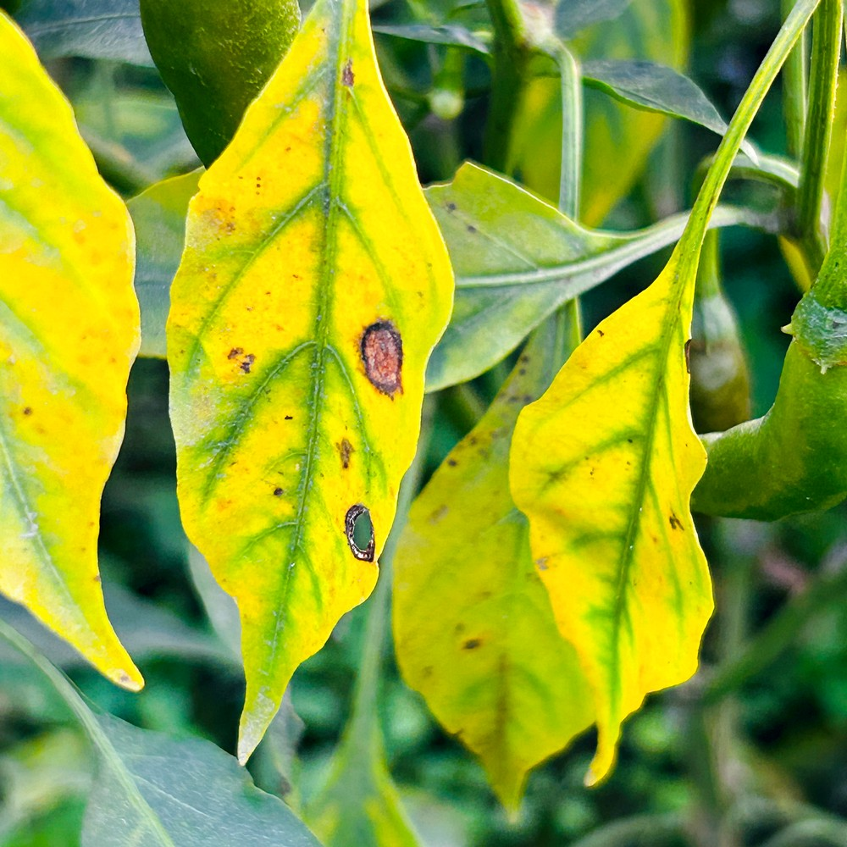


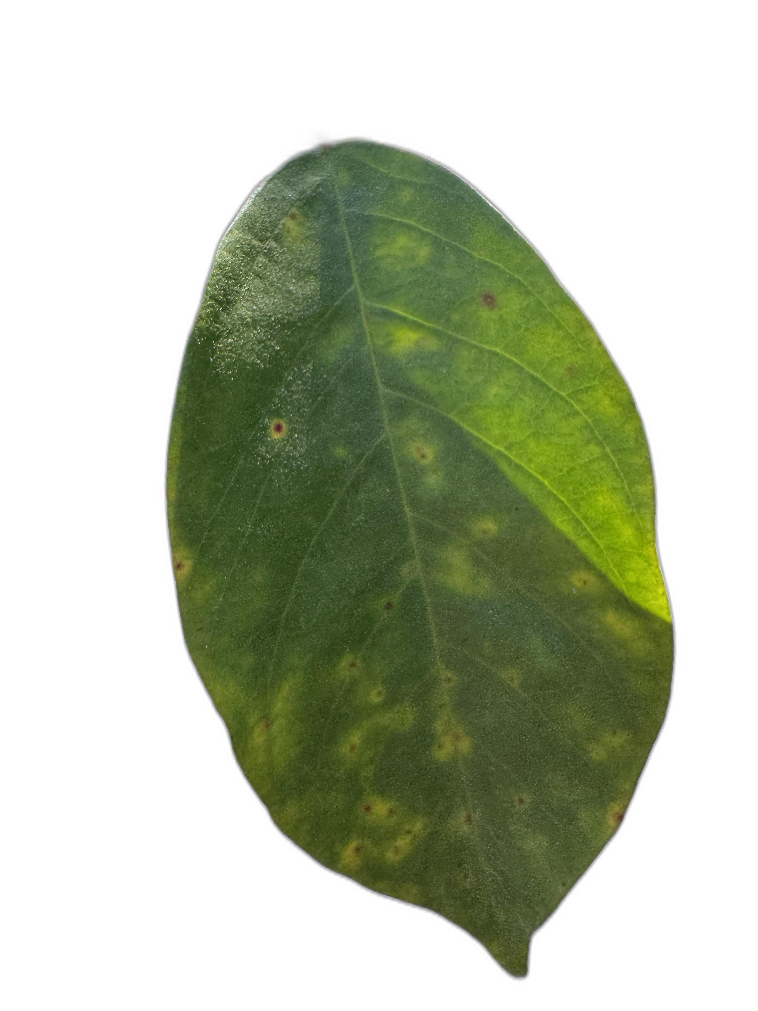
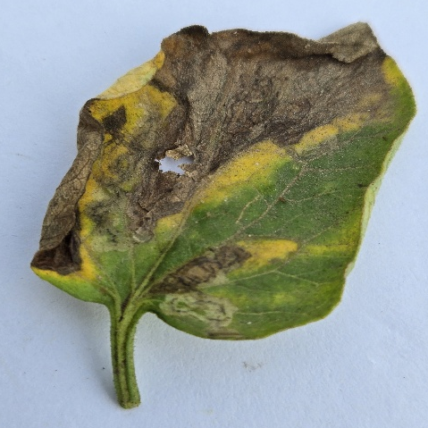
3. Data Engineering & Rigorous Partitioning
Collect
Upload
RGB images
Notes:
Moving into the data engineering phase, our project utilizes a high-quality dataset sourced from Mendeley Data

Slide 11
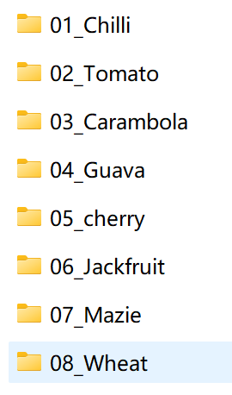
3. Data Engineering & Rigorous Partitioning
Dataset Characteristics:
Data Source: Mendeley Data Repository (Open-source, Expert-labeled).
Image Format:
RGB Images.
Species Diversity:
Comprises 8 distinct crop species (e.g., Chilli, Guava, Jackfruit, etc.).
Background Complexity:
Controlled Environment: Uniform/Solid backgrounds for pure feature learning.
In-field Scenarios: Real-world field backgrounds with soil, weeds, and varying light.
Notes:
We didn't just use clean lab photos; our framework processes both solid-background images and real-world field shots.

Slide 12
3. Data Engineering & Rigorous Partitioning
Binary Classification Logic:
Biotic Class:
Pathogen-driven: Fungal rusts, bacterial blights, and viral spots.
Abiotic Class:
Environment-driven: Nutrient deficiencies (N-P-K), drought, and herbicide burn.
The "Order-based" Sequential Split (80/20):
To prevent Data Leakage from augmented clusters, images are split sequentially within each sub-folder
Notes:
While the raw dataset contains over 20 labels, we consolidated them into two mission-critical categories. Biotic Stress focuses on organic pathogens like fungi and bacteria. Abiotic Stress covers physiological issues like nutrient deficiencies.
To ensure scientific rigor, we implemented a Sequential Splitting strategy. This ensures that if a leaf was photographed multiple times, those 'twins' stay together in either training or testing, preventing the model from 'cheating' by memorizing specific leaves."

Slide 13
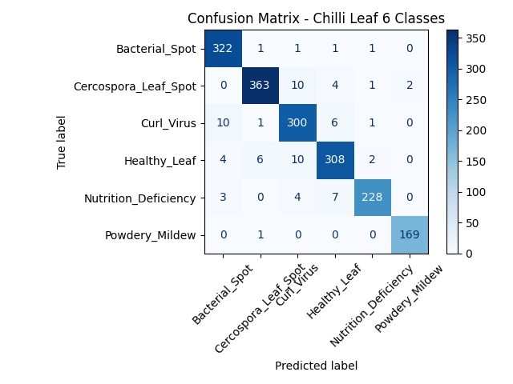
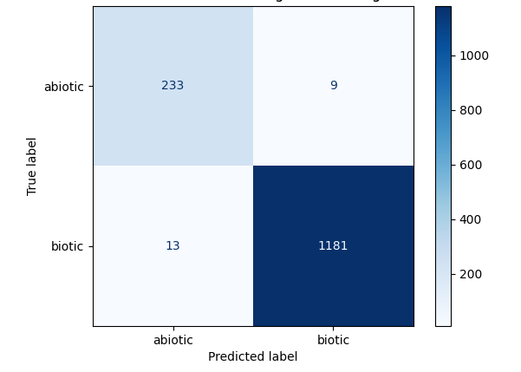
4. Stage 1 - Single Crop Baseline (Phase 1: Binary & 6-Class)
Notes:
In the first stage of our experiment, we conducted a baseline test on a single crop. We didn't just stop at Binary classification; we extended it to a 6-Class fine-grained analysis. This allowed us to see if the model could distinguish between very similar-looking symptoms, such as different types of fungal spots. The results proved that our MobileNetV2 backbone is highly capable of capturing these subtle textural nuances.

Slide 14
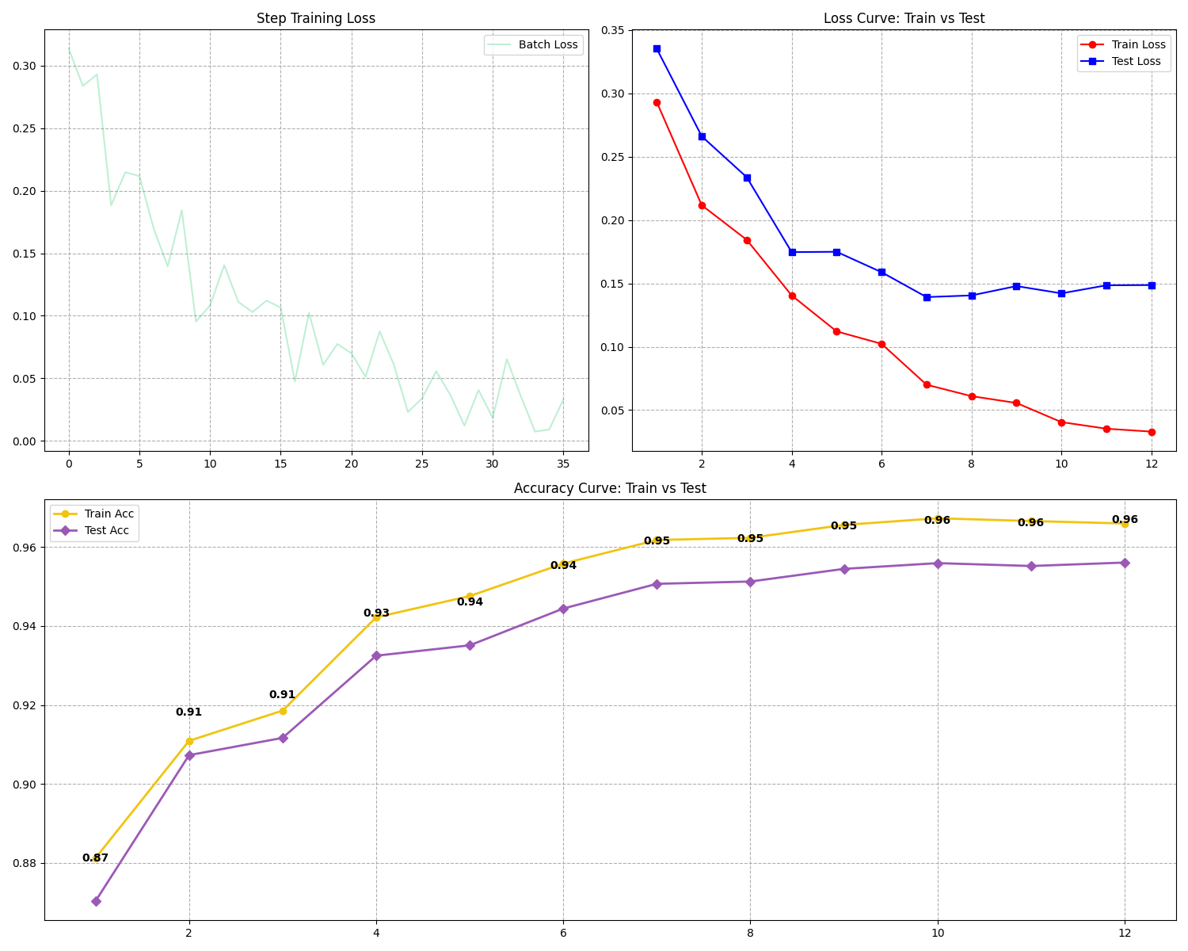
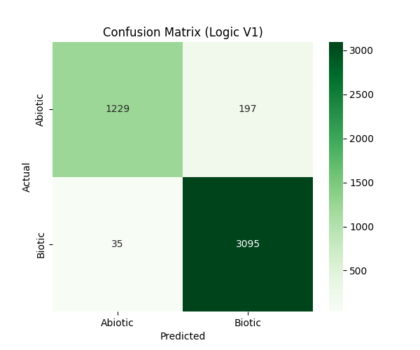
4. Stage 2 - Multi-Crop Generalization (Phase 2: Universal Training)
Notes:
After the successful single-crop test, we moved to the core of our research: Multi-Crop Training. We fed data from all 8 species into the model at once. This is much harder because a fungal spot on a Guava leaf looks different from a spot on a Corn leaf.
Looking at our training dynamics, the model shows excellent convergence. If we analyze the Loss Curve (pointing to the left plot), we see a rapid drop in the first few epochs. After Epoch 9, the test loss plateaus and begins to fluctuate slightly.
Simultaneously, the Accuracy Curve shows a steady upward trend for both training and testing sets. As we can see from the final results, our Training Accuracy reached 0.96. Crucially, the Testing Accuracy followed closely behind, remaining just slightly below the training curve.
After verifying the training curves, we analyzed the Confusion Matrix on the test set. The results show that the model is highly effective at distinguishing between Biotic and Abiotic stress.
By using Epoch 9 weights, our model successfully learned 'universal' features of stress that apply across different plant families.

Slide 15
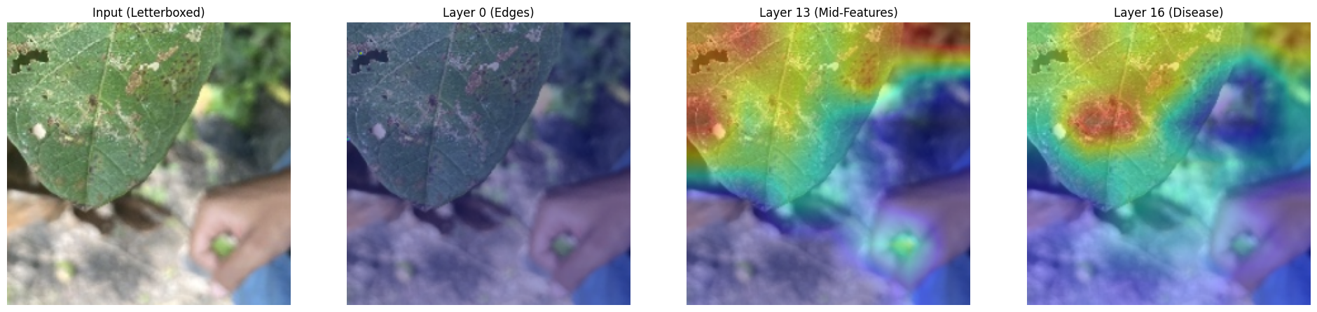
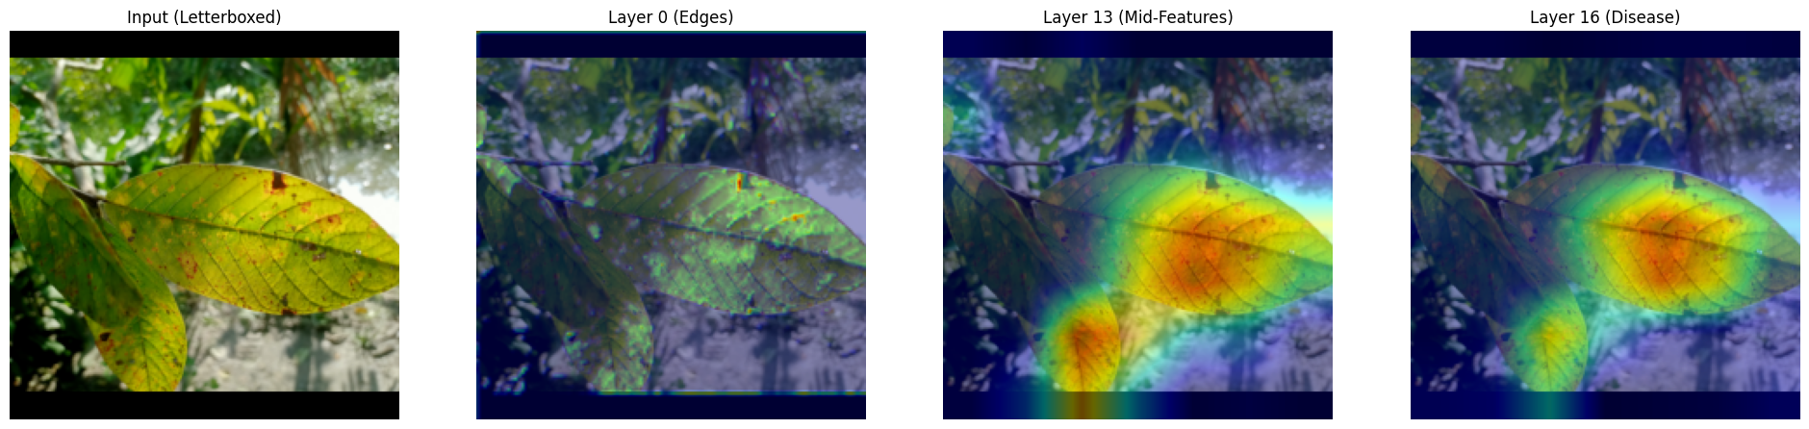
4. Explainable AI (XAI) - Grad-CAM Visual Diagnosis
Notes:
To ensure our model isn't a 'black box,' we applied Grad-CAM to visualize the decision-making process. Red/Orange areas represent high-attention zones. These pixels contribute most to the model’s final classification decision. Blue/Purple areas represent low-attention zones, meaning these pixels are considered irrelevant to the classification task.
As we move from Layer 0 to Layer 16, you can clearly see the model's 'attention' shifting from generic edges to the specific necrotic lesions on the leaf tip. This spatial alignment between the heat map and the actual disease confirms that our Epoch 12 model has learned the correct biological features of plant stress.

Slide 16
5. Limitations & Future Work
Conclusion
This study validates the high performance of the Epoch 12 ResNet architecture. With a 95% accuracy rate, the system demonstrates reliable diagnostic potential. Crucially, Grad-CAM visualization provides explainability, confirming that the model’s decisions are based on actual pathological lesions rather than random noise.
Dataset Imbalance
Although the model performs well, the raw data distribution between Biotic and Abiotic classes is imbalanced
Background Robustness vs. Complexity
The current dataset backgrounds are overly "stable" (clean or relatively consistent).

Slide 17
References
[1]. Cattivelli, L.; Rizza, F.; Badeck, F.W.; Mazzucotelli, E.; Mastrangelo, A.M.; Francia, E.; Stanca, A.M. Drought tolerance improvement in crop plants: An integrated view from breeding to genomics. Field Crop. Res. 2008, 105, 1–14. [CrossRef]
[2]. Araus, J.L.; Cairns, J.E. Field high-throughput phenotyping: The new crop breeding frontier. Trends Plant Sci. 2014, 19, 52–61. [CrossRef] [PubMed]

Slide 18
Thanks

