Slide 1
Dimensionality reduction
Geert Jan Bex
(geertjan.bex@uhasselt.be)

Slide 2
High-dimensional data
Intuition doesn't hold! https://marckhoury.github.io/blog/counterintuitive-properties-of-high-dimensional-space/
Data is sparse
Distance differences can be small
How to visualize?
Dimensions can be "redundant" (correlation)
⇒ reduce number of dimensions

Slide 3
Many techniques
Principal Component Analysis (PCA)
…
t-distributed Stochastic Neighborhood Embedding (t-SNE)
…
Uniform Manifold Approximation and Projection (UMAP)

Slide 4
Principal Component Analysis
Find component that shows
maximum variance
Find orthogonal component that
Shows maximum variance
…

Slide 5
PCA math
Data: n observations of p variables
n × p data matrix X
Compute mean subtracted data B = X – x
Compute covariance matrix C = B^{T}B/(n – 1)
Find eigenvector and eigenvalues of C: V⁻¹CV = D
Reorder such that eigenvalues are in decreasing order
Consider only first L eigenvalues, i.e., dimensions
Reduce p dimensional space to L dimenions

Slide 6
t-distributed Stochastic Neighborhood Embedding (t-SNE)
3
1
2
1
Q₁₂ >> Q₁₃
P₁₂ >> P₁₃
2
3
p-dimensional space
L-dimensional space
Minimize divergence between P and Q

Slide 7
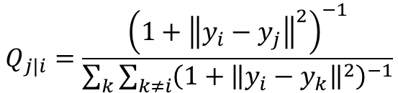

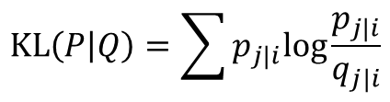
t-SNE math
Data: n observations of p variables
Compute probabilities in p-dimensional space
Compute map to in L-dimensional space
Compute probabilities in L-dimensional space
Optimize map to minimize Kullback-Leibler divergence using gradient descent
$$P_{j|i}=\frac{e^{−\frac{{\left\|x_{i}−x_{j}\right\|}^{2}}{2σ_{i}^{2}}}}{\sum_{k≠i}{e^{−\frac{{\left\|x_{i}−x_{k}\right\|}^{2}}{2σ_{i}^{2}}}}}$$
$$Q_{j|i}=\frac{{\left(1+{\left\|y_{i}−y_{j}\right\|}^{2}\right)}^{−1}}{\sum_{k}{\sum_{k≠i}{{\left(1+{\left\|y_{i}−y_{k}\right\|}^{2}\right)}^{−1}}}}$$
$$KL\left(P | Q\right)=\sum{p_{j|i}\text{log}\frac{p_{j|i}}{q_{j|i}}}$$

Slide 8

Uniform Manifold Approximation and Projection (UMAP)
It's complicated
https://umap-learn.readthedocs.io/en/latest/how_umap_works.html

Slide 9
Ideas from algebraic topology
k-simplices
Simplicial complexes
0-simplex
1-simplex
2-simplex
3-simplex

Slide 10
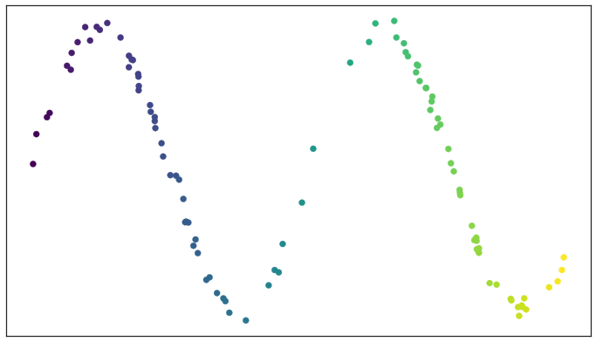
Running example data
How to find an open cover for data?

Slide 11
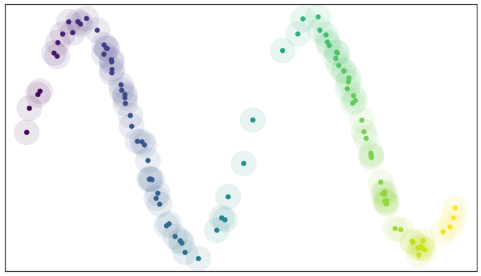
Open sets
Open set = sphere around data point

Slide 12
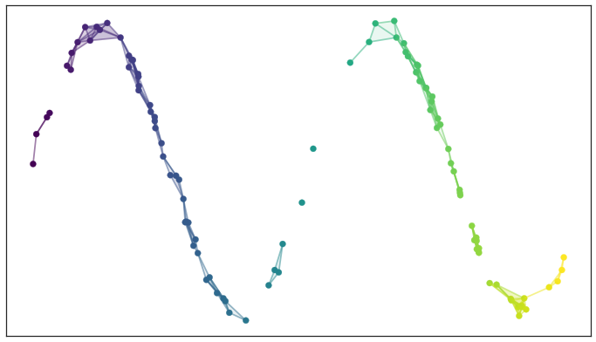
Construct simplicial complex
Captures topology of data set
Mostly 0- and 1-simplexes
Based on overlap between open sets

Slide 13
Problem
Many connected components!

Slide 14
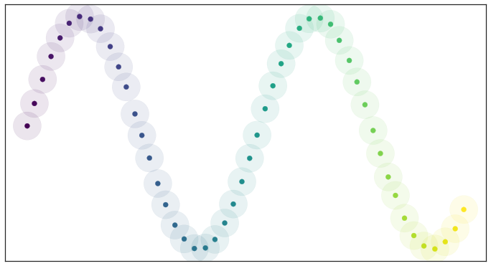
Ideal case
"Evenly" space data: fiddle with radius until done

Slide 15
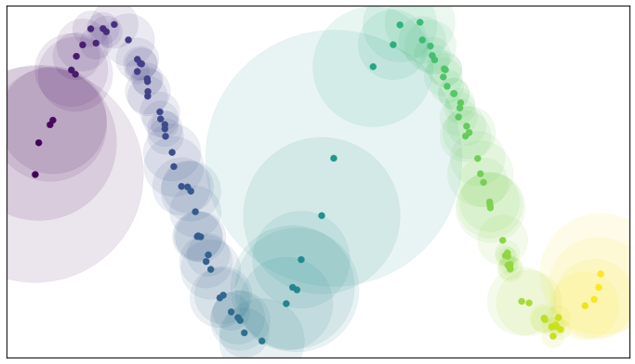
Local metrics
Local geometry/metric: sphere extends to n-th nearest neighbour
n_neighbours hyperparameter

Slide 16
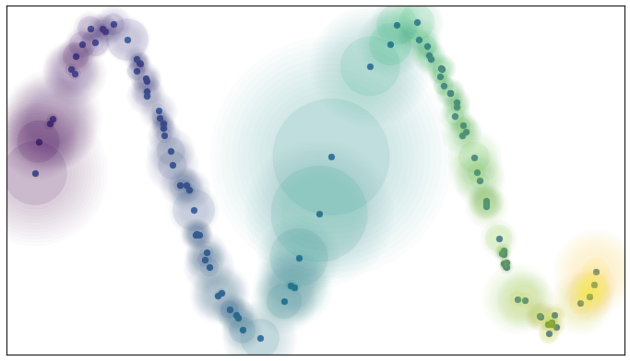
Curse of dimensionality
Distances in high-dimensional spaces are similar
Relax to connected components > 1

Slide 17
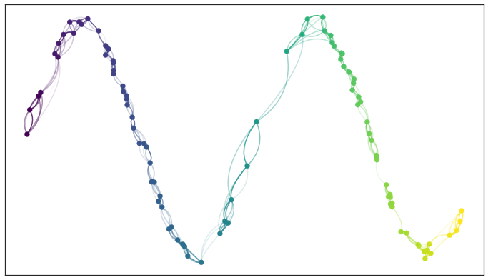
Disagreeing metrics
a
b
Fuzzy union between edges: a + b - ab

Slide 18
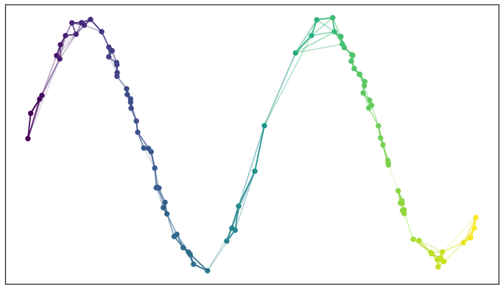
Final high-dimensional representation

Slide 19

To a low-dimensional representation
What?
Fuzzy topological structure of data (same as in high-dimensional space)
"Normal" Euclidian metric
Distance preservation
How?
Minimize cross-entropy for 1-simplices E
min_dist hyperparameter

