Slide 1




Malware Detection Using Artificial Intelligence: A Survey
Presented By: Arnob Chakrobortty
Student ID: M.Sc-260227
Computer Science and Engineering Discipline
Khulna University, Khulna
Date: 19 April, 2026
Course Title: Seminar

Slide 2


Abstract
Malware has emerged as one of the most critical cybersecurity threats in the digital era, causing significant financial and data losses worldwide. Traditional malware detection techniques, such as signature-based and heuristic-based methods, are increasingly ineffective against modern threats like polymorphic and zero-day malware. Artificial Intelligence (AI), particularly Machine Learning (ML) and Deep Learning (DL), offers a promising solution by enabling systems to automatically learn patterns and detect unknown threats. This paper provides a comprehensive survey of AI-based malware detection techniques. It explores various ML and DL approaches, including supervised, unsupervised, and hybrid models. Additionally, the paper discusses feature engineering techniques, datasets, evaluation metrics, and real-world applications. The challenges of AI-based detection, such as adversarial attacks and data imbalance, are also analyzed. Finally, future research directions, including explainable AI and federated learning are presented..

Slide 3
List of Contents
1
2
3
4
Introduction
Background
Types of Malware
Literature Review
5
6
7
8
Machine Learning Techniques
Deep Learning Techniques
AI-based Hybrid Framework
System Architecture
9
10
11
12
Results and Discussions
Case Study
Limitations and Challenges
Conclusion and Future work

Slide 4

Introduction
Malware is one of the most serious and rapidly evolving threats in cyber-security, affecting individuals, organizations, and governments worldwide. It includes various types such as viruses, ransom-ware, spyware, and Trojan, all designed to disrupt systems, steal sensitive data, or cause financial damage. As digital systems become more interconnected, the impact of malware attacks has grown significantly, often leading to large-scale data breaches, operational shutdowns, and economic loss.
Traditional detection methods, which rely mainly on known signatures, are no longer sufficient to handle modern threats, especially new and unknown (zero-day) attacks. Artificial Intelligence offers a more advanced solution by using machine learning and behavior-based analysis to detect unusual patterns and anomalies in real time. This allows systems to identify and respond to previously unseen malware, making AI a powerful and adaptive tool in modern cyber security defense.

Slide 5
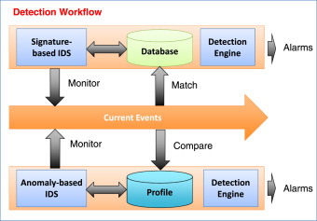
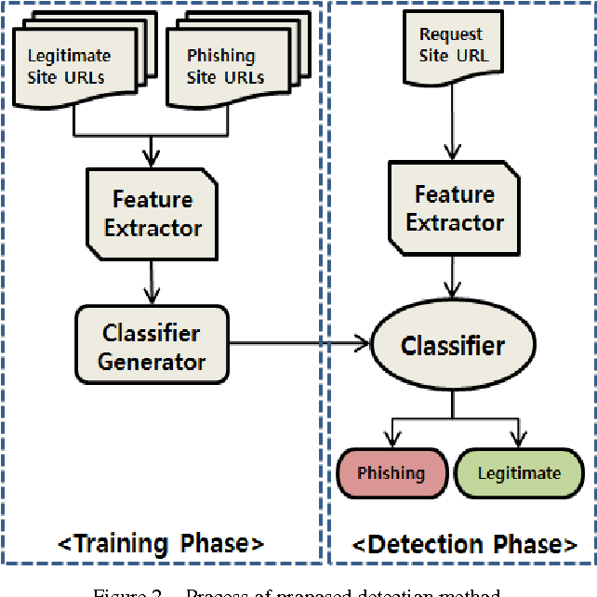
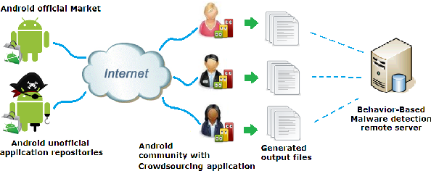
Background
Figure 1: Signature-based Detection
Figure 2: Heuristic Methods
Figure 3: Behavior-based Systems
Signature-based detection matches files or traffic against a database of known threat signatures (hashes, strings).
Heuristic method employs rules or algorithms to detect suspect characteristics, such as code analysis that resembles known malicious families without an exact signature match.
For monitor-based systems, monitors system activities in real-time to identify anomalous behavior, rather than focusing on the file's static code.

Slide 6







Types of Malware
Virus
Trojan Horse
Attaches itself to legitimate files and spreads when executed
Disguised as legitimate software but performs malicious actions
Worm
Ransom-ware
Self-replicates and spreads across networks without user interaction
Encrypts user data and demands payment for the decryption
Spyware
Adware
Collects sensitive user information without consent
Displays unwanted advertisements
Rootkits
Provide unauthorized access while hiding their presence

Slide 7
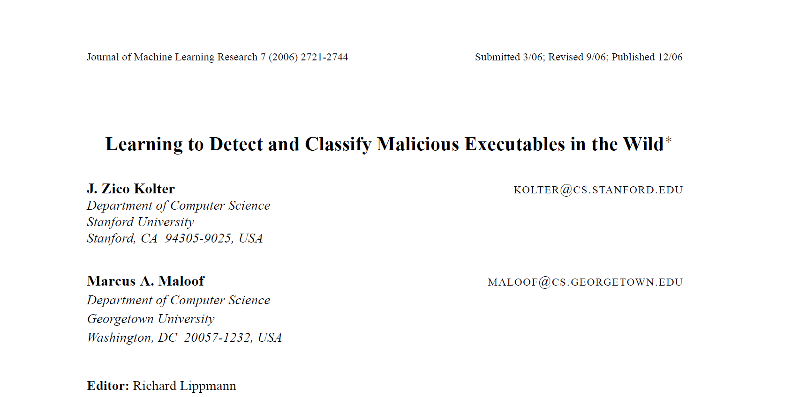
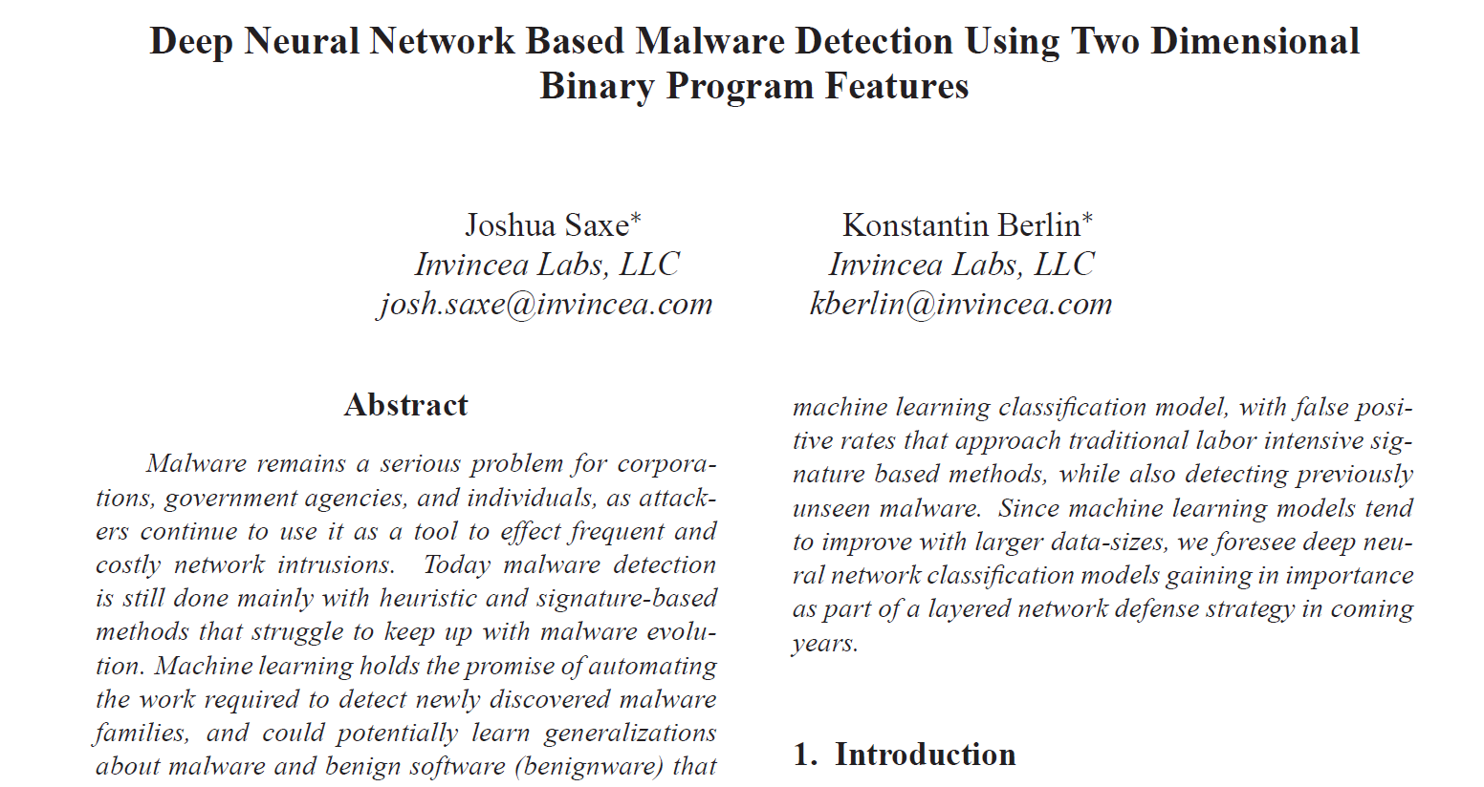
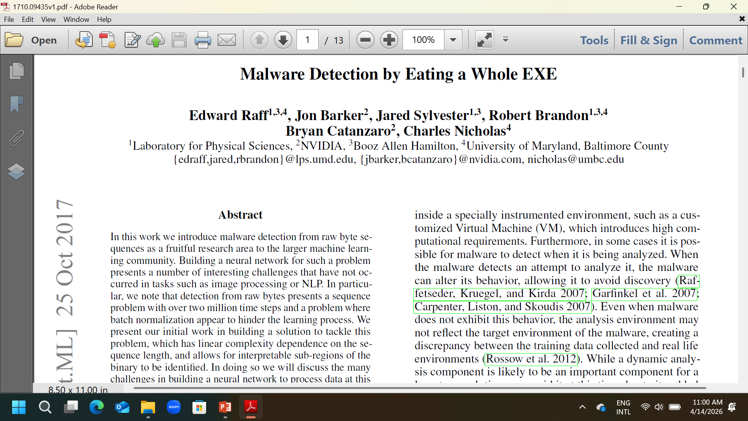
Literature Review
Kolter and Maloof used machine learning for detecting malicious executable, showing improved detection accuracy.
Saxe and Berlin applied deep neural networks for malware classification using binary features.
Raff et al. proposed feeding raw executable files into deep learning models, eliminating manual feature engineering.
ML improves detections
DL models outperform ML models

Slide 8
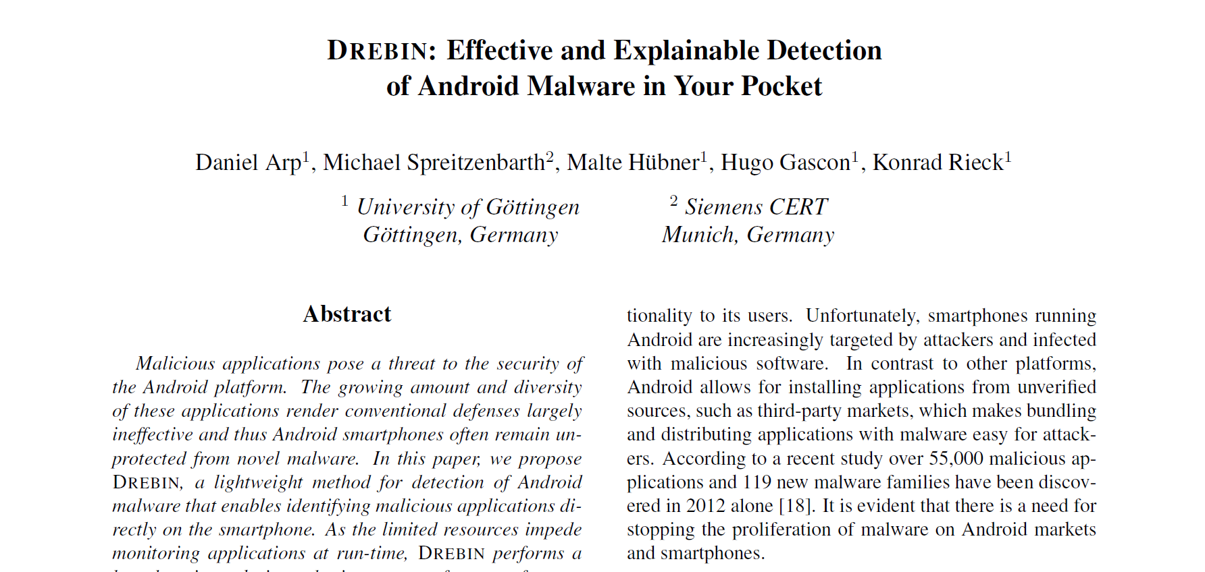
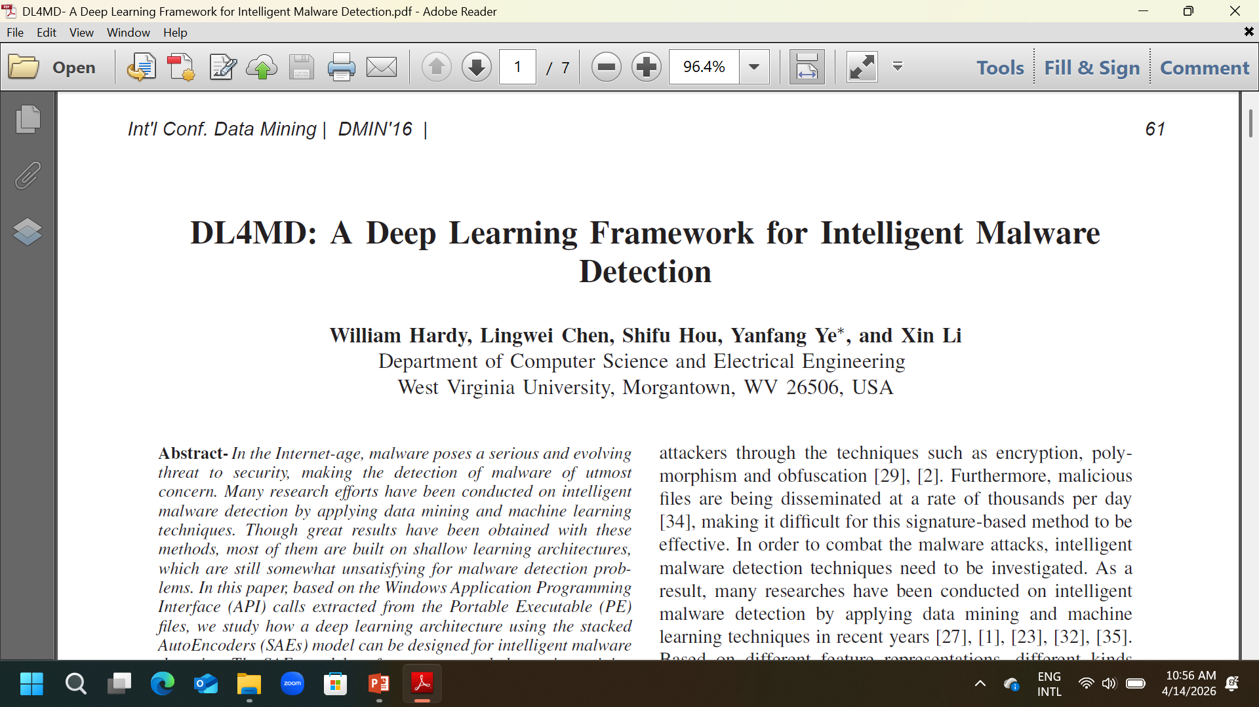
Arp et al. introduced the DREBIN system for Android malware detection.
Hardy et al. proposed DL4MD, a deep learning framework for intelligent malware detection.
Hybrid(ML + DL) approaches are best.

Slide 9
Machine Learning Techniques
Support Vector Machine
Random Forest
Naive Bayes
Decision Tree
KNN Clustering
Anomaly Detection
Figure 4: Supervised Learning Techniques
Figure 5: Unsupervised Learning Techniques

Slide 10
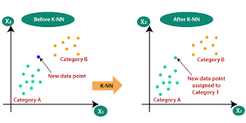
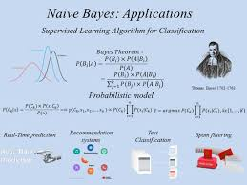
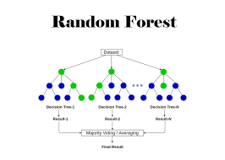
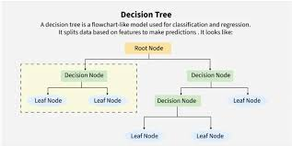
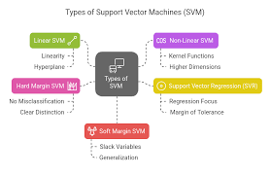
Algorithm | Type | Use of Performance | Case
SVM | Supervised | Binary classification | High
Decision Tree | Supervised | Rule-based classification | Medium
Random Forest | Ensemble | Large dataset classification | High
Naïve Bayes | Probabilistic | Fast classification | Medium
KNN Clustering | Instance-Based | Similarity detection | Low
Table 1: Machine Learning Algorithms for Malware Detection

Slide 11
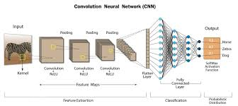
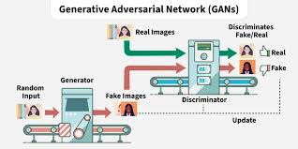
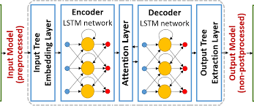

Deep Learning Techniques
CNN = Convolutional Neural Networks
RNN = Recurrent Neural Network
LSTM = Long Short-Term Memory
GAN = Generative Adversarial Network
Table 2: Deep Learning Algorithms for Malware Detection

Slide 12
jhbkhguhs
The AI-based Hybrid Framework
A hybrid AI-based framework is proposed and performed by the researchers combining both static and dynamic analysis.
Key features
Framework Steps
Advantages
ML + DI + AI
Hybrid feature extraction
Real time detection
Static and dynamic analysis
Feature fusion
Classification using ensemble model
Improved accuracy
Reduced false positives
Robust against obfuscation
Environment | Dataset Split | Models Used
Programming Language: Python | Training: 70% | Random Forest
Tools: TensorFlow, Scikit-learn | Testing: 30% | Support Vector Machine
Hardware: GPU-enabled system | Total: 100% | CNN and ANN
Table 3: Experimental Setup

Slide 13
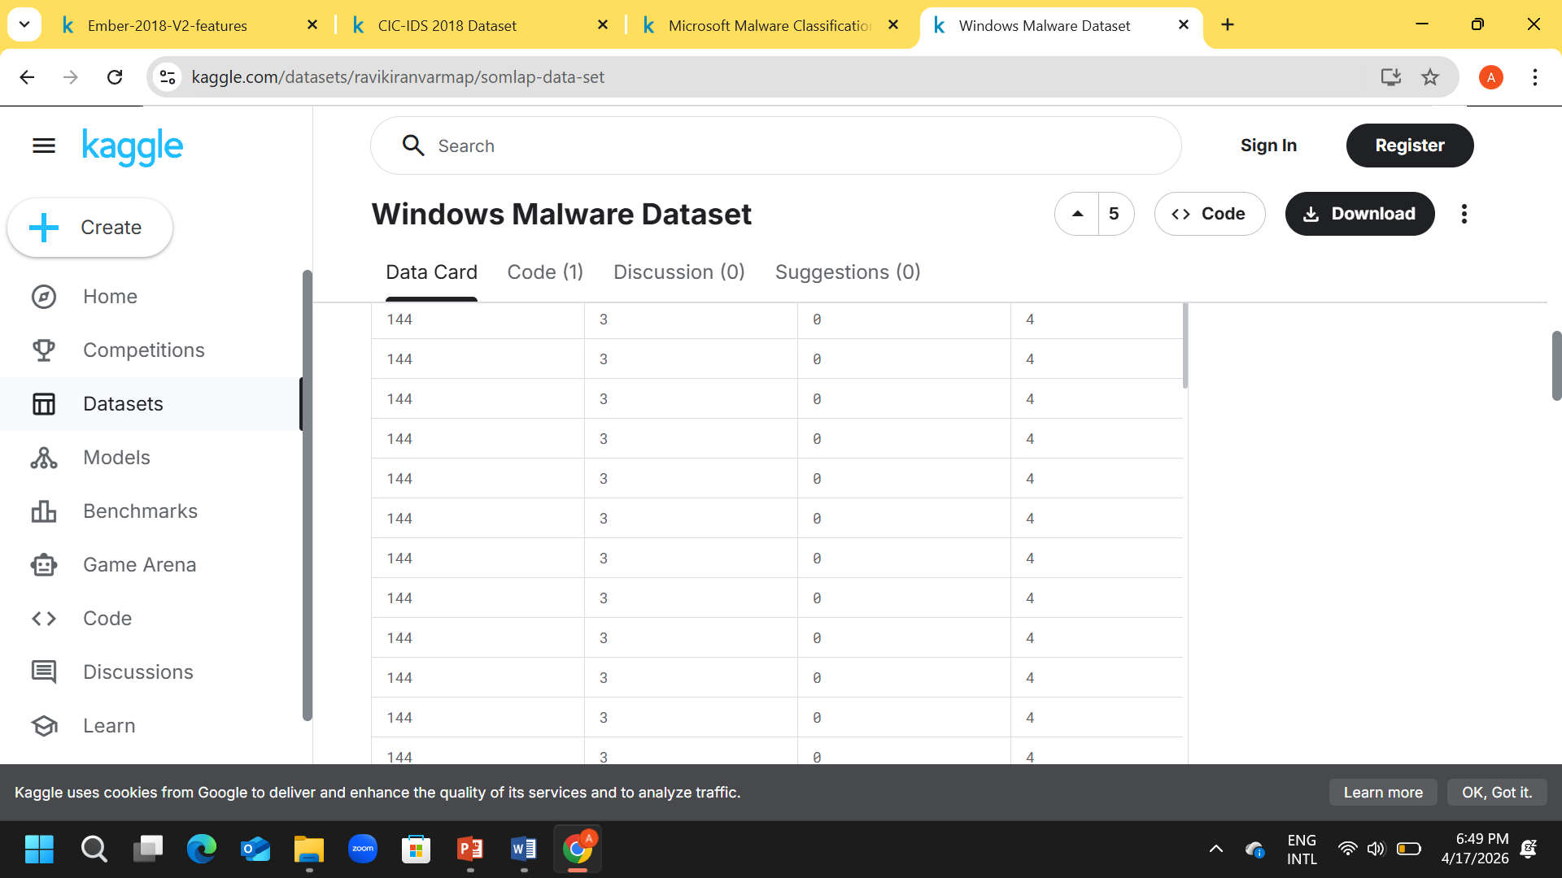
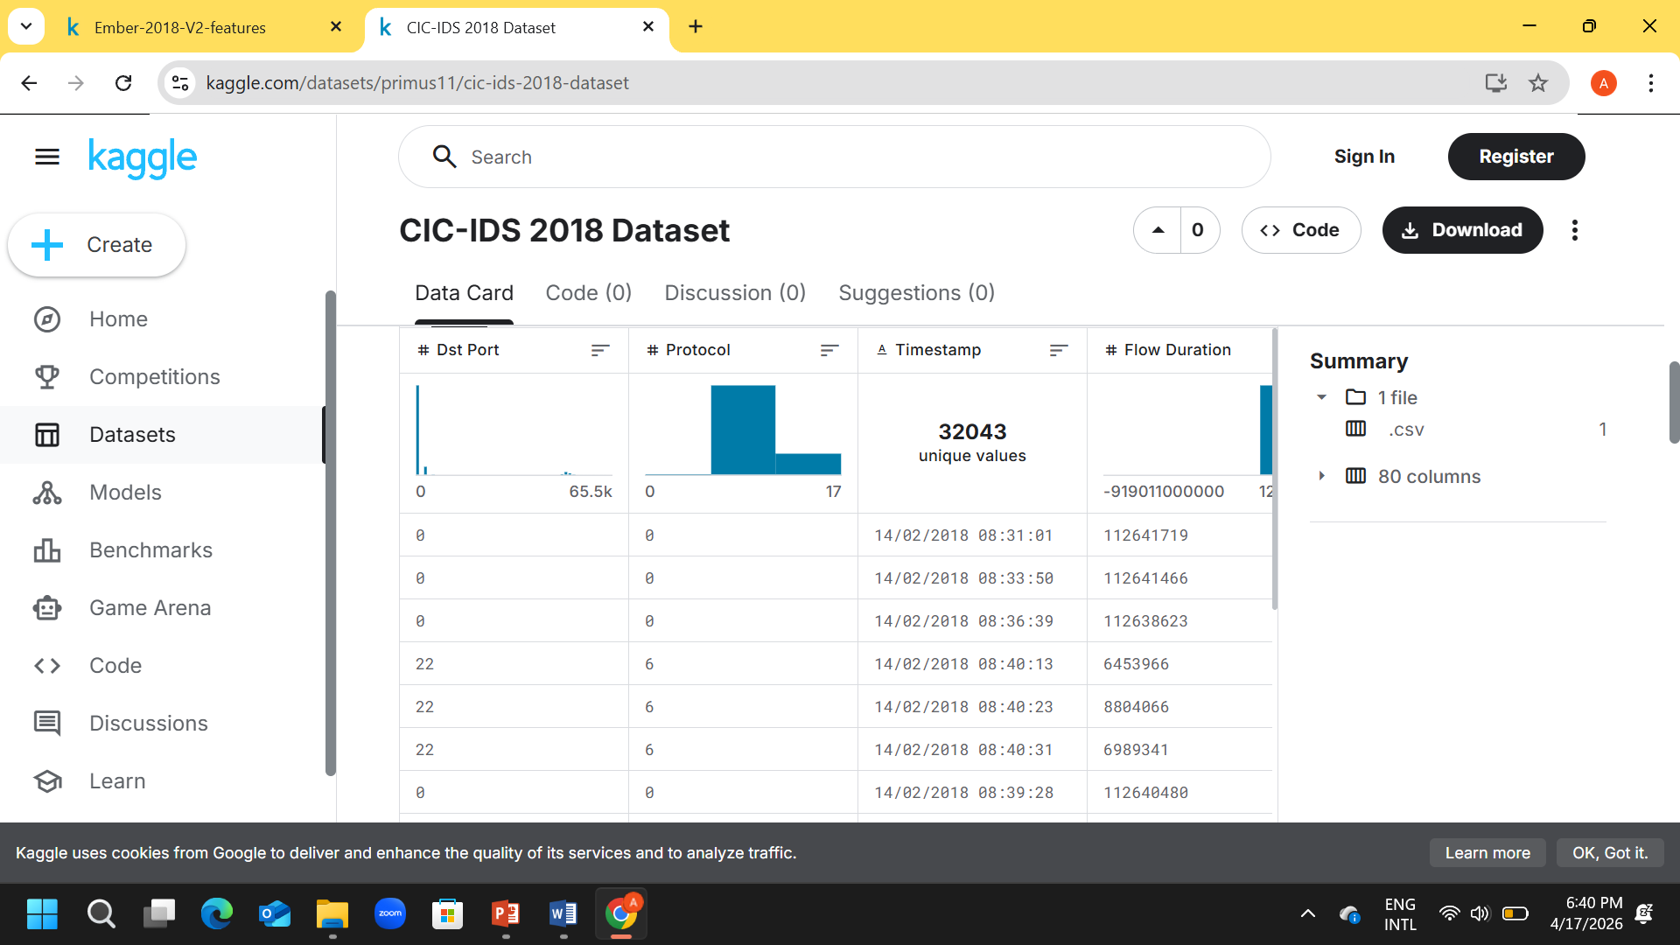
System Architecture
CICIDS and Virus-share dataset are shown below:
Common datasets used in malware detection include:
EMBER Dataset
Virus-Share
CICIDS
Microsoft Malware Dataset
The key Challenges are:
Imbalanced data
Lack of standard datasets
Input Data
Data Preprocessing
Response Action
Feature Extraction
ML + DL Model
Detect Engine
Figure 6: Workflow of the Methodology

Slide 14
Architecture Components/Methodology:
1. Data Collection Module/Input: Collects raw data such as executable files, network traffic, and system logs.
2. Preprocessing Module:
Data cleaning
Noise removal
Normalization
3. Feature Extraction Module: Extracts relevant features such as:
API call sequences
Opcode frequencies
File metadata
4. Model Training Module: Machine Learning and Deep Learning models are trained using labeled datasets.
5. Detection Engine: Classifies incoming files as:
Benign
Malicious
6. Response Module: Takes action such as:
Blocking file
Alerting user
Logging attack

Slide 15
Results and Discussions
The experimental results demonstrate that AI-based models outperform traditional methods. From Observations we notice that Deep Learning models achieve higher accuracy than Machine Learning models. Also, Artificial Neural Network has an important role in increasing the accuracy. Hybrid models reduce false positives and feature quality significantly impacts performance. Performance is measured using Accuracy, Precision, Recall, F1-score, ROC-AUC and False Positive Rate.
Method | Accuracy | Advantages | Limitations
Signature-Based | Low | Fast | Cannot detect new malware
Machine Learning | Medium | Detects unknown threats | Feature dependent
Deep Learning | High | Automatic feature learning | High computation cost
Hybrid Approach | Very High | Best performance | Complex implementation
Table 3: Comparative Analysis of the Methods

Slide 16
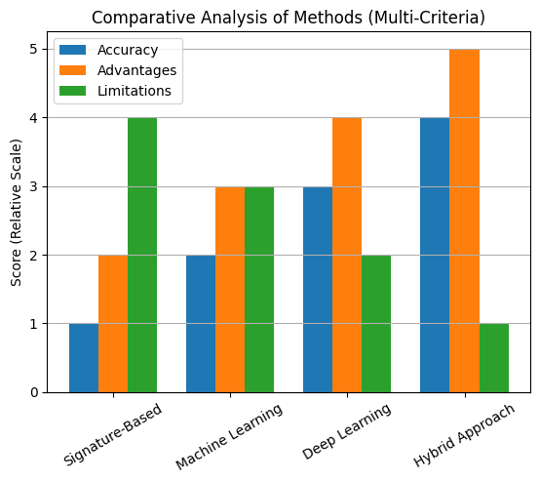
Figure 6: Comparative Analysis of Methods(Multi-criteria)

Slide 17



Case Study
Topic
Process
Outcome
Detecting ransom-ware using AI-based models
Dataset collected, feature extracted, model trained using supervised learning
Accuracy improved, Data encryption was prevented

Slide 18

Limitations & Challenges
Data imbalance
Model generalization issues
High computational cost
Lack of Explain-ability
Limited dataset availability
High computational requirements

Slide 19
Conclusion and Future Work
AI significantly improves malware detection by analyzing large volumes of data and identifying patterns that traditional methods may miss. It can detect new and unknown threats (zero-day attacks) using behavior-based analysis rather than relying only on known signatures. However, challenges still exist, such as false positives, vulnerability to adversarial attacks, high computational costs, and the need for large, high-quality datasets. Therefore, further research is required to make these systems more accurate, efficient, and secure for real-world applications.
Emerging approaches like Explainable AI (XAI), Federated Learning, and Edge AI are helping to address these issues. Explainable AI makes model decisions transparent and understandable, increasing trust in AI systems. Federated Learning enhances privacy by training models across multiple devices without sharing sensitive data, while Edge AI enables real-time malware detection directly on local devices, reducing latency and improving data security. Together, these technologies represent promising directions for the future of AI-based cyber security.

Slide 20
Bibliography
1. U. Bayer, P. Milani Comparetti, C. Hlauschek, C. Kruegel and E. Kirda, “Scalable, Behavior-Based Malware Clustering,” Proc. Network and Distributed System Security Symposium (NDSS), 2009.
2. R. Saxe and K. Berlin, “Deep Neural Network Based Malware Detection Using Two Dimensional Binary Program Features,” Proc. 10th Int. Conf. on Malicious and Unwanted Software (MALWARE), IEEE, 2015.
3. Y. LeCun, Y. Bengio and G. Hinton, “Deep Learning,” Nature, vol. 521, no. 7553, pp. 436–444, 2015.
4. I. Goodfellow, Y. Bengio and A. Courville, Deep Learning, MIT Press, 2016.
5. M. Yousefi-Azar, L. G. C. Hamey, V. Varadharajan, “Autoencoder-Based Feature Learning for Cybersecurity Applications,” Proc. Int. Joint Conf. on Neural Networks (IJCNN), IEEE, 2017.
6. A. Kolosnjaji, A. Zarras, G. Webster and C. Eckert, “Deep Learning for Classification of Malware System Call Sequences,” Australasian Joint Conf. on Artificial Intelligence, 2016.
7. M. Schultz, E. Eskin, E. Zadok and S. Stolfo, “Data Mining Methods for Detection of New Malicious Executables,” Proc. IEEE Symposium on Security and Privacy, 2001.
8. J. Z. Kolter and M. A. Maloof, “Learning to Detect and Classify Malicious Executables in the Wild,” Journal of Machine Learning Research, vol. 7, 2006.
9. B. Anderson and D. McGrew, “Machine Learning for Encrypted Malware Traffic Classification,” Proc. ACM CCS Workshop, 2016.
10. H. S. Anderson, A. Kharkar, B. Filar et al., “EMBER: An Open Dataset for Training Static PE Malware Machine Learning Models,” arXiv preprint arXiv:1804.04637, 2018.

Slide 21

11. S. Raff, J. Barker, J. Sylvester et al., “Malware Detection by Eating a Whole EXE,”
Workshops at AAAI Conference on Artificial Intelligence, 2018.
12. A. Krizhevsky, I. Sutskever and G. Hinton, “ImageNet Classification with Deep Convolutional Neural Networks,” NIPS, 2012.
13. K. He, X. Zhang, S. Ren and J. Sun, “Deep Residual Learning for Image Recognition,” IEEE CVPR, 2016.
14. W. Hardy, L. Chen, S. Hou, Y. Ye and X. Li, “DL4MD: A Deep Learning Framework for Intelligent Malware Detection,” Proc. Int. Conf. on Data Mining (DMIN), 2016.
15. N. McLaughlin, J. Martinez del Rincon, B. Kang et al., “Deep Android Malware Detection,” Proc. ACM CODASPY, 2017.
16. D. Arp, M. Spreitzenbarth, M. Hübner et al., “DREBIN: Effective and Explainable Detection of Android Malware,” NDSS, 2014.
17. S. Hou, Y. Ye, Y. Song and M. Abdulhayoglu, “Hindroid: An Intelligent Android Malware Detection System,” Proc. ACM SIGKDD, 2016.
18. B. Biggio and F. Roli, “Wild Patterns: Ten Years After the Rise of Adversarial Machine Learning,” Pattern Recognition, 2018.
19. N. Papernot, P. McDaniel, I. Goodfellow et al., “Practical Black-Box Attacks Against Machine Learning,” Proc. ACM AsiaCCS, 2017.
20. M. Rigaki and S. Garcia, “Bringing a GAN to a Knife-Fight: Adapting Malware Communication to Avoid Detection,” IEEE Security Workshops, 2018.

Slide 22





THANK YOU!

