Slide 1
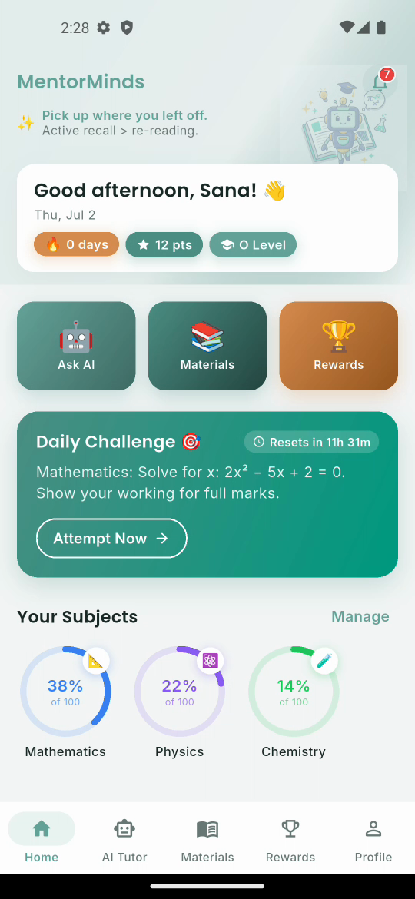
MentorMinds
Learn Smarter. Score Higher.
AI-powered tutoring for O/A Level students
Cambridge (CAIE) & Edexcel · Bangladesh
Flutter · Firebase · MentorBot (Gemini)

Slide 2
3-Minute Showcase Video
Watch the full walkthrough
▶ Open the demo video
file:///Users/arnobrizwan/Desktop/MentorMinds_Showcase/MentorMinds_Showcase.mp4
The recording tours the live app running on an Android emulator:
• Secure email sign-in
• Personalised dashboard — streak, points, subject progress
• MentorBot AI tutor answering exam questions (Maths & Biology)
• Curriculum materials library
• Rewards: badges & class leaderboard
• Student profile & settings

Slide 3
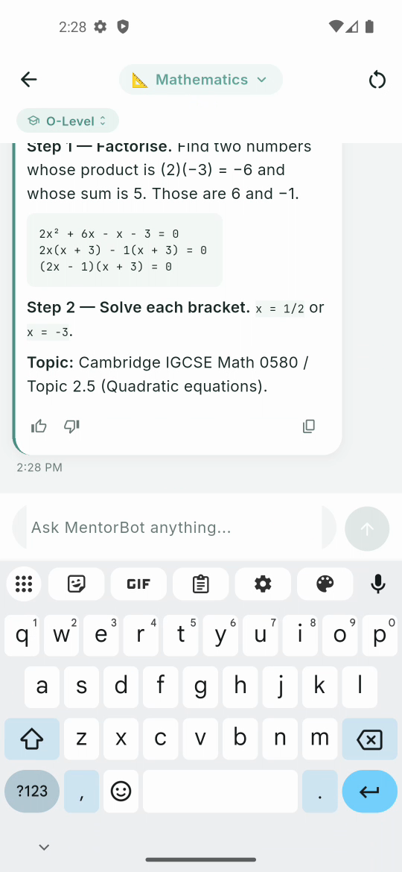
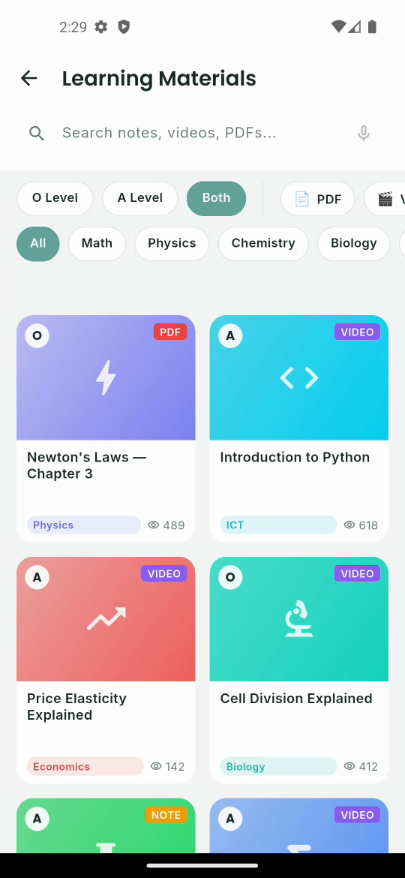
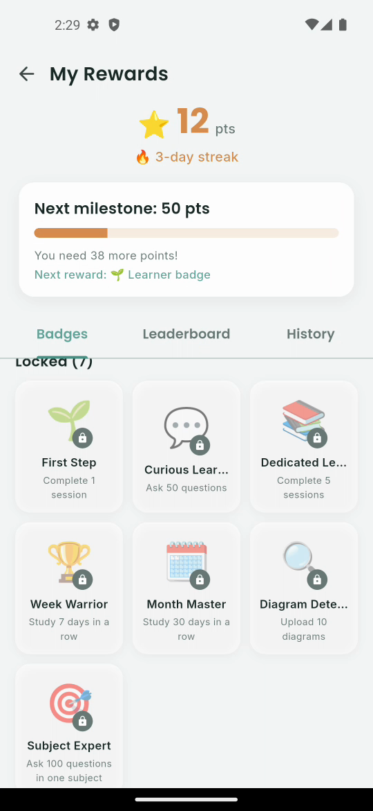
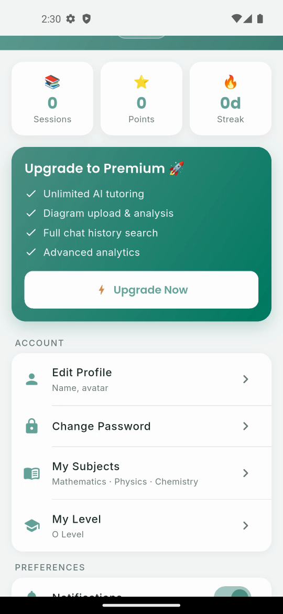
Inside the App
Dashboard
MentorBot AI Tutor
Materials
Rewards
Profile

Slide 4
How this demo runs
Frontend
Flutter 3.41 / Dart · Riverpod · Material 3 — a single mobile codebase.
Backend
Firebase Auth, Firestore, Storage & Cloud Functions — run locally via the
Firebase Local Emulator Suite with seeded students, materials & rewards.
AI Tutor — MentorBot
Questions flow through the mentorBotChat Cloud Function (Gemini in prod).
Verified end-to-end on an Android emulator: sign-in → AI answer → rewards.

