Slide 1

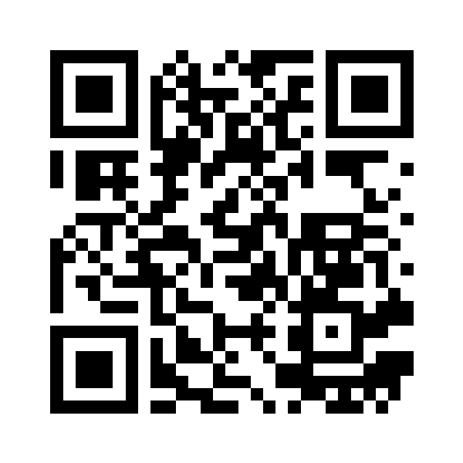
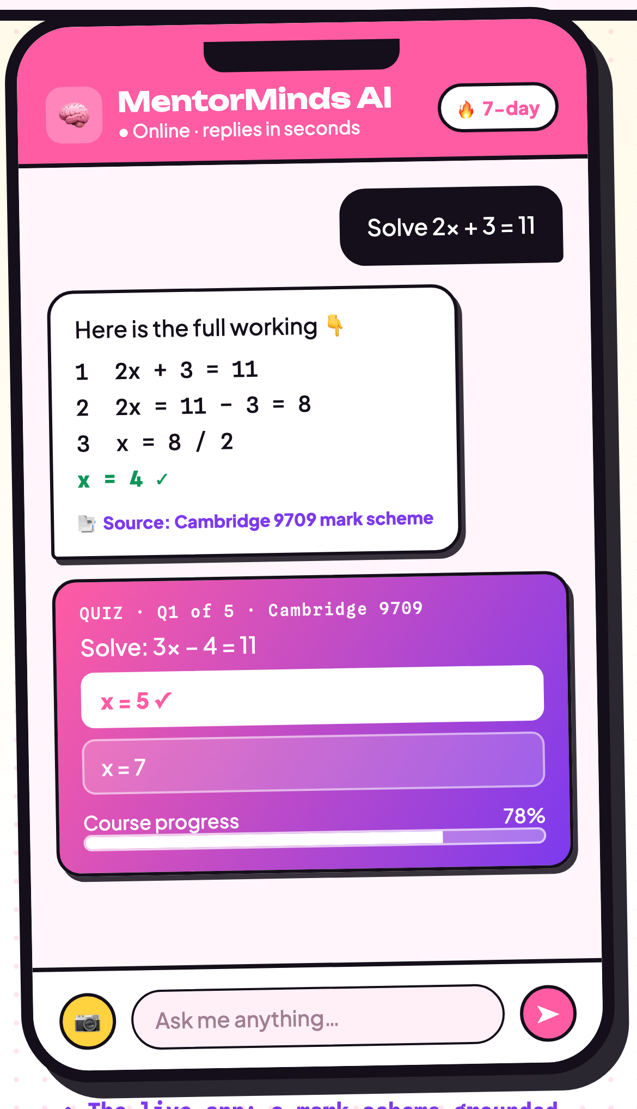
AI-POWERED PERSONAL TUTOR · GROUNDED IN REAL EXAM MARK SCHEMES
Scan for live demo & source
MentorMinds
An examiner-grade AI tutor for every learner — available 24/7.
github.com/Arnobrizwan/mentormind
1
The Problem
Most students cannot get help the moment they are stuck. Quality tutoring remains expensive, scarce, and one-size-fits-all — so doubts pile up and learning gaps widen.
🎓 No personalized tutoring
💸 High tuition costs
📡 Limited access to support
One teacher to 40+ students means individual questions go unanswered, and weaker learners fall behind.
Private tutoring runs RM50–150 per hour — out of reach for the families who need support the most.
Rural and low-income learners lack reliable, on-demand help after school hours or offline.
2
Why It's Different
3
AI Under the Hood
NOVEL CONTRIBUTION
A tutor that grounds every answer in real Cambridge mark schemes — a self-hosted retrieval model returns examiner working and cites the exact paper, with an optional fine-tuned (LoRA) model. No third-party AI APIs.
🧠
Machine Learning
A self-hosted retrieval model matches questions to the mark-scheme corpus, with an optional LoRA fine-tune (Qwen2.5) — no third-party AI APIs.
💬
Natural Language Processing
Understands a typed question, finds the closest Cambridge mark scheme, and explains the answer clearly, step by step.
vs. general chatbots (ChatGPT)
Replies are drawn from the official mark scheme and cite their source — not hallucinated — and cost $0 in AI API fees.
📷
Computer Vision
OpenCV powers exam proctoring (face detection), OMR bubble-sheet auto-grading, and Tesseract OCR for scanned work.
vs. Khan Academy
Built around the exact Cambridge syllabus (20 subjects) with examiner-grade worked solutions, on a fully self-hosted, free-tier stack.
vs. Duolingo
Covers full academic subjects — Maths & Sciences — with step-by-step solutions, not just language drills.
📈
Predictive Analytics & MLOps
A dropout-risk model flags at-risk learners and recommends courses, shipped through a DVC + MLflow pipeline with a drift gate.
↑ The live app: a mark-scheme-grounded solution, a quiz, and progress tracking
4
Evidence & Impact
5
UN SDG Alignment
1,142
20
$0
4
10
mark-scheme answers
Cambridge subjects
third-party AI cost
Quality Education
Reduced Inequalities
Evidence: 1,521 Cambridge past-paper documents ingested · every answer cites its exact mark scheme · k6 load-tested · 100% self-hosted on a free-tier stack, available 24/7.
Classroom pilot in progress — learning-gain & satisfaction results to follow.
Free, examiner-grade tutoring for every learner, any time.
The same support for rural & low-income students as elite tutoring.
Full-stack: Django · FastAPI · Angular · self-hosted retrieval + LoRA tutor · OpenCV · Tesseract · Mistral-OCR ingest · DVC + MLflow · Redis · Postgres · Docker · Kubernetes
Arnob Rizwan Ahmad · A22EC4005 · Faculty of Computing, UTM
Mentor: Dr. Ruhaidah Binti Samsudin

