Slide 1
FINAL PROJECT
Toxic Comment
Detection
Binary text classification with imbalance-aware evaluation
Alikhan Sailybaev | Danial Shaimurat | Arnur Adilkhan
AAI-2601
Data source: Jigsaw Toxic Comment Classification Challenge on Kaggle

Slide 2
Problem and dataset
Classify each comment as toxic or non-toxic
TASK
DATA FIELDS
• Input: English Wikipedia discussion comments
• comment_text for model input
• Target: toxic label, 1 for toxic and 0 for non-toxic
• id for data integrity and database joins
• Challenge: toxic comments form the minority class
• Six labels retained for later analysis
Official file: train.csv from Kaggle. The synthetic sample in the repository is only a pipeline smoke test.
Applied Artificial Intelligence | Final Project

Slide 3
Project workflow
A repeatable path from raw data to model evidence
1
2
3
4
5
Validate CSV
Create SQLite
Train models
Evaluate
Inspect errors
Required columns, missing text, labels
Comments, runs, predictions
Stratified split, class weights
ROC-AUC, PR-AUC, F1, matrix
False positives and false negatives
Console entry point: python -m src.cli
Applied Artificial Intelligence | Final Project

Slide 4
Compared models
Both models use Logistic Regression with balanced class weights
BASELINE
COMPARISON MODEL
Word TF-IDF
Word plus character TF-IDF
• Word 1-2 grams
• Word 1-2 grams
• Sublinear term frequency
• Character-within-word 3-5 grams
• Transparent coefficients
• Captures spelling variants and fragments
The model with the highest held-out ROC-AUC becomes best_model.joblib.
Applied Artificial Intelligence | Final Project

Slide 5
Evaluation for class imbalance
Accuracy alone can hide poor toxic-comment detection
PRIMARY METRIC
THRESHOLD EVIDENCE
ROC-AUC
• Precision: how many flagged comments are toxic
• Recall: how many toxic comments are detected
Measures whether toxic comments receive higher scores than non-toxic comments across all thresholds.
• F1: balance of precision and recall
• Confusion matrix at 0.50 threshold
Official result: word_char_tfidf_lr | ROC-AUC 0.9813 | F1 0.7862
Applied Artificial Intelligence | Final Project

Slide 6
SQLite analysis layer
Data, model runs, and test predictions remain queryable
SCHEMA
comments
model_runs
predictions
comment_id, text, toxic labels, length
model, vectorizer, ROC-AUC, F1, time
actual label, prediction, probability
EIGHT SQL QUERIES
• Class balance and comment-length summaries
• Experiment leaderboard and confusion-matrix cells
• High-confidence false positives and false negatives
• CTE and window-function model ranking
Applied Artificial Intelligence | Final Project

Slide 7
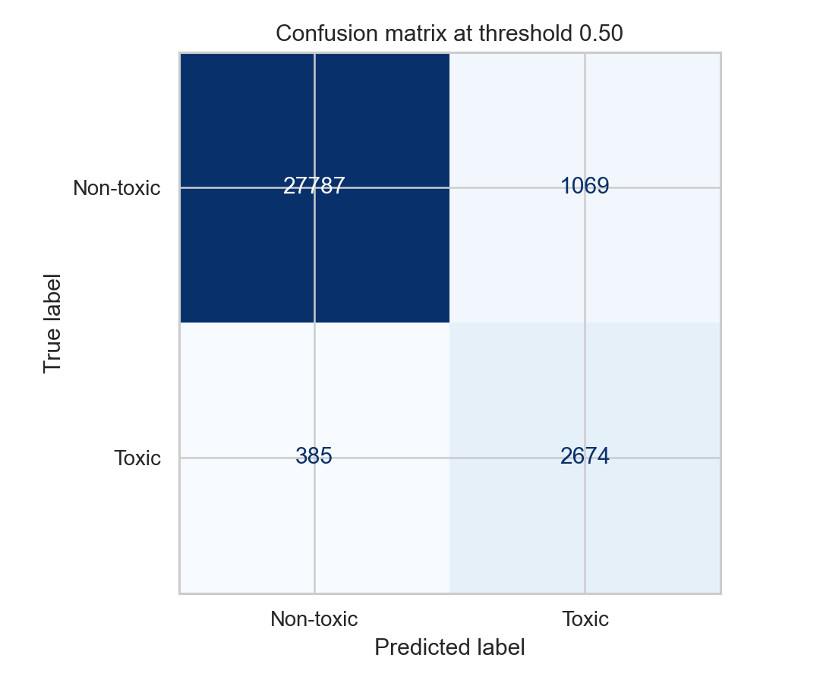
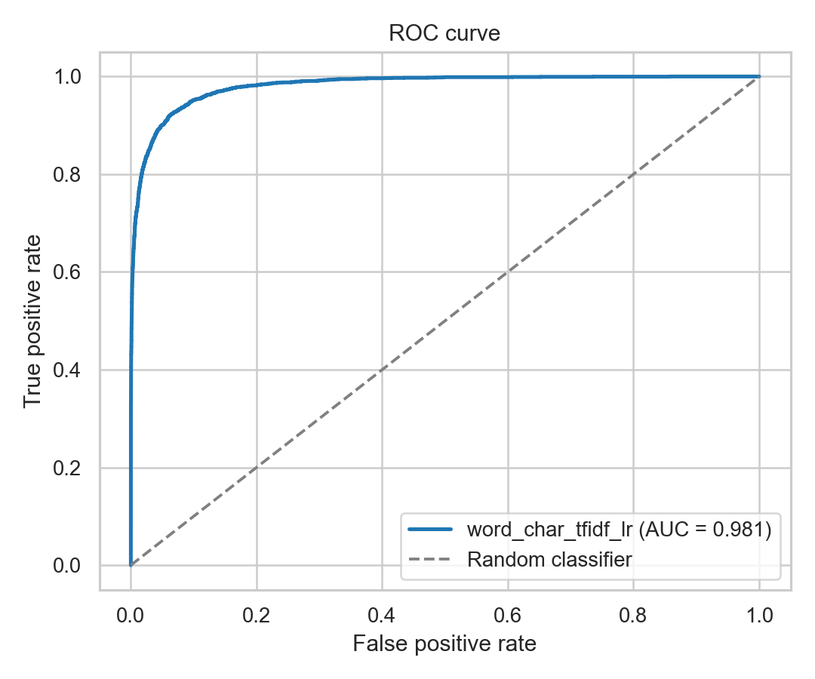
Official model results
Held-out test set with stratified split and random_state 42
Selected model: word_char_tfidf_lr
ROC-AUC 0.9813 PR-AUC 0.8989
Precision 0.7144 Recall 0.8741 F1 0.7862
Applied Artificial Intelligence | Final Project

Slide 8
Conclusion and team contribution
A reproducible baseline with clear limitations and next steps
CONCLUSION
• The project makes imbalance visible through class weights and suitable metrics
• The comparison tests whether character features add value
• SQLite supports repeatable quantitative and qualitative analysis
ERROR ANALYSIS AND CONTRIBUTIONS
False positives can contain hostile vocabulary but still carry a non-toxic annotation, which may reflect quotation or context. False negatives are often long, indirect, or sarcastic comments.
Alikhan: data and SQL | Danial: models and evaluation | Arnur: error analysis, report, slides, and demonstration
Applied Artificial Intelligence | Final Project

