Slide 1

Milestone 1 Presentation
PG05

Slide 2
Catalog

01.Project design

02.Project management

03.Member’s responsibilities

04.Project progress

05.Future work

Slide 3

Project design

Slide 4


Project design
Background
This is a web-based application for helping Maptek assess interviewees and it can be used by administrators from Maptek and interviewees outsides.
Key component of system
Login page, link activation, creating questionnaire, view assignment, upload code file

Slide 5

Project management

Slide 6
Project management

Scope
Build a system “Hire me coder” for Maptek to check whether interviewees’ coding ability.


Goal
To meet all requirements from clients and finish the project online

Team structure
The whole team is divided into two major parts, documentation team and code team. And lead by the project manager, Khate.

Slide 7
Project management
GitHub
To control version and manage processes of the project
1
Weekly meetings
4
Have at least two meetings a week, and share agendas before the meeting and write minutes after the meeting
Trello
2
Work as a to-do list and provide a clear work allocation.
5
Meeting documents
All document will be updated to GitHub and recorded
Slack
Daily internal communication among team.
3

Slide 8

Member’s responsibilities

Slide 9

Member’s responsibilities

Development team
Khate, Arnold, Nick
responsible for coding and implementing the system to meet the requirements of clients.

Documentation team
Kina, Sai, John
responsible for documents which include all plans and presentation materials during this project.

Testing team
Kalpana, Tim
responsible for testing modules finished by the development team.

Slide 10
Member’s responsibilities
Sharon Khate Damaso
1
code review, add admin user(dev), add questions(dev)
Xuankai Feng (Kina)
2
Risk management plan review, SRS, SPMP, milestone 1 presentation slides
Yuedong Wang (Nick)
Junjie Zhao (John)
4
Software requirement specification review, create a test questionnaire(dev)
configuration management plan review, SRS, SPMP, milestone 1 presentation and slides
3
Ying Wang (Arnold)
software requirement specification review, send the link to interviewees(dev)
5
Kalpana Parvathaneni
6
project management plan review, SDD, create test cases
Sai Dheeraj Reddy Pallavolu
Software design document review, SDD, SPMP, milestone 1 presentation
7
Lantian Cai (Tim)
8
testing review, create test cases

Slide 11

Project progress

Slide 12
Project progress
Project documentation
Task allocation
All draft plans of the project, which include SPMP, SRS and SDD had been finished. Further adjustment are processing.
All tasks including documentation and development had been allocated to each team member in this project. Everyone is working on his own task.
System development
Team communication
Finishing developing the administrator module, functions include manage users, create questions, manage tests and send assessment had been implemented.
Weekly internal and external meetings ensure the smooth communication among the whole team as well as the supervisor.

Slide 13

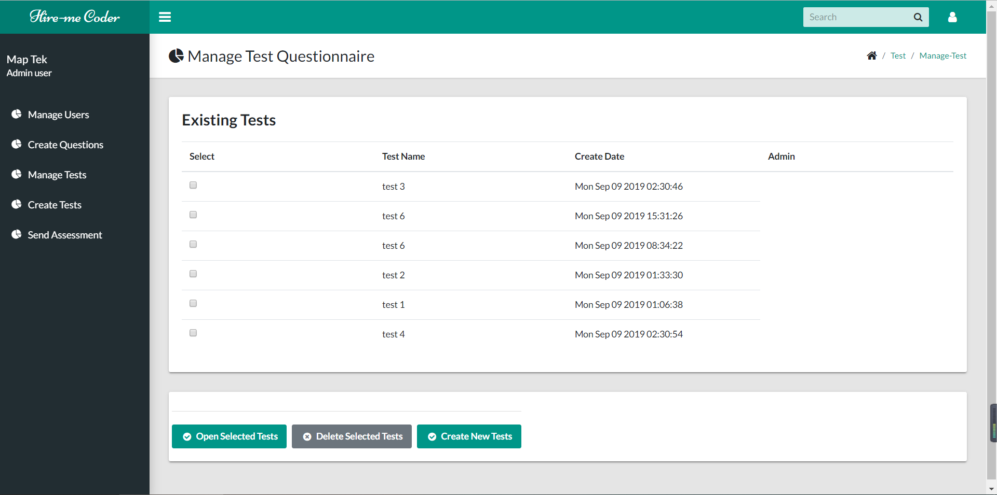
Project progress
Create and view
With the administrator accounts, MapTek staff can create new tests though upload questions.
Manage and edit
MapTek staff can manage current tests and users or delete or modify them.

Slide 14

Future work

Slide 15
Future work
01
Debug the administrator module
Taking advantage of testing cases, debug implemented functions of the administrator module.
Develop the user module
02
Starting designing and development functions of the user module, to satisfy the requirement of clients.
03
Adjust documents
Making adjustments on draft plans with the feedback from the supervisor and finish the final version on time.
Prepare presentation
04
Collecting materials to prepare for the final presentation and demonstration.

Slide 16
Thank you
PG05

