Slide 1

MUTOKO RURAL DISTRICT COUNCIL
WEBSITE ADMINISTRATION,
CONTENT MANAGEMENT &
CAPACITY BUILDING TRAINING
One-Day Practical Training Programme
2 ICT · 3 HR · 2 Finance | Mutoko, Zimbabwe
Notes:
Slide 1 | Welcome
FACILITATOR NOTES
Welcome participants. Explain that the session uses the verified system and approved discovery baseline; capture attendance only when present.
EVIDENCE: Approved discovery audit; source/content.py source list; current public screenshot register.
SAFETY: No production writes, permissions, host changes or real emails. Missing access/screenshot stays pending.
TIMING: Follow the detailed curriculum; keep this slide to its relevant session. Do not spend guided-practice time reading every bullet.

Slide 2
MRDC / INTRODUCTION
What you will be able to do
1
Find Council information and use your permitted CMS modules
2
3
Prepare safe drafts, PDFs and images; check public visibility
Complete your HR, Finance or ICT task and escalate problems
12 NOV 2026 BASELINE | DEVELOPMENT EDITION • LIVE DELIVERY AND ACCEPTANCE PENDING
02
Notes:
Slide 2 | Introduction
FACILITATOR NOTES
S1. Ask each participant to name one duty. Measurable outcomes are demonstrated in the eight-checkpoint assessment, not inferred from attendance.
EVIDENCE: Approved discovery audit; source/content.py source list; current public screenshot register.
SAFETY: No production writes, permissions, host changes or real emails. Missing access/screenshot stays pending.
TIMING: Follow the detailed curriculum; keep this slide to its relevant session. Do not spend guided-practice time reading every bullet.

Slide 3
MRDC / INTRODUCTION
Today: practical work within one day
1
09:00 website and CMS navigation
2
3
10:00 shared content practice · 11:30 departmental tracks
13:30 security · 14:30 maintenance · 15:15 assessment
12 NOV 2026 BASELINE | DEVELOPMENT EDITION • LIVE DELIVERY AND ACCEPTANCE PENDING
03
Notes:
Slide 3 | Introduction
FACILITATOR NOTES
S1. Registration 08:30; tea 11:15–11:30; lunch 12:45–13:30; evaluation 16:00–16:30. Complete pre-test now, 10 minutes.
EVIDENCE: Approved discovery audit; source/content.py source list; current public screenshot register.
SAFETY: No production writes, permissions, host changes or real emails. Missing access/screenshot stays pending.
TIMING: Follow the detailed curriculum; keep this slide to its relevant session. Do not spend guided-practice time reading every bullet.

Slide 4
MRDC / INTRODUCTION
Practice safely and label evidence
1
IMPLEMENTED: source or observed public response
2
3
GOVERNANCE: Council approval and retention decisions
PENDING: access, authenticated screenshots and host evidence
12 NOV 2026 BASELINE | DEVELOPMENT EDITION • LIVE DELIVERY AND ACCEPTANCE PENDING
04
Notes:
Slide 4 | Introduction
FACILITATOR NOTES
S1. Never edit production, change permissions or send real mail. A blocked exercise remains pending. Use only supplied fictional data.
EVIDENCE: Approved discovery audit; source/content.py source list; current public screenshot register.
SAFETY: No production writes, permissions, host changes or real emails. Missing access/screenshot stays pending.
TIMING: Follow the detailed curriculum; keep this slide to its relevant session. Do not spend guided-practice time reading every bullet.

Slide 5
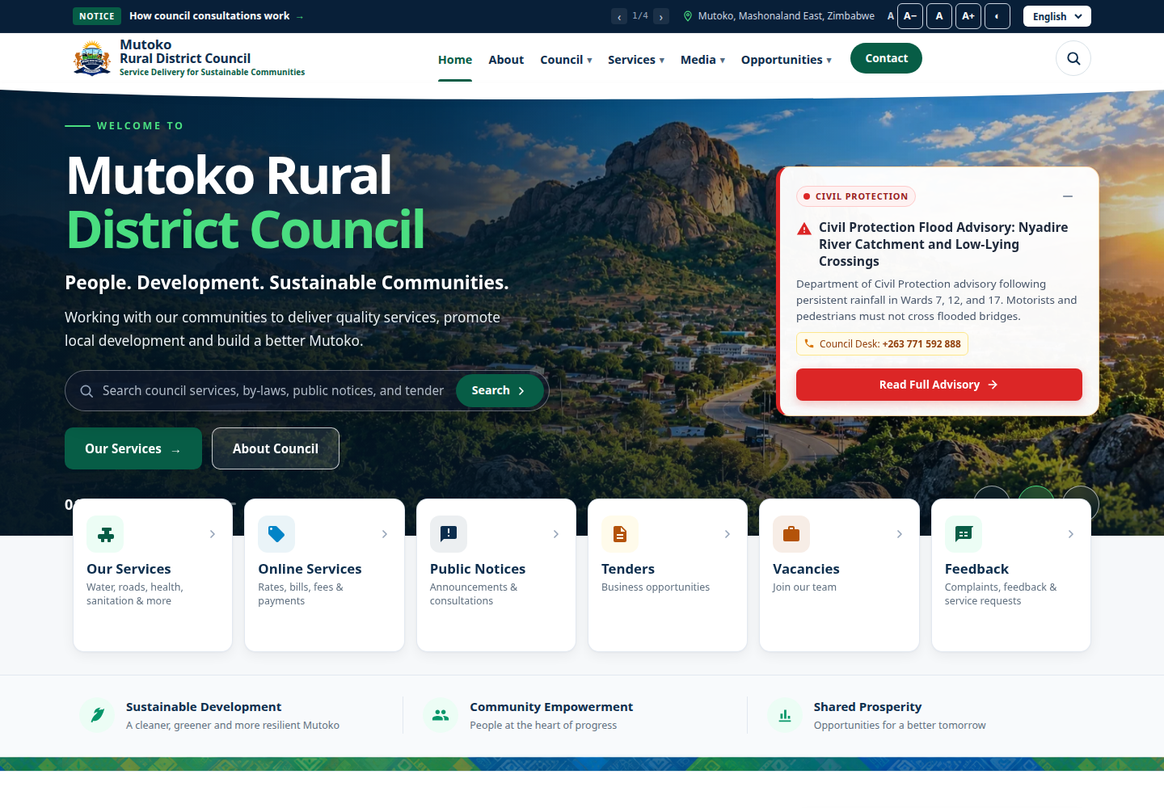
MRDC / PUBLIC WEBSITE
The website connects Council and citizens
01 Public services, opportunities and accountable publications
PUBLIC VIEW
02 Citizens read approved content; officers maintain separate CMS records
03 Transparency requires accurate, current and accessible information
VERIFIED PUBLIC CAPTURE • home • 12 NOV 2026
12 NOV 2026 BASELINE | DEVELOPMENT EDITION • LIVE DELIVERY AND ACCEPTANCE PENDING
05
Notes:
Slide 5 | Public website
FACILITATOR NOTES
S2 demo: identify public navigation and a date/status. Screenshot provenance is in the screenshot register; counts can change.
EVIDENCE: Approved discovery audit; source/content.py source list; current public screenshot register.
SAFETY: No production writes, permissions, host changes or real emails. Missing access/screenshot stays pending.
TIMING: Follow the detailed curriculum; keep this slide to its relevant session. Do not spend guided-practice time reading every bullet.
SCREENSHOT: {"id": "home", "url": "https://www.mutokordc.co.zw/en", "status": "verified", "file": "assets/screenshots/home.png", "captured_at": "2026-11-12T02:26:18.341Z", "viewport": "1440 × 1000", "evidence": "Live browser response 200 and expected component/login heading; no form submitted.", "visual_review": "Visually inspected actual public screen; expected page identity and visible controls; no credentials entered or private data displayed."}

Slide 6
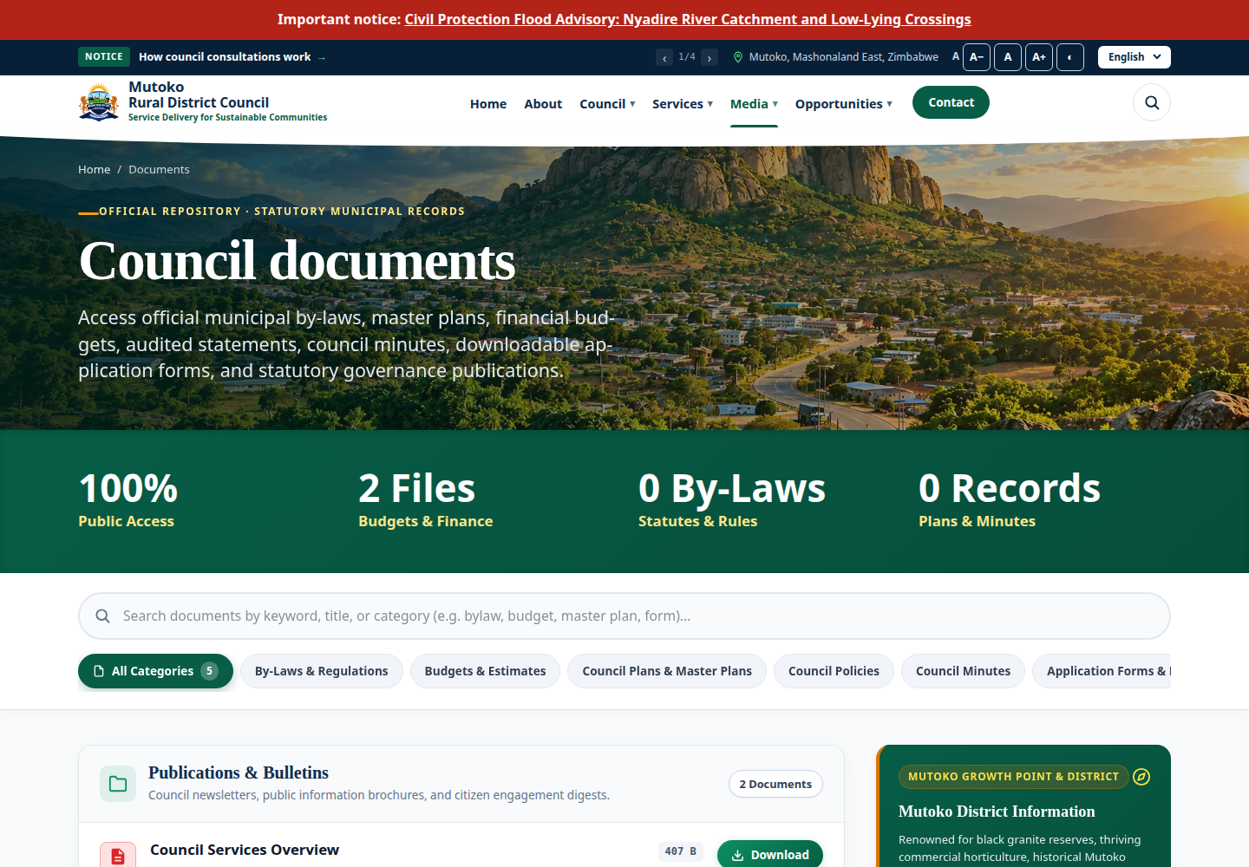
MRDC / PUBLIC WEBSITE
Find a publication and check its context
01 Use Documents filters: category, year, department and search
PUBLIC VIEW
02 Read the detail before relying on the title
03 Verify the approved file, year and visibility after publication
VERIFIED PUBLIC CAPTURE • documents • 12 NOV 2026
12 NOV 2026 BASELINE | DEVELOPMENT EDITION • LIVE DELIVERY AND ACCEPTANCE PENDING
06
Notes:
Slide 6 | Public website
FACILITATOR NOTES
S2 demo E1. Read-only production orientation is permitted; do not register tender downloads. Training download checks use isolated fixtures.
EVIDENCE: Approved discovery audit; source/content.py source list; current public screenshot register.
SAFETY: No production writes, permissions, host changes or real emails. Missing access/screenshot stays pending.
TIMING: Follow the detailed curriculum; keep this slide to its relevant session. Do not spend guided-practice time reading every bullet.
SCREENSHOT: {"id": "documents", "url": "https://www.mutokordc.co.zw/en/documents", "status": "verified", "file": "assets/screenshots/documents.png", "captured_at": "2026-11-12T02:26:20.400Z", "viewport": "1440 × 1000", "evidence": "Live browser response 200 and expected component/login heading; no form submitted.", "visual_review": "Visually inspected actual public screen; expected page identity and visible controls; no credentials entered or private data displayed."}

Slide 7
MRDC / PUBLIC WEBSITE
Languages, search and accessibility
1
English, Shona and Ndebele routes are available
2
3
Missing translations may display English
Try keyboard, text-size and contrast controls; report barriers
12 NOV 2026 BASELINE | DEVELOPMENT EDITION • LIVE DELIVERY AND ACCEPTANCE PENDING
07
Notes:
Slide 7 | Public website
FACILITATOR NOTES
S2. Route availability is not linguistic approval or WCAG certification. Ask a participant to locate an accessibility control and explain fallback.
EVIDENCE: Approved discovery audit; source/content.py source list; current public screenshot register.
SAFETY: No production writes, permissions, host changes or real emails. Missing access/screenshot stays pending.
TIMING: Follow the detailed curriculum; keep this slide to its relevant session. Do not spend guided-practice time reading every bullet.

Slide 8
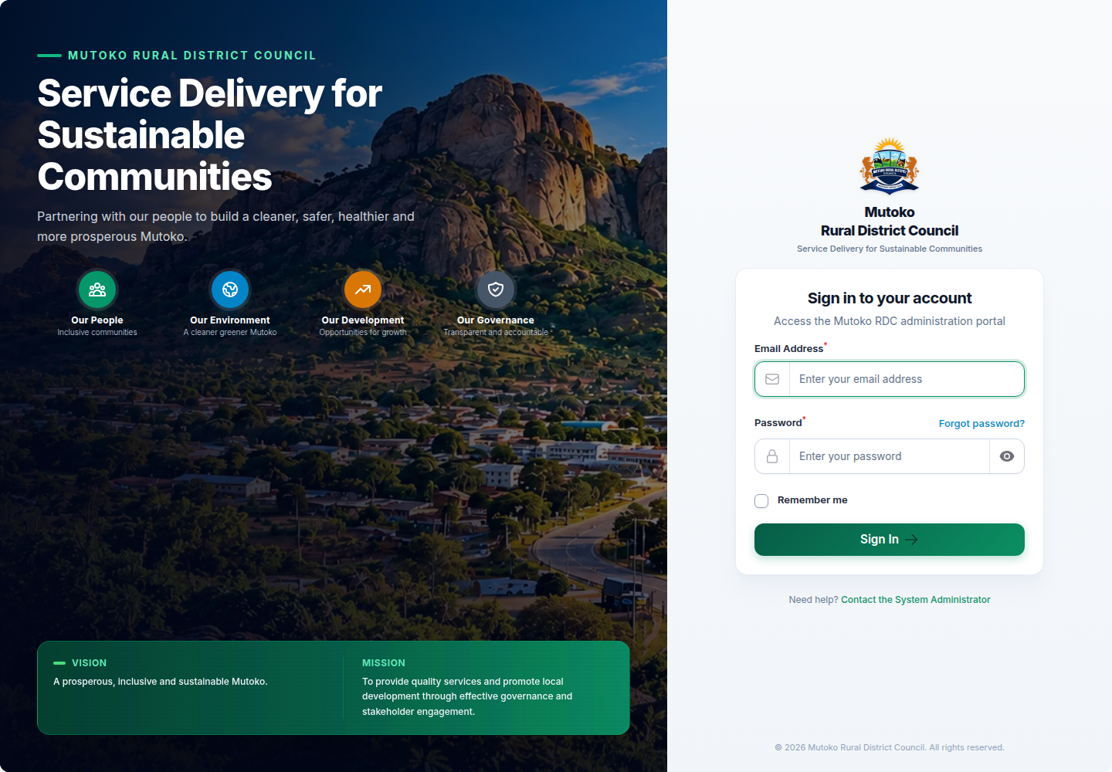
MRDC / ADMINISTRATION
Sign in with your own account
01 Open the approved training address + /admin/login
PUBLIC VIEW
02 Use your own credentials; follow MFA if enrolled
03 Forgot password? requires working registered-mail delivery
VERIFIED PUBLIC CAPTURE • login • 12 NOV 2026
12 NOV 2026 BASELINE | DEVELOPMENT EDITION • LIVE DELIVERY AND ACCEPTANCE PENDING
08
Notes:
Slide 8 | Administration
FACILITATOR NOTES
S2 demo. Do not type real credentials into captured screens. MFA is supported but not verified as mandatory. Profile screen is pending.
EVIDENCE: Approved discovery audit; source/content.py source list; current public screenshot register.
SAFETY: No production writes, permissions, host changes or real emails. Missing access/screenshot stays pending.
TIMING: Follow the detailed curriculum; keep this slide to its relevant session. Do not spend guided-practice time reading every bullet.
SCREENSHOT: {"id": "login", "url": "https://www.mutokordc.co.zw/admin/login", "status": "verified", "file": "assets/screenshots/login.png", "captured_at": "2026-11-12T02:26:28.838Z", "viewport": "1440 × 1000", "evidence": "Live browser response 200 and expected component/login heading; no form submitted.", "visual_review": "Visually inspected actual public screen; expected page identity and visible controls; no credentials entered or private data displayed."}

Slide 9
MRDC / ADMINISTRATION
Six clusters, permissions and scope
1
Content: Pages, News and notices, Media, Documents
2
3
Council; Services & Development; Public Enquiries
Reports & Monitoring; Administration; missing actions go to ICT
AUTHENTICATED SCREENSHOT PENDING • demonstrate only in approved training environment
12 NOV 2026 BASELINE | DEVELOPMENT EDITION • LIVE DELIVERY AND ACCEPTANCE PENDING
09
Notes:
Slide 9 | Administration
FACILITATOR NOTES
S2. Authenticated navigation screenshot PENDING. Demo from actual approved staging only. A role name alone does not establish access.
EVIDENCE: Approved discovery audit; source/content.py source list; current public screenshot register.
SAFETY: No production writes, permissions, host changes or real emails. Missing access/screenshot stays pending.
TIMING: Follow the detailed curriculum; keep this slide to its relevant session. Do not spend guided-practice time reading every bullet.

Slide 10
MRDC / ADMINISTRATION
The content lifecycle has exceptions
Draft
→
Review¹
→
Publishable
→
Publish
→
Citizen check
Core flow: draft → publishable → published → citizen check
Editing core published content normally returns it to draft
FAQs, settings and bank accounts use different visibility controls
¹ Organizational approval is governance; the application does not force a separate reviewer.
AUTHENTICATED SCREENSHOT PENDING • diagram describes the verified source workflow
12 NOV 2026 BASELINE | DEVELOPMENT EDITION • LIVE DELIVERY AND ACCEPTANCE PENDING
10
Notes:
Slide 10 | Administration
FACILITATOR NOTES
S3. Draw the flow. Page verification is not uniform. Independent reviewer approval is governance; the app does not force a second officer.
EVIDENCE: Approved discovery audit; source/content.py source list; current public screenshot register.
SAFETY: No production writes, permissions, host changes or real emails. Missing access/screenshot stays pending.
TIMING: Follow the detailed curriculum; keep this slide to its relevant session. Do not spend guided-practice time reading every bullet.

Slide 11
MRDC / CONTENT MANAGEMENT
Create a clear news draft
1
Content → News and notices → Create → type News
2
3
Use title, summary, body, department and unique slug
Save draft; check wording, links and attachments
AUTHENTICATED SCREENSHOT PENDING • demonstrate only in approved training environment
12 NOV 2026 BASELINE | DEVELOPMENT EDITION • LIVE DELIVERY AND ACCEPTANCE PENDING
11
Notes:
Slide 11 | Content management
FACILITATOR NOTES
S3 demo W5. Authenticated screenshot PENDING. Use TRAINING ONLY in title and fictional data. No future scheduling workflow is verified.
EVIDENCE: Approved discovery audit; source/content.py source list; current public screenshot register.
SAFETY: No production writes, permissions, host changes or real emails. Missing access/screenshot stays pending.
TIMING: Follow the detailed curriculum; keep this slide to its relevant session. Do not spend guided-practice time reading every bullet.

Slide 12
MRDC / CONTENT MANAGEMENT
Notice expiry and urgent alerts
1
Choose type Notice and an intentional expiry date
2
3
Expiry includes its closing day; public queries hide it afterward
Urgent is a publication decision; withdraw when no longer needed
AUTHENTICATED SCREENSHOT PENDING • demonstrate only in approved training environment
12 NOV 2026 BASELINE | DEVELOPMENT EDITION • LIVE DELIVERY AND ACCEPTANCE PENDING
12
Notes:
Slide 12 | Content management
FACILITATOR NOTES
S3. Expiry does not necessarily update the stored status. Past expiry is rejected on save. Explain urgency governance using a fictional notice.
EVIDENCE: Approved discovery audit; source/content.py source list; current public screenshot register.
SAFETY: No production writes, permissions, host changes or real emails. Missing access/screenshot stays pending.
TIMING: Follow the detailed curriculum; keep this slide to its relevant session. Do not spend guided-practice time reading every bullet.

Slide 13
MRDC / CONTENT MANAGEMENT
Upload an image people can understand
1
JPEG/PNG/WebP/PDF; default maximum 10,240 KB
2
3
Inspect file content and add descriptive image alt text
Library upload is separate from approved public publication
AUTHENTICATED SCREENSHOT PENDING • demonstrate only in approved training environment
12 NOV 2026 BASELINE | DEVELOPMENT EDITION • LIVE DELIVERY AND ACCEPTANCE PENDING
13
Notes:
Slide 13 | Content management
FACILITATOR NOTES
S3 E3. Use supplied PNG: fictional training notice board. Authenticated upload screenshot PENDING. Alt text is not universally enforced, so check it deliberately.
EVIDENCE: Approved discovery audit; source/content.py source list; current public screenshot register.
SAFETY: No production writes, permissions, host changes or real emails. Missing access/screenshot stays pending.
TIMING: Follow the detailed curriculum; keep this slide to its relevant session. Do not spend guided-practice time reading every bullet.

Slide 14
MRDC / CONTENT MANAGEMENT
Pages: save, edit and restore carefully
1
Content → Pages: heading, paragraph and internal CTA blocks
2
3
Use the assigned draft and preserve existing URLs
Restore revision creates a draft; review before publication
AUTHENTICATED SCREENSHOT PENDING • demonstrate only in approved training environment
12 NOV 2026 BASELINE | DEVELOPMENT EDITION • LIVE DELIVERY AND ACCEPTANCE PENDING
14
Notes:
Slide 14 | Content management
FACILITATOR NOTES
S3 E2. Screenshot PENDING. Not all About content is CMS-controlled: vision/mission keys and bundled map are code-managed.
EVIDENCE: Approved discovery audit; source/content.py source list; current public screenshot register.
SAFETY: No production writes, permissions, host changes or real emails. Missing access/screenshot stays pending.
TIMING: Follow the detailed curriculum; keep this slide to its relevant session. Do not spend guided-practice time reading every bullet.

Slide 15
MRDC / CONTENT MANAGEMENT
Documents: category and year matter
1
Upload PDF document or select an active library PDF
2
3
Choose category, department and deliberate visibility
Reference date determines the publication year
AUTHENTICATED SCREENSHOT PENDING • demonstrate only in approved training environment
12 NOV 2026 BASELINE | DEVELOPMENT EDITION • LIVE DELIVERY AND ACCEPTANCE PENDING
15
Notes:
Slide 15 | Content management
FACILITATOR NOTES
S3/W7. Authenticated form PENDING. Sample budget uses 2099-01-01 and Budget category. Do not confuse upload year with reporting year.
EVIDENCE: Approved discovery audit; source/content.py source list; current public screenshot register.
SAFETY: No production writes, permissions, host changes or real emails. Missing access/screenshot stays pending.
TIMING: Follow the detailed curriculum; keep this slide to its relevant session. Do not spend guided-practice time reading every bullet.

Slide 16
MRDC / CONTENT MANAGEMENT
Who approves, who publishes?
1
Council approves accuracy, privacy and release responsibility
2
3
Authorized Verify / Mark publishable and Publish control visibility
Verify & Publish may be performed by one authorized editorial user
AUTHENTICATED SCREENSHOT PENDING • demonstrate only in approved training environment
12 NOV 2026 BASELINE | DEVELOPMENT EDITION • LIVE DELIVERY AND ACCEPTANCE PENDING
16
Notes:
Slide 16 | Content management
FACILITATOR NOTES
S3 governance explanation. Do not teach enforced four-eyes approval. Vacancy verification uses update permission.
EVIDENCE: Approved discovery audit; source/content.py source list; current public screenshot register.
SAFETY: No production writes, permissions, host changes or real emails. Missing access/screenshot stays pending.
TIMING: Follow the detailed curriculum; keep this slide to its relevant session. Do not spend guided-practice time reading every bullet.

Slide 17
MRDC / CONTENT MANAGEMENT
Always check the citizen view
1
Open the isolated public page in a separate browser/tab
2
3
Read title, status, dates, image and linked PDF
Check after editing, replacement and withdrawal
AUTHENTICATED SCREENSHOT PENDING • demonstrate only in approved training environment
12 NOV 2026 BASELINE | DEVELOPMENT EDITION • LIVE DELIVERY AND ACCEPTANCE PENDING
17
Notes:
Slide 17 | Content management
FACILITATOR NOTES
S3 demonstration. Public screenshot from production proves appearance only, not the exercise outcome. A success toast is not a citizen-view check.
EVIDENCE: Approved discovery audit; source/content.py source list; current public screenshot register.
SAFETY: No production writes, permissions, host changes or real emails. Missing access/screenshot stays pending.
TIMING: Follow the detailed curriculum; keep this slide to its relevant session. Do not spend guided-practice time reading every bullet.

Slide 18
MRDC / PRACTICE
Shared practice: draft and image
1
E2: edit the assigned TRAINING ONLY Page draft
2
3
E3: upload supplied image and add meaningful alt text
Record saved state or access blocker; never borrow an account
12 NOV 2026 BASELINE | DEVELOPMENT EDITION • LIVE DELIVERY AND ACCEPTANCE PENDING
18
Notes:
Slide 18 | Practice
FACILITATOR NOTES
S3 guided practice 45 minutes across W4–W6. Each participant performs a task when authorized. Blocked tasks use worksheets and remain not demonstrated.
EVIDENCE: Approved discovery audit; source/content.py source list; current public screenshot register.
SAFETY: No production writes, permissions, host changes or real emails. Missing access/screenshot stays pending.
TIMING: Follow the detailed curriculum; keep this slide to its relevant session. Do not spend guided-practice time reading every bullet.

Slide 19
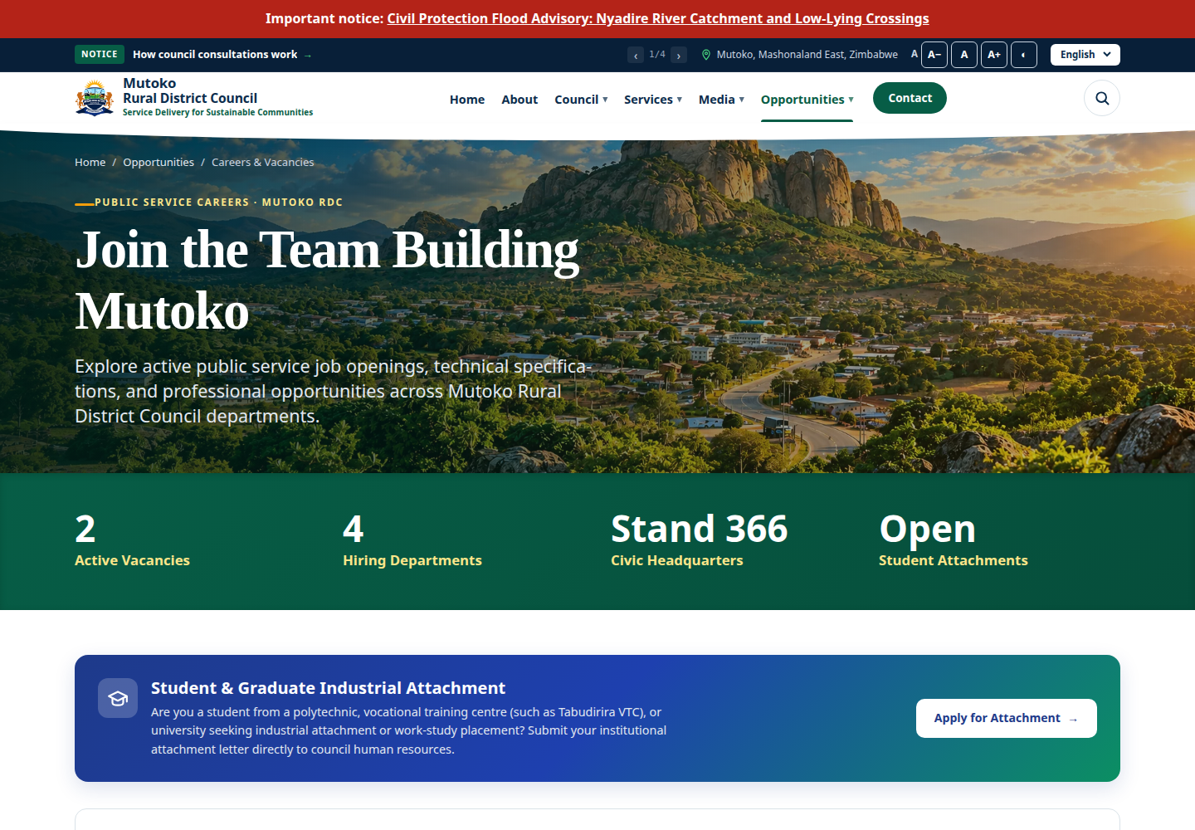
MRDC / HR WORKFLOW
HR: prepare a vacancy
01 Services & Development → Vacancies
PUBLIC VIEW
02 Title/reference, description, requirements, opening and closing dates
03 Link approved advert; save draft, edit and check again
VERIFIED PUBLIC CAPTURE • vacancies • 12 NOV 2026
12 NOV 2026 BASELINE | DEVELOPMENT EDITION • LIVE DELIVERY AND ACCEPTANCE PENDING
19
Notes:
Slide 19 | HR workflow
FACILITATOR NOTES
S4 E4. Vacancy form screenshot PENDING. Default Department Content Owner has no vacancy permissions. Confirm G2 before practice.
EVIDENCE: Approved discovery audit; source/content.py source list; current public screenshot register.
SAFETY: No production writes, permissions, host changes or real emails. Missing access/screenshot stays pending.
TIMING: Follow the detailed curriculum; keep this slide to its relevant session. Do not spend guided-practice time reading every bullet.
SCREENSHOT: {"id": "vacancies", "url": "https://www.mutokordc.co.zw/en/vacancies", "status": "verified", "file": "assets/screenshots/vacancies.png", "captured_at": "2026-11-12T02:26:22.069Z", "viewport": "1440 × 1000", "evidence": "Live browser response 200 and expected component/login heading; no form submitted.", "visual_review": "Visually inspected actual public screen; expected page identity and visible controls; no credentials entered or private data displayed."}

Slide 20
MRDC / HR WORKFLOW
Closing date is not deletion
1
Vacancy remains Open on its closing day, Closed afterward
2
3
A closed vacancy can remain publicly listed
Publication and advert visibility are separate checks
AUTHENTICATED SCREENSHOT PENDING • demonstrate only in approved training environment
12 NOV 2026 BASELINE | DEVELOPMENT EDITION • LIVE DELIVERY AND ACCEPTANCE PENDING
20
Notes:
Slide 20 | HR workflow
FACILITATOR NOTES
S4. Choose training day +7. Do not change system clock or production data. Explain approval, vacancy update-based verification and separate publish right.
EVIDENCE: Approved discovery audit; source/content.py source list; current public screenshot register.
SAFETY: No production writes, permissions, host changes or real emails. Missing access/screenshot stays pending.
TIMING: Follow the detailed curriculum; keep this slide to its relevant session. Do not spend guided-practice time reading every bullet.

Slide 21
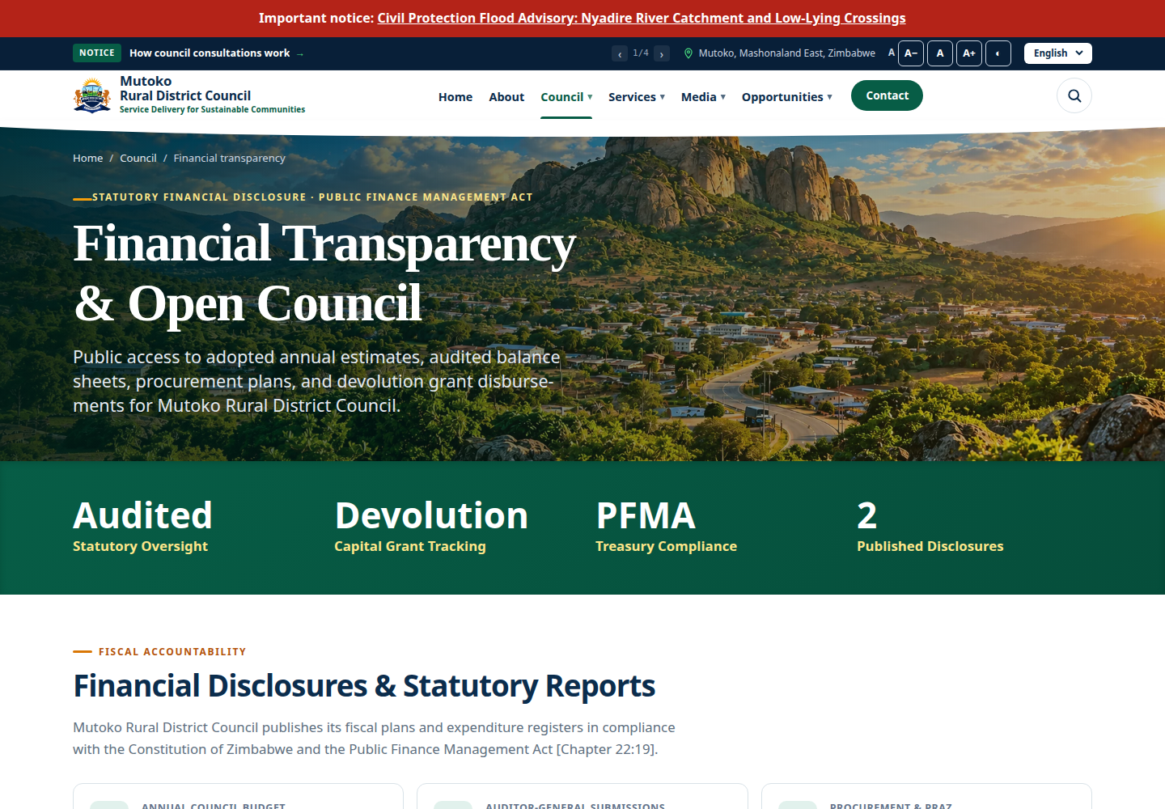
MRDC / FINANCE WORKFLOW
Finance: publish approved disclosure
01 Documents → Category Budget for the fictional budget
PUBLIC VIEW
02 Reference date 2099-01-01; correct department and visibility
03 Inspect PDF; request approval and authorized publication
VERIFIED PUBLIC CAPTURE • transparency • 12 NOV 2026
12 NOV 2026 BASELINE | DEVELOPMENT EDITION • LIVE DELIVERY AND ACCEPTANCE PENDING
21
Notes:
Slide 21 | Finance workflow
FACILITATOR NOTES
S4 E5. Actual public Transparency screenshot is shown; authenticated document form screenshot PENDING. Finance is not automatically procurement/bank-account administrator. Never publish payroll, private transactions or ratepayer data.
EVIDENCE: Approved discovery audit; source/content.py source list; current public screenshot register.
SAFETY: No production writes, permissions, host changes or real emails. Missing access/screenshot stays pending.
TIMING: Follow the detailed curriculum; keep this slide to its relevant session. Do not spend guided-practice time reading every bullet.
SCREENSHOT: {"id": "transparency", "url": "https://www.mutokordc.co.zw/en/transparency", "status": "verified", "file": "assets/screenshots/transparency.png", "captured_at": "2026-11-12T02:26:23.782Z", "viewport": "1440 × 1000", "evidence": "Live browser response 200 and expected component/login heading; no form submitted.", "visual_review": "Visually inspected actual public screen; expected page identity and visible controls; no credentials entered or private data displayed."}

Slide 22
MRDC / FINANCE WORKFLOW
Replace file, preserve the record
Current PDF
→
Replace file
→
Version +1
→
Draft
→
Review / publish
Upload the corrected PDF to permitted Media
Documents → Replace file → select corrected PDF
Version increments; record returns to draft; review and publish again
Use the explicit Replace file action. Ordinary editing does not establish retained version history.
AUTHENTICATED SCREENSHOT PENDING • diagram describes the verified source workflow
12 NOV 2026 BASELINE | DEVELOPMENT EDITION • LIVE DELIVERY AND ACCEPTANCE PENDING
22
Notes:
Slide 22 | Finance workflow
FACILITATOR NOTES
S4 E5/W8. Screenshot PENDING. Finance documents.update/media rights are prerequisites. Ordinary media change in edit is not a guaranteed version-preserving replacement.
EVIDENCE: Approved discovery audit; source/content.py source list; current public screenshot register.
SAFETY: No production writes, permissions, host changes or real emails. Missing access/screenshot stays pending.
TIMING: Follow the detailed curriculum; keep this slide to its relevant session. Do not spend guided-practice time reading every bullet.

Slide 23
MRDC / FINANCE WORKFLOW
Procurement has separate authority
1
Tender lifecycle, publication and award are different decisions
2
3
Download registration collects bidder information
Amounts and bank details require checked organizational approval
AUTHENTICATED SCREENSHOT PENDING • demonstrate only in approved training environment
12 NOV 2026 BASELINE | DEVELOPMENT EDITION • LIVE DELIVERY AND ACCEPTANCE PENDING
23
Notes:
Slide 23 | Finance workflow
FACILITATOR NOTES
S4. Optional procurement demo only in isolated training with explicit rights. Do not submit production bidder details. Procurement document eligibility QA remains pending.
EVIDENCE: Approved discovery audit; source/content.py source list; current public screenshot register.
SAFETY: No production writes, permissions, host changes or real emails. Missing access/screenshot stays pending.
TIMING: Follow the detailed curriculum; keep this slide to its relevant session. Do not spend guided-practice time reading every bullet.

Slide 24
MRDC / PRACTICE
Department practice and peer check
1
HR: save/edit one vacancy and explain dates
2
3
Finance: budget category/year/PDF and version replacement
ICT: observe scope/dependency issues; do not grant new rights
12 NOV 2026 BASELINE | DEVELOPMENT EDITION • LIVE DELIVERY AND ACCEPTANCE PENDING
24
Notes:
Slide 24 | Practice
FACILITATOR NOTES
S4 45-minute guided parallel exercise. Use the workbook track pages. Peer observation supports learning, not final individual competence scoring.
EVIDENCE: Approved discovery audit; source/content.py source list; current public screenshot register.
SAFETY: No production writes, permissions, host changes or real emails. Missing access/screenshot stays pending.
TIMING: Follow the detailed curriculum; keep this slide to its relevant session. Do not spend guided-practice time reading every bullet.

Slide 25
MRDC / SECURITY
Unique passwords and protected recovery
1
Use a long unique password and approved password manager
2
3
Protect authenticator and recovery codes; never share accounts
Lock screens; report leavers and access changes to ICT
12 NOV 2026 BASELINE | DEVELOPMENT EDITION • LIVE DELIVERY AND ACCEPTANCE PENDING
25
Notes:
Slide 25 | Security
FACILITATOR NOTES
S5. Explain MFA support without claiming mandatory enforcement. Never display a real code or reset link. Recovery depends on identity checks and mail readiness.
EVIDENCE: Approved discovery audit; source/content.py source list; current public screenshot register.
SAFETY: No production writes, permissions, host changes or real emails. Missing access/screenshot stays pending.
TIMING: Follow the detailed curriculum; keep this slide to its relevant session. Do not spend guided-practice time reading every bullet.

Slide 26
MRDC / SECURITY
Phishing: pause before acting
1
Urgent bank-detail or vacancy instructions can be fraudulent
2
3
Check address, sender and request through a known channel
Do not share codes or open unexpected attachments; report promptly
12 NOV 2026 BASELINE | DEVELOPMENT EDITION • LIVE DELIVERY AND ACCEPTANCE PENDING
26
Notes:
Slide 26 | Security
FACILITATOR NOTES
S5 E7. Read the fictional message: “Urgent budget approval—send MFA code to avoid suspension.” Participants identify three indicators and safe actions.
EVIDENCE: Approved discovery audit; source/content.py source list; current public screenshot register.
SAFETY: No production writes, permissions, host changes or real emails. Missing access/screenshot stays pending.
TIMING: Follow the detailed curriculum; keep this slide to its relevant session. Do not spend guided-practice time reading every bullet.

Slide 27
MRDC / DATA PROTECTION
Keep public content and private records apart
1
Do not publish complaints, CVs, payroll or personal identifiers
2
3
Use only necessary, approved information and redacted PDFs
No citizen/personnel data in training AI prompts or screenshots
12 NOV 2026 BASELINE | DEVELOPMENT EDITION • LIVE DELIVERY AND ACCEPTANCE PENDING
27
Notes:
Slide 27 | Data protection
FACILITATOR NOTES
S5. AI Draft Reply and AI Translate exist but external availability/approval is unverified. Human review is mandatory governance, not a system guarantee.
EVIDENCE: Approved discovery audit; source/content.py source list; current public screenshot register.
SAFETY: No production writes, permissions, host changes or real emails. Missing access/screenshot stays pending.
TIMING: Follow the detailed curriculum; keep this slide to its relevant session. Do not spend guided-practice time reading every bullet.

Slide 28
MRDC / DATA PROTECTION
Zimbabwe law: report early, escalate correctly
1
Cyber and Data Protection Act: lawful, fair, secure handling
2
3
POTRAZ is the designated data-protection authority
Report suspected disclosure immediately to ICT/privacy lead
12 NOV 2026 BASELINE | DEVELOPMENT EDITION • LIVE DELIVERY AND ACCEPTANCE PENDING
28
Notes:
Slide 28 | Data protection
FACILITATOR NOTES
S5. Sources: ZimLII Act 5/2021 sections 7–19; POTRAZ implementation guidance via Veritas. Section 19 provides a 24-hour authority notification duty for controllers. Designated Council lead checks current law, facts, required forms and notifications; staff must not wait. No Council compliance certification.
EVIDENCE: Approved discovery audit; source/content.py source list; current public screenshot register.
SAFETY: No production writes, permissions, host changes or real emails. Missing access/screenshot stays pending.
TIMING: Follow the detailed curriculum; keep this slide to its relevant session. Do not spend guided-practice time reading every bullet.

Slide 29
MRDC / ENQUIRIES
Internal note or citizen email?
1
Public Enquiries → Enquiries keeps correspondence private
2
3
Add internal note differs from Send Update to Citizen
Route/assign/status actions need specific permissions
AUTHENTICATED SCREENSHOT PENDING • demonstrate only in approved training environment
12 NOV 2026 BASELINE | DEVELOPMENT EDITION • LIVE DELIVERY AND ACCEPTANCE PENDING
29
Notes:
Slide 29 | Enquiries
FACILITATOR NOTES
S5 W13. Authenticated screenshot PENDING. Default department owner has view only. No real messages or external AI calls in exercises; use mail sink.
EVIDENCE: Approved discovery audit; source/content.py source list; current public screenshot register.
SAFETY: No production writes, permissions, host changes or real emails. Missing access/screenshot stays pending.
TIMING: Follow the detailed curriculum; keep this slide to its relevant session. Do not spend guided-practice time reading every bullet.

Slide 30
MRDC / ICT OPERATIONS
Users, roles and scopes
1
Read status, department, role and global/department/own scope
2
3
Custom controls protect the final System Administrator
Request approved changes; never broaden all staff to administrator
AUTHENTICATED SCREENSHOT PENDING • demonstrate only in approved training environment
12 NOV 2026 BASELINE | DEVELOPMENT EDITION • LIVE DELIVERY AND ACCEPTANCE PENDING
30
Notes:
Slide 30 | ICT operations
FACILITATOR NOTES
S5 ICT tabletop W14. User/role screenshot PENDING. Department create-entry and Shield super-admin interactions require focused review; development task grants no change authority.
EVIDENCE: Approved discovery audit; source/content.py source list; current public screenshot register.
SAFETY: No production writes, permissions, host changes or real emails. Missing access/screenshot stays pending.
TIMING: Follow the detailed curriculum; keep this slide to its relevant session. Do not spend guided-practice time reading every bullet.

Slide 31
MRDC / ICT OPERATIONS
Audit and reporting: useful evidence with limits
1
Audit events/report: actor, action, time and subject
2
3
M&E metrics are approximate usage, not unique people
Some generic deletes/direct saves lack complete audit coverage
AUTHENTICATED SCREENSHOT PENDING • demonstrate only in approved training environment
12 NOV 2026 BASELINE | DEVELOPMENT EDITION • LIVE DELIVERY AND ACCEPTANCE PENDING
31
Notes:
Slide 31 | ICT operations
FACILITATOR NOTES
S6. Authenticated audit/M&E screenshots PENDING. Never promise every read/write is logged or erase evidence to hide mistakes.
EVIDENCE: Approved discovery audit; source/content.py source list; current public screenshot register.
SAFETY: No production writes, permissions, host changes or real emails. Missing access/screenshot stays pending.
TIMING: Follow the detailed curriculum; keep this slide to its relevant session. Do not spend guided-practice time reading every bullet.

Slide 32
MRDC / ICT OPERATIONS
Health is more than a green page
1
/up shows liveness, not successful mail or backups
2
3
Redis checks may be irrelevant for database-selected drivers
Queue counts do not prove worker progress; schedule:list is intent
AUTHENTICATED SCREENSHOT PENDING • demonstrate only in approved training environment
12 NOV 2026 BASELINE | DEVELOPMENT EDITION • LIVE DELIVERY AND ACCEPTANCE PENDING
32
Notes:
Slide 32 | ICT operations
FACILITATOR NOTES
S6 E8. Screenshot PENDING. Ask ICT to distinguish pending-job count, observed completion and host process supervision; verify actual cron runs.
EVIDENCE: Approved discovery audit; source/content.py source list; current public screenshot register.
SAFETY: No production writes, permissions, host changes or real emails. Missing access/screenshot stays pending.
TIMING: Follow the detailed curriculum; keep this slide to its relevant session. Do not spend guided-practice time reading every bullet.

Slide 33
MRDC / ICT OPERATIONS
Check email without causing duplicate sends
1
Review active SMTP and queue evidence through authorized ICT
2
3
Keep credentials and recipient data out of documents
Retry may send mail; use controlled training messages only
AUTHENTICATED SCREENSHOT PENDING • demonstrate only in approved training environment
12 NOV 2026 BASELINE | DEVELOPMENT EDITION • LIVE DELIVERY AND ACCEPTANCE PENDING
33
Notes:
Slide 33 | ICT operations
FACILITATOR NOTES
S6. Email & Notifications and Email operations exist. Host delivery/supervision unverified. Some code sends directly; do not claim every mail is queued.
EVIDENCE: Approved discovery audit; source/content.py source list; current public screenshot register.
SAFETY: No production writes, permissions, host changes or real emails. Missing access/screenshot stays pending.
TIMING: Follow the detailed curriculum; keep this slide to its relevant session. Do not spend guided-practice time reading every bullet.

Slide 34
MRDC / ICT OPERATIONS
Backups need proof and a restore plan
1
Check DB dump, files archive, manifest and freshness
2
3
Verify remote disks, retention, encryption and off-server copy
Restore to scratch first; proposed RPO/RTO are not accepted SLAs
AUTHENTICATED SCREENSHOT PENDING • demonstrate only in approved training environment
12 NOV 2026 BASELINE | DEVELOPMENT EDITION • LIVE DELIVERY AND ACCEPTANCE PENDING
34
Notes:
Slide 34 | ICT operations
FACILITATOR NOTES
S6 W16. Backup screenshot/evidence PENDING. backup:create is MySQL-only, compresses not encrypts and does not schedule itself. No restore or production command during course.
EVIDENCE: Approved discovery audit; source/content.py source list; current public screenshot register.
SAFETY: No production writes, permissions, host changes or real emails. Missing access/screenshot stays pending.
TIMING: Follow the detailed curriculum; keep this slide to its relevant session. Do not spend guided-practice time reading every bullet.

Slide 35
MRDC / MAINTENANCE
Safe maintenance and escalation
1
Daily: public pages, errors, email/jobs and backup evidence
2
3
Approved releases: backup, reviewed changes, verification and rollback owner
Content owner → ICT → software/hosting/privacy lead as appropriate
12 NOV 2026 BASELINE | DEVELOPMENT EDITION • LIVE DELIVERY AND ACCEPTANCE PENDING
35
Notes:
Slide 35 | Maintenance
FACILITATOR NOTES
S6. Keep maintenance commands in ICT reference with approval boundaries. No migrate:fresh production. Actual contact names and host path remain blank/pending.
EVIDENCE: Approved discovery audit; source/content.py source list; current public screenshot register.
SAFETY: No production writes, permissions, host changes or real emails. Missing access/screenshot stays pending.
TIMING: Follow the detailed curriculum; keep this slide to its relevant session. Do not spend guided-practice time reading every bullet.

Slide 36
MRDC / ASSESSMENT
Show your own competence
1
25 minutes: eight role-specific practical checkpoints
2
3
10 minutes: 10 post-test questions; 5 minutes capture evidence
Proposed 70/100 plus critical safety checks; Council approval required
12 NOV 2026 BASELINE | DEVELOPMENT EDITION • LIVE DELIVERY AND ACCEPTANCE PENDING
36
Notes:
Slide 36 | Assessment
FACILITATOR NOTES
S7: 5-minute instructions precede practical. Practical 80 points, written 20. Blank is not assessed; blocked activity is pending, not a pass. No peer help in scored task.
EVIDENCE: Approved discovery audit; source/content.py source list; current public screenshot register.
SAFETY: No production writes, permissions, host changes or real emails. Missing access/screenshot stays pending.
TIMING: Follow the detailed curriculum; keep this slide to its relevant session. Do not spend guided-practice time reading every bullet.

Slide 37
MRDC / ASSESSMENT
Common problems: check before escalating
1
Missing menu: approved permission + scope + active status
2
3
Missing publication: draft/date/private/media/attachment conditions
Upload failure: type/size/permissions; record safe error evidence
12 NOV 2026 BASELINE | DEVELOPMENT EDITION • LIVE DELIVERY AND ACCEPTANCE PENDING
37
Notes:
Slide 37 | Assessment
FACILITATOR NOTES
S7/8. Ask one participant per track to give a troubleshooting example. Do not fix an authorization issue by sharing credentials.
EVIDENCE: Approved discovery audit; source/content.py source list; current public screenshot register.
SAFETY: No production writes, permissions, host changes or real emails. Missing access/screenshot stays pending.
TIMING: Follow the detailed curriculum; keep this slide to its relevant session. Do not spend guided-practice time reading every bullet.

Slide 38
MRDC / HANDOVER
Leave with tools and accountable next steps
1
Use your manual, workbook and role quick reference
2
3
Complete feedback and record remediation honestly
Assign pending screenshots, access, host evidence and support owners
12 NOV 2026 BASELINE | DEVELOPMENT EDITION • LIVE DELIVERY AND ACCEPTANCE PENDING
38
Notes:
Slide 38 | Handover
FACILITATOR NOTES
S8. No fabricated attendance, results, signatures or acceptance. Demonstrate package index. Close at 16:30; record actual dates only at delivery.
EVIDENCE: Approved discovery audit; source/content.py source list; current public screenshot register.
SAFETY: No production writes, permissions, host changes or real emails. Missing access/screenshot stays pending.
TIMING: Follow the detailed curriculum; keep this slide to its relevant session. Do not spend guided-practice time reading every bullet.

