Slide 1
Arnold_Ebuka

Slide 2
Quarto
Quarto enables you to weave together content and executable code into a finished presentation. To learn more about Quarto presentations see https://quarto.org/docs/presentations/.

Slide 3
Bullets
When you click the Render button a document will be generated that includes:
Content authored with markdown
Output from executable code

Slide 4
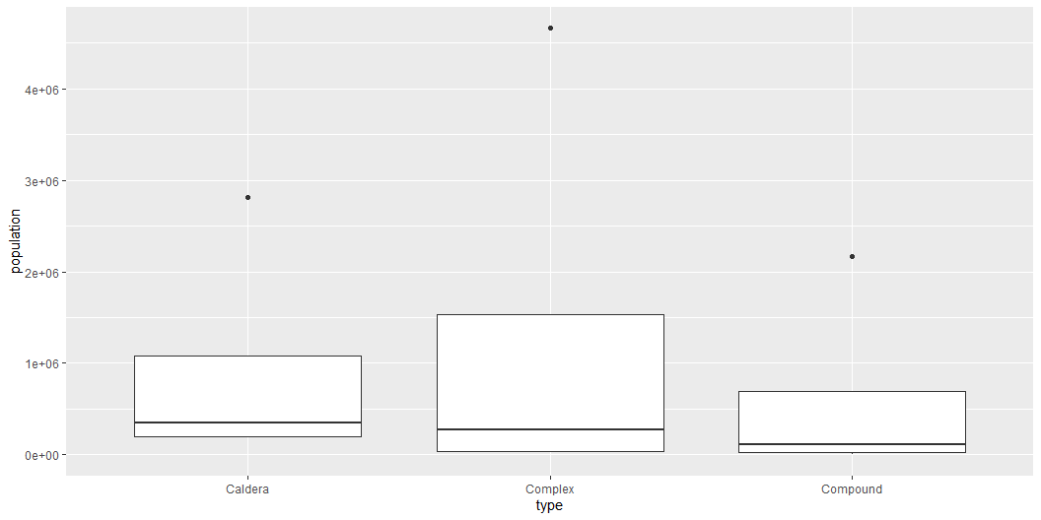
Code
When you click the Render button a presentation will be generated that includes both content and the output of embedded code. You can embed code like this:
Rows: 958 Columns: 26 $ volcano_number <dbl> 283001, 355096, 342080, 213004, 321040, 28317… $ volcano_name <chr> "Abu", "Acamarachi", "Acatenango", "Acigol-Ne… $ primary_volcano_type <chr> "Shield(s)", "Stratovolcano", "Stratovolcano(… $ last_eruption_year <chr> "-6850", "Unknown", "1972", "-2080", "950", "… $ country <chr> "Japan", "Chile", "Guatemala", "Turkey", "Uni… $ region <chr> "Japan, Taiwan, Marianas", "South America", "… $ subregion <chr> "Honshu", "Northern Chile, Bolivia and Argent… $ latitude <dbl> 34.500, -23.292, 14.501, 38.537, 46.206, 37.6… $ longitude <dbl> 131.600, -67.618, -90.876, 34.621, -121.490, … $ elevation <dbl> 641, 6023, 3976, 1683, 3742, 1728, 1733, 1250… $ tectonic_settings <chr> "Subduction zone / Continental crust (>25 km)… $ evidence_category <chr> "Eruption Dated", "Evidence Credible", "Erupt… $ major_rock_1 <chr> "Andesite / Basaltic Andesite", "Dacite", "An… $ major_rock_2 <chr> "Basalt / Picro-Basalt", "Andesite / Basaltic… $ major_rock_3 <chr> "Dacite", " ", " ", "Basalt / Picro-Basalt", … $ major_rock_4 <chr> " ", " ", " ", "Andesite / Basaltic Andesite"… $ major_rock_5 <chr> " ", " ", " ", " ", " ", " ", " ", " ", " ", … $ minor_rock_1 <chr> " ", " ", "Basalt / Picro-Basalt", " ", "Daci… $ minor_rock_2 <chr> " ", " ", " ", " ", " ", "Basalt / Picro-Basa… $ minor_rock_3 <chr> " ", " ", " ", " ", " ", " ", " ", "Andesite … $ minor_rock_4 <chr> " ", " ", " ", " ", " ", " ", " ", " ", " ", … $ minor_rock_5 <chr> " ", " ", " ", " ", " ", " ", " ", " ", " ", … $ population_within_5_km <dbl> 3597, 0, 4329, 127863, 0, 428, 101, 51, 0, 98… $ population_within_10_km <dbl> 9594, 7, 60730, 127863, 70, 3936, 485, 6042, … $ population_within_30_km <dbl> 117805, 294, 1042836, 218469, 4019, 717078, 1… $ population_within_100_km <dbl> 4071152, 9092, 7634778, 2253483, 393303, 5024…

Slide 5
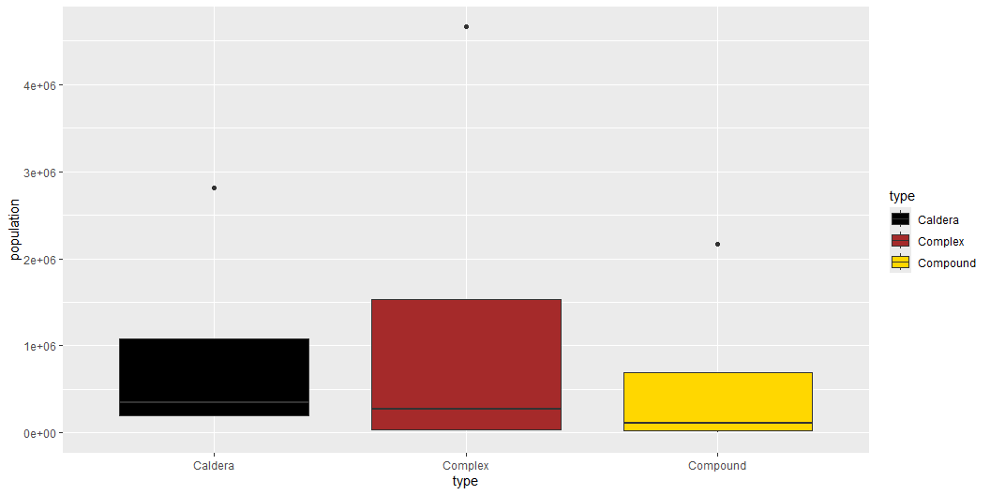

Slide 6
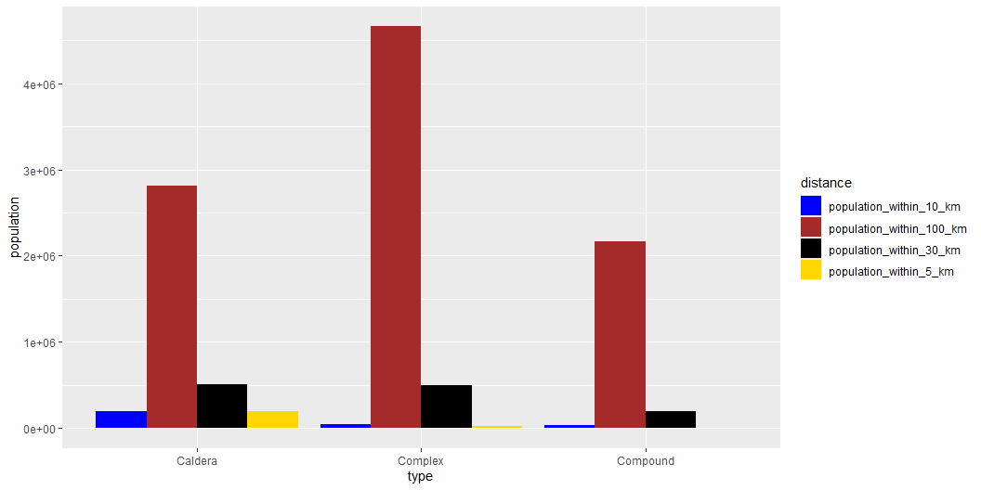

Slide 7
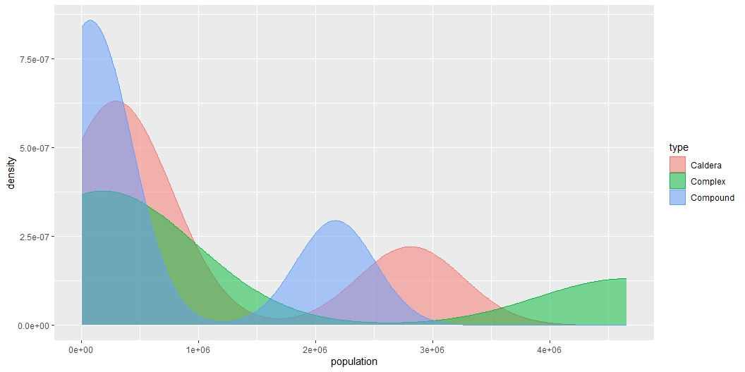

Slide 8
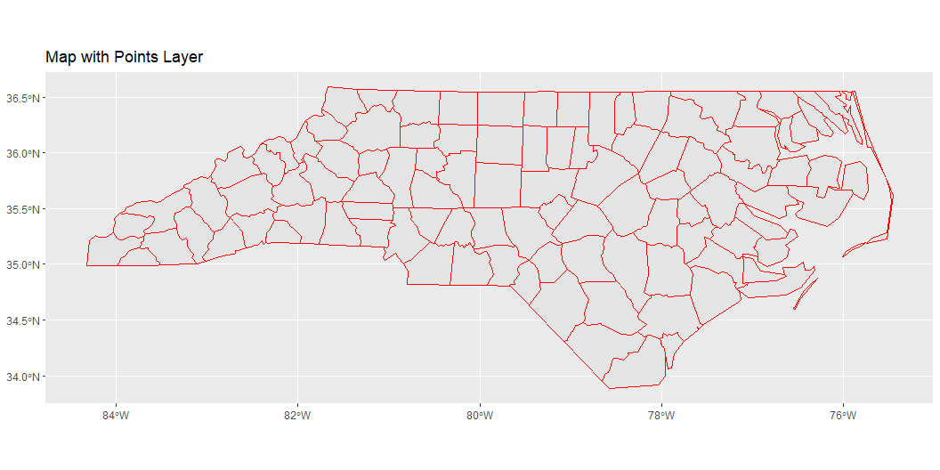
Reading layer `nc' from data source `C:\R\sf\shape\nc.shp' using driver `ESRI Shapefile' Simple feature collection with 100 features and 14 fields Geometry type: MULTIPOLYGON Dimension: XY Bounding box: xmin: -84.32385 ymin: 33.88199 xmax: -75.45698 ymax: 36.58965 Geodetic CRS: NAD27

