Slide 1
Emergency and Disaster Nursing

Slide 2
Objectives
Identify the priorities of care for the client with an emergency disorder, including those with multisystem injuries. (CO 1, 2, 3, 4)
Develop a nursing plan of care for the treatment of clients with a physical and/or mental health emergency. (CO 1, 2, 3, 4)
Identify essential components of an emergency operation plan and disaster preparedness. (CO 1, 2, 3, 4)
Explain clinical manifestations and nursing treatment of injuries and illnesses resulting from disaster and/or mass casualty events. (CO 1, 2, 3, 4)

Slide 3
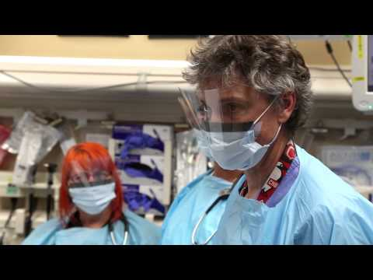

Slide 4
Scope and Practice of Emergency Nursing
Emergency management traditionally refers to urgent & critical care needs. However, the ED has increasingly been used for nonurgent problems, & emergency management has broadened to include the concept that an emergency is whatever the client or family considers it to be.
The emergency nurse has special training, education, experience, and expertise in assessing and identifying health care problems in crisis situations.
The ED staff works as a team.

Slide 5
Issues in Emergency Nursing
Legal issues
Occupational health and safety risks for ED staff
Challenge of providing holistic care in context of fast-paced, technology-driven environment
Treat clients exposed to biologic and other weapons
Mass casualty incident due to natural causes or terrorist event

Slide 6
Priority Emergency Measures for All Clients
Safety is the first priority
Client and staff
Secured and locked unit
Potential for violence
Sentinel events in the ED = delay in care and medication errors
Client- and family-focused interventions
Actions to relieve anxiety and provide a sense of security
Allow family to stay with client, if possible, to alleviate anxiety
Provide explanations and information
Additional interventions are provided depending on the stage of crisis

Slide 7
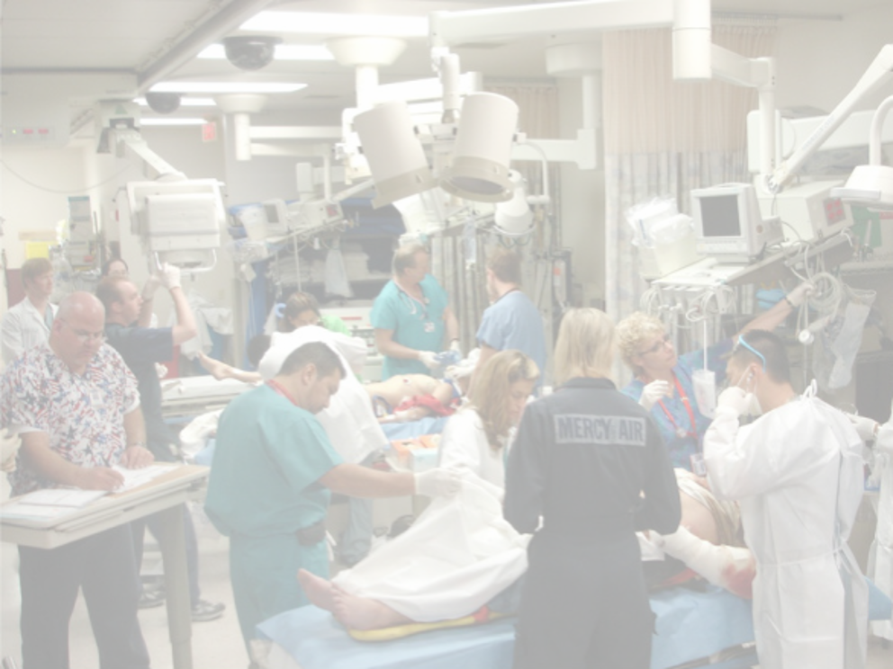
Emergency Nursing Considerations
Client and family focus
Geriatric considerations
Obesity

Slide 8
Emergency Nursing Principles
Guidelines to assess and manage emergent situations
Emergency nursing care management
Triage
Primary survey (ABCDE)
Secondary survey
Cold/heat injuries
Poisoning/bites
Substance use disorder/drug overdose
Trauma
Maltreatment/abuse
Human trafficking
Psychiatric emergencies
Cardiac emergencies

Slide 9
Triage: “to sort”
Hierarchy based on severity of health problems
Collect data to classify the illness and injury
Protocols may be initiated in triage
Basic system
Emergent (life-threatening)
Urgent (treat within 2 hrs.)
Nonurgent (can delay treatment)
Emergency severity index (ESI)
Assigns the client to one of five levels
Level 1 (most urgent) to level 5 (least urgent)

Slide 10
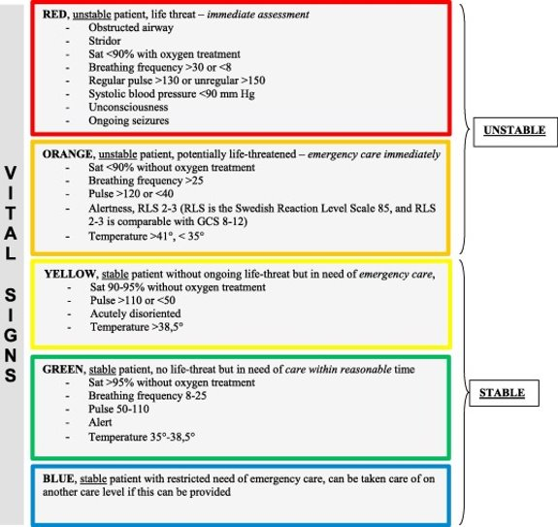

Slide 11

Primary Survey
Rapid assessment of life-threatening conditions
  Airway: establish airway
  Breathing: provide adequate ventilation/oxygenation
  Circulation: evaluate & restore cardiac output; control hemorrhage; prevent & treat shock
  Disability: determine neurologic status; AVPU (alert, verbal, pain, unresponsive)
  Exposure: undress to assess wounds or areas or injury
Never leave the "primary survey" until client is considered stable

Slide 12
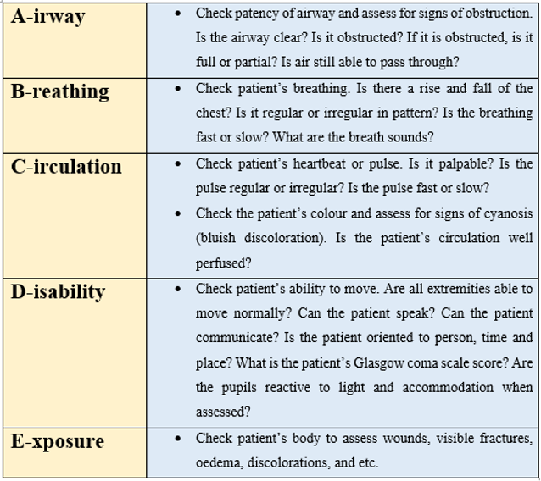

Slide 13
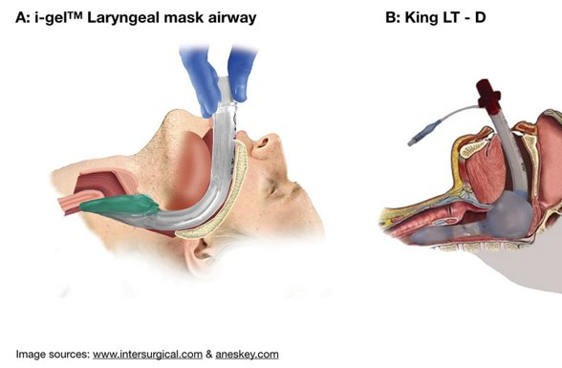
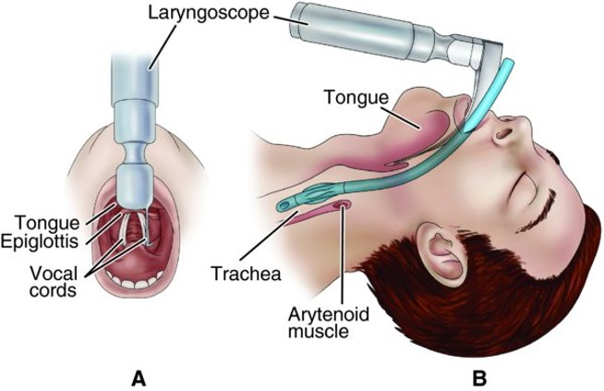
Primary Survey: Airway/Cervical Spine
Airway is the most important initial step
  Brain death occurs within 3-5 minutes
Client is awake and responsive = patent airway
** Always assume a neck injury is present and immobilize in a trauma**

Slide 14
Primary Survey: Breathing
Auscultate breath sounds bilaterally
Observation of chest expansion and respiratory effort (work of breathing)
Rate and depth of respirations
Identification of chest trauma
Assess tracheal position (midline or deviated?)
Assess for JVD
Manual ventilation with bag valve mask if not breathing
Set up for endotracheal intubation if not ventilating or oxygenating

Slide 15
Primary Survey: Circulation
Assess HR, BP, peripheral pulses, cap refill, and skin color
Consider myocardial dysfunction and hemorrhage as precursors to shock
Perform CPR if no pulse present
Assess for external or internal bleeding
Control hemorrhage
Reverse any anticoagulant therapies if possible
Obtain IV access, often 2 large bore IVs if trauma
Stabilize BP and HR if possible with fluids or blood products

Slide 16
Primary Survey: Disability
Quick assessment to determine the client’s level of consciousness
AVPU mnemonic (alert, verbal stimuli, painful stimuli, unresponsive)
Glasgow Coma Scale (GCS)
Frequent neurological assessments

Slide 17
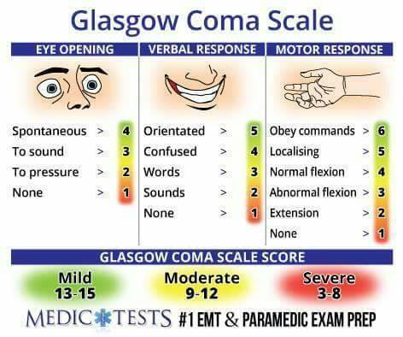
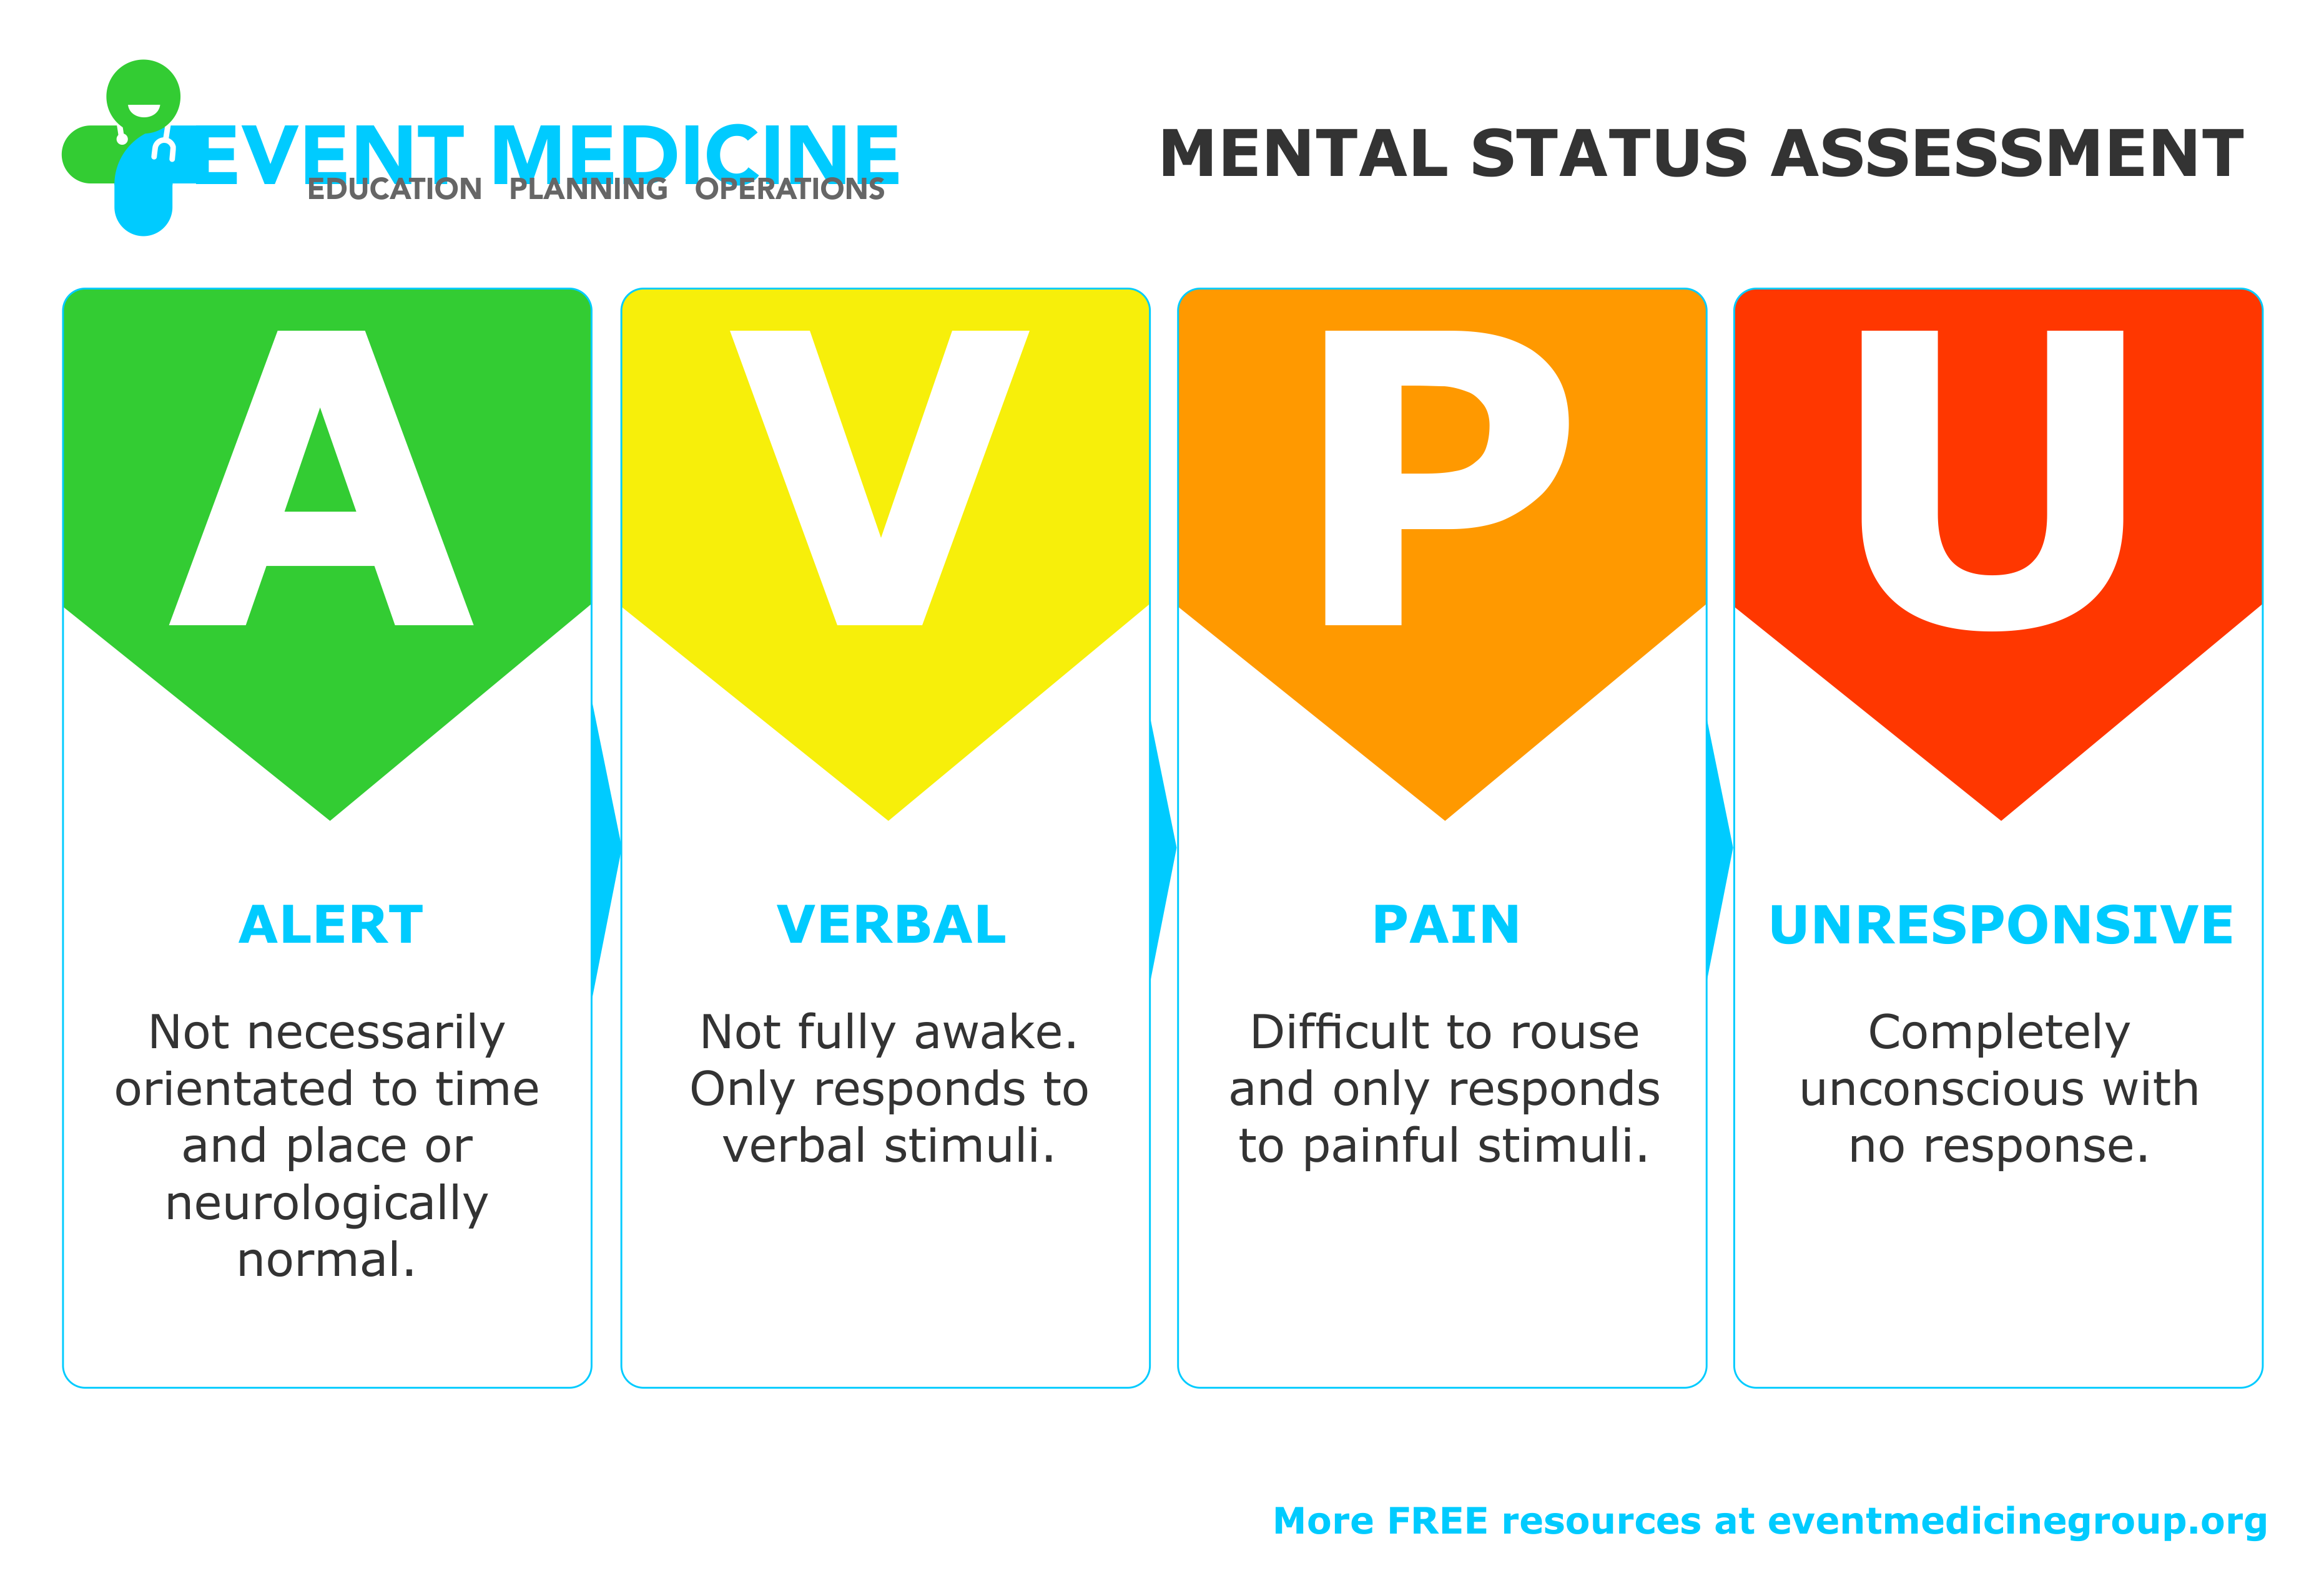

Slide 18
Primary Survey: Exposure/Environment
Remove the client’s clothing for a complete physical assessment
  May need to cut off clothes
  Preserve clothing for evidence
Hypothermia (35 °C/95°F or less) is primary concern b/c of exposure, cool IV fluids, un-warmed oxygen
  Leads to coma, hypoxemia, and acidosis
  Remove wet clothing
  Provide warm blankets
  Increase room temperature
  Warm IV fluids

Slide 19
Secondary Survey
HEAD TO TOE ASSESSMENT
Health history​
Head-to-toe physical assessment
Diagnostic and lab testing​
Monitoring devices: ECG, arterial lines, urinary catheters​
Splinting of fractures​
Wound care​
Other interventions based on condition​
Always revert to primary survey if any instability occurs in client (ABCDE)

Slide 20
Multiple Trauma
Single catastrophic event
Life-threatening injuries to at least two organs or organ systems​
Requires a large healthcare team
Primary and secondary surveys
Determine extent of injuries and establish priorities of treatment
Spinal precautions: Log roll, hard cervical collar
Injuries interfering with vital physiologic function have highest priority
Example: A pedestrian is hit by an oncoming vehicle at 20 miles/hr. The client is brought to the ED with the following vitals: BP: 78/50, HR: 150/min regular and RR: 40/min. There are obvious facial injuries, chest injuries, abdominal bruising, and deformed open fractures of both femurs. The GCS is 6.
What is the priority assessment/intervention sequence when caring for this client?
Discuss the vital signs and GCS, what are potential causes of these data points in this client?

Slide 21
COMPLETED ANSWER • ORIGINAL SLIDE 20
Multiple trauma: assessment and action
01
Priorities: control catastrophic external bleeding while the team performs ABCDE. Protect the cervical spine, suction/open the airway and prepare a definitive airway for GCS 6.
02
Breathing/circulation: support oxygenation and ventilation, identify chest threats, establish large-bore IV/IO access and prepare hemorrhage resuscitation and urgent trauma intervention.
03
Interpretation: BP 78/50 with HR 150 suggests shock; abdominal injury and bilateral femur fractures may conceal major blood loss. RR 40 may reflect hypoxemia, chest injury or shock. GCS 6 may reflect brain injury, hypoxia and/or hypoperfusion.
Added study notes • Original slides and graphics retained • Sources in speaker notes
Notes:
Added answer to original emergency slide 20. Completed answer.
Priorities: control catastrophic external bleeding while the team performs ABCDE. Protect the cervical spine, suction/open the airway and prepare a definitive airway for GCS 6.
Breathing/circulation: support oxygenation and ventilation, identify chest threats, establish large-bore IV/IO access and prepare hemorrhage resuscitation and urgent trauma intervention.
Interpretation: BP 78/50 with HR 150 suggests shock; abdominal injury and bilateral femur fractures may conceal major blood loss. RR 40 may reflect hypoxemia, chest injury or shock. GCS 6 may reflect brain injury, hypoxia and/or hypoperfusion.
Source: user-supplied lecture deck. Supplemental references:
NICE: Major trauma assessment and initial management
https://www.nice.org.uk/guidance/ng39/chapter/Recommendations
Resuscitation Council UK: ABCDE approach
https://www.resus.org.uk/library/abcde-approach

Slide 22
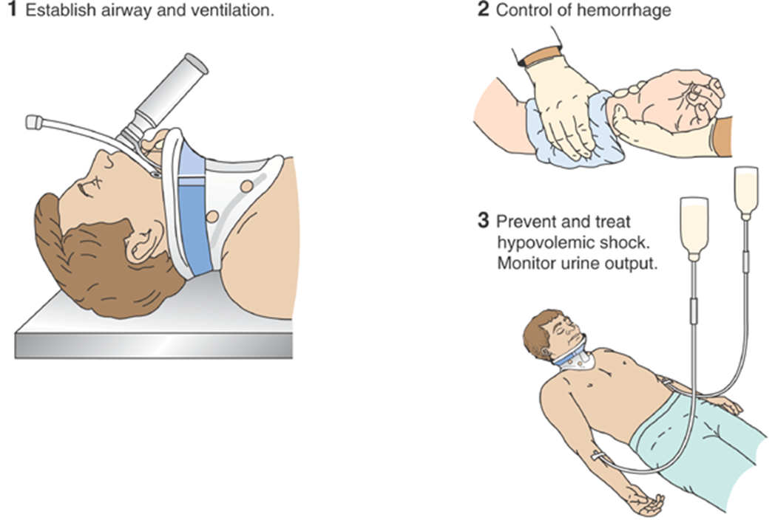
Priorities in the Management of the Client with Multiple Injuries

Slide 23
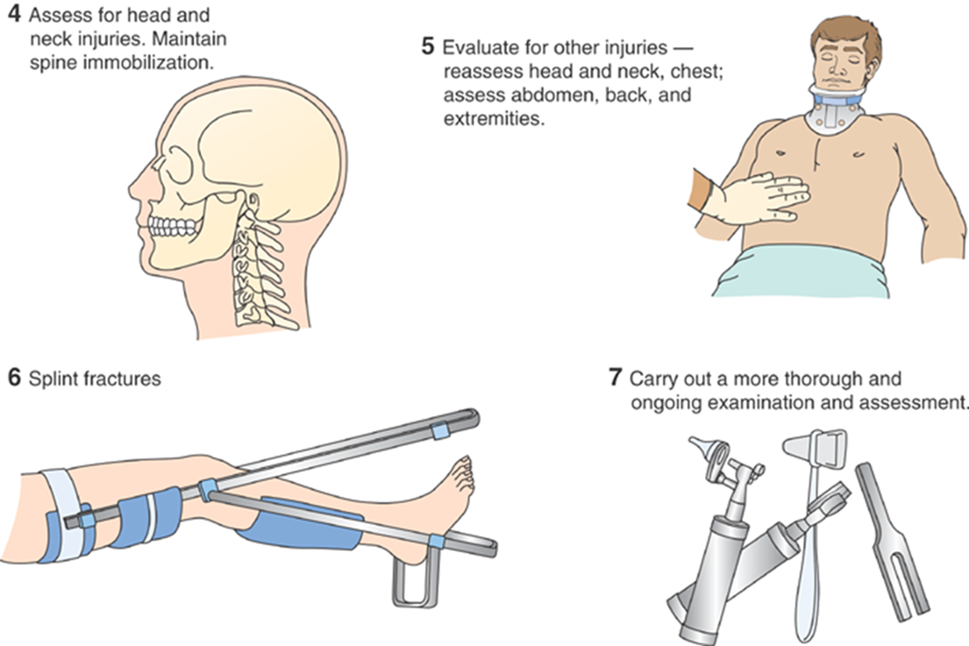
Priorities in the Management of the Client with Multiple Injuries (cont.)

Slide 24
Chest Injuries
Potential injuries
Interventions
Rib fractures, flail chest
Sternal fractures
Pulmonary contusion
Pneumothorax
Hemothorax
Cardiac contusion, cardiac tamponade, cardiac dysrhythmias
Aortic rupture
Needle chest decompression if a tension pneumothorax
Chest tube insertion for pneumothorax or hemothorax
Cardiac monitoring
Pericardiocentesis
IV analgesia
Frequent monitoring of breathing

Slide 25

Abdominal Injuries
Abdominal trauma
Blunt trauma or penetrating injuries may cause significant bleeding
Liver or splenic lacerations, bowel perforations can occur
Management of Client
Ensure ABCs have been assessed
Immobilize cervical spine and continually monitor vital signs
Document all wounds
If viscera are protruding, cover with a sterile, moist saline dressing
Hold oral fluids in case of surgical procedure
NG to aspirate/decompress stomach contents
Provide tetanus and antibiotic prophylaxis
Provide rapid transport to surgery if indicated

Slide 26
Wound Care
Cleaning
Clean with normal saline. No betadine in the wound
Primary closure
Close with sutures or staples
Delayed closure
Tissue loss or risk of infection
Tetanus prophylaxis
Within 5 years

Slide 27
Crush Injuries
Occur when client is caught between opposing forces​​
Assessment:​​
  Hypovolemic shock​​
  Spinal cord injury​​
  Erythema and blistering​​
  Fractures​​
  Acute kidney injury​​

Slide 28
Crush Injuries
A client was jacking up his car to repair it. The jack collapsed while he was under it, resulting in a crush injury to his head, chest, abdomen and upper legs. He has swelling to his anterior neck, decreased air entry to his right chest, and muffled heart sounds upon auscultation.​
GCS: 8 BP 82/55, HR 143/min, RR 36/min, SpO2 82%​ room air
Describe an emergent plan of care for this client upon ED arrival.
What are the immediate priorities identified in the primary survey?
Why would his urine be dark, and his serum potassium be elevated?

Slide 29
COMPLETED ANSWER • ORIGINAL SLIDE 27
Crush injury: immediate priorities
01
Airway and breathing: anterior neck swelling threatens the airway; GCS 8 and SpO2 82% require immediate airway/ventilation support with spinal precautions.
02
Circulation: shock plus reduced right air entry suggests a life-threatening chest injury. Muffled heart sounds raise concern for tamponade. Prepare urgent decompression or other trauma treatment without delaying for nonessential tests.
03
Rhabdomyolysis: damaged muscle releases myoglobin (dark urine) and potassium. Monitor ECG, potassium, CK and renal function; provide ordered fluids and hyperkalemia treatment while watching for overload.
Added study notes • Original slides and graphics retained • Sources in speaker notes
Notes:
Added answer to original emergency slide 27. Completed answer.
Airway and breathing: anterior neck swelling threatens the airway; GCS 8 and SpO2 82% require immediate airway/ventilation support with spinal precautions.
Circulation: shock plus reduced right air entry suggests a life-threatening chest injury. Muffled heart sounds raise concern for tamponade. Prepare urgent decompression or other trauma treatment without delaying for nonessential tests.
Rhabdomyolysis: damaged muscle releases myoglobin (dark urine) and potassium. Monitor ECG, potassium, CK and renal function; provide ordered fluids and hyperkalemia treatment while watching for overload.
Source: user-supplied lecture deck. Supplemental references:
NICE: Major trauma assessment and initial management
https://www.nice.org.uk/guidance/ng39/chapter/Recommendations
CDC: Rhabdomyolysis
https://www.cdc.gov/niosh/rhabdo/about/

Slide 30
Environmental Emergencies:
Heat Exhaustion/Heat Stroke
Heat exhaustion: Usually from prolonged exposure to high temperatures
  Results in excessive sweating, resulting in tachycardia and finally dehydration
  Rehydration with oral and IV fluids will prevent the onset of heat stroke
Heat stroke: Failure of heat-regulating mechanisms in the body
  Can result in death
Who is at risk for the development of heat stroke?
What client education would be appropriate in the prevention of heat stroke?

Slide 31
COMPLETED ANSWER • ORIGINAL SLIDE 28
Heat stroke: risk and prevention
01
At risk: infants, older adults, outdoor workers/athletes, people without cooling, those not acclimatized, and people with chronic illness or medications that impair heat tolerance.
02
Prevention: plan cooler times, shade and rest breaks; gradually acclimatize, wear suitable clothing, drink fluids and check vulnerable people. Never leave children in parked vehicles.
03
Emergency cue: altered mental status with heat exposure requires immediate emergency response and rapid cooling. Do not give oral fluids to someone with impaired consciousness.
Added study notes • Original slides and graphics retained • Sources in speaker notes
Notes:
Added answer to original emergency slide 28. Completed answer.
At risk: infants, older adults, outdoor workers/athletes, people without cooling, those not acclimatized, and people with chronic illness or medications that impair heat tolerance.
Prevention: plan cooler times, shade and rest breaks; gradually acclimatize, wear suitable clothing, drink fluids and check vulnerable people. Never leave children in parked vehicles.
Emergency cue: altered mental status with heat exposure requires immediate emergency response and rapid cooling. Do not give oral fluids to someone with impaired consciousness.
Source: user-supplied lecture deck. Supplemental references:
CDC: Heat-related illnesses
https://www.cdc.gov/niosh/heat-stress/about/illnesses.html

Slide 32
Management of the Client with Heat Stroke
ABCs
Reduce temperature to 39.2°C (102°F) as quickly as possible
Cooling methods
  Cool sheets, towels, or sponging with cool water
  Ice to neck, groin, chest, and axillae
  Cooling blankets
  Immersion in cold water bath
Monitor temperature, VS, ECG, CVP, LOC, I&O
IV fluids to replace fluid losses (0.9% NS)

Slide 33
Frostbite
Trauma from freezing temperature and actual freezing of fluid in the intracellular and intercellular spaces.
Extent of injury may not be evident for 24 hours
1st degree superficial : Only layers of exposed skin are affected with hyperemia and edema. Numb central white area without blistering.
2nd degree partial thickness: Blisters cover the exposed skin areas causing necrotic tissue death and swelling.
3rd degree full thickness: Extensive edema and hemorrhagic vesicles and blisters. No blanching. Need debridement.
4th degree full thickness: Full thickness freezing with necrosis. Complete lack of blood flow. Potential for gangrene.

Slide 34
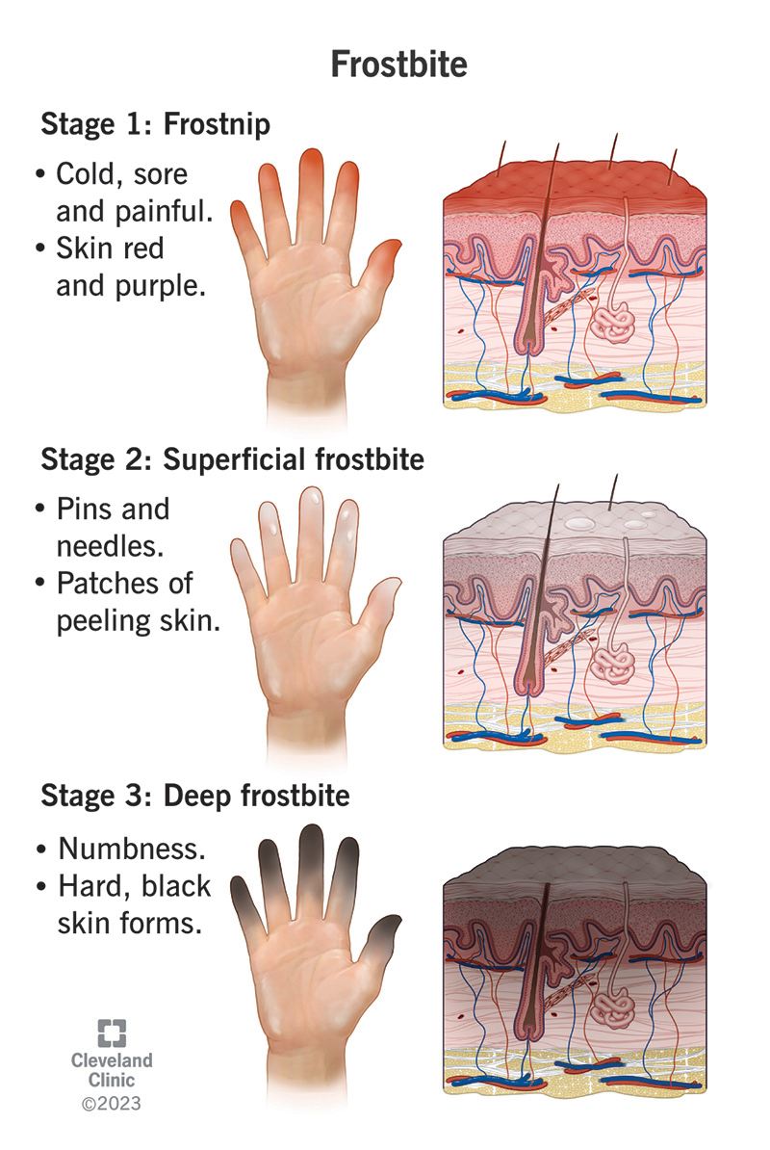

Slide 35
Management of Frostbite
Immediate treatment: cover affected areas and rewarming
Controlled but rapid rewarming with warm bath (104 to 108 °F)
Administer tetanus toxoid
Administer analgesics for pain during rewarming
Do not massage or rub
If feet are involved, do not allow client to walk
Once re-warmed, elevate affected extremity
Assess for compartment syndrome
  Swelling
  Increase in pain
  Needs immediate treatment!

Slide 36
CLINICAL SIDE NOTE • ORIGINAL SLIDE 32
Side note: frostbite rewarming
01
The source lists 104–108°F. Wilderness Medical Society guidance recommends controlled water rewarming at 37–39°C (98.6–102.2°F). Use a thermometer; avoid burning numb tissue.
02
Do not rub or massage. Protect the part and avoid walking on injured feet when possible. Do not thaw tissue if it will refreeze before rescue.
03
Treat associated hypothermia, provide pain relief and obtain specialist assessment; injury depth can evolve after rewarming.
Added study notes • Original slides and graphics retained • Sources in speaker notes
Notes:
Added answer to original emergency slide 32. Clinical side note.
The source lists 104–108°F. Wilderness Medical Society guidance recommends controlled water rewarming at 37–39°C (98.6–102.2°F). Use a thermometer; avoid burning numb tissue.
Do not rub or massage. Protect the part and avoid walking on injured feet when possible. Do not thaw tissue if it will refreeze before rescue.
Treat associated hypothermia, provide pain relief and obtain specialist assessment; injury depth can evolve after rewarming.
Source: user-supplied lecture deck. Supplemental references:
Wilderness Medical Society: Frostbite guidelines
https://journals.sagepub.com/doi/10.1016/j.wem.2019.05.002

Slide 37
Hypothermia
Internal core temperate is 35°C (95° F) or less
Elderly, infants, persons with concurrent illness, the homeless, and trauma victims are at risk
Alcohol ingestion increases susceptibility (systemic vasodilation and diuretic effects)
Hypothermia may be seen with frostbite
Physiologic changes in all organ systems
Continuous monitoring

Slide 38
Management of Hypothermia
Use ABCs, remove wet clothing, and re-warm
Active core re-warming
  Cardiopulmonary bypass, warm fluid administration, warm humidified oxygen, and warm peritoneal lavage, warm bladder irrigation
Passive external re-warming
  Warm blankets and over-the-bed heaters (Bair-Huggers)
Cold blood returning from the extremities has high levels of lactic acid
  Can cause potential cardiac dysrhythmias and electrolyte disturbances

Slide 39
Poisoning
Poison is any substance that when ingested, inhaled, absorbed, applied to the skin, or produced within the body in relativity small amounts injures the body by its chemical action
Treatment goals
Remove or inactivate the poison before it is absorbed
Provide supportive care in maintaining vital organ function
Administer specific antidotes
Implement treatment to hasten the elimination of the poison

Slide 40
Assessment of the Client with Ingested Poisons
ABCs are the initial priority
Monitor VS, LOC, ECG, UO
Determine what, when, and how much substance was ingested
Laboratory specimens
Signs and symptoms of poisoning and tissue damage
Health history
Age and weight

Slide 41
Management of the Client with Ingested Poisons
Measures to remove the toxin or decrease its absorption
  NG tube to suction
  Gastric lavage
  Activated charcoal (within 1-2 hours of ingestion)
  Administration of a specific antidote as early as possible
Most poisons just need supportive care.
Corrosive agents such as acids and alkaline cause destruction of tissues by contact. Do not induce vomiting with corrosive agents.

Slide 42
Carbon Monoxide (CO) Poisoning
Inhaled carbon monoxide binds to hemoglobin as carboxyhemoglobin, which prevents the transport oxygen
Hemoglobin binds carbon monoxide 200 times more readily than oxygen
  Hemoglobin molecule is saturated with carbon monoxide rather than oxygen
Manifestations
  CNS symptoms predominate
  Initial symptom(s) often headache and/or dizziness
  Skin color is not a reliable sign and pulse oximetry is not valid
    Color ranges from pink to cherry-red to cyanotic and pale

Slide 43
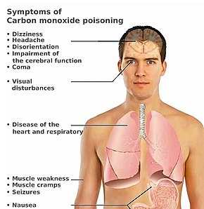
CO Poisoning
Manifestations are related to lack of oxygen supplied to organs such as brain, heart, lungs, and muscles
Causes
    Car idling in an enclosed space, such as a garage
    Kerosene heater or gas barbecue grill indoors
    House fires with smoke inhalation
    Leaky gas or oil furnaces

Slide 44
Management of Clients with Carbon Monoxide Poisoning
Permanent brain damage may occur, dependent on amount and length of exposure to the carbon monoxide
Get to fresh air immediately​ from high CO area
Administer 100% oxygen
  High flow or oxygen under hyperbaric pressure ​to help remove CO from the hemoglobin
Continuously monitor VS, mental status, CO levels in blood, and cardiac status

Slide 45
Food Poisoning
Sudden illness caused by the ingestion of contaminated food or drink
Infectious organisms or their toxins are the most common causes of food poisoning
Symptoms: abdominal cramping, nausea, vomiting, diarrhea
Most food poisoning is mild and resolves without treatment
Adequate hydration is the most important aspect of treatment
Botulism (honey) or certain fish poisonings, may result in respiratory paralysis and death​
ABCs
Supportive measures such as oral or IV fluids​
Determination of food poisoning (stool samples for C&S if diarrhea persists)​
Control nausea and vomiting
Clear liquid diet and progression of diet after nausea and vomiting subside
Treat fluid and electrolyte imbalances ​
Avoid anti-diarrheal medications to allow flushing out the diarrhea

Slide 46
Drug Overdose
Clinical manifestations vary based upon substance
Treatment goals
  Support of respiratory and cardiovascular function​s
    Maintain airway and observe for CNS depression and hypotension
    CNS depression increases the risk of aspiration
  Enhance clearance of the agent and administer antidotes
  Provide safety of client and staff
Examine for withdrawal symptoms, injuries, and evidence of other disorders
Notes:
naloxone for opioid overdose
IV drug users at high risk for:
HIV infection
Hep B and C
Tetanus​

Slide 47
Management of the Client with Acute Alcohol Intoxication
Acute alcohol intoxication = multisystem toxin
Acute alcohol poisoning may result in death from respiratory depression
Maintain airway and observe for CNS depression and hypotension
Rule out other potential causes of the behaviors before it is assumed the client is intoxicated
Use a nonjudgmental, calm manner
May need sedation if agitation or delirium occurs
Withdrawal syndrome will require high doses of benzodiazepines to control symptoms
CIWA (Clinical Institute Withdrawal Assessment for Alcohol) score is used to assess and manage the withdrawal stage of alcohol

Slide 48
Snakebites
Venomous snakebite is a medical emergency
Treatment
  Lie down
  Remove constrictive items (rings)
  Provide warmth
  Cleanse the wound
  Cover with dressing
  Immobilize injured body part below the level of the heart
No ice, tourniquets, heparin, and corticosteroids in the first 6 to 8 hours after the bite
Administer antivenom within 4 to 12 hours if needed
Assess for edema every 15-30 minutes

Slide 49
Sexual Assault
Provide emotional support!
Obtain thorough history, but don’t ask client to repeat information repeatedly
STI testing and prophylaxis
Antipregnancy measures
Do not shower or bathe
SANE = sexual assault nurse examiner called to ED
Gather forensic evidence
  Documentation
  Photo collection
  Specimen collecting – paper bag
  Kits can be done up to 6 days after the assault
Should leave client with a loved one and not leave alone

Slide 50

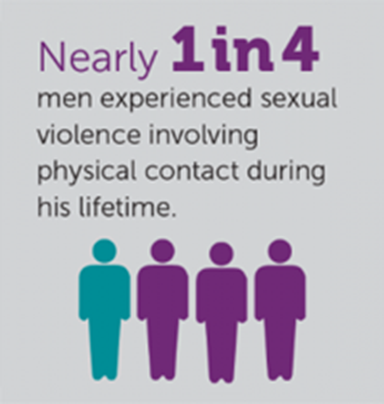

Slide 51


Slide 52
Identifying Victims of Human Trafficking in the ED
May present to ED with injury
Accompanied by boyfriend or travel partner​
Hx of chronic runaway, homelessness, self-mutilation​
Common behaviors: cowering, frightened, agitated, deferring to the person accompanying them​
Common complaints: injuries, poor healing, abd pain, dizziness, headaches, rashes or sores​
May demonstrate behaviors: addiction, panic attacks, impulse control, hostility, suicide ideations

Slide 53
Nursing Role and Interventions for Victims of Human Trafficking
Offer opportunity for client to speak alone, without companion
Use targeted, appropriate questions:
  Are you in control of your own money?
  Are you able to come and go as you please?
  Who is the person(s) accompanying you?
May decline assistance, but offer future contact information
Resource: The National Human Trafficking Hotline

Slide 54
Psychiatric Emergencies
Avoid long delays in care due to potential high-risk situation
Management:
  Maintain the safety of all persons and gain control of the situation
  Determine if the client is at risk for injuring themselves or others
  Maintain the person’s self-esteem while providing care
  Determine if the person has a psychiatric history or is currently under care to contact that therapist
  Illnesses or other conditions need to be ruled out

Slide 55
Psychiatric Emergencies
Crisis intervention
Interventions specific to each of the conditions
  Benzodiazepines such as diazepam or lorazepam frequently used for agitation
  Anti-psychotics such as haloperidol, olanzapine, quetiapine, or risperidone are used for hallucinations, delusions
Involuntary hold
Restraints

Slide 56
Suicidal Clients
Males are at greatest risk for success and females attempt more often
Focus on injuries and preventing further harm
Symptoms
Communication like "I am a burden to my family" or "I am better off dead"
Risk factors
Dealing with loss
Unemployment
Divorced
Widowed
Living alone
Family history
Previous attempt
Loss of a parent at an early age
Specific plan to carry out
Remove any harmful items from client's possession
Veterans and service members

Slide 57
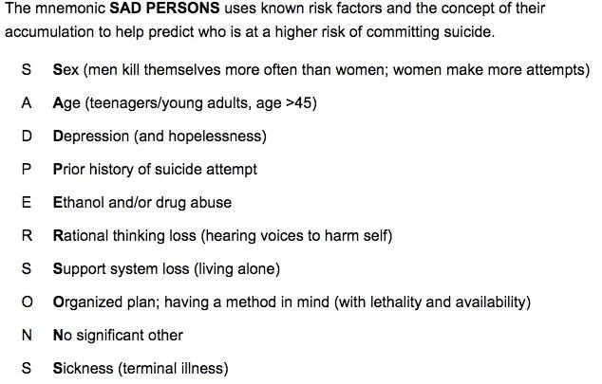

Slide 58
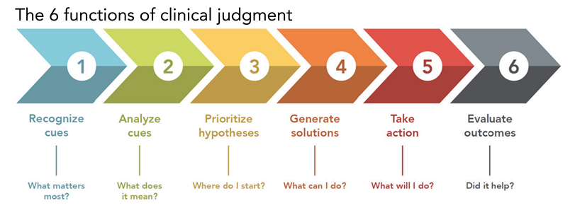
In-Class
ED Case Studies

Slide 59
Client #1: Mr. Raymond

Slide 60
Recognize Cues: Highlight the Priority Findings
S: Mr. Raymond is a 48-year-old man who comes in complaining of severe upper abdominal pain rated 10 out of 10.
B: He has a history of type 2 DM diagnosed 6 months ago and admits he is non-compliant monitoring his BG and occasionally forgets to take his metformin. He states he hasn't eaten in 12 hours due to epigastric pain, which has lessened slightly but hasn't gone away. He admits to having at least a six-pack of beer after work each night to relax.
A: T-101.8°F, HR 128/min, RR 26/min, BP 90/60 mm Hg. He is awake, alert, oriented x3, PERRLA. He follows simple and complex commands; lungs are clear with equal bilateral breath sounds; cardiac S1/S2 are WNL, no murmurs noted. Abdomen is distended and noted to have periumbilical bruising. He has a yellow tinge to his skin. Extremities have equal strength and muscle tone.
R: Admit to the emergency department.

Slide 61
COMPLETED ANSWER • ORIGINAL SLIDE 56
Mr. Raymond: priority cues
01
Possible severe pancreatitis/abdominal emergency: epigastric pain 10/10, distention, periumbilical bruising, fever and jaundice.
02
Possible shock: HR 128, BP 90/60 and RR 26 warrant rapid reassessment and fluid/perfusion evaluation.
03
Relevant history: substantial daily alcohol intake, poor intake and diabetes. Check glucose, assess withdrawal risk and investigate the cause rather than assuming alcohol explains everything.
Added study notes • Original slides and graphics retained • Sources in speaker notes
Notes:
Added answer to original emergency slide 56. Completed answer.
Possible severe pancreatitis/abdominal emergency: epigastric pain 10/10, distention, periumbilical bruising, fever and jaundice.
Possible shock: HR 128, BP 90/60 and RR 26 warrant rapid reassessment and fluid/perfusion evaluation.
Relevant history: substantial daily alcohol intake, poor intake and diabetes. Check glucose, assess withdrawal risk and investigate the cause rather than assuming alcohol explains everything.
Source: user-supplied lecture deck. Supplemental references:

Slide 62
Analyze Cues
What systems may be involved that are causing manifestations described on the previous slide?

Slide 63
COMPLETED ANSWER • ORIGINAL SLIDE 57
Mr. Raymond: systems involved
01
GI/hepatobiliary: pancreatic inflammation is a leading concern; gallstone/biliary obstruction or liver disease may contribute to jaundice.
02
Circulation/respiration: third spacing, dehydration or bleeding can impair perfusion; severe inflammation can affect oxygenation.
03
Endocrine/metabolic: diabetes and pancreatic injury may destabilize glucose. Consider renal injury from poor perfusion and monitor electrolytes.
Added study notes • Original slides and graphics retained • Sources in speaker notes
Notes:
Added answer to original emergency slide 57. Completed answer.
GI/hepatobiliary: pancreatic inflammation is a leading concern; gallstone/biliary obstruction or liver disease may contribute to jaundice.
Circulation/respiration: third spacing, dehydration or bleeding can impair perfusion; severe inflammation can affect oxygenation.
Endocrine/metabolic: diabetes and pancreatic injury may destabilize glucose. Consider renal injury from poor perfusion and monitor electrolytes.
Source: user-supplied lecture deck. Supplemental references:

Slide 64
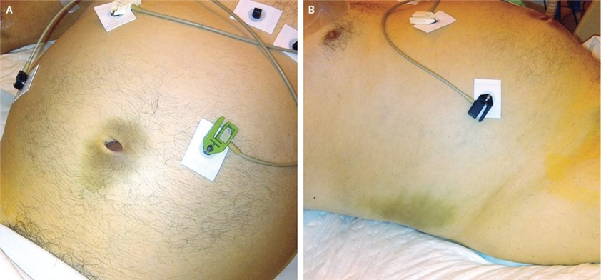
Analyze Cues
What are the clinical signs in the images?

Slide 65
COMPLETED ANSWER • ORIGINAL SLIDE 58
Identify the bruising
01
Image A: Cullen sign — bruising around the umbilicus.
02
Image B: Grey Turner sign — flank bruising.
03
Meaning: possible intra-abdominal or retroperitoneal hemorrhage. These signs may occur with severe pancreatitis but are not specific enough to diagnose it alone. Escalate promptly.
Added study notes • Original slides and graphics retained • Sources in speaker notes
Notes:
Added answer to original emergency slide 58. Completed answer.
Image A: Cullen sign — bruising around the umbilicus.
Image B: Grey Turner sign — flank bruising.
Meaning: possible intra-abdominal or retroperitoneal hemorrhage. These signs may occur with severe pancreatitis but are not specific enough to diagnose it alone. Escalate promptly.
Source: user-supplied lecture deck. Supplemental references:

Slide 66
Prioritize Hypotheses
What testing would you expect to occur in this client?

Slide 67
COMPLETED ANSWER • ORIGINAL SLIDE 59
Mr. Raymond: expected testing
01
Laboratory assessment: lipase, CBC, metabolic panel including renal function and glucose, liver tests/bilirubin, calcium and triglycerides as ordered.
02
Imaging: abdominal ultrasound for biliary disease; CT/MRI when the diagnosis is uncertain, complications are suspected or improvement is inadequate.
03
Bedside priorities: ECG and close oxygenation/perfusion monitoring; additional tests depend on alternative diagnoses and severity. Pancreatitis usually requires at least two of characteristic pain, enzyme elevation or compatible imaging.
Added study notes • Original slides and graphics retained • Sources in speaker notes
Notes:
Added answer to original emergency slide 59. Completed answer.
Laboratory assessment: lipase, CBC, metabolic panel including renal function and glucose, liver tests/bilirubin, calcium and triglycerides as ordered.
Imaging: abdominal ultrasound for biliary disease; CT/MRI when the diagnosis is uncertain, complications are suspected or improvement is inadequate.
Bedside priorities: ECG and close oxygenation/perfusion monitoring; additional tests depend on alternative diagnoses and severity. Pancreatitis usually requires at least two of characteristic pain, enzyme elevation or compatible imaging.
Source: user-supplied lecture deck. Supplemental references:
AGA: Initial management of acute pancreatitis
https://gastro.org/clinical-guidance/initial-management-of-acute-pancreatitis-ap/

Slide 68
Generate Solutions
What nursing procedures are appropriate for this client?

Slide 69
COMPLETED ANSWER • ORIGINAL SLIDE 60
Mr. Raymond: nursing procedures
01
Establish IV access, administer ordered isotonic fluids and reassess lungs, BP, perfusion, daily weight and intake/output.
02
Give ordered analgesic/antiemetic; reassess pain, sedation, respiratory rate and nausea. Monitor glucose, electrolytes, renal function and withdrawal symptoms.
03
Initially follow the NPO order while unstable or vomiting. Coordinate nutrition when tolerated, provide oral care and escalate worsening pain, distention, hypoxia or shock.
Added study notes • Original slides and graphics retained • Sources in speaker notes
Notes:
Added answer to original emergency slide 60. Completed answer.
Establish IV access, administer ordered isotonic fluids and reassess lungs, BP, perfusion, daily weight and intake/output.
Give ordered analgesic/antiemetic; reassess pain, sedation, respiratory rate and nausea. Monitor glucose, electrolytes, renal function and withdrawal symptoms.
Initially follow the NPO order while unstable or vomiting. Coordinate nutrition when tolerated, provide oral care and escalate worsening pain, distention, hypoxia or shock.
Source: user-supplied lecture deck. Supplemental references:
AGA: Initial management of acute pancreatitis
https://gastro.org/clinical-guidance/initial-management-of-acute-pancreatitis-ap/

Slide 70
Take Action
What dietary teaching should the nurse perform?

Slide 71
COMPLETED ANSWER • ORIGINAL SLIDE 61
Mr. Raymond: dietary teaching
01
During recovery: resume oral food as prescribed and tolerated; low-fat meals are often used initially. Small meals may improve tolerance.
02
Avoid alcohol and arrange support for cessation. Review diabetes meal planning, glucose checks and medication use; discuss adequate protein/energy intake with the dietitian.
03
SIDE NOTE: prolonged routine NPO is not the current default. Early oral or enteral nutrition is favored when clinically tolerated; the immediate case order still applies until reassessed.
Added study notes • Original slides and graphics retained • Sources in speaker notes
Notes:
Added answer to original emergency slide 61. Completed answer.
During recovery: resume oral food as prescribed and tolerated; low-fat meals are often used initially. Small meals may improve tolerance.
Avoid alcohol and arrange support for cessation. Review diabetes meal planning, glucose checks and medication use; discuss adequate protein/energy intake with the dietitian.
SIDE NOTE: prolonged routine NPO is not the current default. Early oral or enteral nutrition is favored when clinically tolerated; the immediate case order still applies until reassessed.
Source: user-supplied lecture deck. Supplemental references:
AGA: Initial management of acute pancreatitis
https://gastro.org/clinical-guidance/initial-management-of-acute-pancreatitis-ap/

Slide 72
Evaluate Outcomes
Mr. Raymond received 0.9% NaCl 1000 mL IV bolus, hydromorphone 0.2 mg IV x1 dose, ondansetron 4 mg IV x1 dose, and has been placed on NPO status.
What would the nurse assess to determine effectiveness of these interventions?

Slide 73
COMPLETED ANSWER • ORIGINAL SLIDE 62
Mr. Raymond: evaluate the interventions
01
Fluids: improving BP, heart-rate trend, mentation, peripheral perfusion and urine output without new crackles or worsening oxygenation.
02
Hydromorphone: lower pain score and improved comfort without excessive sedation, respiratory depression or worsening hypotension.
03
Ondansetron/NPO: less nausea/vomiting and no aspiration; reassess abdominal findings and readiness for nutrition. Trend labs and watch for continuing organ dysfunction.
Added study notes • Original slides and graphics retained • Sources in speaker notes
Notes:
Added answer to original emergency slide 62. Completed answer.
Fluids: improving BP, heart-rate trend, mentation, peripheral perfusion and urine output without new crackles or worsening oxygenation.
Hydromorphone: lower pain score and improved comfort without excessive sedation, respiratory depression or worsening hypotension.
Ondansetron/NPO: less nausea/vomiting and no aspiration; reassess abdominal findings and readiness for nutrition. Trend labs and watch for continuing organ dysfunction.
Source: user-supplied lecture deck. Supplemental references:

Slide 74
Client #2: Mr. Grimes

Slide 75
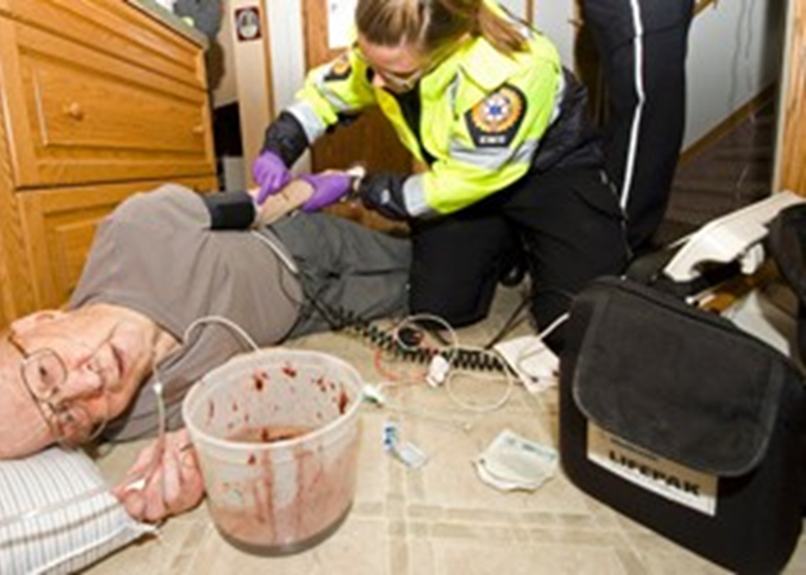

Slide 76
Recognize Cues: Highlight the Priority Findings
S: Mr. Grimes was brought in by ambulance from home. He was found on the kitchen floor with a bloody bucket by his head.
B: His wife was able to tell the paramedics her husband has a history of CABG with a mechanical aortic valve replacement 2 years ago, takes BP ramipril and warfarin for the prosthetic valve. She stated he started vomiting last night but she fell asleep until the morning. She looked for him in the morning and found him on the floor and called 911.
A: He moans when noxious stimulus is applied, withdraws from pain, skin is pale, diaphoretic, HR 142/min, BP 82/38 mm Hg, T-99°F, RR 32/min. Pulses are weak and thready. The paramedics insert a 16g IV in his L antecubital with NS wide open. Abdomen is tender to palpation, BS are hypoactive. Trousers are urine stained and blood stained.

Slide 77
COMPLETED ANSWER • ORIGINAL SLIDE 65
Mr. Grimes: priority cues
01
Life-threatening bleeding/shock: hematemesis, blood-stained clothing, HR 142, BP 82/38, weak pulses, pallor and diaphoresis.
02
Airway threat: reduced responsiveness and vomiting create aspiration risk. Assess airway and ventilation immediately.
03
Anticoagulation: warfarin can worsen the hemorrhage. Activate urgent resuscitation, notify the team and prepare blood and bleeding-control treatment.
Added study notes • Original slides and graphics retained • Sources in speaker notes
Notes:
Added answer to original emergency slide 65. Completed answer.
Life-threatening bleeding/shock: hematemesis, blood-stained clothing, HR 142, BP 82/38, weak pulses, pallor and diaphoresis.
Airway threat: reduced responsiveness and vomiting create aspiration risk. Assess airway and ventilation immediately.
Anticoagulation: warfarin can worsen the hemorrhage. Activate urgent resuscitation, notify the team and prepare blood and bleeding-control treatment.
Source: user-supplied lecture deck. Supplemental references:
ACC: Management of anticoagulant-related bleeding
https://www.acc.org/Latest-in-Cardiology/ten-points-to-remember/2020/07/10/11/26/2020-ACC-Expert-Consensus-Decision-Pathway-on-Bleeding

Slide 78
Analyze Cues
What are the potential causes leading to the manifestations described on the previous slide?

Slide 79
COMPLETED ANSWER • ORIGINAL SLIDE 66
Mr. Grimes: likely causes
01
Leading concern: acute GI hemorrhage causing hypovolemia and reduced tissue perfusion. Ulcer disease or another GI lesion requires diagnostic evaluation.
02
Warfarin may amplify bleeding; it does not identify the source. Altered consciousness can result from shock or another concurrent problem.
03
Tachycardia and tachypnea are compensatory responses. Obtain glucose and evaluate additional causes while resuscitation continues.
Added study notes • Original slides and graphics retained • Sources in speaker notes
Notes:
Added answer to original emergency slide 66. Completed answer.
Leading concern: acute GI hemorrhage causing hypovolemia and reduced tissue perfusion. Ulcer disease or another GI lesion requires diagnostic evaluation.
Warfarin may amplify bleeding; it does not identify the source. Altered consciousness can result from shock or another concurrent problem.
Tachycardia and tachypnea are compensatory responses. Obtain glucose and evaluate additional causes while resuscitation continues.
Source: user-supplied lecture deck. Supplemental references:

Slide 80
Prioritize Hypotheses
How do Mr. Grimes’ medications impact the underlying illness and vital signs?

Slide 81
COMPLETED ANSWER • ORIGINAL SLIDE 67
Mr. Grimes: medication effects
01
Warfarin reduces vitamin K-dependent clotting factors, increasing bleeding risk. Review INR, dose history, interacting drugs and recent illness.
02
Ramipril lowers blood pressure and may worsen hypotension during volume depletion; seek an order to hold it during acute shock.
03
The mechanical valve also creates thrombosis risk. Emergency reversal and the eventual anticoagulation restart need coordinated medical decisions.
Added study notes • Original slides and graphics retained • Sources in speaker notes
Notes:
Added answer to original emergency slide 67. Completed answer.
Warfarin reduces vitamin K-dependent clotting factors, increasing bleeding risk. Review INR, dose history, interacting drugs and recent illness.
Ramipril lowers blood pressure and may worsen hypotension during volume depletion; seek an order to hold it during acute shock.
The mechanical valve also creates thrombosis risk. Emergency reversal and the eventual anticoagulation restart need coordinated medical decisions.
Source: user-supplied lecture deck. Supplemental references:
ACC: Management of anticoagulant-related bleeding
https://www.acc.org/Latest-in-Cardiology/ten-points-to-remember/2020/07/10/11/26/2020-ACC-Expert-Consensus-Decision-Pathway-on-Bleeding

Slide 82
Generate Solutions
What nursing management is appropriate for this client?

Slide 83
COMPLETED ANSWER • ORIGINAL SLIDE 68
Mr. Grimes: nursing management
01
Continuous assessment: airway protection, suction readiness, oxygen/ventilation as needed, cardiac monitoring and repeated perfusion/neuro checks.
02
Access and labs: large-bore IVs, CBC, coagulation studies, metabolic tests and type/crossmatch. Prepare transfusion and urgent endoscopy or other bleeding control.
03
Keep NPO; quantify bleeding, monitor I&O and reactions to treatment. Administer ordered fluids, reversal agents and GI medications with frequent reassessment.
Added study notes • Original slides and graphics retained • Sources in speaker notes
Notes:
Added answer to original emergency slide 68. Completed answer.
Continuous assessment: airway protection, suction readiness, oxygen/ventilation as needed, cardiac monitoring and repeated perfusion/neuro checks.
Access and labs: large-bore IVs, CBC, coagulation studies, metabolic tests and type/crossmatch. Prepare transfusion and urgent endoscopy or other bleeding control.
Keep NPO; quantify bleeding, monitor I&O and reactions to treatment. Administer ordered fluids, reversal agents and GI medications with frequent reassessment.
Source: user-supplied lecture deck. Supplemental references:
ACC: Management of anticoagulant-related bleeding
https://www.acc.org/Latest-in-Cardiology/ten-points-to-remember/2020/07/10/11/26/2020-ACC-Expert-Consensus-Decision-Pathway-on-Bleeding

Slide 84
Take Action
What priority interventions should the nurse perform?

Slide 85
COMPLETED ANSWER • ORIGINAL SLIDE 69
Mr. Grimes: actions to perform first
01
Call the emergency team and address airway/aspiration risk immediately while another team member supports circulation and controls accessible bleeding.
02
Continue rapid hemorrhage resuscitation and prepare blood; do not treat the maintenance-fluid rate as adequate resuscitation for persistent shock.
03
Hold warfarin as ordered and prepare urgent reversal. SIDE NOTE: life-threatening warfarin bleeding generally needs four-factor PCC plus IV vitamin K; vitamin K alone is not immediate reversal.
Added study notes • Original slides and graphics retained • Sources in speaker notes
Notes:
Added answer to original emergency slide 69. Completed answer.
Call the emergency team and address airway/aspiration risk immediately while another team member supports circulation and controls accessible bleeding.
Continue rapid hemorrhage resuscitation and prepare blood; do not treat the maintenance-fluid rate as adequate resuscitation for persistent shock.
Hold warfarin as ordered and prepare urgent reversal. SIDE NOTE: life-threatening warfarin bleeding generally needs four-factor PCC plus IV vitamin K; vitamin K alone is not immediate reversal.
Source: user-supplied lecture deck. Supplemental references:
ACC: Management of anticoagulant-related bleeding
https://www.acc.org/Latest-in-Cardiology/ten-points-to-remember/2020/07/10/11/26/2020-ACC-Expert-Consensus-Decision-Pathway-on-Bleeding

Slide 86
Evaluate Outcomes
Mr. Grimes received 0.9% NaCl 1000 mL IV bolus from the paramedics and current has 0.9% NaCl infusing at a rate of 100 mL/hour. His INR level returned at 6.6 and he received 5 mg vitamin K intravenously.
What would the nurse assess to determine effectiveness of these interventions?

Slide 87
COMPLETED ANSWER • ORIGINAL SLIDE 70
Mr. Grimes: evaluate response
01
Look for improving consciousness, BP/perfusion, pulse quality and urine output, with decreasing visible bleeding and stable oxygenation.
02
Trend INR and hemoglobin/hematocrit; watch for fluid overload or transfusion reactions. INR 6.6 is markedly elevated; a typical non-anticoagulated INR is 0.8–1.1.
03
His therapeutic INR target depends on valve type and risk factors, commonly 2–3 or 2.5–3.5. Confirm the prescribed target. Persistent bleeding or shock requires immediate escalation despite the vitamin K dose.
Added study notes • Original slides and graphics retained • Sources in speaker notes
Notes:
Added answer to original emergency slide 70. Completed answer.
Look for improving consciousness, BP/perfusion, pulse quality and urine output, with decreasing visible bleeding and stable oxygenation.
Trend INR and hemoglobin/hematocrit; watch for fluid overload or transfusion reactions. INR 6.6 is markedly elevated; a typical non-anticoagulated INR is 0.8–1.1.
His therapeutic INR target depends on valve type and risk factors, commonly 2–3 or 2.5–3.5. Confirm the prescribed target. Persistent bleeding or shock requires immediate escalation despite the vitamin K dose.
Source: user-supplied lecture deck. Supplemental references:
ACC: Management of anticoagulant-related bleeding
https://www.acc.org/Latest-in-Cardiology/ten-points-to-remember/2020/07/10/11/26/2020-ACC-Expert-Consensus-Decision-Pathway-on-Bleeding

Slide 88
Client #3: Ms. Green

Slide 89
Recognize Cues: Highlight the Priority Findings
S: Ms. Green is 54-year-old female client with ESRD has missed her last 2 dialysis treatments. She presents to the ED with weakness, fatigue, and palpitations.
B: She is frequently in the ED after missing dialysis when she is on a winning streak at the casino. She has type 2 DM, HTN, a history of cardiac catheterization x2 with 4 stents placed, multiple old clotted fistula sites. Often, she is very difficult to insert an IV. She is taking diltiazem, calcium supplements, clopidogrel, and has a long history of ETOH abuse.
A: She is lethargic, oriented to place and person but not time, is slow to follow commands. Lungs have bilateral coarse crackles with associated wheezing, T-99.3°F, HR 128/min, RR 30/min, BP 186/97 mm Hg. The cardiac monitor shows sinus tachycardia. Normally, she is anuric.

Slide 90
COMPLETED ANSWER • ORIGINAL SLIDE 72
Ms. Green: priority cues
01
Missed two dialysis sessions: anuria plus weakness, fatigue and palpitations raises concern for hyperkalemia and toxin accumulation.
02
Fluid overload: coarse crackles/wheezing, RR 30 and severe hypertension suggest pulmonary congestion.
03
Neurologic change: lethargy and disorientation may reflect uremia, hypoxia or another metabolic problem. Obtain ECG, glucose, oxygenation and urgent renal assessment.
Added study notes • Original slides and graphics retained • Sources in speaker notes
Notes:
Added answer to original emergency slide 72. Completed answer.
Missed two dialysis sessions: anuria plus weakness, fatigue and palpitations raises concern for hyperkalemia and toxin accumulation.
Fluid overload: coarse crackles/wheezing, RR 30 and severe hypertension suggest pulmonary congestion.
Neurologic change: lethargy and disorientation may reflect uremia, hypoxia or another metabolic problem. Obtain ECG, glucose, oxygenation and urgent renal assessment.
Source: user-supplied lecture deck. Supplemental references:
UK Kidney Association: Acute hyperkalaemia guideline
https://www.ukkidney.org/health-professionals/guidelines/treatment-acute-hyperkalaemia-adults-0

Slide 91
Analyze Cues
What are your concerns based upon information described on the previous slide?

Slide 92
COMPLETED ANSWER • ORIGINAL SLIDE 73
Ms. Green: immediate concerns
01
Potential lethal dysrhythmia from potassium accumulation; do not wait for arrest to escalate.
02
Pulmonary edema from retained fluid and possible worsening cardiac function; assess work of breathing and oxygenation.
03
Uremia/metabolic disturbance and limited vascular access. Protect the functioning dialysis access and coordinate urgent dialysis and safe alternative IV access.
Added study notes • Original slides and graphics retained • Sources in speaker notes
Notes:
Added answer to original emergency slide 73. Completed answer.
Potential lethal dysrhythmia from potassium accumulation; do not wait for arrest to escalate.
Pulmonary edema from retained fluid and possible worsening cardiac function; assess work of breathing and oxygenation.
Uremia/metabolic disturbance and limited vascular access. Protect the functioning dialysis access and coordinate urgent dialysis and safe alternative IV access.
Source: user-supplied lecture deck. Supplemental references:
UK Kidney Association: Acute hyperkalaemia guideline
https://www.ukkidney.org/health-professionals/guidelines/treatment-acute-hyperkalaemia-adults-0

Slide 93
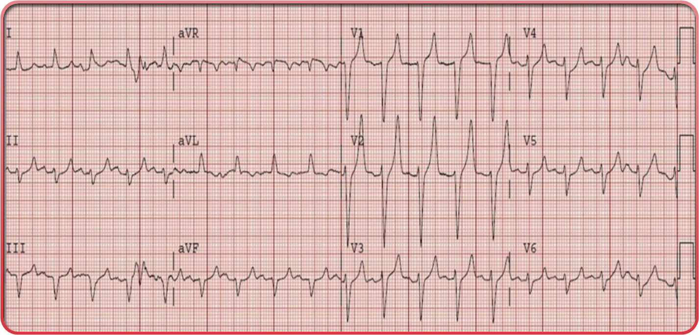
Analyze Cues
An ECG is performed on Ms. Green. Do you notice an irregularity?

Slide 94
COMPLETED ANSWER • ORIGINAL SLIDE 74
Ms. Green: interpret the ECG image
01
The prominent, tall peaked T waves are concerning for hyperkalemia in this clinical context.
02
Confirm with serum potassium and compare serial ECGs; ECG appearance does not reliably predict the potassium concentration.
03
Treat the combination of suspected hyperkalemia, symptoms and ECG changes as urgent. Other ECG abnormalities still require clinician interpretation.
Added study notes • Original slides and graphics retained • Sources in speaker notes
Notes:
Added answer to original emergency slide 74. Completed answer.
The prominent, tall peaked T waves are concerning for hyperkalemia in this clinical context.
Confirm with serum potassium and compare serial ECGs; ECG appearance does not reliably predict the potassium concentration.
Treat the combination of suspected hyperkalemia, symptoms and ECG changes as urgent. Other ECG abnormalities still require clinician interpretation.
Source: user-supplied lecture deck. Supplemental references:
UK Kidney Association: Acute hyperkalaemia guideline
https://www.ukkidney.org/health-professionals/guidelines/treatment-acute-hyperkalaemia-adults-0

Slide 95
Prioritize Hypotheses
What could be causing the irregularities you noted on Ms. Green’s ECG?

Slide 96
COMPLETED ANSWER • ORIGINAL SLIDE 75
Why the ECG changes?
01
Missed dialysis plus ESRD prevents adequate potassium removal; potassium accumulates outside cells.
02
Raised extracellular potassium alters cardiac conduction and repolarization, causing peaked T waves and potentially progressing to severe dysrhythmia.
03
Acidosis, medications, tissue injury or a hemolyzed specimen may also affect potassium; assess them without delaying treatment when toxic ECG changes are present.
Added study notes • Original slides and graphics retained • Sources in speaker notes
Notes:
Added answer to original emergency slide 75. Completed answer.
Missed dialysis plus ESRD prevents adequate potassium removal; potassium accumulates outside cells.
Raised extracellular potassium alters cardiac conduction and repolarization, causing peaked T waves and potentially progressing to severe dysrhythmia.
Acidosis, medications, tissue injury or a hemolyzed specimen may also affect potassium; assess them without delaying treatment when toxic ECG changes are present.
Source: user-supplied lecture deck. Supplemental references:
UK Kidney Association: Acute hyperkalaemia guideline
https://www.ukkidney.org/health-professionals/guidelines/treatment-acute-hyperkalaemia-adults-0

Slide 97
Generate Solutions
What nursing management is appropriate for this client?

Slide 98
COMPLETED ANSWER • ORIGINAL SLIDE 76
Ms. Green: nursing management
01
Continuous cardiac monitoring, urgent 12-lead ECG and prompt labs. Assess airway, breathing, mentation, volume status and the dialysis-access thrill/bruit.
02
Sit upright if tolerated, support oxygenation and obtain urgent nephrology/medical review. Avoid routine fluid boluses in this fluid-overloaded, anuric patient.
03
Prepare prescribed hyperkalemia treatment and dialysis. Monitor response, glucose and repeat potassium; arrange practical support for attending future dialysis.
Added study notes • Original slides and graphics retained • Sources in speaker notes
Notes:
Added answer to original emergency slide 76. Completed answer.
Continuous cardiac monitoring, urgent 12-lead ECG and prompt labs. Assess airway, breathing, mentation, volume status and the dialysis-access thrill/bruit.
Sit upright if tolerated, support oxygenation and obtain urgent nephrology/medical review. Avoid routine fluid boluses in this fluid-overloaded, anuric patient.
Prepare prescribed hyperkalemia treatment and dialysis. Monitor response, glucose and repeat potassium; arrange practical support for attending future dialysis.
Source: user-supplied lecture deck. Supplemental references:
UK Kidney Association: Acute hyperkalaemia guideline
https://www.ukkidney.org/health-professionals/guidelines/treatment-acute-hyperkalaemia-adults-0

Slide 99
Take Action
What priority interventions should the nurse perform?

Slide 100
COMPLETED ANSWER • ORIGINAL SLIDE 77
Ms. Green: priority interventions
01
Escalate immediately for hyperkalemia with ECG changes and pulmonary congestion; maintain ECG monitoring and safe IV access.
02
Give ordered IV calcium to stabilize the cardiac membrane, then potassium-shifting treatment such as insulin with glucose. Calcium does not lower potassium.
03
Arrange urgent dialysis for potassium/fluid removal. Reassess ECG, breathing and consciousness; monitor closely for hypoglycemia after insulin.
Added study notes • Original slides and graphics retained • Sources in speaker notes
Notes:
Added answer to original emergency slide 77. Completed answer.
Escalate immediately for hyperkalemia with ECG changes and pulmonary congestion; maintain ECG monitoring and safe IV access.
Give ordered IV calcium to stabilize the cardiac membrane, then potassium-shifting treatment such as insulin with glucose. Calcium does not lower potassium.
Arrange urgent dialysis for potassium/fluid removal. Reassess ECG, breathing and consciousness; monitor closely for hypoglycemia after insulin.
Source: user-supplied lecture deck. Supplemental references:
UK Kidney Association: Acute hyperkalaemia guideline
https://www.ukkidney.org/health-professionals/guidelines/treatment-acute-hyperkalaemia-adults-0

Slide 101
Analyze Cues
Ms. Green’s laboratory values are as follows:
Glucose 128
Sodium 134
Potassium 6.1
Chloride 96
CO2 26
BUN 55
Creatinine 5.4

Slide 102
COMPLETED ANSWER • ORIGINAL SLIDE 78
Ms. Green: interpret the laboratory values
01
Potassium 6.1 mEq/L (3.5–5.0): high and urgent with ECG changes. Sodium 134 (135–145) and chloride 96 (98–106 mEq/L): mildly low.
02
BUN 55 mg/dL (7–20) and creatinine 5.4 mg/dL (approximately 0.6–1.3): high, consistent with markedly impaired renal clearance in this ESRD case.
03
CO2 26 mEq/L (22–29): within a typical serum bicarbonate range. Glucose 128 mg/dL: above fasting 70–99, but fasting status is unknown. Ranges vary by laboratory; use the reporting lab for interpretation.
Added study notes • Original slides and graphics retained • Sources in speaker notes
Notes:
Added answer to original emergency slide 78. Completed answer.
Potassium 6.1 mEq/L (3.5–5.0): high and urgent with ECG changes. Sodium 134 (135–145) and chloride 96 (98–106 mEq/L): mildly low.
BUN 55 mg/dL (7–20) and creatinine 5.4 mg/dL (approximately 0.6–1.3): high, consistent with markedly impaired renal clearance in this ESRD case.
CO2 26 mEq/L (22–29): within a typical serum bicarbonate range. Glucose 128 mg/dL: above fasting 70–99, but fasting status is unknown. Ranges vary by laboratory; use the reporting lab for interpretation.
Source: user-supplied lecture deck. Supplemental references:

Slide 103
Generate Solutions
What nursing management is appropriate to lower serum potassium levels for this client?

Slide 104
COMPLETED ANSWER • ORIGINAL SLIDE 79
How to lower Ms. Green’s potassium
01
Shift potassium into cells: prescribed IV insulin with glucose; nebulized albuterol may be an adjunct. Monitor glucose before and repeatedly after treatment.
02
Remove potassium: urgent hemodialysis is definitive for an anuric ESRD patient; prescribed binders may be adjuncts but must not delay emergency care.
03
Stop potassium intake/supplements as ordered and review contributing medications. Recheck potassium and ECG for rebound. IV calcium protects the heart but does not remove potassium.
Added study notes • Original slides and graphics retained • Sources in speaker notes
Notes:
Added answer to original emergency slide 79. Completed answer.
Shift potassium into cells: prescribed IV insulin with glucose; nebulized albuterol may be an adjunct. Monitor glucose before and repeatedly after treatment.
Remove potassium: urgent hemodialysis is definitive for an anuric ESRD patient; prescribed binders may be adjuncts but must not delay emergency care.
Stop potassium intake/supplements as ordered and review contributing medications. Recheck potassium and ECG for rebound. IV calcium protects the heart but does not remove potassium.
Source: user-supplied lecture deck. Supplemental references:
UK Kidney Association: Acute hyperkalaemia guideline
https://www.ukkidney.org/health-professionals/guidelines/treatment-acute-hyperkalaemia-adults-0

Slide 105
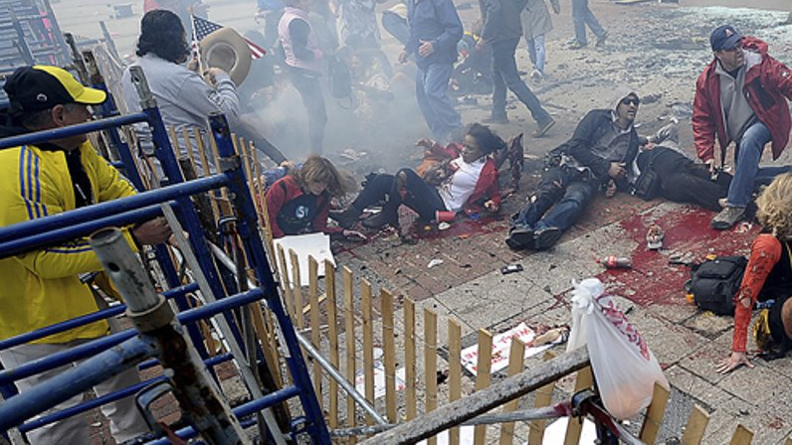
Disaster Nursing

Slide 106
Types of Disasters
Mass casualty incidents
Terrorism
Natural disasters
Outbreaks
Epidemics
Pandemics
Biologic, chemical, and nuclear or radiation incidents

Slide 107
Regulatory Agencies and Preparedness
Federal agencies
Department of Health and Human Services
Department of Justice
Department of Homeland Security
FEMA
CDC
State and local response agencies
American Red Cross
Poison control
Health departments
Hospital Emergency Preparedness Plan
Required by Joint Commission
Incident Command System
Federally mandated command structure for disaster events
Office of Emergency Management
Outlines triage plans and provides an evaluates resources
Must practice twice yearly

Slide 108
Disaster Triage:
The Nurse’s Role
Nurse’s role varies during disaster​
Should be given a clear role
Given a list of procedures that they can perform
May be asked to perform duties outside of expertise- intubate, insert chest tube, suture​
May serve as triage officer​
Nurses must strive to maximize client safety​
Be aware of state regulation​

Slide 109
Ethical Dilemmas and Conflicts
Assisted suicide​
Confidentiality​
Consent ​
Duty ​
Futile therapy​
Rationing care​
Resuscitation

Slide 110
Personal Protective Equipment
Purpose: to shield the healthcare provider from chemical, physical, biologic, and radiologic hazards that may exist when caring for contaminated clients
Level A: self-contained breathing apparatus (SCBA) and vapor-tight chemical-resistant suit, gloves, and boots
Level B: high level of respiratory protection (SCBA) but lesser skin and eye protection; chemical-resistant suit
Level C: air-purified respirator, coverall with splash hood, chemical-resistant gloves and boots
Level D: typical work uniform

Slide 111
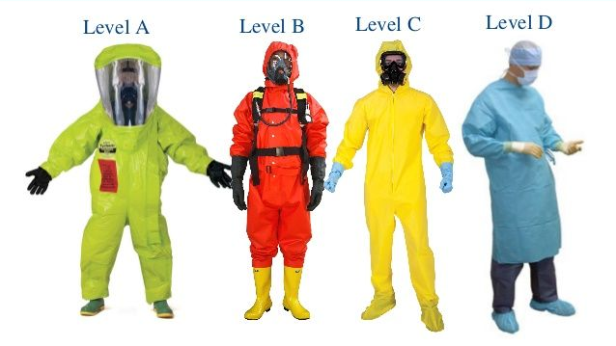

Slide 112
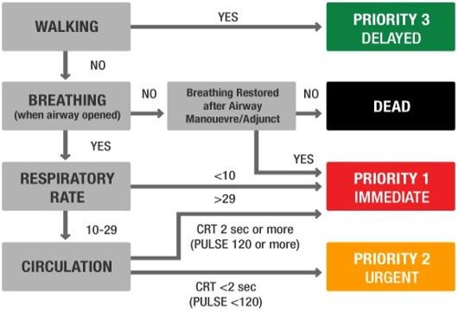
Disaster Triage
Decisions are based on the likelihood of survival and the consumption of resources.​
North Atlantic Treaty Organization (NATO) triage system​
  Red, yellow, green, and black
  Immediately tagged and transported
The greatest good for the greatest number of people

Slide 113
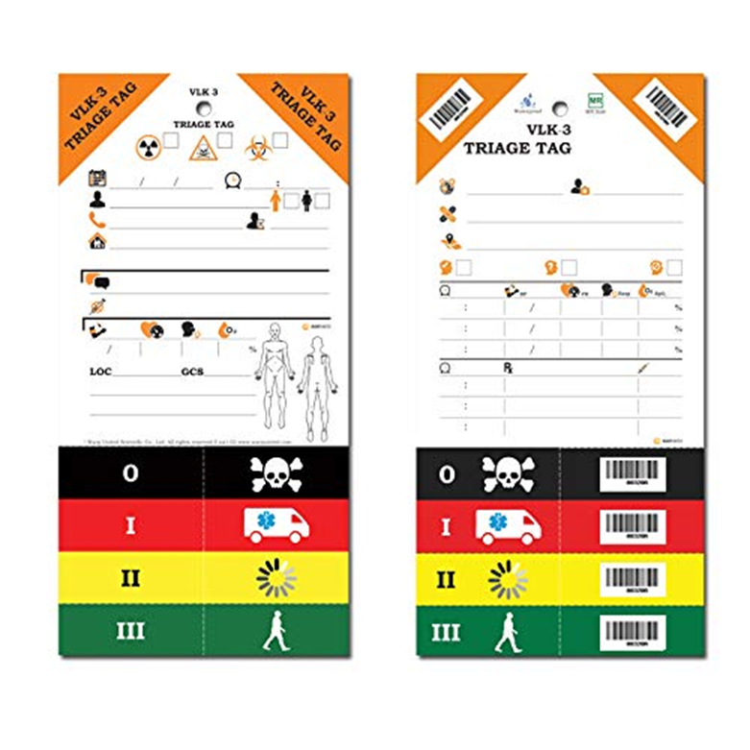
Urgent
Immediate
Delayed
Expectant

Slide 114
COMPLETED ANSWER • ORIGINAL SLIDE 88
Disaster triage color key
01
Red — immediate: life-threatening problems that may be survivable with rapid treatment.
02
Yellow — delayed/urgent: serious injury that can wait while red-tag clients are treated. Green — minor/walking wounded: can wait longer.
03
Black — deceased/expectant in the system taught: survival is unlikely with available resources. Reassess; terminology and separate expectant categories vary by triage system. Provide comfort care.
Added study notes • Original slides and graphics retained • Sources in speaker notes
Notes:
Added answer to original emergency slide 88. Completed answer.
Red — immediate: life-threatening problems that may be survivable with rapid treatment.
Yellow — delayed/urgent: serious injury that can wait while red-tag clients are treated. Green — minor/walking wounded: can wait longer.
Black — deceased/expectant in the system taught: survival is unlikely with available resources. Reassess; terminology and separate expectant categories vary by triage system. Provide comfort care.
Source: user-supplied lecture deck. Supplemental references:

Slide 115
Natural Disasters
Arrive to hospital in three waves
Minimally injured
Severely injured
Rescued
Walking wounded
Need shelter, water
Loss of communication, potable water, and electricity

Slide 116
Outbreaks, Epidemics, and Pandemics
Outbreak: occurrence of a disease within a population that exceeds expectations
  Communicable disease; exposure to chemicals or toxins; unknown source
Epidemic: widespread outbreak of specific infectious disease from a single source that exceeds anticipated levels of impact
Pandemic: epidemic spread across multiple countries or continents
Identify source of illness
Manifestations vary based on source

Slide 117
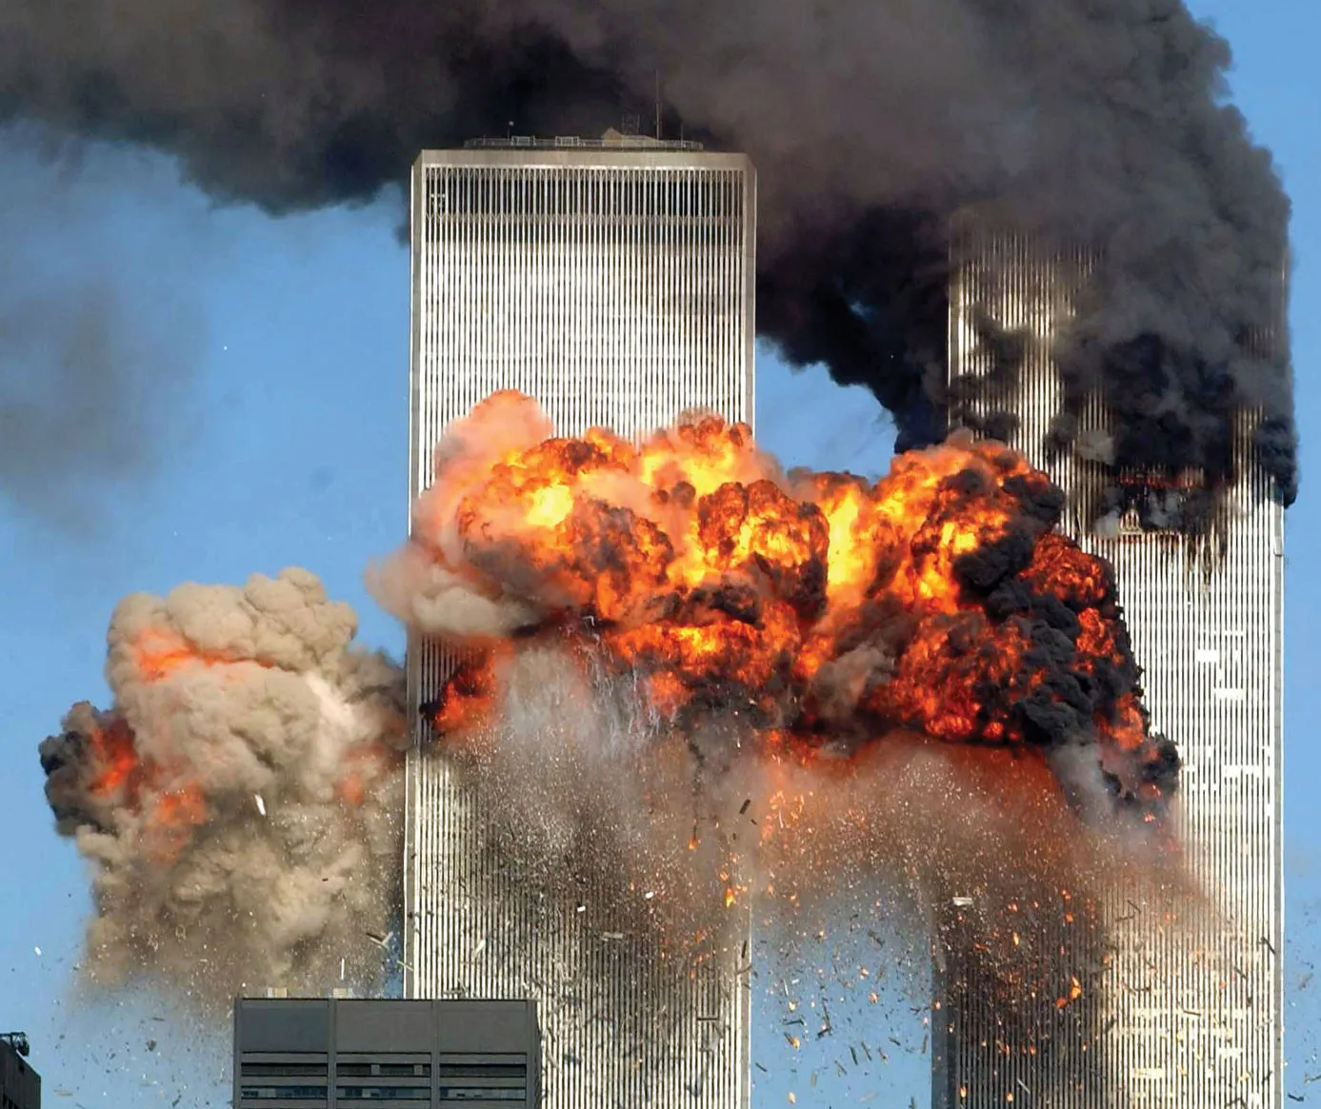
Weapons of Terror
Systemic use of violence to create fear
Blast injury
Biologic weapons
Chemical weapons
Nuclear radiation exposure

Slide 118
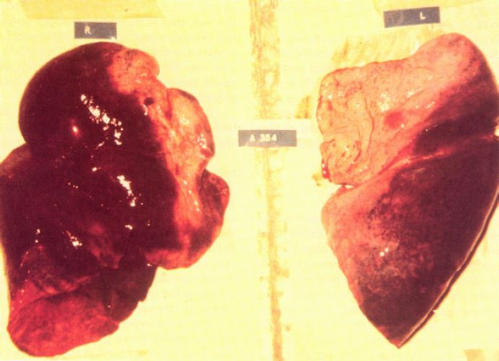
Blast Injury
Distance from blast
Physical injuries
  Blast lung
    Blast wave passes through air-filled lungs
    Hemorrhage and tearing of lungs
    ARDS
    Pneumothorax and hemothorax
  Tympanic membrane rupture
  Abdominal and head injuries

Slide 119
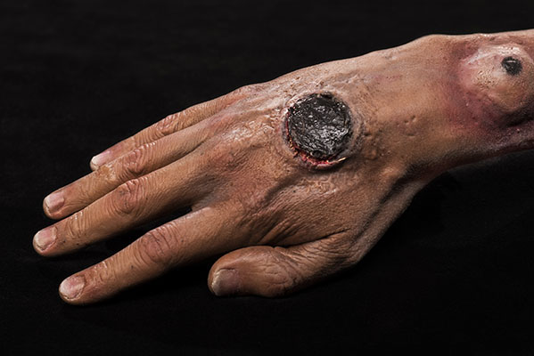
Biologic Agents: Anthrax
Bacteria that results in hemorrhage, edema, and necrosis
Transmission: skin contact, GI ingestion, inhalation​
Manifestations depend upon route of transmission
  Skin lesions – most common manifestation
  N&V, abdominal pain, diarrhea​
  Respiratory symptoms that mimic influenza​
Treatment: penicillin, ciprofloxacin

Slide 120
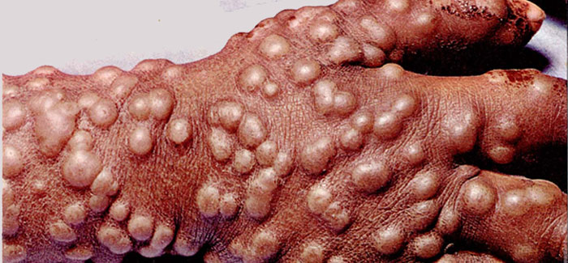
Biologic Agents: Smallpox (variola)
Virus
Extremely contagious; spread by direct contact, by contact with clothing or linens, or by droplets person-to-person​ (only after fever has decreased and rash phase has begun)
Manifestations: High fever, malaise, headache, backache, and prostration; after 1 to 2 days a maculopapular rash appears on the face, mouth, pharynx, and forearms​
Treatment is supportive care
Vaccine can be given after known exposure. Not routinely prophylactically administered except in active military.

Slide 121
CLINICAL SIDE NOTE • ORIGINAL SLIDE 94
Side note: smallpox transmission
01
The source limits spread to after the fever declines. CDC states contagiousness can begin during the initial febrile phase, with greatest contagiousness during early rash and pustular stages.
02
Suspected smallpox requires immediate isolation, infection-control/public-health notification and specialist management. Do not use the slide’s timing statement to delay precautions.
Added study notes • Original slides and graphics retained • Sources in speaker notes
Notes:
Added answer to original emergency slide 94. Clinical side note.
The source limits spread to after the fever declines. CDC states contagiousness can begin during the initial febrile phase, with greatest contagiousness during early rash and pustular stages.
Suspected smallpox requires immediate isolation, infection-control/public-health notification and specialist management. Do not use the slide’s timing statement to delay precautions.
Source: user-supplied lecture deck. Supplemental references:
CDC: Smallpox signs and symptoms
https://www.cdc.gov/smallpox/signs-symptoms/index.html

Slide 122
Chemical Agents
Vesicants ​- lewisite, sulfur mustard
Nerve agents - sarin, soman
Blood agents​ - cyanide
Pulmonary agents- phosgene, chlorine
See table 68-7

Slide 123
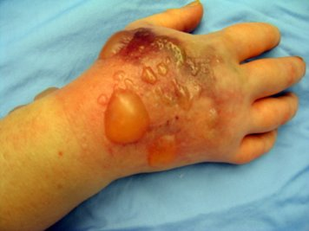
Chemical Agents: Vesicants
Lewisite, sulfur mustard, nitrogen mustard, phosgene​
Cause blistering and burning​
Respiratory effects can be serious and cause death ​
Decontamination with soap and water; do not scrub
Eye exposure requires copious irrigation​

Slide 124
CLINICAL SIDE NOTE • ORIGINAL SLIDE 96
Side note: phosgene classification
01
Phosgene is primarily a pulmonary/choking agent, not a classic vesicant. The previous chemical-agent overview already lists it under pulmonary agents.
02
It can cause delayed severe lung injury/pulmonary edema. Remove exposure safely, decontaminate as indicated and obtain medical assessment even if early symptoms are mild.
Added study notes • Original slides and graphics retained • Sources in speaker notes
Notes:
Added answer to original emergency slide 96. Clinical side note.
Phosgene is primarily a pulmonary/choking agent, not a classic vesicant. The previous chemical-agent overview already lists it under pulmonary agents.
It can cause delayed severe lung injury/pulmonary edema. Remove exposure safely, decontaminate as indicated and obtain medical assessment even if early symptoms are mild.
Source: user-supplied lecture deck. Supplemental references:
CDC: Phosgene
https://www.cdc.gov/chemical-emergencies/chemical-fact-sheets/phosgene.html

Slide 125
Chemical Agents: Nerve Agents
Sarin, soman, tabun, organophosphates, and VX​
Inhibit cholinesterase, causing cholinergic symptoms that progress to loss of consciousness, seizures, copious secretions, apnea, and death​
Treatment: supportive care, atropine, benzodiazepine, and pralidoxime ​(antidote)
Decontaminate with copious amounts of soap and water or saline for at least 20 minutes​
Blot; do not wipe off​
Plastic equipment will absorb sarin gas - do not use oral airway

Slide 126
Nuclear Radiation Exposure
Exposure affected by time, distance, and shielding
Triage victims at the scene, after decontamination
Contamination – occurs with exposure
Incorporation – actual uptake of radioactive material into the cells, tissues, and organs
Survival is categorized as probable, possible, and improbable

Slide 127
Decontamination
The process of removing accumulated contaminants rendering them harmless
Critical to health and safety of health care providers by preventing secondary contamination
Decontamination has minimum of 2 steps
1. Removal of the client's clothing and jewelry and then rinsing the client with water
2. Thorough soap-and-water wash and rinse
Decontamination should be performed prior to entry into the facility
There should be outside decontamination area with shower

Slide 128
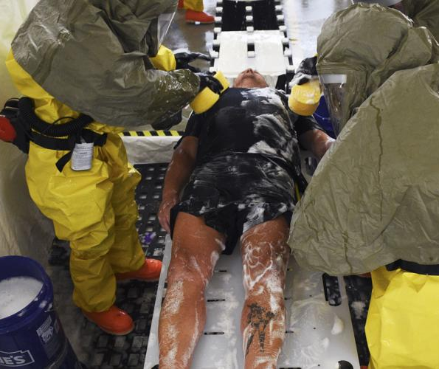
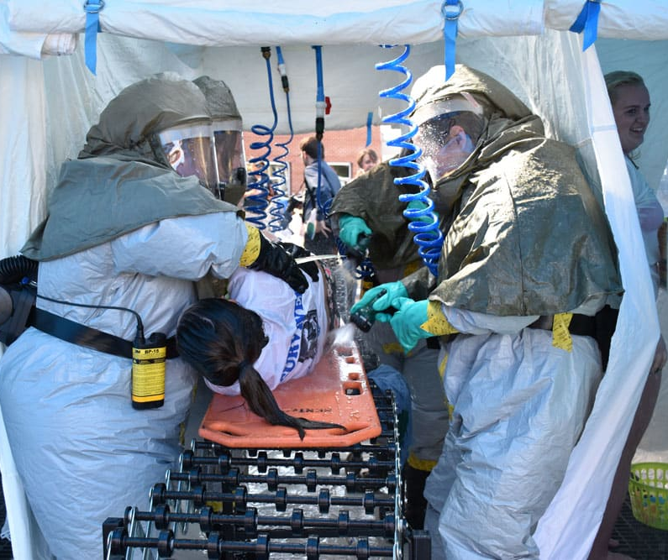

Slide 129


