Slide 1

Reproductive Disorders

Slide 2
Module Content
Female reproductive disorders
Male reproductive disorders
Diagnostics
Cystocele/rectocele
Neoplasms
Breast disorders
Menstrual disorders
Endometriosis
Uterine fibroids
Sexually transmitted infections
Polycystic ovarian syndrome
Diagnostics
Benign prostatic hyperplasia
Prostate cancer
Erectile dysfunction
Inflammatory disorders
Testicular torsion
Testicular cancer

Slide 3
Objectives
Describe health screenings and counseling for female and male reproductive alterations. (CO 1, 2, 3, 4)
Describe the nursing management of the client with female or male reproductive alterations. (CO 1, 2, 3, 4)
Use the nursing process and NCJMM as frameworks for the care of the client undergoing treatment for breast cancer. (CO 1, 2, 3, 4)

Slide 4
Female Reproductive Disorders

Slide 5
Diagnostic Testing
Cervical Cancer
  Pap smear
    Identify precancerous cells of the cervix
  HPV test
    Identify HPV infection that can lead to cervical cancer
Ovarian Cancer
  CA-125
    Immunodiagnostic blood test (tumor marker)
    Elevated in ovarian cancer and endometriosis

Slide 6
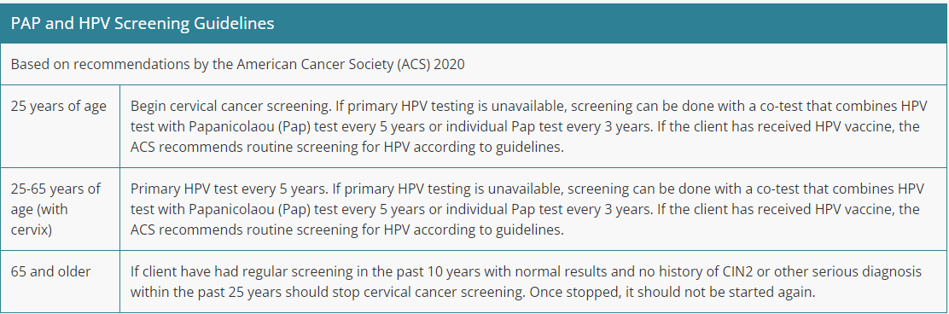
Notes:
From ATI

Slide 7
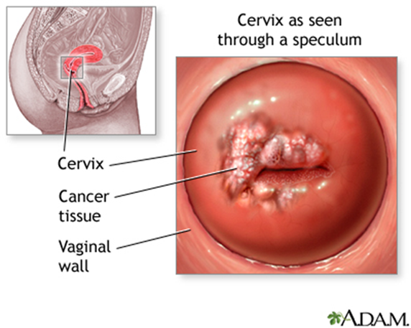
Pelvic Exam with Pap and HPV test
Preprocedural
  Have the client empty the bladder
  Place the client in lithotomy position
  Client education
Postprocedural
  Provide the client with perineal pads/tissues
  Minimal bleeding can occur

Slide 8
COMPLETED ANSWER • ORIGINAL SLIDE 7
Pap/HPV testing: client education
01
Before: explain the purpose and steps, obtain permission and provide privacy. For a Pap test, avoid intercourse, douching and vaginal medicines/products for 2 days when instructed.
02
During: empty the bladder, position comfortably in lithotomy and use a chaperone according to preference/policy. Tell the client to report pain; they may ask to pause.
03
After: mild spotting can occur. Explain when/how results will arrive and the follow-up plan; abnormal screening is not the same as a cancer diagnosis.
Added study notes • Original slides and graphics retained • Sources in speaker notes
Notes:
Added answer to original reproductive slide 7. Completed answer.
Before: explain the purpose and steps, obtain permission and provide privacy. For a Pap test, avoid intercourse, douching and vaginal medicines/products for 2 days when instructed.
During: empty the bladder, position comfortably in lithotomy and use a chaperone according to preference/policy. Tell the client to report pain; they may ask to pause.
After: mild spotting can occur. Explain when/how results will arrive and the follow-up plan; abnormal screening is not the same as a cancer diagnosis.
Source: user-supplied lecture deck. Supplemental references:
ACOG: Cervical cancer screening
https://www.acog.org/womens-health/faqs/cervical-cancer-screening

Slide 9
Colposcopy and Cervical Biopsy
Usually performed if Pap test reveals atypical or precancerous cells
Microscopic examination of vaginal and cervical tissues
Can perform endocervical curettage if lesions are present
Cone biopsy
  Excise a cone-shaped sample of tissues to remove harmful cells
  Can destroy cells using cryosurgery, lasers, or loop electrosurgical excision procedure (LEEP)

Slide 10
Colposcopy and Cervical Biopsy:
Client Education
May experience temporary discomfort and cramping
Rest 24 hours after the procedure
Do not insert anything into the vagina (sexual intercourse, creams, tampons) for 2 weeks
Do not lift heavy objects for 2 weeks
Avoid aspirin
Report excessive bleeding, fever, and foul-smelling drainage to the provider

Slide 11
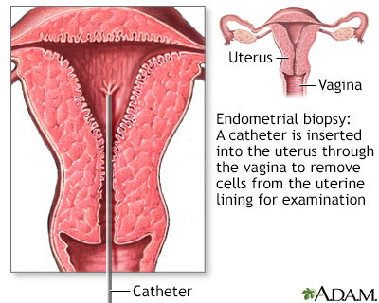
Endometrial biopsy
Removal of tissue from the endometrium that helps diagnose potential causes of abnormal uterine bleeding
Used for the diagnosis of endometrial hyperplasia or uterine cancer
Describe nursing management before, during, and after an endometrial biopsy.

Slide 12
COMPLETED ANSWER • ORIGINAL SLIDE 10
Endometrial biopsy: nursing care
01
Before: verify consent, pregnancy status, allergies, bleeding history and anticoagulant use; explain cramping and the ordered pain-control plan. Have the client empty the bladder.
02
During: support positioning/privacy, assist with aseptic technique, monitor pain or a vasovagal reaction and label the tissue specimen accurately.
03
After: assess pain/bleeding and provide a pad. Follow prescribed pelvic-rest instructions; report heavy bleeding, fever, foul discharge or severe pain. Confirm the pathology follow-up plan.
Added study notes • Original slides and graphics retained • Sources in speaker notes
Notes:
Added answer to original reproductive slide 10. Completed answer.
Before: verify consent, pregnancy status, allergies, bleeding history and anticoagulant use; explain cramping and the ordered pain-control plan. Have the client empty the bladder.
During: support positioning/privacy, assist with aseptic technique, monitor pain or a vasovagal reaction and label the tissue specimen accurately.
After: assess pain/bleeding and provide a pad. Follow prescribed pelvic-rest instructions; report heavy bleeding, fever, foul discharge or severe pain. Confirm the pathology follow-up plan.
Source: user-supplied lecture deck. Supplemental references:
Johns Hopkins: Endometrial biopsy
https://www.hopkinsmedicine.org/health/treatment-tests-and-therapies/endometrial-biopsy

Slide 13
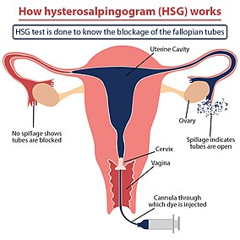
Hysterosalpingogram
Performed to visualize the cervix, uterus, and fallopian tubes using contrast dye and x-rays to evaluate for infertility, fibroids, or tumors
Describe nursing management before, during, and after a hysterosalpingogram.

Slide 14
COMPLETED ANSWER • ORIGINAL SLIDE 11
Hysterosalpingogram: nursing care
01
Before: confirm no pregnancy or active pelvic infection; review prior contrast reactions. Schedule early in the cycle as directed and give ordered analgesic/antibiotic.
02
During: explain contrast-related cramping, support lithotomy positioning/privacy and monitor for pain, faintness or allergic reaction.
03
After: mild cramps and blood-tinged drainage may occur; use a pad. Report fever, worsening pain, heavy bleeding, foul discharge or allergic symptoms and follow the clinician’s activity/sexual-care instructions.
Added study notes • Original slides and graphics retained • Sources in speaker notes
Notes:
Added answer to original reproductive slide 11. Completed answer.
Before: confirm no pregnancy or active pelvic infection; review prior contrast reactions. Schedule early in the cycle as directed and give ordered analgesic/antibiotic.
During: explain contrast-related cramping, support lithotomy positioning/privacy and monitor for pain, faintness or allergic reaction.
After: mild cramps and blood-tinged drainage may occur; use a pad. Report fever, worsening pain, heavy bleeding, foul discharge or allergic symptoms and follow the clinician’s activity/sexual-care instructions.
Source: user-supplied lecture deck. Supplemental references:
ACOG: Hysterosalpingography
https://www.acog.org/womens-health/faqs/hysterosalpingography

Slide 15
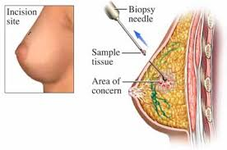
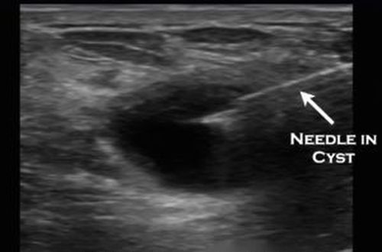
Breast Ultrasound
Useful modality for visualizing and confirming cysts within the breast
Ultrasound guided needle drainage of cysts allows for accurate localization of cyst
Local anesthetic required prior to needle aspiration or needle biopsy of a lesion

Slide 16
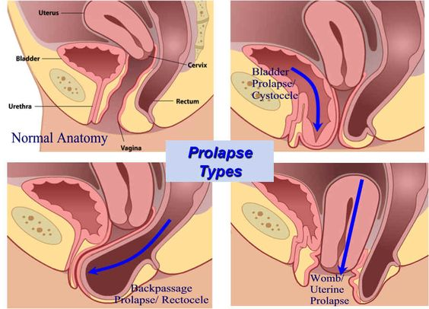
Cystocele and Rectocele

Slide 17
Cystocele and Rectocele
Cystocele:
Weakening of the anterior vaginal wall resulting in bladder bulging into vagina
Risks factors: Obesity, old age, multiple pregnancies, vaginal injury at childbirth, family history
Can be palpated by the client or HCP within the vagina
Findings: Stress incontinence, recurrent UTIs, vaginal fullness, painful intercourse, painful pelvic pain
Diagnostics: pelvic exam reveals anterior vaginal bulging, bladder ultrasound may show residual urine
Rectocele:
Weakening of the posterior vaginal wall resulting in the rectum bulging into vagina
Risk factors: Obesity, old age, constipation, family history, complicated vaginal birth
Findings: constipation, feeling of vaginal fullness, painful intercourse
Diagnostics: vaginal exam reveals posterior bulging

Slide 18
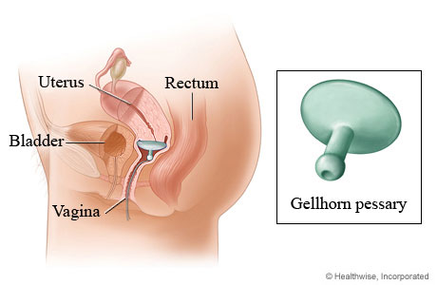
Cystocele and Rectocele Treatments
Intravaginal estrogen
Bladder training
Vaginal pessary
Kegel exercises
Anterior colporrhaphy (cystocele)
Posterior colporrhaphy (rectocele)

Slide 19
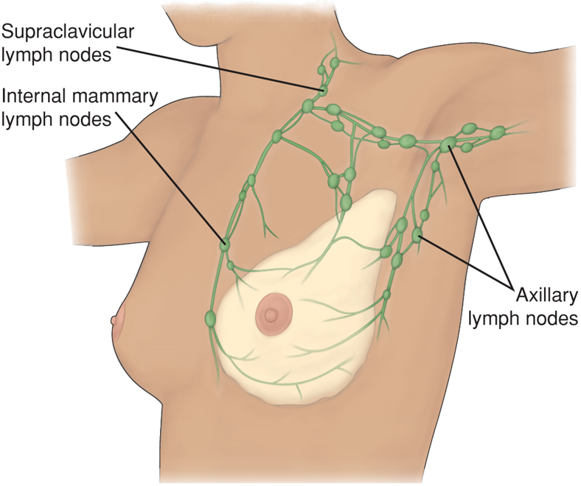
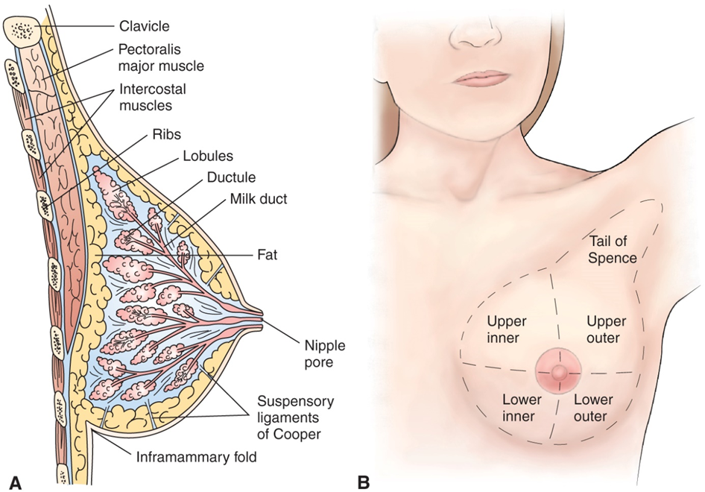
Anatomy of the Breast

Slide 20
Fibrocystic Breast Disease
Occurs in premenopausal women, often young adults
Can also develop with the initiation of HRT in post-menopausal women
Symptoms: tender breast lumps/cysts
Confirmed with breast ultrasound that reveals multiple cysts
  Mammograms often not useful in young adults due to breast density
Fine needle aspiration can be done to reduce tender cysts
Treatment: reduce salt prior to menses, avoid caffeine, supportive bra, ibuprofen/acetaminophen, warm/cool compresses, oral birth control pills, and diuretics

Slide 21
Breast Cancer
Second-leading cause of cancer deaths in females in the U.S.
Woman’s risk of developing breast cancer is about 12% or one in eight
Approximately 268,600 new cases of invasive breast cancer are diagnosed in women each year
Risk of developing breast cancer increases with age
Common sites of metastasis are bone, lung, brain, liver

Slide 22
Breast Cancer
Risk Factors
Protective Factors
Older age
Family history, BRCA1 and BRCA2- genetic mutations
Early menarche, late menopause
HRT/BCP
Previous radiation
Obesity, high-fat diet
Alcohol intake, smoking
Breast feeding for 1-year
Regular physical activity
Heathy body weight

Slide 23
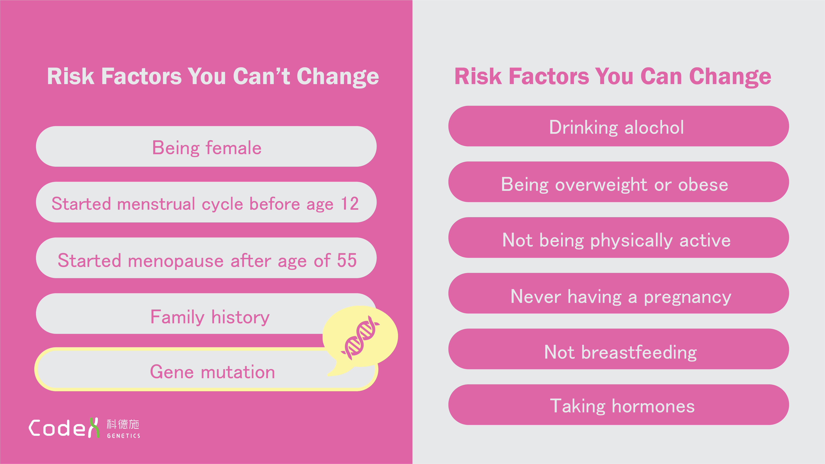

Slide 24
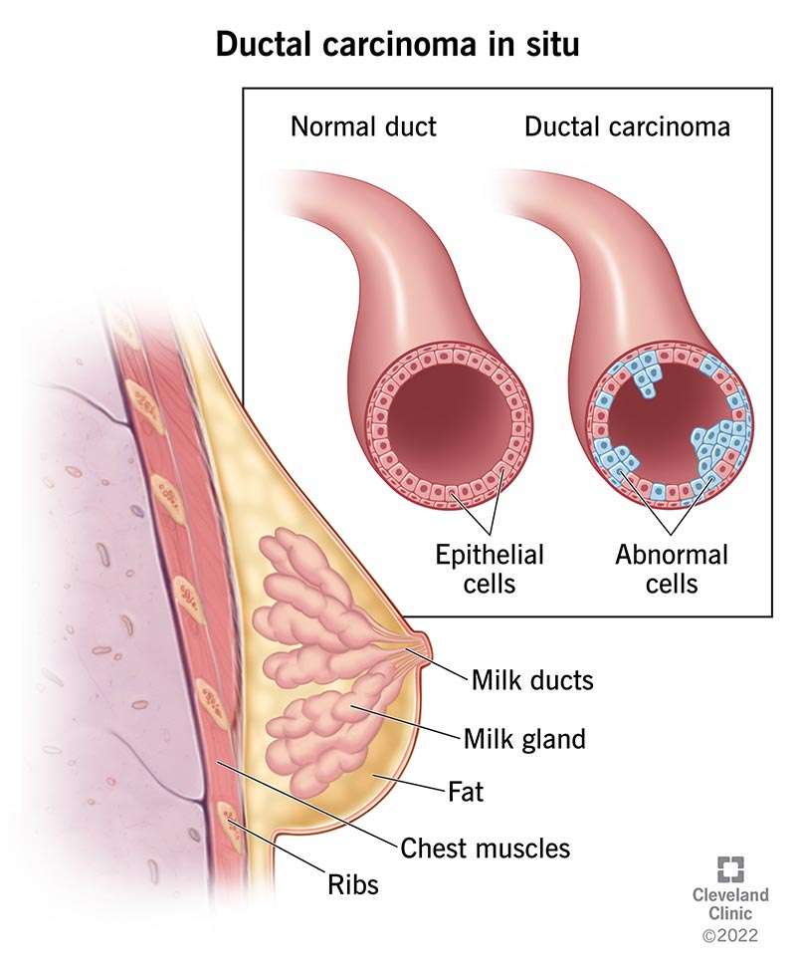
Ductal Carcinoma in Situ
Proliferation of malignant cells inside the milk ducts without invasion into the surrounding tissue
Does not metastasize
Can develop into invasive breast cancer if left untreated.
Treatment: lumpectomy with radiation therapy

Slide 25
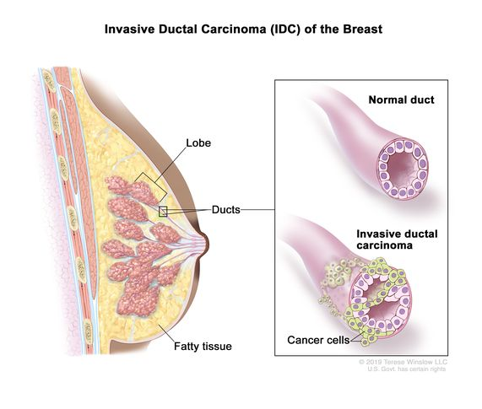
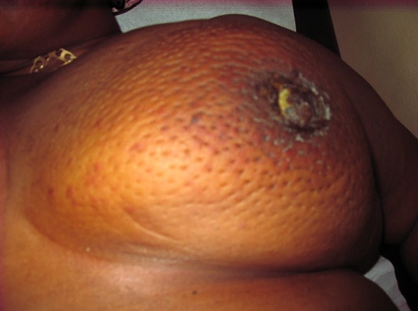
Invasive Breast Cancer
Infiltrating ductal carcinoma
  70 – 80% of all breast cancers
  Form a solid, irregular mass in the breast
Inflammatory carcinoma
  Rare but aggressive
  Diffuse edema and erythema
  “Orange peel” skin

Slide 26
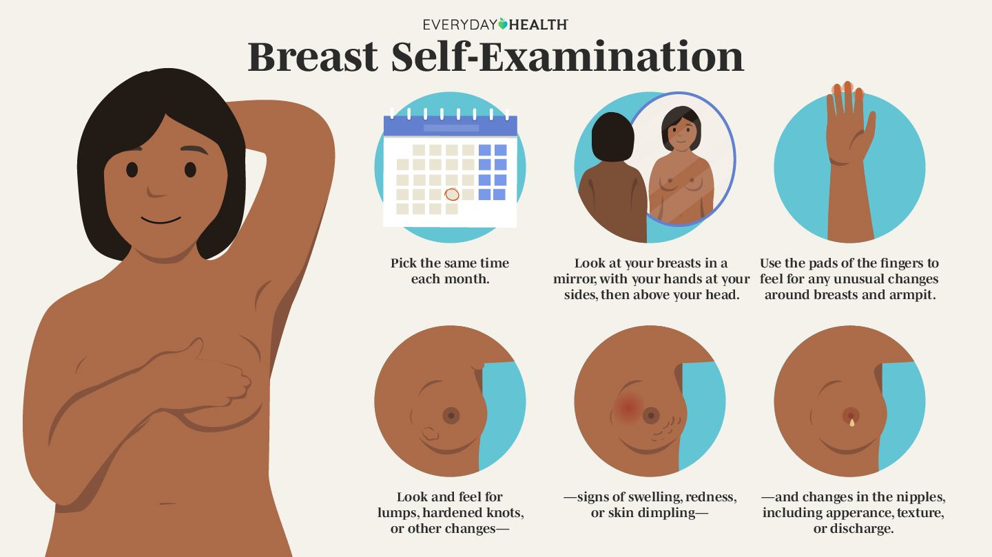
Breast Self-Examinations
Clients should focus on breast self-awareness
Awareness helps detect changes earlier
For those who are high risk or elect BSE, perform monthly
  5 to 7 days after menses
While showering - hands are slippery with soap and easier to feel for tissue changes

Slide 27
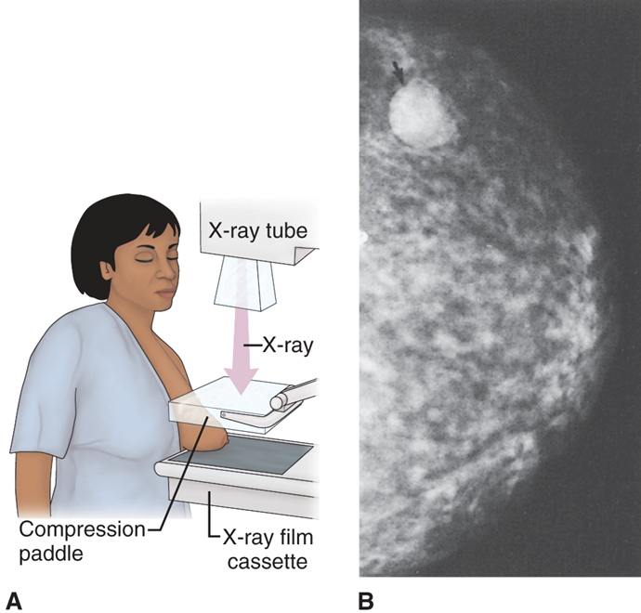
Mammography
ACS recommends healthy women should have screening mammogram yearly beginning at age 45
  Optional for women aged 40 – 44
Client education
  No lotion, deodorants, or powders in the axillary region day of procedure
Mammograms should be avoided during pregnancy

Slide 28

Breast Cancer Survivor

Slide 29
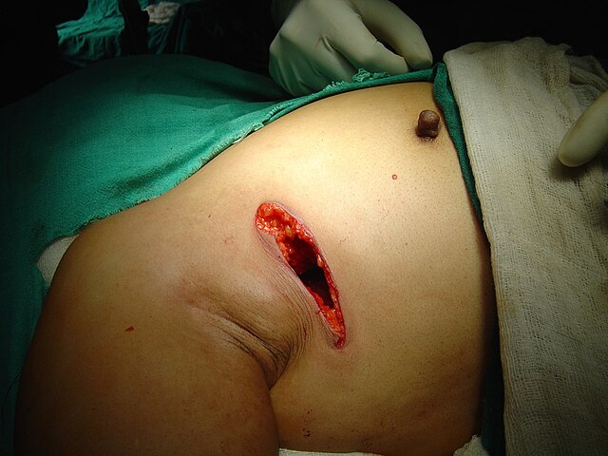
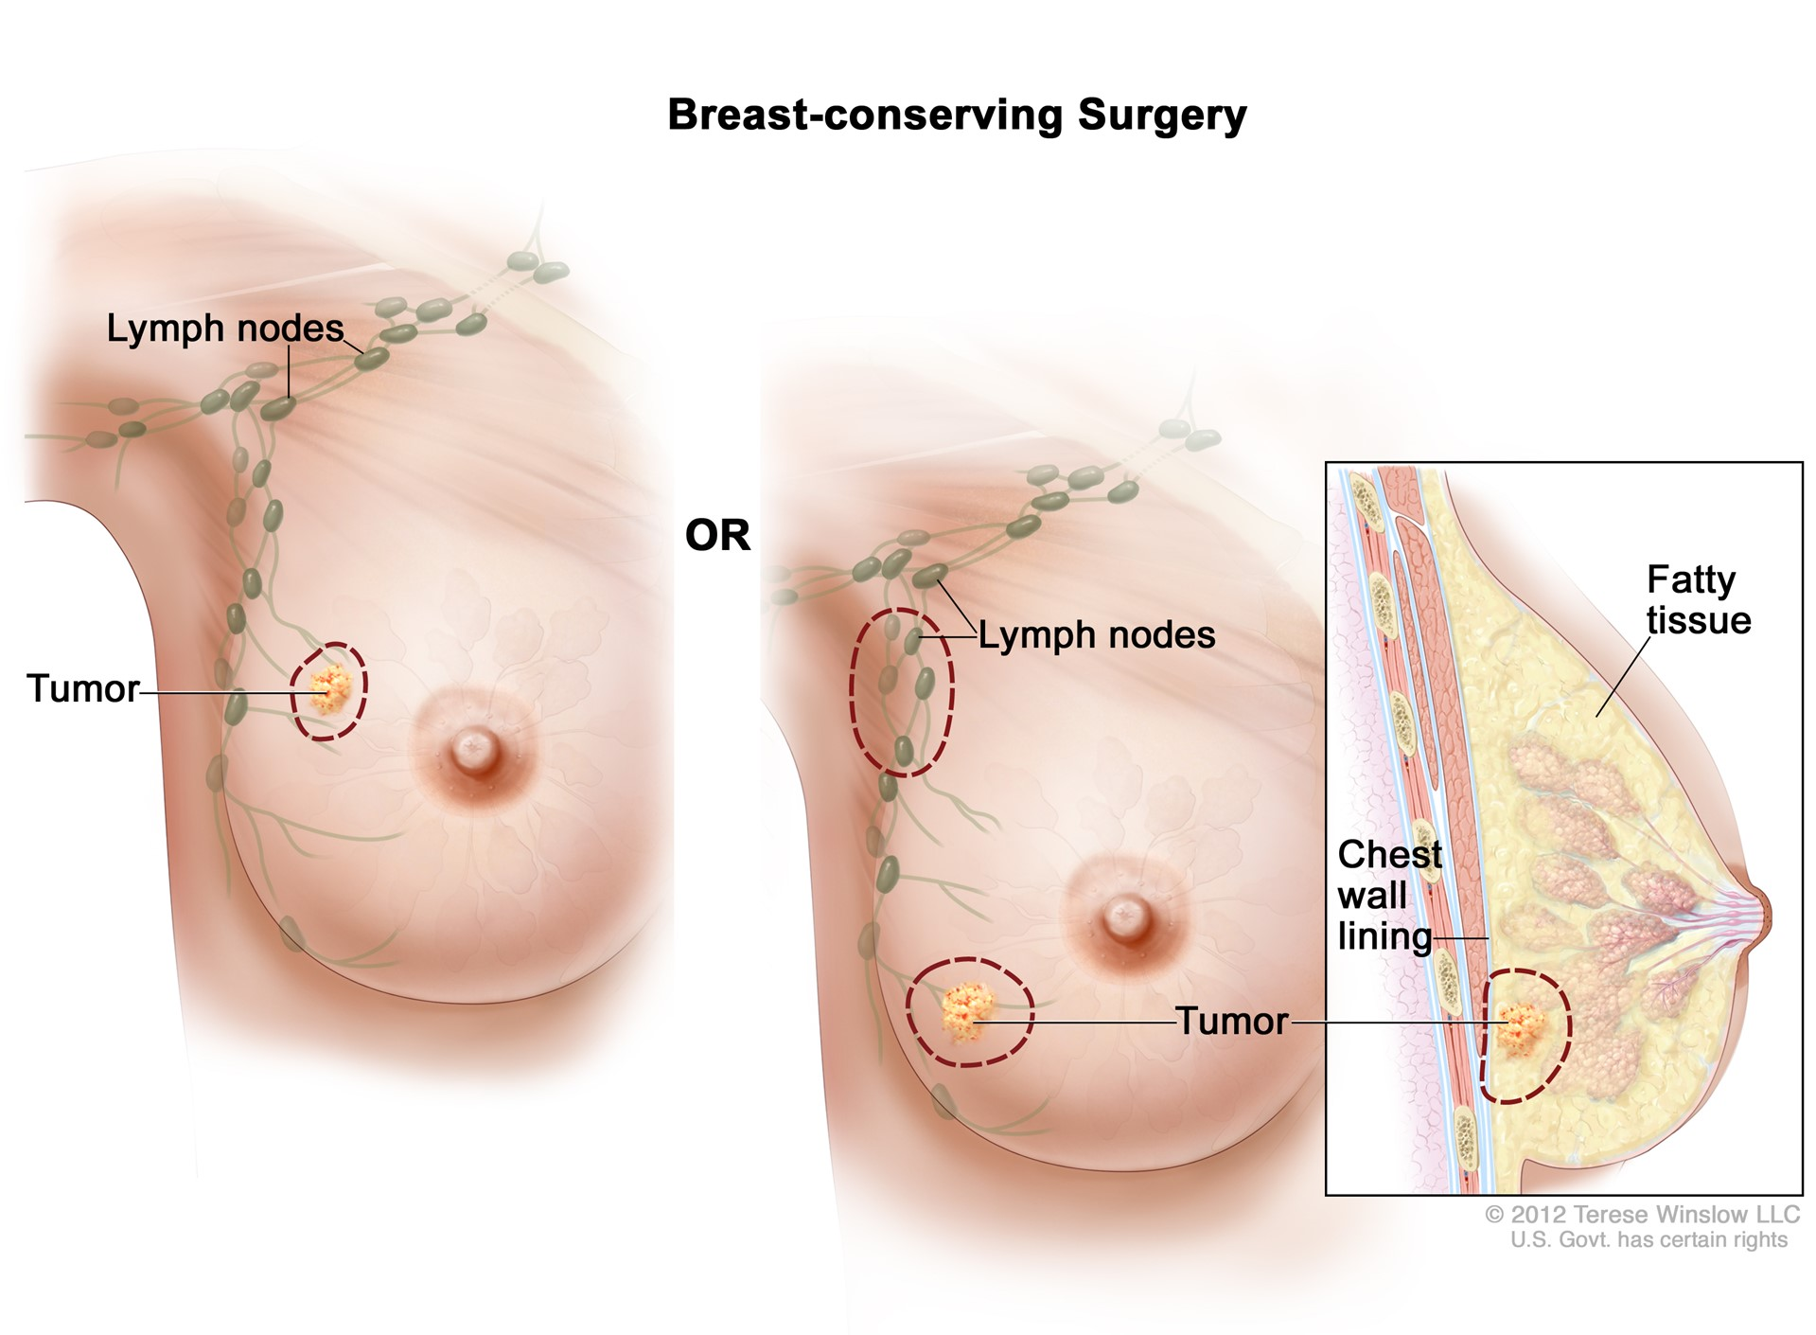
Surgical Management of Breast Cancer
Lumpectomy
  Breast conservation surgery
  Excise tumor while achieving acceptable cosmetic result
  May require lymph node removal

Slide 30
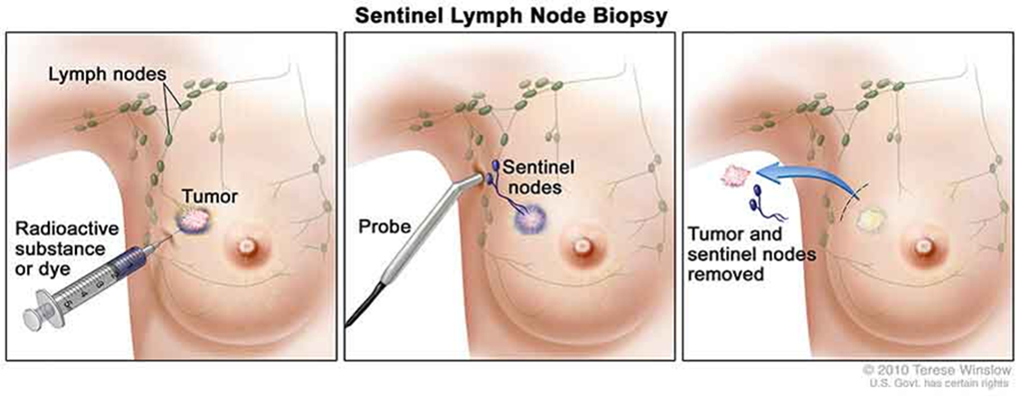
Surgical Management of Breast Cancer
Sentinel lymph node biopsy
  First lymph node (sentinel node) that receives drainage from primary tumor
  Tumor injected with radioisotope blue dye
  Surgeon used handheld probe to locate sentinel node, them removes it
  If the sentinel node is positive for cancer, then axillary node dissection is needed

Slide 31
Surgical Management of Breast Cancer
Total mastectomy
  Removal of the breast and areolar tissue (no axillary nodes)
Radical mastectomy
  Removal of breast tissue, nipple/areola, some axillary nodes, and muscle
Modified radical mastectomy
  Muscle is left intact, lymph nodes removed
Reconstructive surgery (optional)

Slide 32

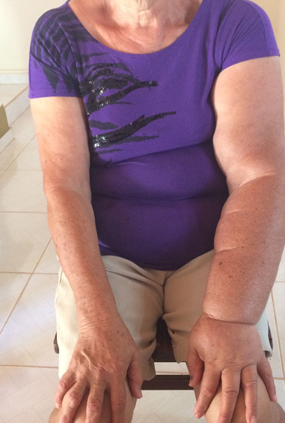

Surgical Complications
Lymphedema
Infection (Mastitis)

Slide 33
Post-op Breast Surgery
Increase
Increase HOB to 30°
Support
Support operative arm on a pillow
Lie on
Lie on the unaffected side to help relieve pain
Wear
Wear a sling when OOB
Offer
Offer emotional support and encourage the client to express feelings related to body image
Drain
Drain care (usually left in for 1 to 3 weeks)
Perform
Perform early hand exercises to prevent lymphedema and improve ROM

Slide 34
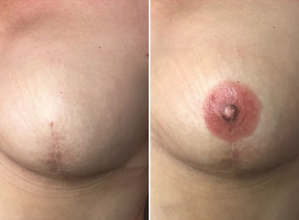
Reconstructive Surgery
Can begin during the original breast removal or after healing
Tissue expander followed by permanent implant
Autologous flap
Nipple–areola reconstruction
  Using tissue from the labia, abdomen, or inner thigh

Slide 35
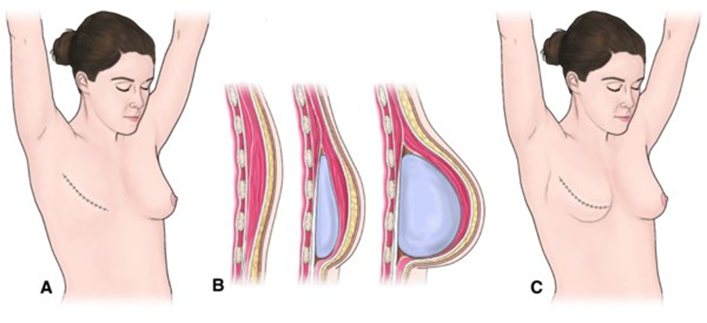
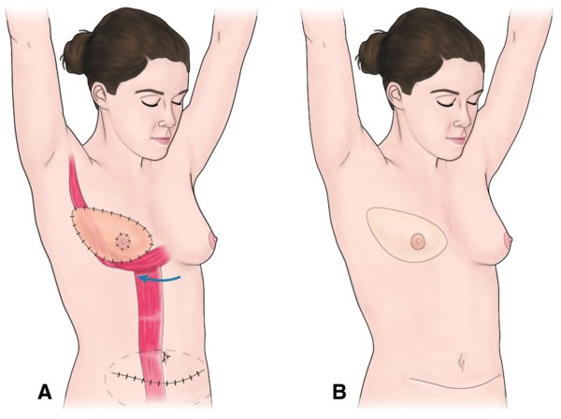
Tissue Expander Autologous Flap

Slide 36
Nonsurgical Management of Breast Cancer
Hormonal therapy
  Most effective in cancer cells with estrogen receptors that can be inhibited
  Selective estrogen receptor modulators (SERMs) — tamoxifen
    Used for those who are high risk for breast cancer or have advanced breast cancer
    Suppresses the growth of cancer cells
    Increases the risk of endometrial cancer (vaginal bleeding)
    Increases the risk of DVT/PE (leg swelling or SOB)
    Common side effect is hot flashes

Slide 37

Nonsurgical Management of Breast Cancer
Chemotherapy
  Combination of antineoplastic drugs
  Usually given over 3 – 6 months
Radiation therapy
Targeted therapies
  Most effective for breast cancer with HER2/neu gene

Slide 38
Breast Cancer in Males
<1% of men develop breast cancer
Average onset age is 68 years
Usually diagnosed later (40% late-stage disease)
  Poorer prognosis
Can present with a hard, painless mass
Gynecomastia can be present
Risk factors
  Low testosterone
  BRCA1 & BRCA2 genetic mutation
  Klinefelter syndrome (decreased testosterone)

Slide 39
Ovarian Cancer
Leading cause of death in female reproductive cancers
Frequently metastatic at the time of diagnosis
  70% are stage III or IV at time of diagnosis
Risk factors
Family history of ovarian, breast cancer, or colon cancer
    Most significant risk factor
BRCA-1 or BRCA-2 gene mutations
Early menarche and late menopause (more cycles)
Nulliparity (more cycles)
Obesity

Slide 40
Ovarian Cancer
Clinical manifestations are usually non-specific
  Abdominal/pelvic pain
  Abdominal bloating
  Abdominal mass
  Weight loss
  Vaginal bleeding
  Urinary urgency/frequency
Tumor markers: CA-125
  Useful in follow-up care, but not as a diagnostic tool
Treatment includes surgery, chemotherapy, palliative care

Slide 41
Endometrial (Uterine) Cancer
Most common female reproductive cancer
Most often diagnosed after menopause
Risk factors
  Cumulative exposure to estrogen is the major risk factor
  Obesity (estrogen production by fat cells)
  Increases mortality and morbidity of disease
  Estrogen replacement therapy
  Nulliparity
  Use of tamoxifen
  Early menarche and/or late age at menopause

Slide 42
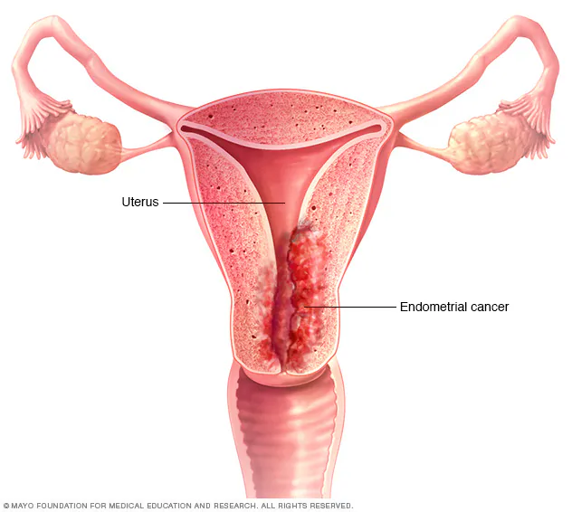
Endometrial (Uterine) Cancer
Clinical manifestations
  Irregular or post-menopausal bleeding
  Pelvic/back pain
Diagnosed by endometrial biopsy
Treatment: Hysterectomy, radiation therapy, chemotherapy

Slide 43
Polycystic Ovarian Syndrome (PCOS)
Dysfunction of the hypothalamic-pituitary ovarian axis
Complex disorder, not well understood
  Highly associated with insulin resistance
  Elevated levels of testosterone
Common disorder affecting 10 to 47% of women in the U.S.
Two of the three criteria must be met for diagnosis
  Hyperandrogenism (increased facial hair)
  Chronic anovulation (irregular cycles)
  Polycystic ovaries on ultrasound

Slide 44
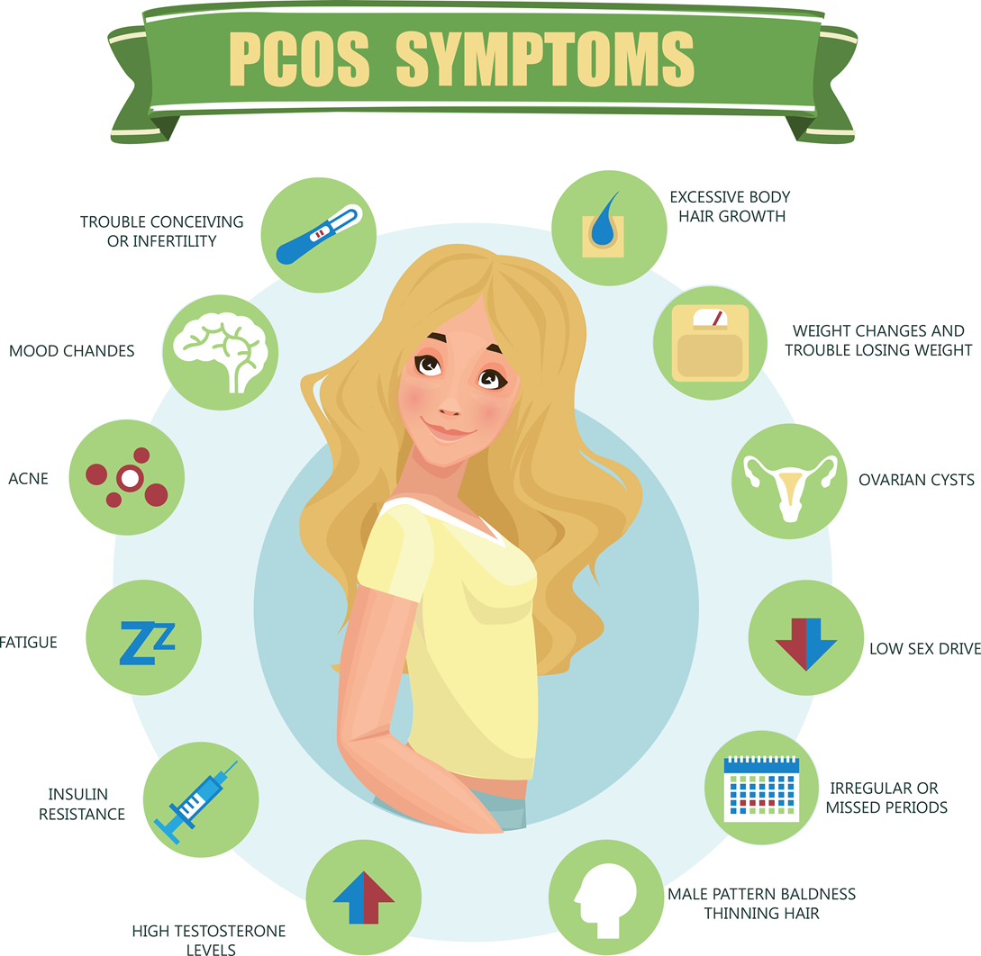

Slide 45
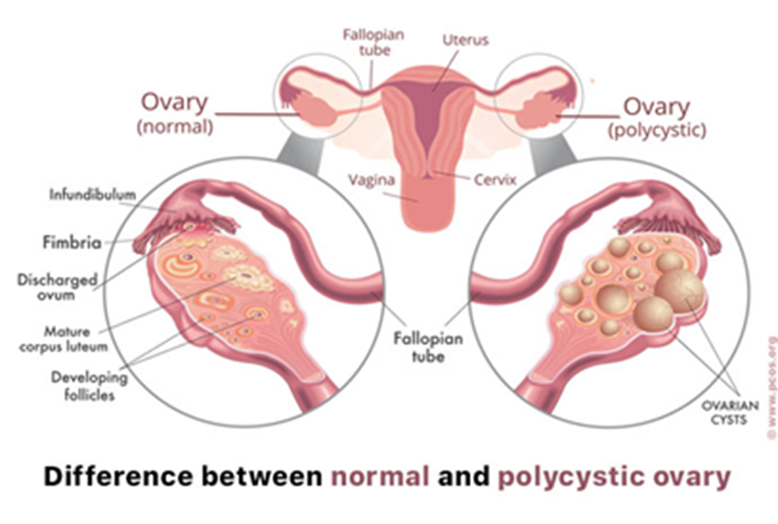
PCOS Treatment
Weight loss
Eat food with a low-glycemic index
Medications
  Metformin
    Regulates periods & helps with weight loss
  Spironolactone
    Reduces hirsutism
  Oral contraceptives
Infertility treatments
Surgery to remove cysts

Slide 46
Infertility Treatments
Pharmacologic therapy (clomiphene)
  Increases the risk of multiple births >25%
Artificial insemination
  Places prepared sperm in the uterus
In vitro fertilization (IVF)
  Collect client’s egg, fertilizing the egg in the lab then transferring to uterus
Gamete intrafallopian transfers (GIFT)
  Mix the egg and sperm into the fallopian tube
  Surgical laparoscopy procedure

Slide 47
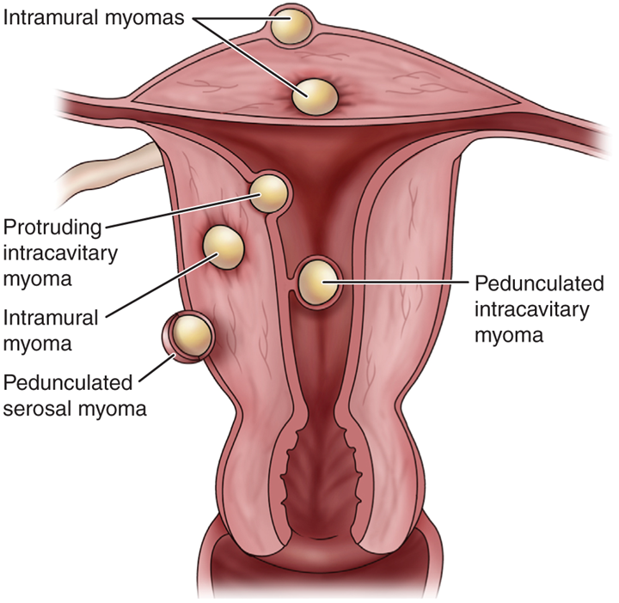
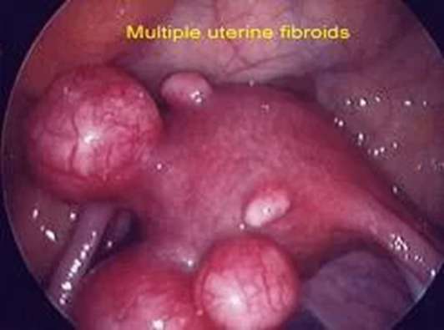
Uterine Fibroids
Common, benign smooth muscle tumors of the uterus
Can be asymptomatic or cause abnormal, heavy menstrual bleeding and abdominal pain
Complications
  Iron deficiency anemia
  Infertility
  Miscarriage
Treatment
  Myomectomy
  Hysterectomy

Slide 48
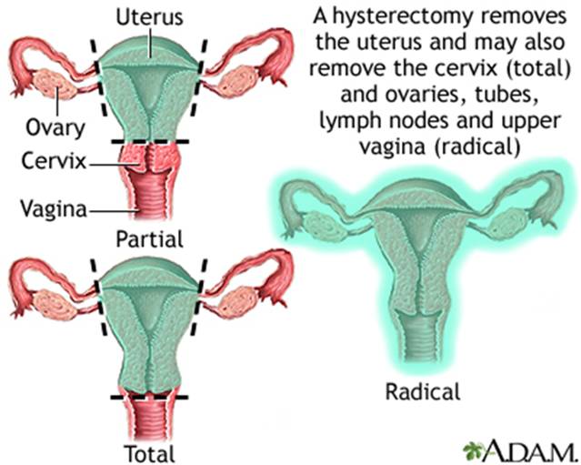
Hysterectomy
Surgical removal of the uterus to treat cancer, dysfunctional uterine bleeding, endometriosis, fibroids, persistent pain, prolapse, and previous injury to the uterus
Total hysterectomy
Subtotal hysterectomy
Bilateral salpingo-oophorectomy
Panhysterectomy
Radical hysterectomy

Slide 49
COMPLETED ANSWER • ORIGINAL SLIDE 45
Hysterectomy: fill in the procedure meanings
01
Total: uterus and cervix. Subtotal/supracervical: uterine body removed, cervix remains.
02
Bilateral salpingo-oophorectomy (BSO): both fallopian tubes and ovaries; it is a separate removal that may accompany hysterectomy.
03
Panhysterectomy: commonly used for uterus/cervix plus both tubes/ovaries; confirm the operative definition. Radical: uterus/cervix, surrounding supporting tissue and upper vagina, with node assessment as indicated; ovaries are not automatically removed.
Added study notes • Original slides and graphics retained • Sources in speaker notes
Notes:
Added answer to original reproductive slide 45. Completed answer.
Total: uterus and cervix. Subtotal/supracervical: uterine body removed, cervix remains.
Bilateral salpingo-oophorectomy (BSO): both fallopian tubes and ovaries; it is a separate removal that may accompany hysterectomy.
Panhysterectomy: commonly used for uterus/cervix plus both tubes/ovaries; confirm the operative definition. Radical: uterus/cervix, surrounding supporting tissue and upper vagina, with node assessment as indicated; ovaries are not automatically removed.
Source: user-supplied lecture deck. Supplemental references:
ACOG: Hysterectomy
https://www.acog.org/womens-health/faqs/hysterectomy

Slide 50
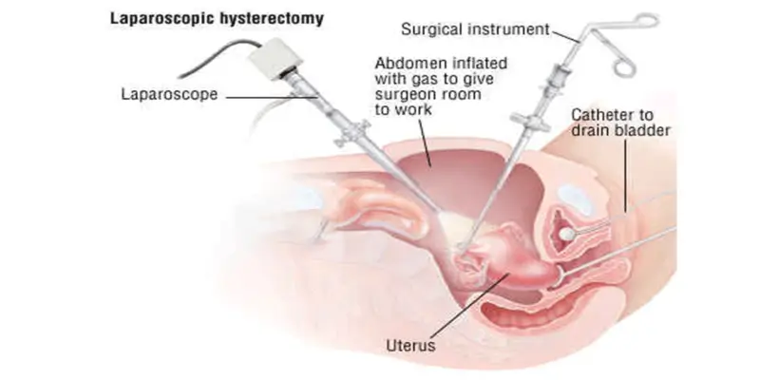
Hysterectomy: Surgical Approaches
Laparoscopic
Vaginal
Abdominal
  Total abdominal hysterectomy
Robotic

Slide 51
Hysterectomy Perioperative Care
Preoperative care
Postoperative care
Negative pregnancy test
Administer preop antibiotics
Place anti-embolism stockings
Indwelling urinary catheter inserted intraoperatively
  Kept in place for 24 hr.
Monitor vaginal bleeding
  Excessive bleeding 1 pad saturation in 4 hours
Monitor for signs of infection, atelectasis, paralytic ileus, wound dehiscence, DVT, bleeding, and hypovolemia

Slide 52
Hysterectomy: Client Education
Well-balanced diet high in protein and vitamin C to promote wound healing
If ovaries have been removed
  Menopausal manifestations
  HRT may be an option
  Vaginal atrophy can cause itching and dryness - instruct client to use artificial lubrication
Activity restrictions including no sexual intercourse for 4 to 6 weeks
Avoid tampons
Report complications

Slide 53
Hysterectomy: Complications
Hypovolemic shock
  Monitor VS, labs, vaginal bleeding
  Administer IVF and blood transfusions as needed
Infection
  Monitor for fever (greater than 37.8°C/100°F), foul-smelling drainage, redness and swelling
Psychological reactions
  Can occur months to years later
  Depression
  Refer to support groups

Slide 54
Menstrual Disorders
Menorrhagia - excessive menstrual bleeding (amount and duration), possibly with clots, saturate more than one tampon or pad per hour
Metrorrhagia - bleeding between menstrual periods, common in adolescents and those entering menopause
Dysmenorrhea - painful menstruation
Amenorrhea - absence of menses, can indicate pregnancy, thyroid disorder, or other disorder

Slide 55
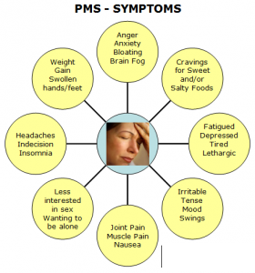
Premenstrual Syndrome (PMS)
PMS is thought to be a caused from an imbalance of estrogen and progesterone
Premenstrual dystrophic disorder (PMDD)
  Severe form of PMS
  Unable to carry out daily activities

Slide 56
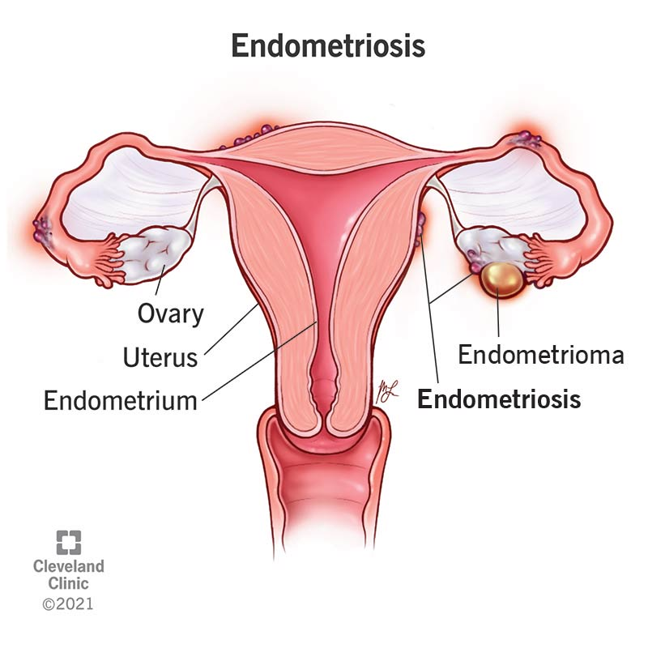
Endometriosis
Overgrowth of endometrial tissue that extends outside of the uterus into the fallopian tubes, ovaries, pelvis
Results in bleeding, inflammation, and scarring
Manifestations
  Pelvic pain
  Painful intercourse (dyspareunia)
  Menorrhagia
  Pain with defecation
  Depressed mood

Slide 57
Endometriosis
Major cause of infertility
Treatment
  Manage pain and limit the progression of implants
    Hormone therapy/BCP, steroids, GnRH agonists (see next slide)
    Pain is often unresponsive to NSAIDS
  Surgical options
    Severe cases
    Excision of endometrial implants and adhesions

Slide 58
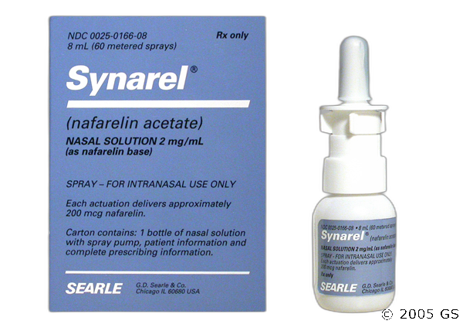
Endometriosis Treatment
Nafarelin
  Gonadotropin-releasing hormone agonist that decreases ovarian function (suppressed release of estrogen)
  Results in medical-induced menopause
  Administration is 1 spray into one nostril in the morning; 1 spray into the opposite nostril in the evening
    May lead to rhinitis and nasal irritation

Slide 59
Perimenopause
Perimenopause is the time (approx. 4 years) before menopause
Ovarian function declines as ova slowly diminish
Clinical manifestations
  Irregular menstrual flow
  Vaginal and urethral atrophy
  Hot flashes
  Night sweats
  Fluctuations of vasoconstriction/vascular spasms → dizziness, numbness/tingling, headaches
  Insomnia
  Fatigue
  Depression

Slide 60
Perimenopause
Client Education
  Pregnancy can still occur, maintain birth control
Complications
  Osteoporosis
    Increase calcium and vitamin D intake
    Avoid caffeine and tobacco
  Coronary artery disease
    Avoid obesity, tobacco, alcohol
    Treat hyperlipidemia, HTN, and DM since heart disease increases at menopause

Slide 61
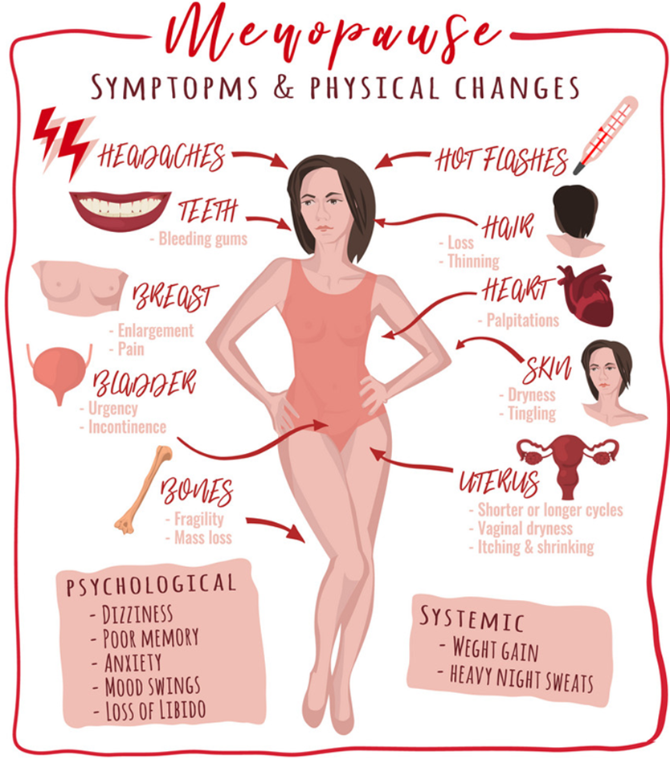
Menopause
Permanent physiologic cessation of menses associated with declining ovarian function
Complete when there is no menses for 12 months
Natural or surgically induced
Laboratory testing
  FSH/LH increased
  Pelvic exam and pap to r/o cancers

Slide 62
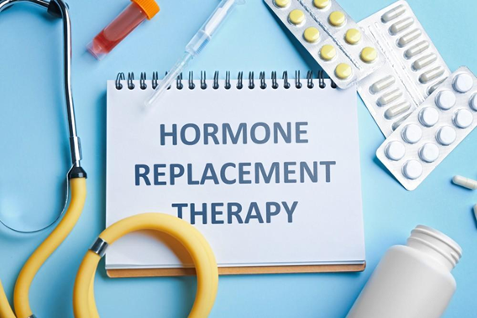
Menopausal Hormone Therapy
Benefits of estrogen therapy
  Suppresses hot flashes
  Prevents atrophy of vaginal tissue
  Consider estrogen vaginal creams
  Reduces the risk of osteoporosis/fractures

Slide 63
Menopausal Hormone Therapy
Contraindicated in women with history of breast cancer, DVT, impaired liver function, uterine cancer, and undiagnosed vaginal bleeding
Risks of estrogen therapy
  CAD
  MI
  DVT
  Stroke
  Breast, ovarian, and endometrial cancer

Slide 64
Alternatives to HT
Herbal therapy
  Black cohosh, ginseng, red clover
  Research findings are inconsistent
Phytoestrogens
  Dandelion greens, alfalfa sprouts, black beans, and soy
  Can decrease s/s of menopause
Vitamin E and Vitamin B6
  Decrease hot flashes in some clients

Slide 65

Sexually Transmitted Infections (STIs)

Slide 66
Human Papilloma Virus (HPV)
Most common sexually transmitted infection in the US
Vaccine
  Starting at age 11 or 12 before they are sexually active and available for those 9-26 years of age
Treatment of genital warts
  Topical agents or surgical removal of warts
Associated with cervical dysplasia and cervical cancer
  Need regular Pap smears
  If cervical dysplasia is present, will need colposcopy, and further treatment
Also increased risk of vulvar, vaginal, oropharyngeal, and penile cancers

Slide 67
Genital Herpes (HSV)
Recurrent, lifelong viral infection
More than 87% of infected individuals are unaware
Education:
  May be transmitted when the carrier is asymptomatic (viral shedding)
  Avoid sexual intercourse with active herpes
  Safe sexual practices using barrier contraception
  Outbreak triggers
Causes painful itching and burning herpetic lesions
Diagnosis may be based on H&P but can be confirmed with lab testing

Slide 68
Trichomoniasis (Trich)
Protozoal infection transmitted by asymptomatic carrier with infection of urogenital tract
Only about 30% of cases are symptomatic
  Vulvovaginal itching and burning
  Frothy yellow-green or yellow-white vaginal discharge
Treatment: metronidazole
All sexual partners should receive treatment

Slide 69
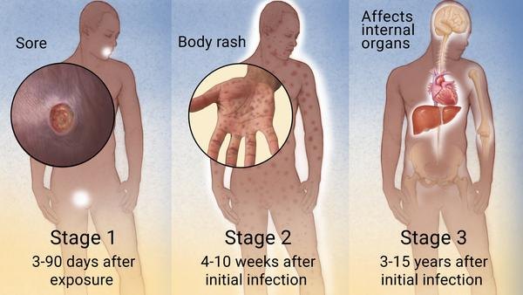
Syphilis
Painless ulcer on genitals, rectum, or mouth
Bacterial disease with 3 stages
Primary stage is a painless sore (chancre)
All stages can be treated with penicillin
Secondary stage occurs with body rash including palms and soles
Latent stage occurs with rash resolving
Tertiary syphilis can occur years later, affecting the blood vessels, brain, eyes, heart, nerves, and joints

Slide 70
Chlamydia
Common bacterial STI
Clear vaginal or penile discharge, dysuria
Many women are unaware of infection - asymptomatic
Can lead to pelvic inflammatory disease and infertility
Can result in ectopic pregnancies
Treated with antibiotics
Standard STI precautions
  Use condoms
  Limit sexual partners
  Obtain screening test

Slide 71
Gonorrhea
Bacterial infection affecting the urethra, vaginal, rectum, or throat
Copious penile discharge, painful urination, vaginal discharge, and pelvic pain
Can result in infertility in men and women
Standard STI precautions
  Condoms
  Limit sexual partners
  Testing for condition

Slide 72
Pelvic Inflammatory Disease (PID)
Infection of the upper female reproductive tract
Usually develops from a bacterial infection in the vagina or cervix
  Gonorrheal and chlamydial organisms are common causes
  Some are associated with more than one infection
Can result in scarring, infertility, and abscess formation
Increases the risk of ectopic pregnancy and chronic pelvic pain later

Slide 73
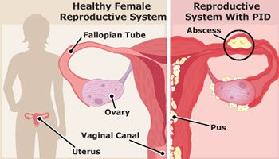
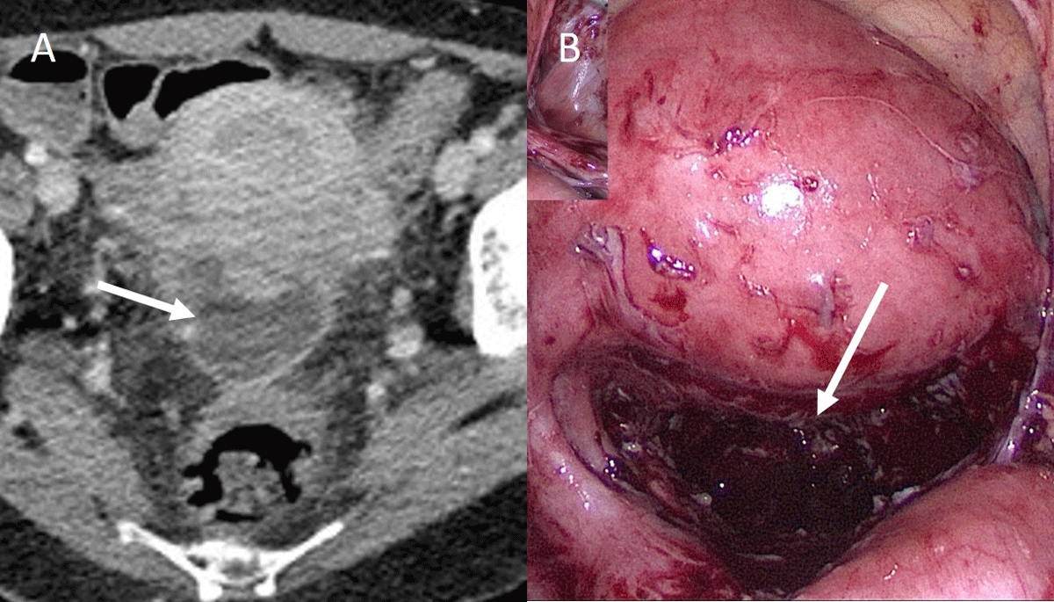
Pelvic Inflammatory Disease (PID)
Manifestations range from asymptomatic to severe
  Fever
  Pain and tenderness in the lower abdomen
  Post coital bleeding
  Cervical motion tenderness
  Abnormal vaginal discharge

Slide 74
Pelvic Inflammatory Disease: Treatment
Mix of broad-spectrum antibiotics
  Cephalosporin injection (ceftriaxone), followed by PO doxycycline and metronidazole
Avoid sexual intercourse during treatment
Treat sexual partners
Acetaminophen and ice packs
No tampon use during treatment
No baths during treatment
  May shower
May need surgery to remove adhesions or drain abscesses if severe

Slide 75
Male Reproductive
Disorders

Slide 76
Male Reproductive System
Includes conditions that affect reproduction, sexuality, and urine elimination
Client may experience anxiety and embarrassment from condition
Be sensitive to cultural and emotional issues related to sexuality and the genitals to accomplish effective assessment and communication
Provide for privacy and education
Conditions include BPH, erectile dysfunction and prostate cancer, epididymitis, testicular torsion, testicular cancer, orchitis

Slide 77
Diagnostic Tests: Digital Rectal Exam (DRE)
Performed in an office or clinic
Client positioned to lean over the exam table, placed on one-side, or lithotomy position
If prostate gland is abnormally large, hard, or irregular shape or lumps, evaluation by ultrasound and transrectal biopsies indicated
Screening guidelines
  Age 40 for client who are at greatest risk
  Age 45 for client who are at high risk
  Age 50 for client who are average risk

Slide 78
Diagnostic Tests:
Prostate Specific Antigen (PSA)
Protein produced by prostate that is found in the blood; sensitive but not specific to cancer
Perform prior to DRE
Increased PSA levels may indicate cancer, BPH, acute urinary retention, acute prostatitis; UTI can elevate PSA for up to 6 weeks
PSA value >4 ng/mL requires further evaluation
ACS recommends against routine screening for clients at average risk

Slide 79
Diagnostic Tests (cont.)
EPCA-2 (serum test)
  Highly sensitive at detecting prostate cancer
Transrectal ultrasound (TRUS)
  Indication: elevated PSA or abnormal DRE
  Position client on the left, side-lying position
  Used to guide biopsy
  May be prescribed an enema prior
  Contraindication: latex allergy

Slide 80
Diagnostic Tests (cont.)
Penile Doppler ultrasonography
  Used to determine the normal anatomy and blood flow of the penis
  Can detect many conditions of the penis including erectile dysfunction
Culture and sensitivity of prostatic fluid
  Determines the organism causing prostatitis
  Determines the type of antibiotic to treat the infection

Slide 81
Benign Prostatic Hyperplasia (BPH)
As an adult male ages, the prostate gland enlarges
Affects half of men over age 60 and 90% of men over age 85
Risk factors:
  Increased age
  Smoking
  ETOH use
  Sedentary lifestyle
  Obesity
  Western diet (high-fat, high-protein, high-carbs; low-fiber)
  DM
  Heart disease

Slide 82
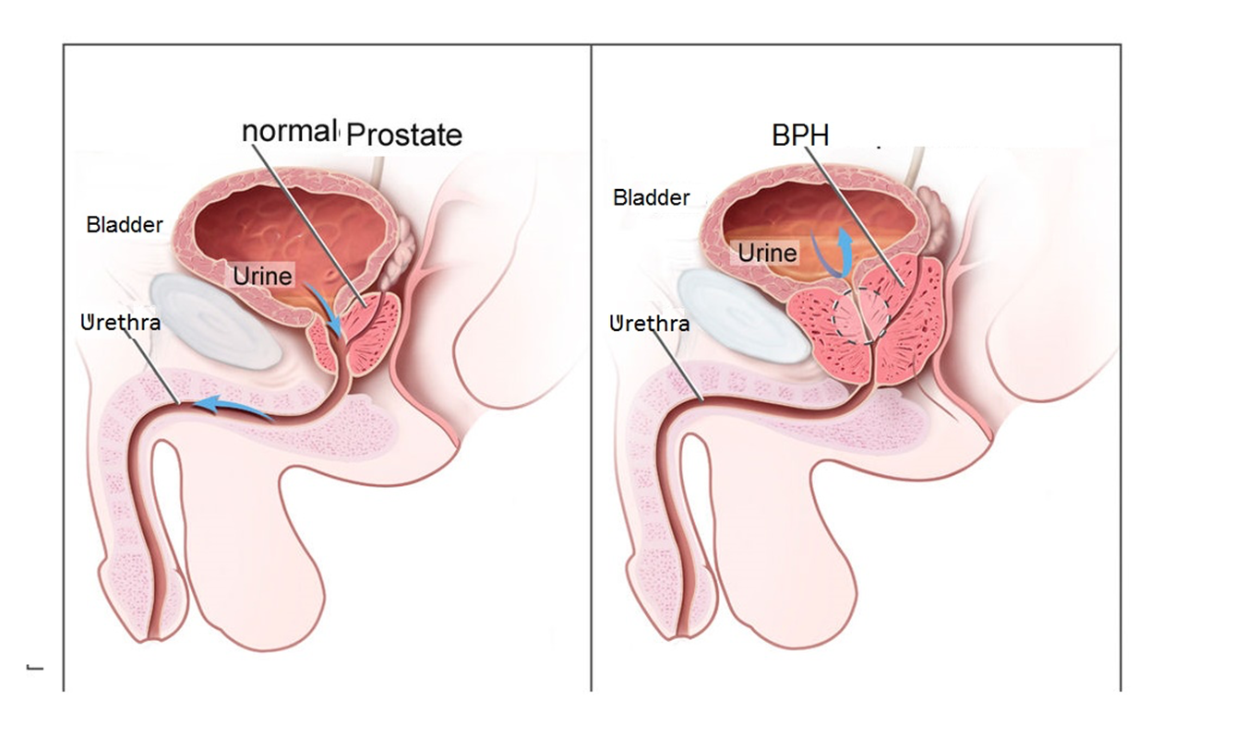

Slide 83
BPH Clinical Manifestations
Urinary symptoms
  Increased frequency
  Urgency
  Hesitancy
  Incontinence
  Incomplete emptying of the bladder
  Dribbling post-voiding
  Nocturia
  Diminished urinary stream
  Hematuria

Slide 84
BPH Medications
Goal is to re-establish unobstructed urine flow from the bladder
Dihydrotestosterone (DHT)-lowering medications (finasteride)
  Inhibits the enzyme 5-alpha-reductase, which converts testosterone to dihydrotestosterone (DHT). This reduces DHT levels, decreases prostate size, and improves symptoms of benign prostatic hyperplasia (BPH).
  Can take 6 months for any therapeutic effect
Alpha-blocking agents (tamsulosin)
  Relaxes the bladder outlet and prostate gland = stronger flow

Slide 85
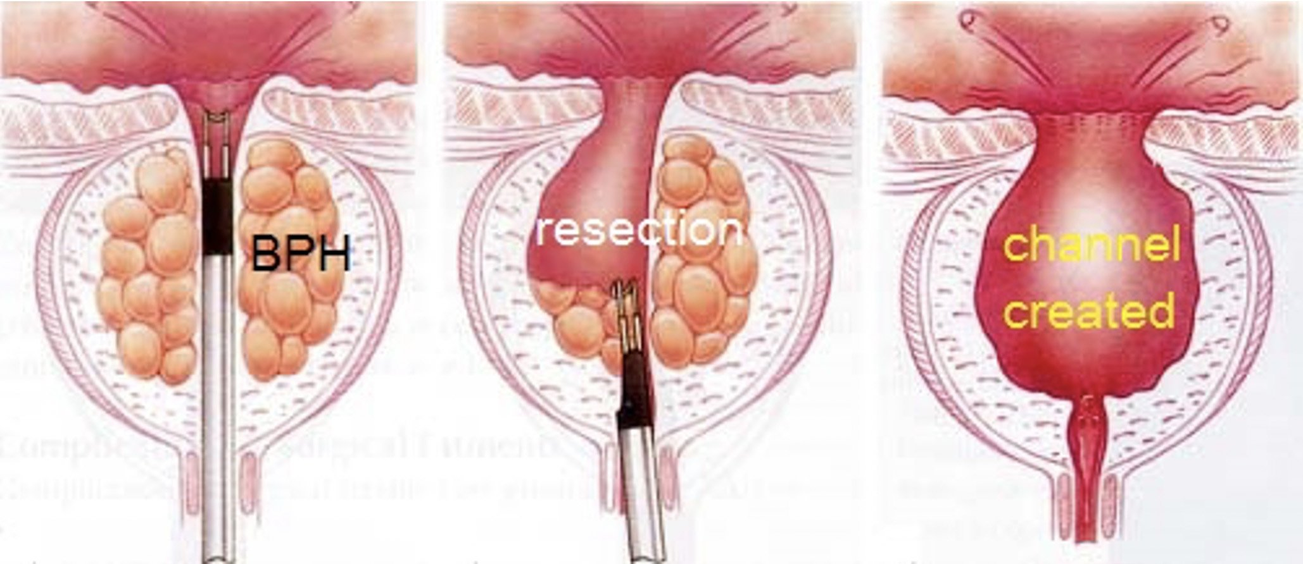
Transurethral Resection of the Prostate (TURP)
Most common surgical procedure for BPH to relieve the urinary obstruction
Resectoscope is inserted through the urethra and trims away excess prostatic tissue → enlarges the passageway of the urethra through the prostate gland

Slide 86
Postoperative Nursing Actions
Client will have a three-way catheter that allows for continuous bladder irrigation (CBI) to keep the catheter free of obstruction
  Adjust rate to keep the output pink or lighter (NEVER place on IV pump)
  If irrigation becomes bright-red, increase CBI flow rate
  For obstructions: turn off the CBI and hand irrigate with 50 mL syringe of irrigation solution
  Record I & O
  Catheter may be taped tightly to the leg to create traction to prevent bleeding
  Catheter has a large balloon - 30 to 45 mL
    Client may have a continuous urge to urinate
    Instruct the client to not void around the catheter

Slide 87
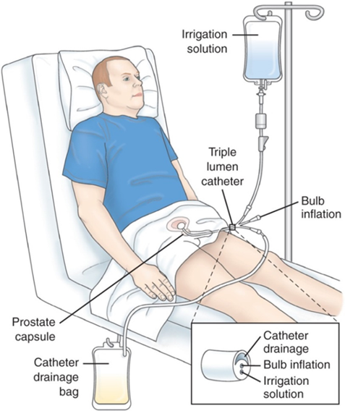





Slide 88
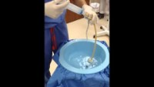
TURP Irrigation

Slide 89
TURP Client Education
Avoid heavy lifting, strenuous exercise, straining, and sexual intercourse for 2-6 weeks
Maintain hydration
Avoid NSAIDS
Avoid bladder stimulants like caffeine and alcohol
If urine becomes bloody, stop activity, rest, and increase fluid intake

Slide 90
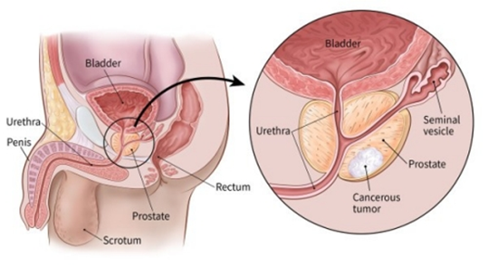
Prostate Cancer
Second most common cancer in men
Slow-growing cancer in elderly
Can be an aggressive cancer in younger clients
Potential to metastasize, especially to bones
Risk factors
  Risk increases with age
  Familial predisposition
  African-American race
  High fat/red meat, low fiber diet
  Gene mutations

Slide 91
Prostate Cancer Manifestations
Early disease has few/no symptoms
Urinary obstruction usually with advanced disease
Blood in urine or semen
Painful ejaculation
Symptoms of metastasis (usually spreads to bones)
  Backache, hip pain, weight loss, weakness
  May be first indications of prostate cancer
Regular screenings and early diagnosis

Slide 92
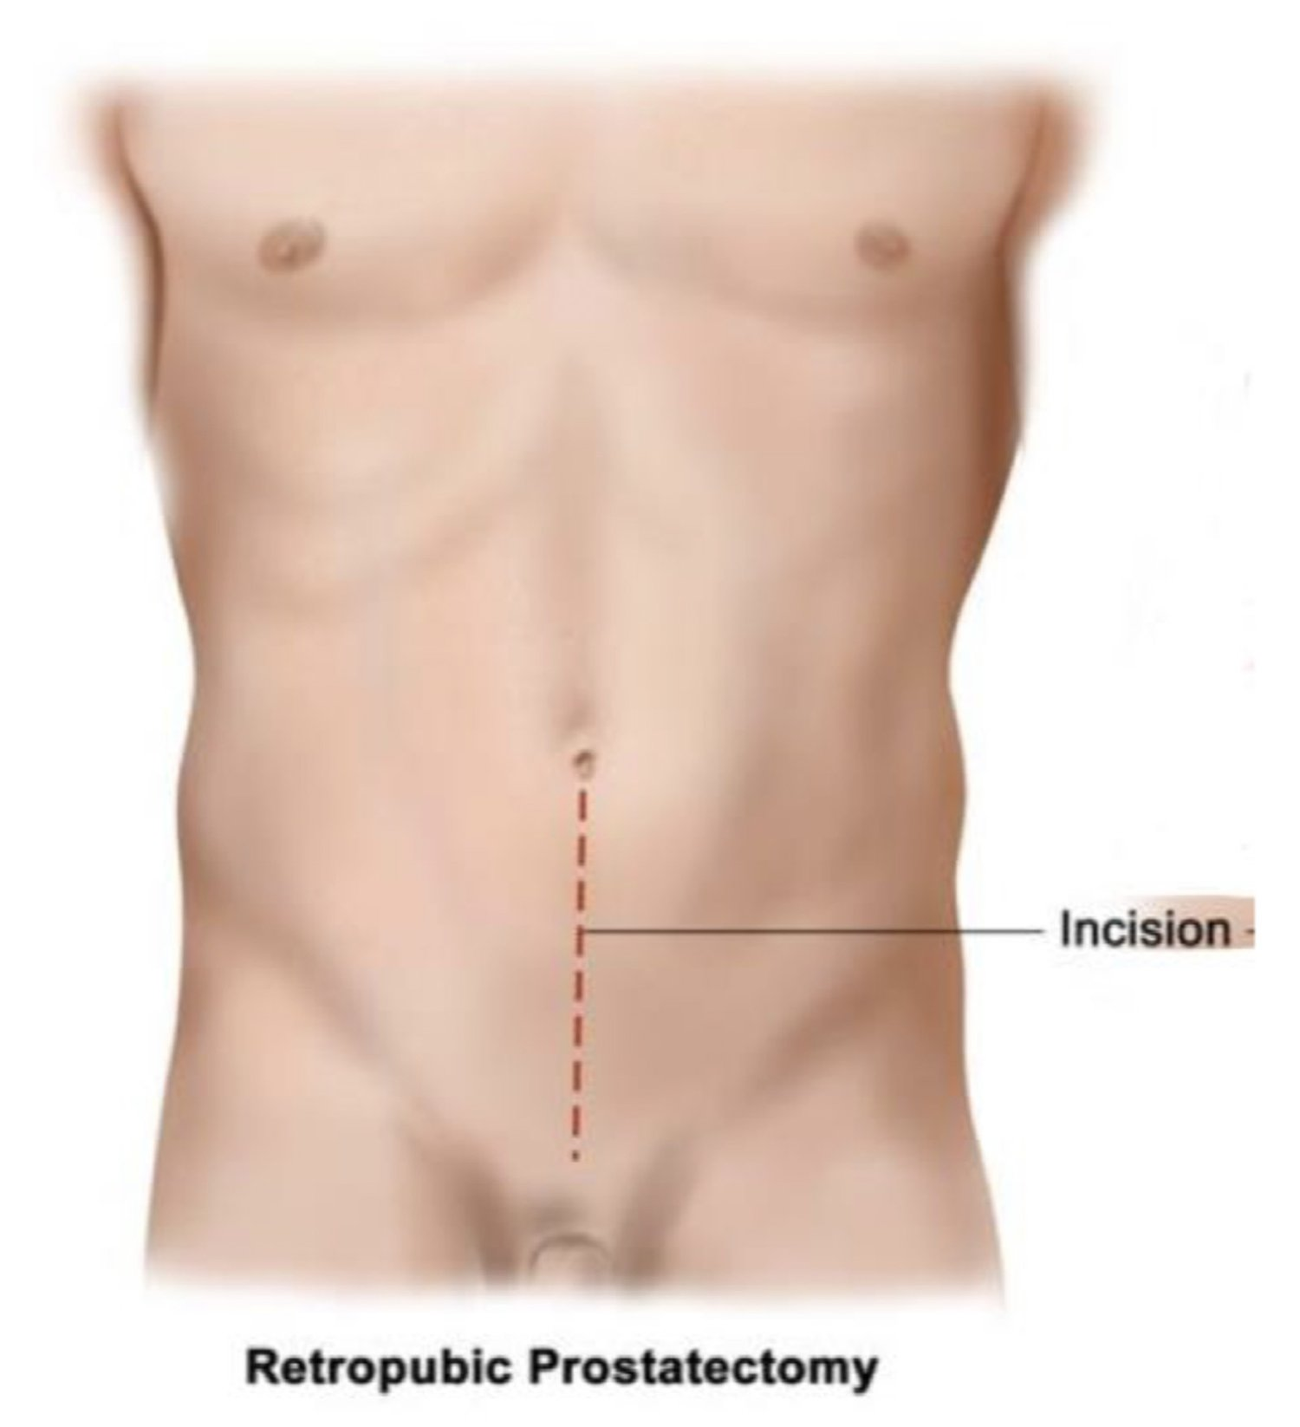
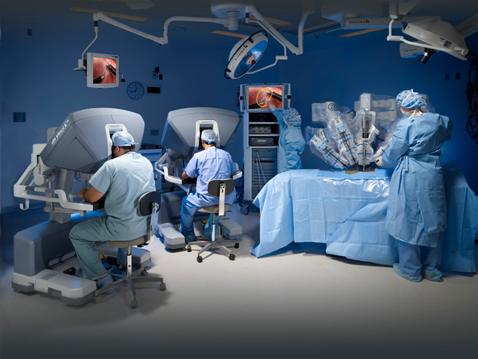
Prostate Cancer: Surgical Management
Prostatectomy
  Retropubic
  Laparoscopic
  Robotic-assisted

Slide 93
Prostate Cancer Management
Radiation therapy
  Brachytherapy or external beam
Hormonal therapy
  Decreases circulating testosterone or interrupts conversion of testosterone to DHT causing prostate epithelium to atrophy
Chemotherapy
  If cancer has spread to distant sites
Cryosurgery
  Probes inserted under US guidance and freezes tissue

Slide 94
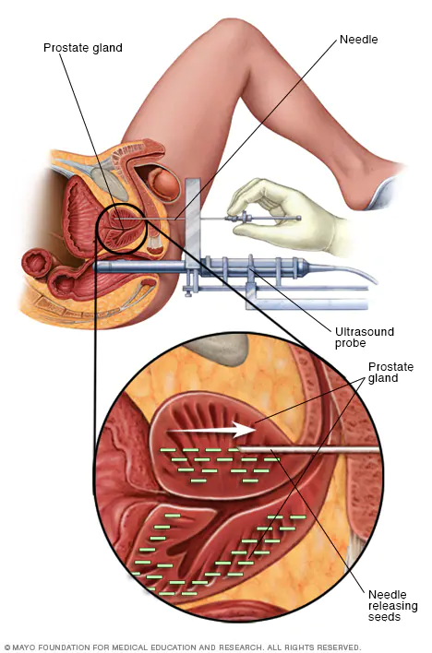
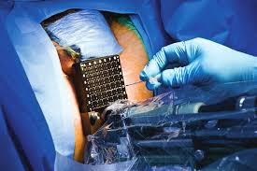
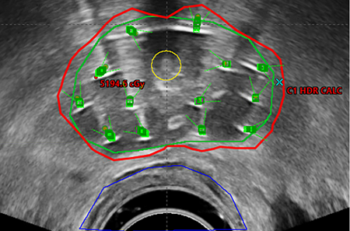
Brachytherapy for Prostate Cancer

Slide 95
Prostate Surgery:
Potential Complications
Hemorrhage and shock
  Highest priority for post-op clients
  Decreased cardiac output
Infection
DVT
Catheter obstruction
  Are you getting out what you’re putting in?
Sexual dysfunction

Slide 96
COMPLETED ANSWER • ORIGINAL SLIDE 91
CBI: are you getting out what goes in?
01
Calculate actual urine: total drainage minus irrigant infused for the same interval. Example: 3,000 mL drainage − 2,400 mL irrigation = 600 mL urine.
02
Less drainage than irrigation, suprapubic pain/distention or leakage can mean obstruction. Assess tubing and stop inflow if outflow is blocked; follow the ordered irrigation protocol and notify the team.
03
Persistent bright-red bleeding, large clots or unstable vital signs need urgent escalation. Increasing irrigation alone does not treat uncontrolled hemorrhage.
Added study notes • Original slides and graphics retained • Sources in speaker notes
Notes:
Added answer to original reproductive slide 91. Completed answer.
Calculate actual urine: total drainage minus irrigant infused for the same interval. Example: 3,000 mL drainage − 2,400 mL irrigation = 600 mL urine.
Less drainage than irrigation, suprapubic pain/distention or leakage can mean obstruction. Assess tubing and stop inflow if outflow is blocked; follow the ordered irrigation protocol and notify the team.
Persistent bright-red bleeding, large clots or unstable vital signs need urgent escalation. Increasing irrigation alone does not treat uncontrolled hemorrhage.
Source: user-supplied lecture deck. Supplemental references:

Slide 97
Prostate Surgery: Nursing Management
Maintain fluid balance
  Monitor urinary drainage and fluid amount used for irrigation, keep catheter patent
Pain relief
  Bladder spasms cause feelings of pressure and fullness, urgency to void, and bleeding from the urethra around the catheter
  Medication and warm compresses or sitz baths can relieve spasm
  Administer analgesics and antispasmodics (B&O) as needed
  Encourage client to walk but to avoid sitting for prolonged periods
  Prevent constipation
  Irrigate catheter as prescribed to relieve obstructions

Slide 98
Prostate Surgery: Client Education
Explanation of anatomy & function, diagnostic tests and surgery, and the surgical experience
Drainage devices
Regaining of bladder continence
  Gradual process (dribbling may continue for up to one year depending on type of surgery)
Perineal exercises
Avoid straining, heavy lifting, long car trips, strenuous exercise
  Increased risk of bleeding

Slide 99
Prostate Surgery: Client Education
Diet
  Encourage fluids and avoid coffee, alcohol, spicy foods which may cause bladder discomfort
Sexual issues
  Erectile dysfunction, decreased libido, fatigue
  Provide privacy and a confidential environment
  Always be mindful of issues that may be embarrassing or of cultural concern to the client
  Allow client to discuss concerns
  Assess and provide referrals as needed

Slide 100
Erectile Dysfunction (ED)
Impotence
  Inability to achieve or maintain an erection
More than 50% of men 40 to 70 years of age
Psychogenic causes: (functional)
Organic causes: (gradual reduction in function)

Slide 101
COMPLETED ANSWER • ORIGINAL SLIDE 95
Erectile dysfunction: complete the causes
01
Psychogenic: performance anxiety, stress, depression, relationship difficulties or other emotional distress; symptoms may vary by situation.
02
Organic: vascular disease/diabetes, neuropathy or spinal injury, pelvic surgery, low testosterone, certain medicines, tobacco or heavy alcohol use.
03
Mixed causes are common. Assess medical, medication and sexual history sensitively; do not assume a psychological cause without evaluating physical contributors.
Added study notes • Original slides and graphics retained • Sources in speaker notes
Notes:
Added answer to original reproductive slide 95. Completed answer.
Psychogenic: performance anxiety, stress, depression, relationship difficulties or other emotional distress; symptoms may vary by situation.
Organic: vascular disease/diabetes, neuropathy or spinal injury, pelvic surgery, low testosterone, certain medicines, tobacco or heavy alcohol use.
Mixed causes are common. Assess medical, medication and sexual history sensitively; do not assume a psychological cause without evaluating physical contributors.
Source: user-supplied lecture deck. Supplemental references:
NIDDK: Erectile dysfunction symptoms and causes
https://www.niddk.nih.gov/health-information/urologic-diseases/erectile-dysfunction/symptoms-causes

Slide 102
Erectile Dysfunction: Management
Pharmacologic therapy
  Prior to medication therapy, a cardiovascular work up is recommended
  Oral medications: sildenafil
    Adverse effects include headache, flushing, dyspepsia
    Take one hour before sexual intercourse
    Contraindicated with any nitroglycerin use for heart disease
Penile implants - semirigid rod vs. Inflatable
Negative pressure (vacuum) devices

Slide 103
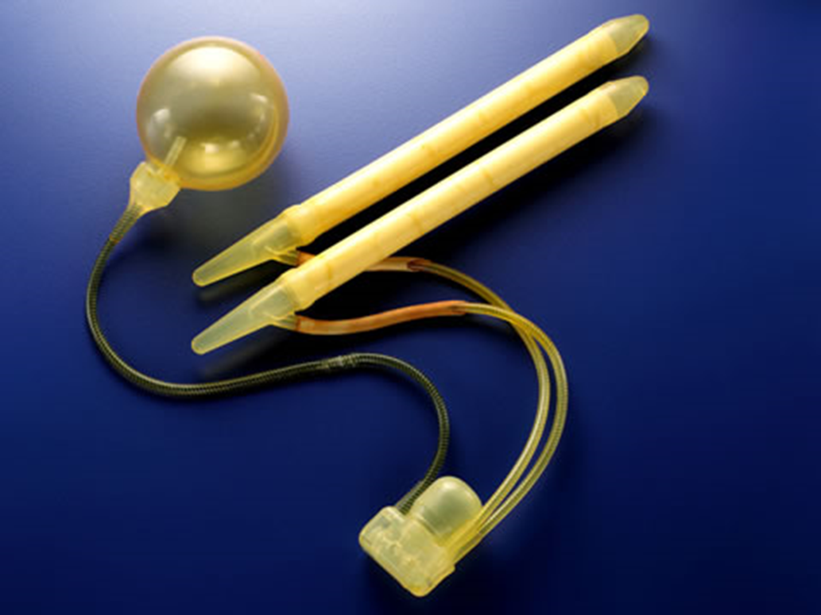
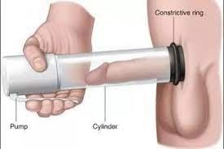
Penile Implant or Penile Vacuum

Slide 104
Prostatitis
Inflammation/infection of the prostate gland
  Often associated with UTI
Clinical Manifestations
  Fever, chills
  Urethral discharge
  Perineal discomfort/pain
  Urinary urgency, frequency, hesitancy, burning
  Boggy, tender prostate
  Elevated PSA, elevated WBC
Treated with oral antibiotics for 3-5 weeks

Slide 105
Prostatitis: Management
Antibiotic therapy
Alpha-adrenergic blockers (tamsulosin) to promote bladder and prostate relaxation
Comfort measures - analgesics, sitz baths
Client teaching- antibiotic therapy, s/s of recurrent prostatitis
Encourage fluids
Avoid indwelling catheters - suprapubic may be needed for severe urinary retention

Slide 106

Epididymitis
Infection of epididymis that spread from urethra, bladder, or prostate
Symptoms are tender and swollen area behind testicle
Confirmed with urinalysis and urethral culture
Treatment: oral antibiotic therapy
May take a month to fully recover

Slide 107

Testicular Cancer
Most common cancer in men ages 15 to 35
Highly treatable and curable
  95% cure rate (ATI, 2023)
Risk factors
  Undescended testicles
  Positive family history
  Personal history of testicular cancer
  Caucasian American race
  HIV-positive

Slide 108
Testicular Cancer
Manifestations
Painless lump or mass in the testes
Early diagnosis
Monthly testicular self-exam (TSE)
Perform after a bath or shower when the scrotum is relaxed
Inspect one testicle at a time
Feel for lumps, bumps, or change
Annual testicular exam
Treatment
Orchiectomy - removal of testis
Retroperitoneal lymph node dissection (open or lap)
Performed after orchiectomy to diagnose & prevent lymphatic spread
Chemotherapy
Radiation therapy - only to affected testicle

