Slide 1
Shock & MODS

Slide 2
Objectives
Describe the pathophysiology, clinical manifestations, and collaborative management of progressive stages of shock, sepsis, and multiple organ dysfunction syndrome. (CO 1, 2, 3, 4)
Examine medical and nursing management priorities in the treatment and prevention of sepsis and septic shock. (CO 1, 2, 3, 4)
Describe the role of nurses in providing psychosocial support to clients and their families experiencing shock, sepsis, and multiple organ dysfunction syndrome. (CO 1, 2, 3, 4)

Slide 3
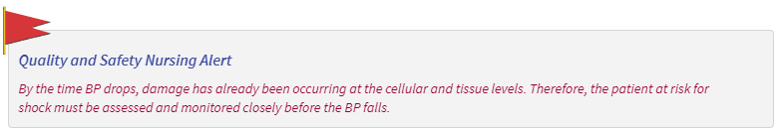
Hemodynamic shock
A condition in which tissue perfusion is inadequate to deliver oxygen and nutrients to support vital organs and cellular function and can lead to organ failure
Any condition that compromises oxygen delivery to organs and tissues can lead to shock
  Low blood pressure occurs in all forms of shock!
  Affects all body systems, resulting in potential organ failure
Rapidly-progressing and life-threatening process
Certain physiologic responses are common to all types of shock: hypoperfusion of tissues, hypermetabolism, and activation of the inflammatory response
Early detection of shock with rapid response is necessary to improve client outcomes
Treatment is based on the type and stage of the shock state

Slide 4
Types of shock (ATI, 2023)
Hypovolemic: A decrease in intravascular volume of at least 15% to 30%
Cardiogenic: failure of the heart to pump effectively due to a cardiac factor
Obstructive: Impairment of the heart to pump effectively as a result of a noncardiac factor
Distributive: Widespread vasodilation and increased capillary permeability, including neurogenic, septic, and anaphylactic shock

Slide 5
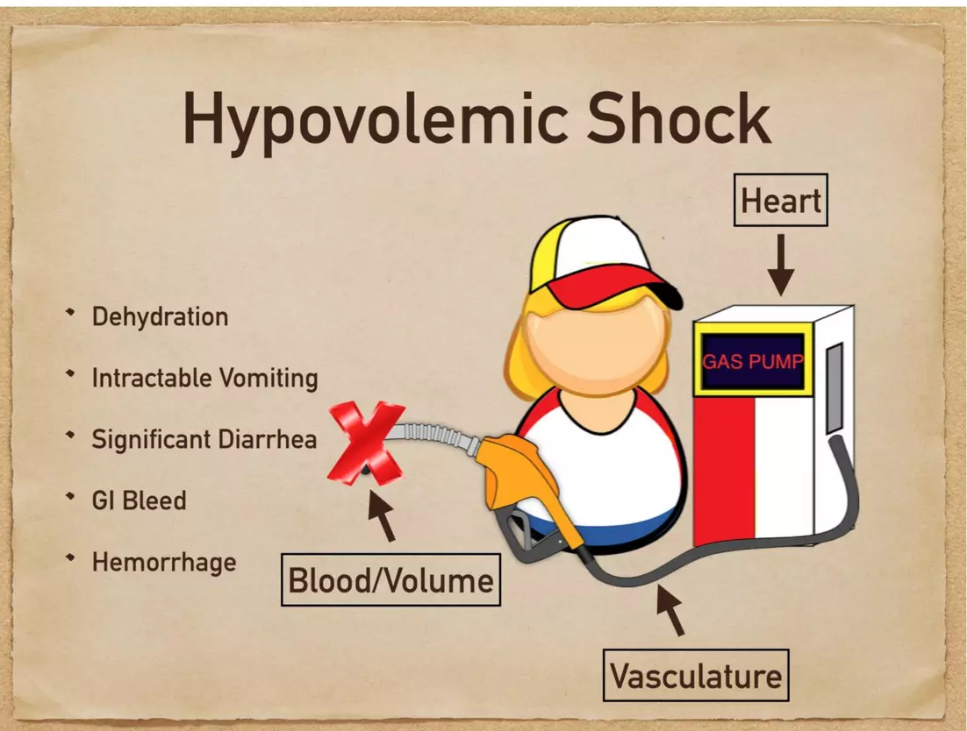
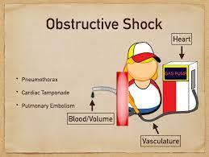
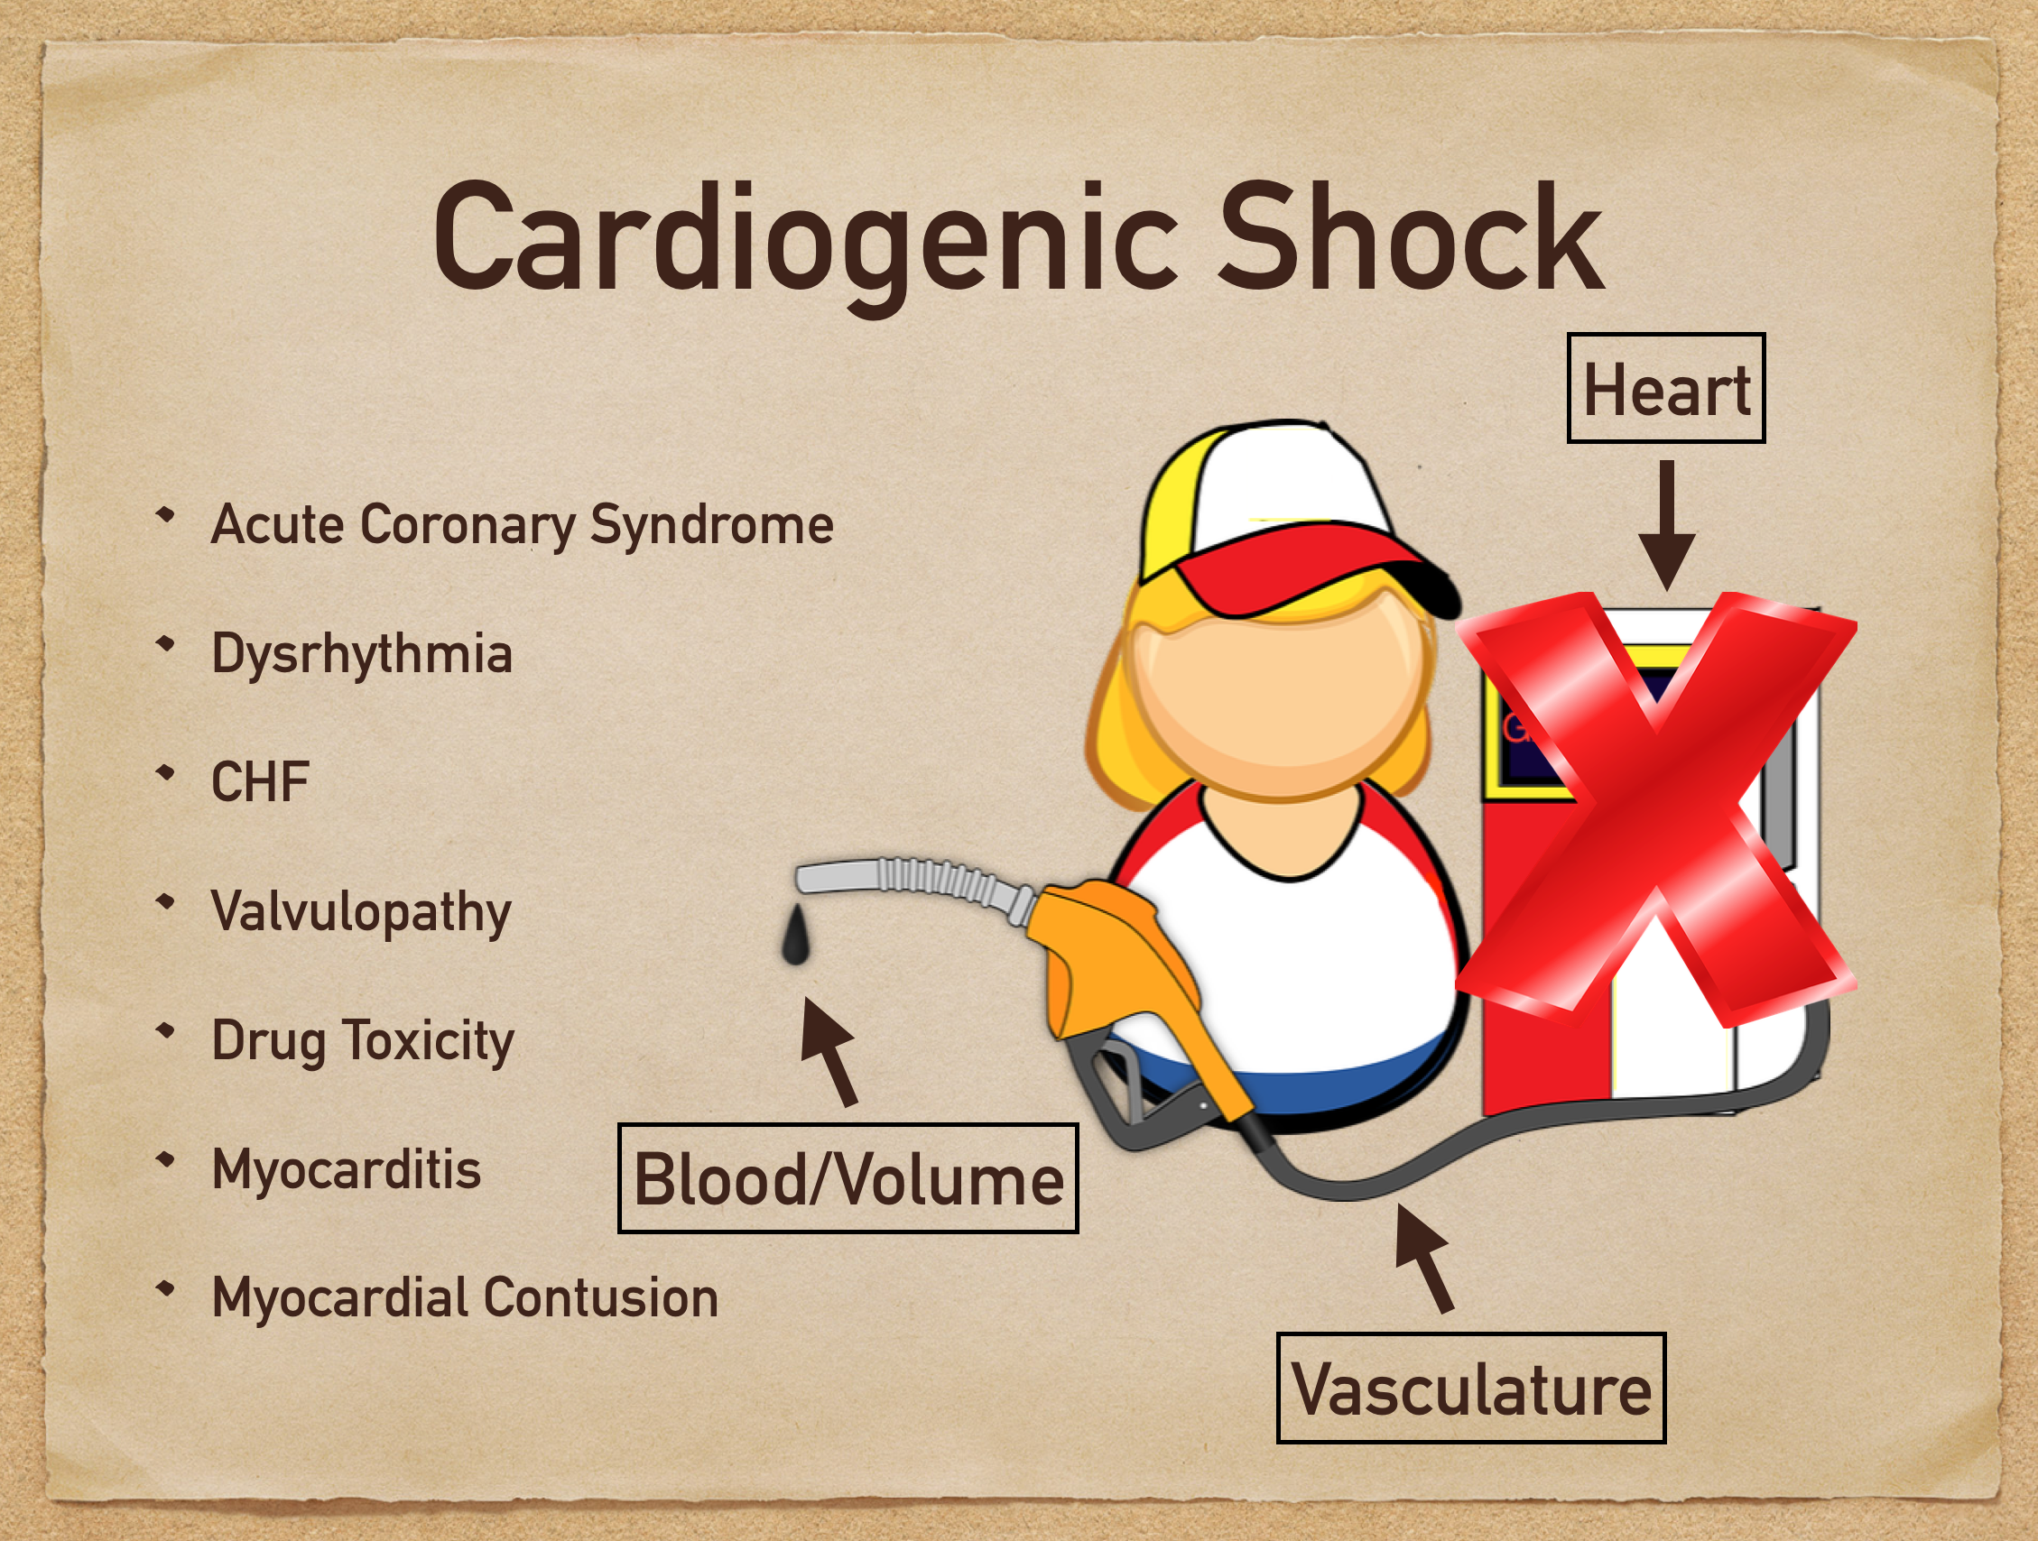
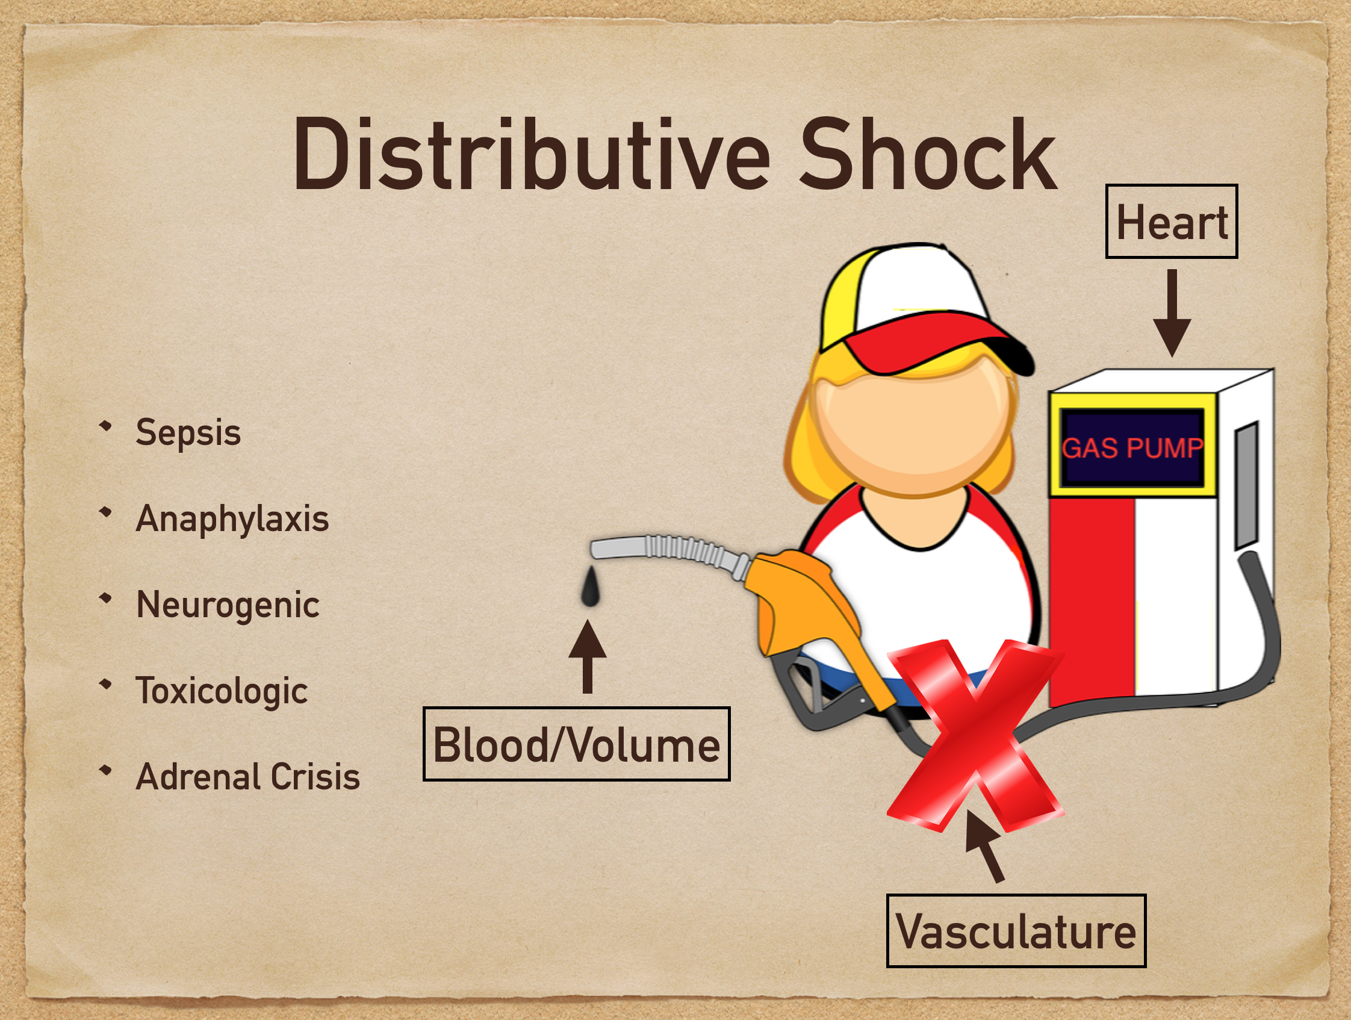

Slide 6
Stages of shock (ATI, 2023)
All types of shock progress through the same stages of shock and produce similar effects on body systems
Initial: no visible changes in client parameters; only changes on cellular level
  MAP decreases 5 to 10 mm Hg from baseline; mild vasoconstriction; HR increases
Compensatory (non-progressive): Measures that increase CO to restore tissue perfusion and oxygenation
  Vasoconstriction increases; HR increases; MAP decreases 10 to 15 mm Hg from baseline; mild acidosis and hyperkalemia
Progressive: Compensatory mechanisms start to fail to maintain CO and BP
  MAP decreases >20 mm Hg from baseline; vital organs experience hypoxia; moderate acidosis and hyperkalemia
Refractory (irreversible): Irreversible shock and total body failure
  Severe tissue hypoxia; MODS; possibly death

Slide 7
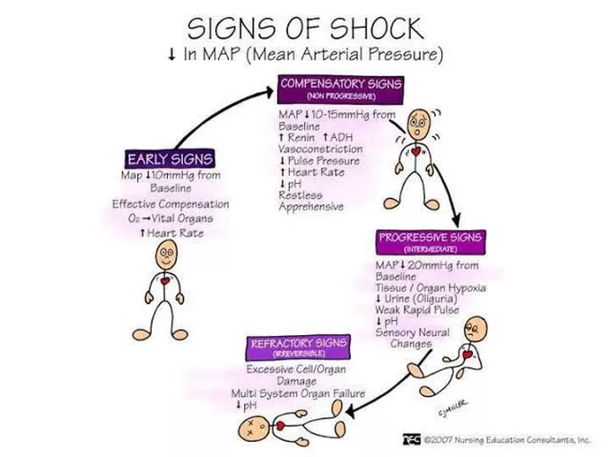
EVOLVING STAGES OF SHOCK OCCUR FROM INABILITY TO MAINTAIN BLOOD PRESSURE RESULTING IN ORGAN FAILURE

Slide 8
Compensatory Stage of Shock
Sympathetic NS causes vasoconstriction, increased HR, and increased contractility
This attempts to maintain blood pressure and CO
Body shunts blood away from skin, kidneys, and GI tract
  Results in cool, clammy skin, hypoactive BS, and decreased UO
Perfusion of tissues has become inadequate
Acidosis occurs because of anaerobic metabolism (lactic acid formation)
Respiratory rate increases due to acids circulating in the bloodstream
Confusion may occur from evolving acidosis

Slide 9
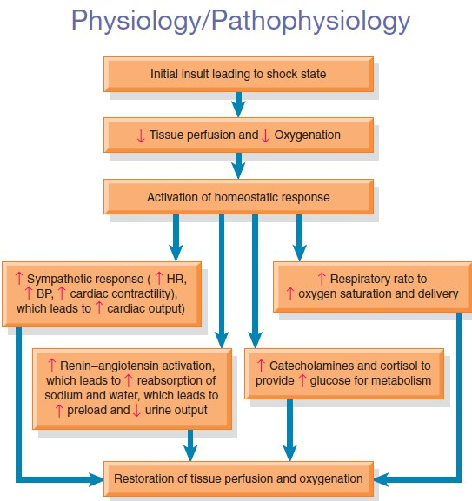
Compensatory Mechanisms in Shock
1) Activation of Sympathetic NS
2) Activation of RAAS
3) Release of cortisol
* * It's all about mechanisms trying to maintain blood pressure to vital organs**

Slide 10
Progressive Stage of Shock
Mechanisms that regulate BP can no longer compensate, and BP and MAP decrease
All organs suffer from hypoperfusion (including heart, lung, and brain)
Vasoconstriction of arterioles continues, further compromising cellular perfusion to organs
Mental status further deteriorates because of decreased cerebral perfusion and hypoxia

Slide 11
Progressive Stage of Shock
Lungs begin to fail:
  Hypoxemia develops, CO2 increases, alveoli collapse, pulmonary edema can occur
Inadequate perfusion of the heart leads to dysrhythmias and ischemia
GFR cannot be maintained, and acute renal failure may occur when MAP falls below 65 mmHg- metabolic acidosis develops
Liver function, GI function, and hematologic function are all affected by low blood pressures
DIC (disseminated intravascular coagulation) may occur as a complication of shock
  Widespread clotting and bleeding occur
  Bruises and bleeding appear on skin and mucous membranes
  Coagulation times are increased from consumption of clotting factors (PTT, PT, and INR)
  Clotting factors & platelets are consumed and may require replacement (lower clotting factors such as fibrinogen, platelets)

Slide 12
Irreversible Stage of Shock
At this point, organ damage is so severe that the client does not respond to treatment and cannot survive
BP is critically low since RAAS and SNS can't maintain proper levels
Renal and liver functions fail (increased creatinine and LFTs)
Anaerobic metabolism results in metabolic acidosis (low pH) and increased serum lactate levels
Multiple organ dysfunction progresses to complete organ failure
The judgment that shock is irreversible is made only in retrospect

Slide 13
For All Types of Shock
Early identification of shock state and timely treatment are critical
Identify and treat the underlying cause of shock (Bleeding? Anaphylaxis? Sepsis?)
The sequence of events/treatments for the different types of shock will vary depending on type of shock
Therefore, the management and care of the client will vary based on the type of shock occurring

Slide 14
Nursing care for all types of shock
Monitor the following:
  Oxygenation status- PRIORITY!
  VS
  Continuous ECG monitoring
  Hourly urine output
  LOC (level of consciousness depends on BP)
  Skin color, temp, moisture, cap refill, turgor
Place the client on high-flow oxygen such as 15 L nonrebreather mask (if the client has COPD use 2 L NC)
Be prepared to intubate
Maintain patent IV access
For hypotension, place the client flat with both legs elevated (modified Trendelenburg)
Prepare for and perform hemodynamic monitoring
  CVP, arterial line and/or pulmonary artery catheter, CO

Slide 15
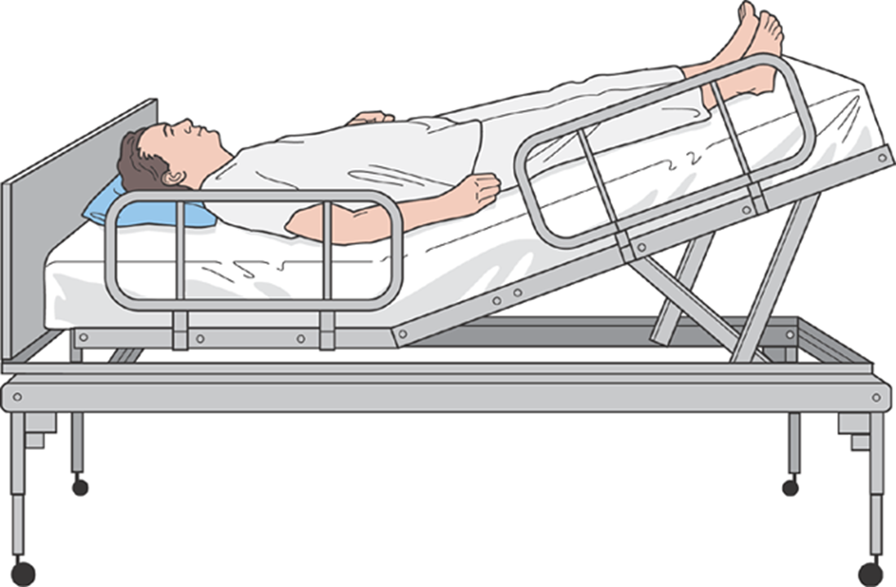
Modified Trendelenburg (passive leg raising [plr])
How does this position help with shock or low blood pressure conditions?

Slide 16
COMPLETED ANSWER • ORIGINAL SLIDE 15
Why passive leg raising helps
01
Temporary preload test: raising the legs shifts venous blood toward the heart. A measurable rise in stroke volume or cardiac output suggests fluid responsiveness.
02
Reassess promptly: use a real-time flow measurement when available. Blood pressure alone is less reliable; responsiveness does not automatically mean fluid is needed.
03
Nursing role: follow the ordered technique and consider injuries or positioning restrictions. This is a reversible assessment, not definitive treatment for shock.
Added study notes • Original slides and graphics retained • Sources in speaker notes
Notes:
Added answer to original shock slide 15. Completed answer.
Temporary preload test: raising the legs shifts venous blood toward the heart. A measurable rise in stroke volume or cardiac output suggests fluid responsiveness.
Reassess promptly: use a real-time flow measurement when available. Blood pressure alone is less reliable; responsiveness does not automatically mean fluid is needed.
Nursing role: follow the ordered technique and consider injuries or positioning restrictions. This is a reversible assessment, not definitive treatment for shock.
Source: user-supplied lecture deck. Supplemental references:
SCCM: Surviving Sepsis Campaign adult guidelines
https://sccm.org/survivingsepsiscampaign/guidelines-and-resources/surviving-sepsis-campaign-adult-guidelines

Slide 17
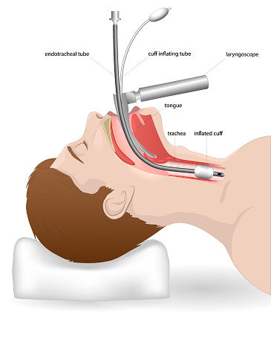
Intubation and mechanical ventilation
Pre-intubation nursing actions
  Monitor ECG, SaO2, breath sounds, and skin color
  Preoxygenate with 100% oxygen
  Assist with ventilation with manual resuscitation bag and mask
  Suction as needed
  Sedation and paralysis will be usually required (Ex: propofol and succinylcholine)
Postintubation nursing actions
  Assess bilateral breath sounds, symmetrical chest movement
  End-tidal CO2 monitoring and O2 saturation
  CXR to confirm placement of tube in trachea
  Secure ETT to avoid dislodgment
  Post procedural sedation and analgesia needed (never allow paralysis alone)
  Monitor all ventilator alarms (low pressure and high pressure)

Slide 18
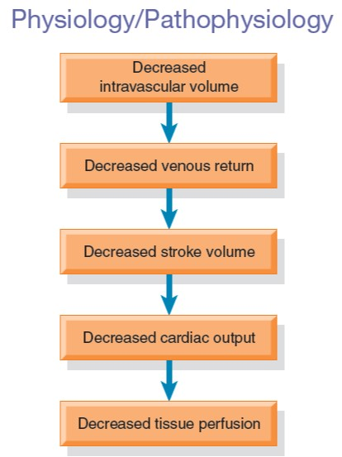
Hypovolemic Shock (fluid/blood loss)
Most common type
Decreased intravascular volume
Decreased CVP
15-30% reduction in volume
  750 to 1500 mL of blood (in 70kg person)
Excessive fluid loss from burns, diuresis, vomiting or diarrhea, or blood loss secondary to surgery, trauma, gynecologic/obstetric causes
Remember the symptoms and signs! (BP, HR, RR, skin color, urine output?)

Slide 19
COMPLETED ANSWER • ORIGINAL SLIDE 17
Expected findings in hypovolemic shock
01
BP and heart rate: falling pressure or a narrowing pulse pressure with tachycardia; compensation can initially maintain BP.
02
Breathing and skin: tachypnea, cool pale clammy skin, weak pulses and delayed capillary refill.
03
Perfusion: decreasing urine output, thirst, anxiety, dizziness or altered mental status. Trend findings together rather than waiting for profound hypotension.
Added study notes • Original slides and graphics retained • Sources in speaker notes
Notes:
Added answer to original shock slide 17. Completed answer.
BP and heart rate: falling pressure or a narrowing pulse pressure with tachycardia; compensation can initially maintain BP.
Breathing and skin: tachypnea, cool pale clammy skin, weak pulses and delayed capillary refill.
Perfusion: decreasing urine output, thirst, anxiety, dizziness or altered mental status. Trend findings together rather than waiting for profound hypotension.
Source: user-supplied lecture deck. Supplemental references:
Resuscitation Council UK: ABCDE approach
https://www.resus.org.uk/library/abcde-approach

Slide 20
Hypovolemic Shock management
Treat the underlying condition resulting in fluid loss!
  Restore the fluids and stop the fluid loss concurrently
Fluid and/or blood replacement- isotonic crystalloids and/or colloids, blood products
Medications
  Fill the tank first! (rehydrate with IV fluids and blood products if bleeding)
  Replace fluid volume before using vasopressors/medications
  Vasoactive meds result in constricting arterioles, helping to maintain systemic BP
  Meds given to reverse the underlying cause
Nursing Management
  Oxygen
  Administration of blood and fluids

Slide 21
Diagnostic procedures
H&H
  Decreased with hemorrhage
  Increased with dehydration (hemoconcentration from fluid loss but not loss of RBCs)
Investigate possible sources of bleeding
  Blood in NG drainage or stools (melena? bright-red rectal blood? hematemesis?)
  EGD and colonoscopy
  CT scan of the abdomen
  Trauma: bleeding can occur in chest, abdomen, pelvis, or thighs r/t femur fracture to cause hypotension

Slide 22
Case Study: highlight priority findings
Mr. Lopez was involved in a motor vehicle crash and suffered blunt trauma to his abdomen. Upon presentation to the emergency department, his vital signs are temperature, 100.9°F; heart rate, 120 bpm; respiratory rate, 20 breaths/min; and blood pressure, 90/54 mm Hg. His abdomen is firm, with bruising around the umbilicus. He is alert and oriented but complains of dizziness when changing positions. The patient is admitted for management of suspected hypovolemic shock.

Slide 23
COMPLETED ANSWER • ORIGINAL SLIDE 20
Mr. Lopez: priority findings
01
Suspect internal hemorrhage: blunt abdominal trauma, a firm abdomen and periumbilical bruising suggest abdominal injury and concealed blood loss.
02
Perfusion is threatened: BP 90/54, pulse 120/min and positional dizziness are concerning even though he is oriented.
03
Act: activate the trauma response; reassess airway, breathing, circulation and bleeding. Keep him supine as tolerated, monitor closely, establish large-bore IV access and prepare blood and urgent source control.
Added study notes • Original slides and graphics retained • Sources in speaker notes
Notes:
Added answer to original shock slide 20. Completed answer.
Suspect internal hemorrhage: blunt abdominal trauma, a firm abdomen and periumbilical bruising suggest abdominal injury and concealed blood loss.
Perfusion is threatened: BP 90/54, pulse 120/min and positional dizziness are concerning even though he is oriented.
Act: activate the trauma response; reassess airway, breathing, circulation and bleeding. Keep him supine as tolerated, monitor closely, establish large-bore IV access and prepare blood and urgent source control.
Source: user-supplied lecture deck. Supplemental references:
NICE: Major trauma assessment and initial management
https://www.nice.org.uk/guidance/ng39/chapter/Recommendations

Slide 24
State the rationale for each of the following prescriptions.
• Infuse 0.9% NS at 125 mL/hr
• Obtain complete blood count, serum electrolytes
• Oxygen at 2 L/min via nasal cannula
• Transfuse 4 units of blood
• X-ray of the abdomen STAT

Slide 25
COMPLETED ANSWER • ORIGINAL SLIDE 21
Mr. Lopez: why these orders?
01
NS and blood: crystalloid supports circulating volume; transfusion restores oxygen-carrying capacity and replaces hemorrhagic losses. Verify compatibility and monitor for reactions.
02
CBC/electrolytes: assess anemia, platelets and electrolyte changes; an initial hemoglobin may not show the full acute loss. Oxygen supports delivery while perfusion is restored.
03
Imaging: investigate the injury. SIDE NOTE: NS at 125 mL/hour and oxygen at 2 L/min may be inadequate for unstable hemorrhage. Escalate; FAST, CT when stable, or immediate intervention may be needed rather than relying on a plain abdominal X-ray.
Added study notes • Original slides and graphics retained • Sources in speaker notes
Notes:
Added answer to original shock slide 21. Completed answer.
NS and blood: crystalloid supports circulating volume; transfusion restores oxygen-carrying capacity and replaces hemorrhagic losses. Verify compatibility and monitor for reactions.
CBC/electrolytes: assess anemia, platelets and electrolyte changes; an initial hemoglobin may not show the full acute loss. Oxygen supports delivery while perfusion is restored.
Imaging: investigate the injury. SIDE NOTE: NS at 125 mL/hour and oxygen at 2 L/min may be inadequate for unstable hemorrhage. Escalate; FAST, CT when stable, or immediate intervention may be needed rather than relying on a plain abdominal X-ray.
Source: user-supplied lecture deck. Supplemental references:
NICE: Major trauma assessment and initial management
https://www.nice.org.uk/guidance/ng39/chapter/Recommendations

Slide 26
Question 1
What are the primary goals of medical management for this client?

Slide 27
COMPLETED ANSWER • ORIGINAL SLIDE 22
Goals for hypovolemic shock
01
Stop the loss: locate and control bleeding or the cause of fluid loss.
02
Restore circulation and oxygen delivery: improve mentation, pulses, BP trend, capillary refill and urine output while avoiding hypothermia.
03
Prevent organ injury: reassess response frequently; follow lactate, hemoglobin, electrolytes and coagulation studies as ordered. Escalate persistent hypoperfusion.
Added study notes • Original slides and graphics retained • Sources in speaker notes
Notes:
Added answer to original shock slide 22. Completed answer.
Stop the loss: locate and control bleeding or the cause of fluid loss.
Restore circulation and oxygen delivery: improve mentation, pulses, BP trend, capillary refill and urine output while avoiding hypothermia.
Prevent organ injury: reassess response frequently; follow lactate, hemoglobin, electrolytes and coagulation studies as ordered. Escalate persistent hypoperfusion.
Source: user-supplied lecture deck. Supplemental references:
NICE: Major trauma assessment and initial management
https://www.nice.org.uk/guidance/ng39/chapter/Recommendations

Slide 28
Cardiogenic Shock (Pump failure)
The heart's ability to contract and to pump blood is impaired due to a direct cardiac cause (the pump is failing!)
  MI, heart failure, cardiomyopathy, dysrhythmias, and valvular rupture/stenosis
70% mortality rate- highest mortality of all types of shock since not easily reversible
Difficult to treat
  Client cannot tolerate a fluid bolus to raise blood pressure
  Results in lack of forward flow of blood (CO) and back-flow of blood into lungs
  Inotropes (dopamine, dobutamine) can be used to stimulate HR and contractility
  Vasopressors (norepinephrine) can be used to raise BP by increasing vascular resistance
  Oxygen, morphine
  Nitroglycerin (works in conjunction with dobutamine and dopamine)

Slide 29
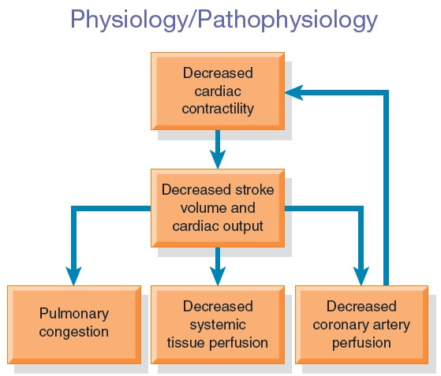
Cardiogenic Shock

Slide 30
Labs and diagnostics for cardiogenic shock
Cardiac enzymes: Why?
BNP- brain natriuretic peptide (protein made by heart and blood vessels): Why?
12-lead ECG: Why?
Hemodynamic monitoring/cardiac monitor
  Arterial line, pulmonary artery catheter
Echocardiogram- transthoracic echocardiography (TEE) may be done at bedside
Cardiac catheterization: Why?
IABP maintenance
  Nurse makes ongoing timing adjustments of the balloon pump to maximize effectiveness by synchronizing it with the cardiac cycle
  Leg on the side where catheter for balloon is inserted is at risk for circulatory compromise- assess neurovascular status of LEs frequently

Slide 31
COMPLETED ANSWER • ORIGINAL SLIDE 25
Why these cardiogenic-shock tests?
01
Troponin/cardiac enzymes: identify myocardial injury. BNP reflects ventricular stretch and supports evaluation of heart failure; neither result stands alone.
02
12-lead ECG: detect ischemia/infarction or a dysrhythmia that may impair pumping. Echocardiography assesses ventricular function, valves and mechanical complications.
03
Cardiac catheterization: define coronary obstruction and permit revascularization when indicated. SIDE NOTE: transthoracic echo is TTE; transesophageal echo is TEE. The source slide mixes these abbreviations.
Added study notes • Original slides and graphics retained • Sources in speaker notes
Notes:
Added answer to original shock slide 25. Completed answer.
Troponin/cardiac enzymes: identify myocardial injury. BNP reflects ventricular stretch and supports evaluation of heart failure; neither result stands alone.
12-lead ECG: detect ischemia/infarction or a dysrhythmia that may impair pumping. Echocardiography assesses ventricular function, valves and mechanical complications.
Cardiac catheterization: define coronary obstruction and permit revascularization when indicated. SIDE NOTE: transthoracic echo is TTE; transesophageal echo is TEE. The source slide mixes these abbreviations.
Source: user-supplied lecture deck. Supplemental references:

Slide 32
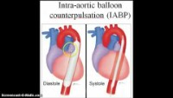
IABP

Slide 33
Cardiogenic Shock Medications
Inotropic agents (milrinone, dobutamine)
  Strengthens cardiac contraction and increases CO while decreasing afterload
  Given IV, constant hemodynamic monitoring, titrate to prescribed parameters, often combined with a vasopressor
  Can result in dysrhythmias and rapid heart rates which may need lowering/stopping of medication
  Phentolamine is reversal agent if extravasates into tissue
Vasopressors (dopamine, norepinephrine, epinephrine)
  Increases vascular resistance by constricting arterioles thereby helping increase BP
  Raises BP by vasoconstricting which helps in keeping the blood on the arterial side
  Increases kidney perfusion at low doses; decreases kidney perfusion at high doses
  Given IV, constant hemodynamic monitoring, titrate to prescribed parameters, monitor UOP, administer through a central line to prevent extravasation
  Phentolamine is reversal agent if vasopressor extravasates into tissue
Vasodilators (nitroglycerin)
  Low doses- venous vasodilator and reduces preload
  Higher doses- arterial vasodilation and reduces afterload, increases CO (in combination with dobutamine), minimizes cardiac workload, enhances blood flow to myocardium

Slide 34
CLINICAL SIDE NOTE • ORIGINAL SLIDE 27
Side note: dopamine and kidney protection
01
The original medication slide is retained. Low-dose dopamine is not recommended to prevent or treat acute kidney injury.
02
Manage perfusion and the cause of shock; monitor urine output and renal function. Vasopressors are selected and titrated to the clinical plan, not prescribed as “renal protection.”
03
Phentolamine is used for certain vasopressor extravasation events under protocol; report pain, pallor or swelling around an infusion immediately.
Added study notes • Original slides and graphics retained • Sources in speaker notes
Notes:
Added answer to original shock slide 27. Clinical side note.
The original medication slide is retained. Low-dose dopamine is not recommended to prevent or treat acute kidney injury.
Manage perfusion and the cause of shock; monitor urine output and renal function. Vasopressors are selected and titrated to the clinical plan, not prescribed as “renal protection.”
Phentolamine is used for certain vasopressor extravasation events under protocol; report pain, pallor or swelling around an infusion immediately.
Source: user-supplied lecture deck. Supplemental references:
ESICM: prevention of acute kidney injury
https://pmc.ncbi.nlm.nih.gov/articles/PMC5487598/

Slide 35
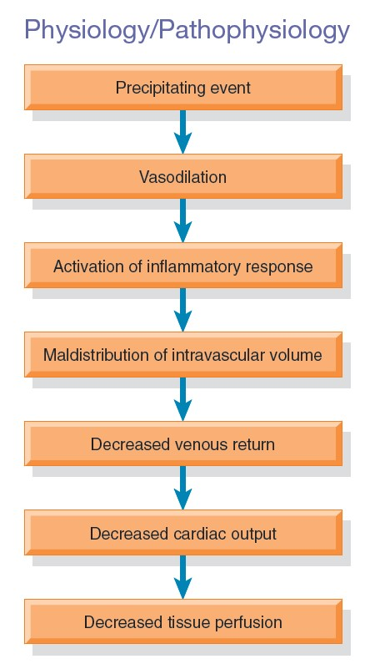
Distributive Shock (leaky blood vessels)
Intravascular fluid leaks out of peripheral vessels
Not enough blood returns to the heart
Leads to inadequate tissue perfusion from loss of fluid into interstitial space
Three types:
  Septic shock: circulating bacteria cause inflammation/vasodilation, causing leaky blood vessels (low BP)
  Neurogenic shock: lack of sympathetic NS causes vasodilation, and bradycardia (low BP)
  Anaphylactic shock: allergen causes inflammation, vasodilation, and leaky blood vessels (low BP)

Slide 36
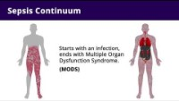
Sepsis and septic shock

Slide 37
Systemic Inflammatory Response Syndrome (SIRS)
Results from a clinical insult that initiates a systemic inflammatory response
Clients with SIRS may be exhibiting protective inflammatory response to the initial insult or exhibiting a response to infection, which may lead to sepsis
Monitor common causes:
  Multiple trauma
  Infection (sepsis)
Criteria
Only need 2/4
Temp >38.3°C (101°F) or <36°C (96.8°F)
Tachycardia >90
Tachypnea >20
WBC > 12,000 cells/mm³ or < 4000 cells/mm³ or >10% bands or 10% of immature bands
Can you make yourself have SIRS right now?
It's an indication that "something" is occurring but not specific yet- more monitoring and testing needed
Monitoring may help "declare" the cause of the SIRS (sepsis? pneumonia? appendicitis?)

Slide 38
COMPLETED ANSWER • ORIGINAL SLIDE 30
Can exercise “give you SIRS”?
01
Teaching point: exercise can briefly raise heart rate and respiratory rate enough to meet two old SIRS thresholds.
02
Interpretation: these numbers are nonspecific. Exercise is not the same as pathologic systemic inflammation, and SIRS alone does not establish infection or sepsis.
03
Sepsis assessment: evaluate suspected infection with organ dysfunction and the whole clinical picture; normal temperature does not rule out serious infection.
Added study notes • Original slides and graphics retained • Sources in speaker notes
Notes:
Added answer to original shock slide 30. Completed answer.
Teaching point: exercise can briefly raise heart rate and respiratory rate enough to meet two old SIRS thresholds.
Interpretation: these numbers are nonspecific. Exercise is not the same as pathologic systemic inflammation, and SIRS alone does not establish infection or sepsis.
Sepsis assessment: evaluate suspected infection with organ dysfunction and the whole clinical picture; normal temperature does not rule out serious infection.
Source: user-supplied lecture deck. Supplemental references:
Sepsis-3 consensus definitions
https://www.bumc.bu.edu/emergencymedicine/files/2016/04/Singer-et-al.-Third-Intnl-Consensus-Definition-Sepsis-Septic-Shock.-JAMA-2016.pdf

Slide 39
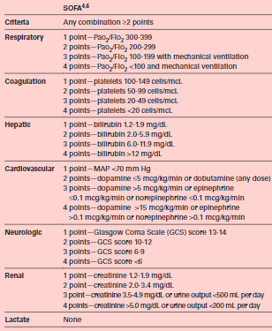
THE SEQUENTIAL ORGAN FAILURE ASSESSMENT (SOFA)
Identifies clients at higher risk for mortality from their suspected infection
Measure of organ dysfunction
  If score decreases by 2 or more from baseline, this is suggestive of organ dysfunction
This is a tool that is part of a hospital toolkit for sepsis surveillance
Notes:
Reference/image: Seckel, Maureen, MSN, RN, APRN, ACNS-BC, CCNS, CCRN & FCCM, FCNS. (2020). Current sepsis research: What nurses need to know. Nursing Critical Care, 15, 6-13. https://doi.org/10.1097/01.CCN.0000654796.79252.dc

Slide 40
CLINICAL SIDE NOTE • ORIGINAL SLIDE 31
Side note: direction of the SOFA score
01
Correction: an acute INCREASE of 2 or more SOFA points from baseline supports organ dysfunction associated with suspected infection.
02
The source says “decreases.” That direction is reversed: a lower score generally reflects less organ dysfunction.
03
Sepsis does not require positive blood cultures or organisms circulating in the bloodstream; infection may begin at a localized site.
Added study notes • Original slides and graphics retained • Sources in speaker notes
Notes:
Added answer to original shock slide 31. Clinical side note.
Correction: an acute INCREASE of 2 or more SOFA points from baseline supports organ dysfunction associated with suspected infection.
The source says “decreases.” That direction is reversed: a lower score generally reflects less organ dysfunction.
Sepsis does not require positive blood cultures or organisms circulating in the bloodstream; infection may begin at a localized site.
Source: user-supplied lecture deck. Supplemental references:
Sepsis-3 consensus definitions
https://www.bumc.bu.edu/emergencymedicine/files/2016/04/Singer-et-al.-Third-Intnl-Consensus-Definition-Sepsis-Septic-Shock.-JAMA-2016.pdf

Slide 41
Septic Shock
Most common type of distributive shock
Widespread infection (usually bacterial) that has entered the bloodstream
Endotoxins and other mediators causing massive vasodilation and inflammation
The deadliest type is gram-negative bacteria (UTI? Pneumonia? Cholecystitis?)
40% mortality rate
One of the most common causes of death in ICUs
Continues to rise, so important to notice SIRS criteria initially

Slide 42
Septic Shock risk factors
Immunosuppression (disease state or from chemotherapy)
Age extremes
Malnourishment
Chronic illness
Invasive procedures
Lack of immunizations
Emergent and/or multiple surgeries
Serious illness that causes bacteria to enter the blood (pyelonephritis, pneumonia, etc.)
** Anything that allows bacteria to enter the bloodstream may result in sepsis**

Slide 43
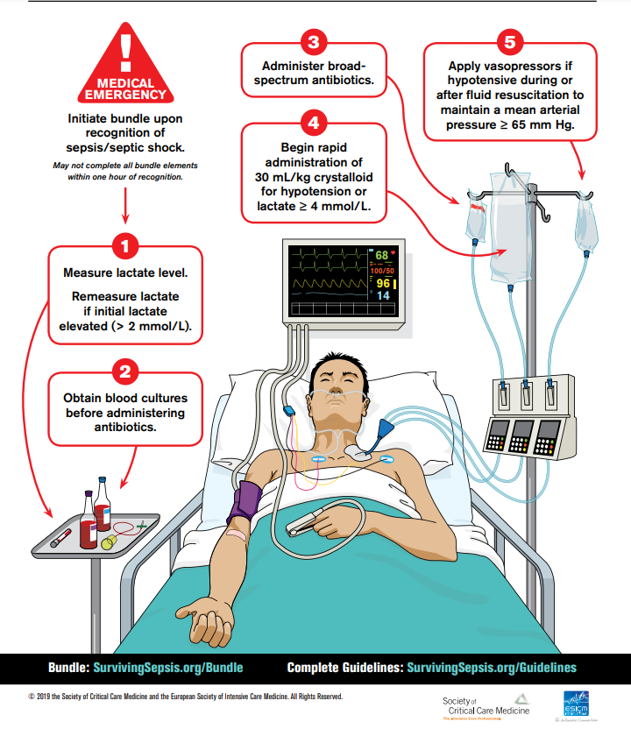
Hour-1 Sepsis Bundle, 2021 Sepsis guidelines (AACN, 2021)
Measure lactate and remeasure if initial lactate is > 2 mmol/L
Obtain blood cultures before administering antibiotics
Administer broad-spectrum antibiotics
Begin rapid administration of crystalloid (LR is recommended) for hypotension or lactate ≥ 4mmol/L
Start vasopressors if hypotensive during or after fluid resuscitation to maintain MAP ≥ 65 mmHg

Slide 44
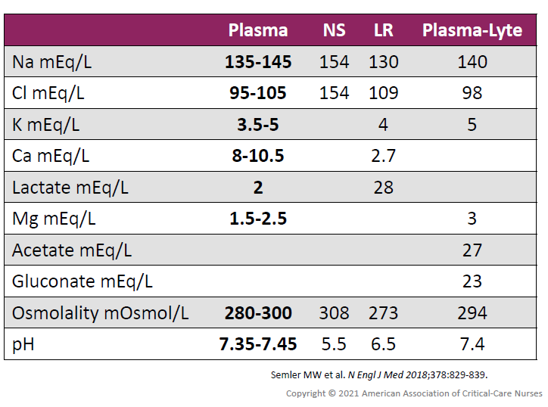
Why LR is recommended over NS (both are used)

Slide 45
COMPLETED ANSWER • ORIGINAL SLIDE 35
Why choose lactated Ringer’s?
01
LR is a balanced crystalloid: its electrolyte composition and buffer reduce the chloride load compared with 0.9% saline.
02
Large saline volumes can contribute to hyperchloremic metabolic acidosis. Balanced solutions are suggested for many adults with sepsis; the choice remains individualized.
03
Reassess after fluid: watch perfusion, oxygenation, lung sounds and fluid balance. Heart/kidney disease or brain injury may change the plan; more fluid is not always better.
Added study notes • Original slides and graphics retained • Sources in speaker notes
Notes:
Added answer to original shock slide 35. Completed answer.
LR is a balanced crystalloid: its electrolyte composition and buffer reduce the chloride load compared with 0.9% saline.
Large saline volumes can contribute to hyperchloremic metabolic acidosis. Balanced solutions are suggested for many adults with sepsis; the choice remains individualized.
Reassess after fluid: watch perfusion, oxygenation, lung sounds and fluid balance. Heart/kidney disease or brain injury may change the plan; more fluid is not always better.
Source: user-supplied lecture deck. Supplemental references:
SCCM: Surviving Sepsis Campaign adult guidelines
https://sccm.org/survivingsepsiscampaign/guidelines-and-resources/surviving-sepsis-campaign-adult-guidelines

Slide 46
Septic Shock management
Medical Management
  Rapid identification and treatment of the infection
  Blood, urine, and wound cultures prior to antibiotics
  Fluid replacement therapy (improve MAP)
  Medications (broad-spectrum antibiotics)
  Nutrition therapy
    Aggressive treatment to address hypermetabolic state
Nursing Management
  Infection prevention and identify those at risk
  Careful monitoring including vital signs

Slide 47
Neurogenic Shock
Caused by widespread vasodilation r/t loss of balance between parasympathetic and sympathetic stimulation
Usually occurs from injury to the sympathetic nervous system
BP drops due to this vasodilation and bradycardia d/t PNS response
Risk Factors
  Head trauma
  SCI
  Epidural anesthesia
  Depressant action of medications
  Lack of glucose

Slide 48
Neurogenic Shock
Medical Management:
  Stabilization of SCI with neck immobilization, rigid backboard or firm mattress
  Proper positioning, avoid movements unless proper logrolling for assessment
  BP needs maintaining with vasopressor, bradycardia may require atropine
Nursing Management:
  Ensure proper positioning
    HOB at least 30 degrees with spinal anesthesia
    Immobilize SCI pts to prevent further damage
  Prevention of thrombus formation (LMWH SC or heparin SC)
  Monitor for skin breakdown and skin ulcers

Slide 49
Anaphylactic Shock
Caused by a widespread hypersensitivity reaction to an allergen (initial exposure sensitizes system)
  Subsequent exposure to an allergen- severe allergic reaction causing massive vasodilation, SVR falls, blood return to the heart is decreased dramatically (preload)
Anaphylaxis occurs rapidly following exposure
Life-threatening reaction: think airway (swelling), breathing (short of breath, wheezing), circulation (hypotension, tachycardia), skin (urticaria), GI (nausea and vomiting)
Risk Factors: (can potentially be any allergen)
  Contrast media
  Transfusion reaction
  Bee stings, snake bites
  Latex sensitivity
  Severe allergy to food (peanuts) or medications (penicillin)

Slide 50
Obstructive shock (Something is blocking pump)
Cardiac pump failure d/t an indirect cardiac factor (all result in hypotension)
  Pulmonary embolus (blocks pulmonary artery)
  Cardiac tamponade (surrounding fluid in pericardium compresses heart chambers)
  Tension pneumothorax (collapsed lung under pressure compresses heart chambers)

Slide 51
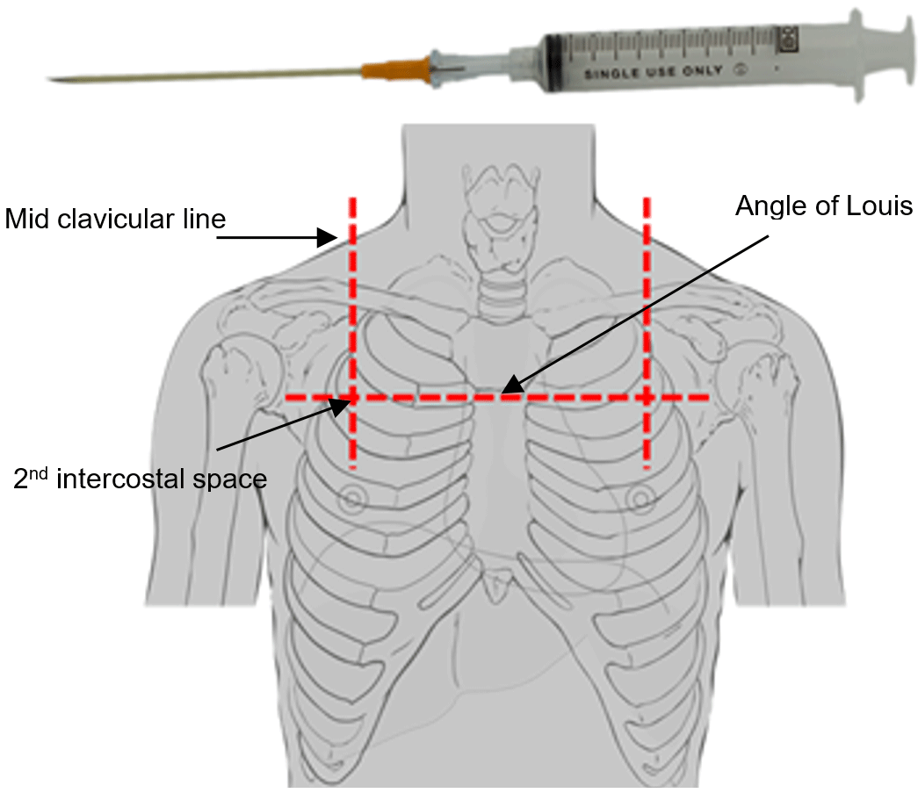
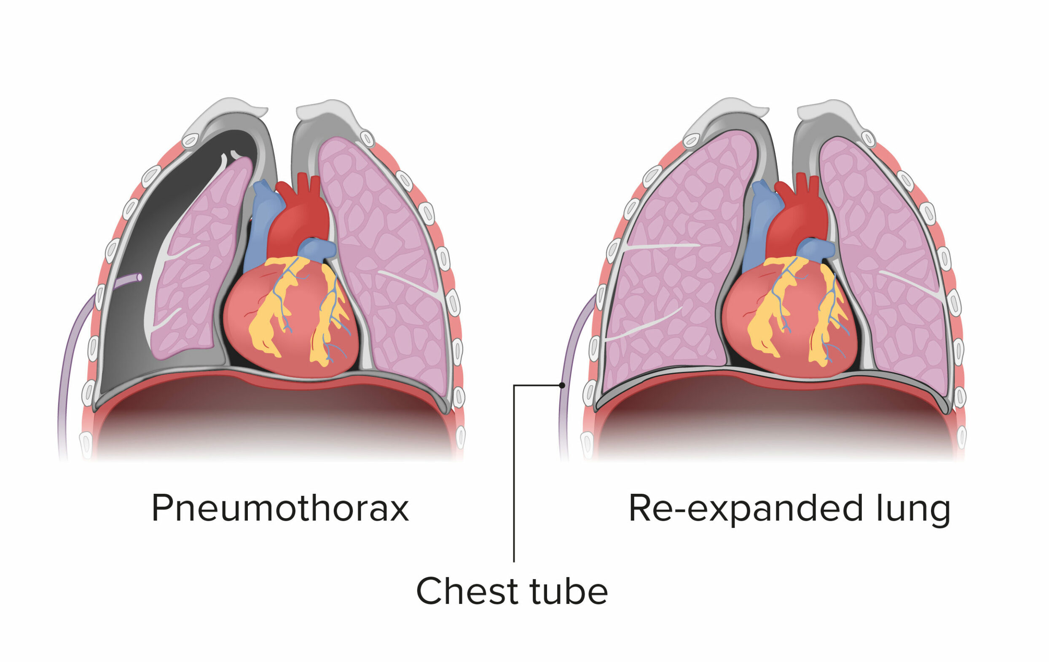
Needle decompression and chest tube insertion
Procedure is used to relieve pressure from a tension pneumothorax
Nursing actions
  Monitor ECG, SaO₂, breath sounds, and color
  Sedate as needed, apply high flow oxygen
  Needle decompression immediately removes the pressure from pleural space
  Set up water seal chest-drainage system and attach it to suction
  Apply an airtight dressing to chest-tube insertion site
  Assess chest tube for leaks along entire length of tube
  Monitor and document drainage
  Assess bubbling in water seal chamber
  Obtain CXR post-procedure for tube position

Slide 52

Chest Tube bubbling

Slide 53
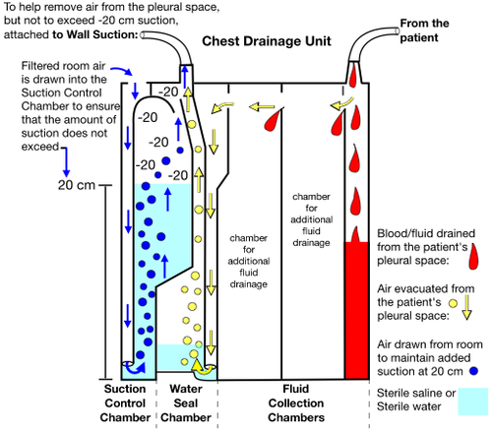
Where is the bubbling normally continuous in system?
Where is the bubbling initial then normally resolves?
Where is the tidaling normally occurring?

Slide 54
COMPLETED ANSWER • ORIGINAL SLIDE 43
Chest drainage: bubbling and tidaling
01
Wet suction-control chamber: gentle continuous bubbling is expected when wet suction is operating. A dry-suction system does not need this bubbling.
02
Water seal: intermittent bubbling can occur as air exits a pneumothorax; continuous bubbling suggests an air leak requiring assessment.
03
Tidaling: the water-seal level may move with breathing. Absent tidaling can mean re-expansion or obstruction; assess the patient and tubing. Keep the unit upright below the chest and avoid routine clamping.
Added study notes • Original slides and graphics retained • Sources in speaker notes
Notes:
Added answer to original shock slide 43. Completed answer.
Wet suction-control chamber: gentle continuous bubbling is expected when wet suction is operating. A dry-suction system does not need this bubbling.
Water seal: intermittent bubbling can occur as air exits a pneumothorax; continuous bubbling suggests an air leak requiring assessment.
Tidaling: the water-seal level may move with breathing. Absent tidaling can mean re-expansion or obstruction; assess the patient and tubing. Keep the unit upright below the chest and avoid routine clamping.
Source: user-supplied lecture deck. Supplemental references:
Open RN: Manage Chest Tube Drainage Systems
https://www.ncbi.nlm.nih.gov/books/NBK594490/

Slide 55
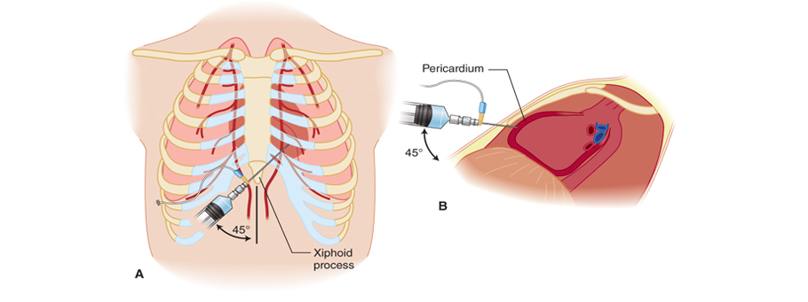
Pericardiocentesis for pericardial tamponade
Excessive pericardial fluid can result in cardiac tamponade and obstructive shock
Becks triad: hypotension, elevated JVD, muffled heart sounds
A pericardiocentesis is the procedure to attempt drainage of the pericardial fluid
Nursing actions
  Monitor ECG, SaO2, breath sounds, and color
  Assess for clinically improving vital signs (BP, HR, and JVD with HOB at 45°angle)
  Obtain CXR post-procedure
Notes:
Image: http://tathagathearthospital.com/pericardiocentesis.php

Slide 56
Management of All Types of Shock
Management starts with ABCs
Airway (mouth to trachea issues), Breathing (lung issues), Circulation (BP, HR, capillary refill, skin color)
Fluid replacement to restore intravascular volume (circulation)….low BP always occurs in shock
Vasoactive medications to restore vasomotor tone and improve cardiac function
Nutritional support to address metabolic requirements
  Support with parenteral or enteral nutrition

Slide 57
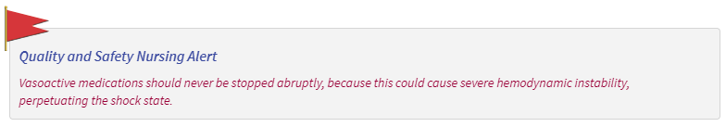
Vasoactive medications
Used when fluid therapy alone does not maintain MAP
Support hemodynamic status; stimulates SNS receptors
Check vital signs frequently; continuous monitoring of vital signs every 15 minutes or more often
Given through central line if possible
  Extravasation may cause extensive tissue damage
  All can result in cardiac dysrhythmias, needs cardiac monitoring
Dosages usually titrated to client response and vitals

Slide 58
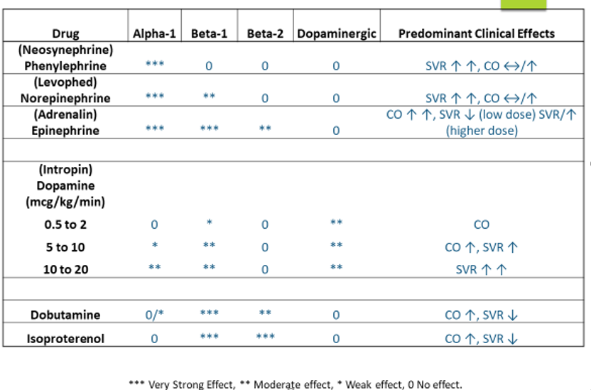
Vasoactive medications

Slide 59
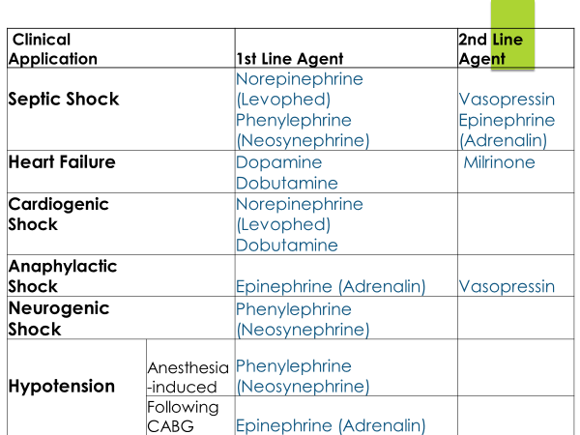
Types of shock and common vasoactive medications used

Slide 60
Multiple Organ Dysfunction Syndrome (MODS)
Altered organ function that requires medical intervention to support continued organ function
Occurs from the release of toxic metabolites and destructive enzymes in response to inadequate oxygenation
Can develop from inadequate tissue perfusion and reperfusion of ischemic cells, causing further tissue injury
High mortality rate
  60% when more than 4 organs fail
Prevention and aggressive treatment of shock is key to avoiding MODS

Slide 61
MODS
Causes
Most associated with sepsis/septic shock
Severe trauma
Burns
Acute pancreatitis
Major surgery
ARDS (acute respiratory distress syndrome)
** Any severe illness that results in hypotension and reduced organ perfusion**

Slide 62
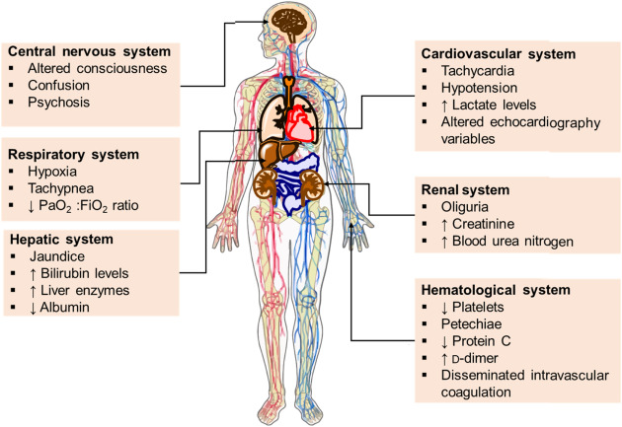
MODS MANIFESTATIONS
MODS:
Organs that can be impacted by multi-organ dysfunction
At least 2 organs are failing in MODS not including the immediate cause
Lungs are most common organ to initially be affected

Slide 63
MODS treatment
Early detection of organ failure
Control the initiating event
  Remove/treat sources of infection
Provide supportive measures
Promote adequate organ perfusion
  Maintain cardiovascular function
Nutritional support
Maximize client comfort
Implement measures that compensate for dysfunction
  Dialysis, mechanical ventilation

Slide 64
Case Study: highlight priority findings
Mr. Smith is a 77-year-old male patient admitted from a nursing home to the intensive care unit with septic shock secondary to urosepsis. The patient has an indwelling catheter in place from the nursing home with cloudy greenish, yellow-colored urine with sediments. The nurse removes the catheter after obtaining a urine culture and replaces it with a condom catheter attached to a drainage bag. The patient has a history of urinary and bowel incontinence. The patient is confused, afebrile, and hypotensive with a blood pressure of 82/44 mm Hg. His respiratory rate is 28 breaths/min. The pulse oximeter reading is at 88% room air, so the healthcare provider prescribed 2 to 4 L/min of oxygen per nasal cannula titrated to keep SaO2 greater than 92%. The patient responded to 2 L/min of oxygen per nasal cannula with an SaO2 of 93%. The patient has diarrhea. His blood glucose level is elevated at 160 mg/dL. The white blood count is 15,000, and the C-reactive protein, a marker for inflammation, is elevated. The patient is treated with broad-spectrum antibiotics and norepinephrine beginning at 2 mcg/min and titrated to keep systolic blood pressure greater than 100 mm Hg. A central venous access device was inserted and verified by chest x-ray for correct placement. An arterial line was placed in the right radial artery to closely monitor the patient’s blood pressure during the vasopressor therapy.

Slide 65
Question 1
What predisposed the patient to develop septic shock?

Slide 66
COMPLETED ANSWER • ORIGINAL SLIDE 54
Mr. Smith: what increases his sepsis risk?
01
Likely source: urinary instrumentation/indwelling catheter and abnormal urine suggest a urinary infection. Culture results and assessment are needed to confirm the organism.
02
Risk context: older age, institutional care and impaired continence increase exposure or vulnerability; incontinence alone does not prove infection.
03
Do not be reassured by no fever: older adults may present with confusion, weakness, tachypnea or hypotension instead.
Added study notes • Original slides and graphics retained • Sources in speaker notes
Notes:
Added answer to original shock slide 54. Completed answer.
Likely source: urinary instrumentation/indwelling catheter and abnormal urine suggest a urinary infection. Culture results and assessment are needed to confirm the organism.
Risk context: older age, institutional care and impaired continence increase exposure or vulnerability; incontinence alone does not prove infection.
Do not be reassured by no fever: older adults may present with confusion, weakness, tachypnea or hypotension instead.
Source: user-supplied lecture deck. Supplemental references:
SCCM: Surviving Sepsis Campaign adult guidelines
https://sccm.org/survivingsepsiscampaign/guidelines-and-resources/surviving-sepsis-campaign-adult-guidelines

Slide 67
Question 2
What potential findings would suggest that the patient’s septic shock is worsening from the point of admission?

Slide 68
COMPLETED ANSWER • ORIGINAL SLIDE 55
Mr. Smith: signs of deterioration
01
Shock cues: BP 82/44, confusion and RR 28/min indicate threatened organ perfusion; SpO2 88% on room air shows hypoxemia.
02
Inflammation/infection cues: WBC 15,000/µL is elevated (typical adult range 4,500–11,000/µL); CRP is reported high, but the slide supplies no number or laboratory range.
03
Glucose 160 mg/dL: above a typical fasting range of 70–99 mg/dL, though fasting status is unknown. Follow ordered glucose checks; this value alone does not diagnose diabetes.
Added study notes • Original slides and graphics retained • Sources in speaker notes
Notes:
Added answer to original shock slide 55. Completed answer.
Shock cues: BP 82/44, confusion and RR 28/min indicate threatened organ perfusion; SpO2 88% on room air shows hypoxemia.
Inflammation/infection cues: WBC 15,000/µL is elevated (typical adult range 4,500–11,000/µL); CRP is reported high, but the slide supplies no number or laboratory range.
Glucose 160 mg/dL: above a typical fasting range of 70–99 mg/dL, though fasting status is unknown. Follow ordered glucose checks; this value alone does not diagnose diabetes.
Source: user-supplied lecture deck. Supplemental references:

Slide 69
Question 3
The norepinephrine concentration is 16 mg in 250 mL of normal saline (NS). Explain how the nurse should administer the medication. What nursing implications are related to the usage of a vasoactive medication?

Slide 70
COMPLETED ANSWER • ORIGINAL SLIDE 56
Norepinephrine: calculate the pump rate
01
Convert and find concentration: 16 mg = 16,000 mcg. 16,000 mcg ÷ 250 mL = 64 mcg/mL.
02
Calculate: (2 mcg/min × 60 min/hour) ÷ 64 mcg/mL = 1.875 mL/hour, approximately 1.9 mL/hour if rounding to tenths.
03
Safety: independently verify the concentration and smart-pump setting per policy. Titrate to the actual order with continuous hemodynamic monitoring; use the ordered line and assess the site.
Added study notes • Original slides and graphics retained • Sources in speaker notes
Notes:
Added answer to original shock slide 56. Completed answer.
Convert and find concentration: 16 mg = 16,000 mcg. 16,000 mcg ÷ 250 mL = 64 mcg/mL.
Calculate: (2 mcg/min × 60 min/hour) ÷ 64 mcg/mL = 1.875 mL/hour, approximately 1.9 mL/hour if rounding to tenths.
Safety: independently verify the concentration and smart-pump setting per policy. Titrate to the actual order with continuous hemodynamic monitoring; use the ordered line and assess the site.
Source: user-supplied lecture deck. Supplemental references:

Slide 71


Slide 72
CALCULATION CORRECTION • ORIGINAL SLIDE 57
Correction to the displayed calculation
01
Correct starting rate: 1.875 mL/hour (about 1.9 mL/hour), not the 3 mL/hour printed in the original image.
02
Reverse check: 3 mL/hour × 64 mcg/mL ÷ 60 = 3.2 mcg/min. That is higher than the ordered 2 mcg/min.
03
The original graphic is preserved so you can compare it with the corrected arithmetic. Confirm the order and concentration before administering any medication.
Added study notes • Original slides and graphics retained • Sources in speaker notes
Notes:
Added answer to original shock slide 57. Calculation correction.
Correct starting rate: 1.875 mL/hour (about 1.9 mL/hour), not the 3 mL/hour printed in the original image.
Reverse check: 3 mL/hour × 64 mcg/mL ÷ 60 = 3.2 mcg/min. That is higher than the ordered 2 mcg/min.
The original graphic is preserved so you can compare it with the corrected arithmetic. Confirm the order and concentration before administering any medication.
Source: user-supplied lecture deck. Supplemental references:

Slide 73
Question 4
Explain the importance of nutritional support for this patient and which type of nutritional support should be provided.

Slide 74
COMPLETED ANSWER • ORIGINAL SLIDE 58
Why nutrition matters during shock
01
Stress is catabolic: inflammation and stress hormones increase energy needs and break down muscle/protein. Nutrition supports healing and recovery.
02
After stabilization: use enteral nutrition when the gut is usable and the patient can tolerate feeding; coordinate with the dietitian and critical-care team.
03
Safety: uncontrolled shock or worsening perfusion may require withholding or adjusting feeds. Monitor tolerance, glucose, fluid balance and electrolytes.
Added study notes • Original slides and graphics retained • Sources in speaker notes
Notes:
Added answer to original shock slide 58. Completed answer.
Stress is catabolic: inflammation and stress hormones increase energy needs and break down muscle/protein. Nutrition supports healing and recovery.
After stabilization: use enteral nutrition when the gut is usable and the patient can tolerate feeding; coordinate with the dietitian and critical-care team.
Safety: uncontrolled shock or worsening perfusion may require withholding or adjusting feeds. Monitor tolerance, glucose, fluid balance and electrolytes.
Source: user-supplied lecture deck. Supplemental references:
SCCM: Surviving Sepsis Campaign adult guidelines
https://sccm.org/survivingsepsiscampaign/guidelines-and-resources/surviving-sepsis-campaign-adult-guidelines

