Slide 1

NUR 235 / WEEK 7 / FULLER
Neurologic & Neuromuscular
VP shunts, increased intracranial pressure, meningitis and seizures
Study copy made from slides shown in the recorded lecture
Notes:
Source recording: https://drive.google.com/file/d/1jR3en5teZqX5G5iW1lLpJjqkuuBU5Go1/view
University logo: https://www.joyce.edu/
Prepared for independent study. Original course slides are linked separately in the Study Hub.

Slide 2
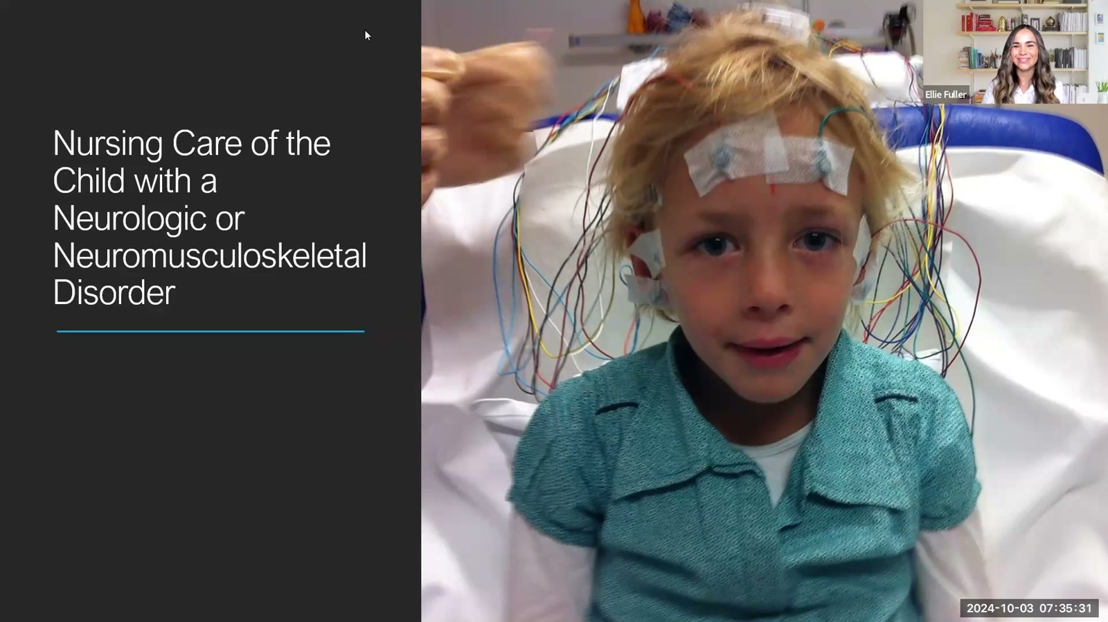
Notes:
Fuller · Week 7 · Neurologic & Neuromuscular
Recording time 0:27
https://drive.google.com/file/d/1jR3en5teZqX5G5iW1lLpJjqkuuBU5Go1/view

Slide 3
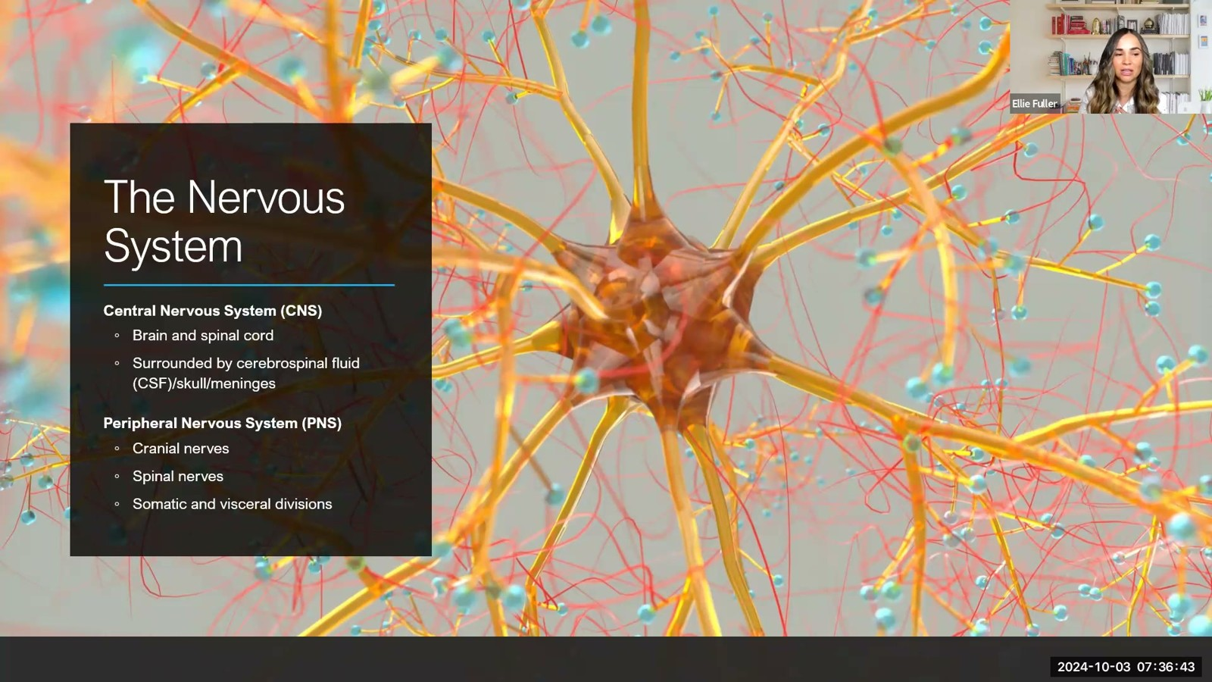
Notes:
Fuller · Week 7 · Neurologic & Neuromuscular
Recording time 1:39
https://drive.google.com/file/d/1jR3en5teZqX5G5iW1lLpJjqkuuBU5Go1/view

Slide 4
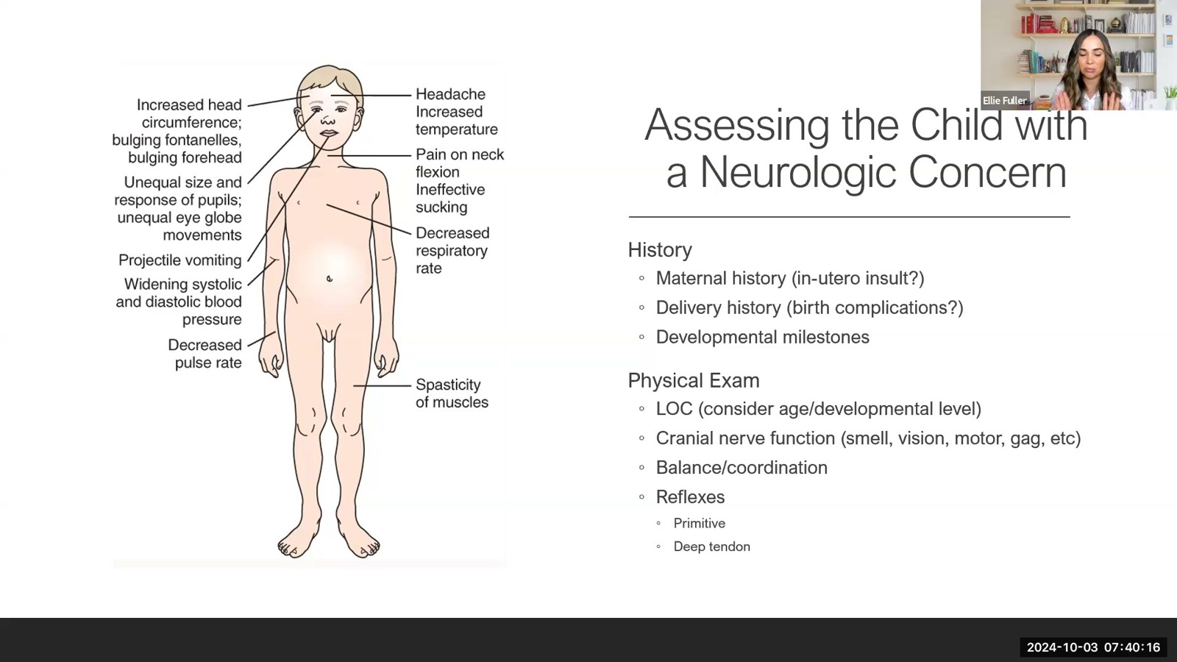
Notes:
Fuller · Week 7 · Neurologic & Neuromuscular
Recording time 5:12
https://drive.google.com/file/d/1jR3en5teZqX5G5iW1lLpJjqkuuBU5Go1/view

Slide 5
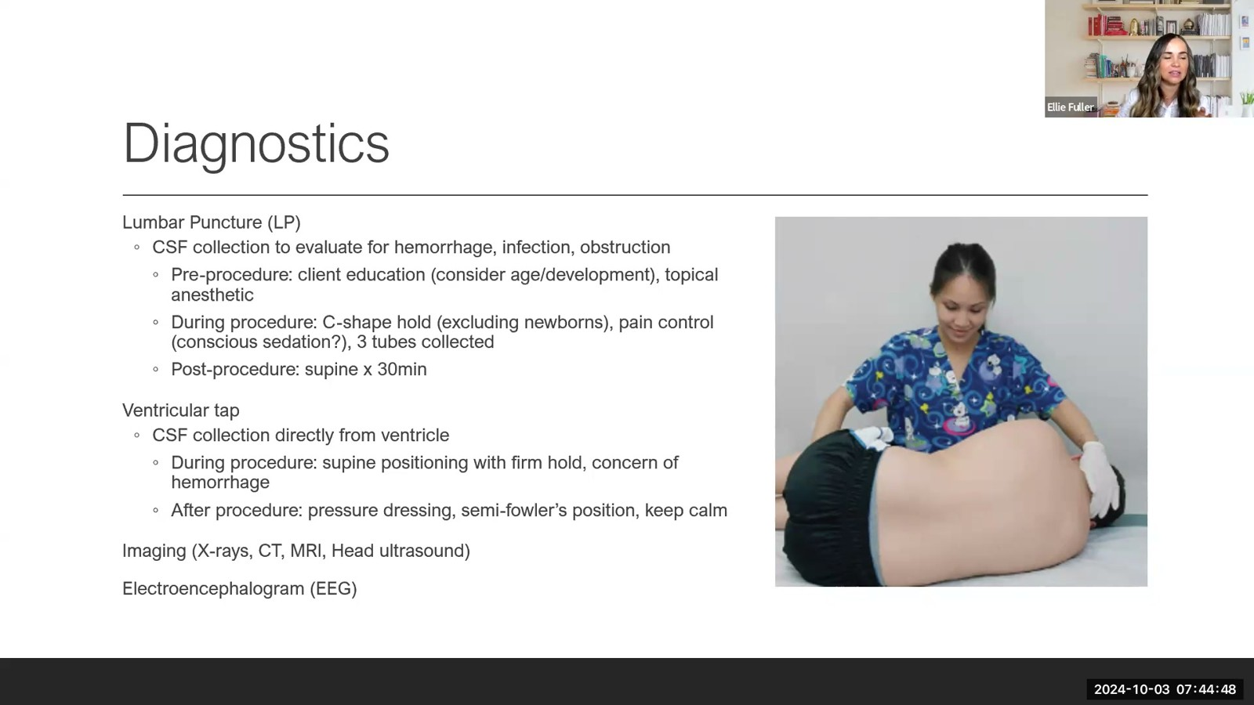
Notes:
Fuller · Week 7 · Neurologic & Neuromuscular
Recording time 9:44
https://drive.google.com/file/d/1jR3en5teZqX5G5iW1lLpJjqkuuBU5Go1/view

Slide 6
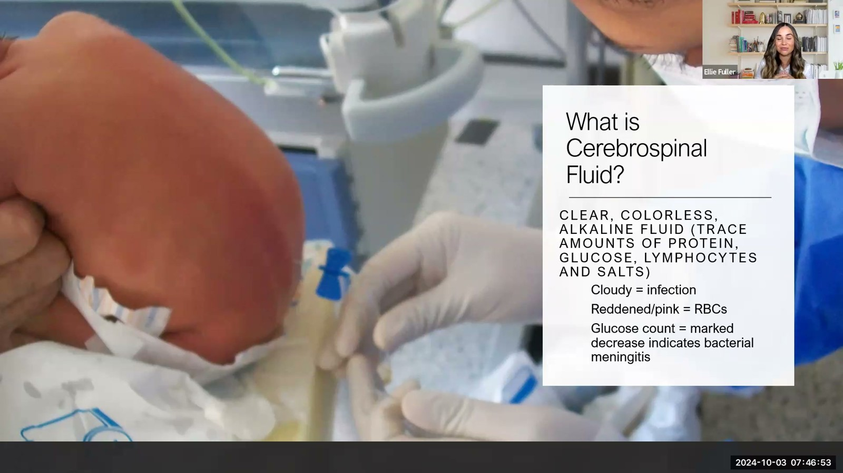
Notes:
Fuller · Week 7 · Neurologic & Neuromuscular
Recording time 11:49
https://drive.google.com/file/d/1jR3en5teZqX5G5iW1lLpJjqkuuBU5Go1/view

Slide 7
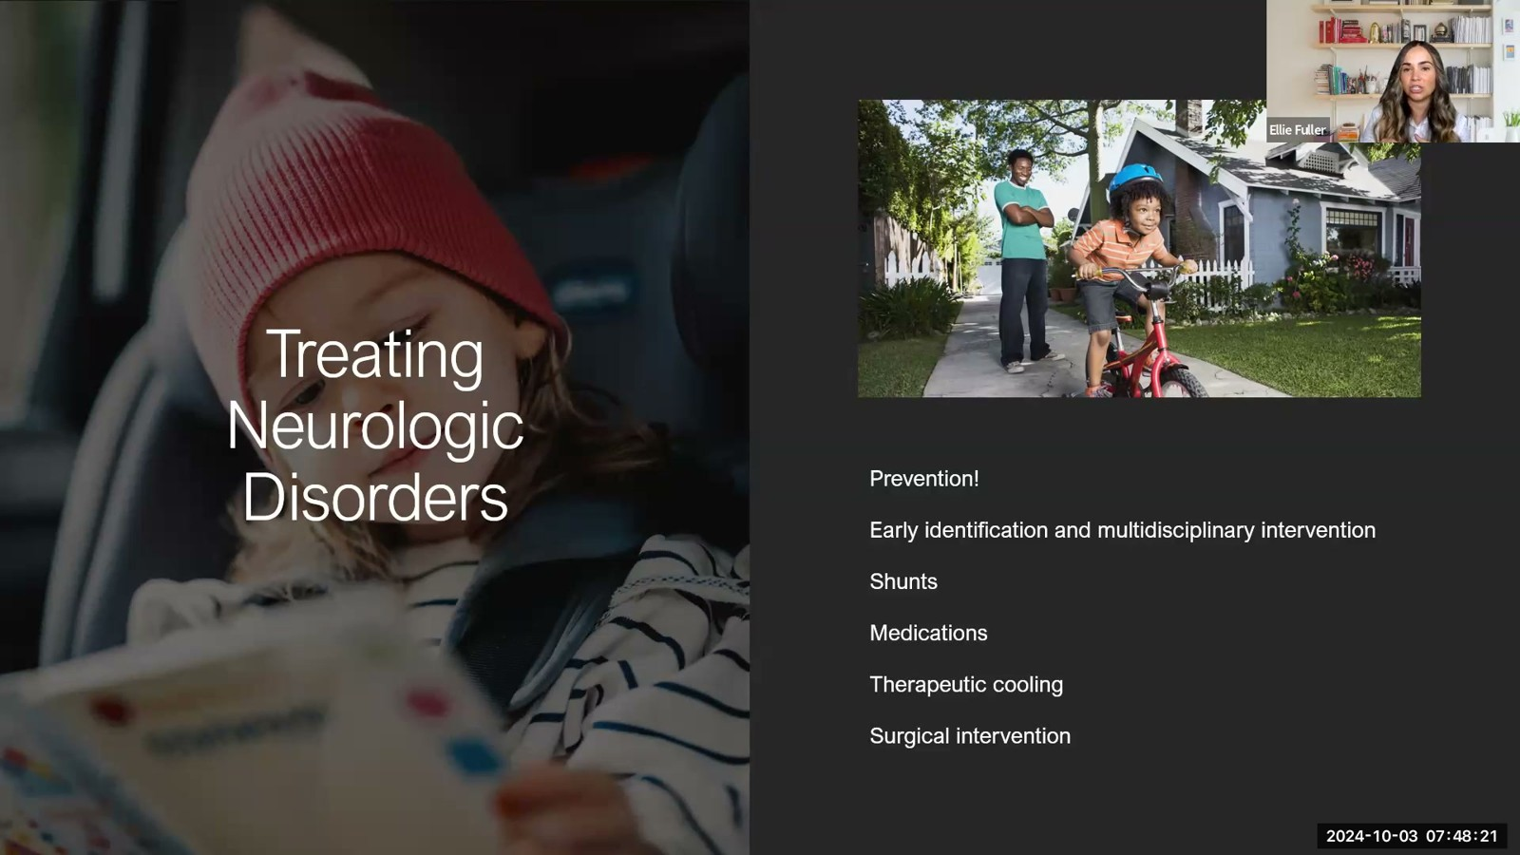
Notes:
Fuller · Week 7 · Neurologic & Neuromuscular
Recording time 13:17
https://drive.google.com/file/d/1jR3en5teZqX5G5iW1lLpJjqkuuBU5Go1/view

Slide 8
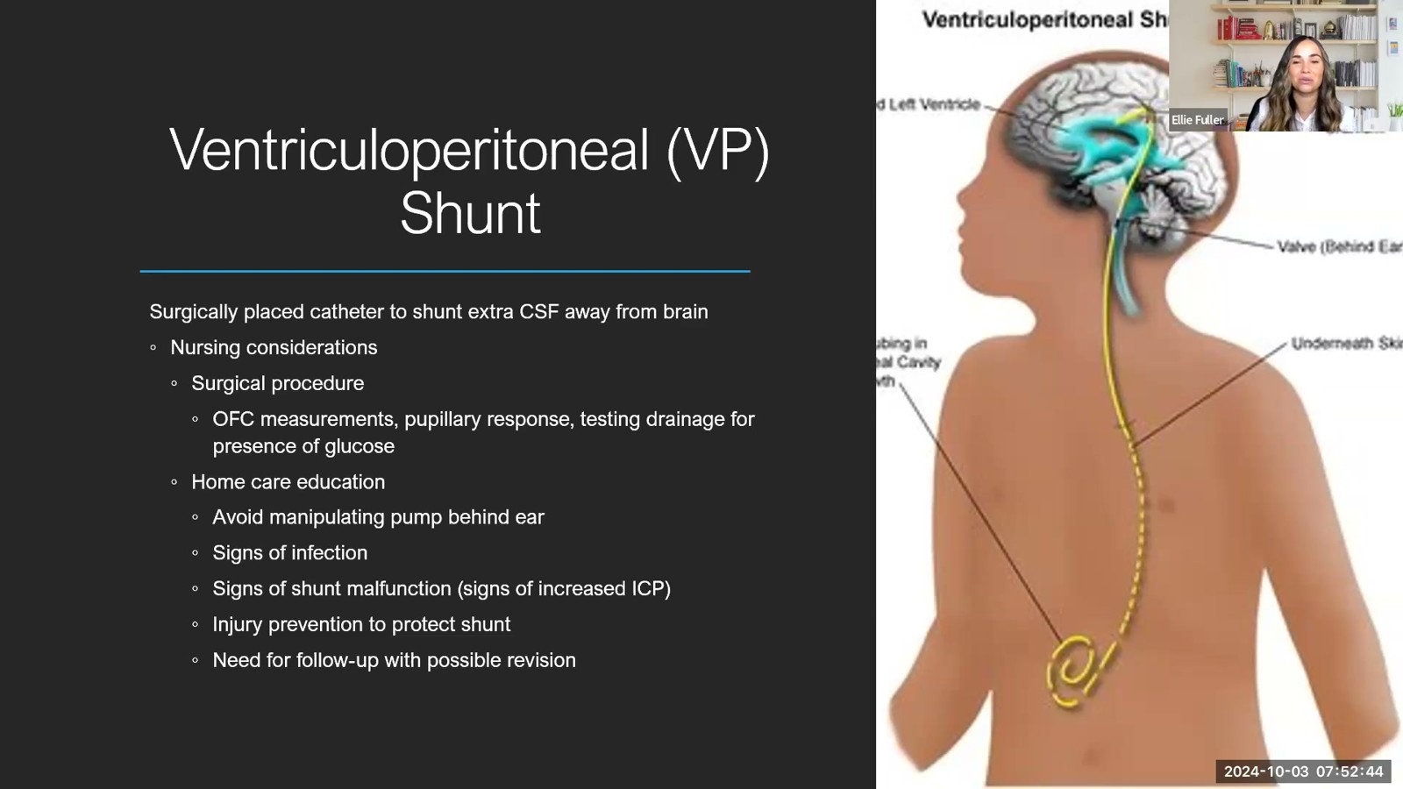
Notes:
Fuller · Week 7 · Neurologic & Neuromuscular
Recording time 17:40
https://drive.google.com/file/d/1jR3en5teZqX5G5iW1lLpJjqkuuBU5Go1/view

Slide 9
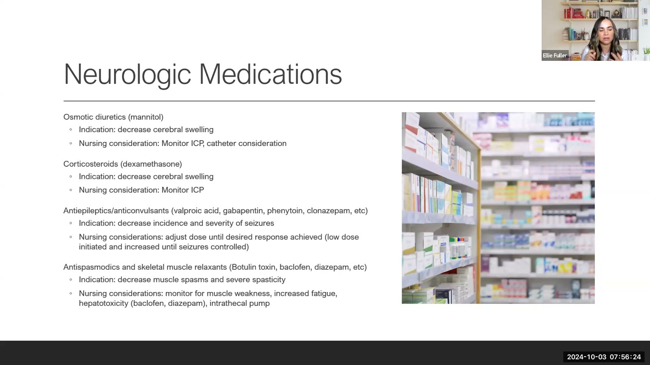
Notes:
Fuller · Week 7 · Neurologic & Neuromuscular
Recording time 21:20
https://drive.google.com/file/d/1jR3en5teZqX5G5iW1lLpJjqkuuBU5Go1/view

Slide 10

Notes:
Fuller · Week 7 · Neurologic & Neuromuscular
Recording time 22:36
https://drive.google.com/file/d/1jR3en5teZqX5G5iW1lLpJjqkuuBU5Go1/view

Slide 11
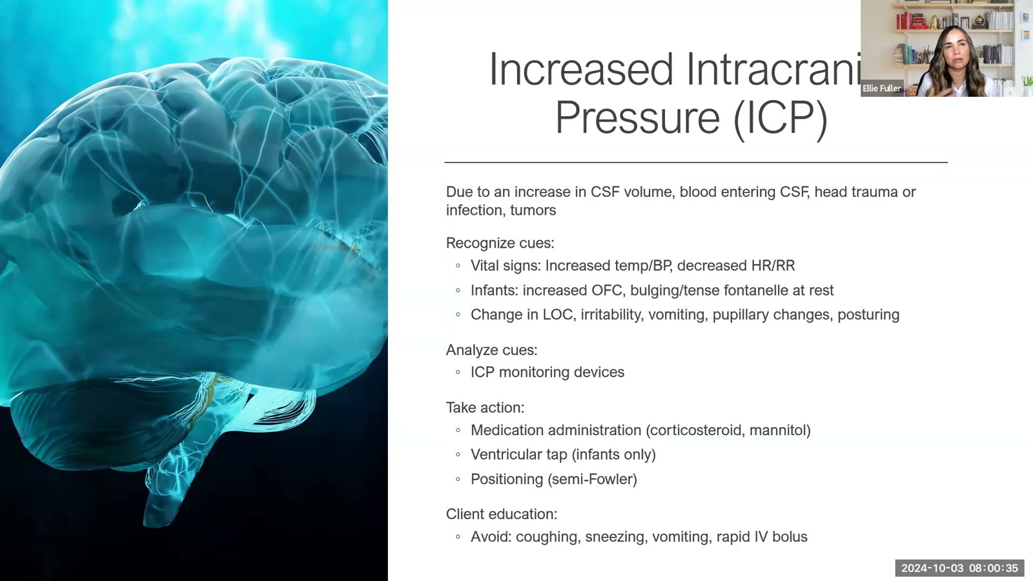
Notes:
Fuller · Week 7 · Neurologic & Neuromuscular
Recording time 25:31
https://drive.google.com/file/d/1jR3en5teZqX5G5iW1lLpJjqkuuBU5Go1/view

Slide 12
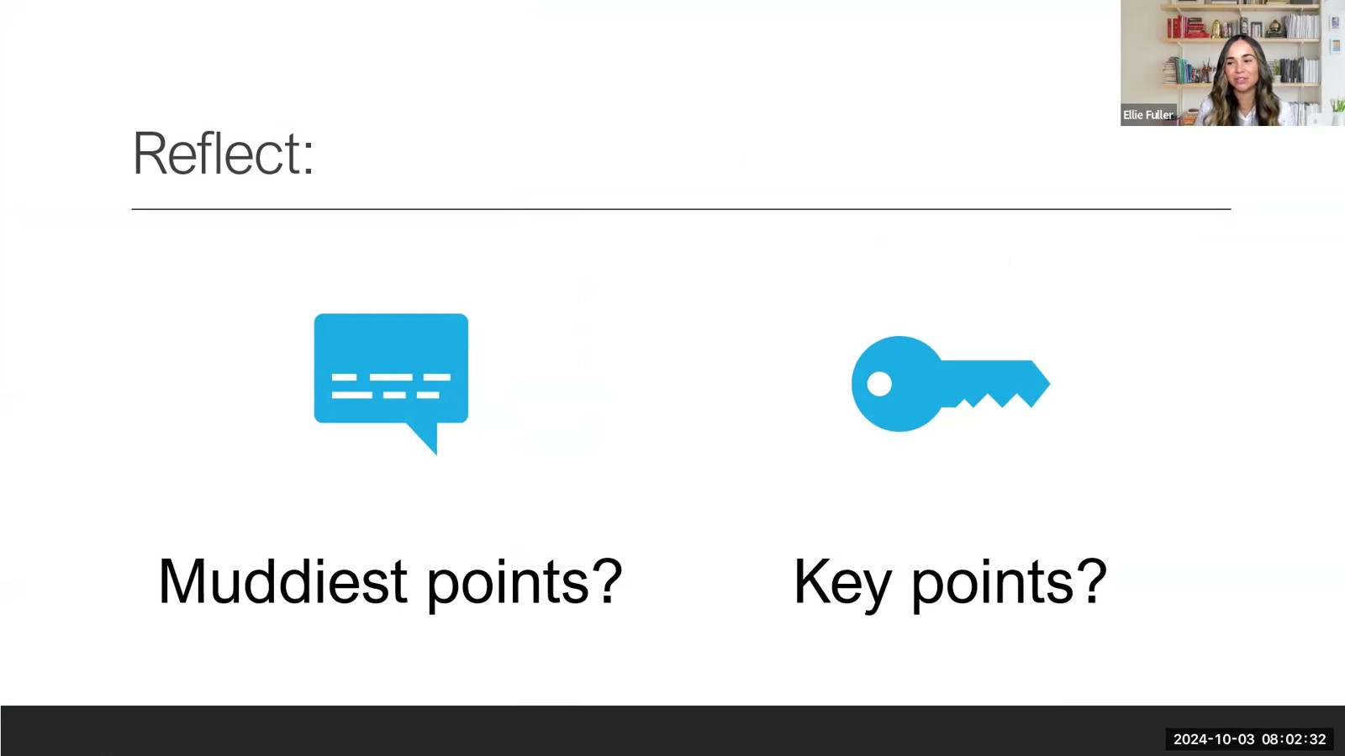
Notes:
Fuller · Week 7 · Neurologic & Neuromuscular
Recording time 27:28
https://drive.google.com/file/d/1jR3en5teZqX5G5iW1lLpJjqkuuBU5Go1/view

Slide 13
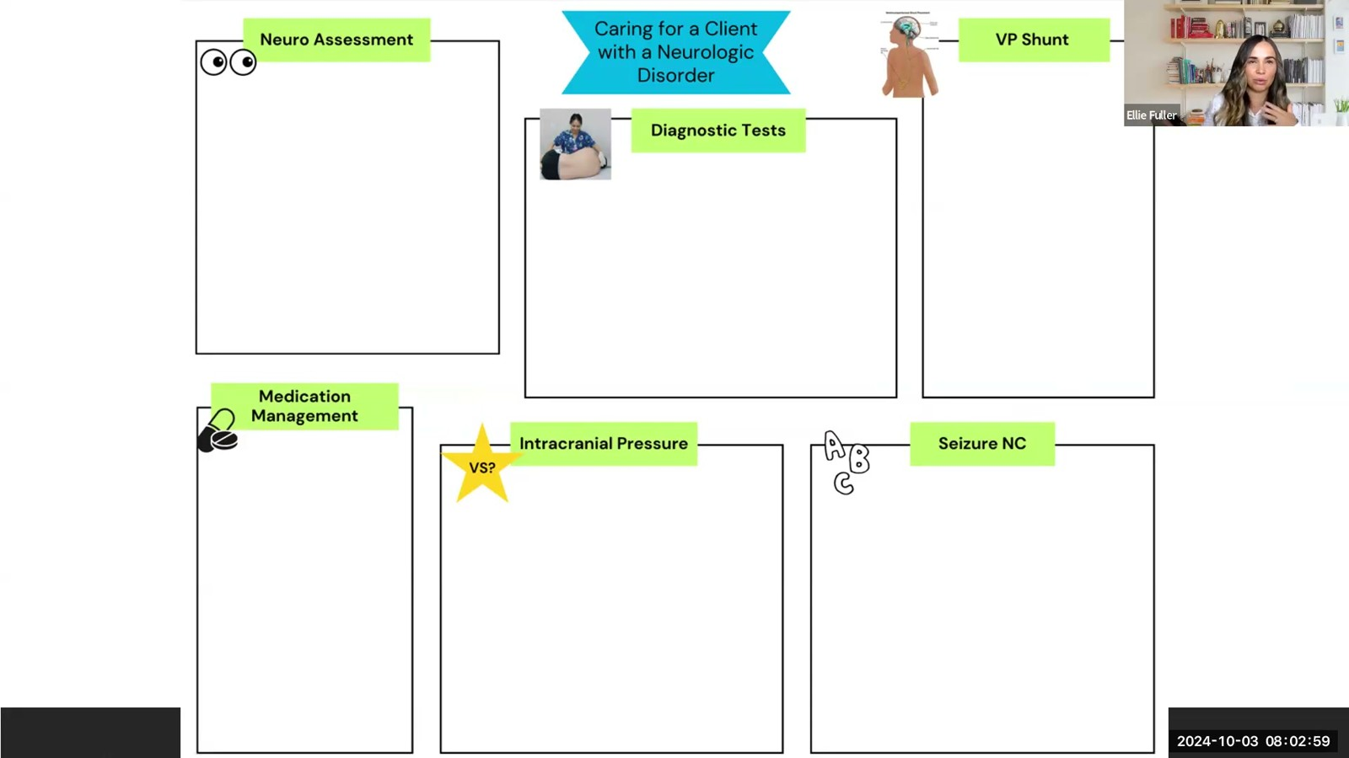
Notes:
Fuller · Week 7 · Neurologic & Neuromuscular
Recording time 27:55
https://drive.google.com/file/d/1jR3en5teZqX5G5iW1lLpJjqkuuBU5Go1/view

Slide 14
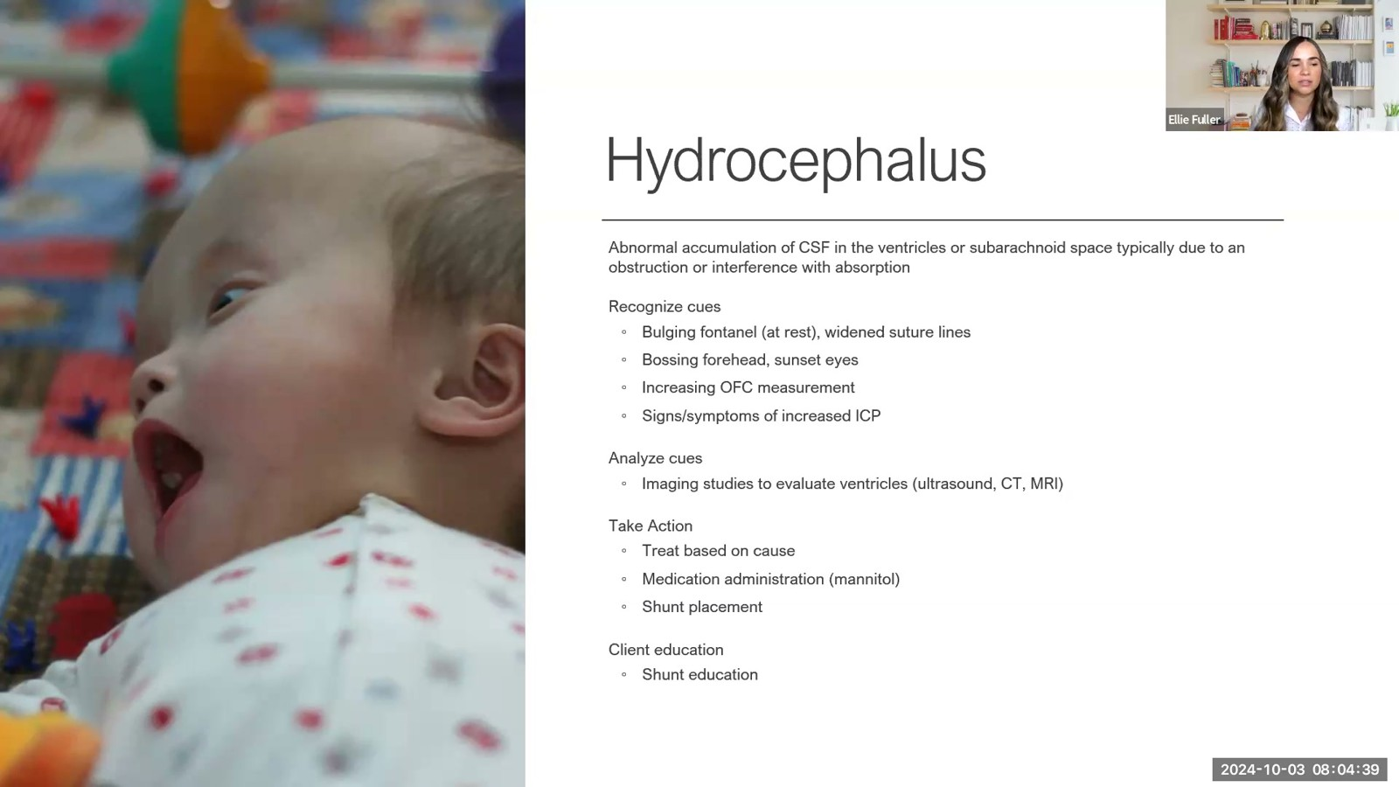
Notes:
Fuller · Week 7 · Neurologic & Neuromuscular
Recording time 29:35
https://drive.google.com/file/d/1jR3en5teZqX5G5iW1lLpJjqkuuBU5Go1/view

Slide 15
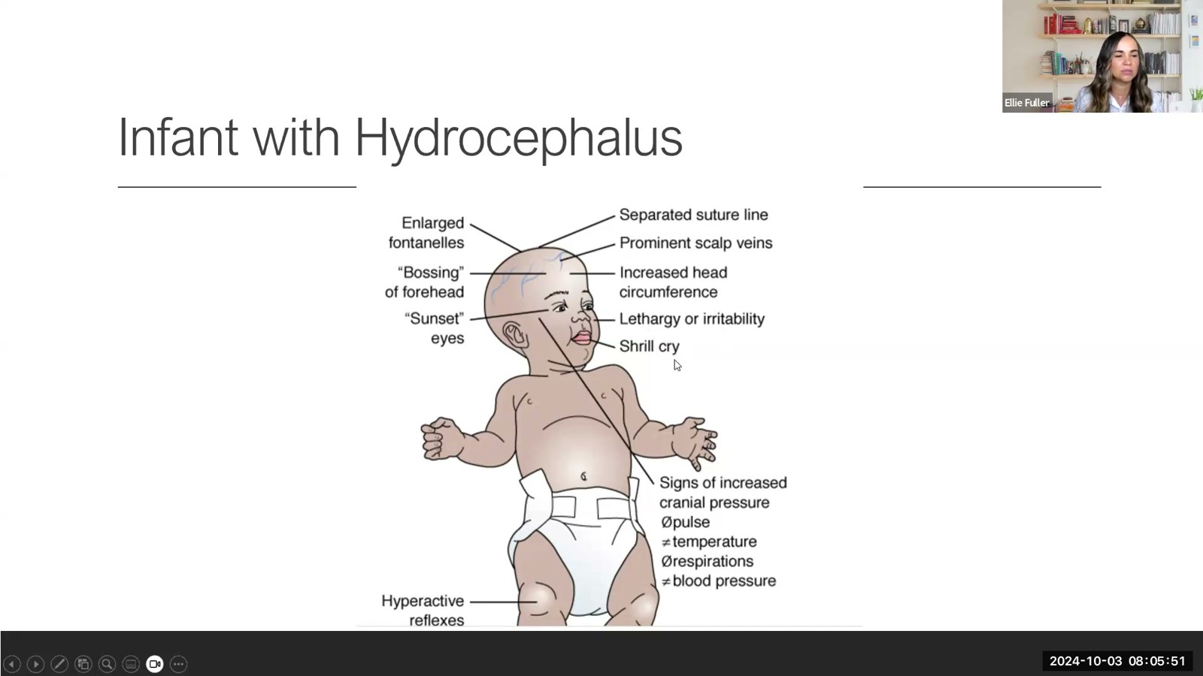
Notes:
Fuller · Week 7 · Neurologic & Neuromuscular
Recording time 30:47
https://drive.google.com/file/d/1jR3en5teZqX5G5iW1lLpJjqkuuBU5Go1/view

Slide 16
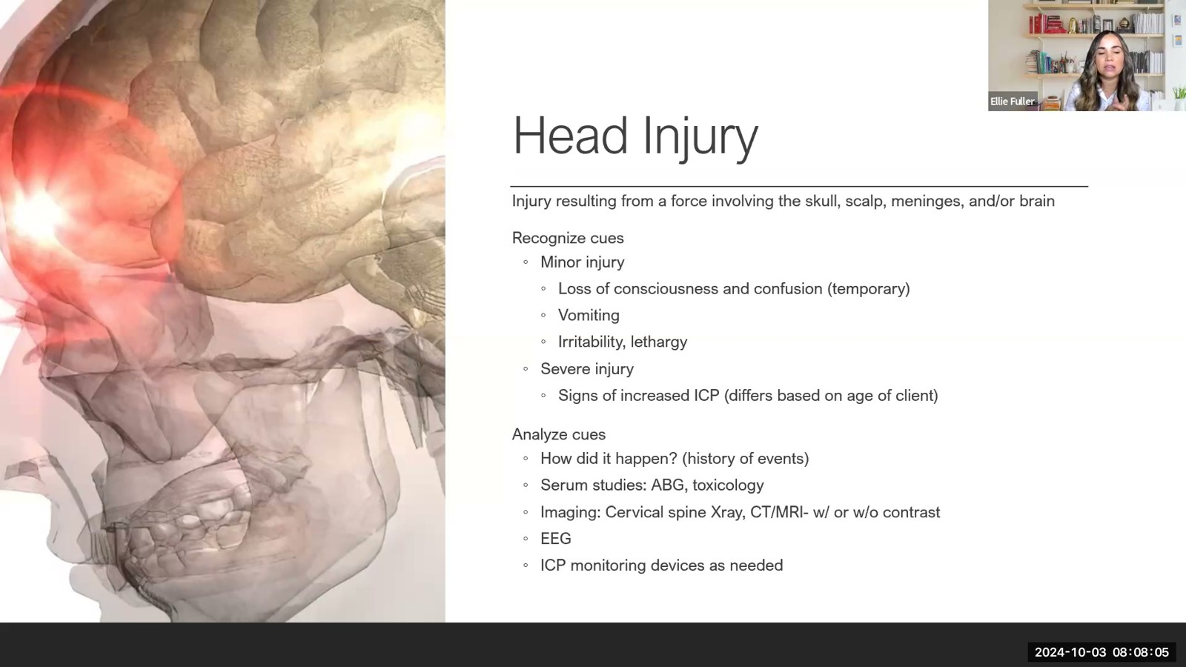
Notes:
Fuller · Week 7 · Neurologic & Neuromuscular
Recording time 33:01
https://drive.google.com/file/d/1jR3en5teZqX5G5iW1lLpJjqkuuBU5Go1/view

Slide 17
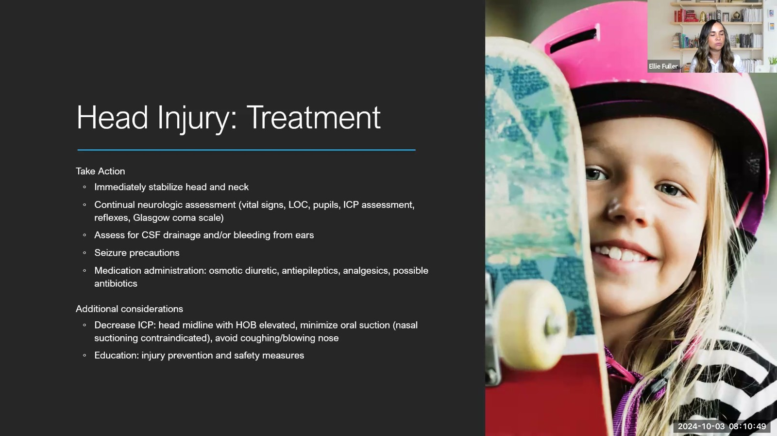
Notes:
Fuller · Week 7 · Neurologic & Neuromuscular
Recording time 35:45
https://drive.google.com/file/d/1jR3en5teZqX5G5iW1lLpJjqkuuBU5Go1/view

Slide 18
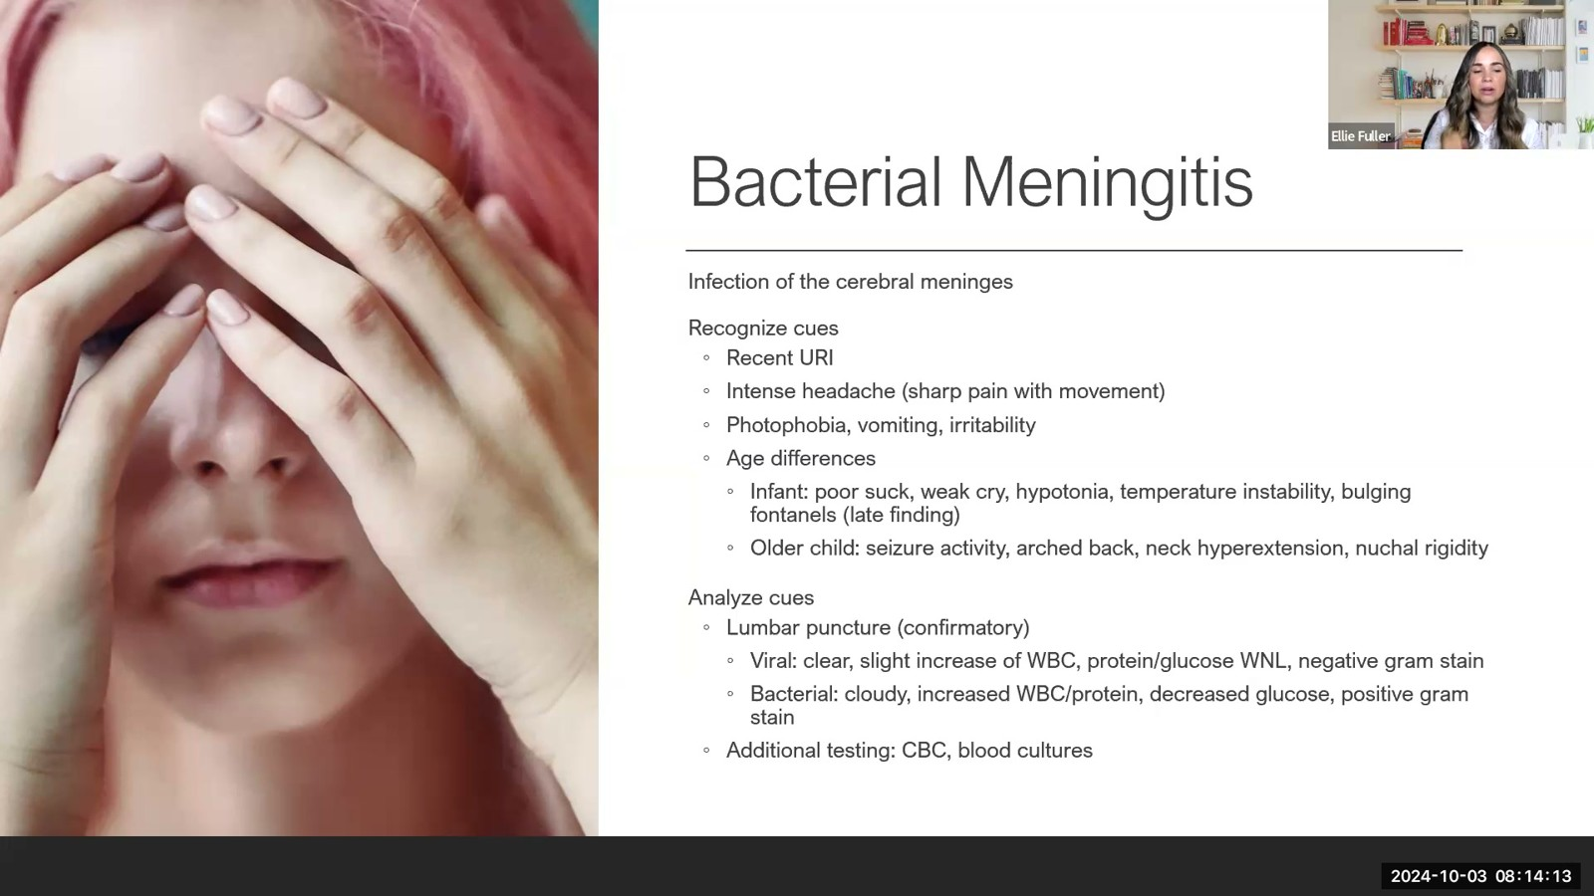
Notes:
Fuller · Week 7 · Neurologic & Neuromuscular
Recording time 39:09
https://drive.google.com/file/d/1jR3en5teZqX5G5iW1lLpJjqkuuBU5Go1/view

Slide 19
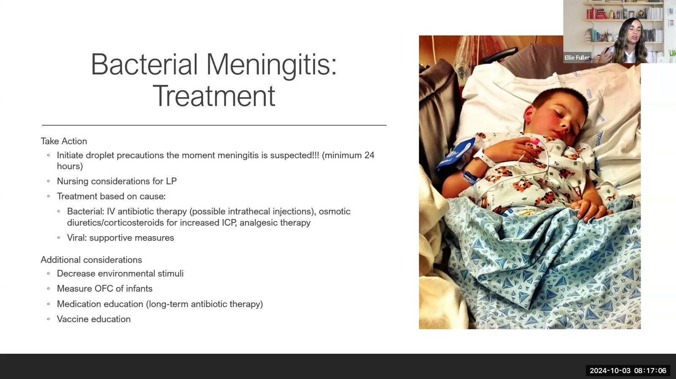
Notes:
Fuller · Week 7 · Neurologic & Neuromuscular
Recording time 42:02
https://drive.google.com/file/d/1jR3en5teZqX5G5iW1lLpJjqkuuBU5Go1/view

Slide 20
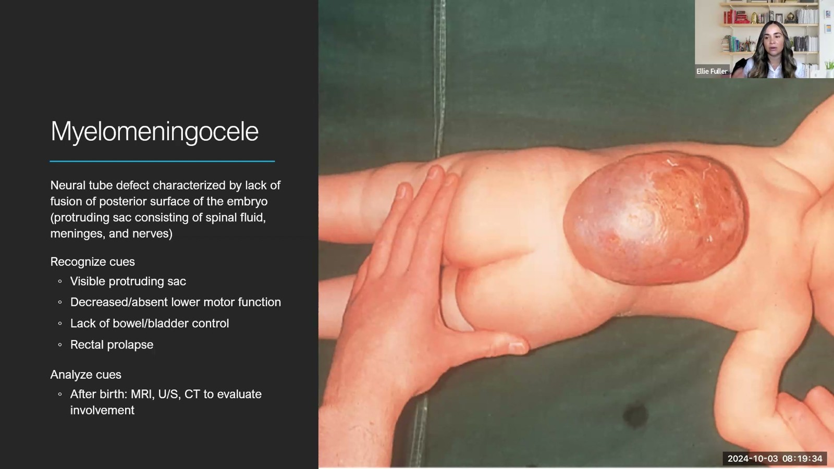
Notes:
Fuller · Week 7 · Neurologic & Neuromuscular
Recording time 44:30
https://drive.google.com/file/d/1jR3en5teZqX5G5iW1lLpJjqkuuBU5Go1/view

Slide 21
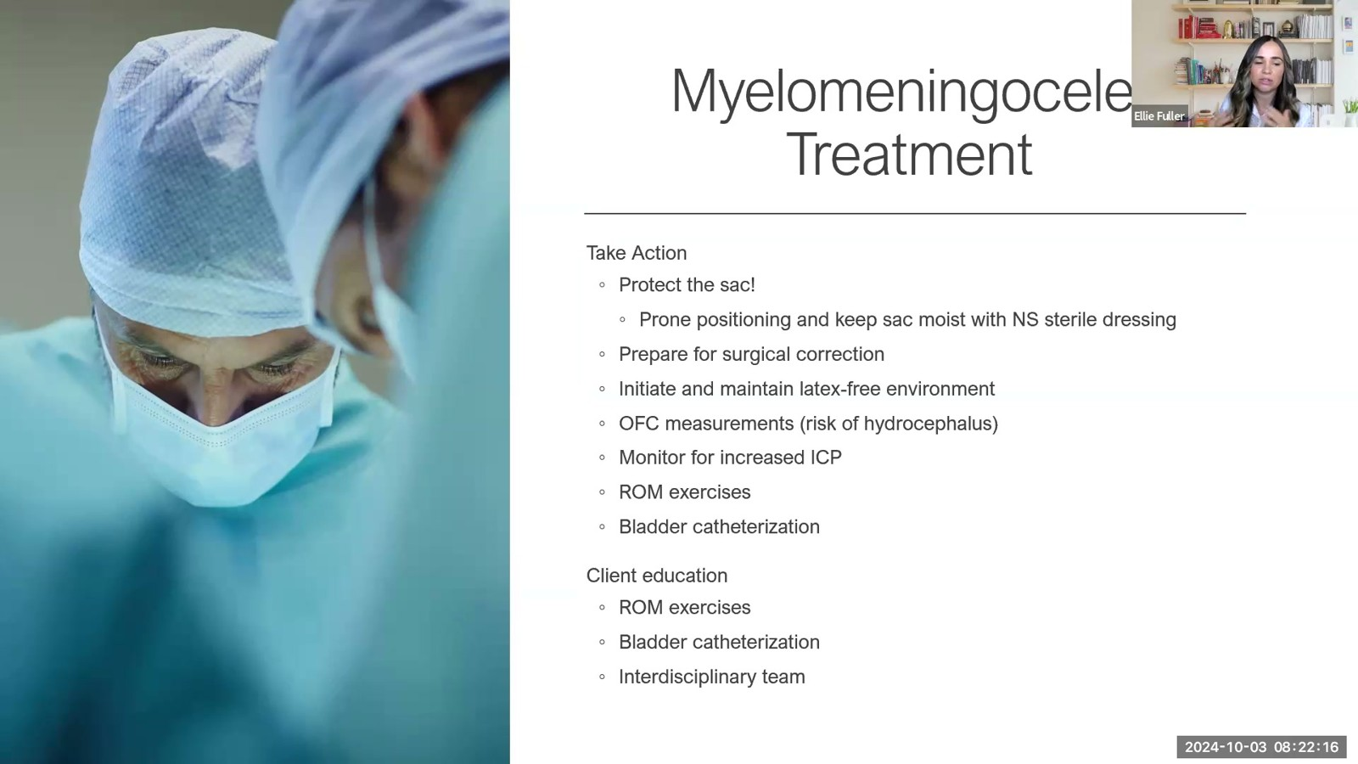
Notes:
Fuller · Week 7 · Neurologic & Neuromuscular
Recording time 47:12
https://drive.google.com/file/d/1jR3en5teZqX5G5iW1lLpJjqkuuBU5Go1/view

Slide 22
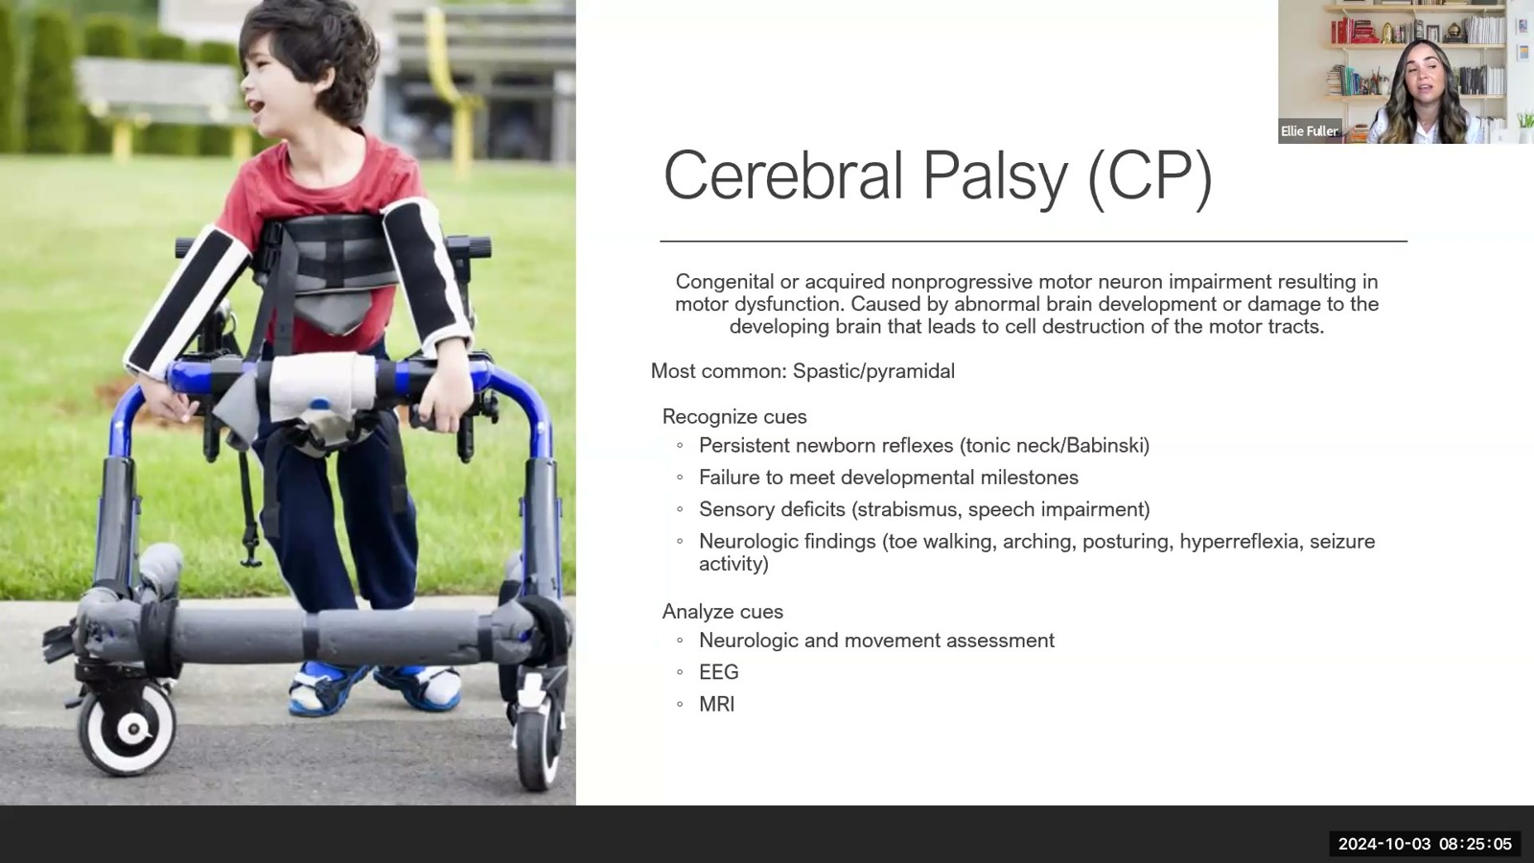
Notes:
Fuller · Week 7 · Neurologic & Neuromuscular
Recording time 50:01
https://drive.google.com/file/d/1jR3en5teZqX5G5iW1lLpJjqkuuBU5Go1/view

Slide 23
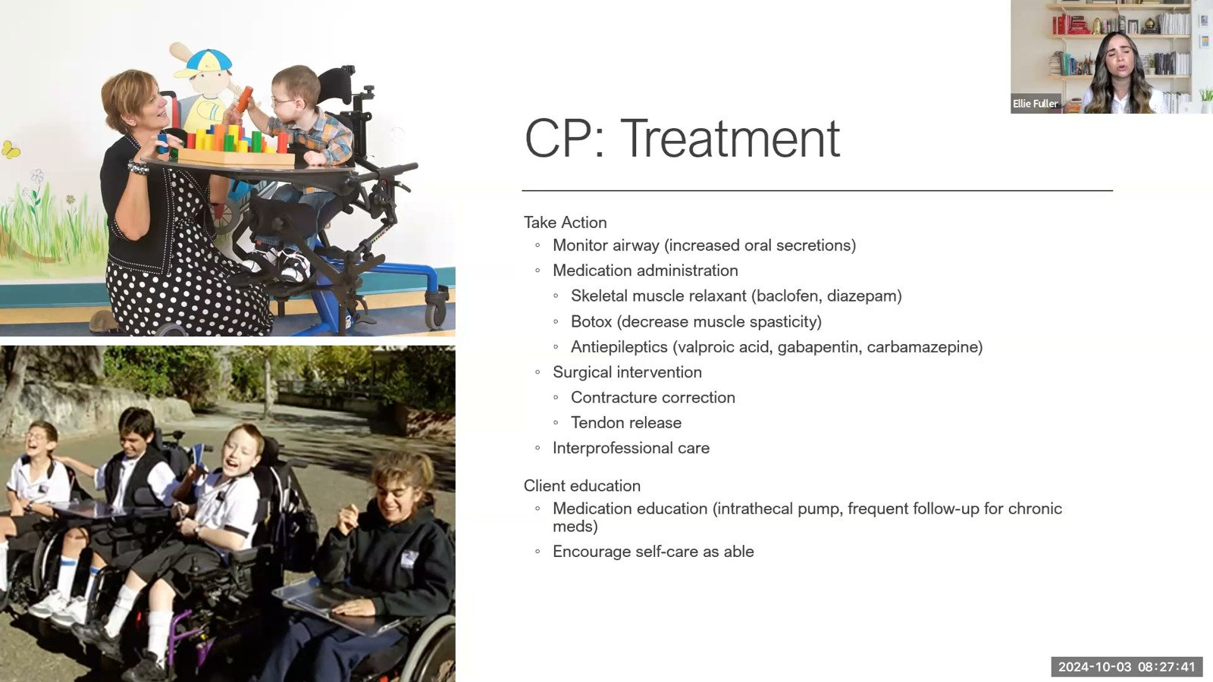
Notes:
Fuller · Week 7 · Neurologic & Neuromuscular
Recording time 52:37
https://drive.google.com/file/d/1jR3en5teZqX5G5iW1lLpJjqkuuBU5Go1/view

Slide 24

Notes:
Fuller · Week 7 · Neurologic & Neuromuscular
Recording time 53:43
https://drive.google.com/file/d/1jR3en5teZqX5G5iW1lLpJjqkuuBU5Go1/view

Slide 25
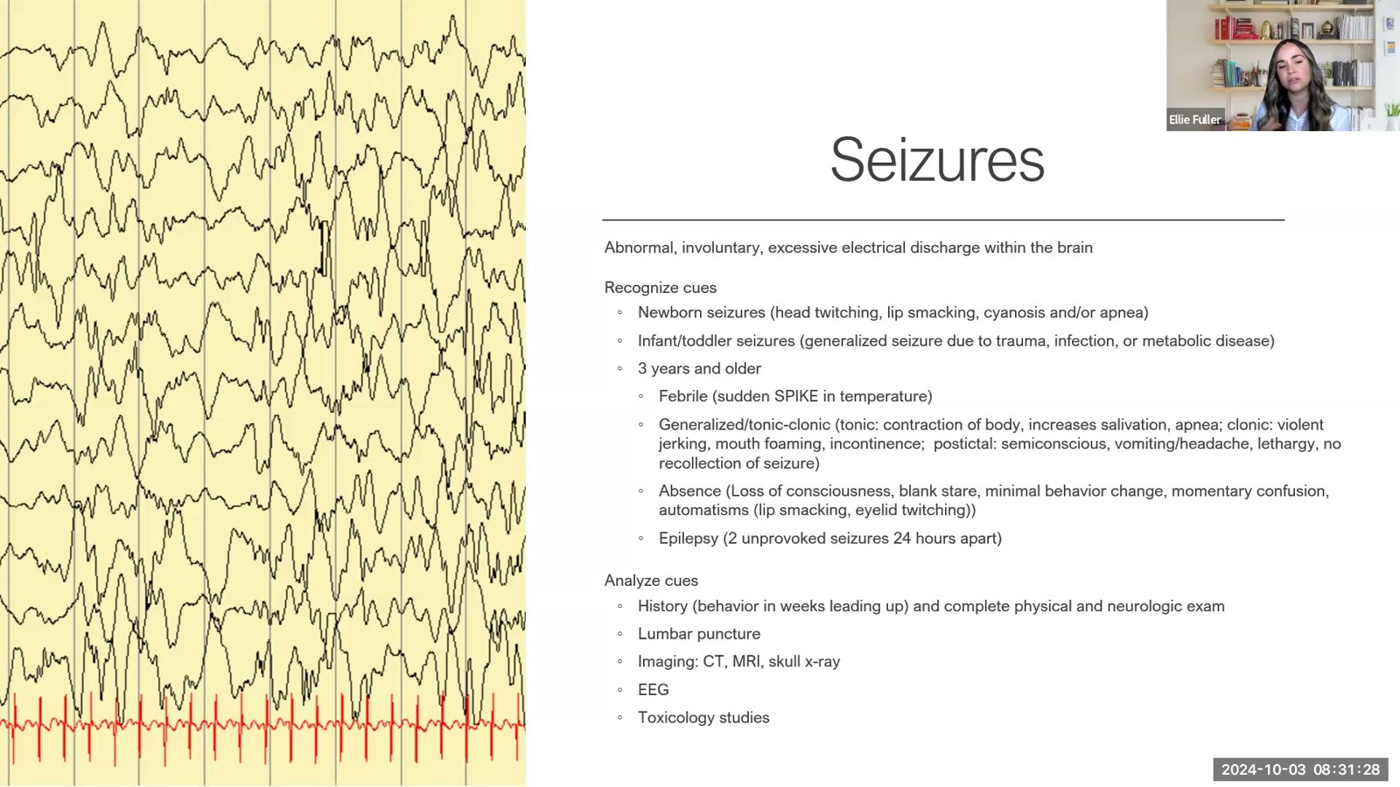
Notes:
Fuller · Week 7 · Neurologic & Neuromuscular
Recording time 56:24
https://drive.google.com/file/d/1jR3en5teZqX5G5iW1lLpJjqkuuBU5Go1/view

Slide 26
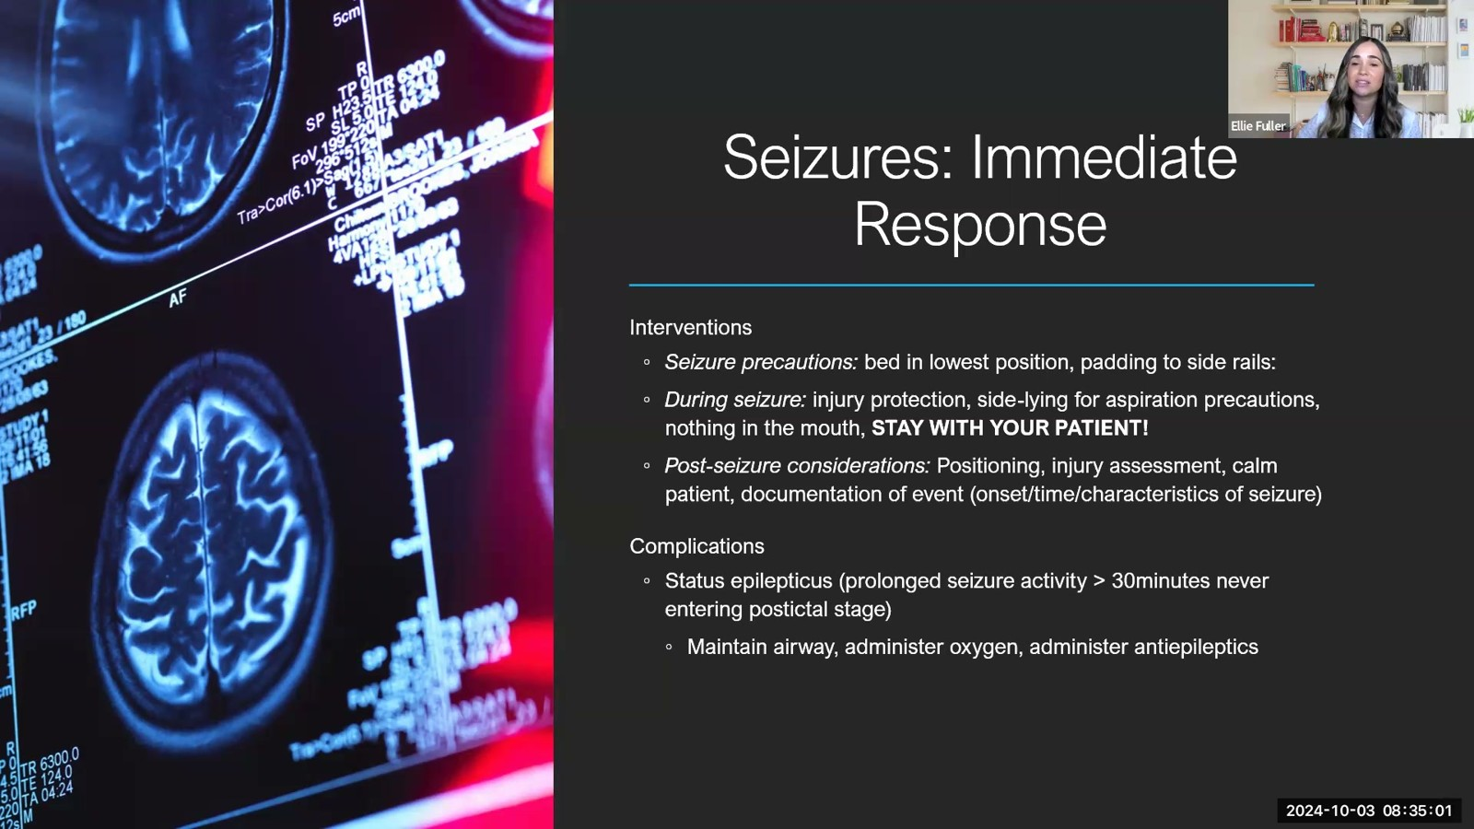
Notes:
Fuller · Week 7 · Neurologic & Neuromuscular
Recording time 59:57
https://drive.google.com/file/d/1jR3en5teZqX5G5iW1lLpJjqkuuBU5Go1/view

Slide 27
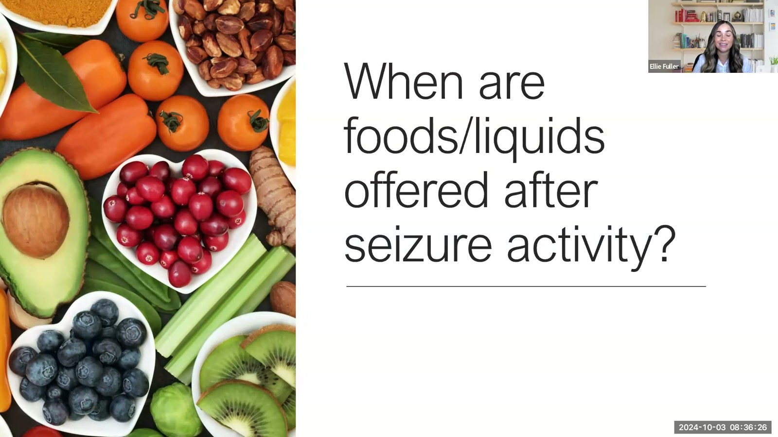
Notes:
Fuller · Week 7 · Neurologic & Neuromuscular
Recording time 61:22
https://drive.google.com/file/d/1jR3en5teZqX5G5iW1lLpJjqkuuBU5Go1/view

Slide 28
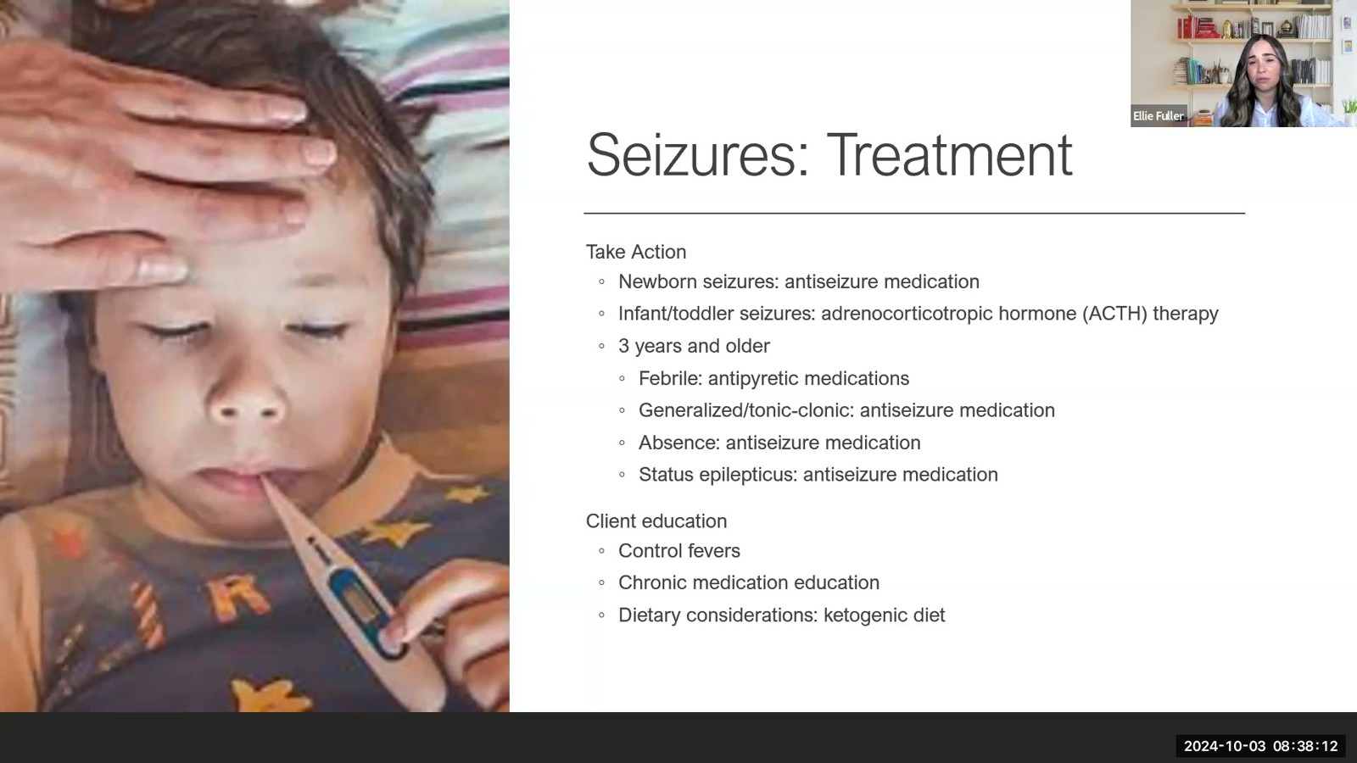
Notes:
Fuller · Week 7 · Neurologic & Neuromuscular
Recording time 63:08
https://drive.google.com/file/d/1jR3en5teZqX5G5iW1lLpJjqkuuBU5Go1/view

Slide 29
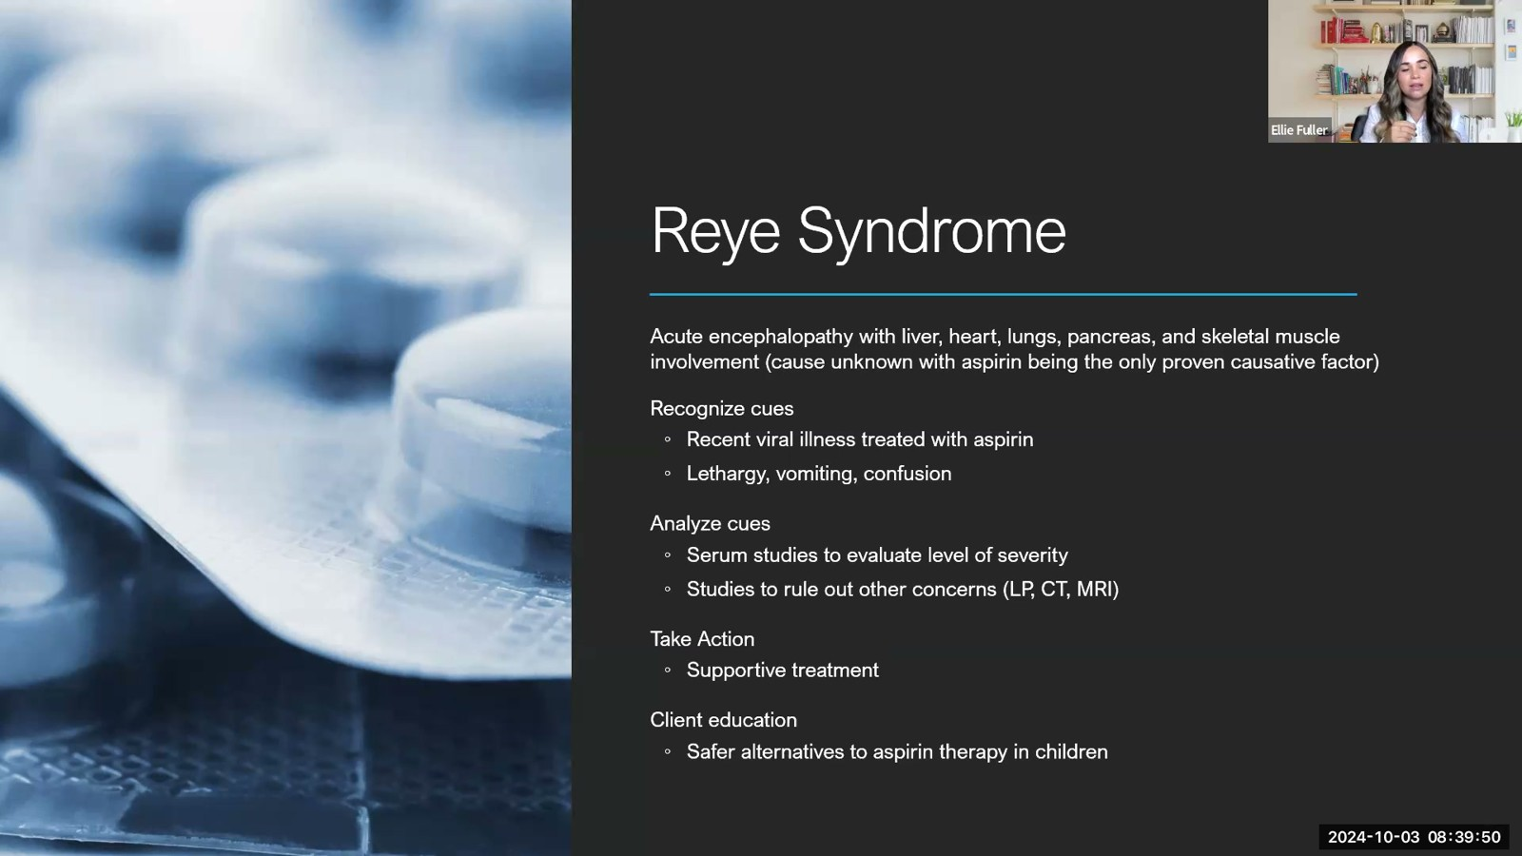
Notes:
Fuller · Week 7 · Neurologic & Neuromuscular
Recording time 64:46
https://drive.google.com/file/d/1jR3en5teZqX5G5iW1lLpJjqkuuBU5Go1/view

Slide 30
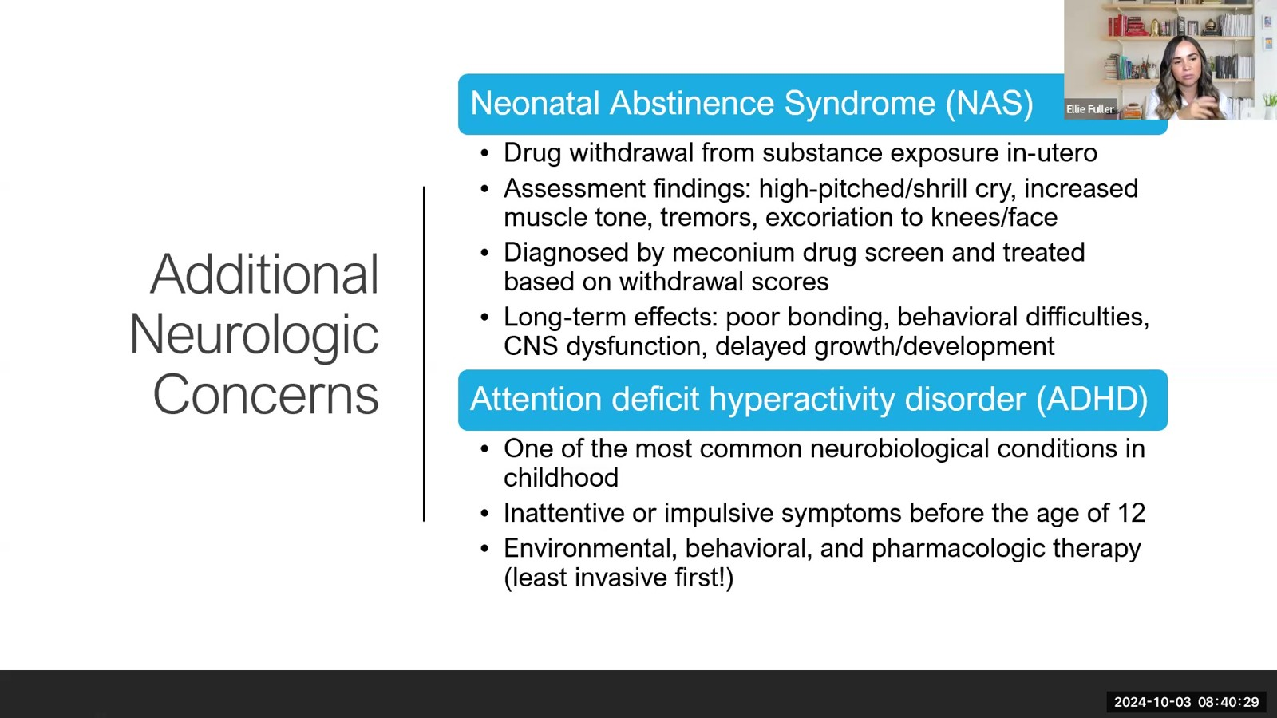
Notes:
Fuller · Week 7 · Neurologic & Neuromuscular
Recording time 65:25
https://drive.google.com/file/d/1jR3en5teZqX5G5iW1lLpJjqkuuBU5Go1/view

Slide 31
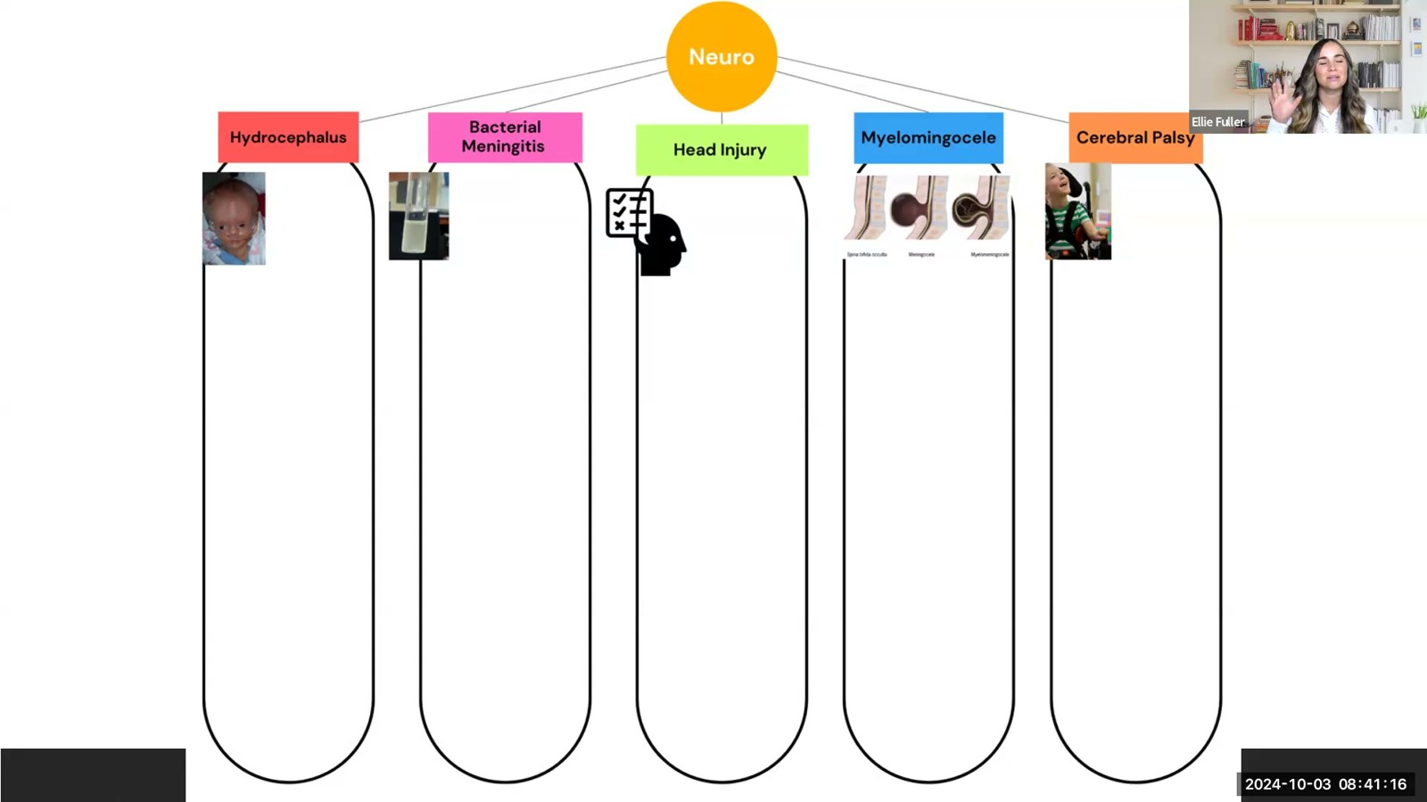
Notes:
Fuller · Week 7 · Neurologic & Neuromuscular
Recording time 66:12
https://drive.google.com/file/d/1jR3en5teZqX5G5iW1lLpJjqkuuBU5Go1/view

