Slide 1

NUR 235 / WEEK 8 / FULLER
Respiratory
Breath sounds, croup, asthma and cystic fibrosis
Study copy made from slides shown in the recorded lecture
Notes:
Source recording: https://drive.google.com/file/d/1swgiP1NKBL7E7FD08zoBzhX_ZiDsVBam/view
University logo: https://www.joyce.edu/
Prepared for independent study. Original course slides are linked separately in the Study Hub.

Slide 2
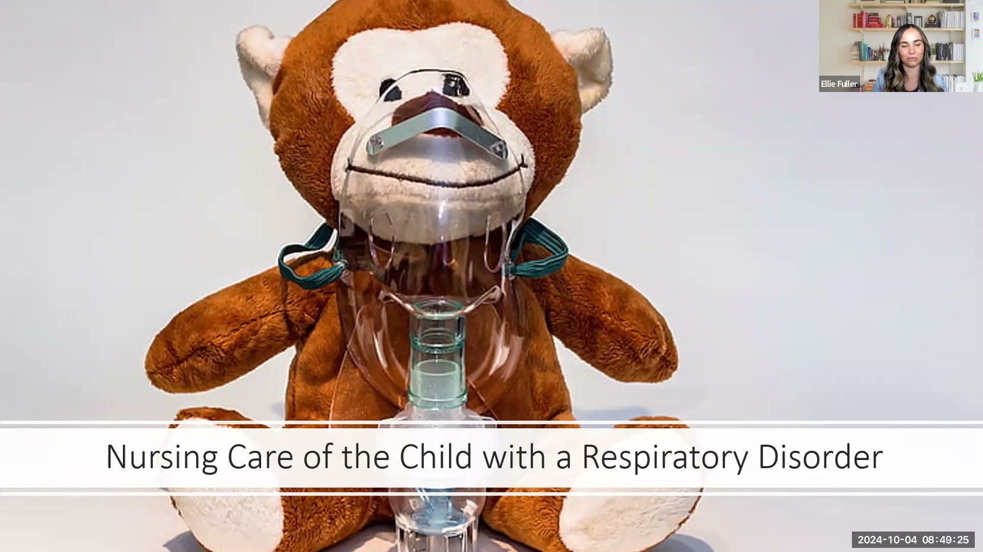
Notes:
Fuller · Week 8 · Respiratory
Recording time 0:47
https://drive.google.com/file/d/1swgiP1NKBL7E7FD08zoBzhX_ZiDsVBam/view

Slide 3
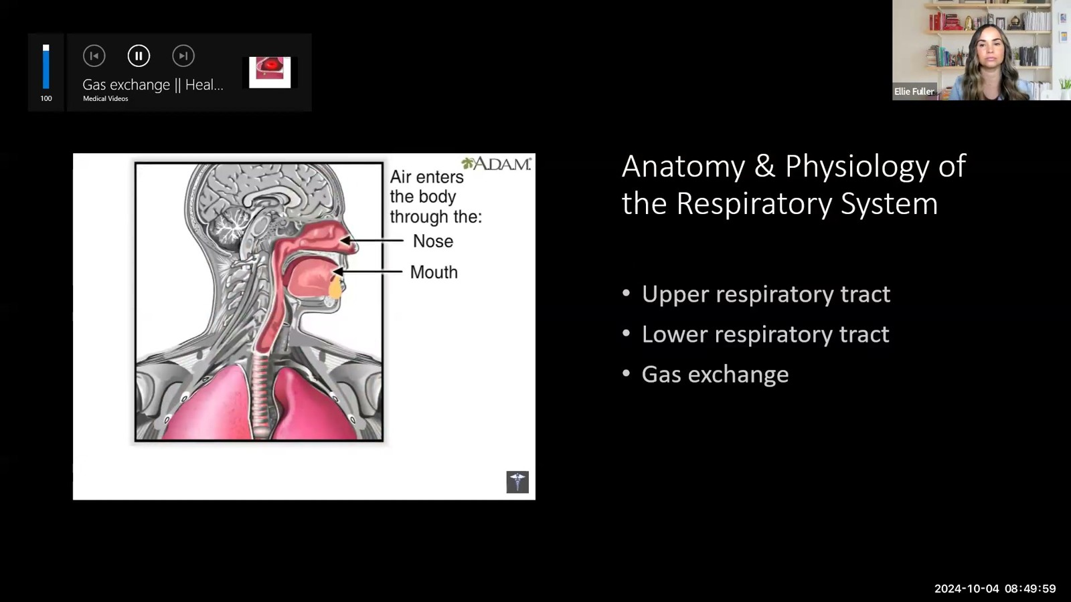
Notes:
Fuller · Week 8 · Respiratory
Recording time 1:21
https://drive.google.com/file/d/1swgiP1NKBL7E7FD08zoBzhX_ZiDsVBam/view

Slide 4
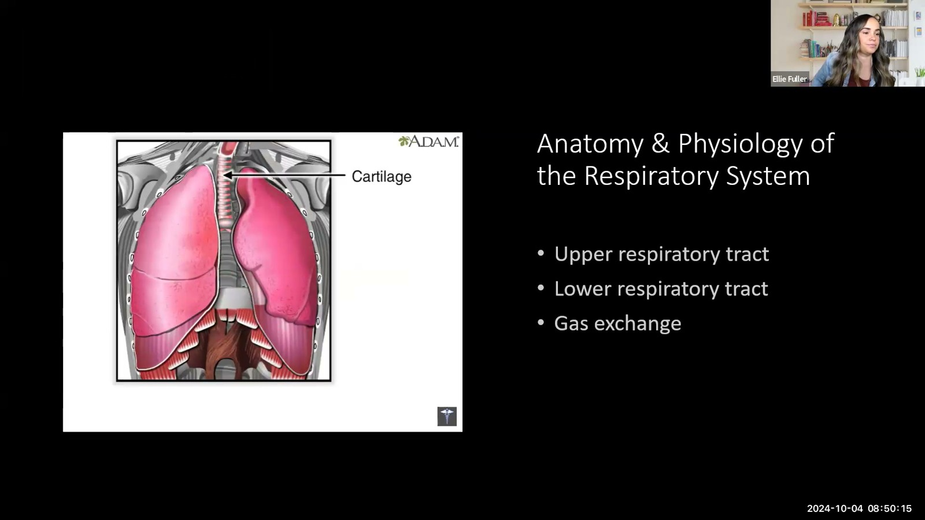
Notes:
Fuller · Week 8 · Respiratory
Recording time 1:37
https://drive.google.com/file/d/1swgiP1NKBL7E7FD08zoBzhX_ZiDsVBam/view

Slide 5
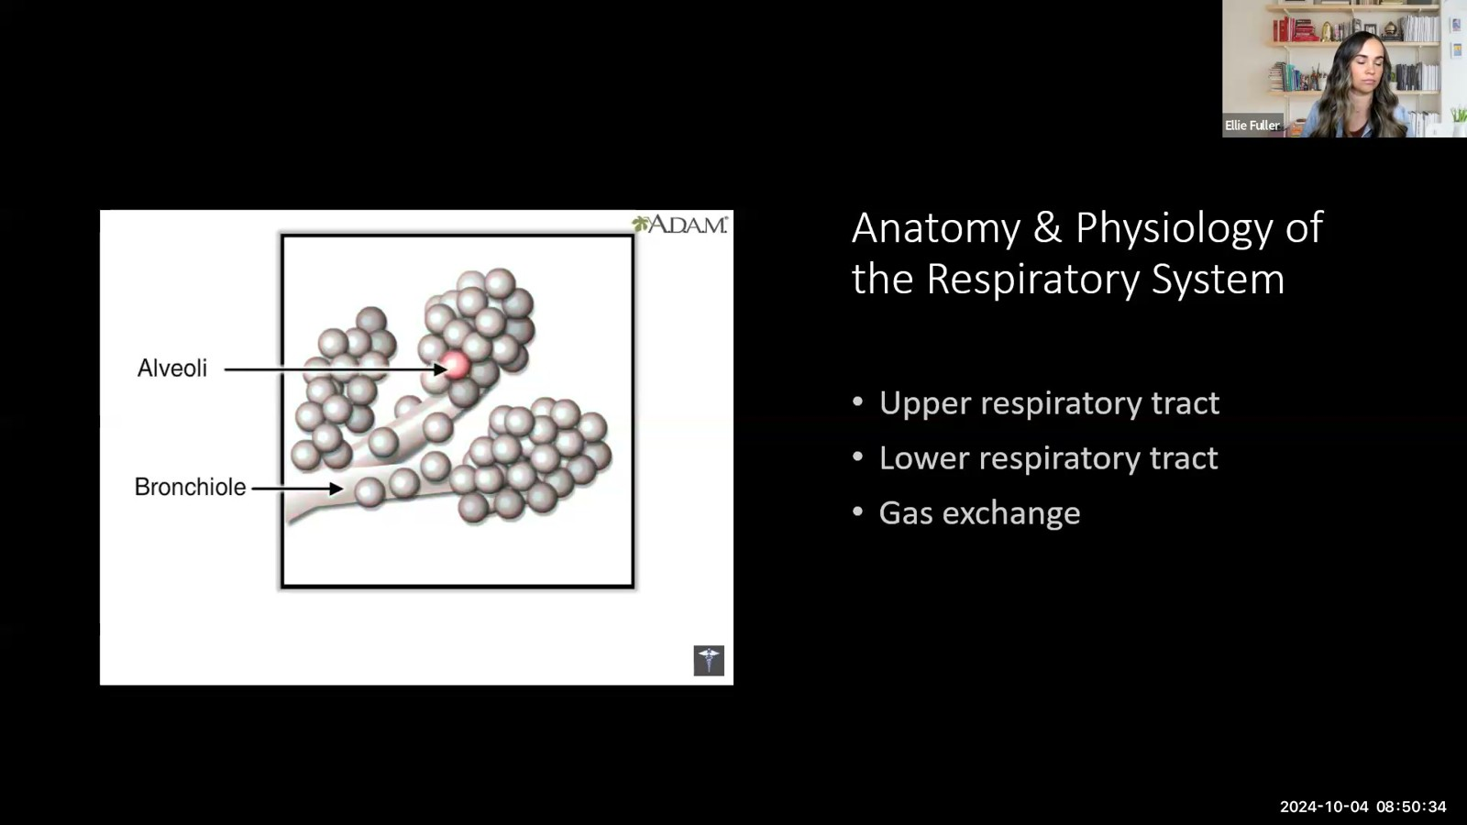
Notes:
Fuller · Week 8 · Respiratory
Recording time 1:56
https://drive.google.com/file/d/1swgiP1NKBL7E7FD08zoBzhX_ZiDsVBam/view

Slide 6
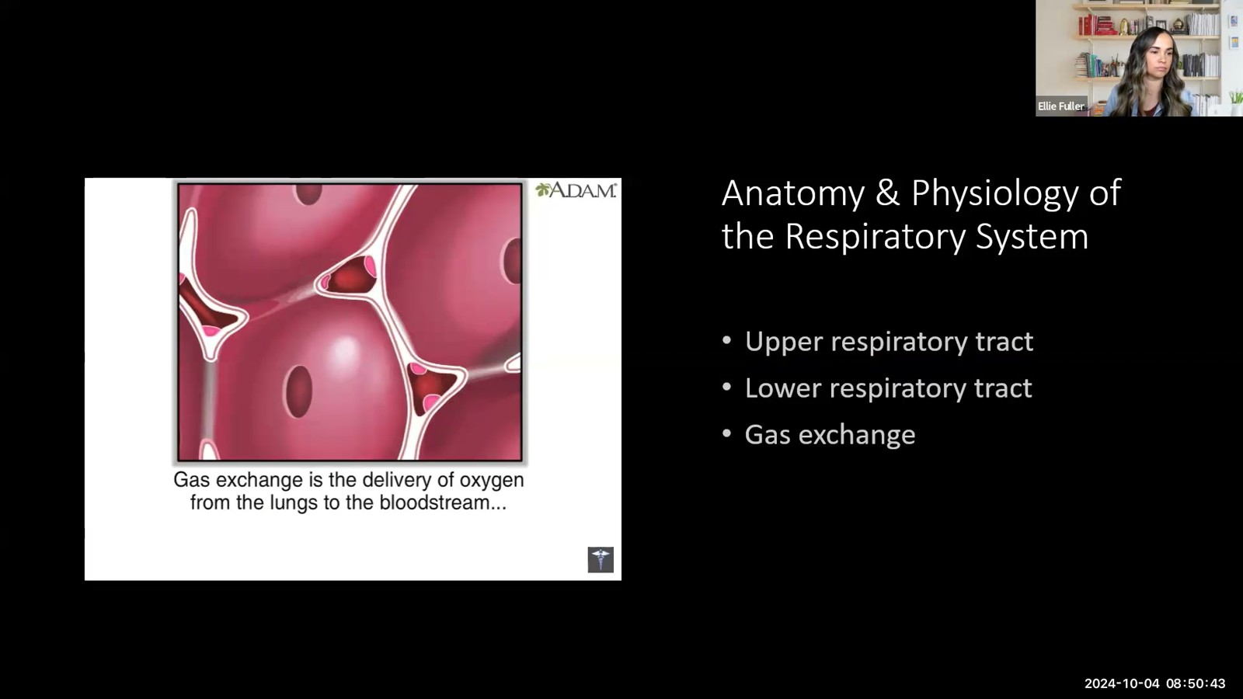
Notes:
Fuller · Week 8 · Respiratory
Recording time 2:05
https://drive.google.com/file/d/1swgiP1NKBL7E7FD08zoBzhX_ZiDsVBam/view

Slide 7
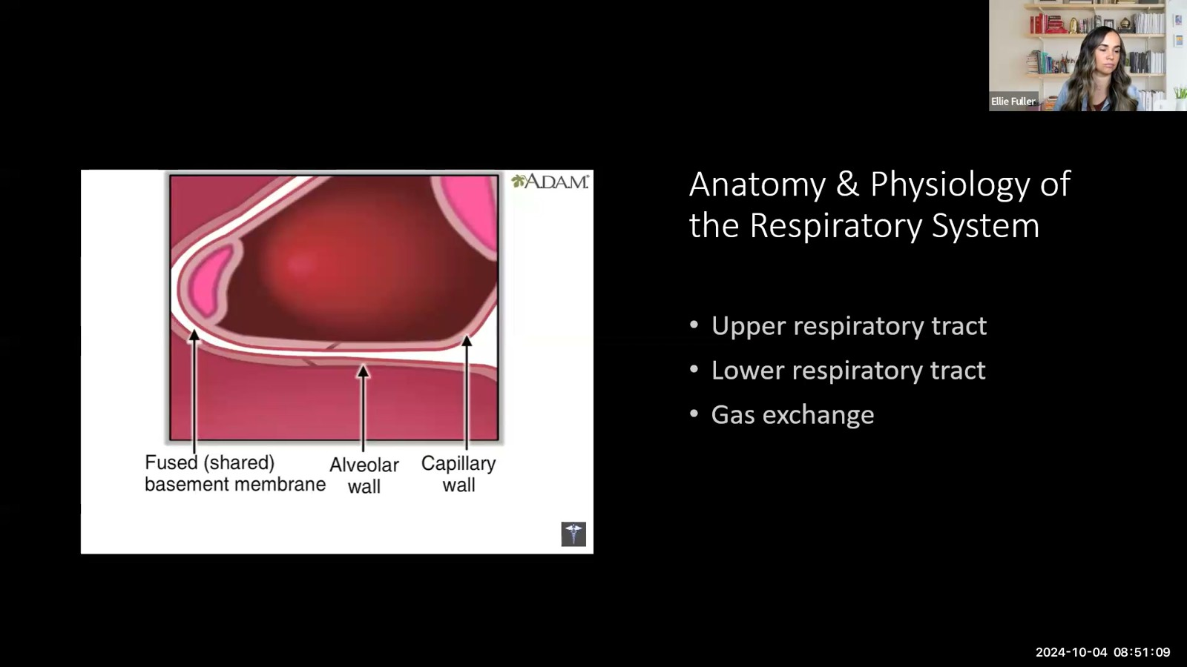
Notes:
Fuller · Week 8 · Respiratory
Recording time 2:31
https://drive.google.com/file/d/1swgiP1NKBL7E7FD08zoBzhX_ZiDsVBam/view

Slide 8
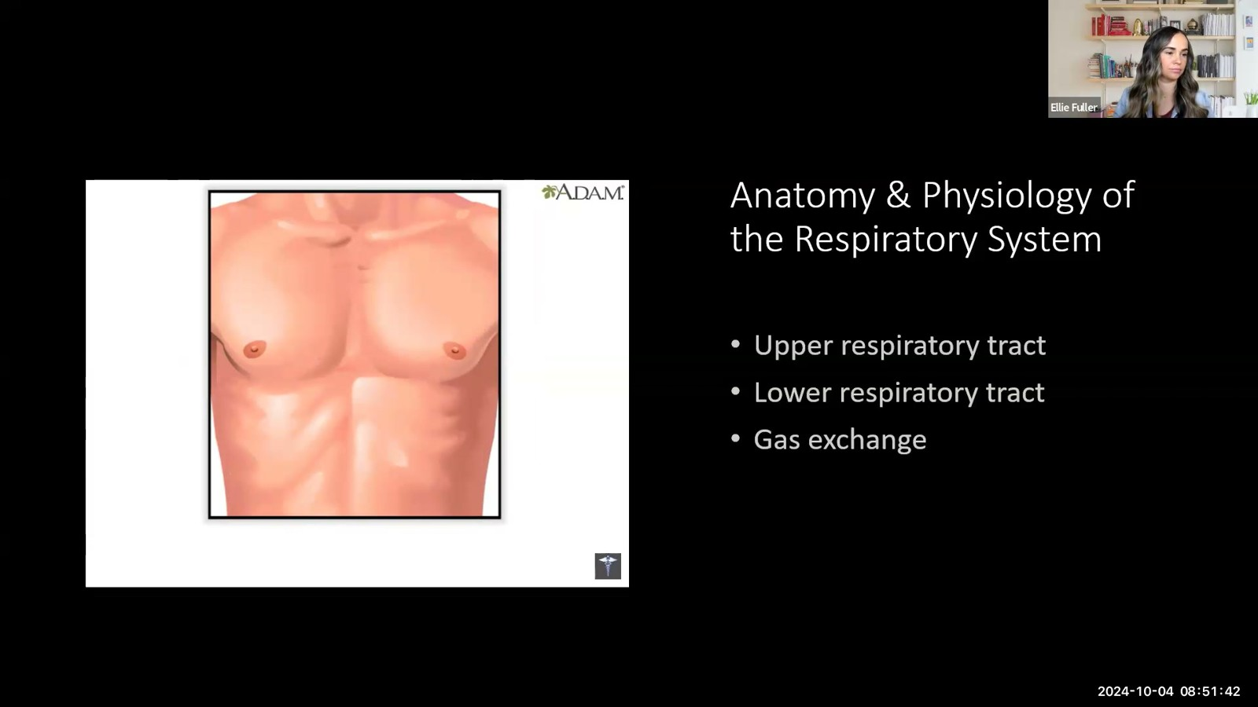
Notes:
Fuller · Week 8 · Respiratory
Recording time 3:04
https://drive.google.com/file/d/1swgiP1NKBL7E7FD08zoBzhX_ZiDsVBam/view

Slide 9
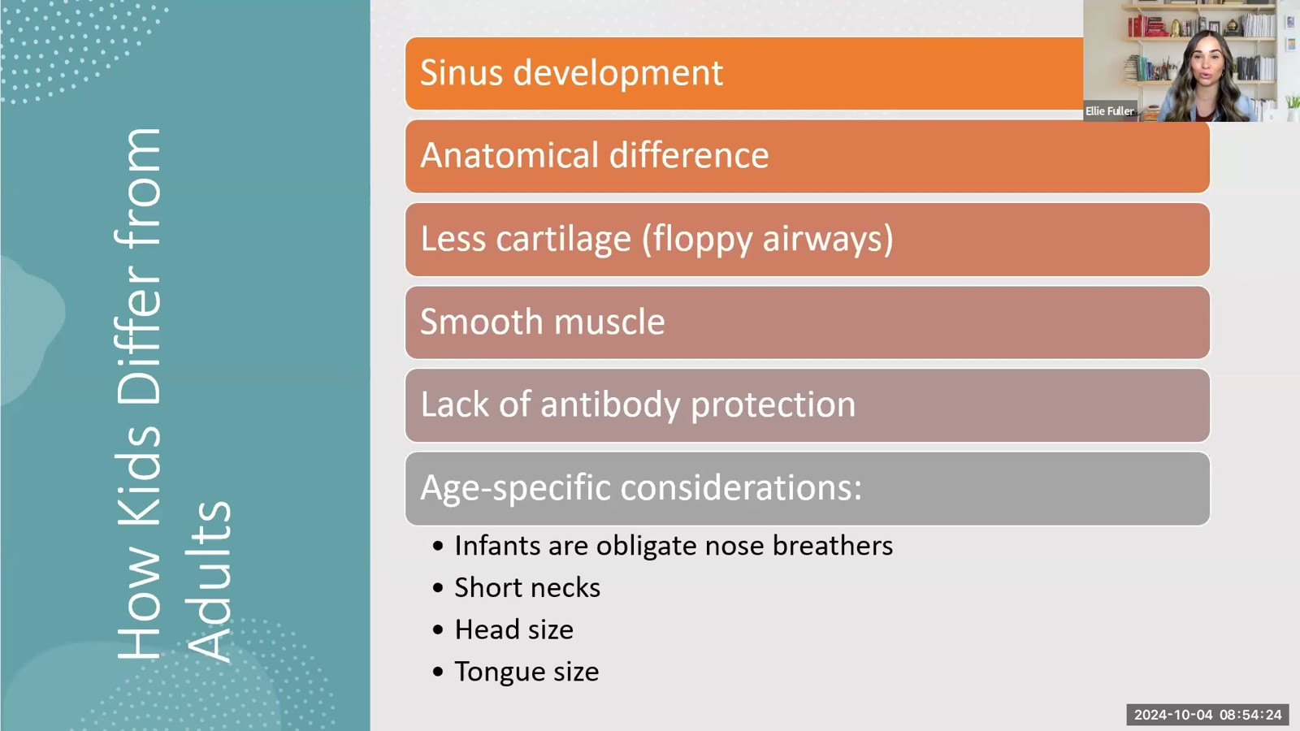
Notes:
Fuller · Week 8 · Respiratory
Recording time 5:46
https://drive.google.com/file/d/1swgiP1NKBL7E7FD08zoBzhX_ZiDsVBam/view

Slide 10
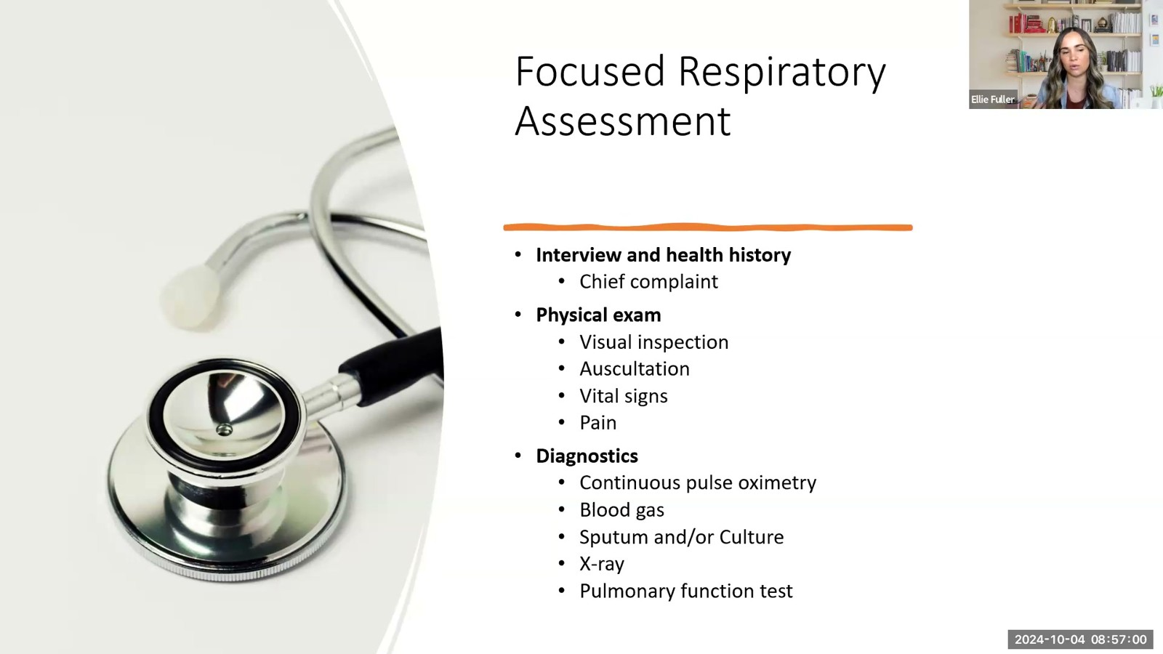
Notes:
Fuller · Week 8 · Respiratory
Recording time 8:22
https://drive.google.com/file/d/1swgiP1NKBL7E7FD08zoBzhX_ZiDsVBam/view

Slide 11
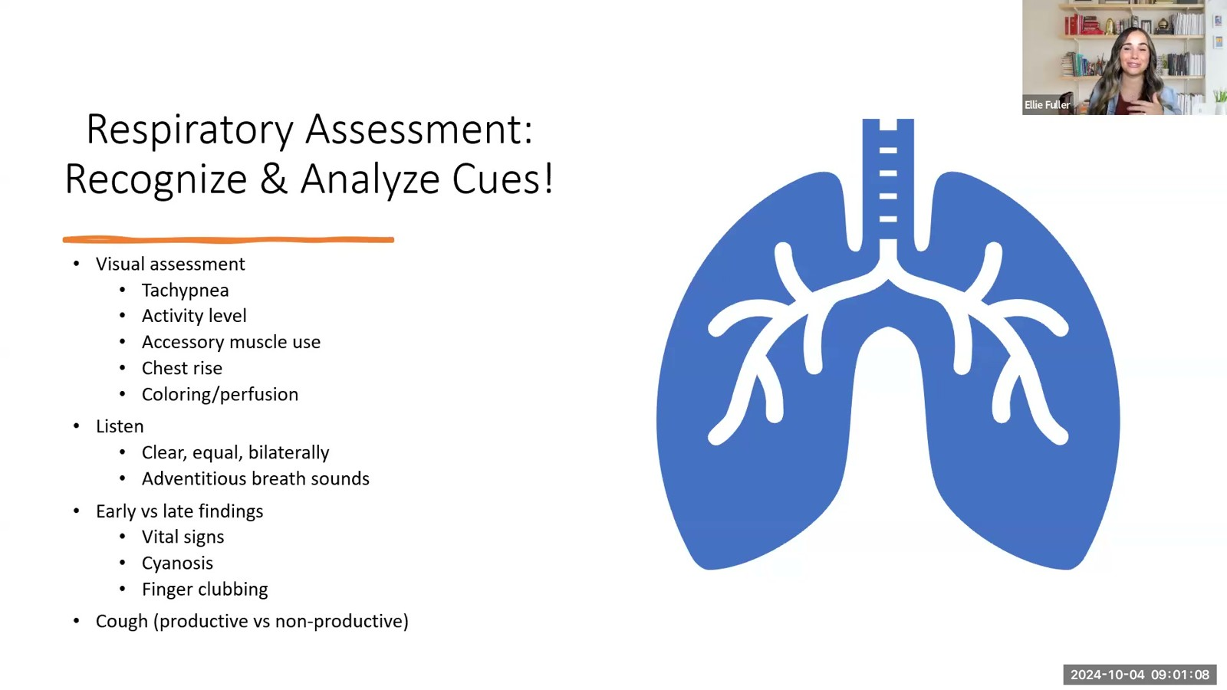
Notes:
Fuller · Week 8 · Respiratory
Recording time 12:30
https://drive.google.com/file/d/1swgiP1NKBL7E7FD08zoBzhX_ZiDsVBam/view

Slide 12
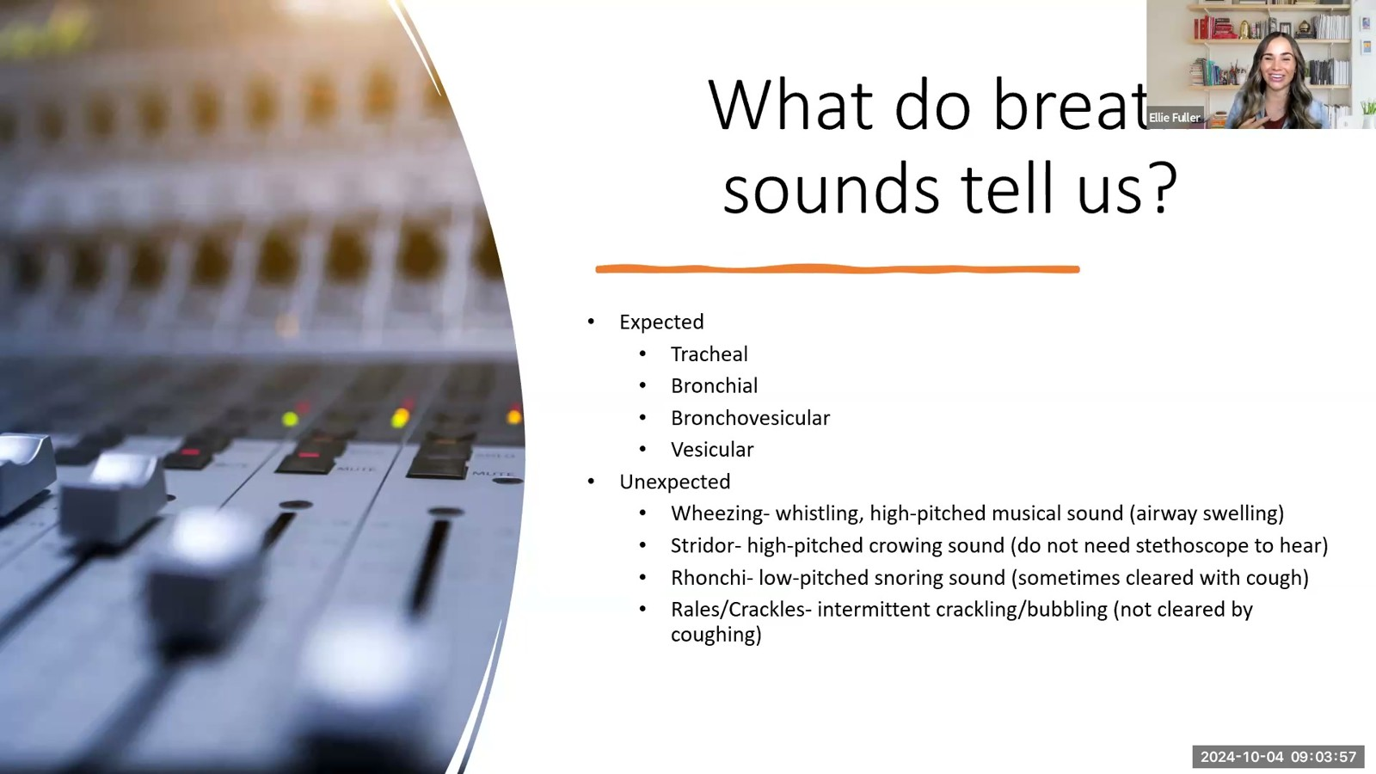
Notes:
Fuller · Week 8 · Respiratory
Recording time 15:19
https://drive.google.com/file/d/1swgiP1NKBL7E7FD08zoBzhX_ZiDsVBam/view

Slide 13
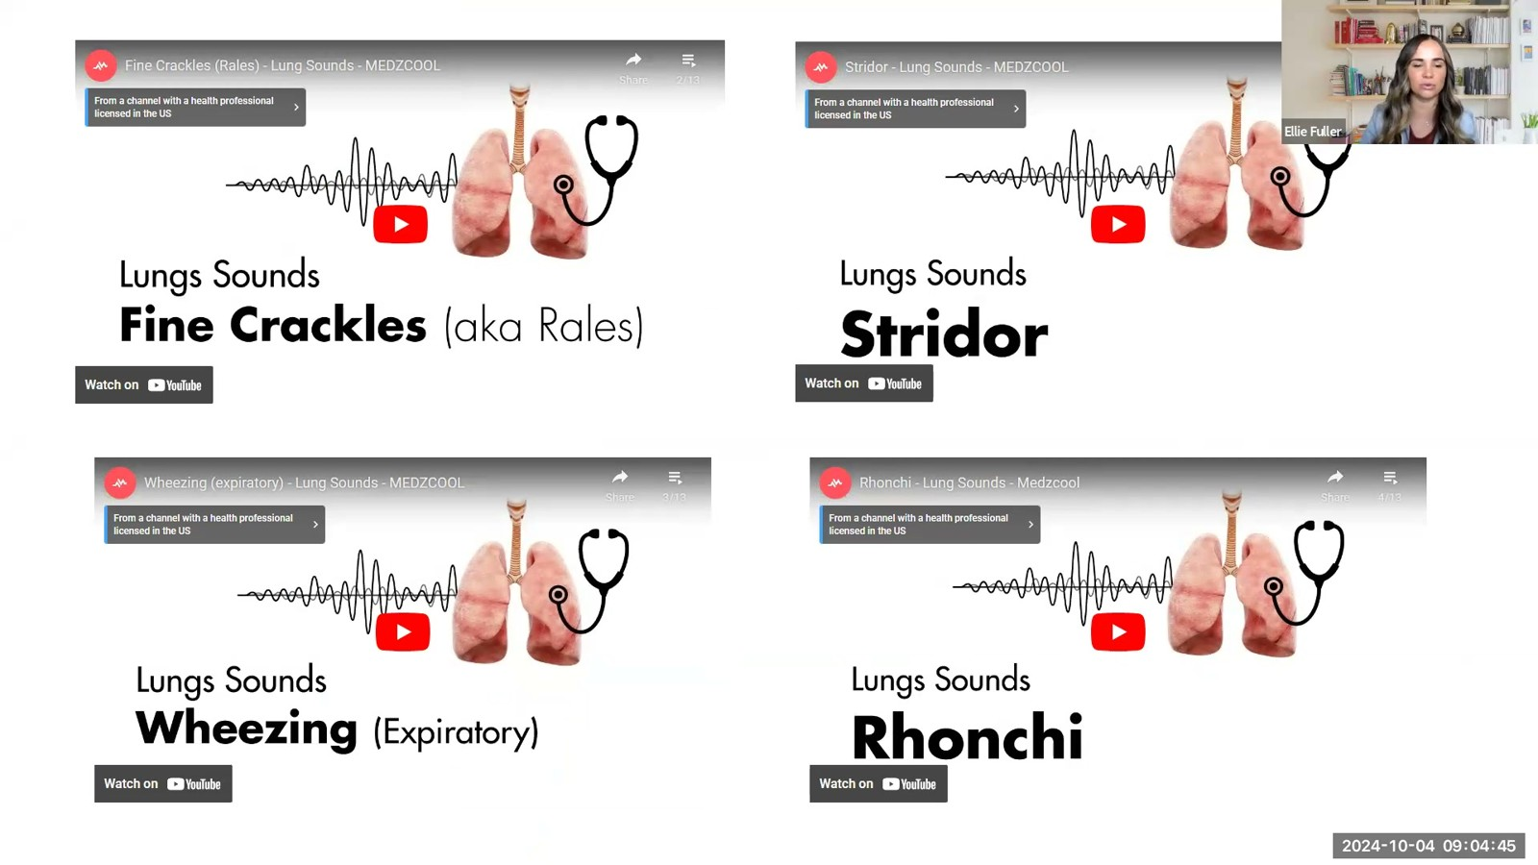
Notes:
Fuller · Week 8 · Respiratory
Recording time 16:07
https://drive.google.com/file/d/1swgiP1NKBL7E7FD08zoBzhX_ZiDsVBam/view

Slide 14
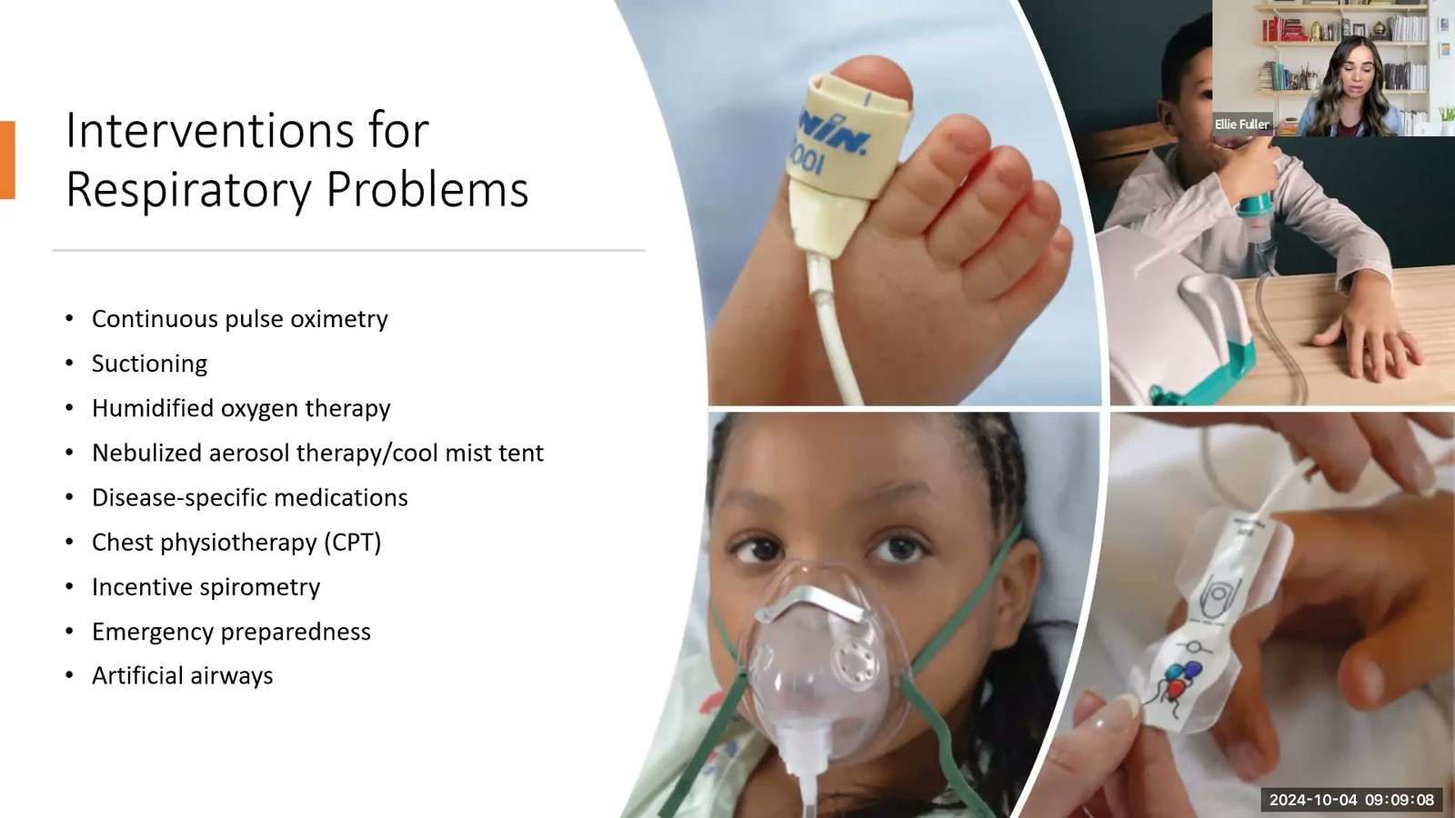
Notes:
Fuller · Week 8 · Respiratory
Recording time 20:30
https://drive.google.com/file/d/1swgiP1NKBL7E7FD08zoBzhX_ZiDsVBam/view

Slide 15
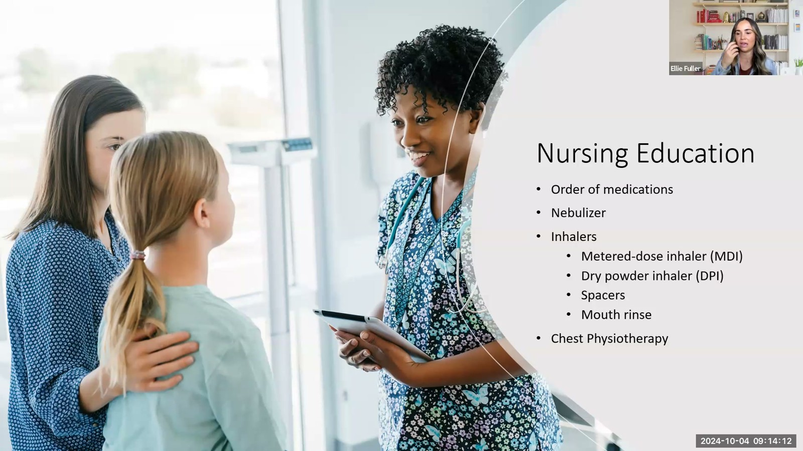
Notes:
Fuller · Week 8 · Respiratory
Recording time 25:34
https://drive.google.com/file/d/1swgiP1NKBL7E7FD08zoBzhX_ZiDsVBam/view

Slide 16
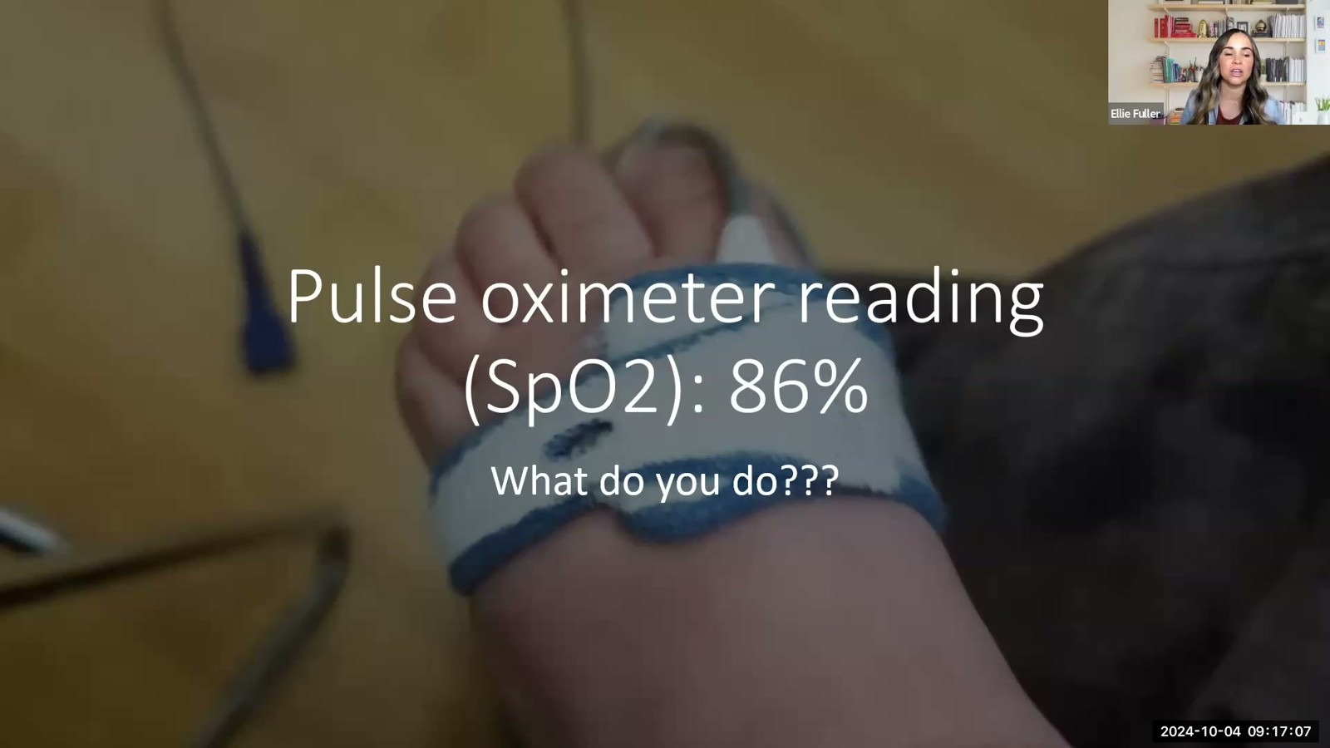
Notes:
Fuller · Week 8 · Respiratory
Recording time 28:29
https://drive.google.com/file/d/1swgiP1NKBL7E7FD08zoBzhX_ZiDsVBam/view

Slide 17

Notes:
Fuller · Week 8 · Respiratory
Recording time 29:36
https://drive.google.com/file/d/1swgiP1NKBL7E7FD08zoBzhX_ZiDsVBam/view

Slide 18
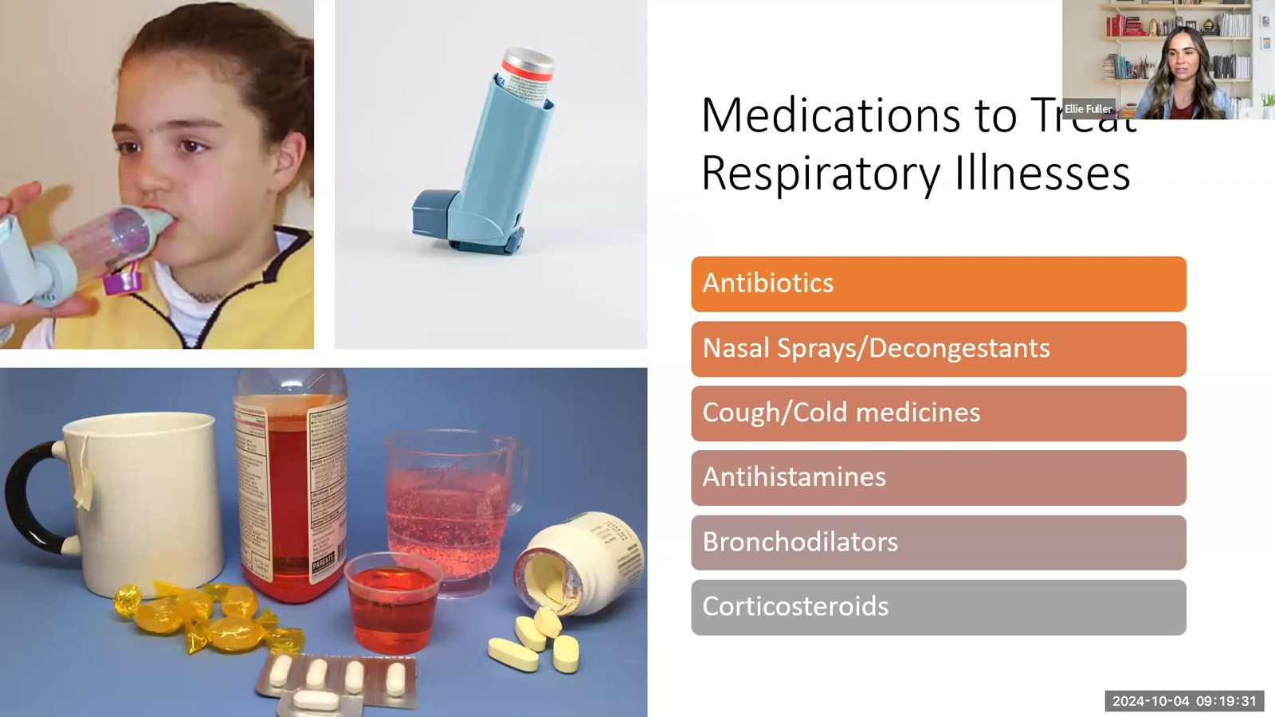
Notes:
Fuller · Week 8 · Respiratory
Recording time 30:53
https://drive.google.com/file/d/1swgiP1NKBL7E7FD08zoBzhX_ZiDsVBam/view

Slide 19

Notes:
Fuller · Week 8 · Respiratory
Recording time 31:53
https://drive.google.com/file/d/1swgiP1NKBL7E7FD08zoBzhX_ZiDsVBam/view

Slide 20
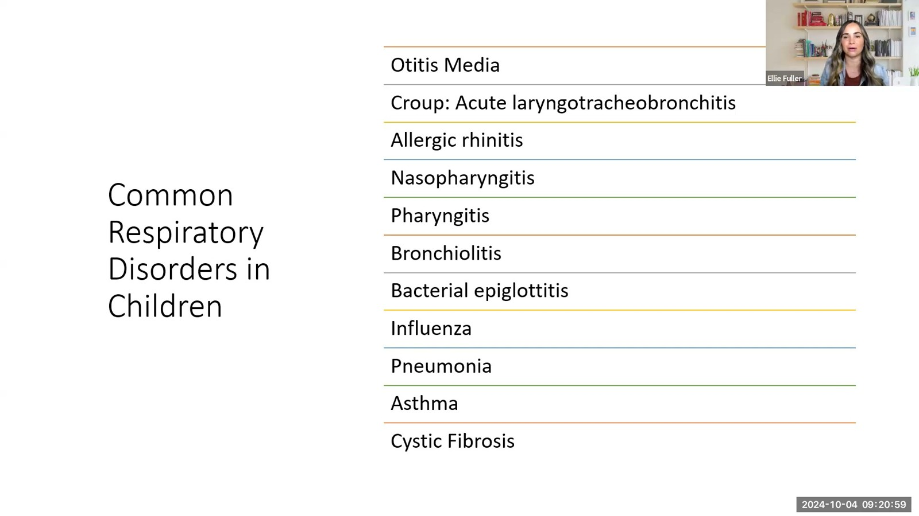
Notes:
Fuller · Week 8 · Respiratory
Recording time 32:21
https://drive.google.com/file/d/1swgiP1NKBL7E7FD08zoBzhX_ZiDsVBam/view

Slide 21
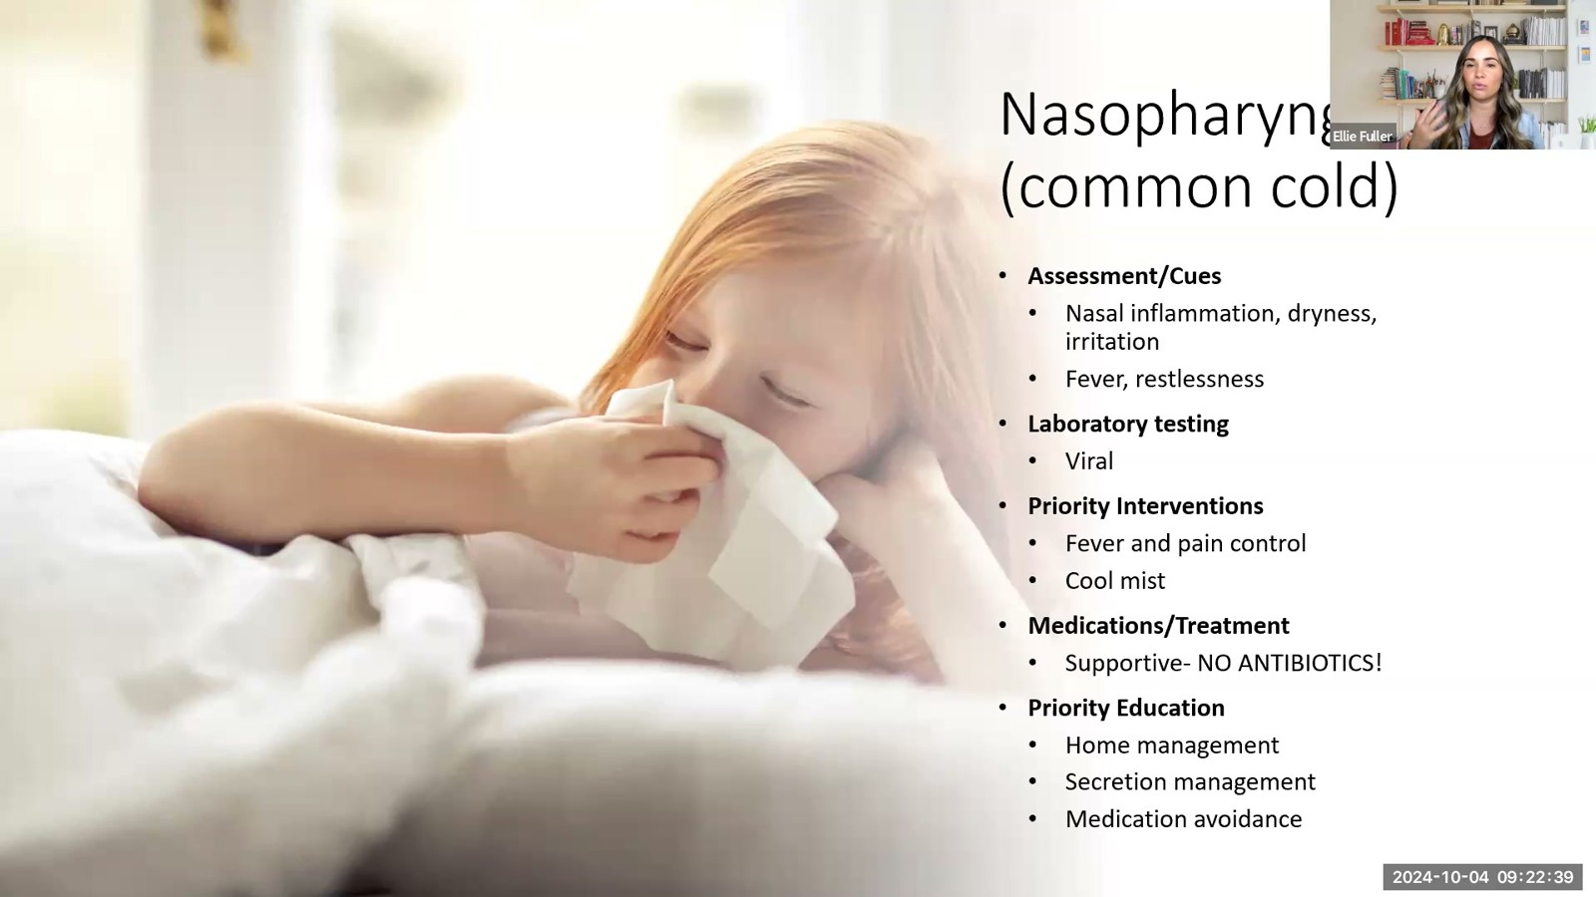
Notes:
Fuller · Week 8 · Respiratory
Recording time 34:01
https://drive.google.com/file/d/1swgiP1NKBL7E7FD08zoBzhX_ZiDsVBam/view

Slide 22
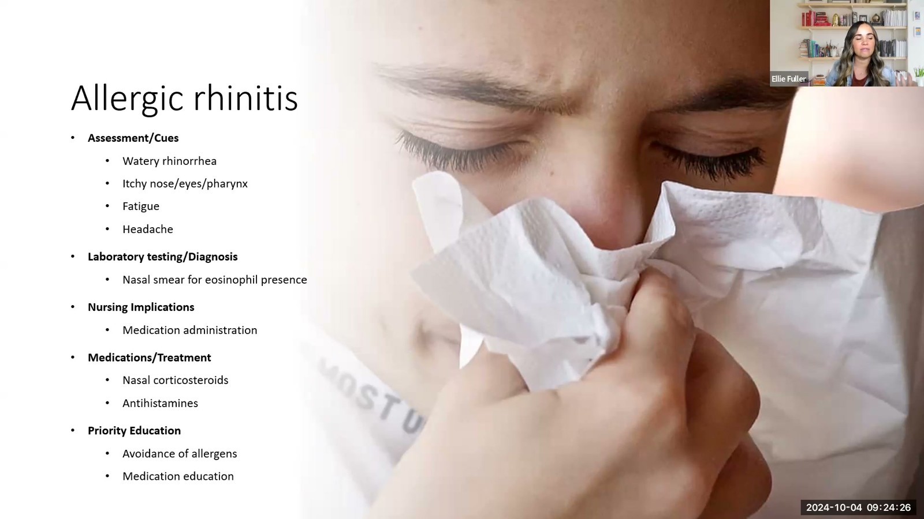
Notes:
Fuller · Week 8 · Respiratory
Recording time 35:48
https://drive.google.com/file/d/1swgiP1NKBL7E7FD08zoBzhX_ZiDsVBam/view

Slide 23
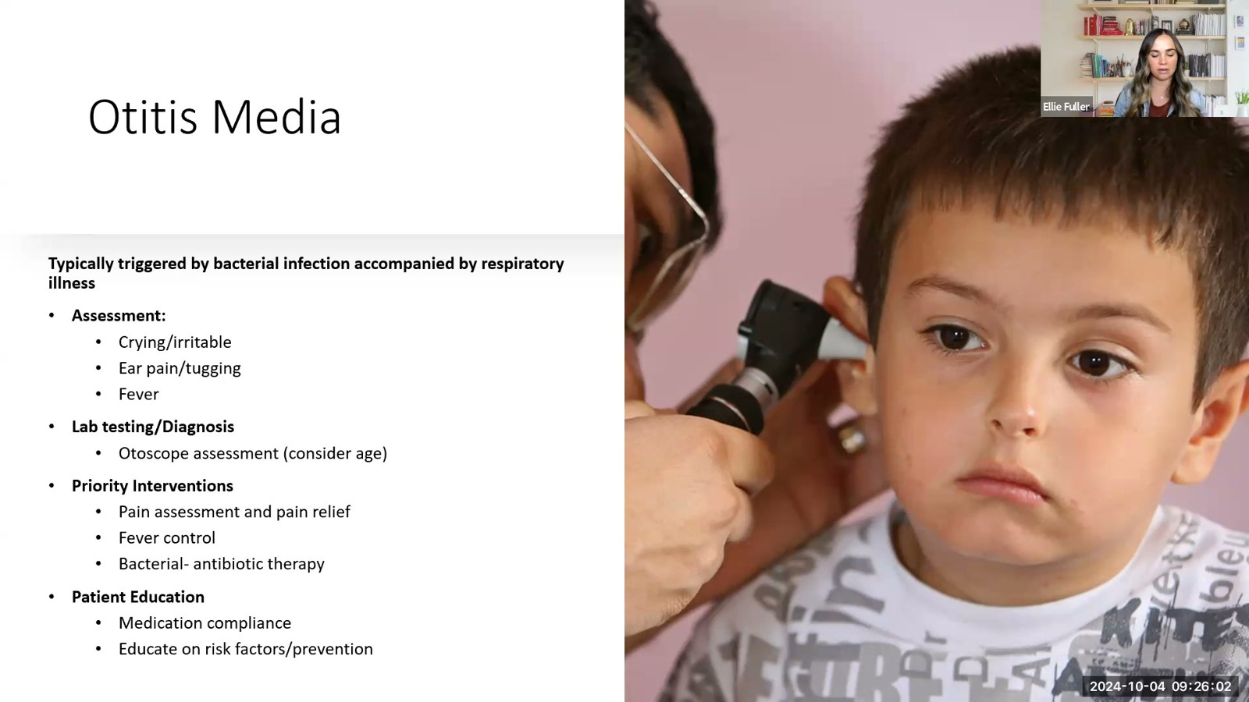
Notes:
Fuller · Week 8 · Respiratory
Recording time 37:24
https://drive.google.com/file/d/1swgiP1NKBL7E7FD08zoBzhX_ZiDsVBam/view

Slide 24
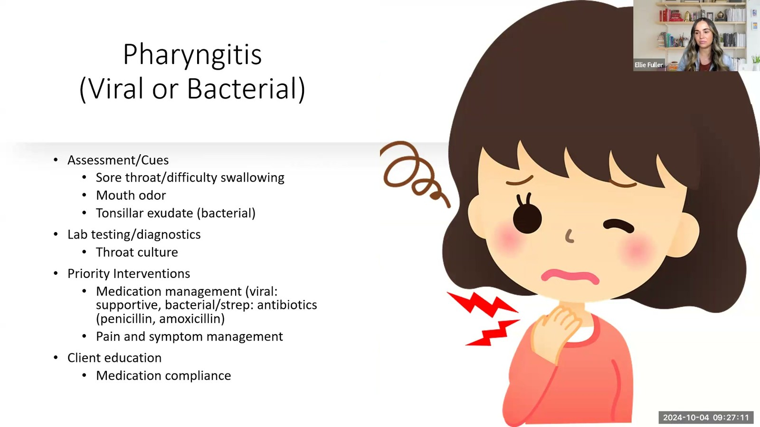
Notes:
Fuller · Week 8 · Respiratory
Recording time 38:33
https://drive.google.com/file/d/1swgiP1NKBL7E7FD08zoBzhX_ZiDsVBam/view

Slide 25
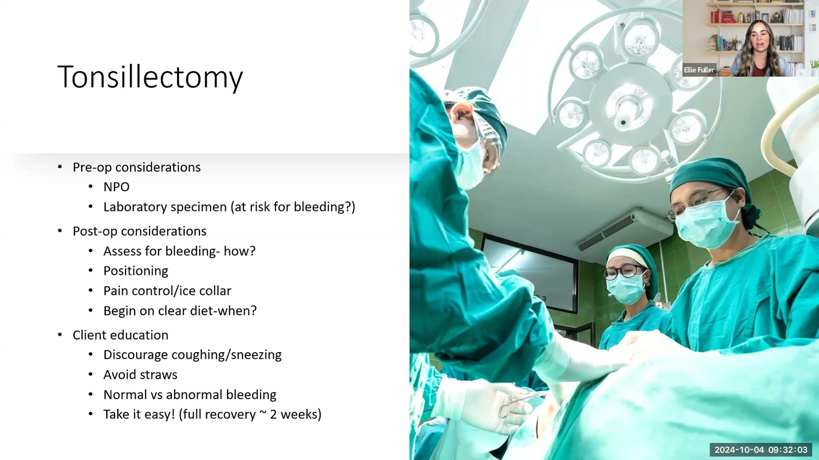
Notes:
Fuller · Week 8 · Respiratory
Recording time 43:25
https://drive.google.com/file/d/1swgiP1NKBL7E7FD08zoBzhX_ZiDsVBam/view

Slide 26
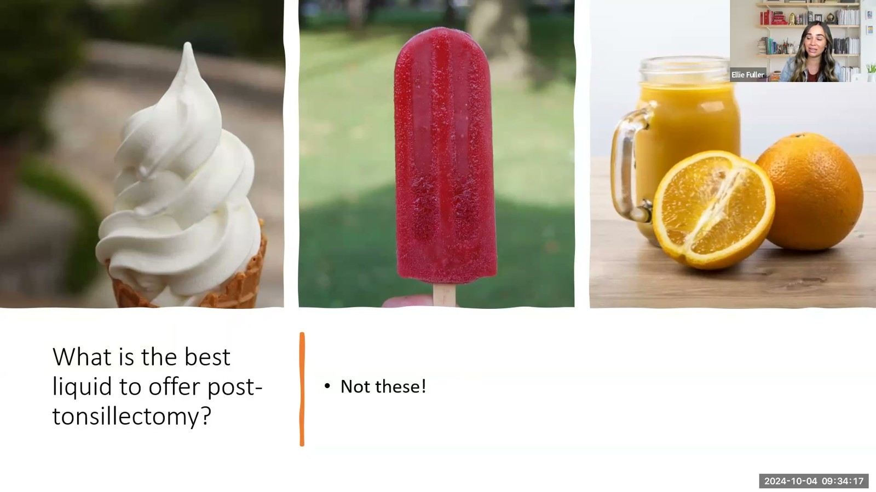
Notes:
Fuller · Week 8 · Respiratory
Recording time 45:39
https://drive.google.com/file/d/1swgiP1NKBL7E7FD08zoBzhX_ZiDsVBam/view

Slide 27
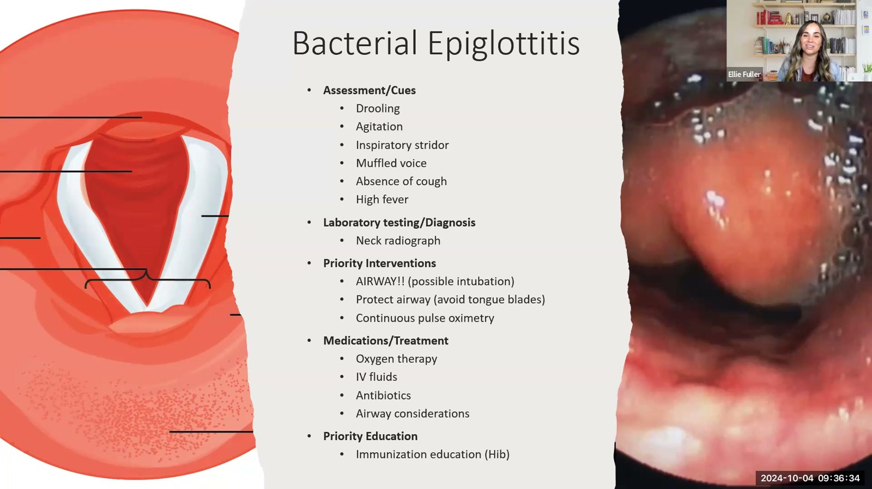
Notes:
Fuller · Week 8 · Respiratory
Recording time 47:56
https://drive.google.com/file/d/1swgiP1NKBL7E7FD08zoBzhX_ZiDsVBam/view

Slide 28
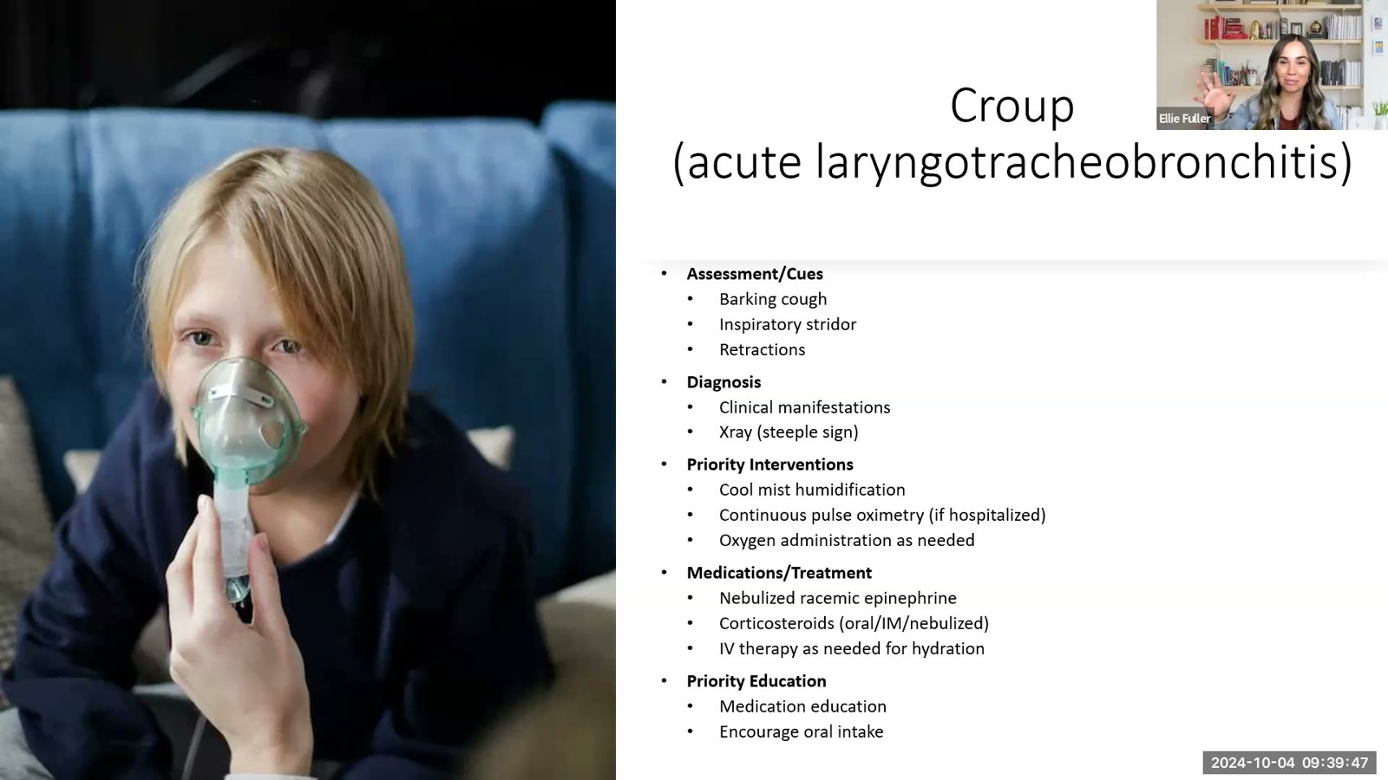
Notes:
Fuller · Week 8 · Respiratory
Recording time 51:09
https://drive.google.com/file/d/1swgiP1NKBL7E7FD08zoBzhX_ZiDsVBam/view

Slide 29
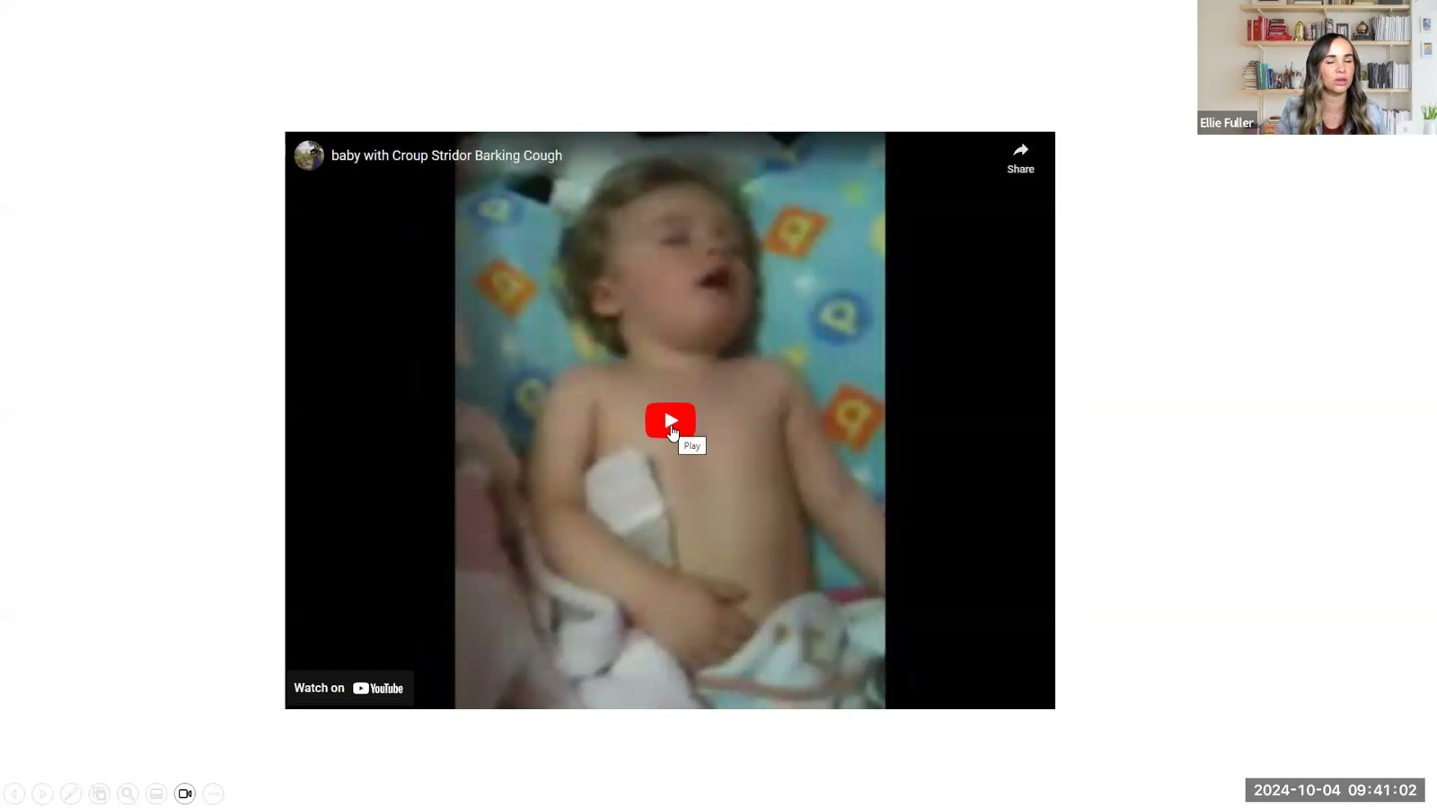
Notes:
Fuller · Week 8 · Respiratory
Recording time 52:24
https://drive.google.com/file/d/1swgiP1NKBL7E7FD08zoBzhX_ZiDsVBam/view

Slide 30
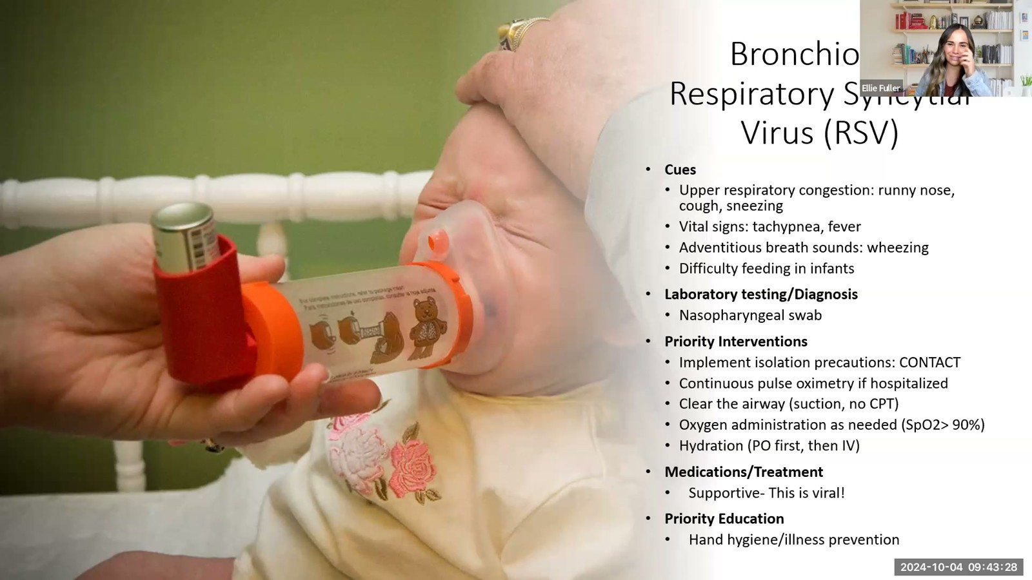
Notes:
Fuller · Week 8 · Respiratory
Recording time 54:50
https://drive.google.com/file/d/1swgiP1NKBL7E7FD08zoBzhX_ZiDsVBam/view

Slide 31
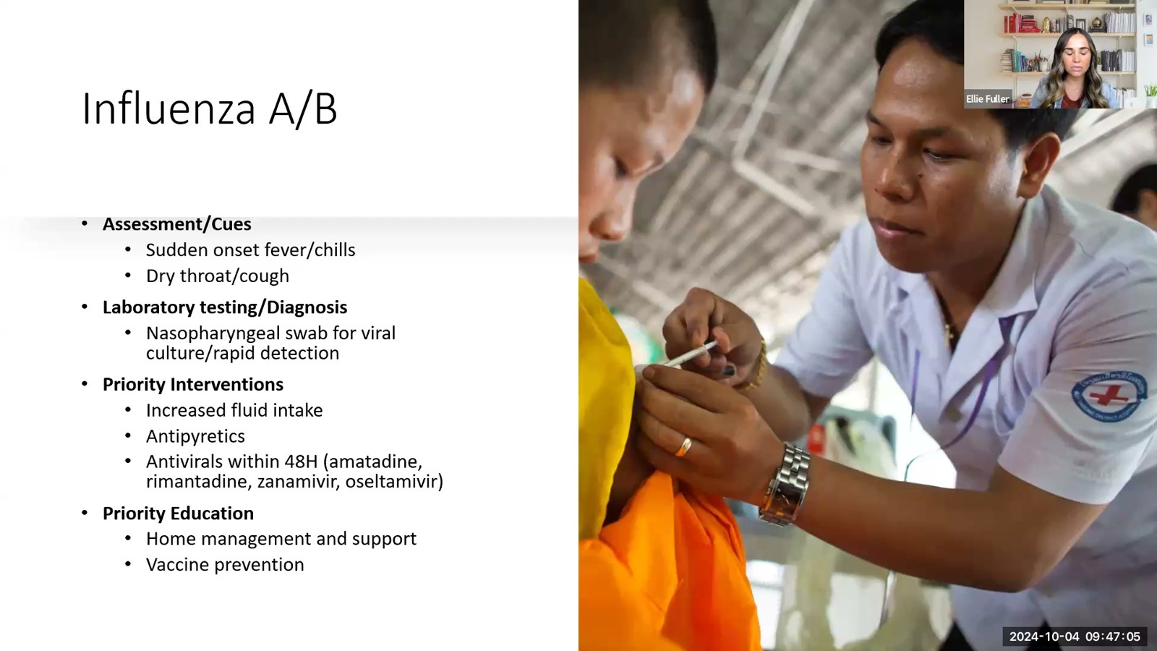
Notes:
Fuller · Week 8 · Respiratory
Recording time 58:27
https://drive.google.com/file/d/1swgiP1NKBL7E7FD08zoBzhX_ZiDsVBam/view

Slide 32
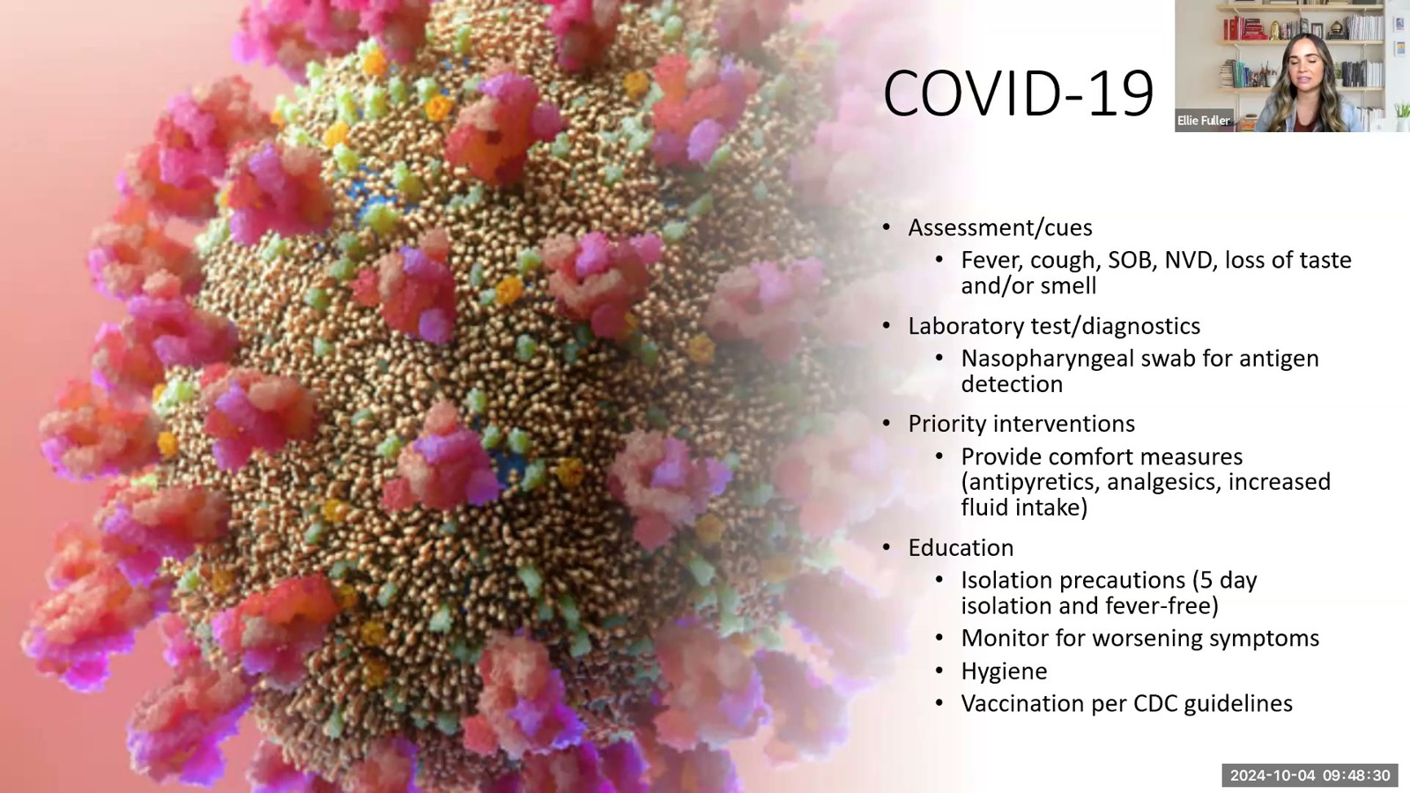
Notes:
Fuller · Week 8 · Respiratory
Recording time 59:52
https://drive.google.com/file/d/1swgiP1NKBL7E7FD08zoBzhX_ZiDsVBam/view

Slide 33
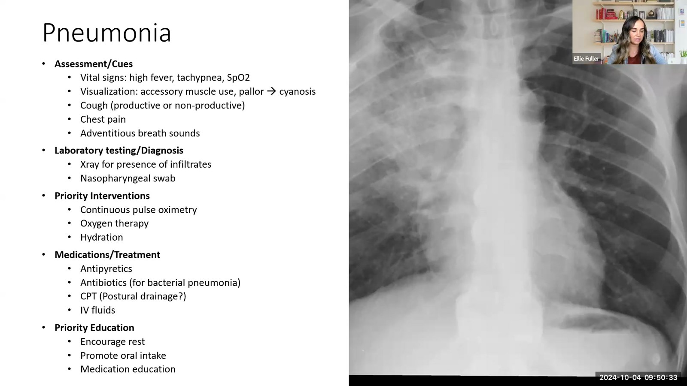
Notes:
Fuller · Week 8 · Respiratory
Recording time 61:55
https://drive.google.com/file/d/1swgiP1NKBL7E7FD08zoBzhX_ZiDsVBam/view

Slide 34
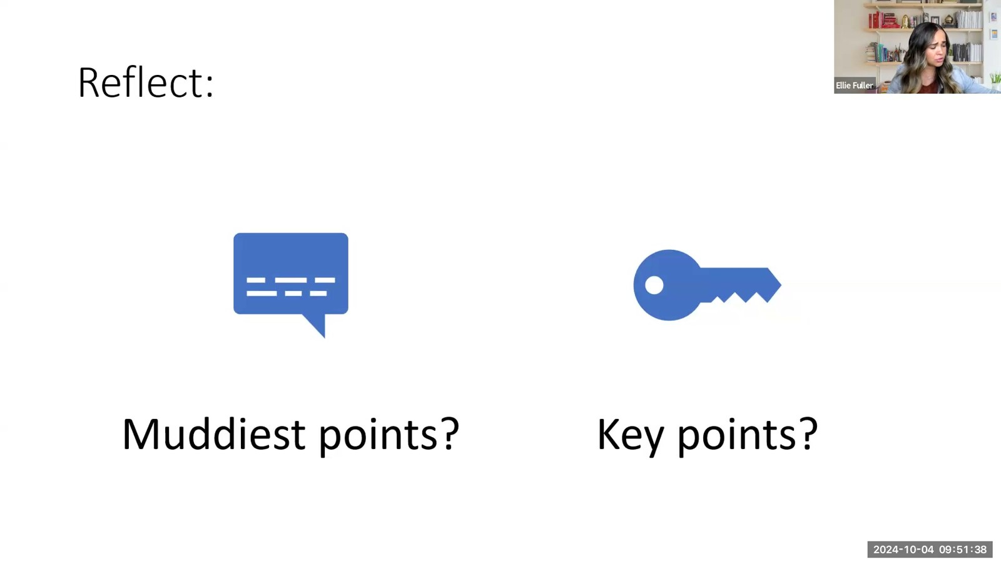
Notes:
Fuller · Week 8 · Respiratory
Recording time 63:00
https://drive.google.com/file/d/1swgiP1NKBL7E7FD08zoBzhX_ZiDsVBam/view

Slide 35
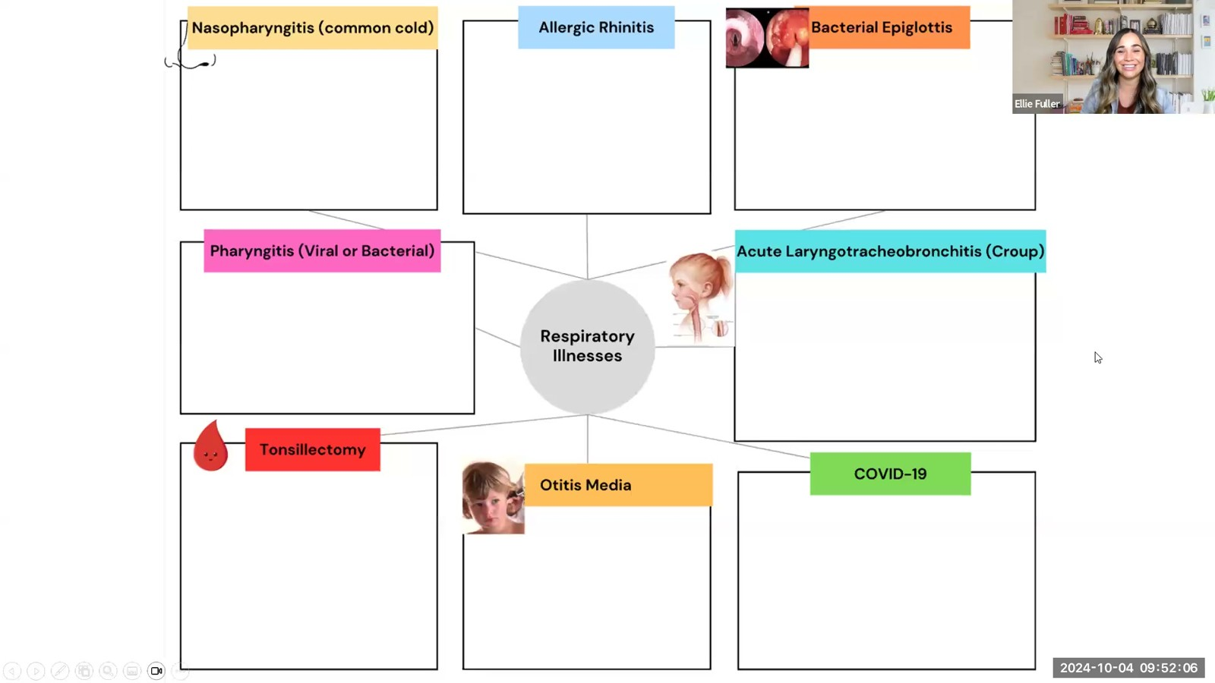
Notes:
Fuller · Week 8 · Respiratory
Recording time 63:28
https://drive.google.com/file/d/1swgiP1NKBL7E7FD08zoBzhX_ZiDsVBam/view

Slide 36
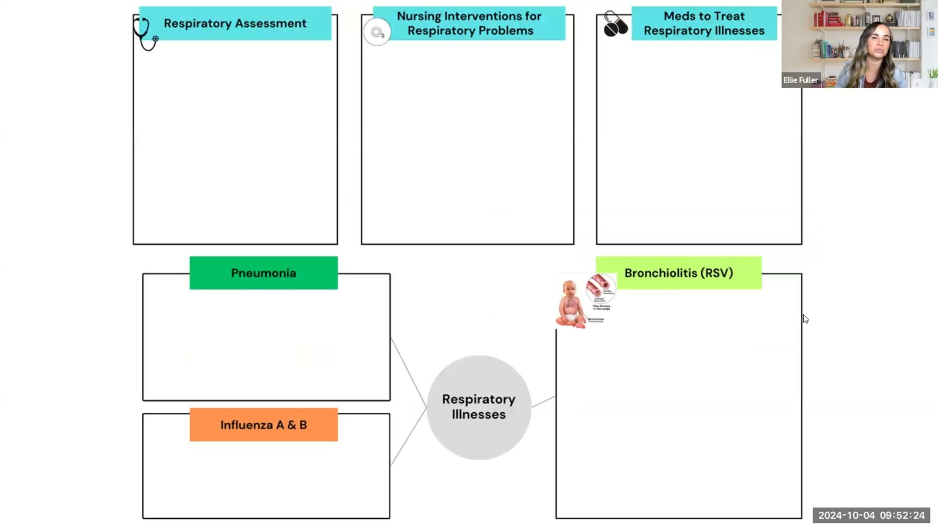
Notes:
Fuller · Week 8 · Respiratory
Recording time 63:46
https://drive.google.com/file/d/1swgiP1NKBL7E7FD08zoBzhX_ZiDsVBam/view

Slide 37
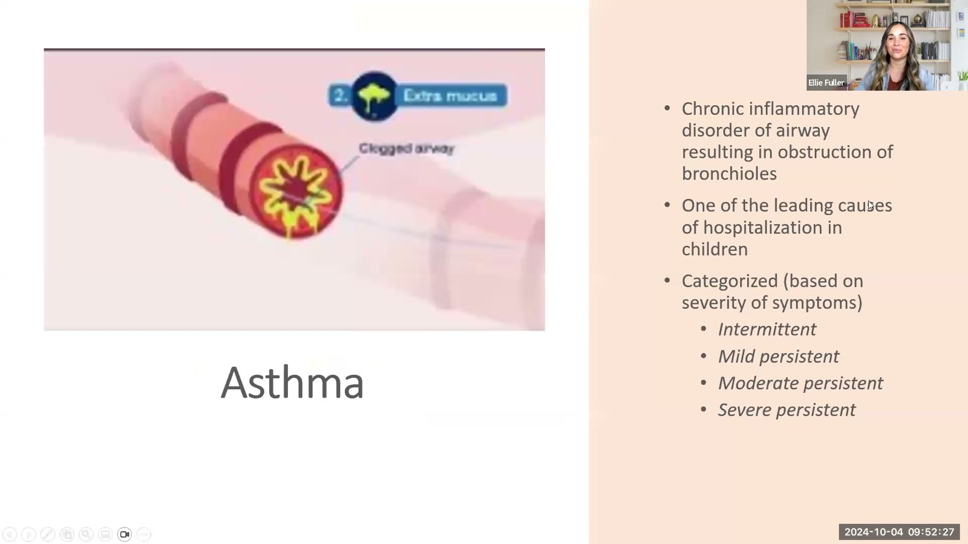
Notes:
Fuller · Week 8 · Respiratory
Recording time 63:49
https://drive.google.com/file/d/1swgiP1NKBL7E7FD08zoBzhX_ZiDsVBam/view

Slide 38
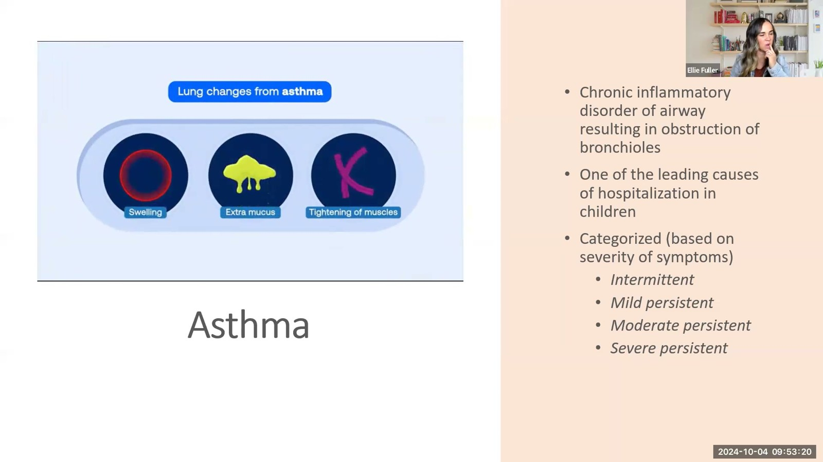
Notes:
Fuller · Week 8 · Respiratory
Recording time 64:42
https://drive.google.com/file/d/1swgiP1NKBL7E7FD08zoBzhX_ZiDsVBam/view

Slide 39
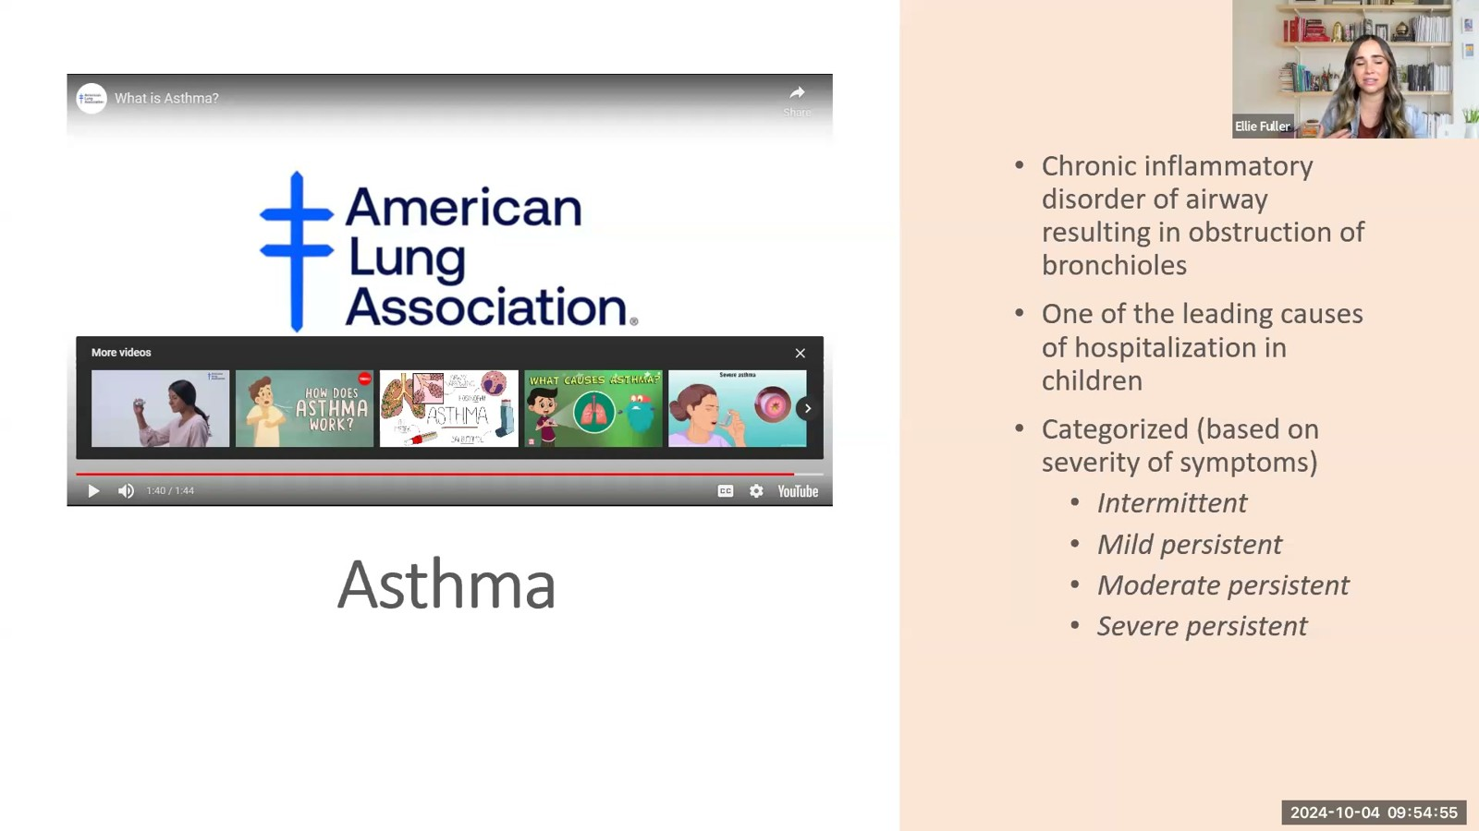
Notes:
Fuller · Week 8 · Respiratory
Recording time 66:17
https://drive.google.com/file/d/1swgiP1NKBL7E7FD08zoBzhX_ZiDsVBam/view

Slide 40
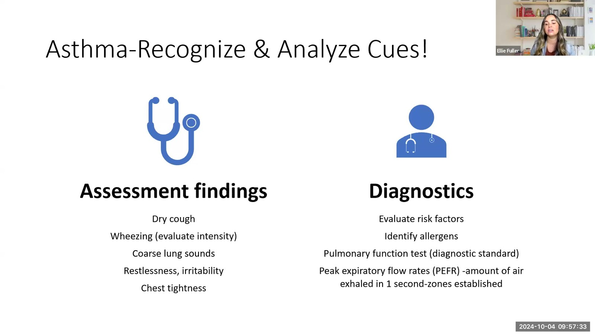
Notes:
Fuller · Week 8 · Respiratory
Recording time 68:55
https://drive.google.com/file/d/1swgiP1NKBL7E7FD08zoBzhX_ZiDsVBam/view

Slide 41
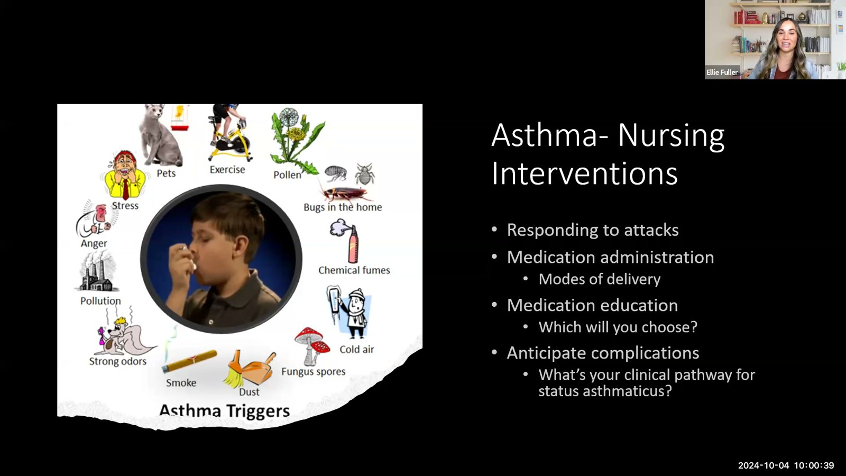
Notes:
Fuller · Week 8 · Respiratory
Recording time 72:01
https://drive.google.com/file/d/1swgiP1NKBL7E7FD08zoBzhX_ZiDsVBam/view

Slide 42
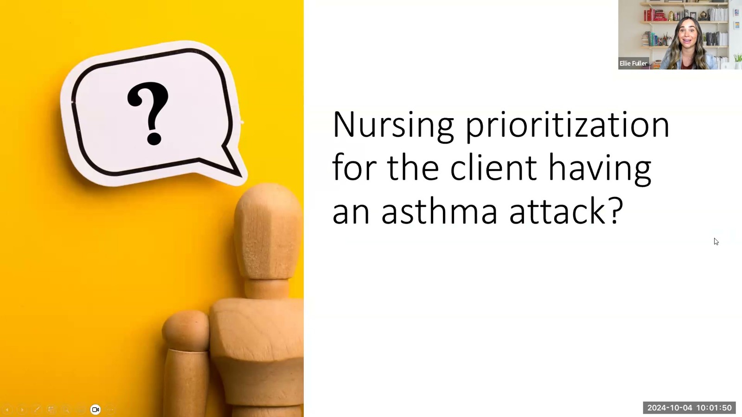
Notes:
Fuller · Week 8 · Respiratory
Recording time 73:12
https://drive.google.com/file/d/1swgiP1NKBL7E7FD08zoBzhX_ZiDsVBam/view

Slide 43
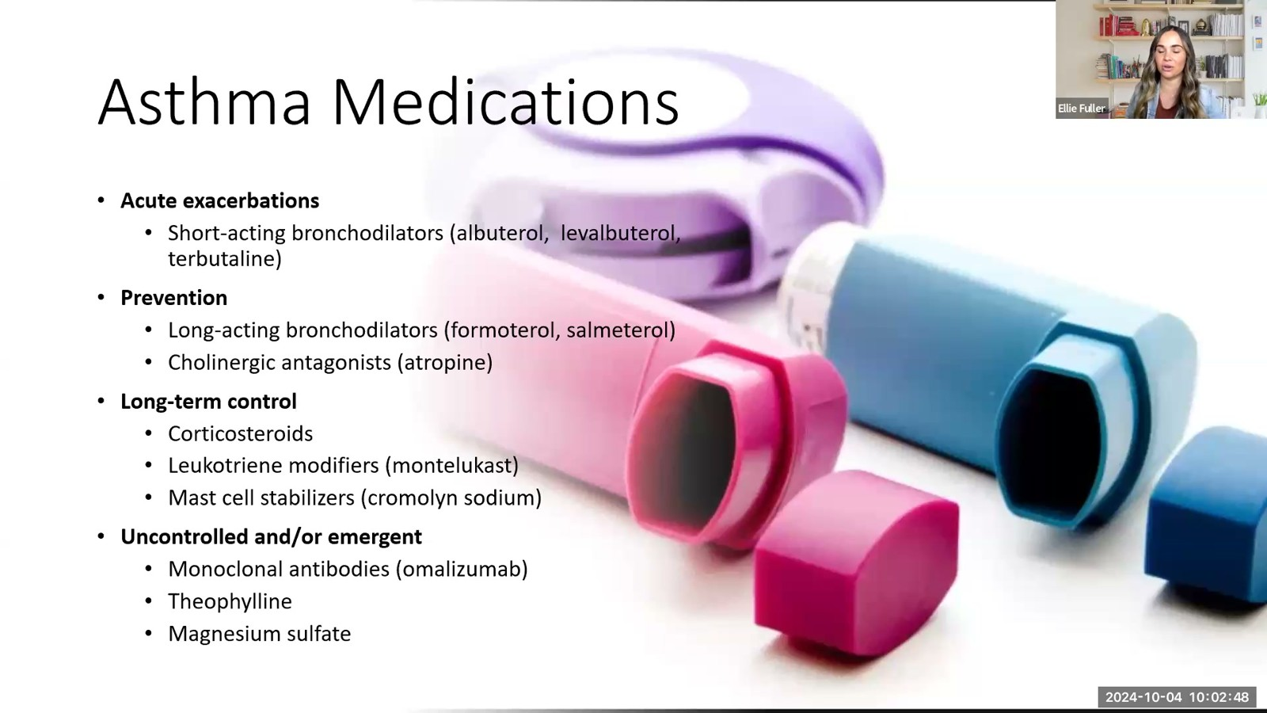
Notes:
Fuller · Week 8 · Respiratory
Recording time 74:10
https://drive.google.com/file/d/1swgiP1NKBL7E7FD08zoBzhX_ZiDsVBam/view

Slide 44
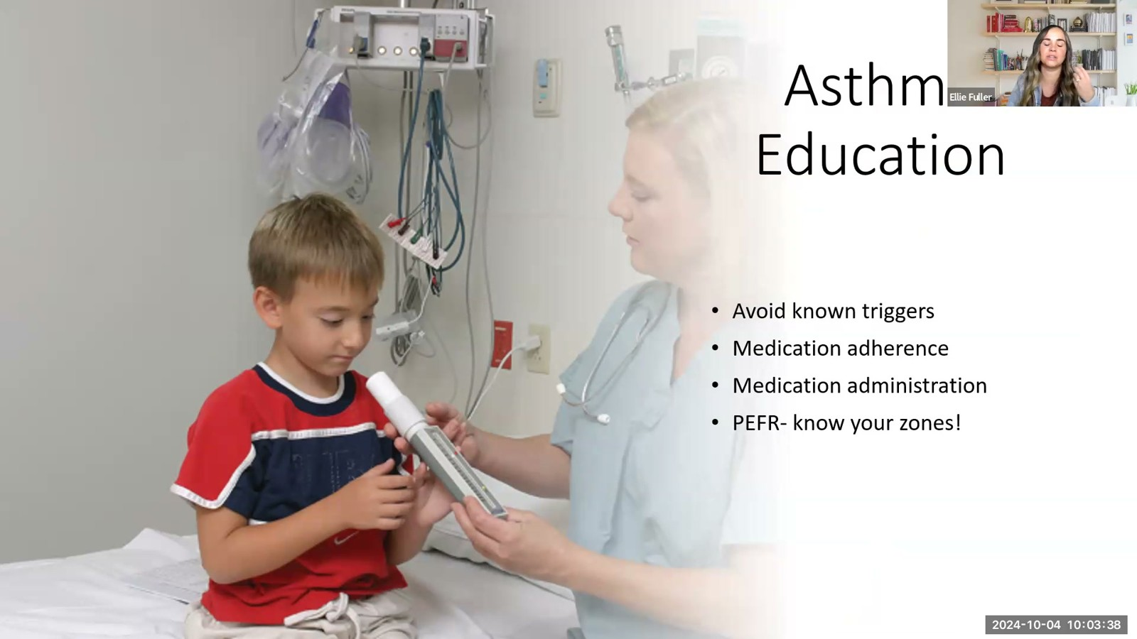
Notes:
Fuller · Week 8 · Respiratory
Recording time 75:00
https://drive.google.com/file/d/1swgiP1NKBL7E7FD08zoBzhX_ZiDsVBam/view

Slide 45
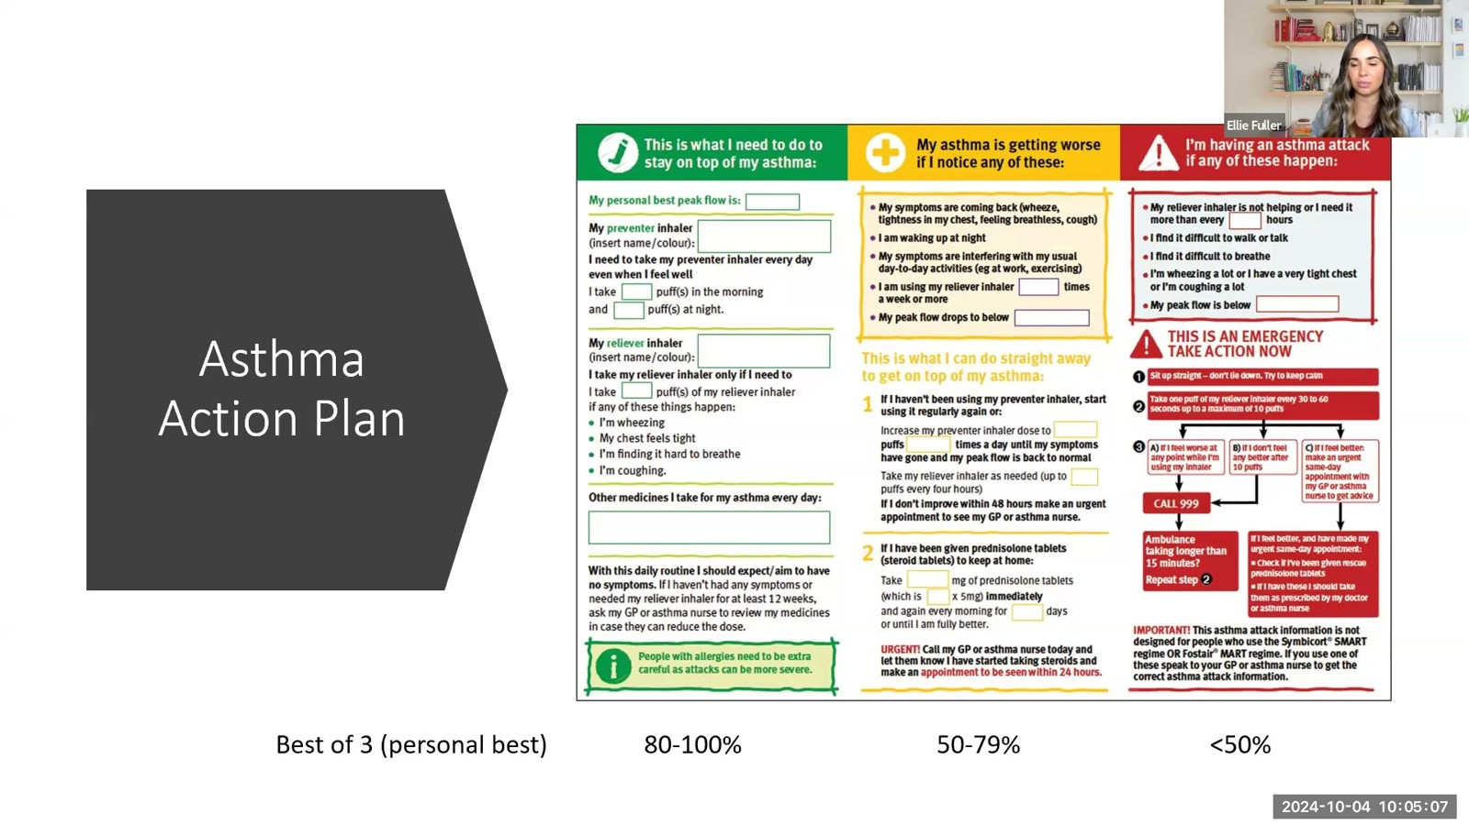
Notes:
Fuller · Week 8 · Respiratory
Recording time 76:29
https://drive.google.com/file/d/1swgiP1NKBL7E7FD08zoBzhX_ZiDsVBam/view

Slide 46
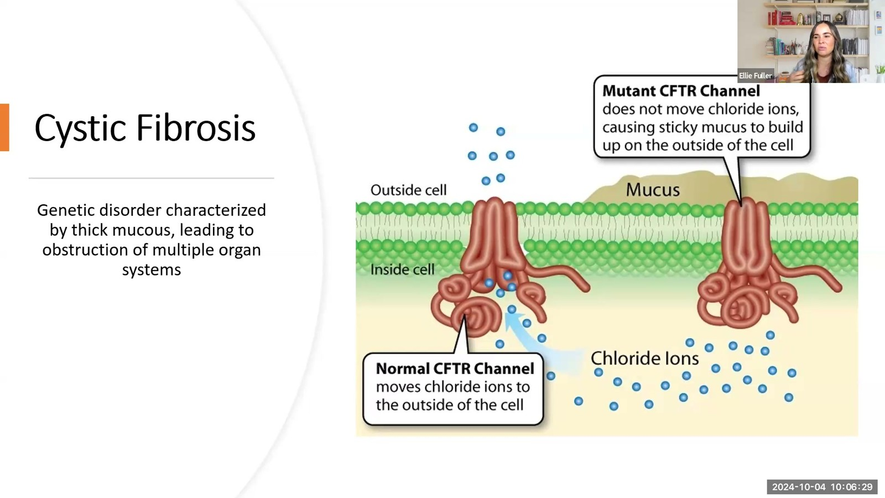
Notes:
Fuller · Week 8 · Respiratory
Recording time 77:51
https://drive.google.com/file/d/1swgiP1NKBL7E7FD08zoBzhX_ZiDsVBam/view

Slide 47
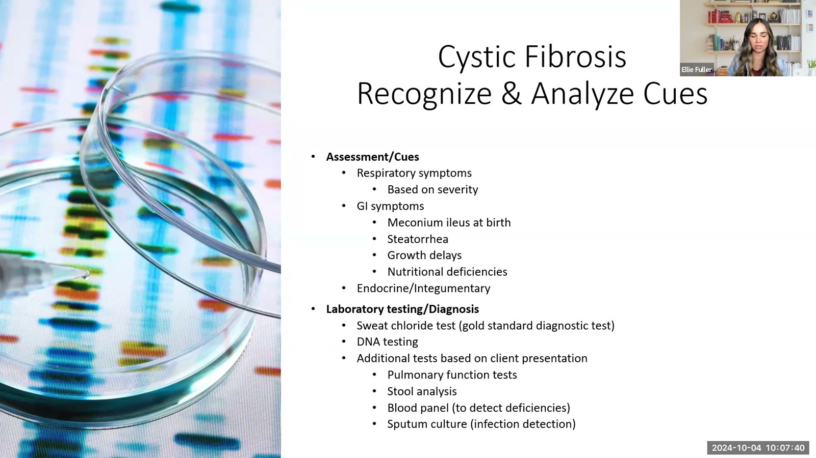
Notes:
Fuller · Week 8 · Respiratory
Recording time 79:02
https://drive.google.com/file/d/1swgiP1NKBL7E7FD08zoBzhX_ZiDsVBam/view

Slide 48
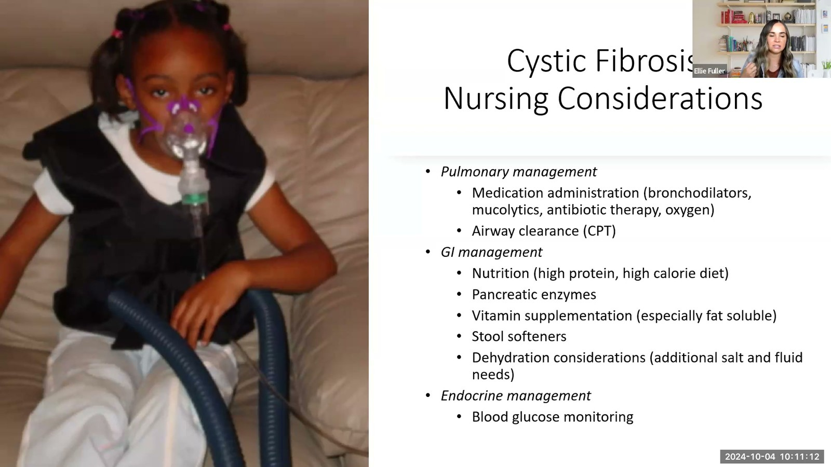
Notes:
Fuller · Week 8 · Respiratory
Recording time 82:34
https://drive.google.com/file/d/1swgiP1NKBL7E7FD08zoBzhX_ZiDsVBam/view

Slide 49
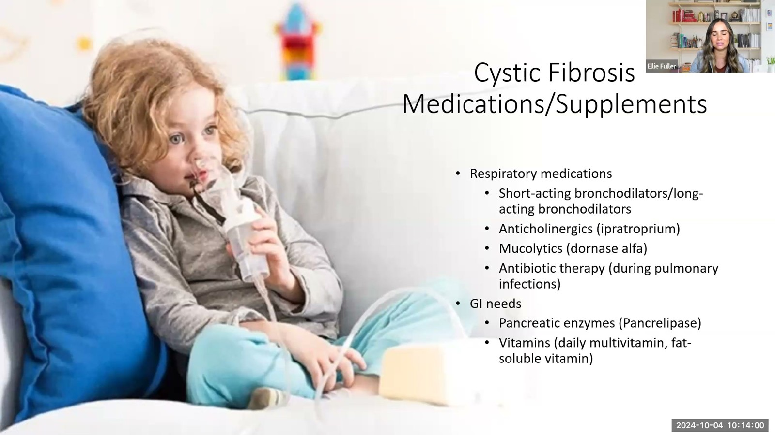
Notes:
Fuller · Week 8 · Respiratory
Recording time 85:22
https://drive.google.com/file/d/1swgiP1NKBL7E7FD08zoBzhX_ZiDsVBam/view

Slide 50
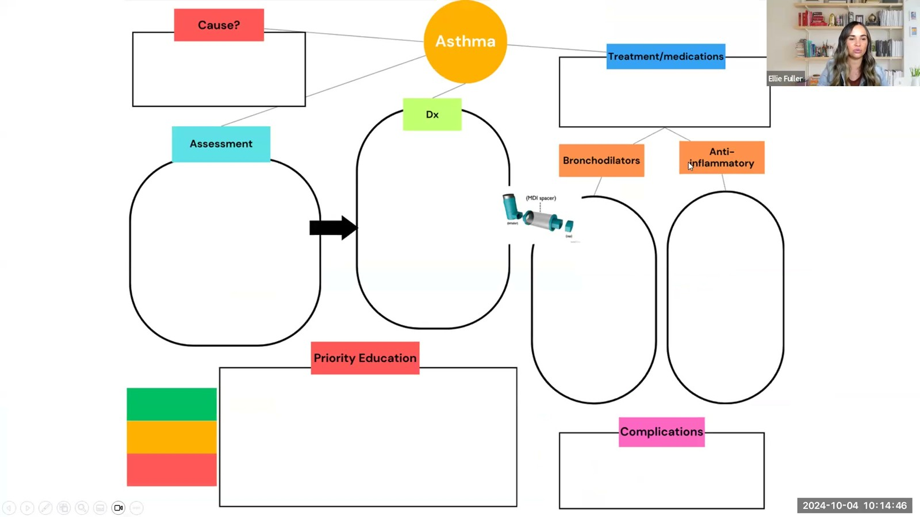
Notes:
Fuller · Week 8 · Respiratory
Recording time 86:08
https://drive.google.com/file/d/1swgiP1NKBL7E7FD08zoBzhX_ZiDsVBam/view

Slide 51
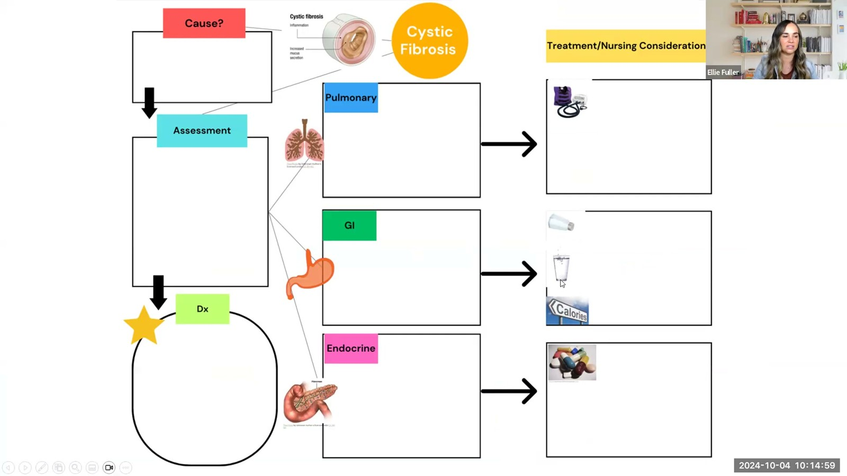
Notes:
Fuller · Week 8 · Respiratory
Recording time 86:21
https://drive.google.com/file/d/1swgiP1NKBL7E7FD08zoBzhX_ZiDsVBam/view

