Slide 1

NUR 235 / WEEK 9 / FULLER
Cardiac
Fetal circulation, shunting and congenital heart defects
Study copy made from slides shown in the recorded lecture
Notes:
Source recording: https://drive.google.com/file/d/1AifHN2lCUw2D1ALY7zSTL1e-4SweDFOZ/view
University logo: https://www.joyce.edu/
Prepared for independent study. Original course slides are linked separately in the Study Hub.

Slide 2

Notes:
Fuller · Week 9 · Cardiac
Recording time 1:56
https://drive.google.com/file/d/1AifHN2lCUw2D1ALY7zSTL1e-4SweDFOZ/view

Slide 3
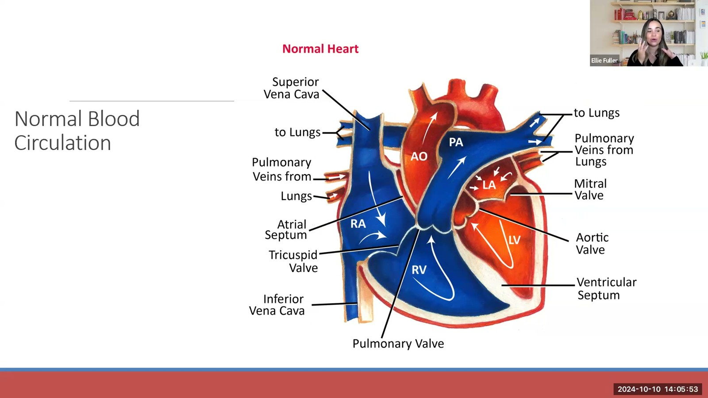
Notes:
Fuller · Week 9 · Cardiac
Recording time 4:40
https://drive.google.com/file/d/1AifHN2lCUw2D1ALY7zSTL1e-4SweDFOZ/view

Slide 4
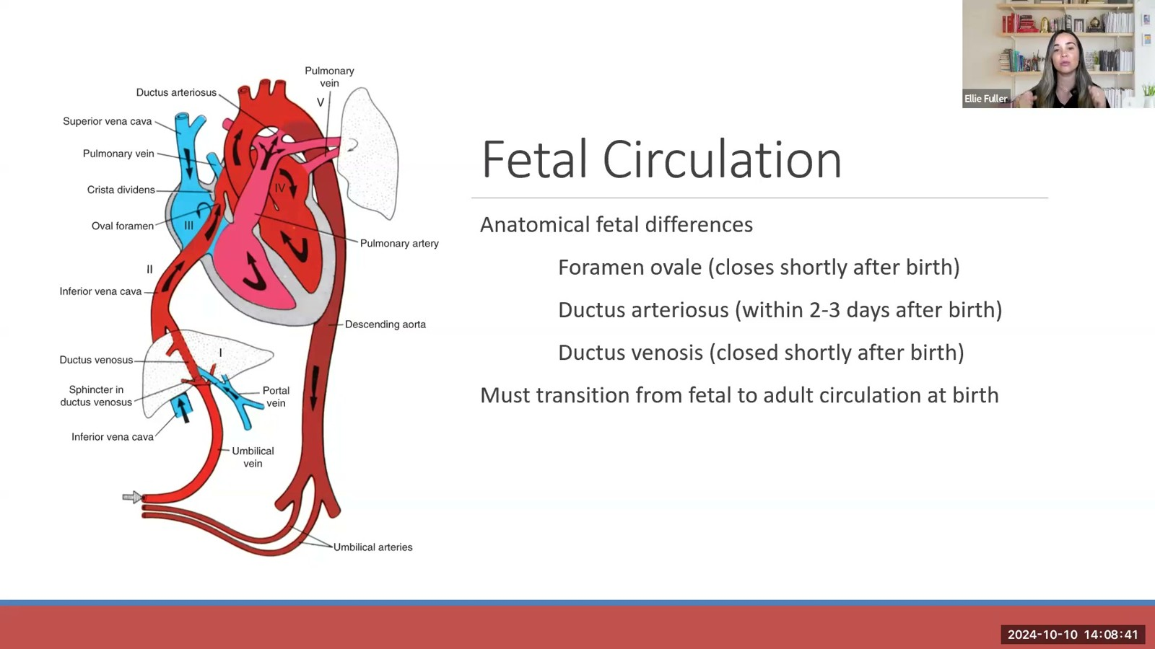
Notes:
Fuller · Week 9 · Cardiac
Recording time 7:28
https://drive.google.com/file/d/1AifHN2lCUw2D1ALY7zSTL1e-4SweDFOZ/view

Slide 5
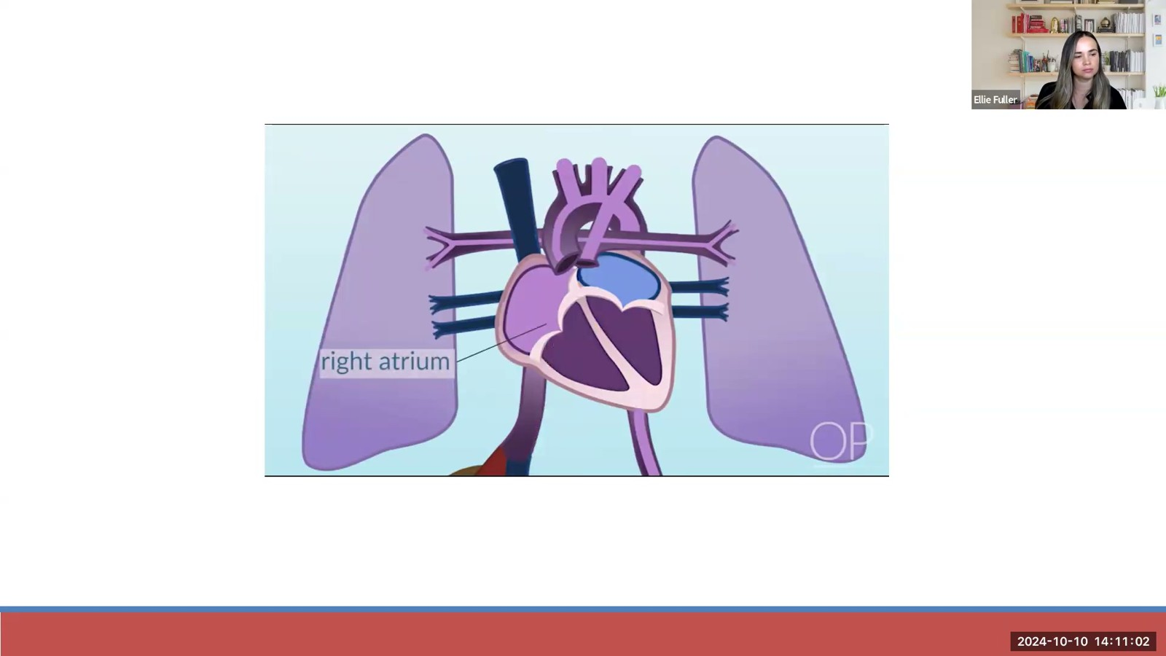
Notes:
Fuller · Week 9 · Cardiac
Recording time 9:49
https://drive.google.com/file/d/1AifHN2lCUw2D1ALY7zSTL1e-4SweDFOZ/view

Slide 6
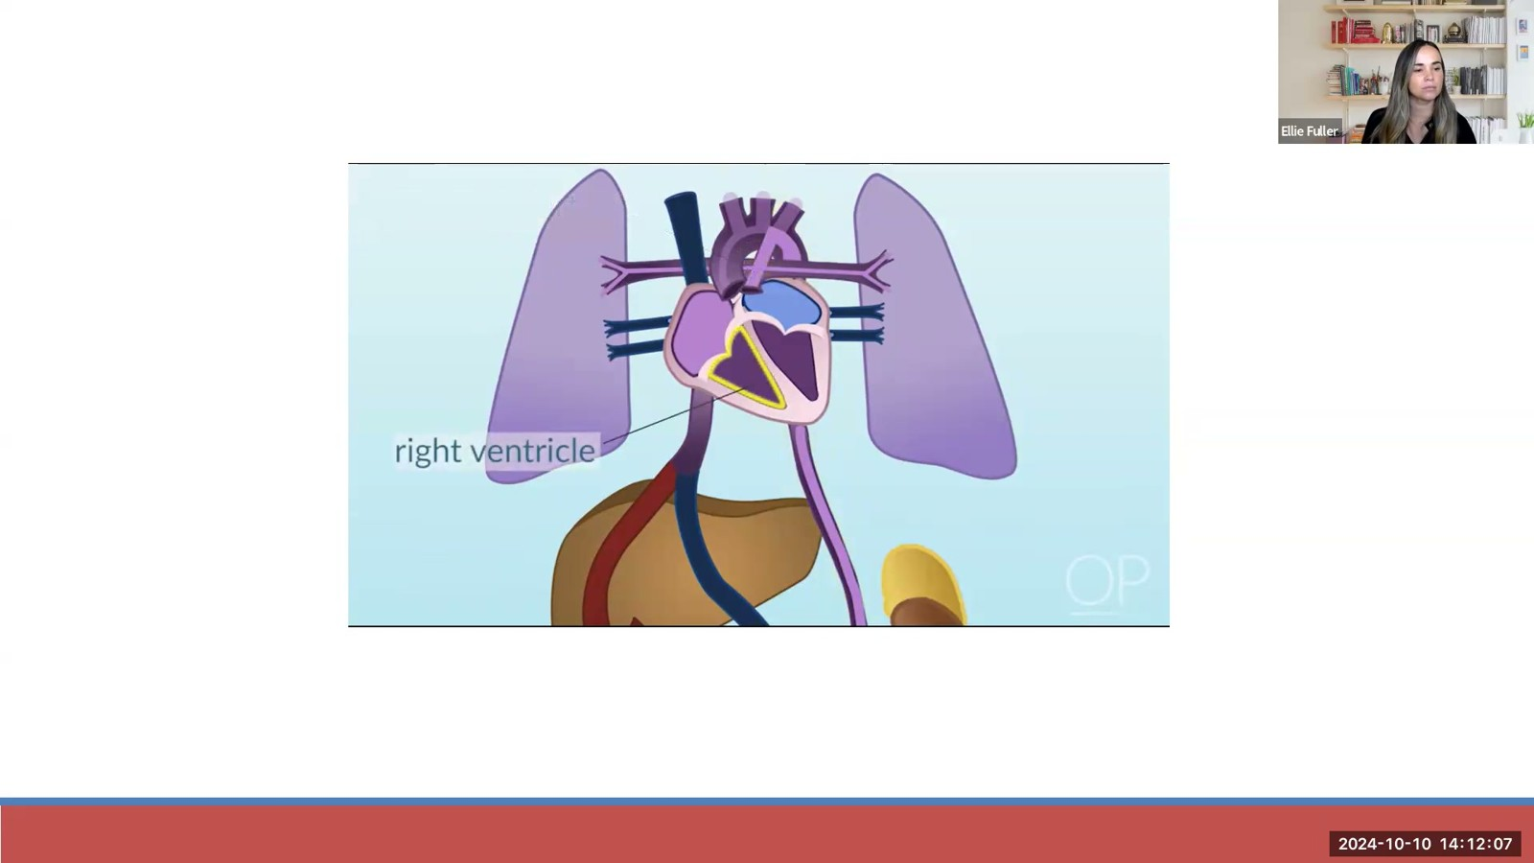
Notes:
Fuller · Week 9 · Cardiac
Recording time 10:54
https://drive.google.com/file/d/1AifHN2lCUw2D1ALY7zSTL1e-4SweDFOZ/view

Slide 7
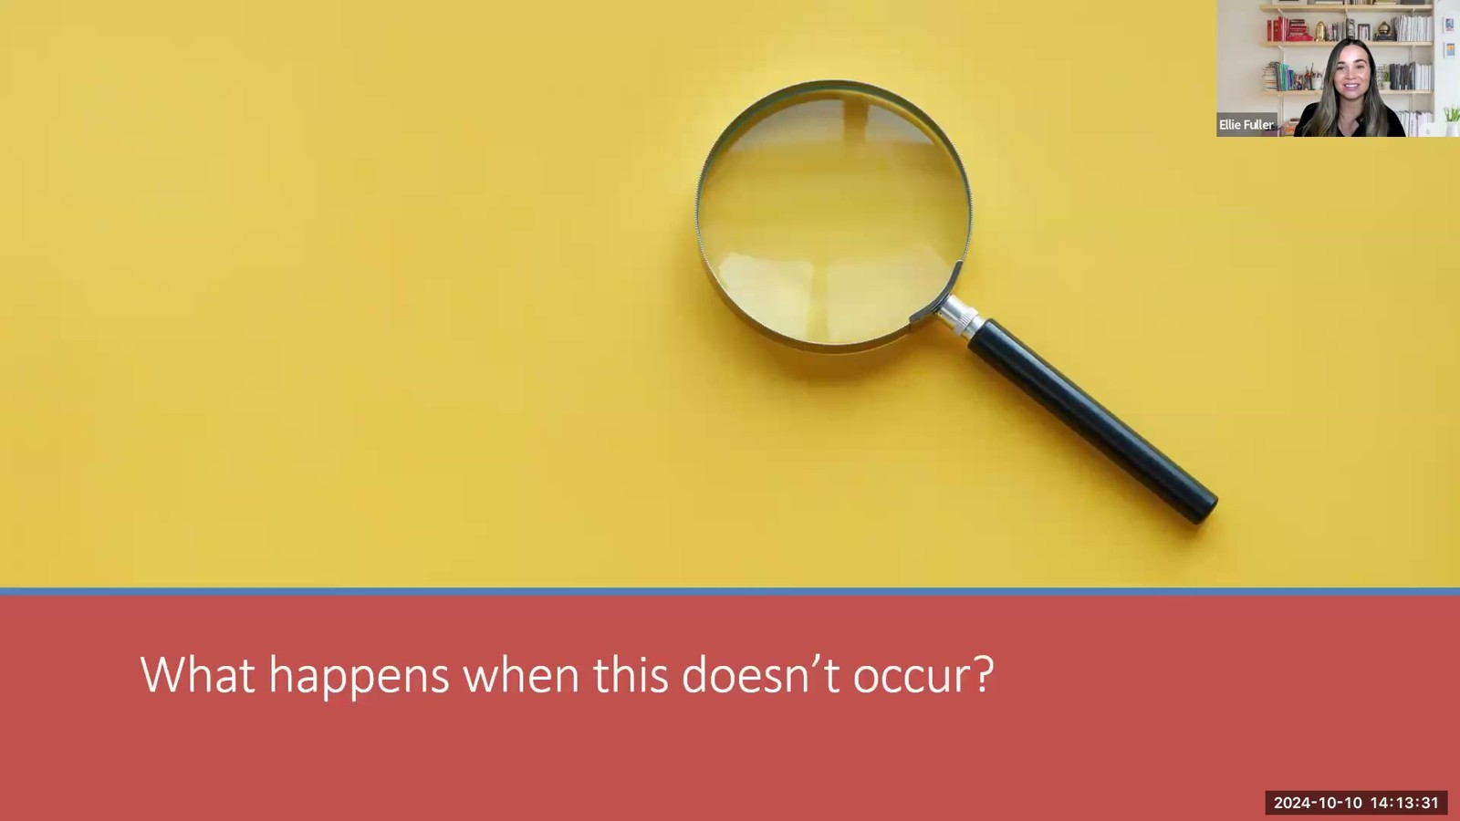
Notes:
Fuller · Week 9 · Cardiac
Recording time 12:18
https://drive.google.com/file/d/1AifHN2lCUw2D1ALY7zSTL1e-4SweDFOZ/view

Slide 8
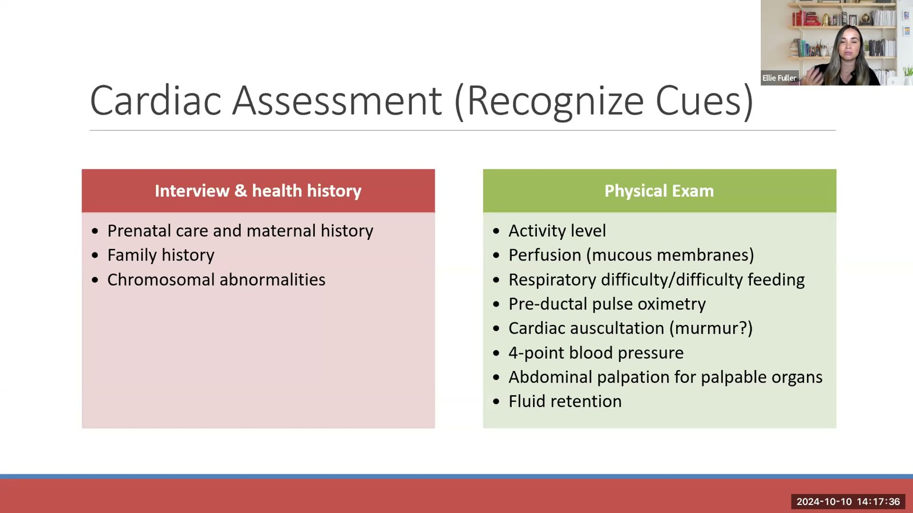
Notes:
Fuller · Week 9 · Cardiac
Recording time 16:23
https://drive.google.com/file/d/1AifHN2lCUw2D1ALY7zSTL1e-4SweDFOZ/view

Slide 9
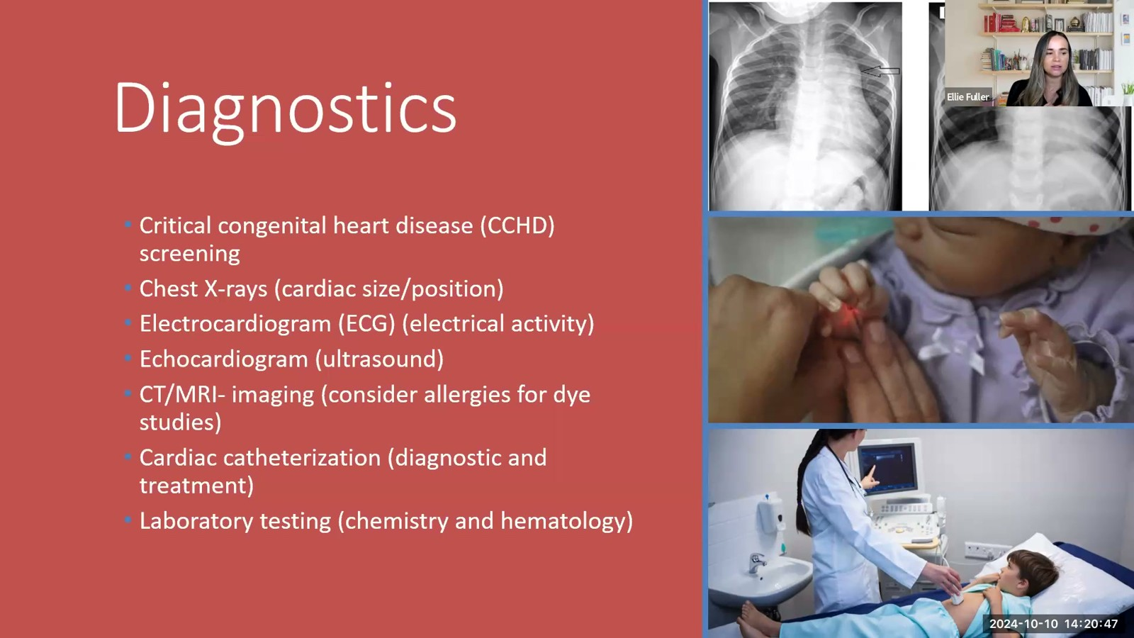
Notes:
Fuller · Week 9 · Cardiac
Recording time 19:34
https://drive.google.com/file/d/1AifHN2lCUw2D1ALY7zSTL1e-4SweDFOZ/view

Slide 10
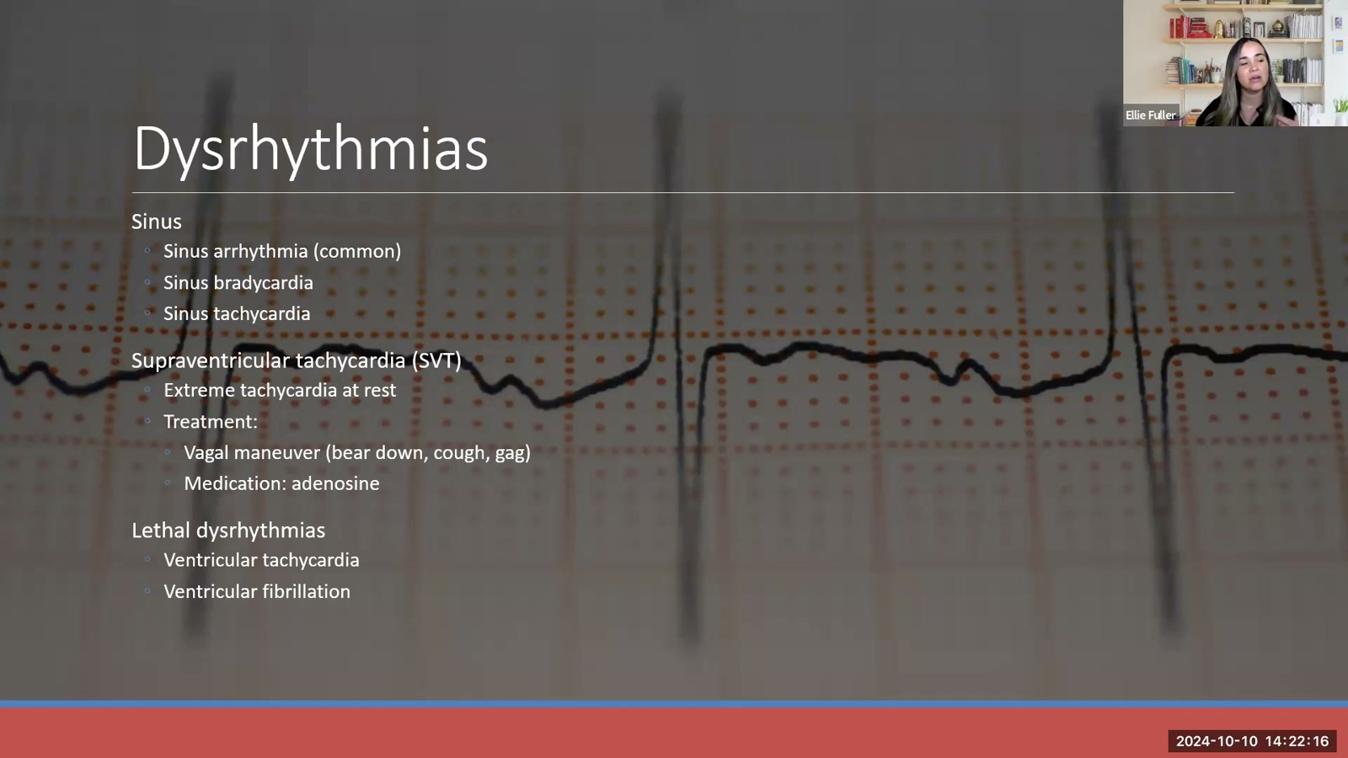
Notes:
Fuller · Week 9 · Cardiac
Recording time 21:03
https://drive.google.com/file/d/1AifHN2lCUw2D1ALY7zSTL1e-4SweDFOZ/view

Slide 11
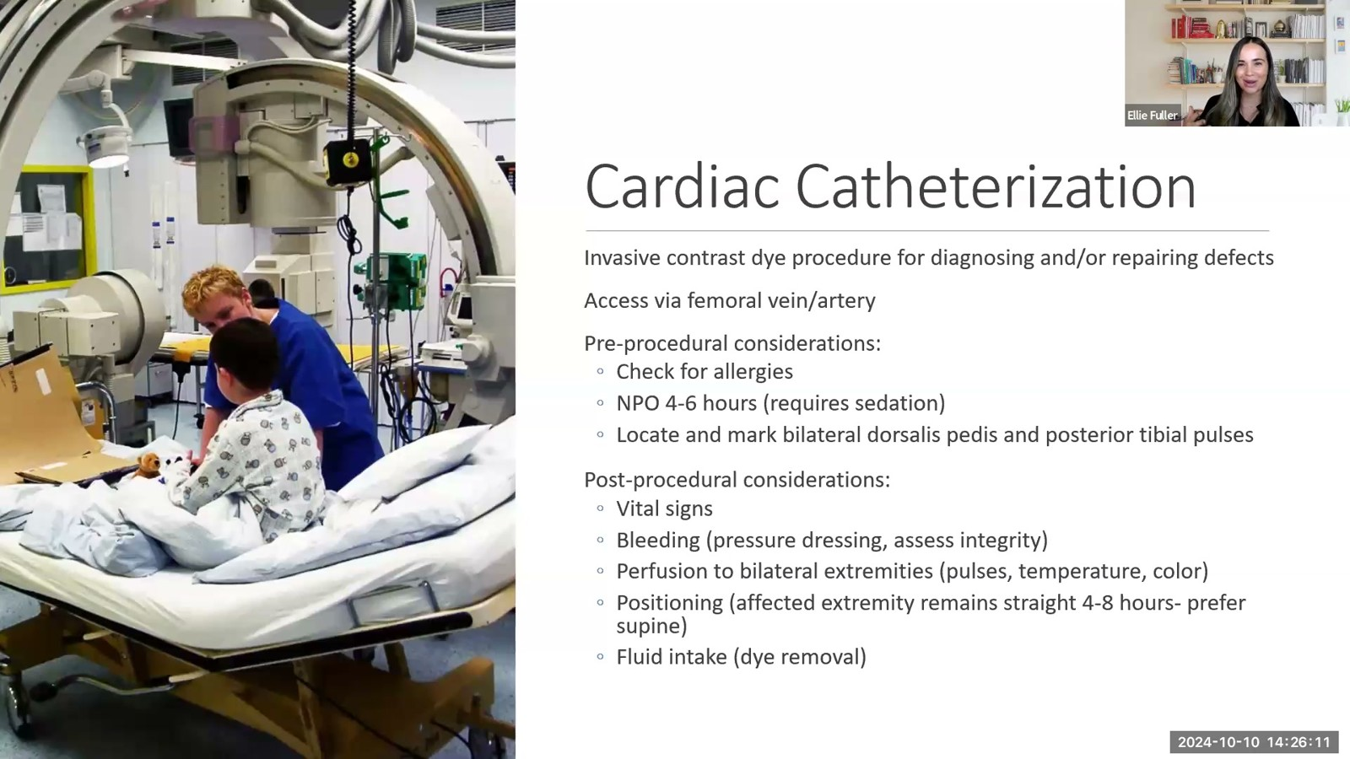
Notes:
Fuller · Week 9 · Cardiac
Recording time 24:58
https://drive.google.com/file/d/1AifHN2lCUw2D1ALY7zSTL1e-4SweDFOZ/view

Slide 12
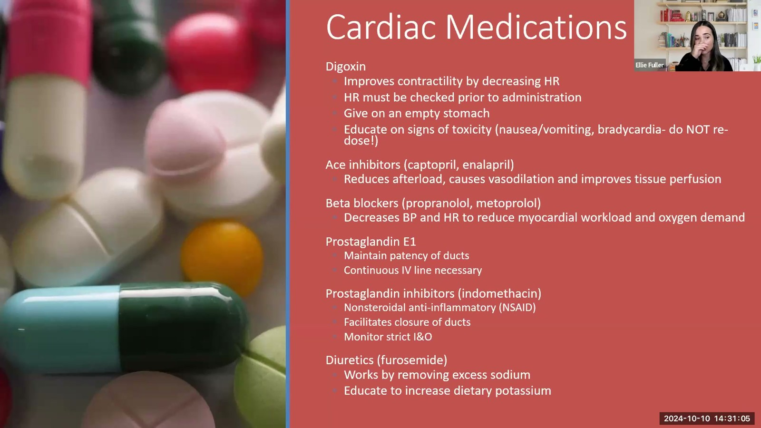
Notes:
Fuller · Week 9 · Cardiac
Recording time 29:52
https://drive.google.com/file/d/1AifHN2lCUw2D1ALY7zSTL1e-4SweDFOZ/view

Slide 13
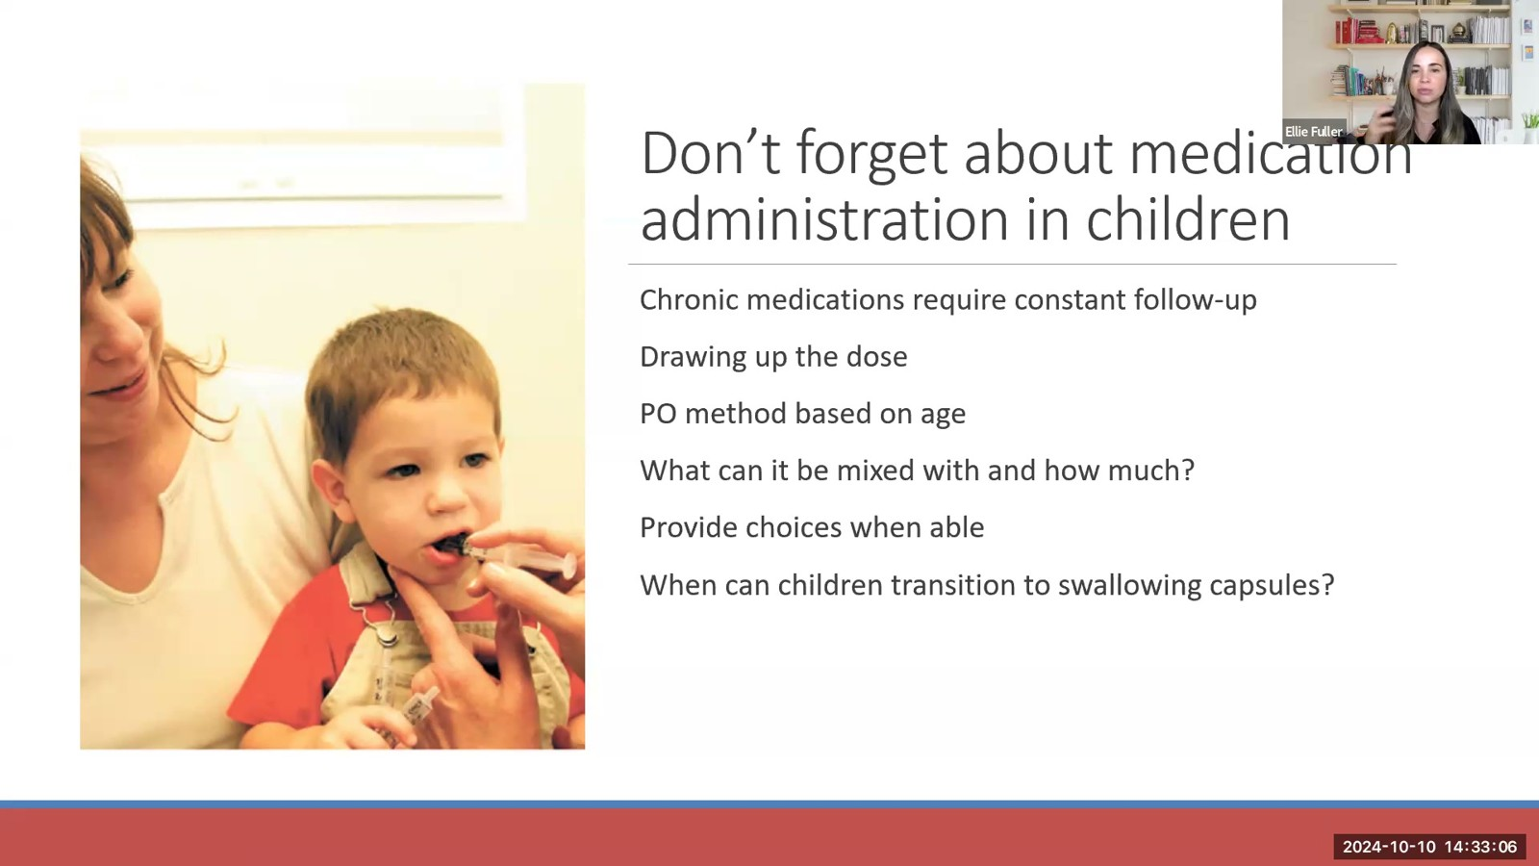
Notes:
Fuller · Week 9 · Cardiac
Recording time 31:53
https://drive.google.com/file/d/1AifHN2lCUw2D1ALY7zSTL1e-4SweDFOZ/view

Slide 14
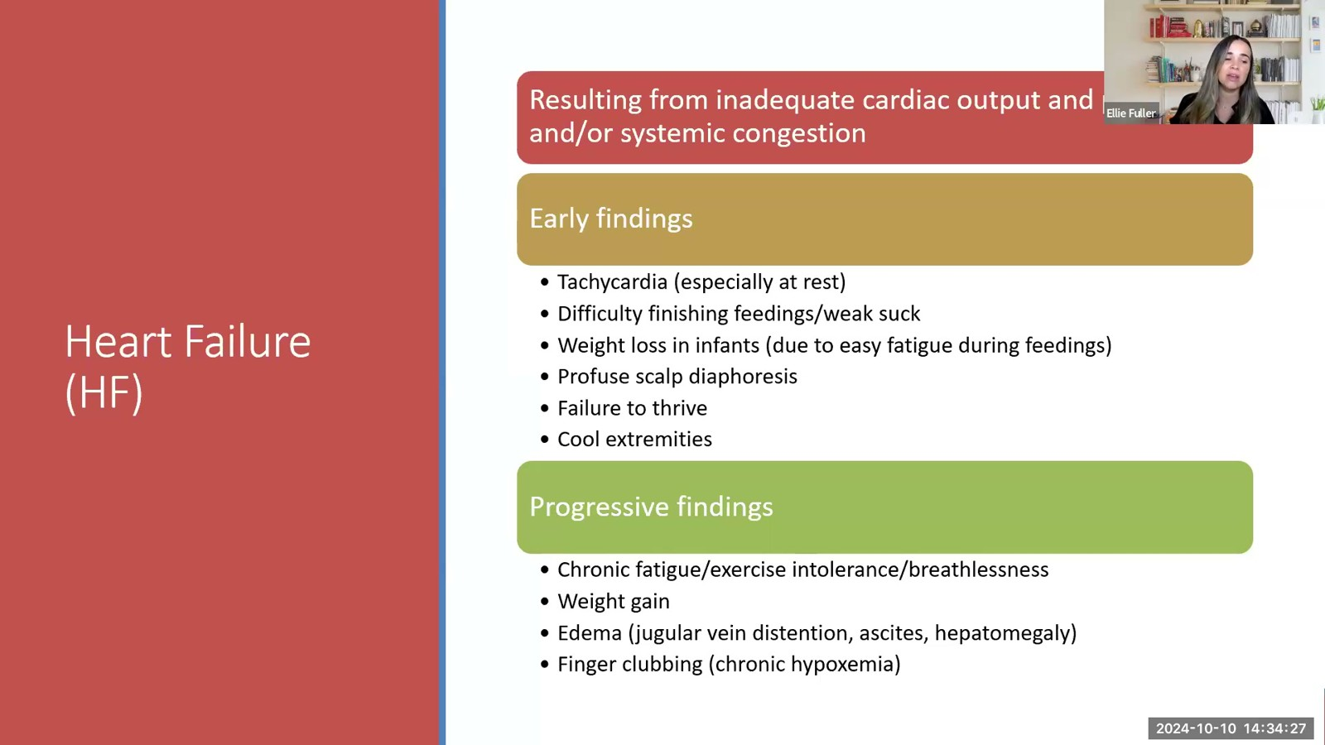
Notes:
Fuller · Week 9 · Cardiac
Recording time 33:14
https://drive.google.com/file/d/1AifHN2lCUw2D1ALY7zSTL1e-4SweDFOZ/view

Slide 15
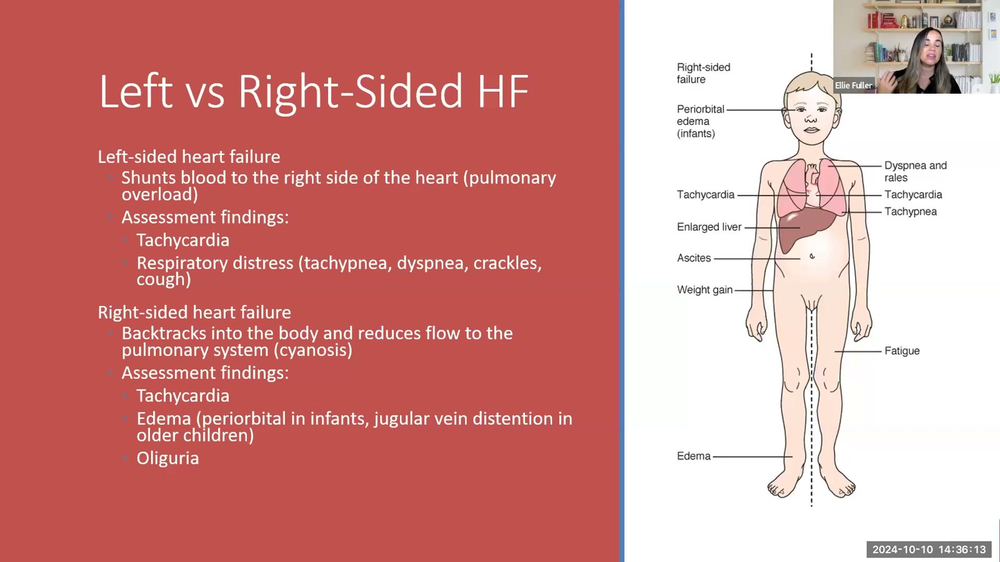
Notes:
Fuller · Week 9 · Cardiac
Recording time 35:00
https://drive.google.com/file/d/1AifHN2lCUw2D1ALY7zSTL1e-4SweDFOZ/view

Slide 16
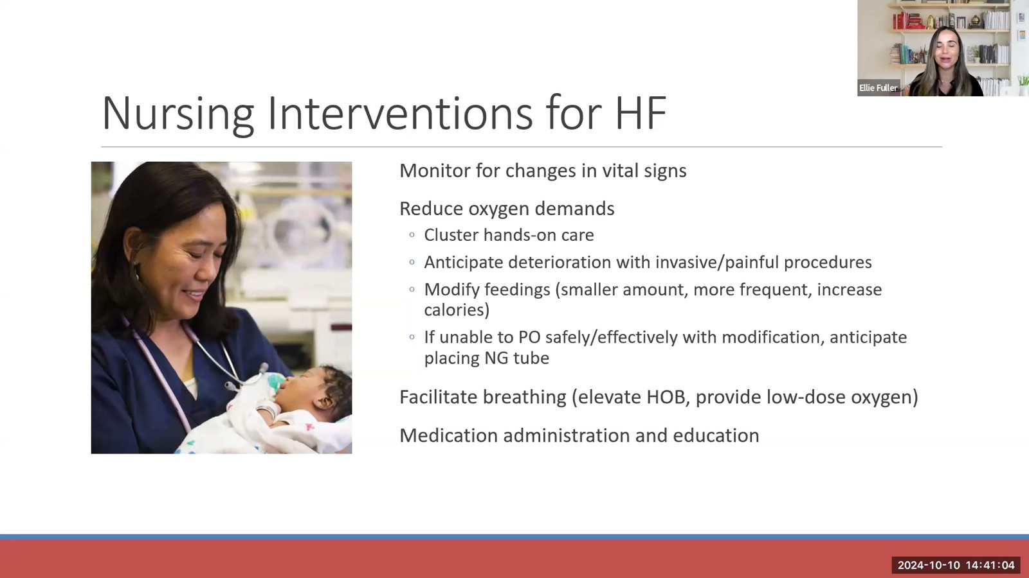
Notes:
Fuller · Week 9 · Cardiac
Recording time 39:51
https://drive.google.com/file/d/1AifHN2lCUw2D1ALY7zSTL1e-4SweDFOZ/view

Slide 17
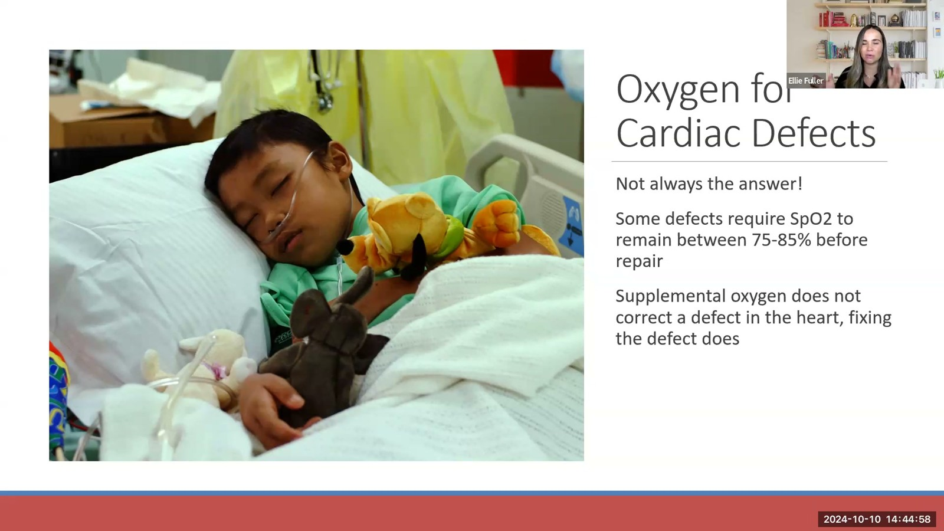
Notes:
Fuller · Week 9 · Cardiac
Recording time 43:45
https://drive.google.com/file/d/1AifHN2lCUw2D1ALY7zSTL1e-4SweDFOZ/view

Slide 18
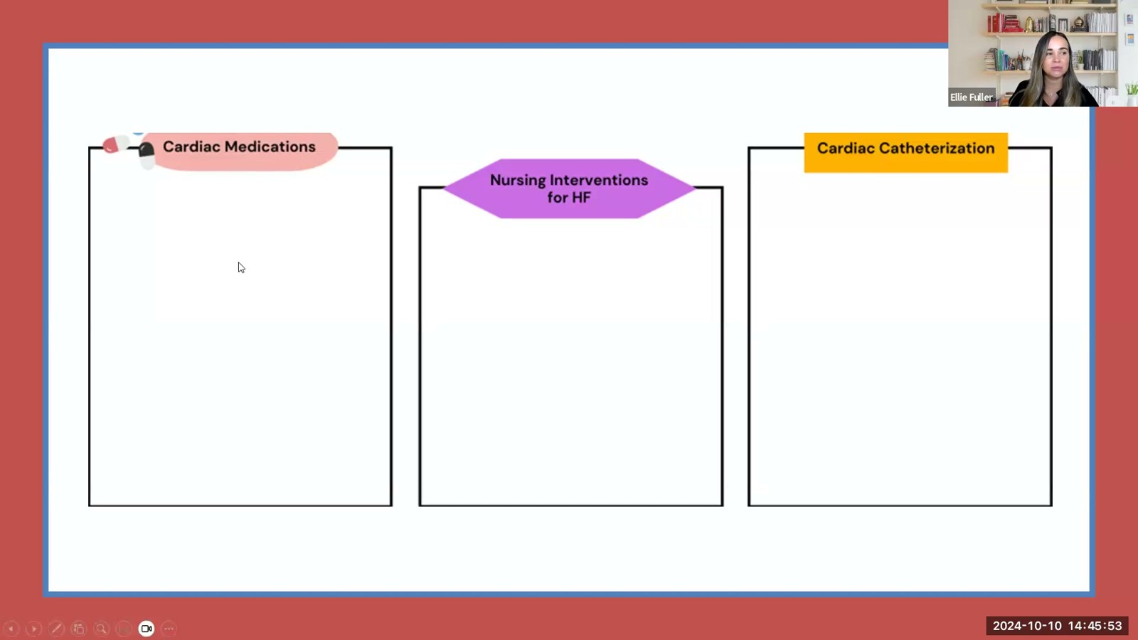
Notes:
Fuller · Week 9 · Cardiac
Recording time 44:40
https://drive.google.com/file/d/1AifHN2lCUw2D1ALY7zSTL1e-4SweDFOZ/view

Slide 19
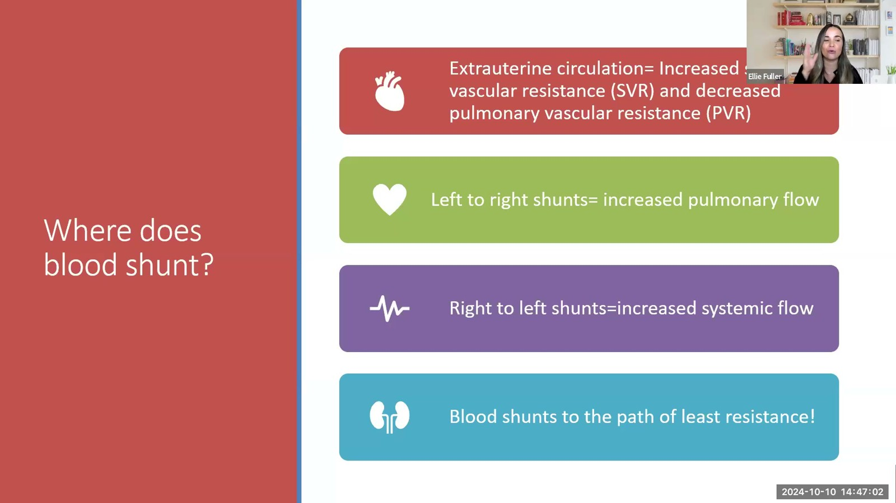
Notes:
Fuller · Week 9 · Cardiac
Recording time 45:49
https://drive.google.com/file/d/1AifHN2lCUw2D1ALY7zSTL1e-4SweDFOZ/view

Slide 20
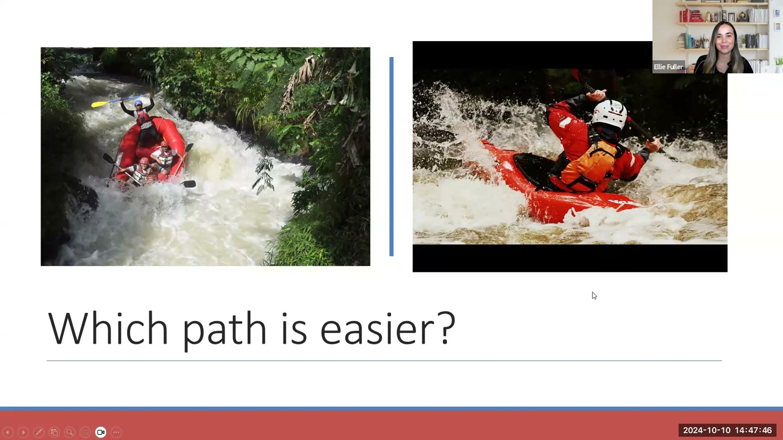
Notes:
Fuller · Week 9 · Cardiac
Recording time 46:33
https://drive.google.com/file/d/1AifHN2lCUw2D1ALY7zSTL1e-4SweDFOZ/view

Slide 21
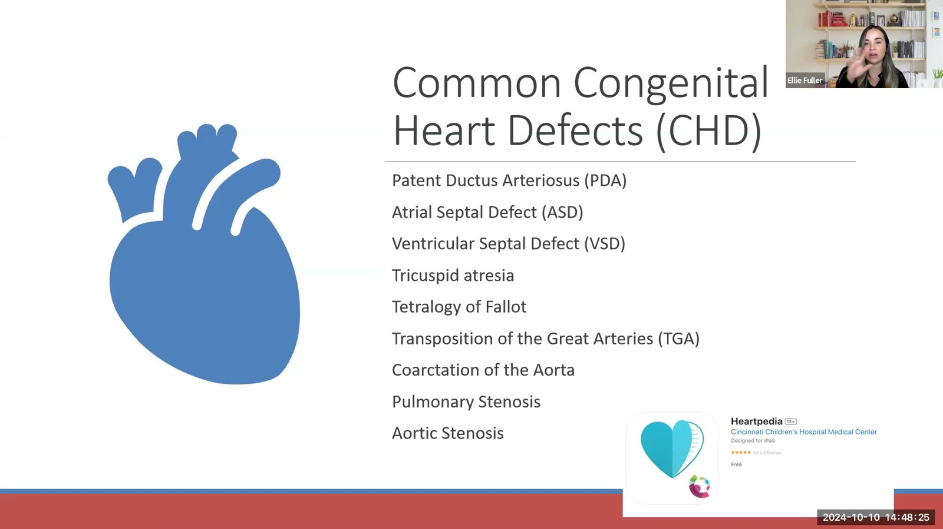
Notes:
Fuller · Week 9 · Cardiac
Recording time 47:12
https://drive.google.com/file/d/1AifHN2lCUw2D1ALY7zSTL1e-4SweDFOZ/view

Slide 22
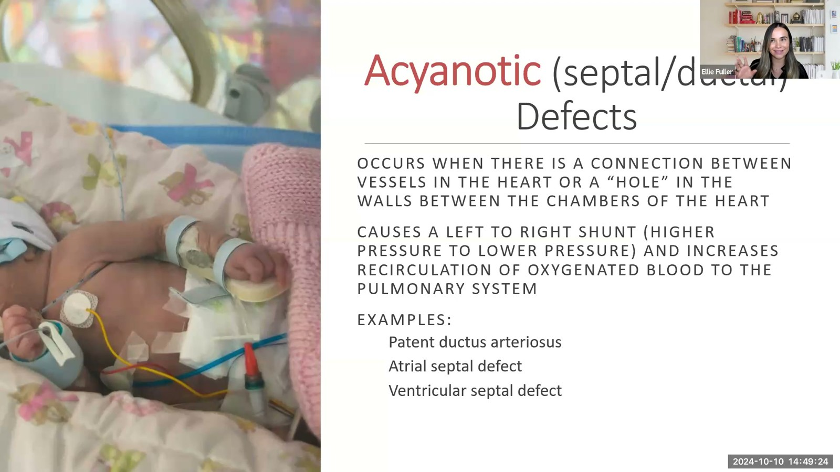
Notes:
Fuller · Week 9 · Cardiac
Recording time 48:11
https://drive.google.com/file/d/1AifHN2lCUw2D1ALY7zSTL1e-4SweDFOZ/view

Slide 23
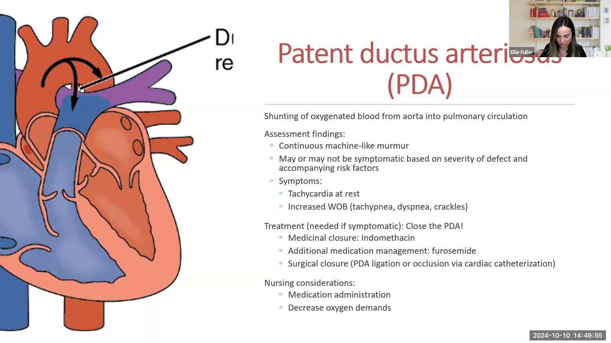
Notes:
Fuller · Week 9 · Cardiac
Recording time 48:42
https://drive.google.com/file/d/1AifHN2lCUw2D1ALY7zSTL1e-4SweDFOZ/view

Slide 24
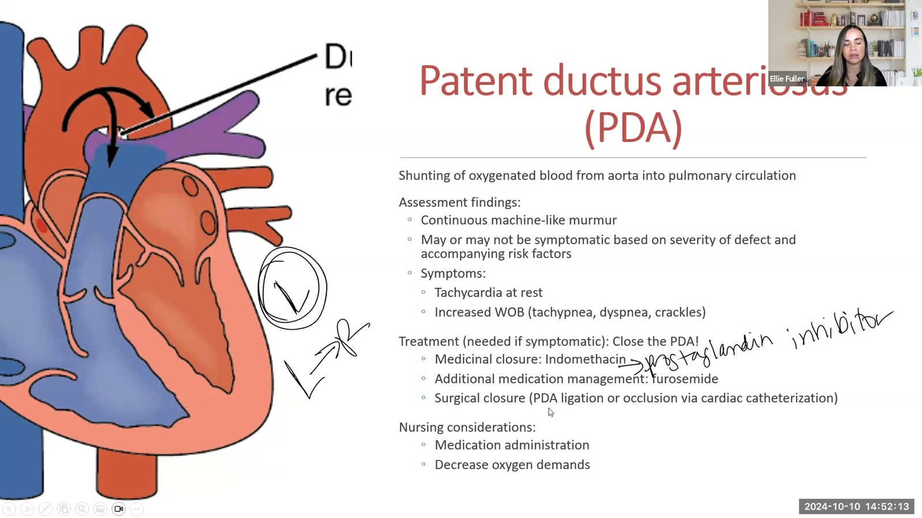
Notes:
Fuller · Week 9 · Cardiac
Recording time 51:00
https://drive.google.com/file/d/1AifHN2lCUw2D1ALY7zSTL1e-4SweDFOZ/view

Slide 25
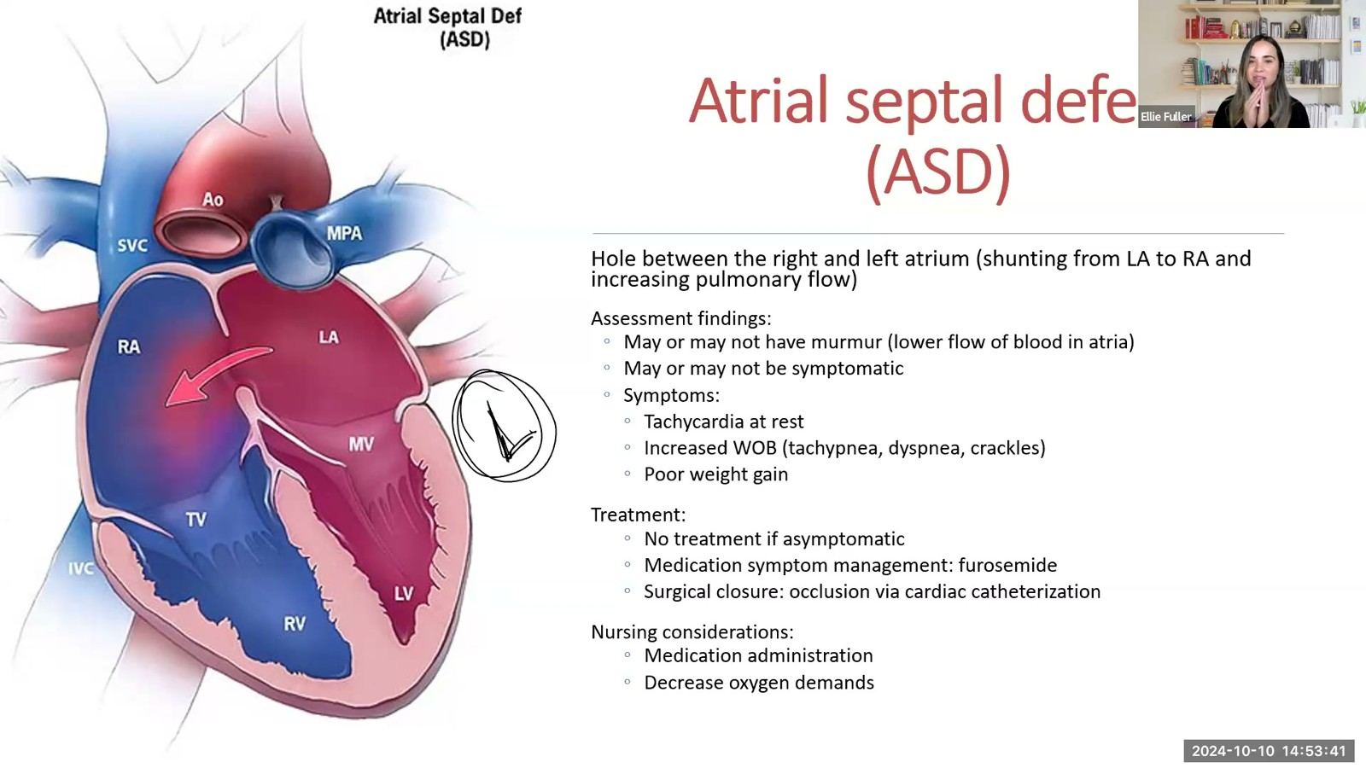
Notes:
Fuller · Week 9 · Cardiac
Recording time 52:28
https://drive.google.com/file/d/1AifHN2lCUw2D1ALY7zSTL1e-4SweDFOZ/view

Slide 26
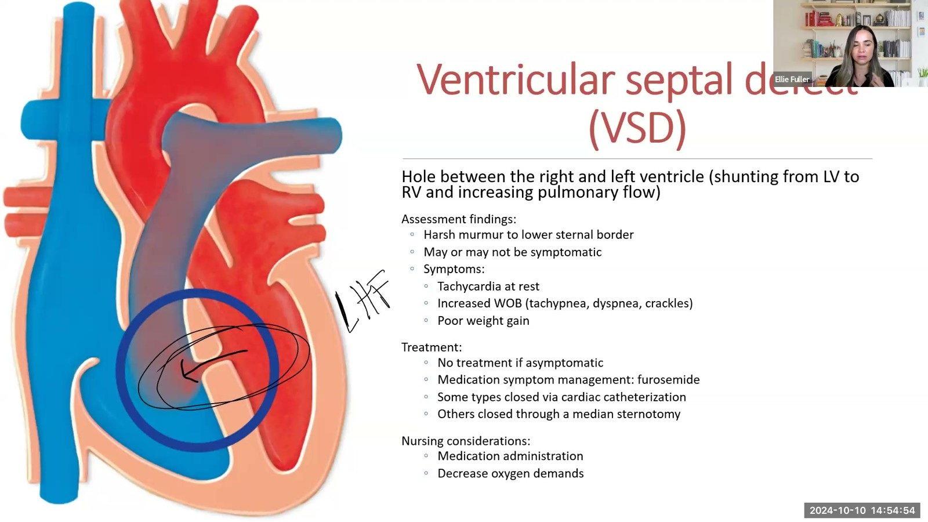
Notes:
Fuller · Week 9 · Cardiac
Recording time 53:41
https://drive.google.com/file/d/1AifHN2lCUw2D1ALY7zSTL1e-4SweDFOZ/view

Slide 27
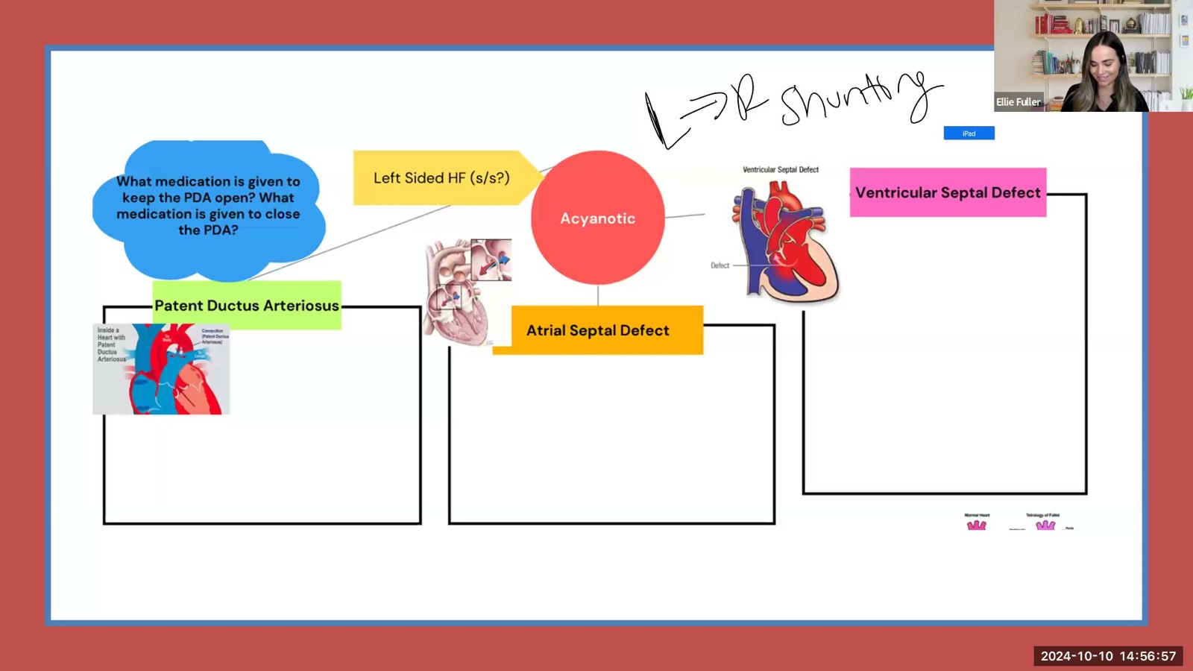
Notes:
Fuller · Week 9 · Cardiac
Recording time 55:44
https://drive.google.com/file/d/1AifHN2lCUw2D1ALY7zSTL1e-4SweDFOZ/view

Slide 28
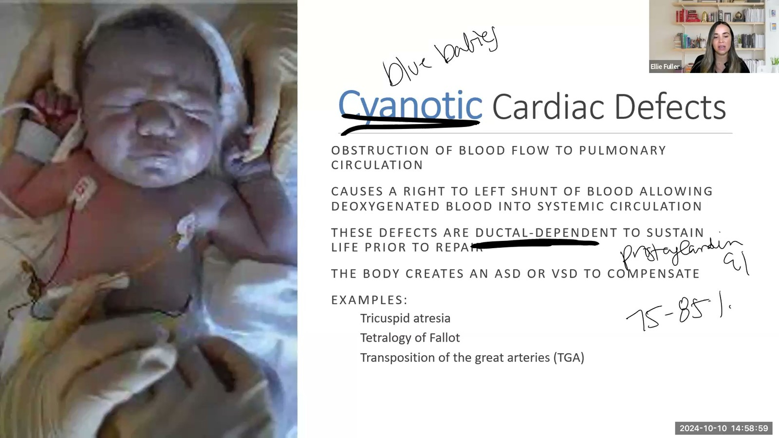
Notes:
Fuller · Week 9 · Cardiac
Recording time 57:46
https://drive.google.com/file/d/1AifHN2lCUw2D1ALY7zSTL1e-4SweDFOZ/view

Slide 29
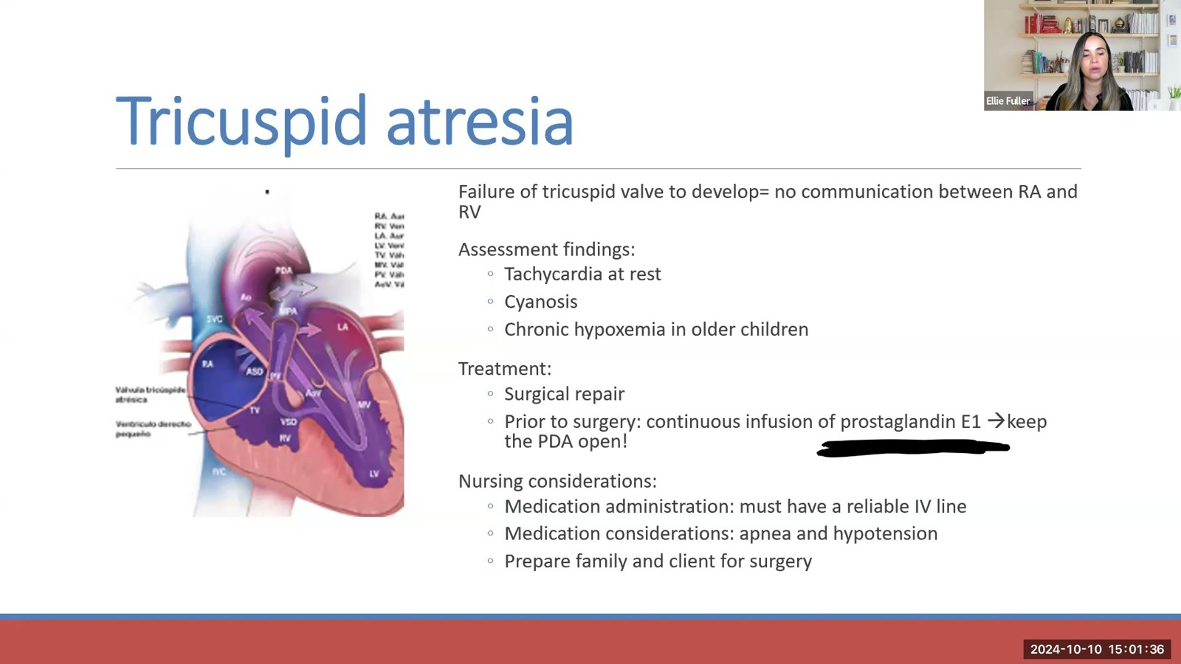
Notes:
Fuller · Week 9 · Cardiac
Recording time 60:23
https://drive.google.com/file/d/1AifHN2lCUw2D1ALY7zSTL1e-4SweDFOZ/view

Slide 30
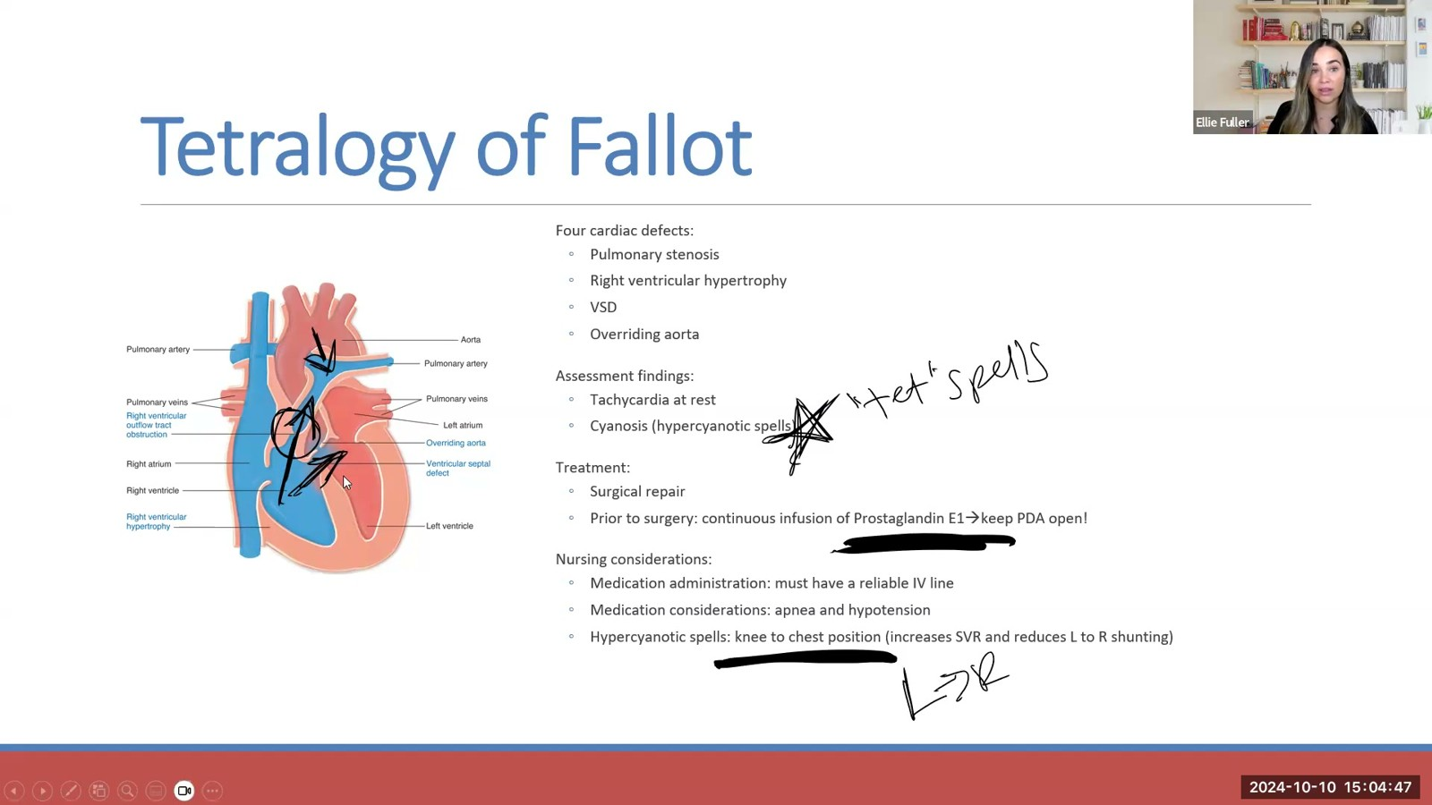
Notes:
Fuller · Week 9 · Cardiac
Recording time 63:34
https://drive.google.com/file/d/1AifHN2lCUw2D1ALY7zSTL1e-4SweDFOZ/view

Slide 31
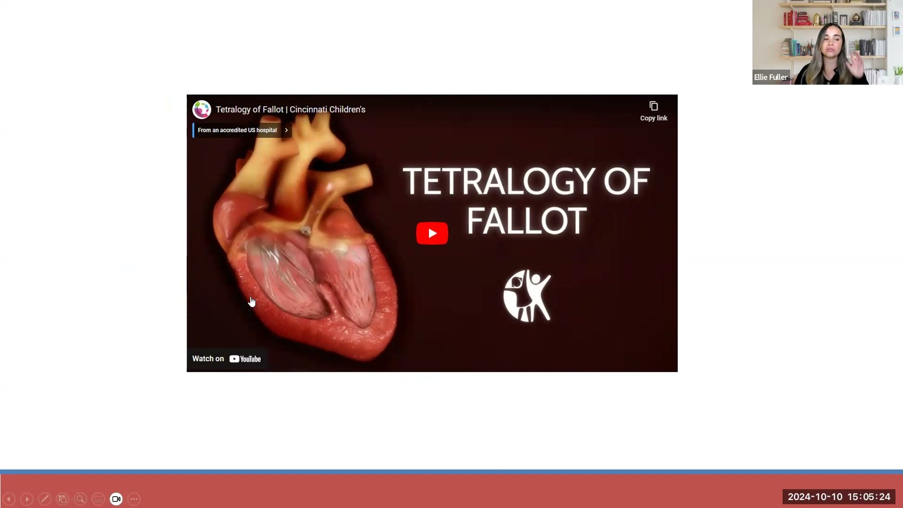
Notes:
Fuller · Week 9 · Cardiac
Recording time 64:11
https://drive.google.com/file/d/1AifHN2lCUw2D1ALY7zSTL1e-4SweDFOZ/view

Slide 32
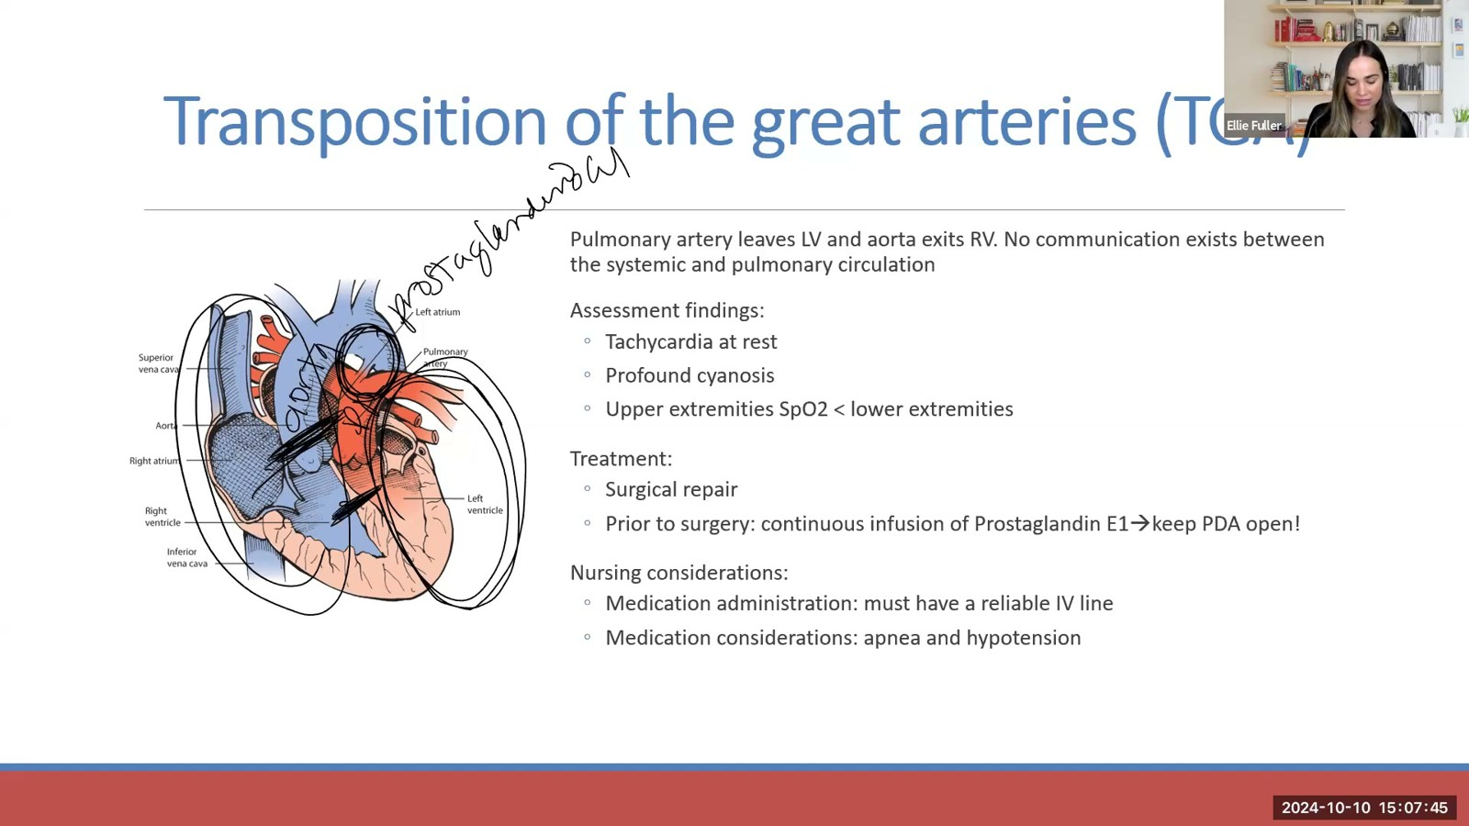
Notes:
Fuller · Week 9 · Cardiac
Recording time 66:32
https://drive.google.com/file/d/1AifHN2lCUw2D1ALY7zSTL1e-4SweDFOZ/view

Slide 33
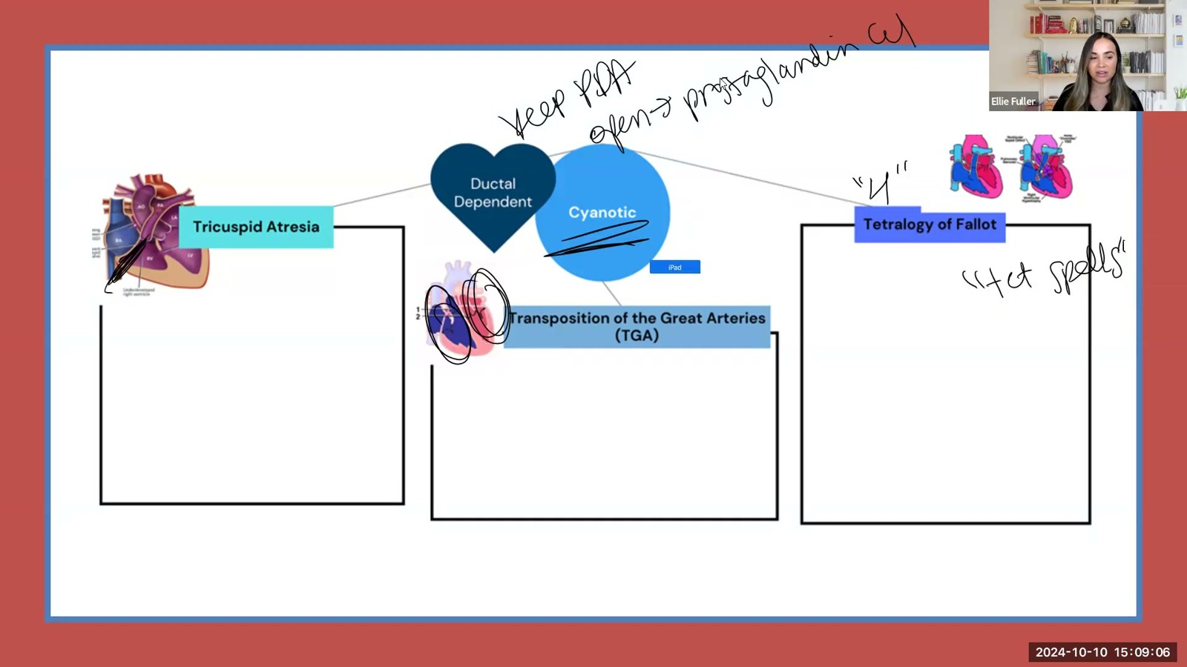
Notes:
Fuller · Week 9 · Cardiac
Recording time 67:53
https://drive.google.com/file/d/1AifHN2lCUw2D1ALY7zSTL1e-4SweDFOZ/view

Slide 34
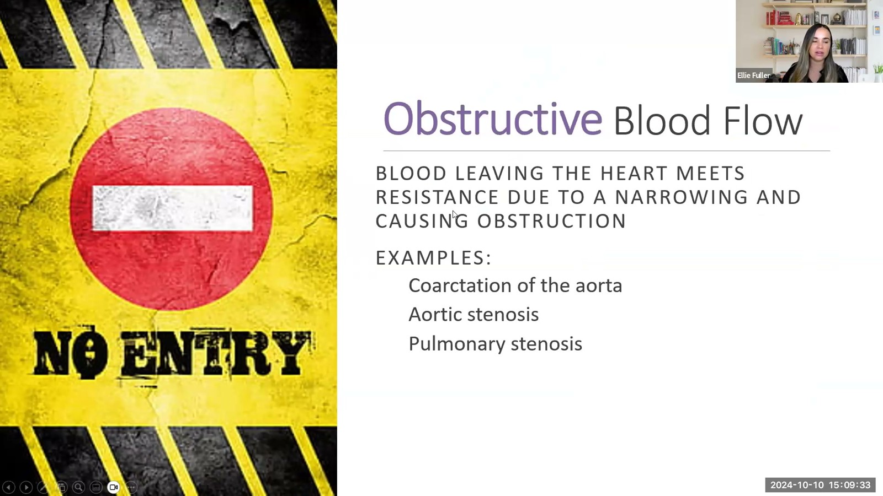
Notes:
Fuller · Week 9 · Cardiac
Recording time 68:20
https://drive.google.com/file/d/1AifHN2lCUw2D1ALY7zSTL1e-4SweDFOZ/view

Slide 35
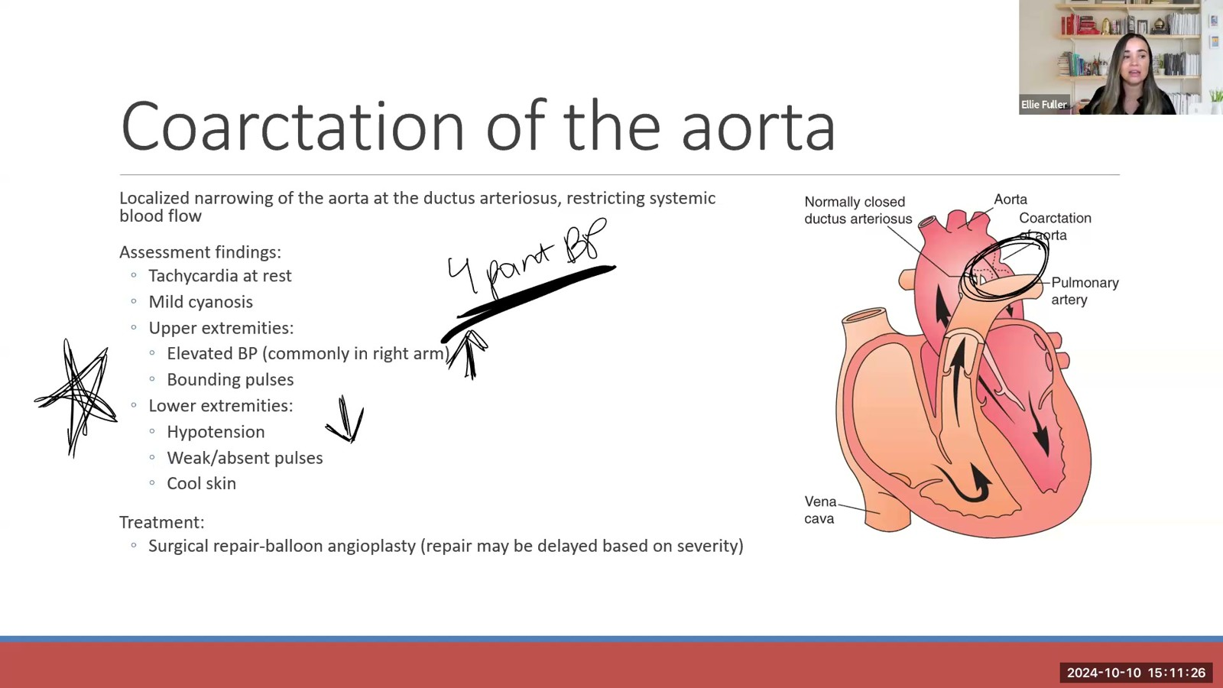
Notes:
Fuller · Week 9 · Cardiac
Recording time 70:13
https://drive.google.com/file/d/1AifHN2lCUw2D1ALY7zSTL1e-4SweDFOZ/view

Slide 36
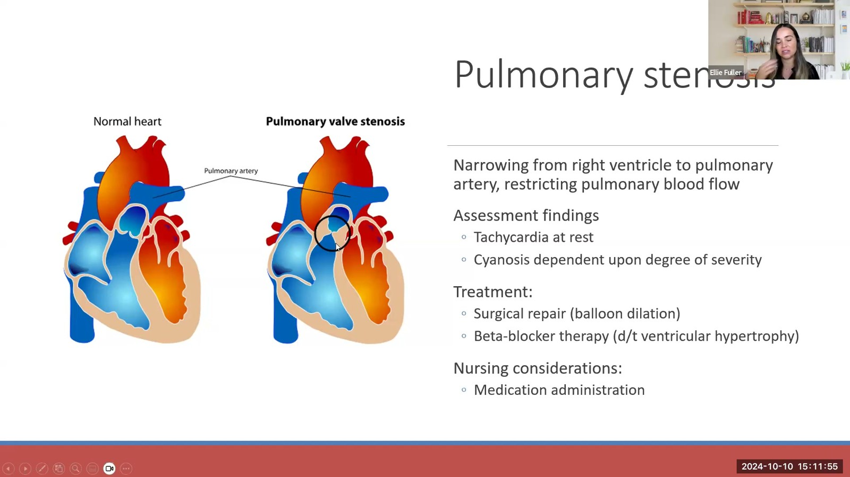
Notes:
Fuller · Week 9 · Cardiac
Recording time 70:42
https://drive.google.com/file/d/1AifHN2lCUw2D1ALY7zSTL1e-4SweDFOZ/view

Slide 37
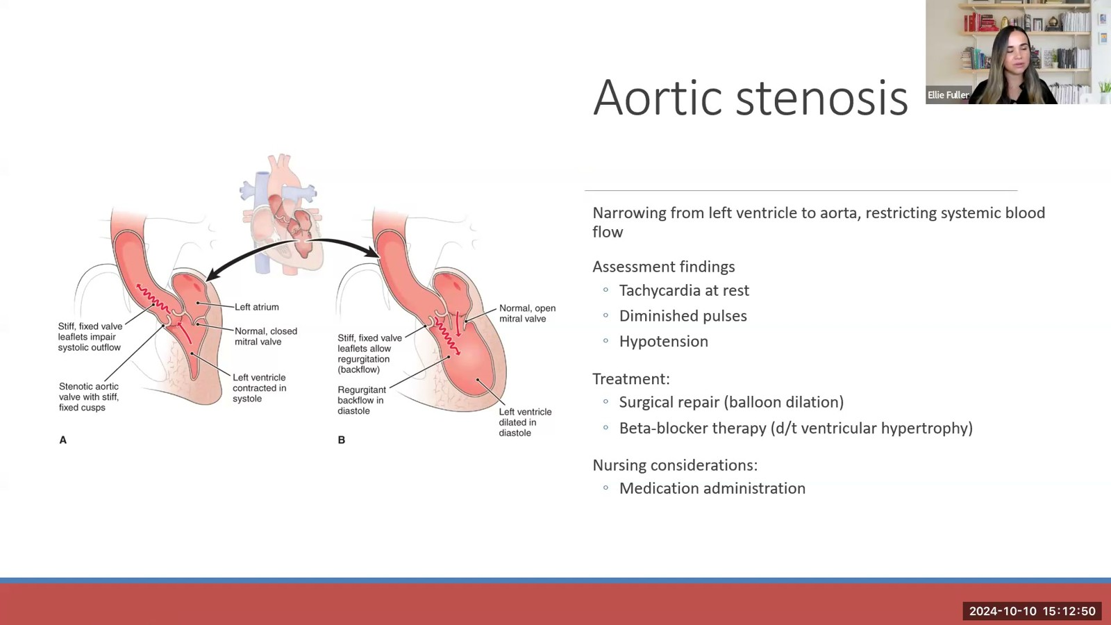
Notes:
Fuller · Week 9 · Cardiac
Recording time 71:37
https://drive.google.com/file/d/1AifHN2lCUw2D1ALY7zSTL1e-4SweDFOZ/view

Slide 38
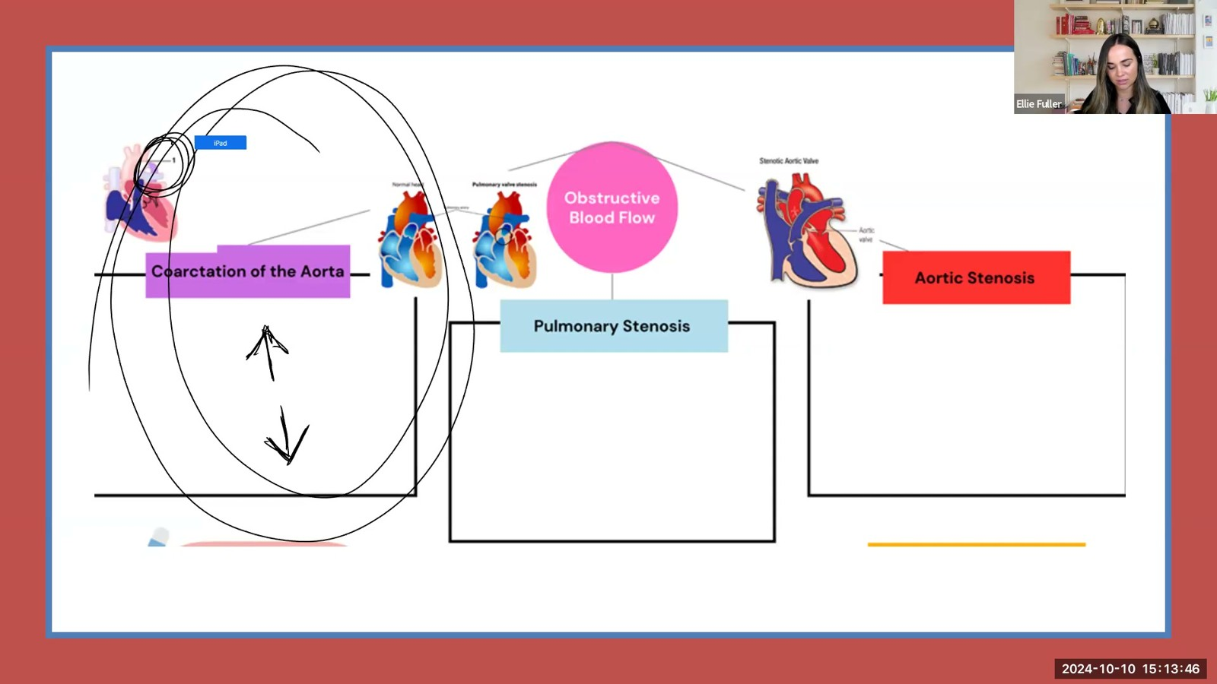
Notes:
Fuller · Week 9 · Cardiac
Recording time 72:33
https://drive.google.com/file/d/1AifHN2lCUw2D1ALY7zSTL1e-4SweDFOZ/view

Slide 39
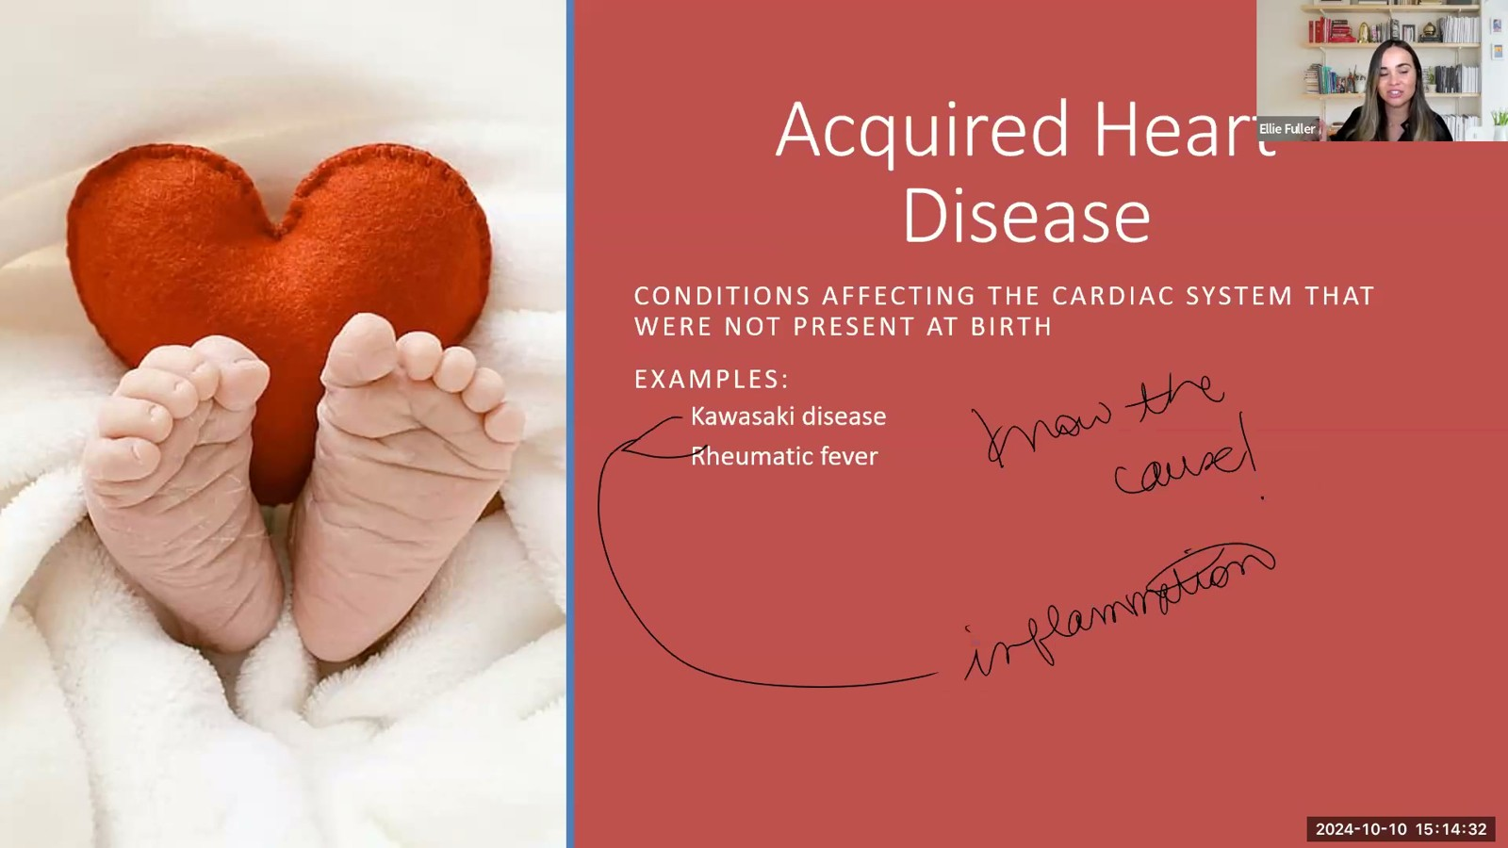
Notes:
Fuller · Week 9 · Cardiac
Recording time 73:19
https://drive.google.com/file/d/1AifHN2lCUw2D1ALY7zSTL1e-4SweDFOZ/view

Slide 40
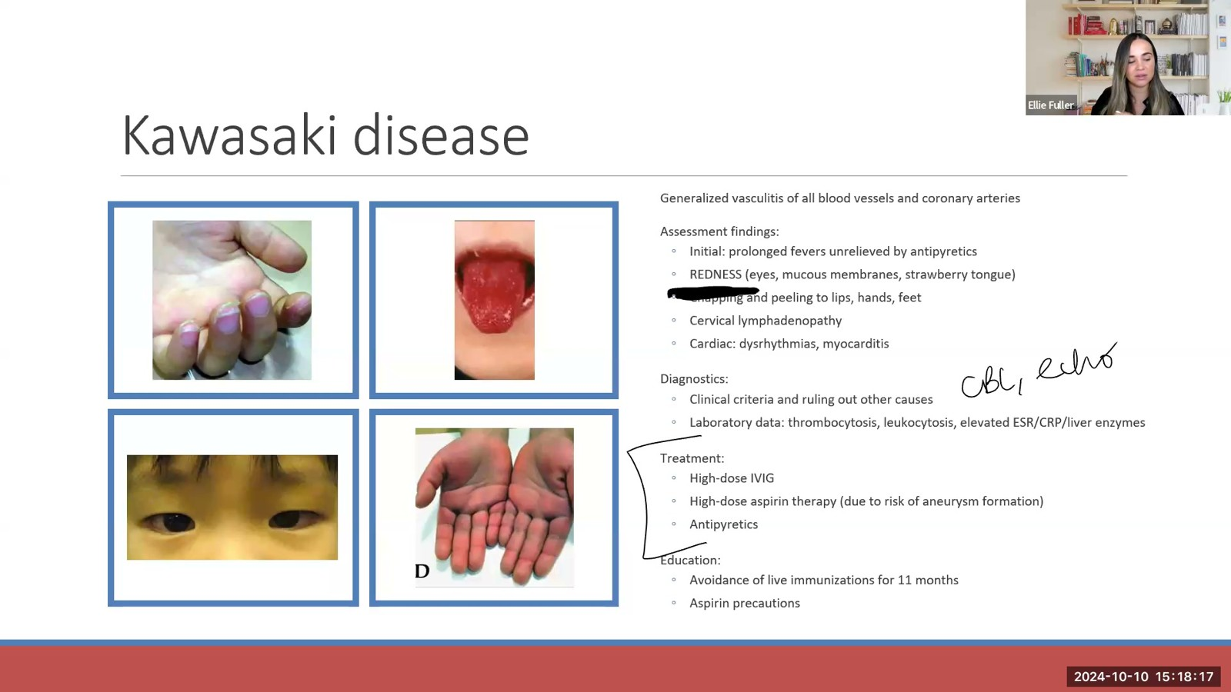
Notes:
Fuller · Week 9 · Cardiac
Recording time 77:04
https://drive.google.com/file/d/1AifHN2lCUw2D1ALY7zSTL1e-4SweDFOZ/view

Slide 41
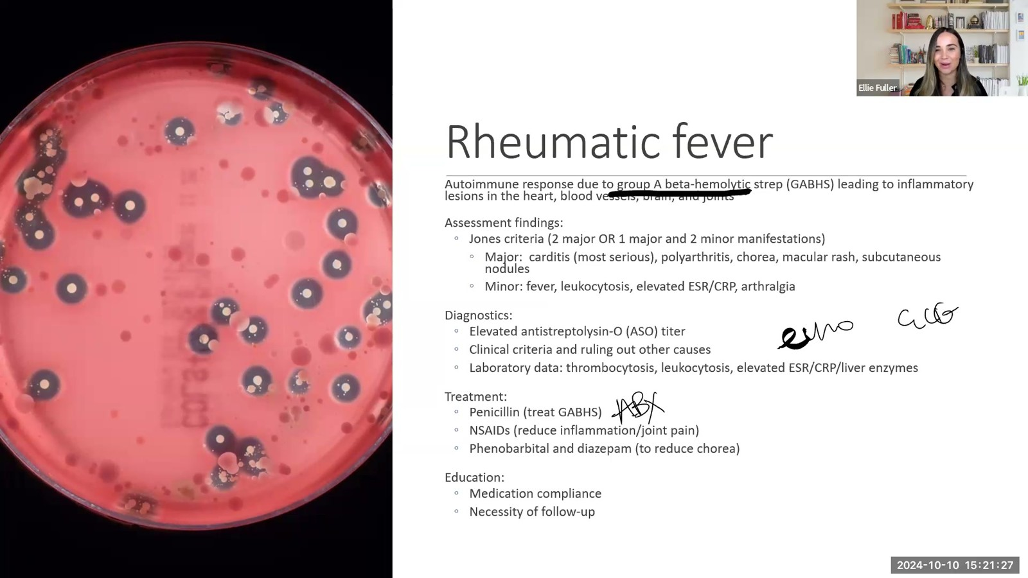
Notes:
Fuller · Week 9 · Cardiac
Recording time 80:14
https://drive.google.com/file/d/1AifHN2lCUw2D1ALY7zSTL1e-4SweDFOZ/view

Slide 42
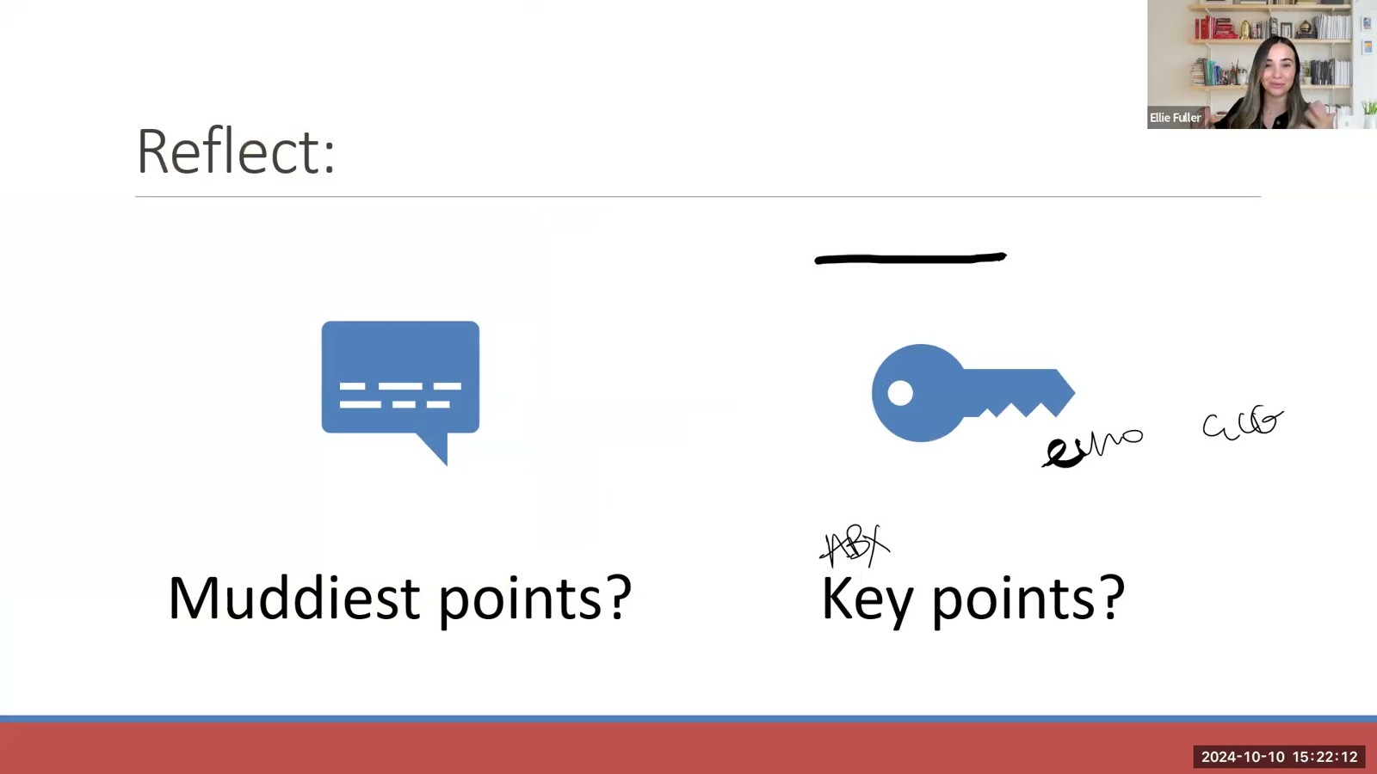
Notes:
Fuller · Week 9 · Cardiac
Recording time 80:59
https://drive.google.com/file/d/1AifHN2lCUw2D1ALY7zSTL1e-4SweDFOZ/view

Slide 43
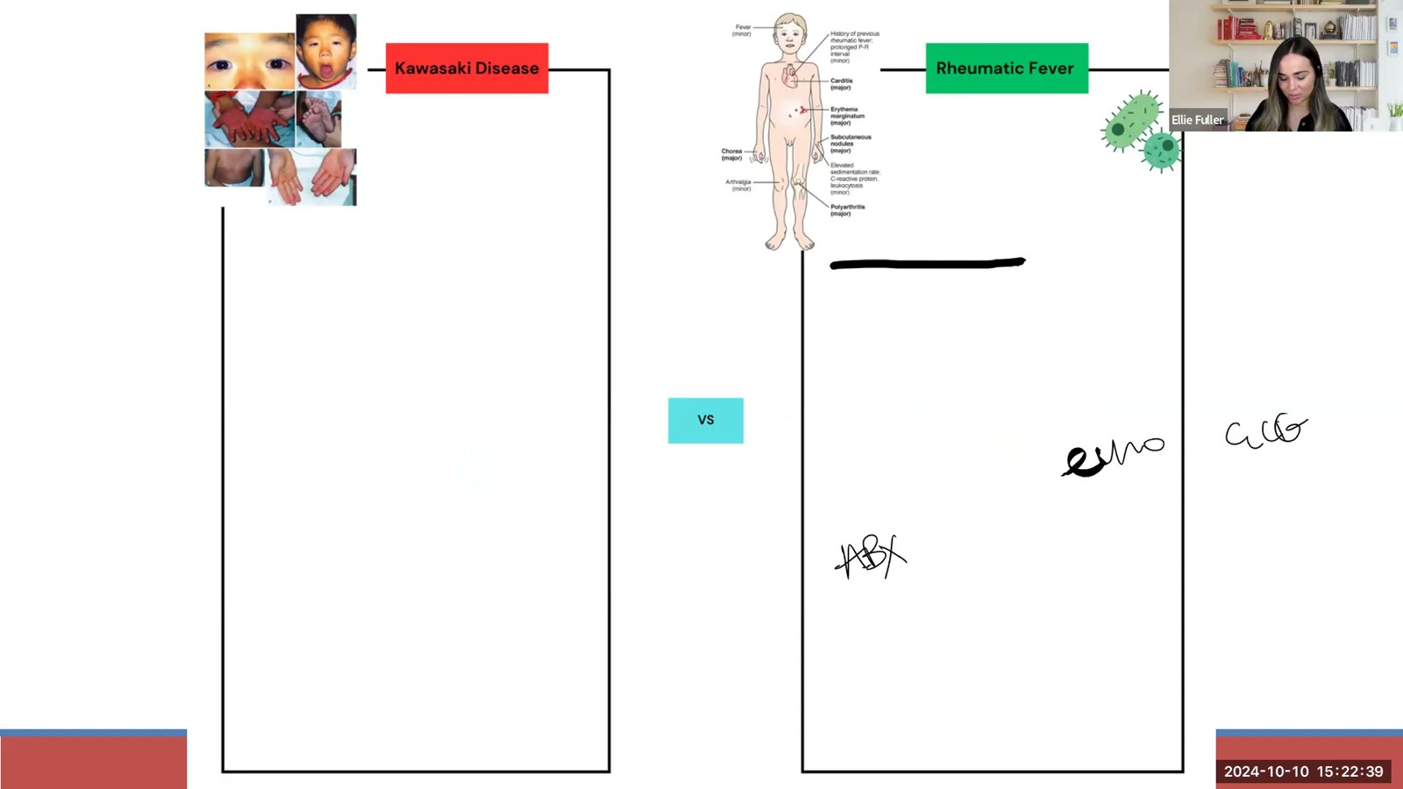
Notes:
Fuller · Week 9 · Cardiac
Recording time 81:26
https://drive.google.com/file/d/1AifHN2lCUw2D1ALY7zSTL1e-4SweDFOZ/view

