Slide 1

NUR 235 / WEEK 10 / FULLER
Musculoskeletal
Fractures, neurovascular checks, hip dysplasia and scoliosis
Study copy made from slides shown in the recorded lecture
Notes:
Source recording: https://drive.google.com/file/d/16EwUYszRhsvigOAsEeVYTPSjMaT_rU-o/view
University logo: https://www.joyce.edu/
Prepared for independent study. Original course slides are linked separately in the Study Hub.

Slide 2

Notes:
Fuller · Week 10 · Musculoskeletal
Recording time 0:29
https://drive.google.com/file/d/16EwUYszRhsvigOAsEeVYTPSjMaT_rU-o/view

Slide 3
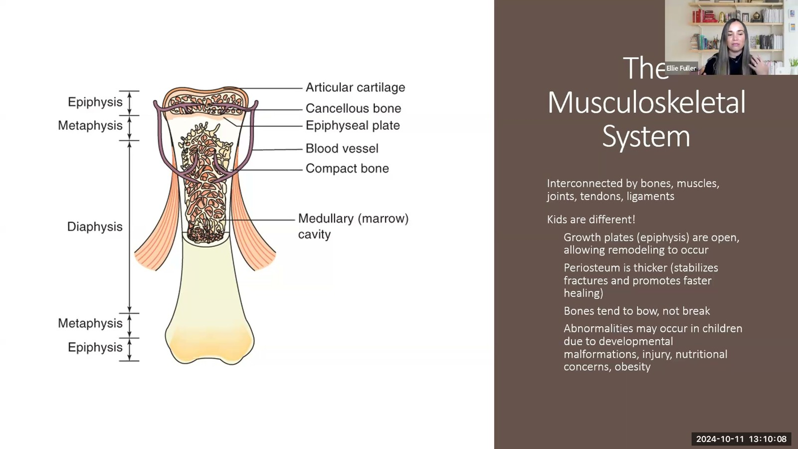
Notes:
Fuller · Week 10 · Musculoskeletal
Recording time 1:40
https://drive.google.com/file/d/16EwUYszRhsvigOAsEeVYTPSjMaT_rU-o/view

Slide 4
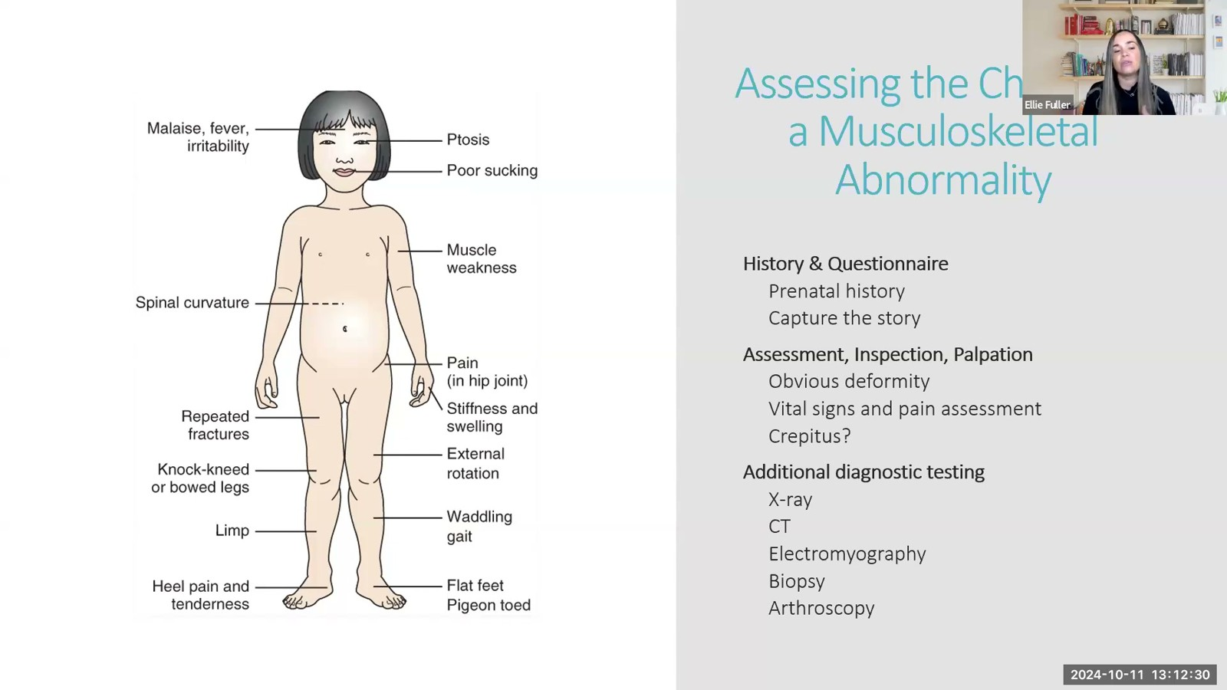
Notes:
Fuller · Week 10 · Musculoskeletal
Recording time 4:02
https://drive.google.com/file/d/16EwUYszRhsvigOAsEeVYTPSjMaT_rU-o/view

Slide 5
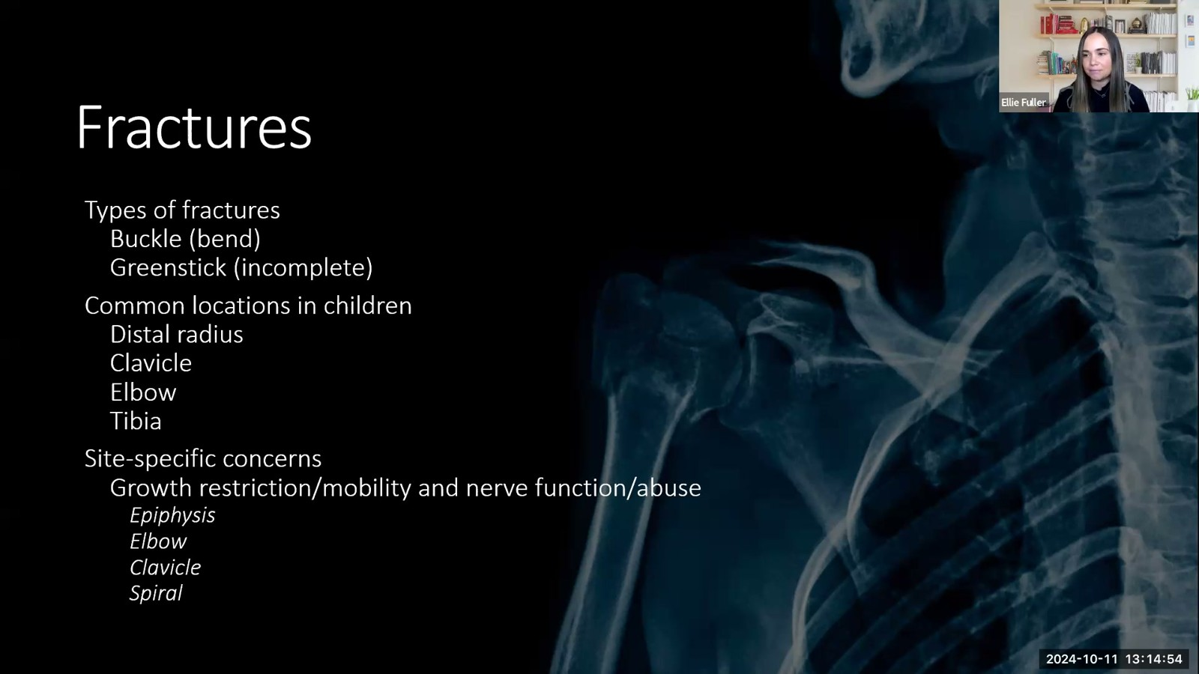
Notes:
Fuller · Week 10 · Musculoskeletal
Recording time 6:26
https://drive.google.com/file/d/16EwUYszRhsvigOAsEeVYTPSjMaT_rU-o/view

Slide 6

Notes:
Fuller · Week 10 · Musculoskeletal
Recording time 7:35
https://drive.google.com/file/d/16EwUYszRhsvigOAsEeVYTPSjMaT_rU-o/view

Slide 7
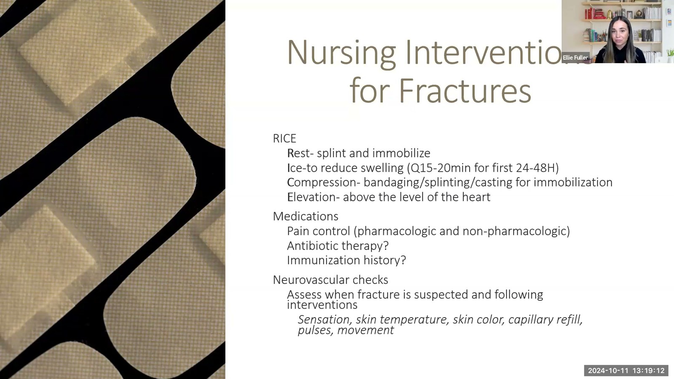
Notes:
Fuller · Week 10 · Musculoskeletal
Recording time 10:44
https://drive.google.com/file/d/16EwUYszRhsvigOAsEeVYTPSjMaT_rU-o/view

Slide 8
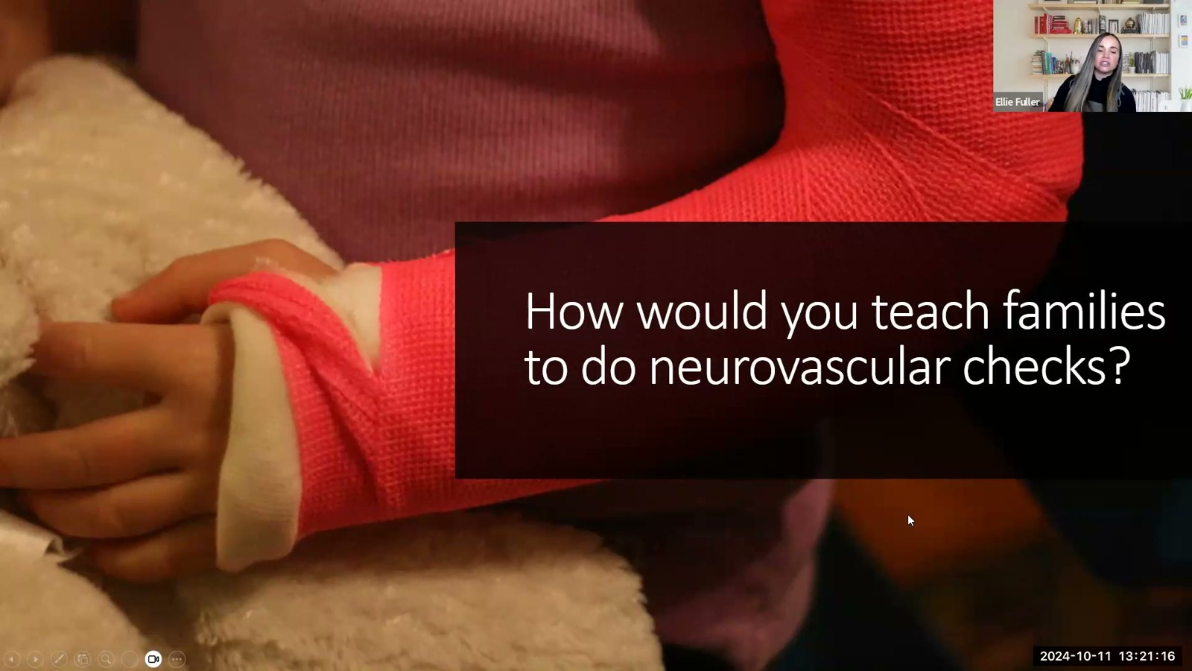
Notes:
Fuller · Week 10 · Musculoskeletal
Recording time 12:48
https://drive.google.com/file/d/16EwUYszRhsvigOAsEeVYTPSjMaT_rU-o/view

Slide 9
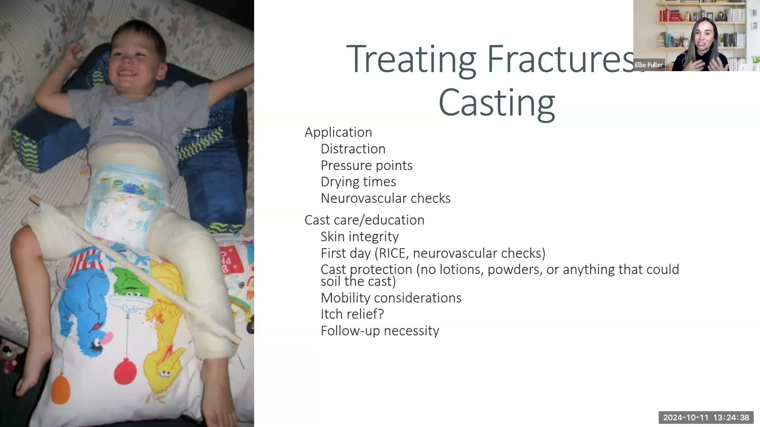
Notes:
Fuller · Week 10 · Musculoskeletal
Recording time 16:10
https://drive.google.com/file/d/16EwUYszRhsvigOAsEeVYTPSjMaT_rU-o/view

Slide 10
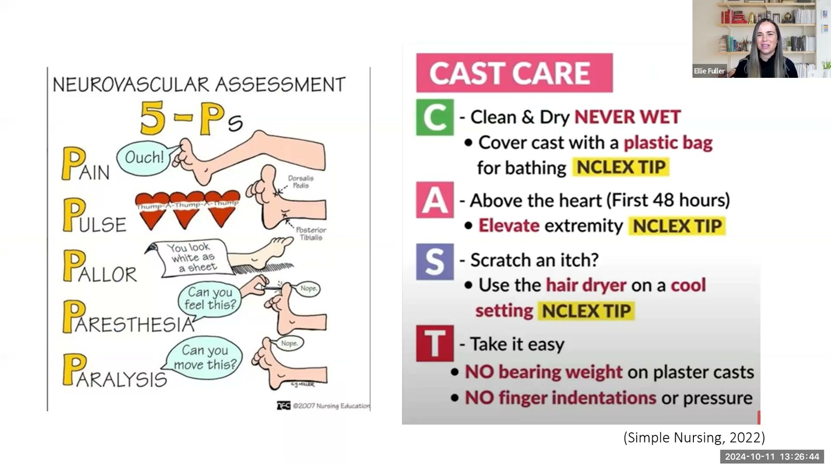
Notes:
Fuller · Week 10 · Musculoskeletal
Recording time 18:16
https://drive.google.com/file/d/16EwUYszRhsvigOAsEeVYTPSjMaT_rU-o/view

Slide 11
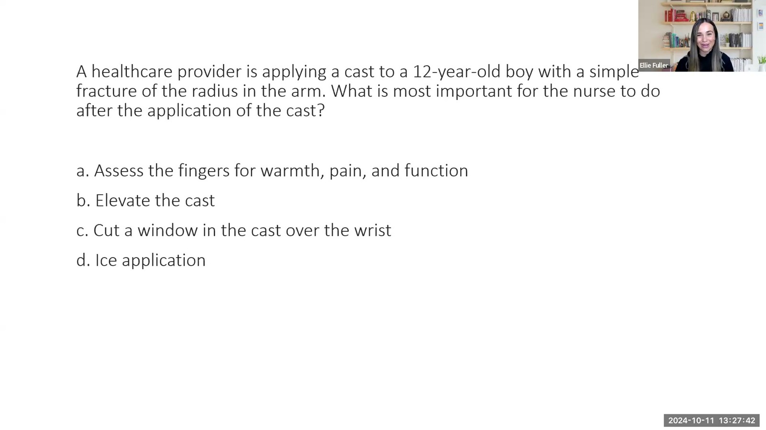
Notes:
Fuller · Week 10 · Musculoskeletal
Recording time 19:14
https://drive.google.com/file/d/16EwUYszRhsvigOAsEeVYTPSjMaT_rU-o/view

Slide 12
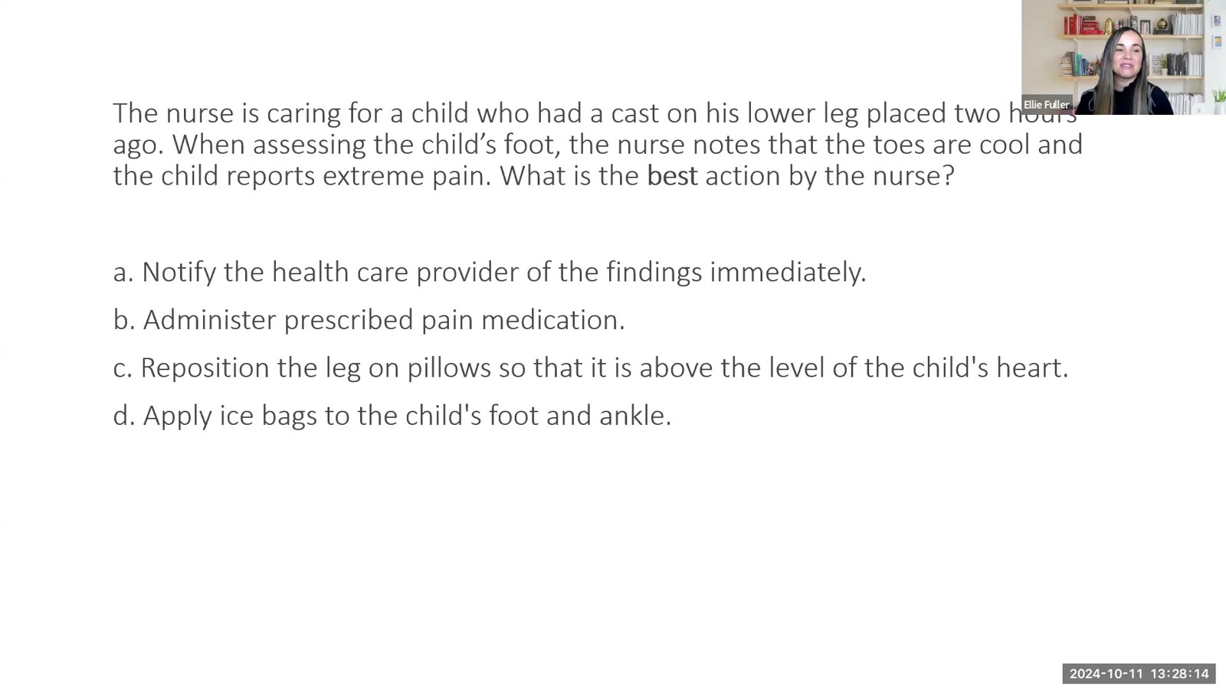
Notes:
Fuller · Week 10 · Musculoskeletal
Recording time 19:46
https://drive.google.com/file/d/16EwUYszRhsvigOAsEeVYTPSjMaT_rU-o/view

Slide 13
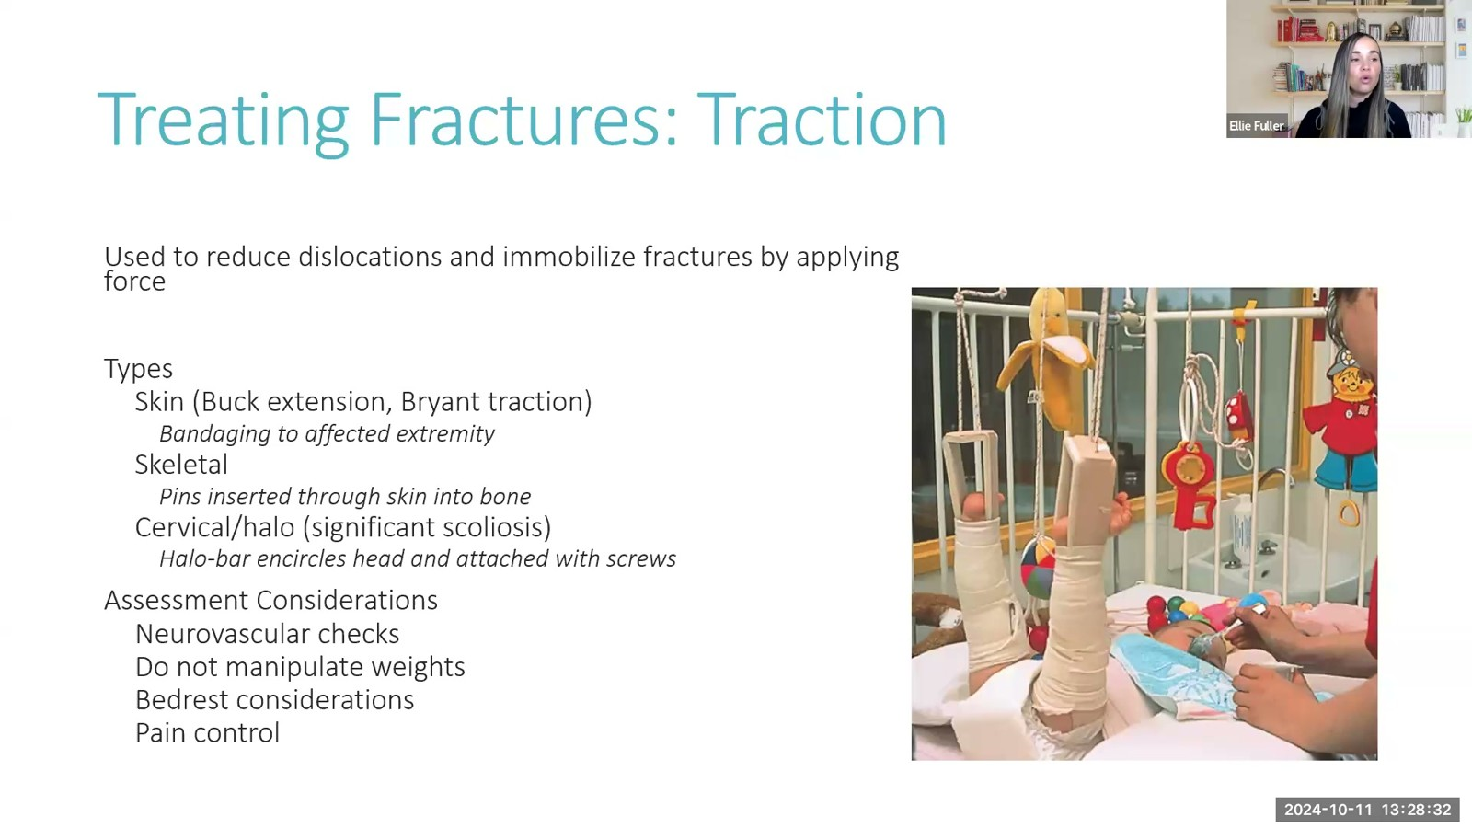
Notes:
Fuller · Week 10 · Musculoskeletal
Recording time 20:04
https://drive.google.com/file/d/16EwUYszRhsvigOAsEeVYTPSjMaT_rU-o/view

Slide 14
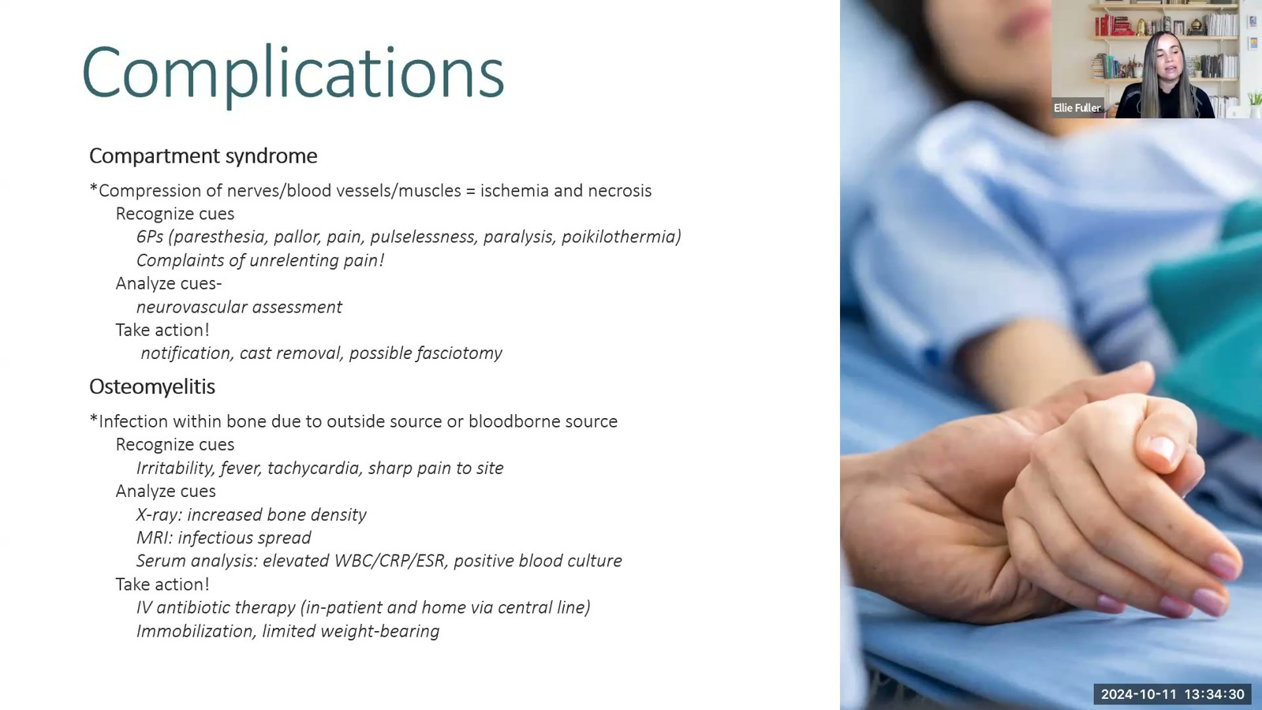
Notes:
Fuller · Week 10 · Musculoskeletal
Recording time 26:02
https://drive.google.com/file/d/16EwUYszRhsvigOAsEeVYTPSjMaT_rU-o/view

Slide 15
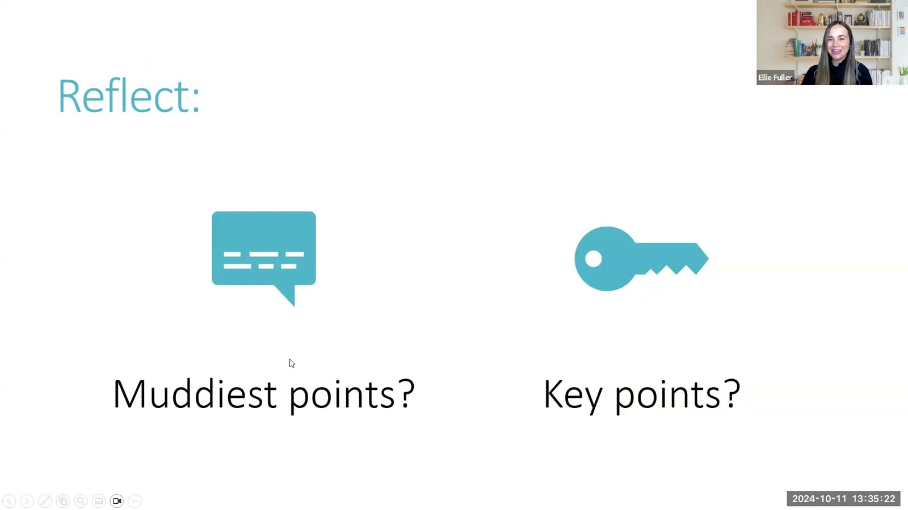
Notes:
Fuller · Week 10 · Musculoskeletal
Recording time 26:54
https://drive.google.com/file/d/16EwUYszRhsvigOAsEeVYTPSjMaT_rU-o/view

Slide 16
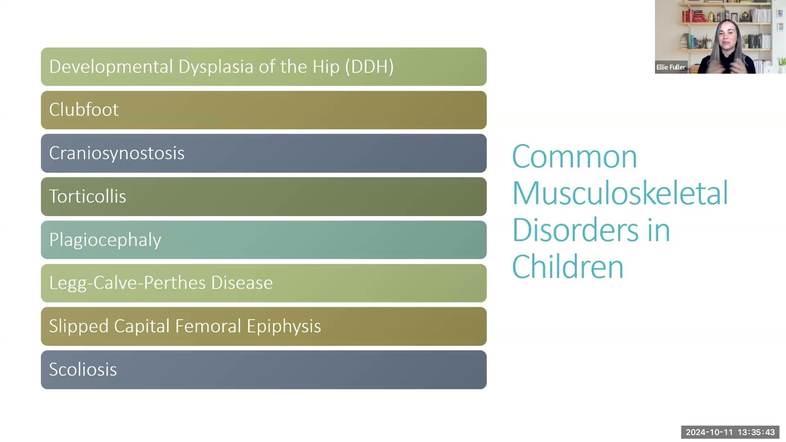
Notes:
Fuller · Week 10 · Musculoskeletal
Recording time 27:15
https://drive.google.com/file/d/16EwUYszRhsvigOAsEeVYTPSjMaT_rU-o/view

Slide 17
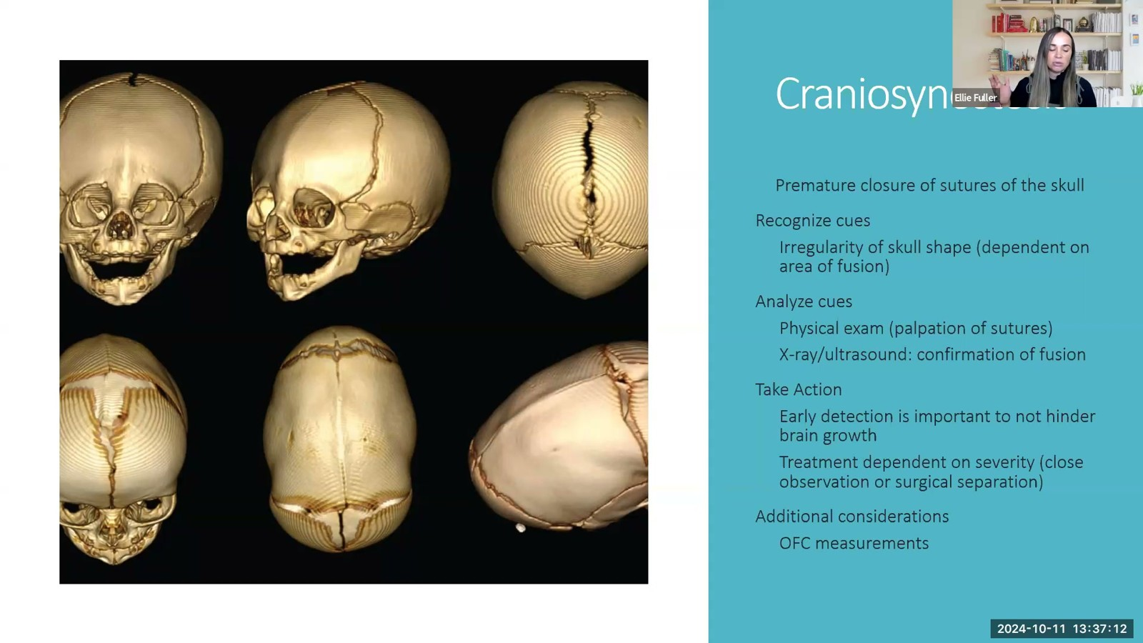
Notes:
Fuller · Week 10 · Musculoskeletal
Recording time 28:44
https://drive.google.com/file/d/16EwUYszRhsvigOAsEeVYTPSjMaT_rU-o/view

Slide 18
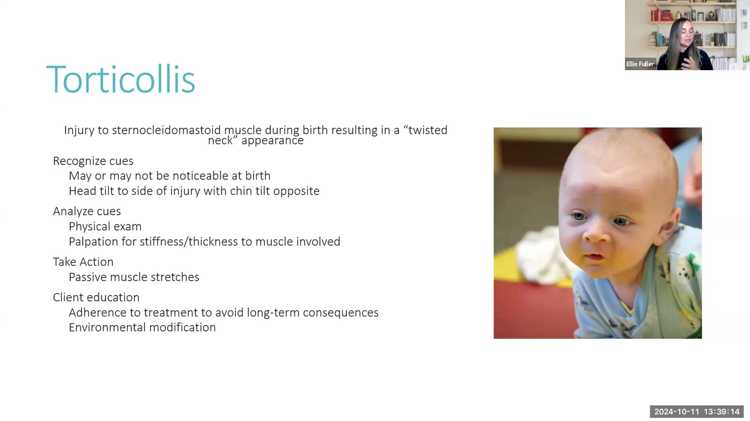
Notes:
Fuller · Week 10 · Musculoskeletal
Recording time 30:46
https://drive.google.com/file/d/16EwUYszRhsvigOAsEeVYTPSjMaT_rU-o/view

Slide 19
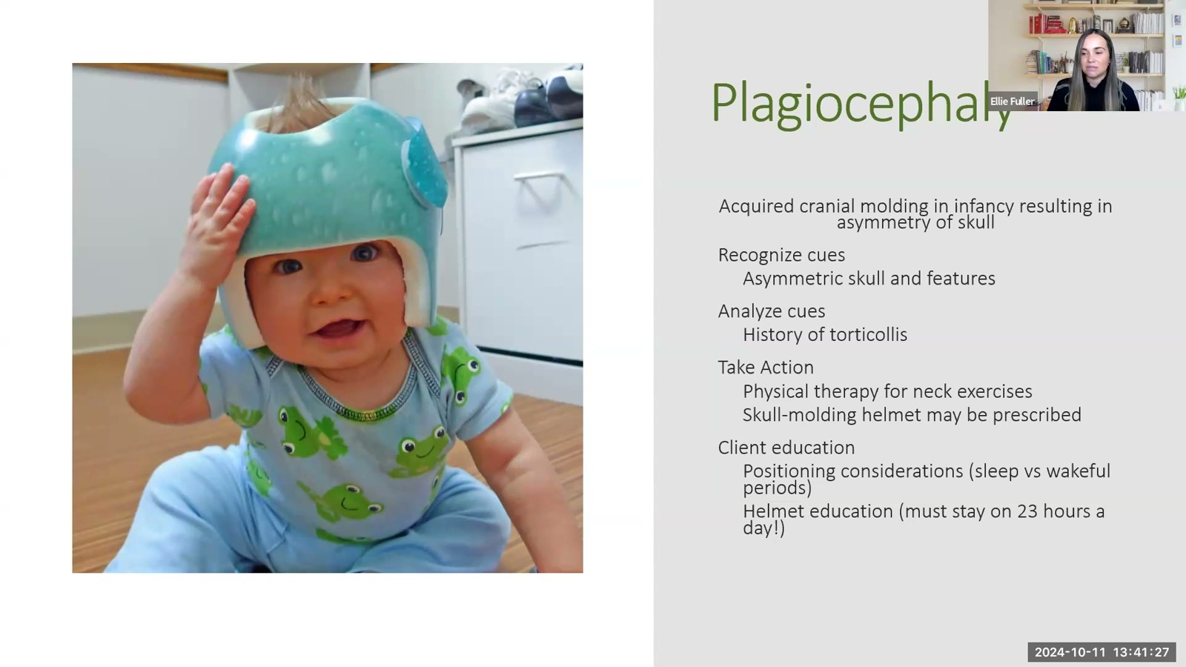
Notes:
Fuller · Week 10 · Musculoskeletal
Recording time 32:59
https://drive.google.com/file/d/16EwUYszRhsvigOAsEeVYTPSjMaT_rU-o/view

Slide 20
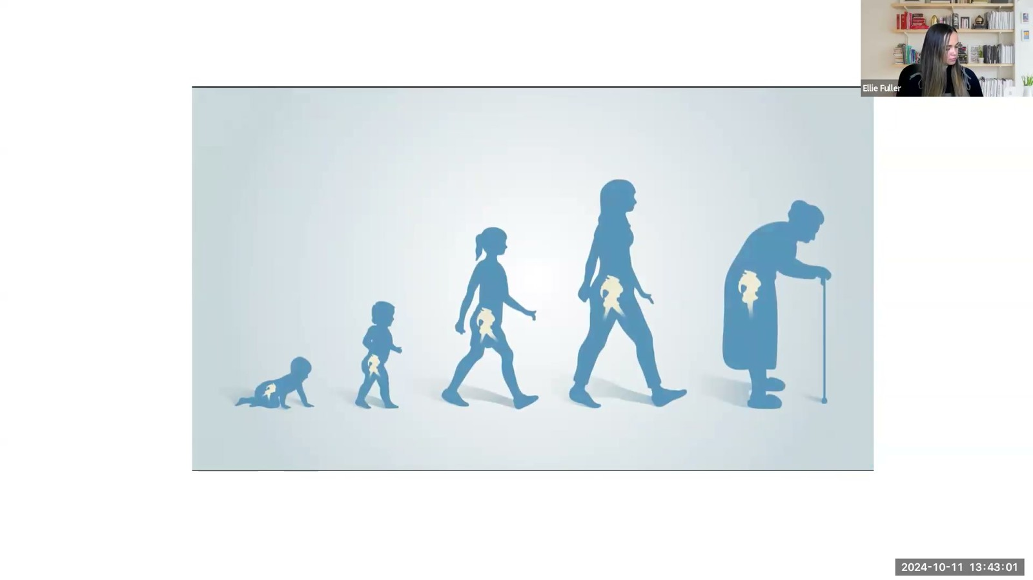
Notes:
Fuller · Week 10 · Musculoskeletal
Recording time 34:33
https://drive.google.com/file/d/16EwUYszRhsvigOAsEeVYTPSjMaT_rU-o/view

Slide 21
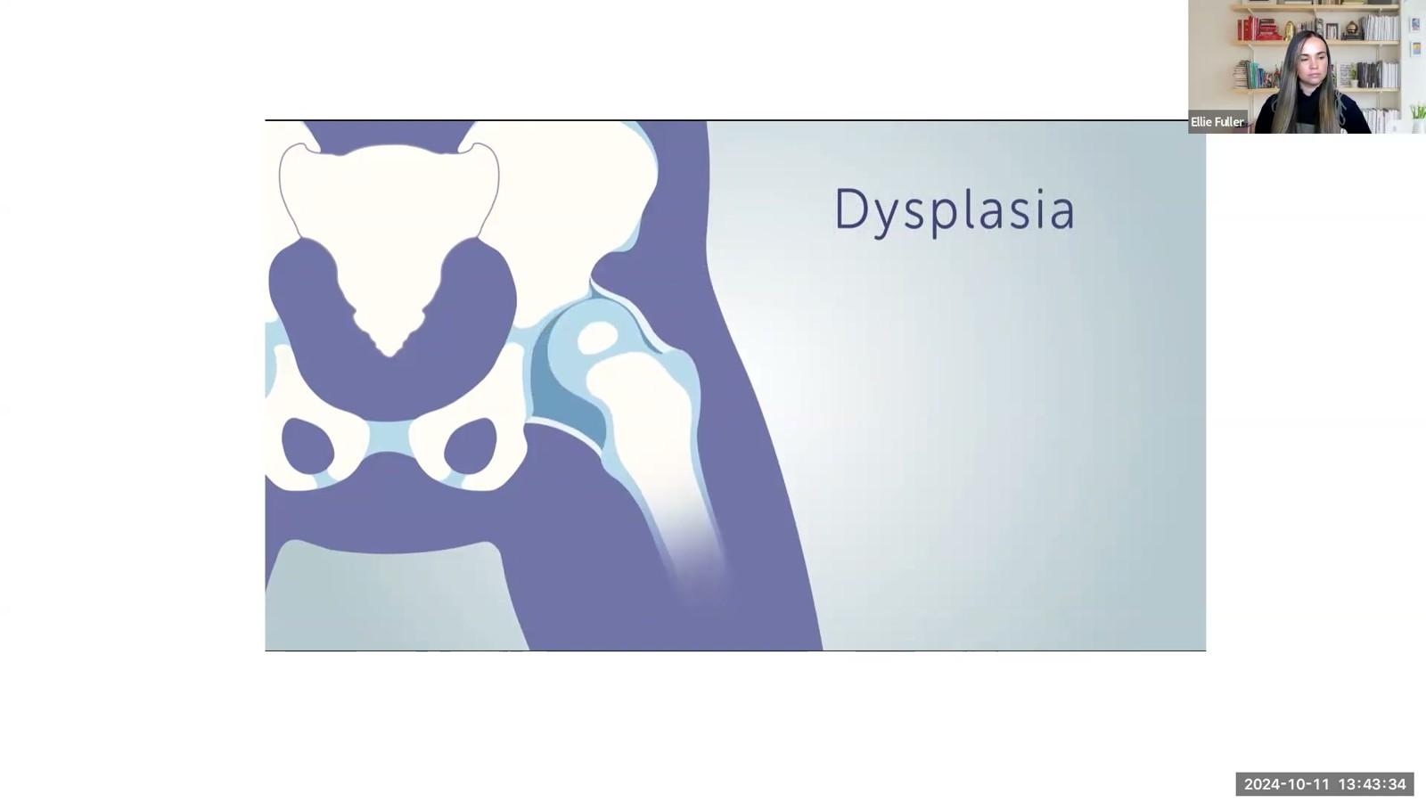
Notes:
Fuller · Week 10 · Musculoskeletal
Recording time 35:06
https://drive.google.com/file/d/16EwUYszRhsvigOAsEeVYTPSjMaT_rU-o/view

Slide 22
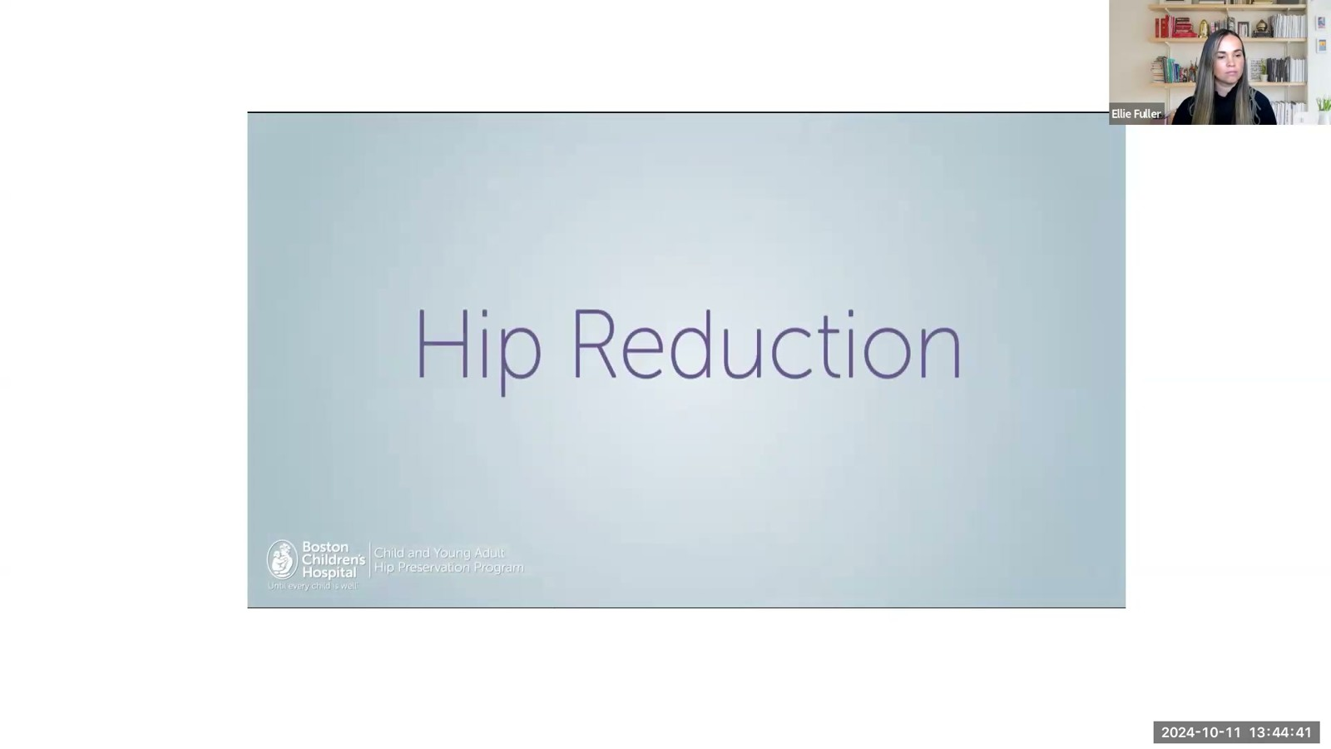
Notes:
Fuller · Week 10 · Musculoskeletal
Recording time 36:13
https://drive.google.com/file/d/16EwUYszRhsvigOAsEeVYTPSjMaT_rU-o/view

Slide 23
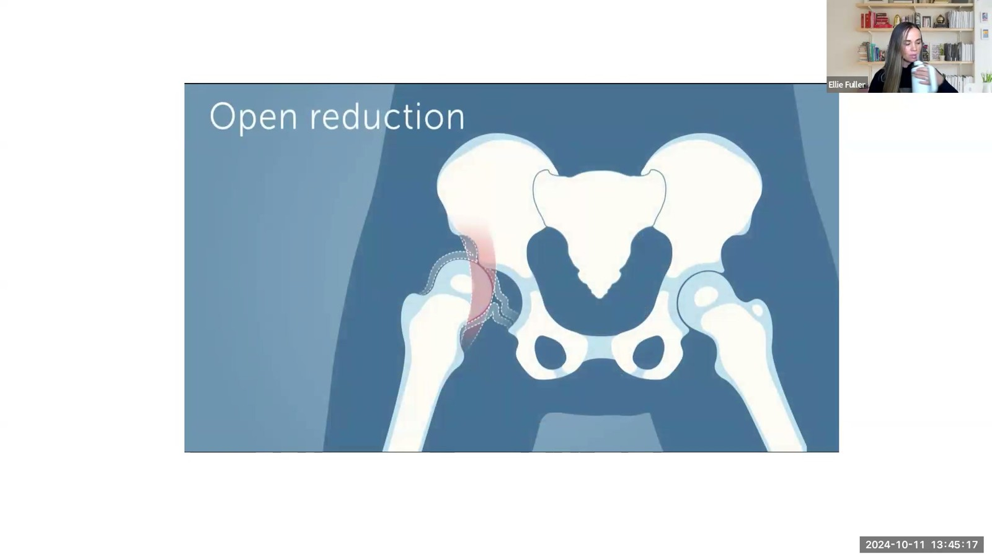
Notes:
Fuller · Week 10 · Musculoskeletal
Recording time 36:49
https://drive.google.com/file/d/16EwUYszRhsvigOAsEeVYTPSjMaT_rU-o/view

Slide 24
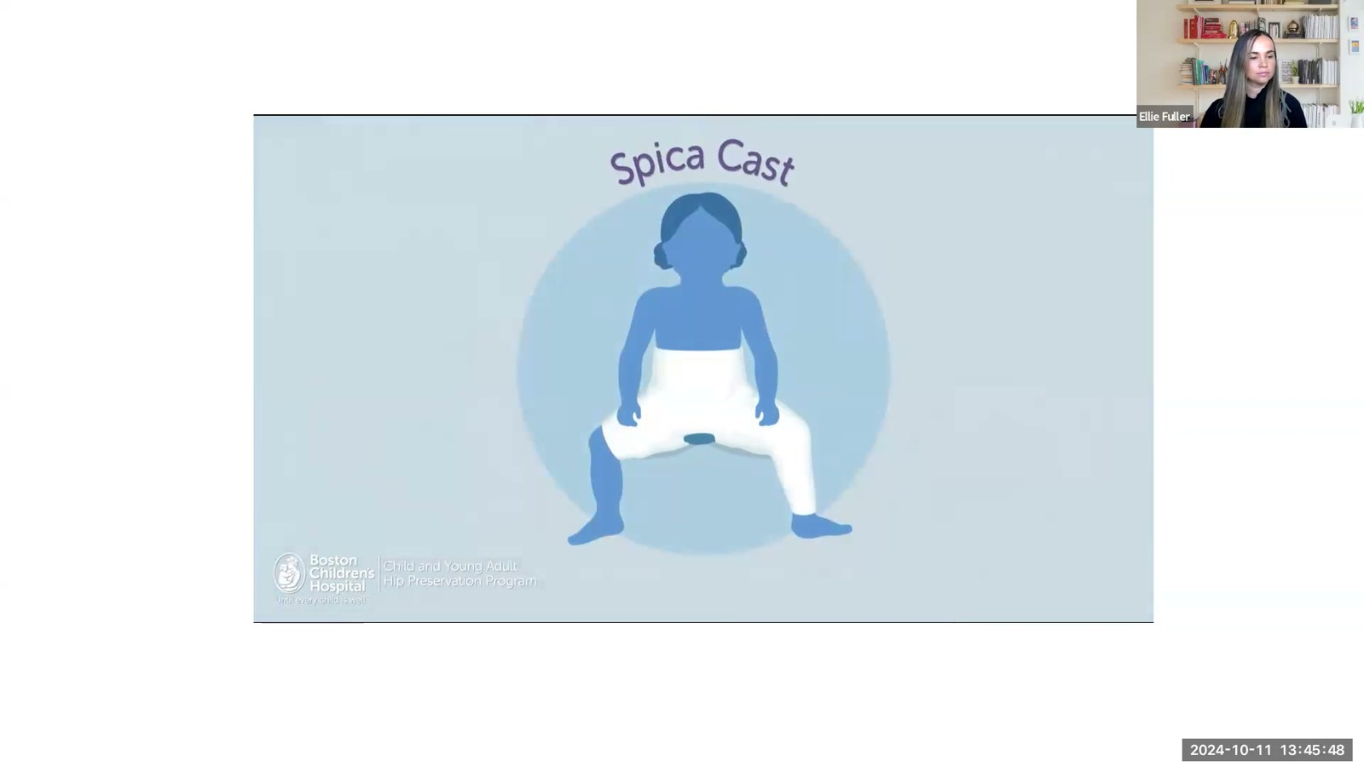
Notes:
Fuller · Week 10 · Musculoskeletal
Recording time 37:20
https://drive.google.com/file/d/16EwUYszRhsvigOAsEeVYTPSjMaT_rU-o/view

Slide 25
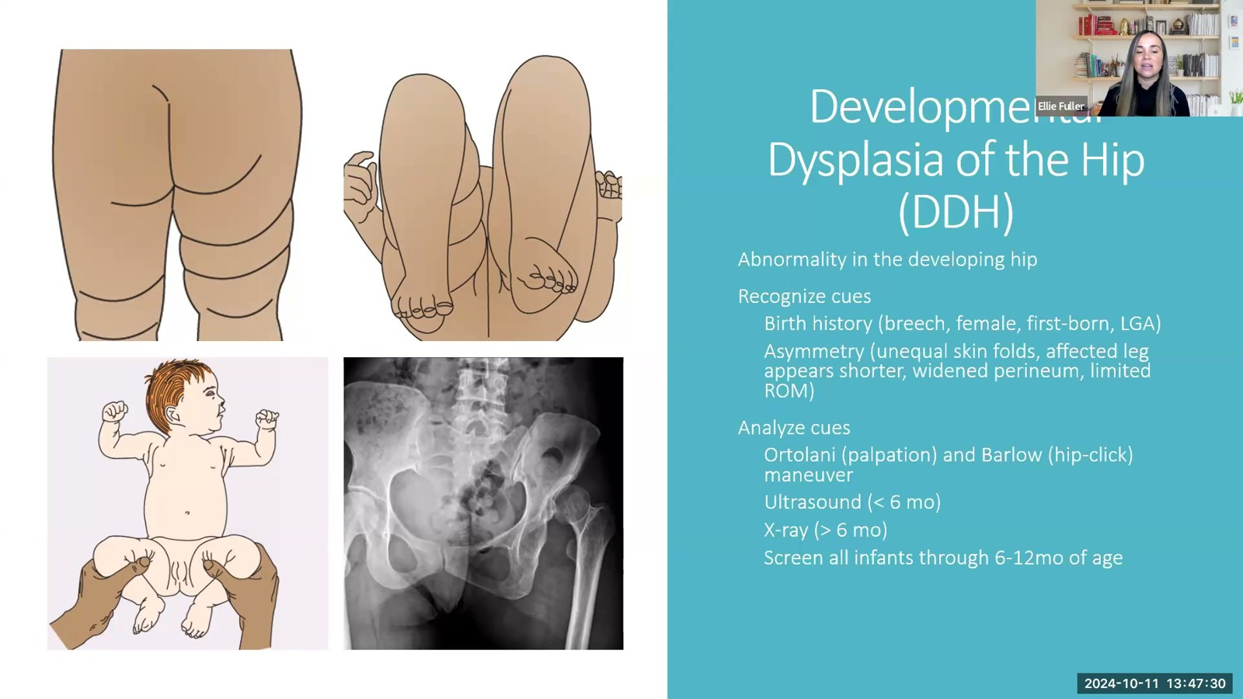
Notes:
Fuller · Week 10 · Musculoskeletal
Recording time 39:02
https://drive.google.com/file/d/16EwUYszRhsvigOAsEeVYTPSjMaT_rU-o/view

Slide 26
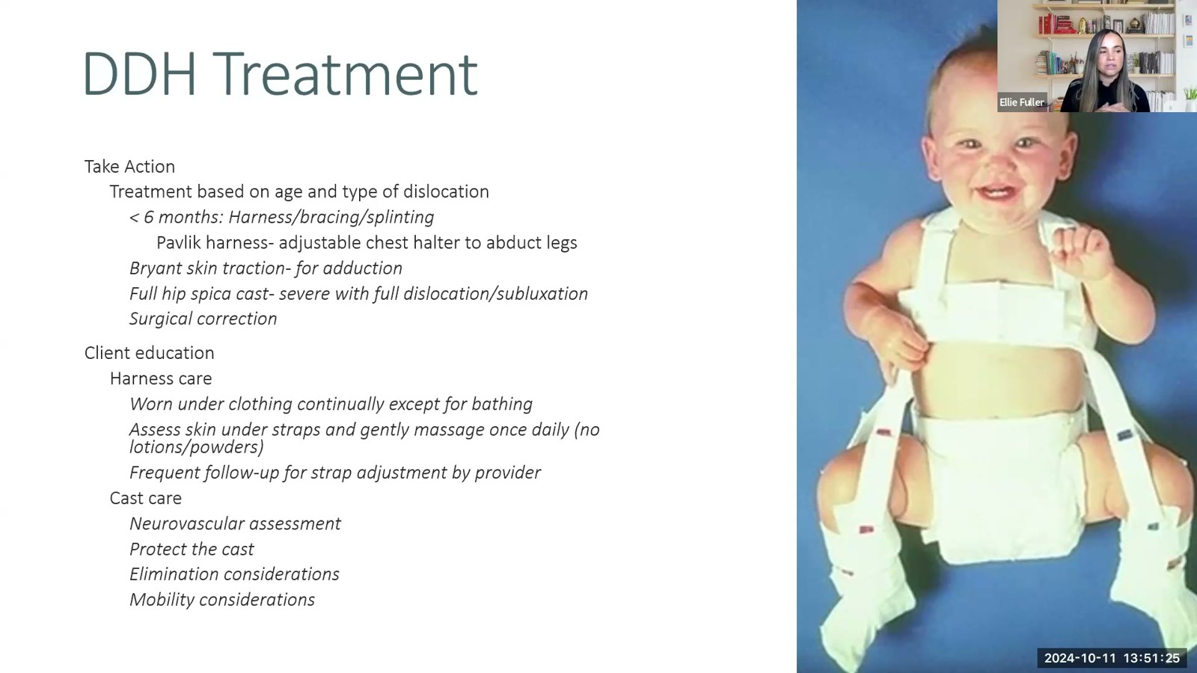
Notes:
Fuller · Week 10 · Musculoskeletal
Recording time 42:57
https://drive.google.com/file/d/16EwUYszRhsvigOAsEeVYTPSjMaT_rU-o/view

Slide 27
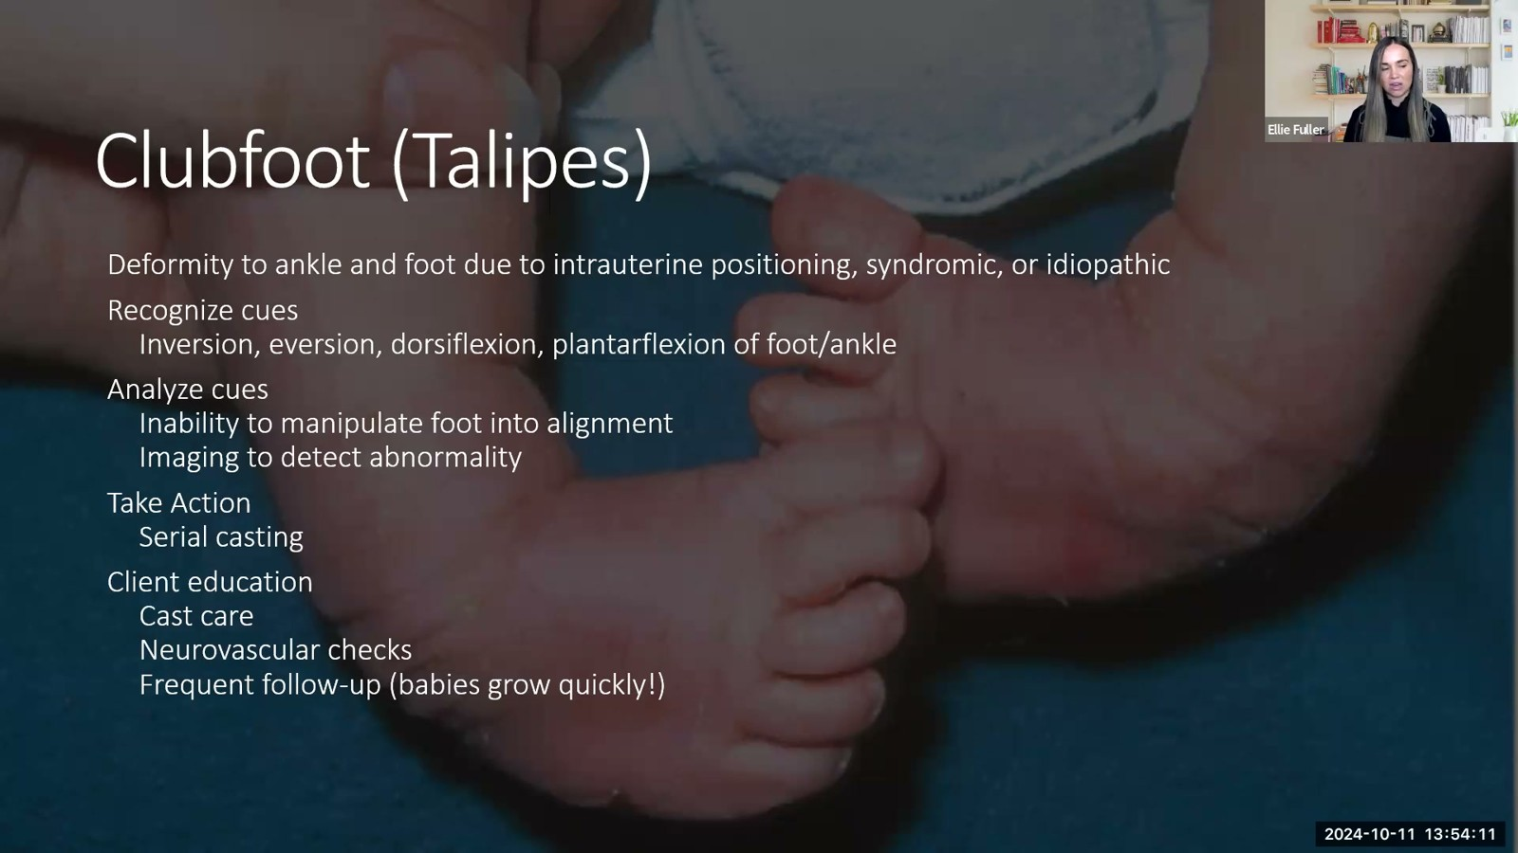
Notes:
Fuller · Week 10 · Musculoskeletal
Recording time 45:43
https://drive.google.com/file/d/16EwUYszRhsvigOAsEeVYTPSjMaT_rU-o/view

Slide 28
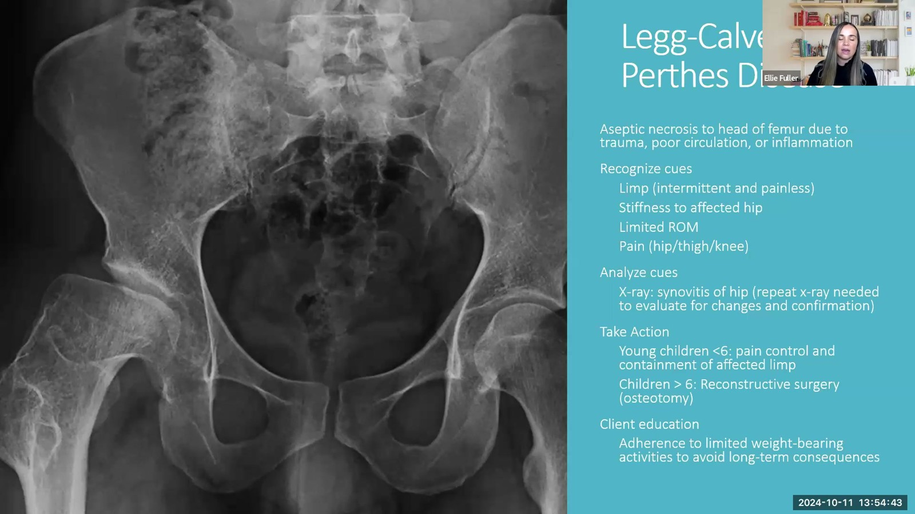
Notes:
Fuller · Week 10 · Musculoskeletal
Recording time 46:15
https://drive.google.com/file/d/16EwUYszRhsvigOAsEeVYTPSjMaT_rU-o/view

Slide 29
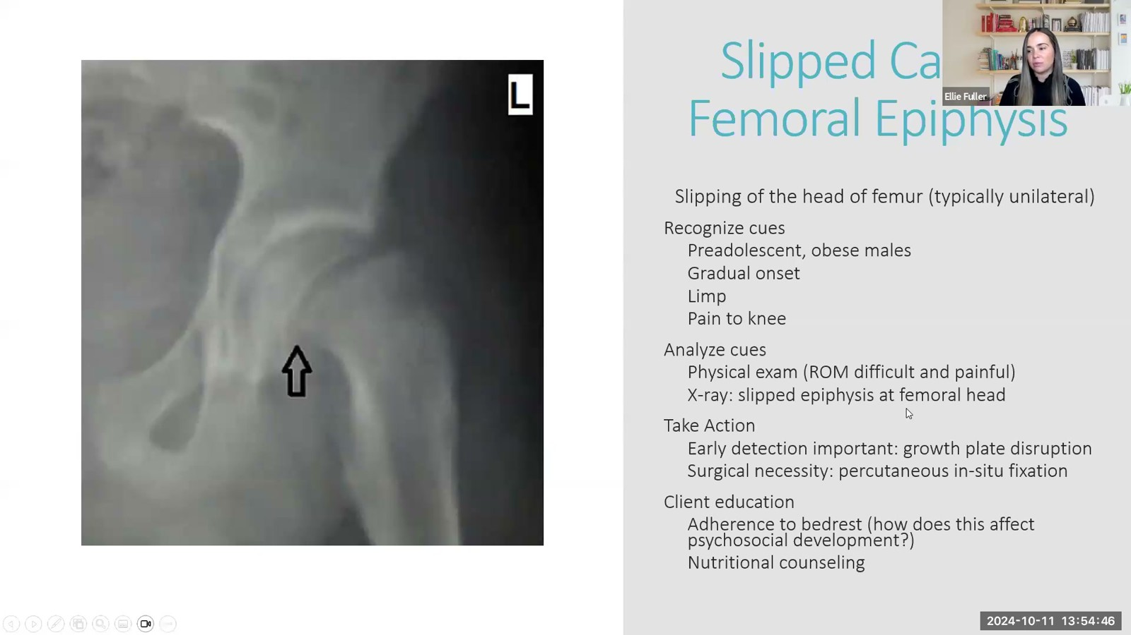
Notes:
Fuller · Week 10 · Musculoskeletal
Recording time 46:18
https://drive.google.com/file/d/16EwUYszRhsvigOAsEeVYTPSjMaT_rU-o/view

Slide 30
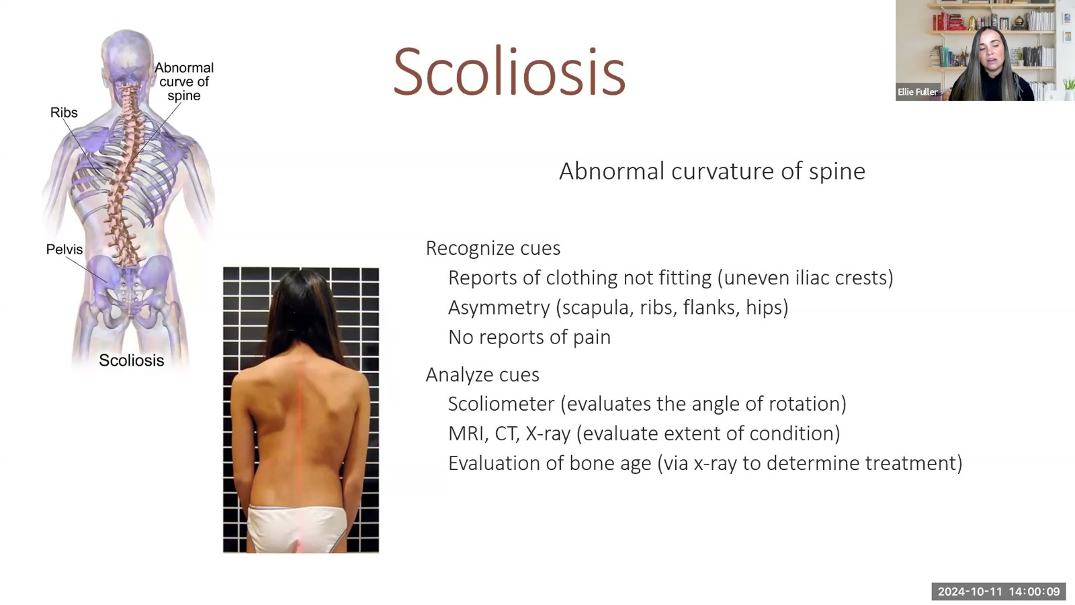
Notes:
Fuller · Week 10 · Musculoskeletal
Recording time 51:41
https://drive.google.com/file/d/16EwUYszRhsvigOAsEeVYTPSjMaT_rU-o/view

Slide 31
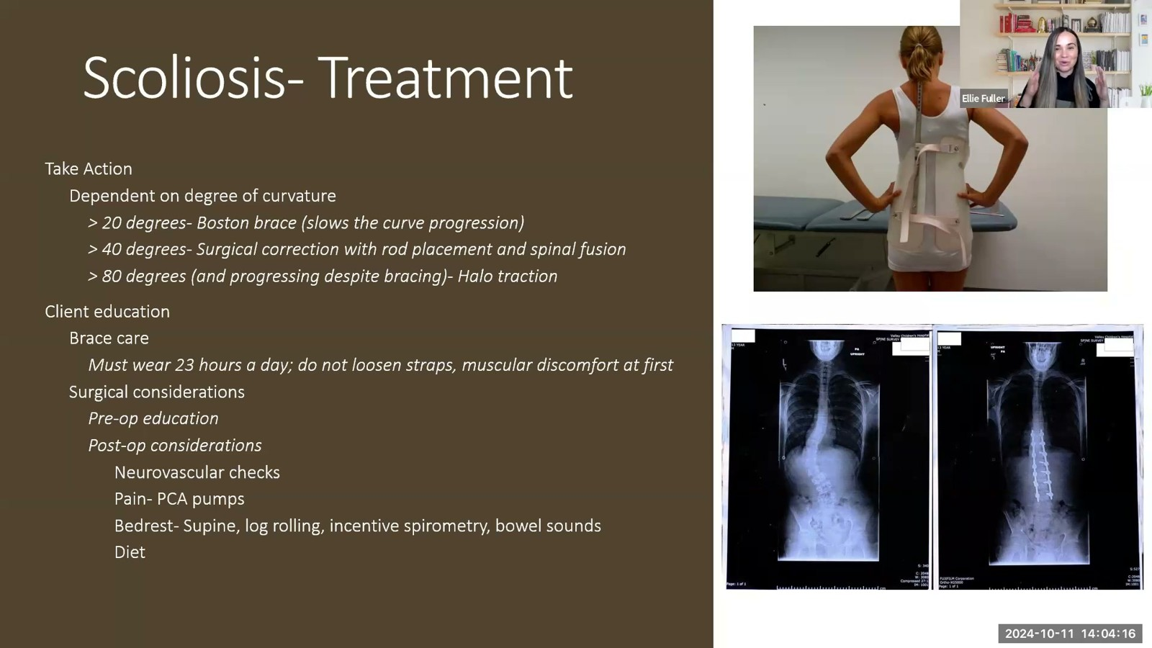
Notes:
Fuller · Week 10 · Musculoskeletal
Recording time 55:48
https://drive.google.com/file/d/16EwUYszRhsvigOAsEeVYTPSjMaT_rU-o/view

Slide 32
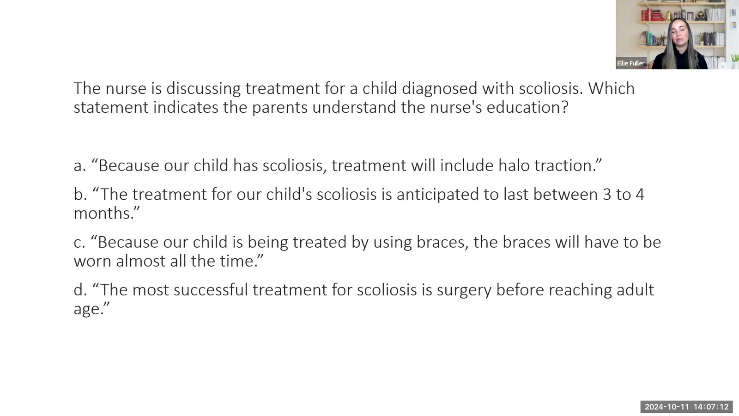
Notes:
Fuller · Week 10 · Musculoskeletal
Recording time 58:44
https://drive.google.com/file/d/16EwUYszRhsvigOAsEeVYTPSjMaT_rU-o/view

Slide 33
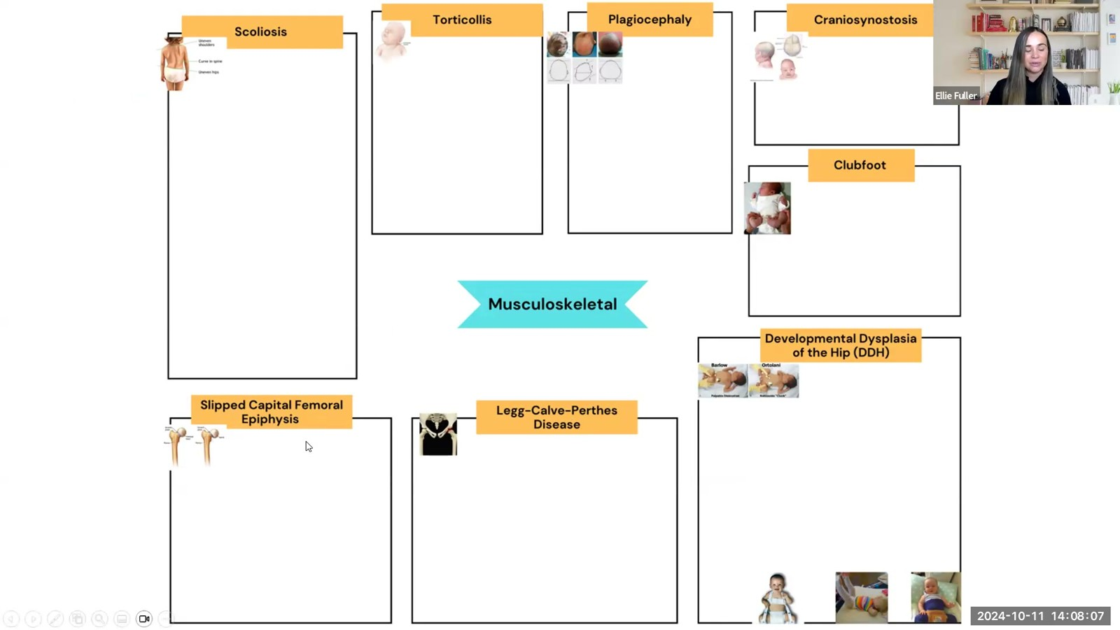
Notes:
Fuller · Week 10 · Musculoskeletal
Recording time 59:39
https://drive.google.com/file/d/16EwUYszRhsvigOAsEeVYTPSjMaT_rU-o/view

Slide 34
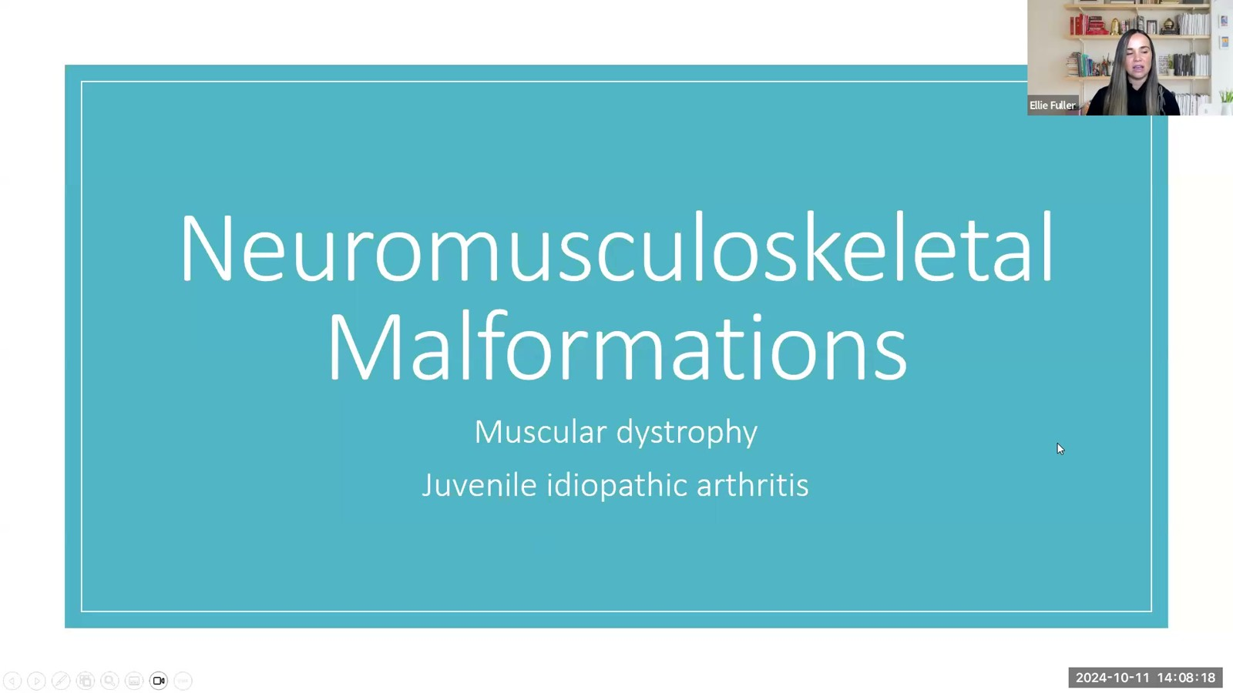
Notes:
Fuller · Week 10 · Musculoskeletal
Recording time 59:50
https://drive.google.com/file/d/16EwUYszRhsvigOAsEeVYTPSjMaT_rU-o/view

Slide 35
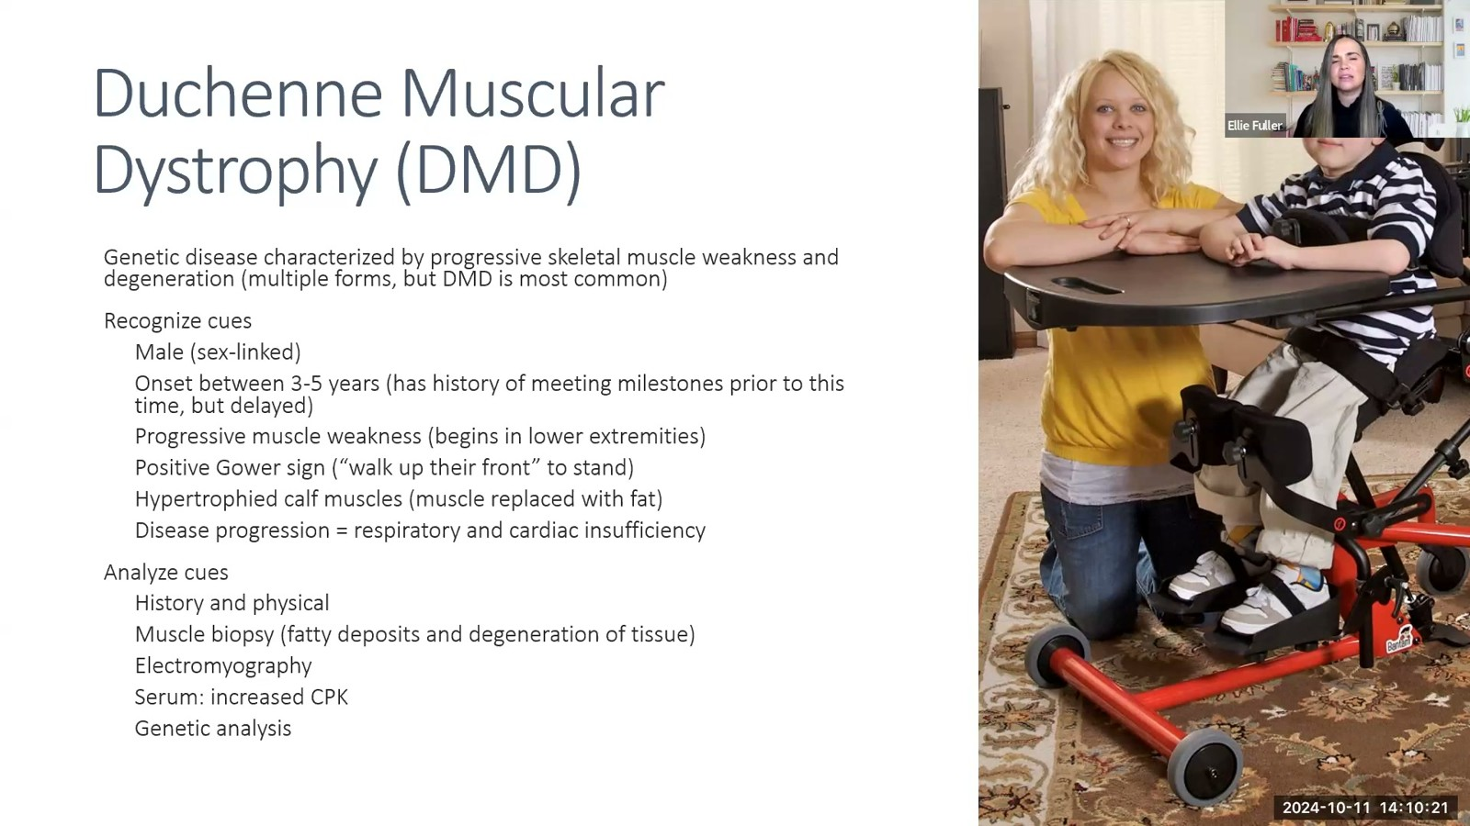
Notes:
Fuller · Week 10 · Musculoskeletal
Recording time 61:53
https://drive.google.com/file/d/16EwUYszRhsvigOAsEeVYTPSjMaT_rU-o/view

Slide 36
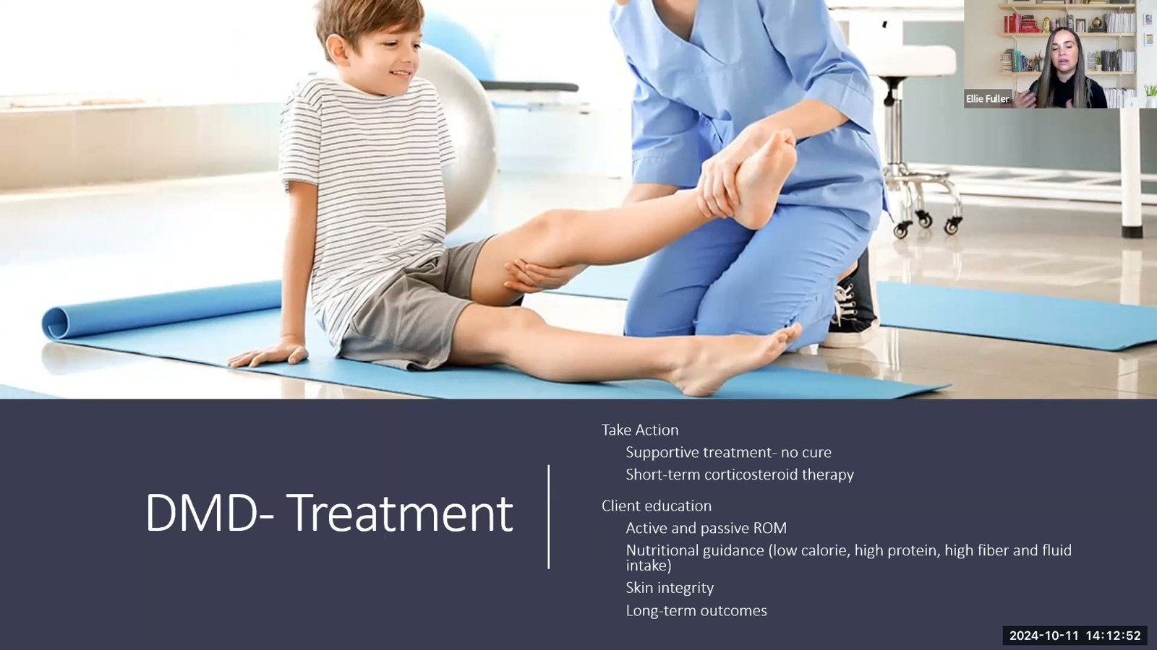
Notes:
Fuller · Week 10 · Musculoskeletal
Recording time 64:24
https://drive.google.com/file/d/16EwUYszRhsvigOAsEeVYTPSjMaT_rU-o/view

Slide 37
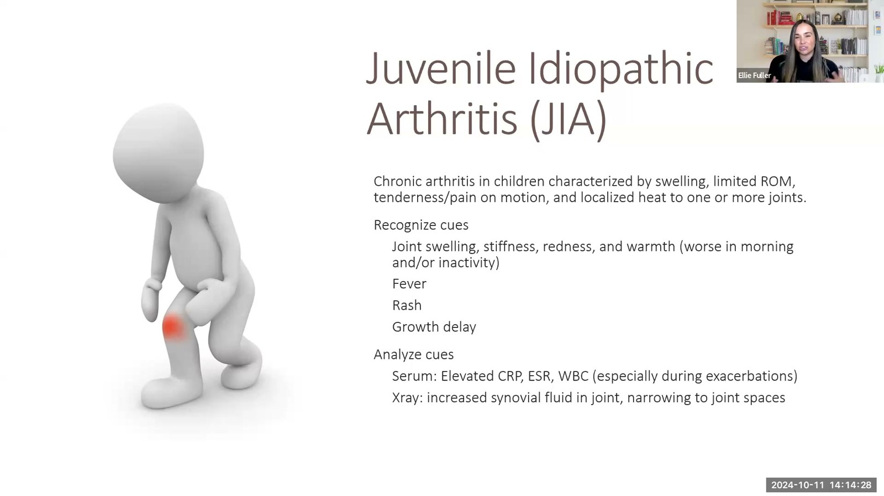
Notes:
Fuller · Week 10 · Musculoskeletal
Recording time 66:00
https://drive.google.com/file/d/16EwUYszRhsvigOAsEeVYTPSjMaT_rU-o/view

Slide 38
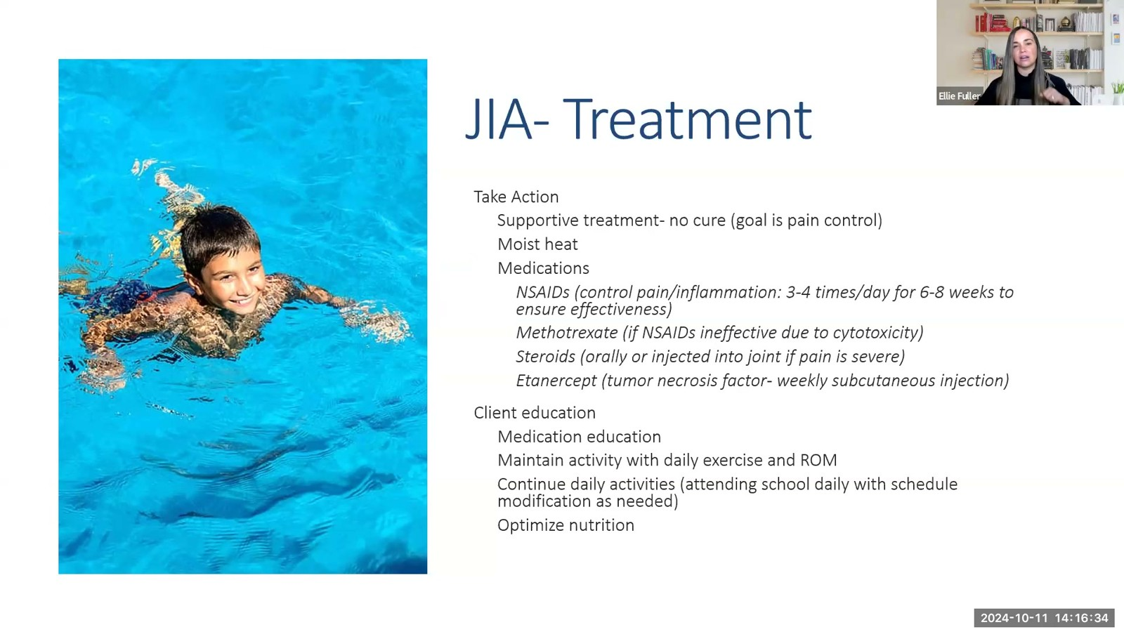
Notes:
Fuller · Week 10 · Musculoskeletal
Recording time 68:06
https://drive.google.com/file/d/16EwUYszRhsvigOAsEeVYTPSjMaT_rU-o/view

Slide 39
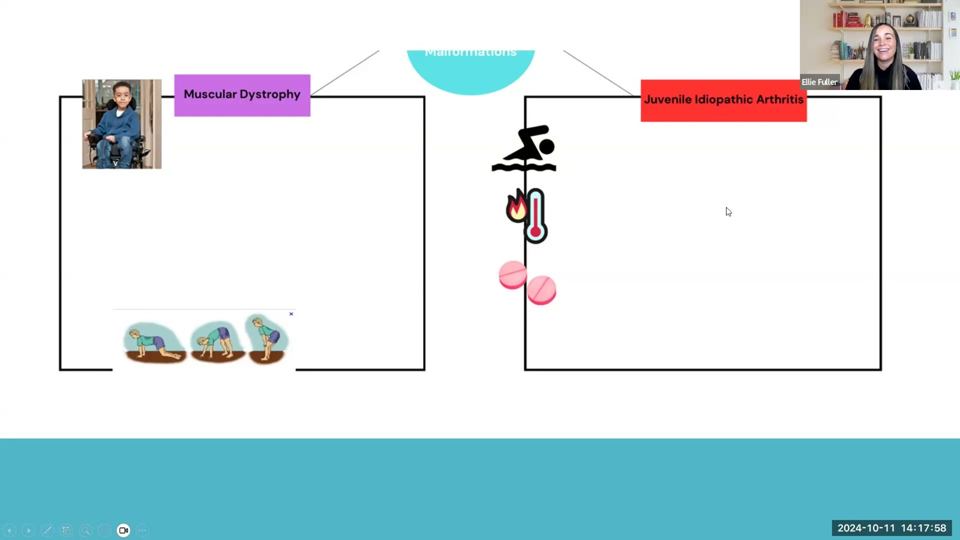
Notes:
Fuller · Week 10 · Musculoskeletal
Recording time 69:30
https://drive.google.com/file/d/16EwUYszRhsvigOAsEeVYTPSjMaT_rU-o/view

