Slide 1

NUR 235 / WEEK 11 / FULLER
Endocrine & Metabolic
Diabetes insipidus, SIADH, type 1 diabetes, DKA and thyroid disorders
Study copy made from slides shown in the recorded lecture
Notes:
Source recording: https://drive.google.com/file/d/133wvGtArpMkxl4khAoNhoauyza9hWRvo/view
University logo: https://www.joyce.edu/
Prepared for independent study. Original course slides are linked separately in the Study Hub.

Slide 2

Notes:
Fuller · Week 11 · Endocrine & Metabolic
Recording time 0:03
https://drive.google.com/file/d/133wvGtArpMkxl4khAoNhoauyza9hWRvo/view

Slide 3
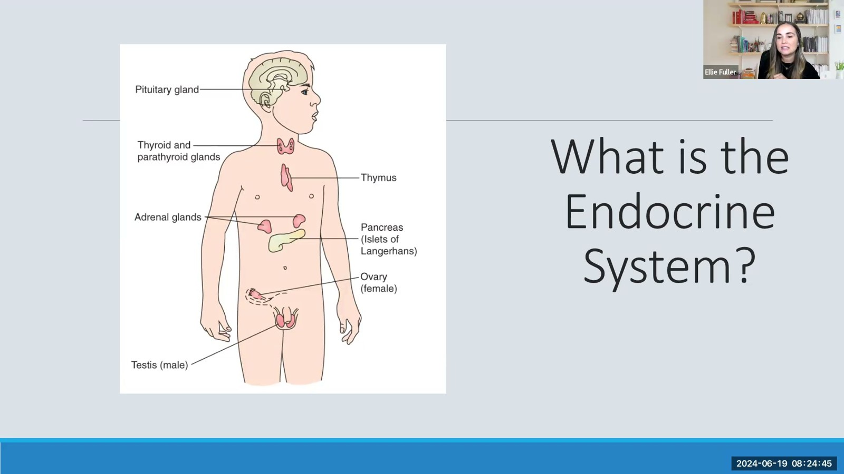
Notes:
Fuller · Week 11 · Endocrine & Metabolic
Recording time 1:39
https://drive.google.com/file/d/133wvGtArpMkxl4khAoNhoauyza9hWRvo/view

Slide 4
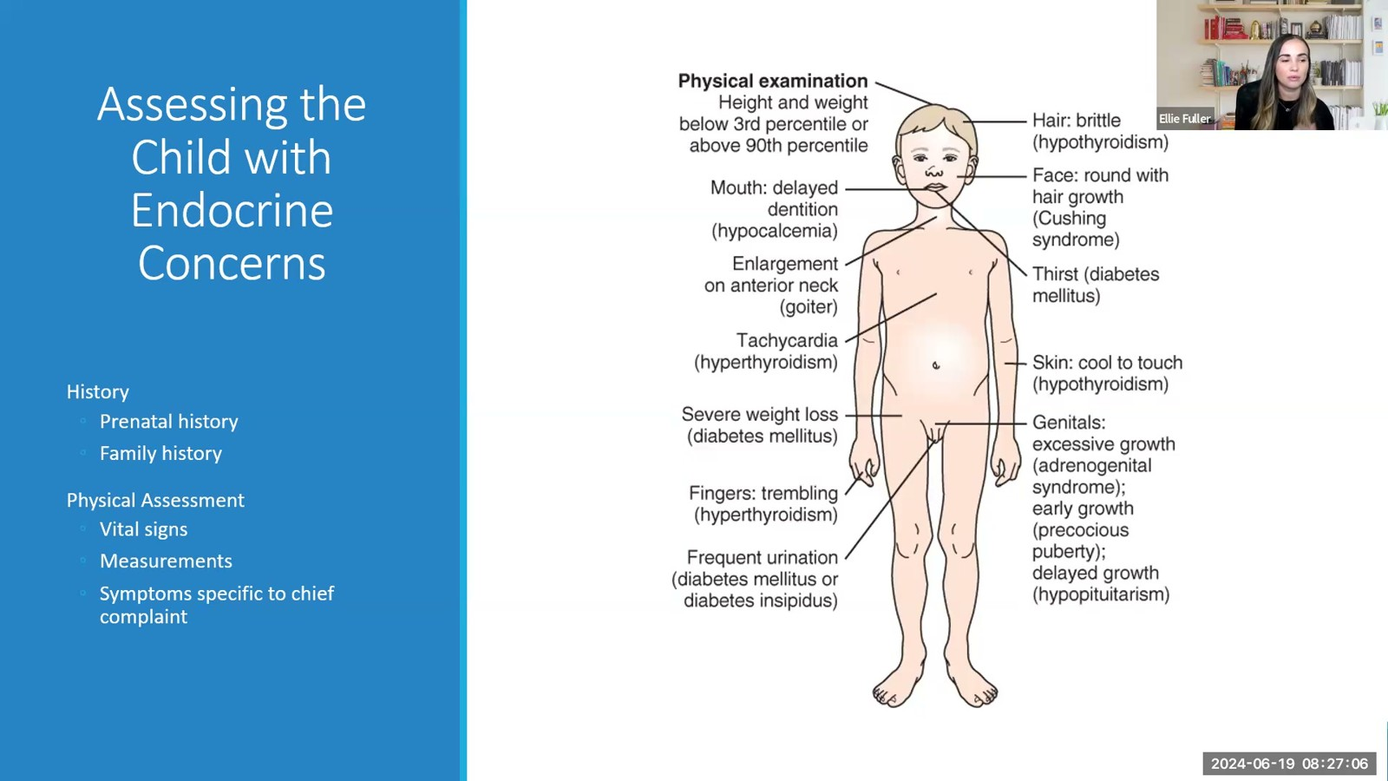
Notes:
Fuller · Week 11 · Endocrine & Metabolic
Recording time 4:00
https://drive.google.com/file/d/133wvGtArpMkxl4khAoNhoauyza9hWRvo/view

Slide 5
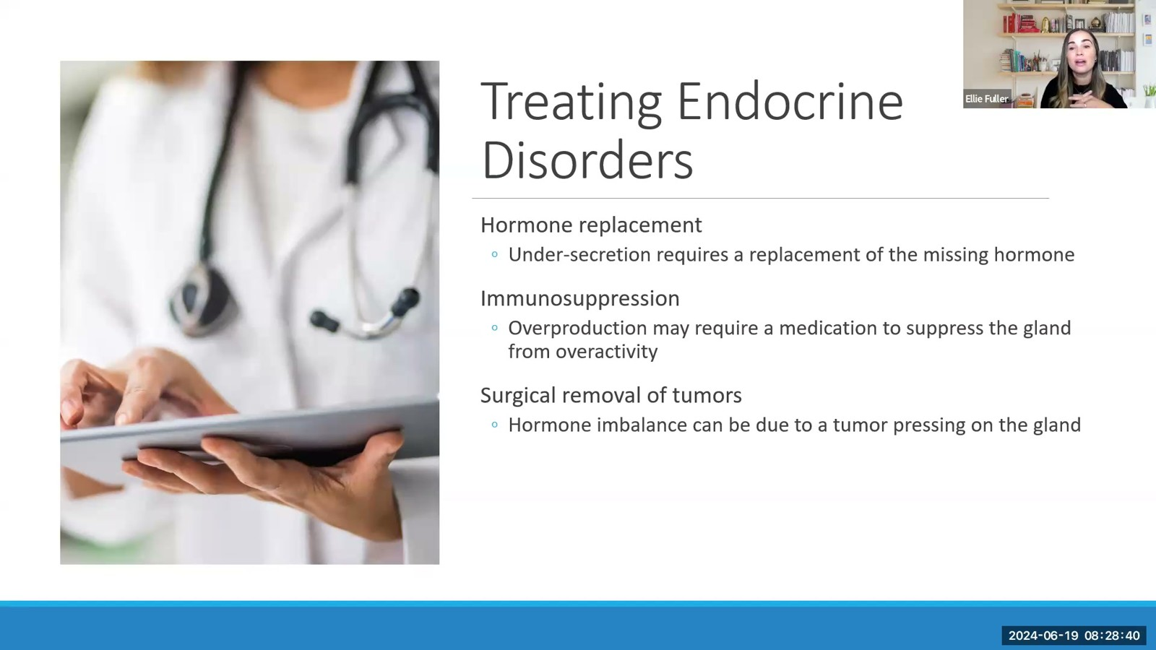
Notes:
Fuller · Week 11 · Endocrine & Metabolic
Recording time 5:34
https://drive.google.com/file/d/133wvGtArpMkxl4khAoNhoauyza9hWRvo/view

Slide 6
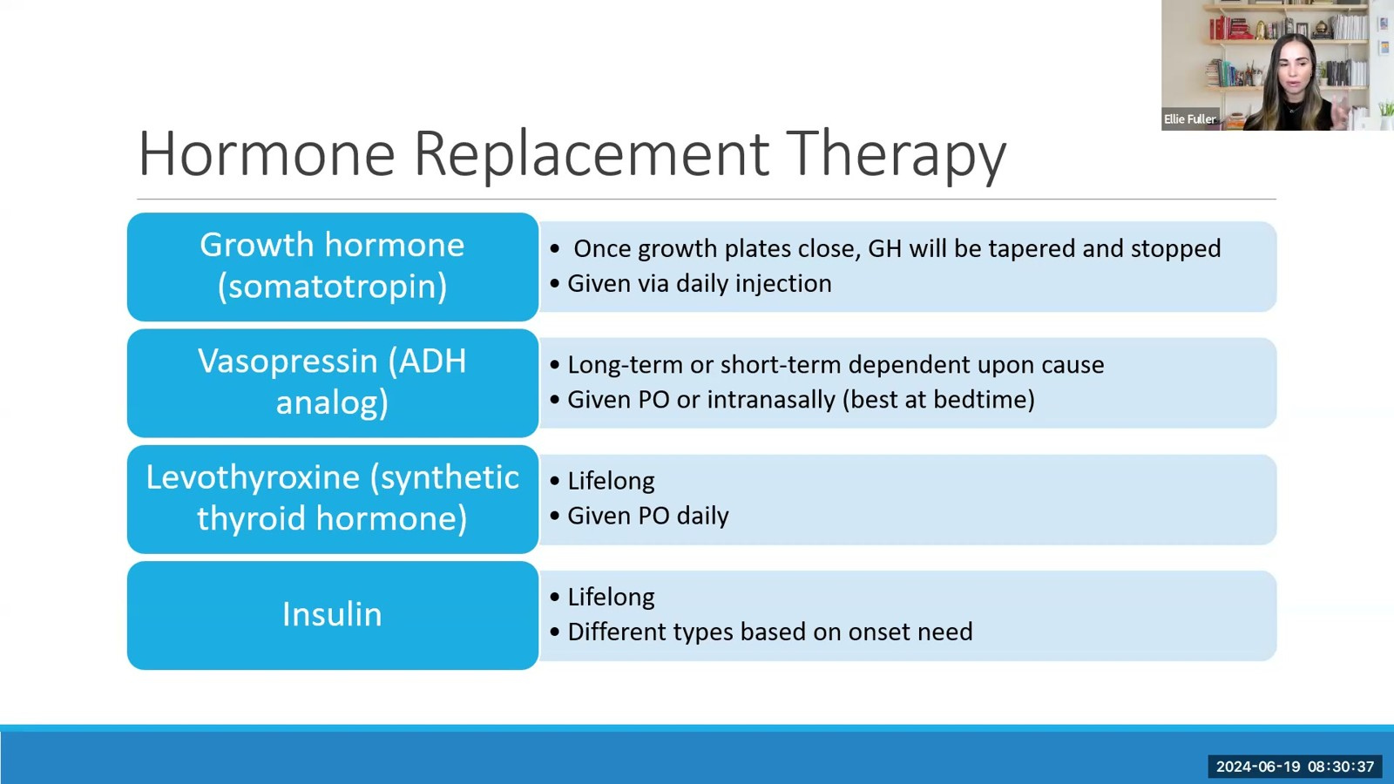
Notes:
Fuller · Week 11 · Endocrine & Metabolic
Recording time 7:31
https://drive.google.com/file/d/133wvGtArpMkxl4khAoNhoauyza9hWRvo/view

Slide 7
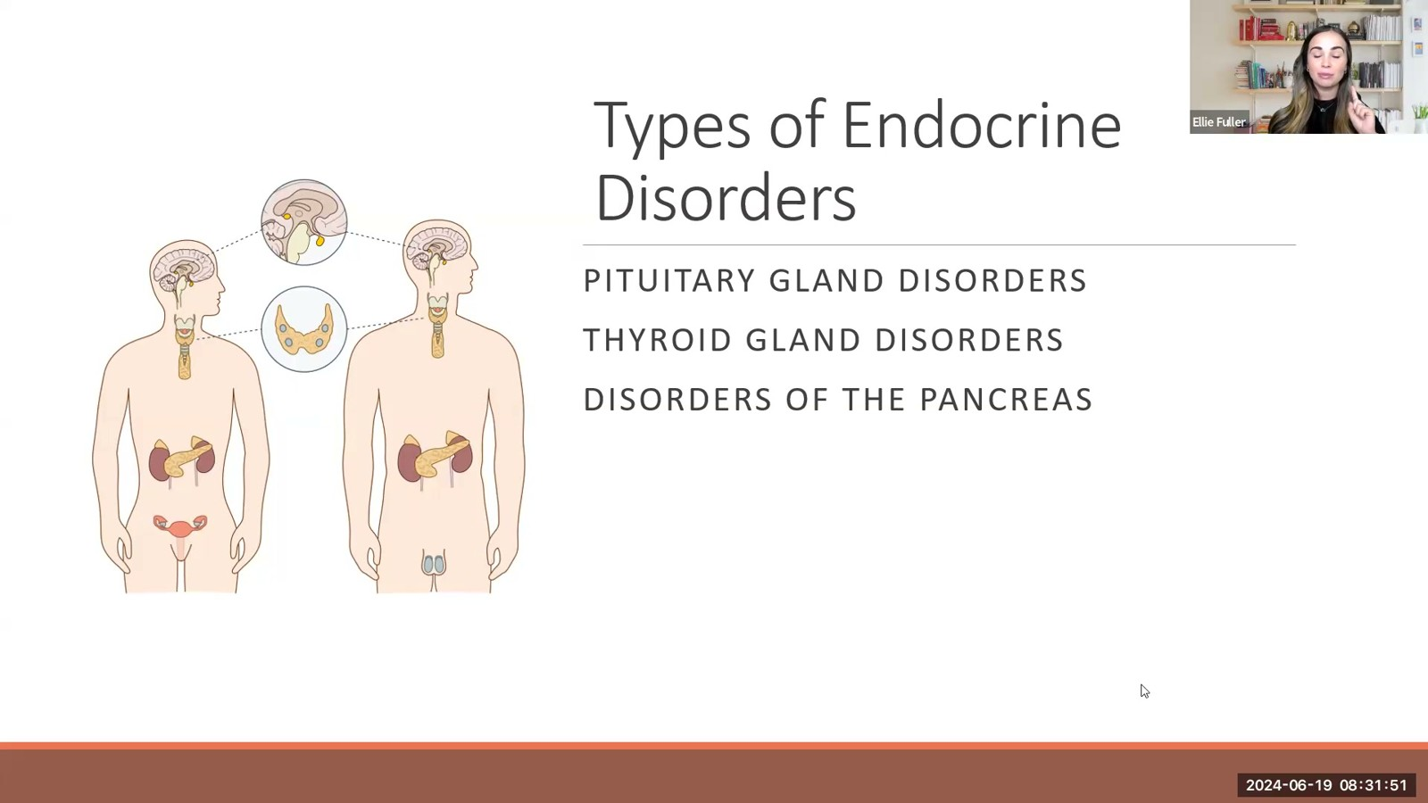
Notes:
Fuller · Week 11 · Endocrine & Metabolic
Recording time 8:45
https://drive.google.com/file/d/133wvGtArpMkxl4khAoNhoauyza9hWRvo/view

Slide 8
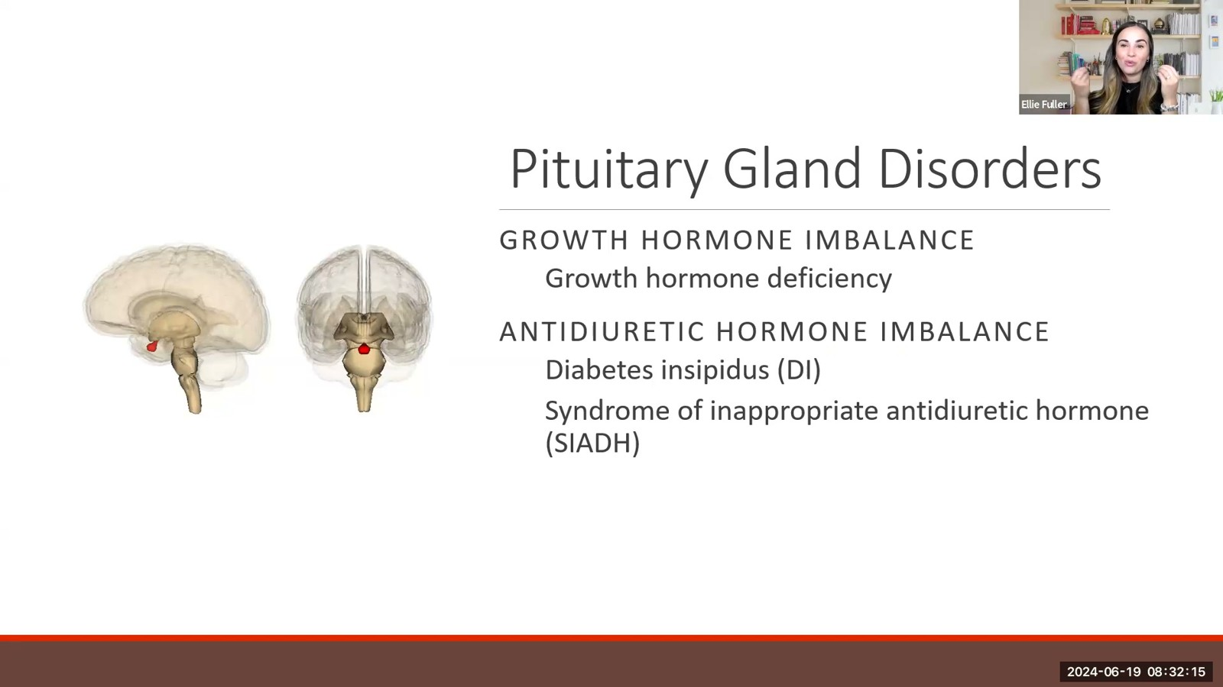
Notes:
Fuller · Week 11 · Endocrine & Metabolic
Recording time 9:09
https://drive.google.com/file/d/133wvGtArpMkxl4khAoNhoauyza9hWRvo/view

Slide 9
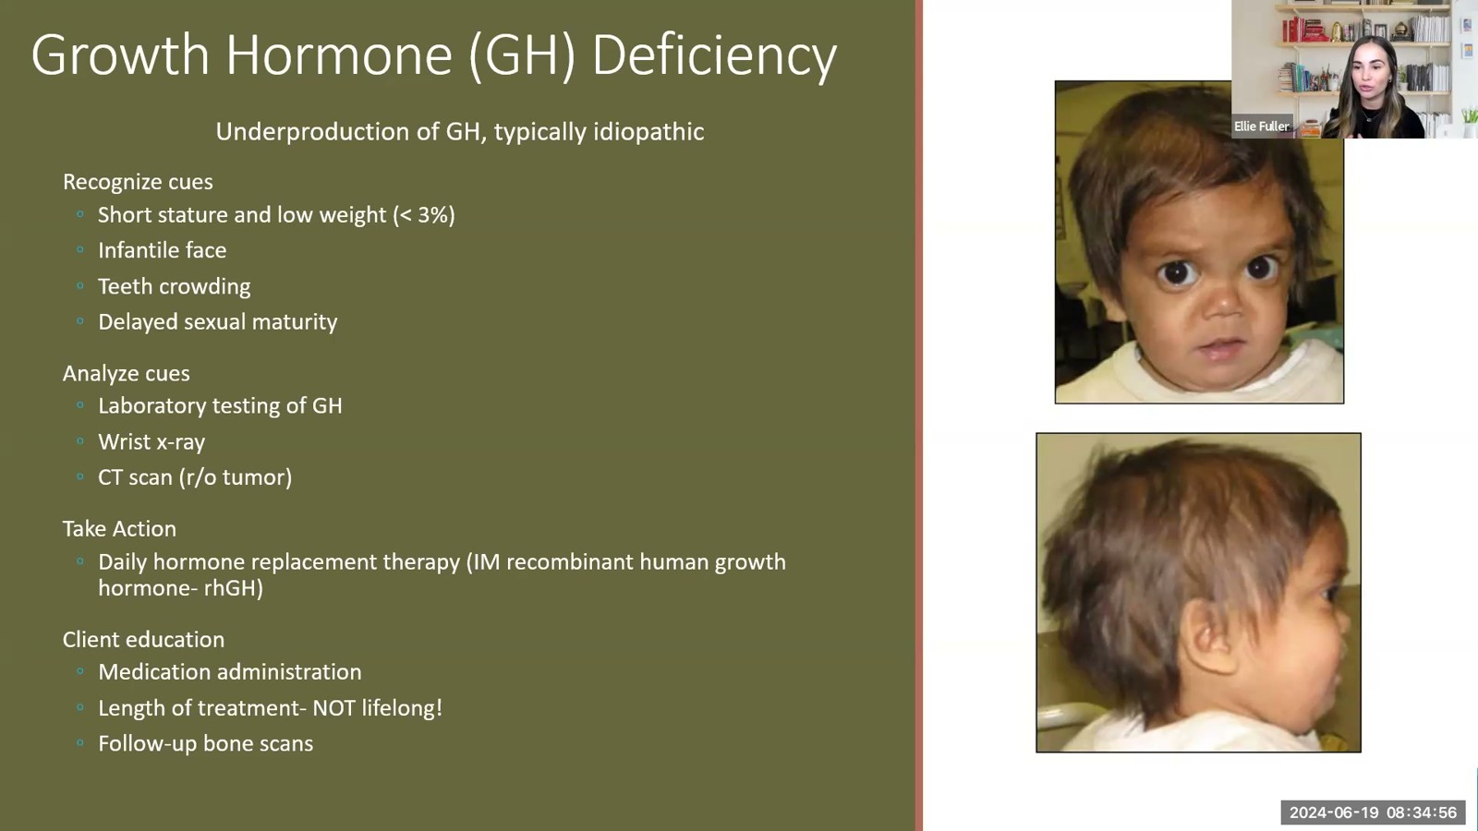
Notes:
Fuller · Week 11 · Endocrine & Metabolic
Recording time 11:50
https://drive.google.com/file/d/133wvGtArpMkxl4khAoNhoauyza9hWRvo/view

Slide 10
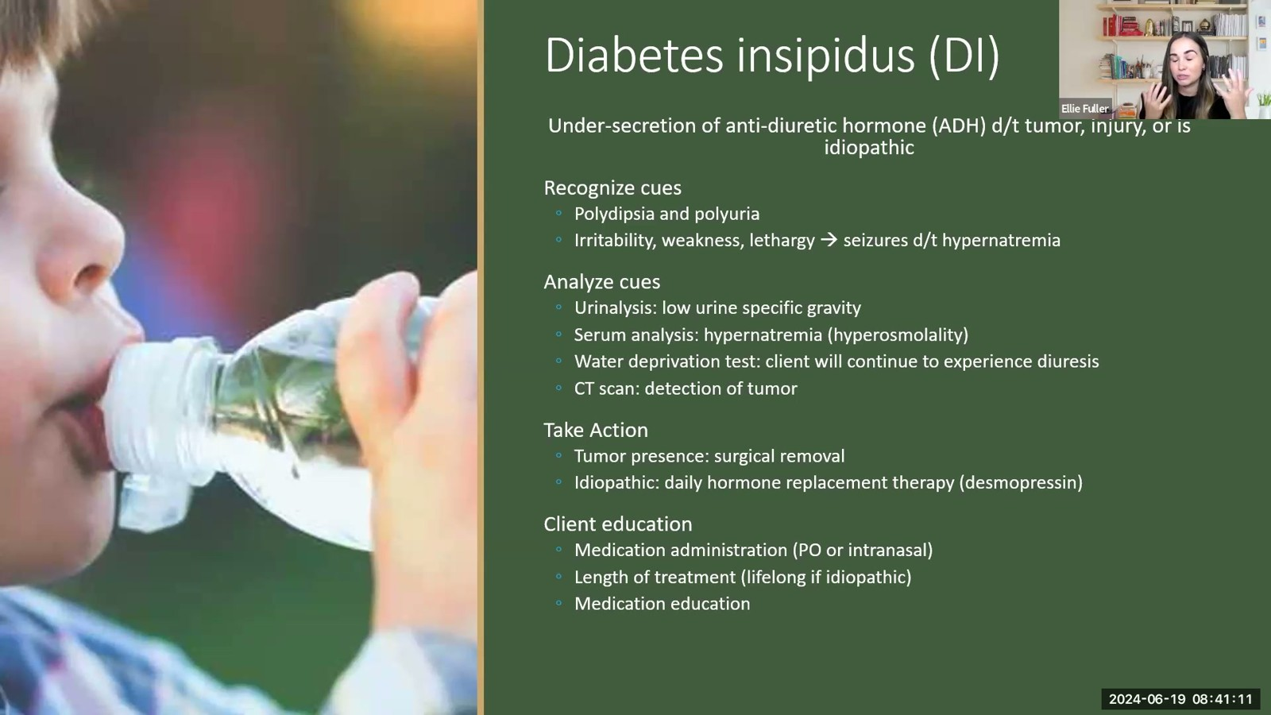
Notes:
Fuller · Week 11 · Endocrine & Metabolic
Recording time 18:05
https://drive.google.com/file/d/133wvGtArpMkxl4khAoNhoauyza9hWRvo/view

Slide 11
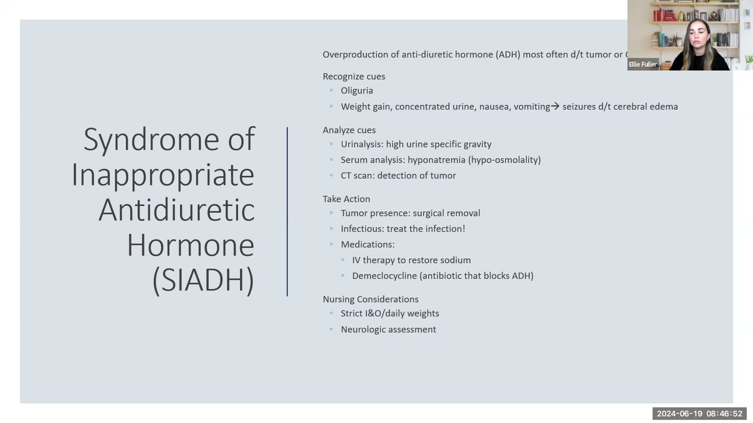
Notes:
Fuller · Week 11 · Endocrine & Metabolic
Recording time 23:46
https://drive.google.com/file/d/133wvGtArpMkxl4khAoNhoauyza9hWRvo/view

Slide 12
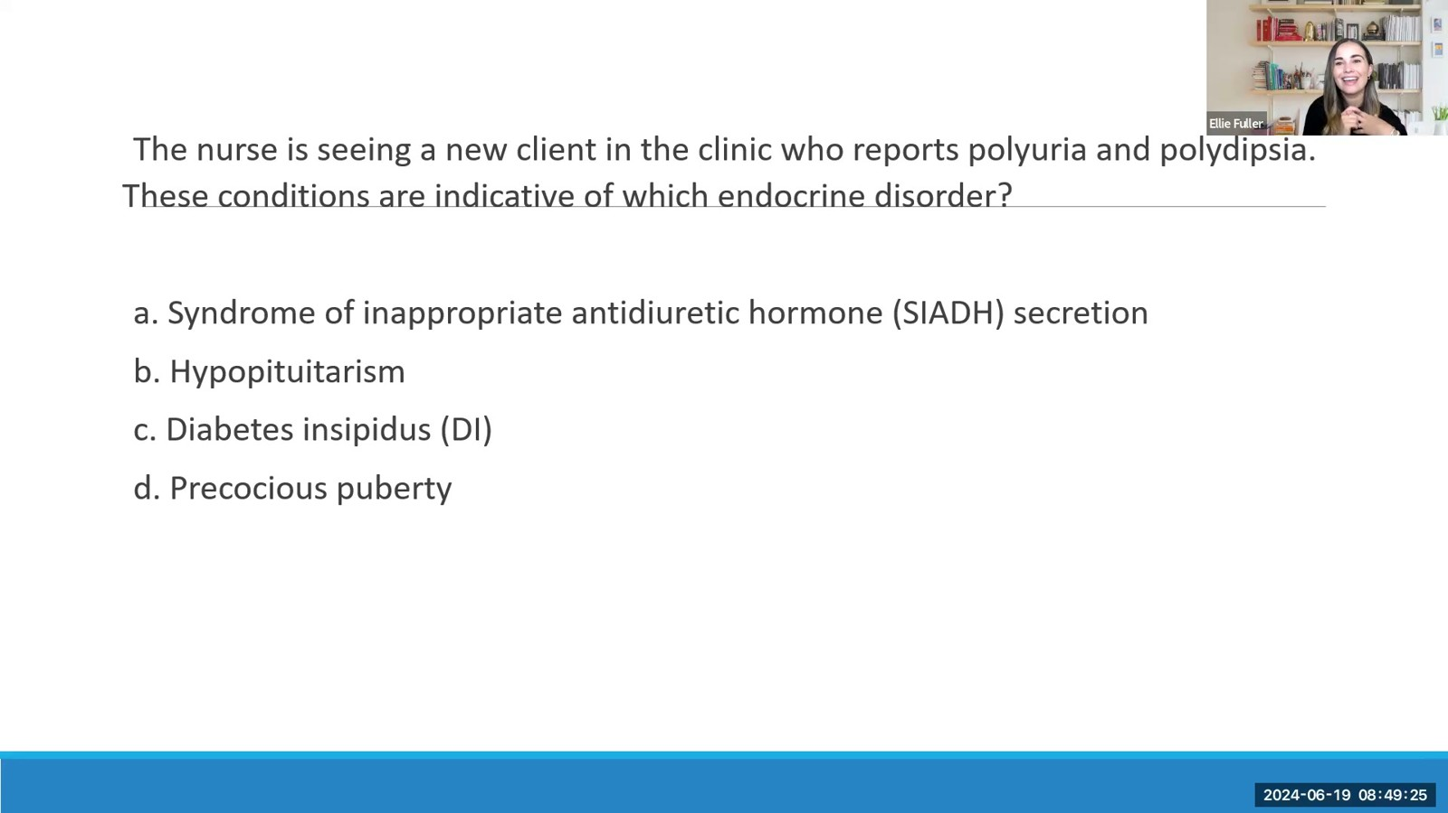
Notes:
Fuller · Week 11 · Endocrine & Metabolic
Recording time 26:19
https://drive.google.com/file/d/133wvGtArpMkxl4khAoNhoauyza9hWRvo/view

Slide 13
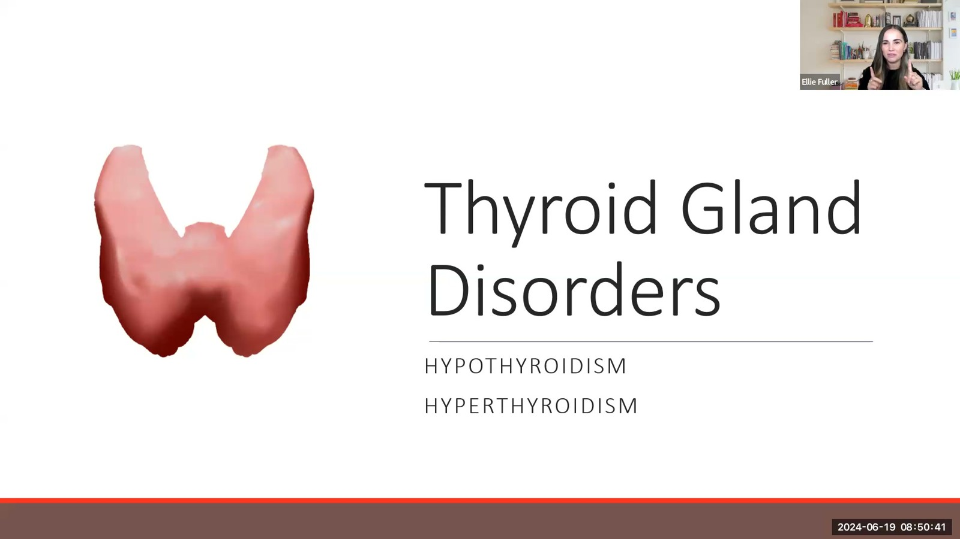
Notes:
Fuller · Week 11 · Endocrine & Metabolic
Recording time 27:35
https://drive.google.com/file/d/133wvGtArpMkxl4khAoNhoauyza9hWRvo/view

Slide 14
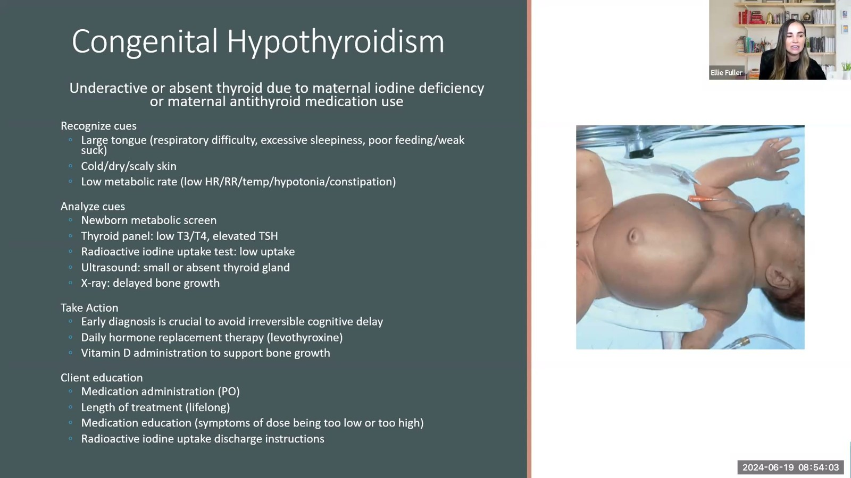
Notes:
Fuller · Week 11 · Endocrine & Metabolic
Recording time 30:57
https://drive.google.com/file/d/133wvGtArpMkxl4khAoNhoauyza9hWRvo/view

Slide 15
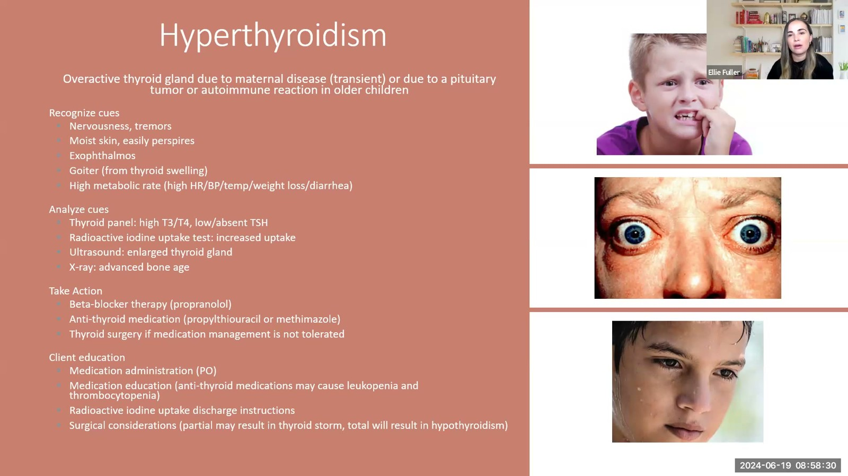
Notes:
Fuller · Week 11 · Endocrine & Metabolic
Recording time 35:24
https://drive.google.com/file/d/133wvGtArpMkxl4khAoNhoauyza9hWRvo/view

Slide 16
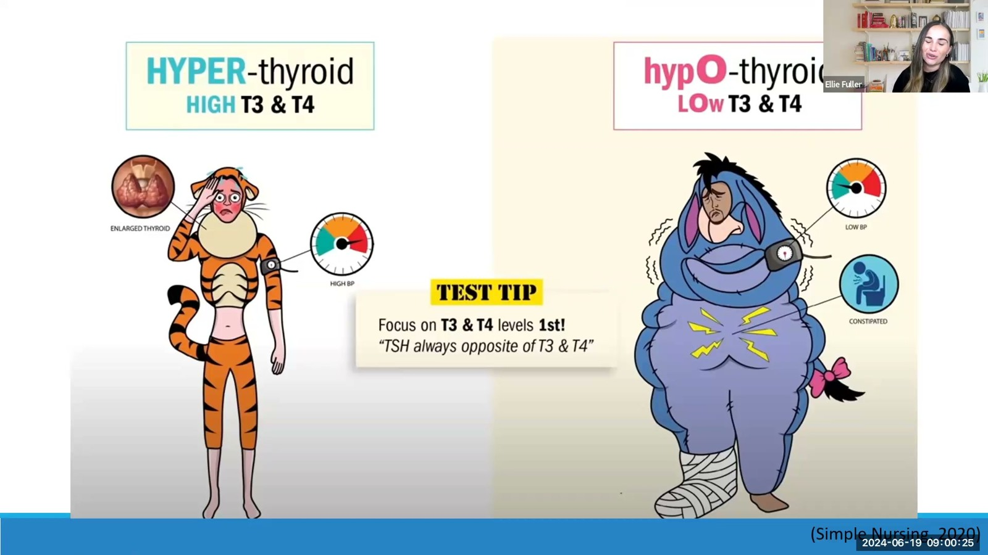
Notes:
Fuller · Week 11 · Endocrine & Metabolic
Recording time 37:19
https://drive.google.com/file/d/133wvGtArpMkxl4khAoNhoauyza9hWRvo/view

Slide 17
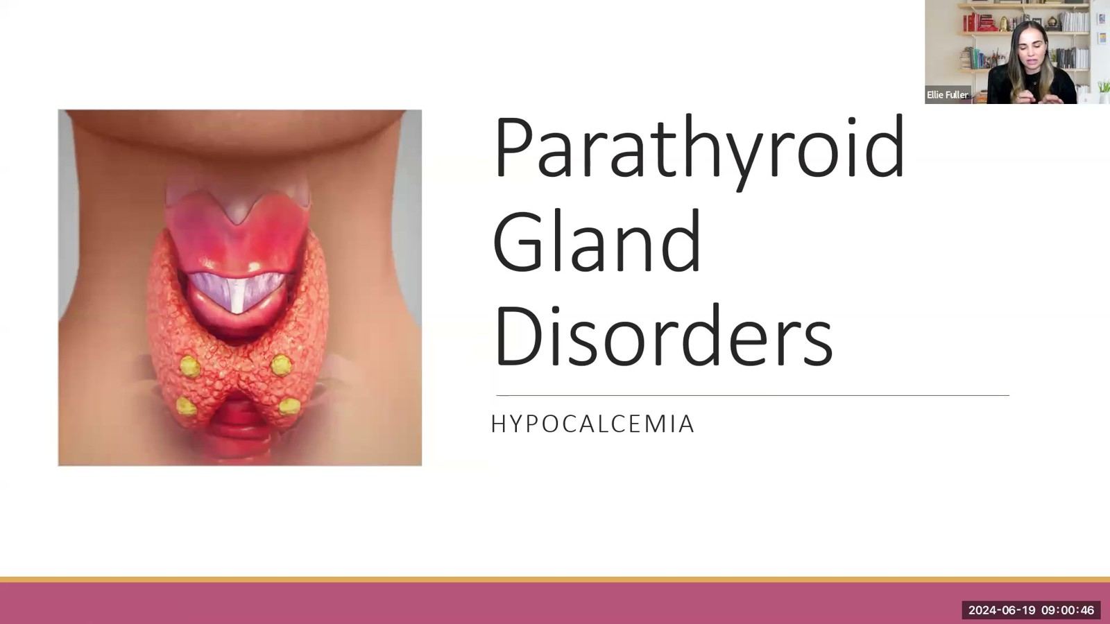
Notes:
Fuller · Week 11 · Endocrine & Metabolic
Recording time 37:40
https://drive.google.com/file/d/133wvGtArpMkxl4khAoNhoauyza9hWRvo/view

Slide 18
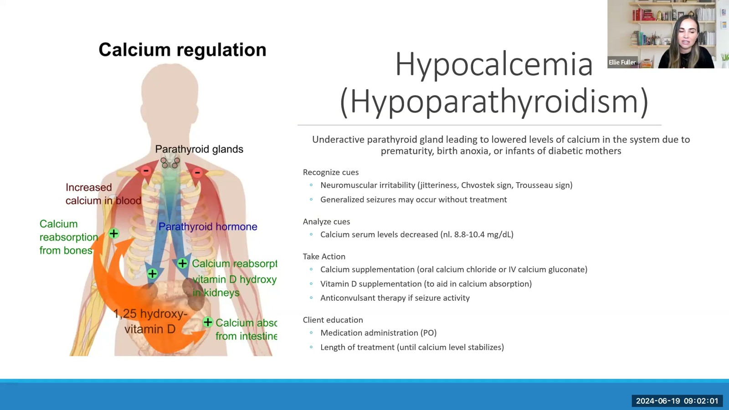
Notes:
Fuller · Week 11 · Endocrine & Metabolic
Recording time 38:55
https://drive.google.com/file/d/133wvGtArpMkxl4khAoNhoauyza9hWRvo/view

Slide 19
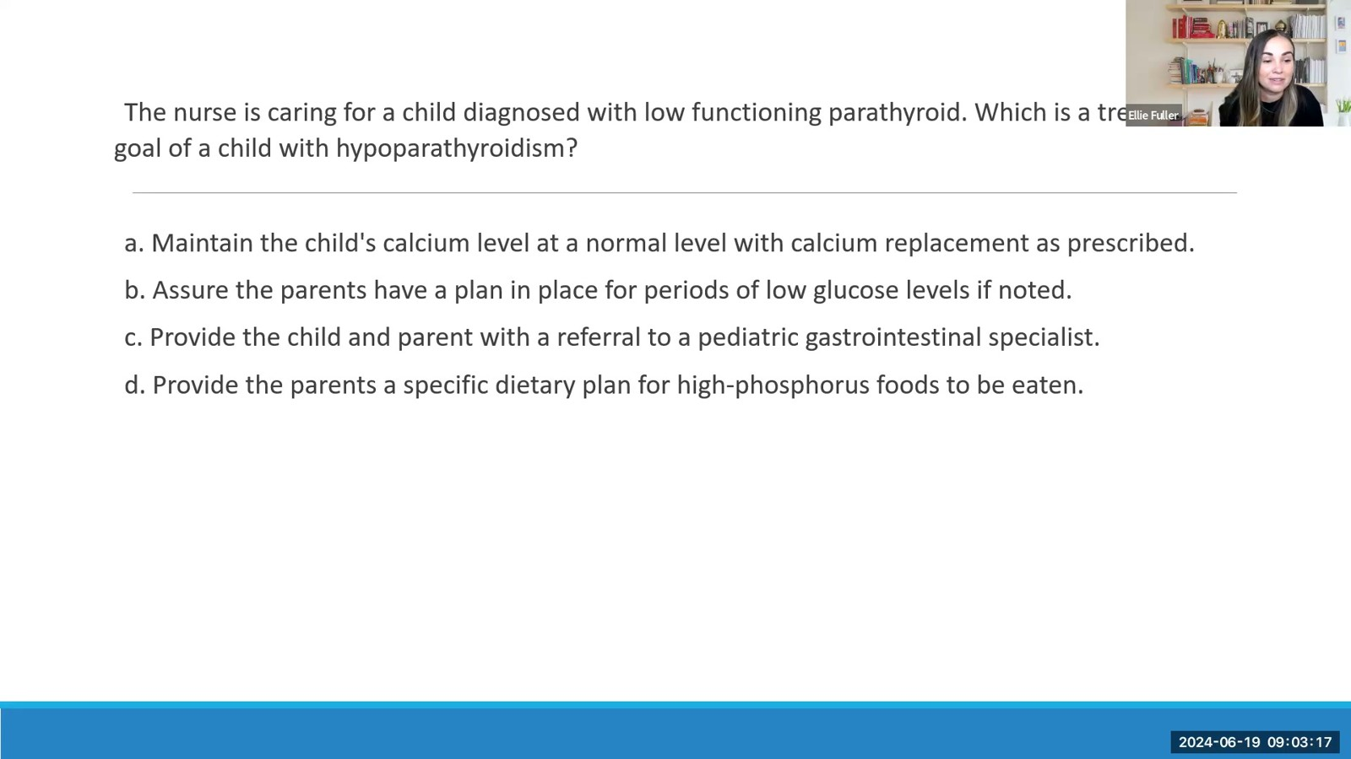
Notes:
Fuller · Week 11 · Endocrine & Metabolic
Recording time 40:11
https://drive.google.com/file/d/133wvGtArpMkxl4khAoNhoauyza9hWRvo/view

Slide 20
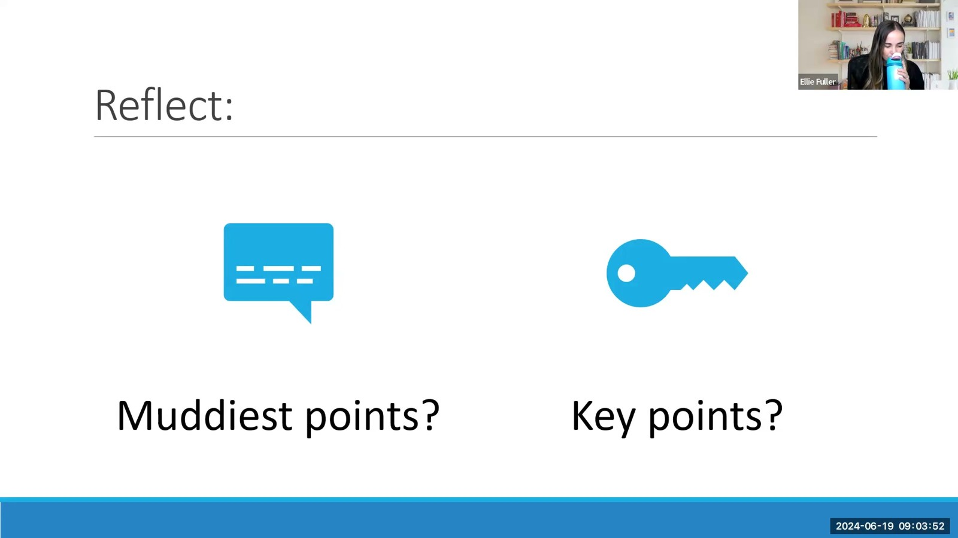
Notes:
Fuller · Week 11 · Endocrine & Metabolic
Recording time 40:46
https://drive.google.com/file/d/133wvGtArpMkxl4khAoNhoauyza9hWRvo/view

Slide 21
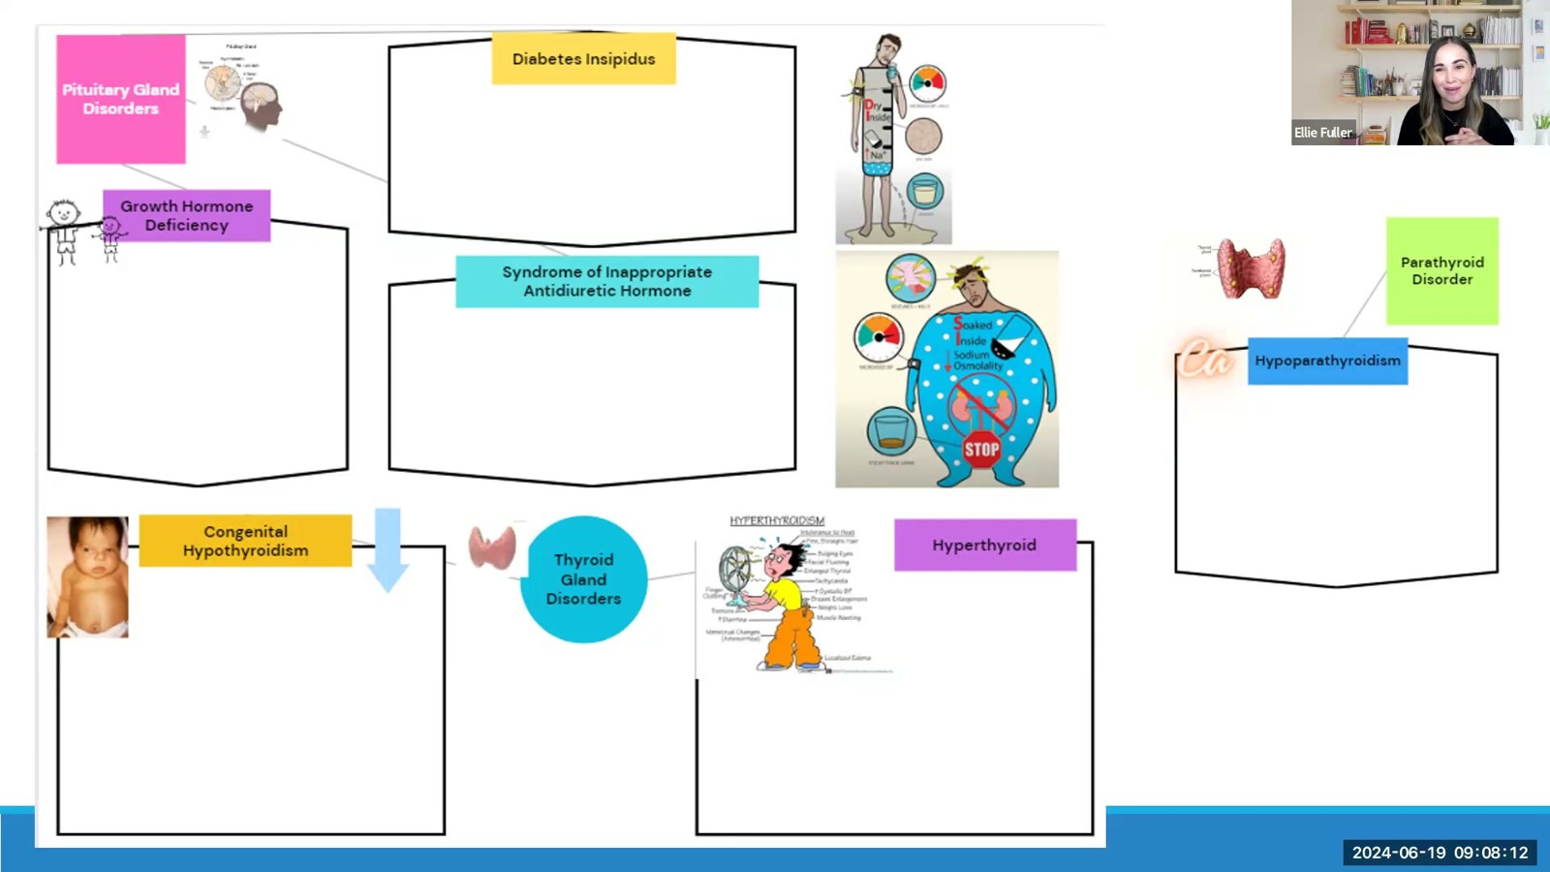
Notes:
Fuller · Week 11 · Endocrine & Metabolic
Recording time 45:06
https://drive.google.com/file/d/133wvGtArpMkxl4khAoNhoauyza9hWRvo/view

Slide 22
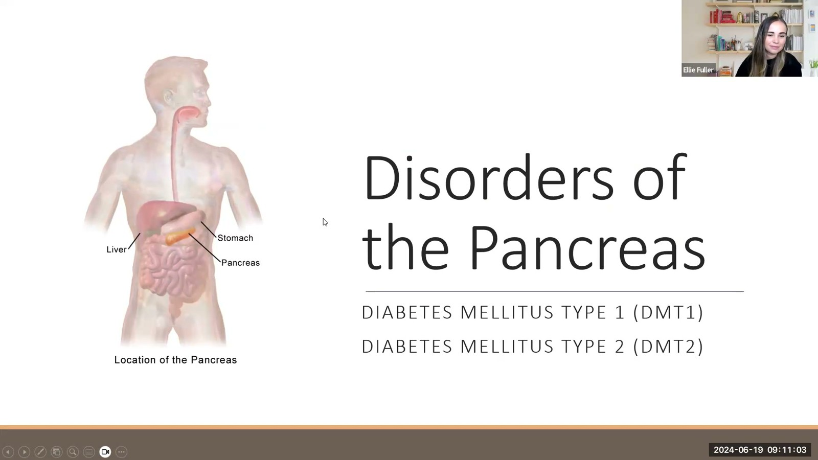
Notes:
Fuller · Week 11 · Endocrine & Metabolic
Recording time 47:57
https://drive.google.com/file/d/133wvGtArpMkxl4khAoNhoauyza9hWRvo/view

Slide 23
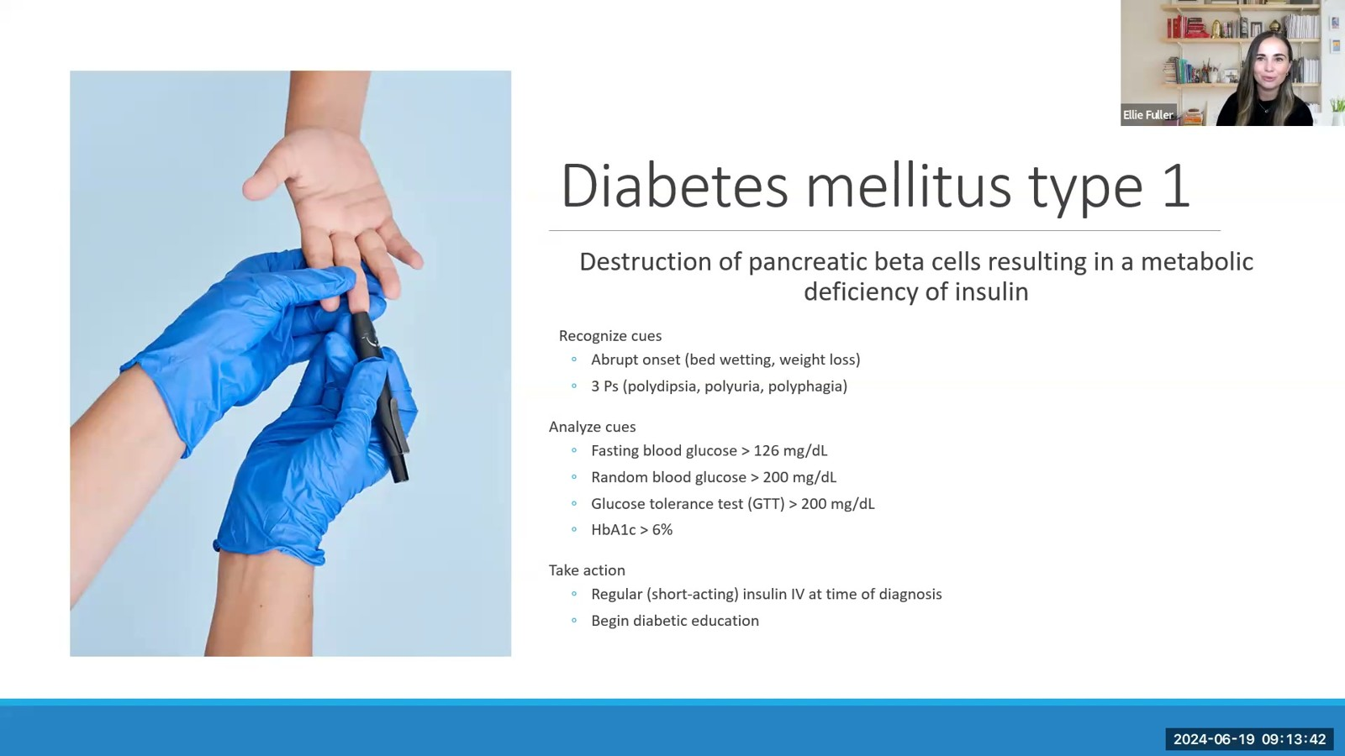
Notes:
Fuller · Week 11 · Endocrine & Metabolic
Recording time 50:36
https://drive.google.com/file/d/133wvGtArpMkxl4khAoNhoauyza9hWRvo/view

Slide 24
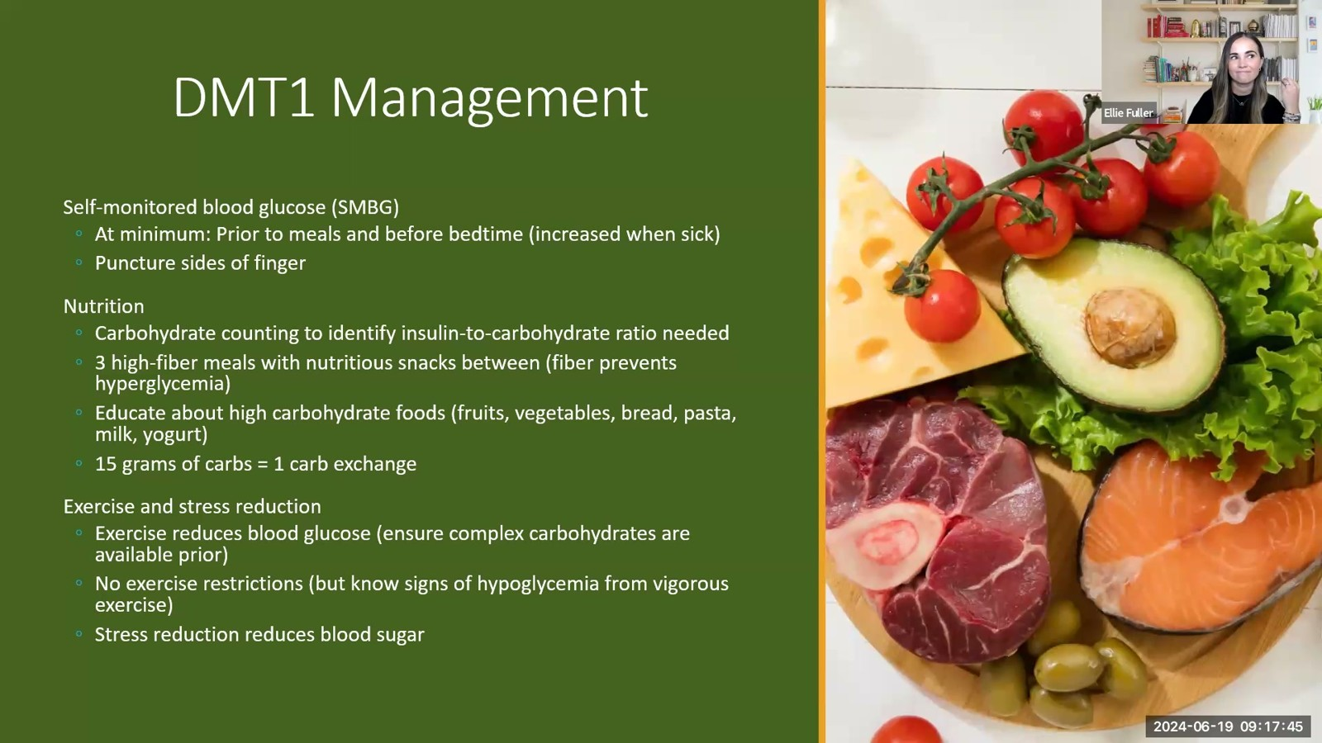
Notes:
Fuller · Week 11 · Endocrine & Metabolic
Recording time 54:39
https://drive.google.com/file/d/133wvGtArpMkxl4khAoNhoauyza9hWRvo/view

Slide 25
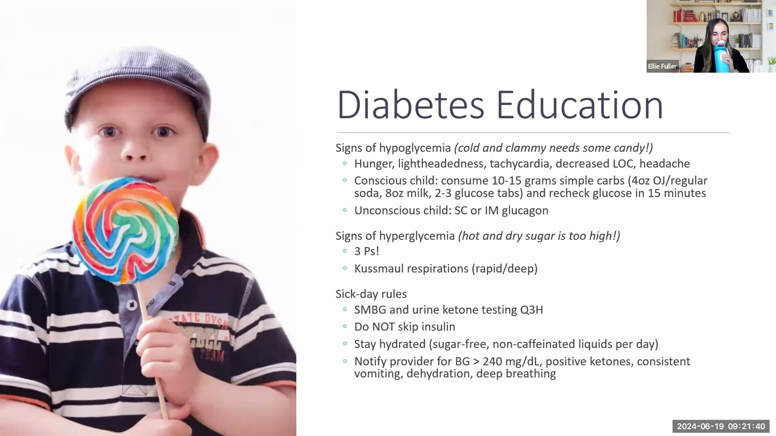
Notes:
Fuller · Week 11 · Endocrine & Metabolic
Recording time 58:34
https://drive.google.com/file/d/133wvGtArpMkxl4khAoNhoauyza9hWRvo/view

Slide 26
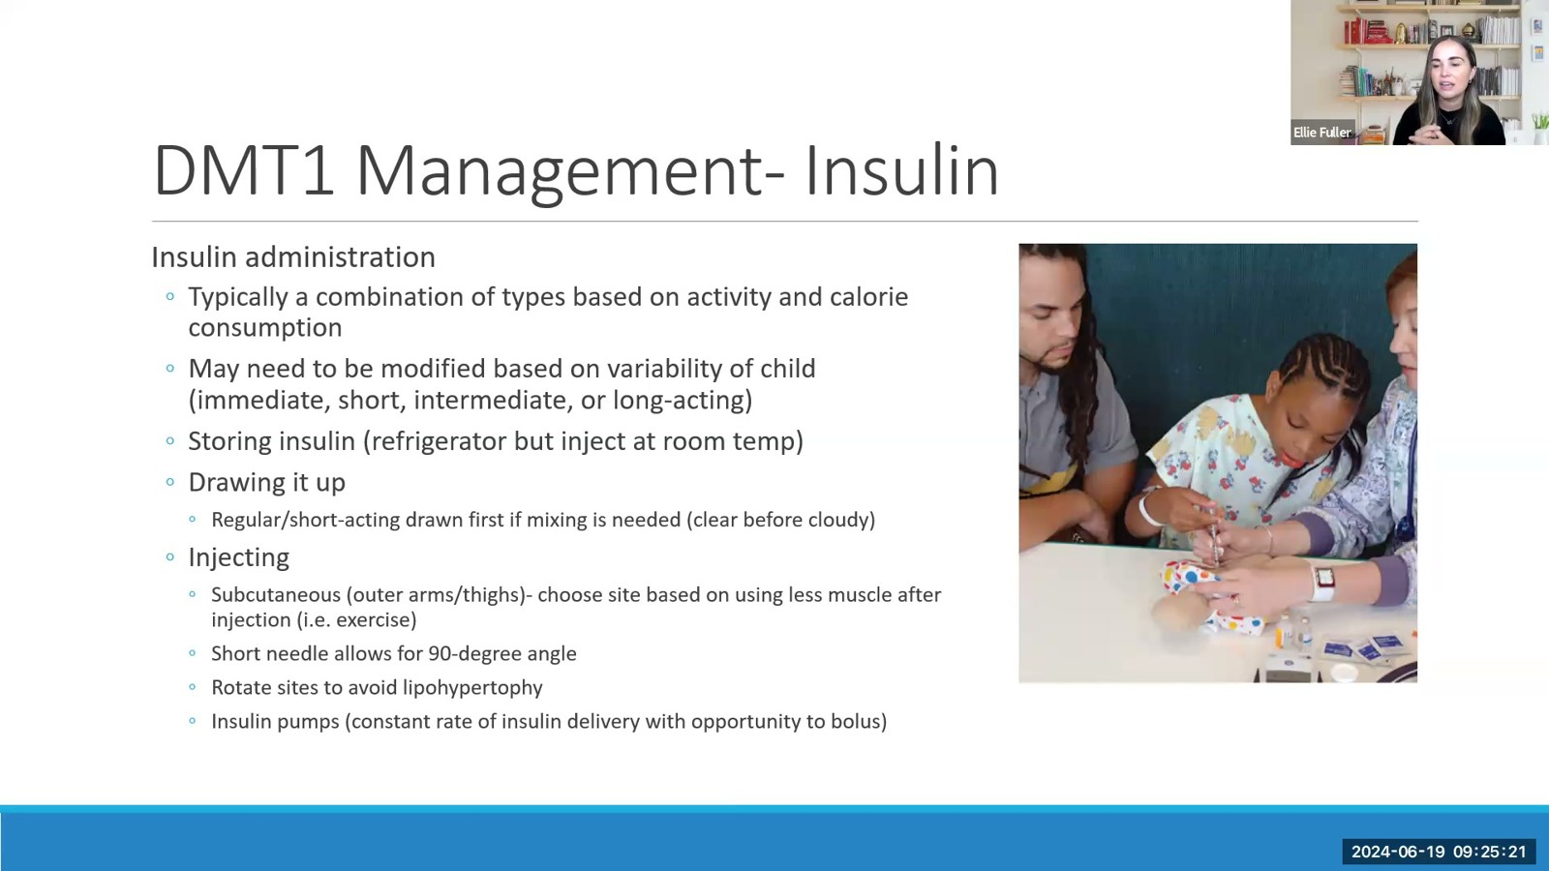
Notes:
Fuller · Week 11 · Endocrine & Metabolic
Recording time 62:15
https://drive.google.com/file/d/133wvGtArpMkxl4khAoNhoauyza9hWRvo/view

Slide 27
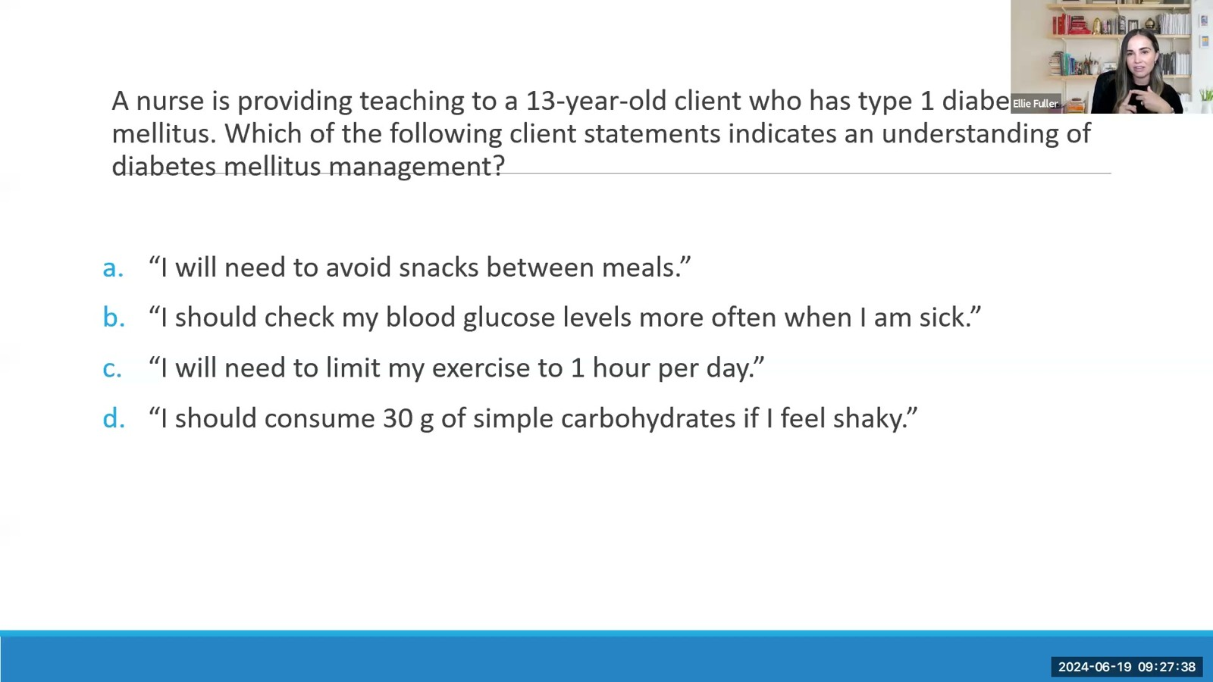
Notes:
Fuller · Week 11 · Endocrine & Metabolic
Recording time 64:32
https://drive.google.com/file/d/133wvGtArpMkxl4khAoNhoauyza9hWRvo/view

Slide 28
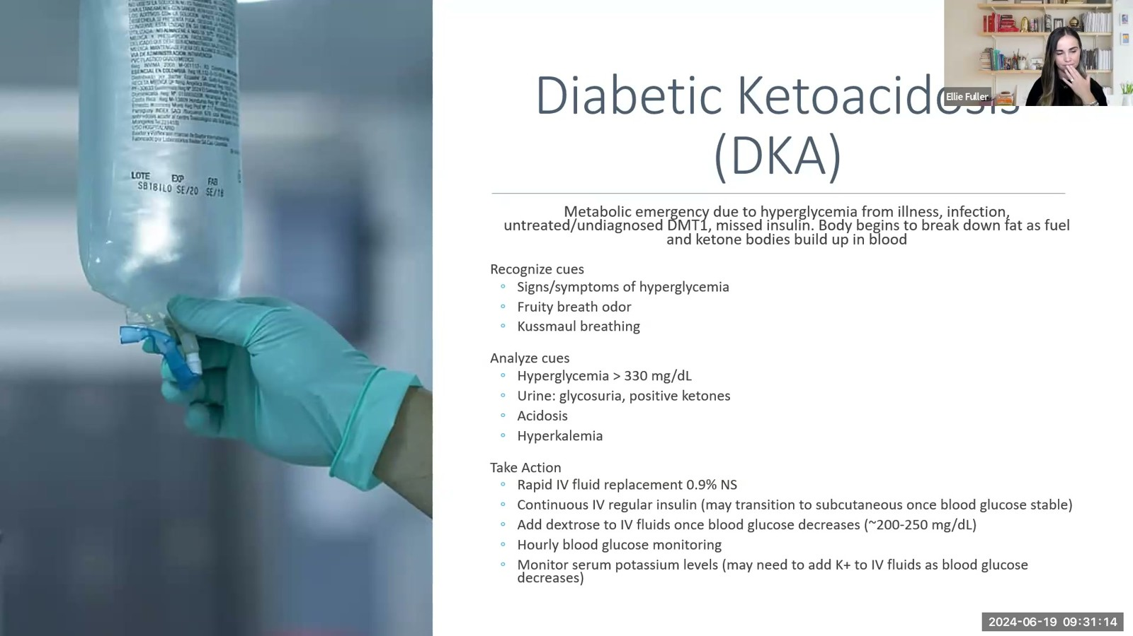
Notes:
Fuller · Week 11 · Endocrine & Metabolic
Recording time 68:08
https://drive.google.com/file/d/133wvGtArpMkxl4khAoNhoauyza9hWRvo/view

Slide 29
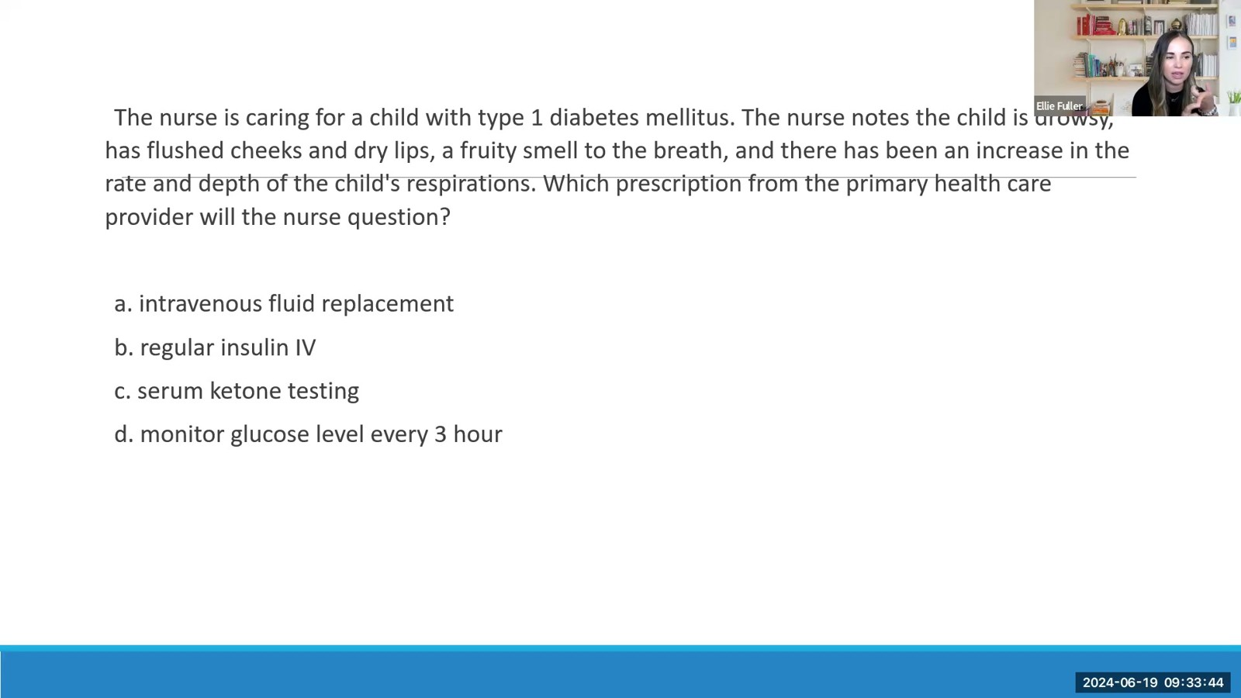
Notes:
Fuller · Week 11 · Endocrine & Metabolic
Recording time 70:38
https://drive.google.com/file/d/133wvGtArpMkxl4khAoNhoauyza9hWRvo/view

Slide 30
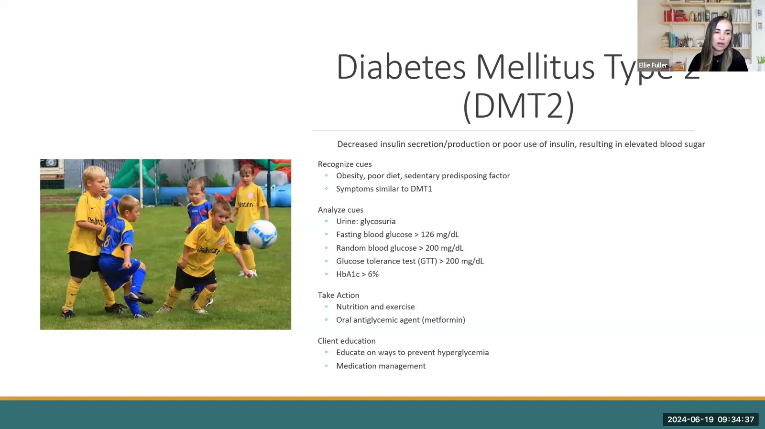
Notes:
Fuller · Week 11 · Endocrine & Metabolic
Recording time 71:31
https://drive.google.com/file/d/133wvGtArpMkxl4khAoNhoauyza9hWRvo/view

Slide 31
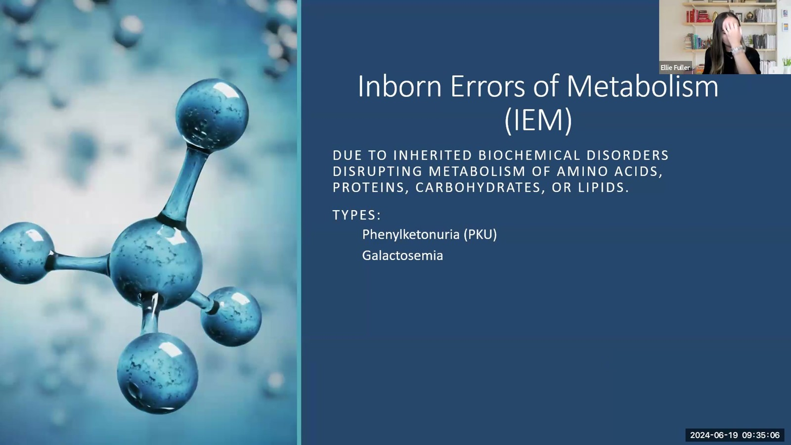
Notes:
Fuller · Week 11 · Endocrine & Metabolic
Recording time 72:00
https://drive.google.com/file/d/133wvGtArpMkxl4khAoNhoauyza9hWRvo/view

Slide 32
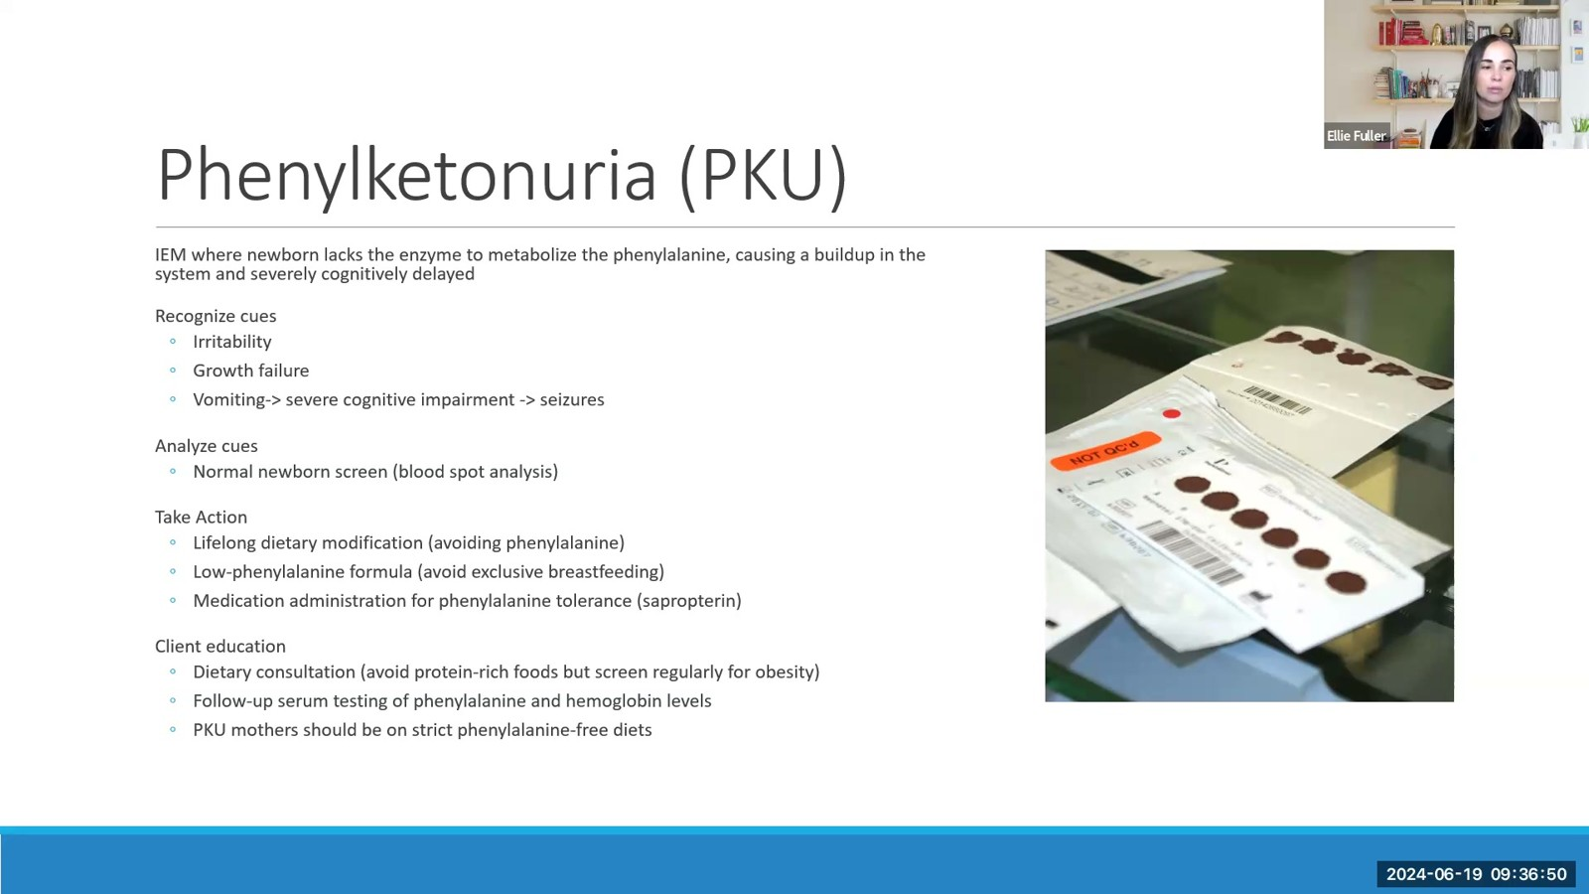
Notes:
Fuller · Week 11 · Endocrine & Metabolic
Recording time 73:44
https://drive.google.com/file/d/133wvGtArpMkxl4khAoNhoauyza9hWRvo/view

Slide 33
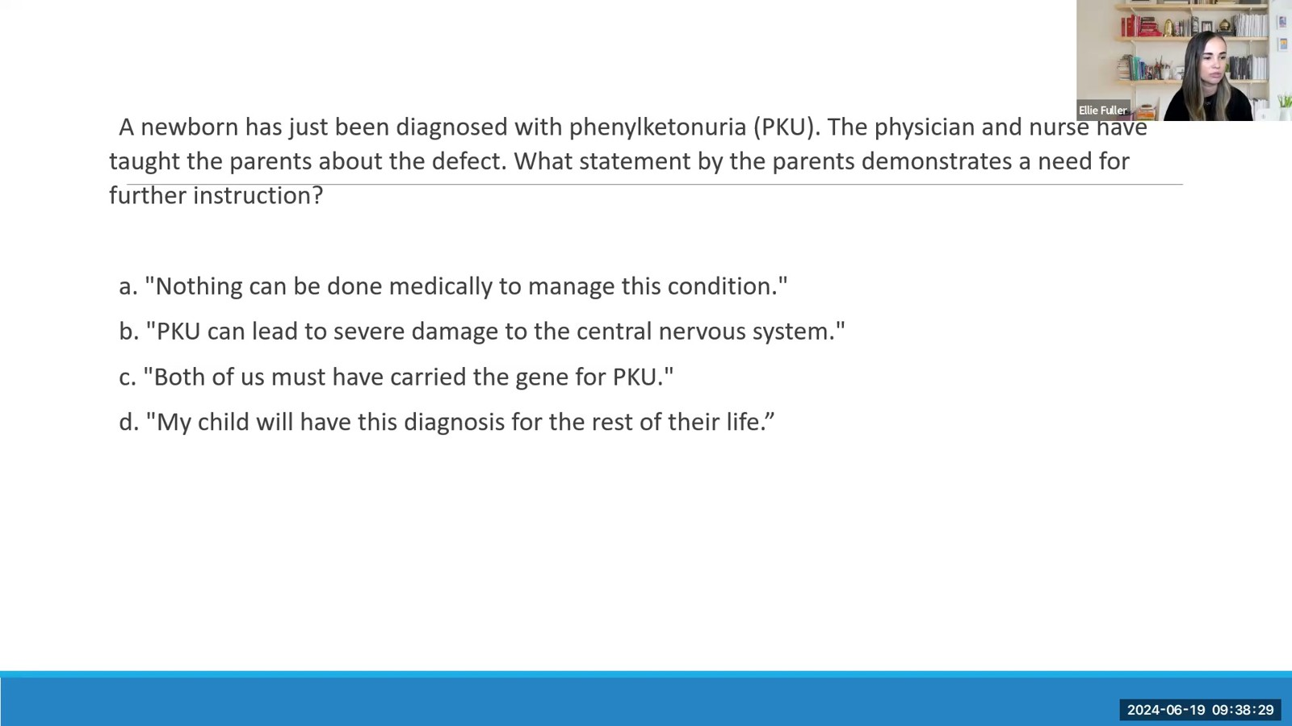
Notes:
Fuller · Week 11 · Endocrine & Metabolic
Recording time 75:23
https://drive.google.com/file/d/133wvGtArpMkxl4khAoNhoauyza9hWRvo/view

Slide 34
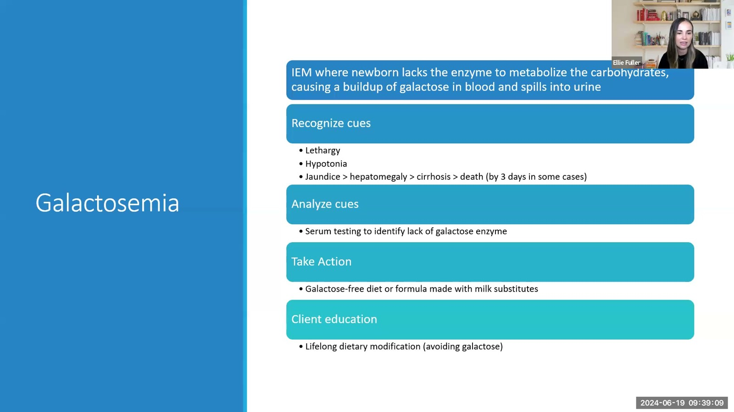
Notes:
Fuller · Week 11 · Endocrine & Metabolic
Recording time 76:03
https://drive.google.com/file/d/133wvGtArpMkxl4khAoNhoauyza9hWRvo/view

Slide 35
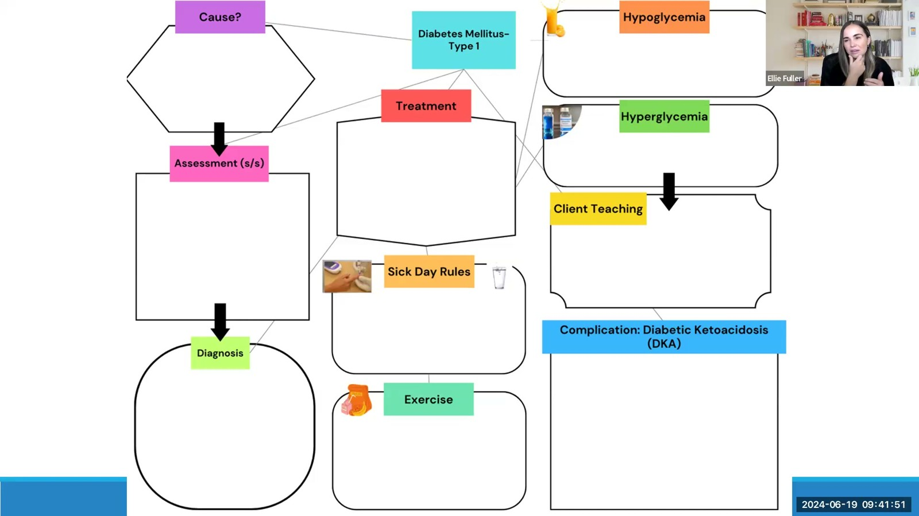
Notes:
Fuller · Week 11 · Endocrine & Metabolic
Recording time 78:45
https://drive.google.com/file/d/133wvGtArpMkxl4khAoNhoauyza9hWRvo/view

Slide 36
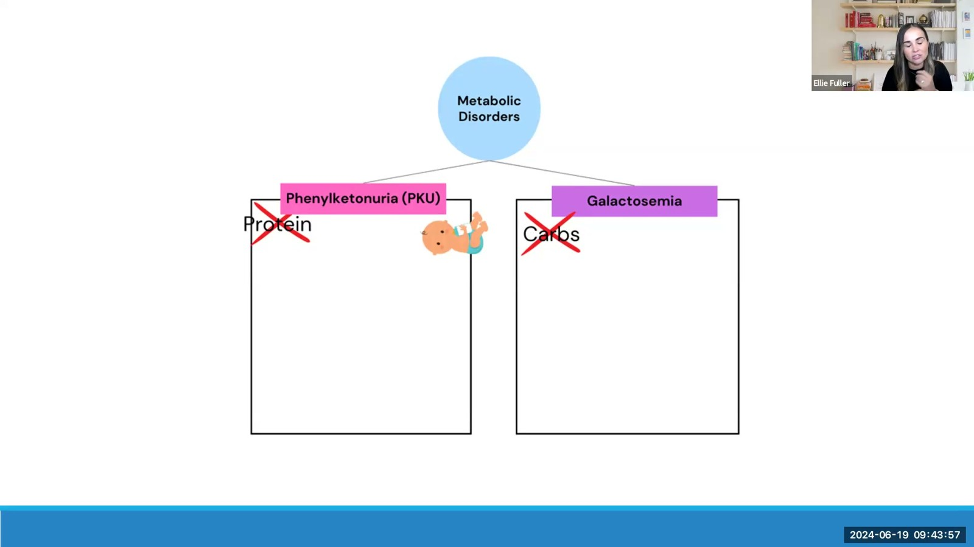
Notes:
Fuller · Week 11 · Endocrine & Metabolic
Recording time 80:51
https://drive.google.com/file/d/133wvGtArpMkxl4khAoNhoauyza9hWRvo/view

Slide 37
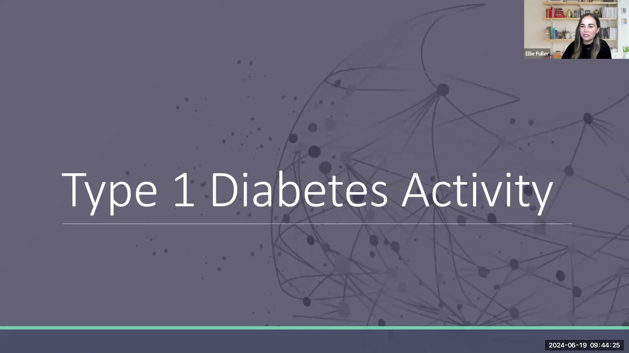
Notes:
Fuller · Week 11 · Endocrine & Metabolic
Recording time 81:19
https://drive.google.com/file/d/133wvGtArpMkxl4khAoNhoauyza9hWRvo/view

