Slide 1

NUR 235 / WEEK 12 / FULLER
Gastrointestinal
Dehydration, maintenance fluids, pyloric stenosis and intussusception
Study copy made from slides shown in the recorded lecture
Notes:
Source recording: https://drive.google.com/file/d/1kqvvmD470PE4FpYVJuWQyjF_jkmS0qIa/view
University logo: https://www.joyce.edu/
Prepared for independent study. Original course slides are linked separately in the Study Hub.

Slide 2
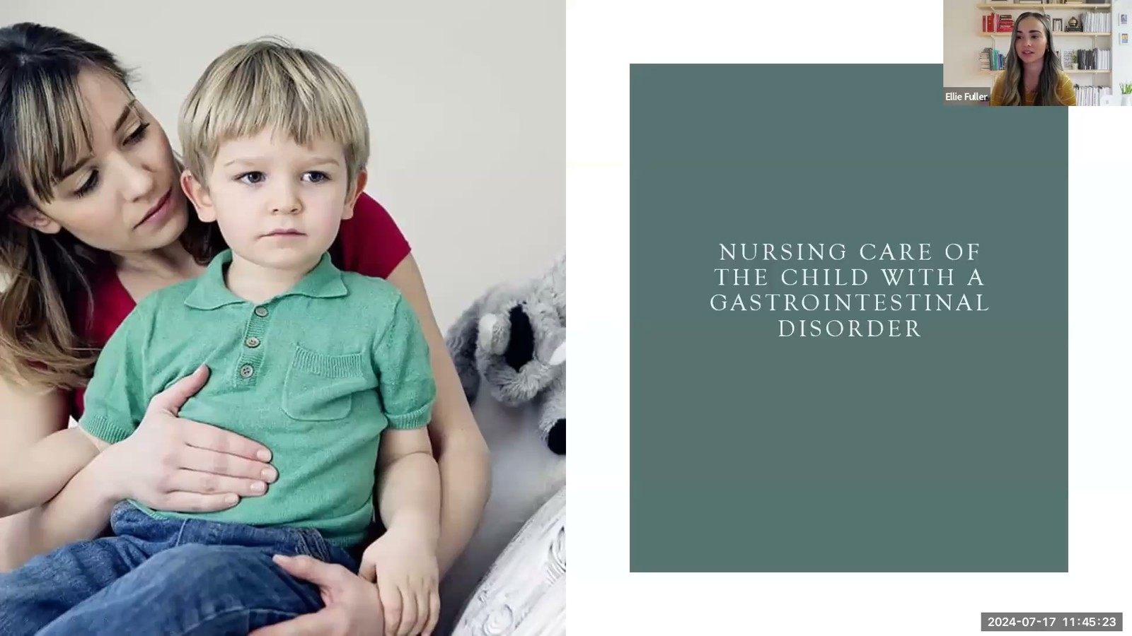
Notes:
Fuller · Week 12 · Gastrointestinal
Recording time 0:03
https://drive.google.com/file/d/1kqvvmD470PE4FpYVJuWQyjF_jkmS0qIa/view

Slide 3
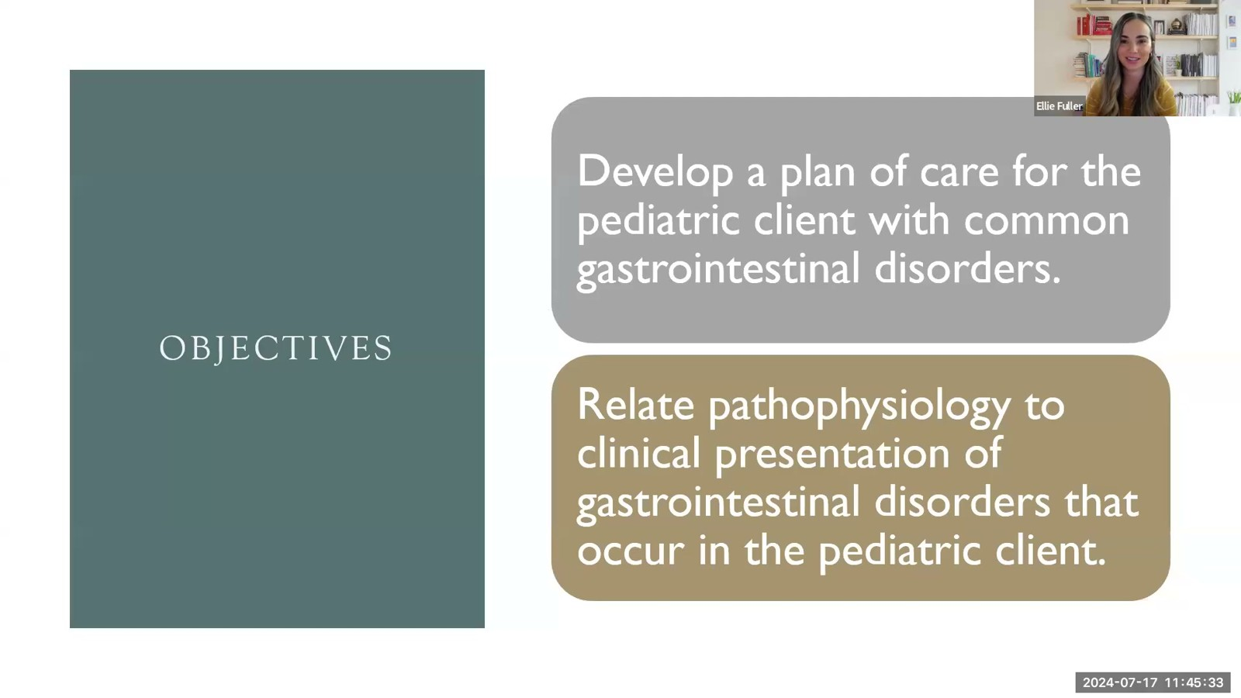
Notes:
Fuller · Week 12 · Gastrointestinal
Recording time 0:13
https://drive.google.com/file/d/1kqvvmD470PE4FpYVJuWQyjF_jkmS0qIa/view

Slide 4
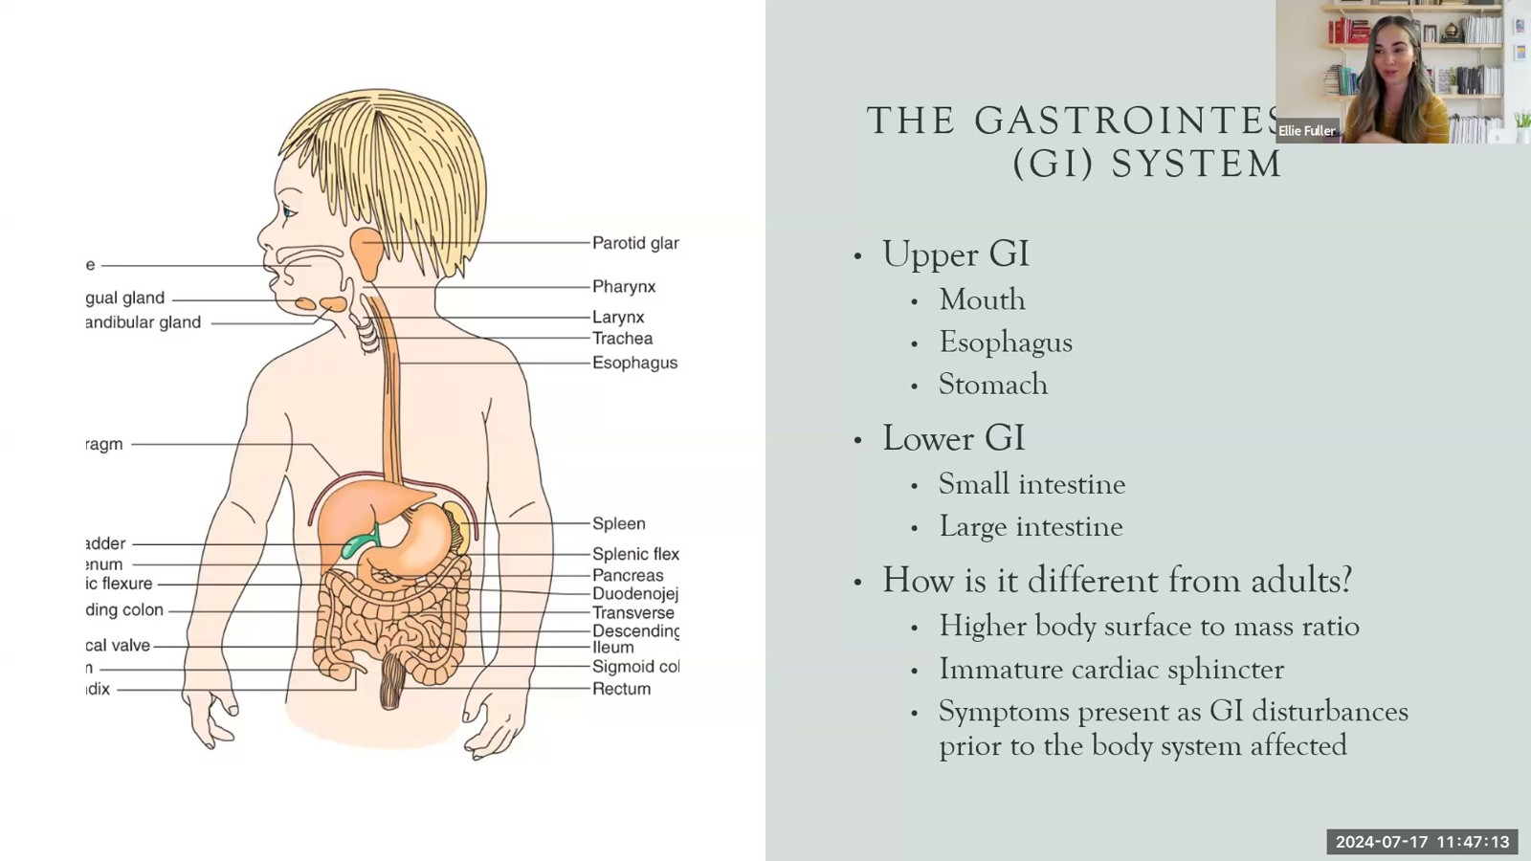
Notes:
Fuller · Week 12 · Gastrointestinal
Recording time 1:53
https://drive.google.com/file/d/1kqvvmD470PE4FpYVJuWQyjF_jkmS0qIa/view

Slide 5
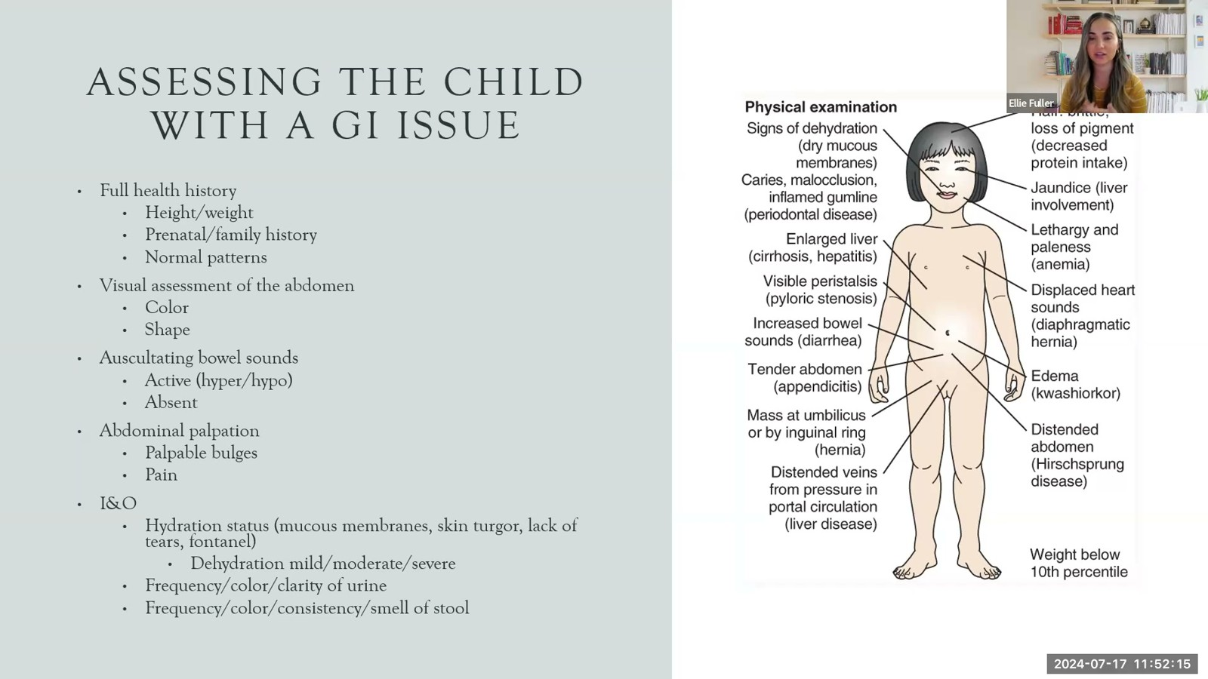
Notes:
Fuller · Week 12 · Gastrointestinal
Recording time 6:55
https://drive.google.com/file/d/1kqvvmD470PE4FpYVJuWQyjF_jkmS0qIa/view

Slide 6
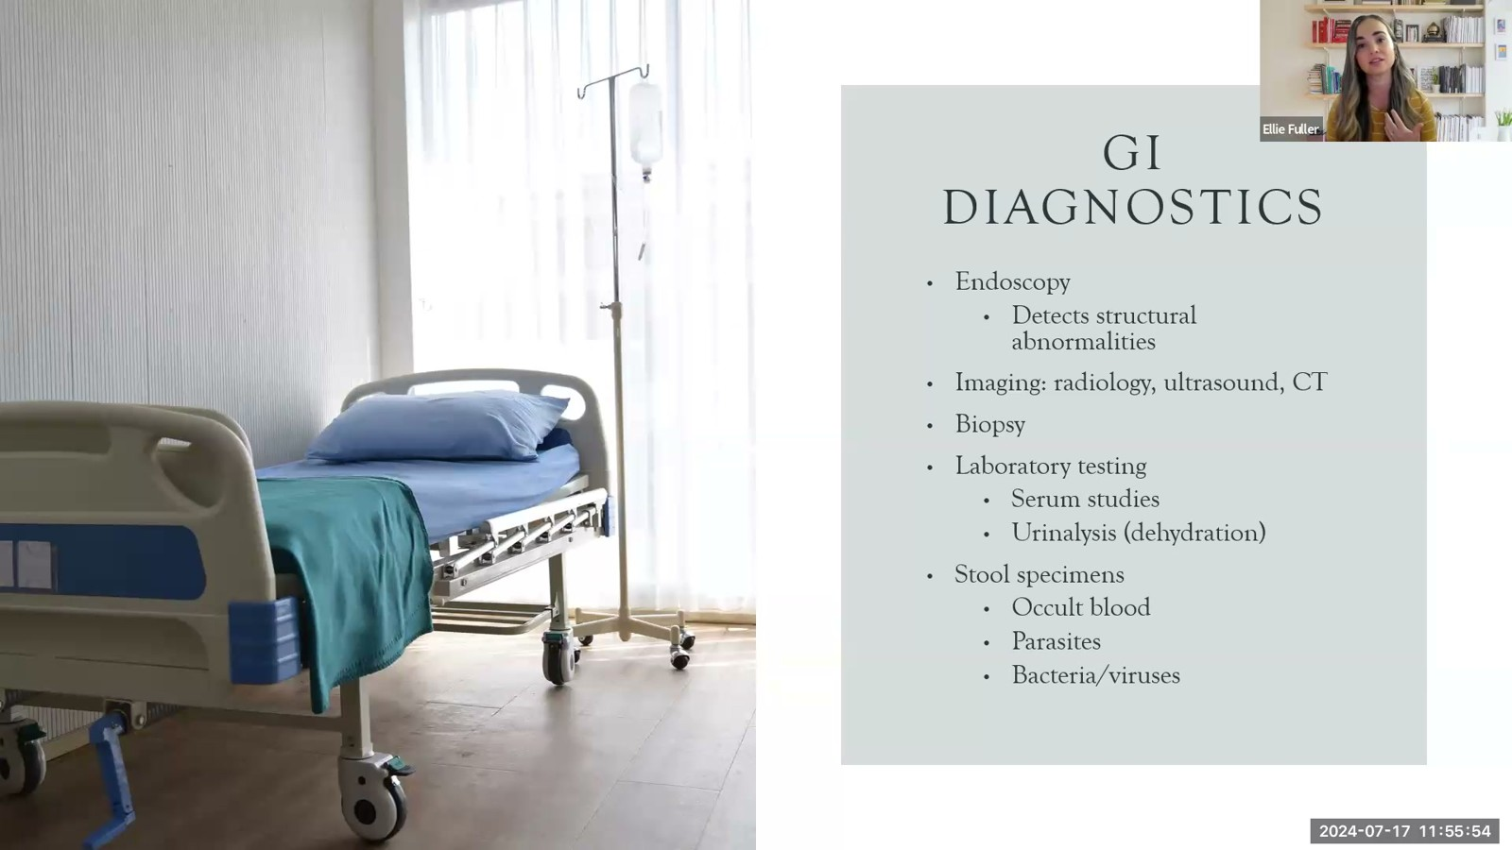
Notes:
Fuller · Week 12 · Gastrointestinal
Recording time 10:34
https://drive.google.com/file/d/1kqvvmD470PE4FpYVJuWQyjF_jkmS0qIa/view

Slide 7
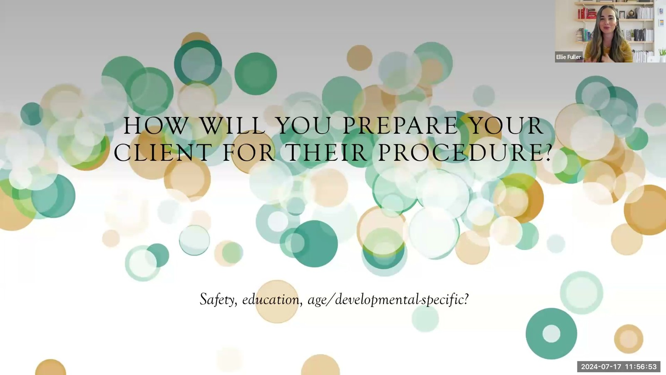
Notes:
Fuller · Week 12 · Gastrointestinal
Recording time 11:33
https://drive.google.com/file/d/1kqvvmD470PE4FpYVJuWQyjF_jkmS0qIa/view

Slide 8
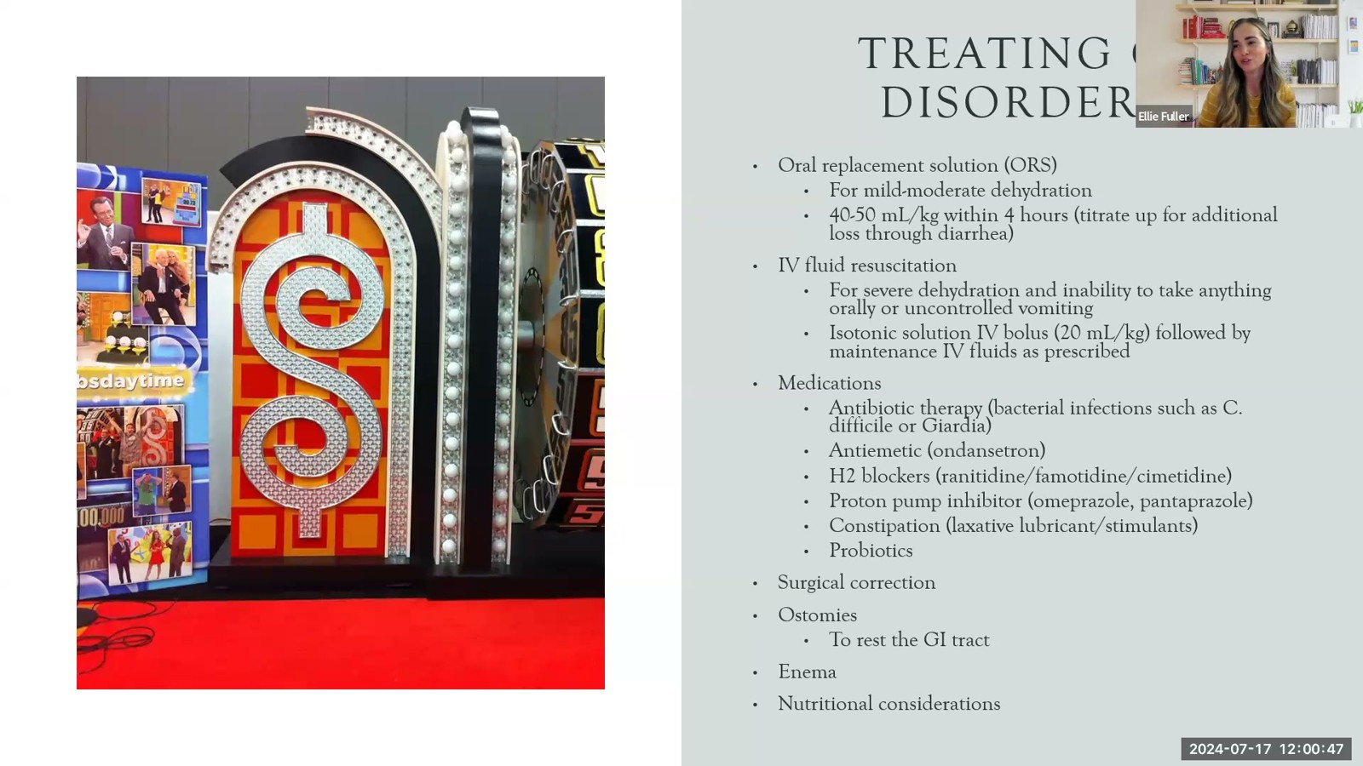
Notes:
Fuller · Week 12 · Gastrointestinal
Recording time 15:27
https://drive.google.com/file/d/1kqvvmD470PE4FpYVJuWQyjF_jkmS0qIa/view

Slide 9
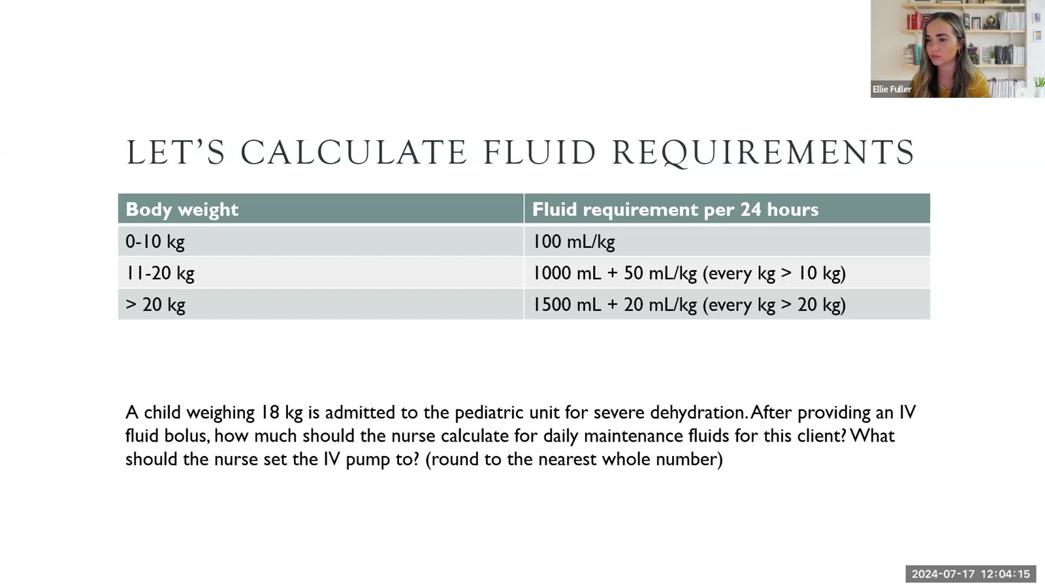
Notes:
Fuller · Week 12 · Gastrointestinal
Recording time 18:55
https://drive.google.com/file/d/1kqvvmD470PE4FpYVJuWQyjF_jkmS0qIa/view

Slide 10
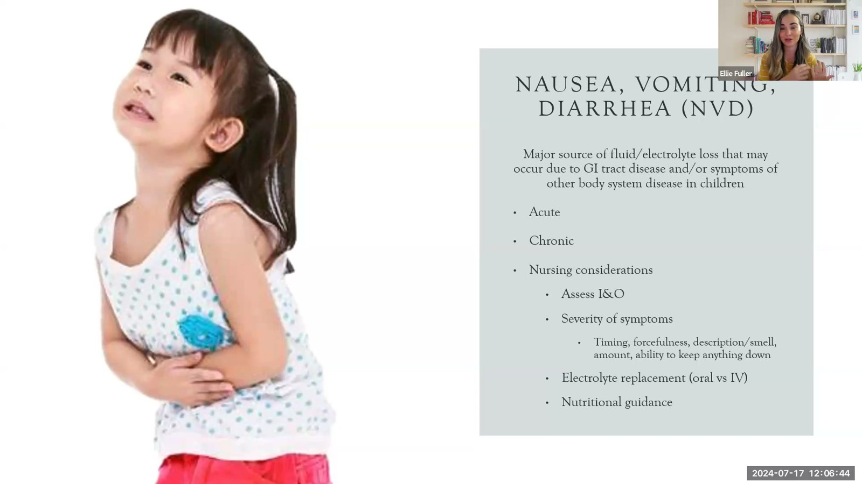
Notes:
Fuller · Week 12 · Gastrointestinal
Recording time 21:24
https://drive.google.com/file/d/1kqvvmD470PE4FpYVJuWQyjF_jkmS0qIa/view

Slide 11
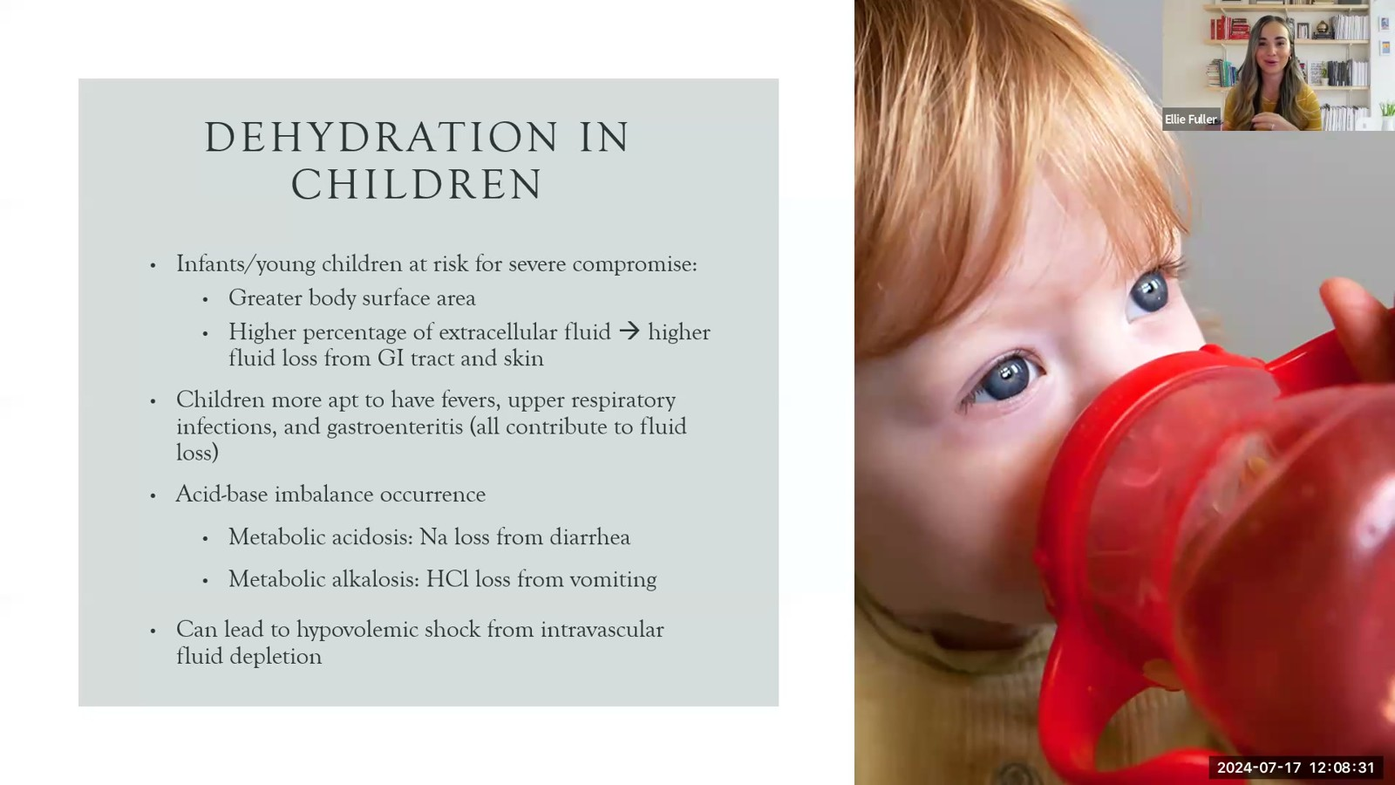
Notes:
Fuller · Week 12 · Gastrointestinal
Recording time 23:11
https://drive.google.com/file/d/1kqvvmD470PE4FpYVJuWQyjF_jkmS0qIa/view

Slide 12
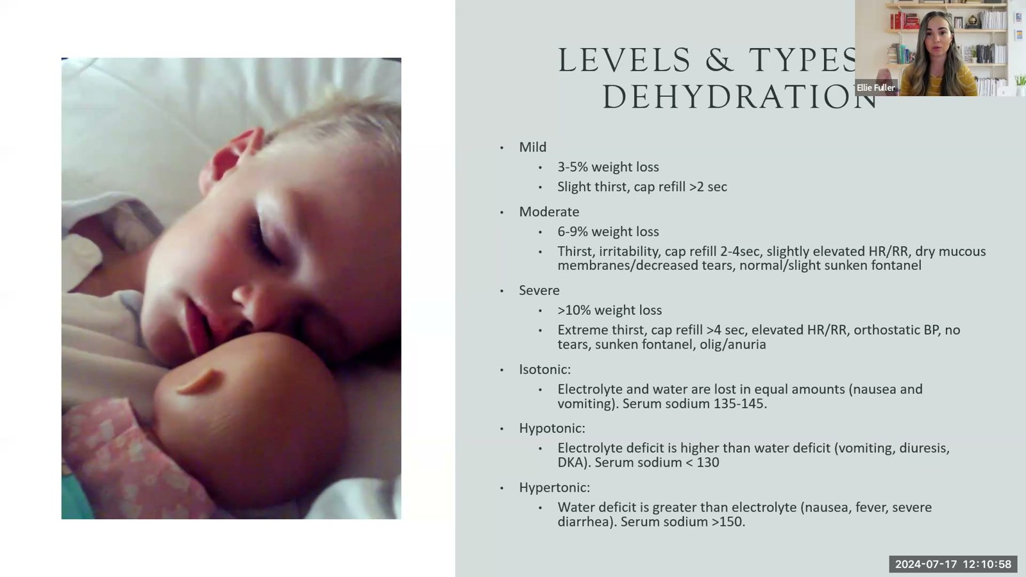
Notes:
Fuller · Week 12 · Gastrointestinal
Recording time 25:38
https://drive.google.com/file/d/1kqvvmD470PE4FpYVJuWQyjF_jkmS0qIa/view

Slide 13
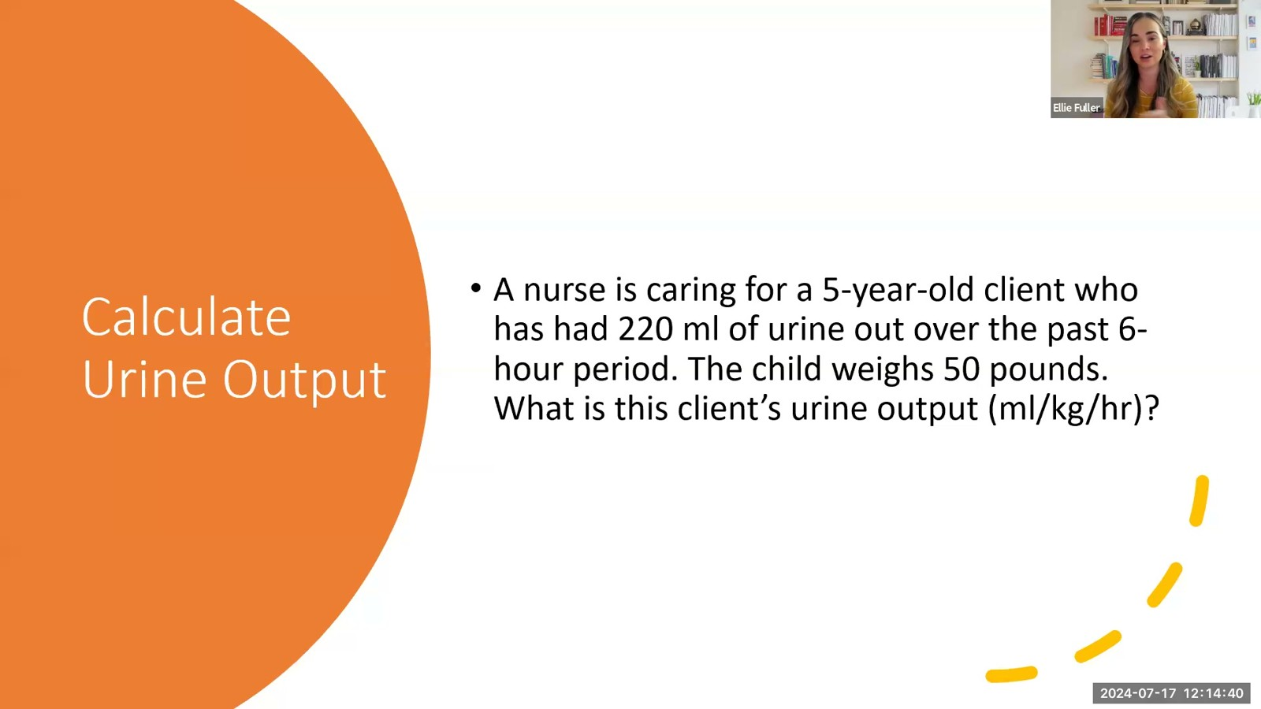
Notes:
Fuller · Week 12 · Gastrointestinal
Recording time 29:20
https://drive.google.com/file/d/1kqvvmD470PE4FpYVJuWQyjF_jkmS0qIa/view

Slide 14

Notes:
Fuller · Week 12 · Gastrointestinal
Recording time 31:39
https://drive.google.com/file/d/1kqvvmD470PE4FpYVJuWQyjF_jkmS0qIa/view

Slide 15
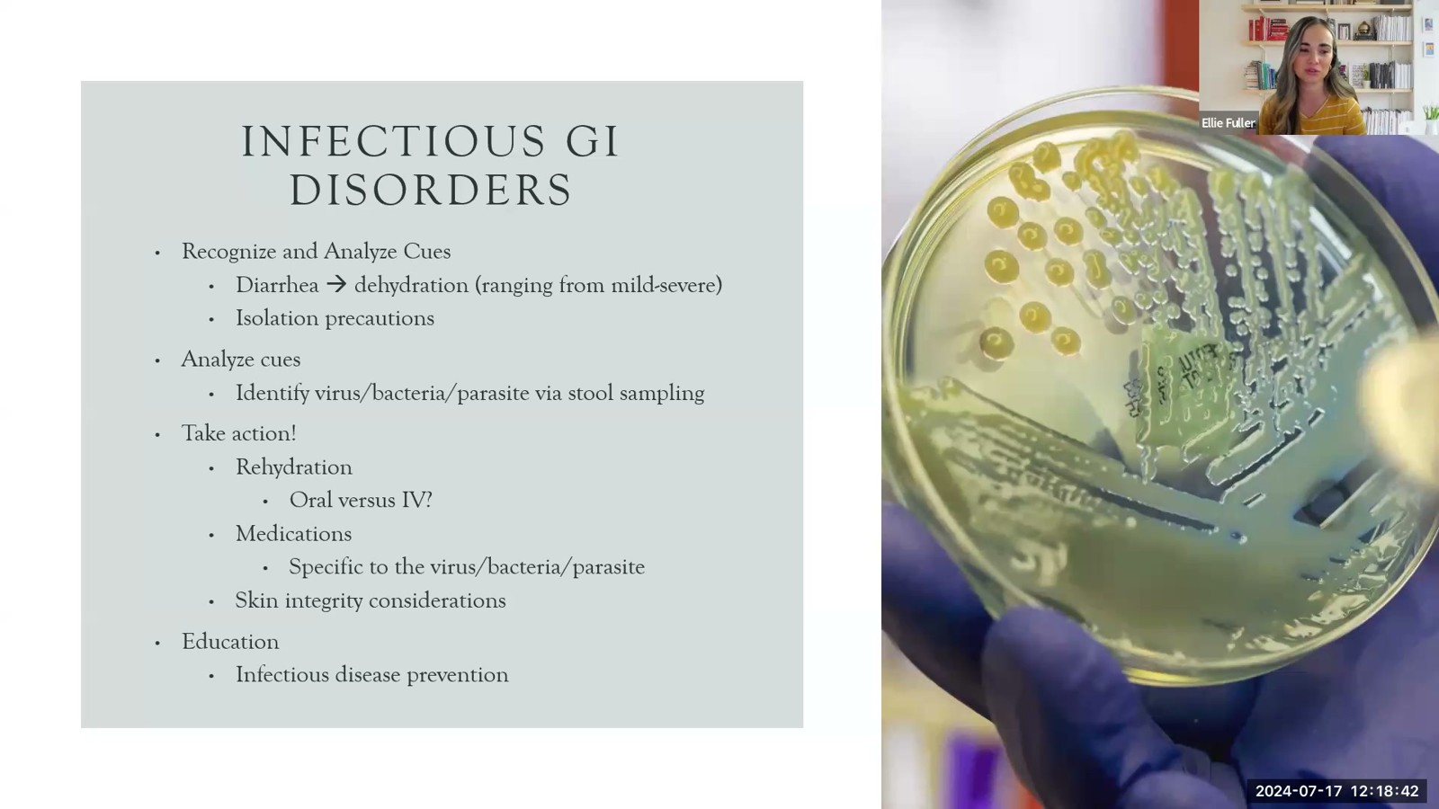
Notes:
Fuller · Week 12 · Gastrointestinal
Recording time 33:22
https://drive.google.com/file/d/1kqvvmD470PE4FpYVJuWQyjF_jkmS0qIa/view

Slide 16

Notes:
Fuller · Week 12 · Gastrointestinal
Recording time 34:23
https://drive.google.com/file/d/1kqvvmD470PE4FpYVJuWQyjF_jkmS0qIa/view

Slide 17
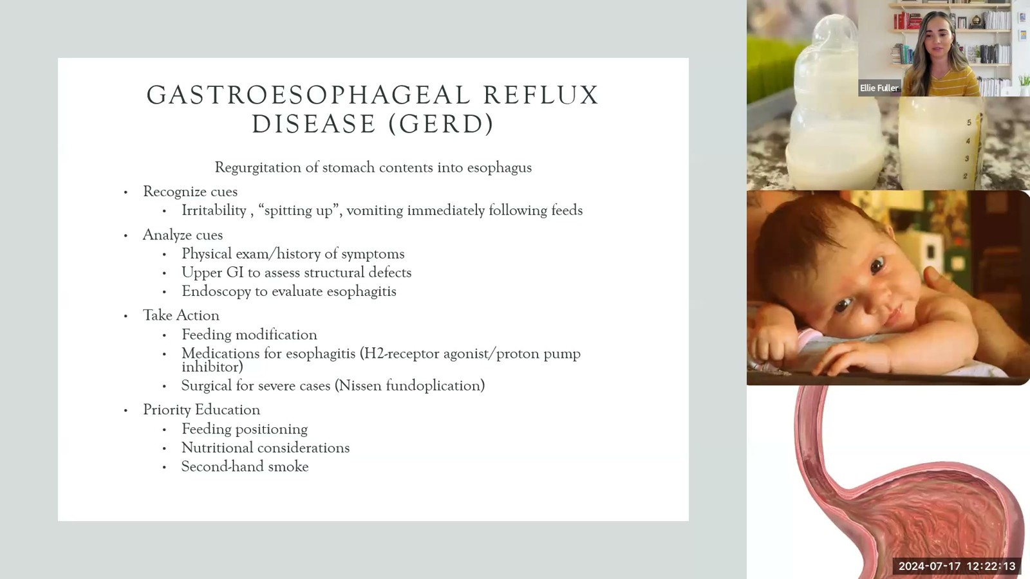
Notes:
Fuller · Week 12 · Gastrointestinal
Recording time 36:53
https://drive.google.com/file/d/1kqvvmD470PE4FpYVJuWQyjF_jkmS0qIa/view

Slide 18
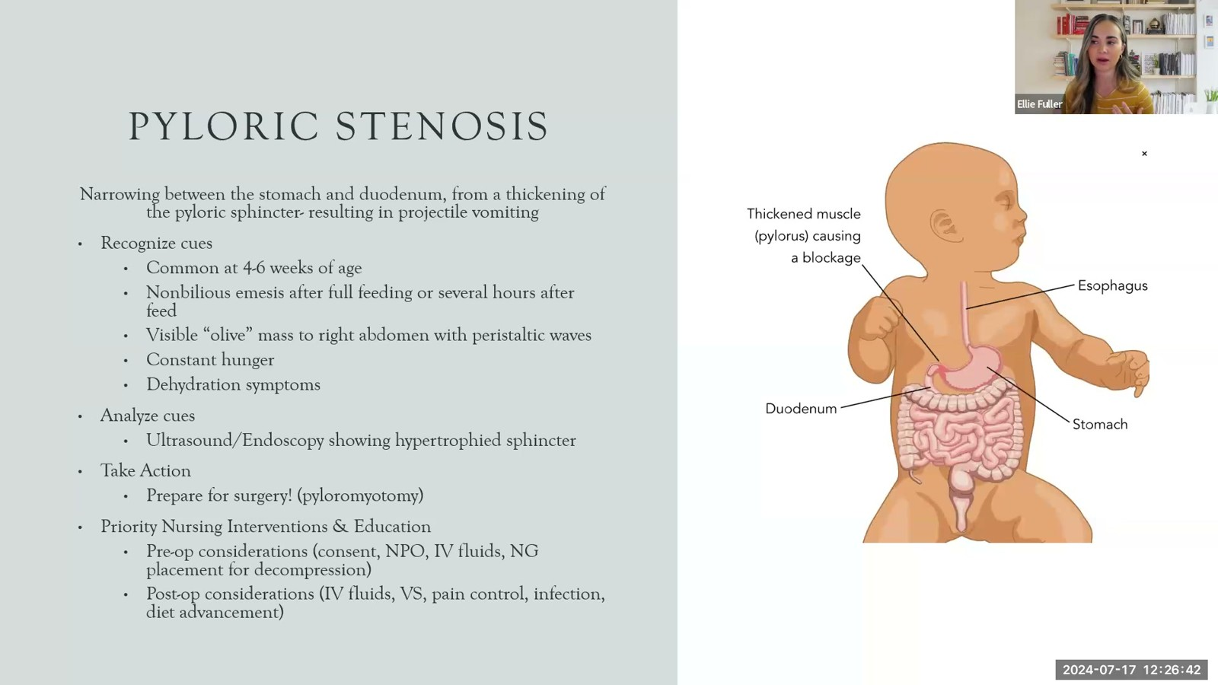
Notes:
Fuller · Week 12 · Gastrointestinal
Recording time 41:22
https://drive.google.com/file/d/1kqvvmD470PE4FpYVJuWQyjF_jkmS0qIa/view

Slide 19
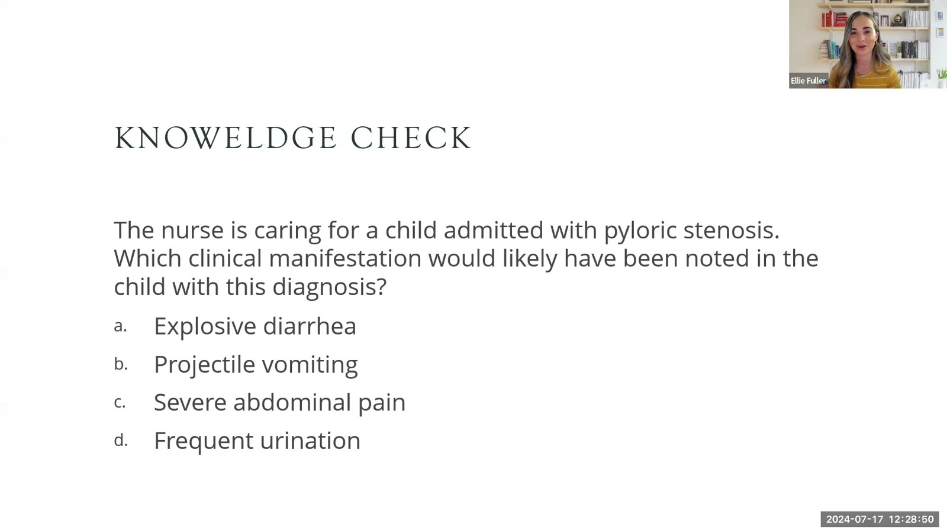
Notes:
Fuller · Week 12 · Gastrointestinal
Recording time 43:30
https://drive.google.com/file/d/1kqvvmD470PE4FpYVJuWQyjF_jkmS0qIa/view

Slide 20
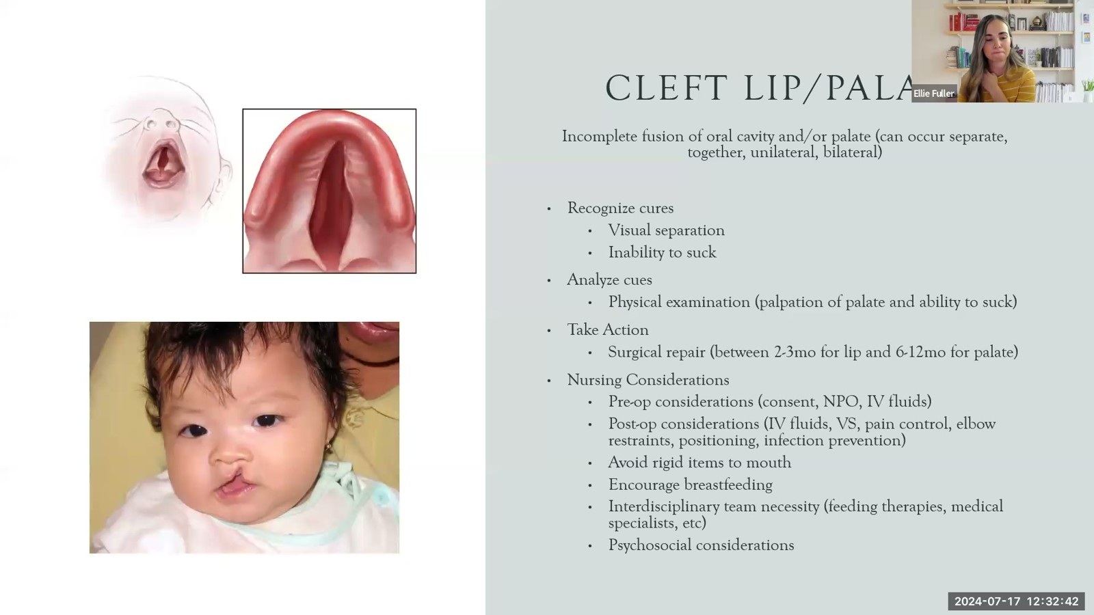
Notes:
Fuller · Week 12 · Gastrointestinal
Recording time 47:22
https://drive.google.com/file/d/1kqvvmD470PE4FpYVJuWQyjF_jkmS0qIa/view

Slide 21
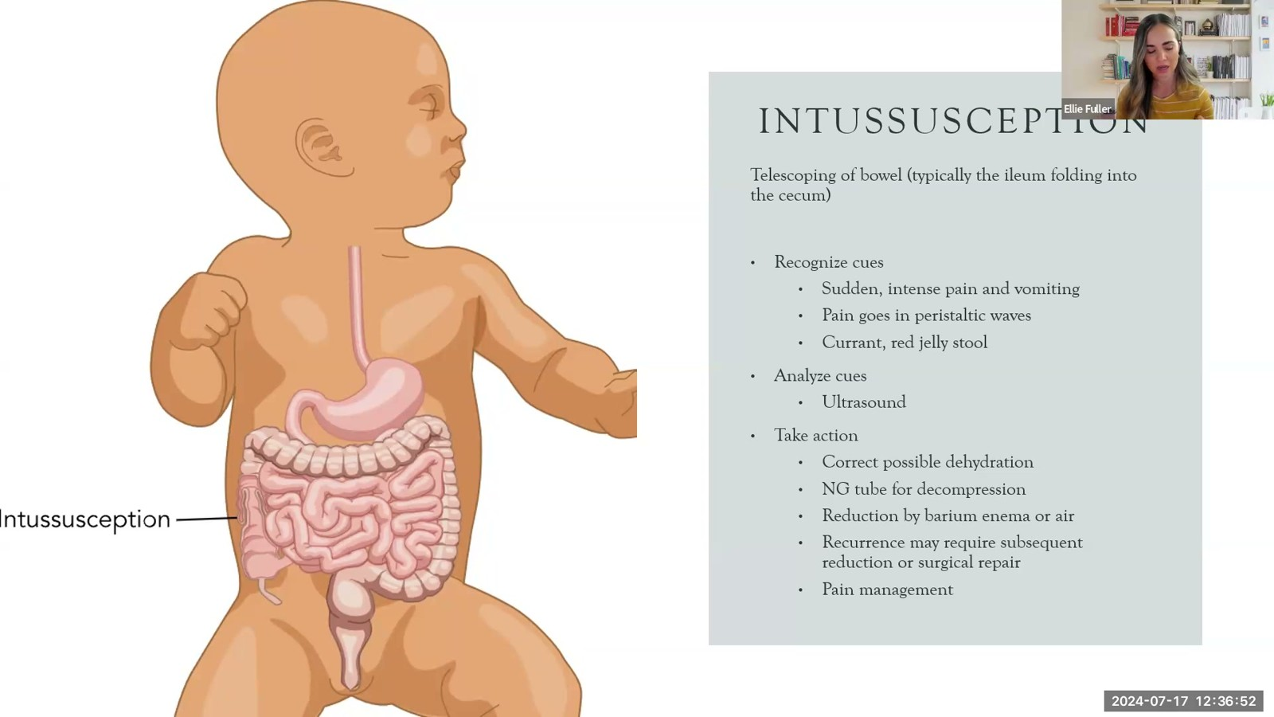
Notes:
Fuller · Week 12 · Gastrointestinal
Recording time 51:32
https://drive.google.com/file/d/1kqvvmD470PE4FpYVJuWQyjF_jkmS0qIa/view

Slide 22
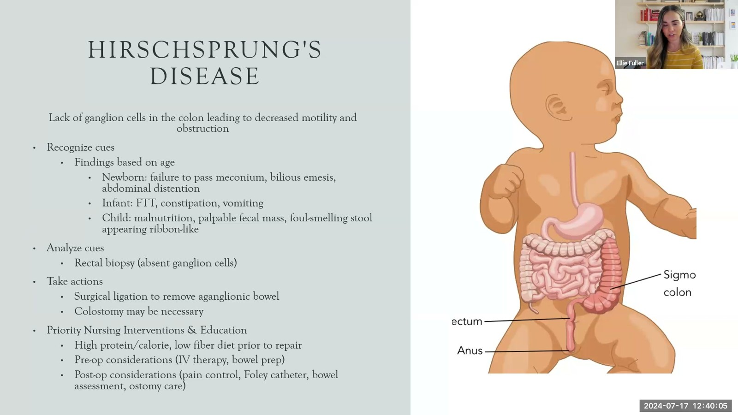
Notes:
Fuller · Week 12 · Gastrointestinal
Recording time 54:45
https://drive.google.com/file/d/1kqvvmD470PE4FpYVJuWQyjF_jkmS0qIa/view

Slide 23
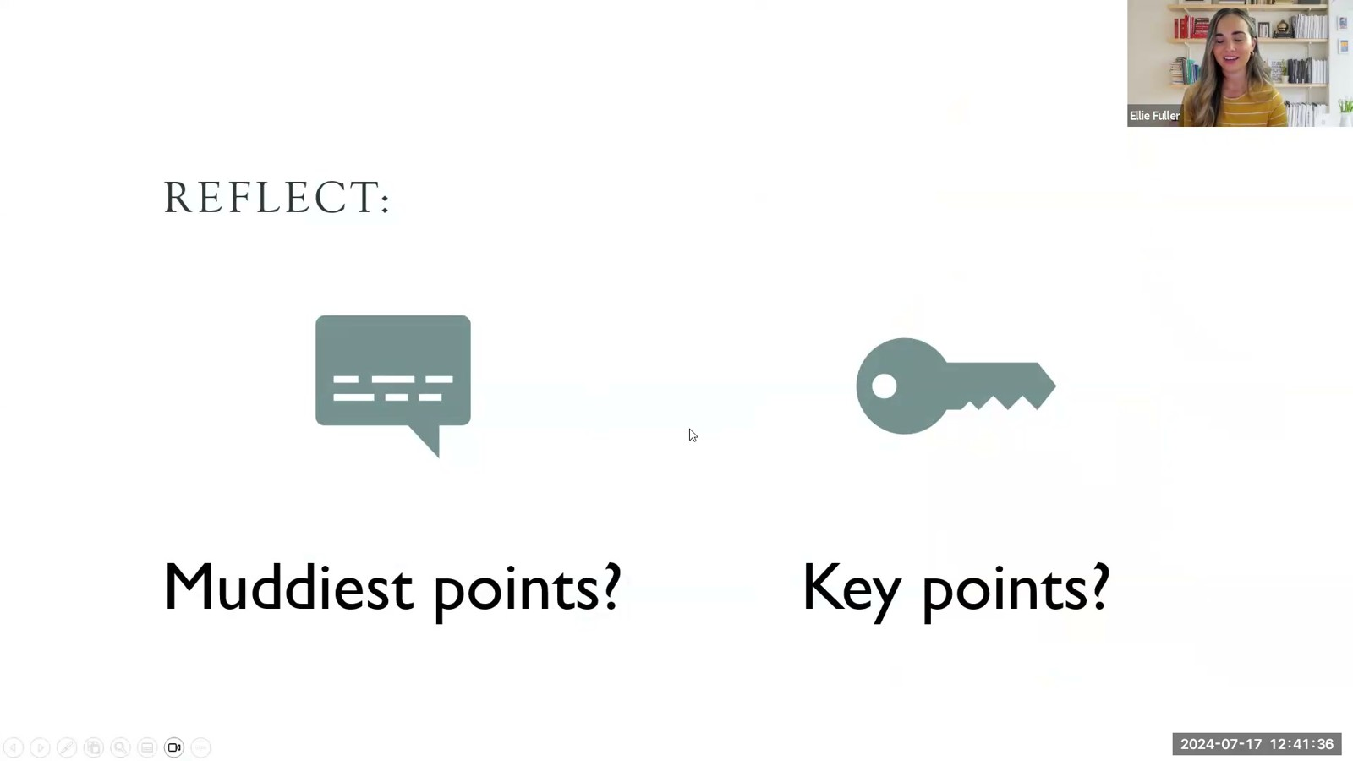
Notes:
Fuller · Week 12 · Gastrointestinal
Recording time 56:16
https://drive.google.com/file/d/1kqvvmD470PE4FpYVJuWQyjF_jkmS0qIa/view

Slide 24
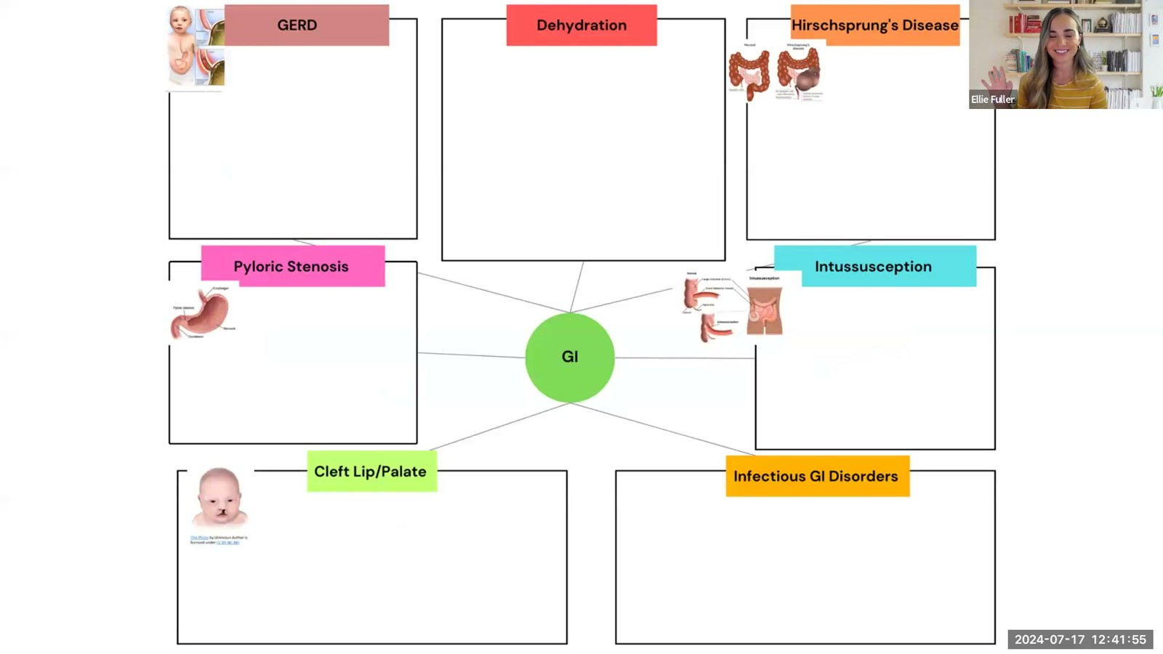
Notes:
Fuller · Week 12 · Gastrointestinal
Recording time 56:35
https://drive.google.com/file/d/1kqvvmD470PE4FpYVJuWQyjF_jkmS0qIa/view

Slide 25
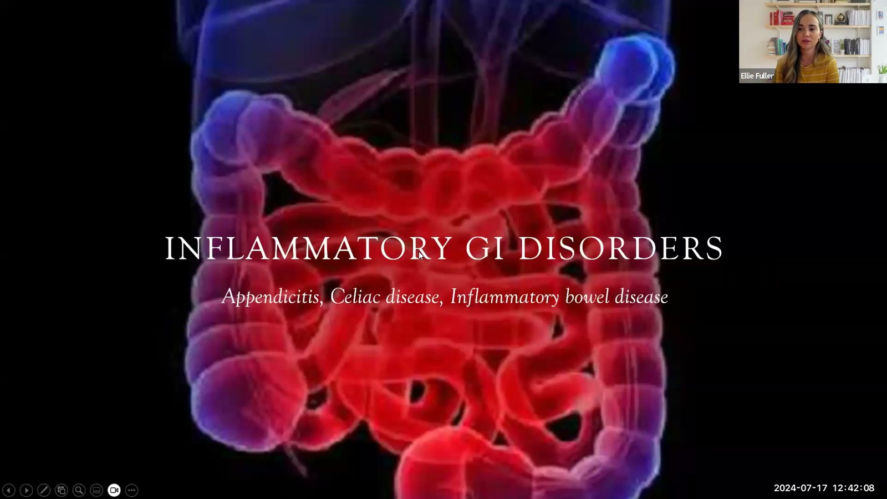
Notes:
Fuller · Week 12 · Gastrointestinal
Recording time 56:48
https://drive.google.com/file/d/1kqvvmD470PE4FpYVJuWQyjF_jkmS0qIa/view

Slide 26
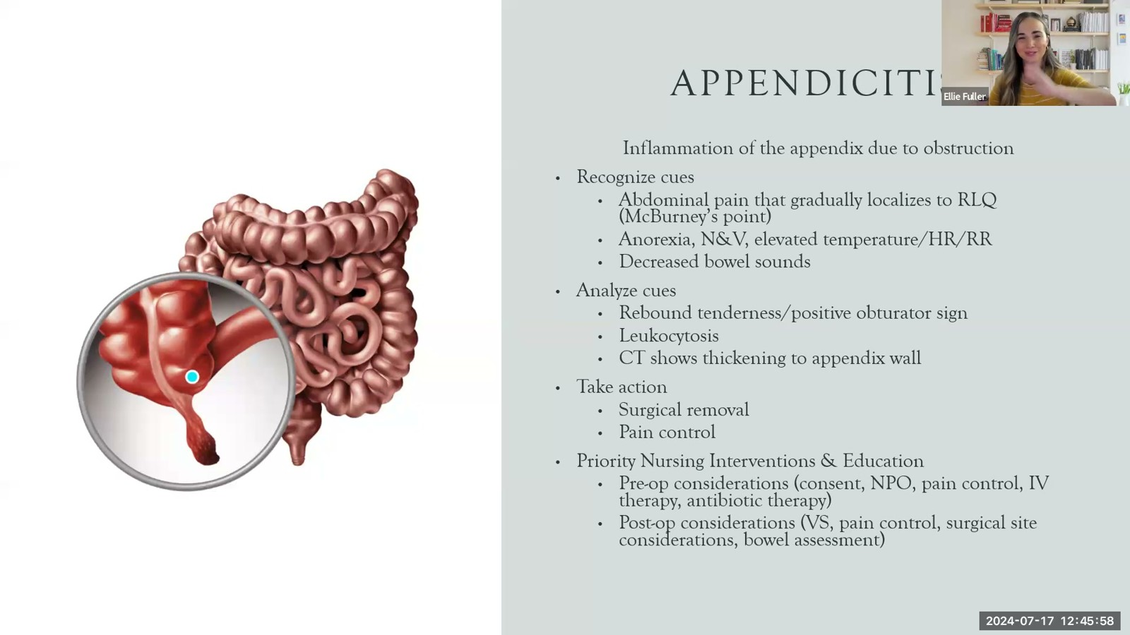
Notes:
Fuller · Week 12 · Gastrointestinal
Recording time 60:38
https://drive.google.com/file/d/1kqvvmD470PE4FpYVJuWQyjF_jkmS0qIa/view

Slide 27
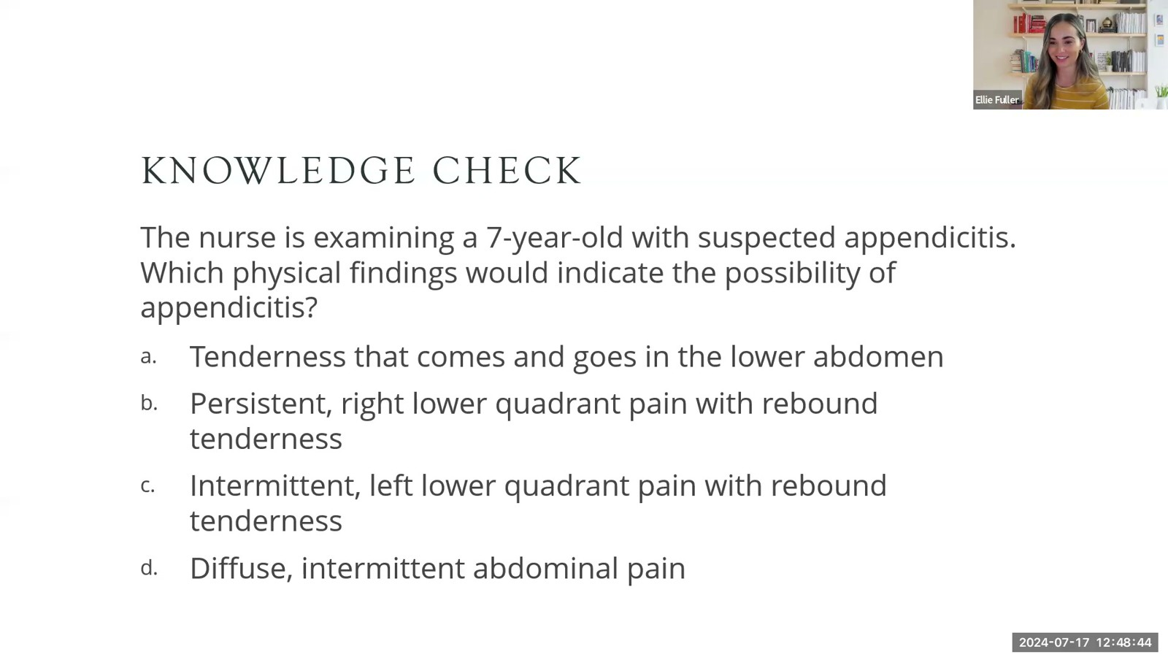
Notes:
Fuller · Week 12 · Gastrointestinal
Recording time 63:24
https://drive.google.com/file/d/1kqvvmD470PE4FpYVJuWQyjF_jkmS0qIa/view

Slide 28
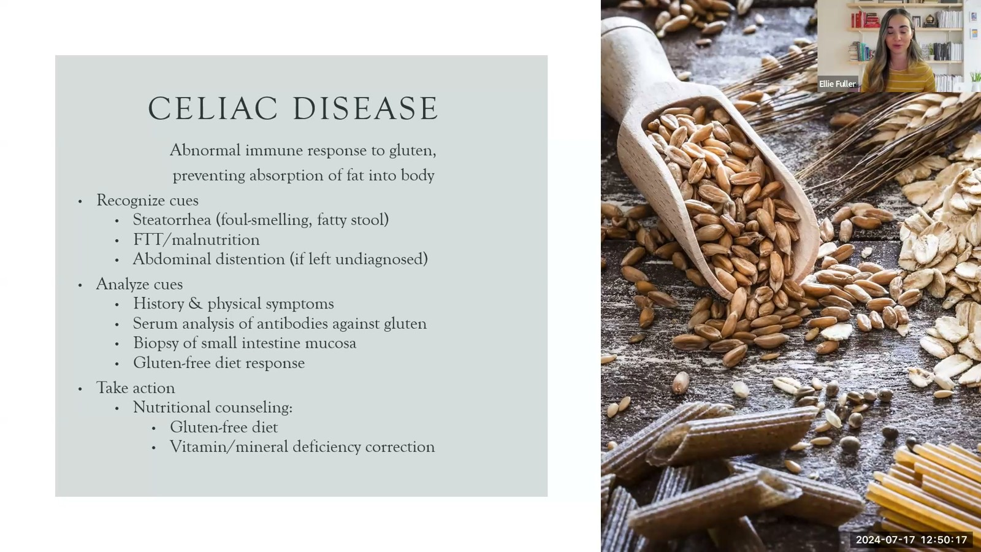
Notes:
Fuller · Week 12 · Gastrointestinal
Recording time 64:57
https://drive.google.com/file/d/1kqvvmD470PE4FpYVJuWQyjF_jkmS0qIa/view

Slide 29
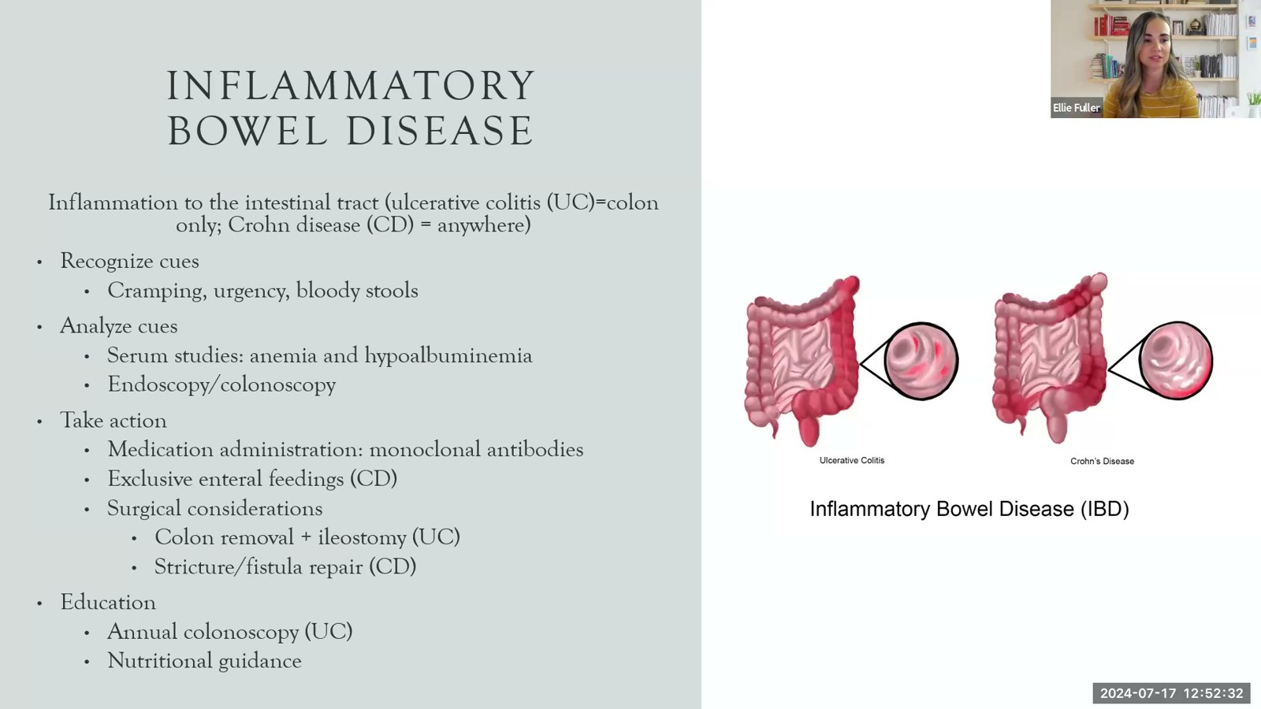
Notes:
Fuller · Week 12 · Gastrointestinal
Recording time 67:12
https://drive.google.com/file/d/1kqvvmD470PE4FpYVJuWQyjF_jkmS0qIa/view

Slide 30
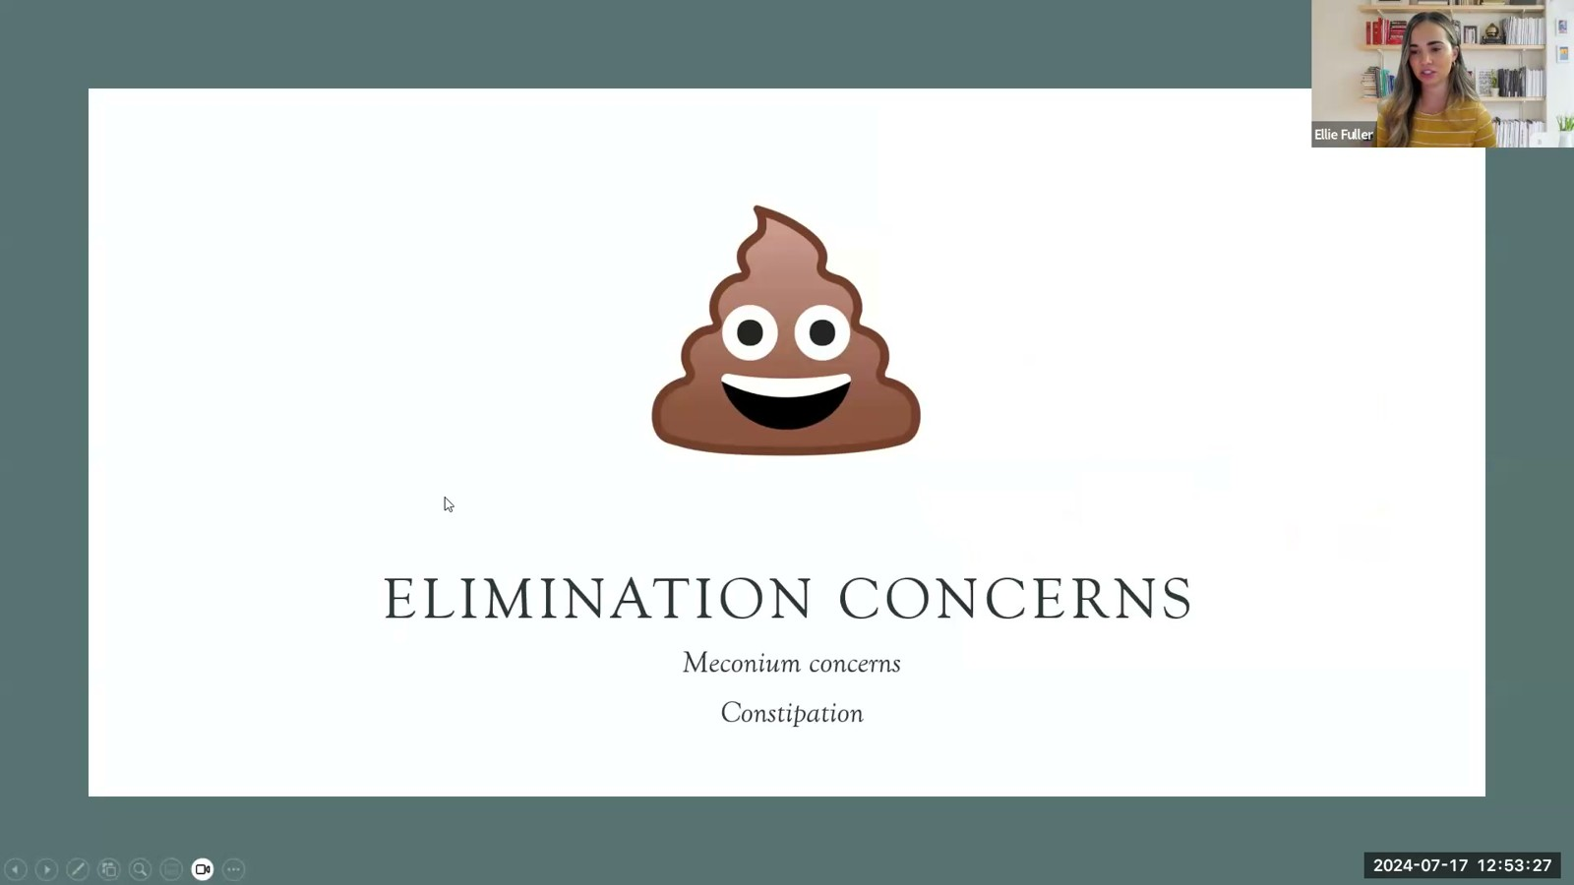
Notes:
Fuller · Week 12 · Gastrointestinal
Recording time 68:07
https://drive.google.com/file/d/1kqvvmD470PE4FpYVJuWQyjF_jkmS0qIa/view

Slide 31
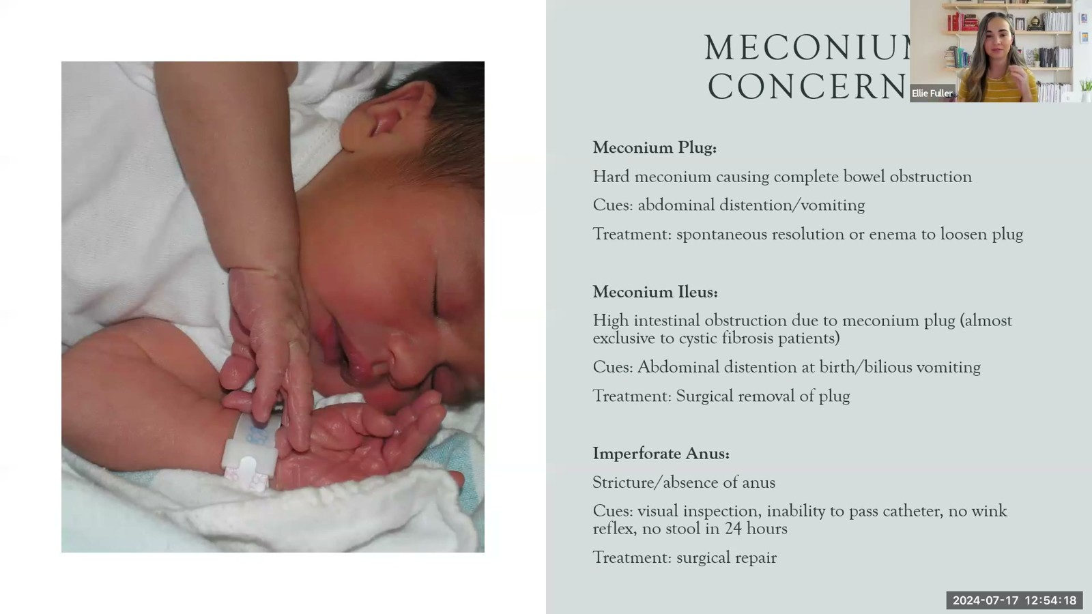
Notes:
Fuller · Week 12 · Gastrointestinal
Recording time 68:58
https://drive.google.com/file/d/1kqvvmD470PE4FpYVJuWQyjF_jkmS0qIa/view

Slide 32
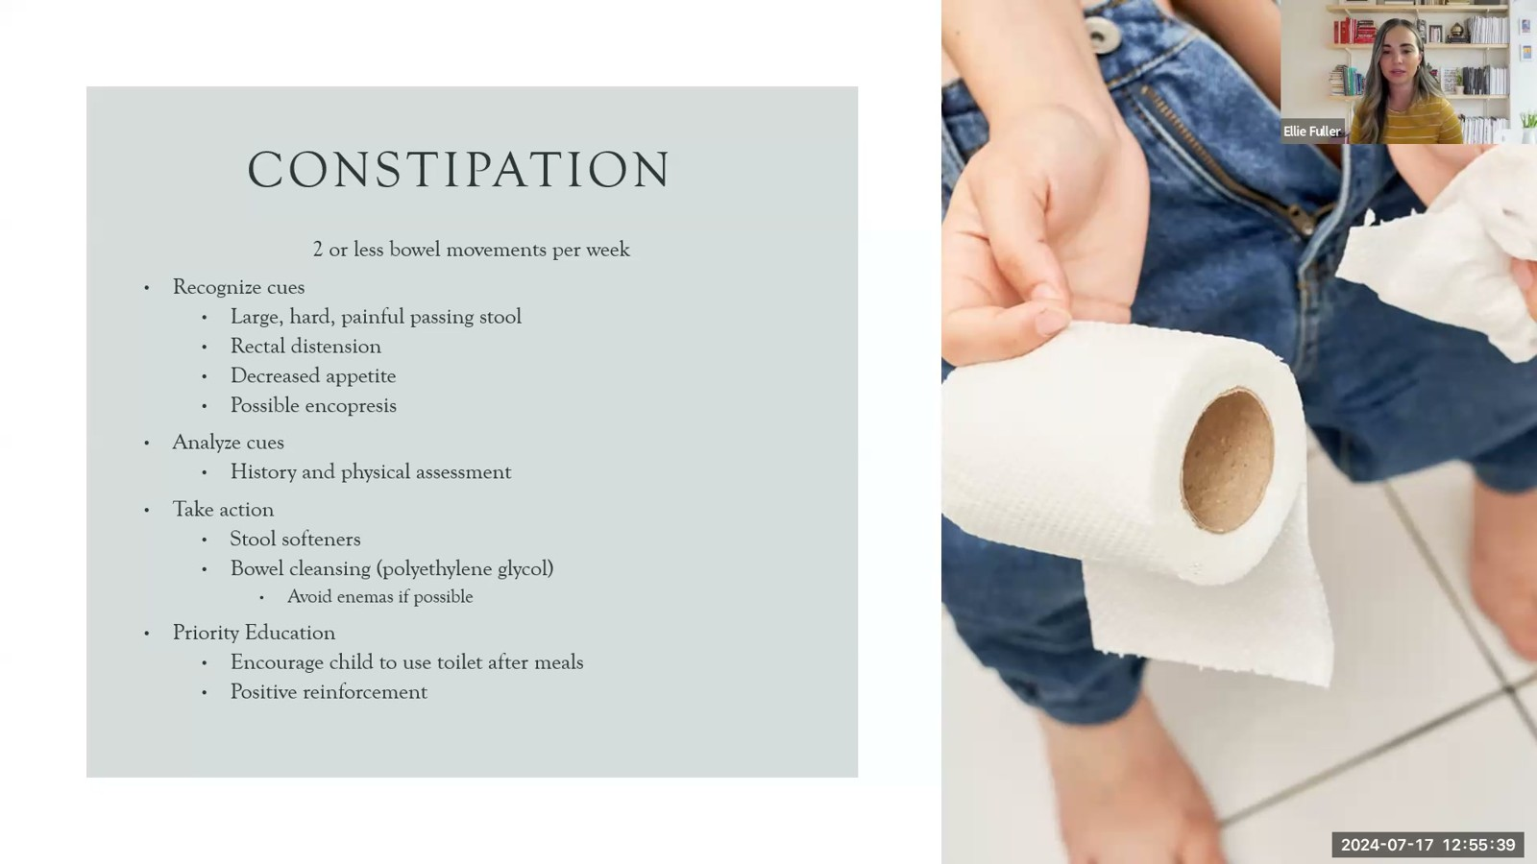
Notes:
Fuller · Week 12 · Gastrointestinal
Recording time 70:19
https://drive.google.com/file/d/1kqvvmD470PE4FpYVJuWQyjF_jkmS0qIa/view

Slide 33
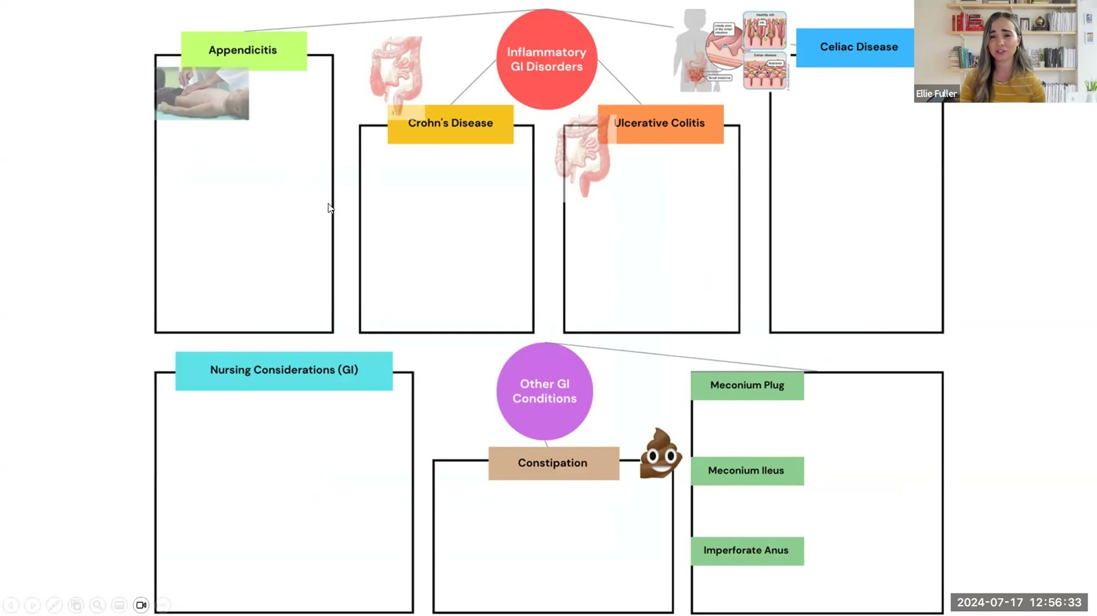
Notes:
Fuller · Week 12 · Gastrointestinal
Recording time 71:13
https://drive.google.com/file/d/1kqvvmD470PE4FpYVJuWQyjF_jkmS0qIa/view

Slide 34
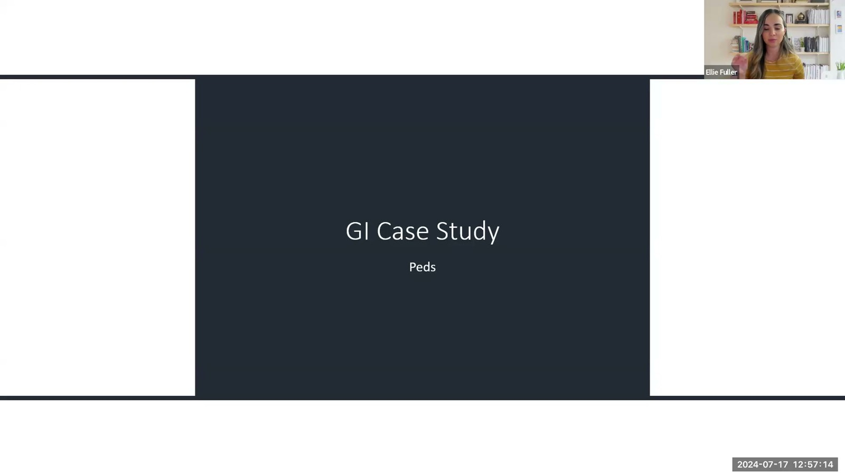
Notes:
Fuller · Week 12 · Gastrointestinal
Recording time 71:54
https://drive.google.com/file/d/1kqvvmD470PE4FpYVJuWQyjF_jkmS0qIa/view

Slide 35
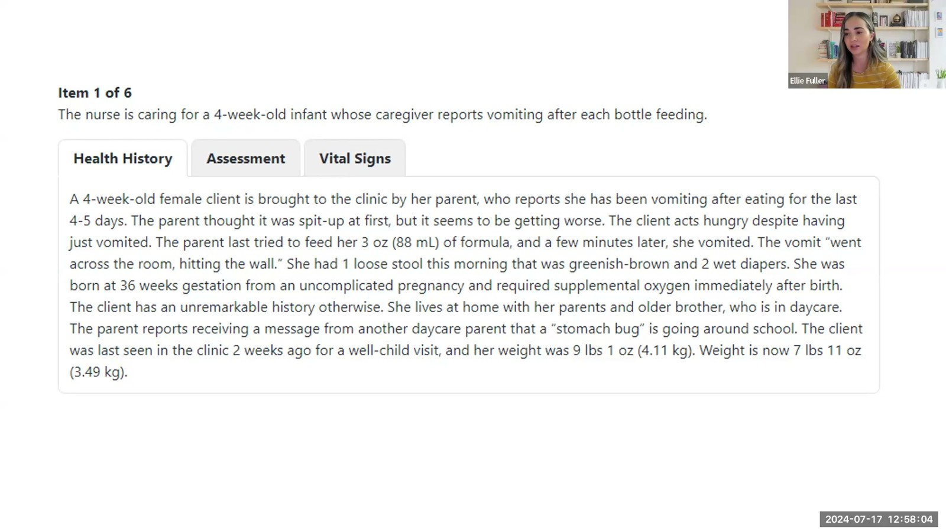
Notes:
Fuller · Week 12 · Gastrointestinal
Recording time 72:44
https://drive.google.com/file/d/1kqvvmD470PE4FpYVJuWQyjF_jkmS0qIa/view

Slide 36
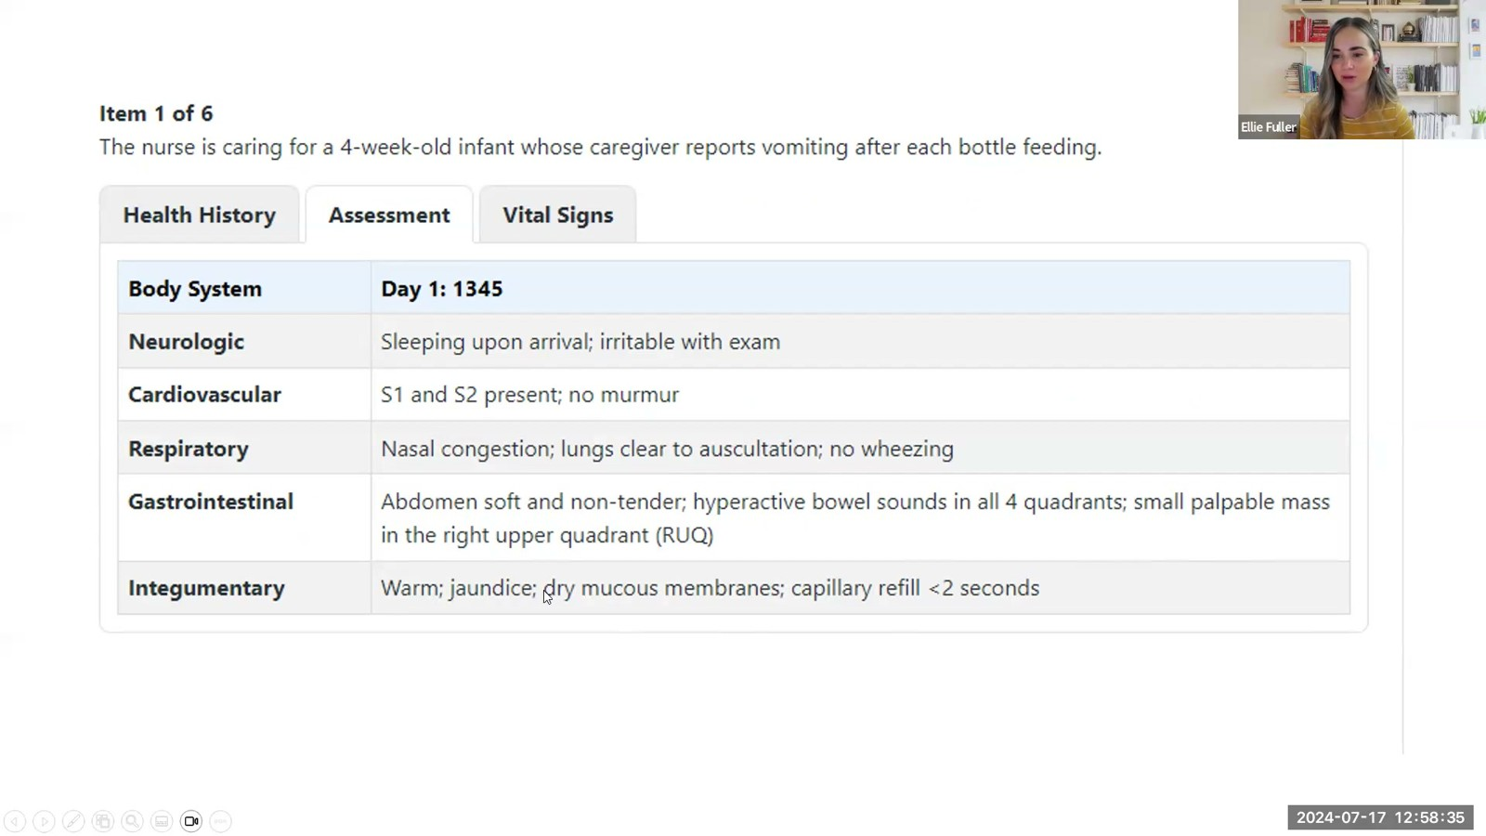
Notes:
Fuller · Week 12 · Gastrointestinal
Recording time 73:15
https://drive.google.com/file/d/1kqvvmD470PE4FpYVJuWQyjF_jkmS0qIa/view

Slide 37
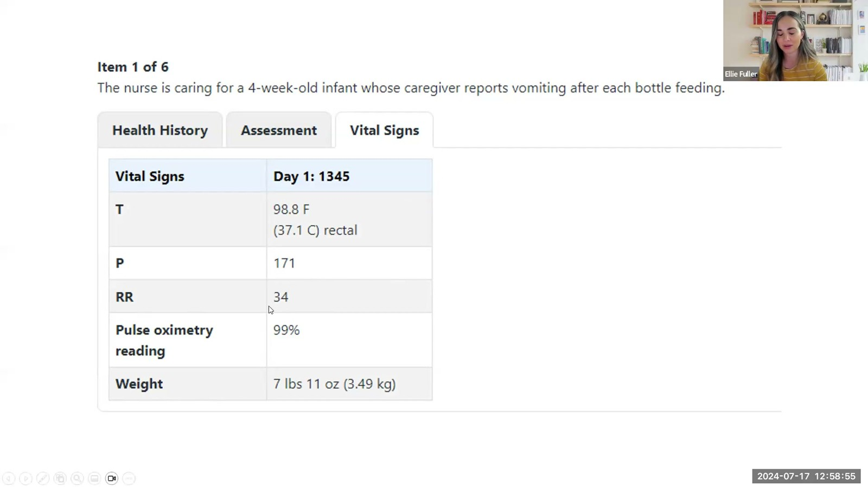
Notes:
Fuller · Week 12 · Gastrointestinal
Recording time 73:35
https://drive.google.com/file/d/1kqvvmD470PE4FpYVJuWQyjF_jkmS0qIa/view

Slide 38
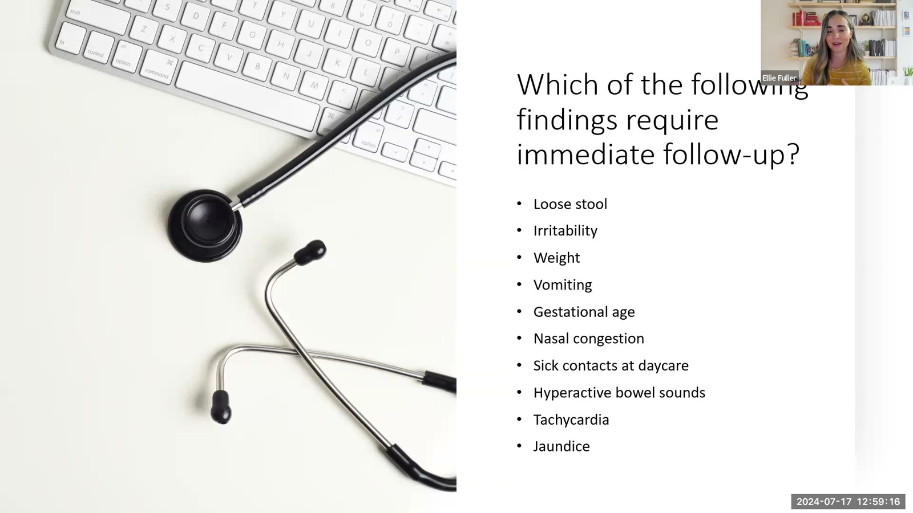
Notes:
Fuller · Week 12 · Gastrointestinal
Recording time 73:56
https://drive.google.com/file/d/1kqvvmD470PE4FpYVJuWQyjF_jkmS0qIa/view

Slide 39
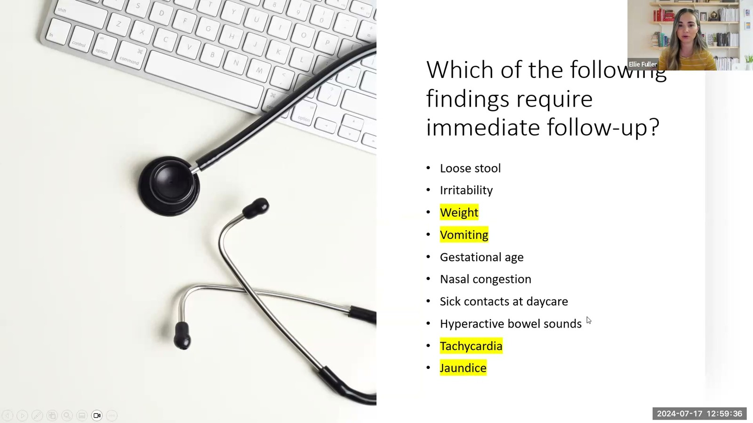
Notes:
Fuller · Week 12 · Gastrointestinal
Recording time 74:16
https://drive.google.com/file/d/1kqvvmD470PE4FpYVJuWQyjF_jkmS0qIa/view

Slide 40
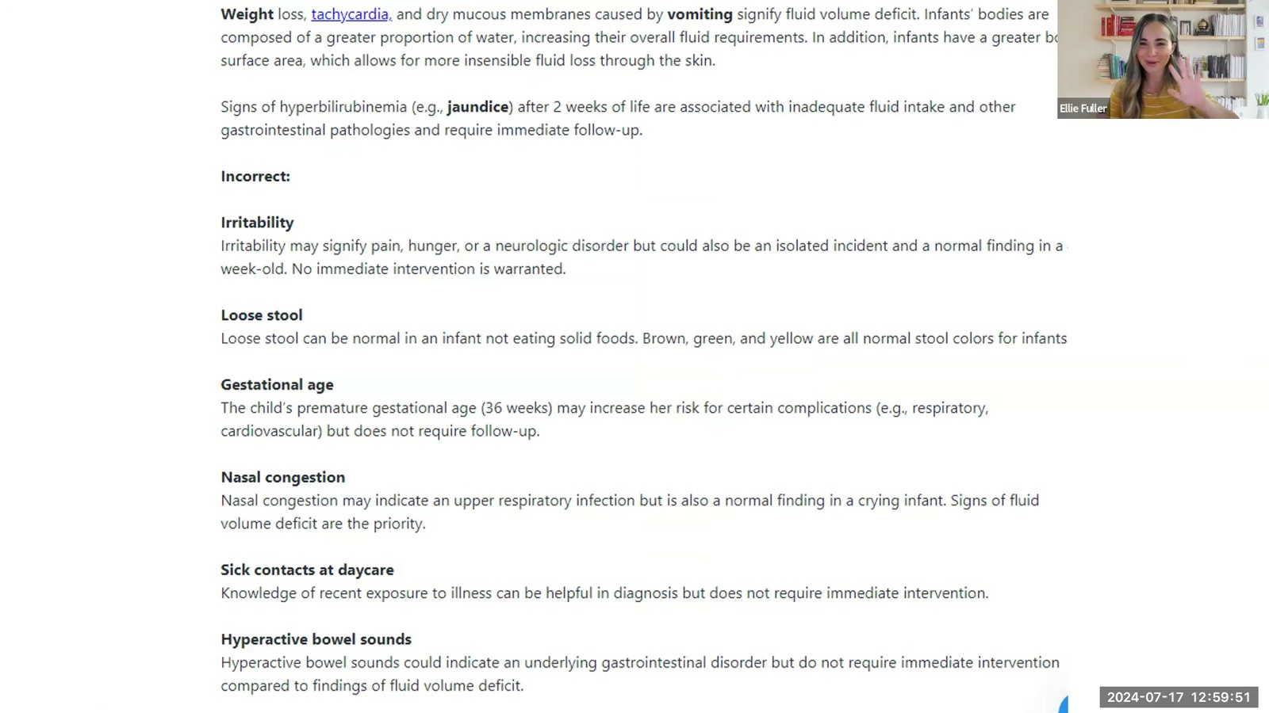
Notes:
Fuller · Week 12 · Gastrointestinal
Recording time 74:31
https://drive.google.com/file/d/1kqvvmD470PE4FpYVJuWQyjF_jkmS0qIa/view

Slide 41
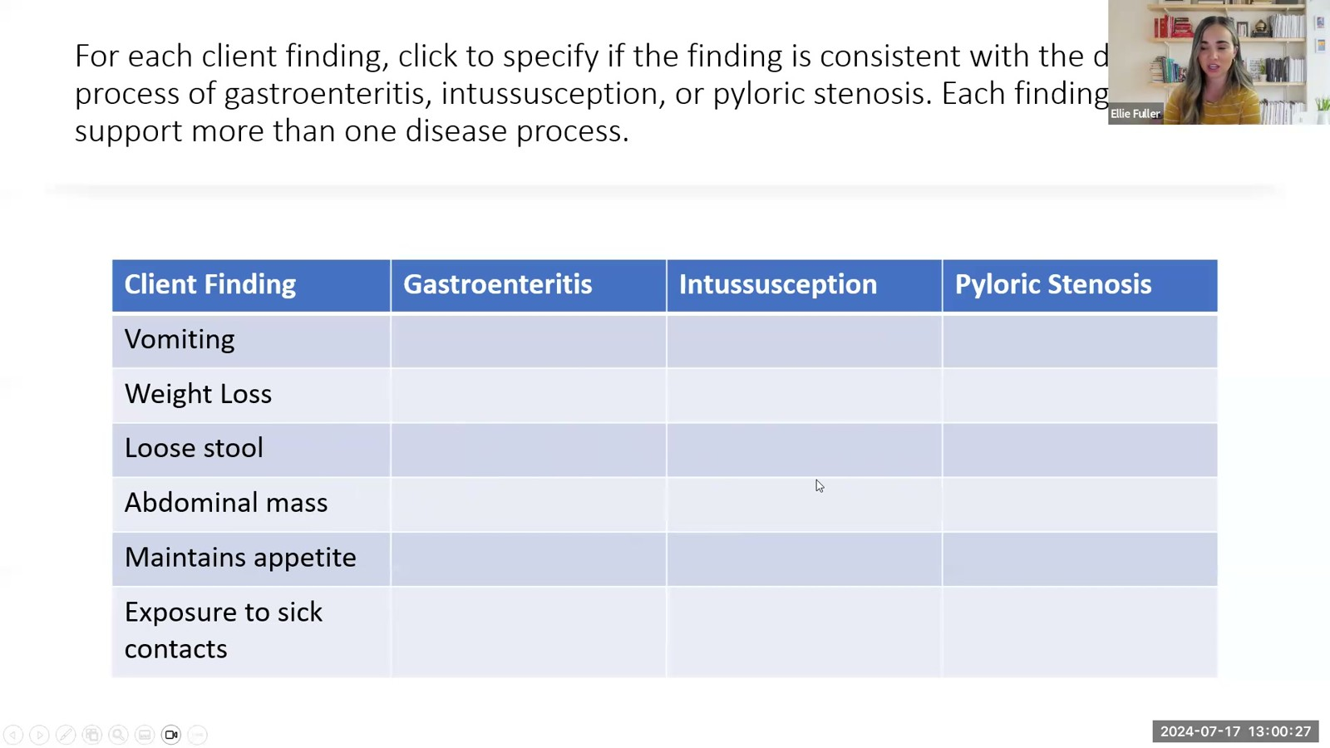
Notes:
Fuller · Week 12 · Gastrointestinal
Recording time 75:07
https://drive.google.com/file/d/1kqvvmD470PE4FpYVJuWQyjF_jkmS0qIa/view

Slide 42
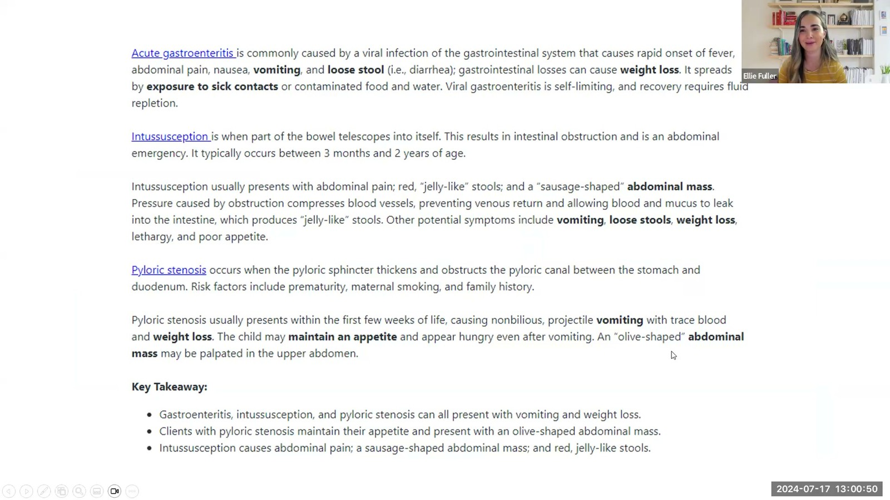
Notes:
Fuller · Week 12 · Gastrointestinal
Recording time 75:30
https://drive.google.com/file/d/1kqvvmD470PE4FpYVJuWQyjF_jkmS0qIa/view

Slide 43
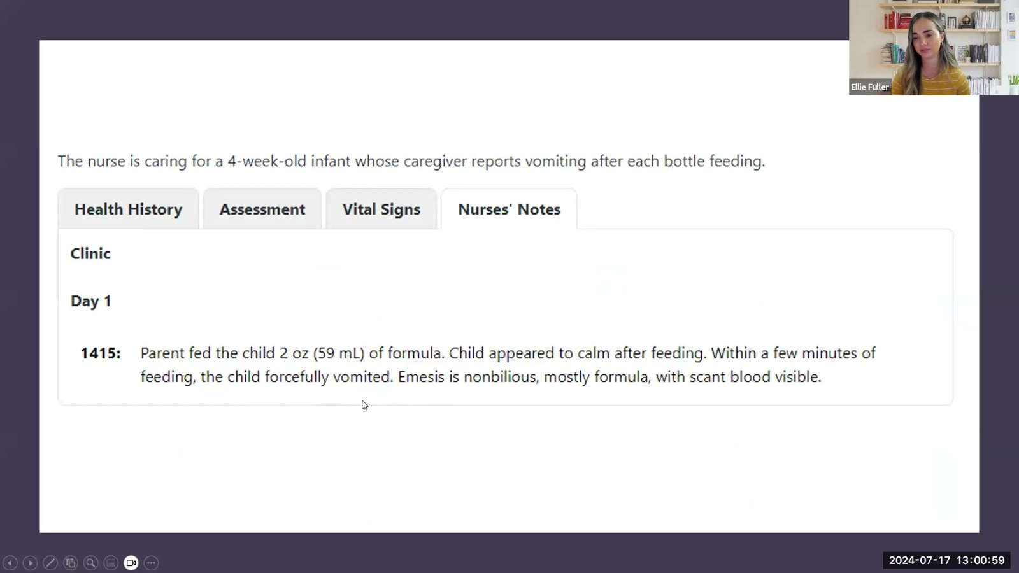
Notes:
Fuller · Week 12 · Gastrointestinal
Recording time 75:39
https://drive.google.com/file/d/1kqvvmD470PE4FpYVJuWQyjF_jkmS0qIa/view

Slide 44
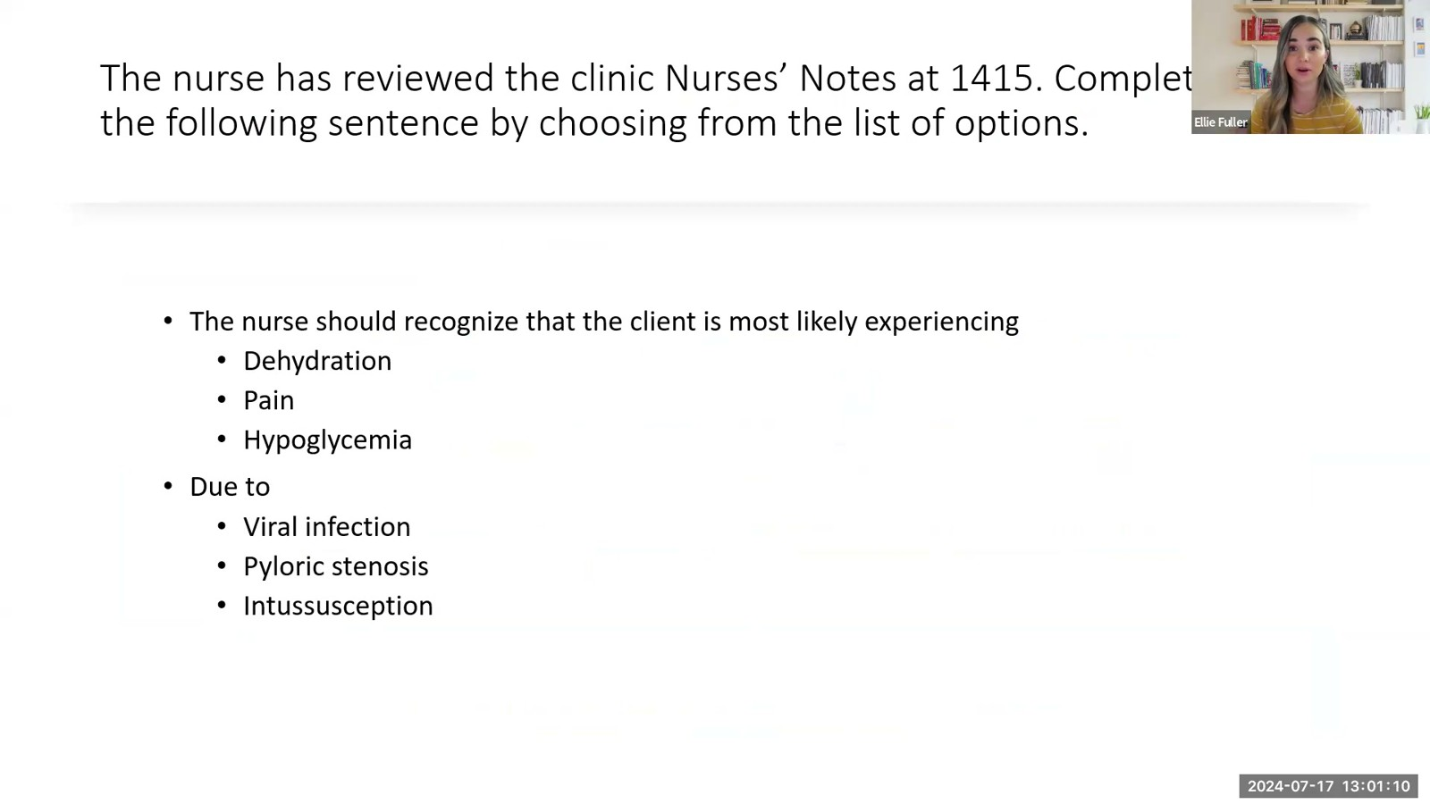
Notes:
Fuller · Week 12 · Gastrointestinal
Recording time 75:50
https://drive.google.com/file/d/1kqvvmD470PE4FpYVJuWQyjF_jkmS0qIa/view

Slide 45
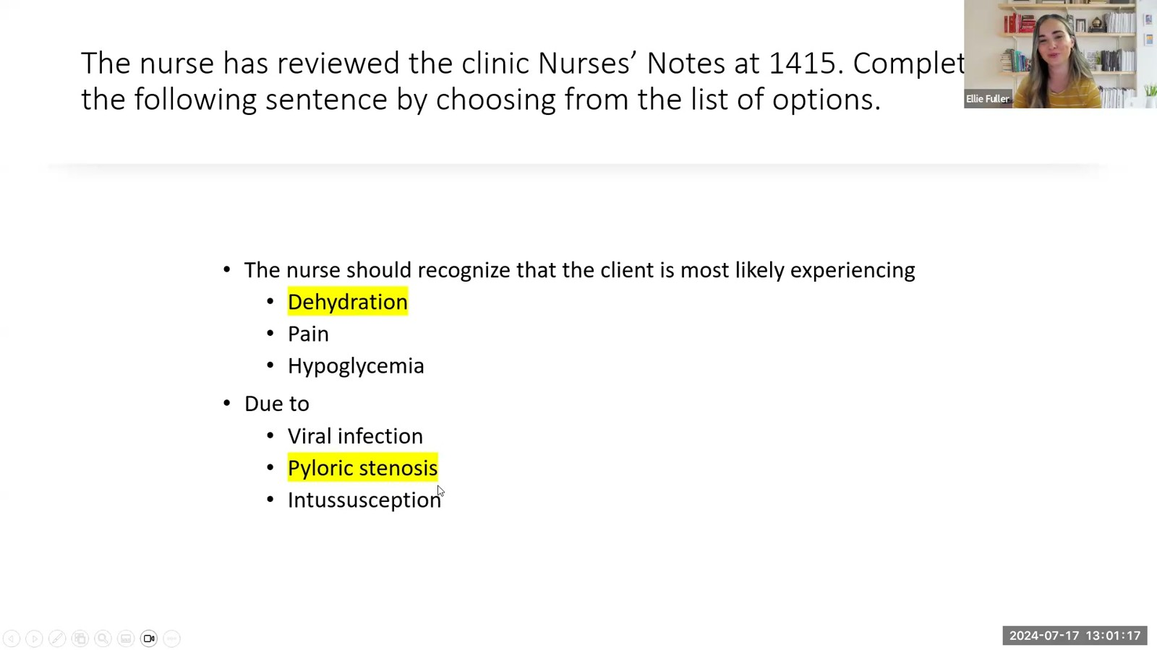
Notes:
Fuller · Week 12 · Gastrointestinal
Recording time 75:57
https://drive.google.com/file/d/1kqvvmD470PE4FpYVJuWQyjF_jkmS0qIa/view

Slide 46
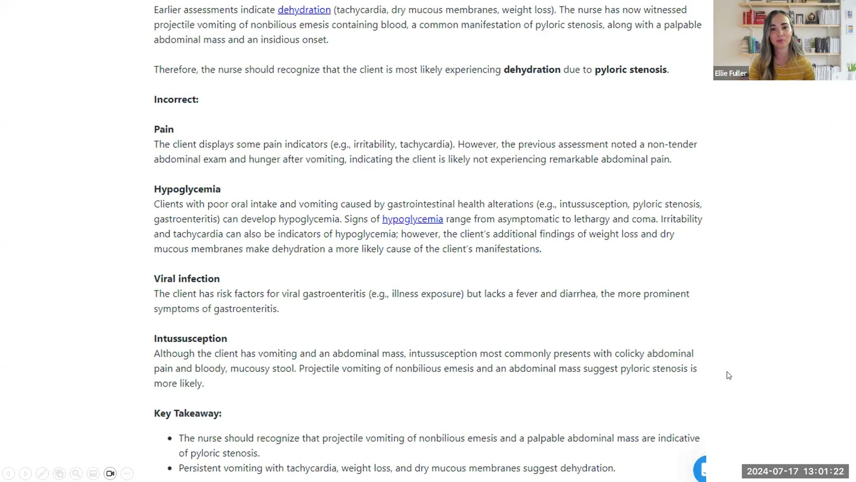
Notes:
Fuller · Week 12 · Gastrointestinal
Recording time 76:02
https://drive.google.com/file/d/1kqvvmD470PE4FpYVJuWQyjF_jkmS0qIa/view

Slide 47
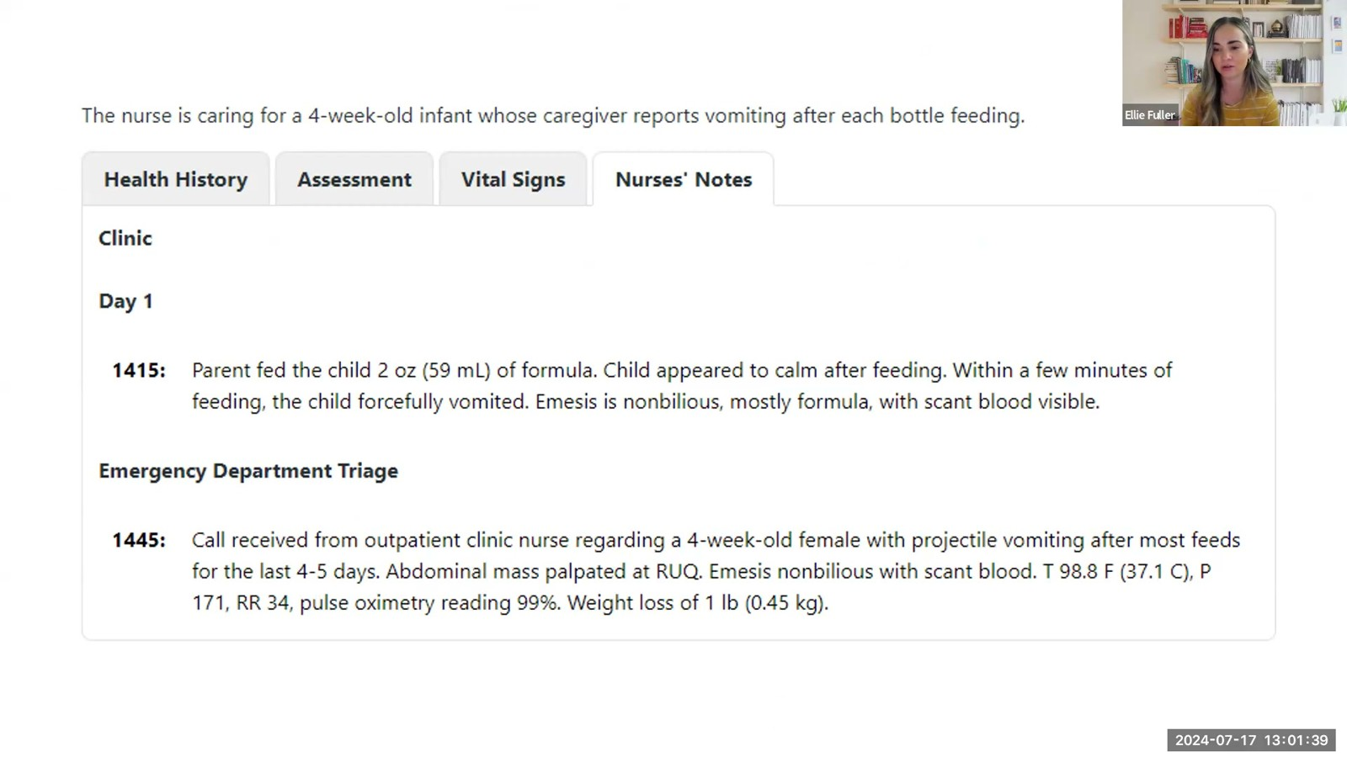
Notes:
Fuller · Week 12 · Gastrointestinal
Recording time 76:19
https://drive.google.com/file/d/1kqvvmD470PE4FpYVJuWQyjF_jkmS0qIa/view

Slide 48
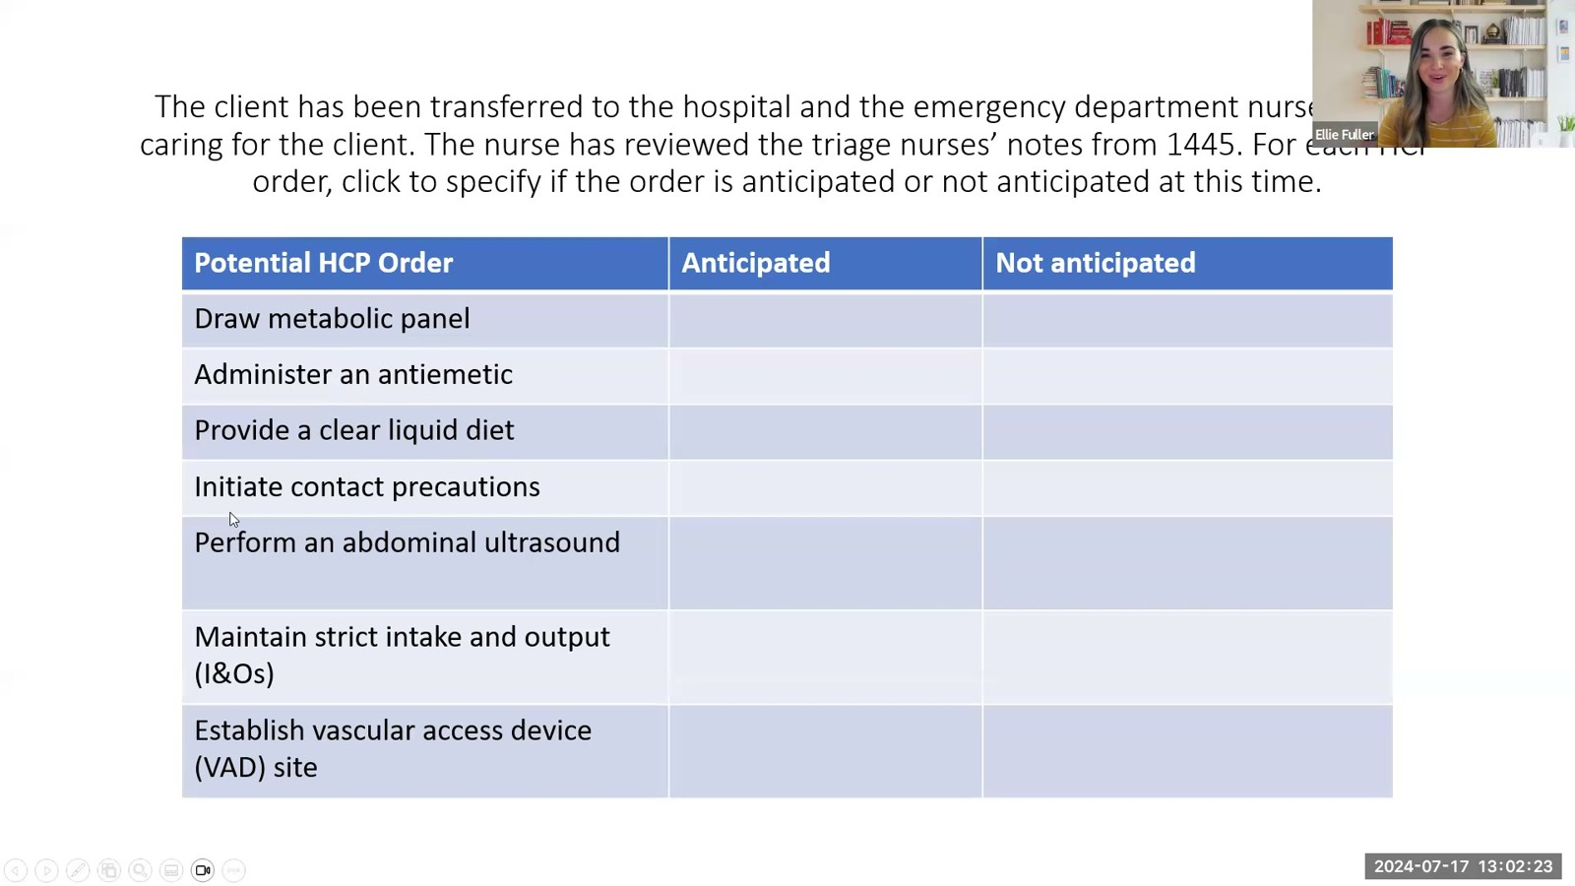
Notes:
Fuller · Week 12 · Gastrointestinal
Recording time 77:03
https://drive.google.com/file/d/1kqvvmD470PE4FpYVJuWQyjF_jkmS0qIa/view

Slide 49
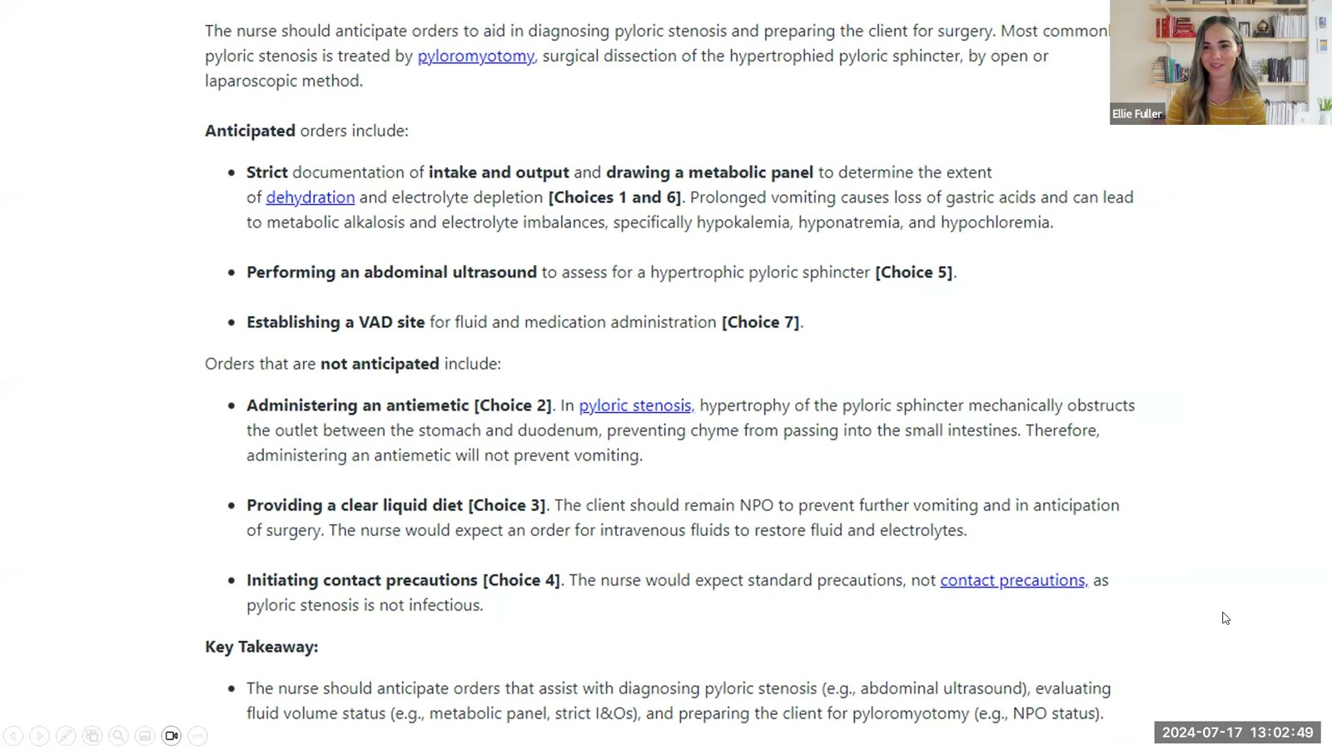
Notes:
Fuller · Week 12 · Gastrointestinal
Recording time 77:29
https://drive.google.com/file/d/1kqvvmD470PE4FpYVJuWQyjF_jkmS0qIa/view

Slide 50
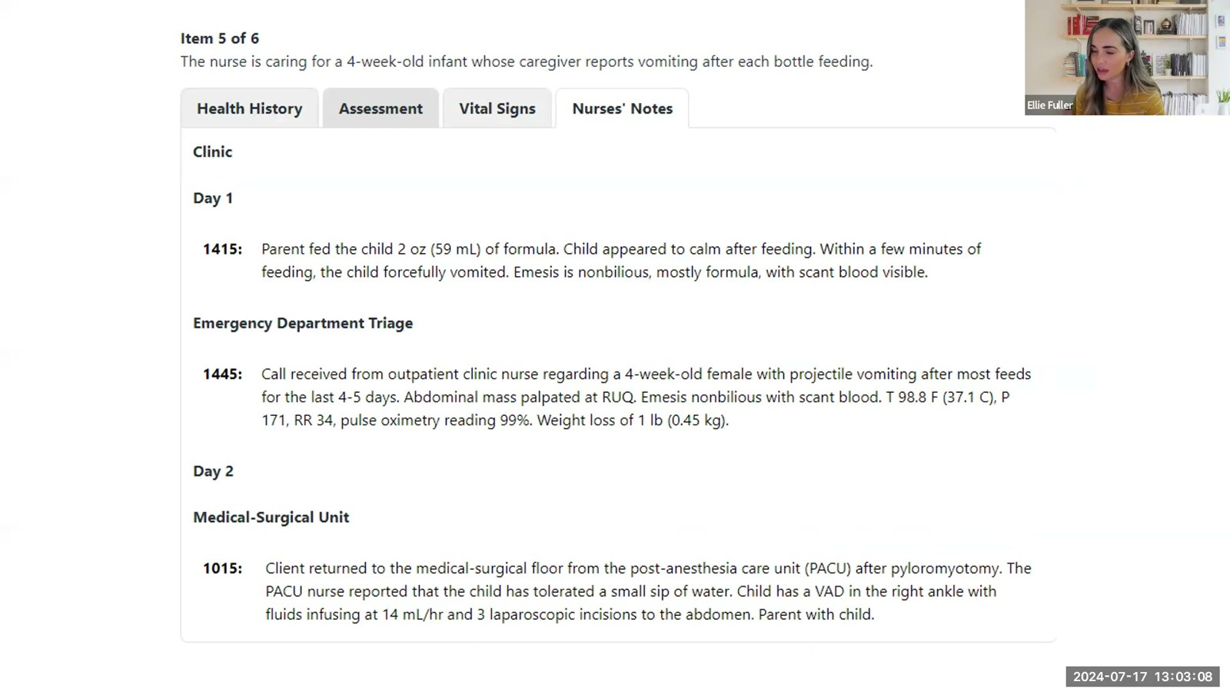
Notes:
Fuller · Week 12 · Gastrointestinal
Recording time 77:48
https://drive.google.com/file/d/1kqvvmD470PE4FpYVJuWQyjF_jkmS0qIa/view

Slide 51
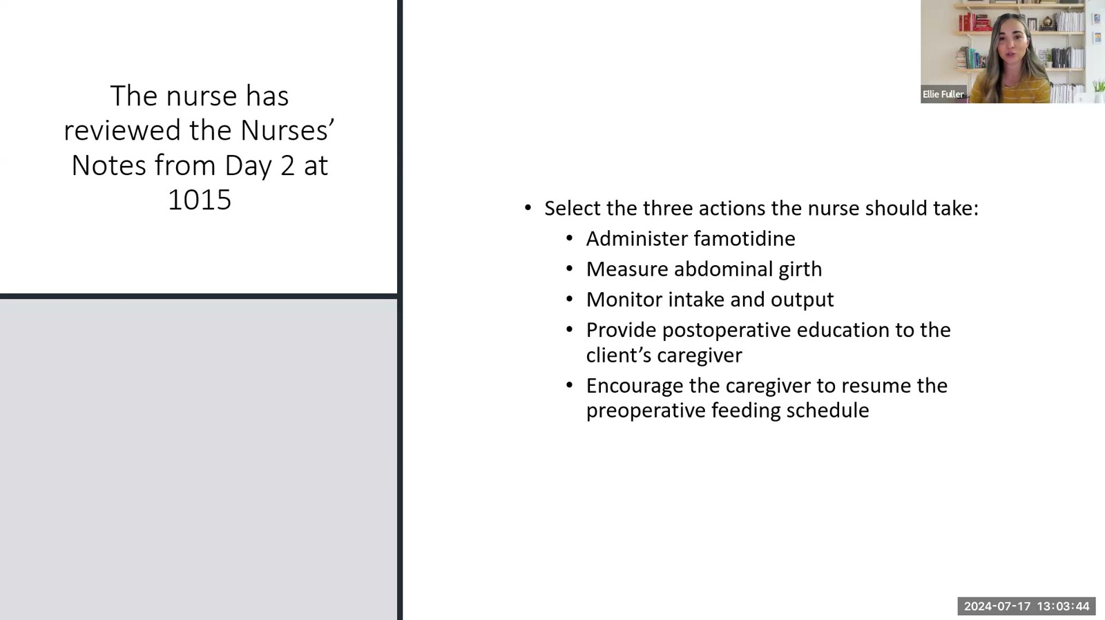
Notes:
Fuller · Week 12 · Gastrointestinal
Recording time 78:24
https://drive.google.com/file/d/1kqvvmD470PE4FpYVJuWQyjF_jkmS0qIa/view

Slide 52
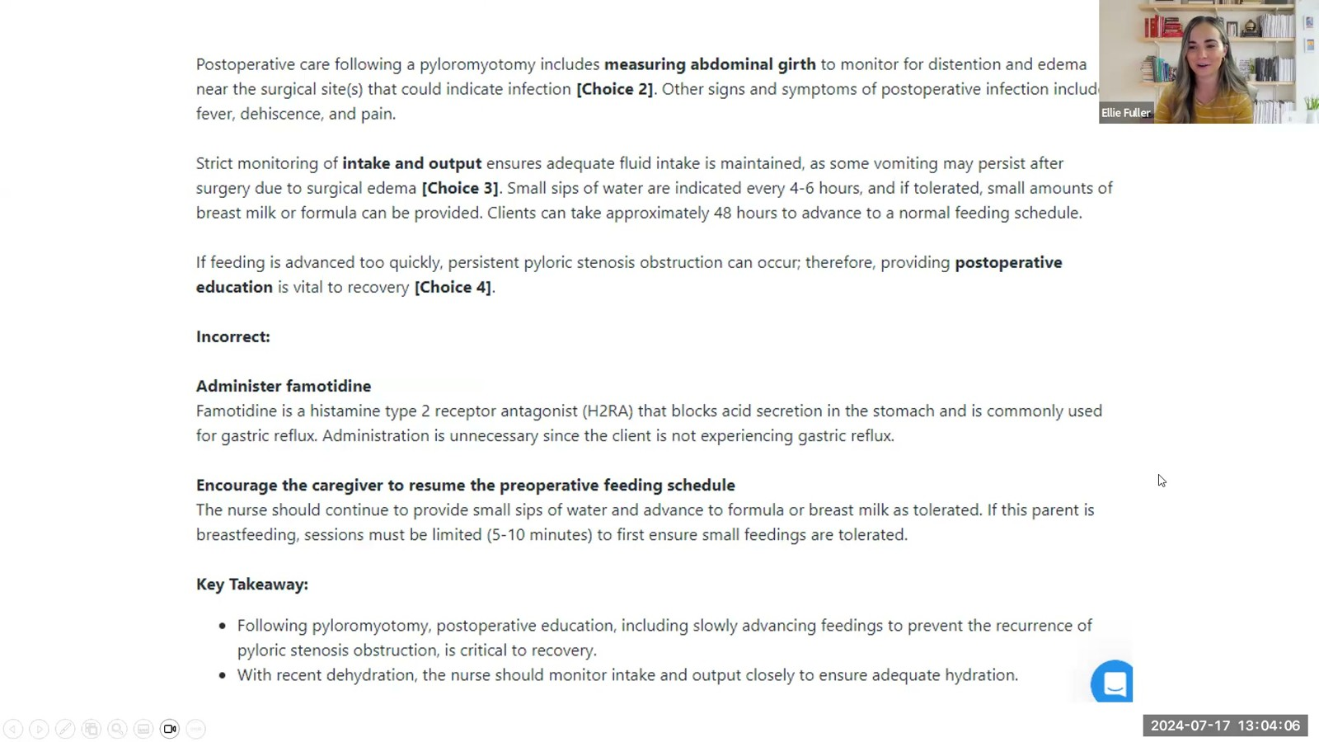
Notes:
Fuller · Week 12 · Gastrointestinal
Recording time 78:46
https://drive.google.com/file/d/1kqvvmD470PE4FpYVJuWQyjF_jkmS0qIa/view

Slide 53
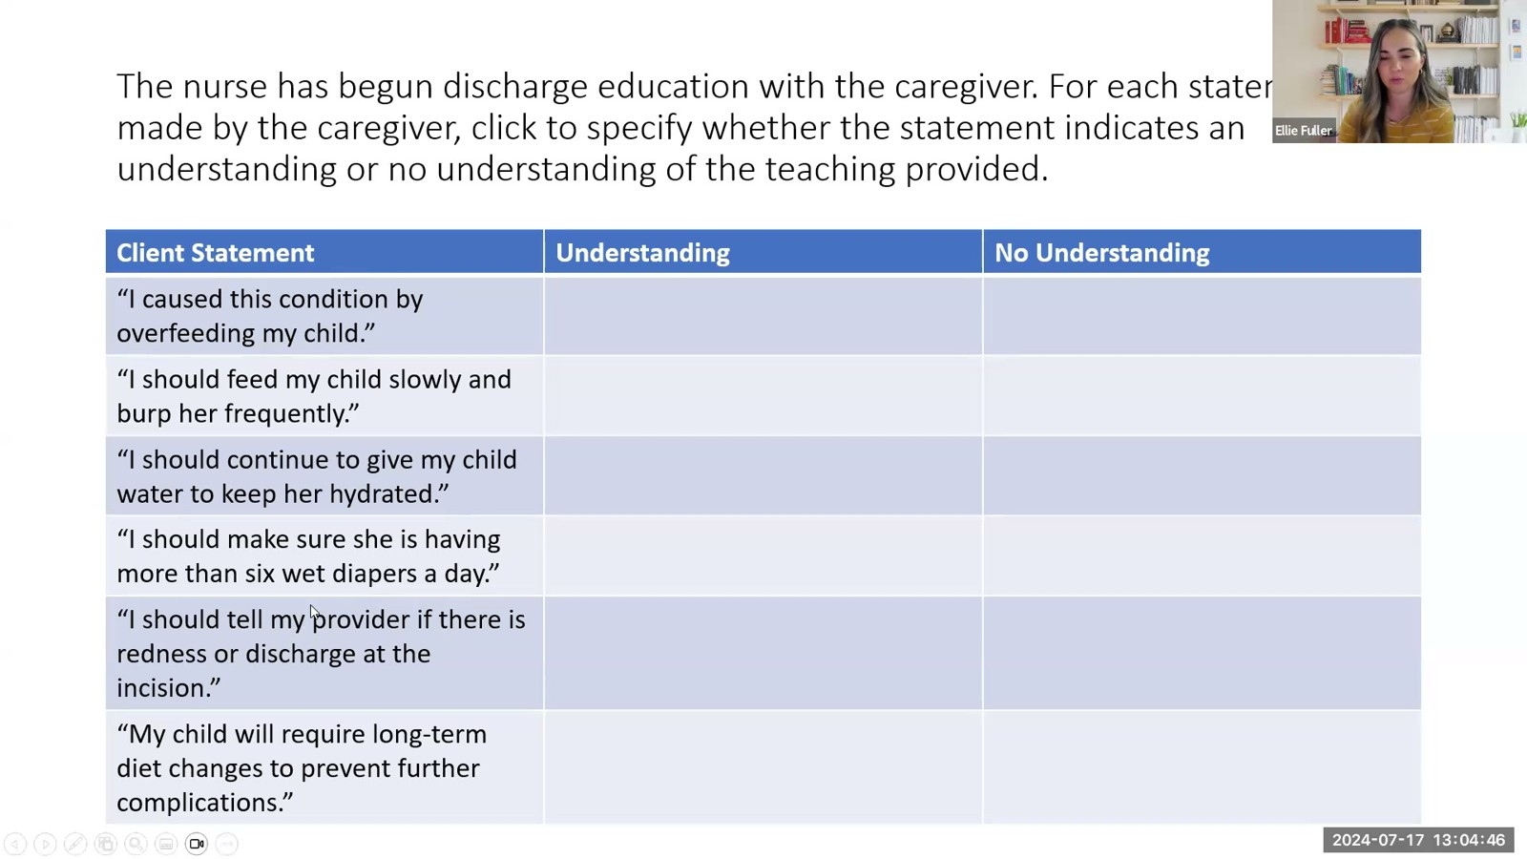
Notes:
Fuller · Week 12 · Gastrointestinal
Recording time 79:26
https://drive.google.com/file/d/1kqvvmD470PE4FpYVJuWQyjF_jkmS0qIa/view

Slide 54

Notes:
Fuller · Week 12 · Gastrointestinal
Recording time 79:54
https://drive.google.com/file/d/1kqvvmD470PE4FpYVJuWQyjF_jkmS0qIa/view

Slide 55

Notes:
Fuller · Week 12 · Gastrointestinal
Recording time 80:11
https://drive.google.com/file/d/1kqvvmD470PE4FpYVJuWQyjF_jkmS0qIa/view

