Slide 1

NUR 235 / WEEK 13 / FULLER
Renal & Genitourinary
Urine output calculations, nephrotic syndrome and glomerulonephritis
Study copy made from slides shown in the recorded lecture
Notes:
Source recording: https://drive.google.com/file/d/1-BkPOxpFIbj2aeyDnLvIS87yyEX4_wsw/view
University logo: https://www.joyce.edu/
Prepared for independent study. Original course slides are linked separately in the Study Hub.

Slide 2

Notes:
Fuller · Week 13 · Renal & Genitourinary
Recording time 0:22
https://drive.google.com/file/d/1-BkPOxpFIbj2aeyDnLvIS87yyEX4_wsw/view

Slide 3
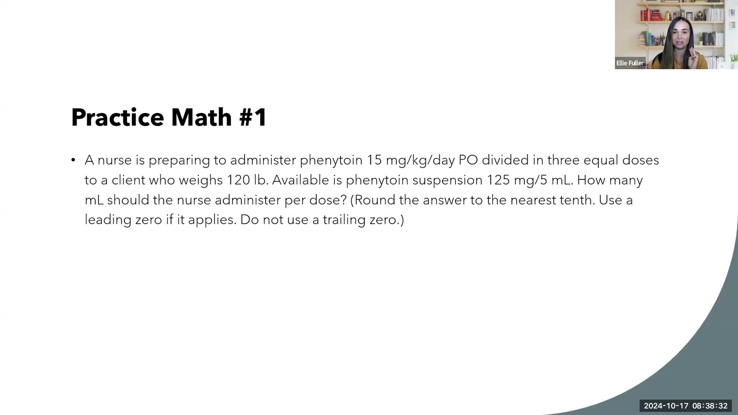
Notes:
Fuller · Week 13 · Renal & Genitourinary
Recording time 2:27
https://drive.google.com/file/d/1-BkPOxpFIbj2aeyDnLvIS87yyEX4_wsw/view

Slide 4
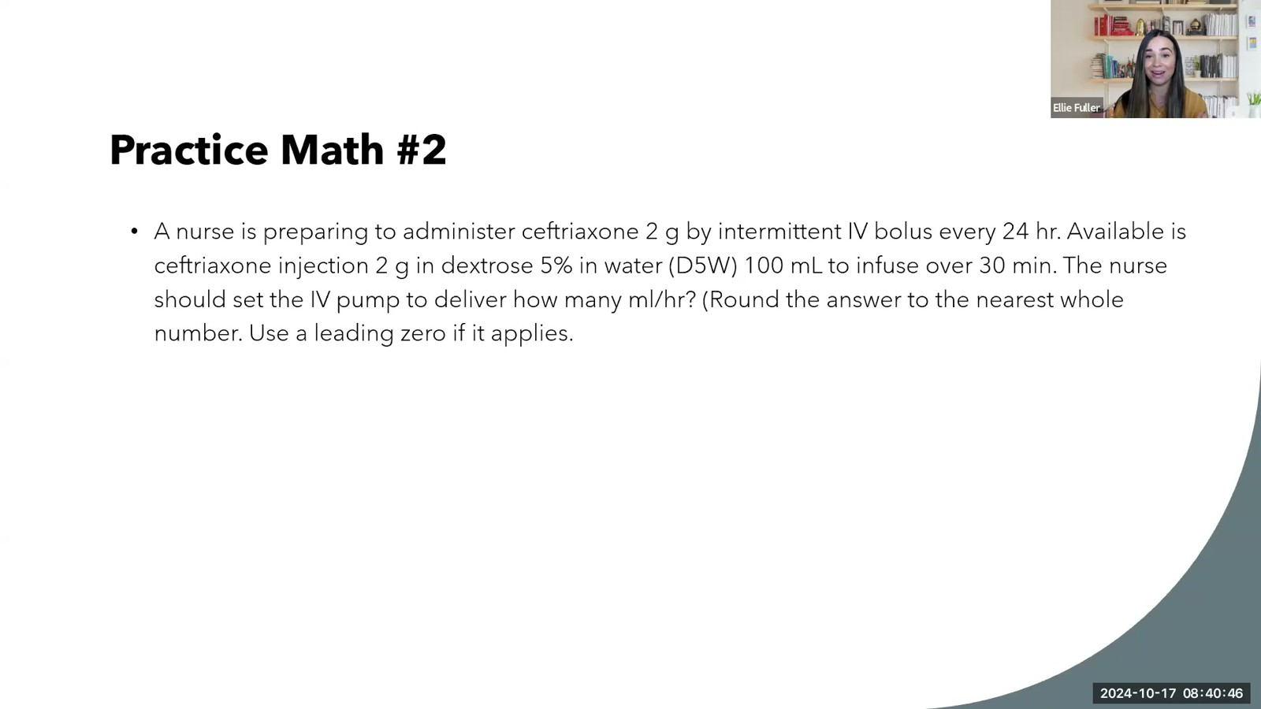
Notes:
Fuller · Week 13 · Renal & Genitourinary
Recording time 4:41
https://drive.google.com/file/d/1-BkPOxpFIbj2aeyDnLvIS87yyEX4_wsw/view

Slide 5
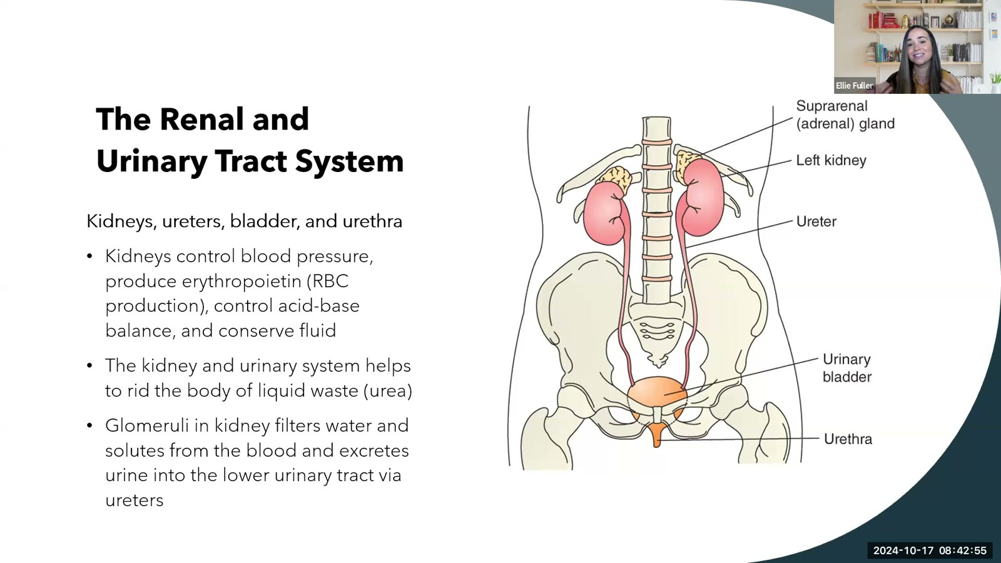
Notes:
Fuller · Week 13 · Renal & Genitourinary
Recording time 6:50
https://drive.google.com/file/d/1-BkPOxpFIbj2aeyDnLvIS87yyEX4_wsw/view

Slide 6
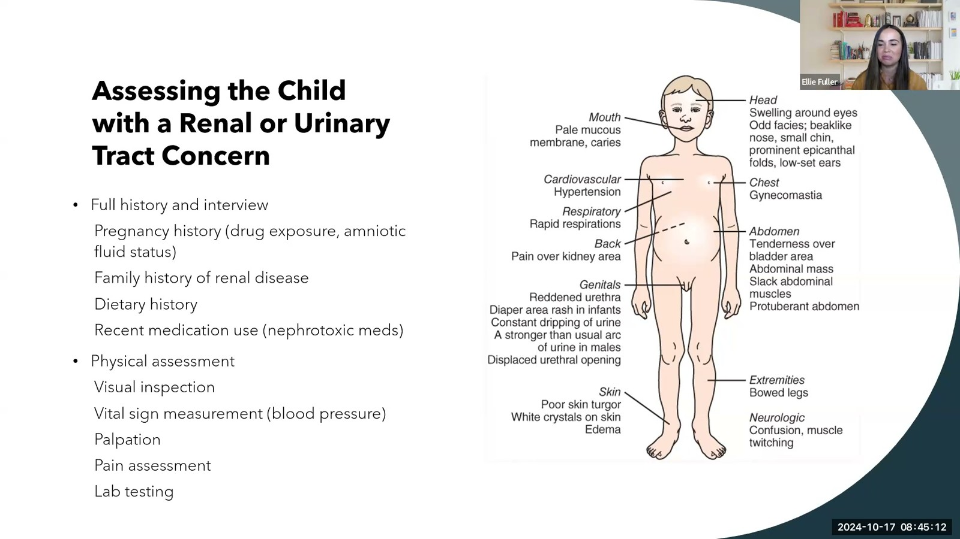
Notes:
Fuller · Week 13 · Renal & Genitourinary
Recording time 9:07
https://drive.google.com/file/d/1-BkPOxpFIbj2aeyDnLvIS87yyEX4_wsw/view

Slide 7
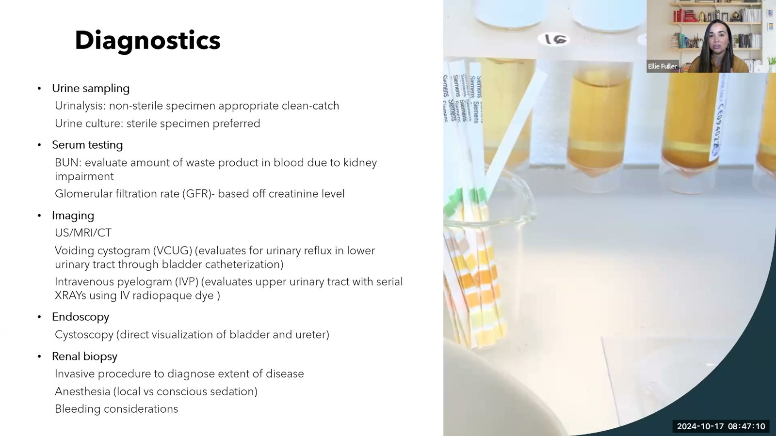
Notes:
Fuller · Week 13 · Renal & Genitourinary
Recording time 11:05
https://drive.google.com/file/d/1-BkPOxpFIbj2aeyDnLvIS87yyEX4_wsw/view

Slide 8
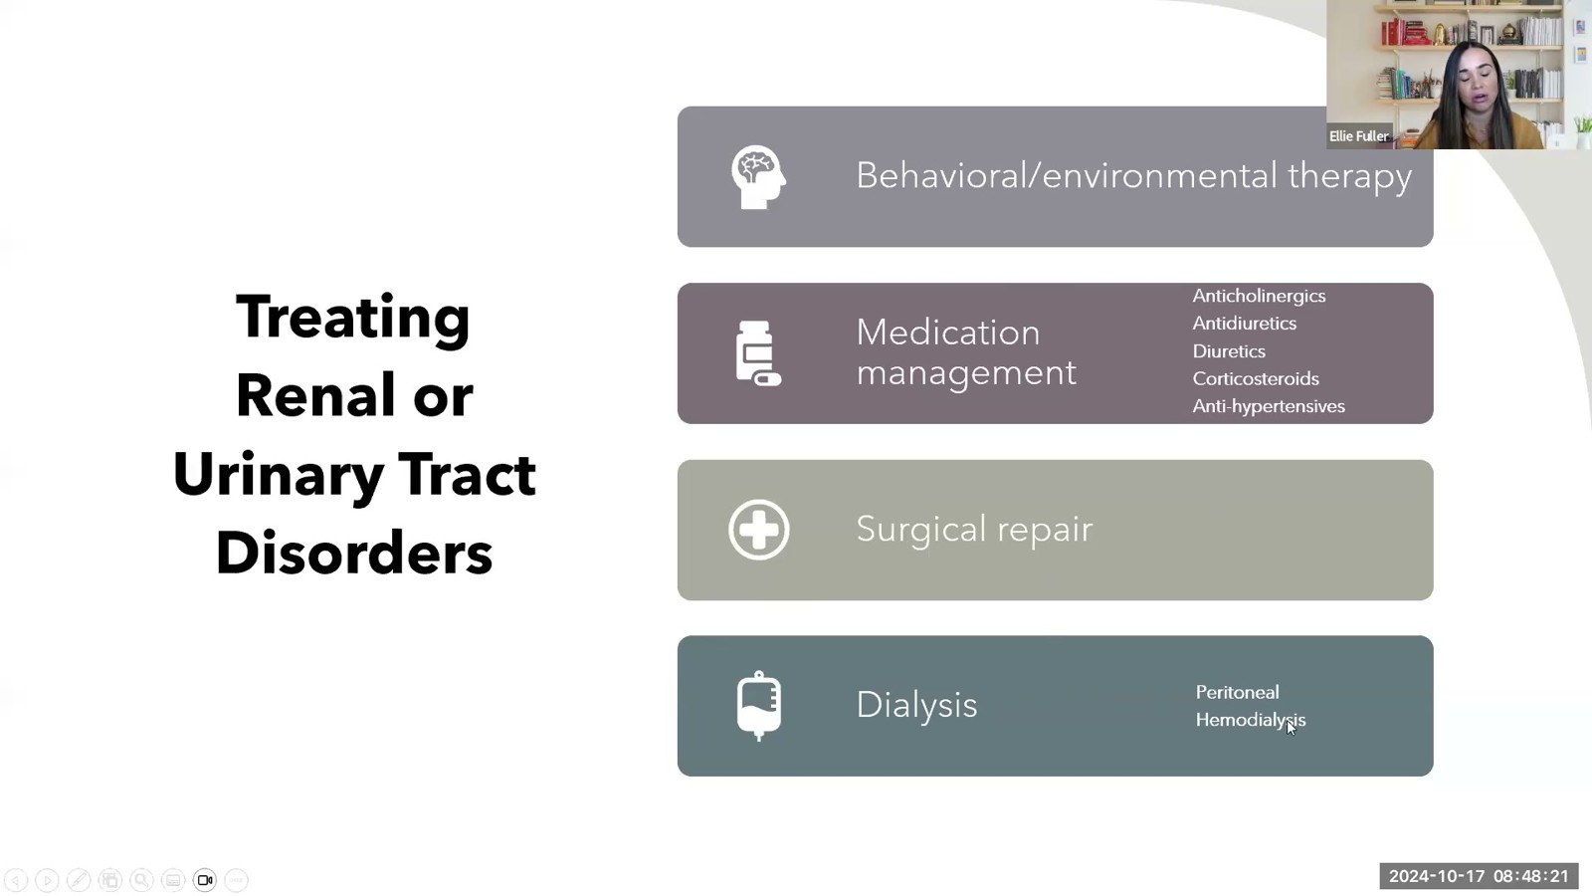
Notes:
Fuller · Week 13 · Renal & Genitourinary
Recording time 12:16
https://drive.google.com/file/d/1-BkPOxpFIbj2aeyDnLvIS87yyEX4_wsw/view

Slide 9

Notes:
Fuller · Week 13 · Renal & Genitourinary
Recording time 13:07
https://drive.google.com/file/d/1-BkPOxpFIbj2aeyDnLvIS87yyEX4_wsw/view

Slide 10

Notes:
Fuller · Week 13 · Renal & Genitourinary
Recording time 13:38
https://drive.google.com/file/d/1-BkPOxpFIbj2aeyDnLvIS87yyEX4_wsw/view

Slide 11
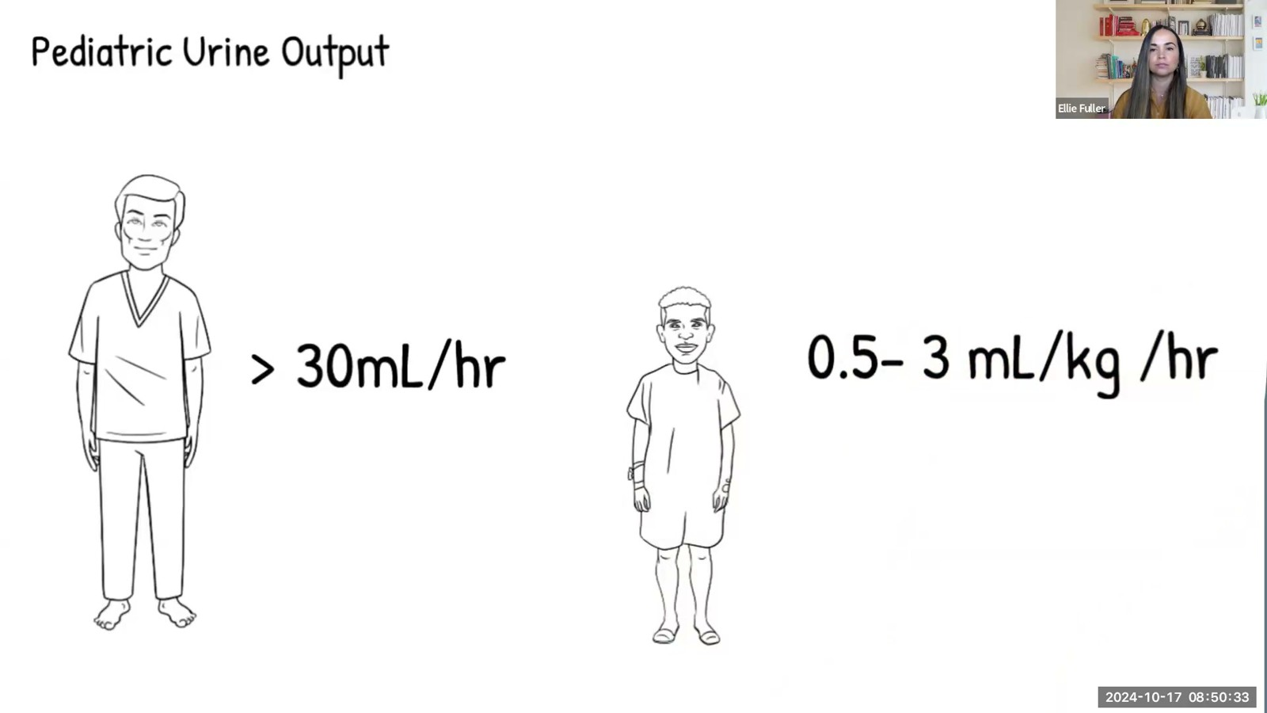
Notes:
Fuller · Week 13 · Renal & Genitourinary
Recording time 14:28
https://drive.google.com/file/d/1-BkPOxpFIbj2aeyDnLvIS87yyEX4_wsw/view

Slide 12
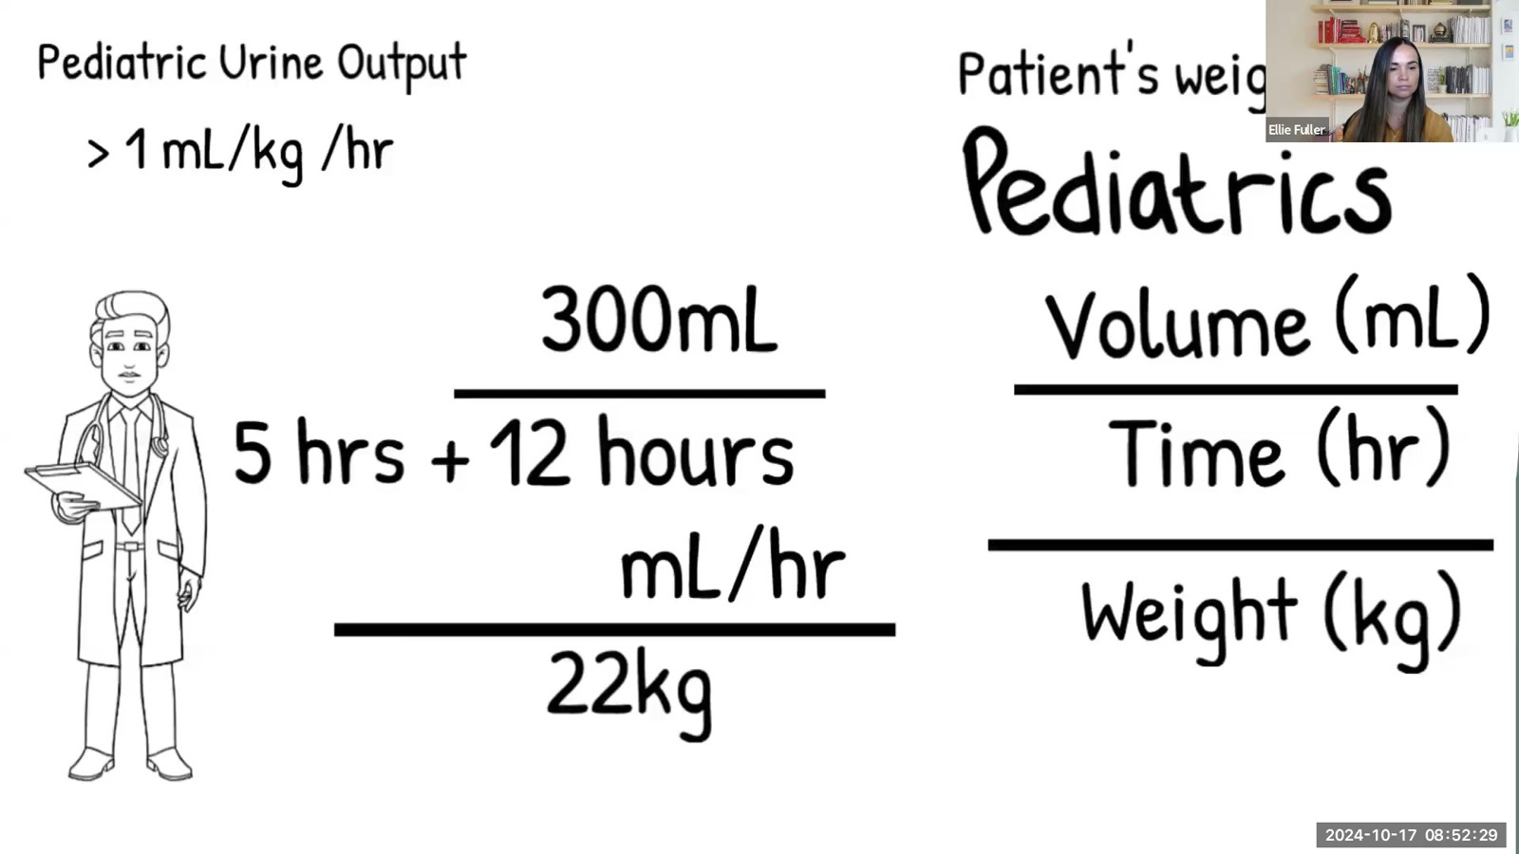
Notes:
Fuller · Week 13 · Renal & Genitourinary
Recording time 16:24
https://drive.google.com/file/d/1-BkPOxpFIbj2aeyDnLvIS87yyEX4_wsw/view

Slide 13
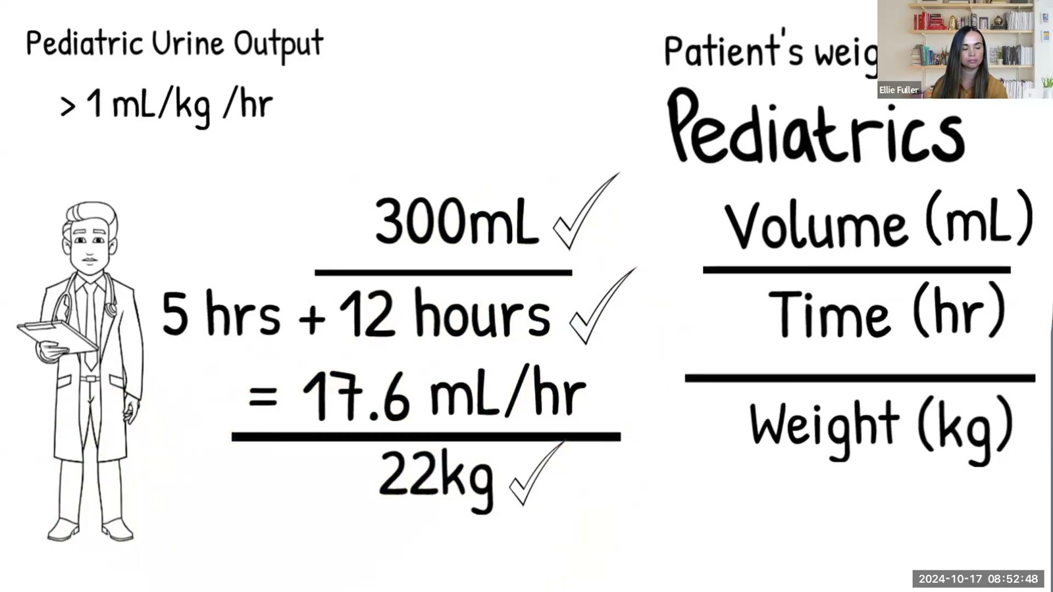
Notes:
Fuller · Week 13 · Renal & Genitourinary
Recording time 16:43
https://drive.google.com/file/d/1-BkPOxpFIbj2aeyDnLvIS87yyEX4_wsw/view

Slide 14
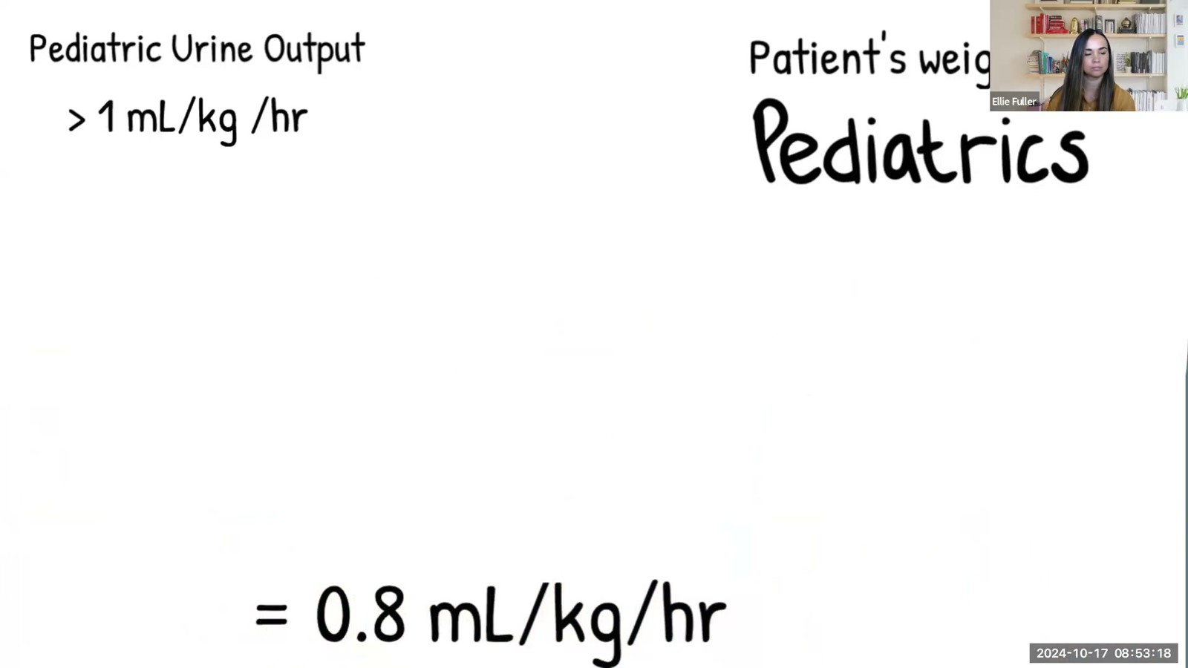
Notes:
Fuller · Week 13 · Renal & Genitourinary
Recording time 17:13
https://drive.google.com/file/d/1-BkPOxpFIbj2aeyDnLvIS87yyEX4_wsw/view

Slide 15
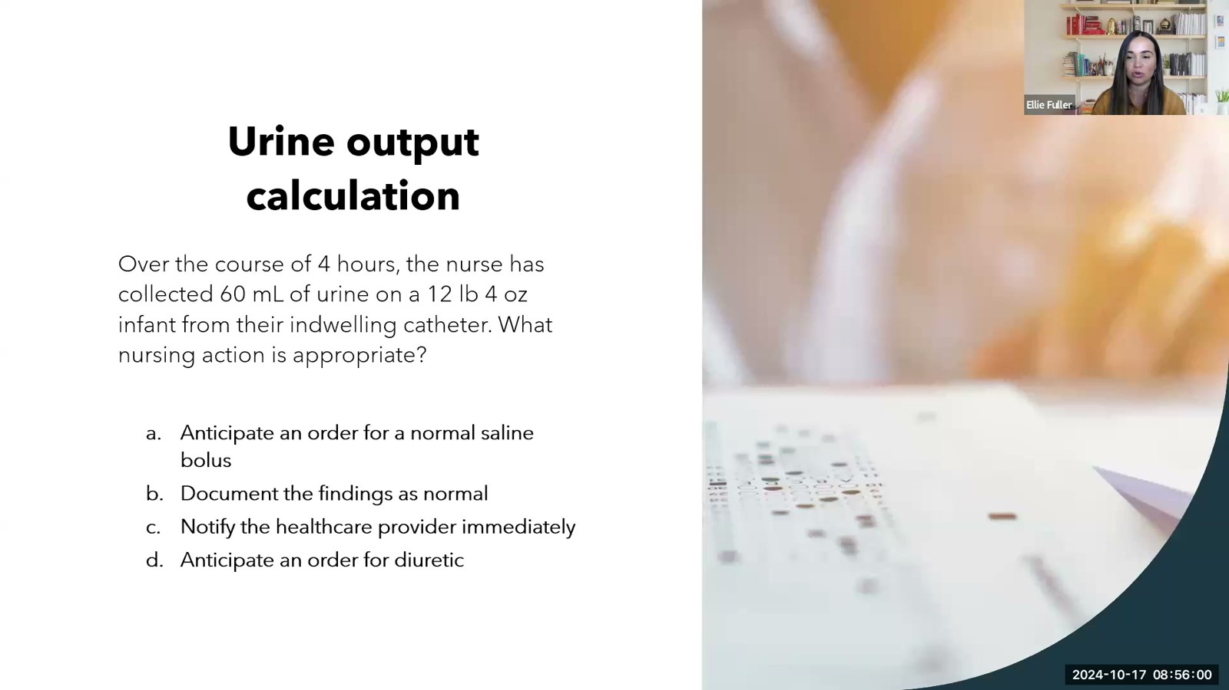
Notes:
Fuller · Week 13 · Renal & Genitourinary
Recording time 19:55
https://drive.google.com/file/d/1-BkPOxpFIbj2aeyDnLvIS87yyEX4_wsw/view

Slide 16
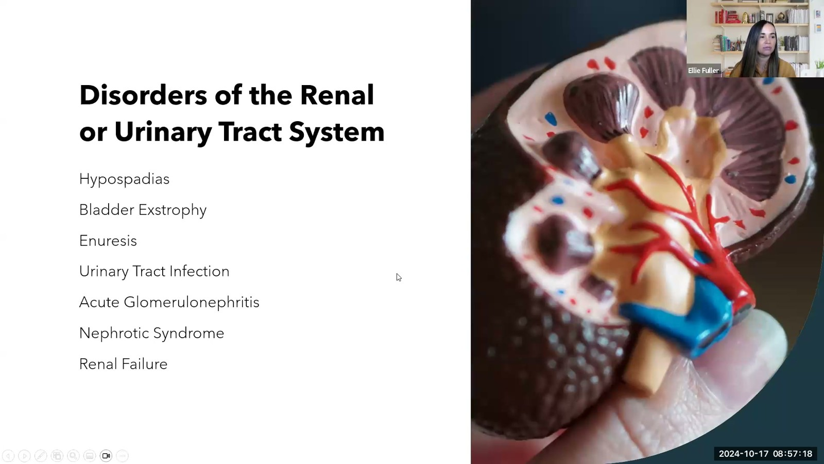
Notes:
Fuller · Week 13 · Renal & Genitourinary
Recording time 21:13
https://drive.google.com/file/d/1-BkPOxpFIbj2aeyDnLvIS87yyEX4_wsw/view

Slide 17
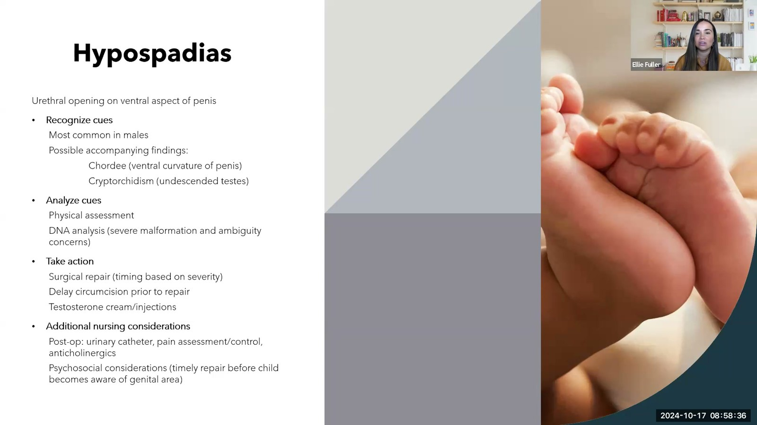
Notes:
Fuller · Week 13 · Renal & Genitourinary
Recording time 22:31
https://drive.google.com/file/d/1-BkPOxpFIbj2aeyDnLvIS87yyEX4_wsw/view

Slide 18
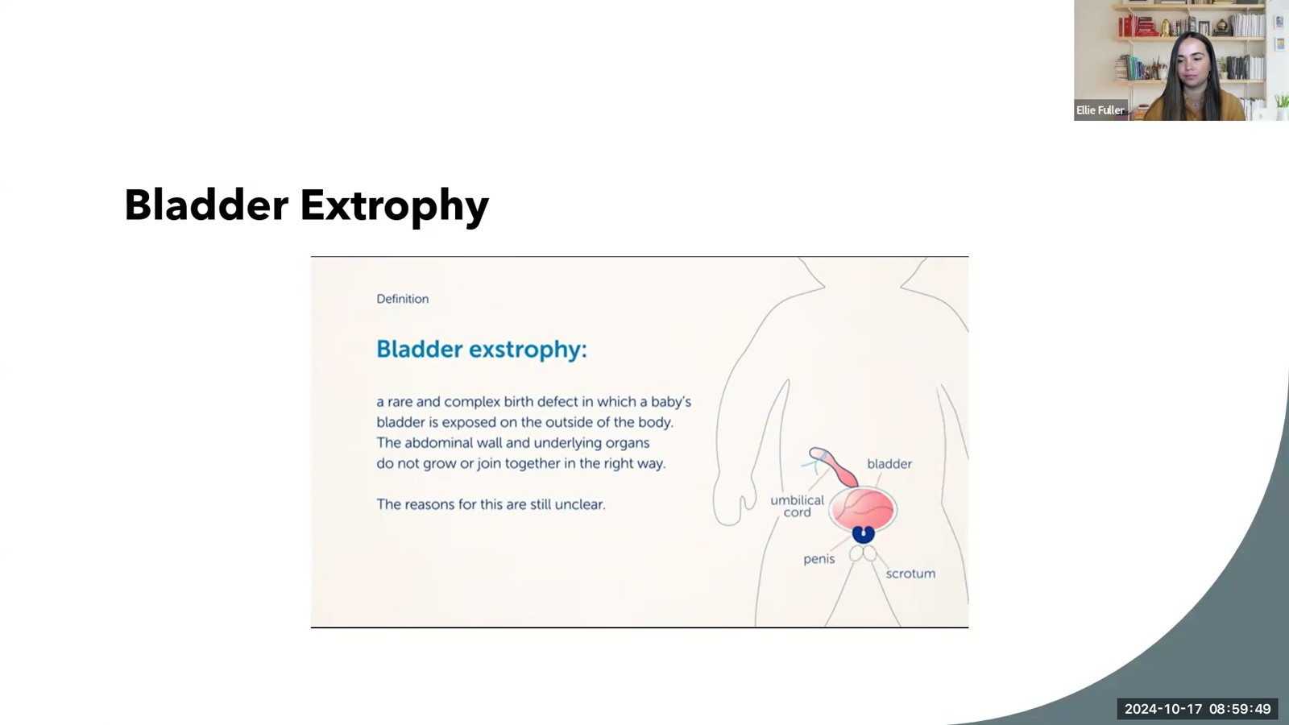
Notes:
Fuller · Week 13 · Renal & Genitourinary
Recording time 23:44
https://drive.google.com/file/d/1-BkPOxpFIbj2aeyDnLvIS87yyEX4_wsw/view

Slide 19
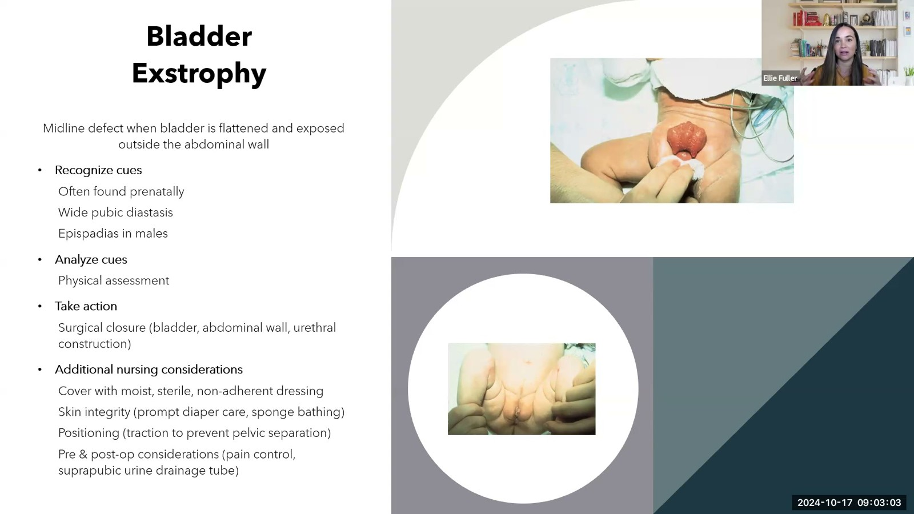
Notes:
Fuller · Week 13 · Renal & Genitourinary
Recording time 26:58
https://drive.google.com/file/d/1-BkPOxpFIbj2aeyDnLvIS87yyEX4_wsw/view

Slide 20
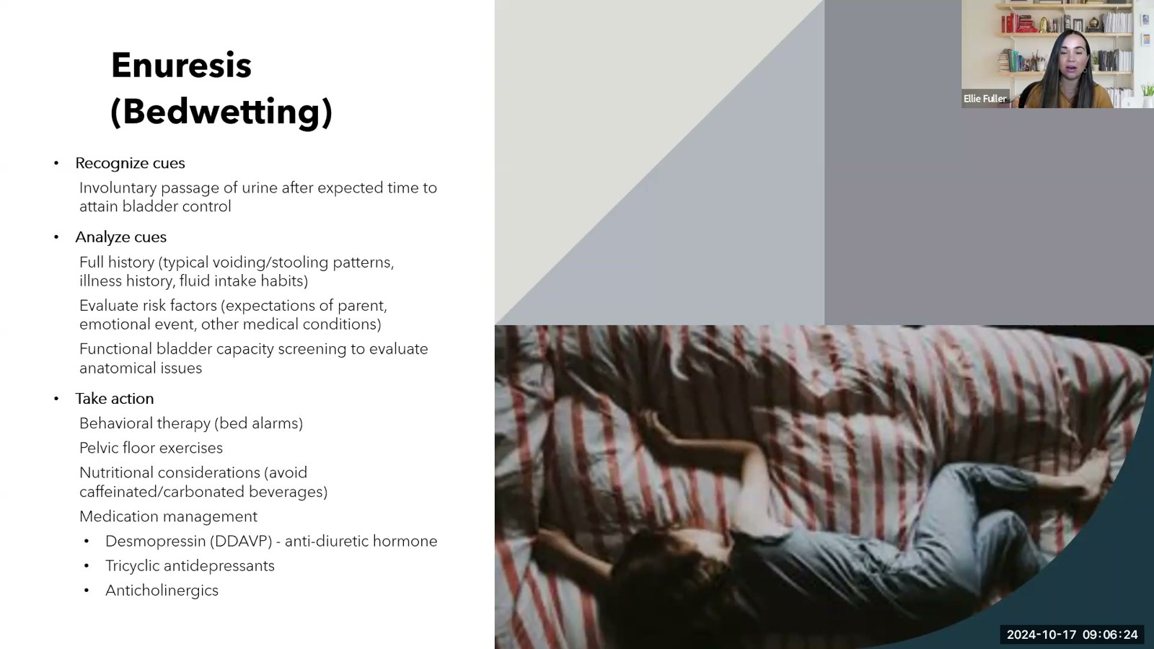
Notes:
Fuller · Week 13 · Renal & Genitourinary
Recording time 30:19
https://drive.google.com/file/d/1-BkPOxpFIbj2aeyDnLvIS87yyEX4_wsw/view

Slide 21
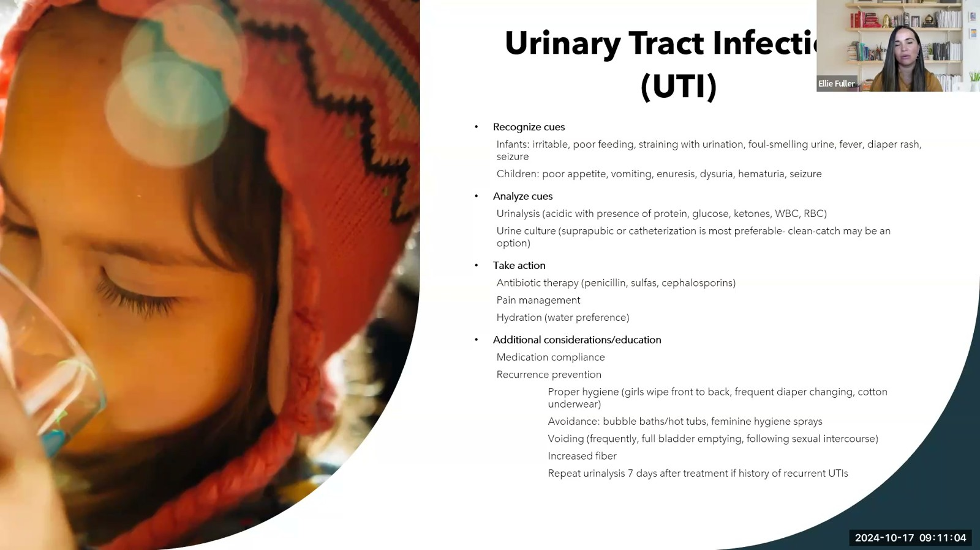
Notes:
Fuller · Week 13 · Renal & Genitourinary
Recording time 34:59
https://drive.google.com/file/d/1-BkPOxpFIbj2aeyDnLvIS87yyEX4_wsw/view

Slide 22
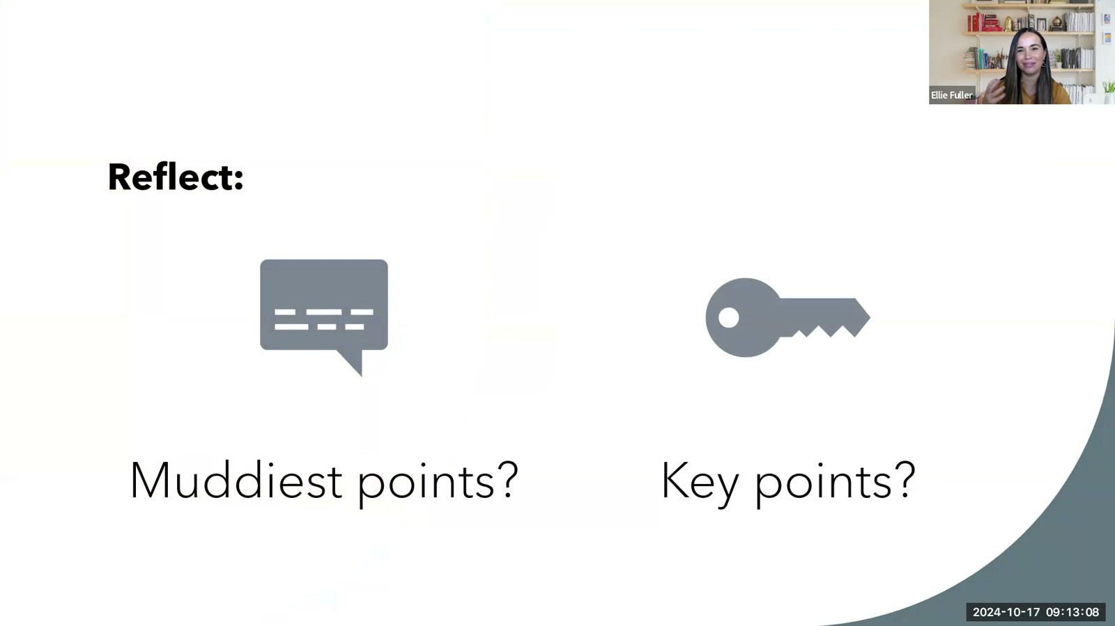
Notes:
Fuller · Week 13 · Renal & Genitourinary
Recording time 37:03
https://drive.google.com/file/d/1-BkPOxpFIbj2aeyDnLvIS87yyEX4_wsw/view

Slide 23
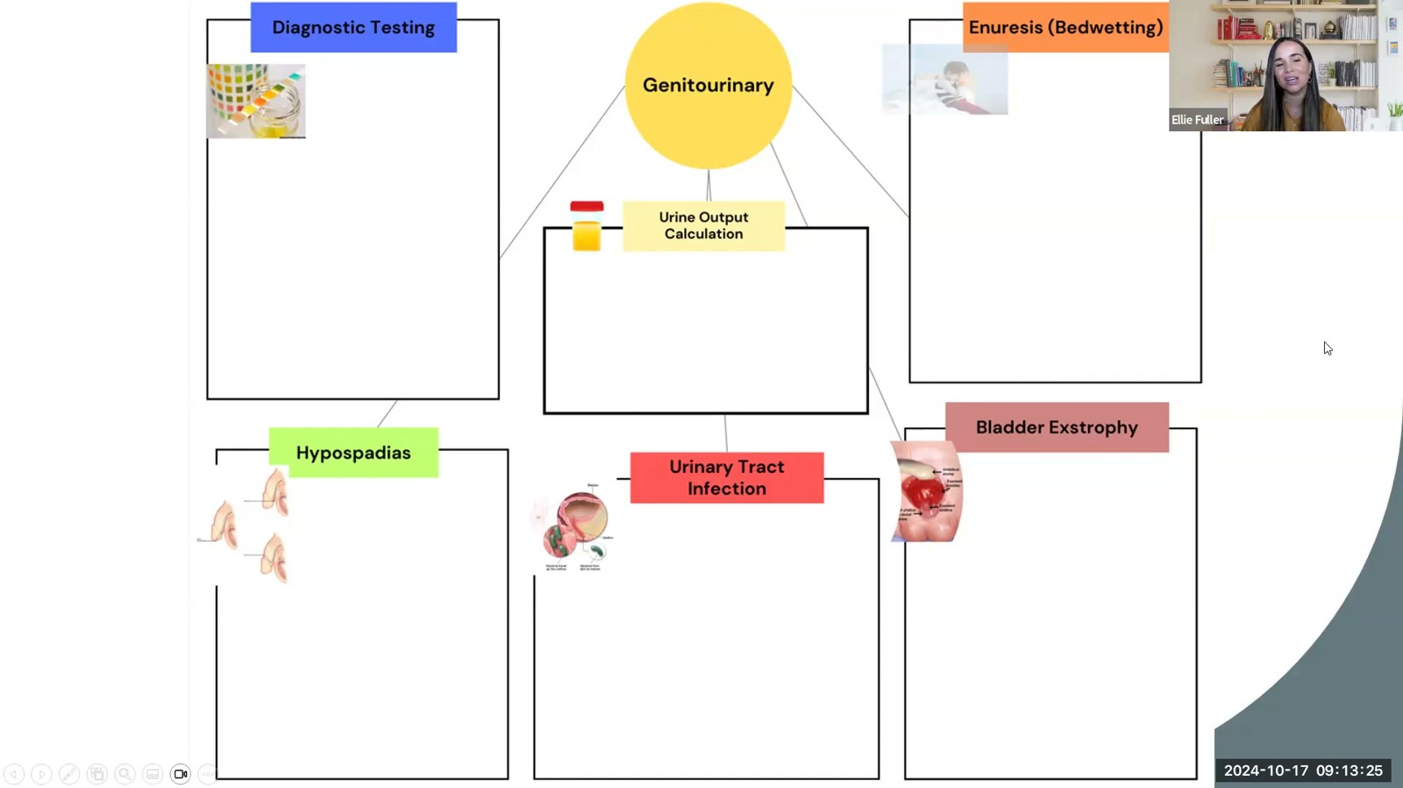
Notes:
Fuller · Week 13 · Renal & Genitourinary
Recording time 37:20
https://drive.google.com/file/d/1-BkPOxpFIbj2aeyDnLvIS87yyEX4_wsw/view

Slide 24
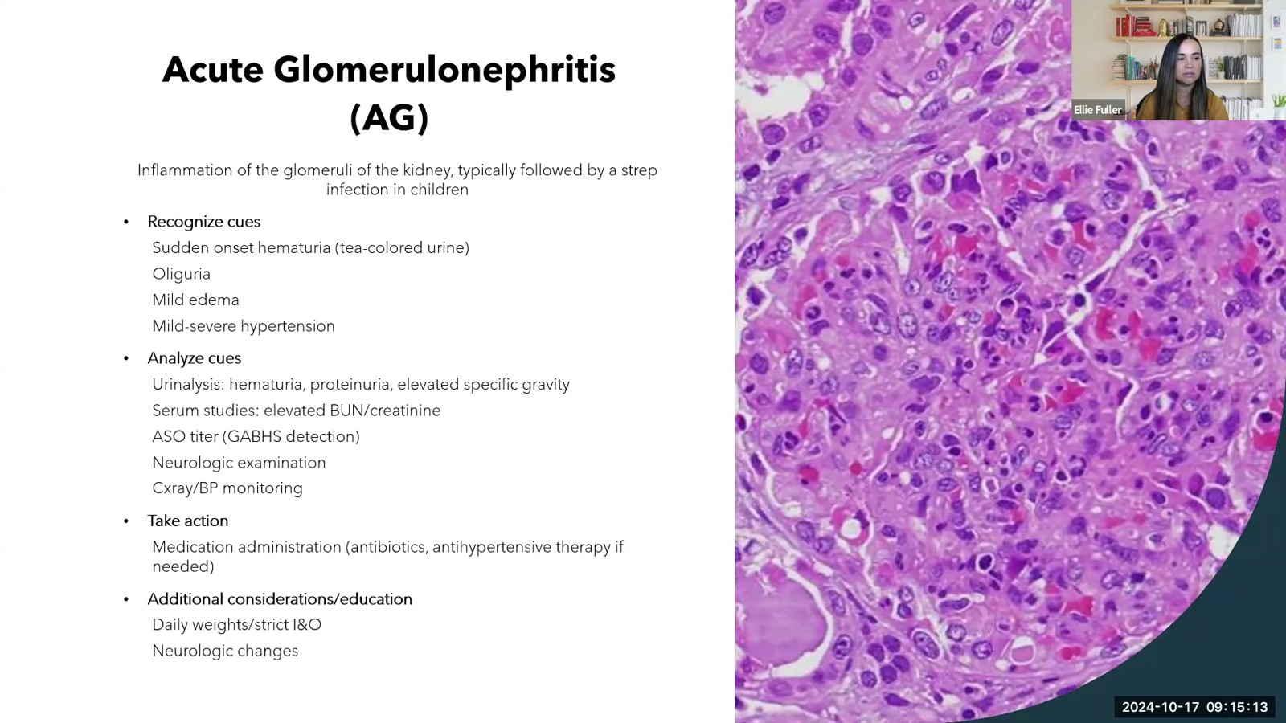
Notes:
Fuller · Week 13 · Renal & Genitourinary
Recording time 39:08
https://drive.google.com/file/d/1-BkPOxpFIbj2aeyDnLvIS87yyEX4_wsw/view

Slide 25
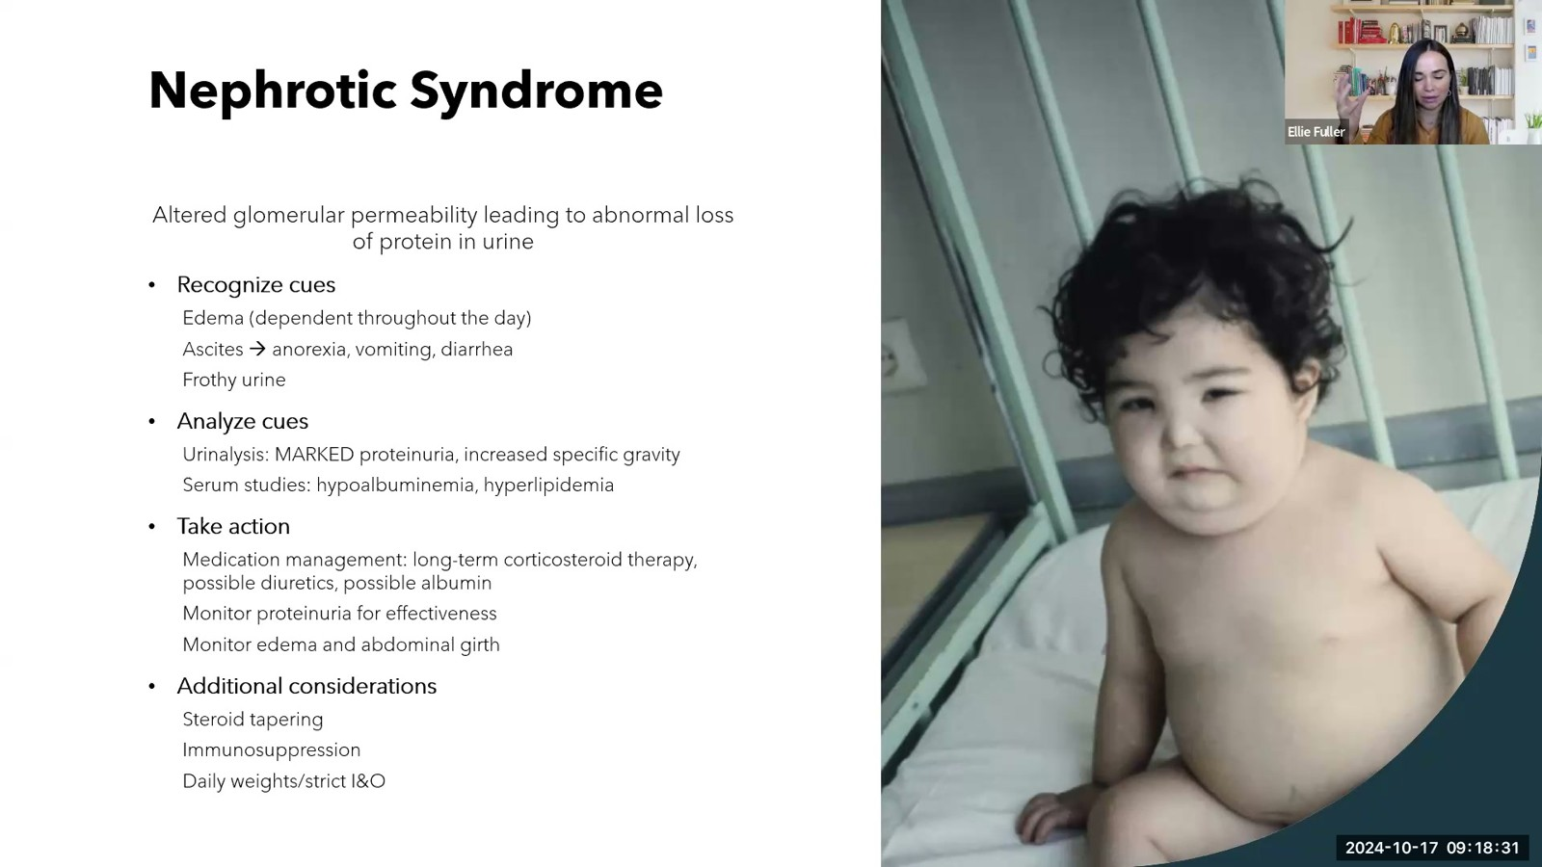
Notes:
Fuller · Week 13 · Renal & Genitourinary
Recording time 42:26
https://drive.google.com/file/d/1-BkPOxpFIbj2aeyDnLvIS87yyEX4_wsw/view

Slide 26
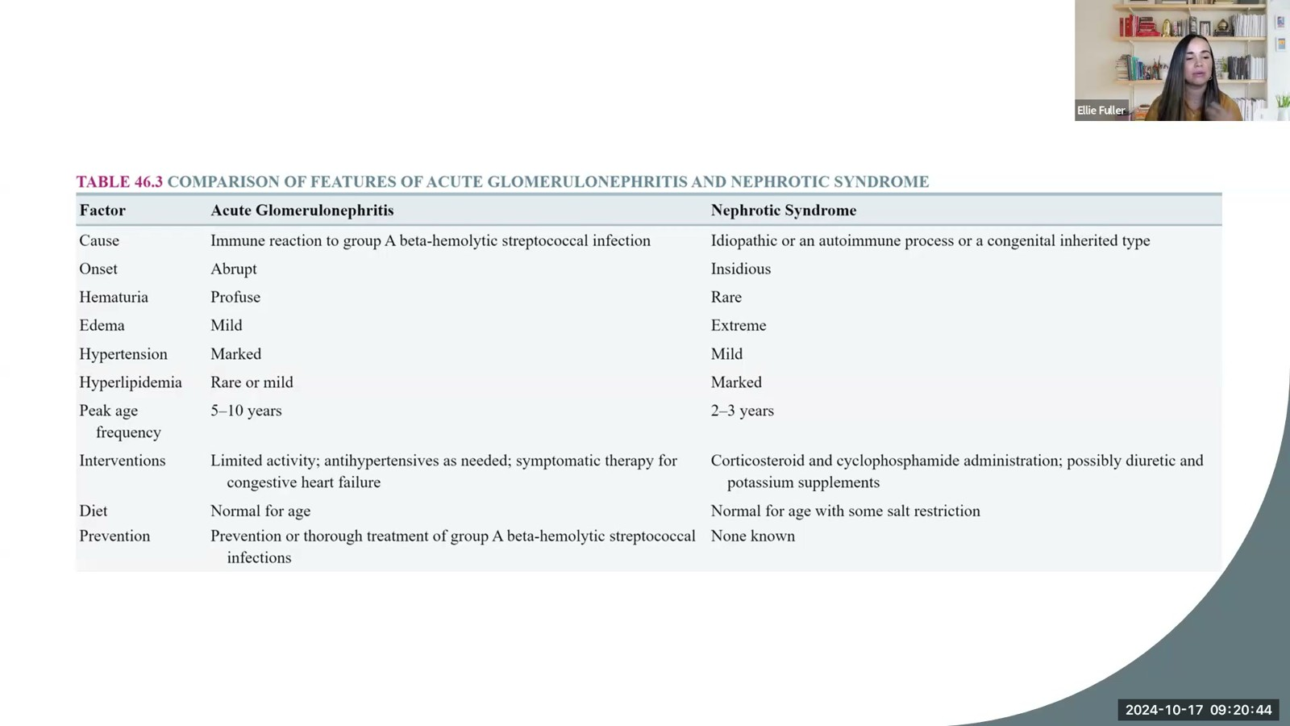
Notes:
Fuller · Week 13 · Renal & Genitourinary
Recording time 44:39
https://drive.google.com/file/d/1-BkPOxpFIbj2aeyDnLvIS87yyEX4_wsw/view

Slide 27
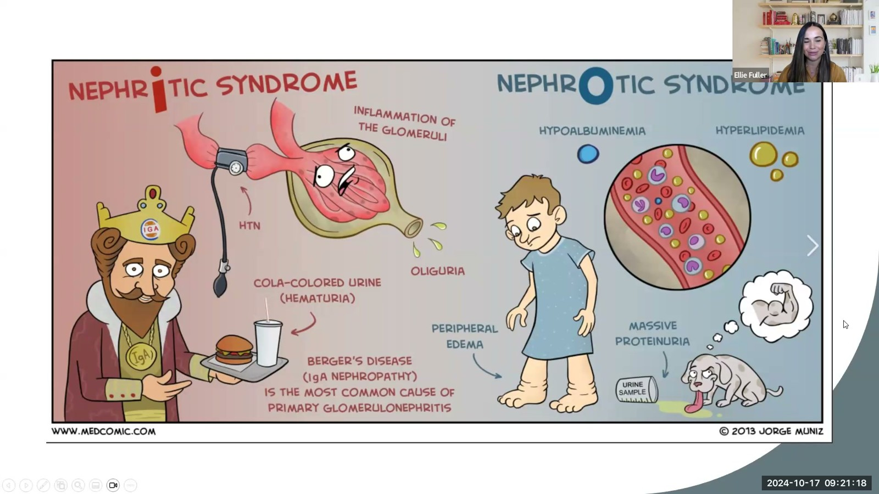
Notes:
Fuller · Week 13 · Renal & Genitourinary
Recording time 45:13
https://drive.google.com/file/d/1-BkPOxpFIbj2aeyDnLvIS87yyEX4_wsw/view

Slide 28
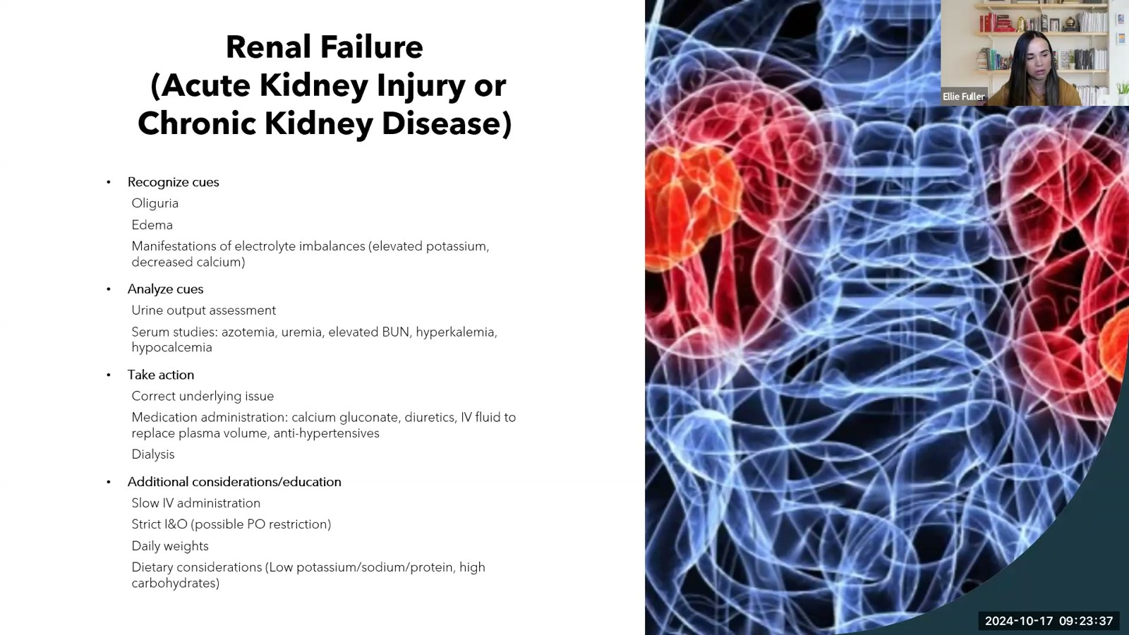
Notes:
Fuller · Week 13 · Renal & Genitourinary
Recording time 47:32
https://drive.google.com/file/d/1-BkPOxpFIbj2aeyDnLvIS87yyEX4_wsw/view

Slide 29
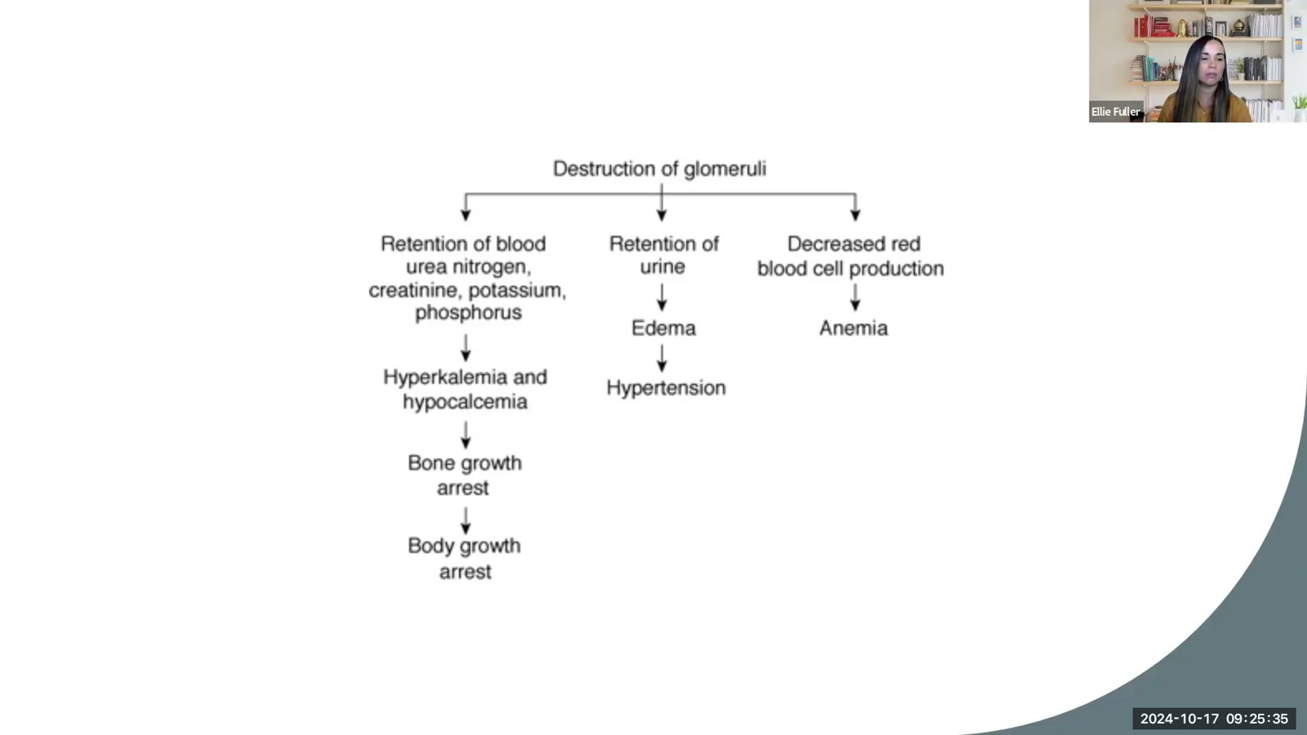
Notes:
Fuller · Week 13 · Renal & Genitourinary
Recording time 49:30
https://drive.google.com/file/d/1-BkPOxpFIbj2aeyDnLvIS87yyEX4_wsw/view

Slide 30
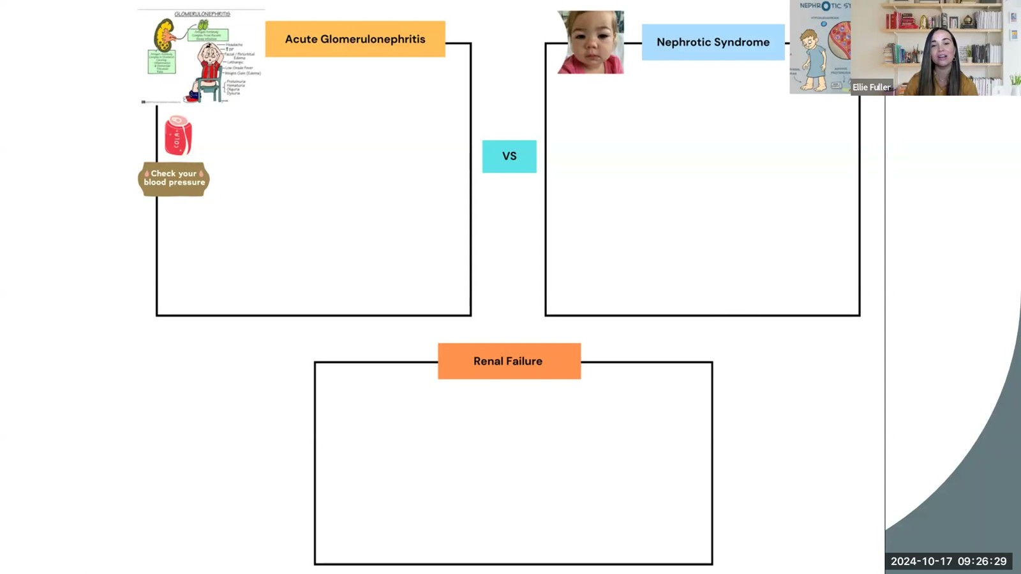
Notes:
Fuller · Week 13 · Renal & Genitourinary
Recording time 50:24
https://drive.google.com/file/d/1-BkPOxpFIbj2aeyDnLvIS87yyEX4_wsw/view

