Slide 1

NUR 235 / WEEK 14 / FULLER
Comprehensive Final Review
Growth and development, vital signs and body-system concept maps
Study copy made from slides shown in the recorded lecture
Notes:
Source recording: https://drive.google.com/file/d/1pvRIoJTyknef4TVk57Ajdng5oGCH5EHt/view
University logo: https://www.joyce.edu/
Prepared for independent study. Original course slides are linked separately in the Study Hub.

Slide 2
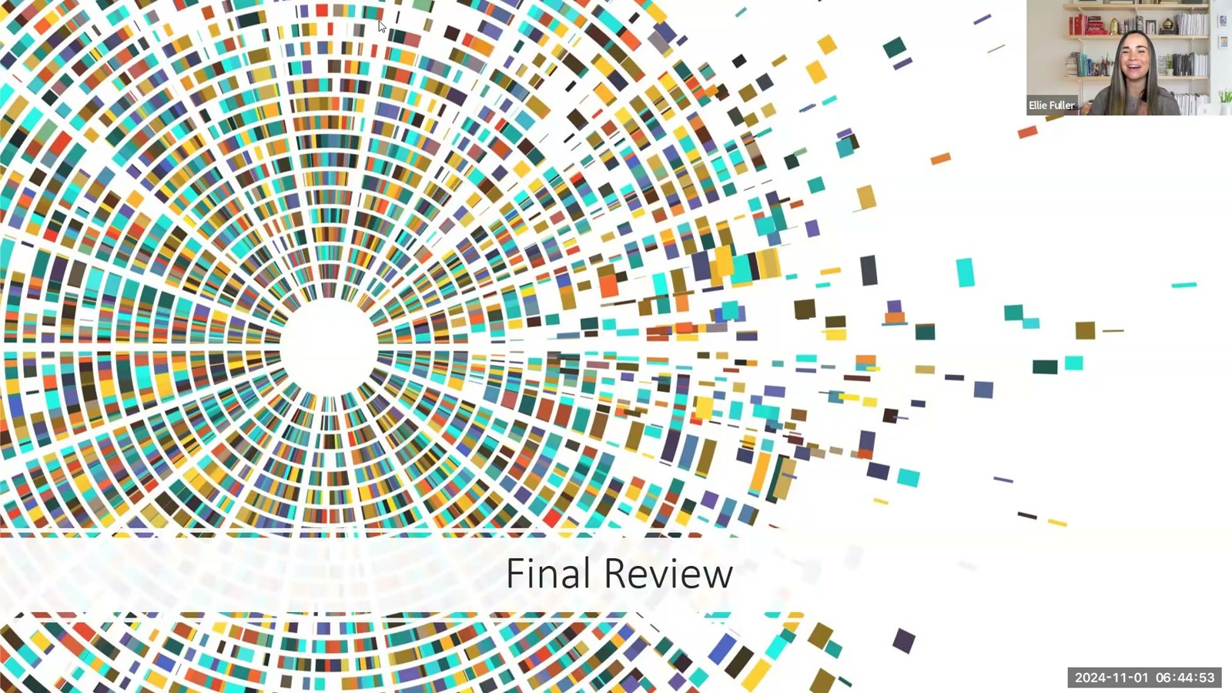
Notes:
Fuller · Week 14 · Comprehensive Final Review
Recording time 0:26
https://drive.google.com/file/d/1pvRIoJTyknef4TVk57Ajdng5oGCH5EHt/view

Slide 3
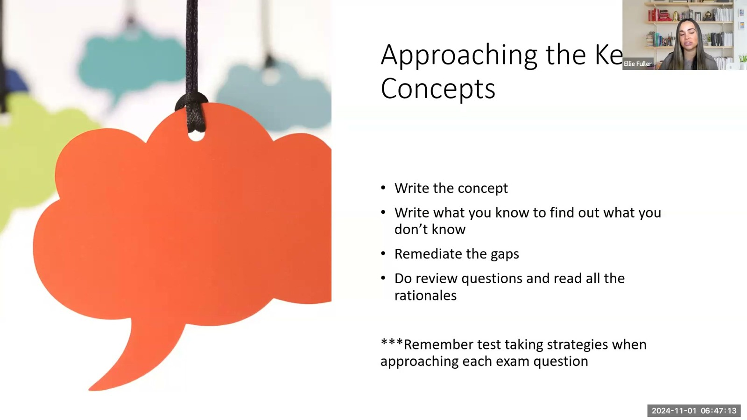
Notes:
Fuller · Week 14 · Comprehensive Final Review
Recording time 2:46
https://drive.google.com/file/d/1pvRIoJTyknef4TVk57Ajdng5oGCH5EHt/view

Slide 4
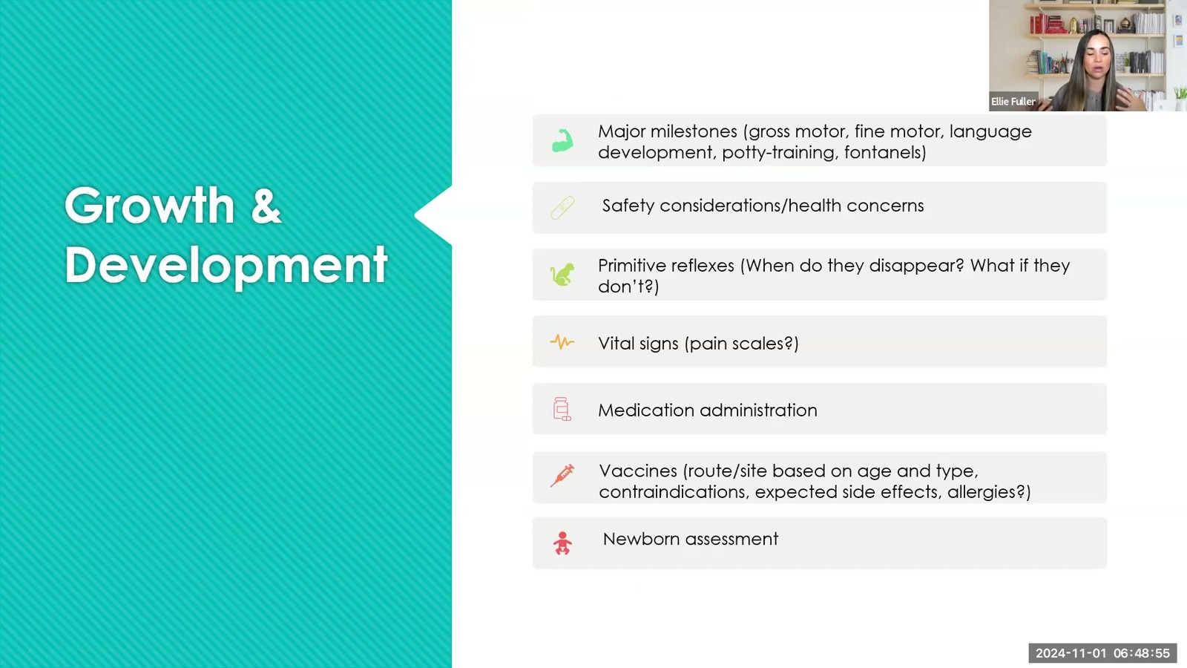
Notes:
Fuller · Week 14 · Comprehensive Final Review
Recording time 4:28
https://drive.google.com/file/d/1pvRIoJTyknef4TVk57Ajdng5oGCH5EHt/view

Slide 5
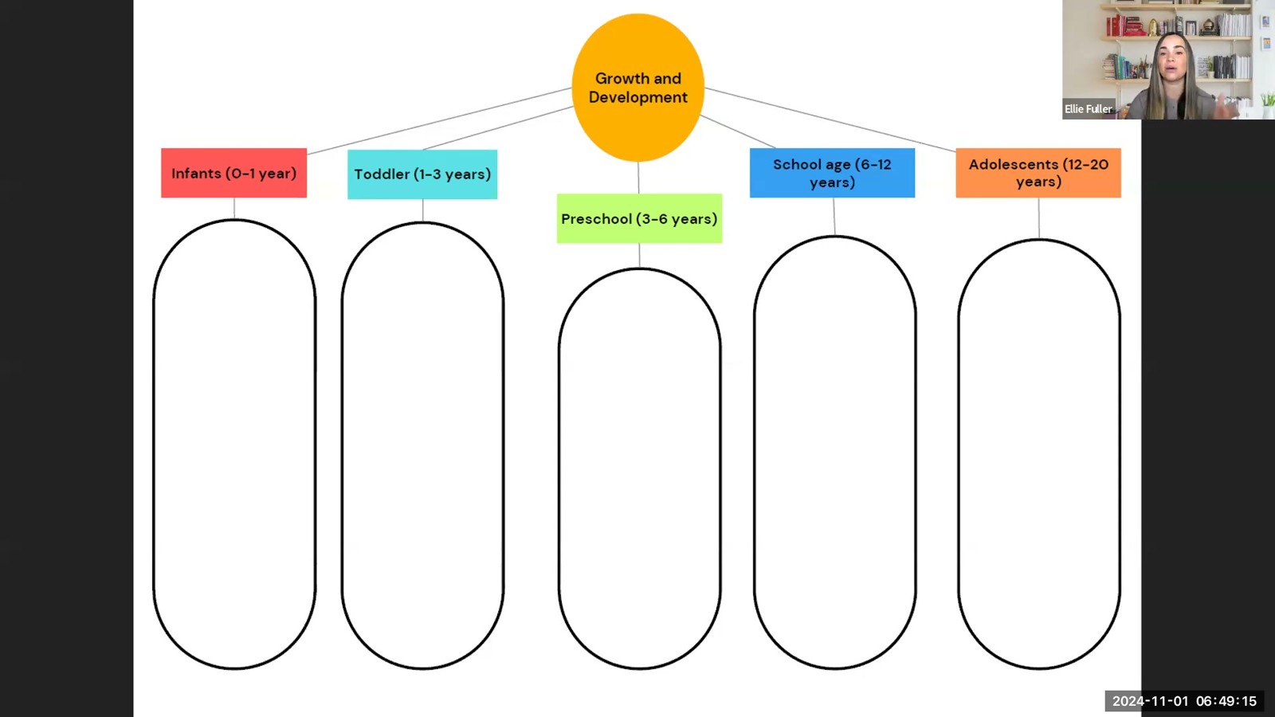
Notes:
Fuller · Week 14 · Comprehensive Final Review
Recording time 4:48
https://drive.google.com/file/d/1pvRIoJTyknef4TVk57Ajdng5oGCH5EHt/view

Slide 6
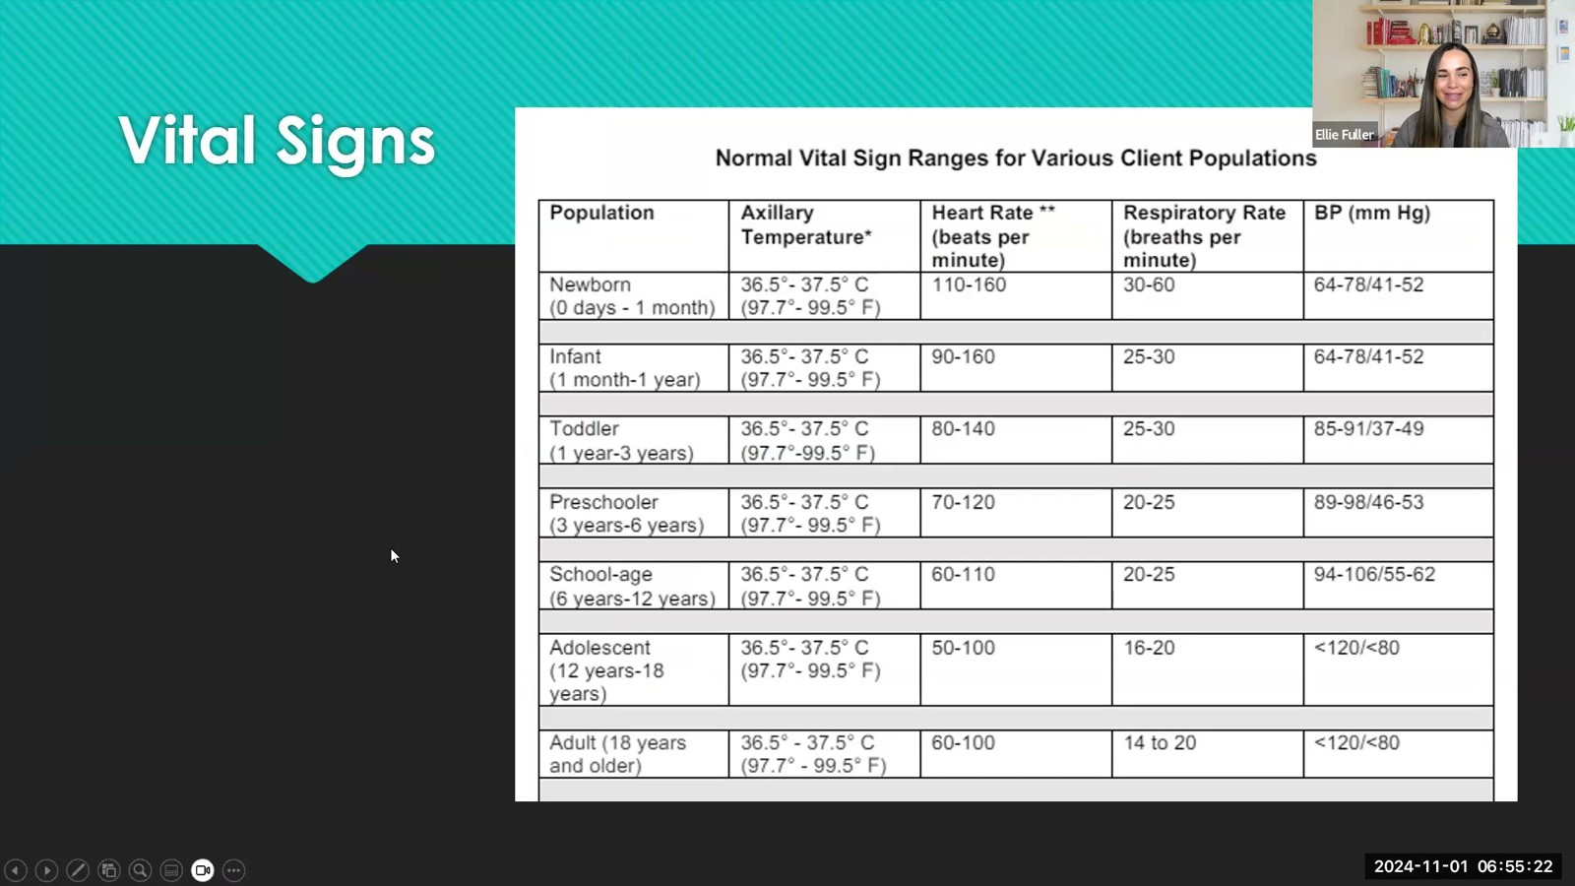
Notes:
Fuller · Week 14 · Comprehensive Final Review
Recording time 10:55
https://drive.google.com/file/d/1pvRIoJTyknef4TVk57Ajdng5oGCH5EHt/view

Slide 7
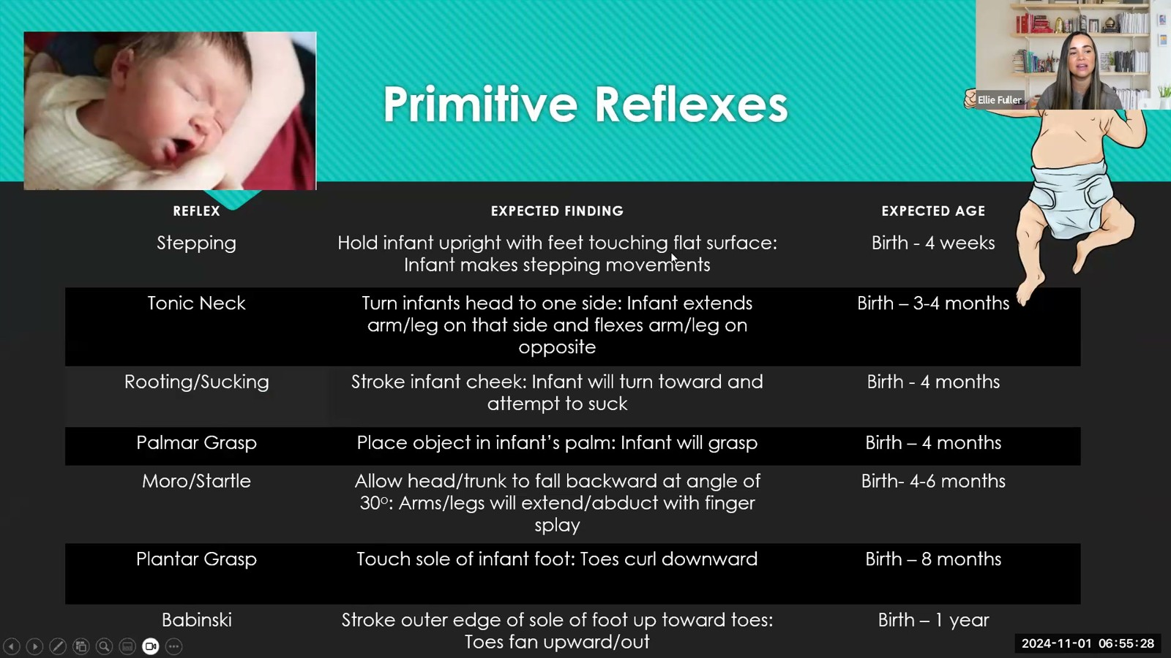
Notes:
Fuller · Week 14 · Comprehensive Final Review
Recording time 11:01
https://drive.google.com/file/d/1pvRIoJTyknef4TVk57Ajdng5oGCH5EHt/view

Slide 8
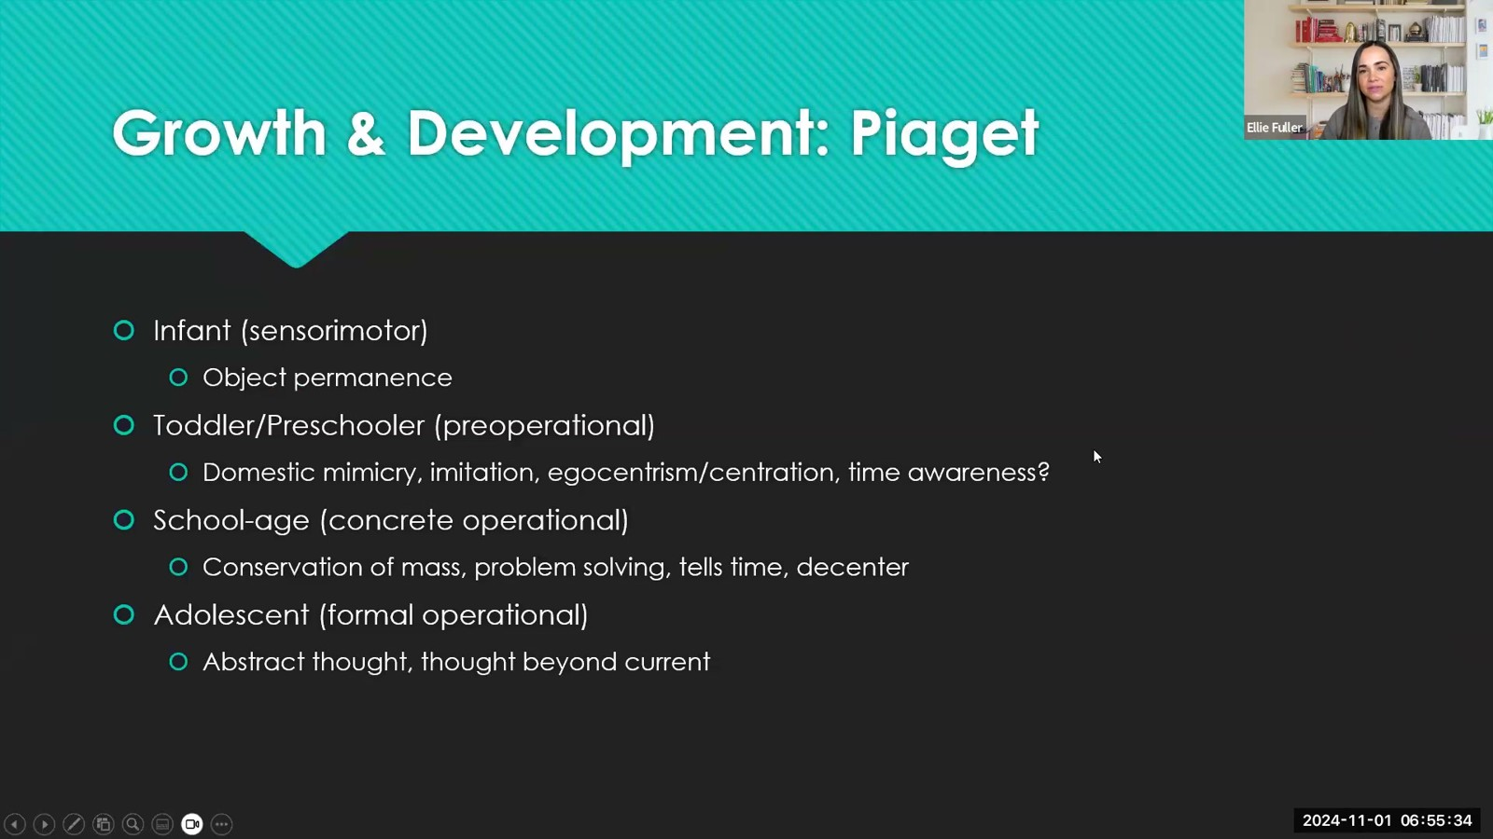
Notes:
Fuller · Week 14 · Comprehensive Final Review
Recording time 11:07
https://drive.google.com/file/d/1pvRIoJTyknef4TVk57Ajdng5oGCH5EHt/view

Slide 9
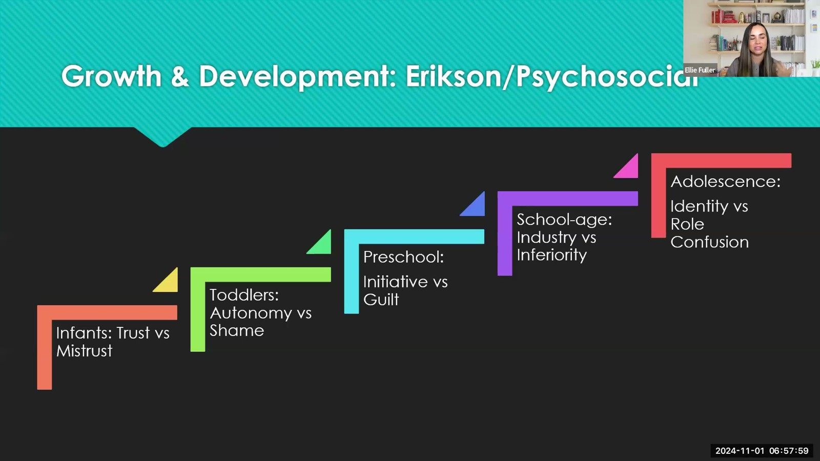
Notes:
Fuller · Week 14 · Comprehensive Final Review
Recording time 13:32
https://drive.google.com/file/d/1pvRIoJTyknef4TVk57Ajdng5oGCH5EHt/view

Slide 10
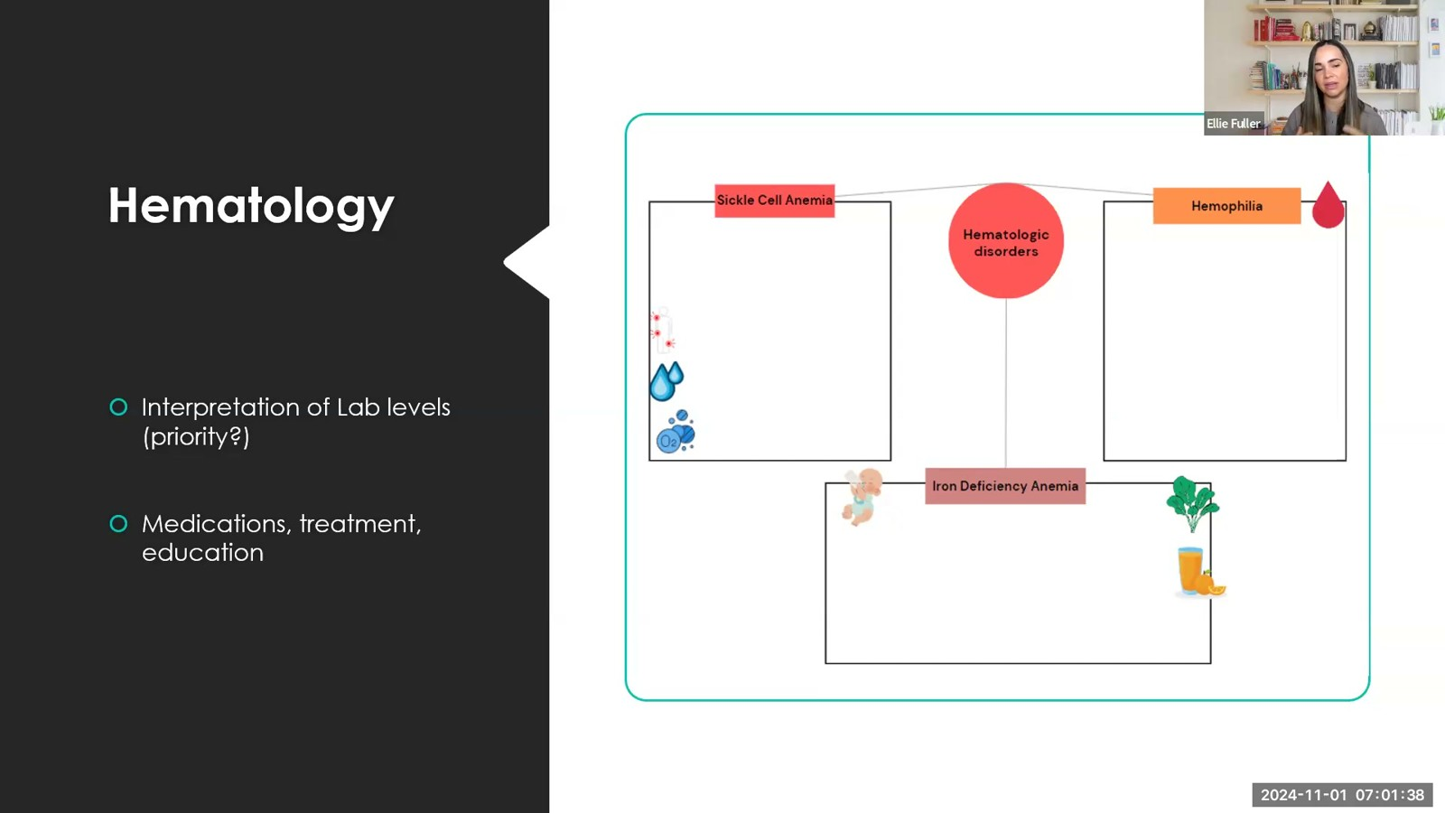
Notes:
Fuller · Week 14 · Comprehensive Final Review
Recording time 17:11
https://drive.google.com/file/d/1pvRIoJTyknef4TVk57Ajdng5oGCH5EHt/view

Slide 11
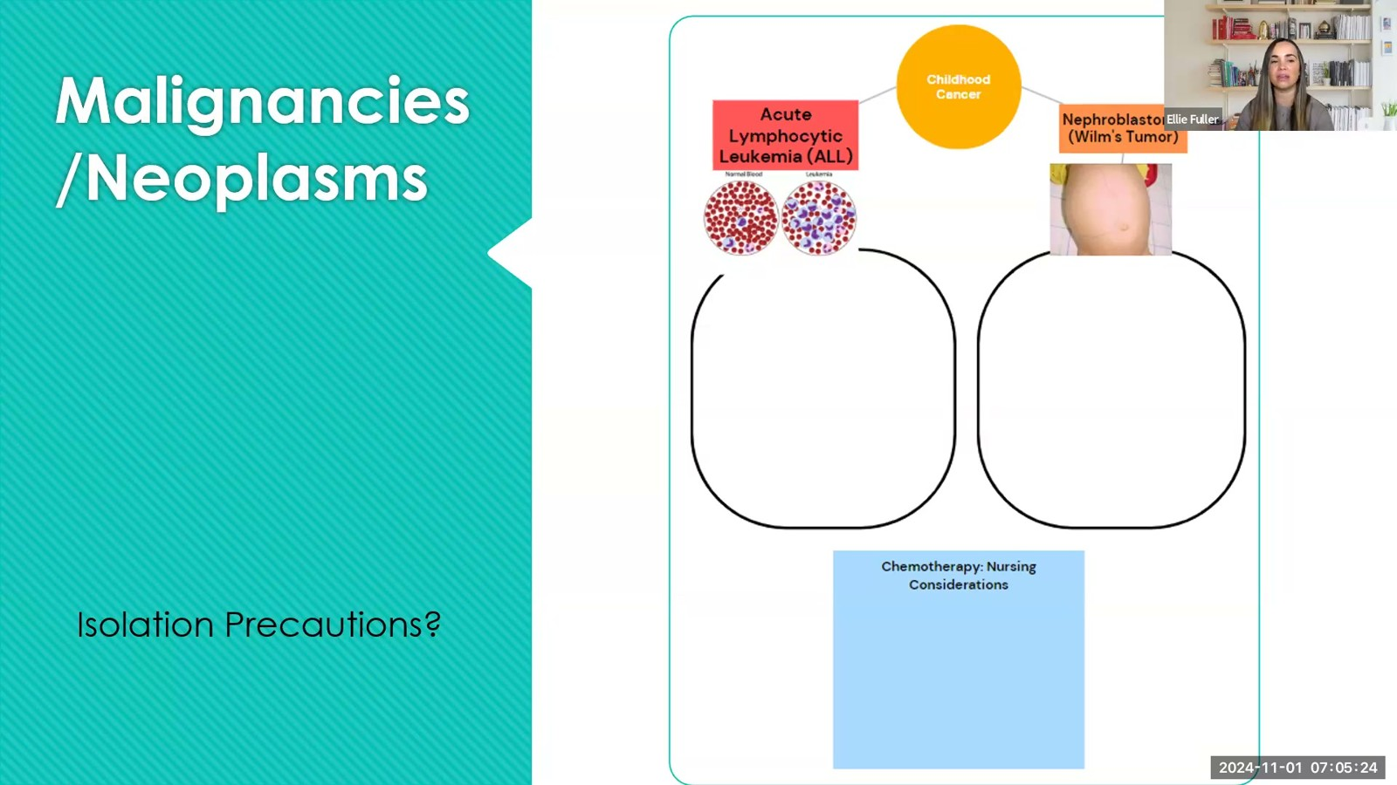
Notes:
Fuller · Week 14 · Comprehensive Final Review
Recording time 20:57
https://drive.google.com/file/d/1pvRIoJTyknef4TVk57Ajdng5oGCH5EHt/view

Slide 12
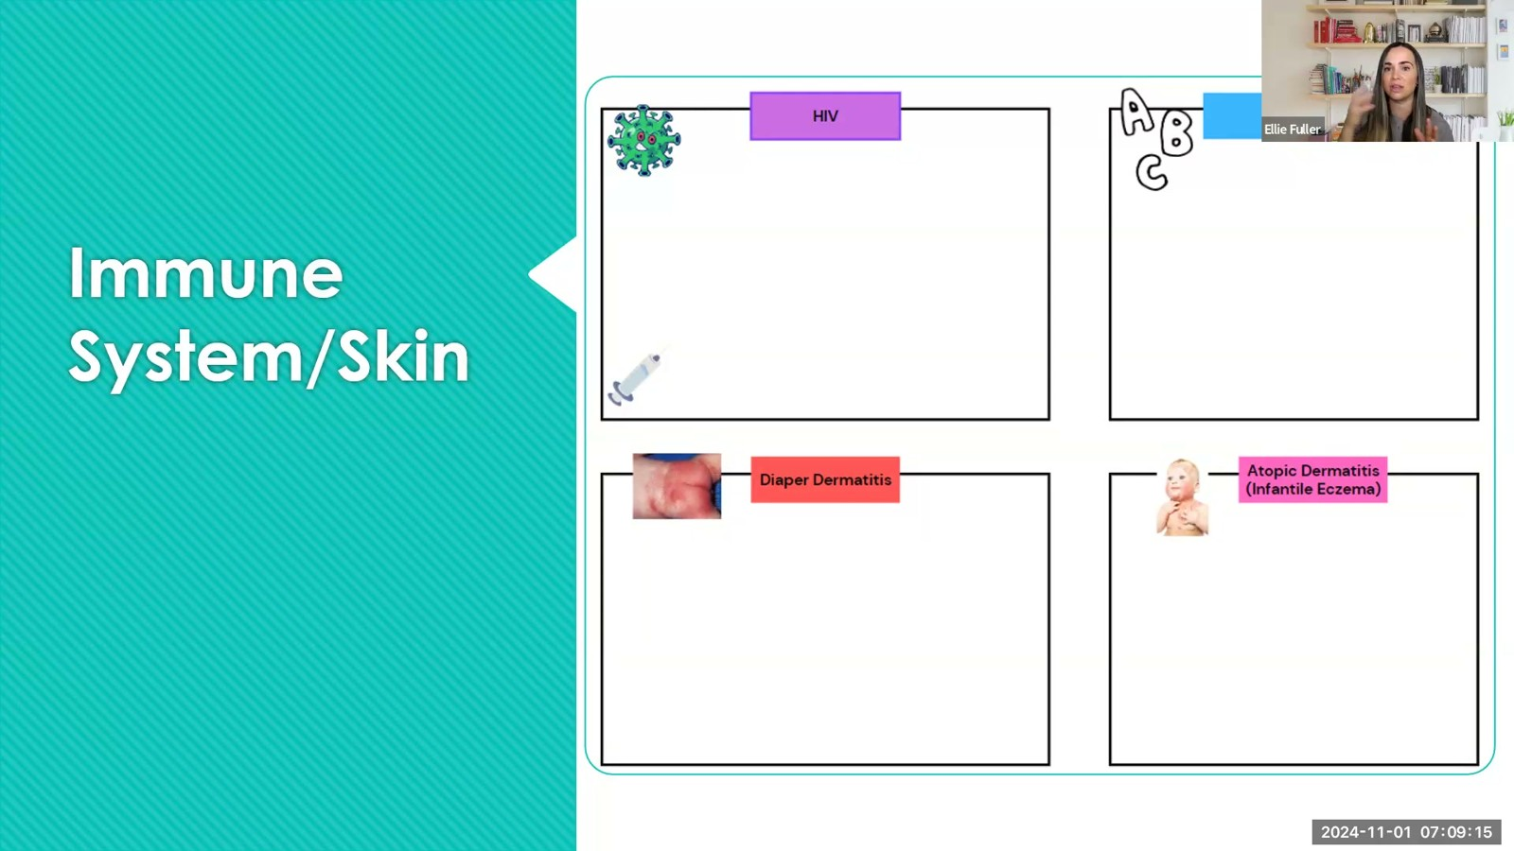
Notes:
Fuller · Week 14 · Comprehensive Final Review
Recording time 24:48
https://drive.google.com/file/d/1pvRIoJTyknef4TVk57Ajdng5oGCH5EHt/view

Slide 13
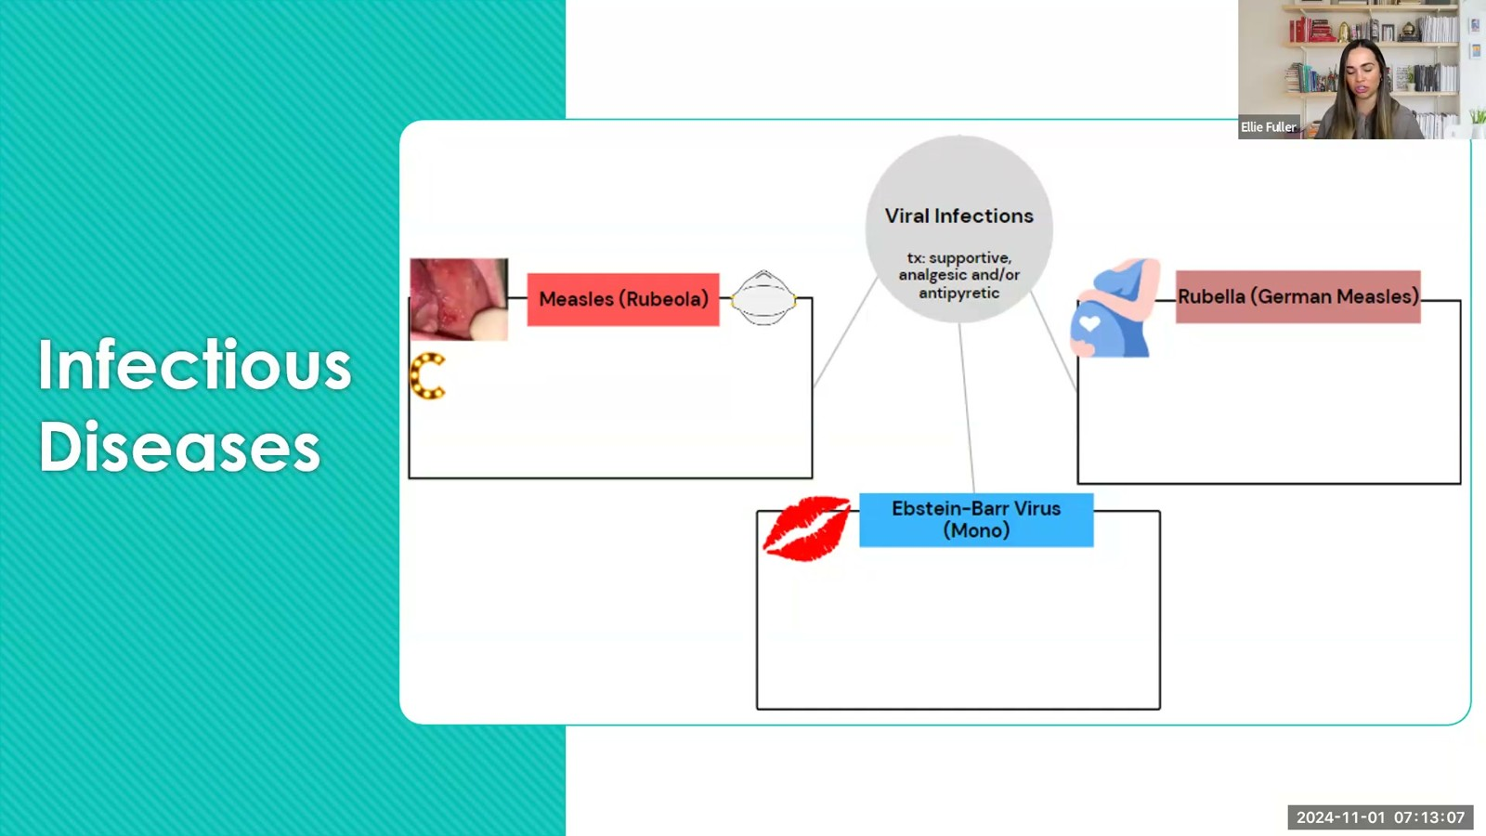
Notes:
Fuller · Week 14 · Comprehensive Final Review
Recording time 28:40
https://drive.google.com/file/d/1pvRIoJTyknef4TVk57Ajdng5oGCH5EHt/view

Slide 14
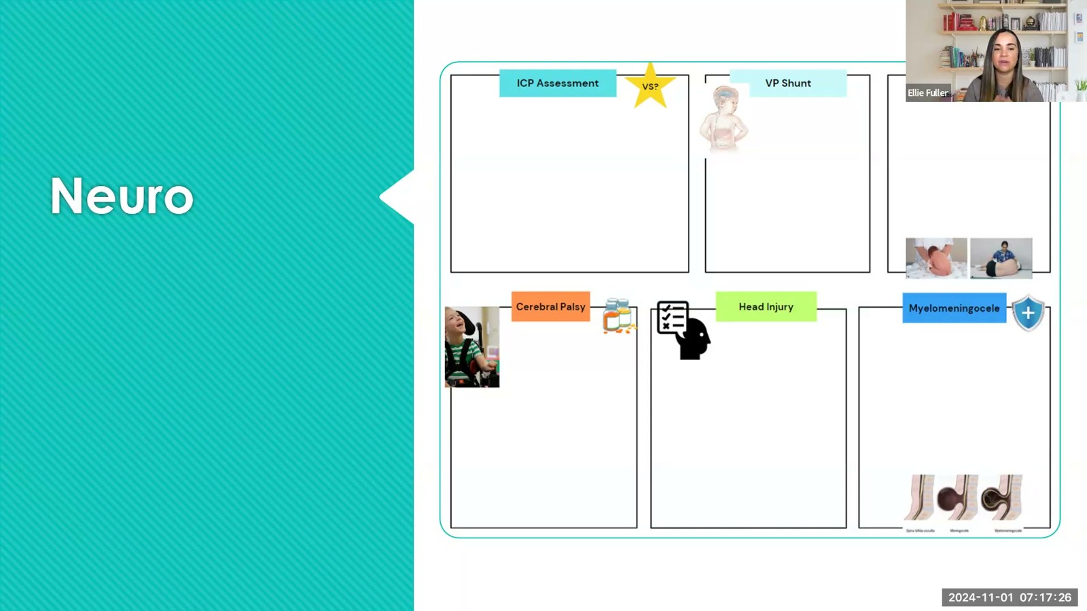
Notes:
Fuller · Week 14 · Comprehensive Final Review
Recording time 32:59
https://drive.google.com/file/d/1pvRIoJTyknef4TVk57Ajdng5oGCH5EHt/view

Slide 15
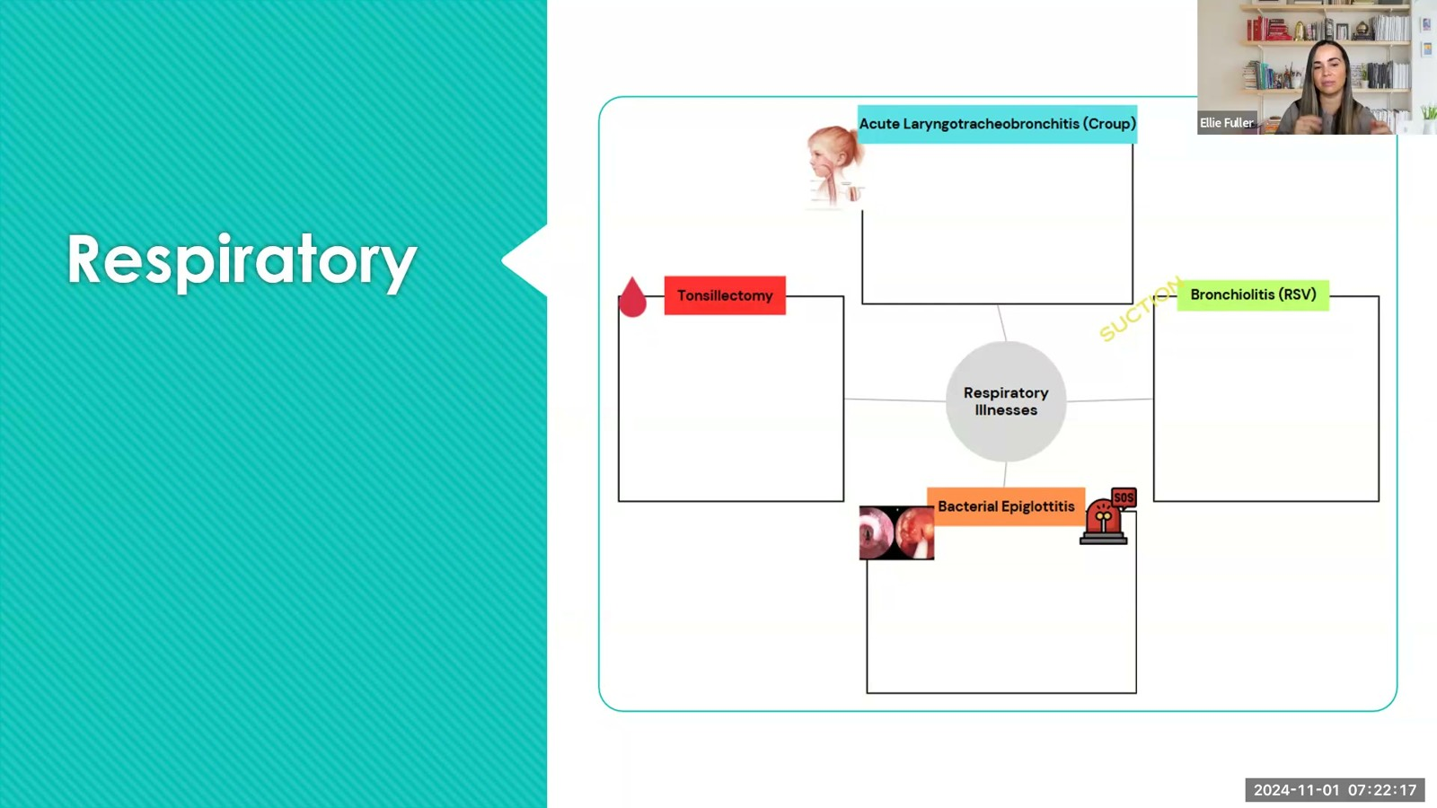
Notes:
Fuller · Week 14 · Comprehensive Final Review
Recording time 37:50
https://drive.google.com/file/d/1pvRIoJTyknef4TVk57Ajdng5oGCH5EHt/view

Slide 16
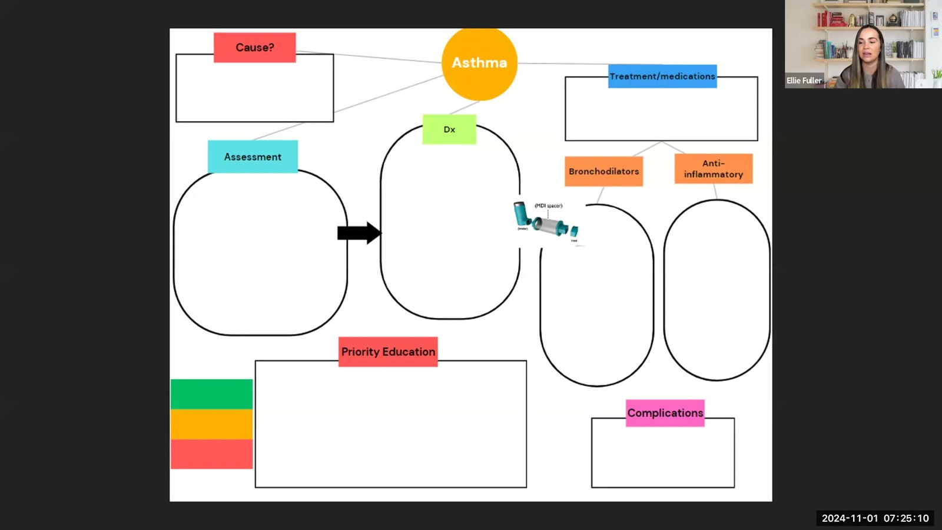
Notes:
Fuller · Week 14 · Comprehensive Final Review
Recording time 40:43
https://drive.google.com/file/d/1pvRIoJTyknef4TVk57Ajdng5oGCH5EHt/view

Slide 17
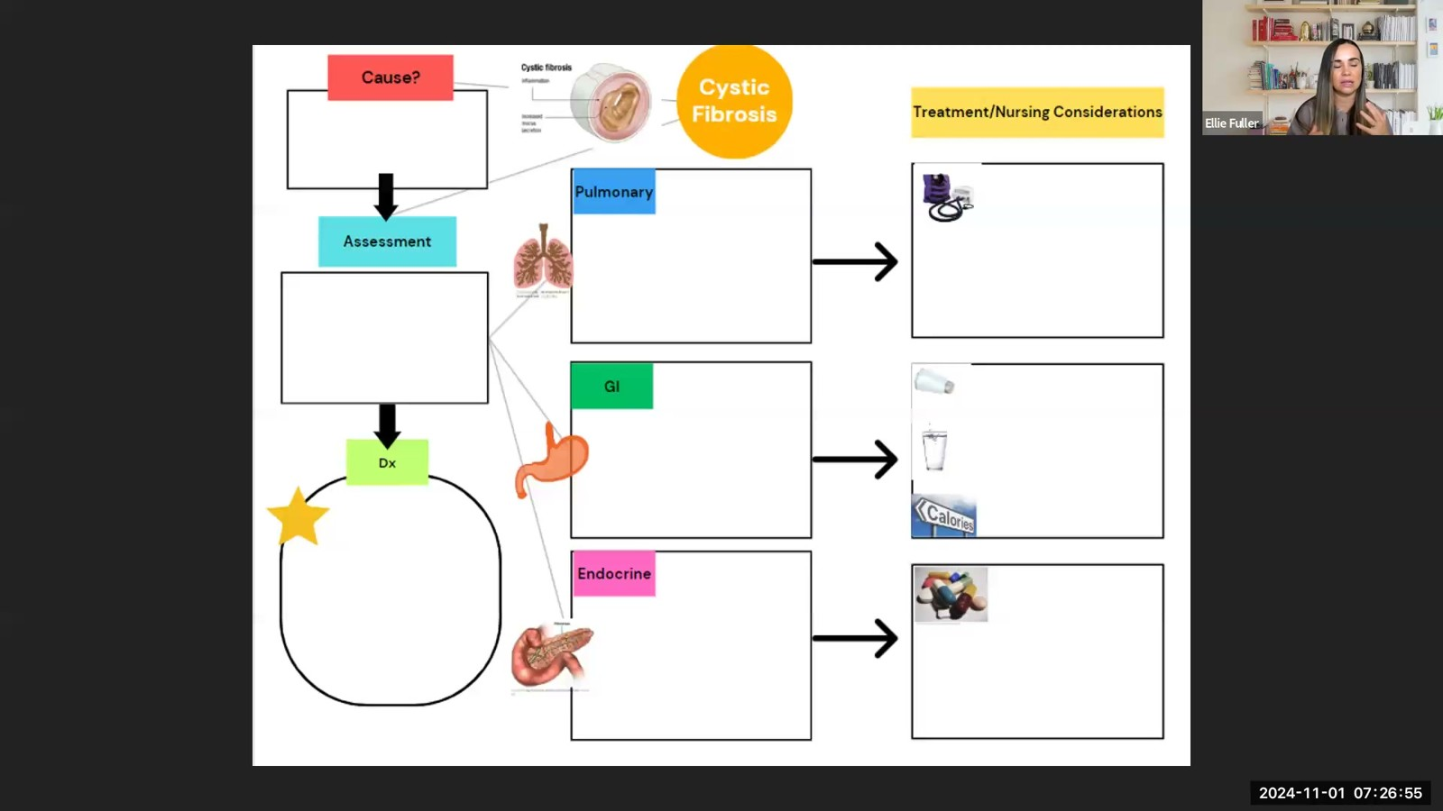
Notes:
Fuller · Week 14 · Comprehensive Final Review
Recording time 42:28
https://drive.google.com/file/d/1pvRIoJTyknef4TVk57Ajdng5oGCH5EHt/view

Slide 18
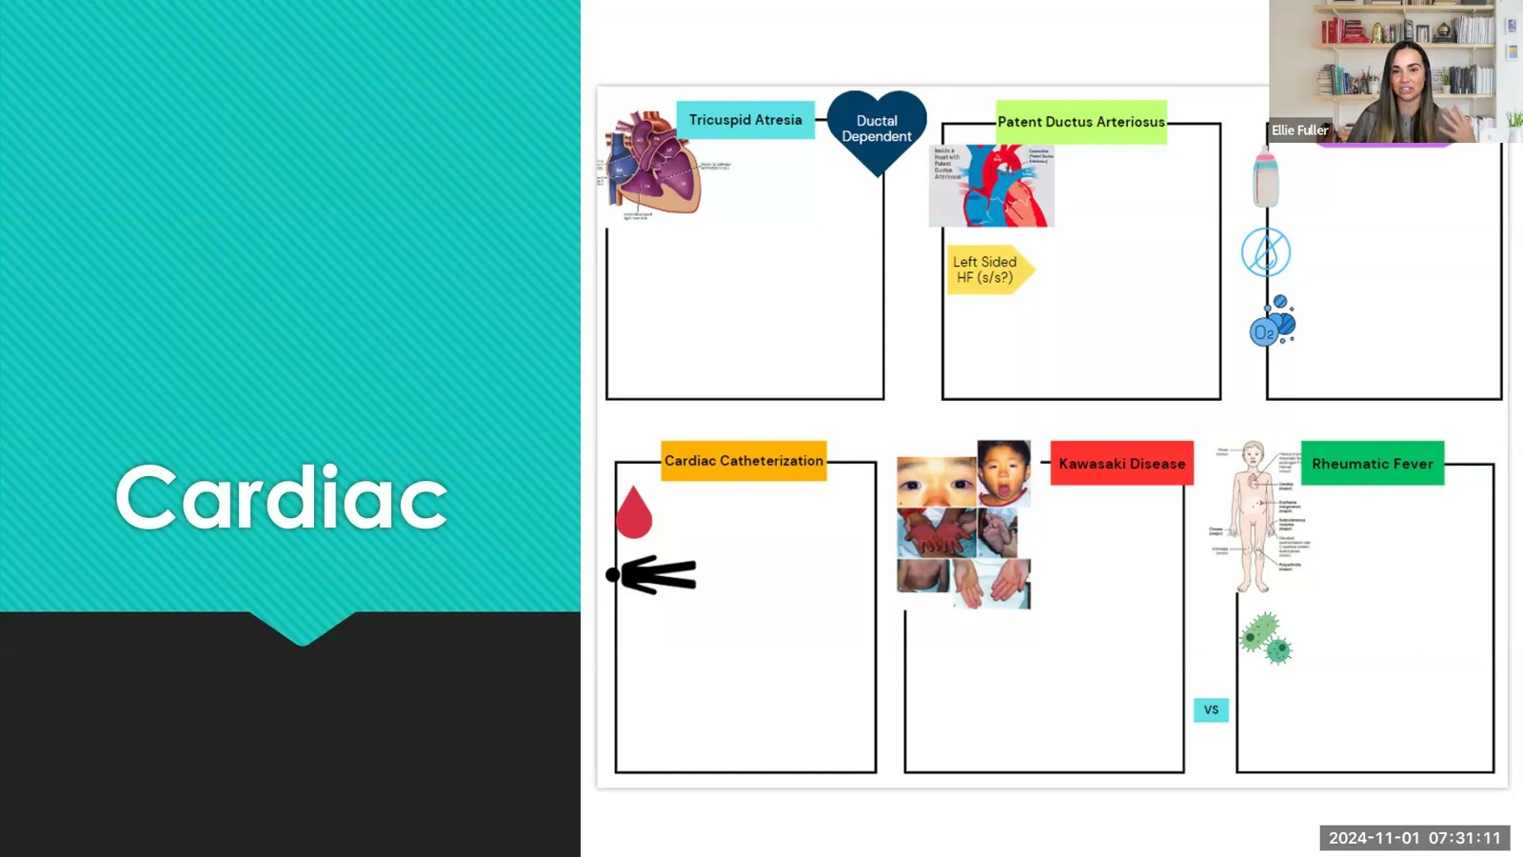
Notes:
Fuller · Week 14 · Comprehensive Final Review
Recording time 46:44
https://drive.google.com/file/d/1pvRIoJTyknef4TVk57Ajdng5oGCH5EHt/view

Slide 19
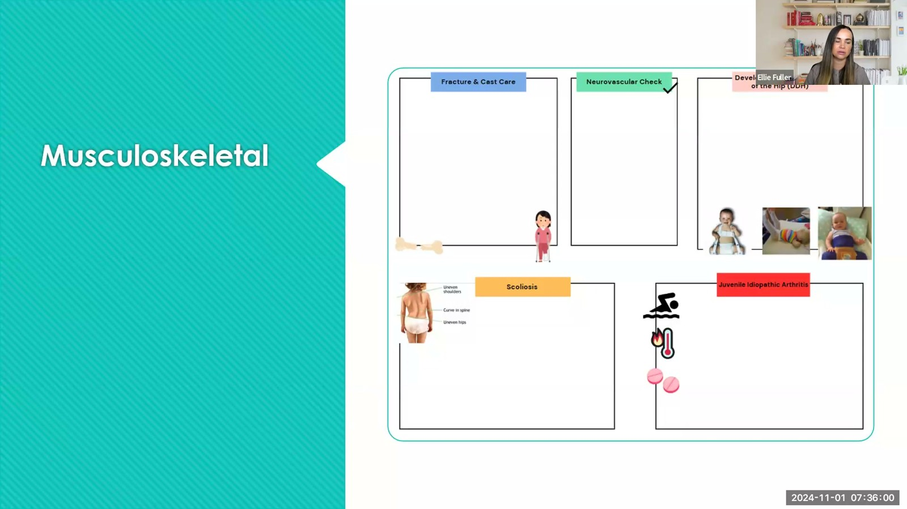
Notes:
Fuller · Week 14 · Comprehensive Final Review
Recording time 51:33
https://drive.google.com/file/d/1pvRIoJTyknef4TVk57Ajdng5oGCH5EHt/view

Slide 20
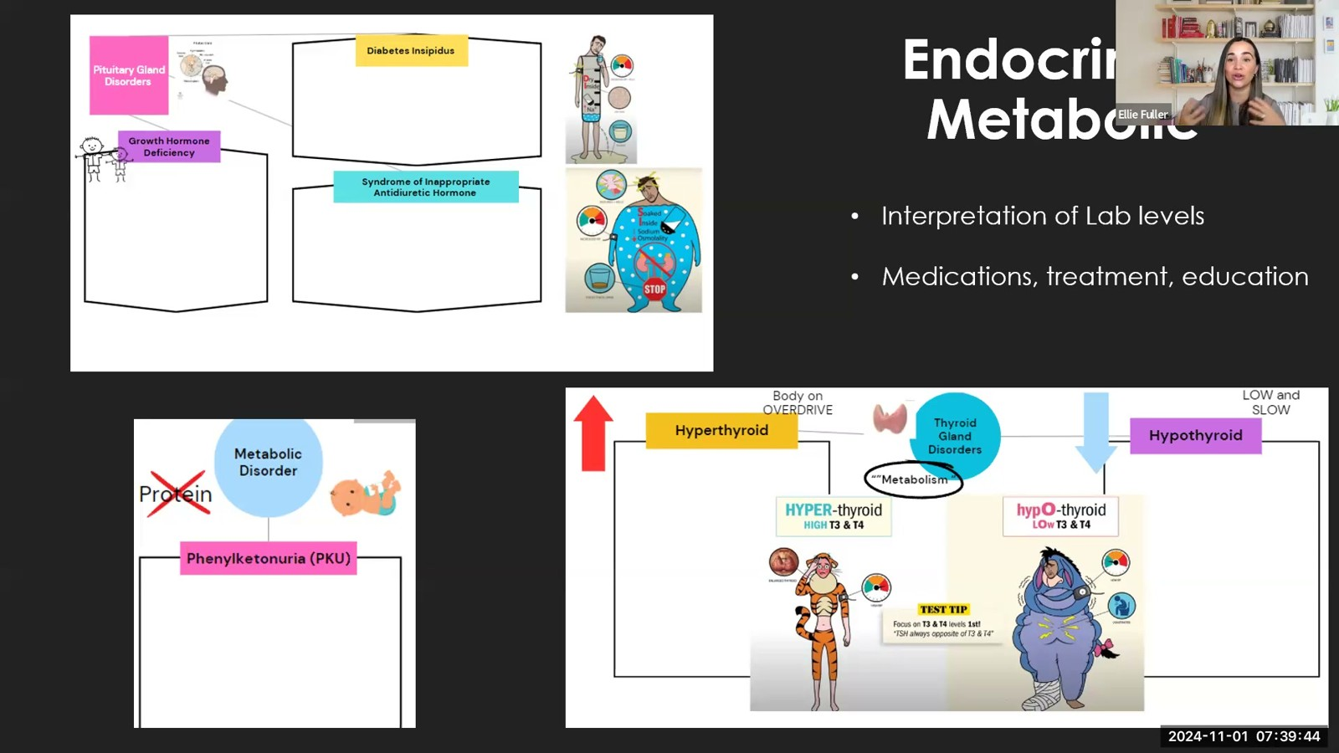
Notes:
Fuller · Week 14 · Comprehensive Final Review
Recording time 55:17
https://drive.google.com/file/d/1pvRIoJTyknef4TVk57Ajdng5oGCH5EHt/view

Slide 21
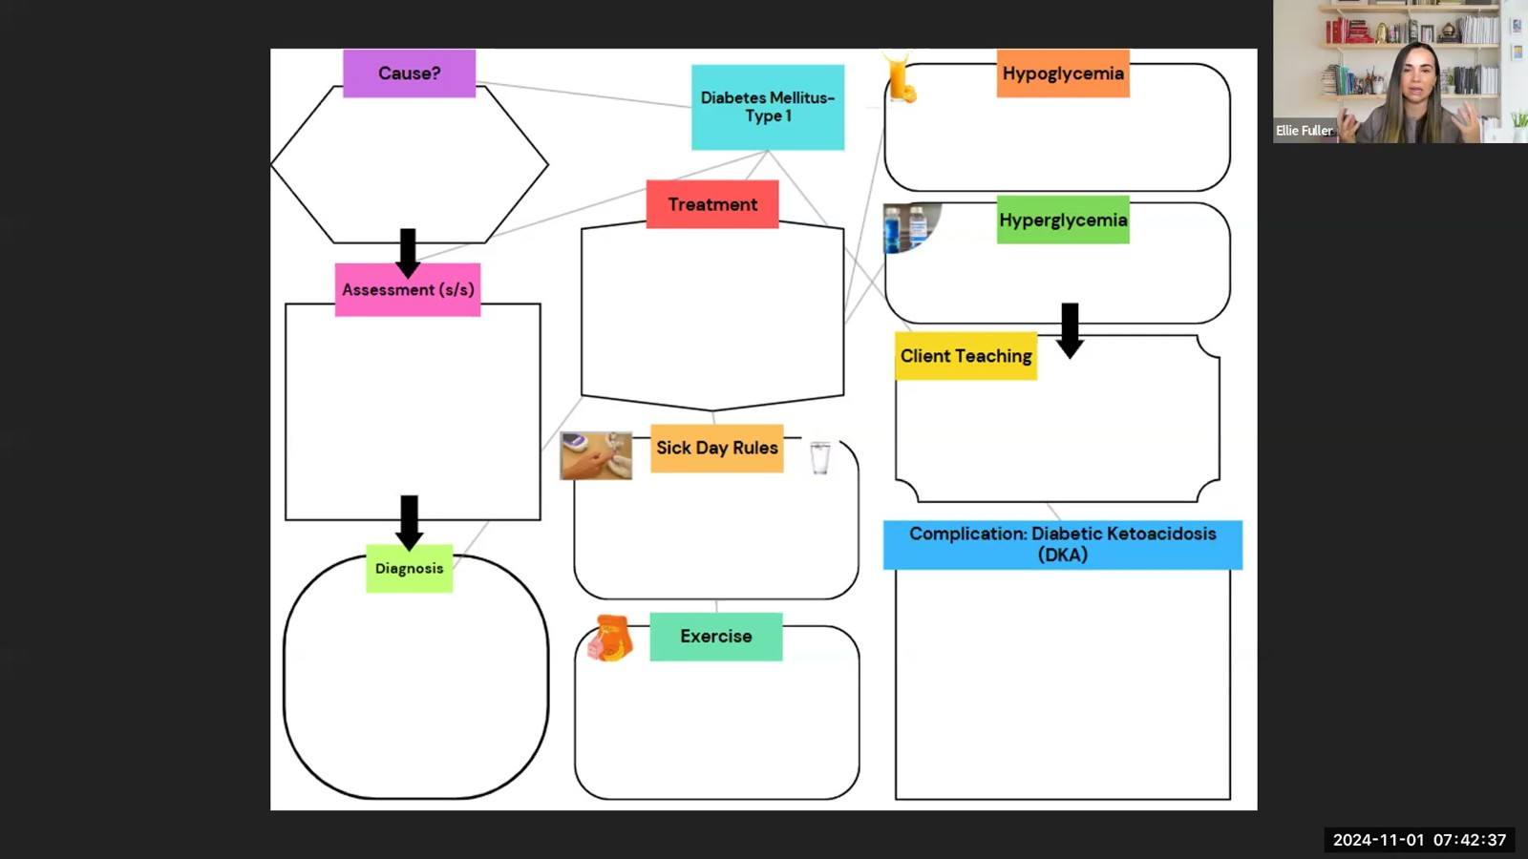
Notes:
Fuller · Week 14 · Comprehensive Final Review
Recording time 58:10
https://drive.google.com/file/d/1pvRIoJTyknef4TVk57Ajdng5oGCH5EHt/view

Slide 22
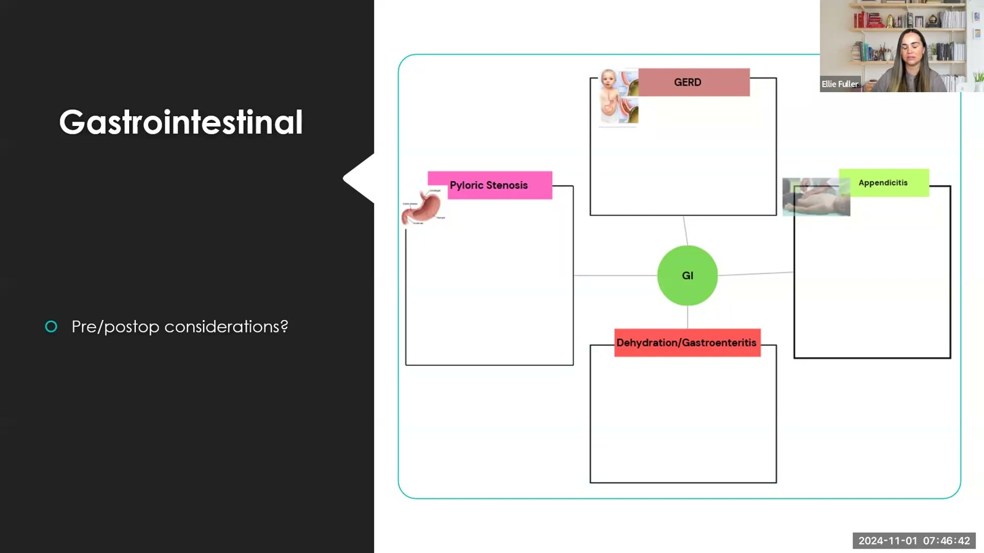
Notes:
Fuller · Week 14 · Comprehensive Final Review
Recording time 62:15
https://drive.google.com/file/d/1pvRIoJTyknef4TVk57Ajdng5oGCH5EHt/view

Slide 23
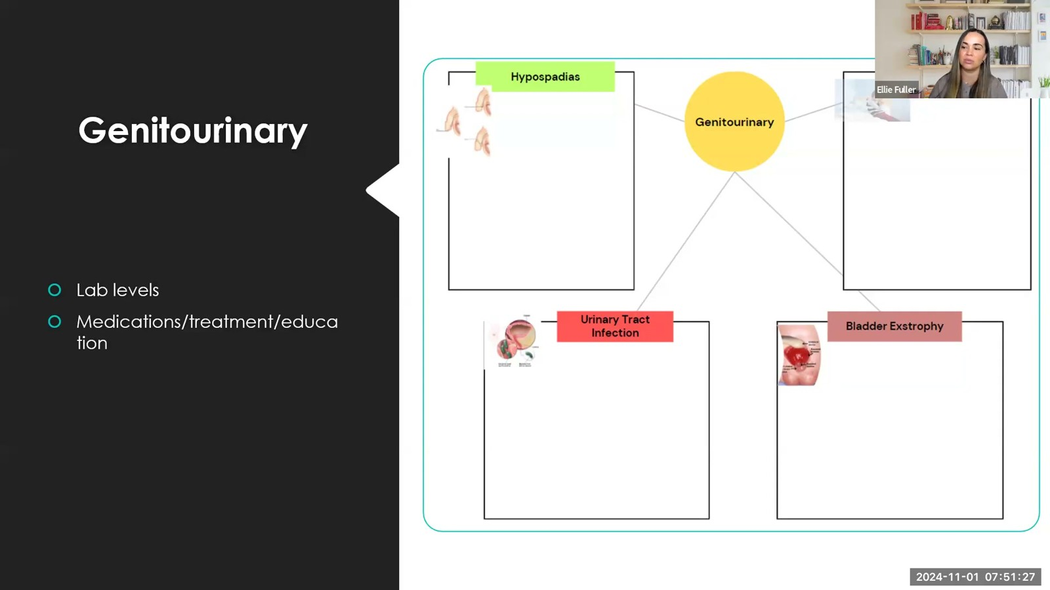
Notes:
Fuller · Week 14 · Comprehensive Final Review
Recording time 67:00
https://drive.google.com/file/d/1pvRIoJTyknef4TVk57Ajdng5oGCH5EHt/view

Slide 24
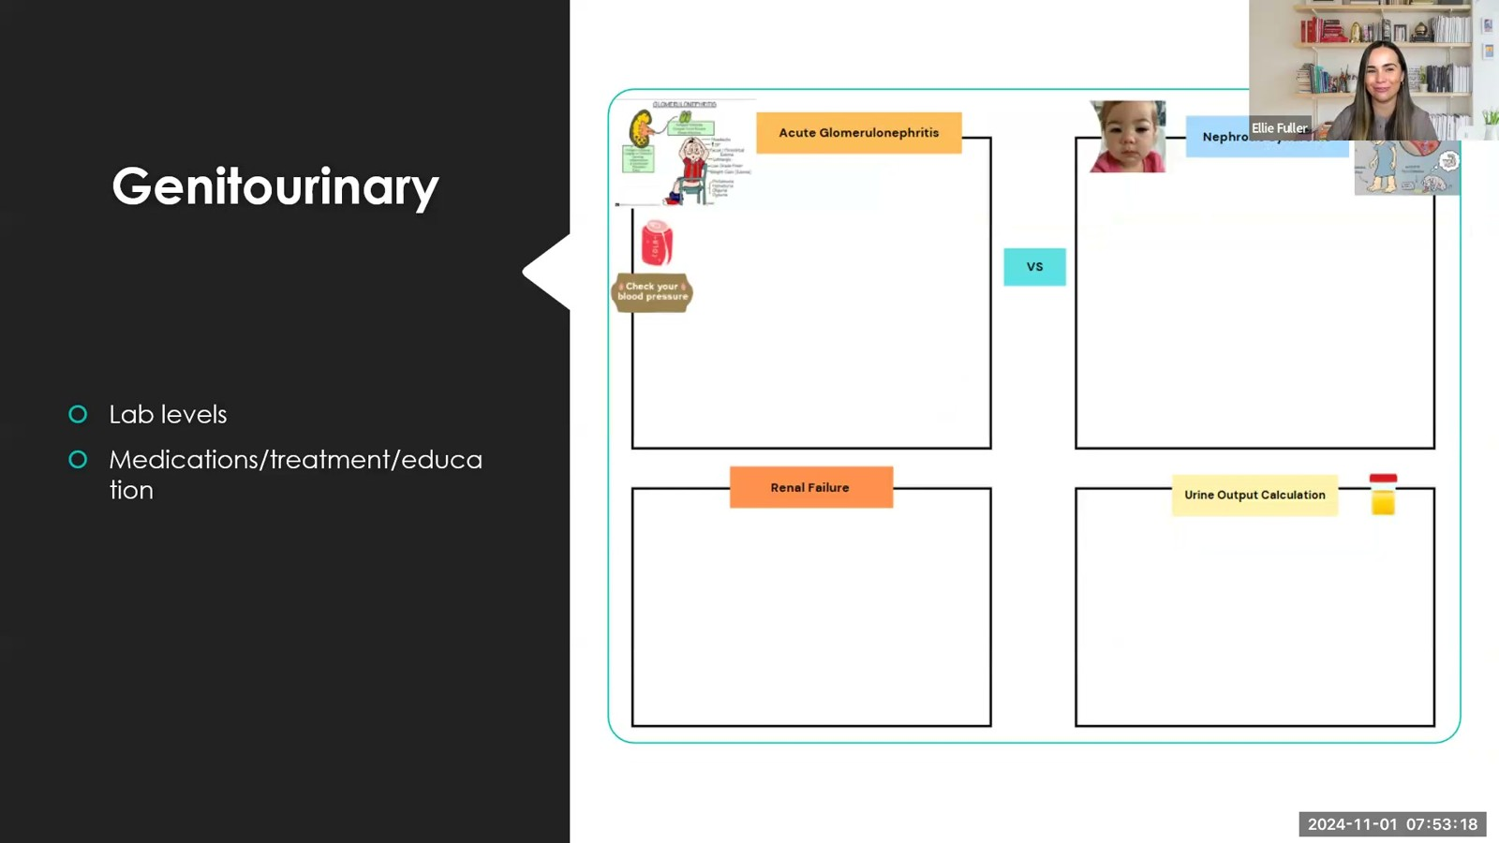
Notes:
Fuller · Week 14 · Comprehensive Final Review
Recording time 68:51
https://drive.google.com/file/d/1pvRIoJTyknef4TVk57Ajdng5oGCH5EHt/view

Slide 25
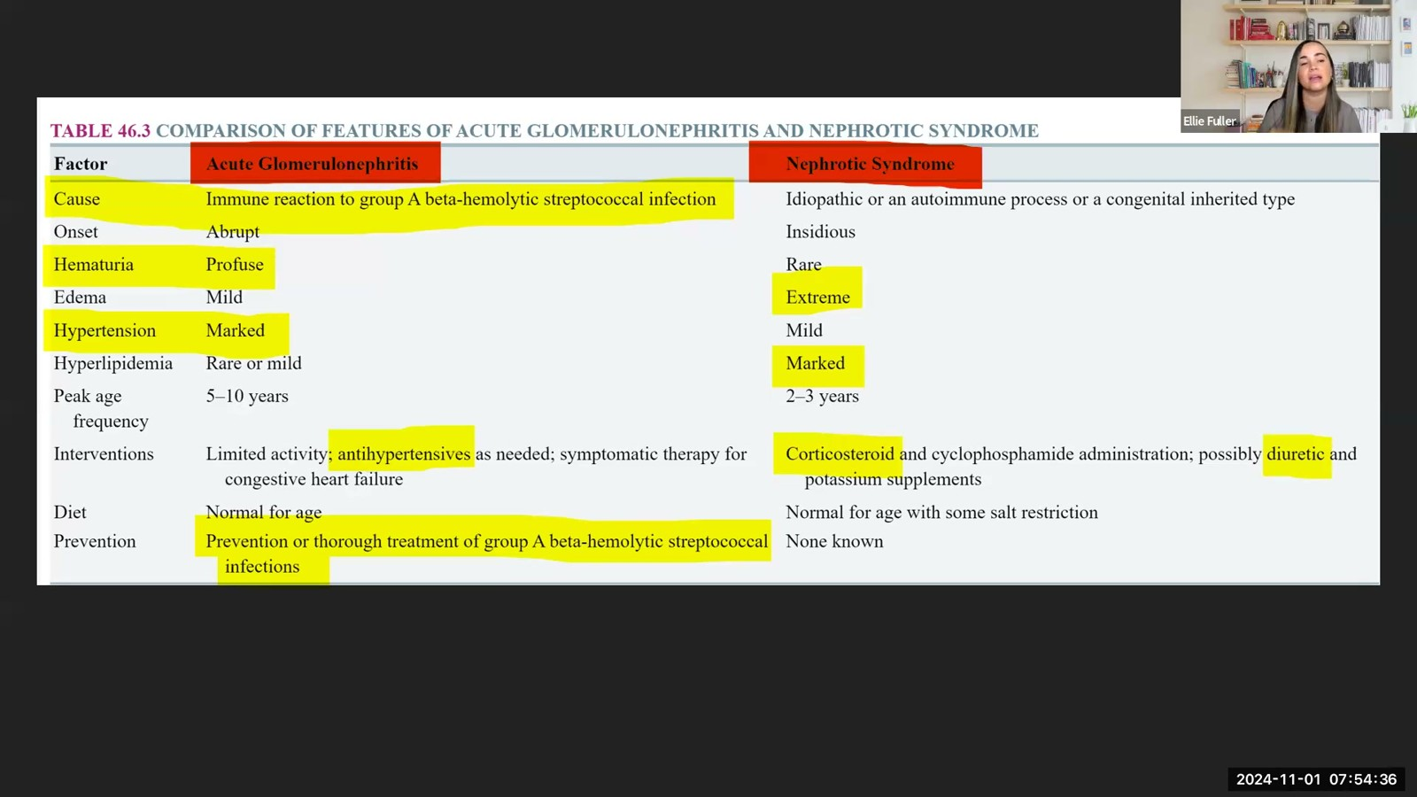
Notes:
Fuller · Week 14 · Comprehensive Final Review
Recording time 70:09
https://drive.google.com/file/d/1pvRIoJTyknef4TVk57Ajdng5oGCH5EHt/view

Slide 26
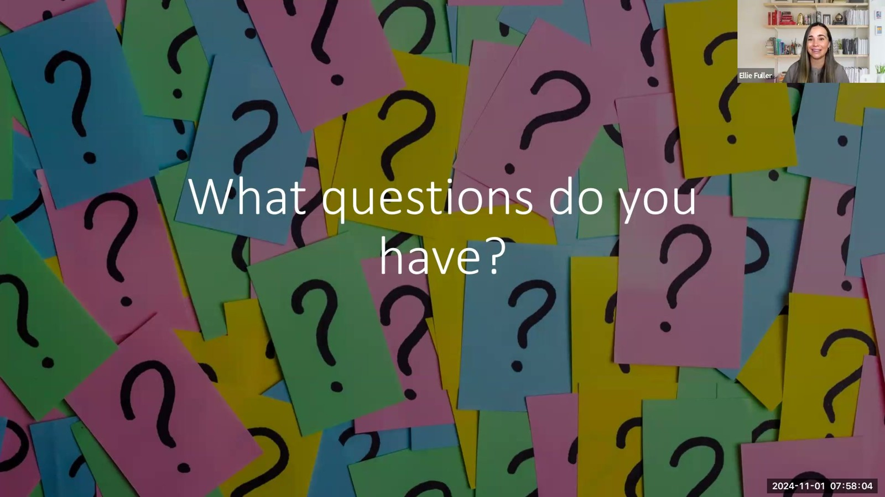
Notes:
Fuller · Week 14 · Comprehensive Final Review
Recording time 73:37
https://drive.google.com/file/d/1pvRIoJTyknef4TVk57Ajdng5oGCH5EHt/view

