Slide 1

Immunologic (HIV) and Infectious Diseases

Slide 2
Module Learning Objectives
Describe the nursing management of clients with infectious diseases.
Use the nursing process and NCJMM as frameworks for care of the client with human immunodeficiency virus/acquired immunodeficiency syndrome.

Slide 3
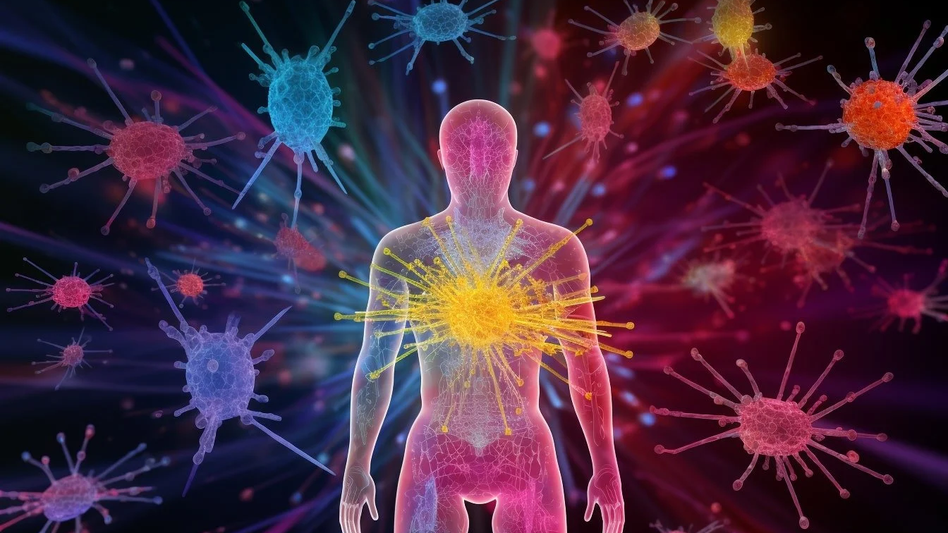
List and discuss variables that may affect the function of a client’s immune system.

Slide 4
Answer: variables that affect immune function (1 of 2)
Age
Very young (immature system) and older adults – fewer and slower T cells, thinner skin, less stomach acid, weaker vaccine response.
Nutrition
Protein-calorie malnutrition and low zinc, iron, vitamins A, C, D and E reduce antibody and cell responses; obesity blunts them too.
Chronic disease
Diabetes, kidney or liver failure, cancer, autoimmune disease, HIV, burns, major trauma or surgery, splenectomy.

Slide 5
Answer: variables that affect immune function (2 of 2)
Medications and treatments
Corticosteroids, chemotherapy, radiation, transplant immunosuppressants, biologics; long antibiotic courses disturb normal flora.
Lifestyle and environment
Chronic stress and poor sleep (cortisol), smoking, alcohol, inactivity, occupational and travel exposures, crowded living.
Other
Genetics and primary immunodeficiencies, pregnancy, and the immunization history that shapes acquired immunity.

Slide 6
Interpretation of Leukocyte (WBC) values
What is the expected range for WBCs?
Define leukopenia.
Define leukocytosis.
What is a “left shift” of WBCs?
Define neutropenia.
Contrast leukopenia and neutropenia.

Slide 7
Answer: interpreting WBC values (1 of 2)
Expected WBC range
5,000–10,000/mm³ (some texts 4,500–11,000). Neutrophils make up 55–70% of the total.
Leukopenia
Total WBC below 5,000/mm³ – too few white cells overall (marrow suppression, chemo, viral illness, some drugs).
Leukocytosis
Total WBC above 10,000/mm³ – usually infection or inflammation; also stress, steroids, leukemia.

Slide 8
Answer: interpreting WBC values (2 of 2)
Left shift
More immature neutrophils (bands) pushed out of the marrow early – the sign of an acute bacterial infection (“bandemia”).
Neutropenia
Absolute neutrophil count (ANC) below 1,500/mm³; severe below 500. ANC = WBC × (% segs + % bands).
Leukopenia vs neutropenia
Leukopenia = the whole count is low. Neutropenia = the neutrophils specifically are low, which is what drives infection risk. A client can be neutropenic with a near-normal total WBC and still needs protective precautions.

Slide 9

Neutropenic precautions (protective environment)
What client population has the highest risk for developing neutropenia?
Discuss the nurse’s role when implementing neutropenic precautions.

Slide 10
Answer: neutropenia – who is at risk and the nurse’s role
Highest risk
Clients on chemotherapy (marrow suppression, nadir 7–14 days after a dose); also leukemia and lymphoma, bone-marrow or stem-cell transplant, radiation to marrow, advanced HIV, long-term immunosuppressants.
The nurse’s role
Private room; meticulous hand hygiene by everyone; screen visitors and staff – no colds, coughs or recent live vaccines.
No fresh flowers, plants or standing water; low-microbial diet per policy (no raw or unwashed produce, raw meat or eggs).
Protect the barriers: no rectal temps, suppositories or enemas; avoid IM injections and invasive procedures; soft-brush oral care; daily skin care; dedicated equipment kept in the room.
Monitor temperature every 4 hours and the ANC daily; signs are subtle because there are not enough neutrophils to make pus.
Fever of 100.4°F (38°C) is an emergency: cultures first, then IV broad-spectrum antibiotics within 1 hour of the order. Give filgrastim as ordered; mask the client when leaving the room.

Slide 11
Management of Clients with immune deficiency disorders

Slide 12
Hiv/Aids
HIV is a chronic infection caused by the human immunodeficiency virus.
Acquired immunodeficiency syndrome (AIDS) is the disease caused by HIV infection.

Slide 13
HIV statistics: US & worldwide
CDC – United States (2024 reports)
WHO HIV Worldwide Statistics
About 1.2 million people are living with HIV; roughly 1 in 8 does not know it.
An estimated 31,800 new infections in 2022 – down 12% from 2018, driven by a 30% drop among ages 13–24.
38,793 new HIV diagnoses in 2024; 69% of people with HIV had a suppressed viral load.
WHO / UNAIDS – worldwide (end of 2024)
40.8 million people living with HIV, 65% of them in the WHO African Region; 53% are women and girls.
1.3 million people newly acquired HIV in 2024; 630,000 died of HIV-related causes – deaths down 70% from the 2004 peak.
77% of people with HIV are on treatment, and 94% of those on treatment are virally suppressed.

Slide 14
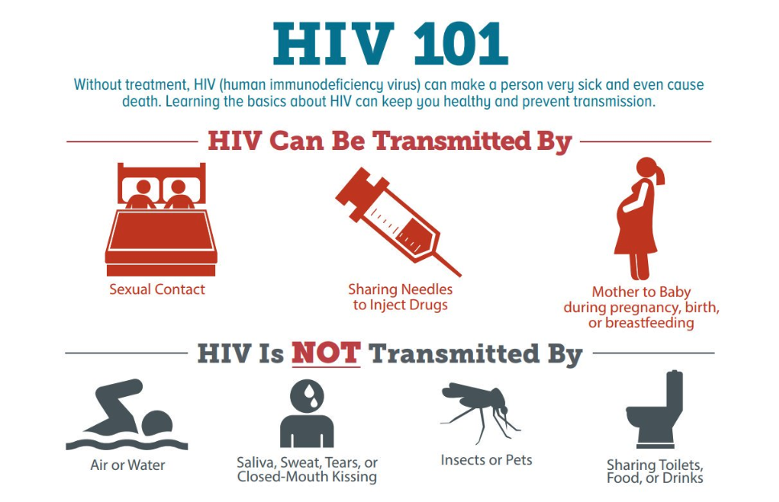
TRANSMISSION OF HIV
Transmitted by body fluids containing infected cells
Cannot be transmitted through casual contact.
High-risk populations

Slide 15
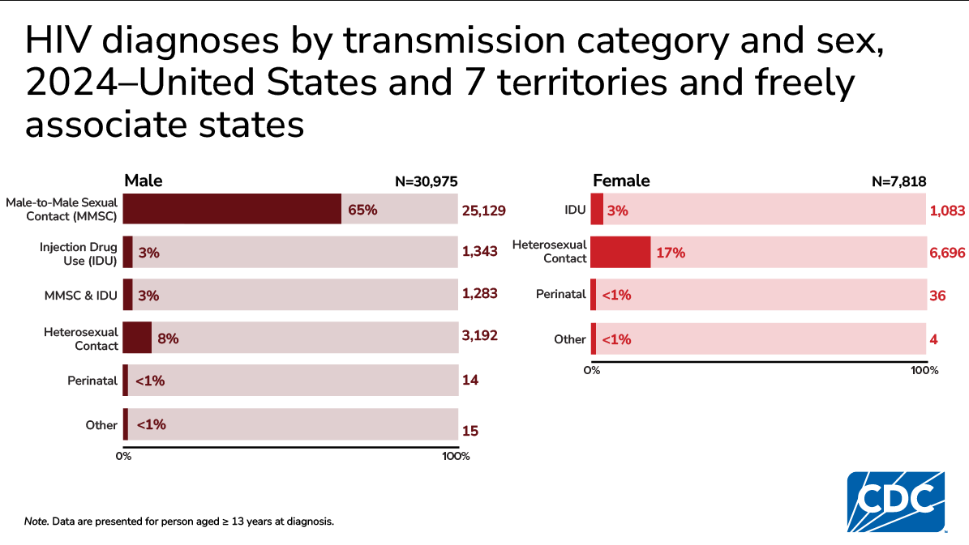

Slide 16
Older Adults and HIV
In 2021, adults aged 50+ made up 16.3% of new HIV diagnoses in the US (CDC, 2023)
May not consider themselves to be at risk for HIV
Less likely than younger people to get tested
Normal age-related changes often mask the signs of HIV/AIDS
Clinical manifestations are like other illnesses that are common in older adults (infections such as pneumonia, cancers such as lymphoma)
More susceptible to HIV complications than younger adults
Older adult women have an increased risk due to the vaginal changes of aging
The number of older adults living with HIV is increasing b/c effective HIV treatment has increased with lifespan of people with HIV

Slide 17
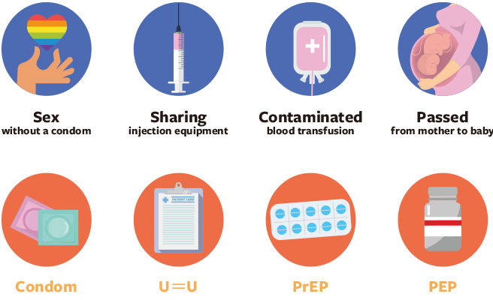
What education should the nurse provide about the prevention of HIV transmission?

Slide 18
Answer: preventing HIV transmission – client education
Use a condom correctly every time (latex or polyurethane, water-based lubricant); limit partners; get tested with any new partner.
Know your status: everyone 13–64 tested at least once, yearly or more if at risk. Treat other STIs – they make HIV easier to catch.
PrEP for ongoing risk: daily oral emtricitabine/tenofovir or long-acting injectable cabotegravir, with HIV testing every 2–3 months.
PEP after a possible exposure: start within 72 hours (sooner is better), three antiretrovirals for 28 days.
U = U: a person on ART with an undetectable viral load does not transmit HIV sexually – adherence is prevention.
Never share needles, syringes, works or razors; use syringe-services programs. Donated blood and organs are screened.
Pregnancy: ART throughout, testing and prophylaxis for the newborn, formula rather than breastfeeding in the US – transmission falls below 1%.

Slide 19
Occupational exposure to HIV (needle stick)
Wash the area with soap and water
Follow facility protocol for needlestick
Alert your supervisor
Identify the source client
Report quickly to employee health
Consent for baseline testing
Post-exposure prophylaxis (PEP) medications
CDC : begin antiretroviral meds ASAP (<72 hours after possible HIV exposure)
Drugs prescribed for ≈28 days
Follow-up blood testing

Slide 20
Stages of HIV
Stage 1:
HIV Asymptomatic for years
Stage 2:
HIV Symptomatic fevers, weight loss, swollen nodes
Stage 3:
AIDS: CD4<200, or an AIDS defining disease
Stage O:
Primary Infection like a cold

Slide 21
Primary HIV infection: stage 0
From initial infection to the development of antibodies (stage 1)
AKA acute HIV infection or window period
Virus replicates rapidly in CD4 immune cells
Usually present with non-specific viral illness symptoms that are similar to influenza
Person can test negative for at least 2-3 weeks

Slide 22
HIV Asymptomatic: stage 1
Client can remain asymptomatic for 10 years or more, but the immune system’s CD4 cells are being destroyed
Clients generally feel well and have few, if any, symptoms
CD4 is within normal range (500 – 1500 cell/mmᶟ)
High enough to preserve immune defensive responses

Slide 23
HIV symptomatic: Stage 2
CDC Category B or stage 2
HIV begins actively replicating
CD4+ cells are further destroyed
CD4 count = 200 – 499
Viral load increases
Client develops symptoms/conditions related to the HIV infection

Slide 24
Aids: stage 3
All people with AIDS have HIV, but not all people with HIV have AIDS.
Defined as a CD4 count < 200 CD4 or the occurrence of an AIDS defining illness
Not enough CD4 T-lymphocytes present to fight off infection
Immune system is severely impaired
Characterized by life-threatening opportunistic infections
End stage of HIV
Without treatment, death often occurs within 5 years

Slide 25

HIV Testing

Slide 26

Hiv testing
HIV antibody screening: Enzyme-linked immunosorbent assay (ELISA)
Many false positives, so NOT a definitive test
HIV antibody confirmation: Western blot
Viral load
Used for assessing effectiveness of antiviral medications
CD4 count
Perform when Western blot is positive
Used for assessing the health of the client’s immune system

Slide 27

HIV TESTING RESULTS
If initial ELISA test is positive, it needs confirmation with Western blot test
Positive results
Psychological response
Social and interpersonal consequences
Begin treatment
Ongoing counseling and education
Negative results
If ELISA test is negative, it may be repeated in weeks or months
False sense of security
Ongoing counseling and education

Slide 28
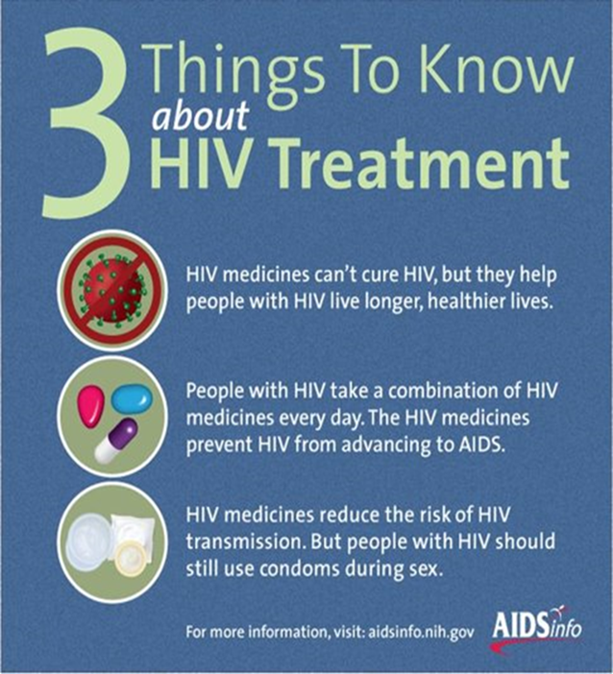
TREATMENT FOR HIV infection

Slide 29
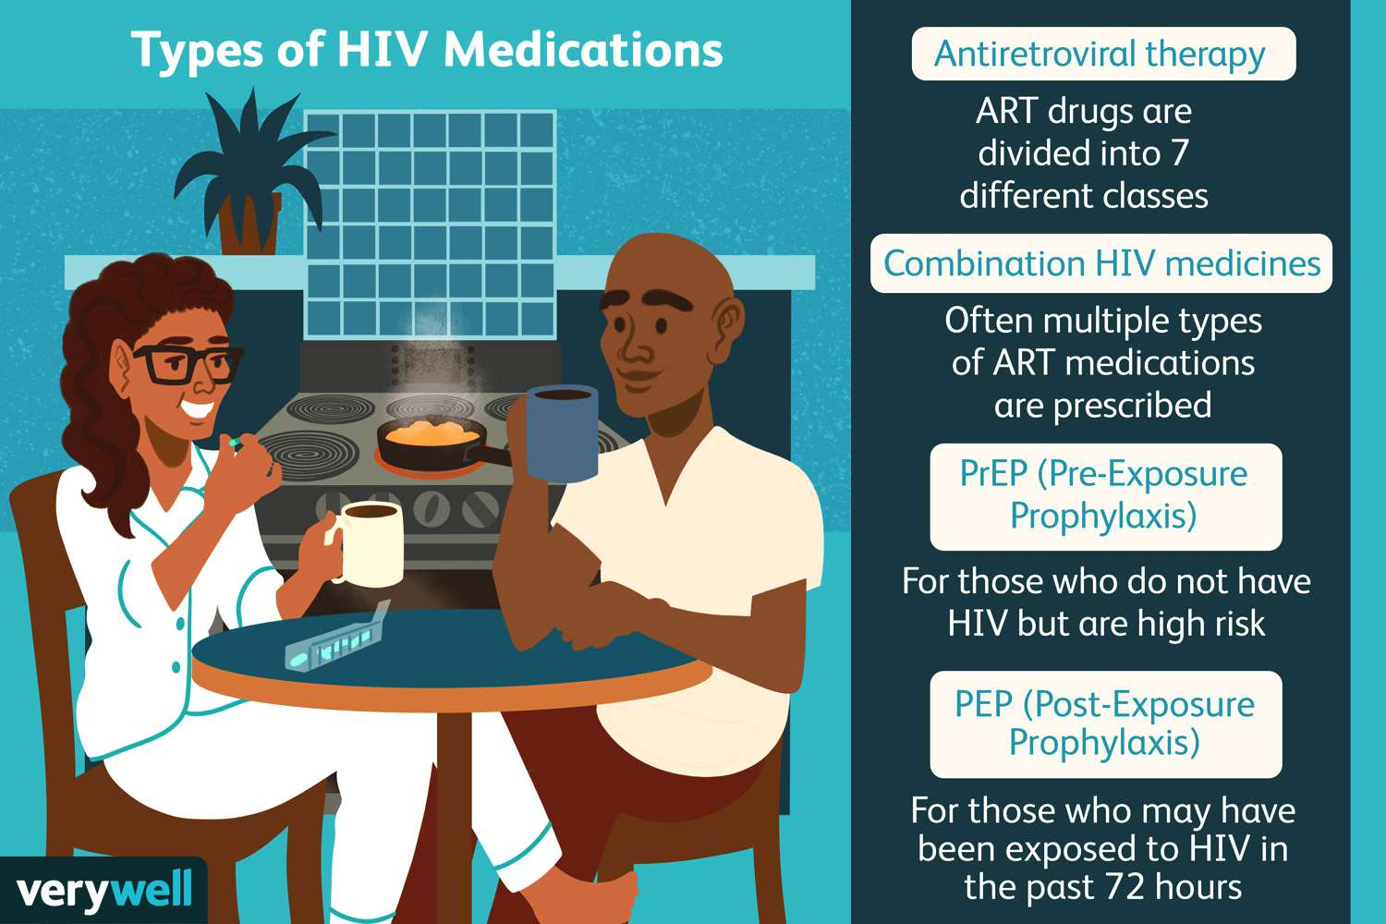

Slide 30
TREATMENT FOR HIV
Treatment and protocols are continually evolving and have made tremendous advances in recent years
Pharmacotherapy with antiretroviral therapy (ART)
Goals of ART therapy
Suppress HIV replication​
Reduce HIV-associated morbidity and prolong duration and quality of life​
Restore and preserve immunologic function​ of client
Prevent HIV transmission by reducing serum viral load
Use of combination therapy to prevent resistant HIV infection

Slide 31
Why is antiretroviral therapy (ART) compliance important?
If clients are non complaint with their ART, they may develop viral strains that are resistant to their current medication regimen.
If resistant strains develop, antiretroviral therapy may not be as effective in treating HIV/AIDS.
Risk of progressing from HIV+ to AIDS.
Increased risk of transmission.

Slide 32
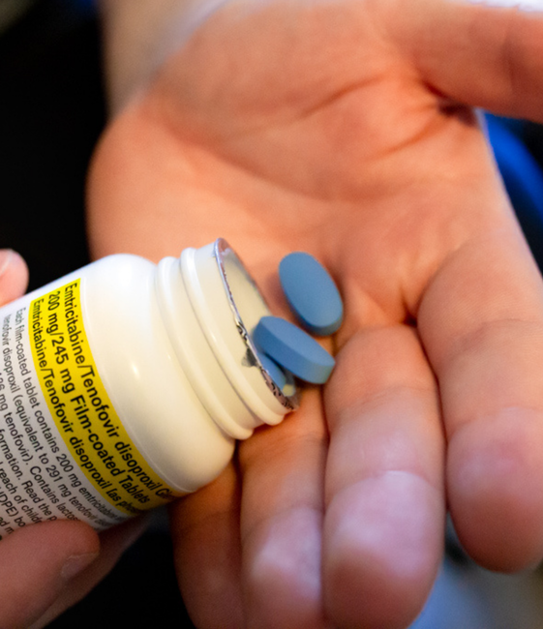
Combination drug therapy as Treatment for HIV
Multiple medication combinations are essential to prevent HIV resistance from developing
Medications have been combined in capsules for easier administration and reduce non-adherence
At least 2-3 medications are used in combination every day to suppress HIV replication

Slide 33
Overview of medications used in art
Fusion inhibitors
Block the entry of HIV into cells
Nucleoside reverse transcriptase inhibitors
Block the conversion of HIV RNA to DNA
Prototype: zidovudine (AZT)
Used in pregnant women to prevent passing the HIV to unborn child
Also given to newborns to protect from HIV mother
Non-nucleoside reverse transcriptase inhibitors
Block the conversion of HIV RNA to DNA
Protease inhibitors
Blocks proteases from forming the final HIV protein products

Slide 34
ART: nursing management
Monitor lab results
CBC
LFT
CD4 count
Client education
Adverse effects of medications
Methods to decrease the severity of adverse effects
Compliance
Take medications on a regular schedule and do not miss doses
Can lead to drug resistance

Slide 35
Pulmonary Manifestations of AIDS
Pneumocystis (PCP) pneumonia
Most common AIDS-related opportunistic infection
Initial symptoms may be nonspecific
Progressive dyspnea, fever, nonproductive cough, chest discomfort
If untreated, progresses to respiratory failure
Mycobacterium avium complex (MAC)
Tuberculosis
What nursing assessments should be performed on the client’s respiratory system?

Slide 36
Answer: respiratory assessment in AIDS
Rate, depth, effort and pattern; accessory-muscle use; can the client speak in full sentences; position of comfort.
SpO₂ at rest and with exertion – PCP classically desaturates with activity while the x-ray looks mild; ABGs when ordered.
Auscultate all fields for crackles, diminished sounds and wheezes; note dyspnea on exertion and orthopnea.
Cough: dry and nonproductive (PCP) versus productive; sputum color and blood; night sweats, fever pattern, weight loss (TB, MAC).
Cyanosis of lips and nail beds; level of consciousness and restlessness as early hypoxia signs; chest discomfort.
Screen for TB and keep airborne precautions until it is ruled out; collect sputum for PCP and AFB as ordered.
Interventions: oxygen, semi-Fowler’s, incentive spirometry, energy conservation, TMP-SMX (Bactrim) to treat PCP and to prevent it once CD4 is below 200.

Slide 37
Gastrointestinal manifestations of aids
Candidiasis
Oral, esophageal, stomach
Diarrhea from opportunistic infection
Wasting syndrome
Involuntary loss of more than 10% of body weight and loss of muscle, plus 30 days of either diarrhea or weakness and fever
What nursing interventions and education should be provided for clients experiencing GI manifestations of AIDS?

Slide 38
Answer: GI manifestations of AIDS – interventions and education
Assess daily weight, intake and output, skin turgor and mucous membranes, stool number and character, albumin and electrolytes – potassium especially.
Nutrition: small frequent high-calorie, high-protein meals, oral supplements, dietitian referral, appetite stimulants (megestrol, dronabinol) as ordered.
Candidiasis: inspect the mouth daily; soft, cool, non-acidic foods; gentle oral care; nystatin swish-and-swallow or fluconazole.
Diarrhea: fluids and electrolytes (IV if needed); low-fat, low-fiber, lactose-free diet; no caffeine or very hot or spicy food; antidiarrheals only after infection is ruled out; barrier cream for perianal skin.
Food safety: no raw eggs, undercooked meat, unpasteurized dairy or juice, raw sprouts; wash produce; safe water; hand hygiene before eating.
Wasting: weigh weekly, resistance exercise as tolerated, treat the underlying infection, control nausea before meals.

Slide 39
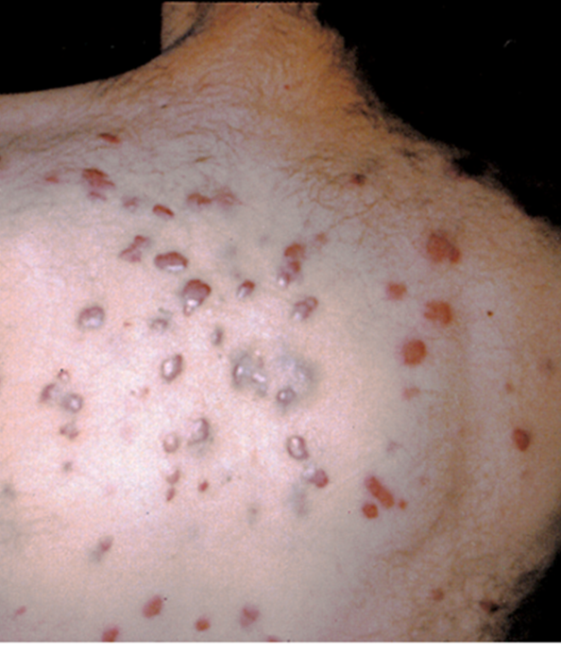
Oncologic manifestations of aids
Kaposi Sarcoma (KS)
Brownish pink to deep purple skin lesions
May be flat or raised
Surrounded by ecchymosis and edema
Lesions cause discomfort, disfigurement, ulceration, and potential for infection
B-cell, Hodgkin, and non-Hodgkin lymphomas
Poor prognosis related the need for chemotherapy in a severely immunocompromised client

Slide 40
neurologic manifestations of aids
HIV encephalopathy
Progressive cognitive, behavioral, and motor function decline
May lead to seizures
Cryptococcus Neoformans
Fungal infection that causes fever, headache, malaise, stiff neck, N/V, mental status changes, seizures
CMV (cytomegalovirus) retinitis
Herpes-type virus that can lead to visual impairment
Depression: High prevalence in clients with HIV/AIDS
What nursing interventions and education should be provided for clients experiencing neurologic manifestations of AIDS?

Slide 41
Answer: neurologic manifestations of AIDS – interventions and education
Assess level of consciousness, orientation, memory, speech, gait and balance, headache, neck stiffness, vision and seizure activity every shift.
Safety: bed low and locked, call light in reach, help with walking, clear pathways, night light; seizure precautions with suction and oxygen at the bedside.
Cognitive decline: one-step instructions, a consistent routine, calendar and clock, written medication schedules, pill organizers, family reminders.
Cryptococcal meningitis: amphotericin B then fluconazole; dark quiet room; watch for rising intracranial pressure – worsening headache, vomiting, change in LOC.
CMV retinitis: ganciclovir; report floaters or blurred vision at once; regular eye exams; adapt the home for low vision.
Screen for depression and suicide risk at every visit; counseling, antidepressants, support groups; support caregivers; start advance-care planning early.

Slide 42
Nursing management: opportunistic infections
Stress the importance of regular office visits
Assess for manifestations of opportunistic infections, including unusual neoplasms
Immediately report indications of infection to the provider
Monitor CD4 count to assess the level of remaining immune function
Monitor viral load level to assess effectiveness of the medication regimen

Slide 43
Nursing plan of care
Develop a plan of nursing care for a client diagnosed with HIV infection. What are the priority nursing assessments and interventions? What education would you provide?

Slide 44
Answer: nursing plan of care for the client with HIV
Priority assessments
Vital signs and temperature; breathing and SpO₂; weight, nutrition and hydration; skin, mouth and perianal area; neurologic status; CD4, viral load and CBC; medication list and adherence; mood, support system and safety at home.
Priority interventions
Protect from infection (hand hygiene, precautions, prophylaxis); give ART and other drugs on time; manage fever, pain, nausea, diarrhea and fatigue; keep up nutrition and skin integrity; balance activity and rest; refer to case management, social work and counseling.
Education
How HIV is and is not transmitted; ART adherence and side effects; signs of opportunistic infection to report; food and water safety; safer sex and U = U; PrEP for partners; vaccines; avoiding tobacco, alcohol and drugs; support groups and legal rights.

Slide 45
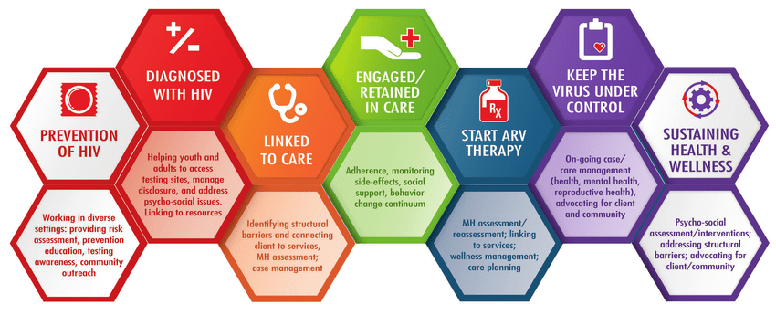

Slide 46
HIV/AIDS: emotional & Ethical Concerns
HIPAA
Prejudices and stigma
Fear of infection
Failure to disclose HIV status

Slide 47
Infectious diseases

Slide 48
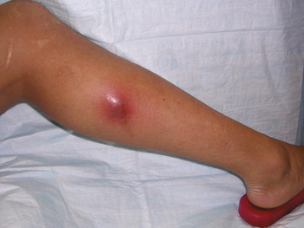
Methicillin-Resistant Staphylococcus Aureus (mrsa)
Easily colonizes on skin
Individual serves as a reservoir for MRSA transmission to others
Infection can spread to wounds or immunocompromised clients
Treated with mupirocin ointment if not extensive, or IV vancomycin if severe or systemic
Admission screenings
Contact isolation recommended by CDC

Slide 49
Vancomycin-Resistant Enterococcus (VRE)
Normally found in the GI tract
Admission screenings done
Survives well on skin/hands and environmental objects
2nd most common source of HAI in US
Contact isolation

Slide 50

Central Line Associated Blood Stream Infection (CLABSI)
What nursing interventions should be implemented to prevent central line associated blood stream infections?

Slide 51
Answer: preventing CLABSI – the central line bundle
Hand hygiene before every contact; maximal sterile barrier for insertion (cap, mask, sterile gown and gloves, full-body drape); chlorhexidine skin prep.
Avoid the femoral site, use ultrasound guidance and an insertion checklist – the nurse is empowered to stop the procedure if sterility breaks.
Scrub the hub with alcohol for 15 seconds and let it dry before every access; keep needleless connectors capped.
Dressing: transparent semipermeable every 7 days, gauze every 2 days, either at once if wet, soiled or loose; chlorhexidine dressing; assess and date it every shift.
Change IV tubing per policy (continuous every 96 hours, lipids every 24 hours, blood every 4 hours); daily chlorhexidine bathing in ICU.
Ask every day whether the line is still needed and remove it as soon as it is not – line-days drive the infection rate.

Slide 52
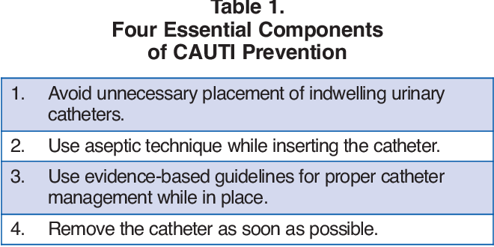
Catheter Associated Urinary tract infection (CAUTI)
What nursing interventions should be implemented to prevent catheter associated urinary tract infections?

Slide 53
Answer: preventing CAUTI
Insert only for a true indication – retention, exact output in the critically ill, protecting a perineal wound, comfort at end of life – never for incontinence or convenience.
Aseptic insertion by trained staff, the smallest catheter that works, secured to the thigh with a securement device.
Keep the closed system closed: bag below the bladder but off the floor, tubing free of kinks and dependent loops, empty into a clean container used only for that client, sample from the port.
Daily perineal care with soap and water and after every bowel movement; hand hygiene and gloves for any handling.
Assess need every day and remove early – nurse-driven removal protocols; use a bladder scanner, straight catheterization, or an external (condom or PureWick) catheter instead.
Watch for fever, flank pain, cloudy or foul urine, and new confusion in older adults.

Slide 54
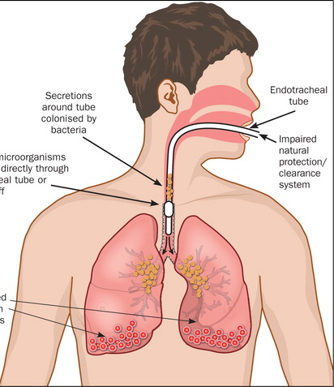
Ventilator Associated Pneumonia (VAP)
What nursing interventions should be implemented to prevent ventilator associated pneumonia?

Slide 55
Answer: preventing VAP – the ventilator bundle
Head of bed at 30–45 degrees at all times unless contraindicated.
Oral care: brush teeth every 12 hours and give chlorhexidine or antiseptic oral care per policy every 2–4 hours; suction oral secretions.
Daily sedation interruption and spontaneous breathing trial – extubate as soon as it is safe.
Endotracheal tube with subglottic suctioning; cuff pressure 20–30 cm H₂O; drain circuit condensate away from the client; change circuits only when soiled.
Hand hygiene and gloves; sterile technique for tracheal suctioning; turn every 2 hours; early mobility.
DVT and stress-ulcer prophylaxis; avoid gastric overdistension with tube feeds; check tube placement and residuals.

Slide 56
Diarrheal diseases
Significant cause of mortality worldwide, especially in children (CDC, 2020j)
Priority concern: Dehydration
Most effective treatment: Hydration
Primarily transmitted through oral ingestion

Slide 57
Common Diarrheal diseases
Calicivirus (Norovirus)
Campylo-bacter
Salmonella
Escherichia coli
Giardia lamblia

Slide 58
Diarrheal diseases: nursing management
What nursing assessments should be done and what interventions should be implemented to treat and prevent diarrheal disease?

Slide 59
Answer: diarrheal disease – assessment, treatment and prevention
Assess
Stool frequency, volume, blood or mucus; onset, food and travel history, recent antibiotics; vital signs and orthostatics, weight, skin turgor, mucous membranes, urine output; potassium, sodium, BUN and creatinine; stool culture, ova and parasites, C. difficile toxin.
Treat
Oral rehydration solution, IV fluids for moderate to severe loss; replace potassium; contact (enteric) precautions with soap-and-water hand washing; skin care; bland diet as tolerated, no caffeine, alcohol, dairy or high-fat foods; antimotility drugs only when there is no fever, blood or toxin; antibiotics only for specific organisms.
Prevent
Hand hygiene after toileting and before food; cook meat fully, wash produce, refrigerate leftovers, safe water when traveling; rotavirus vaccine for infants; antibiotic stewardship and limited PPIs to prevent C. difficile; report outbreaks to the health department.

Slide 60

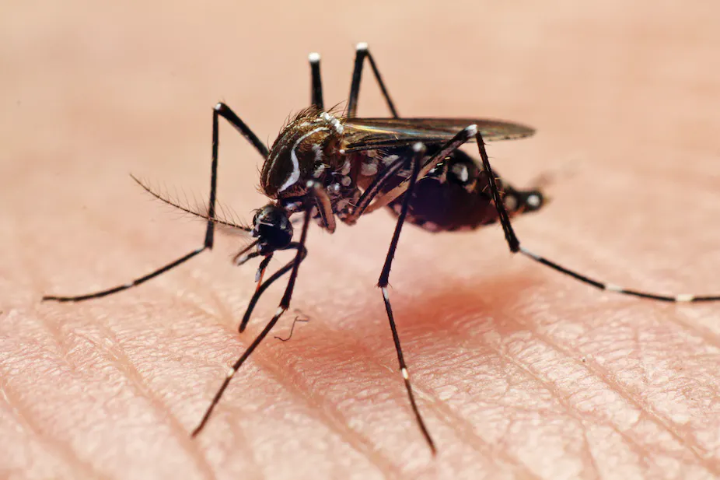
Emerging infectious diseases
Zika virus – global reduction in worldwide cases since 2017
West Nile virus – leading cause of mosquito-borne disease in the U.S.
Ebola virus disease – rare but severe, often fatal illness (50%)
Worldwide outbreak in 2014
Legionnaires Disease – multisystem illness that includes pneumonia and respiratory symptoms

Slide 61
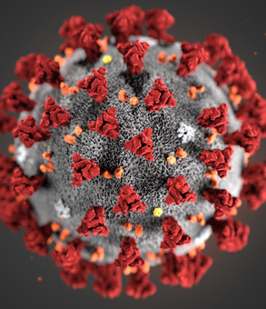
Emerging infectious diseases: covid-19
SARS-CoV-2 is primarily transmitted by close contact through droplets and aerosolized particles.
CDC recommendations include all PPE measures be taken including contact, airborne, and droplet precautions.
Primary prevention methods, like vaccination, should be included in nursing education.
Adults aged 65+ years, pregnancy, immunosuppression, and chronic lung disease increase risk of severe disease
Wide spectrum of clinical manifestations
About 80% of clients with mild symptoms can be managed at home
Severe disease may require oxygen and ventilatory support

Slide 62
immunizations

Slide 63
immunizations
Administration of vaccine causes production of specific protective antibodies
Contraindications
Previous serious reaction to vaccine
Some live vaccines contraindicated in severely immunosuppressed individuals and during pregnancy
CDC Adult Immunization Schedule by Age
Adult vaccines
Influenza - yearly
Herpes zoster (shingles)
COVID-19
Tetanus
Pneumococcal
Meningococcal
Hepatitis A & B
All healthcare workers should have documented immunity from MMR

Slide 64

Questions?

Slide 65
For review: isolation precautions

Slide 66

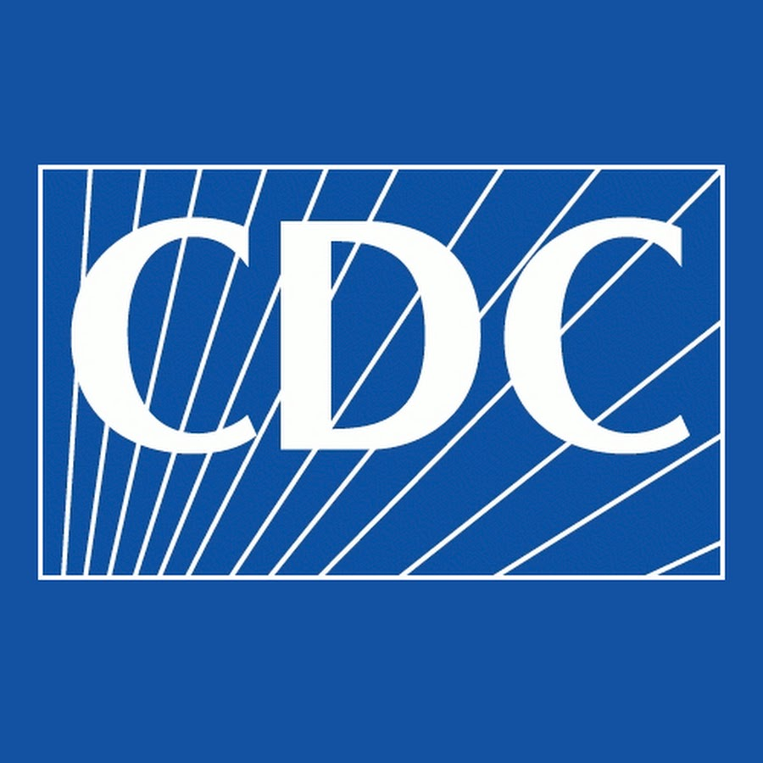

resources for infection control
World Health Organization (WHO)
Centers for Disease Control and Prevention (CDC)
Occupational Safety and Health Administration (OSHA)
The Joint Commission (TJC)
Local agencies (health departments)
Hospital/facility infection control specialists and facility policies

Slide 67
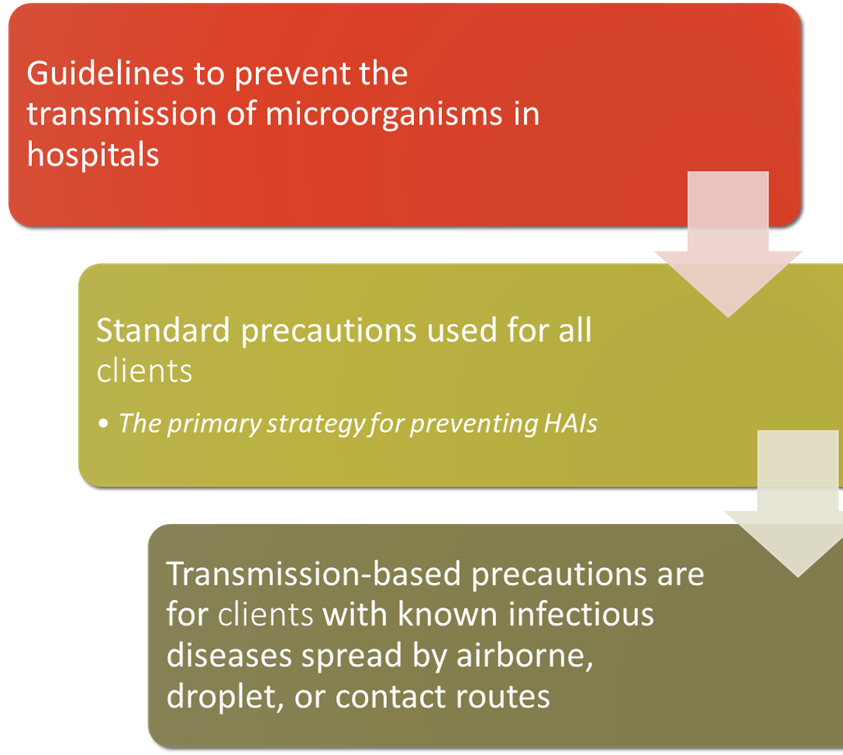
Isolation precautions

Slide 68
Standard precautions
Hand hygiene
Use of gloves and other barriers (PPE)
Proper handling of client care equipment and linen
Environmental controls
Prevention of injury from sharps and needles
Clients’ room assignments within facility
These are used for ALL clients!

Slide 69
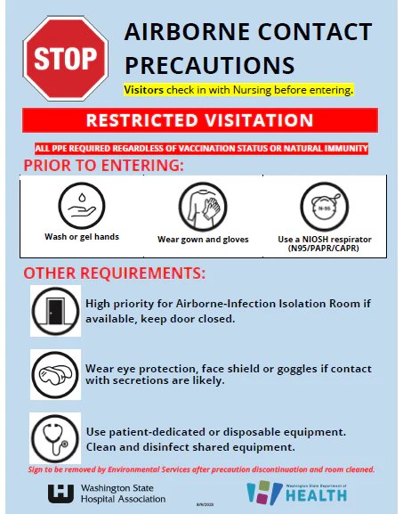
Airborne precautions
For clients with airborne pathogens
TB
Varicella
Measles
Private, negative air pressure/airflow room
Keep door closed
Negates room pressure if left open
N-95 mask

Slide 70
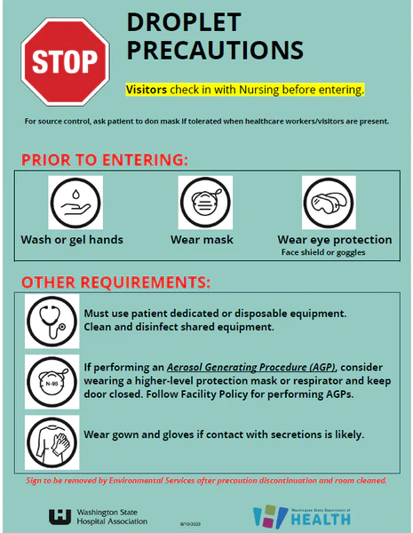
Droplet precautions
Transmission by close contact
Influenza, meningitis, mumps, pertussis
Face mask used within 3 to 6 feet of the client
Private room
Door can remain open

Slide 71
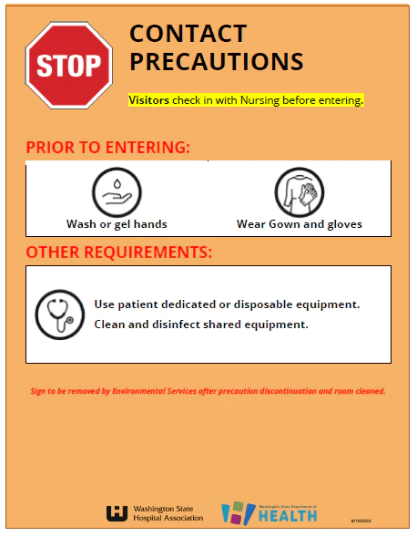
Contact precautions
Spread by skin-to-skin contact
MRSA, VRE
Private room, or room with client who has same infection
Gowns
Masks not needed
Doors do not need to be closed
Organism is easily transmitted from client to healthcare worker

Slide 72
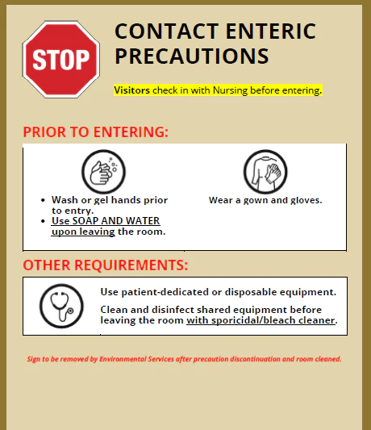
Clostridium difficile (C. diff)
Related to antibiotic therapy or immunosuppression
Toxins from bacteria are released into the bowel and cause excessive diarrhea
Spreads easily
Treated with oral vancomycin or metronidazole
Special contact precautions
Use gowns and gloves for all client contact
Handwashing with soap and water
Clean equipment with a bleach product

