Slide 1

Allergic, inflammatory, and Immunologic (rheumatic) disorders

Slide 2
Module Learning Objectives
Describe the nursing management of a client with an allergic disorder.
Use the nursing process as a framework for care of the client with an inflammatory rheumatic disorder.

Slide 3
Allergic disorders

Slide 4
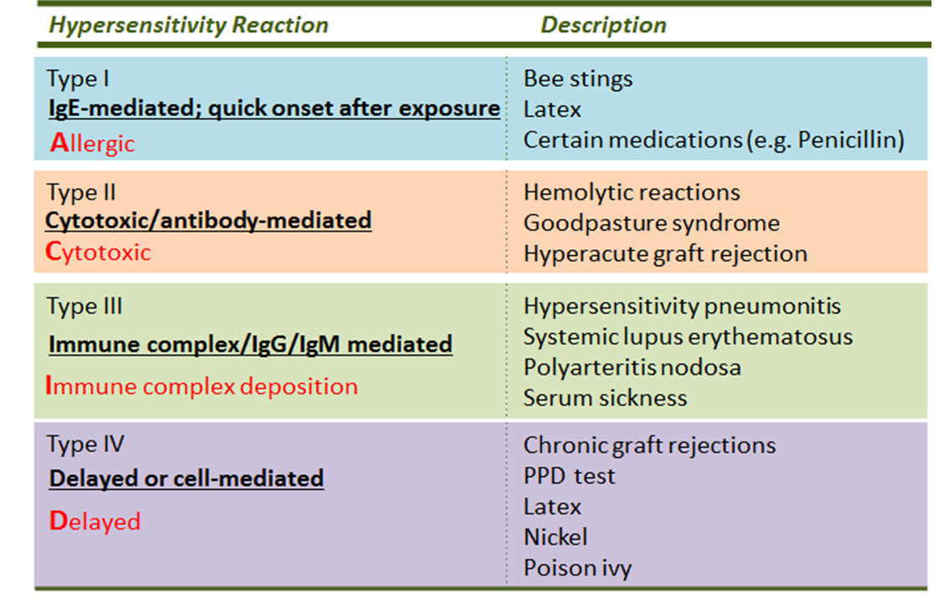
Types of hypersensitivity reactions

Slide 5
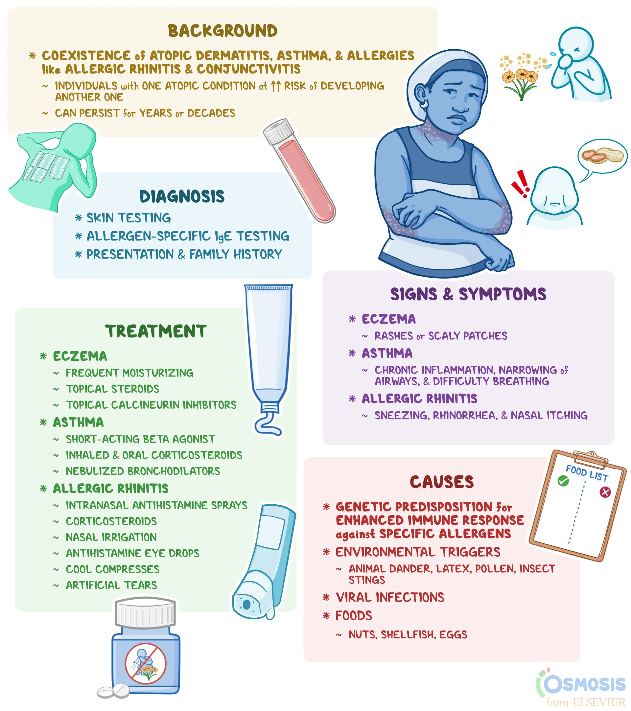
Allergic Reactions
Allergy
Allergen
Atopy

Slide 6
Answer: allergy, allergen, atopy
Allergy
An exaggerated, inappropriate immune response to a substance that is harmless to most people – a type I (IgE-mediated) hypersensitivity in most cases, ranging from a runny nose to anaphylaxis.
Allergen
The antigen that triggers the allergic response: foods (peanut, shellfish, egg, milk), drugs (penicillin, sulfa, NSAIDs, contrast dye), insect venom, latex, pollen, dust mites, animal dander, mold.
Atopy
The inherited tendency to make IgE against common environmental allergens – shows up as the “atopic triad”: allergic rhinitis, asthma and atopic dermatitis (eczema), often running in families.

Slide 7
Evaluation of Allergic Disorders
Describe how the nurse evaluates a client’s allergy status. What questions are appropriate to ask and why?

Slide 8
Answer: evaluating a client’s allergy status (1 of 2)
Ask, and why
“What are you allergic to?” – drugs, foods, latex, environmental, insect stings, contrast dye; include over-the-counter products and herbals.
“What exactly happens when you are exposed?” – separates a true allergy (hives, swelling, wheeze, anaphylaxis) from a side effect or intolerance (nausea from codeine, upset stomach from antibiotics); only true reactions go on the allergy band.
“How soon after exposure, and how severe? Did you need epinephrine or an ER visit?” – guides risk and whether an EpiPen is needed.
“When did it last happen, and what treated it?” – some drug allergies are outgrown; documents what worked.
“Any family history of allergy, asthma or eczema?” – atopy runs in families. “Any latex reactions, or allergies to banana, kiwi, avocado, chestnut?” – latex-fruit cross-reactivity.
“Do you have asthma or take beta blockers?” – both make anaphylaxis harder to treat.

Slide 9
Answer: evaluating a client’s allergy status (2 of 2)
Then
Physical assessment (skin, eyes, nose, lungs), review of skin-prick or serum IgE (RAST) results, eosinophil count; apply the red allergy band, document in the chart and the pharmacy profile, and re-check before every new medication, contrast study or surgery.

Slide 10
anaphylaxis
Potentially life-threatening allergic reaction
Rapid release of IgE-mediated chemicals like histamine
Mild, moderate, or severe symptoms
Symptoms are sudden in onset and may progress over minutes or hours
Penicillin is most common pharmacologic cause

Slide 11
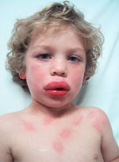
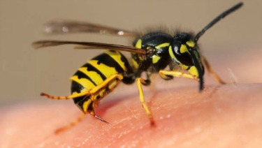
Anaphylaxis causes and manifestations
Food
Medications
Insect stings
Latex
Bronchoconstriction
Angioedema
Urticaria
Hypotension

Slide 12
Anaphylaxis: treatment
Assess client, including vital signs
Priority medication is IM epinephrine
Oxygen
Adjunct therapies
Antihistamines
Corticosteroids
Bronchodilators
IV fluids

Slide 13
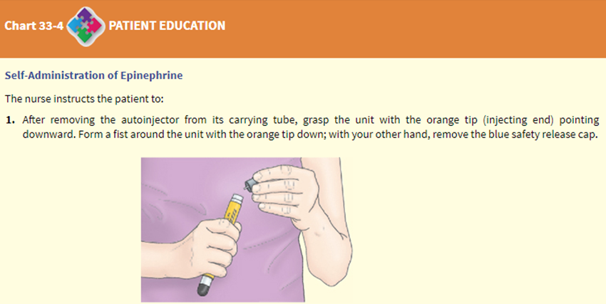
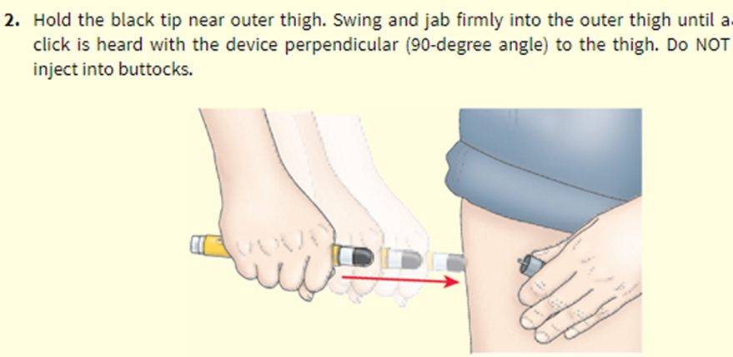
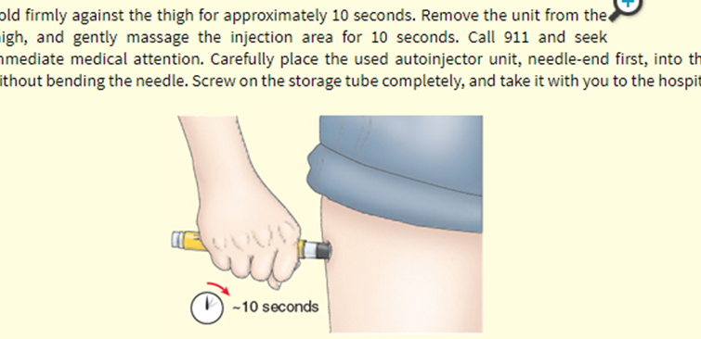
Self-administration of epinephrine

Slide 14
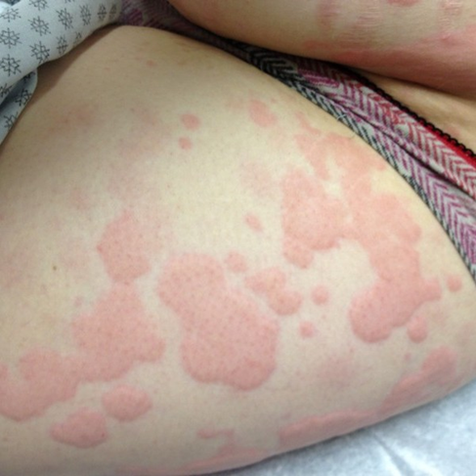
Urticaria (hives)
Pinkish, edematous elevations (wheals of variable size)
Associated with itching
Lesions come and go in minutes to hours
Acute urticaria from an allergen is not an emergency like anaphylaxis
Antihistamines are used for itching
If it persists for longer than 6 weeks, it is called chronic urticaria, and often no cause is found

Slide 15
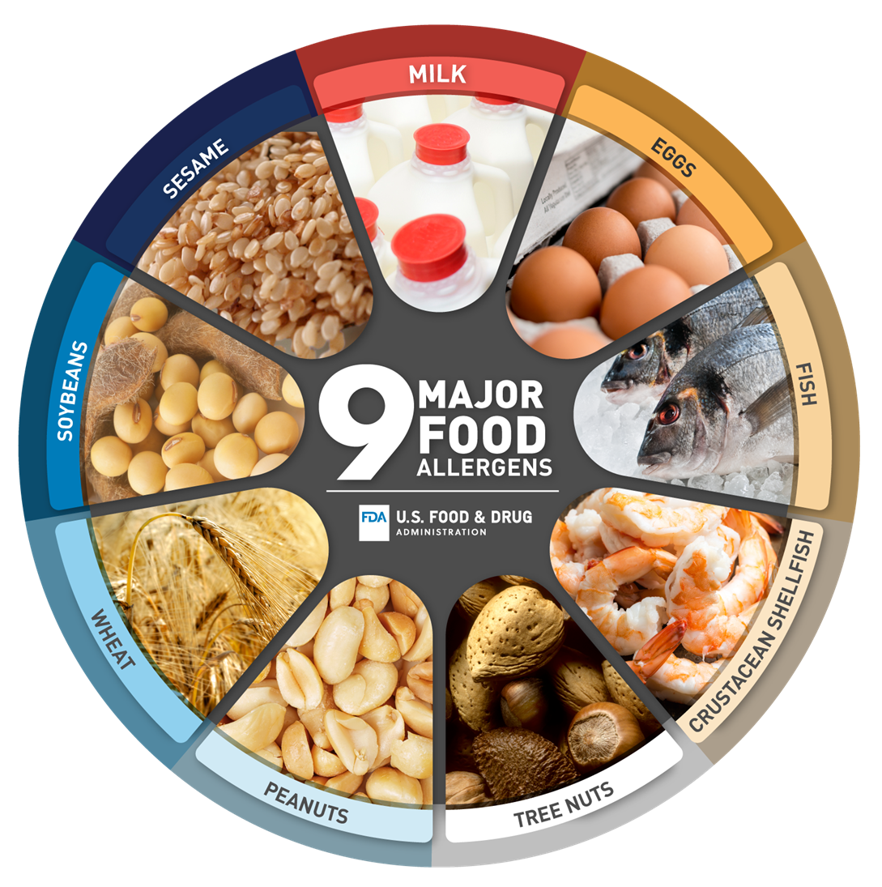
Food Allergies
5% of adults have food allergies
Genetic predisposition
Can occur with any food
Can result in simple urticaria or severe anaphylaxis
If allergy results in anaphylaxis, will need an Epi-Pen at home/person
May be hidden in unsuspected foods

Slide 16
Latex Allergy
4 - 7% of general population
At-risk populations
Powder in latex gloves becomes carrier for latex proteins; Can become airborne and inhaled during removal
Common cause of anaphylaxis is during the intraoperative period
How can healthcare workers decrease their exposure to latex?

Slide 17
Answer: reducing latex exposure for healthcare workers
Use non-latex gloves (nitrile, vinyl) for routine tasks and powder-free, low-protein latex gloves only when latex is truly needed – powder carries the protein into the air.
Avoid oil-based hand creams under latex gloves (they break the glove down and increase protein release); wash hands with mild soap after removing gloves.
Know the latex-containing supplies – catheters, tourniquets, blood-pressure cuffs, adhesive tape, syringe stoppers, some IV ports – and choose latex-free alternatives; keep latex-free carts.
Recognize early signs in yourself: itchy, red, cracked hands, hives, runny nose, watery eyes, wheeze after wearing gloves – report to employee health and get tested.
Anyone with a latex allergy: latex-free environment, allergy band and chart alert, tell every provider, carry epinephrine, and note the cross-reacting foods (banana, avocado, kiwi, chestnut).

Slide 18
Rheumatic disorders

Slide 19
Rheumatic Disease
Rheumatic diseases include more than 100 different disorders
Three distinct characteristics
Inflammation (redness, swelling and tenderness)
Autoimmunity
Degeneration and destruction of joints
Primarily affect joints, but also muscles, bone, ligament, tendons, cartilage
Can affect a single joint or multiple joints
Depending on the rheumatic disease, other organs may also be involved

Slide 20
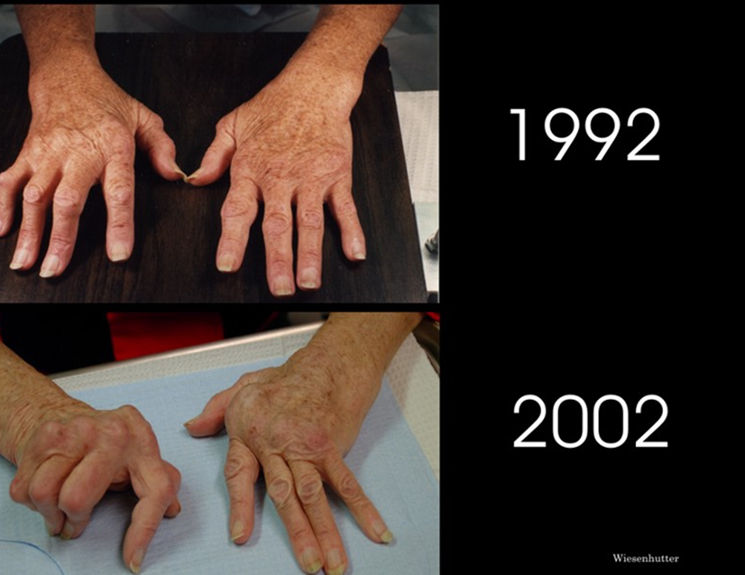
Rheumatoid arthritis
Chronic systemic inflammatory disease (autoimmune)
Destruction of connective tissue and synovial membrane within the joint
Weakens the joint, leading to dislocation and permanent deformity
Bilateral and symmetric
Typically begins in small joints of hands and feet

Slide 21
Rheumatoid arthritis: clinical manifestations
Inflammation, tenderness, and stiffness of the joints
Moderate to severe pain with morning stiffness lasting longer than 30 minutes
Joint deformities, muscle atrophy, and decreased range of motion in the affected joint
Low grade fever, fatigue, and weakness
Joints are spongy on palpation (filled with fluid)
Client may have systemic manifestations

Slide 22
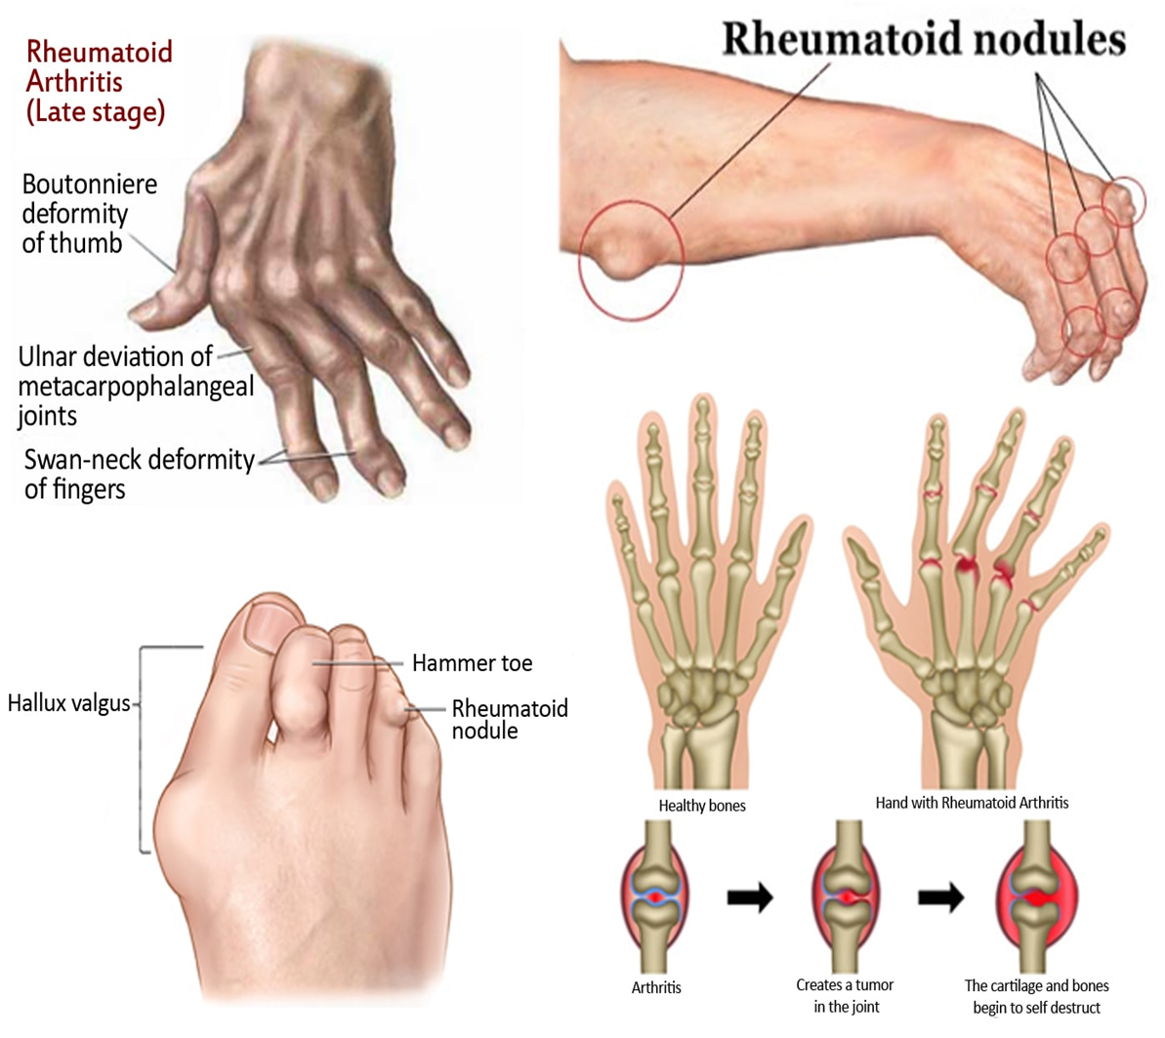

Slide 23
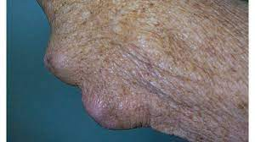
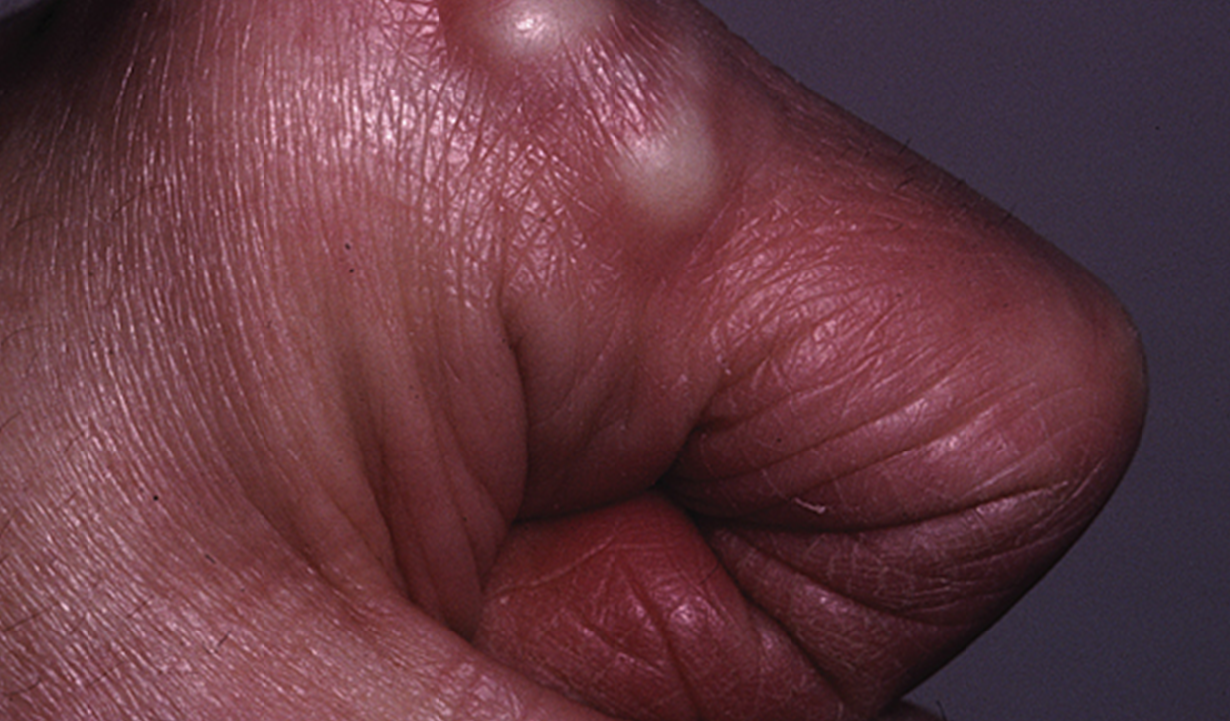
Rheumatoid Nodules
Occur more often in clients with elevated serum rheumatoid factor
Nontender and moveable lump of tissue, often over extensor surfaces like the elbow
Often associated with rapidly progressive and destructive disease
Can be injected with cortisone or surgically removed if very bothersome

Slide 24
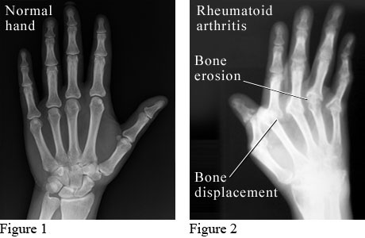
Rheumatoid arthritis: diagnostics
Serum rheumatoid factor (RF) antibody
Erythrocyte sedimentation rate (ESR)
C-reactive protein (CRP)
Radiography

Slide 25
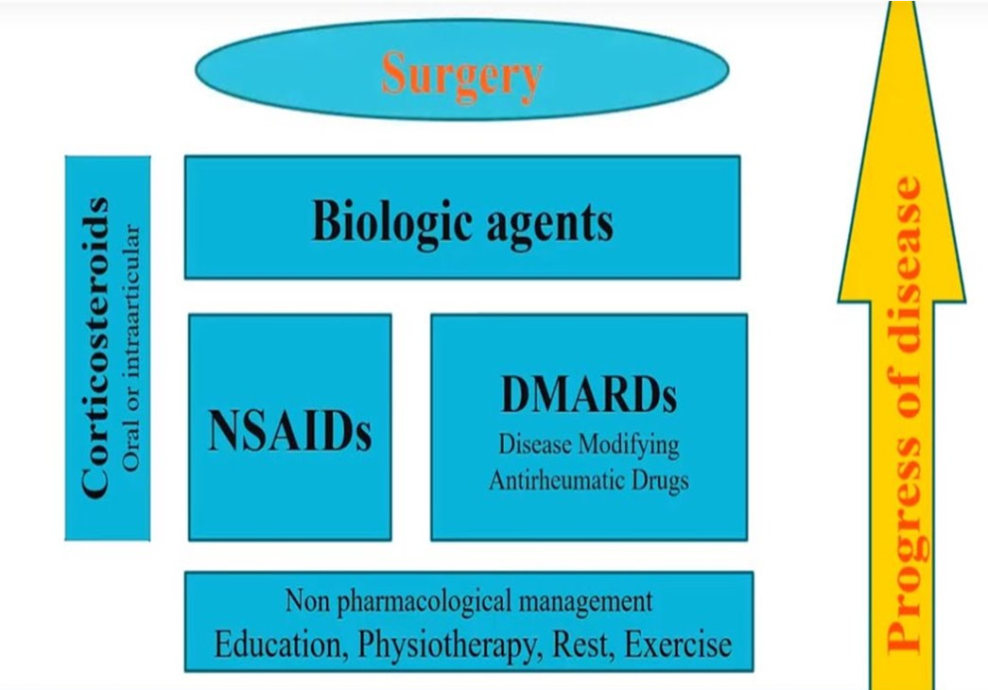
Rheumatoid Arthritis: medical management
NSAIDS
DMARDS
Corticosteroids
Reconstructive surgery
Joint arthroplasty

Slide 26
Rheumatoid Arthritis: pharmacotherapy
Nonsteroidal anti-inflammatory drugs (NSAIDs)
Non-biologic DMARD: Methotrexate
Biologic DMARD: Infliximab
Describe pharmacotherapy education the nurse should provide to the client with rheumatoid arthritis.

Slide 27
Answer: rheumatoid arthritis pharmacotherapy education (1 of 2)
NSAIDs (ibuprofen, naproxen, celecoxib)
Take with food; watch for GI bleeding (black stools, abdominal pain), kidney problems and raised blood pressure; do not combine NSAIDs; they relieve pain and inflammation but do not slow the disease.
Methotrexate (non-biologic DMARD)
Once a WEEK, never daily – a daily dose is fatal; take folic acid as prescribed; avoid alcohol; report mouth sores, fever, cough or shortness of breath, bruising, jaundice; labs (CBC, liver, kidney) every 4–12 weeks; strict contraception for both partners – it causes birth defects; takes 6–8 weeks to work.

Slide 28
Answer: rheumatoid arthritis pharmacotherapy education (2 of 2)
Infliximab and other biologic DMARDs (etanercept, adalimumab)
Suppress the immune system: TB test and hepatitis screen before starting; report any fever, cough or infection at once and hold the dose when sick; no live vaccines; infusion reactions with infliximab – premedicate and monitor during and after; teach injection technique and refrigeration for self-injected biologics.
Corticosteroids (prednisone)
Lowest dose for the shortest time; take in the morning with food; never stop suddenly; watch glucose, blood pressure, weight, mood, bone density (calcium and vitamin D), and infection.
General
Keep taking DMARDs even when you feel well; keep all lab appointments; combine with rest, heat and cold, splints, and exercise.

Slide 29
Rheumatoid Arthritis: nursing management
Assist with and encourage physical activity
Balance activity and rest
Provide referrals for OT and PT to maintain maximal function and ADLs
Facilitate use of assistive devices
Monitor for medication effectiveness
Adequate nutrition
Nonpharmacologic pain relief
Follow routine health screenings
Report manifestations that can indicate RA exacerbation
Express feelings regarding body image

Slide 30
Systemic lupus erythematosus

Slide 31
Systemic Lupus Erythematosus (Sle)
Chronic, progressive, systemic inflammatory disease that can cause failure of major organs and body systems
Exaggerated production of autoantibodies that attack many sites in the body
Immunologic, hormonal, and environmental factors
> 80% of clients with lupus are female
3 times more common in African Americans than Caucasians
Varies in severity and progression
Periods of exacerbations and remissions
No cure

Slide 32
Sle: clinical manifestations
Clinical manifestations caused by inflammation due to autoantibody attack
Systemic
Musculoskeletal
Cutaneous
Cardiovascular
Renal
Nephritis is the most common cause of increased mortality in SLE
Neurological

Slide 33
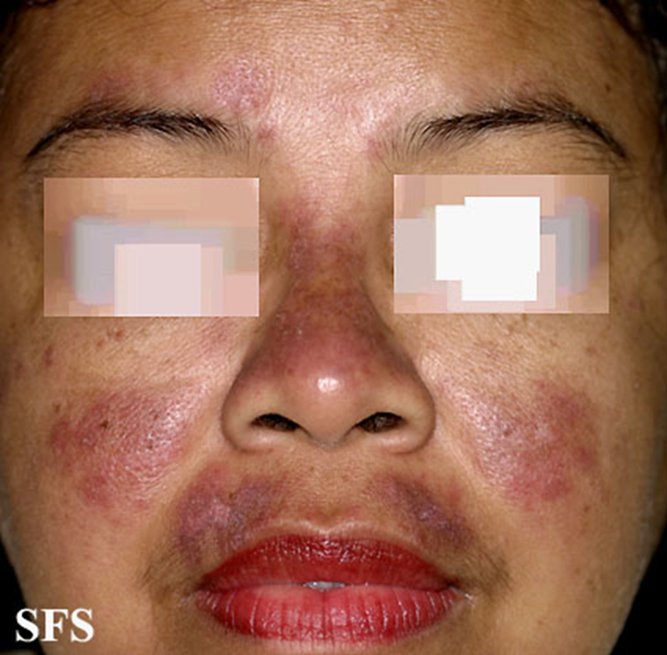
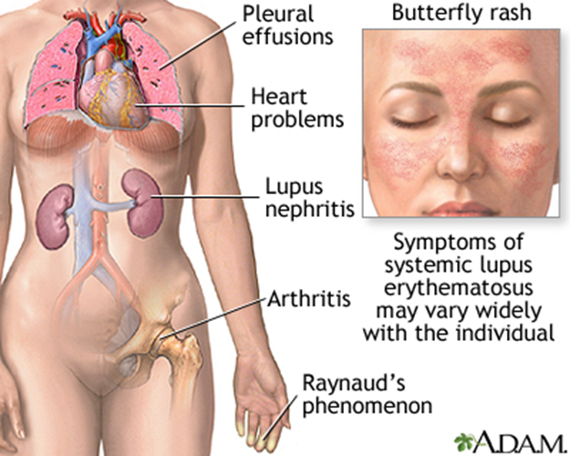

Slide 34
Sle: diagnostics
H&P
Serum diagnostics
Antinuclear antibodies
Present in autoimmune disorders and certain cancers
Positive in 95% of SLE cases
ESR and CRP elevated
CBC may show pancytopenia

Slide 35
Sle: medical management
Goals of medical management:
Symptom control
Prevention of further organ damage
Pharmacotherapy
NSAIDs
Corticosteroids
Biologic DMARDs
Non-biologic DMARDs
Antimalarials
Describe pharmacotherapy education the nurse should provide to the client with SLE.

Slide 36
Answer: SLE pharmacotherapy education (1 of 2)
Hydroxychloroquine (antimalarial)
The backbone drug for almost every client – keeps flares away and protects organs; take with food; takes months to work; eye exam at baseline and yearly for retinal toxicity; report vision changes; generally safe in pregnancy.
Corticosteroids
For flares and organ involvement; morning dose with food; never stop abruptly; watch glucose, blood pressure, weight, mood, infection, bone loss (calcium, vitamin D) and avascular necrosis of the hip.
NSAIDs
For joint pain and fever; with food; avoid in lupus nephritis and kidney disease; watch for GI bleeding.

Slide 37
Answer: SLE pharmacotherapy education (2 of 2)
Immunosuppressants (azathioprine, mycophenolate, cyclophosphamide, methotrexate)
For nephritis and severe disease: regular CBC, liver and kidney labs; report infection, bleeding, bruising; strict contraception – most are teratogenic; cyclophosphamide needs hydration and bladder protection.
Biologics (belimumab, anifrolumab)
Infusion or injection; screen for infection first; no live vaccines; report fever, depression or suicidal thoughts.
For everyone
Sun protection every day (SPF 30+, hats, cover up) because UV triggers flares; keep vaccines current (inactivated); rest during flares; report fever, chest pain, edema, foamy urine or new rash promptly; plan pregnancy only in remission and with the rheumatologist.

Slide 38
Sle: nursing management
Focused assessment
Monitor for medication effectiveness
Monitor for adverse effects of medication
Adequate nutrition
Pain relief: pharmacologic & nonpharmacologic
Follow routine health screenings
Report manifestations that can indicate SLE exacerbation or complications
Teach to avoid cold for hands/toes​​
Protect from sun exposure​​
Treatments for impaired skin integrity​
Provide psychosocial support

Slide 39
gout

Slide 40
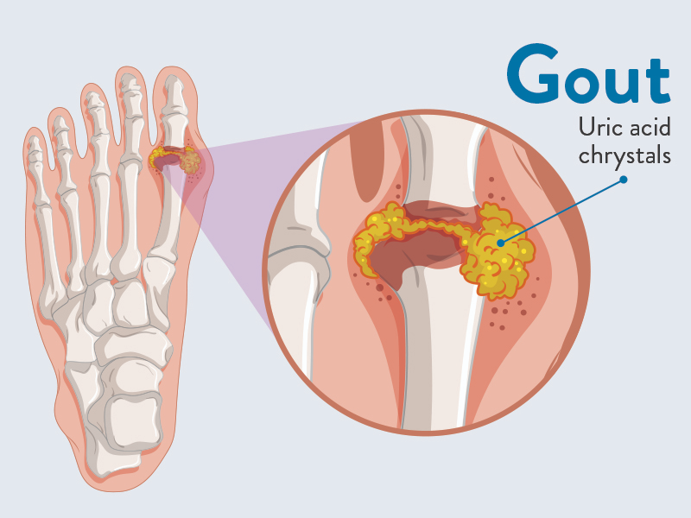
Gout
Most common form of intermittent inflammatory arthritis
Hyperuricemia occurs, causing uric acid crystals to deposit in joints and body tissues
Uric acid results from the breakdown of purines in cells

Slide 41
Gout: risk factors
Increasing age
Males are mainly affected until women reach menopause
Estrogen is protective against gout before menopause
High BMI
Genetic predisposition
High intake of purine rich foods
Alcohol ingestion
Chronic renal failure
Medications
Thiazide diuretics
Salicylates
Ethambutol
Nicotinic acid (niacin)
Cyclosporine

Slide 42
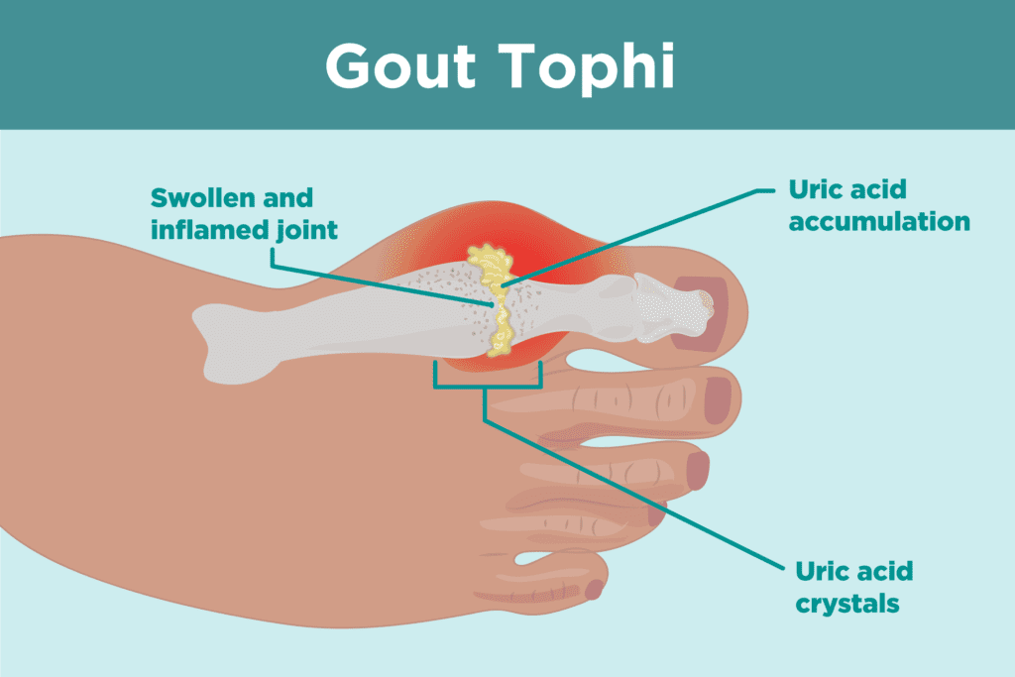
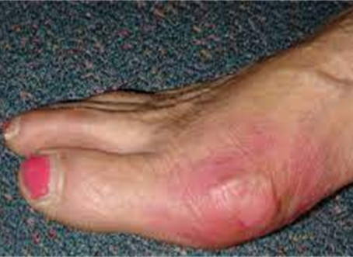
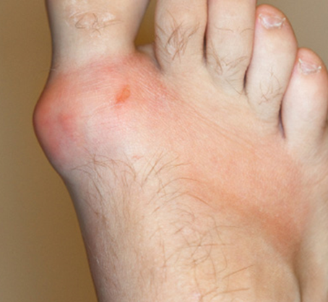
Gout: clinical manifestations
Severe pain, redness, warmth, edema of affected joint
Most common in big toe joint
Very painful when the swollen joint is touched or moved
Appearance of tophi in soft tissues (chronic gout)
Most attacks will subside over 3-10 days with treatment
Attacks come and go, but result in gradual joint damage

Slide 43
Gout: Pharmacotherapy
Medications are divided into 2 categories: preventive or treatment
Preventive
Allopurinol
Treatment
NSAIDs
Colchicine
Corticosteroids
What medication education should the nurse provide regarding pharmacotherapy for gout?
Notes:
First-line therapy for acute attack
Monitor for side-effects (renal injury, hypertension, edema, PUD, bleeding)
Colchicine:
Acute attack, when NSAIDs are not effective
Decreases inflammation caused by uric

Slide 44
Answer: gout medication education (1 of 2)
Allopurinol (prevention)
Take every day, with food and 2–3 L of fluid daily; do not start during an acute attack, but do not stop it if one occurs while on it; report any rash immediately (severe hypersensitivity, especially in Asian clients – HLA-B*5801); regular uric acid, kidney and liver labs; takes weeks to lower uric acid, so a colchicine or NSAID “bridge” is often given at first.
Febuxostat, probenecid
Alternatives for prevention: febuxostat – watch for cardiovascular effects and liver labs; probenecid – lots of fluid, avoid aspirin (it blocks the drug).
NSAIDs (naproxen, indomethacin) – acute attack
First-line; start at the first twinge; take with food; avoid with kidney disease, ulcers or anticoagulants.

Slide 45
Answer: gout medication education (2 of 2)
Colchicine – acute attack
Start within 12–24 hours of onset; stop and call if diarrhea, nausea or vomiting start (toxicity); low dose in kidney disease; dangerous with statins, clarithromycin and grapefruit; keep out of reach of children.
Corticosteroids – acute attack
Oral, IM or injected into the joint when NSAIDs and colchicine cannot be used; short course; watch glucose.
For everyone
Avoid aspirin and thiazide diuretics; limit alcohol (beer and spirits), organ meats, shellfish, sugary drinks; lose weight slowly – crash diets trigger attacks; drink water; rest and elevate the joint during an attack.

Slide 46
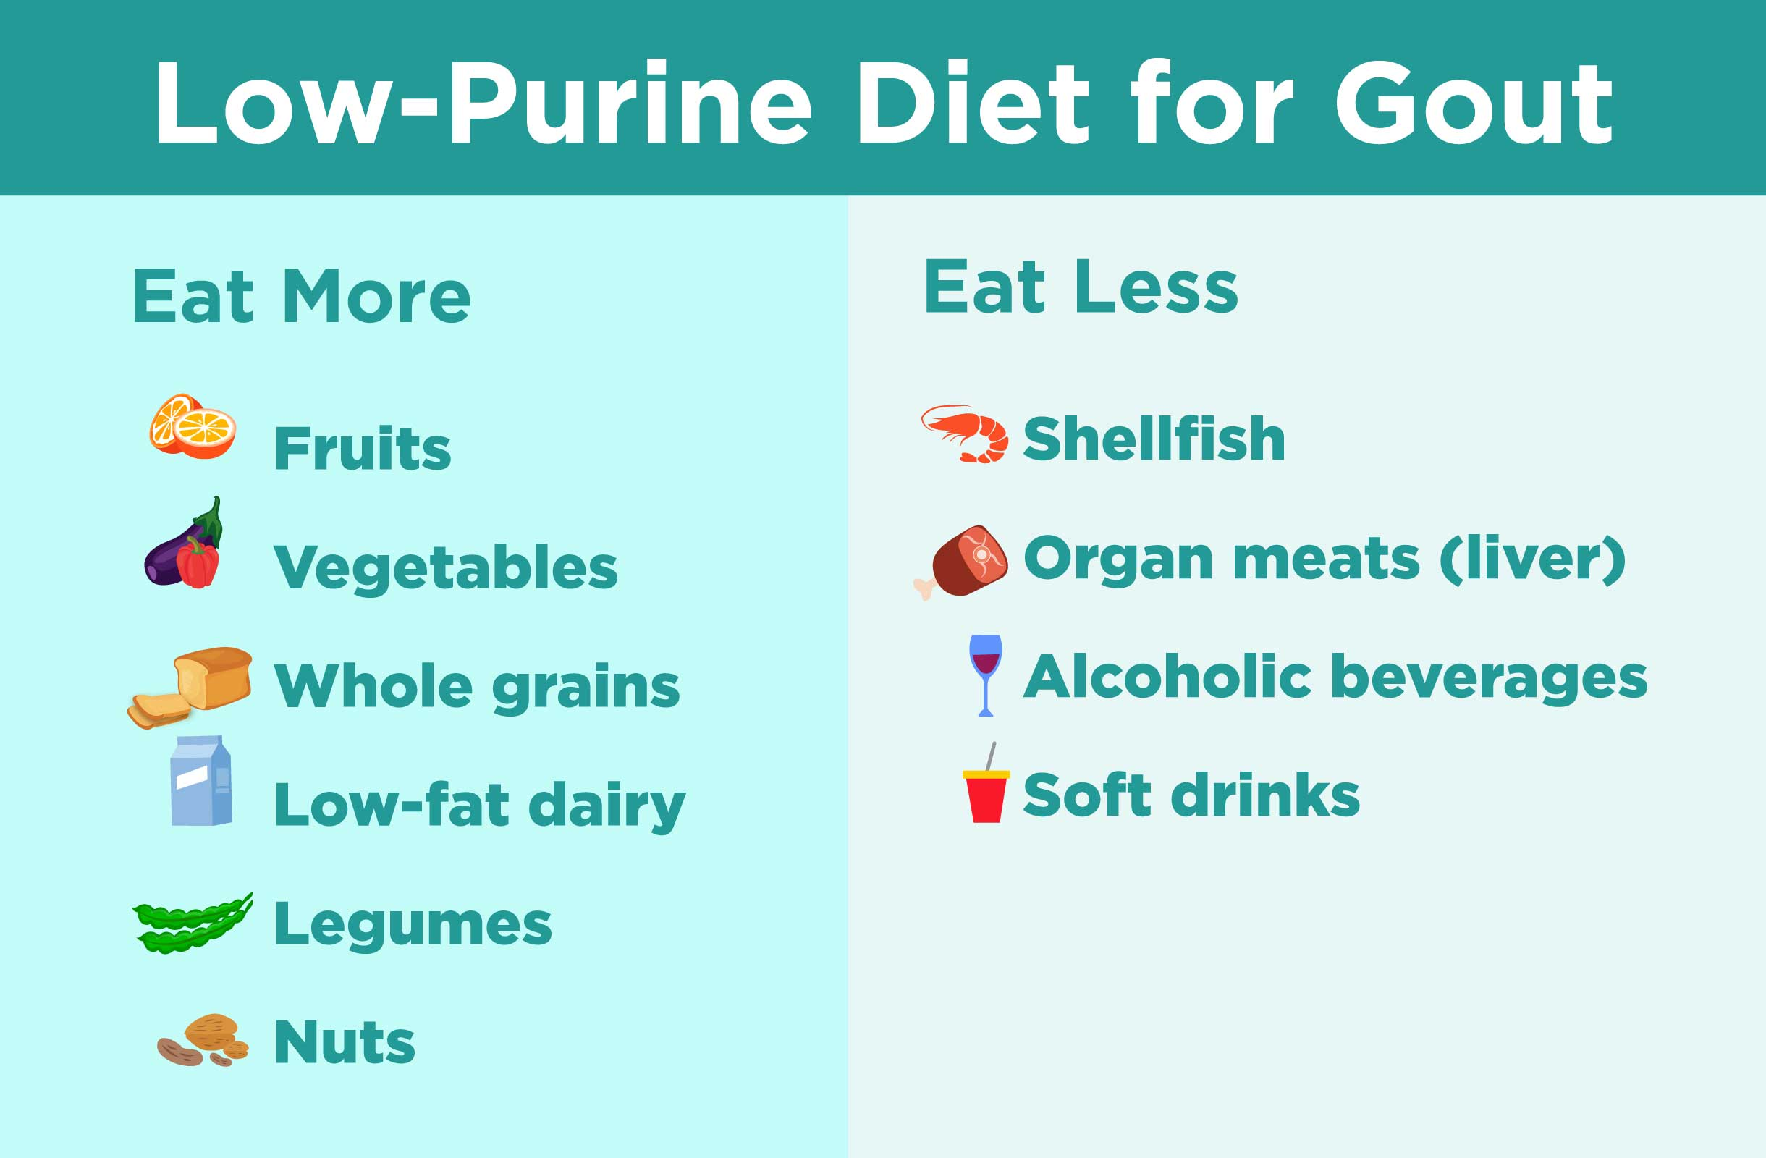
GOUT: nursing management and education
Low-purine diet
Limit intake of ETOH
Avoid starvation diets, aspirin, and diuretics
Limit physical or emotional stress
Increase fluid intake
Maintain normal body weight

Slide 47
fibromyalgia

Slide 48
Fibromyalgia
Chronic disorder that causes extensive musculoskeletal pain, fatigue, and sleep, cognitive, and mood problems.
Pain sensations are increased related to altered brain and spinal cord interpretation of painful and non-painful signals.
Symptoms usually appear after a traumatic event, such as surgery, infection, or considerable psychological stress.
Tension headaches, temporomandibular joint (TMJ) issues, irritable bowel syndrome, anxiety, and depression are common manifestations
More common in women

Slide 49
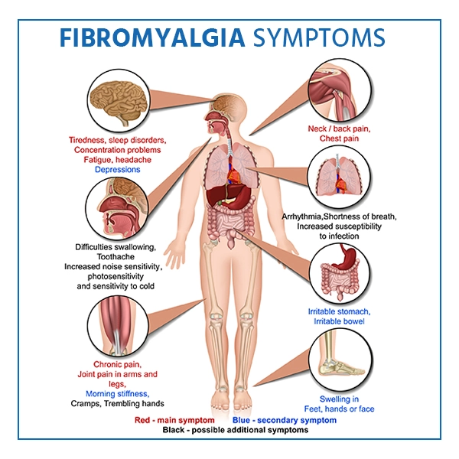

Slide 50
Fibromyalgia: Diagnostics and medical management
No specific tests for fibromyalgia
H&P
Often diagnosed through a “process of elimination.”
Medical treatment is aimed at reducing symptoms.
Pharmacotherapy
NSAIDs
SNRIs
GABA analogs
TCAs or zolpidem
Exercise, activity, PT/OT
Sleep hygiene

Slide 51
Fibromyalgia: nursing management and education
Assess/monitor pain, fatigue, mobility
Assist with symptom management
Limit intake of caffeine, alcohol, and other substances that interfere with sleep
Develop a sleep routine
Engage in low-impact exercise daily
Acupuncture, stress, management, tai chi, hypnosis can also be used
Medication education
Provide support and encouragement
Clients typically have had symptoms for extensive period and may feel that their symptoms have not been taken seriously

