Slide 1

INNOVATION MANAGEMENT EXPO
Innovista: Revolutionising Water Conservation and Monitoring
Presented by Team Innovista — pioneering smart solutions for a water-secure future.
Neeraj N
Arnold
2320030103
2320030480

Slide 2

THE CHALLENGE
The Global Water Crisis: A Looming Threat
Water is the world's most critical resource — yet it is rapidly becoming its most endangered. The scale of the crisis demands urgent, technology-driven action.
5B+
55%
People at Risk
Demand Surge
Over 5 billion people could face water scarcity by 2050 if consumption trends continue unchecked.
Global water demand is projected to surge by 55% by 2050, far outpacing sustainable supply levels.
70%
Industrial Draw
Industrial and agricultural sectors account for 70% of all global freshwater withdrawals annually.

Slide 3
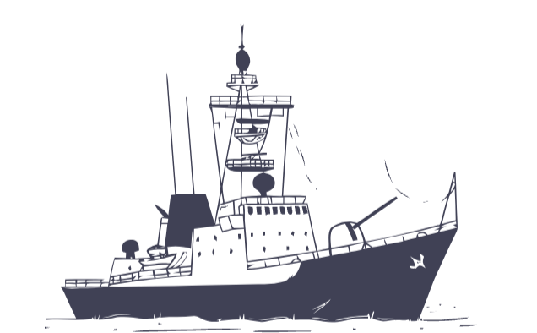


OUR SOLUTION
Introducing Innovista: Smart Water Management
Innovista is a next-generation, end-to-end water management platform that combines cutting-edge sensor hardware with AI-powered intelligence to deliver real-time monitoring, predictive analytics, and actionable conservation insights.
Real-Time Monitoring
AI-Driven Analytics
Versatile Applications
Continuous, 24/7 tracking of water quality, flow, and consumption across any infrastructure.
Machine learning algorithms detect anomalies, predict failures, and optimise usage patterns automatically.
Purpose-built for industrial plants, agricultural operations, and municipal water supply networks.

Slide 4
TECHNOLOGY
How Innovista Works: Precision Monitoring
The Technology Stack
Advanced Sensor Deployment
Innovista's architecture is built on three tightly integrated layers — physical sensing, data transmission, and intelligent analytics — working in concert to deliver unparalleled water intelligence in real time.
Multi-parameter sensors are deployable across rivers, reservoirs, distribution pipes, and irrigation channels, measuring flow rate, turbidity, pH, and contamination levels.
Real-Time Data Transmission
Data is streamed continuously to a centralised cloud dashboard, providing operators with live consumption patterns and instant alerts on deviations.
AI-Powered Anomaly Detection
Proprietary algorithms instantly flag leaks, inefficiencies, and quality issues, enabling rapid corrective action before waste escalates.

Slide 5
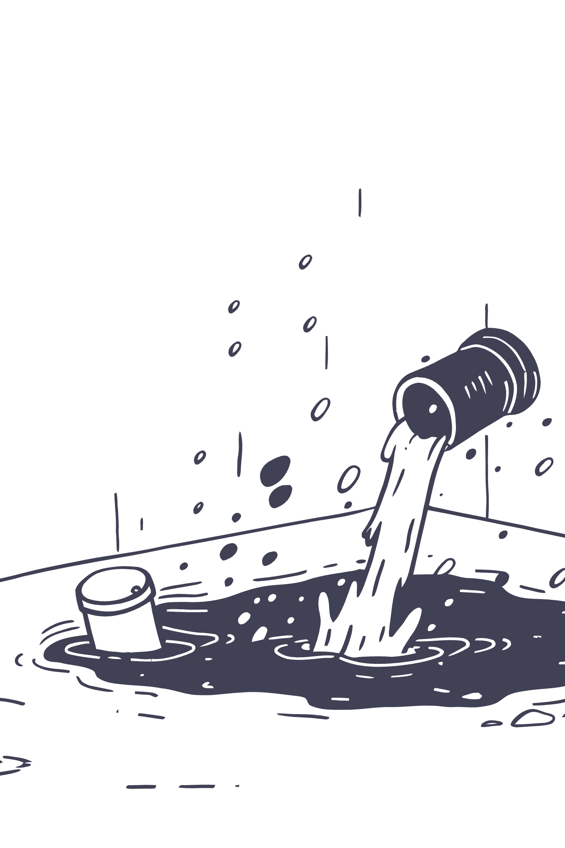
IMPACT
Innovista's Conservation Impact: Quantifiable Results
Innovista does not just monitor water — it actively drives measurable conservation outcomes, delivering verifiable results across every deployment scenario.
🔍 Leak Detection
⚙️ Optimised Usage
Reduces water loss by up to 30% in pilot projects by identifying and alerting on leaks within minutes of occurrence.
Achieves a 15–20% reduction in water consumption for industrial clients through intelligent demand-side management.
🔧 Predictive Maintenance
Forecasts infrastructure stress points before failure, preventing costly breakdowns and associated water wastage.

Slide 6

CASE STUDY 01
Case Study: Agri-Tech Innovations
Measurable Outcomes
25%
10%
Less Water Used
Crop Yield Gain
Significant reduction in total irrigation water consumption across the pilot farm.
Optimised watering schedules improved crop health, resulting in a 10% increase in total yield.
The Challenge
The Innovista Solution
This case demonstrates that smarter water use does not mean compromising productivity — it enhances it.
Large-scale farming operations were losing enormous volumes of water to inefficient, schedule-based irrigation that ignored actual soil and weather conditions.
Precision irrigation driven by real-time soil moisture sensors and live weather data feeds, ensuring water is applied only when and where it is needed.

Slide 7
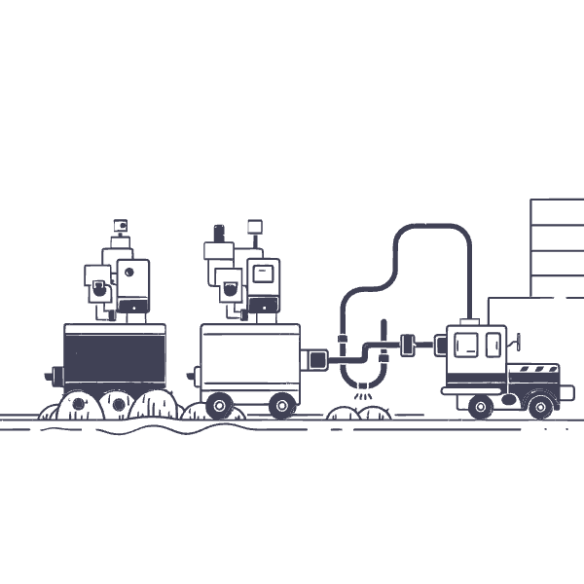
CASE STUDY 02
Case Study: Urban Water Management
Measurable Outcomes
18%
↑
NRW Reduction
Supply Reliability
Non-revenue water losses slashed by 18%, translating directly into operational cost savings for the municipality.
Citizens experienced markedly improved water pressure consistency and fewer supply interruptions.
The Challenge
The Innovista Solution
Ageing underground pipe networks were causing rampant non-revenue water (NRW) losses, with leaks going undetected for weeks and straining city budgets.
A city-wide network of pressure and flow sensors enabling precise leak localisation and dynamic pressure zone optimisation across the distribution grid.

Slide 8

THE ADVANTAGE
The Innovista Advantage: Beyond Monitoring
Innovista delivers value that extends well beyond data collection — it transforms water management into a strategic asset for organisations committed to efficiency, sustainability, and compliance.
Significant Cost Savings
Clients experience substantial reductions in water utility bills and operational expenditures, delivering a fast and measurable return on investment.
Environmental Stewardship
By reducing waste and optimising consumption, Innovista directly contributes to sustainable water resource management and a lower environmental footprint.
Regulatory Compliance
Automated reporting and audit trails ensure organisations meet water usage quotas and quality standards with confidence and minimal administrative burden.

Slide 9
OUR TEAM
Meet the Innovista Team
Team Innovista is a multidisciplinary group of passionate engineers and data scientists united by a shared mission: to harness technology in the service of the world's most precious resource.
Neeraj N
Project Lead
Drives hardware architecture, sensor integration, and the end-to-end technical implementation of the monitoring system.
Arnold
Data Scientist
Leads AI model development, anomaly detection algorithms, and the data analytics engine powering Innovista's intelligence layer.

Slide 10


Innovista: Securing Our Water Future, Today.
Water is not merely a resource — it is the foundation of life, agriculture, and civilisation. The challenge of conserving it is the defining environmental imperative of our generation.
🌍 Conserve
📡 Monitor
Deploy smart monitoring to eliminate waste and drive measurable reductions in consumption across all sectors.
Ensure real-time visibility into every litre — from source to tap — with precision sensors and live analytics.
💡 Innovate
Continuously evolve our platform to meet the growing demands of a water-stressed world, together.
Join Team Innovista in building a more sustainable, equitable, and water-secure world. Let's conserve, monitor, and innovate for a better tomorrow — starting now.

