Slide 1


ENGLISH TITLE
中文标题
學生：XXX 導師：XXX

Slide 2
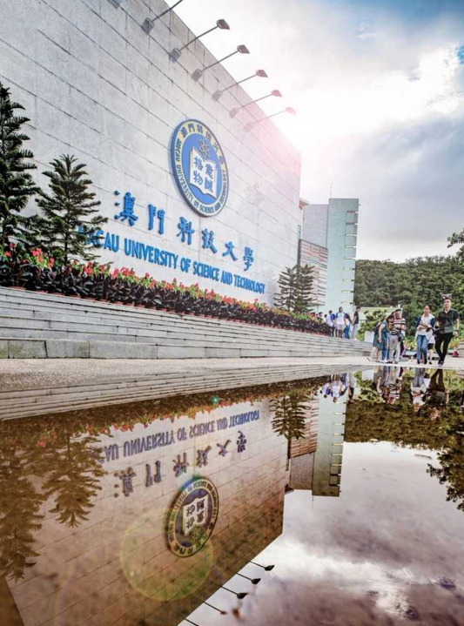
CONTENTS
01
02
選題背景Background
相關研究Related Works
03
04
研究方法
Methods
實驗設計
Experiments
05
總結展望
Conclusion & Plans

Slide 3

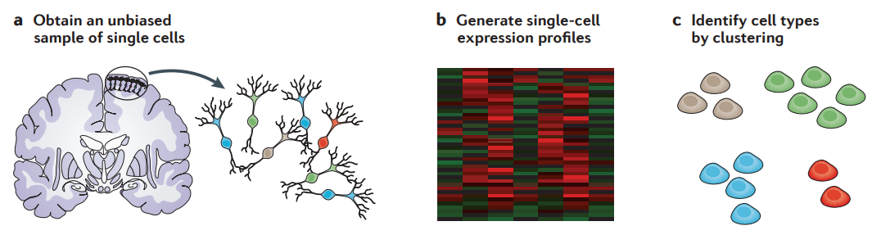
·
相關研究
研究方法
實驗設計
總結展望
選題背景
Background
Related Works
Methods
Experiments
Conclusion& Plans
Title
1.
2.
3.
…
Figure 1.2. XXXX
Figure 1.1. Simple procedure of Sc-RNA seq.[1]
Notes:
First of all please allow me to introduce some background. You know, my interest is about bioinformatics, but I'm exactly not good at biology. But as student in the school of computer science, we don't need to know a lot as biological students. We only need to know what the dataset is and how to handle it. So I will briefly talk about biological background to make you sense. Well obviously it’s a slice of human brain. It contains different cells with different genes. Traditionally, our techniques can read genes from this slice and do some analysis. But it takes average. It may ignore some effect of rare but important cells, like cancer. So recent years a new technique called single cell sequencing can test cells one by one, and can be used to identify the cell types, reveal the disease and do rare cell analysis. With the amount of cell number detected grow exponentially year by year, the publications of this field increase rapidly. And with the big and complex data, the help of our major as cs and data science is essential.

Slide 4
·
相關研究
研究方法
實驗設計
總結展望
選題背景
Background
Related Works
Methods
Experiments
Conclusion& Plans
Notes:
First of all please allow me to introduce some background. You know, my interest is about bioinformatics, but I'm exactly not good at biology. But as student in the school of computer science, we don't need to know a lot as biological students. We only need to know what the dataset is and how to handle it. So I will briefly talk about biological background to make you sense. Well obviously it’s a slice of human brain. It contains different cells with different genes. Traditionally, our techniques can read genes from this slice and do some analysis. But it takes average. It may ignore some effect of rare but important cells, like cancer. So recent years a new technique called single cell sequencing can test cells one by one, and can be used to identify the cell types, reveal the disease and do rare cell analysis. With the amount of cell number detected grow exponentially year by year, the publications of this field increase rapidly. And with the big and complex data, the help of our major as cs and data science is essential.

Slide 5
選題背景
·
研究方法
實驗設計
總結展望
相關研究
Background
Related Works
Methods
Experiments
Conclusion& Plans

Slide 6
選題背景
相關研究
·
選題背景
研究方法
實驗設計
總結展望
Background
Background
Related Works
Methods
Experiments
Conclusion& Plans

Slide 7
選題背景
相關研究
研究方法
·
選題背景
實驗設計
總結展望
Background
Background
Related Works
Methods
Experiments
Conclusion& Plans

Slide 8
選題背景
相關研究
研究方法
實驗設計
·
選題背景
總結展望
Background
Background
Related Works
Methods
Experiments
Conclusion& Plans

Slide 9
Reference
[1] Shapiro, E., Biezuner, T., & Linnarsson, S. (2013). Single-cell sequencing-based technologies will revolutionize whole-organism science. Nature Reviews Genetics, 14(9), 618-630.
[2] XXXX
….

Slide 10
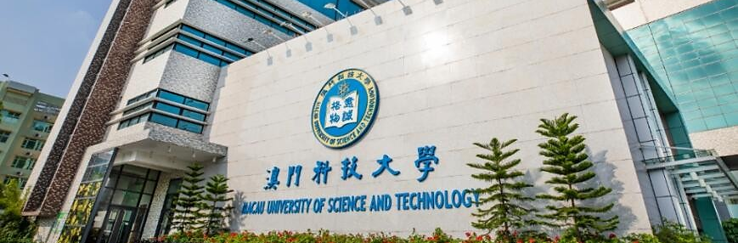
谢谢! Thanks a lot!
答辯人：XXX

