Slide 1

E Commerce Mobile Application
Project Group Number: 4
Group Member Details:
Team Member 1 Name: Aditya Singh Rajput
Branch : B-tech Stream: CSE Year: IV
Team Member 2 Name: Amit Pandey
Branch: B-tech Stream : CSE Year : IV Team Member 3 Name: Prafull Raghuwanshi
Branch : B-tech Stream : CSE Year : IV
Team Member 4 Name: Laveena Pahuja
Branch : B-tech Stream : CSE Year : IV
Project Guide: Dr. Komal Tahiliani
Major Project - II
CS- 805
Notes:
Team mentor

Slide 2






Idea/Approach Details
Idea Solution/Prototype here:
Introducing a streamlined e-commerce mobile application solution utilizing Flutter for the frontend and Spring Boot for the backend, this system simplifies online shopping and coordination while ensuring a seamless user experience. The frontend, developed with Flutter, offers a responsive interface across platforms. Powered by Spring Boot, the backend seamlessly integrates with the frontend through Restful APIs, facilitating product browsing, cart management, user registration, order processing, integrated payment solutions, and analytics/reporting functionalities. This precise solution ensures efficiency, scalability, and ease of maintenance, making it ideal for organizations seeking to optimize their e-commerce processes.
Technology stack here:

Slide 3
Project Requirements
Functional Requirements
Non Functional Requirements
User Account Management: Each account is restricted to a single user to ensure individual accountability.
Product Browsing Functionality: Enable users to efficiently browse and search for available products, with options to filter and sort based on various criteria.
Shopping Cart Management: Users can easily add, remove, and modify items in their shopping cart, facilitating a smooth and flexible shopping experience.
Order Processing: Streamlined order processing functionality allows users to complete purchases with ease, including payment integration and order confirmation.
Usability and Accessibility: The application must be user-friendly, efficient, and accessible to a wide range of users.
Real-time Data Management: The system must continuously update the database in real-time to reflect the most recent orders and changes, ensuring data reliability.
User Authentication and Security: User authentication is password-protected, and access to booking functionality is limited to registered users, ensuring the security of the system.
User Support and Guidance: Adequate support and guidance must be provided to users to help them navigate and maintain its proper functioning.

Slide 4
Scope of the project
Project Objectives: Develop an efficient and user-friendly e-commerce mobile application to streamline online shopping, enhance the customer experience, and improve sales conversions.
Deliverables: Fully functional and responsive E Commerce Mobile Application.
Inclusions:
Dynamic inventory management.
Auto checkout orders.
Role based Authentication and Authorization.
Cloud database for scalability.

Slide 5
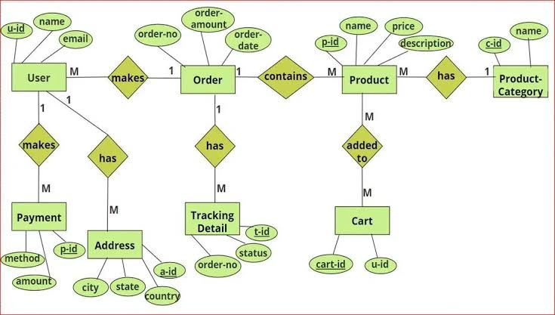
Design
ER Diagram here:

Slide 6
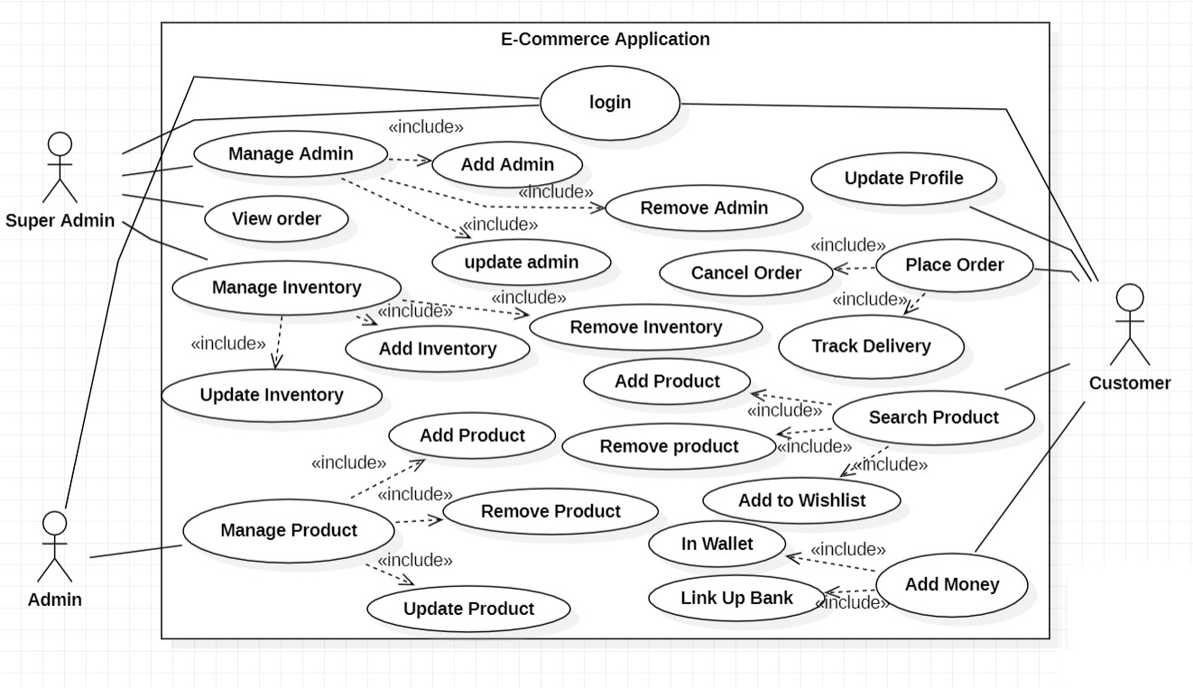
Use Case

Slide 7
Deployment Details
Describe Deployment Details here
Show Stopper/Dependencies
1. Hosting on Aiven:
We've chosen Aiven as the platform to host our application's database. This decision ensures robust data management, security, and accessibility for all our users, including admins and super admin.
2. UI via Google Play Store:
The user interface of our application can be easily downloaded and accessed by Android users through the Google Play Store. This distribution method provides a convenient and familiar way for our target audience to interact with the E-commerce mobile application.
An E-commerce mobile application tailored to meet the needs of customers, providing a personalized shopping experience, secure transactions, and valuable product information to foster customer loyalty.

Slide 8
Monetary Support
Financial Requirements
The expenditure of deployment of an application on the play store is 2,500/- for the UI
Hosting charges on the Aiven database and backend on cloud platform depends upon usecase it's a pay as you go model hence the approx cost will be $80

Slide 9
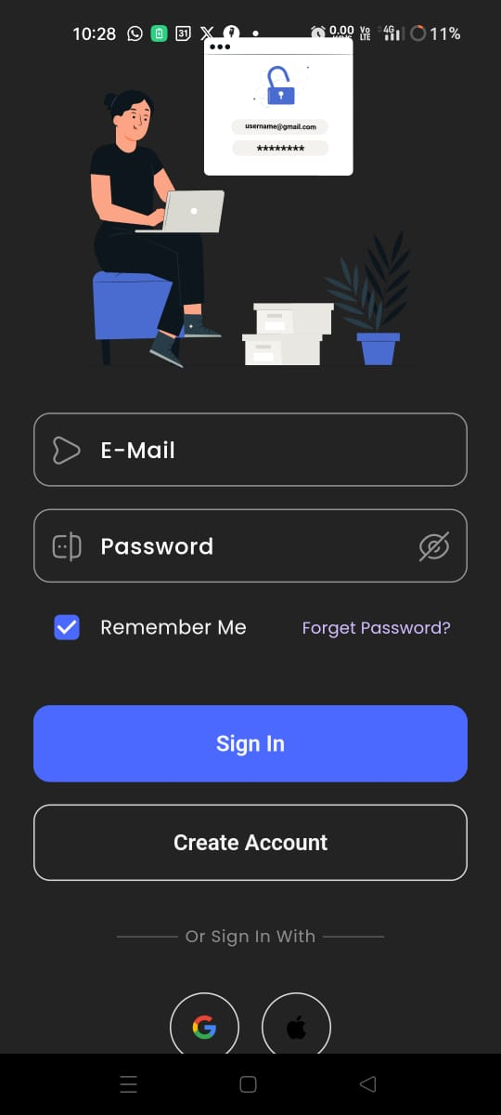
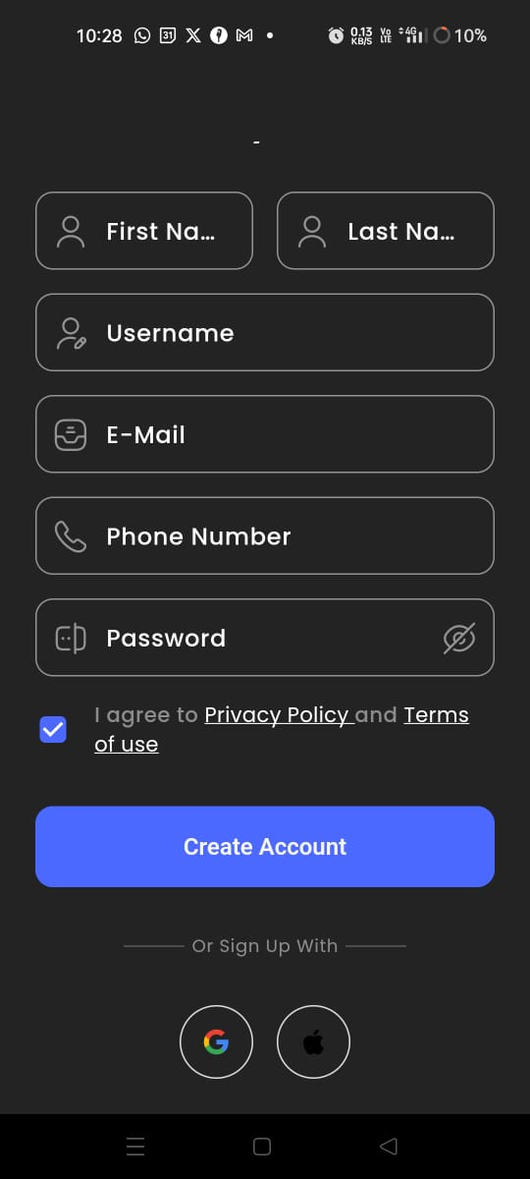
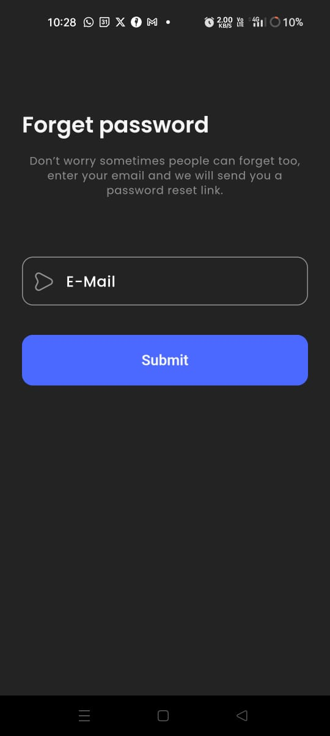
Project Screenshots

Slide 10
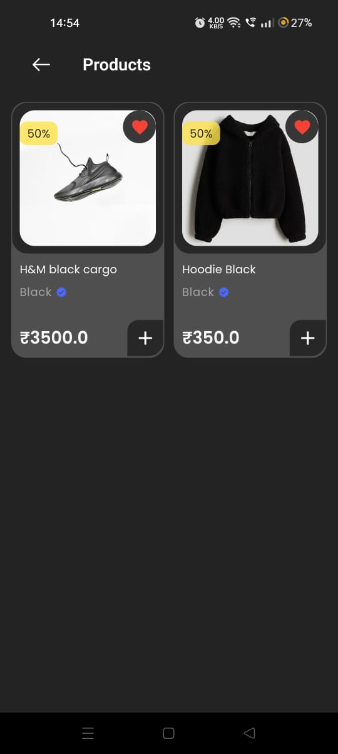
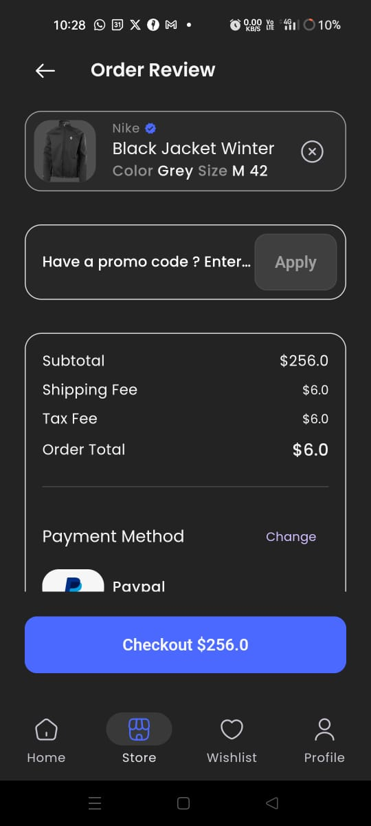
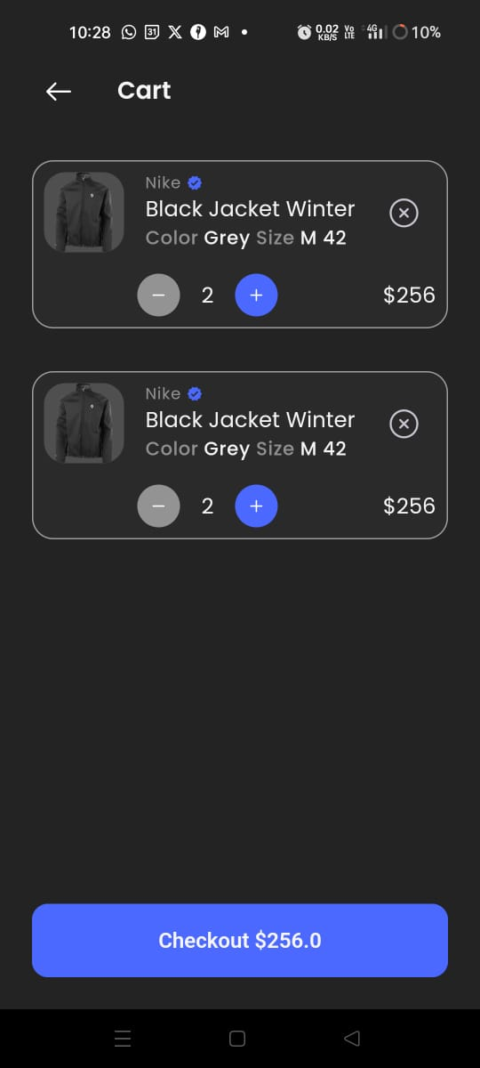
Project Screenshots

Slide 11


