Slide 1
Adrian Haro
(Links Searches)

Slide 2
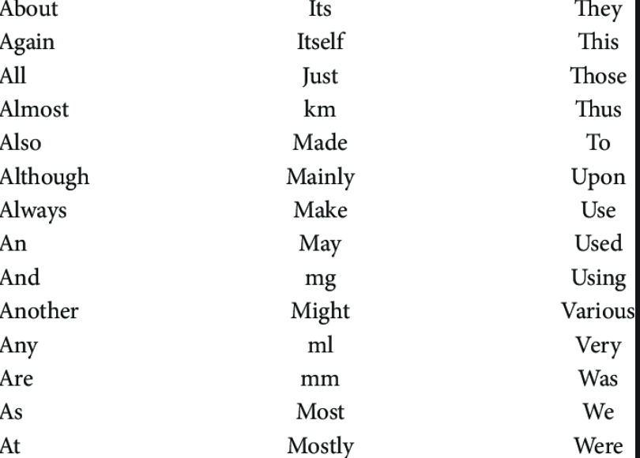
Favorite part: The concordance function
The coolest part of this script is the concordance function from the NLP. (will demo)
Other NLP functions are word count, remove “stop words”

Slide 3
Favorite code
for a in page_soup.select(' body a[href*=".html"]', href=True):
Expresses exactly what I wanted to do right away.
- Inside body element, select all anchors element,
attribute selector a[] and grab the value of the
‘href attribute

Slide 4
If I could do it all over again, I would…
Implement web crawling past 1 layer such as the root of all the topics
Issues that could arise are making sure the selector grabs the intended links.
Try out other scraping methods since grabbing intended links
Make the search word multiple words approach using freq. count or RE search
Make the search words not case sensitive

Slide 5
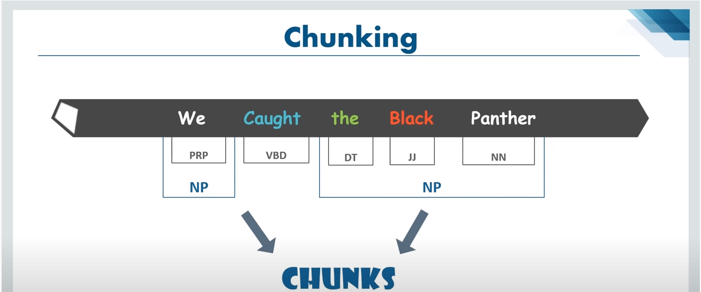
The thing that I learned the most was…
Somewhat relevant to my project
NLP: potential
Sentence ->tokenized -> tagged, chunked
Notes:
https://www.youtube.com/watch?v=05ONoGfmKvA

Slide 6
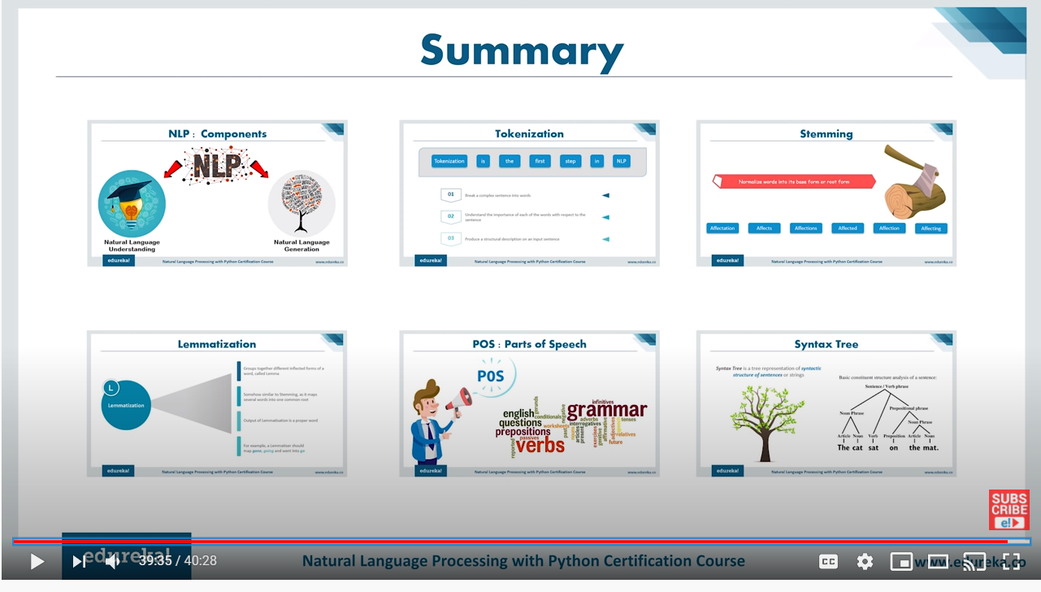
Next approaches? New Language? Accommodate language?
(not required)
Notes:
https://www.youtube.com/watch?v=05ONoGfmKvA

