Slide 1

Practical Integration of Feed-Forward Neural Networks
into Core Actuarial Workflows
INSURANCE DATA SCIENCE CONFERENCE 2026
HOUSE OF INSURANCE, LEBNIZ UNIVERSITÄT HANNOVER
Carlos Arocha, FSA, SCR
9 June 2026

Slide 2
OUTLINE
01 | Motivation
02 | Case setup and actuarial framing
03 | Baseline models: GLM Toolkit
04 | FFNN challenger
05 | Decision framework and adoption path
06 | Conclusions

Slide 3
01 Motivation

Slide 4
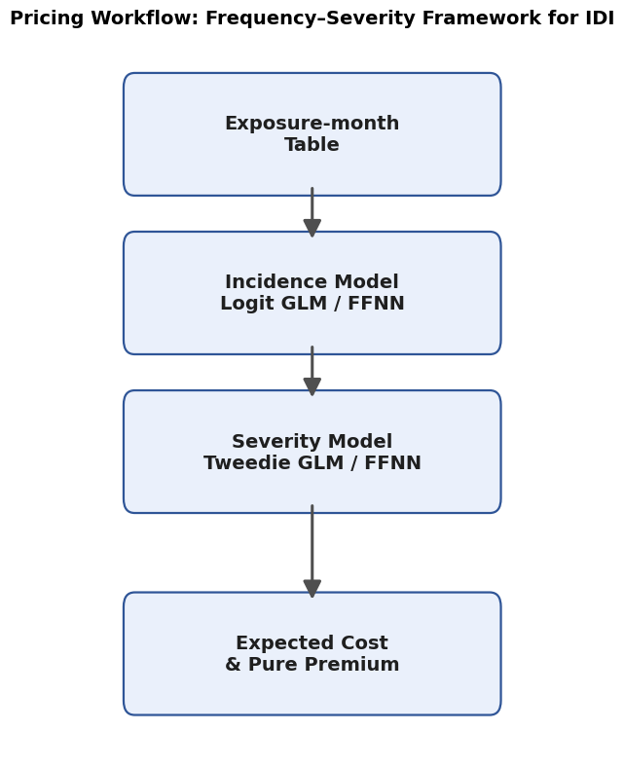
GLMs vs Feed-Forward Neural Networks (FFNNs) in practice
GLMs anchor governance; FFNNs add lift—best delivered via hybrids.
Individual Disability Income (IDI) pricing case study using synthetic data
Objective: incremental lift that remains governable
calibration
stability
audit trail
Output is a deployable frequency—severity workflow

Slide 5
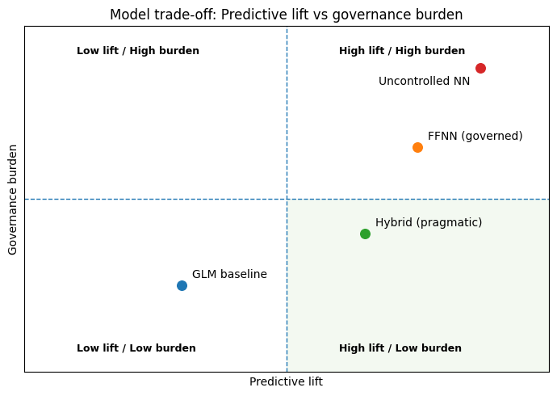
Why this matters now
AI is reshaping workflows: we need performance gains with audit-ready governance.
Actuarial reality
accuracy alone is not sufficient; models must be explainable and controllable
Typical blockers are
calibration risk
tail instability
weak drift controls
unclear documentation
Key question is:
can FFNNs be adopted as structured extensions to GLMs rather than black-box replacements?

Slide 6
02 Case Setup and Actuarial Framing

Slide 7
The synthetic IDI dataset
Synthetic data lets us prove the end-to-end GLM-FFNN-Hybrid workflow safely.
Two files:
exposure—month (onset)
claims (ultimate cost)
Modeling challenges baked in:
Rare events
Heavy-tailed costs
High-cardinality factors (region / occupation / employer / plan)
Climate impacts
A synthetic design enables open sharing and controllable experiments without confidentiality risk
Metric | Value
Exposure rows | 144,000
Claim rows | 1,565
Date min | 2022-01-01
Date max | 2023-12-31
Monthly onset rate | 0.010868
Mean claim cost (CHF) | 101,625
P90 claim cost (CHF) | 160,396

Slide 8
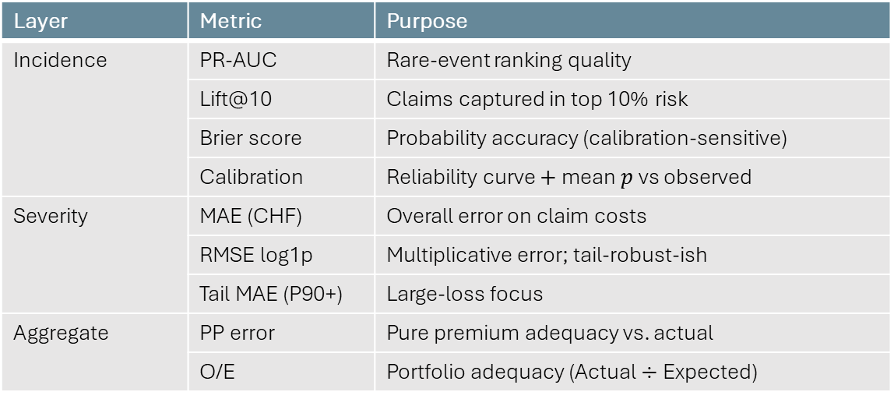
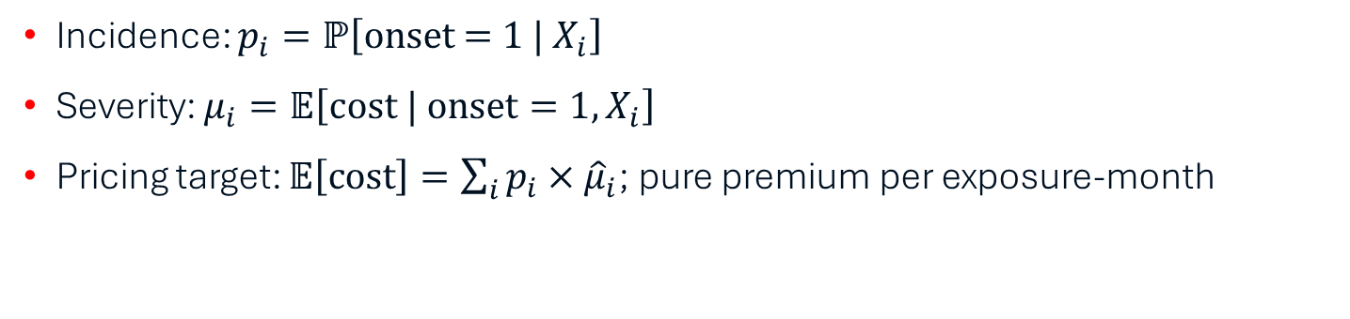
Frequency—severity and pure premium
Pure premium (PP) is the governed bridge from models to price.
Incidence: $p_{i}=ℙ\left[\text{onset} \text{=} \text{1} | X_{i}\right]$
Severity: $μ_{i}=𝔼\left[\text{cost} | \text{onset}=1, X_{i}\right]$
Pricing target: $𝔼\left[\text{cost}\right]=\sum_{i}{p_{i}×{\hat{μ}}_{i}}$; pure premium per exposure-month
The layers will be evaluated using specific metrics
Layer | Metric | Purpose
Incidence | PR-AUC | Rare-event ranking quality
 | Lift@10 | Claims captured in top 10% risk
 | Brier score | Probability accuracy (calibration-sensitive)
 | Calibration | Reliability curve $+$ mean $p$ vs observed
Severity | MAE (CHF) | Overall error on claim costs
 | RMSE log1p | Multiplicative error; tail-robust-ish
 | Tail MAE (P90+) | Large-loss focus
Aggregate | PP error | Pure premium adequacy vs. actual
 | O/E | Portfolio adequacy (Actual $÷$ Expected)

Slide 9

Governance-first validation design
Design validation first, then models: calibrate, stress-test, and prove stability before benchmarking.
Time-based split
Train on earlier months (24)
Test on most recent months (12)
Same split $+$ same features for all models to achieve a fair comparison
Decision criteria emphasize:
Calibration
Stability
Tail behaviour
Adequacy

Slide 10
03 Baseline models: GLM Toolkit

Slide 11
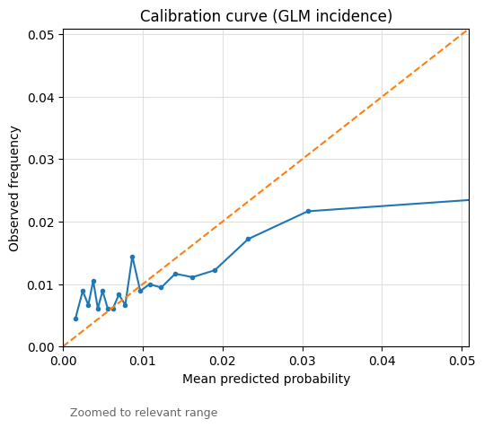
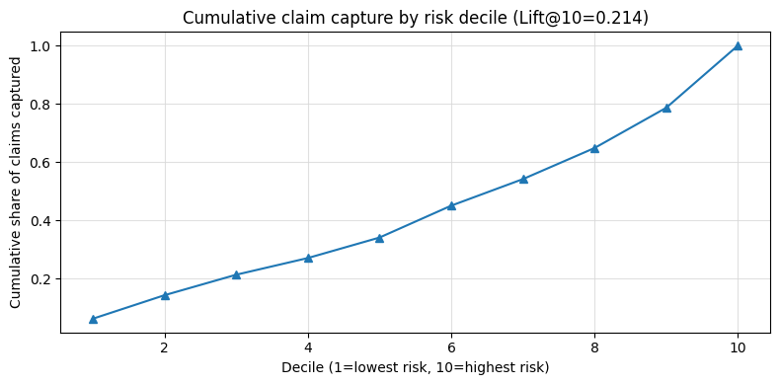
Incidence baseline: Logit GLM (sparse $+$ regularised)
A sparse, regularised logit GLM typically gives a stable, audit-ready incidence baseline which is strong enough to benchmark any FFNN lift.
Logistic regression on exposure-month rows (one-hot categoricals + scaled numerics)
Rare event focus: PR-AUC and Lift@10 matter more than ROC AUC

Slide 12
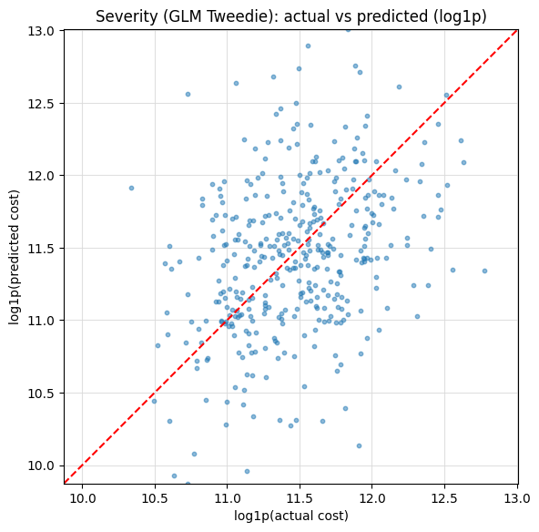
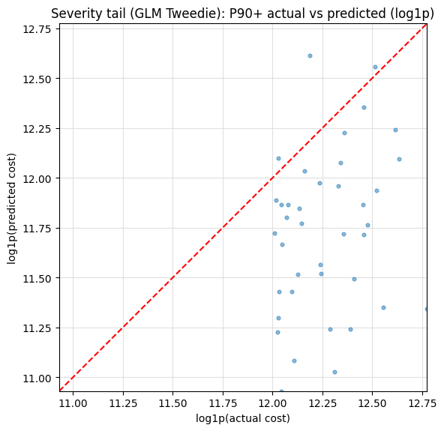
Severity baseline: Tweedie GLM (log link)
May be ideal as the audit-ready benchmark for any FFNN gain.
Tweedie with log link is a robust baseline for skewed positive distributions
Evaluate central accuracy and tail behaviour
Mean actual (CHF) | 106,135
Mean predicted (CHF) | 106,932
MAE (CHF) | 47,339
RMSE log1p | 0.5587
Tail MAE P90+ (CHF) | 89,130

Slide 13
04 FFNN Challenger

Slide 14
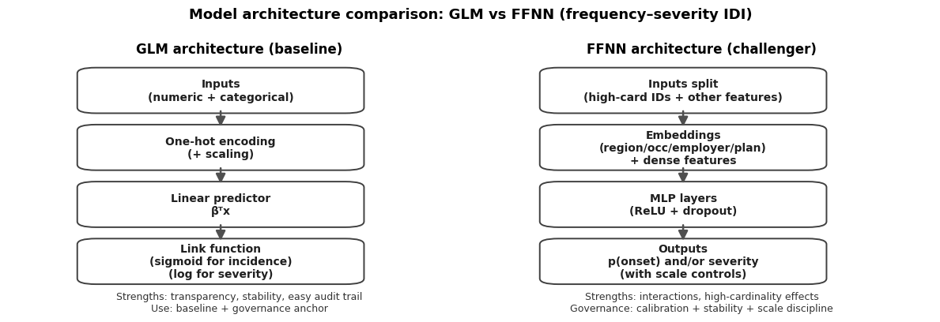
FFNN as a structured extension
FFNNs should avoid a “black box” connotation by proper governance and validation.
Same frequency—severity actuarial structure
Governance discipline: controlled transforms, bounded outputs, and reproducibility

Slide 15
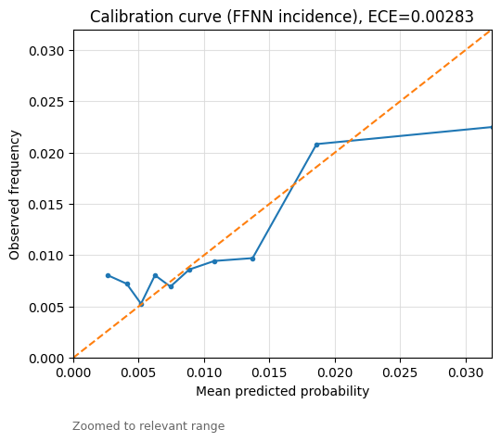
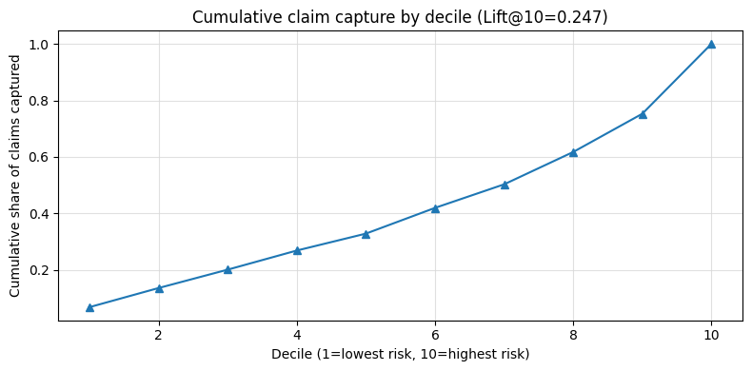
FFNN incidence
FFNN incidence improves rare-event ranking and calibration.
ECE drops by 47% relative to GLM, i.e., the average absolute gap between predicted and observe incidence is substantially smaller
Lift@10 increases 15%, i.e., top 10% highest-scored exposure-months capture a larger share of claims

Slide 16
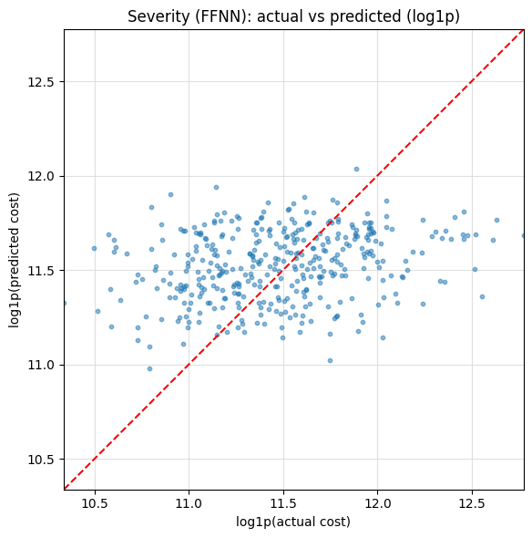
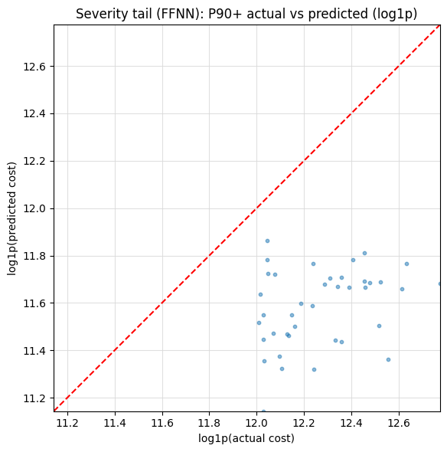
FFNN severity
FFNN severity improves fit on typical claims (MAE & RMSE) relative to GLM
A lower RMSE suggests a better capture of the multiplicative structure of severity for the bulk of claims → smoother pricing relativities
But a higher Tail MAE P90+ suggests less reliability where large claims concentrate
Mean actual (CHF) | 106,135
Mean predicted (CHF) | 103,042
MAE (CHF) | 36,608
RMSE log1p | 0.4313
Tail MAE P90+ (CHF) | 108,032

Slide 17
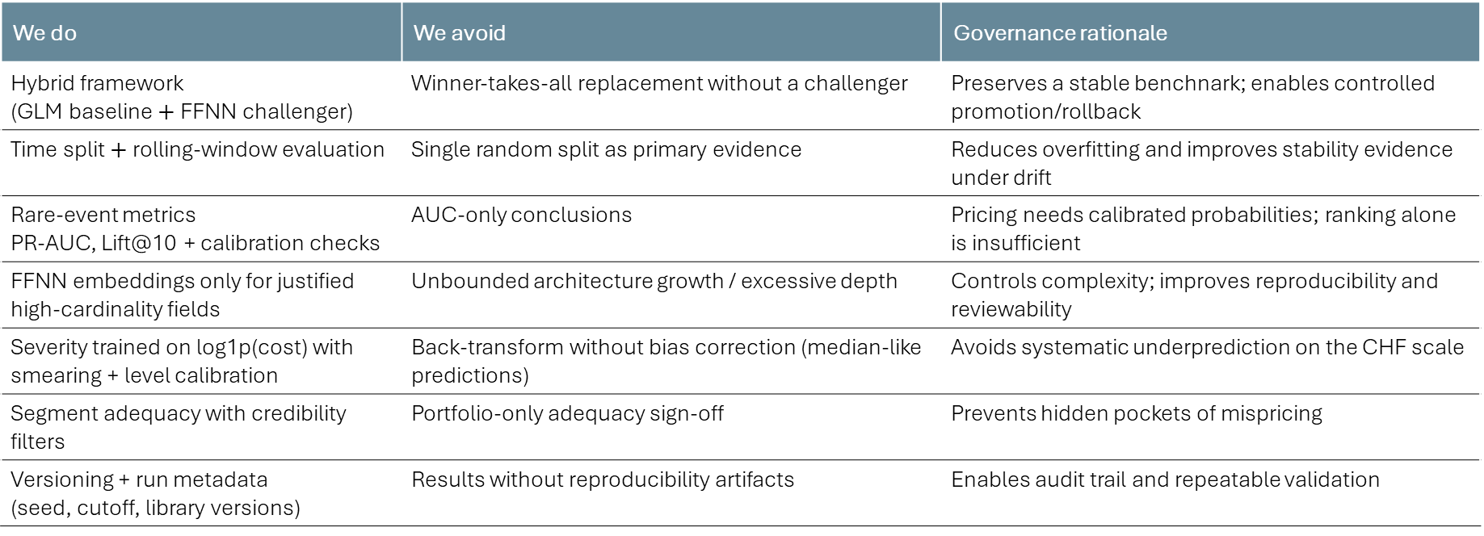
Caveat emptor
Design choices: our team’s governance principles
We do | We avoid | Governance rationale
Hybrid framework (GLM baseline $+$ FFNN challenger) | Winner-takes-all replacement without a challenger | Preserves a stable benchnark; enables controlled promotion/rollback
Time split $+$ rolling-window evaluation | Single random split as primary evidence | Reduces overfitting and improves stability evidence under drift
Rare-event metrics PR-AUC, Lift@10 + calibration checks | AUC-only conclusions | Pricing needs calibrated probabilities; ranking alone is insufficient
FFNN embeddings only for justified high-cardinality fields | Unbounded architecture growth / excessive depth | Controls complexity; improves reproducibility and reviewability
Severity trained on log1p(cost) with smearing + level calibration | Back-transform without bias correction (median-like predictions) | Avoids systematic underprediction on the CHF scale
Segment adequacy with credibility filters | Portfolio-only adequacy sign-off | Prevents hidden pockets of mispricing
Versioning + run metadata (seed, cutoff, library versions) | Results without reproducibility artifacts | Enables audit trail and repeatable validation

Slide 18
05 Decision Framework and adoption path

Slide 19
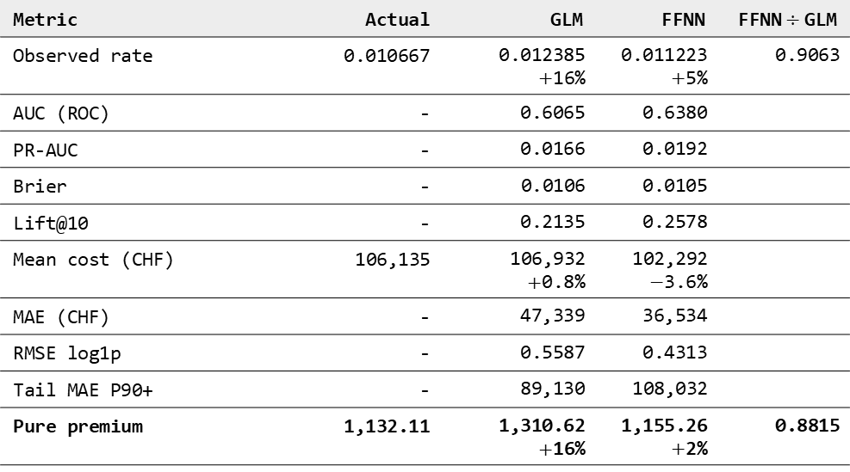
GLM vs FFNN
FFNN delivers better incidence calibration and risk ranking; GLM remains the stability anchor
Metric | Actual | GLM | FFNN | FFNN$÷$GLM
Observed rate | 0.010667 | 0.012385 $+$16% | 0.011223 $+$5% | 0.9063
AUC (ROC) | - | 0.6065 | 0.6380
PR-AUC | - | 0.0166 | 0.0192
Brier | - | 0.0106 | 0.0105
Lift@10 | - | 0.2135 | 0.2578
Mean cost (CHF) | 106,135 | 106,932 $+$0.8% | 102,292 $−$3.6%
MAE (CHF) | - | 47,339 | 36,534
RMSE log1p | - | 0.5587 | 0.4313
Tail MAE P90+ | - | 89,130 | 108,032
Pure premium | 1,132.11 | 1,310.62 $+$16% | 1,155.26 $+$2% | 0.8815
FFNN relative to GLM:
AUC uplift suggests a meaningful improvement in ranking power
PR-AUC improvement is more meaningful for rare events because it focuses perramance in the “positive” class
Brier change is negligible, which suggests both models have similar average probability error in the full population

Slide 20
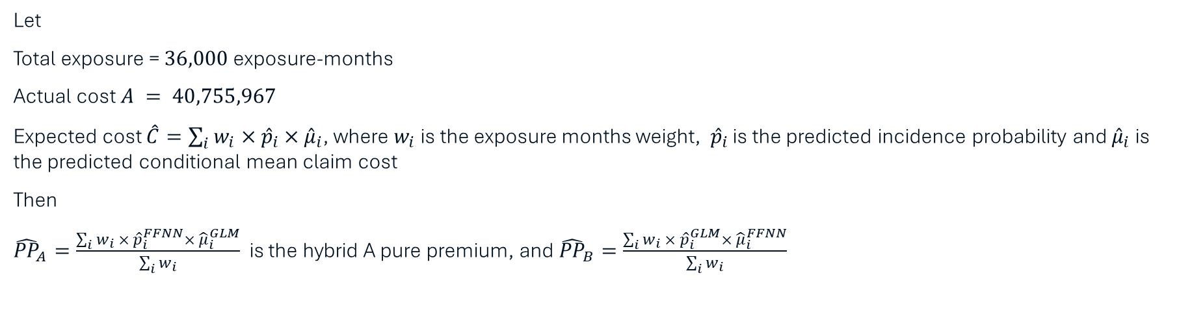
Hybrid alternatives
Hybrid alternative isolate where the lift really comes from, so we can choose the strongest governance-to-performance trade-off.
Let
Total exposure = $36,000$ exposure-months
Actual cost $A = 40,755,967$
Expected cost $\hat{C}=\sum_{i}{w_{i}×{\hat{p}}_{i}{×\hat{μ}}_{i}}$, where $w_{i}$ is the exposure months weight, ${\hat{p}}_{i}$ is the predicted incidence probability and ${\hat{μ}}_{i}$ is the predicted conditional mean claim cost
Then
${\hat{PP}}_{A}=\frac{\sum_{i}{w_{i}{ × \hat{p}}_{i}^{FFNN}×{ \hat{μ}}_{i}^{GLM}}}{\sum_{i}{w_{i}}}$ is the hybrid A pure premium, and ${\hat{PP}}_{B}=\frac{\sum_{i}{w_{i}{ × \hat{p}}_{i}^{GLM}×{ \hat{μ}}_{i}^{FFNN}}}{\sum_{i}{w_{i}}}$
Model | Expected Total Cost (CHF) | Pure Premium (CHF / exp-mo) | O/E | PP Error vs Actual | Comment
GLM | 47,182,238 | 1,310.62 | 0.864 | +15.8% | Material overstatement
FFNN | 40,963,136 | 1,137.86 | 0.995 | +0.5% | Closest to adequacy
Hybrid A (FFNN inc, GLM sev) | 41,837,421 | 1,162.15 | 0.974 | +2.7% | Best hybrid bridge
Hybrid B (GLM inc, FFNN sev) | 45,609,436 | 1,266.93 | 0.894 | +11.9% | Still too conservative

Slide 21
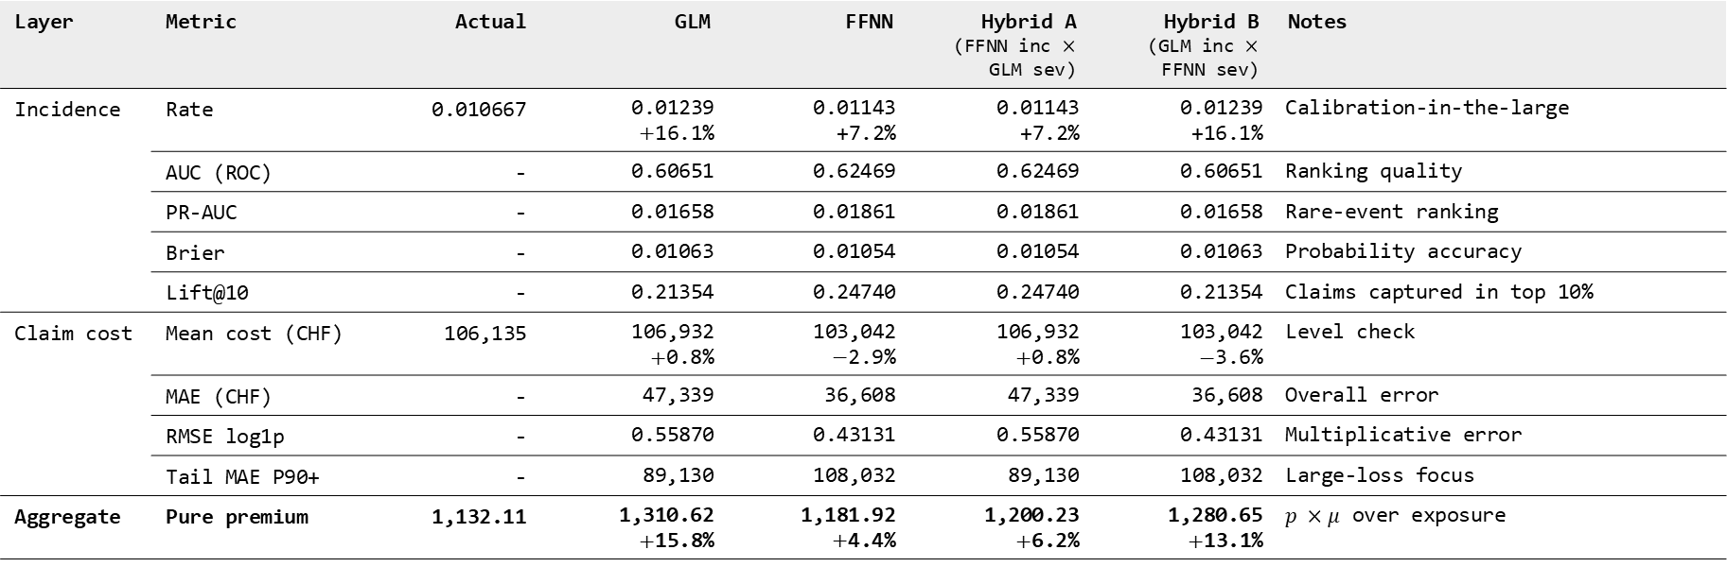
Model comparison scorecard
A scorecard traces performance driver and supports a clear go/no-go decision.
Layer | Metric | Actual | GLM | FFNN | Hybrid A (FFNN inc $×$ GLM sev) | Hybrid B (GLM inc $×$ FFNN sev) | Notes
Incidence | Rate | 0.010667 | 0.01239 $+$16.1% | 0.01143 +7.2% | 0.01143 +7.2% | 0.01239 +16.1% | Calibration-in-the-large
 | AUC (ROC) | - | 0.60651 | 0.62469 | 0.62469 | 0.60651 | Ranking quality
 | PR-AUC | - | 0.01658 | 0.01861 | 0.01861 | 0.01658 | Rare-event ranking
 | Brier | - | 0.01063 | 0.01054 | 0.01054 | 0.01063 | Probability accuracy
 | Lift@10 | - | 0.21354 | 0.24740 | 0.24740 | 0.21354 | Claims captured in top 10%
Claim cost | Mean cost (CHF) | 106,135 | 106,932 $+$0.8% | 103,042 $−$2.9% | 106,932 $+$0.8% | 103,042 $−$3.6% | Level check
 | MAE (CHF) | - | 47,339 | 36,608 | 47,339 | 36,608 | Overall error
 | RMSE log1p | - | 0.55870 | 0.43131 | 0.55870 | 0.43131 | Multiplicative error
 | Tail MAE P90+ | - | 89,130 | 108,032 | 89,130 | 108,032 | Large-loss focus
Aggregate | Pure premium | 1,132.11 | 1,310.62 $+$15.8% | 1,181.92 $+$4.4% | 1,200.23 $+$6.2% | 1,280.65 $+$13.1% | $p ×μ$ over exposure

Slide 22
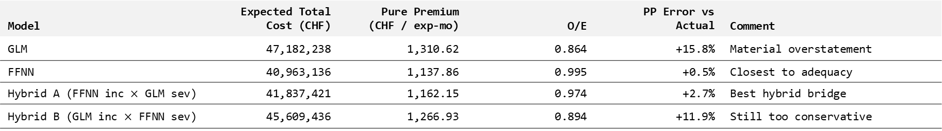
Pros and cons of the model alternatives
A pros- and cons- view translates performance into implementation trade-offs.
Model | Expected Total Cost (CHF) | Pure Premium (CHF / exp-mo) | O/E | PP Error vs Actual | Comment
GLM | 47,182,238 | 1,310.62 | 0.864 | +15.8% | Material overstatement
FFNN | 40,963,136 | 1,137.86 | 0.995 | +0.5% | Closest to adequacy
Hybrid A (FFNN inc $×$ GLM sev) | 41,837,421 | 1,162.15 | 0.974 | +2.7% | Best hybrid bridge
Hybrid B (GLM inc $×$ FFNN sev) | 45,609,436 | 1,266.93 | 0.894 | +11.9% | Still too conservative
Model | Pros | Cons
GLM | Strong transparency and explainability Well understood validation | May miss nonlinearities and interaction effects May require more feature engineering to compete w/ FFNN
FFNN | Handles nonlinearities and interactions naturally Embeddings make high-cardinality factors practical | Governance overhead is higher; explicit calibration checks Tail behaviour can be weaker unless explicitly addressed
Hybrid A | Governance-friendlier hybrid Clean attribution sroy: improvement attributed to severity layer | Still operationally “two-model” Can forgo potential serveriy gains from FFNN
Hybrid B | Keeps incidence highly interpretable Allows FFNN to add value on severity | If GLM incidence is miscalibrated, it can dominate PP adequacy May deliver less aggregate benefit than Hybrid A

Slide 23
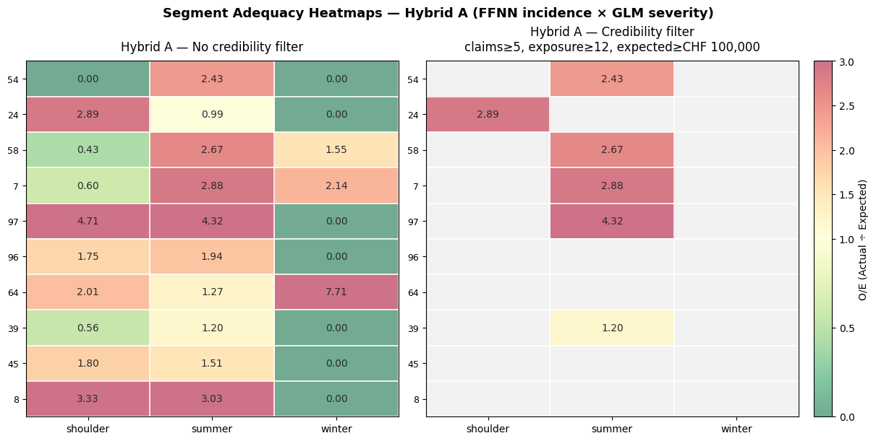
Segment adequacy heatmap
Pricing adequacy must be demonstrated at the segment level but ignore one-off noise.

Slide 24
Suggested governance pack
Key objective is to turn model outputs into a repeatable, audit-ready decision.
One control sheet for each run
Run ID
Dataset / version
Owner
Reviewer
Notes
Minimum content
Scope
Data & split controls
Model specification
Validation (test window)
Adequacy by segment
Stability
Operational readiness
Attachments
A governance one-pager (control sheet) available in the project GitHub repository (cf. Appendix)

Slide 25
06 Conclusions

Slide 26
Conclusions
For practising actuaries, the most credible path forward may be a hybrid modelling framework in which neural networks are introduced selectively, validated rigourously, and governed as structrured extensions of the actuarial toolkit.
✅ | GLMs remain strong defaults—they provide the actuarial anchor
✅ | FFNNs can add value when they pass actuarial validation—they provide targeted predictive enhancement
✅ | A hybrid framework offers the strongest balance of performance, explainability, and governance

Slide 27
Appendix

Slide 28
References
Goodfellow, I., Bengio, Y., & Courville, A. (2016). Deep Learning: MIT Press https://doi.org/10.1007/s10710-017-9314-z
Holvoet, F., Antonio, K., & Henckaerts, R. (2025). Neural Networks for Insurance Pricing with Frequency and Severity Data: A Benchmark Study from Data Preprocessing to Technical Tariff. North American Actuarial Journal, 29(3), 519–562. https://doi.org/10.1080/10920277.2025.2451860
Richman, R. (2022). Mind the gap – safely incorporating deep learning models into the actuarial toolkit. British Actuarial Journal, 27, e21. https://doi.org/10.1017/S1357321722000162
Samek, W., Montavon, G., Vedaldi, A., Hansen, L. K., & Müller, K.-R. (Eds.). (2019). Explainable AI: Interpreting, explaining and visualizing deep learning. Springer. https://doi.org/10.1007/978-3-030-28954-6
Wüthrich, M. V., Richman, R., Avanzi, B., Lindholm, M., Maggi, Marco, Mayer, M., Schelldorfer, J,, and Scognamiglio, S. AI Tools for Actuaries (January 20, 2026). http://dx.doi.org/10.2139/ssrn.5162304

Slide 29
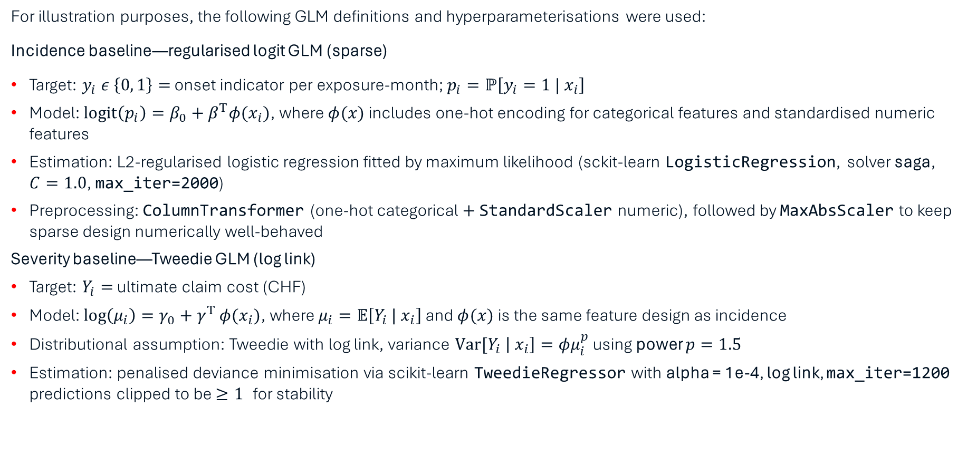
GLM Model Definition
For illustration purposes, the following GLM definitions and hyperparameterisations were used:
Incidence baseline—regularised logit GLM (sparse)
Target: $y_{i} ε \left\{0, 1\right\}=$ onset indicator per exposure-month; $p_{i}=ℙ\left[y_{i}=1 | x_{i}\right]$
Model: $\text{logit}\left(p_{i}\right)=β_{0}+β^{T}φ(x_{i})$, where $φ(x)$ includes one-hot encoding for categorical features and standardised numeric features
Estimation: L2-regularised logistic regression fitted by maximum likelihood (sckit-learn LogisticRegression, solver saga, $C=1.0$, max_iter=2000)
Preprocessing: ColumnTransformer (one-hot categorical $+$ StandardScaler numeric), followed by MaxAbsScaler to keep sparse design numerically well-behaved
Severity baseline—Tweedie GLM (log link)
Target: $Y_{i}=$ ultimate claim cost (CHF)
Model: $\log\left(μ_{i}\right)=γ_{0}+γ^{T}φ(x_{i})$, where $μ_{i}=𝔼\left[Y_{i} | x_{i}\right]$ and $φ(x)$ is the same feature design as incidence
Distributional assumption: Tweedie with log link, variance $\text{Var}\text{[}Y_{i} \left| x_{i}\right]=φμ_{i}^{p}$ using power $p=1.5$
Estimation: penalised deviance minimisation via scikit-learn TweedieRegressor with alpha = 1e-4, log link, max_iter=1200 predictions clipped to be $≥1$ for stability

Slide 30
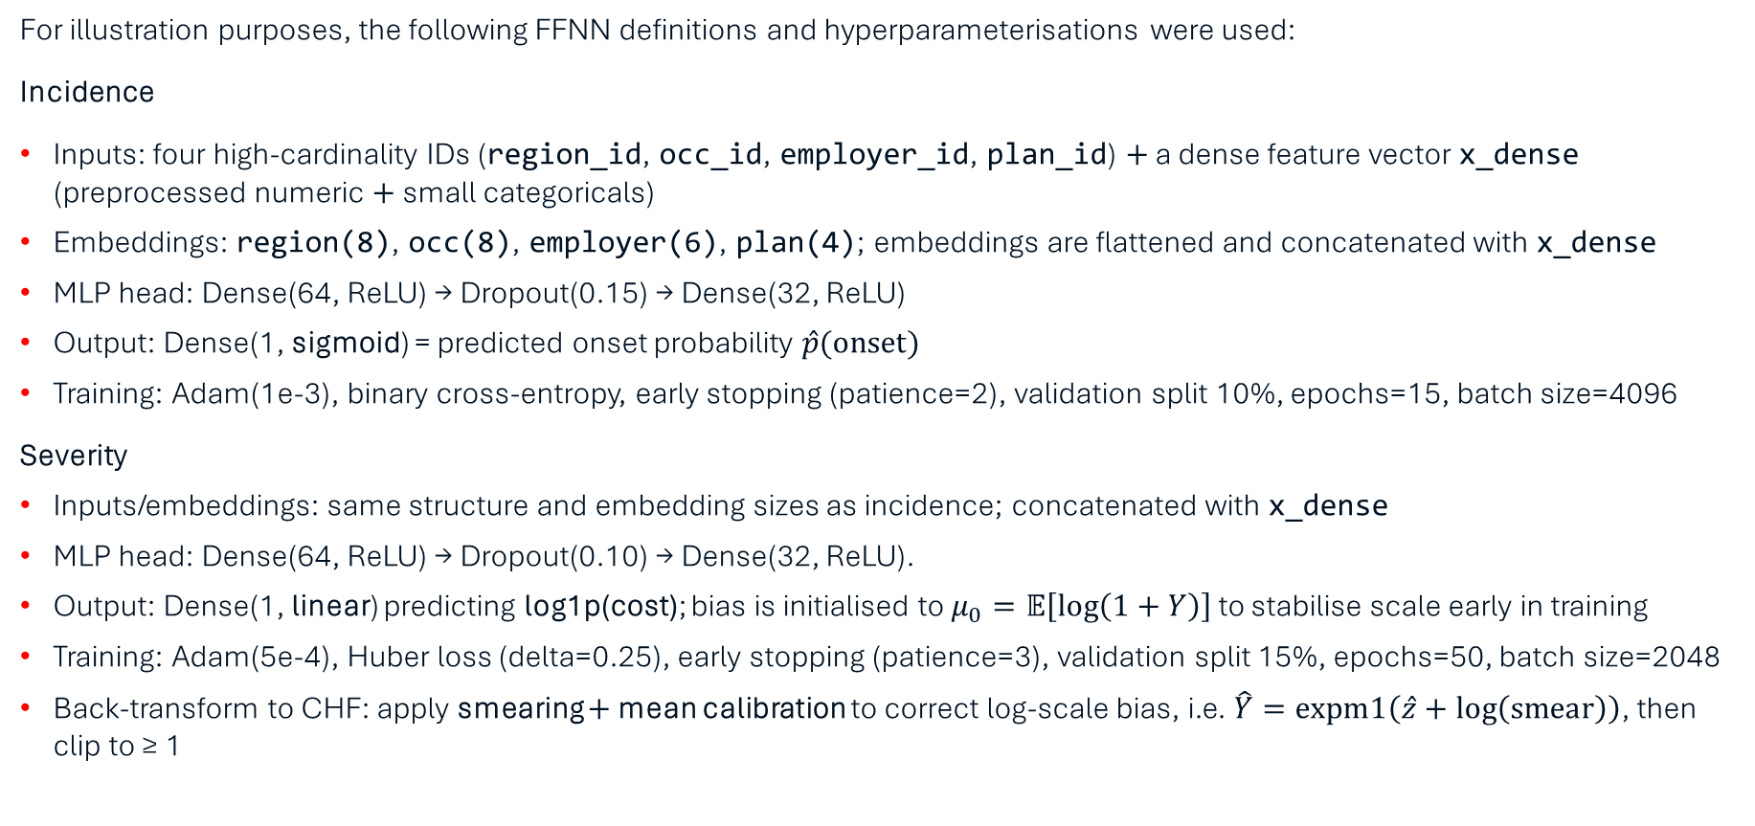
FFNN Model Definition
For illustration purposes, the following FFNN definitions and hyperparameterisations were used:
Incidence
Inputs: four high-cardinality IDs (region_id, occ_id, employer_id, plan_id) $+$ a dense feature vector x_dense (preprocessed numeric $+$ small categoricals)
Embeddings: region(8), occ(8), employer(6), plan(4); embeddings are flattened and concatenated with x_dense
MLP head: Dense(64, ReLU) → Dropout(0.15) → Dense(32, ReLU)
Output: Dense(1, sigmoid) = predicted onset probability $\hat{p}(\text{onset})$
Training: Adam(1e-3), binary cross-entropy, early stopping (patience=2), validation split 10%, epochs=15, batch size=4096
Severity
Inputs/embeddings: same structure and embedding sizes as incidence; concatenated with x_dense
MLP head: Dense(64, ReLU) → Dropout(0.10) → Dense(32, ReLU).
Output: Dense(1, linear) predicting log1p(cost); bias is initialised to $μ_{0}=𝔼\left[\log\left(1+Y\right)\right]$ to stabilise scale early in training
Training: Adam(5e-4), Huber loss (delta=0.25), early stopping (patience=3), validation split 15%, epochs=50, batch size=2048
Back-transform to CHF: apply smearing $+$ mean calibration to correct log-scale bias, i.e. $\hat{Y}=\text{expm}\text{1}\left(\hat{z}+\log\left(\text{smear}\right)\right)$, then clip to ≥ 1

Slide 31
Further research and extensions for practitioners
Compare Tweedie vs FFNN + tail-aware loss vs two-part models (body + EVT/mixture tail) and measure impact on P90+ MAE
Evaluate Platt/logistic recalibration, isotonic, and segment-aware credibility calibration (region/ season / occupation) under rolling windows
Track heatmap persistence over time (raw vs credibility-filtered) and quantify dispersion
Formalise when to choose Hybrid A vs Hybrid B
Add local explanations (e.g., SHAP on dense features + embedding diagnostics) with an audit trail
Stress test against more realistic operational effects (claim reporting lag, inflation regime shifts, benefit cap changes)
Evaluate whether hazard proxies improve stability/segmentation

Slide 32

GitHub
Visit the GitHub repository to view code and add your own contributions!

