Slide 1
Market Basket Insight
Submitted by,
Ashlin.S
Archana.K
Aashika.A
Arockia Binolin.S

Slide 2
Market Basket Insights
DEFINITION
Market Basket Insights is a statistical technique that identifies the co-occurrence patterns of products in transactions or baskets by customers.
APPLICATION
It is commonly used in retail,supermarkets, and e-commerce websites to optimize pricing strategies and improve sales performance.
METHOD
The technique uses algorithms such as Apriori and FP-Growth to identify frequently occurring item sets.

Slide 3
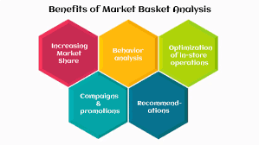
BENEFITS

Slide 4
PROBLEM STATEMENT
The problem statement for Market Basket Insights involves analyzing customer purchase data to discover patterns and associations between products bought together. This analysis helps businesses optimize their sales strategies, improve customer satisfaction, and enhance inventory management. The main challenge is to develop efficient algorithms and data mining techniques that can handle large datasets, identify meaningful patterns, and provide actionable insights to boost sales and customer experience in retail environments

Slide 5
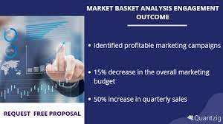
SOLUTION
In this Market basket research,we try to offers insights into customer behavior, including what products they buy together and which products they buy the most frequently. Retailers can use this information to better understand their customers and make informed decisions.

Slide 6
CONCLUSION
Market basket insights is a data mining technique used by retailers to understand customer purchasing patterns. By analyzing transaction data, retailers can identify relationships between products frequently bought together. This information helps in various aspects of business, such as improving product placement, cross-selling, and targeted marketing strategies. If you have specific questions or need assistance with a particular aspect of market basket analysis.

