Slide 1
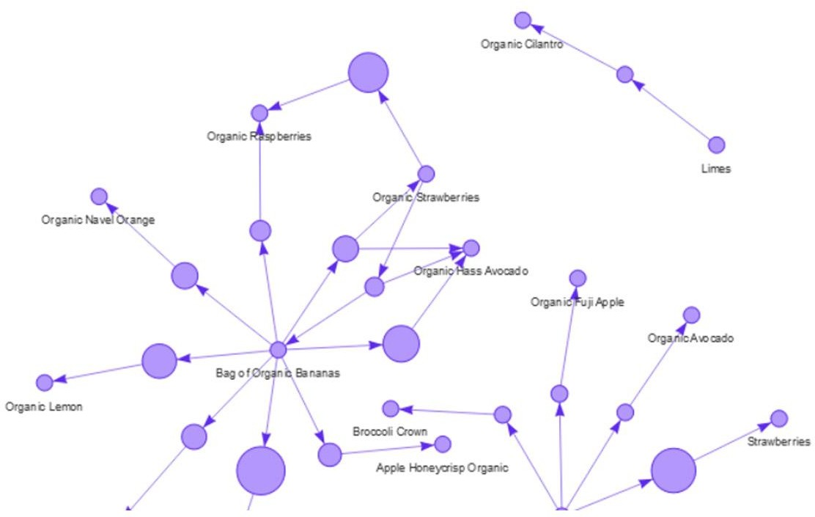
MARKET BASKET INSIGHTS
INTRODUCTION:
Market basket analysis is a data mining technique used by retailers to increase sales by better understanding customer purchasing patterns. It involves analyzing large data sets, such as purchase history, to reveal product groupings, as well as products that are likely to be purchased together.
The adoption of market basket analysis was aided by the advent of electronic point-of-sale (POS) systems. Compared to handwritten records kept by store owners, the digital records generated by POS systems made it easier for applications to process and analyze large volumes of purchase data.
Implementation of market basket analysis requires a background in statistics and data science, as well as some algorithmic computer programming skills. For those without
the needed technical skills, commercial, off-the-shelf tools exist.
ALGORITHM:
What Is Association Rule for Market Basket Analysis?
Let I = {I1, I2,…, Im} be an itemset. These itemsets are called antecedents. Let D, the data, be a set of database transactions where each transaction T is a nonempty itemset such that T ⊆ I. Each transaction is associated with an identifier called a TID(or Tid). Let A be a set of items(itemset). T is

Slide 2
the Transaction that is said to contain A if A ⊆ T. An Association Rule is an implication of form A ⇒ B, where A ⊂ I, B ⊂ I, and A ∩B = φ.
The rule A ⇒ B holds in the data set(transactions) D with supports, where ‘s’ is the percentage of transactions in D that contain A 𝖴 B (i.e., the union of set A and set B, or both A and B). This is taken as the probability, P(A 𝖴 B). Rule A ⇒ B has confidence c in the transaction set D, where c is the percentage of transactions in D containing A that also contains B. This is taken to be the conditional probability, like P(B|A). That is,
support(A⇒ B) =P(A 𝖴 B) confidence(A⇒ B) =P(B|A)
Rules that satisfy both a minimum support threshold (called min sup) and a minimum confidence
threshold (called min conf ) are called “Strong”.
Confidence(A⇒ B) = P(B|A) = support(A 𝖴 B) /support(A) =
support count(A 𝖴 B) / support count(A)
Generally, Association Rule Mining can be viewed in a two-step process:
Find all Frequent itemsets: By definition, each of these itemsets will occur at least as frequently as a pre-established minimum support count, min sup.
Generate Association Rules from the Frequent itemsets: By definition, these rules must satisfy minimum support and minimum confidence.
Association Rule Mining
Association Rule Mining is primarily used when you want to identify an association between different items in a set and then find frequent patterns in a transactional database or relational database.
The best example of the association:
Algorithms Used in Market Basket Analysis
There are multiple data mining techniques and algorithms used in Market Basket Analysis. One of the important objectives is “to predict the probability of items that are being bought together by customers.”
Apriori Algorithm

Slide 3
AIS
SETM Algorithm FP Growth
Apriori Algorithm
Apriori Algorithm is a widely-used and well-known Association Rule algorithm and is a popular algorithm used in market basket analysis. It is also considered accurate and overtop AIS and SETM algorithms. It helps to find frequent itemsets in transactions and identifies association rules between these items. The limitation of the Apriori Algorithm is frequent itemset generation. It needs to scan the database many times, leading to increased time and reduced performance as a computationally costly step because of a large dataset. It uses the concepts of Confidence and Support.
AIS Algorithm
The AIS algorithm creates multiple passes on the entire database or transactional data. During every pass, it scans all transactions. As you can see, in the first pass, it counts the support of separate items and determines then which of them are frequent in the database. Huge itemsets of every pass are enlarged to generate candidate itemsets. After each scanning of a transaction, the common itemsets between the itemsets of the previous pass and the items of this transaction are determined. This algorithm was the first published algorithm which is developed to generate all large itemsets in a transactional database. It focused on the enhancement of databases with the necessary performance to process decision support. This technique is bounded to only one item in the consequent.
Advantage: The AIS algorithm was used to find whether there was an association between items or not.
Disadvantage: The main disadvantage of the AIS algorithm is that it generates too many candidates set that turn out to be small. As well as the data structure is to be maintained.
SETM Algorithm
This Algorithm is quite similar to the AIS algorithm. The SETM algorithm creates collective passes over the database. As you can see, in the first pass, it counts the support of single items and then determines which of them are frequent in the database. Then, it also generates the candidate itemsets by enlarging large itemsets of the previous pass. In addition to this, the SETM algorithm recalls the TIDs(transaction ids) of the generating transactions with the candidate itemsets.
Advantage: While generating candidate itemsets, the SETM algorithm arranges candidate itemsets together with the TID(transaction Id) in a sequential manner.
Disadvantage: For every item set, there is an association with Tid; hence it requires more space to store a huge number of TIDs.
FP Growth

Slide 4
FP Growth is known as Frequent Pattern Growth Algorithm. FP growth algorithm is a concept of representing the data in the form of an FP tree or Frequent Pattern. Hence FP Growth is a method of Mining Frequent Itemsets. This algorithm is an advancement to the Apriori Algorithm. There is no need for candidate generation to generate a frequent pattern. This frequent pattern tree structure maintains the association between the itemsets.
A Frequent Pattern Tree is a tree structure that is made with the earlier itemsets of the data. The main purpose of the FP tree is to mine the most frequent patterns. Every node of the FP tree represents an item of that itemset. The root node represents the null value, whereas the lower nodes represent the itemsets of the data. The association of these nodes with the lower nodes, that is, between itemsets, is maintained while creating the tree.
For Example:
Frequent Pattern Tree (FPT)
IMPLEMENTATION:
Implementing Market Basket Analysis Using the Apriori Method
The Apriori algorithm is frequently used by data scientists. We are required to import the necessary libraries. Python provides the apyori as an API that is required to be imported to run the Apriori Algorithm.
import pandas as pd import numpy as np
from apyori import apriori
Now we want to read the dataset that is downloaded from Kaggle. There is no header in the dataset; hence, the first row contains the first transaction, so we have mentioned header = None here.
Python Code:
Once we have read the dataset completely, we are required to get the list of items in every transaction. So we are going to run two loops. One will be for the total number of transactions, and the other will be for the total number of columns in every transaction. The list will work as a training set from where we can generate the list of Association Rules.
#converting dataframe into list of lists

Slide 5
l=[]
for i in range(1,7501):
l.append([str(st_df.values[i,j]) for j in range(0,20)])
So we are ready with the list of items in our training set, then we need to run the apriori algorithm, which will learn the list of association rules from the training set, i.e., list. So, the minimum support here will be 0.0045, which is taken here as support. Now let us see that we have kept 0.2 as the min confidence. The minimum lift value is taken as 3, and the minimum length is considered as 2 because we have to find an association among a minimum of two items.
#applying apriori algorithm
association_rules = apriori(l, min_support=0.0045, min_confidence=0.2, min_lift=3, min_length=2) association_results = list(association_rules)
After running the above line of code, we generated the list of association rules between the items. So to see these rules, the below line of code needs to be run.
for i in range(0, len(association_results)): print(association_results[i][0])
Output:
frozenset({'light cream', 'chicken'}) frozenset({'mushroom cream sauce', 'escalope'}) frozenset({'pasta', 'escalope'})
frozenset({'herb & pepper', 'ground beef'}) frozenset({'tomato sauce', 'ground beef'})
frozenset({'whole wheat pasta', 'olive oil'}) frozenset({'shrimp', 'pasta'}) frozenset({'nan', 'light cream', 'chicken'})
frozenset({'shrimp', 'frozen vegetables', 'chocolate'})
frozenset({'spaghetti', 'cooking oil', 'ground beef'}) frozenset({'mushroom cream sauce', 'nan', 'escalope'}) frozenset({'nan', 'pasta', 'escalope'}) frozenset({'spaghetti', 'frozen vegetables', 'ground beef'}) frozenset({'olive oil', 'frozen vegetables', 'milk'})

Slide 6
frozenset({'shrimp', 'frozen vegetables', 'mineral water'})
frozenset({'spaghetti', 'olive oil', 'frozen vegetables'})
frozenset({'spaghetti', 'shrimp', 'frozen vegetables'}) frozenset({'spaghetti', 'frozen vegetables', 'tomatoes'}) frozenset({'spaghetti', 'grated cheese', 'ground beef'}) frozenset({'herb & pepper', 'mineral water', 'ground beef'}) frozenset({'nan', 'herb & pepper', 'ground beef'}) frozenset({'spaghetti', 'herb & pepper', 'ground beef'}) frozenset({'olive oil', 'milk', 'ground beef'}) frozenset({'nan', 'tomato sauce', 'ground beef'}) frozenset({'spaghetti', 'shrimp', 'ground beef'}) frozenset({'spaghetti', 'olive oil', 'milk'})
frozenset({'soup', 'olive oil', 'mineral water'}) frozenset({'whole wheat pasta', 'nan', 'olive oil'})
frozenset({'nan', 'shrimp', 'pasta'}) frozenset({'spaghetti', 'olive oil', 'pancakes'})
frozenset({'nan', 'shrimp', 'frozen vegetables', 'chocolate'}) frozenset({'spaghetti', 'nan', 'cooking oil', 'ground beef'}) frozenset({'spaghetti', 'nan', 'frozen vegetables', 'ground beef'}) frozenset({'spaghetti', 'frozen vegetables', 'milk', 'mineral water'}) frozenset({'nan', 'frozen vegetables', 'milk', 'olive oil'}) frozenset({'nan', 'shrimp', 'frozen vegetables', 'mineral water'}) frozenset({'spaghetti', 'nan', 'frozen vegetables', 'olive oil'}) frozenset({'spaghetti', 'nan', 'shrimp', 'frozen vegetables'}) frozenset({'spaghetti', 'nan', 'frozen vegetables', 'tomatoes'}) frozenset({'spaghetti', 'nan', 'grated cheese', 'ground beef'}) frozenset({'nan', 'herb & pepper', 'mineral water', 'ground beef'}) frozenset({'spaghetti', 'nan', 'herb & pepper', 'ground beef'}) frozenset({'nan', 'milk', 'olive oil', 'ground beef'}) frozenset({'spaghetti', 'nan', 'shrimp', 'ground beef'}) frozenset({'spaghetti', 'nan', 'milk', 'olive oil'})

Slide 7
frozenset({'soup', 'nan', 'olive oil', 'mineral water'})
frozenset({'spaghetti', 'nan', 'olive oil', 'pancakes'}) frozenset({'spaghetti', 'milk', 'mineral water', 'nan', 'frozen vegetables'})
Here we are going to display the Rule, Support, and lift ratio for every above association rule by using for loop.
for item in association_results: # first index of the inner list
# Contains base item and add item pair = item[0]
items = [x for x in pair]
print("Rule: " + items[0] + " -> " + items[1]) # second index of the inner list
print("Support: " + str(item[1]))
# third index of the list located at 0th position
# of the third index of the inner list print("Confidence: " + str(item[2][0][2]))
print("Lift: " + str(item[2][0][3]))
print(" ") Output:
Rule: light cream -> chicken Support: 0.004533333333333334
Confidence: 0.2905982905982906
Lift: 4.843304843304844
Rule: mushroom cream sauce -> escalope Support: 0.005733333333333333
Confidence: 0.30069930069930073
Lift: 3.7903273197390845

Slide 8
Rule: pasta -> escalope
Support: 0.005866666666666667
Confidence: 0.37288135593220345
Lift: 4.700185158809287
Rule: herb & pepper -> ground beef Support: 0.016
Confidence: 0.3234501347708895
Lift: 3.2915549671393096
Rule: tomato sauce -> ground beef Support: 0.005333333333333333
Confidence: 0.37735849056603776
Lift: 3.840147461662528
Rule: whole wheat pasta -> olive oil Support: 0.008
Confidence: 0.2714932126696833
Lift: 4.130221288078346
Rule: shrimp -> pasta
Support: 0.005066666666666666
Confidence: 0.3220338983050848
Lift: 4.514493901473151
Rule: nan -> light cream
Support: 0.004533333333333334
Confidence: 0.2905982905982906
Lift: 4.843304843304844
Rule: shrimp -> frozen vegetables

Slide 9
Support: 0.005333333333333333
Confidence: 0.23255813953488372
Lift: 3.260160834601174
Rule: spaghetti -> cooking oil Support: 0.0048
Confidence: 0.5714285714285714
Lift: 3.281557646029315
Rule: mushroom cream sauce -> nan Support: 0.005733333333333333
Confidence: 0.30069930069930073
Lift: 3.7903273197390845
Rule: nan -> pasta
Support: 0.005866666666666667
Confidence: 0.37288135593220345
Lift: 4.700185158809287
Rule: spaghetti -> frozen vegetables Support: 0.008666666666666666
Confidence: 0.3110047846889952
Lift: 3.164906221394116
Rule: olive oil -> frozen vegetables Support: 0.0048
Confidence: 0.20338983050847456
Lift: 3.094165778526489
Rule: shrimp -> frozen vegetables Support: 0.0072

Slide 10
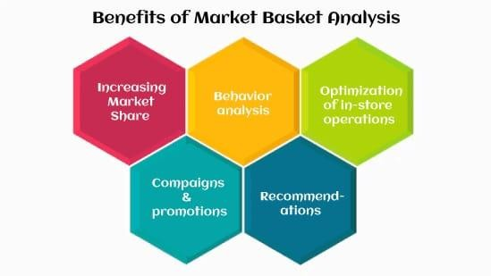
Confidence: 0.3068181818181818
Lift: 3.2183725365543547
Rule: spaghetti -> olive oil Support: 0.005733333333333333
Confidence: 0.20574162679425836
Lift: 3.1299436124887174
Rule: spaghetti -> shrimp Support: 0.006
Confidence: 0.21531100478468898
Lift: 3.0183785717479763
BENEFITS:
Benefits of market basket analysis
Market basket analysis can increase sales and customer satisfaction. Using data to determine that products are often purchased together, retailers can optimize product placement, offer special deals and create new product bundles to encourage further sales of these combinations.
These improvements can generate additional sales for the retailer, while making the shopping experience more productive and valuable for customers. By using market basket analysis, customers may feel a stronger sentiment or brand loyalty toward the company.

Slide 11

AI IN MARKET BASKET INSIGHTS:
Market Basket Analysis, also known as Affinity Analysis, is a modeling technique based on the theory that if you buy a certain group of items, you're more likely to purchase another group of items. For example, someone purchasing peanut butter and bread is far more likely to also want to purchase jelly.
CONCLUSION:
Market basket refers to a selection of goods and services that are consistently purchased and sold throughout an economic system. Economists, politicians, and financial analysts use market baskets to track price changes over time and determine inflation levels.

Slide 12
