Slide 1
WEB ASSISTANCE FOR SELF HELP GROUP
By
AROCKIA JENISH. A
1913213037001
III MCA

Slide 2
ABSTRACT
Self – Help – Group web assistance is a java project that can give access to the users through online services.
This system was built using JAVA, JAVA SERVLET, HTML, CSS, ORACLE and TOMCAT SERVER 9.
The system is easy to operate and manage, the user can sign up an account and provide a login information before you join the self help group.
The user must fill up some needed information to start up a group

Slide 3
EXISTING SYSTEM
The existing system of Self help group is the member of self help group can’t access their details and don’t know how much amount should I pay. And They can’t run the group because of the lack of information.
DRAWBACKS:
Ignorance of Members / participants
Inadequate Training Facilities
Problems Related with Raw Materials
Problems of Marketing

Slide 4
PROPOSED SYSTEM
The purpose of the technique is to create website for Self – Help Group, and give authorized to access their details by logging in to the web site. And they should register their names and details in the Self Help Group website.
ADVANTAGES:
It is used to know their details by our home
It is making as digitalized
It can make online payment
It will remind us to pay the amount so we can prepare our amount to pay

Slide 5
SYSTEM REQUIREMENTS
HARDWARE
PROCESSOR : Intel Core i3.
RAM : 4 GB
MONITOR : 15” COLOR
HARD DISK : 500 GB
SOFTWARE
Front End : HTML, CSS, JAVASCRIPT
Back End : JAVA, JAVA SERVLET, QUERY LANGUAGE
Operating System : Windows 8 OR LATER
Software : NOTEPAD, XAMPP , SERVER

Slide 6
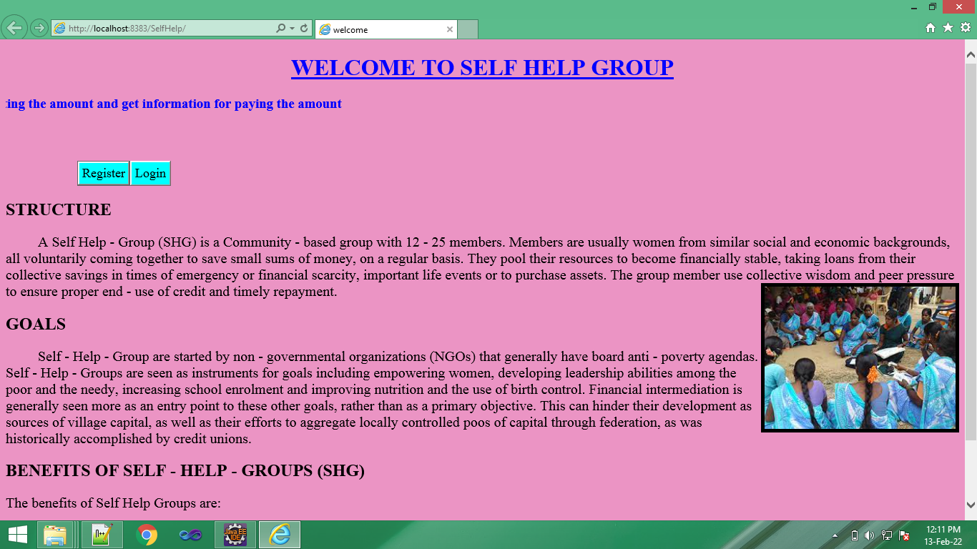
WELCOME PAGE

Slide 7
MODULES:
Login / Registration – Module
Admin – Module.
User – Module.
Resource List – Module.

Slide 8
MODULES DESCRIPTION
Login / Registration – Module:
Registration module is used to register the derails about the user. That contain create a unique username and password. It also needs a full name of user and email id of user for authentication.
The basic module login is used to web page. The module has username and password. That will be verified with database and allow to login to the web page.

Slide 9
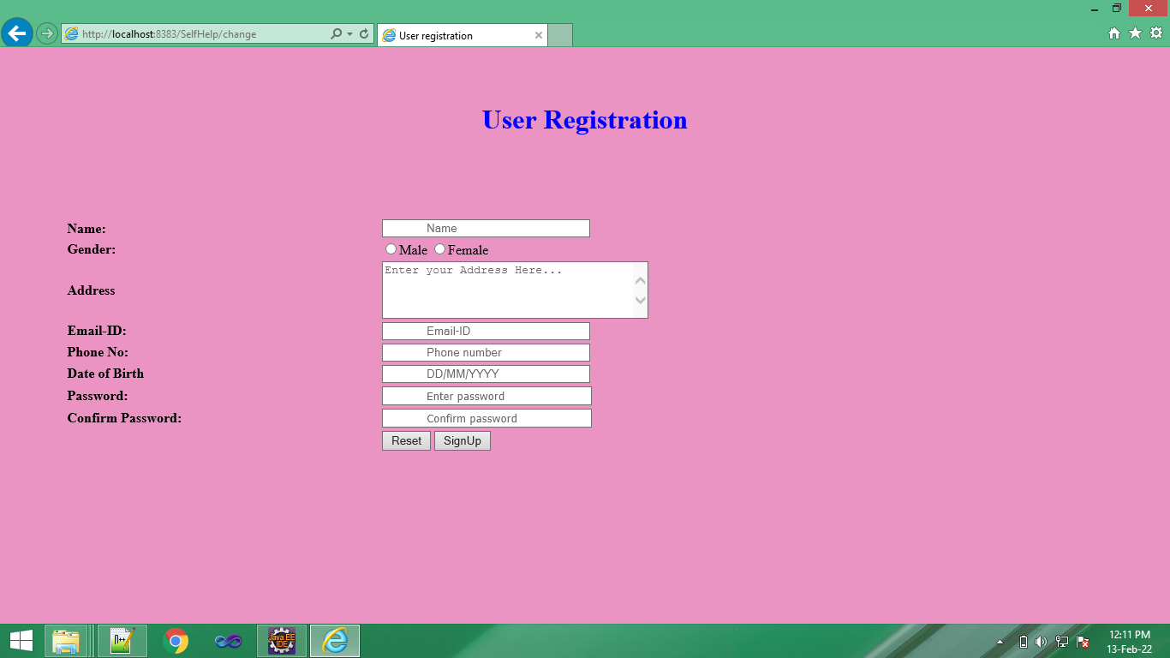
REGISTRATION PAGE

Slide 10
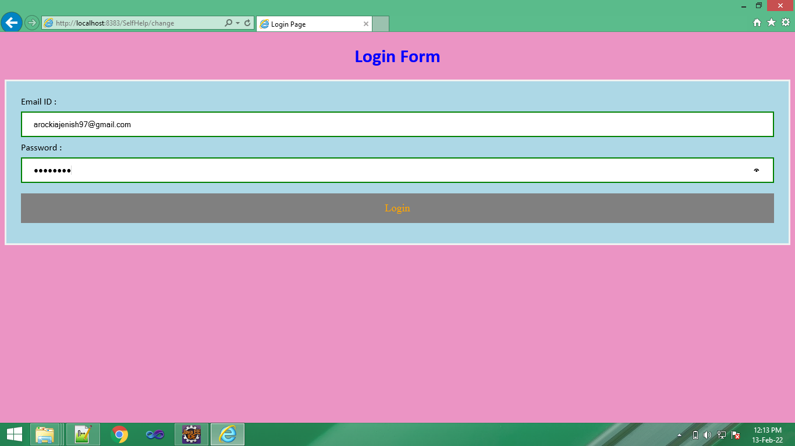
LOGIN PAGE

Slide 11
ADMIN MODULE
This module is used to verify the User, it is helps to prevent from the unauthorized problems. Admin can select the members of the group, and create a group.
Only admin can access the amount details and the user details for contact them. And He / She can give loan, filling monthly record. Like that the things.

Slide 12
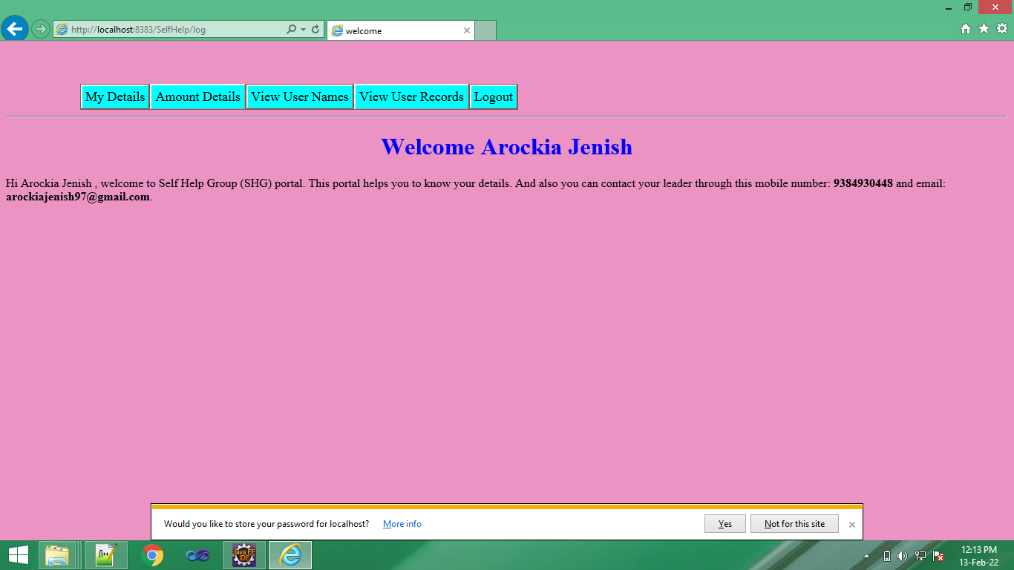
ADMIN - VIEW

Slide 13
WORKS OF ADMINE

Slide 14
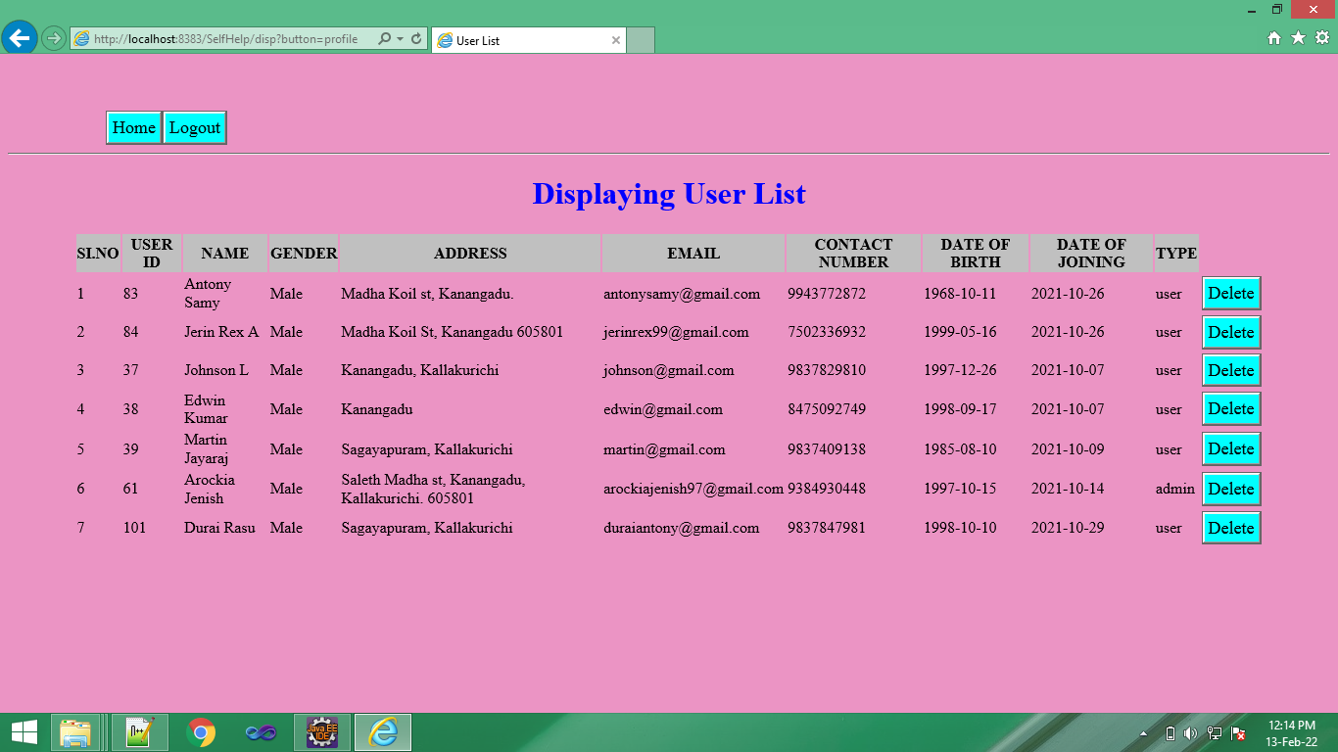
Viewing the user details:

Slide 15
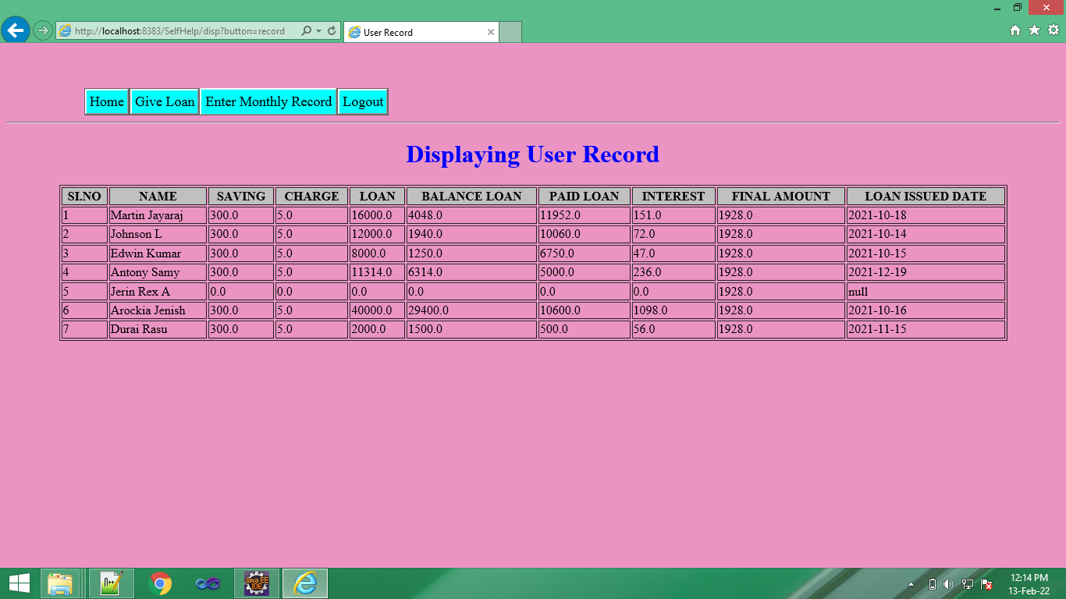
Viewing user records:

Slide 16
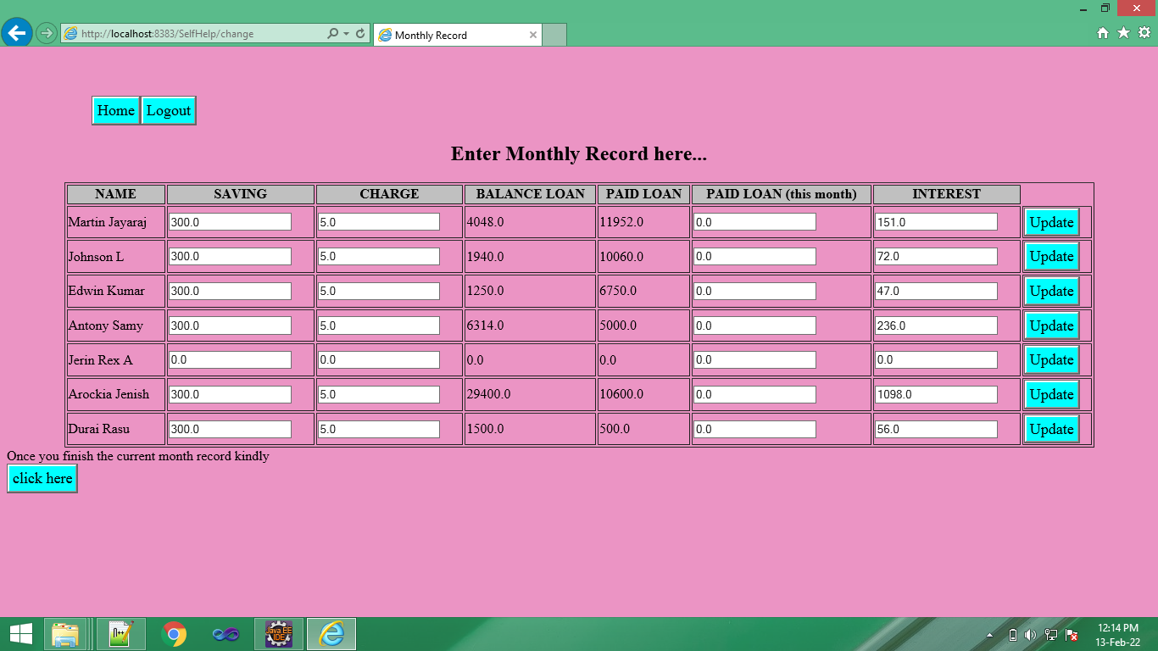
Filling monthly Records

Slide 17
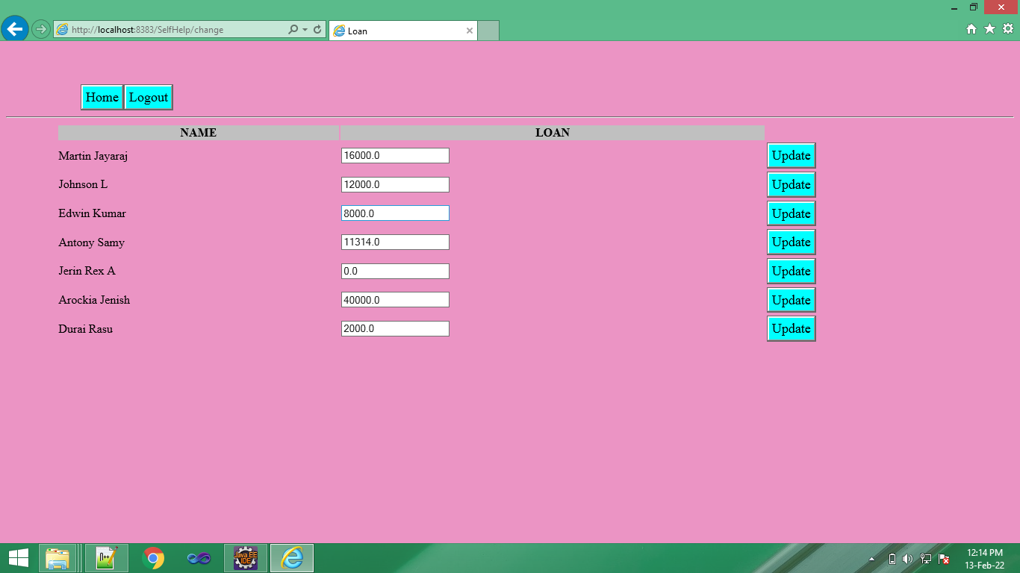
Giving loan to the user

Slide 18
USER MODULE
User should register their name in the register page.
They can login using email id and password
The user can view their details, and amount details.
They can pay the amount.

Slide 19
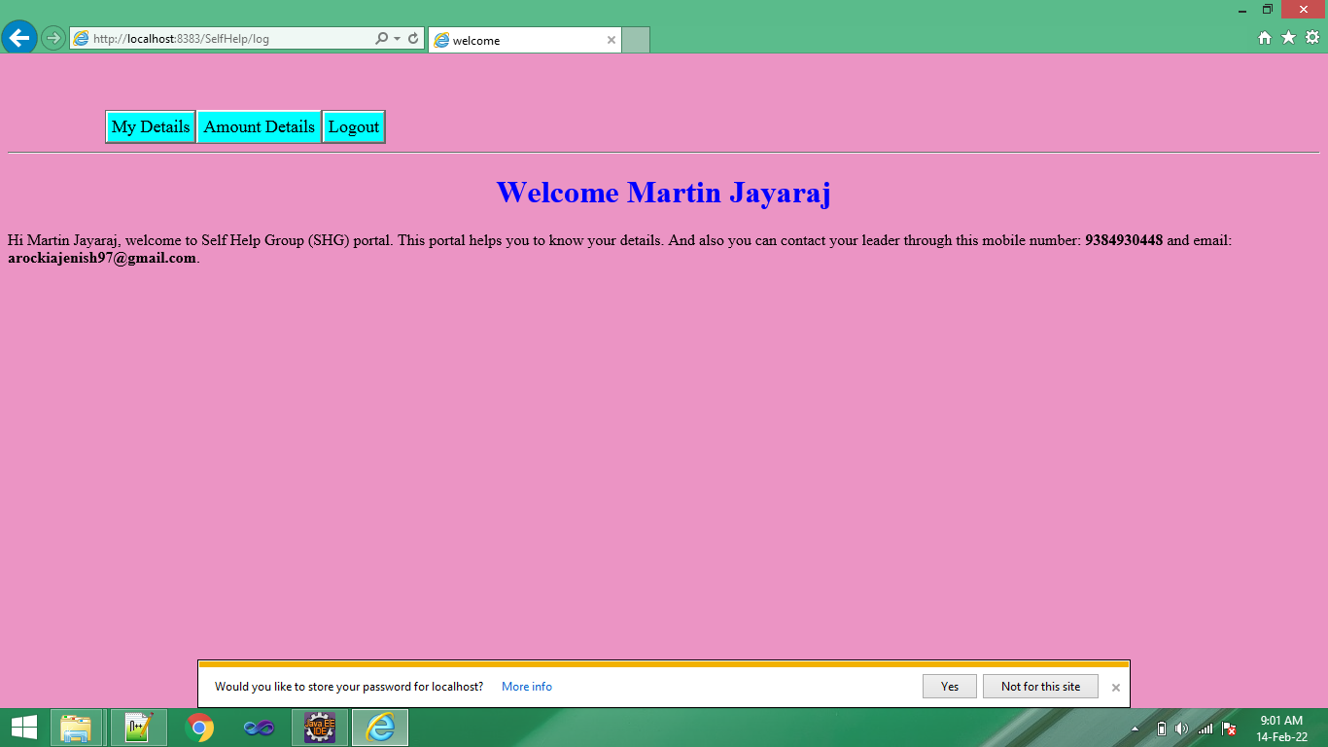
User View

Slide 20
ACCESS FOR USER

Slide 21
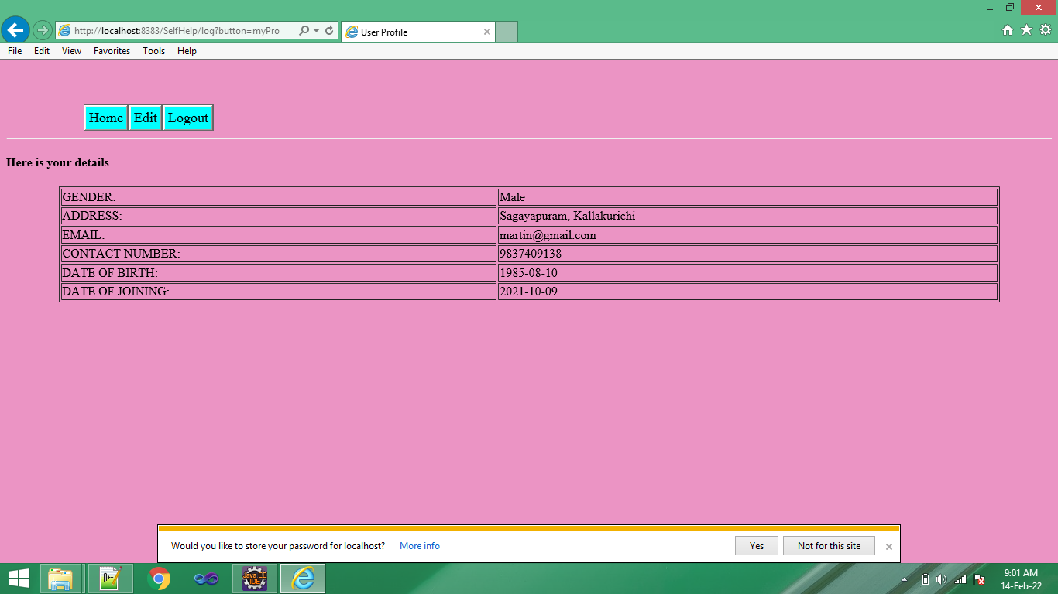
Viewing their details

Slide 22
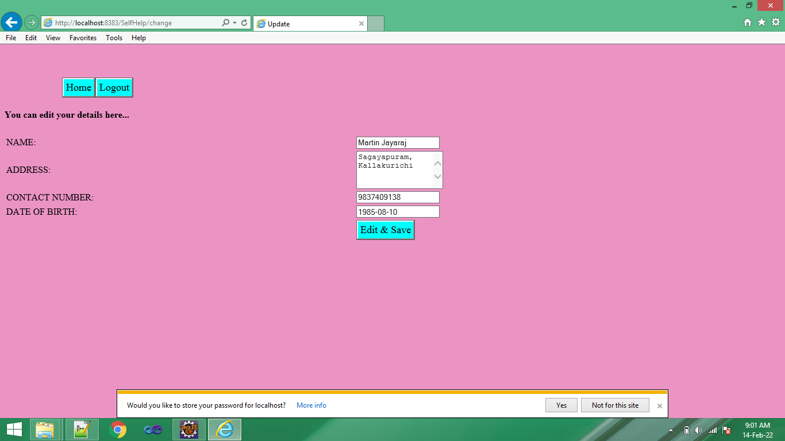
Edit their Details

Slide 23
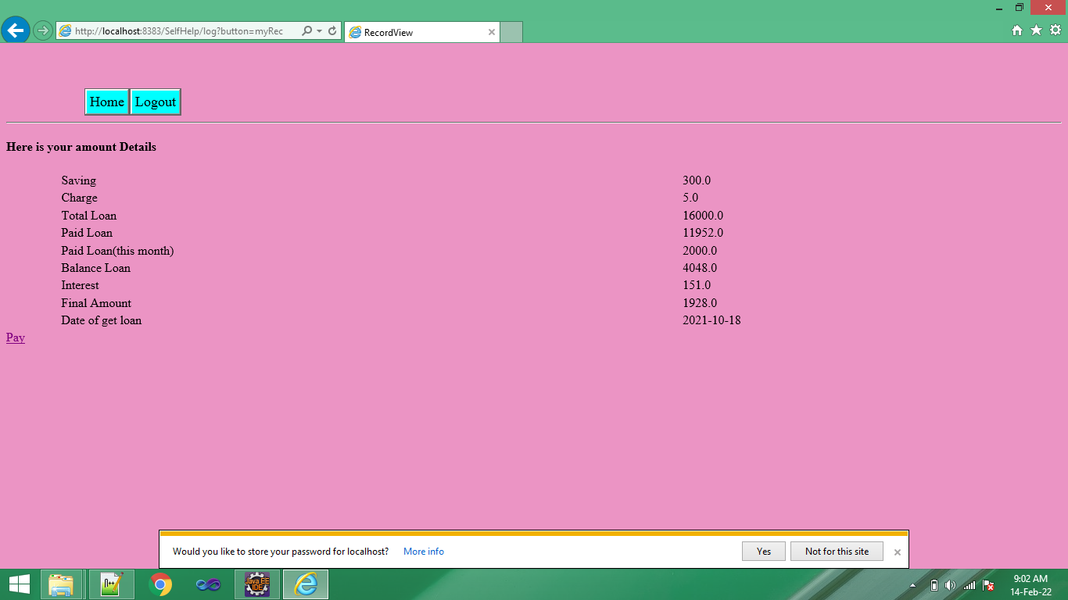
Viewing Amount details

Slide 24
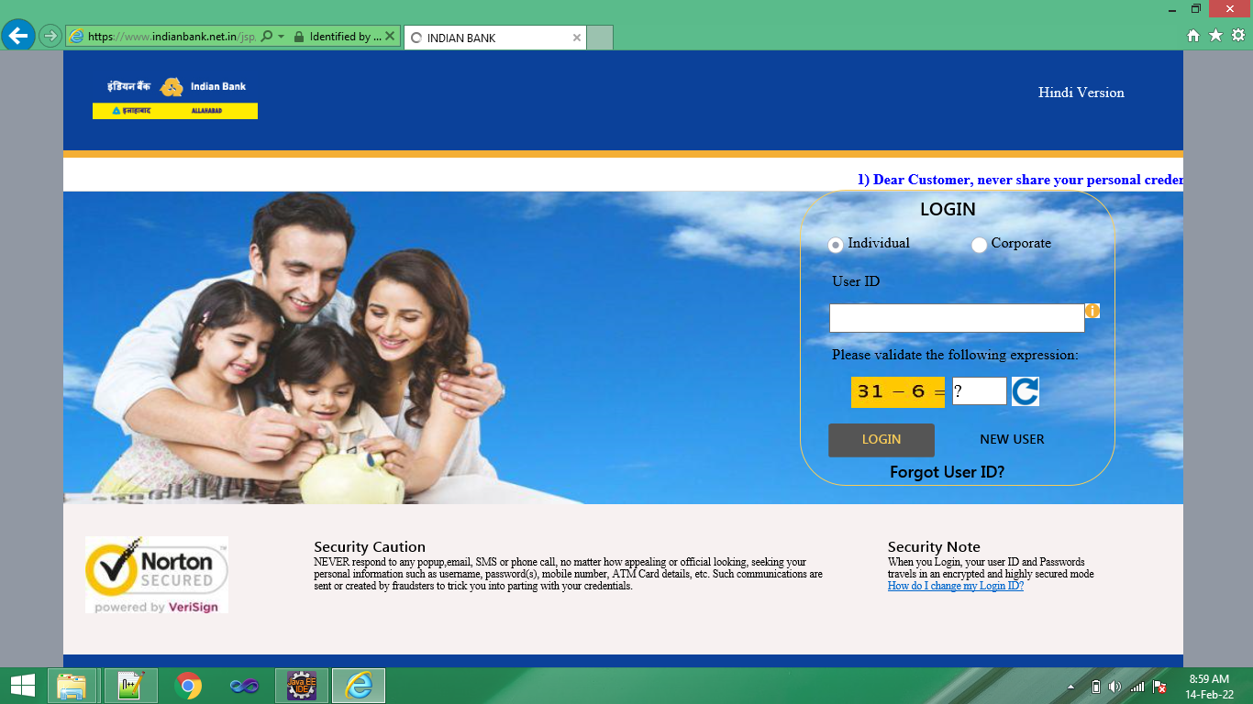
Paying amount through online

Slide 25
CONCLUSION
Thus the “SELF HELP GROUP WEB ASSISTANCE” application has been designed and developed successfully. It has been developed by backend language such JAVA, JAVA SERVLETS. Both user and admin can easily interact with this system.
In conclusion, the system will be able to serve as a web base application when it is finally developed and help the organization to manage their service more effectively.

Slide 26
THANK YOU

