Slide 1
AI INNOVATION CHALLENGE 2026 · ROUND 3
DISSENT
We audit the paperwork,
not the bridge.
TEAM NEXUS NETWORK
dissent-nexus.netlify.app
DEPT. OF CSE (CYBER SECURITY)
Notes:
Open cold. "Every bridge in America gets looked at about once every two years. In between, the only thing anyone consults is a file. Tonight I am going to show you the bridges whose file is lying."

Slide 2
THE PROBLEM
730 days
between one look at a bridge and the next.
In between, the file is the only thing anyone consults.
The file is standing still. The bridge is not.
Notes:
Two years between looks. In between, the paperwork IS the bridge as far as any decision-maker is concerned. That is the gap this lives in.

Slide 3
TWO QUESTIONS YOU ARE ABOUT TO ASK
Why bridges? Why America?
WHY BRIDGES
WHY AMERICA
Because it is the one asset class with a record worth auditing: public, national, per-structure, numeric, and thirty-four years deep. You cannot audit a record that does not exist.
Because that record only exists there. The FHWA publishes every state, every year, free. If you want to prove a model can catch a file drifting from reality, that is where the experiment can be run.
Buildings have no equivalent. Surfside cost 98 lives and there was nothing to check it against.
India is building the same thing now: IBMS already inventories 172,517 structures on the same 0–9 idea.
Notes:
Answer both head on. Bridges because the record exists. America because that is the only place it exists publicly. Do not say anything is deployed in India.

Slide 4
THE IDEA
Keep two accounts of every bridge.
Sell the argument between them.
THE RECORD
THE PHYSICS
What the
institution filed
What the
evidence implies
An inspector visits, and writes one number.
Age, traffic, trucks, span, weather. No rating among them.
When they stop agreeing, that disagreement is the product.
Notes:
Slow down here. Two accounts of the same bridge. The model is graded against the inspector rating but never gets to read one. The product is not a risk score. It is the contradiction.

Slide 5
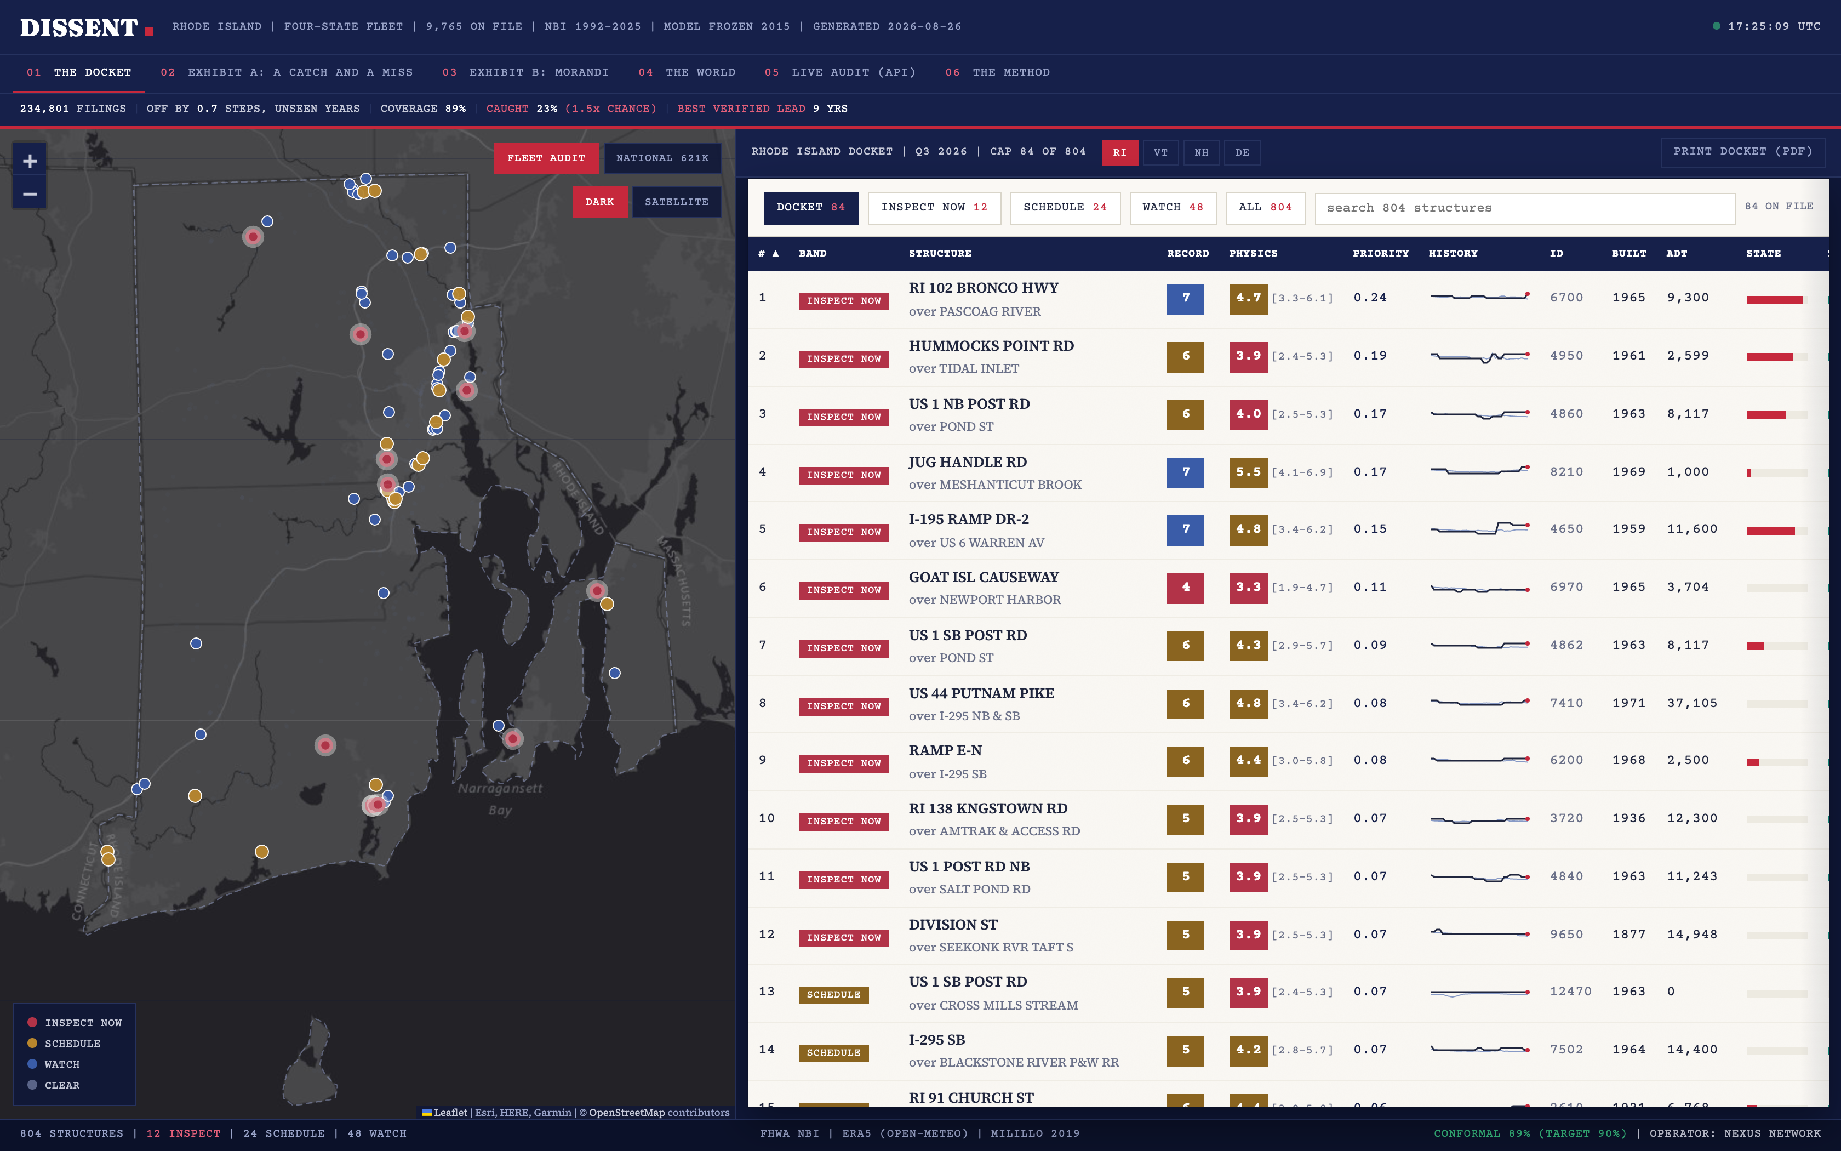
WHAT WE BUILT
Not a dashboard.
A docket.
A ranked list of the bridges whose file has drifted furthest from the evidence — capped to what an inspection team can actually visit in a quarter.
RHODE ISLAND · 804 STRUCTURES
12 FLAGGED FOR IMMEDIATE INSPECTION
Notes:
This is the working surface. Left is the map, right is the ranked docket. Top row: the record says 7, physics says 4.7. That gap is the product.

Slide 6
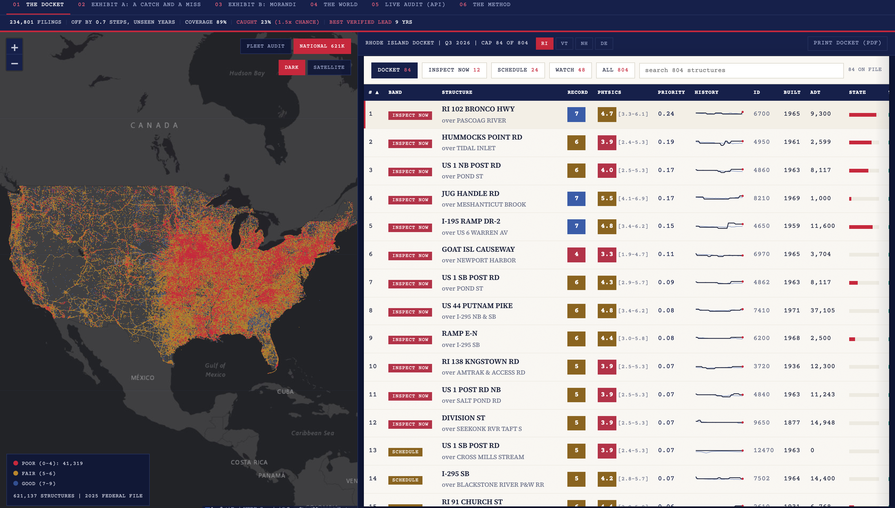
COVERAGE
621,137 bridges. Zero sensors installed.
Every rated structure in the country, drawn in the browser from a 10MB file. 41,319 are rated poor by their own inspectors. This view does not even need our server.
Notes:
Let scale land. The whole country, live in the browser, and this view does not even need our server.

Slide 7
HOW IT WORKS
Public data in. A work order out.
01
02
03
04
PUBLIC FILES
PHYSICS ONLY
FROZEN MODEL
THE GAP
The federal inspection file and the weather history. Both free.
18 features about the structure itself. No filed rating among them.
Trained to 2015 and never updated. It has never seen a later year.
Record minus physics, with a calibrated interval on every verdict.
The whole design is one refusal: no inspector rating is ever one of its inputs. It is graded against that rating. It never gets to read one.
Notes:
Walk it left to right in twenty seconds. Land the last line: graded against the rating, never allowed to read one. That is what makes it a second opinion and not an echo.

Slide 8
HOW YOU KNOW IT DID NOT CHEAT
Frozen in 2015. The rest is hidden.
TRAINED
CALIBRATED
NEVER SEEN
168,864 filings it learned from
interval set here
46,541 rows of pure holdout
1992 – 2015
2016 – 2018
2019 – 2025
Every number we quote comes from the red block. It is data the model has never been shown, and we did not go back and retune anything to make it look better.
Conformal coverage 89% against a 90% target — reported short, not retuned.
Notes:
This is the slide that lets a technical judge relax. Frozen 2015, calibrated to 2018, everything from 2019 is holdout. And the coverage number is deliberately below its target because we refuse to retune on test years.

Slide 9
THE OBVIOUS OBJECTION
Just sort by the worst rating.
No machine learning at all. Take the bridges the file already rates worst, inspect the top 15%, and count how many of the 166 real failures you catch.
Sort by worst rating
40
of 166
DISSENT
38
of 166
On the raw count, the version with no model in it wins.
That is printed in our own product, not buried in an appendix.
Notes:
Do not soften this. Say out loud that the dumb baseline beats us, 40 to 38, and that it is printed in our own product. Then turn the page.

Slide 10
SO WHY DOES THE MODEL EARN ITS PLACE
108
of those 166 failures were on bridges
the record still called FINE.
Sorting by the worst rating is blind to every one of them, by construction. It can only point at bridges you already worry about.
Notes:
Let the number sit for two seconds before you say anything. Then: 108 of the 166 were on bridges the paperwork still called fine, and a ranking based on the paperwork cannot see them.

Slide 11
THE SAME 108 FAILURES, TWO WAYS OF CHOOSING
One of them found none.
SORT BY WORST RATING
DISSENT
0
25
It only ever looks at bridges the file already calls bad, so it never arrives.
It reads the physical evidence, so a good-looking file does not hide anything from it.
A failure on a bridge the file still calls fine is the only kind that carries a warning. That column is the product.
Notes:
This is the peak. Worst-first found zero of the 108. We found 25. And a failure on a bridge nobody was worried about is the only kind of failure that carries any warning.

Slide 12
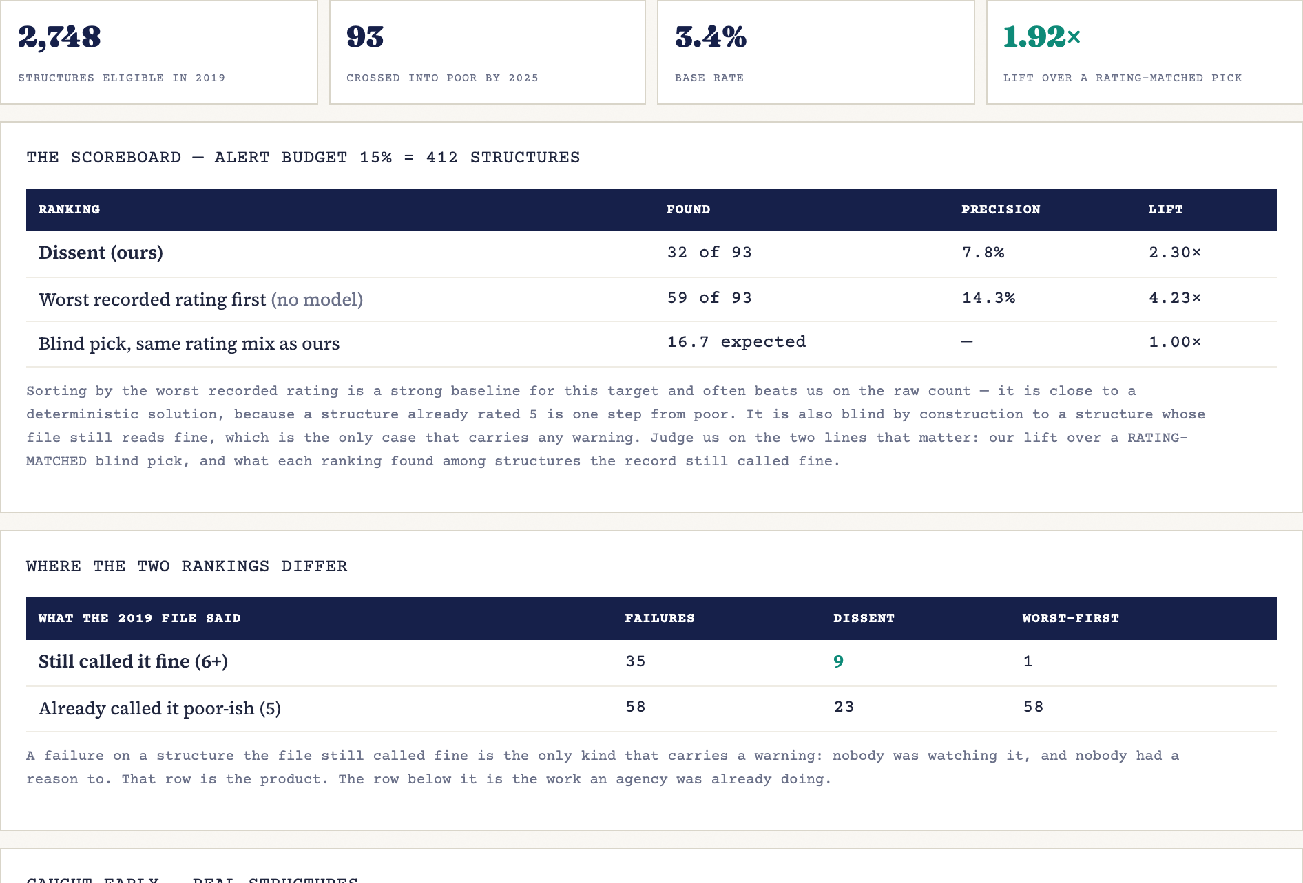
AND YOU CAN TEST IT YOURSELF, RIGHT NOW
Pick a state and a year.
It grades itself.
The server pulls that year’s federal file, scores every bridge with the 2015 model, ranks them — then pulls the 2025 file and checks what actually happened.
VERMONT, 2019
93
bridges crossed into POOR by 2025
35
of those the 2019 file still called fine
9 vs 1
dissent found 9. Worst-first found 1.
The base rate and the baseline that beats us are printed on screen every time — including on the states where we lose.
Notes:
Ask a judge for a state and a year. Two seconds later the server has pulled two federal files and graded itself. Invite them to try a state where we lose.

Slide 13
WHAT IT CANNOT DO
The limits are in the product.
IT ABSTAINS
IT UNDER-COVERS
IT WITHHOLDS
IT MISSED ONE
On any bridge under five years old. Nothing to calibrate against yet.
Intervals cover 89% against a 90% target. We report the shortfall.
27 of 51 states get no ranking at all. Outside our calibration climate we cannot tell their optimism from our own error.
The Washington Bridge closed in 2023 and we rated it slightly better than the record did. It is in the app, labelled a miss.
A system that cannot tell you where it stops working is not a second opinion. It is a guess.
Notes:
Do not rush this. All four are enforced in the running product where a judge can check them, including the miss we display on purpose.

Slide 14
IN CLOSING
We did not simulate
a single bridge.
234,801 real inspection filings from the US federal government, 1992 to 2025. Both halves of the system are deployed and running tonight, and the download script is in the repo.
CONSOLE
dissent-nexus.netlify.app
API
dissent-api-jgod.onrender.com/docs
SOURCE
github.com/ArockiaRajamanickam/dissent
TEAM NEXUS NETWORK
Notes:
Close on verifiability. Every number is downloadable, nothing was simulated, both halves are live. Then open the console and run the Time Machine on whatever state they name.

